Slide 1


HYALURONIC ACID-POLOXAMER THERMOSENSITIVE HYDROGELS STUDIED BY SMALL-ANGLE NEUTRON SCATTERING (SANS) AND RHEOLOGY: FROM NANOSTRUCTURE TO BIOMEDICAL APPLICATIONS
Anderson F. Sepulveda
Federal University of ABC

Slide 2
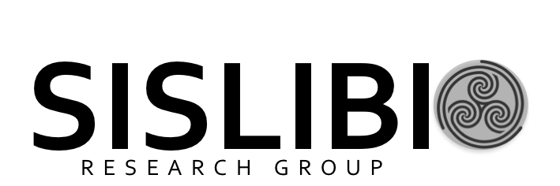
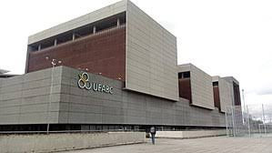
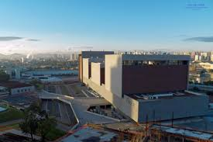
SISLIBIO
Drugs and Bioactives Delivery Systems Research Group;
Federal University of ABC, São Paulo, Brazil;
Drug-delivery systems;
Development and characterization of hydrogels and organogels;
Drug release control;
Physico-chemical analysis;
Structural analysis

Slide 3
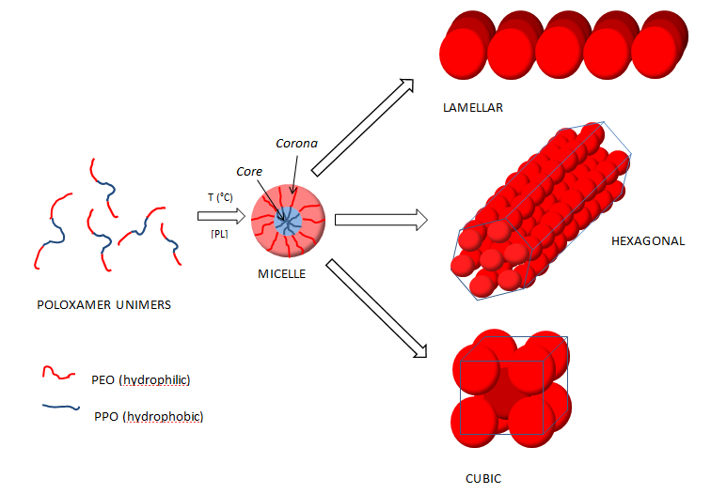
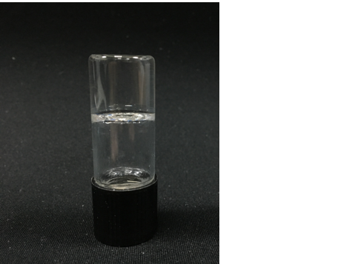
Structural analysis of Poloxamer-based hydrogels
Poloxamer: synthetic triblock copolymer;
Low toxicity;
Thermosensitive hydrogel;
x:y ratio confers different physico-chemical properties.
sol
gel

Slide 4
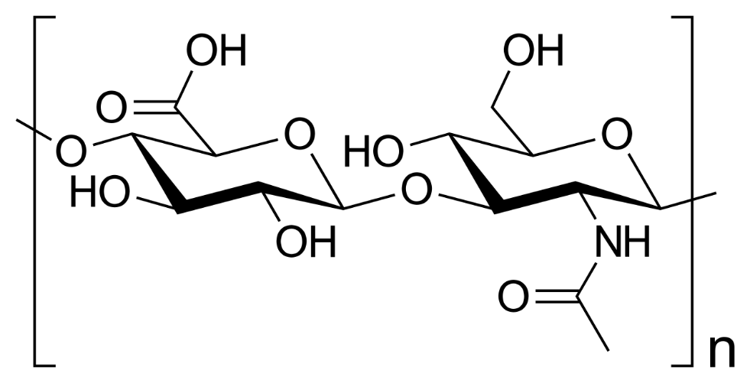
Hyaluronic acid
Extracellular component;
Synovial fluid, intervertebral disc;
Mucoadhesive character;
anionic polyelectrolyte.

Slide 5

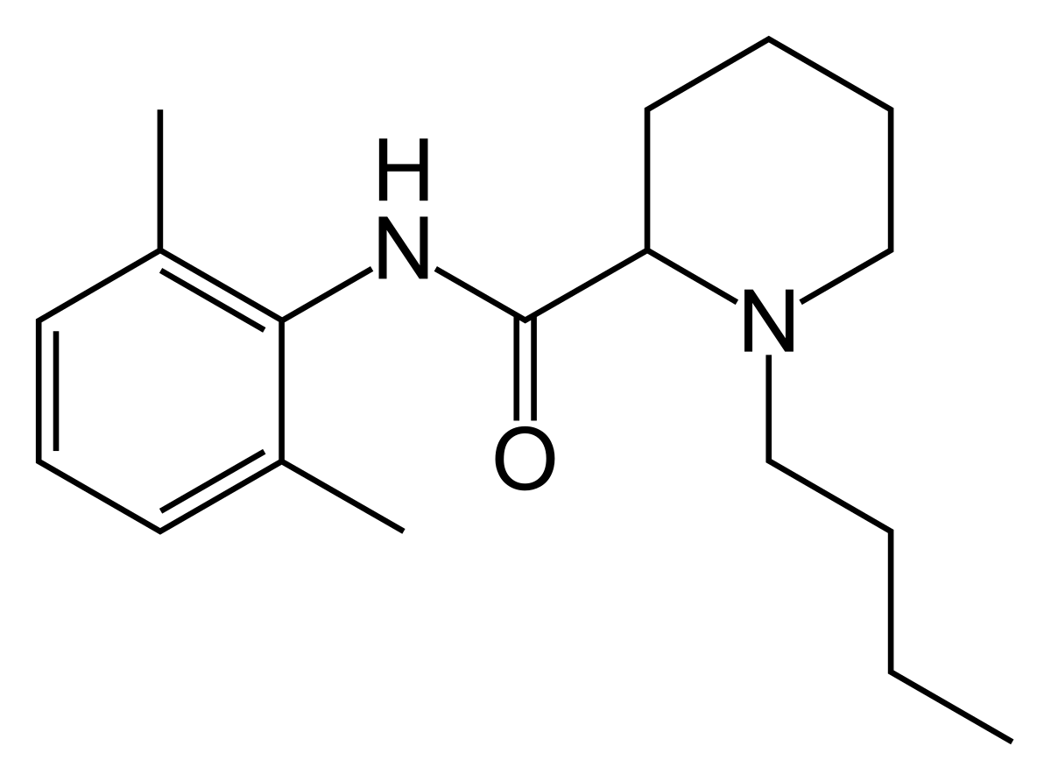
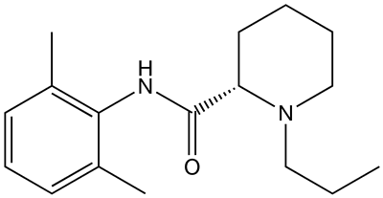
PL 407 15%
PL 407 30%
PL 407 15 + PL 338 15%
PL 407 15% + BVC
PL 407 15% + RVC
PL 407 30% + BVC
PL 407 30% + RVC
PL 407 15 + PL 338 15% + BVC
PL 407 15 + PL 338 15% + RVC
PL 407 15% + HA
PL 407 30% + HA
PL 407 15 + PL 338 15% + HA
PL 407 15% + HA + BVC
PL 407 15% + HA + RVC
PL 407 30% + HA + BVC
PL 407 30% + HA + RVC
PL 407 15 + PL 338 15% + HA + BVC
PL 407 15 + PL 338 15% + HA + RVC
Ropivacaine
Bupivacaine

Slide 6
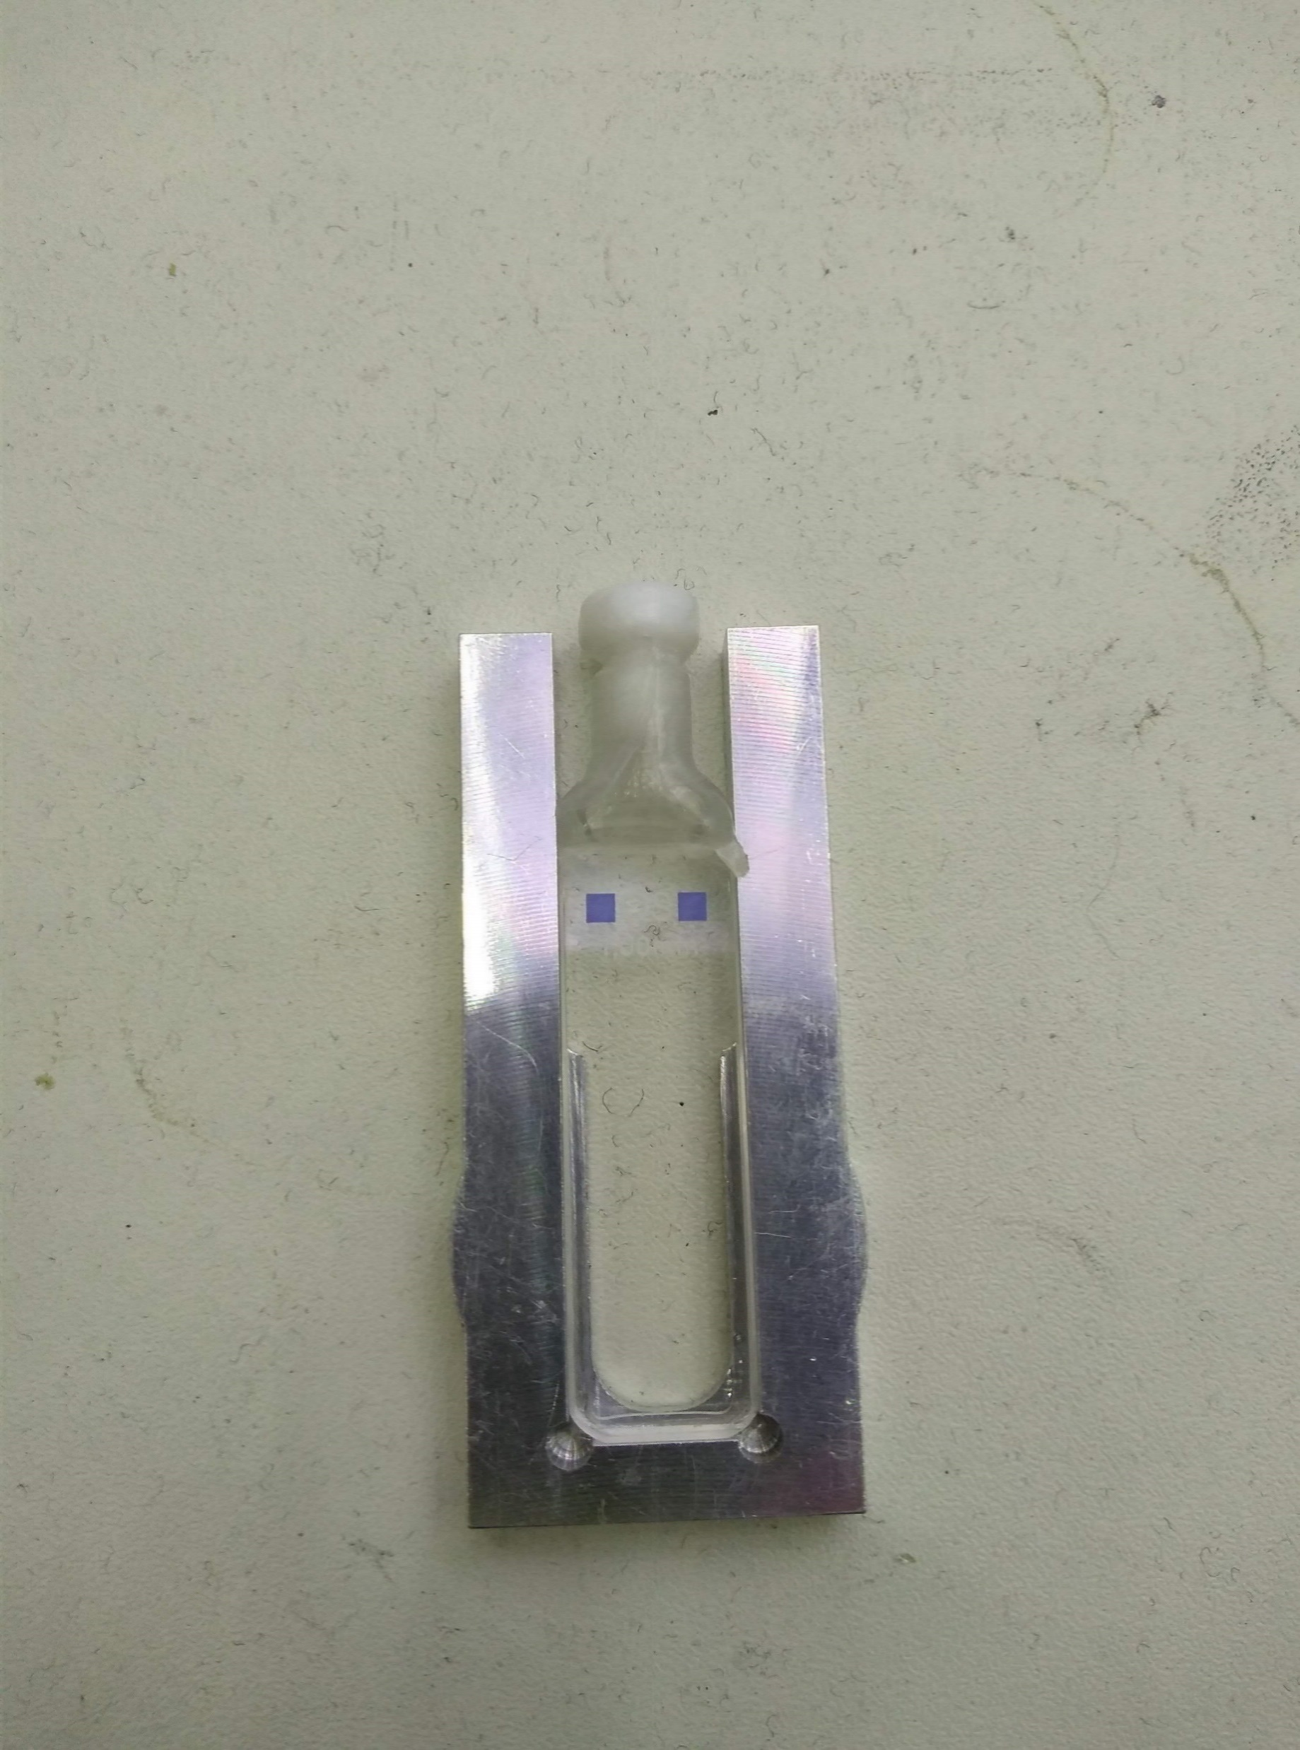
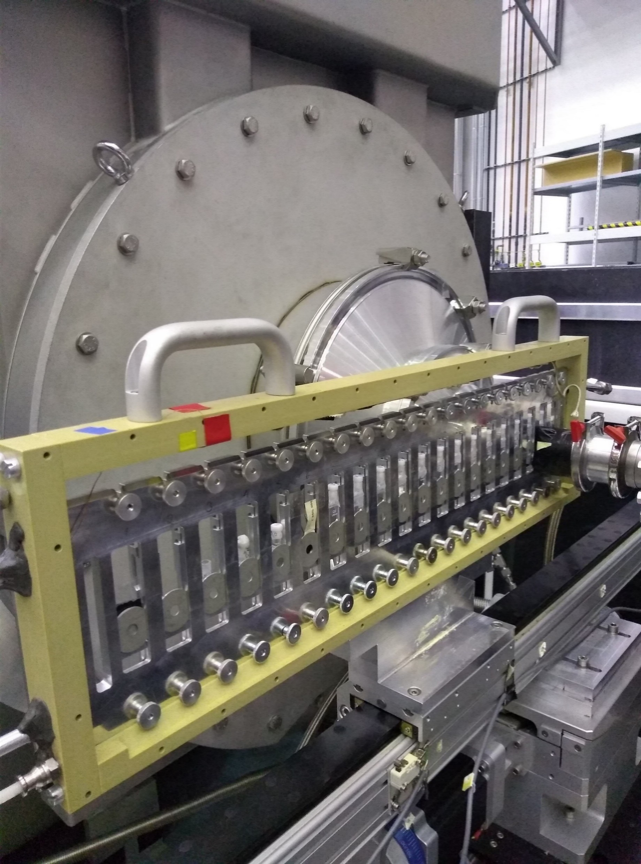
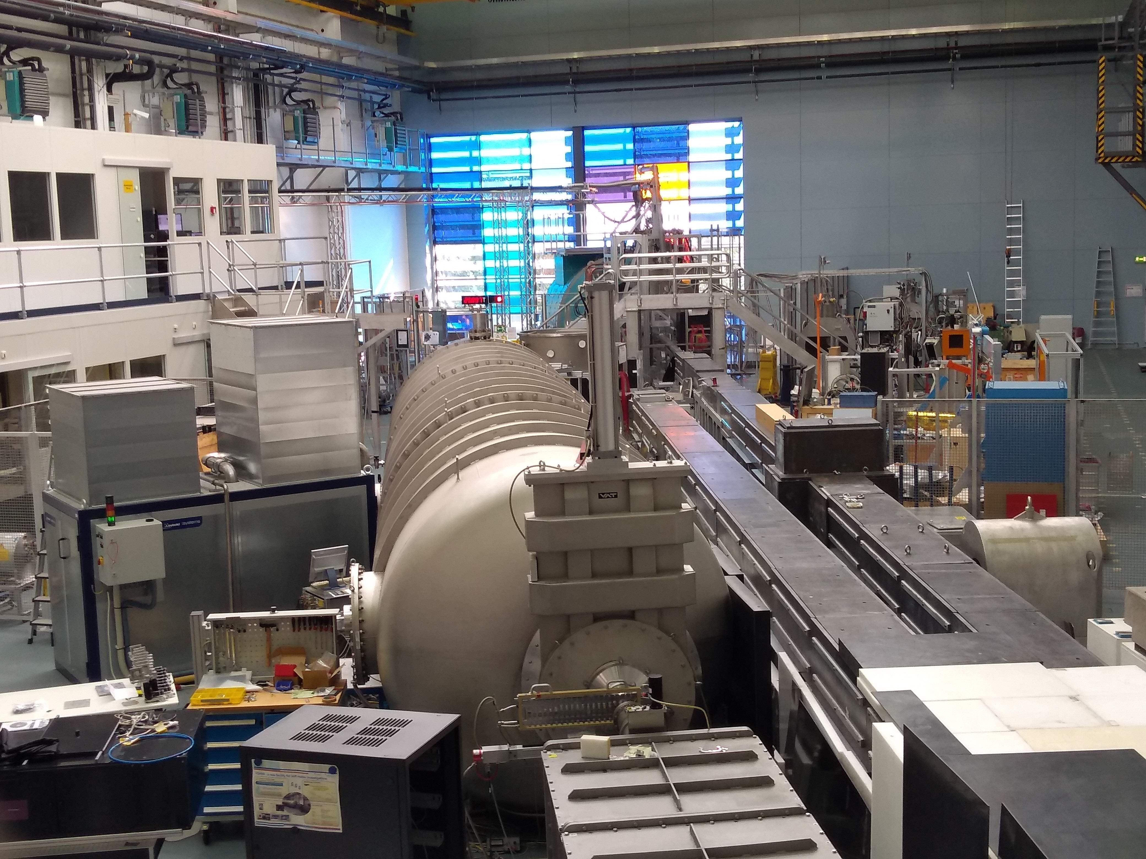
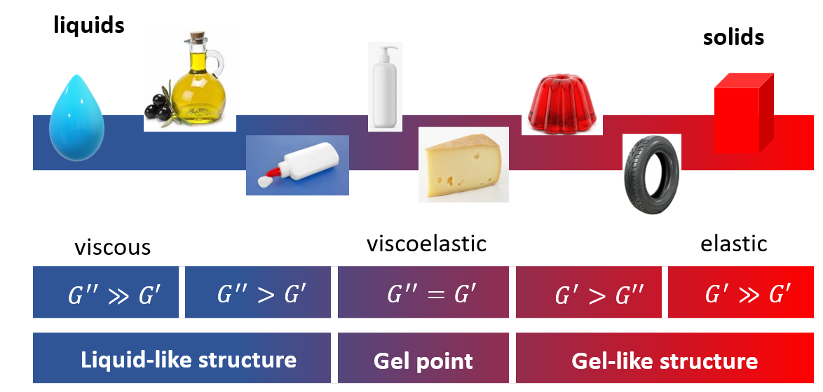
Structural analysis of Poloxamer-based hydrogels
Small-angle neutron scattering (SANS):
  Supramolecular structure identification;
  Lattice parameters.
Rheology:
  Viscoelastic characteristics;
  Elastic modulus (G’) x Viscous modulus (G’’);
  Consistency;
  Adhesion.

Slide 7
SANS
Structure identification is based on q_{m} determination of principal peak.
Error calculation is done by Gaussian curve modelling under principal peak.

Slide 8
SANS
Lamellar structures for PL 407 15% formulations;
Coexistence of cubic and hexagonal structures in PL 407 30% and PL 407 15% + PL 338 15% formulations;
Addition of hyaluronic acid or any drug does not change phase organization.

Slide 9
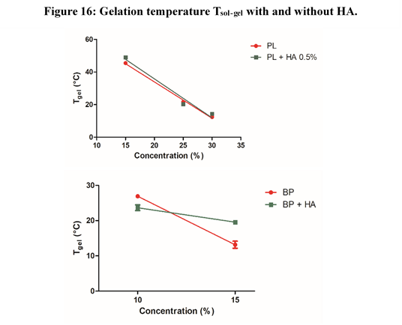
Rheology
Gelation temperature is linearly affected by PL concentration;
Isolated systems are little affected by hyaluronic acid presence.

Slide 10
Rheology
Bupivacaine diminishes gelation temperature: increased interaction among chains in PL407 30%;
Both drugs do not affect binary formulations with HA.

Slide 11
Rheology
G’/G’’
 |  |  | 25 °C |  | 37 °C
Concentration (%) | Drug |  | PL | PL + HA | PL | PL + HA
15 |  | - | 0.62 | 0.29 | 0.17 |  | 0.20
 |  | BVC | 0.55 | 0.25 | 0.16 |  | 0.70
 |  | RVC | 0.62 | 0.27 | 0.46 |  | 3.30
30 |  | - | 42.20 | 11.98 | 48.30 |  | 16.84
 |  | BVC | 44.8 | 40.8 | 164.1 |  | 67.9
 |  | RVC | 31.2 | 36.0 | 53.2 |  | 58.9
15 / 15 |  | - | 65.20 | 36.87 | 67.0 |  | 41.82
 |  | BVC | 54.1 | 40.1 | 89.9 |  | 45.4
 |  | RVC | 58.4 | 51.0 | 74.1 |  | 34.8
Increased interactions between the chains: increase in the elastic modulus of the hydrogel;
Hyaluronic acid decreases G’/G’’: viscous character;
Binary formulations have a small increase in G’/ G’’;
Hyaluronic acid in BP decreases more than in PL 407 15% and 30%;
Are interactions between PL 338 and HA more favored?

Slide 12
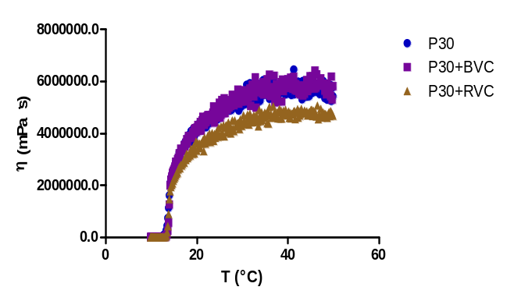
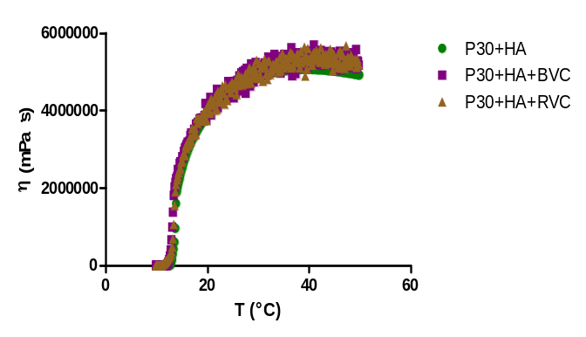
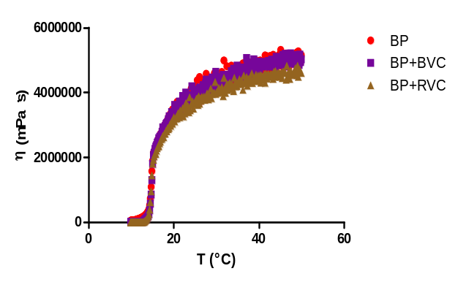
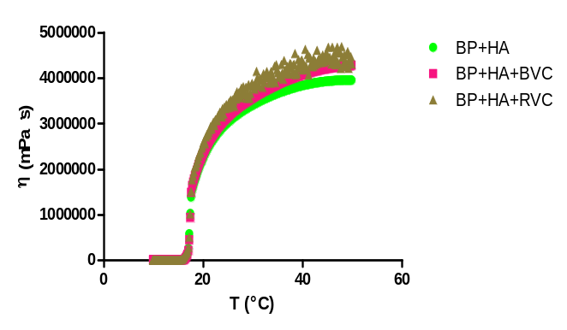
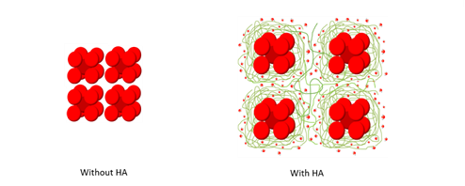
Rheology
Hyaluronic acid acts as a phase linker;
Hyaluronic acid decreases system viscosity
Micelle
Water
HA chains

Slide 13
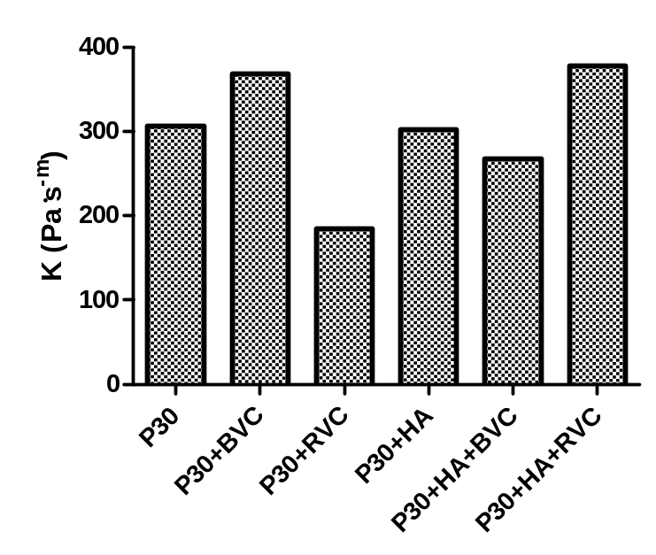
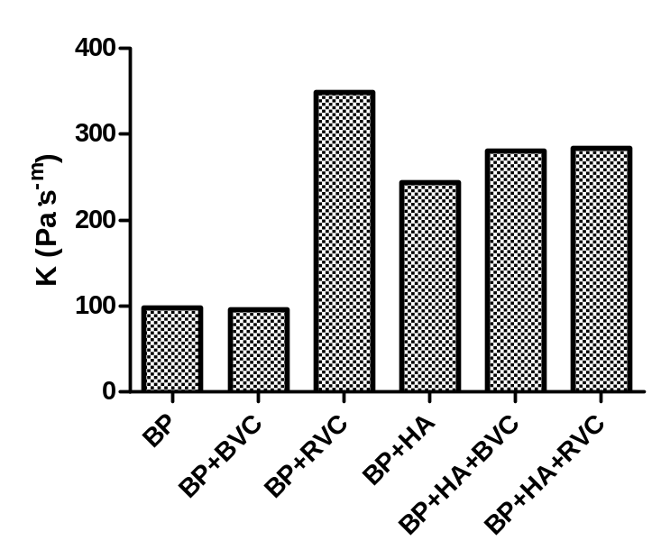
Rheology
The consistency in binary systems, without hyaluronic acid, is almost three times less than in P30;
Less consistency means better applicability: less force required.

Slide 14
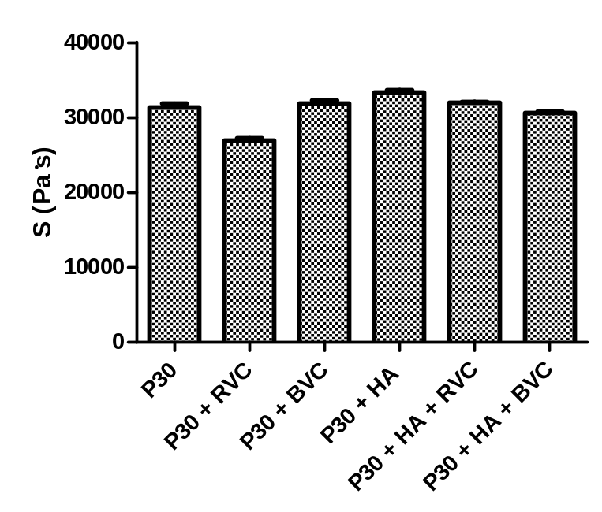
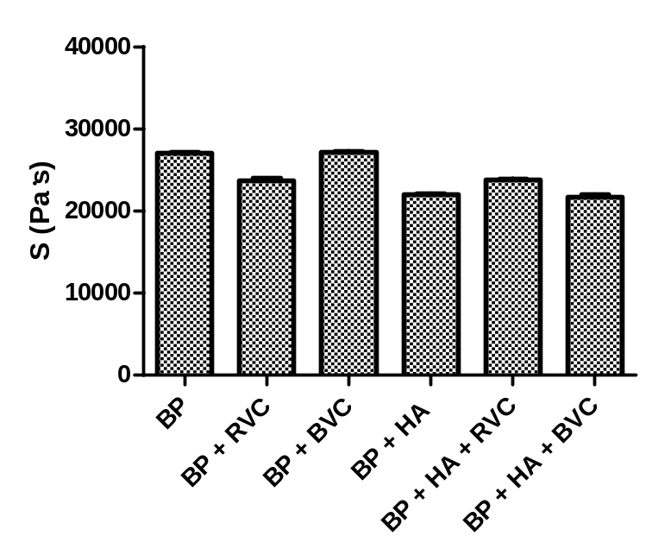
Rheology
Hydrogels from binary systems have considerably less adhesion power than P30;
Less adhesion to a smooth surface means less wasted gel.

Slide 15
Conclusion
Increasing the concentration of PL promotes greater structuring of the gel;
cubic and hexagonal structures are more rigid than lamellar one;
Presence of a more hydrophilic element (PL 338) improves the gel's consistency and adhesion.

Slide 16



Acknowledgment

Slide 17
Thank you!
anderson.f.sepulveda@gmail.com
anderson.sepulveda@ufabc.edu.br

