Slide 1
Recent advancements in solid-state dosimetry technologies for radiation therapy and space applications
Anatoly Rosenfeld
Centre for Medical Radiation Physics , University of Wollongong, Australia
Australian Accelerator Technology Forum , 27-30 October, 2020

Slide 2
Acknowledgement of Contributors
Centre for Medical Radiation Physics , University Of Wollongong
Dr L. Tran, A/Prof M. Petasecca, A/Prof S. Guatelli, Prof M Lerch,
CMRP PhD students: Stefania Peracchi, Lachlan Chartier, David Bolst, Emily Debrot, James Vohradsky, Ben James, Vladimir Pan and many others
POWH: Dr Michael Jackson, MD
ANSTO: Dr D Prokopovich, Dr M Reinhard, Dr D Boardman, Dr Z Pastuovic, Prof D Cohen,
3DMiMiC European-Australian Collaboration
SINTEF : Dr Angela Kok, Dr Marco Povoli and 3DMiMiC team
SPA BIT Ukraine , Dr V.Perevertaylo
HIMAC: Prof N.Matsufuji (NIRS), Dr T. Inaniwa, Dr S.H. Lee, Prof T.Kanai, (GUMC)
MGH F Burr Proton Therapy Center and Harvard Medical School Dr Ben Clasie, Dr Jay Flanz, Dr Nicolas Depauw, Dr Hanne Kooy, Dr Aimee McNamara, Prof Harald Paganetti
Mayo Clinic Prof Chris Beltran et al
iThemba Labs Vandevoorde C, Beukes P, Miles X, de Kock E, Symons J, Nieto-Camero Parisi, A. , Vanhavere F, Peterson S, Vral A, Slabbert J,
University of Groningen Dr Stefan Both, Dr Sytze Brandenburg,
Dirk Wagennar (PhD student)
INFN: Drs P Cirrone, G Petinga, V.Conte, P.Colautti at al.
,

Slide 3
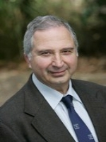
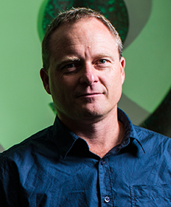

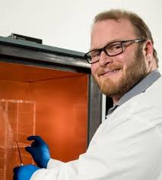
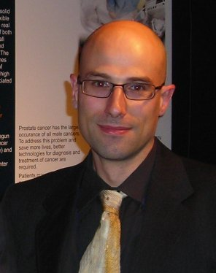
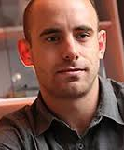
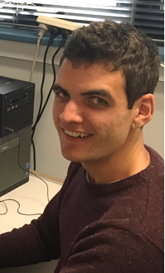
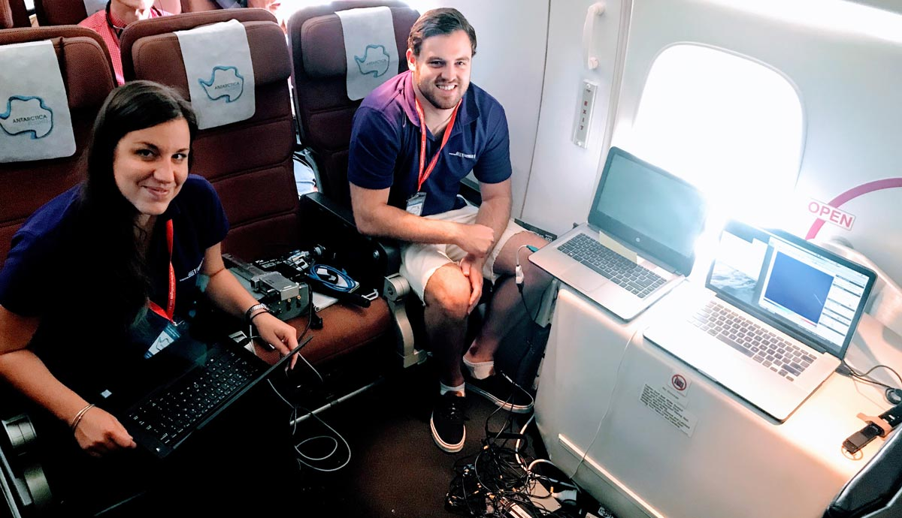
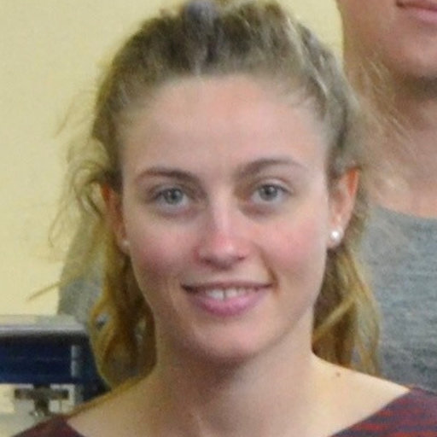
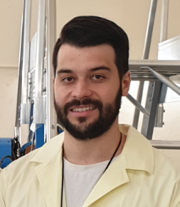
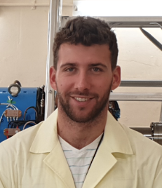

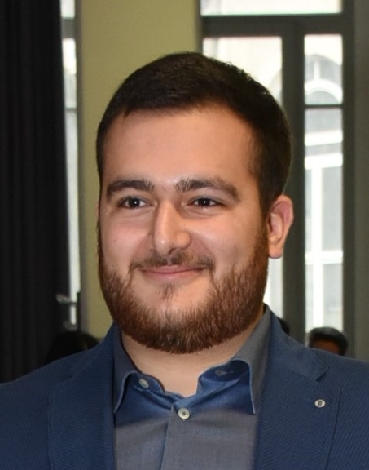
Meet the CMRP microdosimetry team
Dist. Prof Anatoly Rozenfeld
Founder and Director
Prof Michael Lerch
Dr Susanna Guatelli
Dr Linh Tran
Dr Dale Prokopovich
Dr Marco Petasecca
Dr Jeremy
Davis
Dr David Bolst
Ben James
Stefania Peracchi
Dr Emily Debrot
James Vohradsky
Vladimir
Pan
Fang Su
Federico
Pagani

Slide 4
Outline
Microdosimetry concept introduction
Silicon microdosimeters development : state –of-the-art
Application for RBE studies in proton and heavy ion pencil scanning beam therapy
Correlation of cell survival with microdosimeter based RBE derivation
Space applications: radiation shielding evaluation

Slide 5
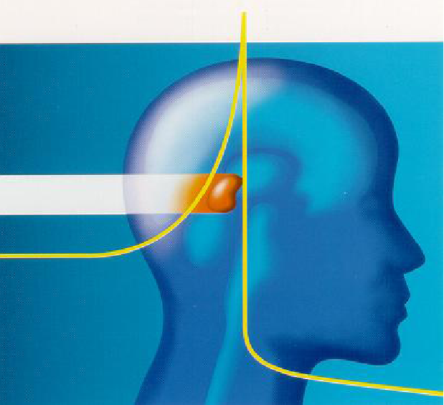
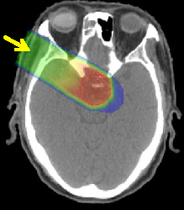
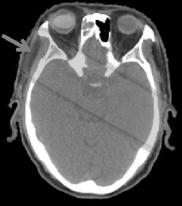
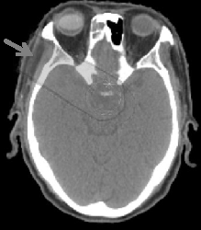
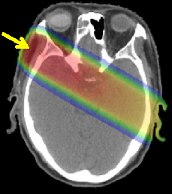
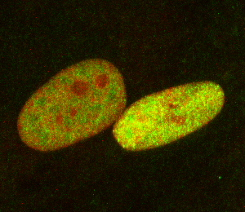
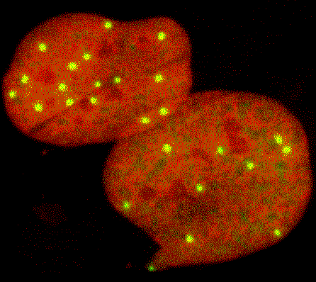
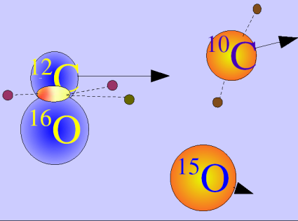
Advantages of Heavy Ion Therapy
X rays
Carbon Ion beams
Secondary nuclear fragments
Secondary neutrons
Cell damage due to indirect DNA damage
Cell damage due to direct DNA damage, irreparable DNA breaks
Courtesy of M. Scholz
Notes:
Charged particle therapy with ¹²C ions has the advantage of dose distribution over X-ray radiotherapy due to the Bragg Peak (BP) energy deposition profile. Charged particle therapy is normally used for the treatment of deep-seated tumours while preserving the surrounding healthy tissue.
The conventional radiation (photon beam) has the strongest effect in shallow regions of the body and its effect is gradually decreasing with depth; in addition, it does not stop at a finite depth but is penetrating furthermore. Therefore, it causes damage to normal tissue before and after the tumor.
Carbon ions stop at the exact depth given by prescribed energy. Carbon ion therapy has the advantage that enormous effect on killing cells is shown only at the point where they stop. The normal tissue located surrounding the tumor can be preserved (green regions)

Slide 6
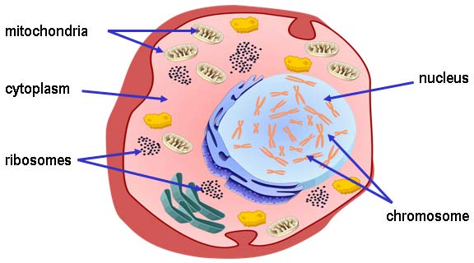

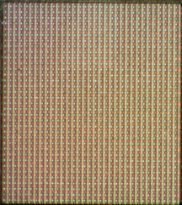
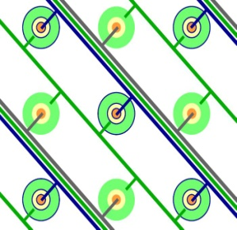
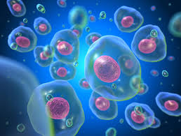
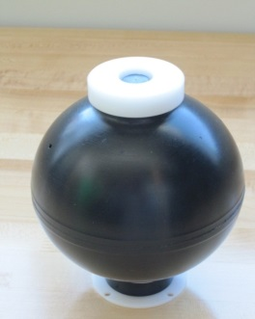

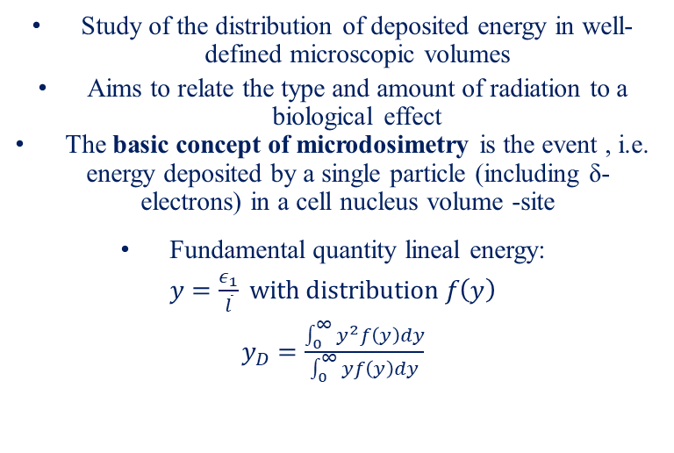
Microdosimetry
Silicon on insulator (SOI) Microdosimeter
Study of the distribution of deposited energy in well-defined microscopic volumes
Aims to relate the type and amount of radiation to a biological effect
The basic concept of microdosimetry is the event , i.e. energy deposited by a single particle (including δ-electrons) in a cell nucleus volume -site
Fundamental quantity lineal energy:
$y=\frac{ε_{1}}{\overline{l}} with distribution f\left(y\right)$
$y_{D}=\frac{\int_{0}^{∞}{y^{2}f\left(y\right)dy}}{\int_{0}^{∞}{yf\left(y\right)dy}}$
Array of micron sized Si cells
Portable
Low power
High spatial resolution
Suitable for routine clinical applications
TEPC
2cm-2mm
SOI SV
10μm-2μm
E_{t}
E_{g}
TEPC
Notes:
Microdosimetry is essentially the study of the distribution of energy deposited by radiation within microscopic sized volumes in media, called sites. It aims to relate the type of radiation and its energy distributions within matter, to a biological effect. The problem is that radiations of different types and energies do differing amounts of damage but can produce the same absorbed dose, rendering conventional dosimetry somewhat useless.

Slide 7

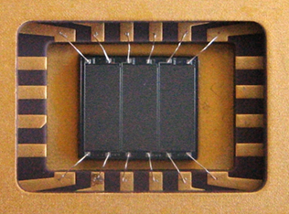
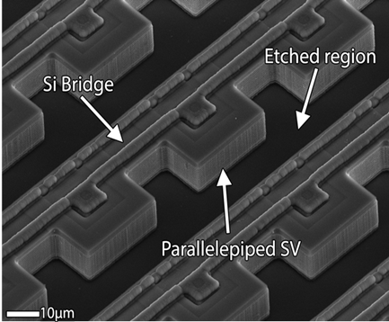
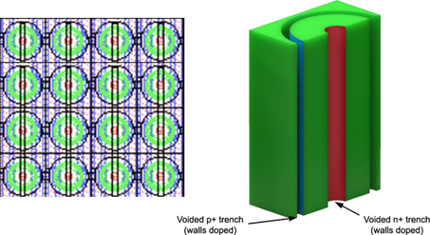
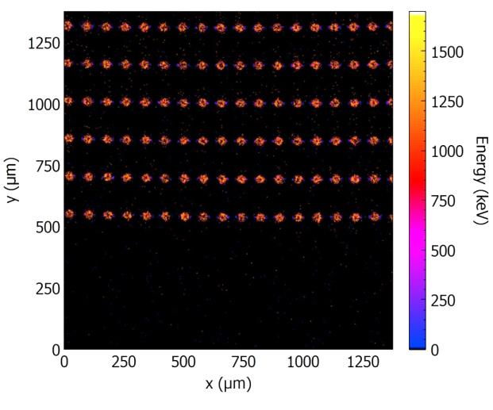
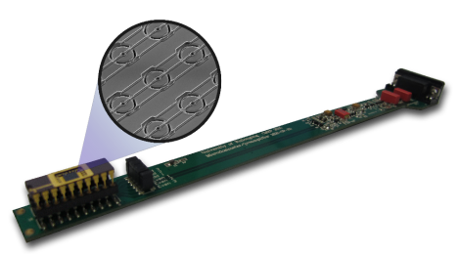
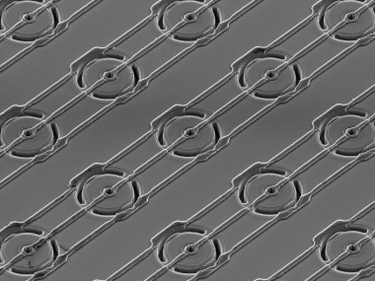
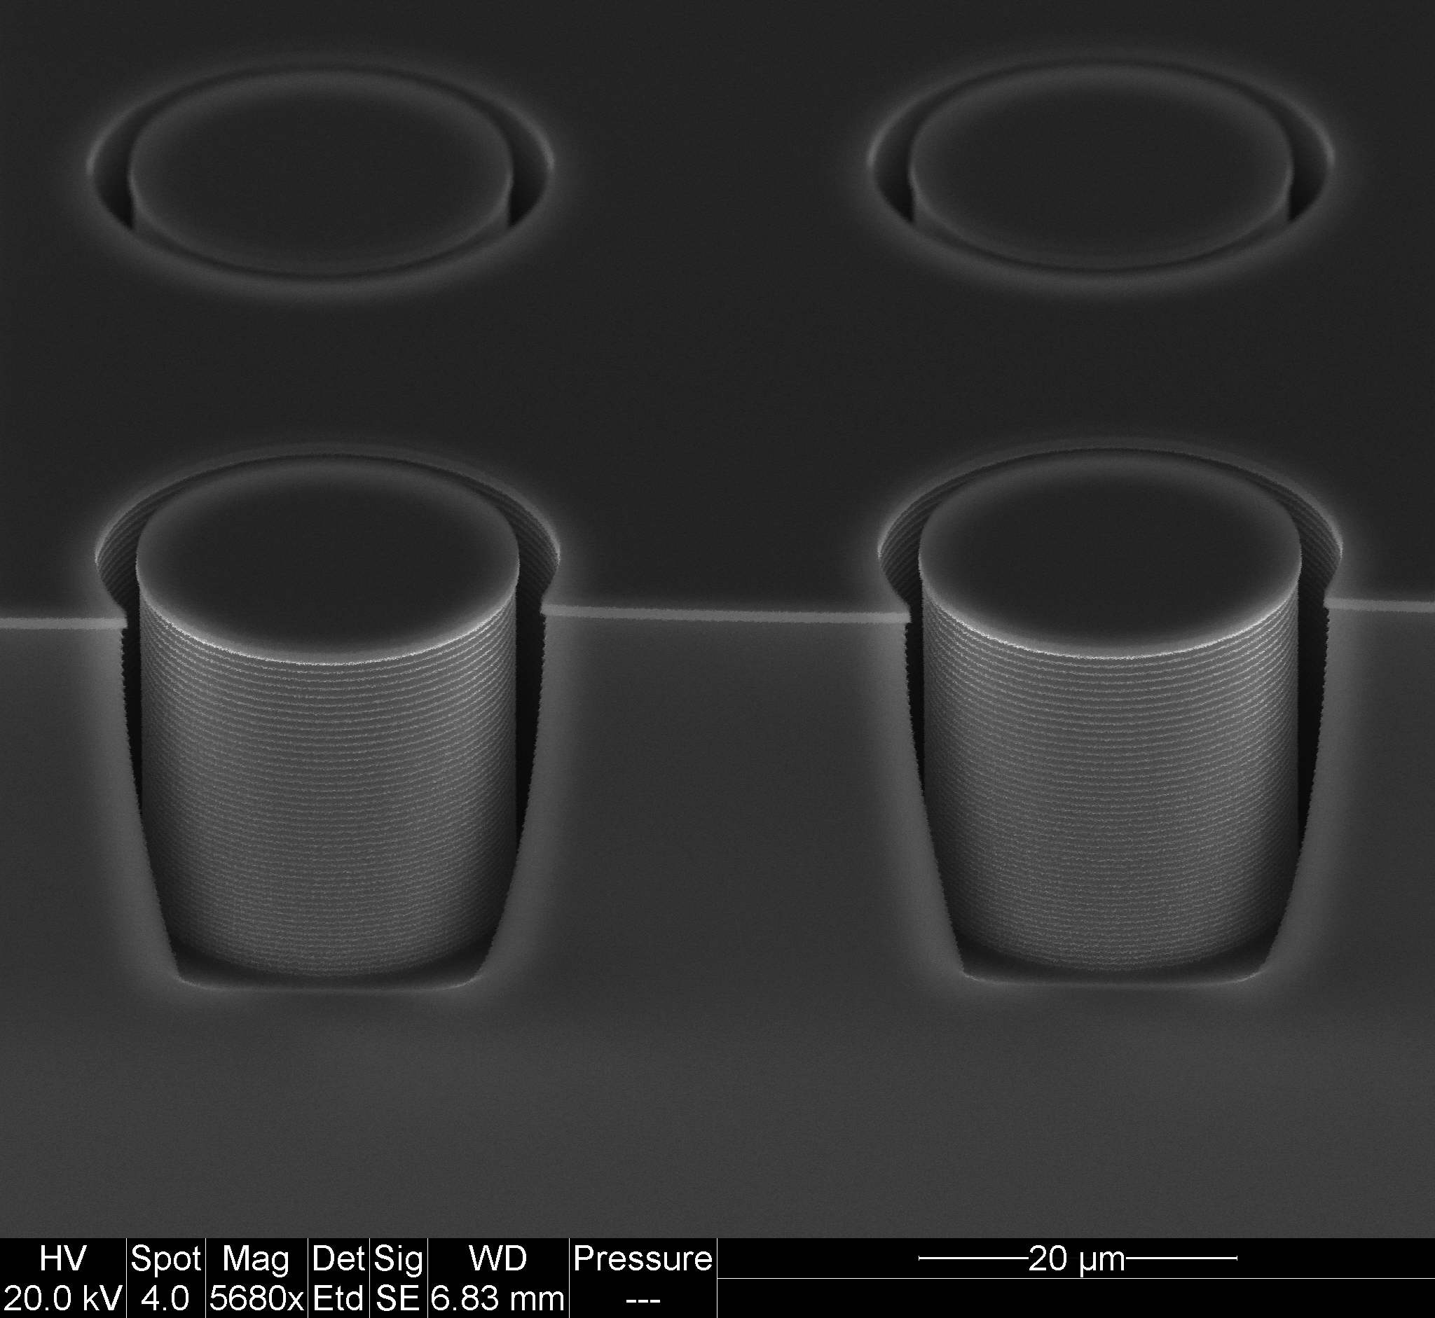
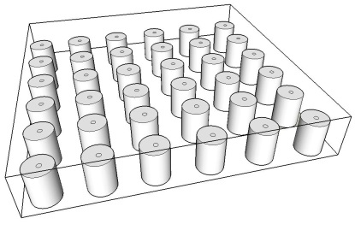
CMRP Silicon Microdosimeters:18 years of development
Bridge MD Version 2
SEM image of Mushrooms
From patent U.S. Patent No. 8421022
EP 2 102 685 B1
To reality
Median energy map showing good sensitive volume yield in the Mushroom microdosimeter, biased at -10 V
MicroPlus probe with SOI Mushroom Microdosimeter, and SEM image showing 3D sensitive volumes
A.Rosenfeld “Novel detectors for silicon based microdosimetry, their concepts and applications”, NIM A, 809, 156-170, 2016

Slide 8
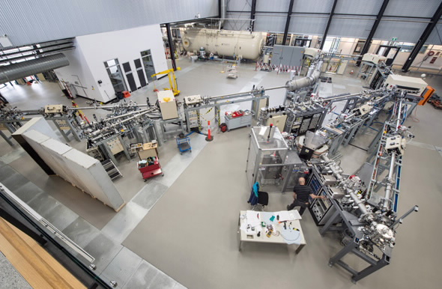
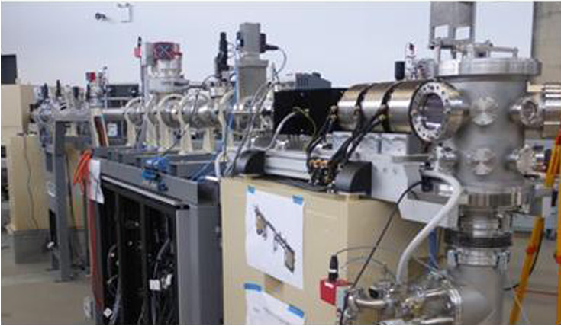
The 6MV SIRIUS Tandem Accelerator, ANSTO for Ion beam induced charge collection (IBIC) study
New nuclear microprobe–Confocal Heavy Ion Micro-Probe (CHIMP)
Microbeam spatial resolution:
0.6 µm x 1.5 µm for 3 MeV H⁺
1.5 µm x 1.5 µm for 6 MeV He²⁺

Slide 9
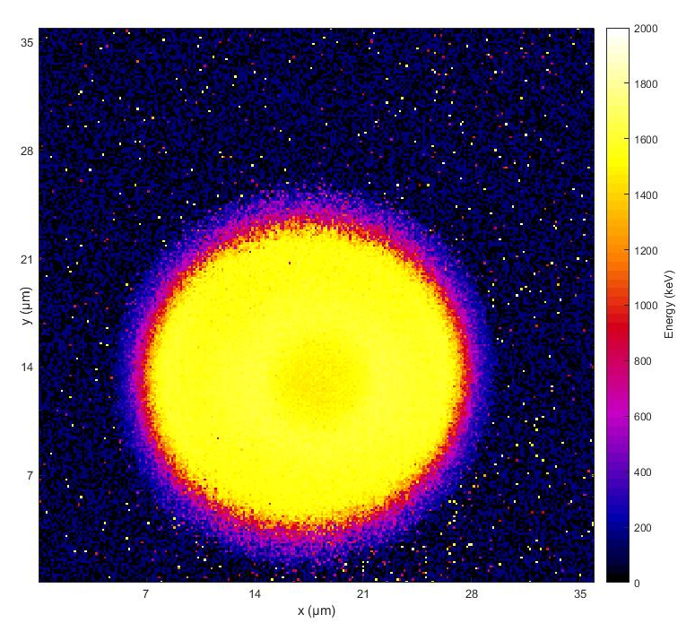
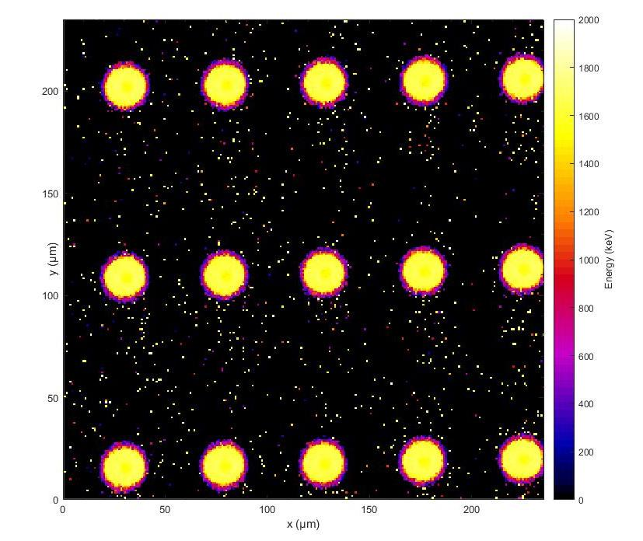
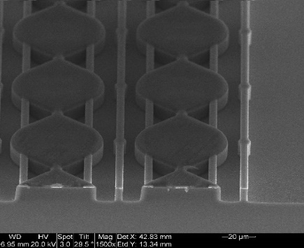
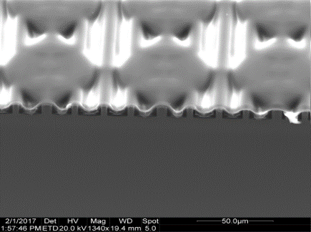
Mushrooms in Polyamide: Tissue Equivalency improvement
Charge Collection study using 5.5 MeV He²⁺ microbeam
Single Mushroom , 18mm diameter
Mushroom Array , 50mm pitch
3D mushroom microdosimeter
Median energy maps generated using two different scan sizes, in both cases the detector is biased using 10V
No cross-talk between adjacent sensitive volumes
100% CCE and 100% yield in fabrication
B.James et al. , IEEE Trans on NS., 66(1), 2019 and 67(1), 2020
Notes:
1x0.1 for single cell
6.7x0.1 for 5x3 picture
no cross talk due to beautiful technology

Slide 10
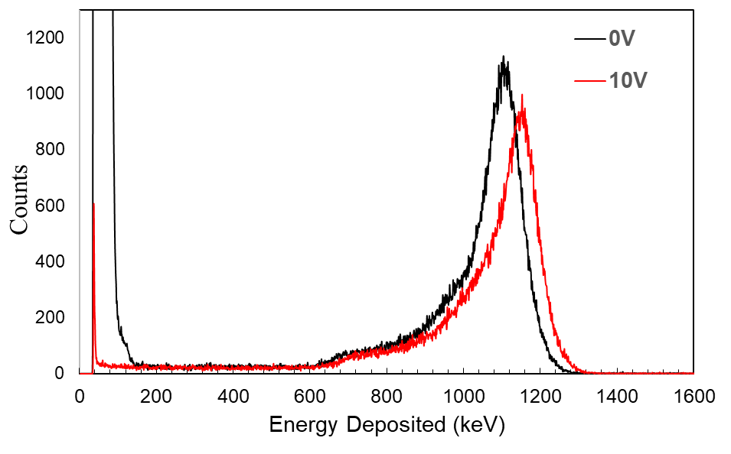
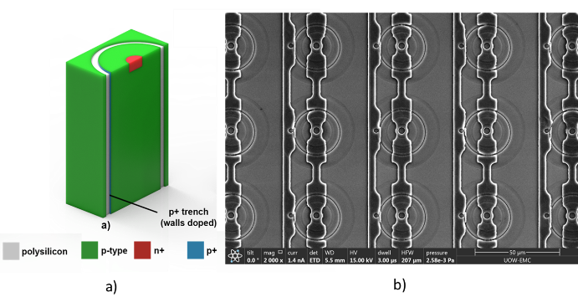
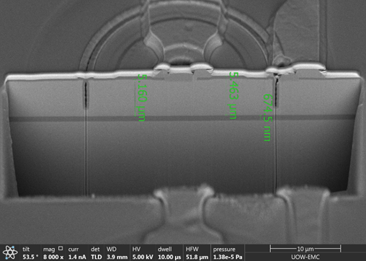
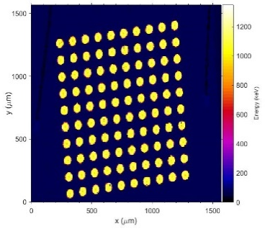
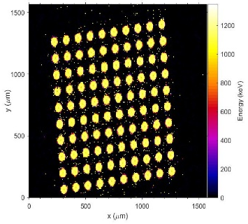
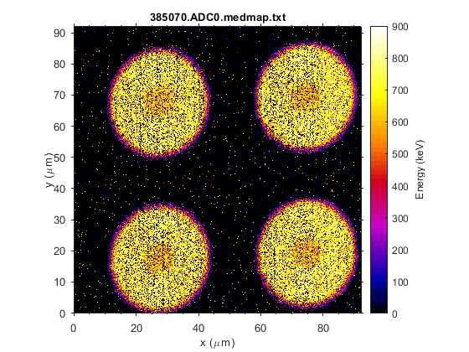
Mushroom microdosimeter (5µm thin)
ESA Project
IBIC 3 MeV He²⁺ ions
Cross-section image of the 5um thin mushroom microdosimeter.
0V
10V

Slide 11
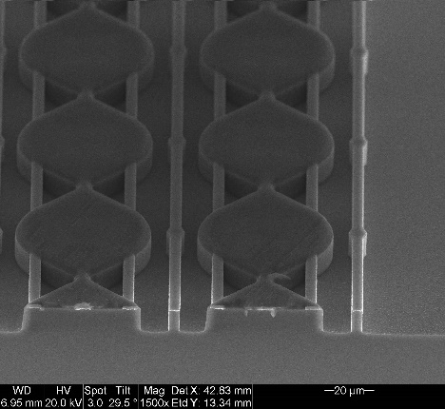
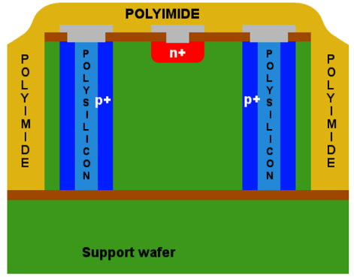
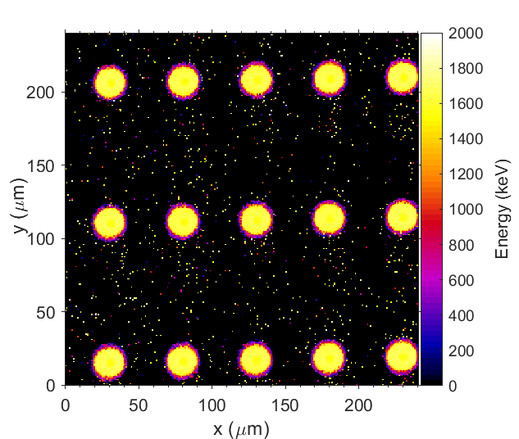
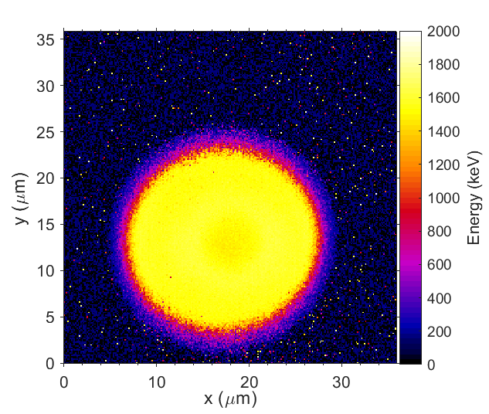
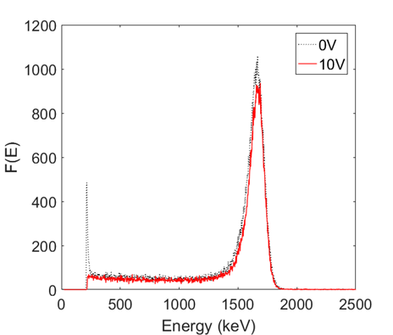
Mushroom Microdosimeters covered with polyimide
IBIC 5.5 MeV He²⁺ ions
Median energy map of charge collection within three rows of the Mushroom microdosimeter at 10V, only even array is connected.
MCA spectra obtained during IBIC for 0V and 10V

Slide 12






Assumption of MK model
Developed by Hawkins (1994-2003) based on the concept of DRA by Kellerer and Rossi (1978)
MK model ignores the stochastic nature of z_{n} by assuming all nucleus in cell population receive z_{n} = D.
Courtesy of Dr T. Inaniwa
constant β in MKM

Slide 13





Microdosimetric Kinetic Model (MKM)
Linear Quadratic Model
S(D) = exp [ - αD - βD²]
Kase et al , 2006
$$α= α_{o}+\frac{β}{ρπr_{d}^{2}} y^{∗}$$
Physics/Biology
$$y^{∗}=\frac{y_{o}^{2}\int_{0}^{∞}{\left(1−exp\left(−y^{2}/y_{o}^{2}\right)\right)f\left(y\right)dy}}{\int_{0}^{∞}{yf\left(y\right)}dy}$$
$$y_{0}=\frac{ρπr_{d}R_{n}^{2}}{\sqrt{β\left(r_{d}^{2}+R_{n}^{2}\right)}}$$
$${;RBE}_{10}=\frac{2βD_{10,R}}{\sqrt{α^{2}−4βln\left(0.1\right)}−α}$$
α_{o}= 0.13 Gy⁻¹; β= 0.05 Gy⁻² ; r_{d} = 0.42 µm is radius of sub cellular domain in MK model, y_{o} = 150 keV/µm
Where D_{10,R} = 5Gy is 10% survival of 200 kVp X rays for HSG cells

Slide 14



Applications in proton and heavy ion therapy
Proton therapy facility,
Mayo Clinics, USA
Heavy ion medical accelerator in Chiba, (HIMAC), Japan
Heidelberg ¹²C ion facility,
Germany

Slide 15





Heavy Ion Medical Accelerator in Chiba
HIMAC, Japan
290 MeV/u ¹²C ion SOBP
HIMAC Bio-cave beam port with passive scattering delivery
MicroPlus probe with XY-movement stage
$μ^{+}$ microdosimeter probe in PMMA sheath

Slide 16



400MeV/u ¹⁶O Ion Irradiation
Parameters measured:
  Physical dose
  Dose-mean lineal energy ($y_{D}$)
  Relative Biological Effectiveness ($RBE_{10}$)
Dose-mean lineal energy measured for 400 MeV/u ¹⁶O ions
Physical dose distribution of 400 MeV/u ¹⁶O ions

Slide 17




A
D
B
K
E
J
C
Bragg Peak
I
F
H
G
Entrance
E
D
Downstream
Dose mean lineal energy and RBE₁₀ distribution with microdosimetric spectra for each region along the Bragg Peak
400 MeV/u ¹⁶O Ions
F
I
C
G
J
A
B
H
K

Slide 18






Ability for Multi-ion therapy: RBE₁₀ obtained with SOI microdosimeter in response to pristine BP of ¹⁴N, ¹⁶O and ¹²C ion beam (HIMAC at NIRS, Japan
180 MeV/u ¹⁴N
400 MeV/u ¹⁶O
290 MeV/u ¹²C
Linh T. Tran, et. al., “The relative biological effectiveness for carbon, nitrogen and oxygen ion beams using passive and scanning techniques evaluated with fully 3D silicon microdosimeters” Medical Physics, 2018 ,(AAPM Award: The best paper in Med .Phys. in 2018)

Slide 19


Validation of MK model in MIT
Microdosimetric spectra were measured with MicroPlus-mushroom probe at different depths along pristine BP for He, C, O, Ne ions to compare MKM predicted SF with measured from in vitro MiaPaca cells experiment in a wide range of LETs
MicroPlus probe
Cell flasks were setup behind PMMA slabs of different thicknesses.
Measurements with MicroPlus probe
qt the same condition as cells
PBS dose delivery

Slide 20




Survival fraction of in vitro data compared to microdosimetric measurements
⁴He
166 MeV/u
¹²C
313MeV/u
Survival fraction (markers) of in vitro data of the MIA PaCa-2 cells for each LET of He, C, O and Ne ion beams and the survival curves (solid lines) calculated from physical dose and lineal energy measured with SOI Mushroom microdosimeter.
¹⁶O
374 MeV/u
²⁰Ne
430 MeV/u
MKM parameters of MIA PaCa-2 cells
𝛼₀ = 0.001 Gy⁻¹, 𝛽 = 0.085 Gy⁻²,
𝑅_{n} = 6.8 𝜇m,
𝑟₀ = 0.57 𝜇m and 𝑦₀ = 260 keV/𝜇m.

Slide 21




SF: MicroPlus predicted vs TPS
MicroPlus
SOBP
TPS: RBE₁₀xD
10x10x6 cm³
$$α= α_{o}+\frac{β}{ρπr_{d}^{2}} y^{∗}$$
MicroPlus
SOBP
Linear Quadratic Model
S(D) = exp [ - αD - βD²]
Dose in SOBP
measured by Markus IC
Good prediction
of SF

Slide 22








Fast proton range verification in perspex
Developed at CMRP -Implemented in Mayo Clinic proton synchrotron

Slide 23


radiation detection technology
Application in space environment

Slide 24





Radiobiological shielding optimization, astronaut personal dosimetry and SEU prediction
GCR: Heavy Charged Particles
ISS Columbus Module
Layout of the Columbus debris shield configuration [R. Destefanis et. al.]
S.Peracchi et al “Modelling of SOI microdosimeters response at ISS for rad. prot. of astronauts “ in press , 2019

Slide 25


Study the shielding properties of component materials of the ISS/Columbus
Beams:
490 MeV/u Si,
400 MeV/u Ne
500 MeV/u Fe
MicroPlus probe
Walls (Al, Nextel, Kevlar)
Experiment carried out last week at HIMAC, Japan:
Assemble a realistic sample of the ISS/Columbus;
Measure microdosimetric spectra, Q and H(10) after each layer;
Use different order configuration of layers and new materials.
Mimicking measurements inside/outside of ISS
Sample layers of the ISS/Columbus build at CMRP./ANSTO
Materials composition, thicknesses, and properties have been considered the same as found in the literature and provided by Alenia and Thales space companies
S.Peracchi et al “Solid State Microdosimeter for dose and radiation quality monitoring for astronauts in space”, IEEE TNS, 67(1), 2020

Slide 26



Columbus shielding wall
Materials’ specification from the literature [3, 4].
Configurations:
Standard materials: full wall, pressurizes shell, reversed layers order.
Layer
1
2
3
4
(pressurized shell)
5
6
(Out-fitting)
Alternative materials to aluminium: Carbon Fiber, Polyoxymethylene (POM), and Perspex.
Requirement: Do not vary the mass of the original Columbus shielding design
Areal density of the new material MUST be the same as the aluminum which is replaced.
[3] M. Silvestri, et al., "Impact of Spacecraft-Shell Composition on 1 GeV/Nucleon 56Fe Ion-Fragmentation and Dose Reduction," IEEE Transactions on Nuclear Science, vol. 58, no. 6, pp. 3126-3133, 2011.
[4] C. Lobascio et al., "Accelerator-based tests of radiation shielding properties of materials used in human space infrastructures," Health Physics, vol. 94, no. 3, pp. 242-247, 2008.
Notes:
A the realistic shielding configuration of the Columbus module docked at the ISS was found in the literature so we reproduce our own sample of the layers (photo on the right bottom) based on specification about the material shown in the table (top right).
The Columbus “wall” was represented as: 4 layers for the Pressurized Shell (MLI was not available) and 2 extra layers for the Out-fitting.
The Out-fitting is modeled to include a great number of devices and structures located inside the habitable volume of the Columbus that do not influence the structure’s resistance of the spacecraft but effect astronauts’ shielding.
We considered several configurations using these standards materials. We studied what we call “full wall”, meaning all 6 layers, only the pressurized shell, and we also change the order of layers to see the consequences.
Secondly, as it is well know that aluminium is the main responsible of fragmentation of energetic heavy ions and production of secondary particles, as neutrons for instance, that can cause higher biological damage. Thus we decided to compare the shielding efficiency of those configurations cited above by replacing the aluminum layers with suggested materials as Carbon Fiber, Polyoxymethylene, and Perspex.
Requirement for the replacement: do not vary the mass of the original Columbus shielding design, so we kept the areal density constant, and we calculated the thickness of the new material to be used instead.

Slide 27






Configuration | $$\overline{Q}$$ | $Hp(10)$ (Sv/Gy)
“No wall” | 16.95 | 2.55
“Shell(1)” | 17.15 | 2.53
“Shell(12)” | 17.16 | 2.54
“Shell(123)” | 17.31 | 2.57
“Shell(1234)” | 17.76 | 2.66
“Out-fitting(12345)” | 23.78 | 4.10
“Out-fitting(123456)” | 24.08 | 5.00
Results : Standard Wall
Out-fitting:
90keV/µm
Shell:
60keV/µm
+ 54%
+ 22%
SOI
Kevlar/Epoxy =29mm
Aluminium =28mm
Columbus’s shell
10mm PMMA
Stefania Peracchi, NSREC Conference 2020
Notes:
I am going now to show some of the results, starting from the “Standard Full wall configuration” irradiated with 490 MeV/u silicon ions.
We wanted to evaluate the shielding efficiency of each layer in the Columbus, so as we can see in this simplistic animation, we set up our SOI Mushroom, with the 10mm PMMA converter, and we add one layer at a time in front of it till the full sample was built. For each step, we measured the microdosimetric spectrum, the Average quality factor Q and the dose equivalent Hp(10).
The microdosimetric spectra seem not to vary a lot while adding the first 4 layers of the pressurized shell, meaning primary silicon ions pass through the shell and do not interact with it, or very slightly. Consequently the quality factor and the dose are almost unvaried. However, when the 5th aluminium layer, 28mm thick is added the dose increase of 54%. Silicon ions interact with aluminium and slow down in energy, increasing their LET closer to 100keV/um and consequently the Q increase as well (as we can see in the ICRP graph), thus the dose.
Because the peak remains well defined , we can say that the 6th layer of Kevlar-Epoxy contributes to an increase of dose due to the incoming silicon ions lowered in energy and also higher LET fragments.
Finally, 490MeV/u silicon ions are not fully stopped by the current Columbus wall and the dose inside the spacecraft (behind the full wall) is double the dose outside the spacecraft (in absence of shielding).

Slide 28






Ions comparison
${}_{}^{12}C 290 MeV/u$ ${}_{}^{20}{Ne} 400 MeV/u$ ${}_{}^{28}{Si} 490 MeV/u$
Configuration | $$\overline{Q}$$ | $Hp(10)$ (Sv/Gy)
“No wall” | 3.30 | 0.18
“7.3 mm Al” | 3.41 | 0.18
“Al Shell” | 3.55 | 0.19
“Al Full wall” | 6.42 | 0.46
Configuration | $$\overline{Q}$$ | $Hp(10)$ (Sv/Gy)
“No wall” | 9.29 | 1.26
“Shell(1)” | 9.41 | 1.28
“Shell(12)” | 9.45 | 1.26
“Shell(123)” | 9.51 | 1.29
“Shell(1234)” | 9.80 | 1.33
“Out-fitting(12345)” | 13.34 | 2.02
“Out-fitting(123456)” | 16.22 | 2.71
Configuration | $$\overline{Q}$$ | $Hp(10)$ (Sv/Gy)
“No wall” | 16.95 | 2.55
“Shell(1)” | 17.15 | 2.53
“Shell(12)” | 17.16 | 2.54
“Shell(123)” | 17.31 | 2.57
“Shell(1234)” | 17.76 | 2.66
“Out-fitting(12345)” | 23.78 | 4.10
“Out-fitting(123456)” | 24.08 | 5.00
+ 256%
+ 215%
+ 196%
+ 242%
+ 52%
+ 54%
Stefania Peracchi, NSREC Conference 2020
Notes:
The full wall configuration was irradiated also with 290 MeV/u Carbon ions and 400 MeV/u Neon ions.
The microdosimetric spectra happen to have the same behaviour: shift to higher lineal energy while adding layers, meaning a slowing down in energy of primary ions and production of secondary particles.
The values of doses equivalent are more than twice bigger inside the spacecraft than outside for incoming Carbon and Neon ions.

Slide 29




Results : PMMA Wall
Replace aluminium layer 5 with a mass-equivalent PMMA layer:
Thickness: 28 mm Al ←→ 62.7 mm PMMA
 | ${}_{}^{28}{Si},$ 490 MeV/u |  | ${}_{}^{20}{Ne},$ 400 MeV/u
Configuration | $$\overline{Q}$$ | $Hp(10)$ (Sv/Gy) | $$\overline{Q}$$ | $Hp(10)$ (Sv/Gy)
“No wall” | 16.95 | 2.55 | 9.29 | 1.26
“Al Full wall” | 24.08 | 5.00 | 16.22 | 2.71
“PMMA Full wall” | 21.94 | 4.96 | 19.22 | 3.48
- 0.9%
+ 22%
PMMA =62.7mm
SOI
Kevlar/Epoxy = 29mm
Si: 150keV/µm
Ne: 79keV/µm
10mm PMMA
Columbus’s shell
Notes:
Confirming that the aluminium is the most responsible of the dose and quality factor increase due to secondary particles production, we decided to substitute it with PMMA first.
Following the requirement of constant areal density, the 5th layer of aluminium (28 mm thick) was replaced by 62.7 mm of PMMA mass-equivalent and the full wall was irradiated with 400 MeV/u Neon and 490 MeV/u silicon ions.
PMMA does not fully stop ions which anyway deposit energy. Though, we can observe the “overkilling effect” happening for silicon ions: if PMMA is used, the microdosimetric spectrum shifted to the region of LET higher than 150 keV/μm, corresponding to an over-clustering of ionization in one individual ion track, increasing the absorbed dose. On the contrary, the Quality factor decreases for LET>150 keV/μm, making the product $\overline{Q}∗D$ describe the biological effect as constant, hence the dose equivalent.
Also, as the microdosimetric spectra areas are always normalized to 1, the fact that the spectra amplitude of peaks for silicon ions is less than the ones for neon ions tells us that more fragments and neutrons have been produced in case of Silicon.
Neon does not undergo such fragmentation, thus the field is predominantly characterized by primary ions with LET lower that 100keV/um, which increasing leads to an higher dose equivalent.

Slide 30



Personal SOI microdosimetry in GCR: Large Area 3D SV array
Challenges in Space :
Low dose rate
mixed ions field
Real time dose
equivalent needed
Octobox
MicroPlus, c/axis
Multi-microdosimeter system: large area, high sensitivity, low noise
Beams:
490 MeV/u ²⁸Si,
400 MeV/u ²⁰Ne
490 MeV/u ²⁸Si
Out of Field
H=15mSv
Good statistics
Measured Dose Eq.
laterally out of field
H=(1.40 ± 0.05-
0.54 ± 0.04) mSv/Gy
Q =5.02 ± 0.15-
5.39 ± 0.32
V.Pan et al, NIM , 2020 (in press)

Slide 31




SPE and GCR proton spectra at Paul Sherrer Institute (PSI)
0ᴼ beam (spot/4x4cm²)
Inner 10mm PMMA
µ-Plus probe
90ᴼ beam
Print Circuit Board
Outer 15mm PMMA
10mm PMMA
180ᴼ beam
25 mm PMMA
S. Peracchi et al, Advance in Space Research ,2020 (in press)

Slide 32





Stefania Peracchi,
“Moon to Mars and beyond”
Representing the University of Wollongong and the Centre for Medical Radiation Physics
Winner of the People’s Choice Award
@ the final of 3MT Asia-Pacific Competition 2020

Slide 33













Acknowledgements
PT: University of Groningen, Netherlands
Thanks to CMRP postdocs and PhD students:
HIT: HIMAC, Japan
PSI proton therapy, Switzerland
David Bolst
Lachlan Chartier
Benjamin James
Emily Debrot
Stefania Peracchi
James Vohradsky
Vladimir Pan
Federico Pagani
PT: Mayo Clinic,
USA
FNT and PT: Ithemba,
South Africa
PT: MGH, USA
Presented works are under leadership of Distinguished Professor Anatoly Rozenfeld

Slide 34
Conclusion
Portable, low power SOI microdosimeter utilizing 3D detector technology was developed and introduced for particle therapy QA
Microdosimetric property of ²H, ⁴He, ¹²C, ¹⁴N, ¹⁶O, ²⁰Ne and ⁵⁶Fe ion beams were investigated with SOI microdosimeters
Good agreement between cell experiment SF and predicted by SOI microdosimeter for 3 cell lines was demonstrated
Ability for microdosimetry in PBS delivery without pile up
Practical for LET_{D} based TPS verification in proton therapy
SOI microdosimetry useful for in citu spacecraft shielding evaluation and low dose equivalent rate measurements in GCR analog environment
Further work to be done on 3D SV reducing to 1μm and extending of dynamic range of electronic
For contact : Anatoly Rosenfeld, E: anatoly@uow.edu.au

