Slide 1

ATF October 2020
Progress report on the operations and upgrades at ANU HIAF
Nikolai Lobanov
on behalf of Accelerator Operation and Development Team

Slide 2
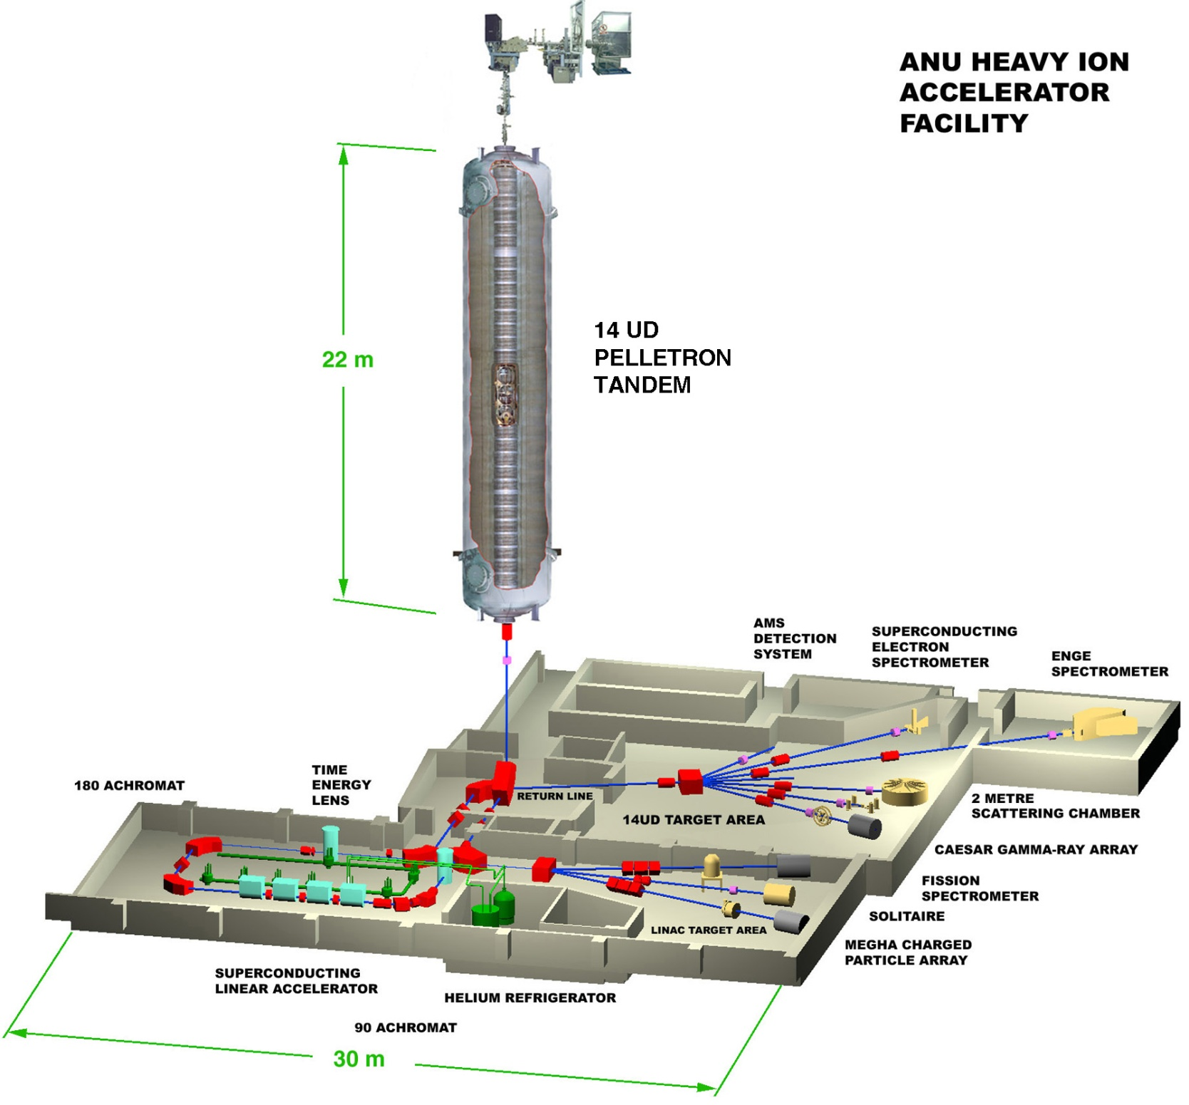
22 tonnes of SF6

Slide 3
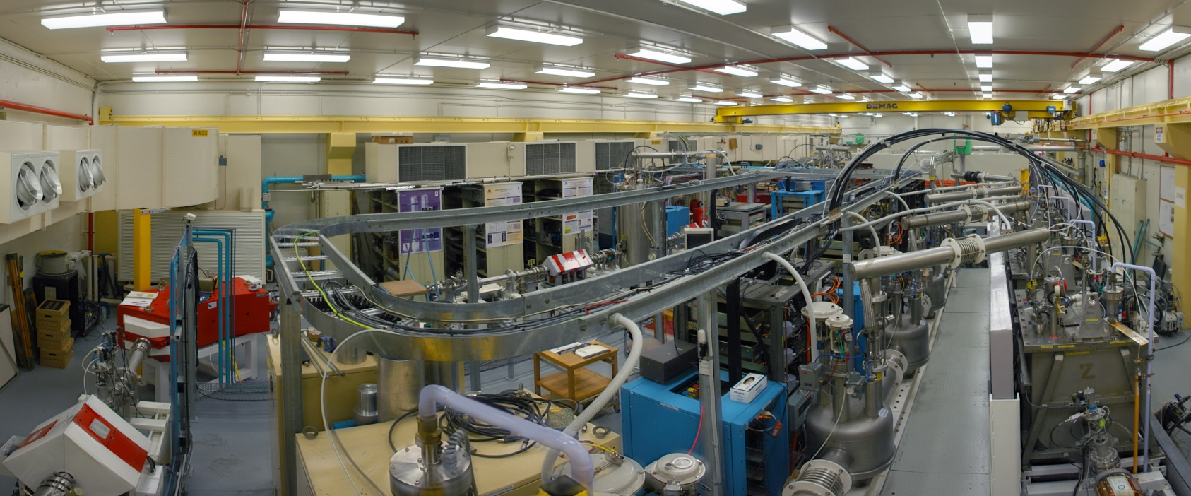
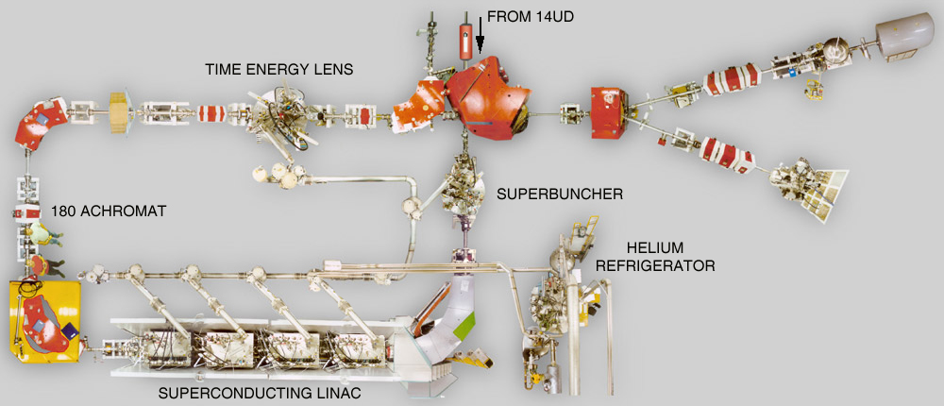
SRF linac booster 6.5 MV effective voltage

Slide 4
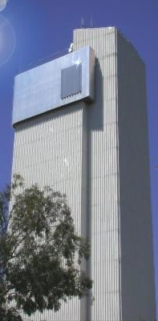
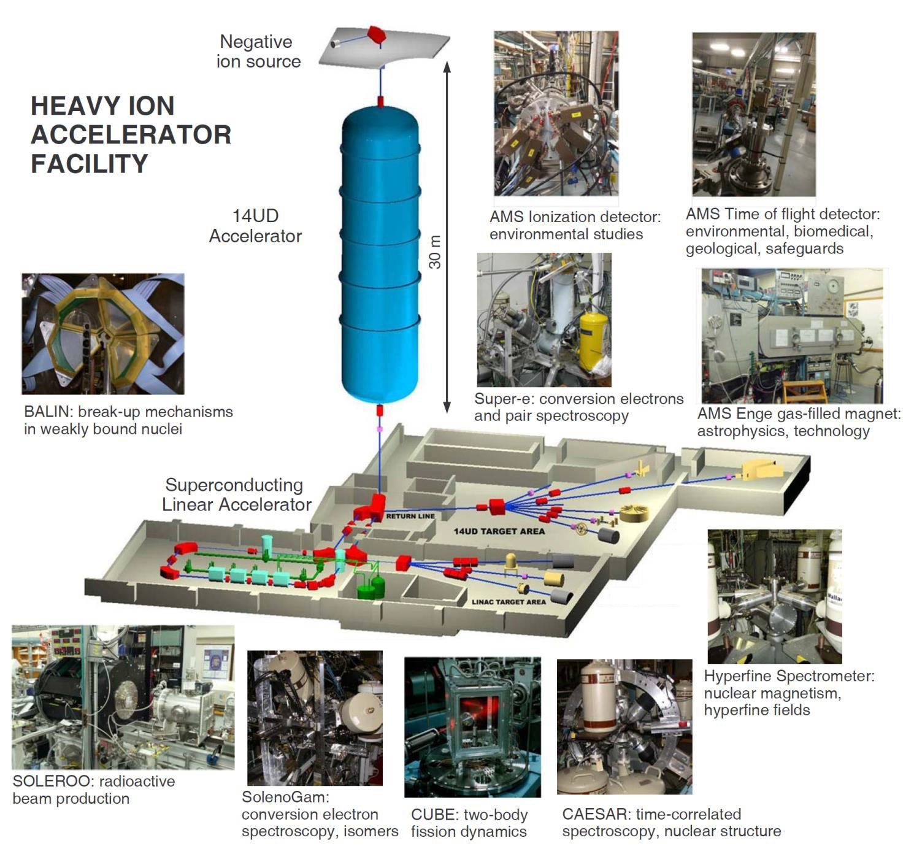
Ten Beam Lines

Slide 5
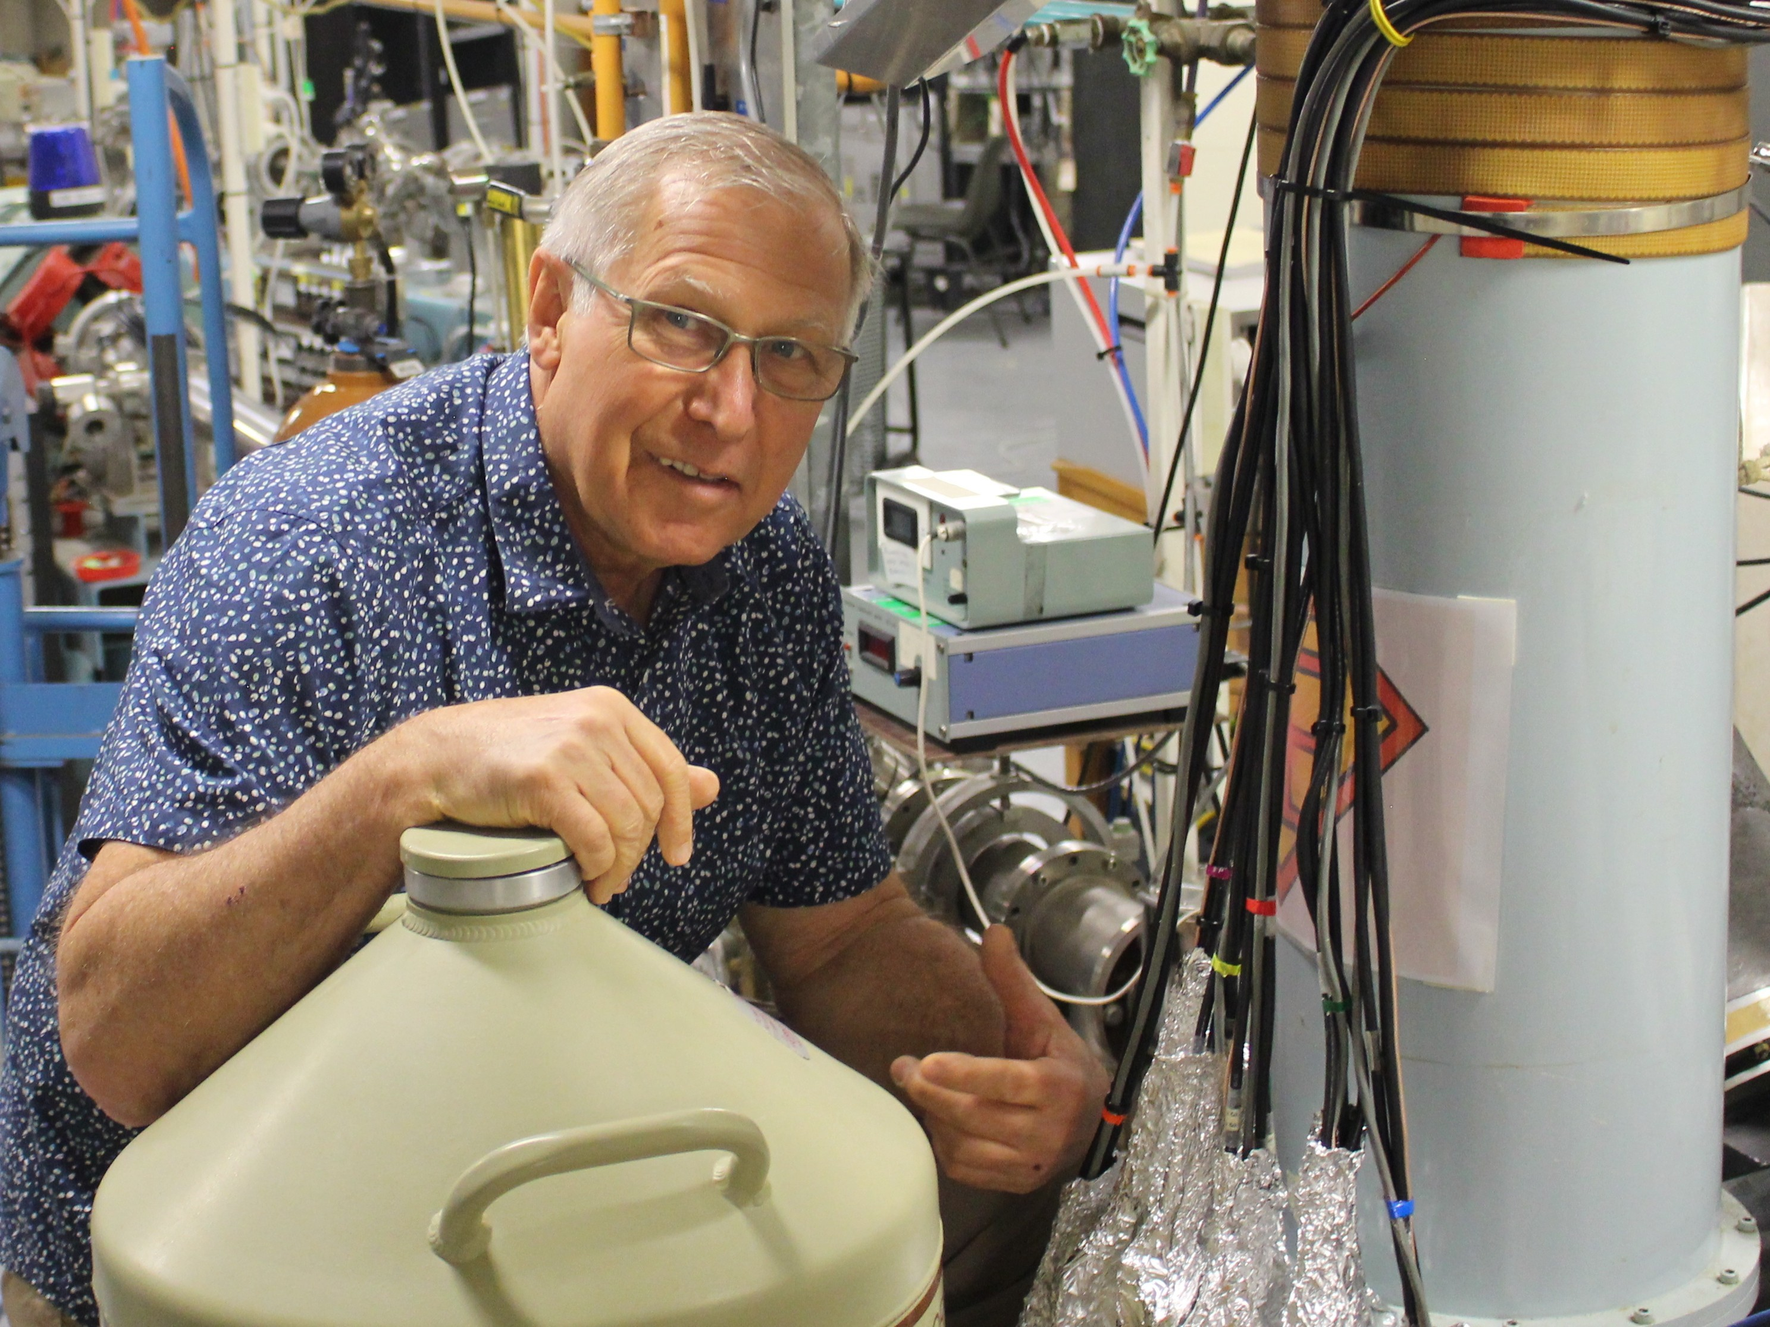
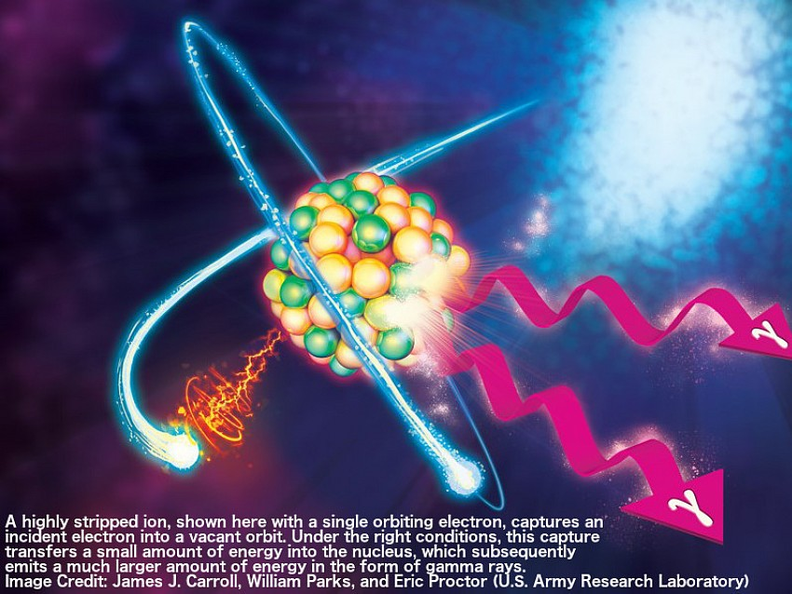

News
A new measurement of how quickly stars create carbon may trigger a major shift in our understanding of how stars evolve and die, how the elements are created, and even the origin and abundance of the building blocks of life.
Research will help scientists understand how stars create elements by demonstrating nuclear effect, called Nuclear Excitation by Electron Capture. The research at ANU was the first positive observation and has achieved the first quantified measurement of the phenomenon.
Ocean sediments reveal nearby supernovae mystery -the Earth has been travelling for the last 33,000 years through a cloud of faintly radioactive dust. 'These clouds could be remnants of previous supernova explosions

Slide 6
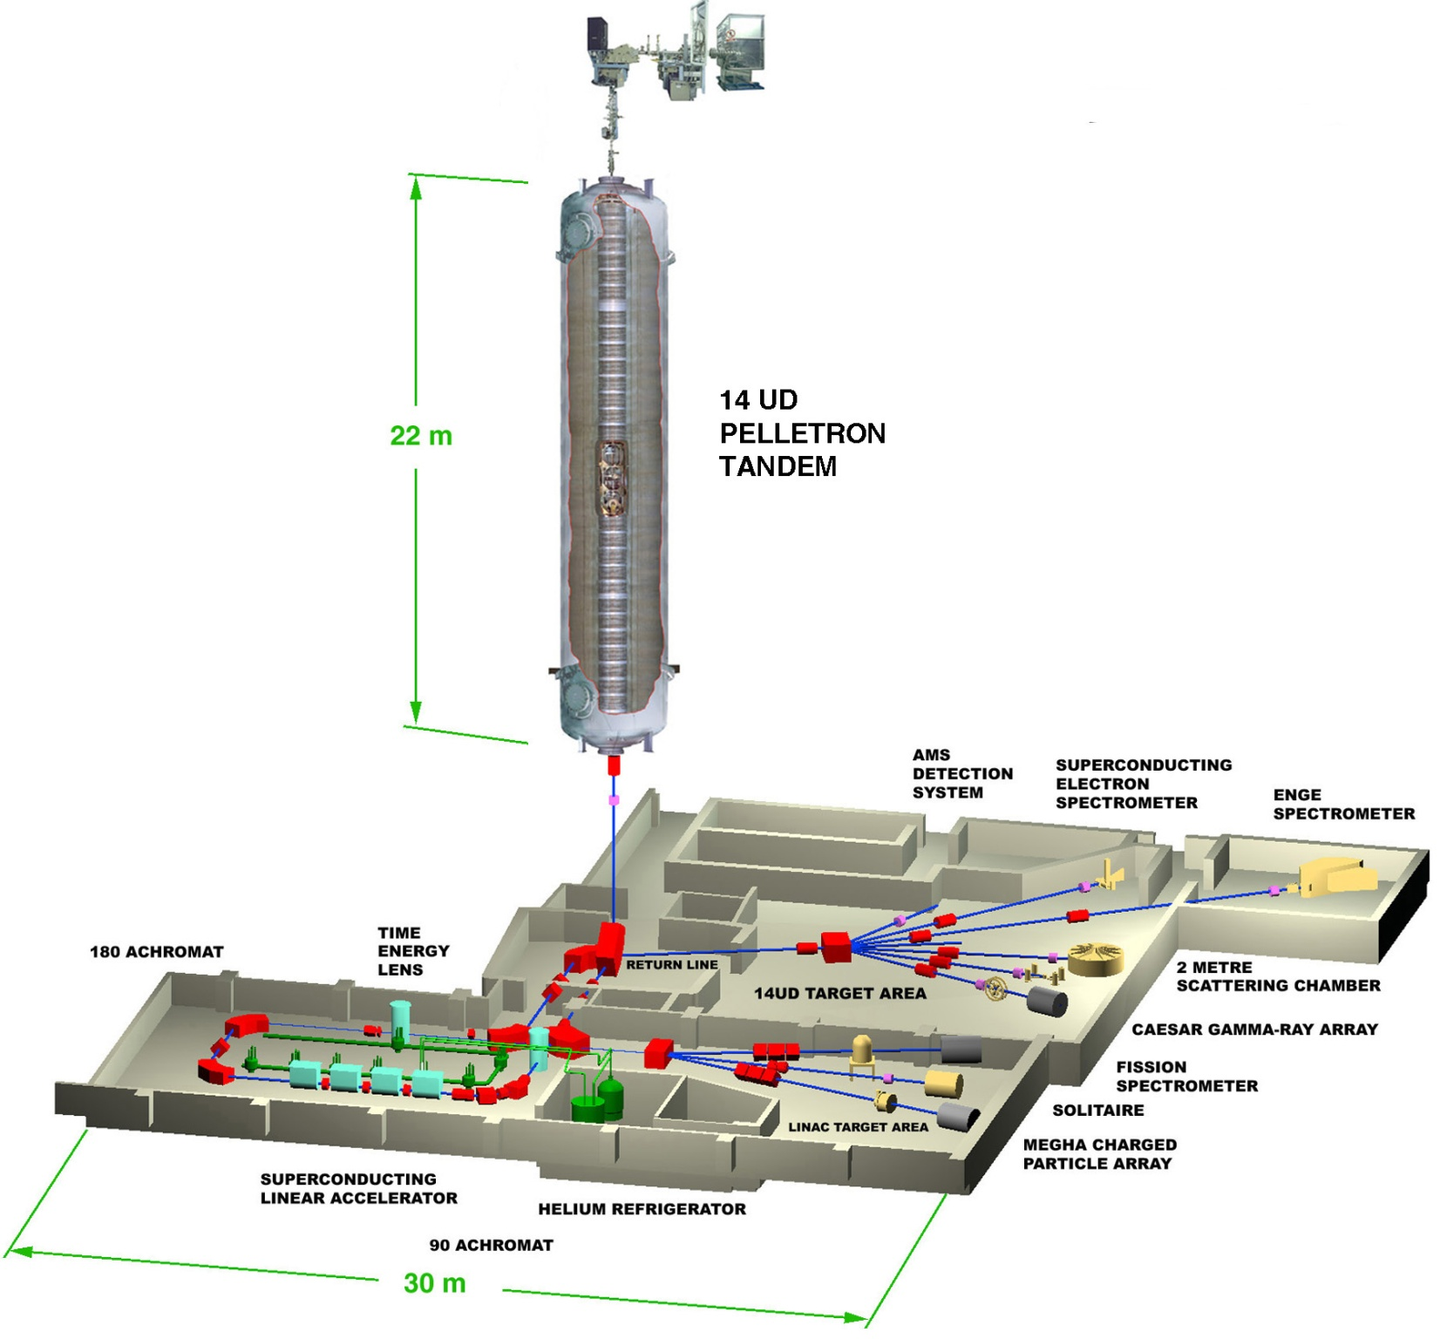
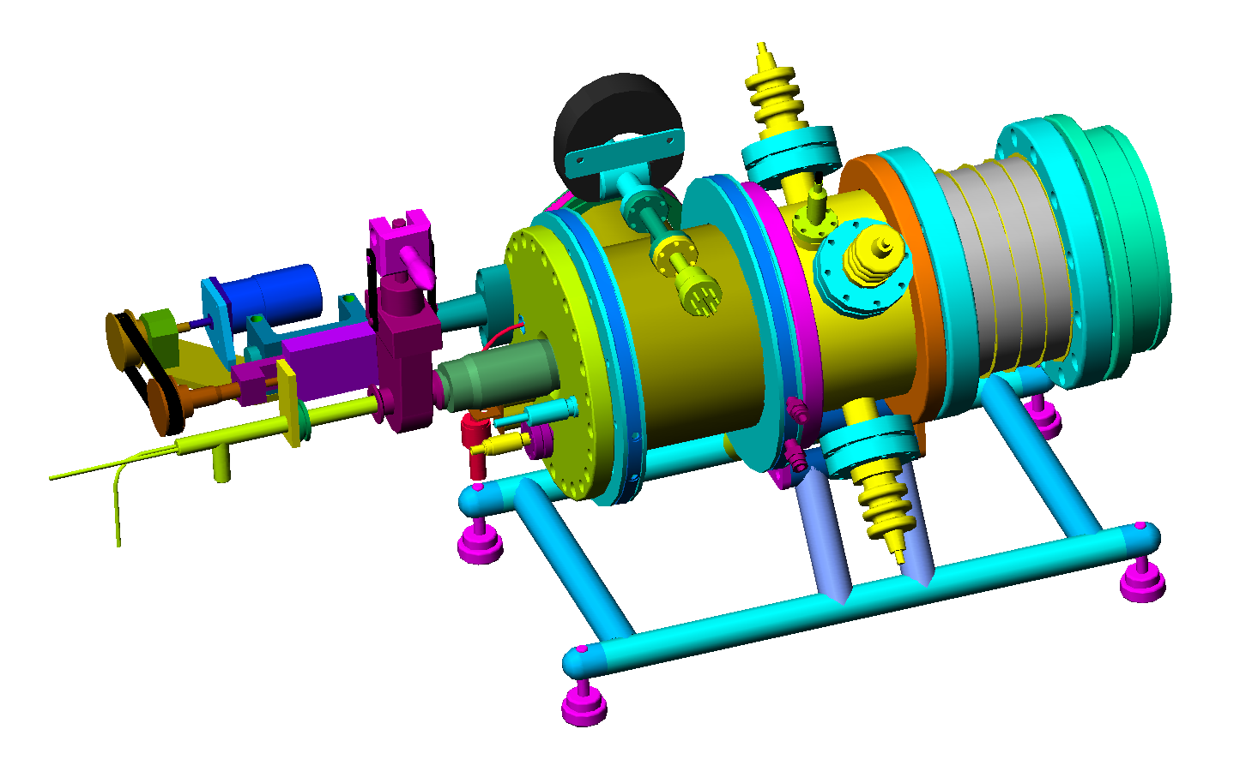
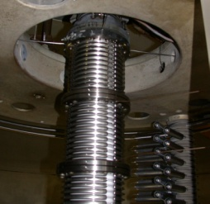
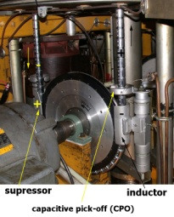
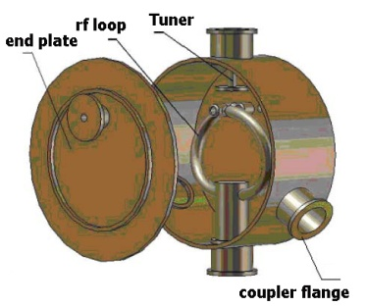
2010-2020 SUPERSCIENCE ENHANCEMENT OF HIAF
Six high precision accelerator tubesfor better transmission
Upgrade pulsing system:
resonators and rf control
SNICS development: construction
the second source for better
maintenance and reliability
Replacement vacuum pumps and gauges
Purchasing SF₆ gas to allow optimum tank pressure. Upgrade SF₆ monitoring system
New accelerator computer control
and data acquisition systems
Improvement charging system through installation of the latest technology charging chains and oil-free conductive wheels
Enhance AMS capabilities, beam-lines, RIB capability and Accelerator User Support
Develop 150 MHz room
temperature superbuncher

Slide 7
Past and present HIAF upgrades
14UD/linac and its instruments:
Tube entrance lens control NIMB 421 (2018) and NIMA 767 (2014)
L5 major upgrade and new He⁻ ion source Linardakis talk
Entire inventory of posts and tubes ordered from NEC
(new e magnetic suppression- ondulator)
New target area, and beam lines under investigation
NP Department 3-6-9 years development plan has been updated
Upgraded SNICS and McSNIC for reliability NIM B 415 (2018)
Linac beam pulse width monitor, tunes with srf phase detector
PRAB 19 (2016), Cryogenics 85 (2017) and Physica C 519 (2015)
Linac resonators upgrade 2 x PRST AB 9 (2006), and PRST AB 10 (2007)

Slide 8
Past and present HIAF upgrades
Bunching and chopping:
Fast chopper upgrade
HE normal conducting buncher and acceleration modules and 10 kW amplifier
(work in progress)
LE buncher and HE chopper upgrades 2 papers under review NIMB
Beam lines:
8.5T solenoid- mechanical suspension and commissioning NIMA 983 (2020)
ANU neutron shielding- few beamlines upgraded
Supere line 6 upgrades
AMS cycling system NIMB (2015)
Operation:
TO#130 detailed TOR available PRST AB 18 (2015)
Linac#29 Cryo crew training in operation and compressor maintenance
14UD operation up to 14.5 MV
Sulphur and Fluorine decease treated successfully work in progress

Slide 9
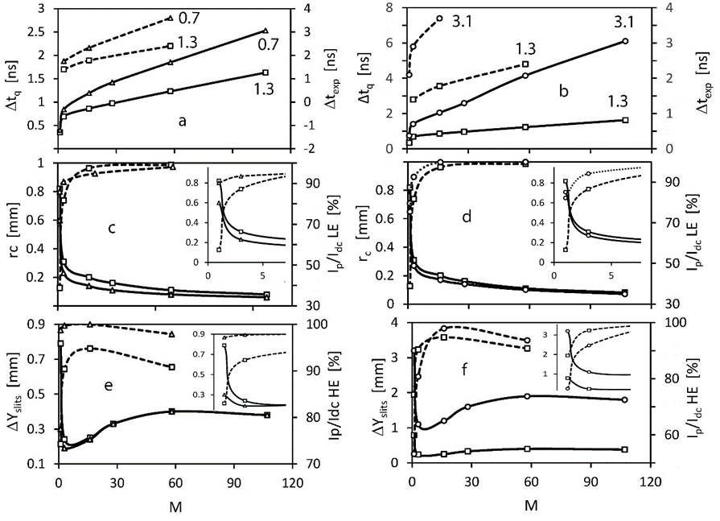
LE buncher
High U_{T}
Low U_{T}

Slide 10
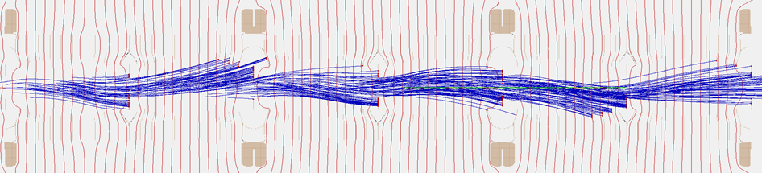
14 UD Posts and tubes replacement
For e-suppression NEC added weak magnets to the 22 gap tubes for 6 MV system. There are 4 apertures per 1 MV, without cones, with 1 aperture in the middle on each 22 gap tube. The magnetic field is 47 gauss on axis between apertures, and falls off near each aperture because of rotation the field 90 degrees from one set of 11 gaps to the next. NEC modelling shows an average electron energy of only 222 keV- excellent suppression.
The main issue with the “spiral” magnetic field is significant steering of the beam both in LE and HE sections.
A good alternative to the “spiral” B filed might be “snake” B field configuration in which case the net steering is negligibly small- suggested by David Hinde
The electrons are terminated well mainly at the apertures with an average energy of 290 keV -SIMION by T. Tunningley
No effect of magnets on pulse beam broadening. Also no change of beam transmission due to injection bouncing in the tube with magnetic suppression

Slide 11
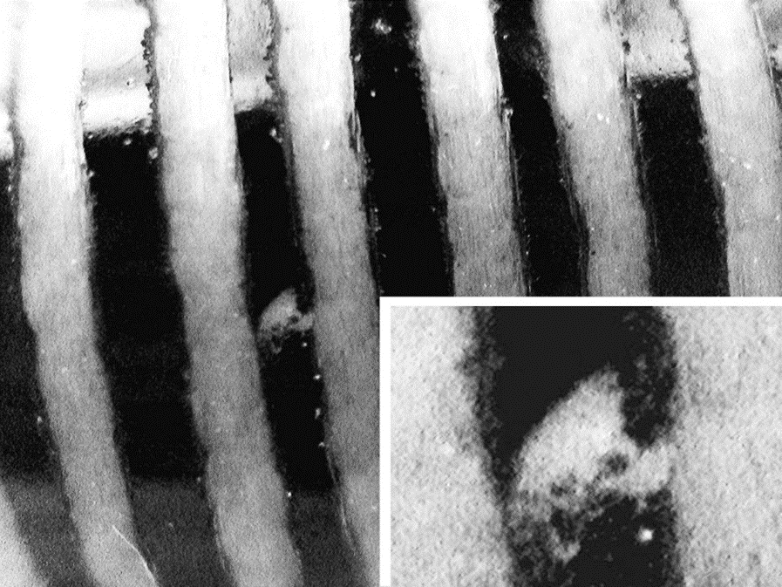
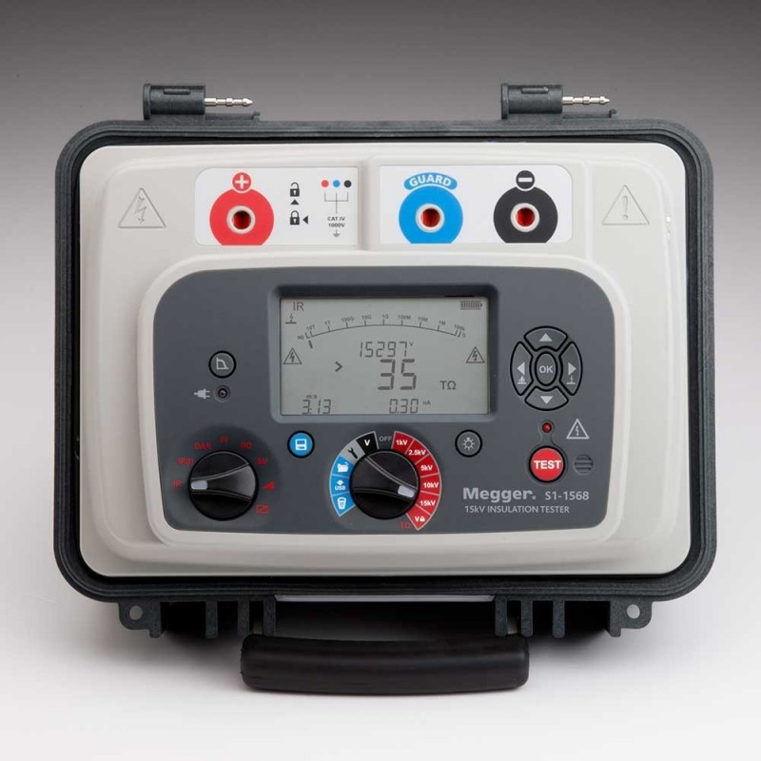
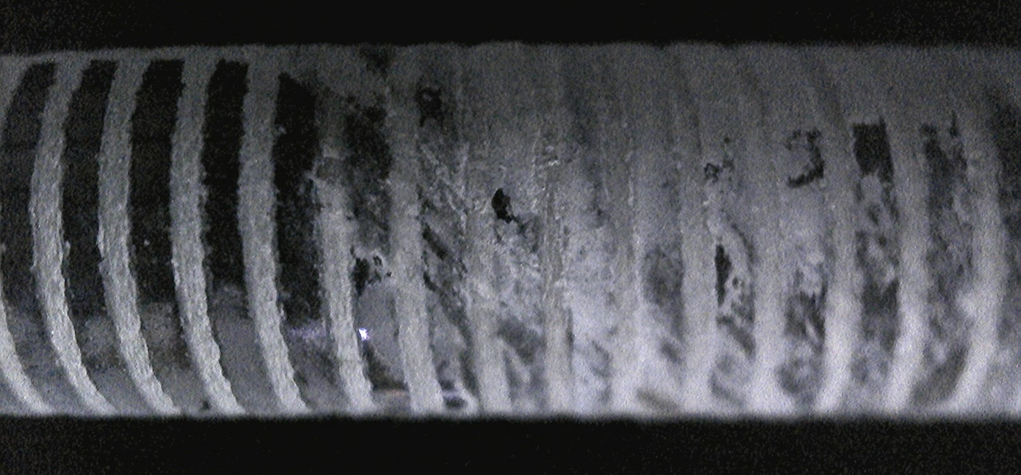
High impedance diagnostic: INFINITRON 800 and Megger S1-1568
“microbreak” on a Welwyn 982 MΩ
post resistor
35 TΩ - 15 kV
Example of “microbreak II”

Slide 12
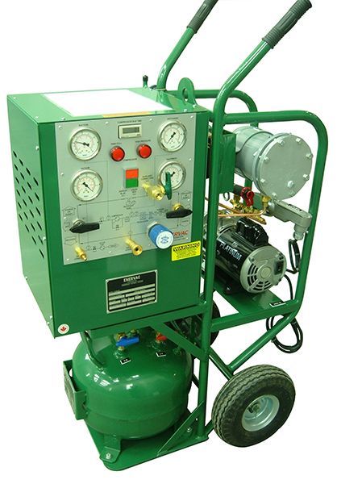
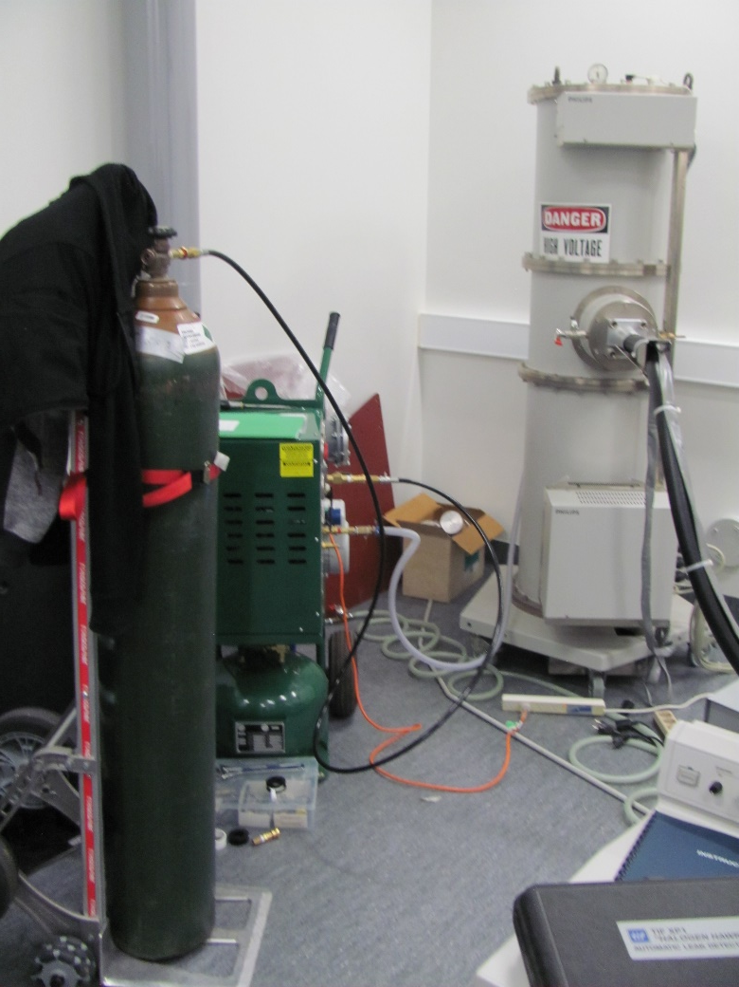
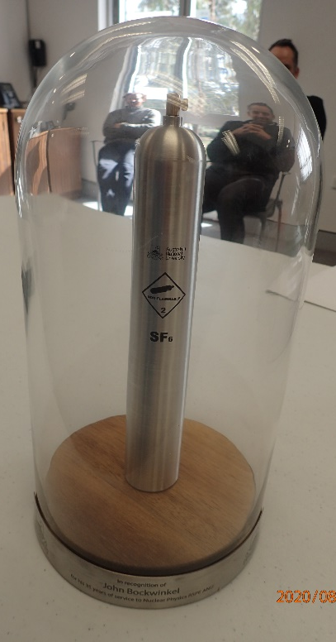
SF6 Gas Recovery unit GRU-4
SF6 gas recovery from
300 kV PS EMU in Sept 2020

Slide 13
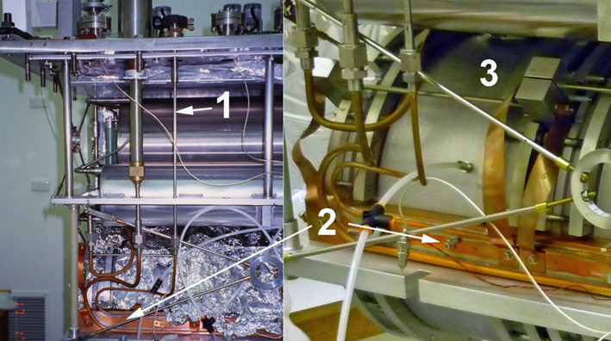
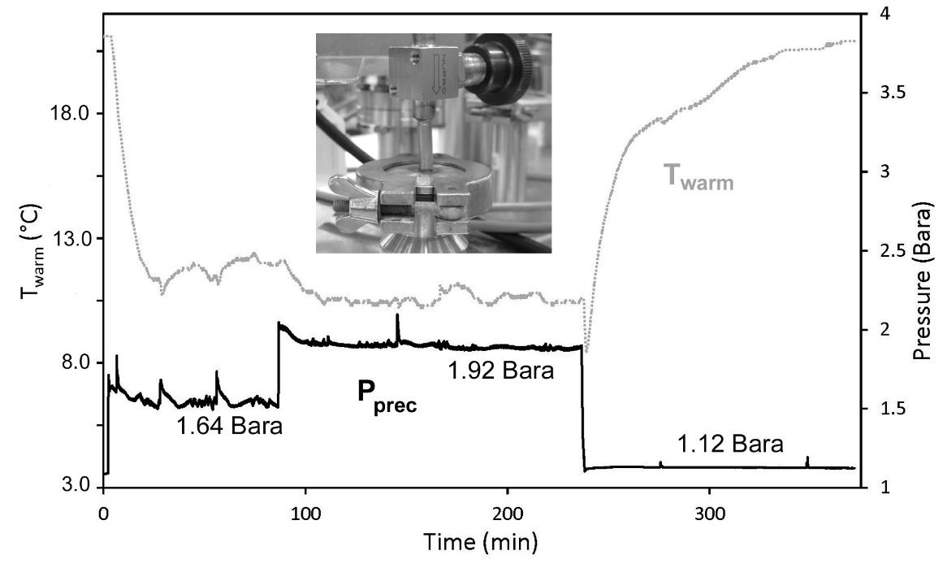
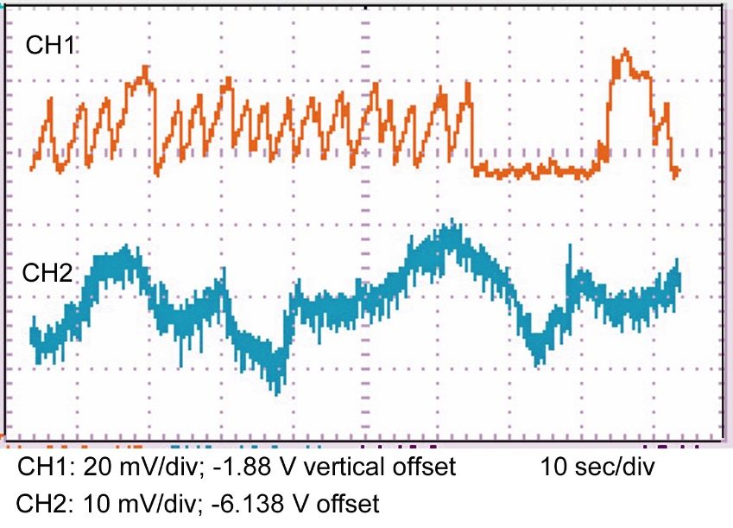
Precool TAO mitigation linac #29

Slide 14
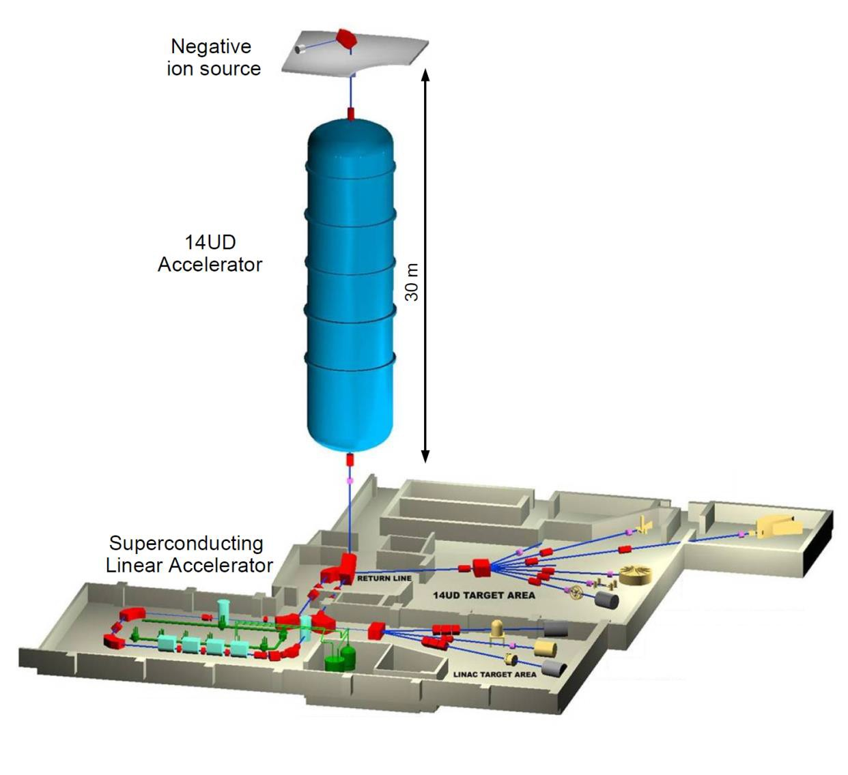
Accelerator & Beamlines (0-3 years)
Consolidating EIF projects: optimization & operational experience
OHS: Lifting Platform & Electrical Safety Compliance
HIAF Capability Goals
3 freq. bunching
Sub ns pulsing
Ion source for ³He, ⁴He beams
New ceramic
New radiation protection system
Pulsed beam system
Additional Users:
EME HI irradiations
Dark Matter
Medical Physics
Space
Building Project
Active discussion
Electrical distribution upgrade
  Preparation
  implementation
  Safety upgrade

Slide 15


3-6 years Accelerator & Beam lines
Ion source development:
Positive ion source in terminal terminal?
Building program:
Control room move
Target Lab Move & Upgrade
Beam line extensions
Future accelerator / beam line extension?
Beam line extension?

Slide 16
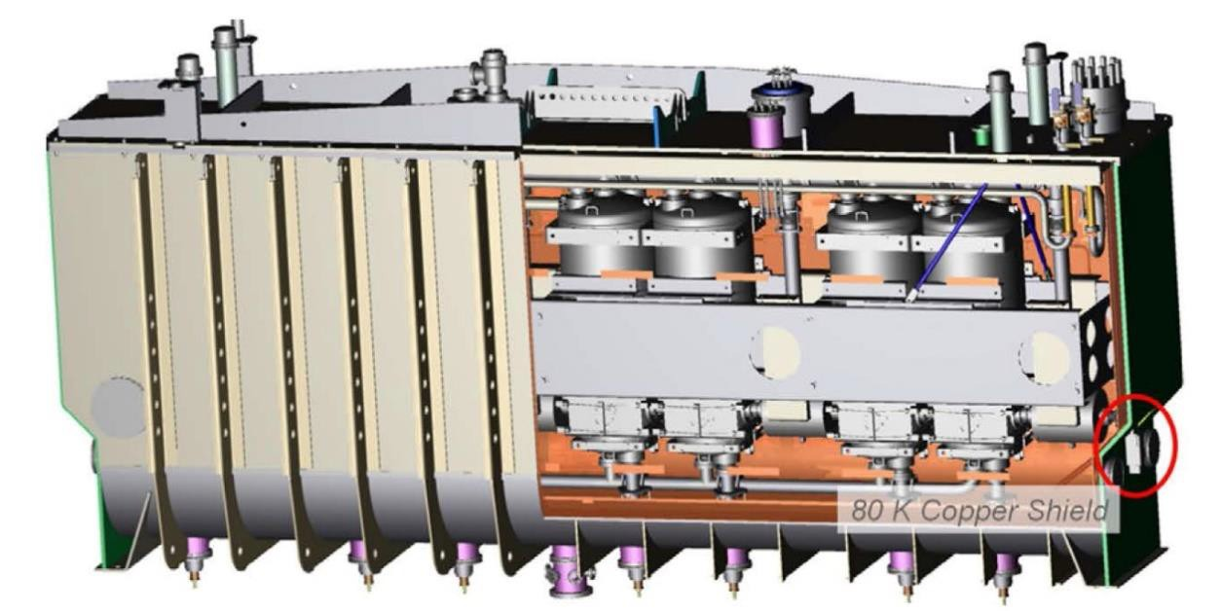
6-9 years and beyond
Accelerator development aspirations
Cost
Staged as funding available
New beam lines
New Linac 4× higher field gradient
New Linac injector
  Parallel operation of 14UD and Linac
Time
Prepared for new NCRIS infrastructure program
State of the art cryomodules
2 fit present Linac footprint
  Two give 35 MV boost
  5 times present Linac
  USD $4M each

Slide 17
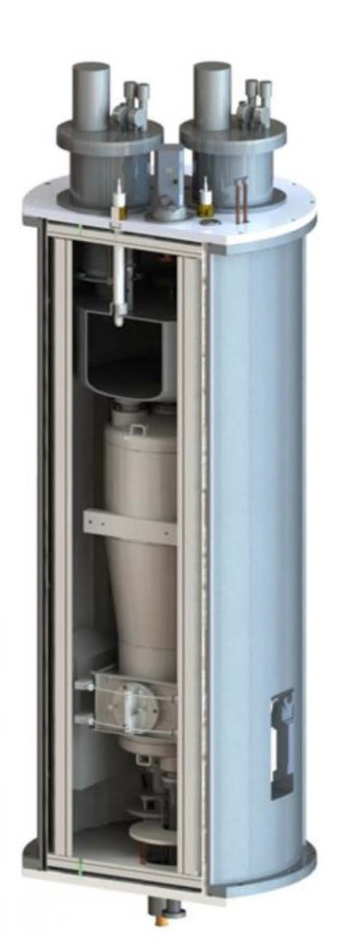
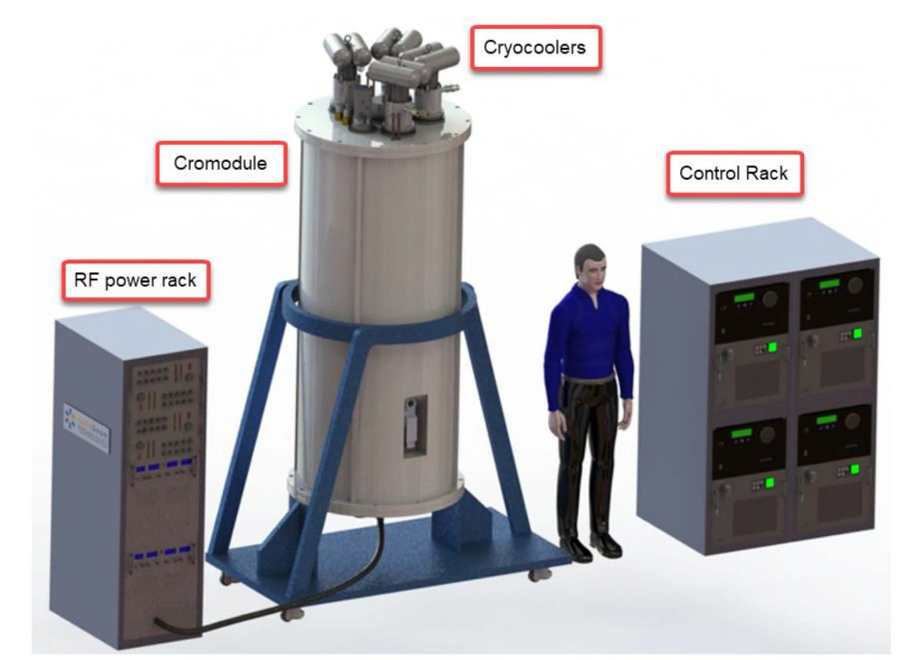
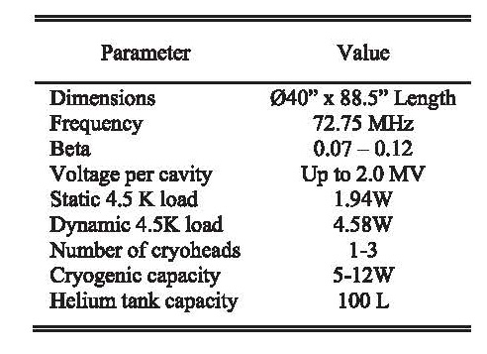
Alternatively
State of the art stand-alone cryomodule based on
Nb QWR (RadiaBeam Systems and ANL)
2 fit present Linac footprint
  One gives 2 MV boost
  3 replace present Linac
  USD $1M each
  Cryoplant and cryo crew are not required

Slide 18
Acknowledgement
NP Technical Staff:
A.Cooper (part time), S. Battison, J. Heighway,
T. Kitchen (50%) A.Pynt (secondment), B.Tranter, D. Tempra, T.Tunningley, P. Linardakis
B Graham- joining AS ANSTO soon

Slide 19
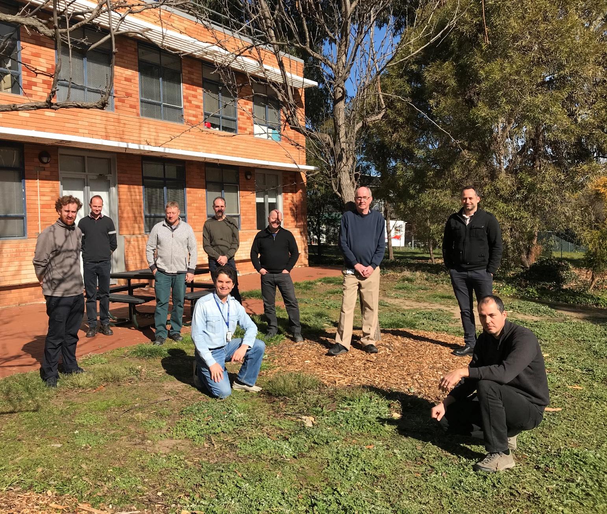
Q

