Slide 1







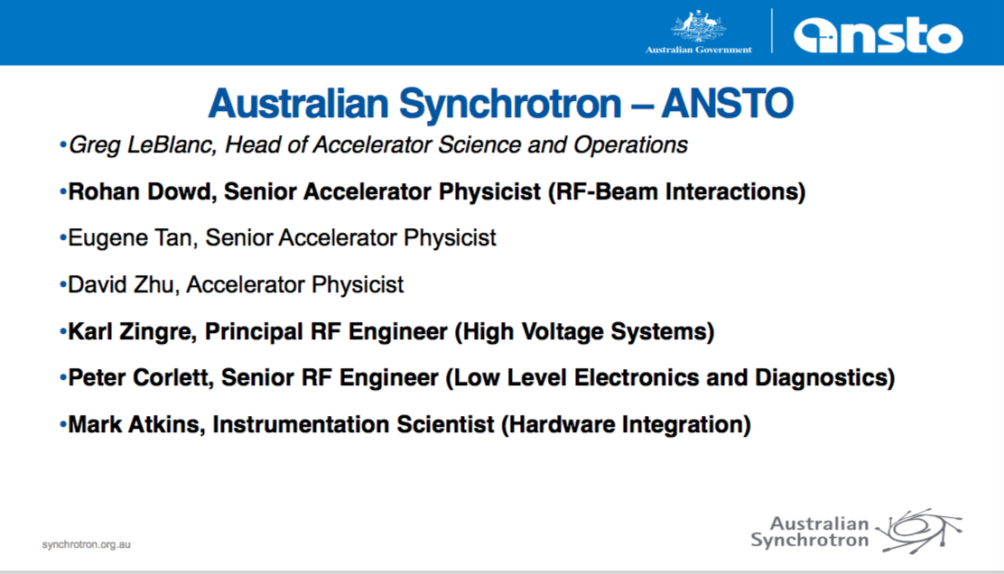


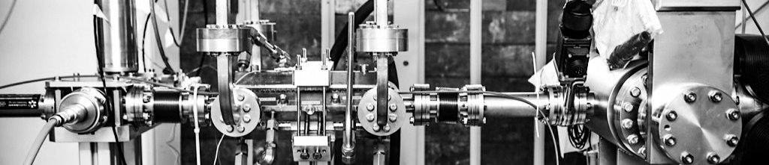
High-gradient accelerator technology transfer to Australia medicine and industry
Matteo Volpi
on behalf of Melbourne team Accelerator Technology Forum 2020

Slide 2
X-band Laboratory for Accelerators and Beams (X-LAB)
  A new laboratory will be created at the University of Melbourne to build a next generation compact light source.
    First high-power, high-frequency accelerator laboratory in the South Hemisphere.
    Testing high gradient structure prototype and RF components for CLIC
    Ultra-precision manufacturing
    Design and develop more widely available high quality x-ray sources.
  This project will provide local researchers and students with an opportunity to make significant advances in accelerator design
  Excellent potential for applications in medical radiation therapy and beyond

Slide 3

Organizations Participant
Collaboration with staff from CERN, Canadian Light Source (CLS), Eindhoven University of Technology (TU/e), The University of Oxford and the Australian Synchrotron (ANSTO) accelerator teams
CERN and CLIC collaborators => compact X-band accelerator radio frequency (RF) system known as XBOX3 become MeL-BOX.
CLS => kindly provide an S-Band electron gun.
TU/e=> Is building a LINAC-based ICS source
VHEE machine => simulation/design
RAPISCAN => Worlds largest supplier of airport and security X-ray scanners.
ANFF-SA is a world-class micro & nanofabrication facility
Marand => Australian leading global supplier of precision engineered solutions
Australian Synchrotron and University of Melbourne => testing and operating the integrated system.

Slide 4
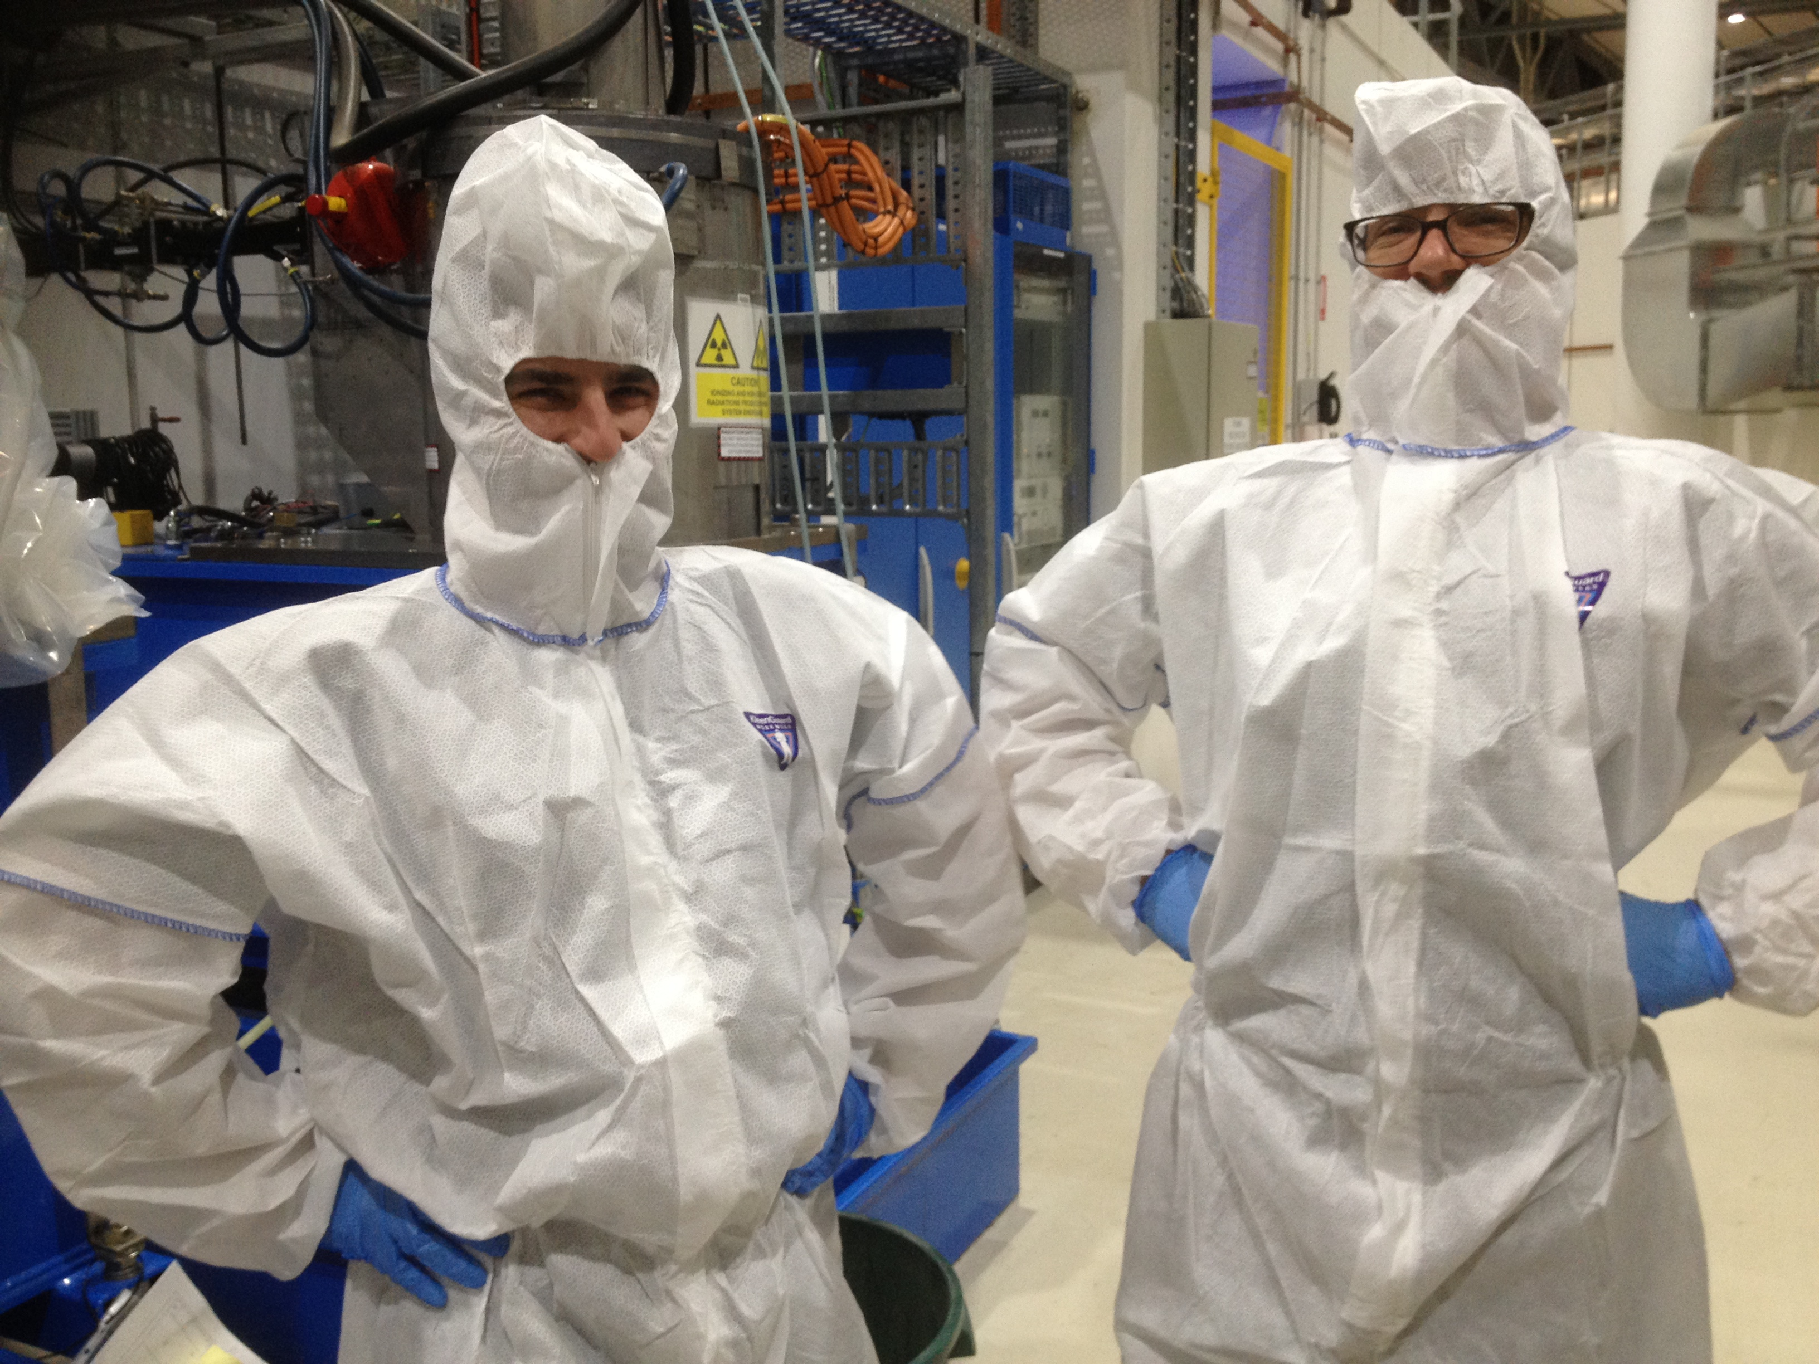
University Melbourne
Melbourne University Team
  Suzie Sheehy (Accelerator Physics)
  Geoff Taylor (Australian Collaboration for Accelerator Science)
  Roger Rassool (Particle and X-ray Detectors)
  Matteo Volpi, XBOX commissioning and operations
  Scott Williams and Paul Giansiracusa PhD students
Preliminary G4 simulation
  Rohan Dowd, Senior Accelerator Physicist (RF beam interactions)
  Eugene Tan, Senior Accelerator Physicist
  Karl Zingre, Principal RF Engineer
  Rebecca Auchettl, Accelerator Physicist
  Jonathan Chi, Accelerator Physicist

Slide 5
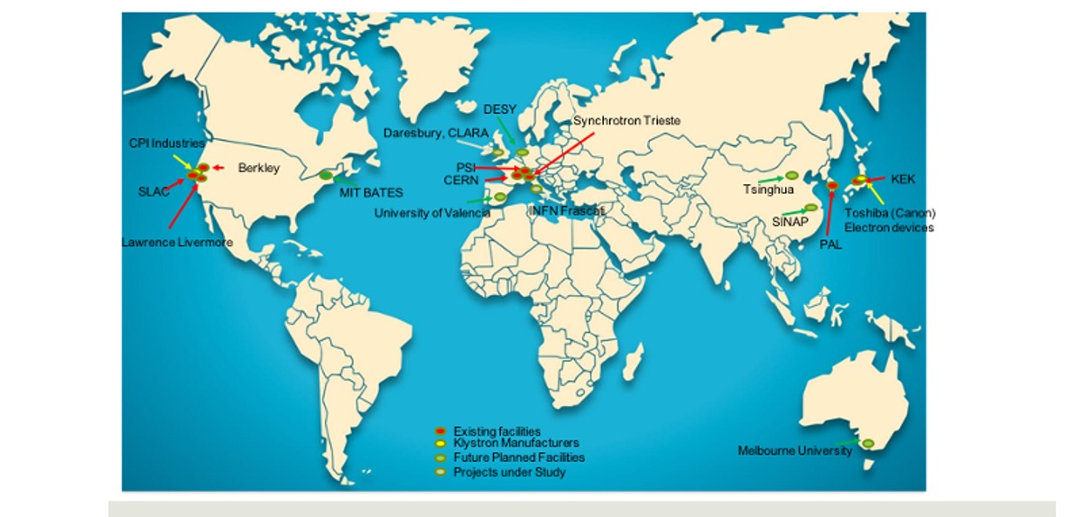
Location of Xband Facilities and High Gradient Tests Stands

Slide 6
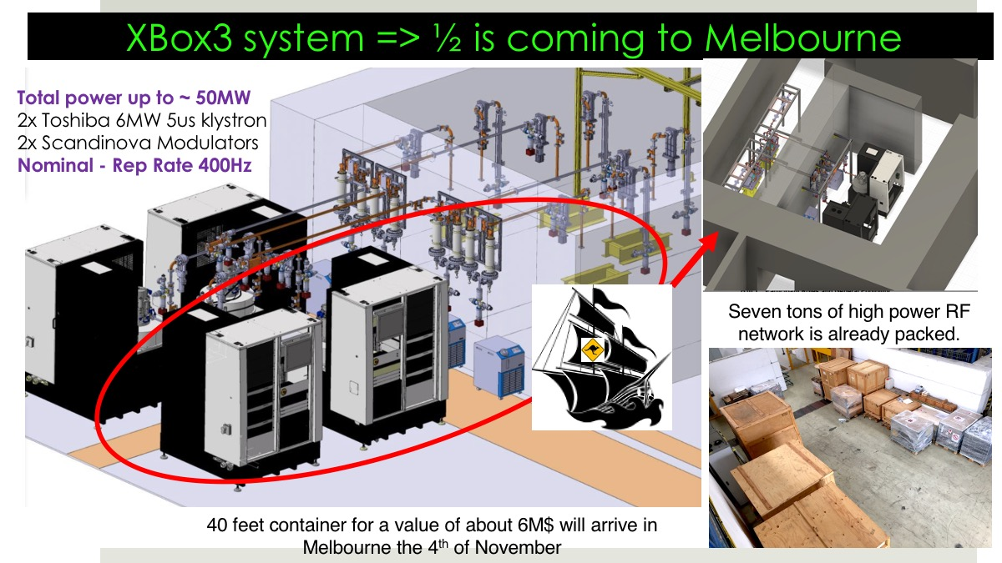
18th

Slide 7
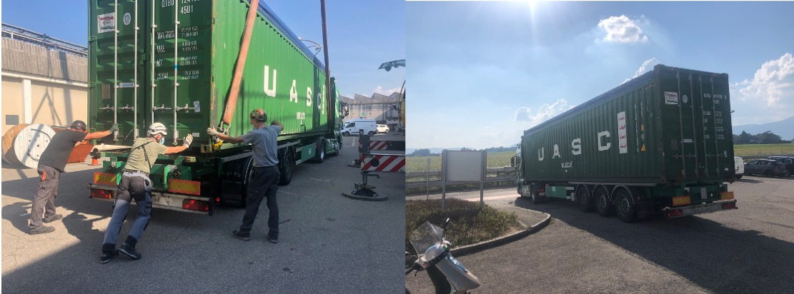
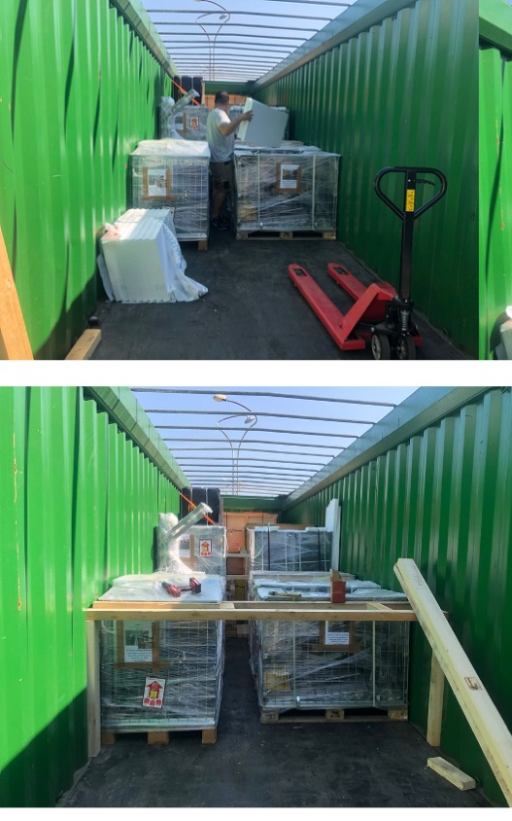
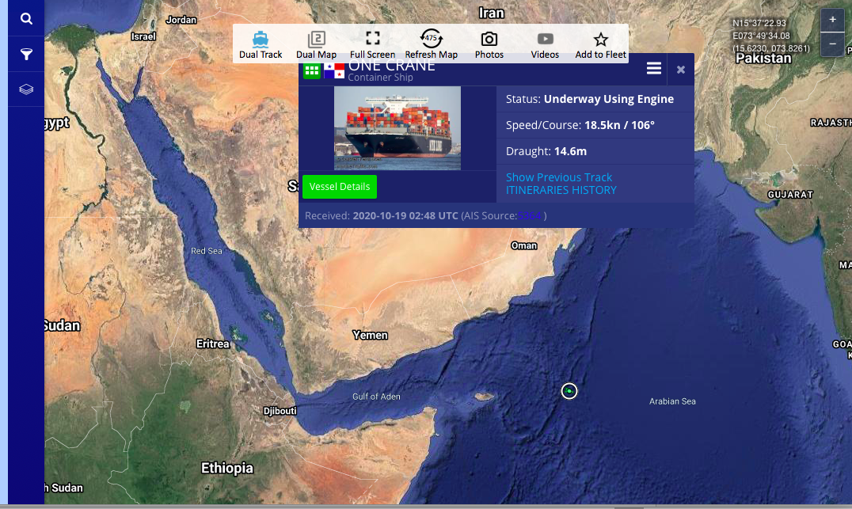
Vessel on the way

Slide 8
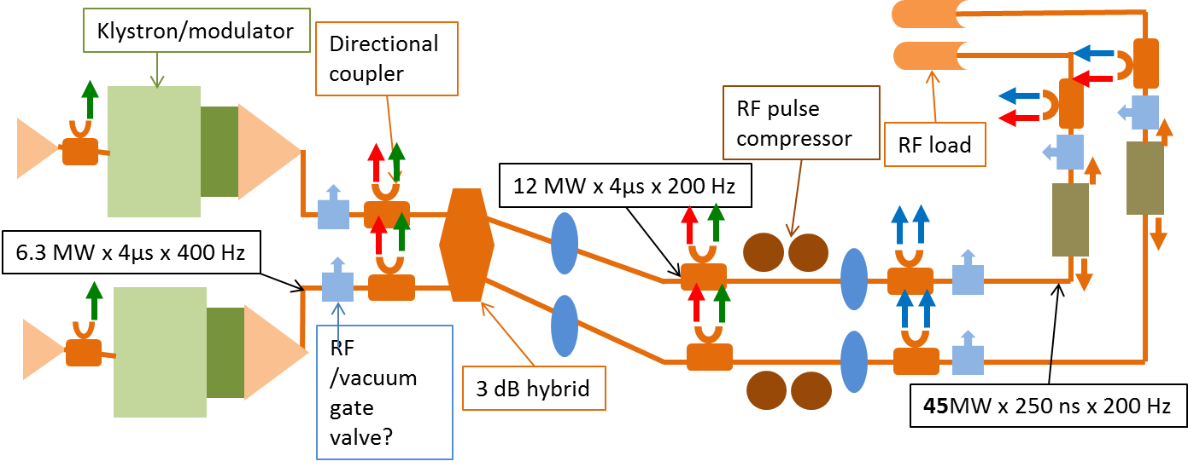
MeL-BOX Layout
x4:2 Faraday Cups (250MSPS ADCs) → Used to interlock the system and are interesting for high gradient physics.
x6 Log detectors ~50MHz Bandwidth, 45dB dynamic range (250MSPS ADCs) → Used for interlocking the system.
x6 FPGA IQ demodulation 400-MHz AC (228MSPS ADCs)→Phase and amplitude needed for reliable line/phase switching.
x6:3 FPGA IQ demodulation 400-MHz AC (1600MSPS ADCs) → Most interesting signals for BD physics.

Slide 9
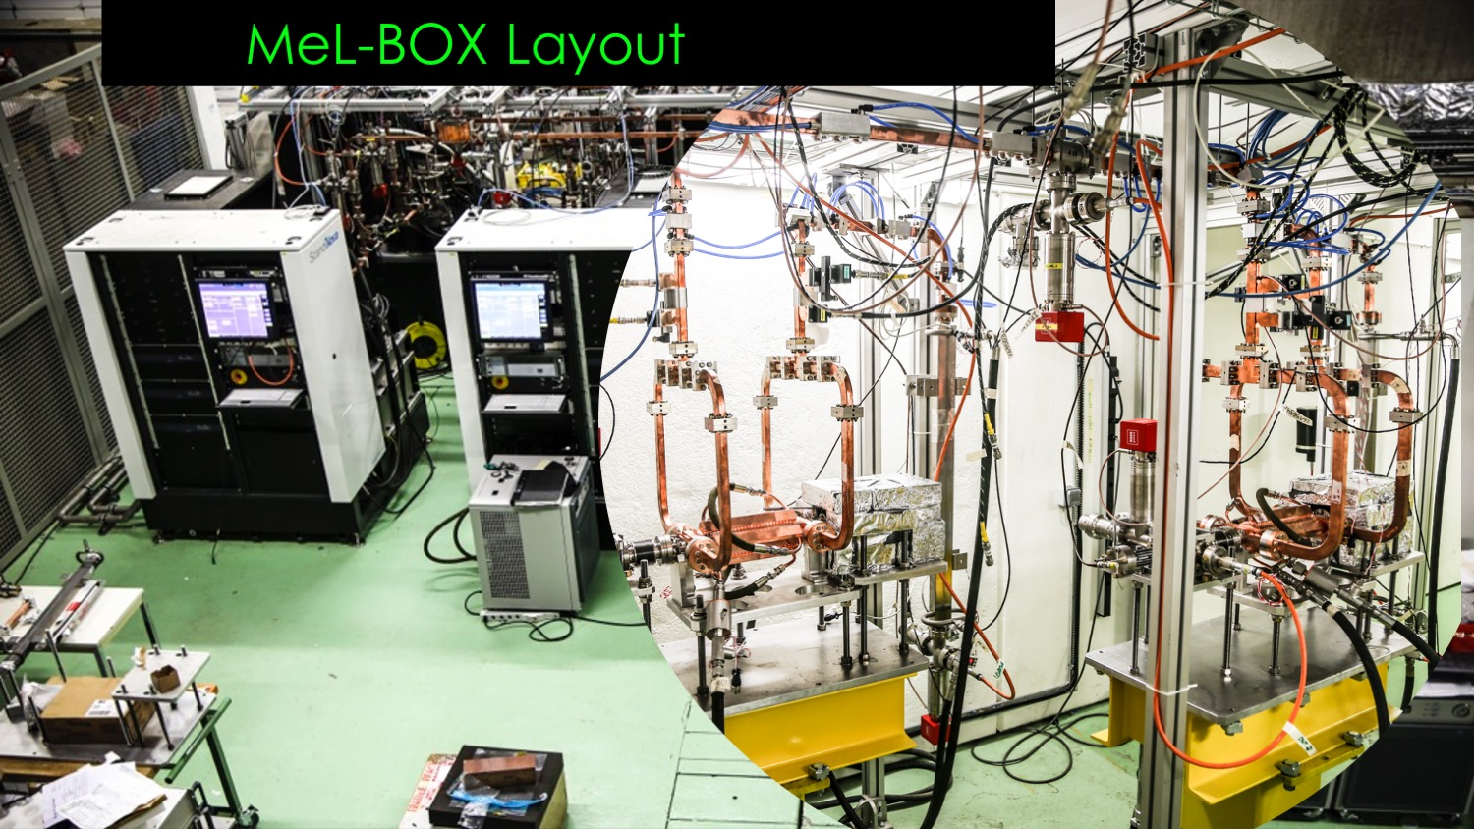

Slide 10
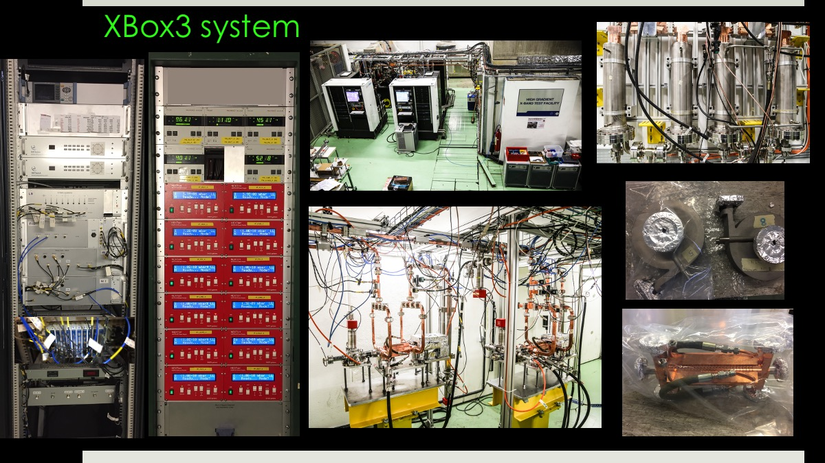
Pulse Compressors
Vacuum Rack
TD 24 Structure
3D titanium load prints
NI-PXI Crate

Slide 11
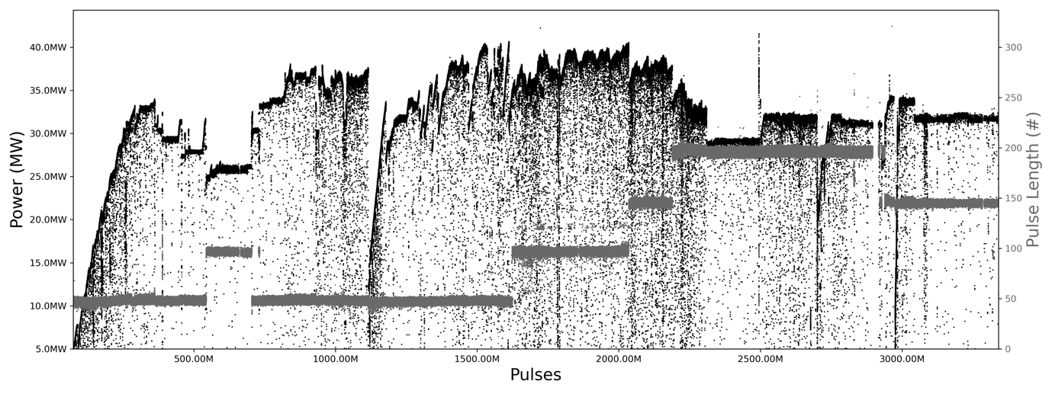
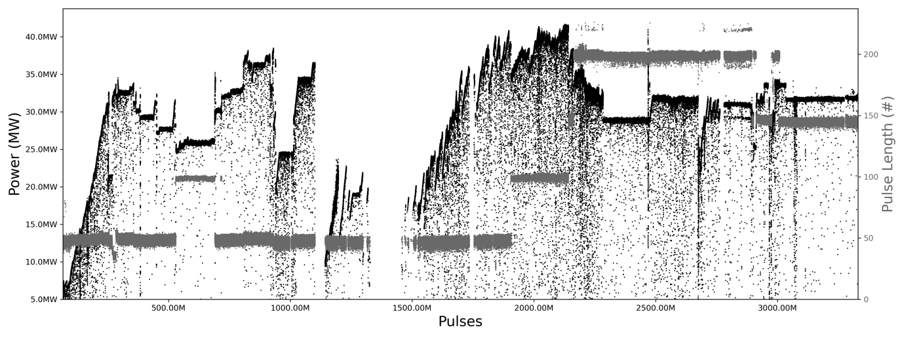
2xTD24 structures on the way to Melbourne
TD24_BO@Line3 so far reached 40.45 MW which is 97.9 MV/m.
TD24_UBO@Line4 so far reached 41.5 MW which is 99.2 MV/m.

Slide 12
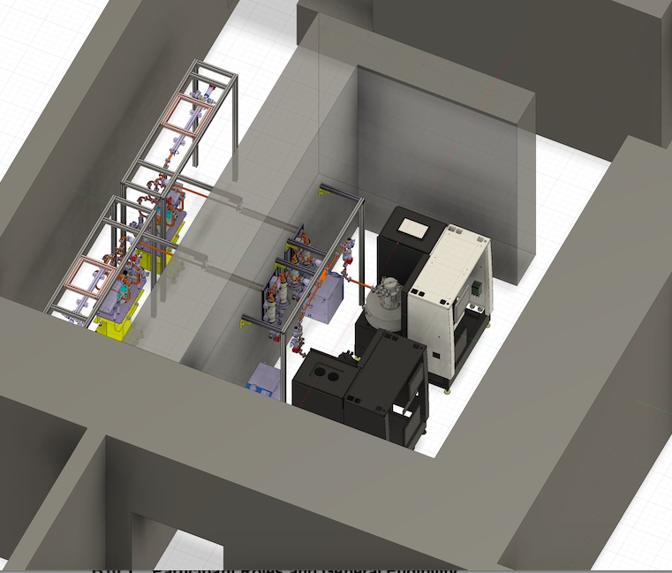
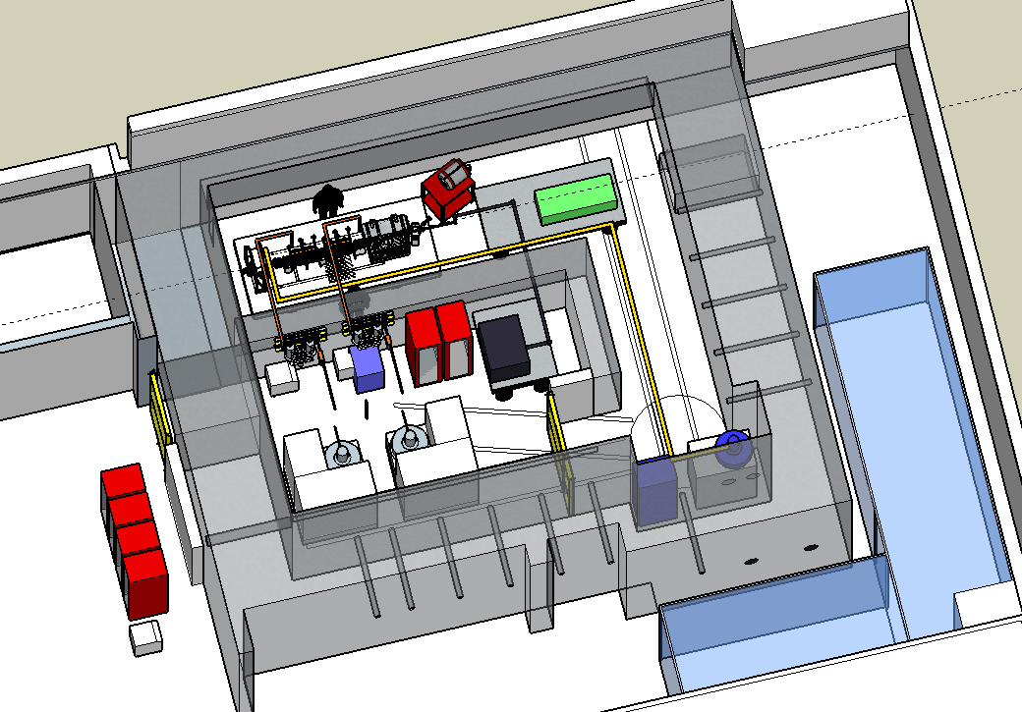
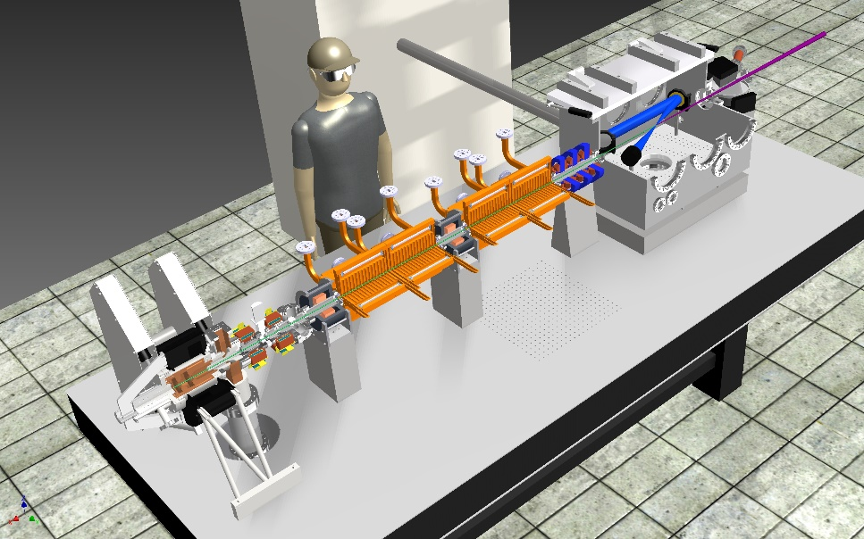
Melbourne plans
Phase 1 : Structure conditioning
8m
Courtesy of TU Eindhoven
6m
Previously used for 35 MeV betatron
Space for x-band linac and laser for Compton source
  Bunker layout (done) + mechanical drawing (on going)
Phase 2 : Smart*Light setup in bunker

Slide 13
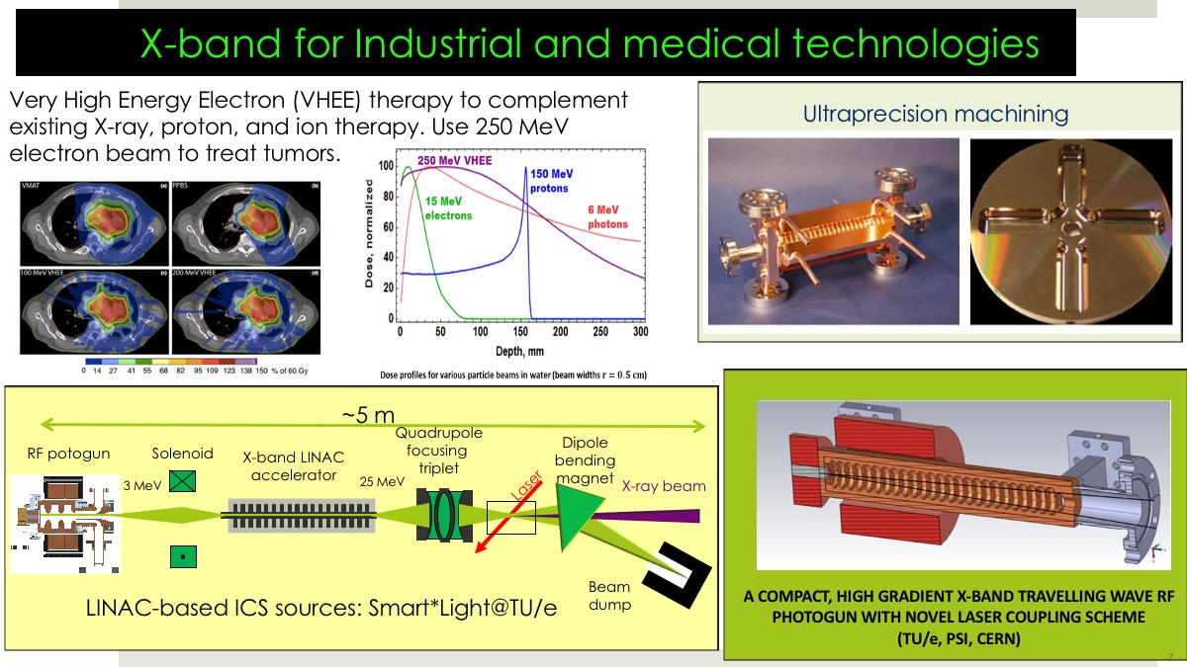
X-band for Industrial and medical technologies
Courtesy of TU/e Eindhoven
Courtesy of TU Eindhoven

Slide 14
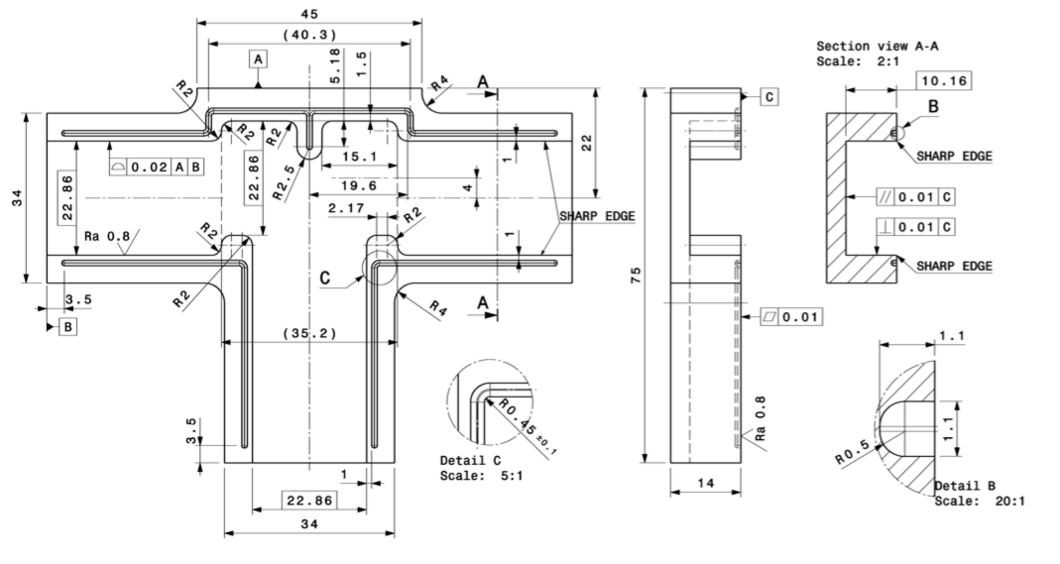
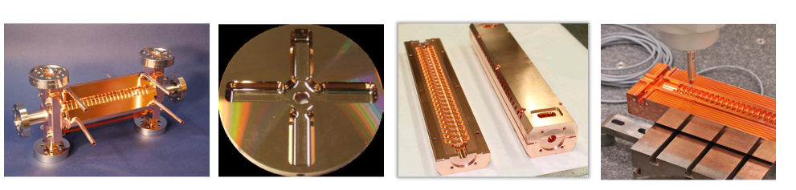
X-band Copper Structures
In the spirit of knowledge sharing and dissemination
Diamond-tool ultraprecision machining
Turning and milling
Very strict qualification based on visual inspection and CMM metrology
VDL (NL), LT-Ultra (DE), Yvon Boyer (FR), DMP (ES), Morikawa (JP), KERN (DE)

Slide 15
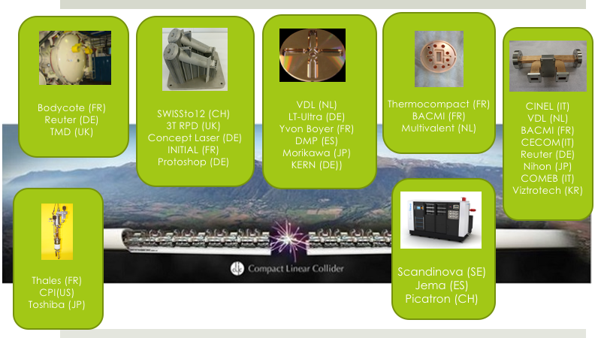
The annual market for all medical and industrial accelerators is estimated to now be
US$5.0 Billion/year and growing at 4% per year over the past decade, even during the recession.

Slide 16
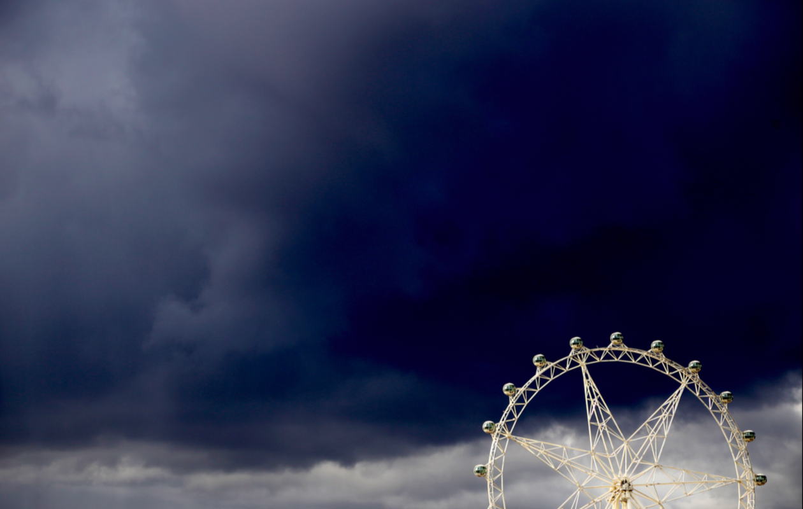
Conclusion and future plan
Project is going on !!
  Australian Research Council Funding
Nov/Dec 2020 => Mel-BOX will dock at Port Melbourne
Refurbishing of the Uni basement delayed due COVID
  First high power Xband pulses, middle 2021
  Welcome to visit the facility !

