Slide 1
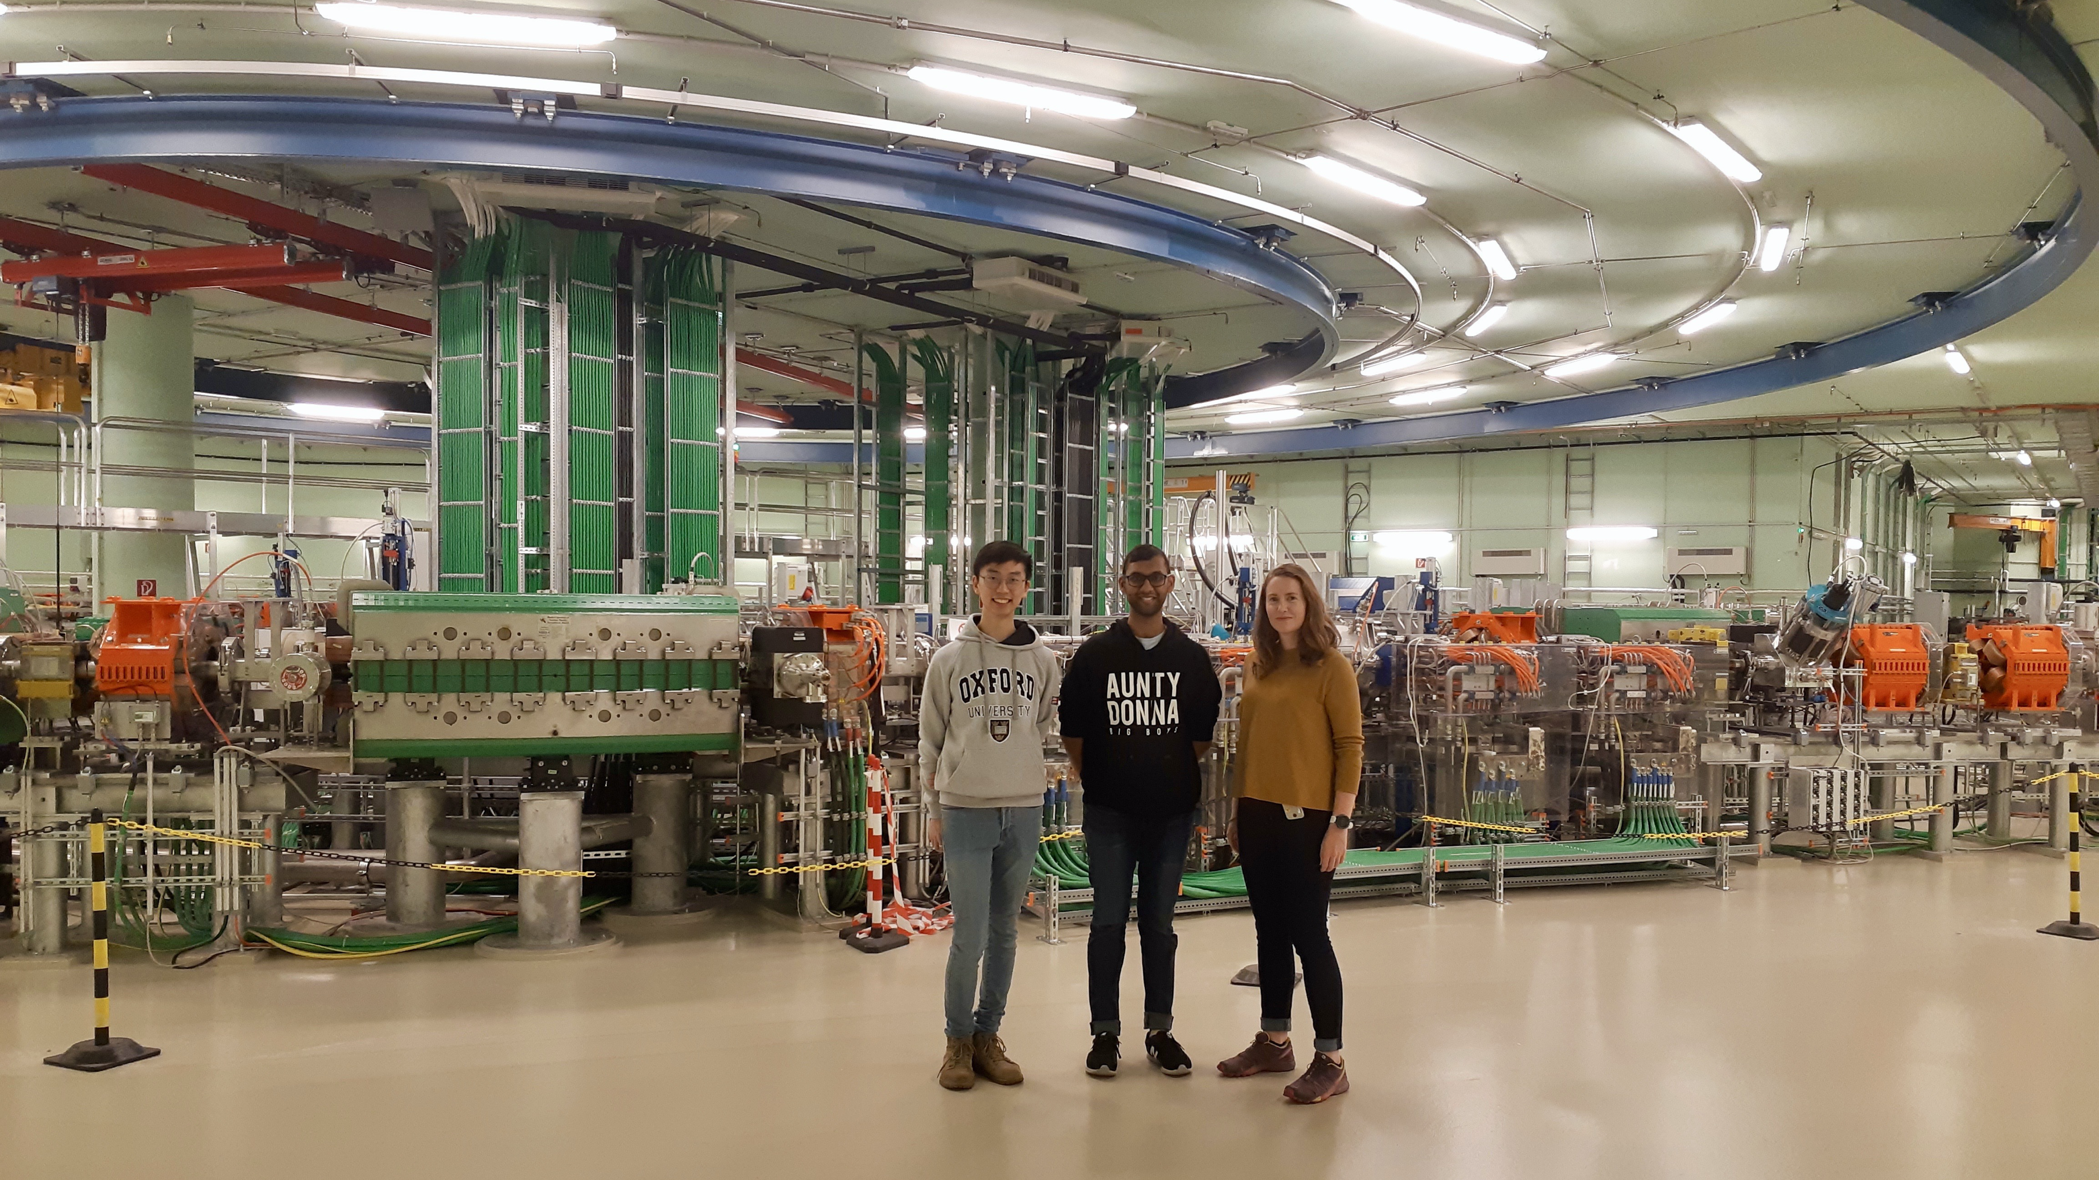
Technology options and challenges in the design of future ion therapy facilities
Dr. Suzie Sheehy
Senior Lecturer, University of Melbourne
Baker/ANSTO Fellow in Medical Accelerator Physics
@suziesheehy

Slide 2
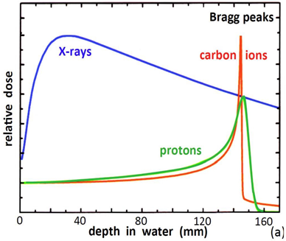
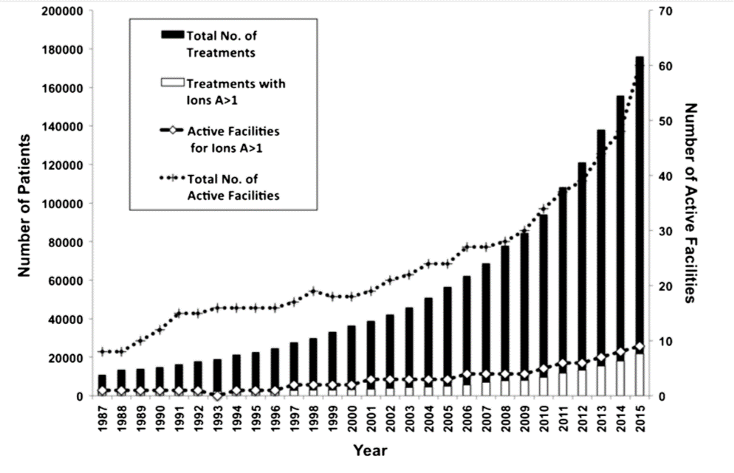
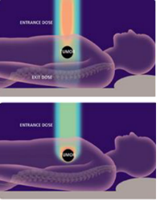
Hadron therapy (protons or ions)
Slide adapted from M. Vretenar, 10/22/20
Protons (and ions) deposit their energy at a given depth inside the tissues, minimising dose to the organs close to the tumour, sparing nearby organs.
Required energy for full-body penetration: 230 MeV protons, 450 MeV/u C-ions.
First experimental treatment: 1954, Berkeley.
First hospital-based proton treatment facility: 1993, Loma Linda, US.
First treatment facility with carbon ions: 1994, HIMAC, Japan.
Hadron therapy remains a niche in cancer therapy:
22,000 patients/year (2018) treated with particle beams against 25,000,000 patients/year with conventional RT
Notes:
Why?

Slide 3
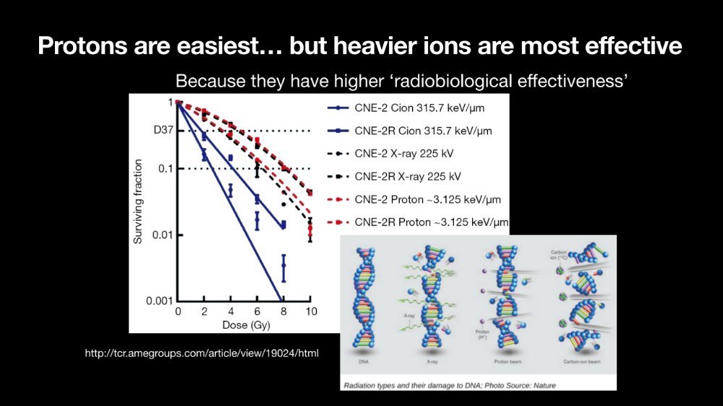

Slide 4
Therapy with heavier ions (Carbon and others)
Slide adapted from M. Vretenar, 10/22/20
Heavy ions are more effective than protons or X-rays in attacking cancer:
The higher energy deposition (and ionisation) per length generates a large number of double-strand DNA breaks that are not reparable by the cell itself.
The different damage mechanism makes them effective on hypoxic radioresistant tumours
Are more precise, with lower straggling and scattering.
Recent studies show that ion therapy combined with immunotherapy may be successful in treating diffused cancers and metastasis.
So far, 2/3 of cases at the mixed facilities like CNAO are treated with carbon.
(M. Vretenar)
The development of ion therapy needs to be supported by tests with other ions (He, O, etc.) and by a strong experimental effort covering: Pre-clinical radiobiology; Medical physics; Animal studies; Clinical trials on patients.

Slide 5
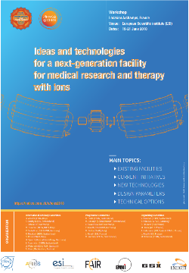
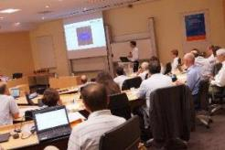
CERN Strategy
Slide adapted from M. Vretenar, 10/22/20
Proton therapy is now commercial, 4 companies offer turnkey treatment facilities (3 SC cyclotrons, one conventional synchrotron), and in competition with conventional radiation therapy (X-rays).
Heavy ion therapy (mainly carbon) is still in an early phase (13 facilities worldwide, 4 in Europe) in spite of its several advantages but its diffusion is limited mainly by:
  Size and cost of the accelerator;
  Lack of experimental data.
Specifications from the scientific community
(Archamps Workshop, June 2018)
Accelerator
Lower cost, compared to present (~120 M€);
Higher beam intensities than present (10¹⁰ ppp);
Reduced footprint, to about 1’000 m²;
Lower running costs.
Delivery
Fast dose delivery (possibly with 3D feedback);
Equipped with a rotating gantry;
Using multiple ions;
With range calibration and diagnostics online.
Opportunity for a strong impact on the medical field with an R&D programme based on critical accelerator technologies for a next generation ion therapy and research facility, smaller, possibly less expensive and more performant than the present reference design.

Slide 6

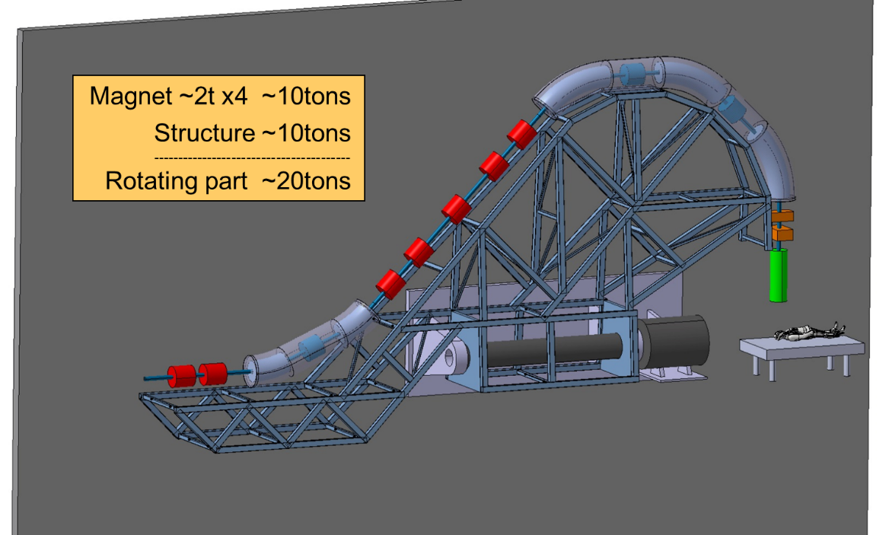
Future needs/concepts:
Smaller/cheaper/higher throughput accelerators & gantries
Accelerator challenges:
Superconducting magnets (novel CCT/helical coil)
Beamline and beam delivery challenges
Fast extraction and control
High current operation accelerator (synchrotron or FFA?)
Fast switching ion species
Magnetic field interactions
‘FLASH’ proton/ion therapy
  (Higher dose rate/beam current)
Multi-ion therapy:
Dose optimization and conformality using multiple ion species within treatment planning (see M. Safavi-Naeini)
MRI-guided proton/ion therapy
  See P. Keall, B. Oborn et al

Slide 7
PIMMS was in 2000, new study “NIMMS”
PIMMS study
MedAustron, Austria

Slide 8
The NIMMS Collaboration
Slide adapted from M. Vretenar, 10/22/20
Large number of international partners collaborating with NIMMS (a collaboration MoU is planned):
SEEIIST E. Benedetto, M. Sapinski, S. Damjanovic, P. Grübling
TERA Foundation U. Amaldi, P. Riboni, N. Alharbi
GSI P. Foka
INFN G. Bisoffi, L. Rossi
CIEMAT J. Navarro, C. Oliver, D. Perez
Cockcroft Institute H. Owen
CNAO S. Rossi, M. Pullia
Imperial College K. Long, R. Taylor
MedAustron P. Urschütz
U. Melbourne S. Sheehy, X. Zhang
Interest in joining the collaboration expressed by other partners:
Indian Institutions
Baltic Institutions
Input from medical community via the ENLIGHT Network (managed by M. Dosanjh with M. Ristova and P. Georgieva)
Input from ion therapy scientific community via M. Durante (GSI) and his International Biophysics Collaboration.
CERN contributors, who have in different ways contributed to the study:
M. Vretenar, A. Lombardi, V. Bencini, D. Gibellieri, A. Grudiev, H. Pommerenke, S. Ramberger, M. Khalvati, E. Oponowicz, D. Tommasini, D. Perini, M. Karpinen, etc.

Slide 9
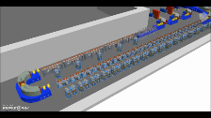
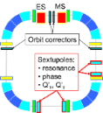
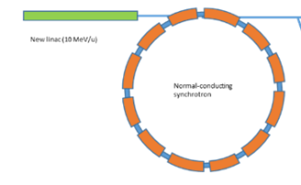
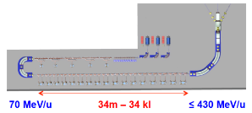
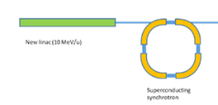
NIMMS: three alternative accelerator designs
Slide adapted from M. Vretenar, 10/22/20
Improved synchrotron (warm)
Equipped with several innovative features: multi-turn injection for higher beam intensity, new injector at higher gradient and energy, multiple extraction schemes, multi-ion.
Circumference ~ 75 m
Improved synchrotron (superconducting)
Equipped with the same innovative features as warm, but additionally 90⁰ superconducting magnets.
Circumference ~ 27 m
Linear accelerator
Linear sequence of accelerating cells, high pulse frequency.
Length ~ 53 m
Other options considered as less interesting because of cost and/or required R&D: RC synchrotron, FFA, SC cyclotron, PWFA

Slide 10
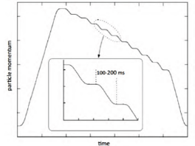
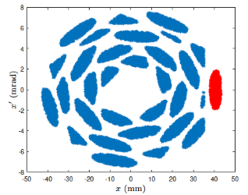
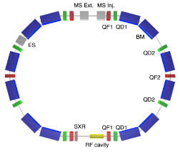
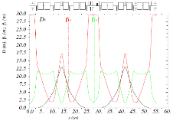
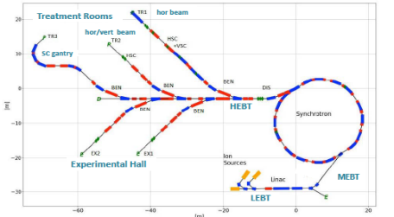
Advanced synchrotron design, key elements
Slide adapted from M. Vretenar, 10/22/20
Multiple flat-top operation (from HIMAC, Japan)
Optimisation of multi-turn injection: phase space after 30 turns
(A. Avdic, U. Sarajevo)
Alternative lattice based on Double Bend Achromat cells, with dispersion-free drift sections and only 12 dipoles and 14 quadrupoles (16 dipoles and 24 quadrupoles in PIMMS)
(X. Zhang, U. Melbourne)
Higher beam intensity for faster treatment (2x10¹⁰, 20 times higher)
Multiple energy extraction (multiple flat-tops)
Additional fast extraction for FLASH operation
Redesigned linac at higher frequency, for lower cost and parallel isotope production
Multiple particles: p, He, C, O
Optimised layout of beam transport, for both research and therapy
Design study together with SEEIST project

Slide 11
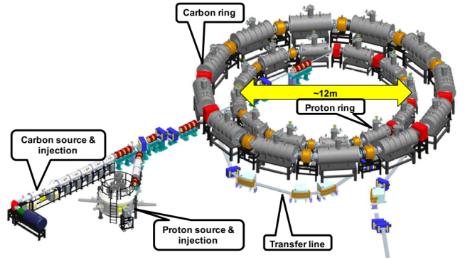
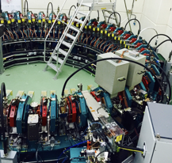
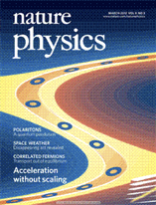
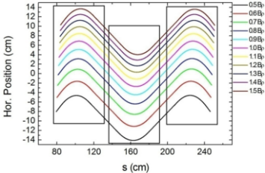
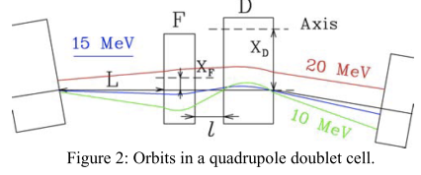
The FFA: Fixed Field alternating gradient Accelerator
Advantages:
Rapid variable energy <1kHz
Pencil beam scan quickly in 3D
Protons & carbon for therapy and imaging
Sufficient dose rate, rescanning capability
Design driven by demanding future clinical requirements
Disadvantages:
Similar size to synchrotron
Many novel parts (magnets)

Slide 12
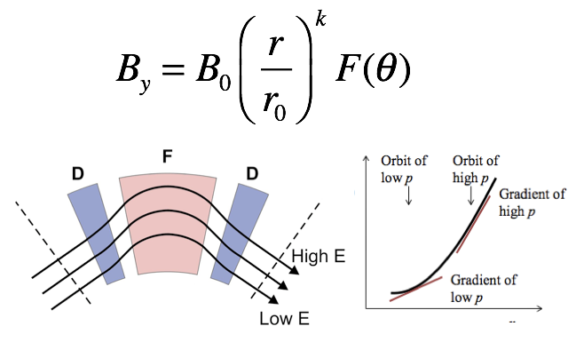
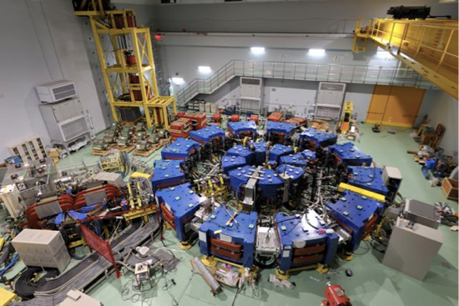
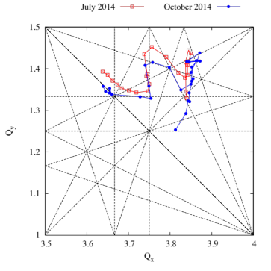
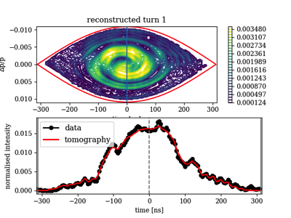
Alternative tech: Fixed Field Accelerators
This type of accelerator has been built and now studied in detail.
More de-risking needed: scaled down beamline test at UniMelb
S. L. Sheehy et al., Prog. Theor. Exp. Phys. 7, 073G01, July 2016

Slide 13
Future needs/concepts: work in Melbourne
Jacinta Yap (PDRA): scaled beamline design and future ion therapy design for Australia
Smaller/cheaper/higher throughput accelerators & gantries
Accelerator tech/concepts:
Superconducting magnets (novel CCT/helical coil)
Beamline and beam delivery challenges
Fast extraction and control
New synchrotron designs
High current operation accelerator (synchrotron or FFA?)
Fast switching ion species
Magnetic field interactions in beam delivery systems
Hannah Norman (joint PhD Manchester): beam dynamics studies with superconducting magnets using pyZGOUBI
‘FLASH’ proton/ion therapy
  (Higher dose rate/beam current)
Australia should be at the forefront of developing the next generation of ion therapy accelerator, not just becoming a user. We are well underway….
Elodie Higgins (Masters): design of a scaled FFA gantry at UniMelb
Multi-ion therapy:
Dose optimization and conformality using multiple ion species within treatment planning (see M. Safavi-Naeini)
Frank Zhang (PhD): novel synchrotron lattice designs for ion therapy and injection/extraction optimisation
MRI-guided proton/ion therapy
  See P. Keall, B. Oborn et al
Adam Steinberg (joint PhD Manchester): design of an FFA accelerator for ion therapy

Slide 14
Future needs/concepts: work in Melbourne
Jacinta Yap (PDRA): scaled beamline design and future ion therapy design for Australia
Smaller/cheaper/higher throughput accelerators & gantries
Accelerator tech/concepts:
Superconducting magnets (novel CCT/helical coil)
Beamline and beam delivery challenges
Fast extraction and control
New synchrotron designs
High current operation accelerator (synchrotron or FFA?)
Fast switching ion species
Magnetic field interactions in beam delivery systems
Hannah Norman (joint PhD Manchester): beam dynamics studies with superconducting magnets using pyZGOUBI
‘FLASH’ proton/ion therapy
  (Higher dose rate/beam current)
Elodie Higgins (Masters): design of a scaled FFA gantry at UniMelb
Multi-ion therapy:
Dose optimization and conformality using multiple ion species within treatment planning (see M. Safavi-Naeini)
Frank Zhang (PhD): novel synchrotron lattice designs for ion therapy and injection/extraction optimisation
MRI-guided proton/ion therapy
  See P. Keall, B. Oborn et al
Adam Steinberg (joint PhD Manchester): design of an FFA accelerator for ion therapy

Slide 15
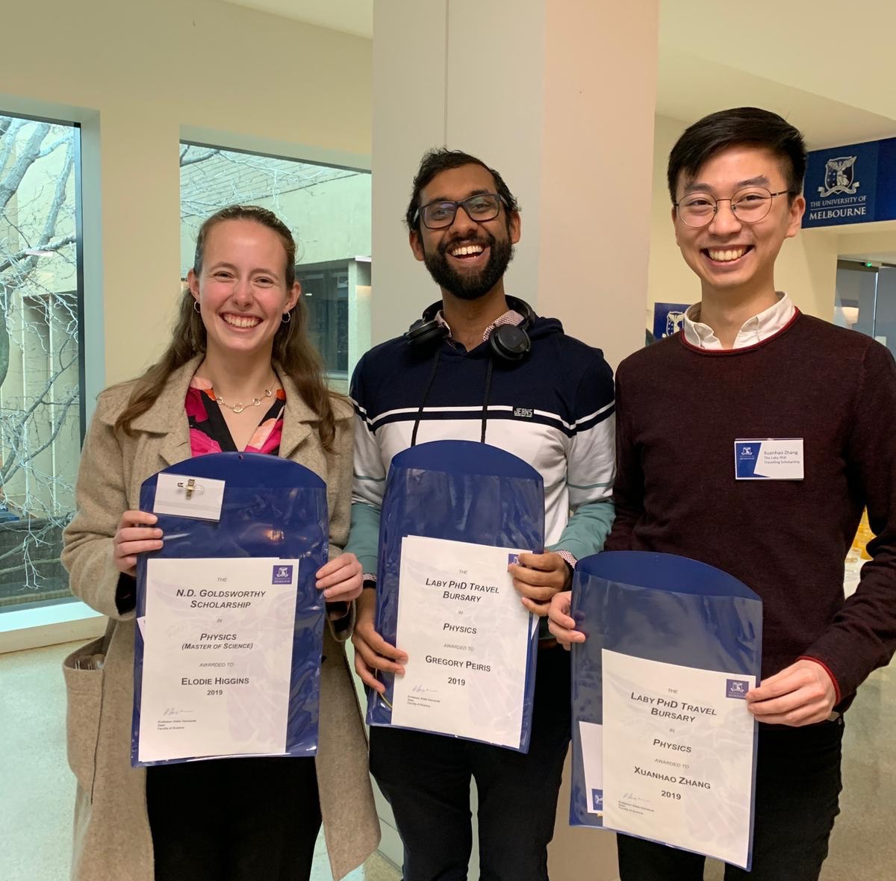
Dr. Suzie Sheehy
@suziesheehy
Thankyou
suzie.sheehy@unimelb.edu.au
Please talk to members of my group, many of whom are attending this meeting!

