Slide 1
Beam Profile Monitor at the 1MW Spallation Neutron Source
Shin-ichiro Meigo¹⁾, Motoki Ooi¹⁾, Kiyomi Ikezaki¹⁾, Tomoyuki Kawasaki¹⁾, Hidetaka Kinoshita¹⁾,
Atsushi Akutsu¹⁾, Masaaki Nisikawa¹⁾,
Shinpei Fukuta¹⁾ and Hiroshi Fujimori²⁾
1) JAEA/J-PARC, 2) KEK/J-PARC

Slide 2
Outline
Introduction of JSNS
Beam monitor system at JSNS
  Multi Wire Profile Monitor (MWPM)
  Beam Halo Monitor
Beam flattening system
Development infrared and near-infrared camera system

Slide 3
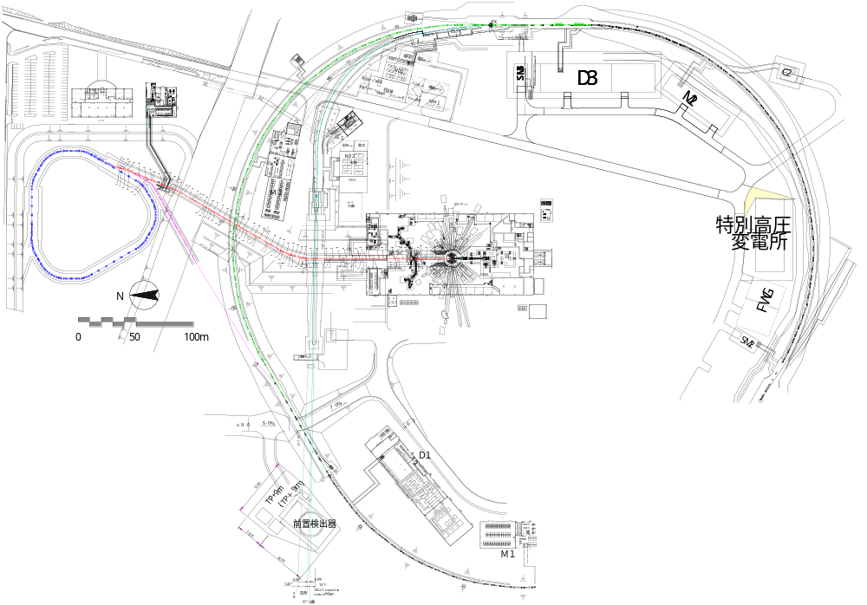
Beam transport to MLF
600ns
Ep: 3GeV
Power: 1MW
Rep.: 25Hz
600ns
Length of BT: 314m
50-GeV MR
FWHM ~150ns
road to
coast
Material and Life Science Experimental Hall (MLF)
3NBT
Neutrino line
MUSE
JSNS
3-GeV
RCS
3-50BT
Muon target
Neutron target

Slide 4
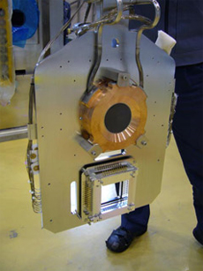
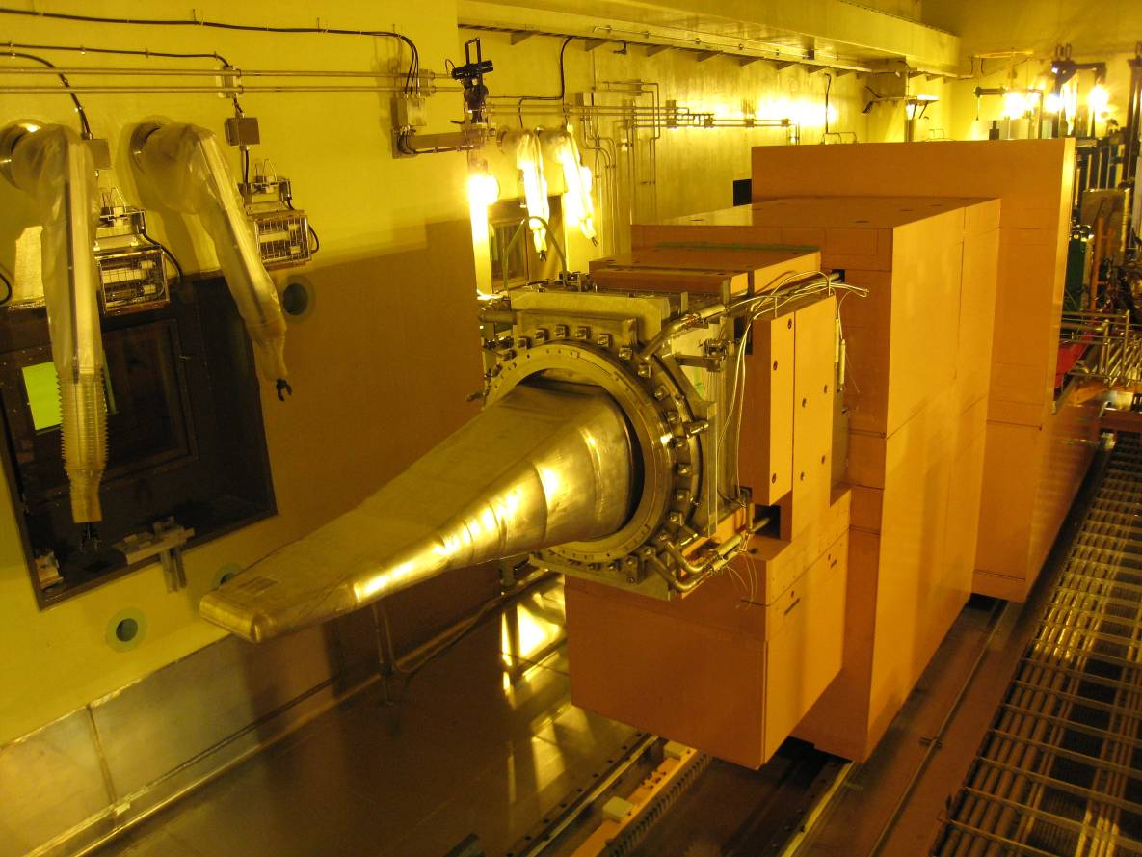
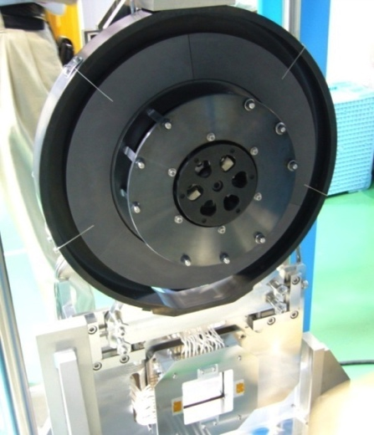
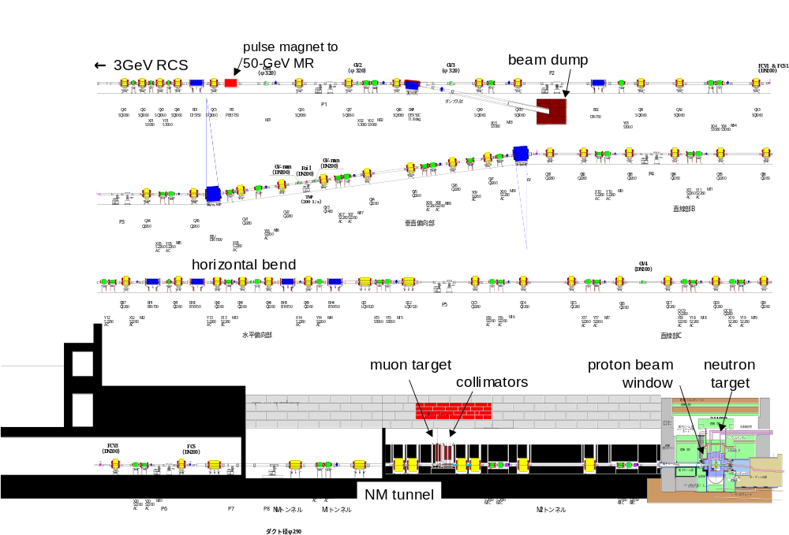
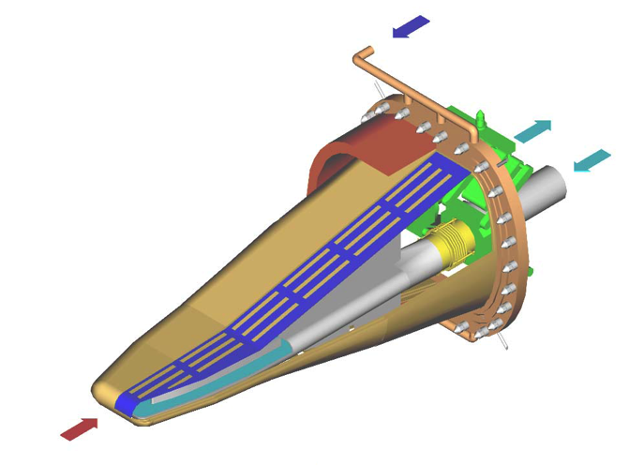
Targets located at MLF
Muon target
  Carbon graphite (IG430)
  Highest intensity in the world
Neutron target
  Mercury
  Highest pulse intensity in the world
Rotating target
(6rpm)
Mercury target trolley
Fixed target
Thick. 2cm
Diam. 7cm
Width 34cm
Length 2m
Light Water
Safety shroud
Double wall structure
Hg
Proton

Slide 5
Introduction of JSNS
Beam monitor system at JSNS
  Multi Wire Profile Monitor (MWPM)
  Beam Halo Monitor
Beam flattening system
Development infrared and near infrared camera system

Slide 6
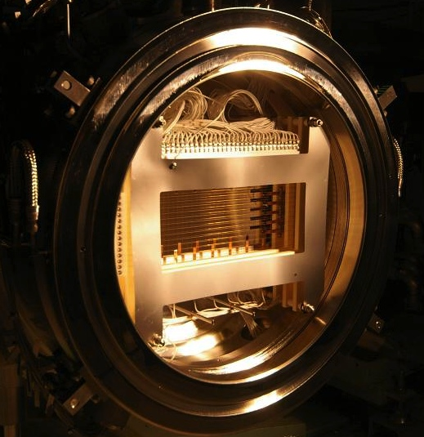
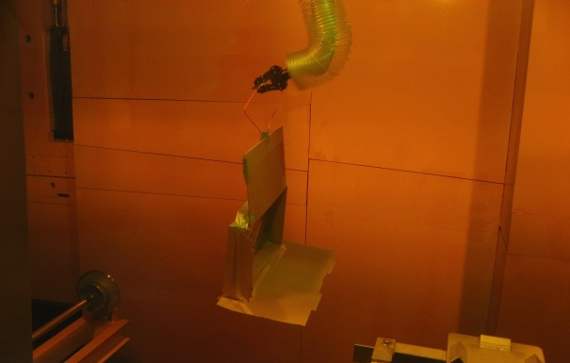
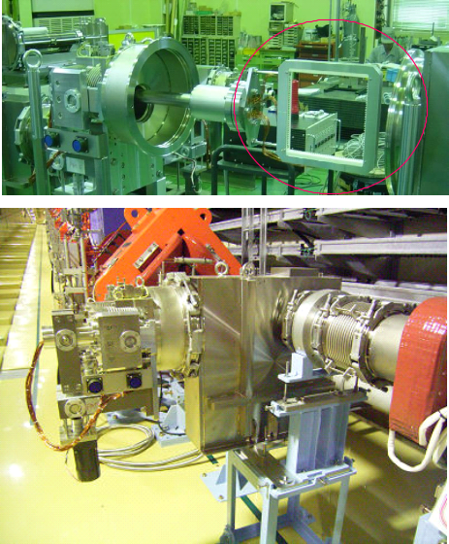
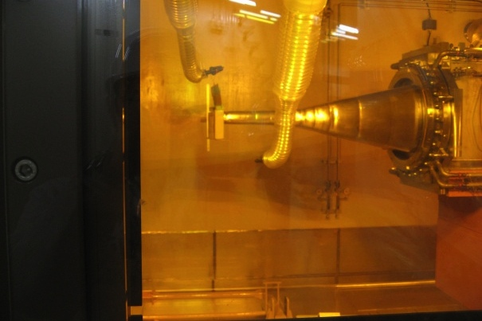
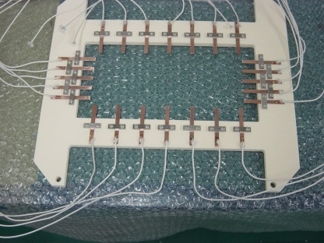
Beam diagnostics for profile and halo
Profile monitor and halo monitor (online monitor)
  Multi Wire Profile Monitors (MWPMs) (15 sets located) : SiC wires
  Stationary MWPM at proton beam window (PBW) placed at 1.8 m upstream of the mercury target
2D profile： Residual radiation read by the IP (Offline type)
After beam operation: IP was attached at the target by the remote handling
MWPM
Hot cell
IP
Halo monitor
・SEC
・ TC
Target
TC
Placed by RH
MWPM
Monitors at PBW
Imaging Plate(IP)

Slide 7
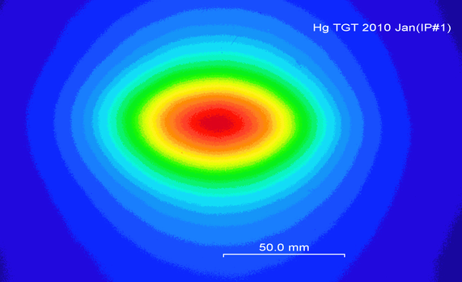
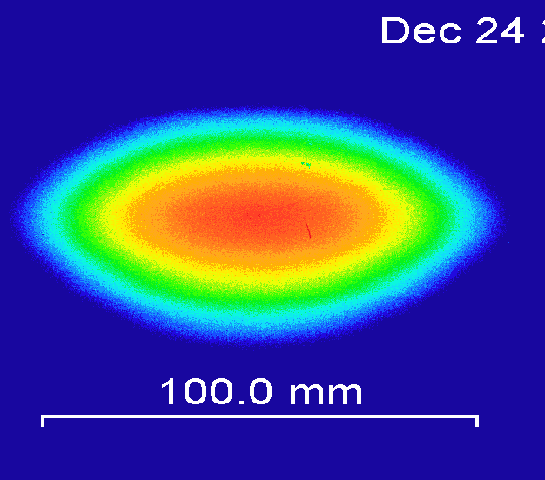
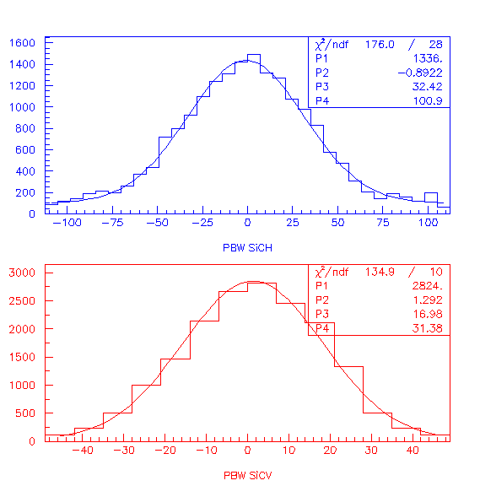
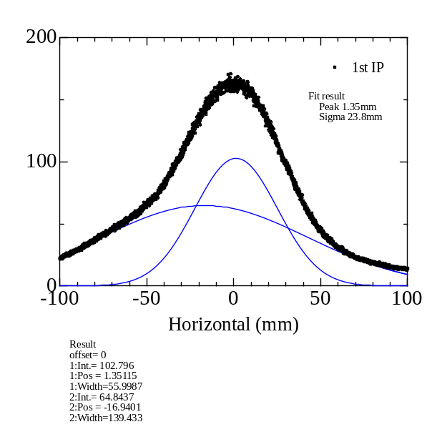
Beam profile at mercury target
2-D measurement by IP
MWPM at PBW
0.1 MW (2009 Dec)
0.2 MW (2010 Dec)
Obtained only 6 days of cooling duration after irradiation of 0.2 MW beam
⇒ Possible for 1MW with
certain cooling time
Result by MWPM
- Fitting by Gaussian
Width and position for each pulse obtained
Good agreement width result by IP
Profile result by the IP
Fitted by two Gaussian curves
Contribution of primary protons and secondary particles (almost neutrons)

Slide 8
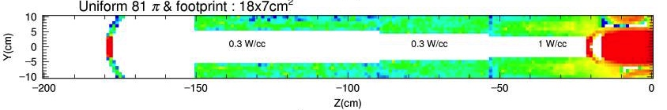
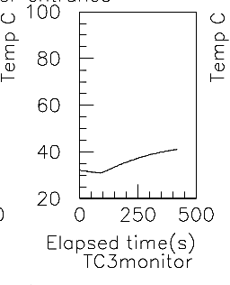
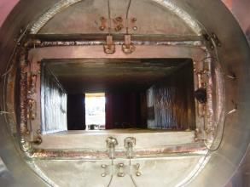
Beam halo measurements
Heat distribution at entrance of target station
  Scattering beam at PBW producing heat at target vicinities ( < 1W/cc i.e. 10⁻⁴ of peak), which is allowable level.
PBW (Al 5mm-t)
Hg target
Vertical (cm)
Proton beam entrance at target station
Q=CdK/dt
PBW Halo monitor TC-type
Thermocouples(TC)

Slide 9
Introduction of JSNS
Beam monitor system at JSNS
  Multi Wire Profile Monitor (MWPM)
  Beam Halo Monitor
Beam flattening system
Development infrared and near infrared camera system

Slide 10
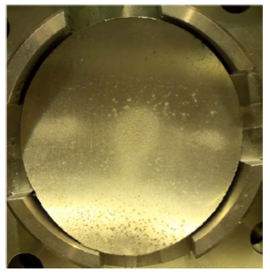
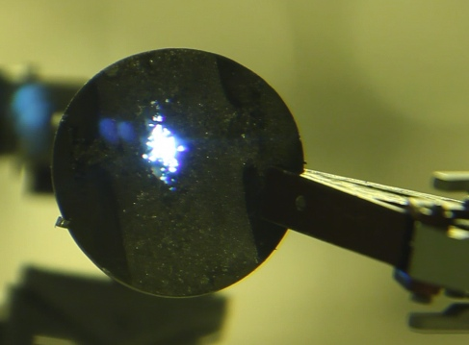
Proton beam at the target
Beam operational status
  Study with 1 MW beam
  User operation with 0.5MW
  Getting narrow storage space
Pitting damage is critical
  Negative pressure attacks
  Proportional to 4th power of the peak current density at target
    Useless beam rastering to mitigate
JSNS harder condition than SNS
  SNS: 60 Hz, Storage ring w/o muon target
  JSNS: 25 Hz, RCS with muon target
Although helium bubbling mitigates the pitting damage, peak reduction is essential.
5 cm
Damage at
JSNS target
Pin holes at target of SNS
Here
Target vessel

Slide 11
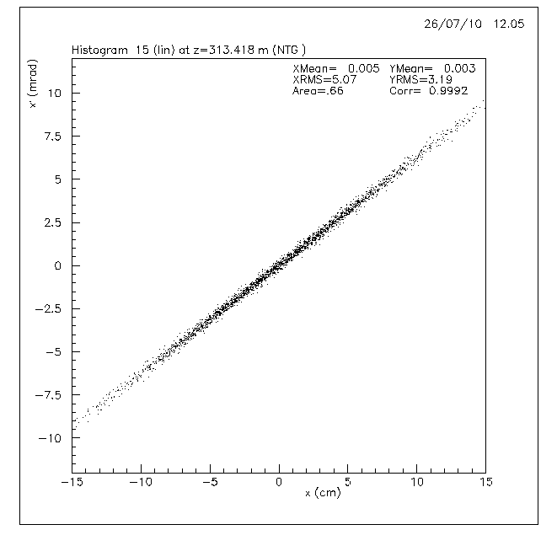
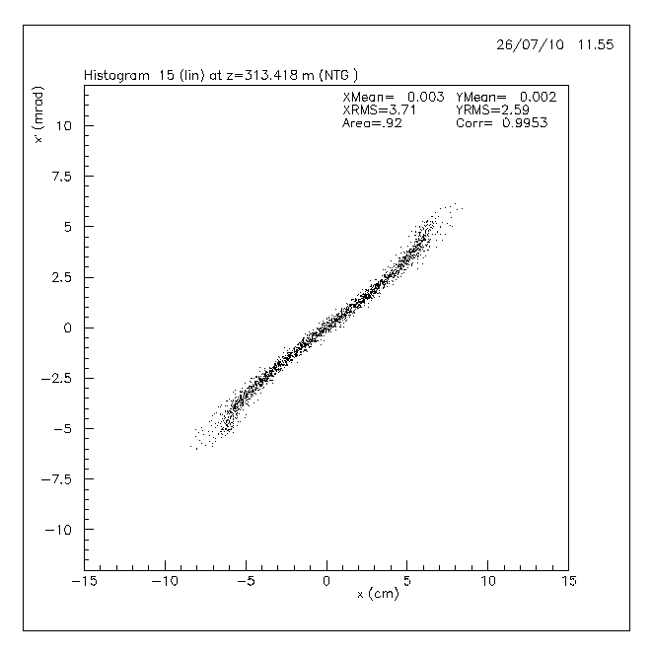
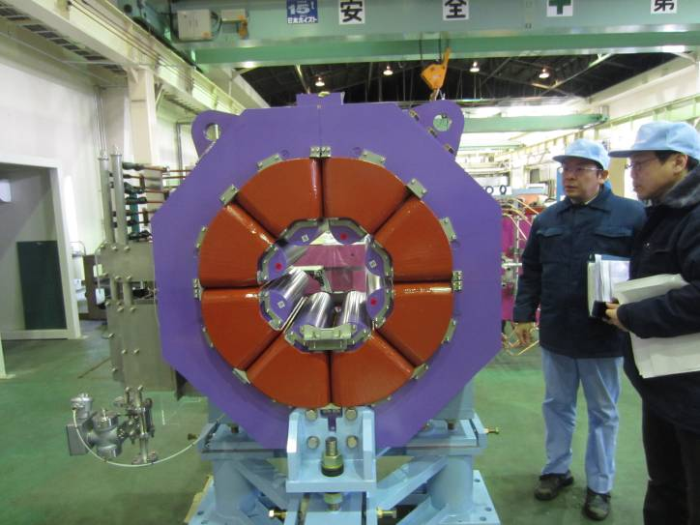
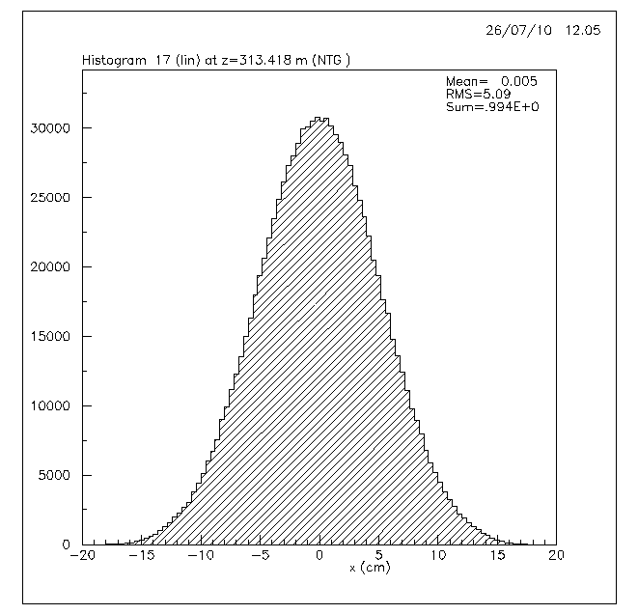
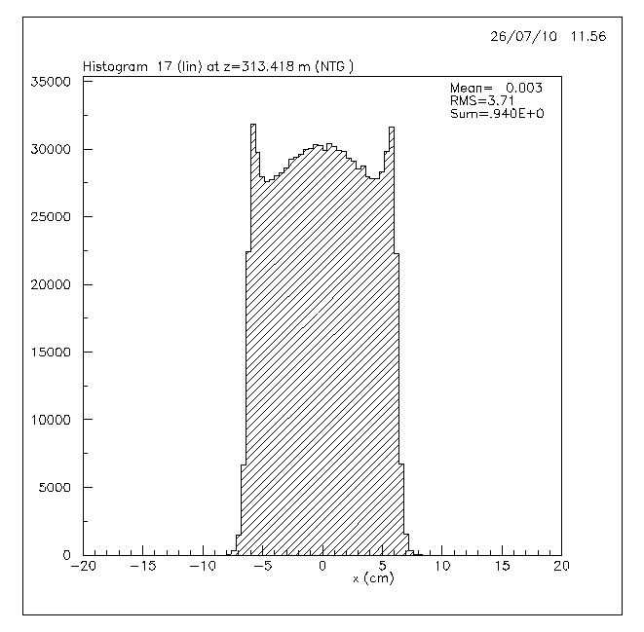
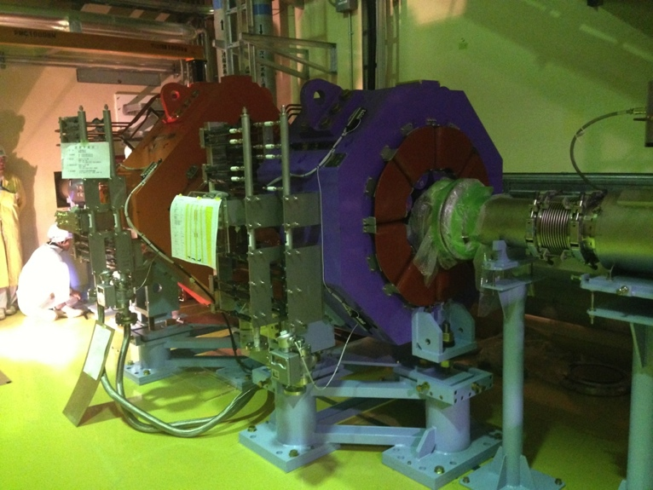
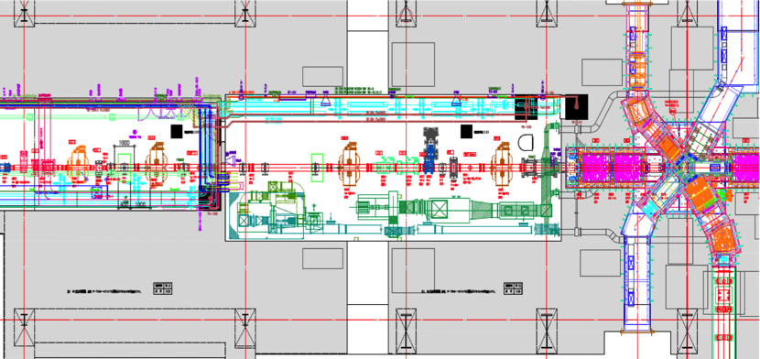
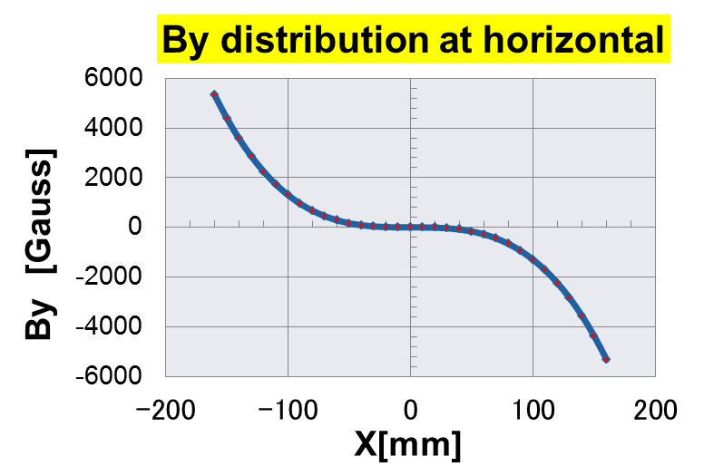
Beam flattening system
Beam edge folding by non-linear optics (octupole magnet)
Linear
Non-linear
Octupole magnet: 800 T/m³
Phase space
Divergence
Real space (Horizontal)
Intensity
Position
Position
OCT1
OCT2
1m
Horizontal plan

Slide 12
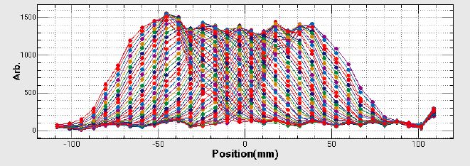
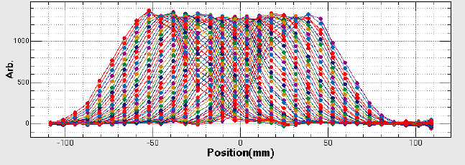
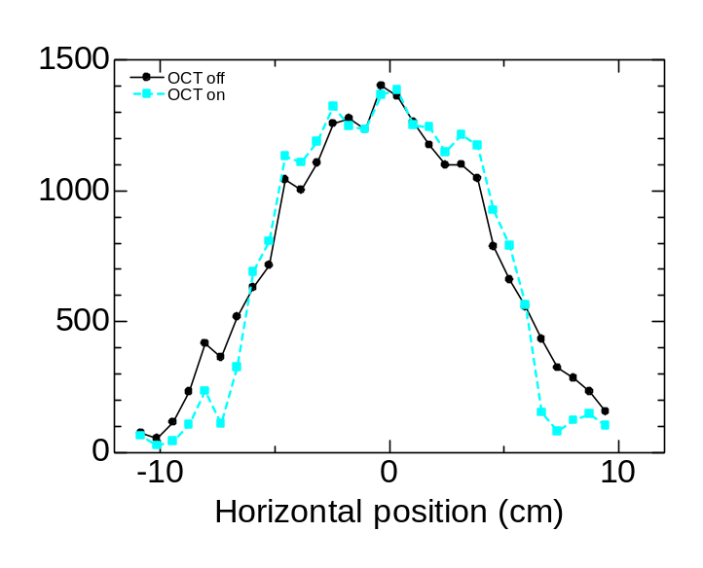
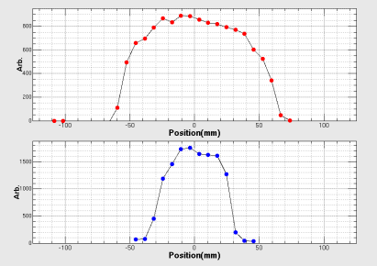
Calibration of MWPM
By narrow beam scanning, sensitivity of wire was calibrated
  Maximum correction ~6%
w/o cor.
w/ cor.
Profile w/ correction
Profile w/o correction

Slide 13
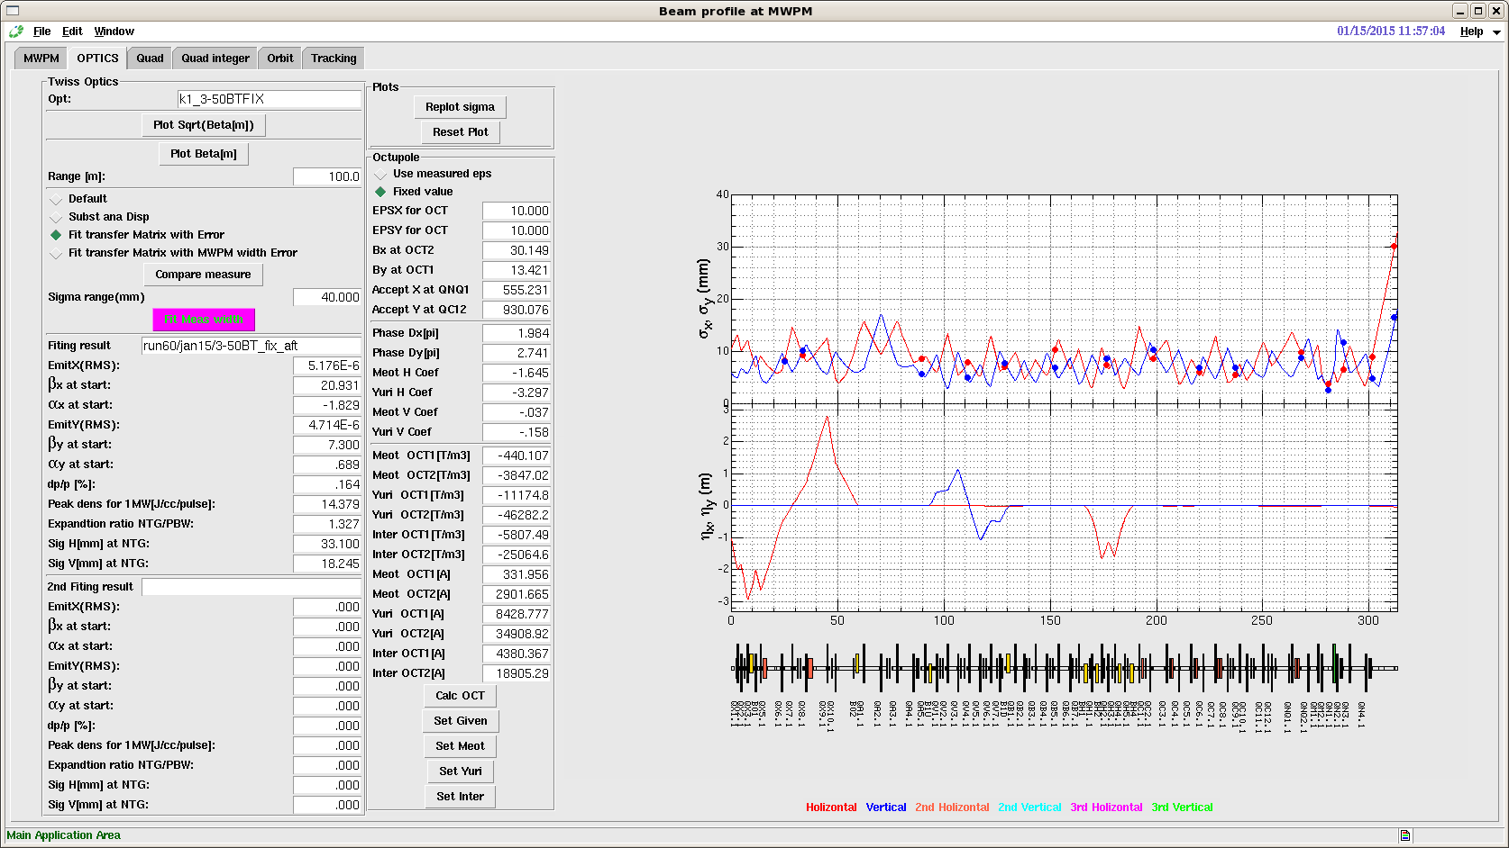
Beam tuning tool with SAD code
T=M⁻¹S
Fit by observed width and extrapolate to NTG
Fitting region
Extrapolate
PBW
MTG
Initial condition
OCT tuning
Acuracy of RMS emittance ~5 %

Slide 14
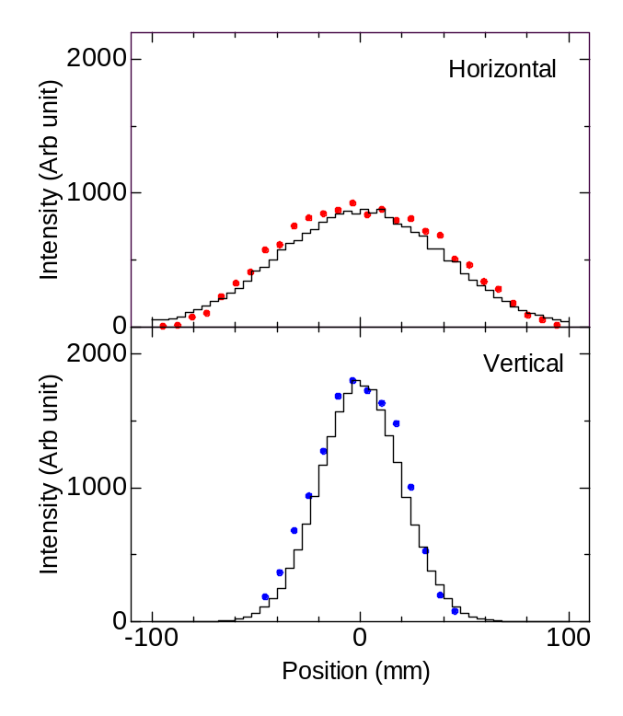
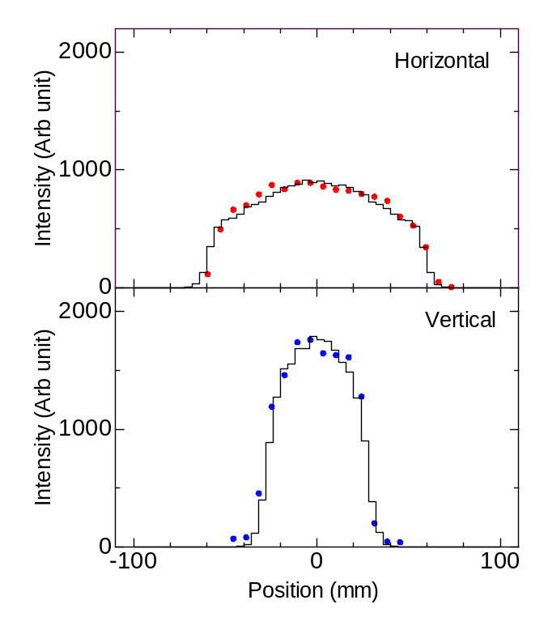
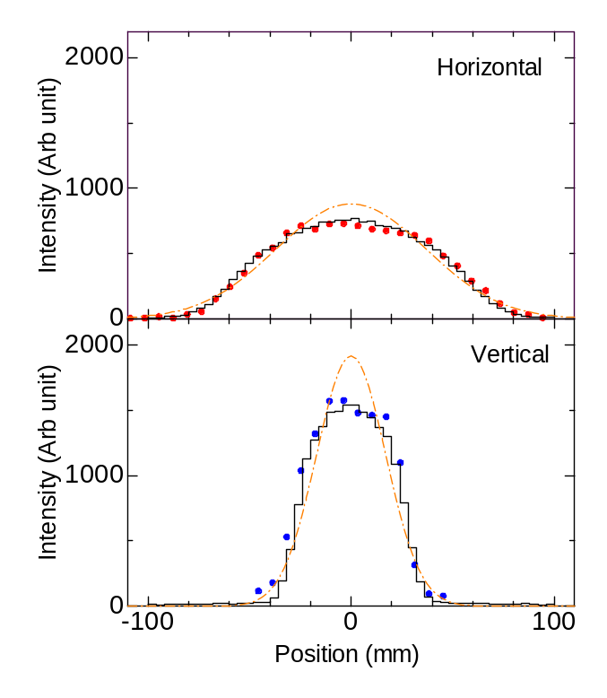
Obtained beam profile
OCT 698A
w/ muon target
OCT 0A
OCT 698A
Flat beam was obtained and lower intensity of beam halo was observed
Good agreement of calculation shown even for w/ muon target
Peak smaller by 14 % and 20 % at horizontal and vertical. Overall 40 % reduced.

Slide 15
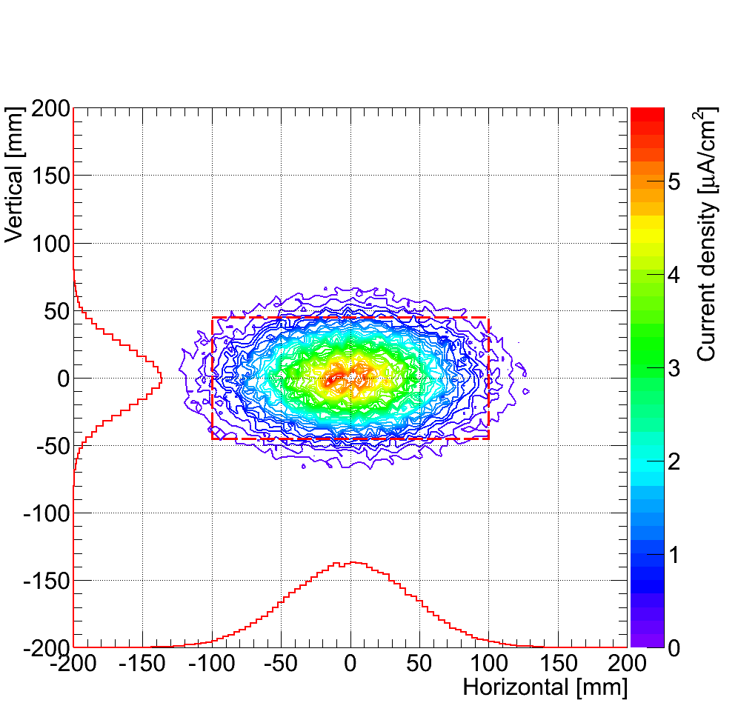
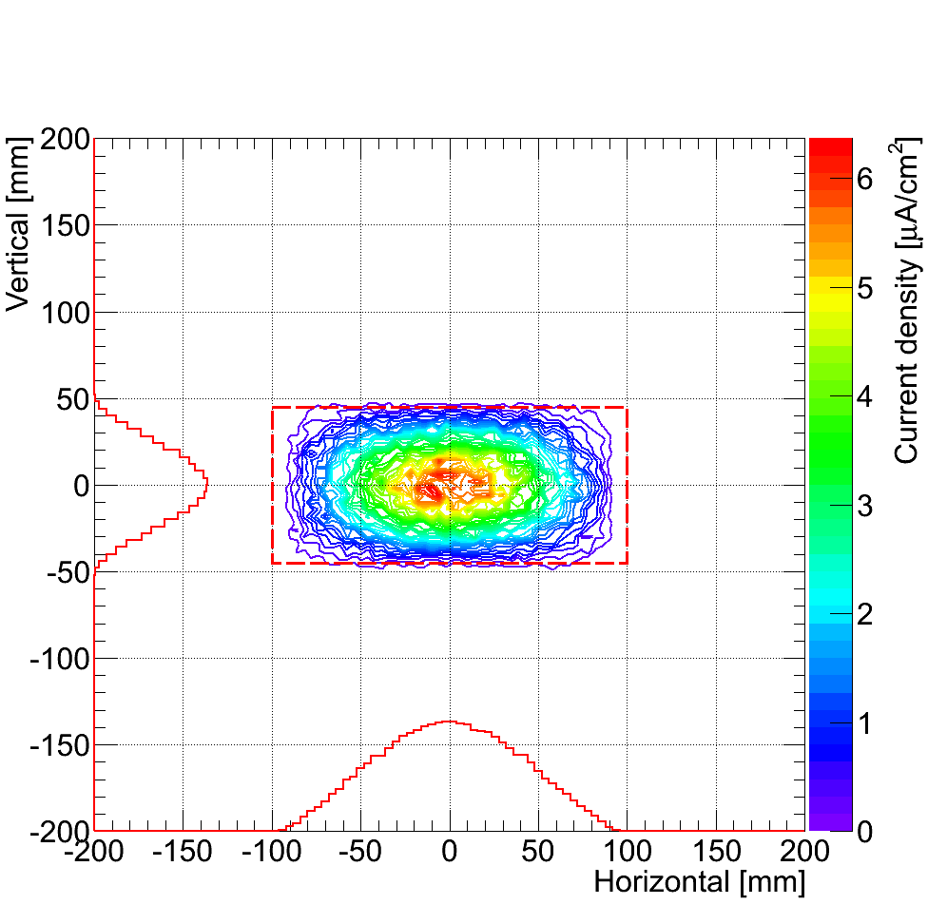
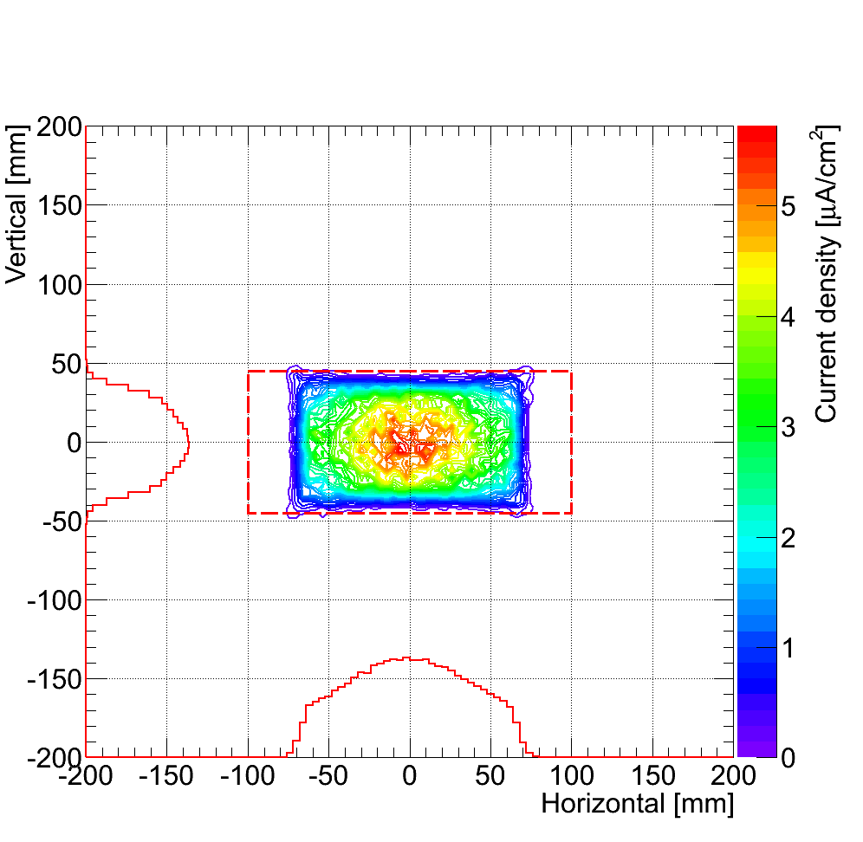
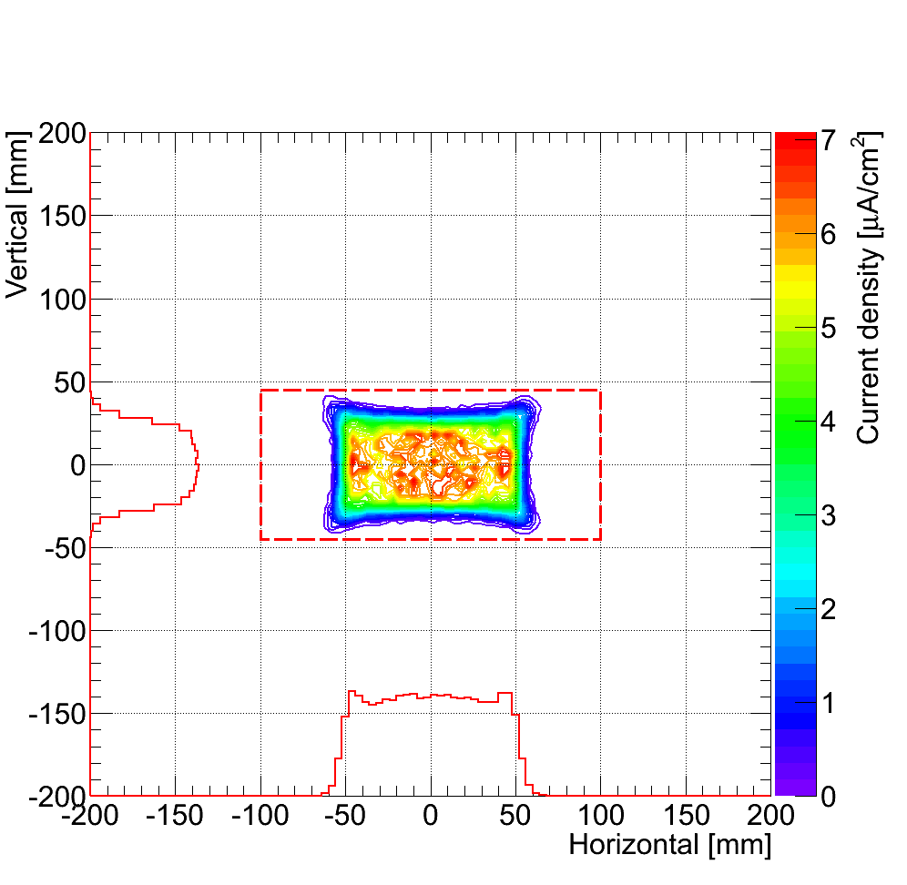

Beam profile at neutron target (calculation)
OCT 0A
OCT 400A
OCT 698A
OCT 1200A
OCT 698A w/ muon target
Ideal shape however slight beam loss detected around octupole magnets which can be reduced by changing duct shape at Q mag
Need develop profile monitor at the target

Slide 16
Introduction
Beam monitor system at JSNS
  Multi Wire Profile Monitor (MWPM)
  Beam Halo Monitor
Beam flattening system
Development infrared and near infrared camera system

Slide 17
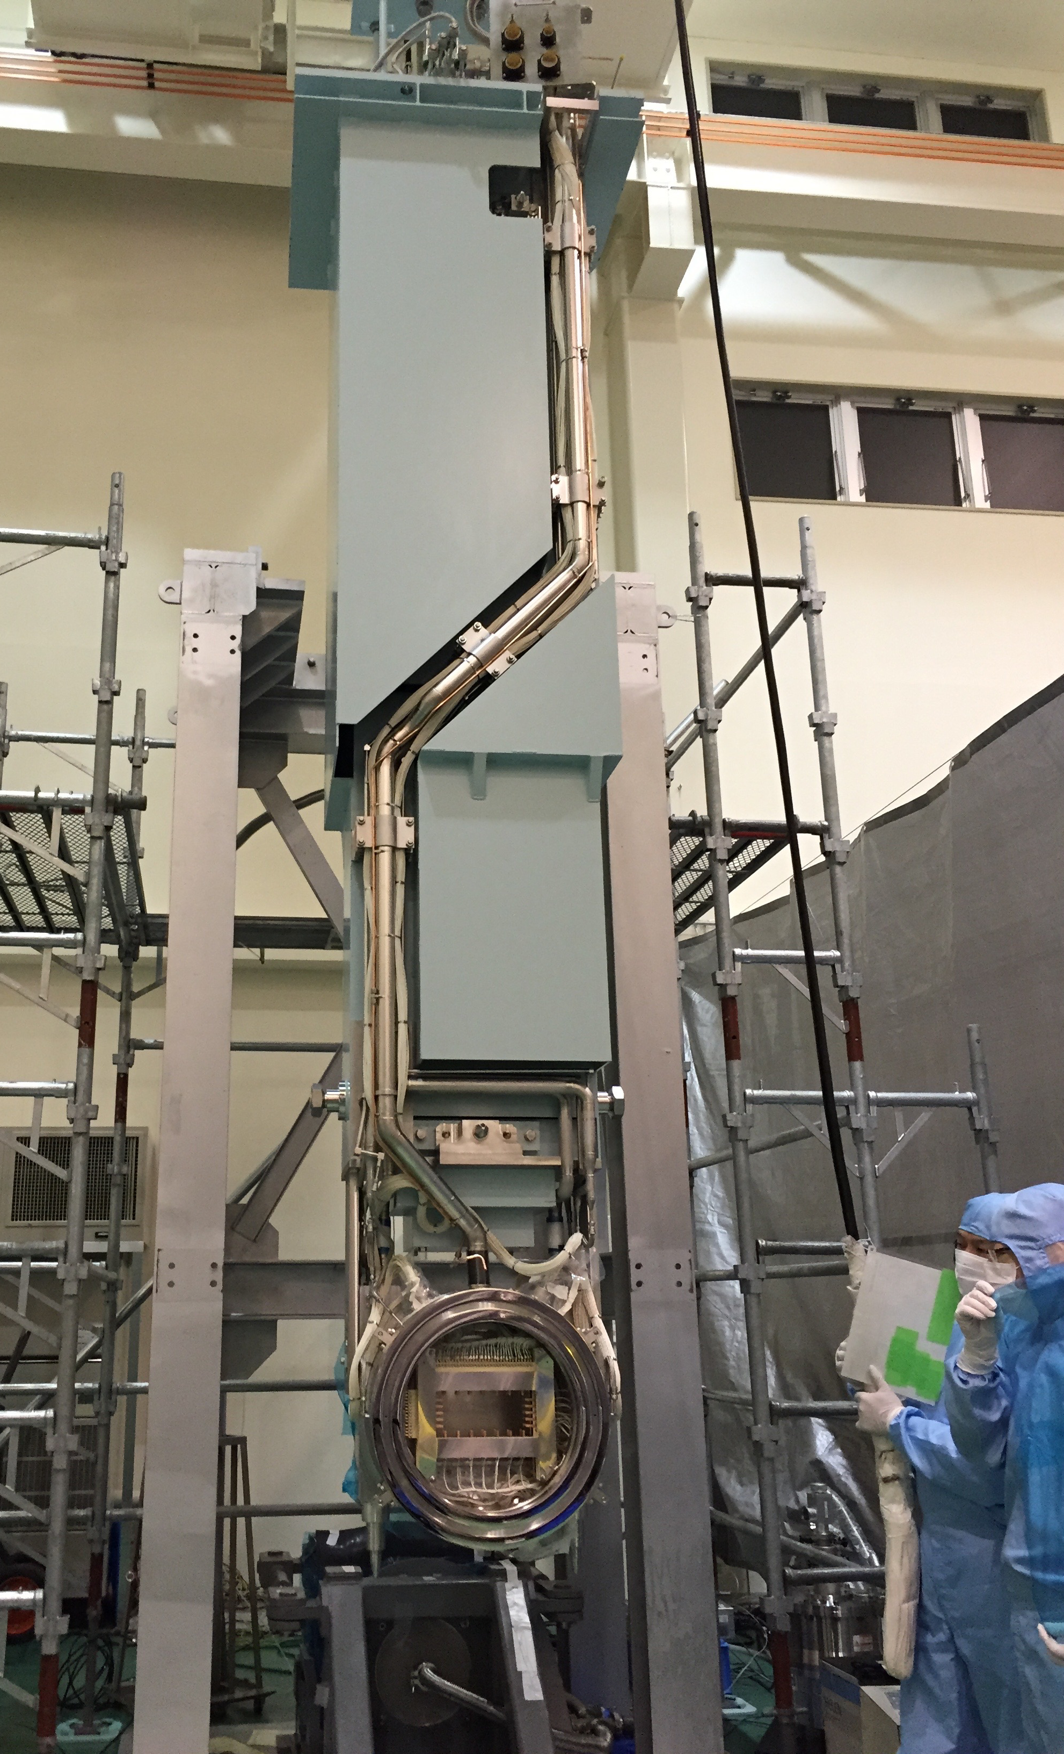
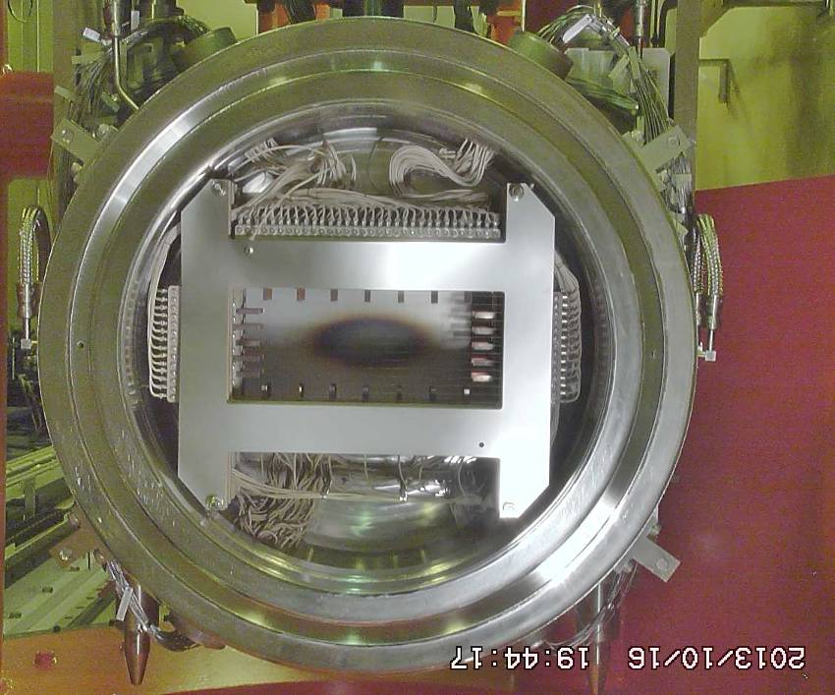
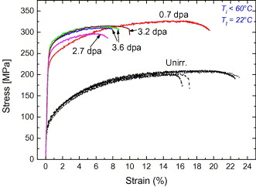
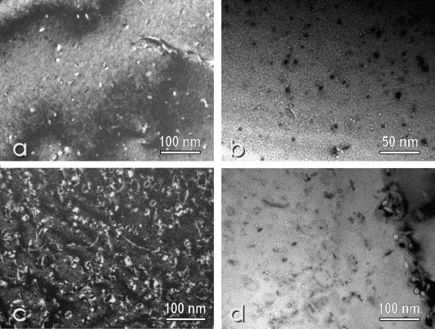
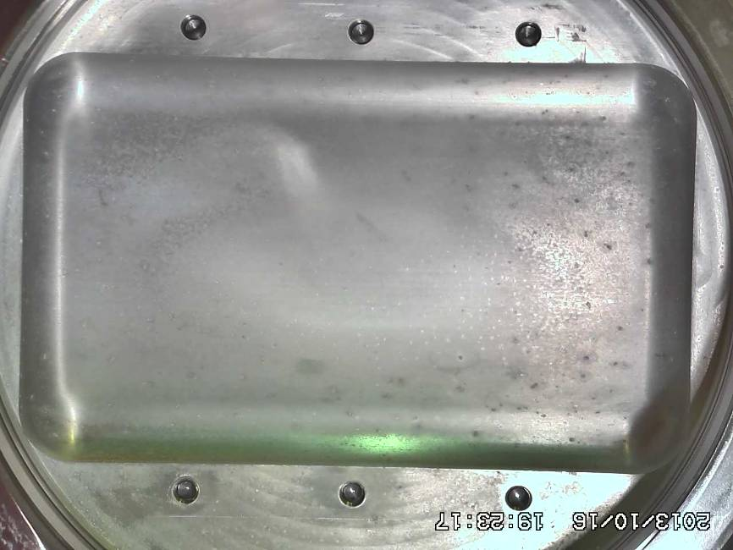
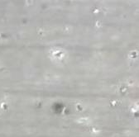
Development 2D profile monitor
Desirable 2D profile monitor at the target with long lifetime
Unknown lifetime of MWPM
Lifetime of proton beam window (PBW) ~2 years is determined by embrittlement due to helium gas production at the PBW
Gas production rate will be carried out by using dump line and thin aluminum foil with Q-mass spectrometer
PBW
Spent PBW
Result at SINQ/PSI for 0.6GeV
Y. Dai, et al, J. Nucl Mat. 343 184 (2005)
VAC
60cm
He

Slide 18
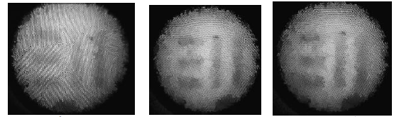
2D profile monitor by thermal
  Low temp(<100C)
For observation of spallation neutron target Infrared with capillary tubes
  High temp(~1000C) :
For observation of rotating carbon target
Near-infrared with fiber scope
(Based on rad hard fiber to up 2 MGy)
Fujikura Fiber
0 MGy 1 MGy 2 MGy
PBW
Camera
Mercury target

Slide 19
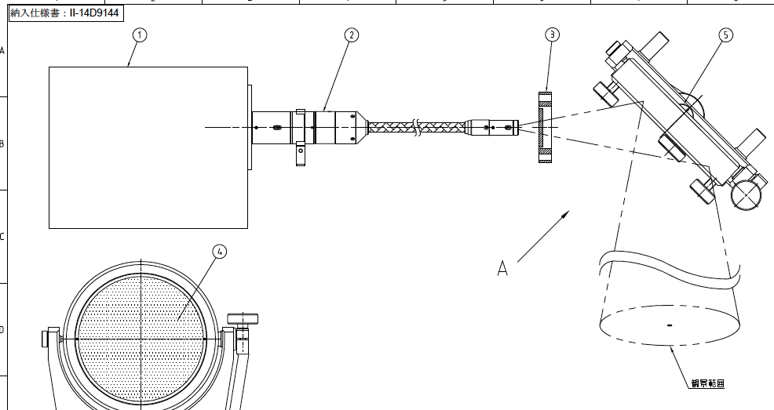
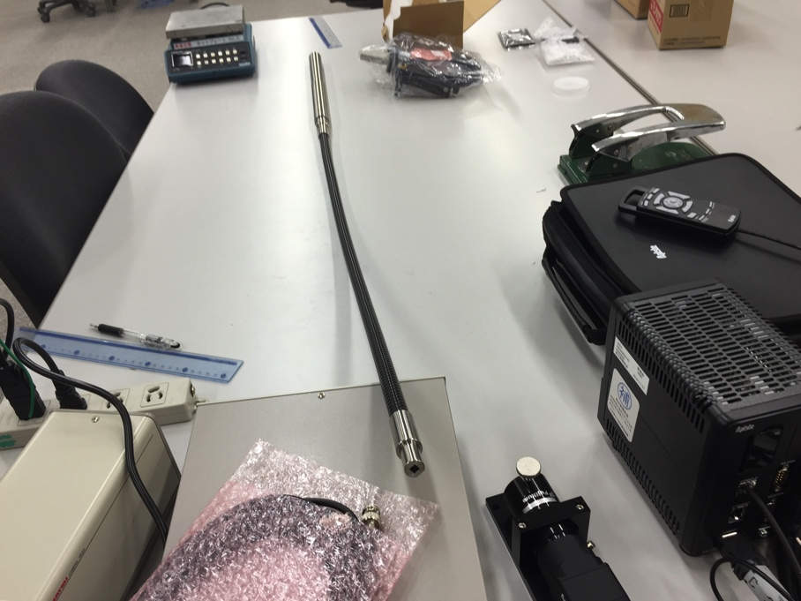
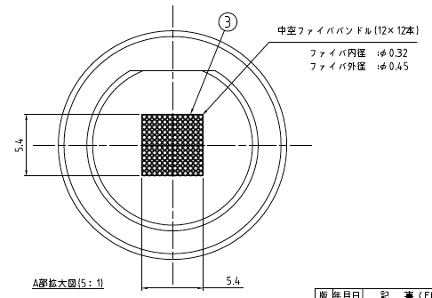



Infrared(IR) monitor
Bundled hollow core fibers of quartz capillary tube coated by polyimide
Mirror
Heater
IR Camera
1m
IR camera
Present system can be utilized as monitor for target-temp.
50 °C
150 °C
300 °C

Slide 20





Near-IR system
Rad hard fiber scope (Fujikura FIGR-20, 20000 pixels) coupled with near-IR filter
Profile at muon target with high temp can be observed.
Utilize for temp anomaly detection of the target
650 °C
980 °C
1300 °C

Slide 21



Visible light fiber scope system
Setup for visible light
SNS monitor (SNS web page)
Observation by luminescence with painting on target vessel is already established at SNS.

Slide 22


New facility at J-PARC for ADS development
TEF-T: For Pb-Bi target test facility
    H⁻, 25Hz, 400 MeV, 250 kW beam
  High current density (20 μA/cm²) required
    JSNS: 6 μA/cm²
Also long lifetime profile monitor required
250kW

Slide 23
Summary
Using present beam monitor system, high power beam operation can be performed with highly confident.
To mitigate pitting damage, beam flattening system has been developed. Peak intensity will be reduced by ~30 % intensity of linear optics.
New profile monitor system developing by using fiber system
Acknowledgement:
This work is partly supported by the MEXT Grant-in-Aid for Scientific Research (C) Grant no. 26390114.

Slide 24

Thank you for your attention
Died on 2nd Sep 2015
R. I. P.

