Slide 1
First LHC Emittance
Measurements at 6.5 TeV
IBIC15 Melbourne, Australia 2015
Maria Kuhn^{1,2} – September 16, 2015
F. Antoniou², E. Bravin², B. Dehning², J. Emery², V. Kain², A. Langner^{1,2}, Y. Papaphilippou², E. Piselli², G. Trad²,
¹Hamburg University, Hamburg, Germany,
²CERN, Geneva, Switzerland

Slide 2
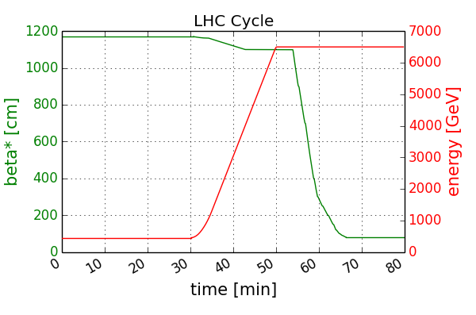
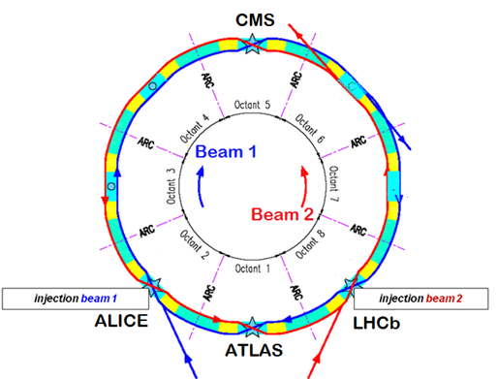
Introduction: LHC Cycle and Beam Parameters
Injection
Ramp
Squeeze
Collisions
Energy ramp
(20.2 min)
450 GeV injection plateau (30min)
β* squeeze (12.5 min)
Two circulating beams.
  Beam 1 rotating clockwise, beam 2 counter-clockwise.
Collisions in four interaction points in the LHC.
  ATLAS and CMS are the two large multi purpose detectors.

Slide 3
Introduction: LHC Cycle and Beam Parameters
Injection
Ramp
Squeeze
Collisions
Energy ramp
(20.2 min)
450 GeV injection plateau (30min)
β* squeeze (12.5 min)
Proton beam parameters | LHC Design | 2012 LHC | Early 2015 LHC
# bunches/ beam | 2808 | 1374 | 3 - 458
Bunch spacing [ns] | 25 | 50 | 25 and 50
Mean bunch length [ns] | 1.3 | 1.2 | 1.2
Bunch intensity [10¹¹ p] | 1.15 | 1.1 - 1.7 | 1.0 – 1.2
Emittance at injection [μm] | 3.5 | 1.5 – 2.0 | 1.5 – 3.0
Collision energy/beam [TeV] | 7 | 4 | 6.5
Emittance at collision [μm] | 3.75 | 2.4 | 1.5 – 4.0
β* at ATLAS/CMS [m] | 0.55 | 0.6 | 0.8

Slide 4
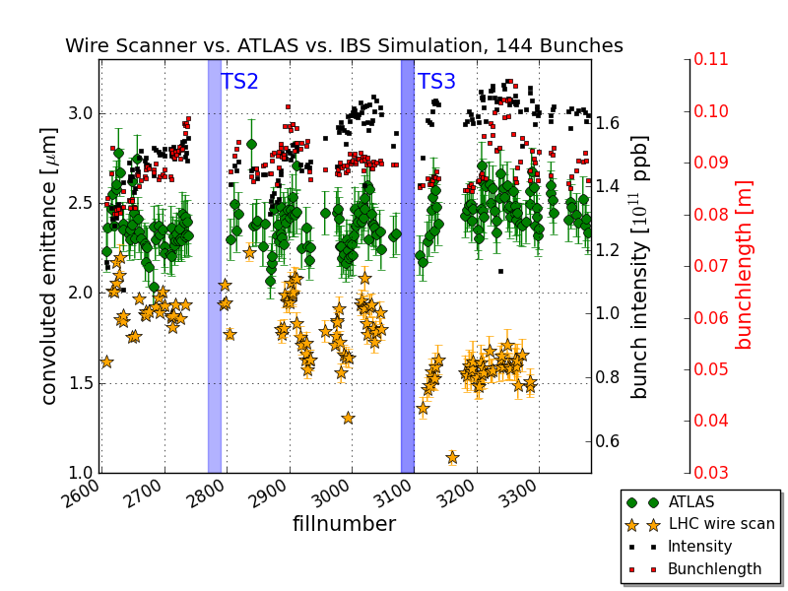
Reminder: 2012 Emittance Blow-up
In 2012 LHC was operated with high brightness beams.
  Transverse emittance could not be preserved during the LHC cycle.
  ~ 0.4 – 0.9 μm normalized emittance growth from LHC injection to start of collisions.
  But emittance measurement precision during LHC Run 1 doubtful.
2012 LHC performance

Slide 5
LHC Wire Scanner Intensity Limitations
Several types of beam profile measurement systems in the LHC.
  The wire scanners are the most precise and versatile instruments.
  Two operational wire scanners per beam.
    Horizontal and vertical.
Wire scanners cannot be used with high intensity physics fills.
  Synchrotron light telescope (BSRT) is used for that purpose.
BSRT cross calibrated with wire scanners.
Currently, wire scanners are the only instrument to measure beam sizes through the LHC energy ramp.
  Low intensity test fills (a few bunches) are measured to evaluate emittance preservation during the LHC cycle.

Slide 6

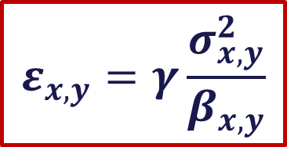
Run 2 LHC Wire Scanner Accuracy
Transverse normalized emittance ε:
  (For location with no dispersion)
LHC Run 2 optics measured with k-modulation at 450 GeV and turn-by-turn phase advance method at 6.5 TeV.
  β function accuracy better than 3 %.
Lorentz factor γ (beam energy)
Wire scanner beam size σ accuracy
  Wire position measurement precision
    Estimated position measurement potentiometer precision: 50 μm
  Wire position measurement calibration
    Verified with beam by orbit bump scans at the wire scanner location
$$ε_{x,y}=γ\frac{σ_{x,y}^{2}}{β_{x,y}}$$

Slide 7
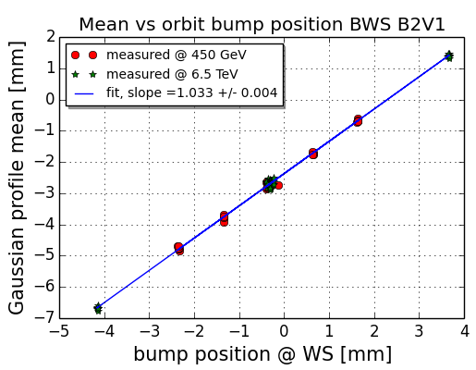
Wire Position Measurement Calibration
Using local orbit bumps to verify the wire position measurement calibration of the wire scanners.
  Beam position measured with LHC orbit system and extrapolated to wire scanner.
  Compared to mean position obtained from Gaussian fit to measured transverse beam profile.
  Measurements at 450 GeV and 6.5 TeV are consistent.
➔ Overestimating B2V
emittances by 6.6 %.
Example B2V1: slope of linear fit shows + 3.3 % calibration error.

Slide 8
Wire Scanner Emittance Measurement Errors
Wire scanner position calibration verification results (Δε_{calibration}):
  Another set of orbit bumps foreseen for the near future to check reproducibility of obtained results.
  The results in this talk do not include a correction of the calibration.
All wire scanner measurements show large σ spread from scan to scan (Δε_{450GeV} and Δε_{6.5TeV}).
  Depending on scanner and energy.
Wire Scanner | Δε_{calibration} [%] | Δε_{450GeV} [%] | Δε_{6.5TeV} [%]
B1H2 | + 7.2 | 25 | 20
B1V2 | - 5.2 | 20 | 10
B2H1 | + 9.0 | 25 | 15
B2V1 | + 6.6 | 15 | 10

Slide 9
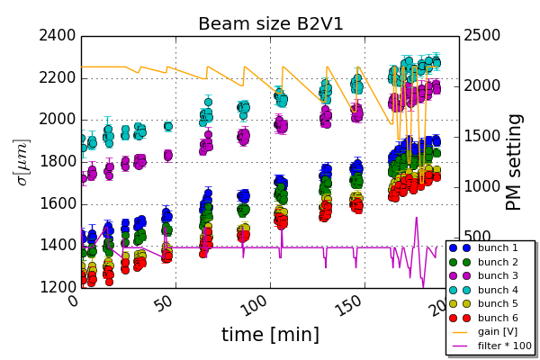
Photomultiplier Working Point Investigations
Wire scanner shower product amplified by photomultiplier (PM).
  Amplification settings (gain + filter) can alter obtained beam profile.
LHC Run 1: strong dependence of measured σ on PM settings.
Optimum PM working point has to be established!
  Scan through all available gain and filter setting combinations.
Bunches with different beam sizes were injected.
To remove natural ε growth, scans with fixed reference settings done after each settings change.
Exponential fit
Example: B2V1 at 450 GeV

Slide 10
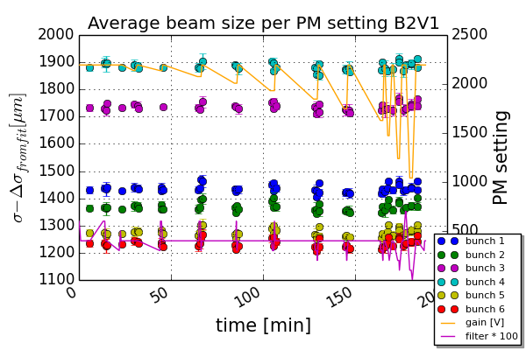
Photomultiplier Working Point Investigations
Wire scanner shower product amplified by photomultiplier (PM).
  Amplification settings (gain + filter) can alter obtained beam profile.
LHC Run 1: strong dependence of PM settings on measured σ.
Optimum PM working point has to be established!
  Scan through all available gain and filter setting combinations.
Measured beam sizes minus the fitted growth.
Measurements with same gain + filter settings are averaged.
No sign of PM saturation at 450 GeV could be detected.
Same for 6.5 TeV.

Slide 11
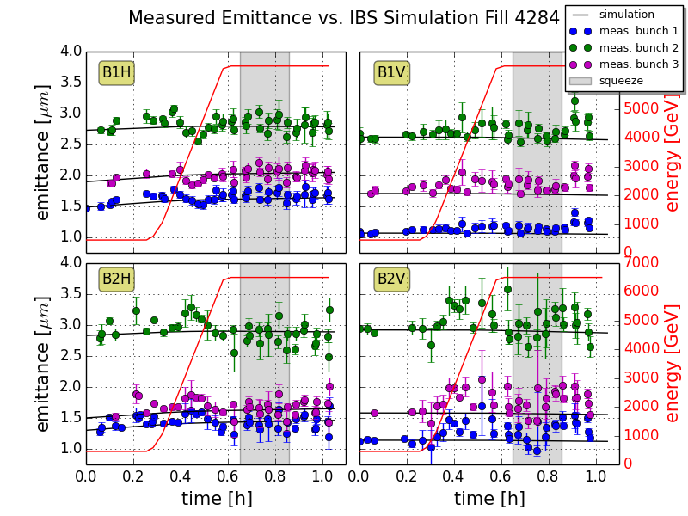
First Emittance Measurements (1)
Example Fill 4284 (August 28, 2015):
  3 bunches with different initial emittances, intensities (0.6 –
  1.1 x 10¹¹ ppb) and bunch lengths (1.0 – 1.25 ns).
  IBS simulations with MADX IBS module include measured initial beam parameters, dispersion, and radiation damping.
➔ Measurements in the horizontal planes match IBS simulation.

Slide 12
First Emittance Measurements (2)
Example Fill 4284 (August 28, 2015):
  3 bunches with different initial emittances, intensities (0.6 –
  1.1 x 10¹¹ ppb) and bunch lengths (1.0 – 1.25 ns).
  Emittance growth through the cycle of bunch 3
  IBS simulations with MADX IBS module include measured initial beam parameters, dispersion, and radiation damping.
➔ Measurements in the horizontal planes match IBS simulation.
 | ε_{450GeV} [μm] | ε_{6.5TeV} [μm] | Δε [%] | Δε_{sim} [%]
B1H | 1.90 | 2.08 | 9 | 8
B1V | 1.71 | 2.04 | 19 | -2
B2H | 1.50 | 1.65 | 10 | 10
B2V | 1.58 | 1.95 | 23 | -2
Vertical emittance growth through the cycle could not be reproduced with IBS simulations.

Slide 13
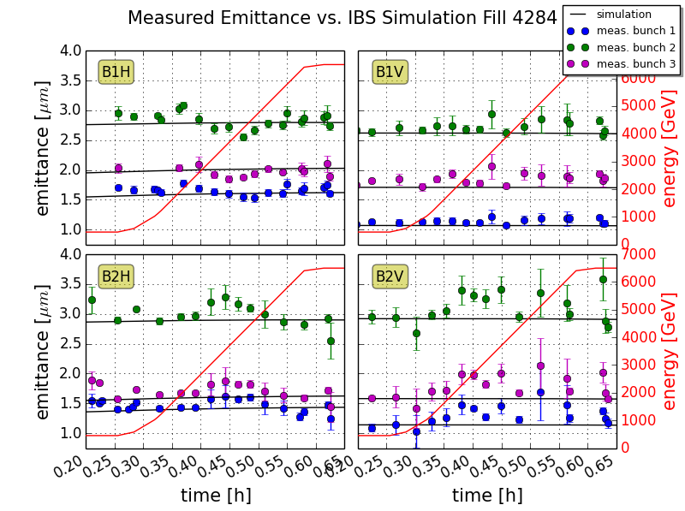
Emittance Growth during the LHC Ramp
Measured β during ramp not yet available.
  Using linear interpolation of measured β at injection + flattop.
Current β knowledge results in unphysically growing/shrinking ε.
  Run 1 experience: non-monotonically changing β functions during the ramp.
  Measurements in the horizontal planes consistent with IBS simulations during the ramp.
Beam 2 vertical emittances grow 20 % (~ 0.3 μm).

Slide 14
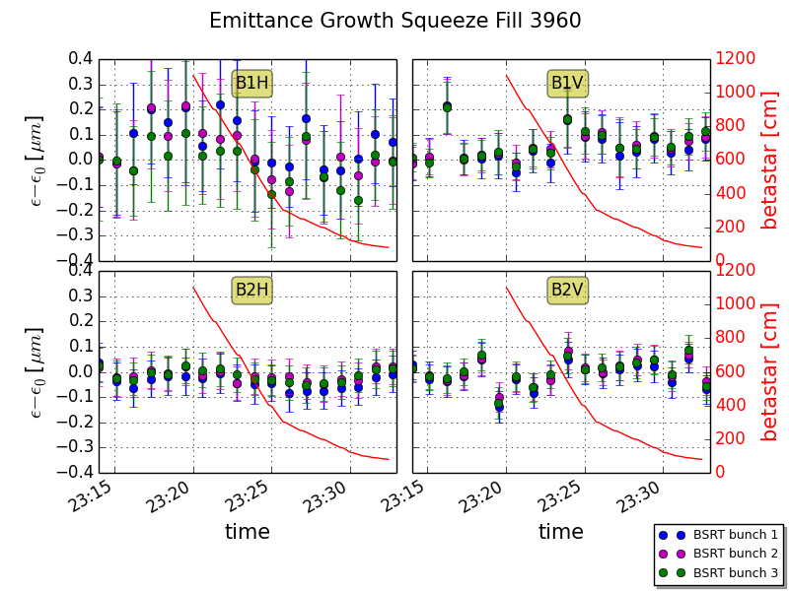
Emittance Preservation during the Squeeze
Within measurement accuracy emittances are conserved during the β* squeeze.
  Result is reproducible.
  Emittances measured with BSRT and averaged over several hundred measurements.
  Also need measured β functions during the squeeze.

Slide 15
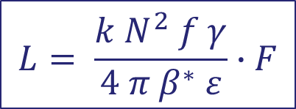
Emittance at Start of Collisions
Comparison of emittance from wire scans
and luminosity:
  Fill 3954 (July 4, 2015), one bunch in collision.
  According to experts ATLAS luminosity low
  by ~10 % with uncertainty±10 %.
    5 % error on crossing angle
    ±1 cm error on measured bunch length.
    β* measured with k-modulation with 1 % uncertainty.
Preliminary: ATLAS and wire scanner results agree within errors.
  Better than during Run 1.
$$L= \frac{k N^{2} f γ}{4 π{ β}^{∗} ε}∙F$$
L …. Luminosity
k …. # bunches
N …. # protons / bunch
f …. Revolution freq.
F …. Luminosity
reduction factor
 | Injection | Collision | Growth
WS ε [μm] | 2.51 ± 0.10 | 2.75 ± 0.20 | 0.24 | 10 %
ATLAS ε [μm] | n.a. | 2.97 ± 0.36 | 0.46 | 19 %

Slide 16
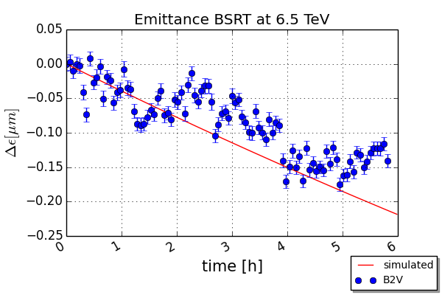
Radiation Damping at 6.5 TeV
At high energies protons circulating in the LHC emit enough synchrotron radiation to modify the beam parameters
  First observed during LHC Run 2
  Counteracts IBS: reduction of vertical emittance
  Simulations with MADX IBS module.
Simulation predicts slightly faster emittance decrease than measured with BSRT.
Additional emittance growth from proton collisions + beam–beam effects not included in the simulation.

Slide 17
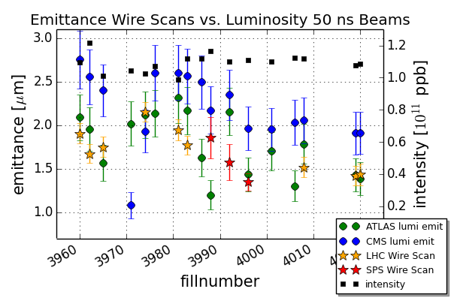
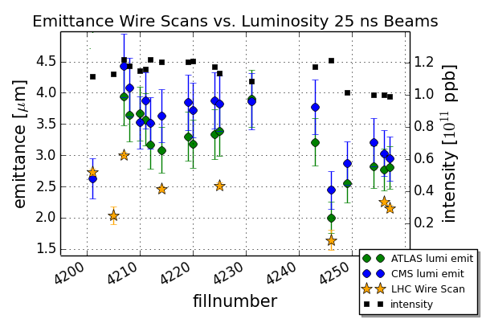
Current Performance of the LHC
Emittance in collisions derived from luminosity.
Injection emittance of first batch measured with SPS and LHC wire scanners.
Emittance blow-up through the cycle:
50 ns beams show very little blow-up (~ 10 %), much smaller than during Run 1.
Large blow-up for 25 ns beams (25 % for most recent fills).
  Electron cloud effects
  Beam instabilities

Slide 18
Summary & Conclusion
Good progress in understanding wire scanner emittance measurements for LHC Run 2.
  Wire scanner calibration verified, no PM saturation effects detected.
Emittance growth during the LHC cycle:
  Horizontal emittance growth matches IBS simulations.
  Small growth in the vertical planes not yet understood.
    Caveat: single bunch fills.
  Synchrotron radiation damping observed for the first time at 6.5 TeV.
  With still not fully calibrated luminosity data: emittances from wire scans and ATLAS luminosity agree within errors.
Smaller emittance blow-up (~ 10 %) through the cycle than during Run 1 for 50 ns beams.
25 ns physics beams show much larger growth.
  Electron cloud effects and beam instabilities.

Slide 19
appendix

Slide 20
Outline
LHC cycle and beam parameters
  LHC Run 1 transverse normalized emittance blow-up
LHC wire scanner intensity limitations
Run 2 LHC wire scanner accuracy
  Wire position measurement calibration
  Photomultiplier working point investigations
First transverse normalized emittance measurements
  Emittance growth during the LHC ramp
  Emittance preservation during the squeeze
  Emittance at start of collisions
  Radiation damping at 6.5 TeV
Current performance of the LHC

Slide 21
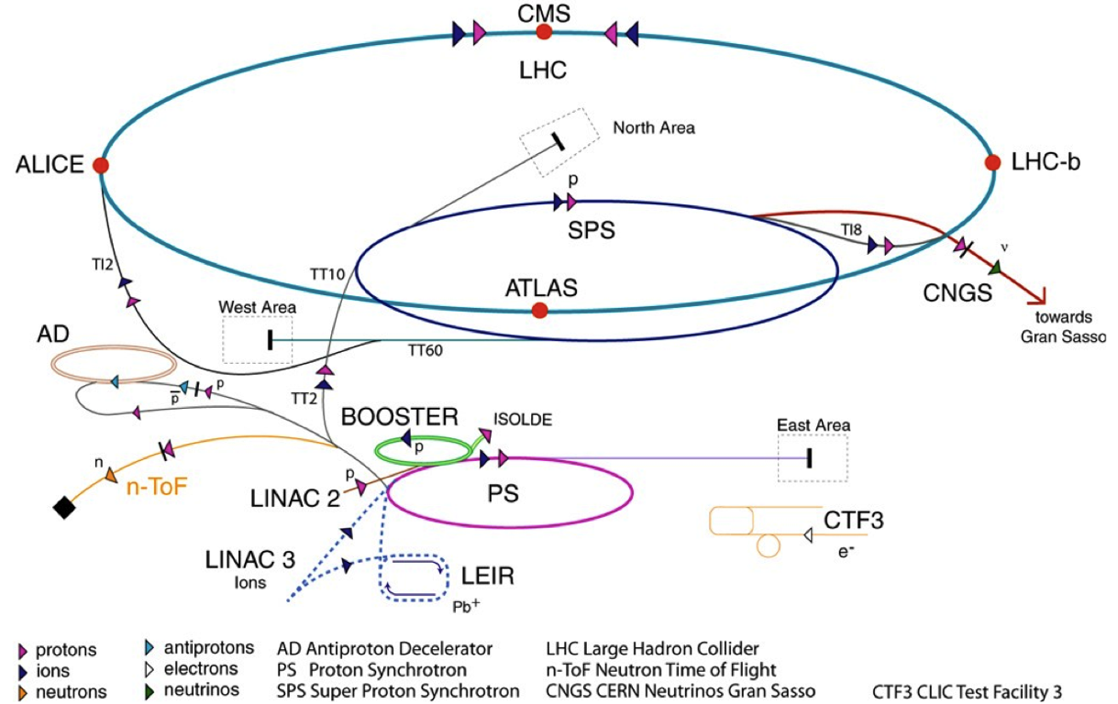
CERN Accelerator Complex
Beam 1
Beam 2
TI2
TI8
LHC proton path
The LHC needs most of the CERN accelerators...

Slide 22
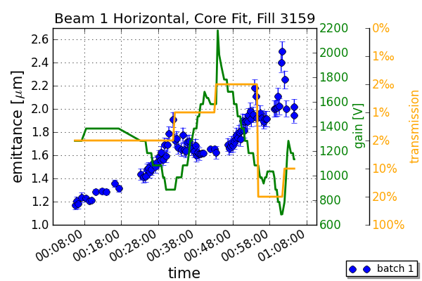
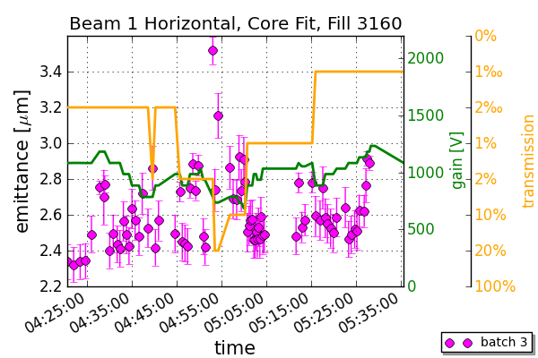
Photomultiplier Saturation Studies Run 1
Photomultiplier (PM) gain and filter can have a strong influence on measured beam size
  See measurements of 2012
Observed strong gain dependence at 450 GeV and 4 TeV during Run 1!
PM saturation studies at 450 GeV in 2012.
PM saturation studies at 4 TeV in 2012.

Slide 23
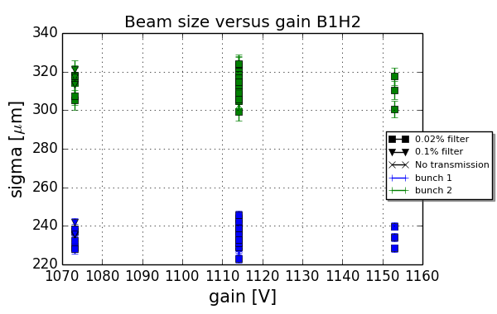
Photomultiplier Working Point at 6.5 TeV
Measurements at 6.5 TeV
more difficult.
  Smaller range of
  possible PM settings before ADC saturation.
No evident sign of PM
saturation at 6.5 TeV
could be seen.
Run 1 investigations showed significant dependency of measured beam size on PM settings.
➔ LHC wire scanner upgrade during Long Shutdown 1:
  One broken wire scanner replaced (beam 2).
  Power supply schematics upgraded.
  PM gain dependency on light intensity reduced.

Slide 24
LHC Optics Measurements
Can use results from optics measurements with the turn-by-turn phase advance method and k-modulation for:
Outstanding measurements:
  K-modulation at 6.5 TeV and after the squeeze
  Turn-by-turn phase advance measurements at 450 GeV (repeated) and during the ramp!
For emittance plots: using measured β where possible
  β function measurement error < 3 %
  Maximum measured beta beat is 5 % at the wire scanners
  Linear interpolation during the ramp and squeeze
 | IR4 |  |  |  | IP1/2/5/8
 | Injection | Ramp | Flattop | After Squeeze | β*
K-modulation | x |  |  |  | x
Turn-by-turn |  |  | x | x

Slide 25
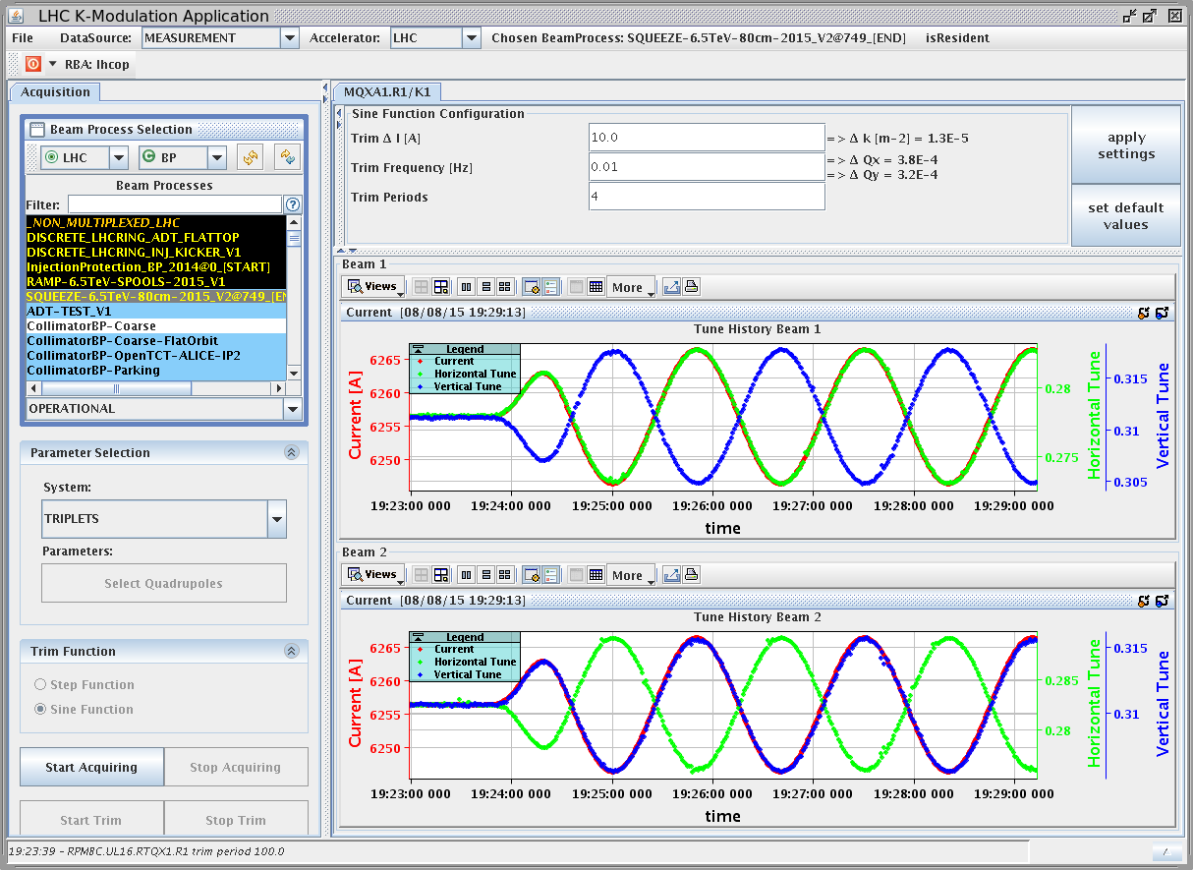
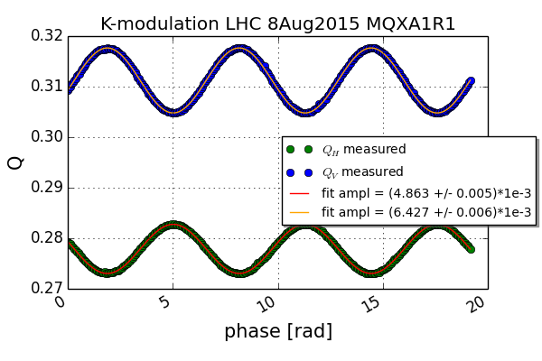
β* Measurements
Sinusoidal k-modulation in IP1/5 on August 8, 2015
Measurement error on tune oscillation amplitude in sub-percent level
β* meas. uncertainty ≤ 1 %
Beta beat ≤ 1 %
Compatible with turn-by-turn measurements
I = 10 A
f = 0.01 Hz
Preliminary! | IP1 [m] |  | IP5 [m]
 | B1 | B2 | B1 | B2
β* H | 0.81 | 0.79 | 0.80 | 0.80
ΔβH | 0.01 | 0.004 | 0.001 | 0.01
β* V | 0.81 | 0.79 | 0.79 | 0.79
ΔβV | 0.01 | 0.01 | 0.01 | 0.002

Slide 26
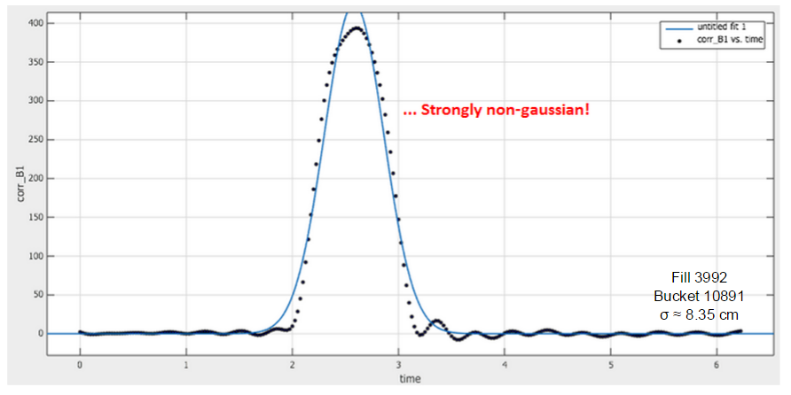
Bunch Length Measurement
Longitudinal bunch shape not Gaussian at 6.5 TeV
  Due to controlled longitudinal RF blow-up at flattop energy
But LHC bunch length monitor publishes 4σ bunch length values based on FWHM algorithm assuming Gaussian profiles
Bunch length error ±1 cm!
“True” emittance from luminosity should be larger by 0.1 μm

