Slide 1
Design of a Compact L-­band Transverse Deflecting Cavity with Arbitrary Polarizations for the SACLA Injector
MOCLA02
Sep. 14th, 2015
H. Maesaka, T. Asaka, T. Ohshima, S. Matsubara,
H. Tanaka, Y. Otake
RIKEN SPring-8 Center
Japan Synchrotron Radiation Research Institute (JASRI)

Slide 2
Outline
Introduction
  X-ray Free Electron Laser (XFEL) “SACLA”
Temporal Profile Measurement
  Transverse Deflector Cavity (TCAV) System
TCAV System for the SACLA Injector
  Requirements
  Time Resolution and Measurement Range
  Polarization (Linear and Circular)
TCAV Design
  RF Simulation
Summary

Slide 3
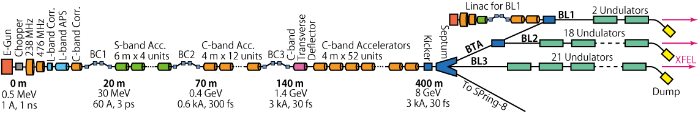
Introduction
X-ray Free Electron Laser Facility “SACLA”
  Low-emittance 500 kV thermionic electron gun (ε_{n} ~ 1 μm rad)
  238 MHz, 476 MHz, L-band (1428 MHz) and S-band (2856 MHz) accelerators for acceleration and bunch compression
  High-gradient C-band Main Linac (5712 MHz, > 35 MV/m)
  Short-period in-vacuum undulator (λ_{u} = 18 mm)
Precise bunch compression for > 3 kA peak current is necessary
  Velocity bunching in the injector section
  Three bunch compressor chicanes (BC1, BC2, BC3)
Recent progress
  New undulator beamline “BL2” was built
  Kicker magnet was installed for pulse-to-pulse beamline switching
  SCSS test accelerator was moved to the upstream of SACLA-BL1
Reliability of the accelerator is extremely important

Slide 4
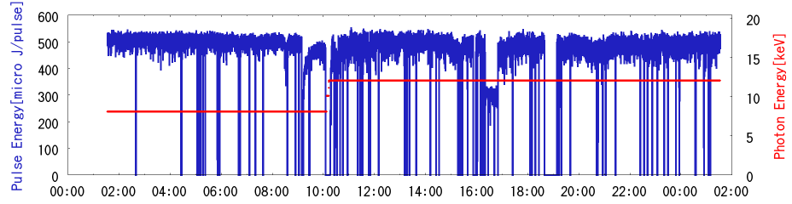
XFEL Performance
8 keV, ~ 500 μJ/pulse
12keV, ~ 450 μJ/pulse
24 hours
Present performance of SACLA
  24-hour trend graph during a user operation
XFEL Intensity: ~500 μJ/pulse
Intensity fluctuation: ~10% (std. dev.)
Pointing Stability: ~10 μm (std. dev.)

Slide 5
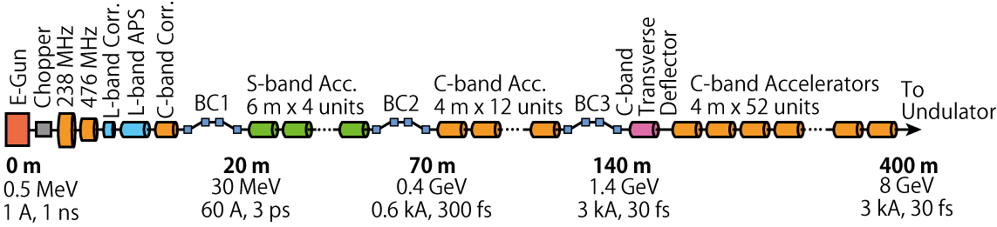
Accelerator Tuning
Bunch compression condition is highly sensitive to the XFEL performance
Longitudinal bunch profile monitor is required for fine-tuning of the bunch compression
  C-band transverse deflector system (C-TDS) was installed downstream of BC3
  C-TDS is useful for tuning of BC2 and BC3
Tuning of the injector section is quite important
  Injector section determines the initial condition of an electron beam
  No longitudinal bunch profile monitor is prepared in the injector section
  RF parameters are set to a simulation result or a previous operation condition
  Fine-tuning is performed so as to maximize the XFEL pulse energy
Transverse deflector system is demanded for the velocity bunching section

Slide 6
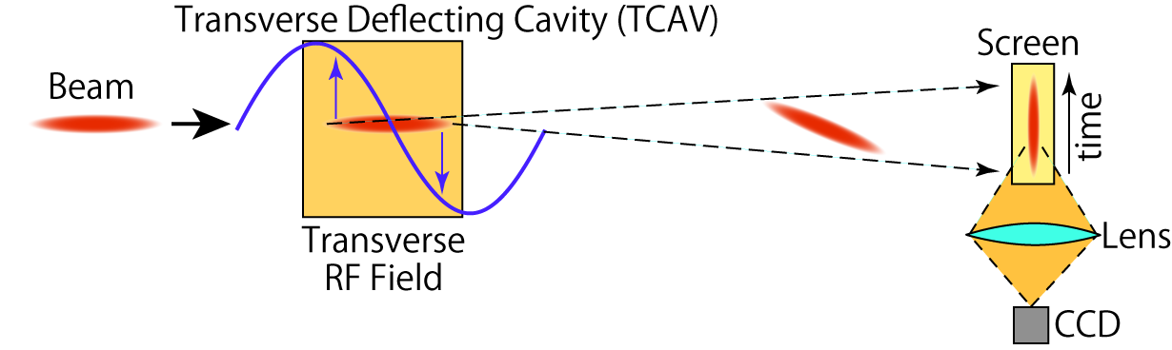
Temporal Profile Measurement
A Transverse Deflecting Cavity (TCAV) gives a transverse kick to an electron beam
  e.g. TM110 mode in a pillbox cavity
  RF phase is set to zero-crossing
The temporal structure of the electron beam is converted to a transverse profile.
The beam profile is taken by a screen monitor

Slide 7
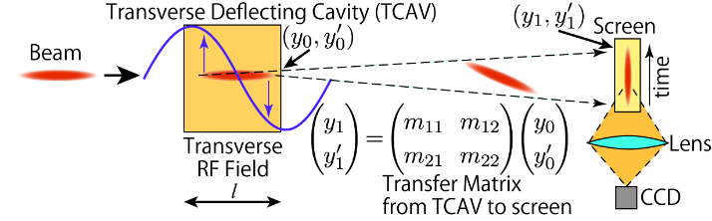
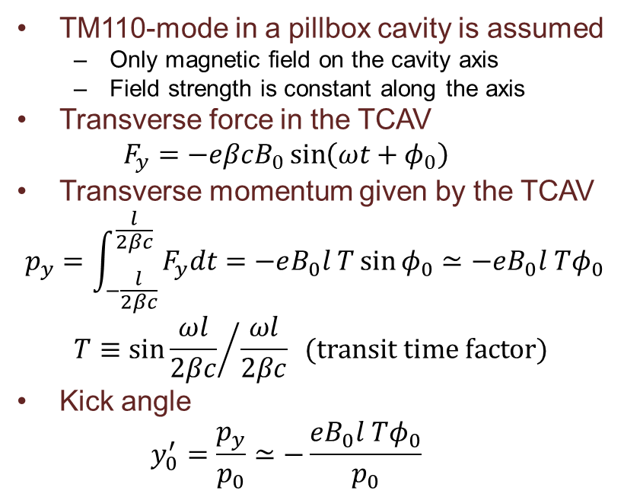
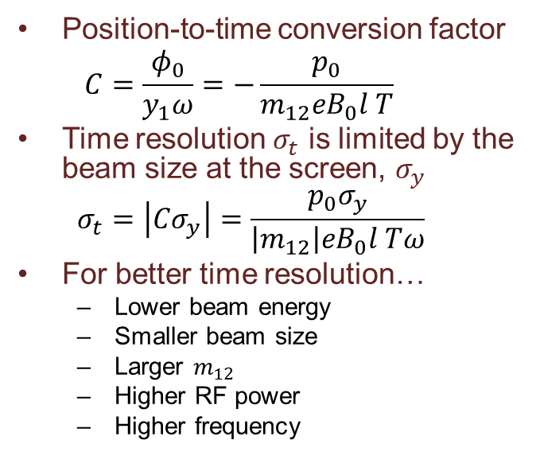
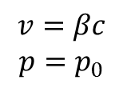

Time Resolution
$$v=βc$$
$$p=p_{0}$$
$$B_{0}\sin\left(ωt+φ_{0}\right)$$
TM110-mode in a pillbox cavity is assumed
  Only magnetic field on the cavity axis
  Field strength is constant along the axis
Transverse force in the TCAV
  $$F_{y}=−eβcB_{0}\sin\left(ωt+φ_{0}\right)$$
Transverse momentum given by the TCAV
  $$p_{y}=\int_{−\frac{l}{2βc}}^{\frac{l}{2βc}}{F_{y}dt}=−eB_{0}l T\sin{φ_{0}}≃−eB_{0}l Tφ_{0}$$
  $$T≡{\sin{\frac{ωl}{2βc}}}/{\frac{ωl}{2βc}} (transit time factor)$$
Kick angle
  $$y_{0}^{′}=\frac{p_{y}}{p_{0}}≃−\frac{eB_{0}l Tφ_{0}}{p_{0}}$$
Position-to-time conversion factor
  $$C=\frac{φ_{0}}{y_{1}ω}=−\frac{p_{0}}{m_{12}eB_{0}l T}$$
Time resolution $σ_{t}$ is limited by the beam size at the screen, $σ_{y}$
  $$σ_{t}=\left|Cσ_{y}\right|=\frac{p_{0}σ_{y}}{\left|m_{12}\right|eB_{0}l Tω}$$
For better time resolution…
  Lower beam energy
  Smaller beam size
  Larger $m_{12}$
  Higher RF power
  Higher frequency

Slide 8
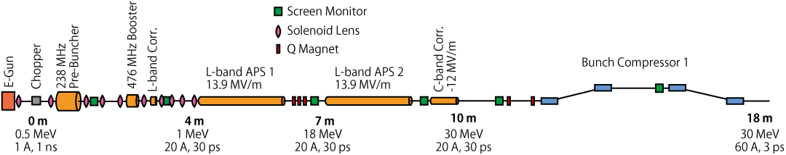
Requirements for TCAV
Place for TCAV
Velocity
bunching
TCAV for velocity bunching
  Upstream of the L-APS is the best position for TCAV
  The end of the velocity bunching section
Low energy beam doesn’t need high deflecting field
  Several 10 kV is enough for 1 MeV beam
  Single-cell cavity can be used. → Compact
Bunch length ranges from 10 ps – 1 ns
  High time resolution (< 3 ps) for a short bunch → Large kick angle
  Wide measurement range for a long bunch (1 ns) → Low frequency
Longitudinal magnetic field in a solenoid should be taken into account
  Transverse momentum is rotated
  Stretched image can be distorted
Screen monitor is downstream of L-APS
  Beam dynamics in the L-APS should also be considered.

Slide 9
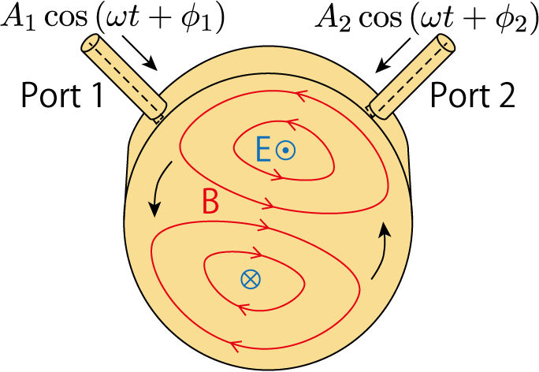
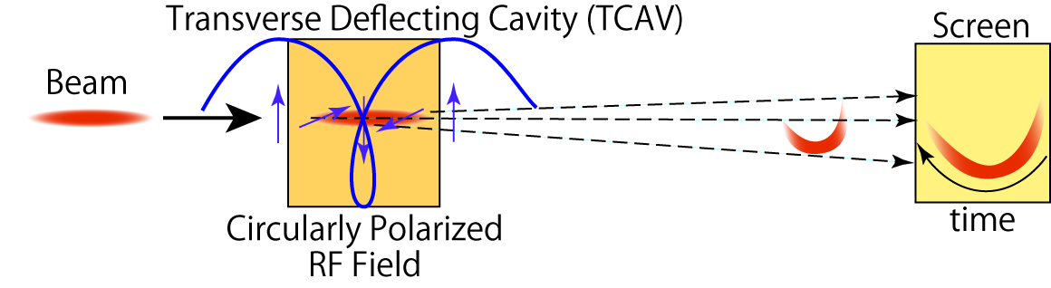
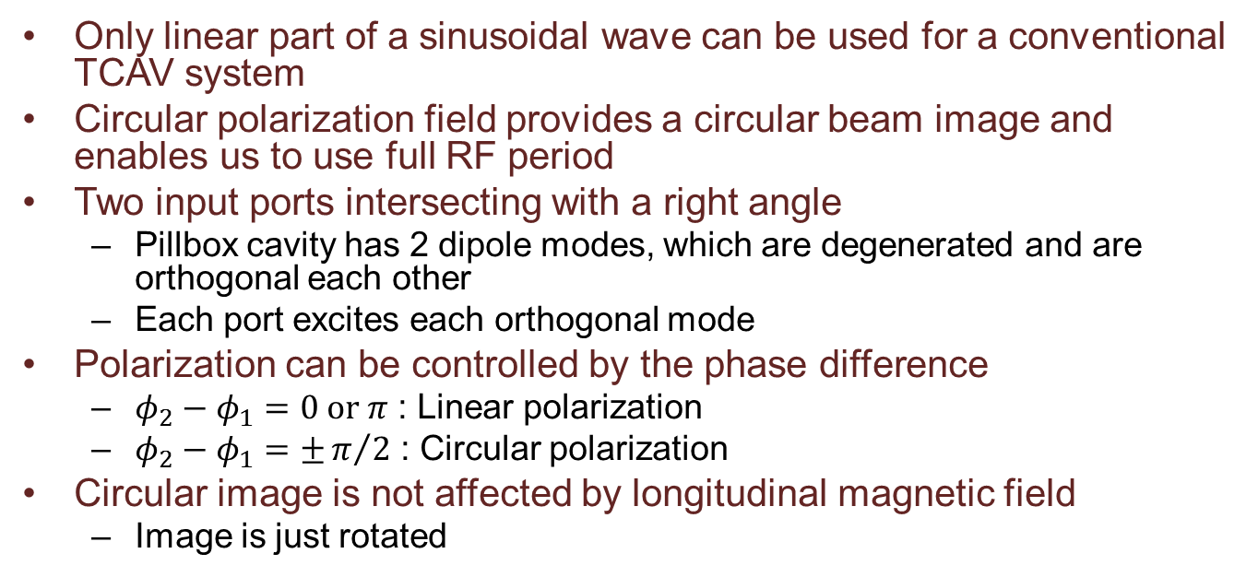
For Wide Measurement Range
Only linear part of a sinusoidal wave can be used for a conventional TCAV system
Circular polarization field provides a circular beam image and enables us to use full RF period
Two input ports intersecting with a right angle
  Pillbox cavity has 2 dipole modes, which are degenerated and are orthogonal each other
  Each port excites each orthogonal mode
Polarization can be controlled by the phase difference
  $φ_{2}−φ_{1}=0 or π$ : Linear polarization
  $φ_{2}−φ_{1}=±π/2$ : Circular polarization
Circular image is not affected by longitudinal magnetic field
  Image is just rotated

Slide 10
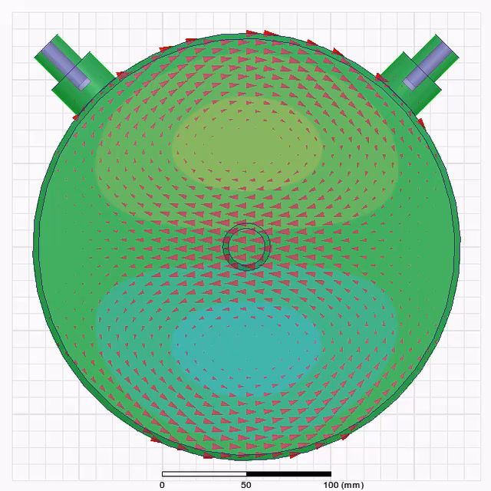
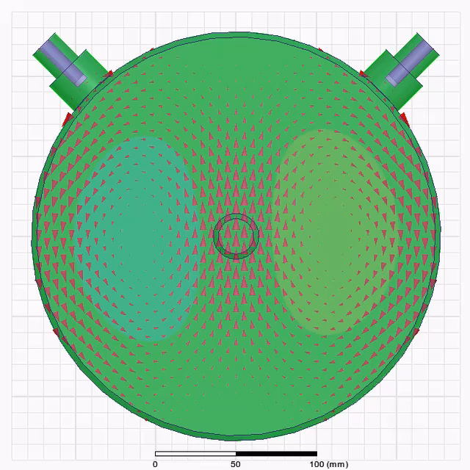
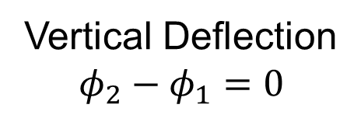
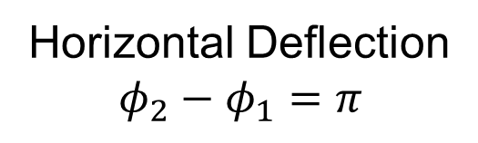
Linear Polarization
Vertical Deflection
$$φ_{2}−φ_{1}=0$$
Horizontal Deflection
$$φ_{2}−φ_{1}=π$$
Contour: E-field
Arrows: H-field

Slide 11
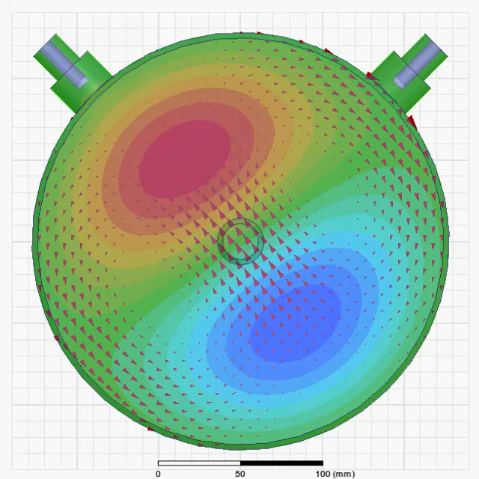
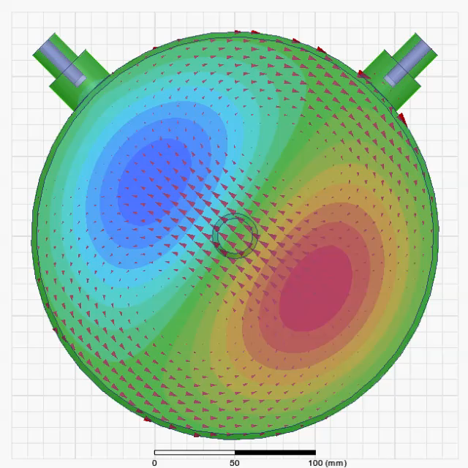

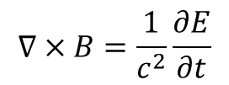
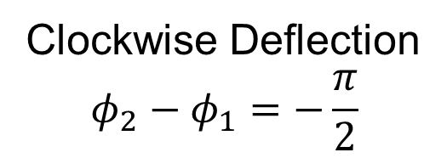
Circular Polarization
Clockwise Deflection
$$φ_{2}−φ_{1}=−\frac{π}{2}$$
Counter Clockwise Deflection
$$φ_{2}−φ_{1}=\frac{π}{2}$$
Contour: E-field
Arrows: H-field
$$∇×B=\frac{1}{c^{2}}\frac{∂E}{∂t}$$

Slide 12
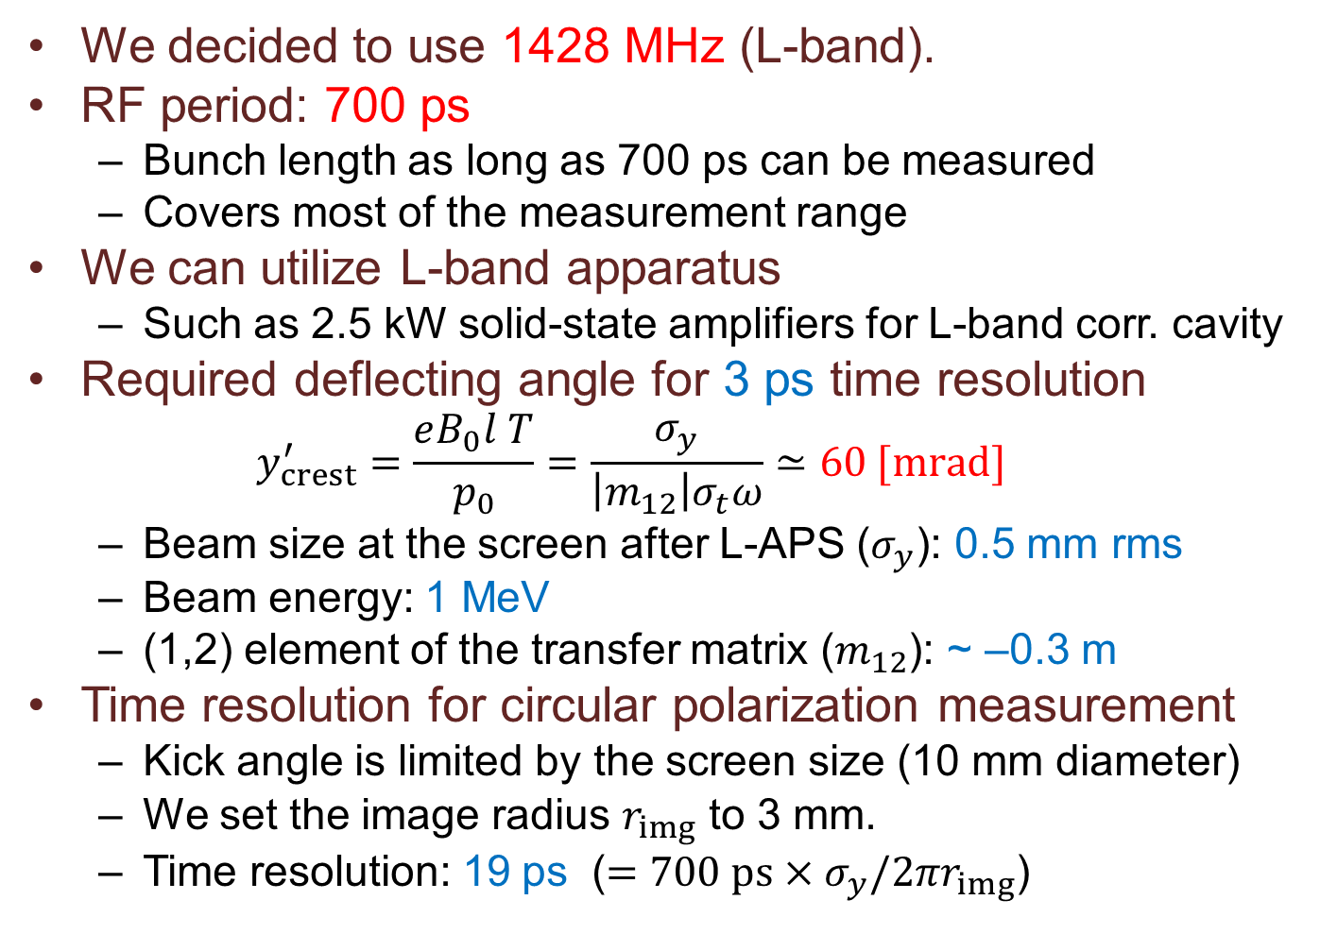
RF Frequency
We decided to use 1428 MHz (L-band).
RF period: 700 ps
  Bunch length as long as 700 ps can be measured
  Covers most of the measurement range
We can utilize L-band apparatus
  Such as 2.5 kW solid-state amplifiers for L-band corr. cavity
Required deflecting angle for 3 ps time resolution
  $$y_{crest}^{′}=\frac{eB_{0}l T}{p_{0}}=\frac{σ_{y}}{\left|m_{12}\right|σ_{t}ω}≃60 [mrad]$$
  Beam size at the screen after L-APS ($σ_{y}$): 0.5 mm rms
  Beam energy: 1 MeV
  (1,2) element of the transfer matrix ($m_{12}$): ~ –0.3 m
Time resolution for circular polarization measurement
  Kick angle is limited by the screen size (10 mm diameter)
  We set the image radius $r_{img}$ to 3 mm.
  Time resolution: 19 ps ($=700 ps×σ_{y}/2πr_{img}$)

Slide 13
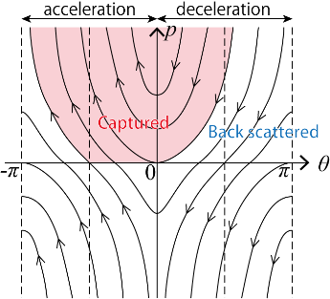
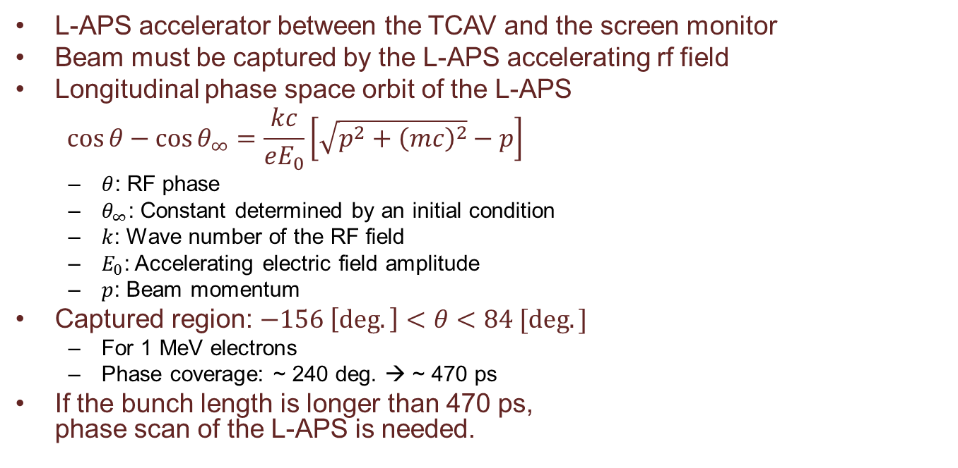
RF Capture by L-APS
L-APS accelerator between the TCAV and the screen monitor
Beam must be captured by the L-APS accelerating rf field
Longitudinal phase space orbit of the L-APS
$$\cos{θ}−\cos{θ_{∞}}=\frac{kc}{eE_{0}}\left[\sqrt{p^{2}+{\left(mc\right)}^{2}}−p\right]$$
  $θ$: RF phase
  $θ_{∞}$: Constant determined by an initial condition
  $k$: Wave number of the RF field
  $E_{0}$: Accelerating electric field amplitude
  $p$: Beam momentum
Captured region: $−156 \left[deg.\right]<θ<84 [deg.]$
  For 1 MeV electrons
  Phase coverage: ~ 240 deg. → ~ 470 ps
If the bunch length is longer than 470 ps,
phase scan of the L-APS is needed.
TCAV

Slide 14
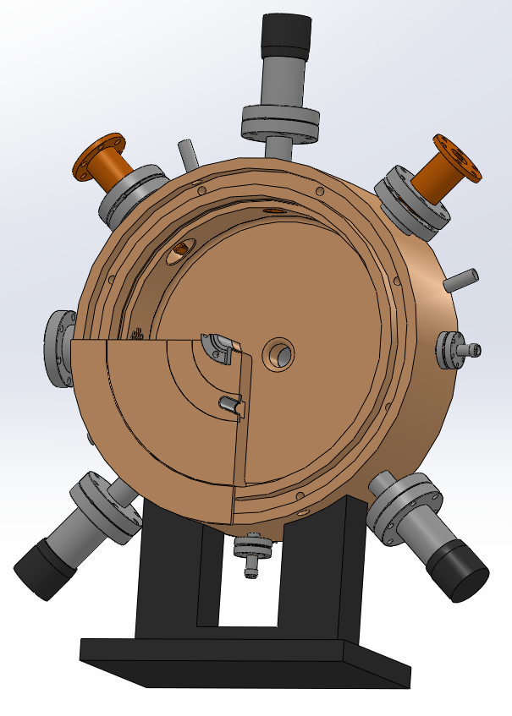
Cavity Design
Resonant Frequency:
1428 MHz
Resonant Mode: TM110
2 input ports for arbitrary polarization
3 tuners
  Port 1 frequency
  Port 2 frequency
  Orthogonality
2 pickup ports for monitoring
Inner length: 60 mm
Inner diameter: ~256 mm
Flange-to-flange distance:
160 mm
Input power: 2.5 kW each
  From Solid-state amplifier
Tuner for
orthogonality
Port 1
Port 2
Pickup 1
Pickup 2
Tuner for
Port 2
Tuner for
Port 1

Slide 15
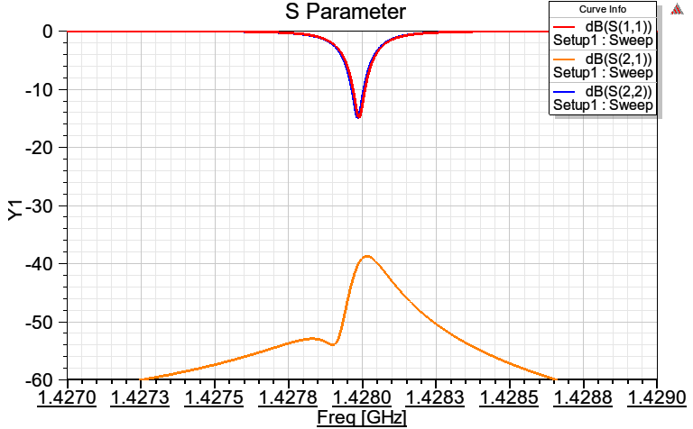
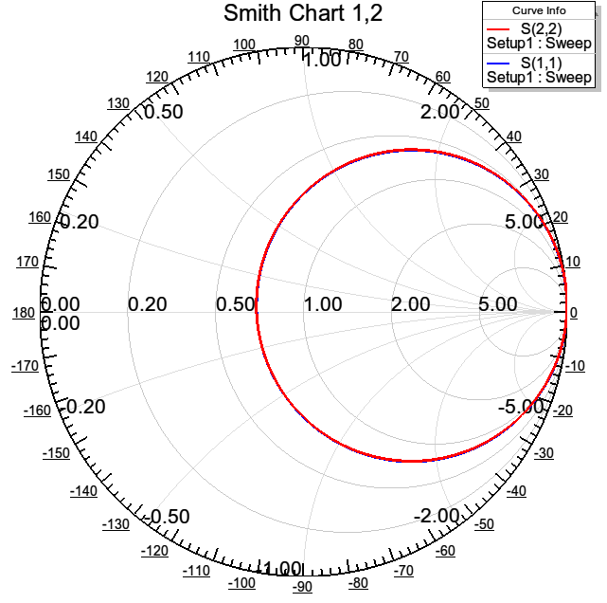
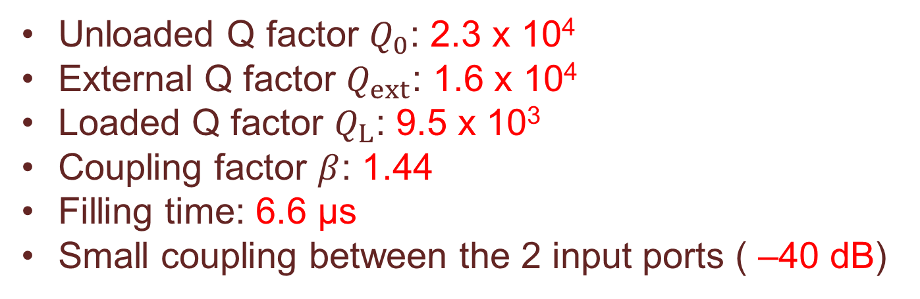
RF Simulation
Unloaded Q factor $Q_{0}$: 2.3 x 10⁴
External Q factor $Q_{ext}$: 1.6 x 10⁴
Loaded Q factor $Q_{L}$: 9.5 x 10³
Coupling factor $β$: 1.44
Filling time: 6.6 μs
Small coupling between the 2 input ports ( –40 dB)
S11
S22
S21

Slide 16
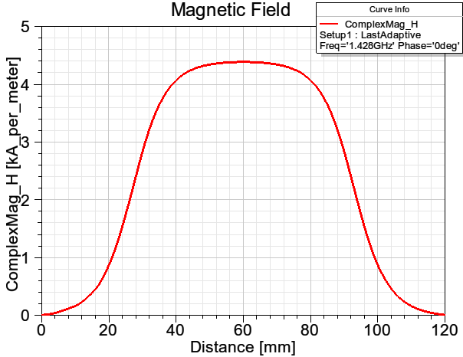
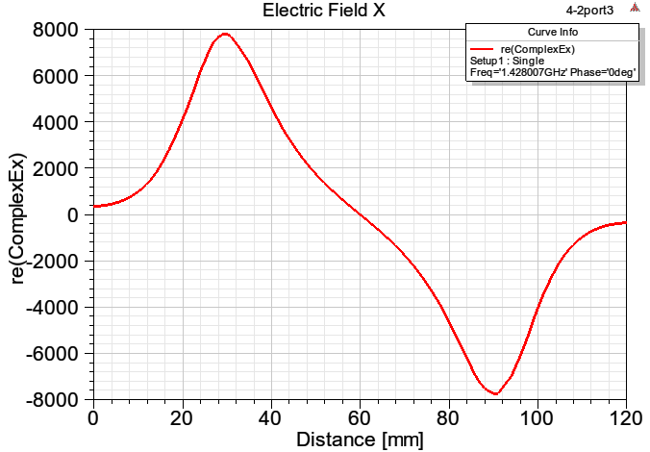
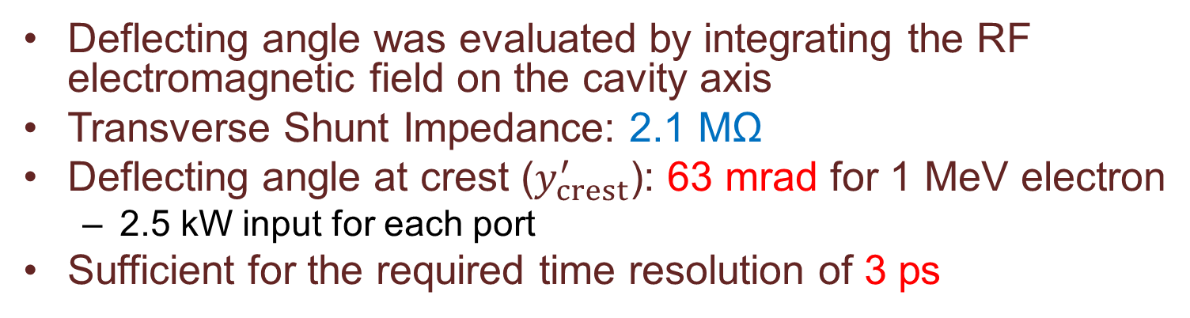
Deflecting Angle
Deflecting angle was evaluated by integrating the RF electromagnetic field on the cavity axis
Transverse Shunt Impedance: 2.1 MΩ
Deflecting angle at crest ($y_{crest}^{′}$): 63 mrad for 1 MeV electron
  2.5 kW input for each port
Sufficient for the required time resolution of 3 ps
H
2.5 kW input
for each port
E

Slide 17
Summary
Temporal bunch structure measurement is demanded in the velocity bunching section at SACLA
  Beam Energy: ~ 1 MeV
  Bunch Length: 10 ps – 1 ns
  Time Resolution: 3 ps for 10 ps bunch
We designed a compact L-band transverse deflector system
  RF Frequency: 1428 MHz (L-band)
  Arbitrary polarization selection
    2 input ports intersecting at a right angle
  Linear polarization: high time resolution
  Circular polarization: long bunch
  Inner cavity length: 60 mm
  2.5 kW input for each port
Wide measurement range up to 700 ps
High time resolution down to 3 ps

