Slide 1
IBIC 2014
Highlights
Monterey, California, USA
September 14-18, 2014
http://accelconf.web.cern.ch/AccelConf/IBIC2014/

Slide 2
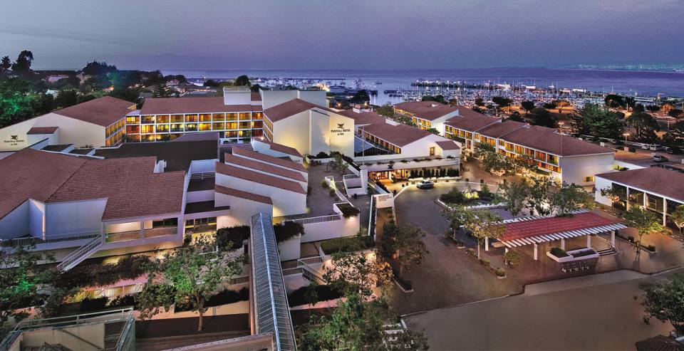

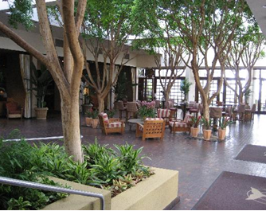
Monterey, California
Downtown Monterey
California coast
Close to marina,
Fisherman’s Wharf
Restaurants
Whale watching

Slide 3
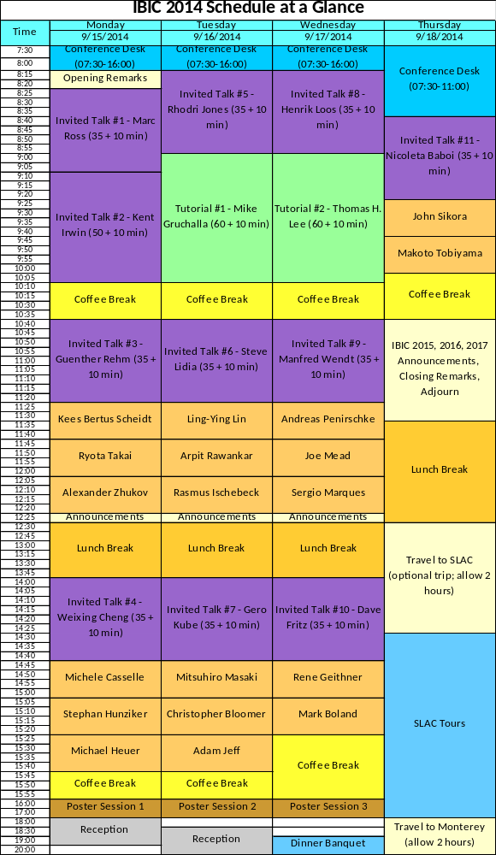
Program
2 tutorials
  “Managing EM interference”
    Mike Gruchalla
  “Dark Secrets or RF Design”
    Thomas H. Lee
11 invited talks
19 contributed oral
180 posters
21 exhibitors
Reception / discussion sessions:
  Sunday evening
  Monday
    (Faraday Cup celebration)
  Tuesday
Banquet Wednesday
SLAC tour Thursday

Slide 4
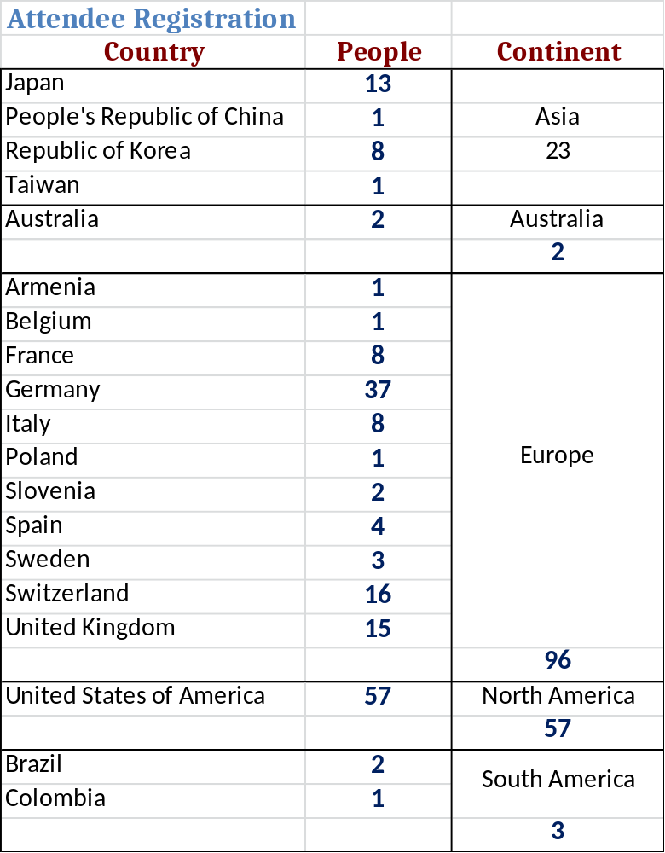
181 Participants
Europe wins participation contest
Asia /Australia waiting for IBIC 2015
Lab | People
SLAC/Stanford U | 18
DESY | 16
Brookhaven N L | 13
CERN | 11
Pohang | 7
Alba | 5
Elettra | 5
GSI | 5
KEK | 5
LANL | 5
Diamond | 4
FRIB | 4
FNAL | 4
HZDR | 4
PSI | 4
ISIS | 4
Daresbury | 3
ESS | 3
GANIL | 3
Darmstadt | 3
Others | 55

Slide 5
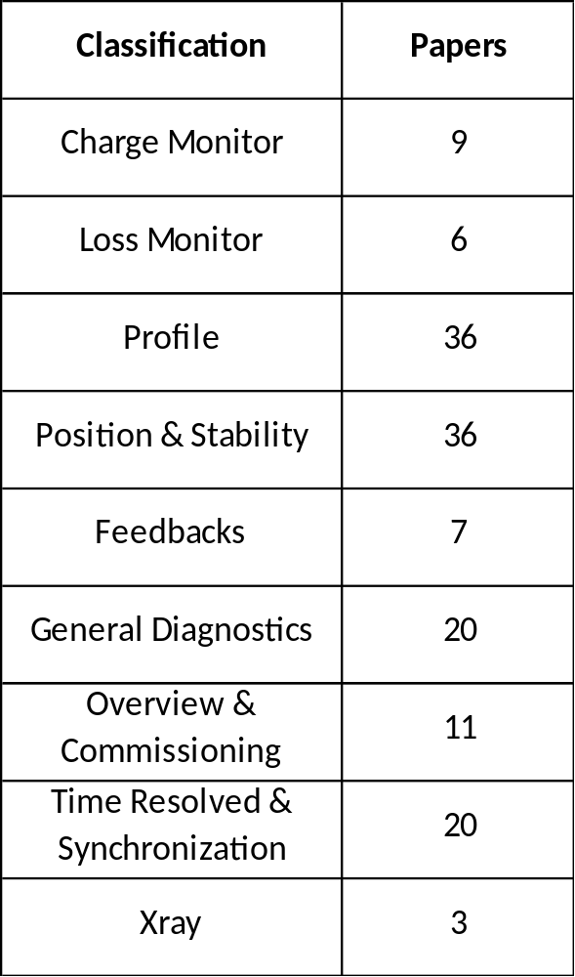
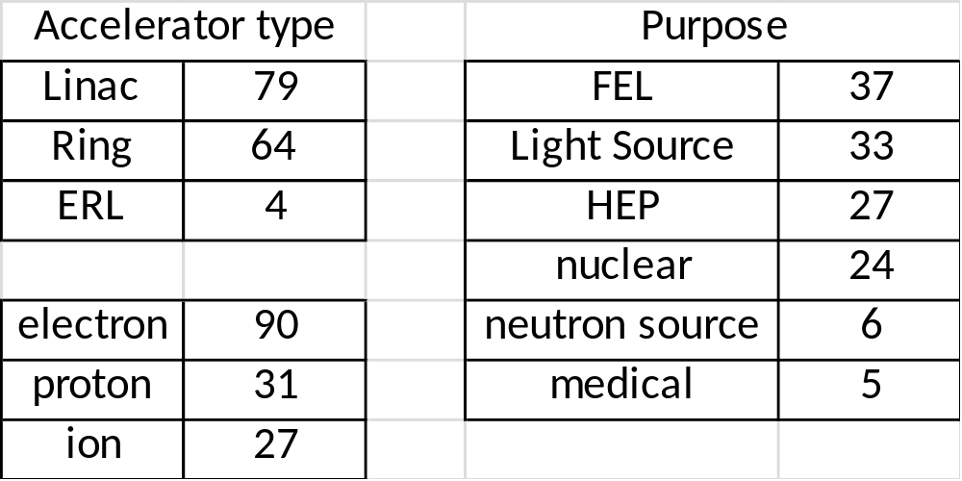
Talks
Many talks on
  Beam Position
  Profile
  Longitudinal

Slide 6
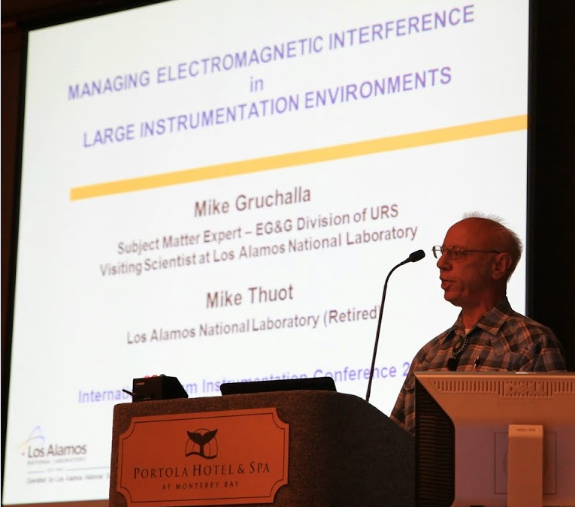
TUTORIAL
Notes:
The tutorials were real highlights of the Confference

Slide 7
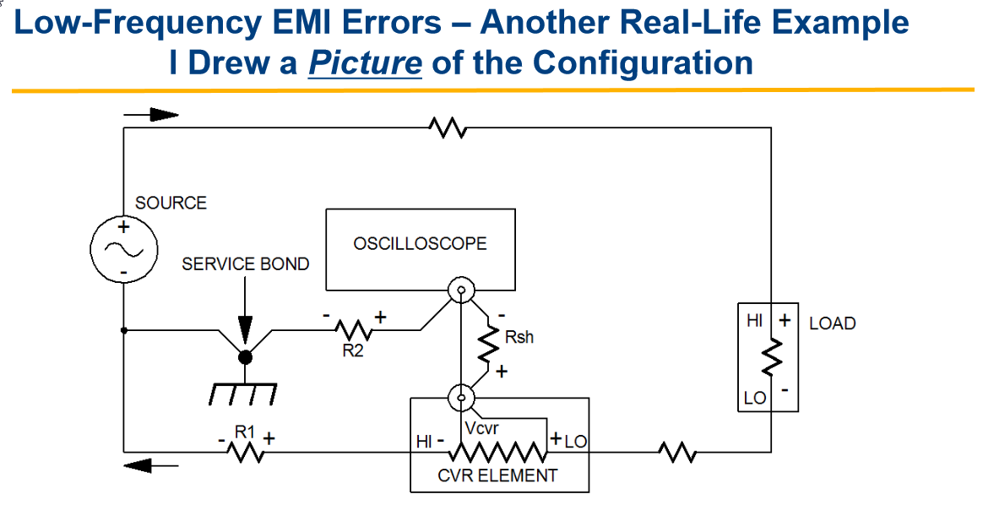
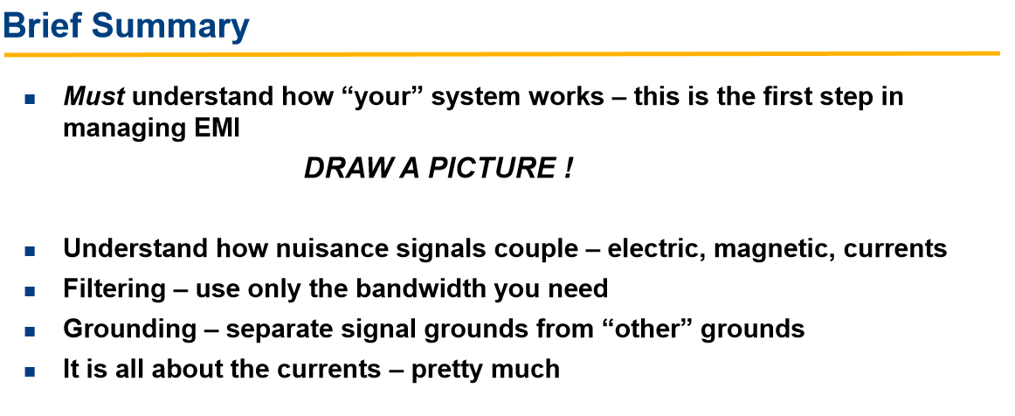
  Tutorial - Mike Gruchalla
  Managing Electromagnetic Interference in Large Instrumentation Environments

Slide 8
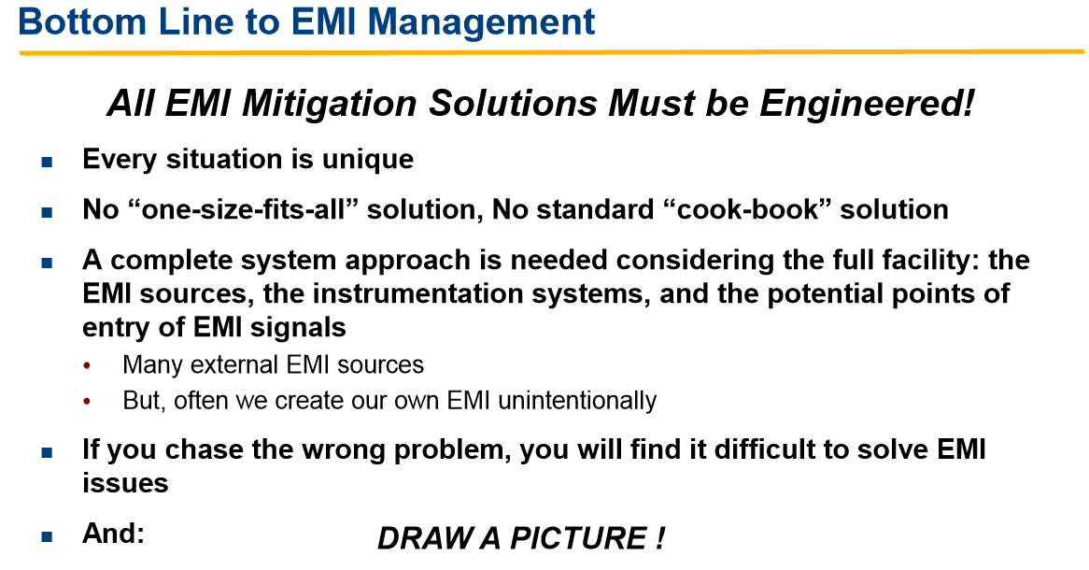
  Tutorial:
  Managing Electromagnetic Interference in Large Instrumentation Environments
  Mike Gruchalla

Slide 9
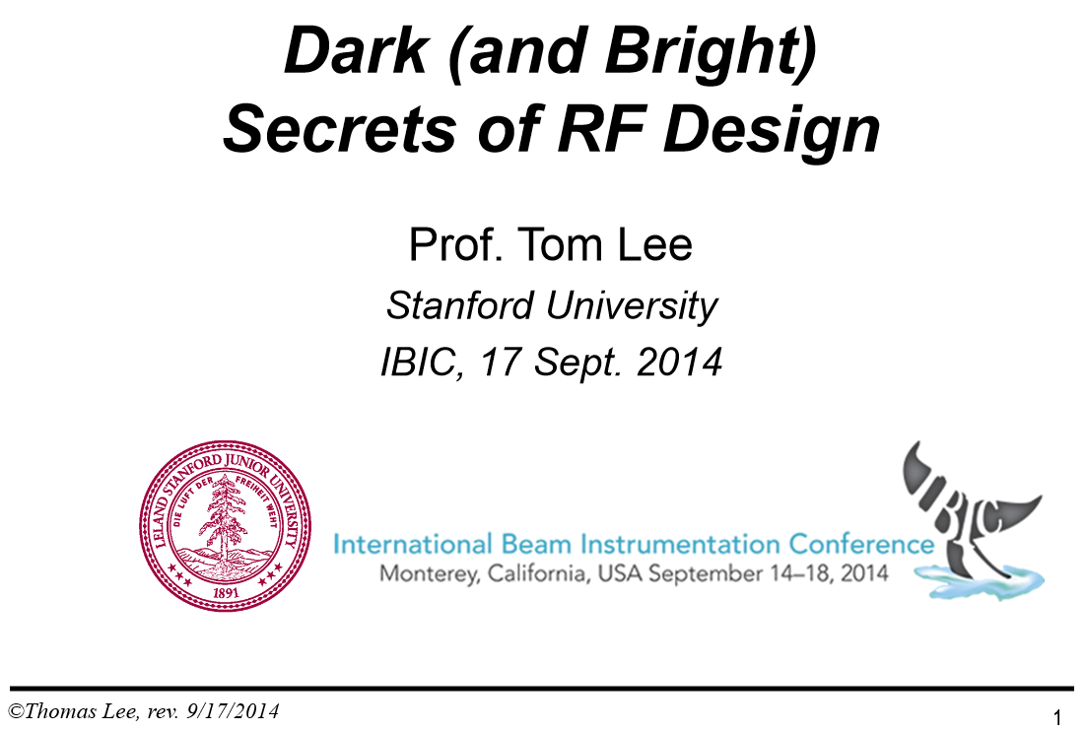
Tutorial
RF design is a mystery to many engineers …
It sometimes seems that a pointy hat and arcane incantations are needed to make oscillators oscillate and amplifiers amplify (and not vice-versa).
Part of the mystery has to do with the many ways that ever-present parasitics undergo surprising impedance transformations, as well as the sometimes counterintuitive ways that nonlinear and time-varying processes can affect noise in amplifiers, oscillators and mixers.

Slide 10
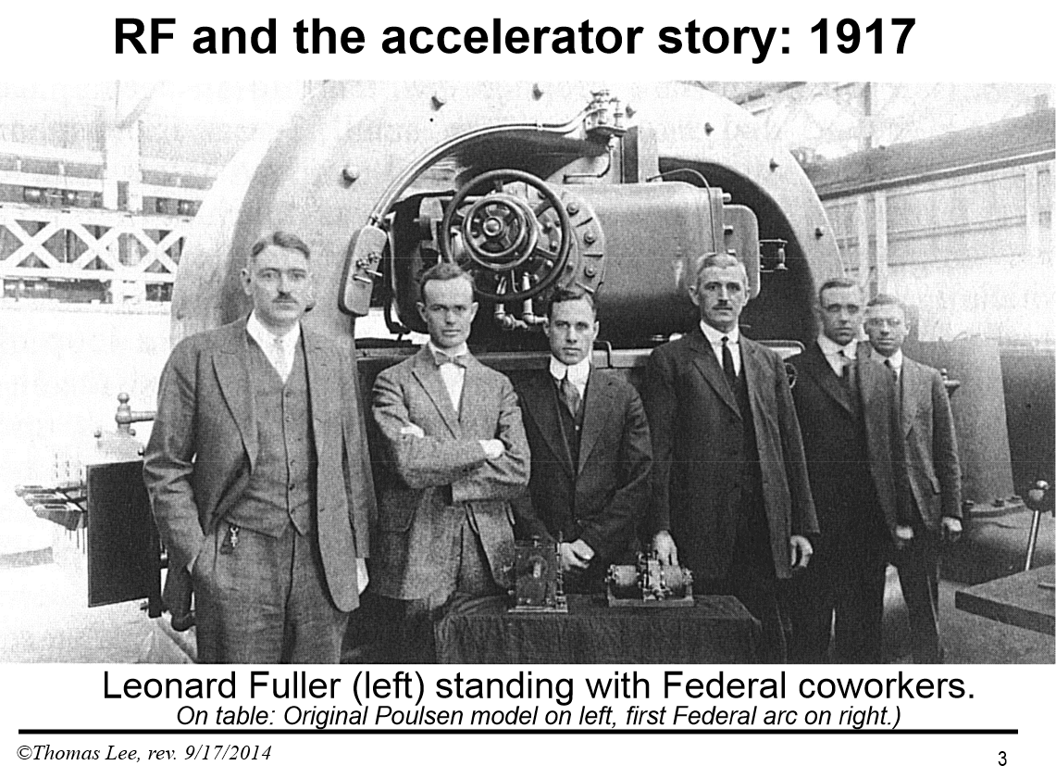
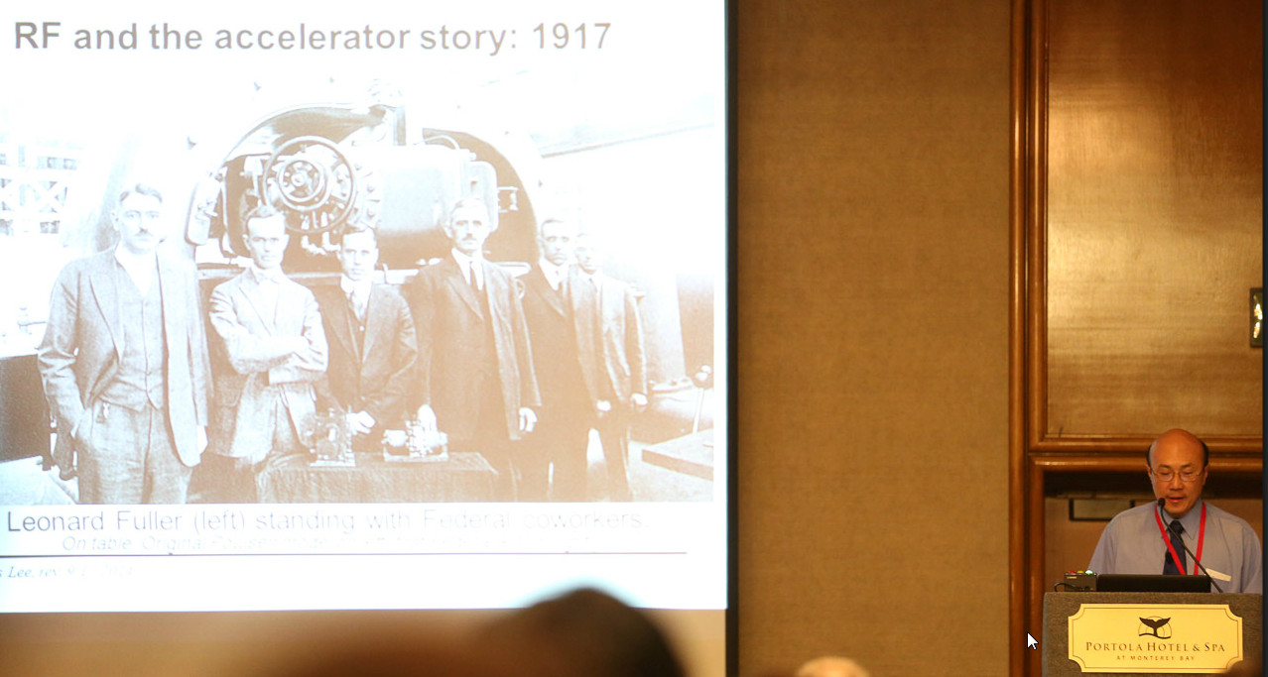
Tutorial – Thomas H. Lee

Slide 11
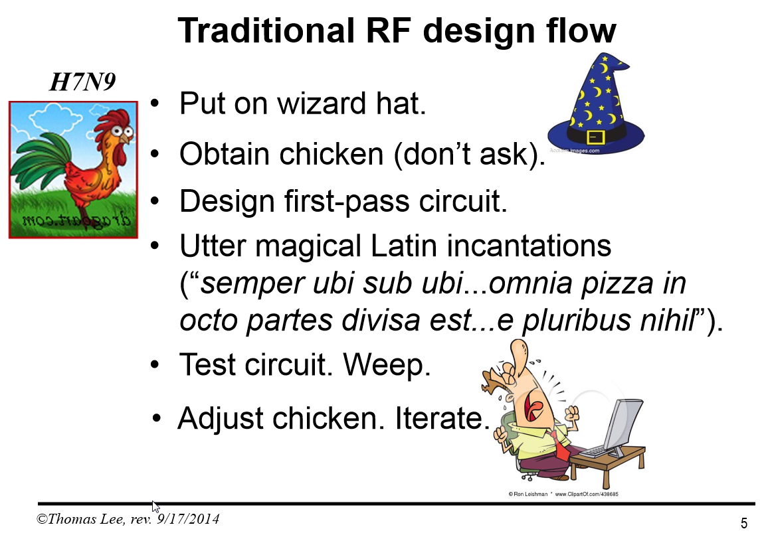

Slide 12
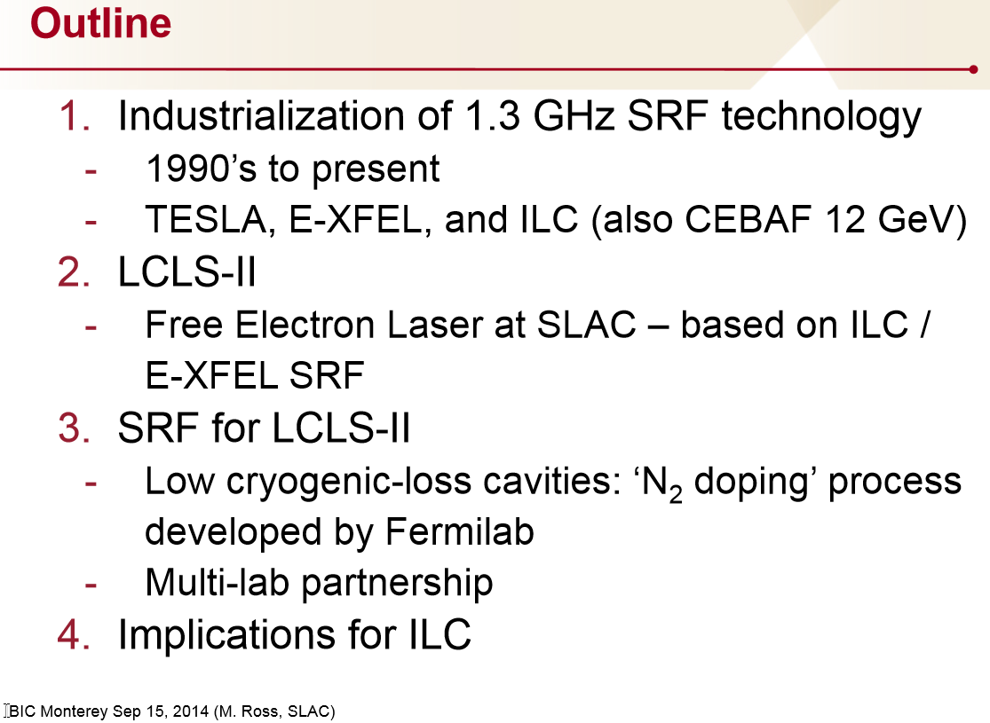
Lab / Project Reports
Marc Ross (SLAC), “Technical Developments in Support of Accelerator-Based Science at SLAC”
  Superconducting RF for SLAC XFEL/International Linear Collider
Kent Irwin (Stanford), “Superconducting Spectrometers for X-ray Beamline Applications and Cosmology”
  Superconducting photon spectrometer arrays for Cosmic Microwave Background studies, Xray detectors for XFELs & other things
  mK noise, electronics, massively parallel SQUID readout,…
Ryota Takai (KEK), “Beam Diagnostics for the KEK Compact ERL”
  BPMs, YAG screens, Beam loss fibers
  design and early commissioning.
Weixing Cheng (BNL), “NSLS2 Diagnostic Systems Commissioning and Measurements” and Yong Hu (BNL), “Diagnosing NSLS-II: A New Advanced Synchrotron Light Source”
  Commissioning starts
  Most diagnostic systems commissioned with beam
  proved to be critical to success of machine commissioning.

Slide 13
Lab / Project Reports (2)
Rhodri Jones (CERN), The Beam Instrumentation and Diagnostic Challenges for LHC Operation at High Energy”
  Machine protection, beam loss, & abort gap monitor interlocks on the beam position and fast beam current change system.
  profile monitoring challenges: synchrotron light imaging limited by diffraction, rest gas ionization dominated by space charge effects.
  beam instabilities require synchronized bunch-by-bunch, turn-by-turn information from many distributed instrumentation systems
Rasmus Ischebeck (PSI), Overview of Beam Instrumentation Activities for SwissFEL”
Henrik Loos (SLAC), “LCLS Beam Diagnostics”
  What worked / what didn’t / what’s new & improved since initial commissioning
  New operational modes

Slide 14
Lab / Project Reports (3)
Nicoletta Baboi (DESY), “Commissioning of the FLASH2 Electron Beam Diagnostics in Respect to its use at the European XFEL”
  first operation of electron beam diagnostics at FLASH2.
  Most electron beam diagnostics installed (beam loss monitors, cavity beam position monitors, toroids, beam halo monitors) designed for the European XFEL.
Dirk Noelle (DESY), “Status of the Standard Diagnostic Systems of the European XFEL”
  design phase finished for all main systems
  most components in production

Slide 15
Highlights
Faster electronics
  High Bandwidth Sampling
  Laser wire for longitudinal profile
    SNS
  ps sample/hold
    KIT
  Short optical pulse timing systems (OMO)
    PSI, DESY
Higher dynamic range
  Halo measurements far out on tails
  BPM resolutions over dynamic range
More digital processing
  FPGAs

Slide 16
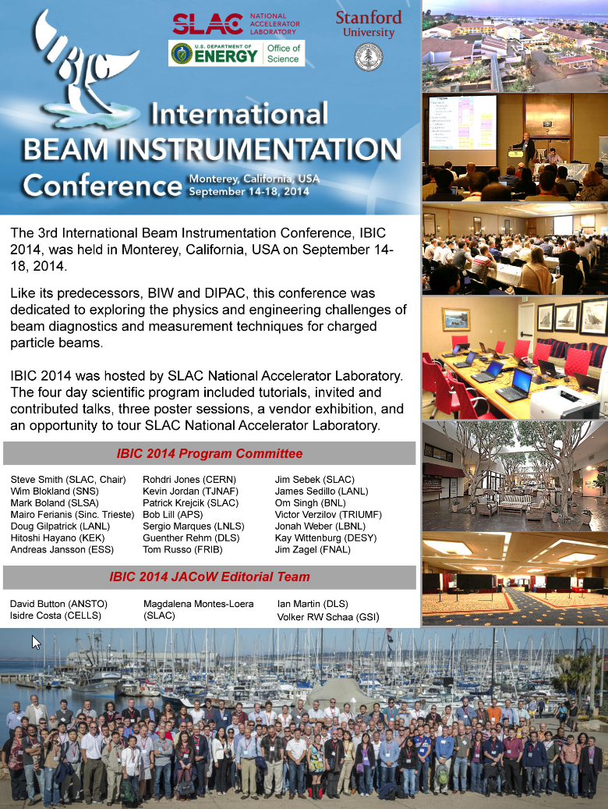
Proceedings
Papers:
Proceedings of the 3rd International Beam Instrumentation Conference
http://accelconf.web.cern.ch/AccelConf/IBIC2014/
http://accelconf.web.cern.ch/AccelConf/IBIC2014/
Slides:
  https://conf-slac.stanford.edu/ibic-2014/

Slide 17
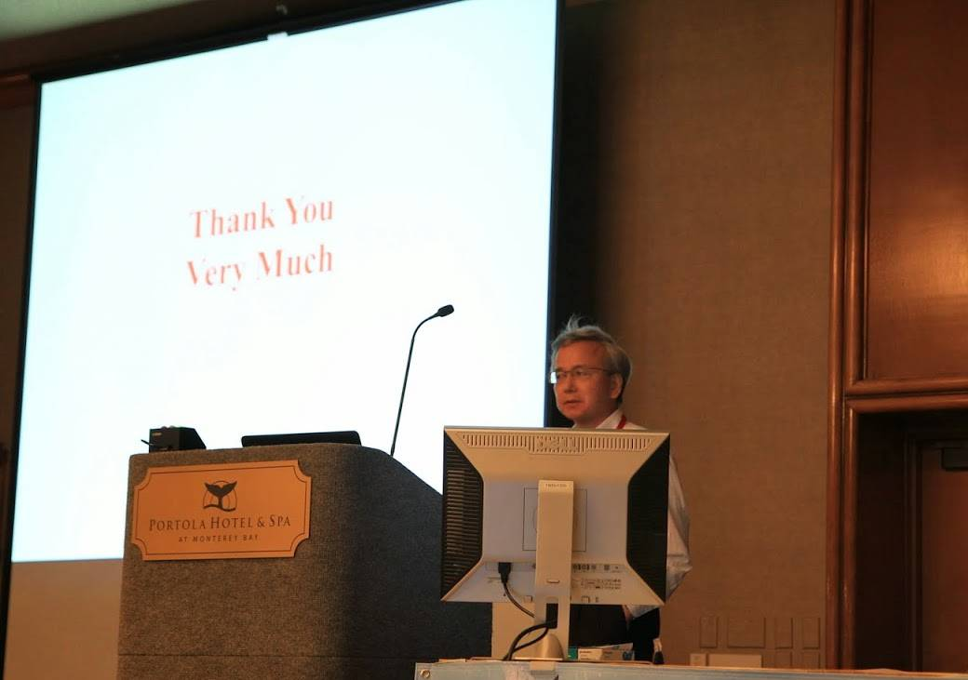

Slide 18
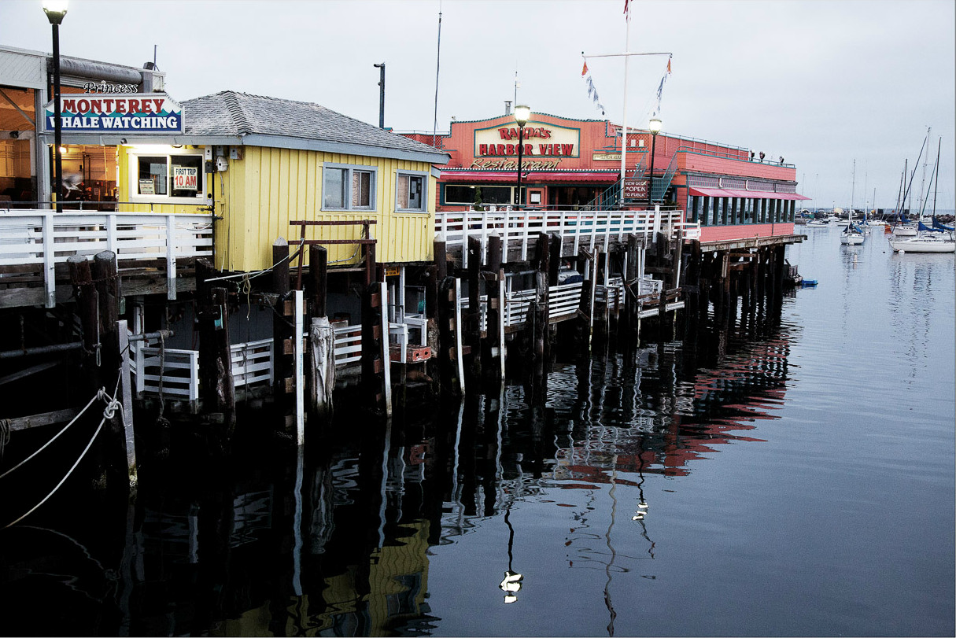
Dirk Nölle

Slide 19

Dirk Nölle

Slide 20
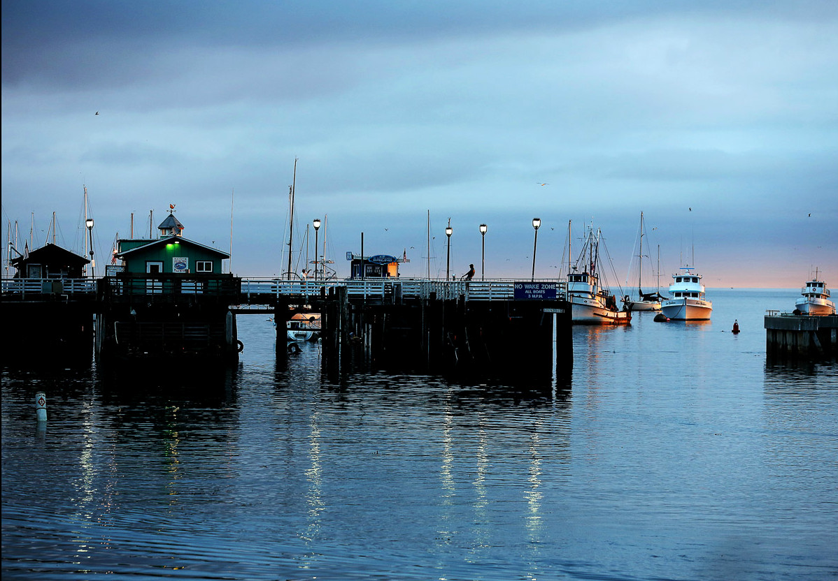
Dirk Nölle

Slide 21

Dirk Nölle

