Slide 1

BPM System Design
Invited tutorial at IBIC 2015, Melbourne
Hermann Schmickler, CERN
With most slides from:
Peter Forck (GSI), Manfred Wendt (CERN), Piotr Kowina (GSI), Rhodri Jones (CERN), Marek Gasior (CERN), T.Lefevre (CERN)
David Rubin (Cornell), M.Tejima (KEK)

Slide 2
Outline
Principle, Applications of BPMs
Functional Specifications (FS)
Sensors + Sensor Signals
Electronics
Synchronization, accelerator timing
From precision to accuracy
Outlook
Not covered: Simulation Tools, Managerial Considerations
Speed

Slide 3
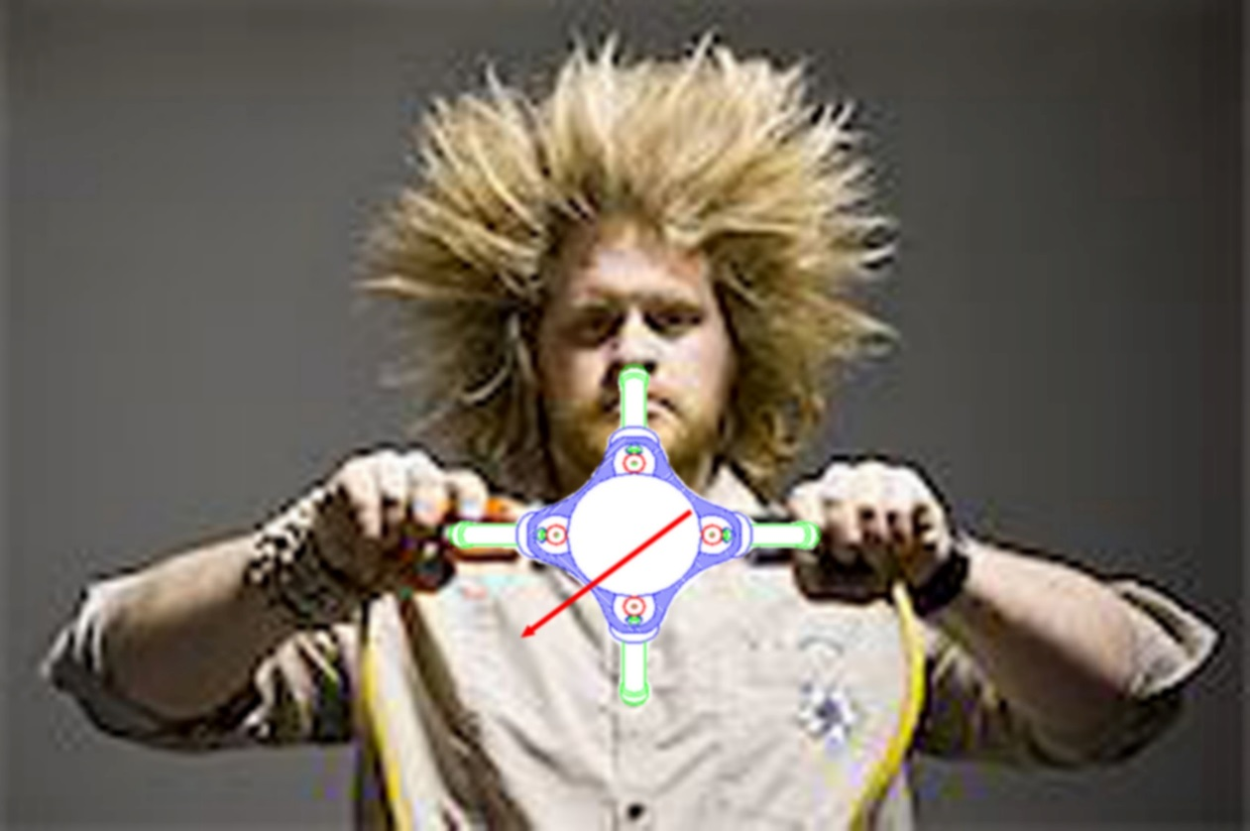
Introduction
The particle beam induces an electrical signal in two opposing electrodes. The induced signals depend
- on the beam intensity
- on the proximity of the beam to the sensors
Intuitively the term:
“difference over sum” should measure the beam position….how well we will see later
One of the principle problems is that the requested observable (beam position) is measured as the difference of two large numbers….
We will see what impact this has on the measurement resolution/accuracy/precision
Some smart people build monitors, which give the difference by the nature of the monitor…cavity BPMs.
Those we will treat separately. In general they are limited to applications in linear accelerators due to their high coupling impedance.

Slide 4
Application of BPMs
On bunched beam
Trajectory Measurement: Measure beam positions during one revolution/passage through transfer line
Closed Orbit Measurement (CO): Average over “many” trajectories
Time resolution: from long averages of CO up to turn by turn trajectories, turn by turn trajectories even bunch by bunch
→ depending on bunch length even observation of bunch shape
Derived quantities:
- tune, chromaticity, coupling (using excited betatron oscillations plus observation with a single BPM)
- β-function and phase advance around the ring (using excited betatron oscillations plus observation with all BPMs), dispersion, injection matching…
Usage in real time feedbacks (on CO, multibunch stability)
Sensitivity down to nA beams (pC)

Slide 5
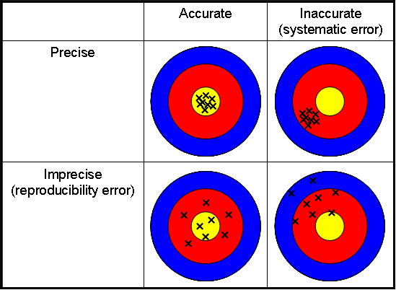
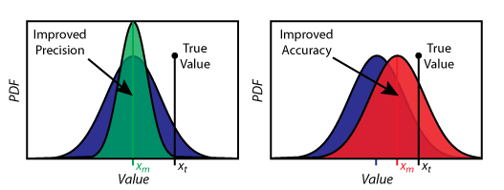
Accuracy, Precision, Resolution
Very often confused in day-to-day language
Accuracy:= also called trueness of measurement
Precision:= indicates how well one can reproduce measurements
Resolution:= smallest possible difference in successive measurements
Ex: BPM: Mechanical and electrical offsets, gain factors influence the accuracy, various noise sources or timing jitter influence the precision, quantization in the ADC can limit the resolution.

Slide 6
Functional Specification (FS)
Make sure you have this (in writing) before you start developing.
Initiative normally comes from the Instrument responsible, FS has to be written by future users of instrument.
FS needs to contain
- beam parameters,
- modes of operation,
- required accuracy, precision, resolution
- expected frequency of usage (i.e. wire scanners)
- specifications for control software and data analysis tools
Leads to an Engineering Specification (ES) produced by instrument specialist.
ES and FS represent a “contract” between producer and user.
Examples: http://sl-div-bi.web.cern.ch/sl-div-bi/LHC/ParamAndLayouts/Doc/FuncSpec.htm

Slide 7
Outline
Principle, Applications of BPMs
Functional Specifications (FS)
Sensors + Sensor Signals: capacitive sensors
Electronics
Synchronization, accelerator timing
From precision to accuracy
Outlook

Slide 8
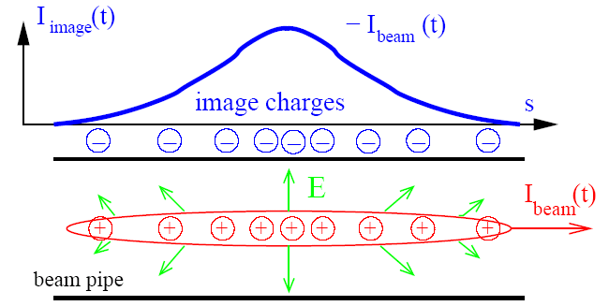
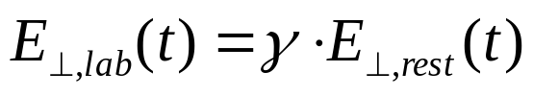
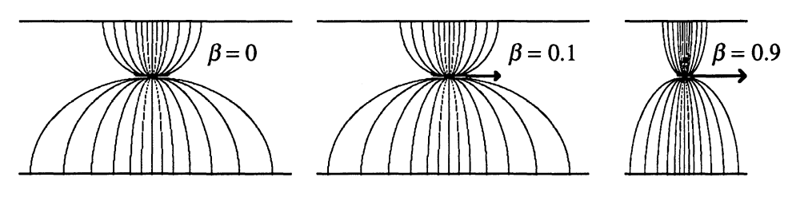
General Idea: Detection of Wall Charges
The image current at the vacuum wall is monitored on a high frequency basis
i.e. the ac-part given by the bunched beam.
Beam Position Monitor BPM equals Pick-Up PU
For relativistic velocities, the electric field is mainly transversal:

Slide 9
Principle of Signal Generation of capacitive BPMs
V
-
+
-
+
-
-
+
-
+
-
+
-
-
+
-
+
-
+
-
+
-
-
+
-
+
-
+
-
+
-
+
-
+
-
-
-
+
+
-
-
+
+
-
-
-
-
+
-
+
-
+
-
-
+
-
+
-
+
-
-
+
-
-
-
-
-
+
-
+
+
-
+
-
-
+
-
+
-
+
-
+
-
+
+
+
+
-
+
-
-
+
-
+
+
+
+
+
+
+
+
+
+
+
+
+
+
+
+
+
+
+
+
+
+
+
+
+
+
+
+
+
+
+
+
+
+
+
+
+
+
+
+
+
+
+
+
+
+
+
+
+
+
+
+
+
+
+
+
+
+
+
+
+
+
+
+
+
+
+
+
+
+
+
+
+
+
+
+
+
+
Same behavior as top plate
Animation by Rhodri Jones (CERN)

Slide 10
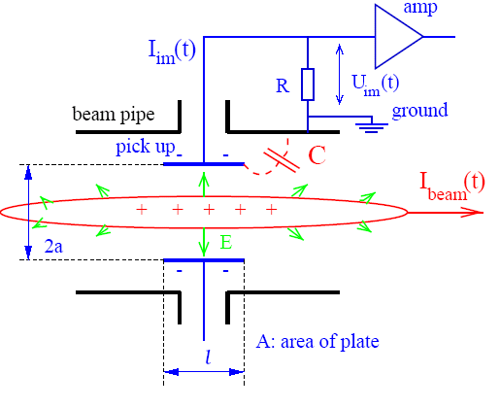
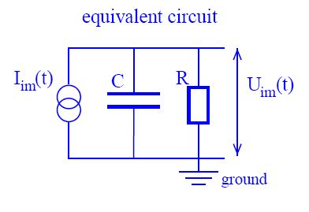
Model for Signal Treatment of capacitive BPMs
The wall current is monitored by a plate or ring inserted in the beam pipe:
The image current I_{im} at the plate is given by the beam current and geometry:
Using a relation for Fourier transformation: I_{beam} = I₀e^{iωt} ⇒ dI_{beam}/dt = iωI_{beam}.

Slide 11
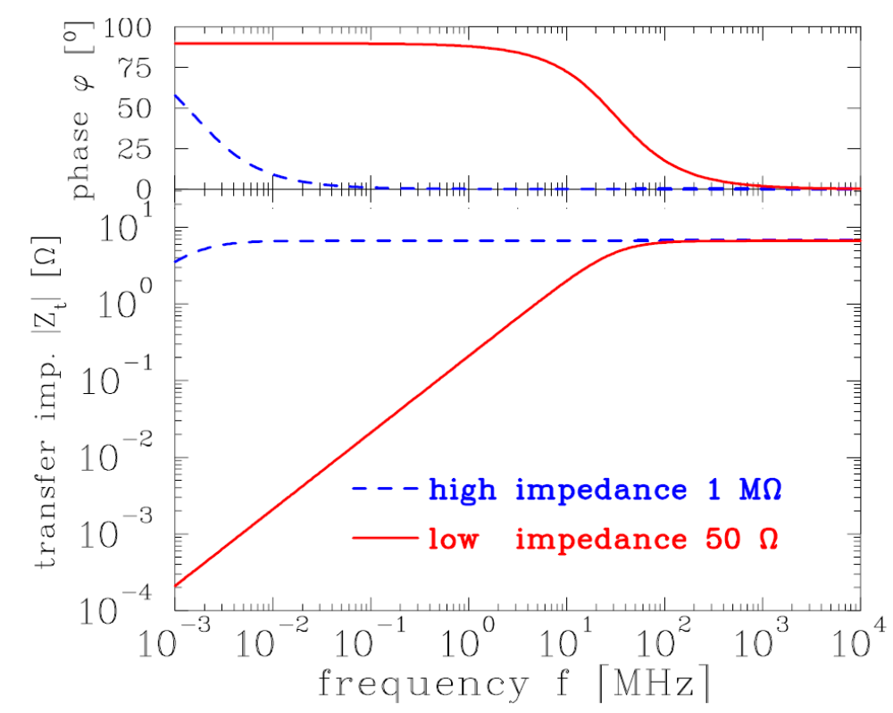
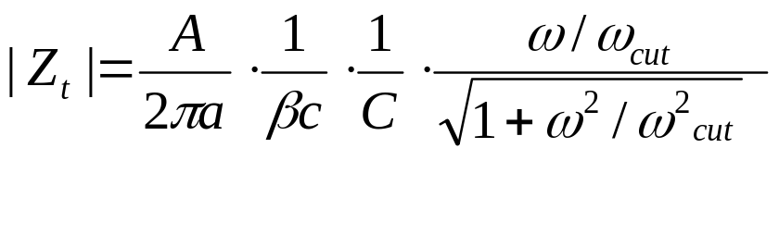

Example of Transfer Impedance for Proton Synchrotron
The high-pass characteristic for typical synchrotron BPM:
U_{im}(ω)=Z_{t}(ω)·I_{beam}(ω)
Parameter for shoe-box BPM:
C=100pF, l=10cm, β=50%
f_{cut}= ω/2π=(2πRC)⁻¹
for R=50 Ω ⇒ f_{cut}= 32 MHz
for R=1 MΩ ⇒ f_{cut}= 1.6 kHz

Slide 12
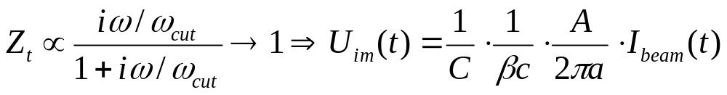
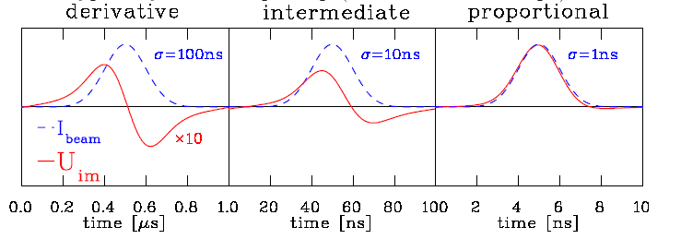
Signal Shape for capacitive BPMs: differentiated ↔ proportional
Depending on the frequency range and termination the signal looks different:
High frequency range ω >> ω_{cut} :
⇒ direct image of the bunch. Signal strength Z_{t} ∝ A/C i.e. nearly independent on length
Low frequency range ω << ω_{cut}:
⇒ derivative of bunch, single strength Z_{t} ∝ A, i.e. (nearly) independent on C
Example from synchrotron BPM with 50 Ω termination (reality at p-synchrotron : σ>>1 ns):

Slide 13
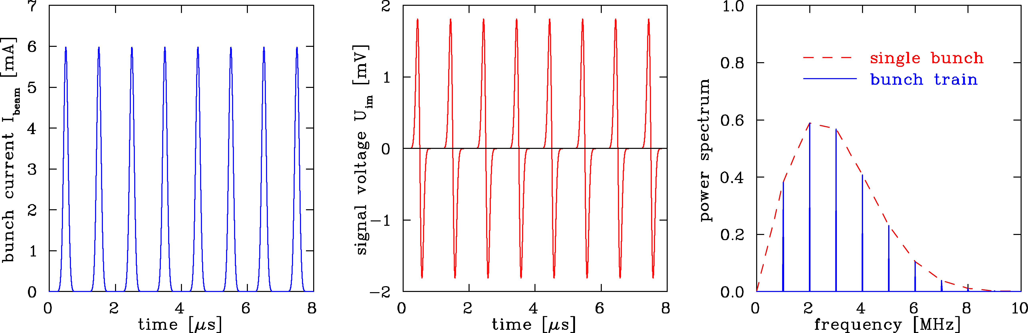
Calculation of Signal Shape: Bunch Train
Train of bunches with R=50 Ω termination ⇒ f << f_{cut} :
Calculation:
Parameter: R=50 Ω ⇒ f_{cut}=32 MHz, all buckets filled
C=100pF, l=10cm, β=50%, σ_{t}=100 ns
Fourier spectrum is composed of lines separated by acceleration f_{rf}
Envelope given by single bunch Fourier transformation
Differenciated bunch shape due to f_{cut} >> f_{rf}
Remark: 1 MHz< f_{rf} <10MHz ⇒ Bandwidth ≈100MHz = 10∙f_{rf} for broadband observation.

Slide 14
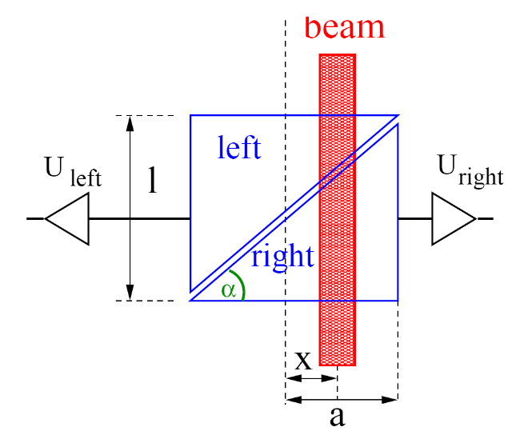
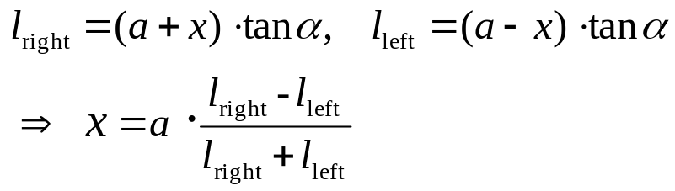
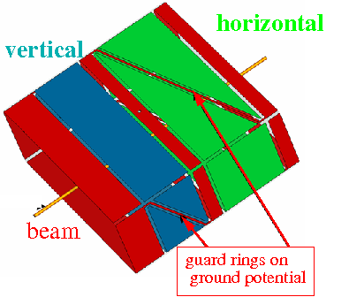
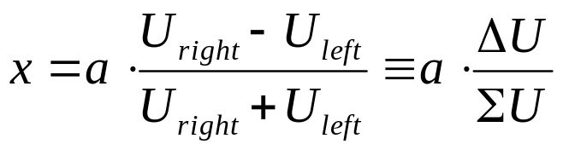
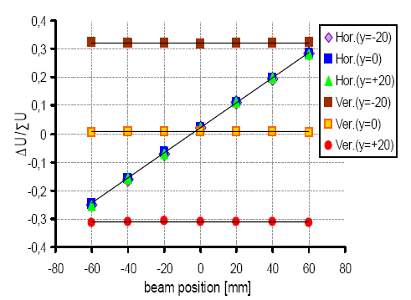
Shoe-box BPM for Proton or Ion Synchrotron
Frequency range: 1 MHz < f_{rf} < 10 MHz ⇒ bunch-length >> BPM length.
Signal is proportional to actual plate length:
In ideal case: linear reading
Size: 200x70 mm²
Shoe-box BPM:
Advantage: Very linear, low frequency dependence
i.e. position sensitivity S is constant
Disadvantage: Large size, complex mechanics
high capacitance

Slide 15
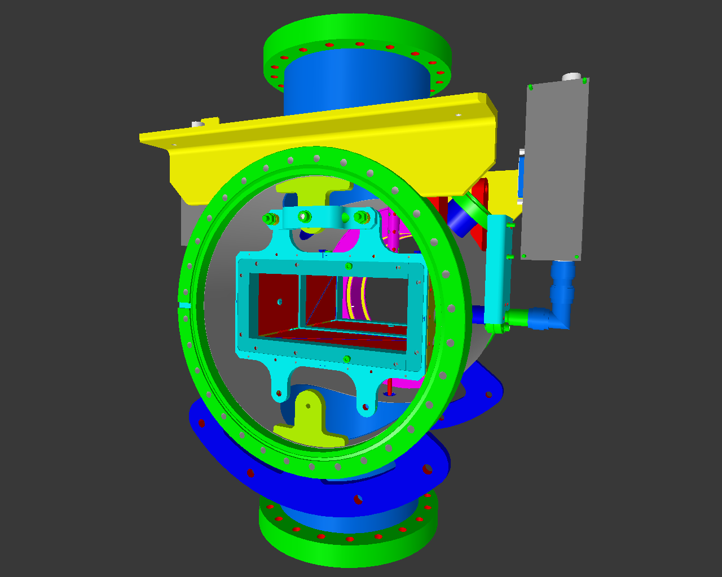
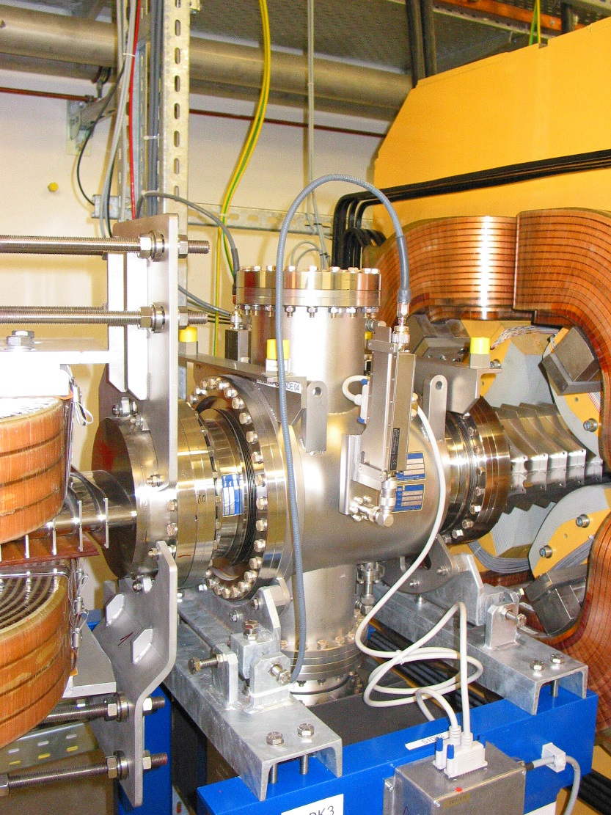
Technical Realization of Shoe-Box BPM
Technical realization at HIT synchrotron of 46 m length for 7 MeV/u→440 MeV/u
BPM clearance: 180x70 mm², standard beam pipe diameter: 200 mm.
Quadrupole
Linear Ampl.
Linear Ampl.
70
Beam
Right
channel
180

Slide 16
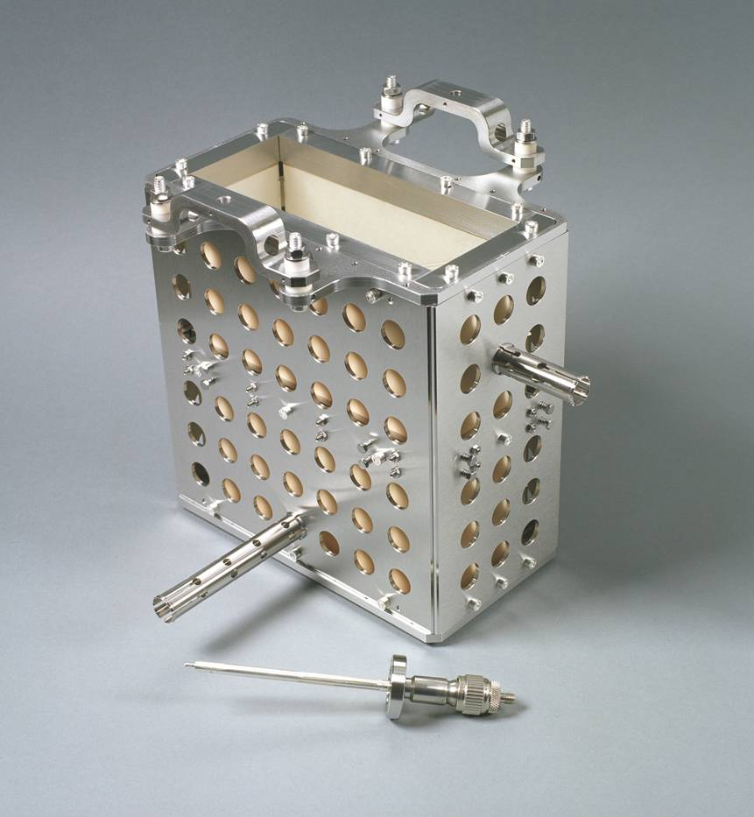

Technical Realization of Shoe-Box BPM
Technical realization at HIT synchrotron of 46 m length for 7 MeV/u→440 MeV/u
BPM clearance: 180x70 mm², standard beam pipe diameter: 200 mm.
Linear Ampl.
70
Right
channel
180

Slide 17
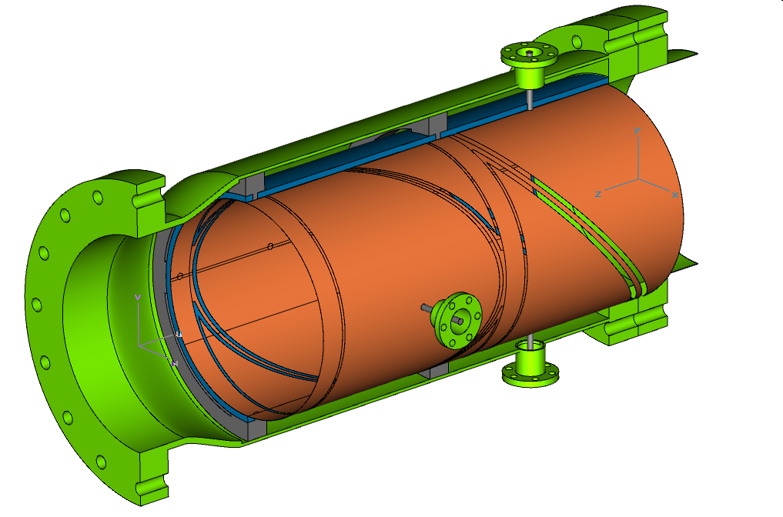
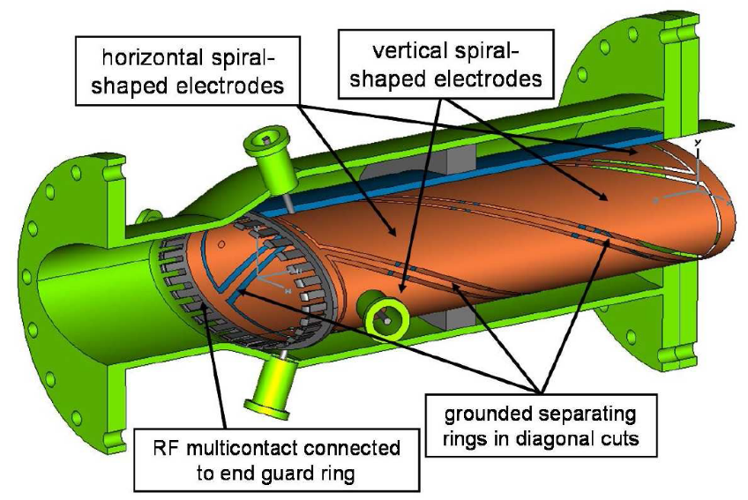
Other Types of diagonal-cut BPM
Round type: cut cylinder
Same properties as shoe-box:
Wound strips:
Same distance from beam and capacitance for all plates
But horizontal-vertical coupling.
Horizontal BPM
Vertical BPM
Signal Out
Guard Ring
Other realization: Full metal plates
No guard rings required
but mechanical alignment more difficult

Slide 18
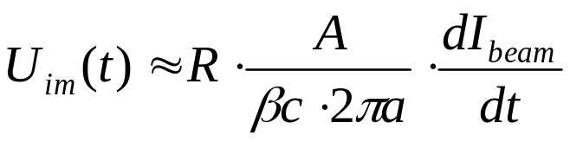
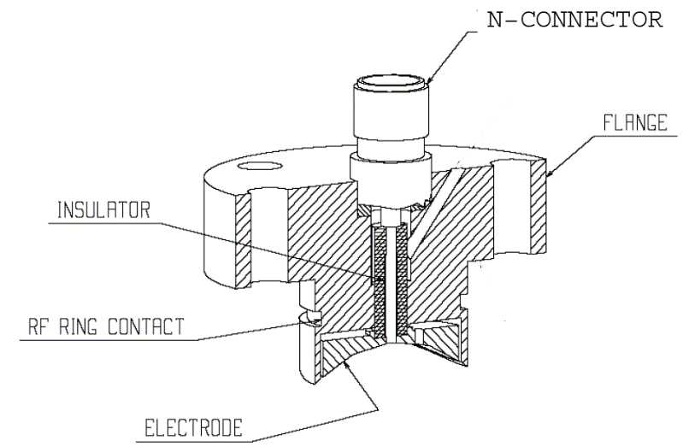
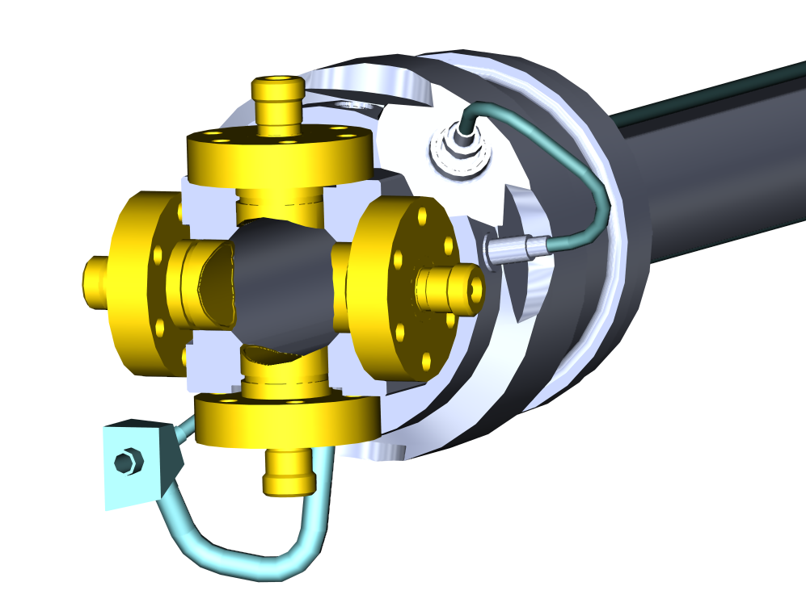
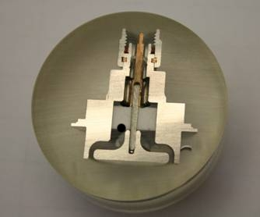
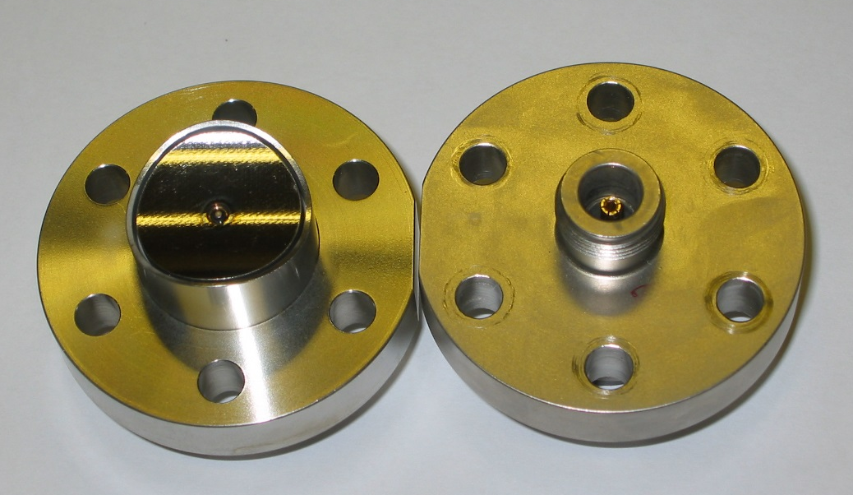
Button BPM Realization
LINACs, e⁻-synchrotrons: 100 MHz < f_{rf} < 3 GHz → bunch length ≈ BPM length
→ 50 Ω signal path to prevent reflections
Button BPM with 50 Ω ⇒
Example: LHC-type inside cryostat:
24 mm, half aperture a =25 mm, C =8 pF
⇒ f_{cut}= 400 MHz, Z_{t} = 1.3 Ω above f_{cut}
Ø24 mm
From C. Boccard (CERN)

Slide 19
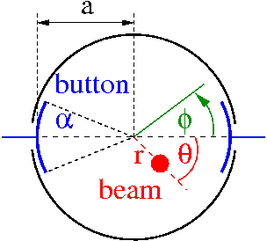
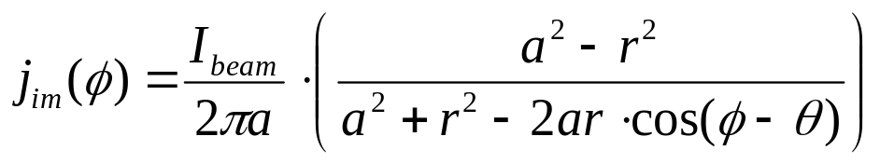
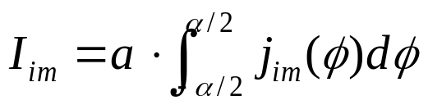
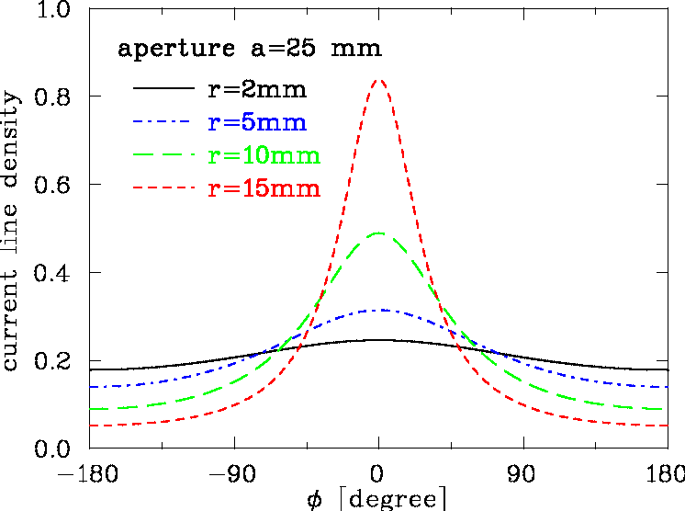
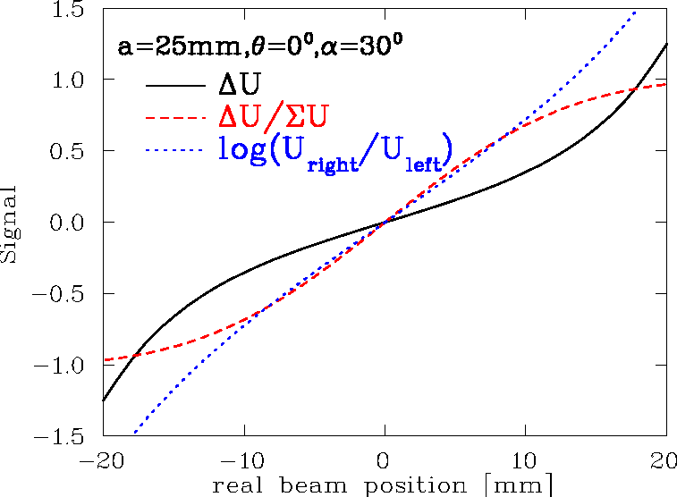
2-dim Model for Button BPM
‘Proximity effect’: larger signal for closer plate
Ideal 2-dim model: Cylindrical pipe → image current density
via ‘image charge method’ for ‘pencil’ beam:
Image current: Integration of finite BPM size:

Slide 20
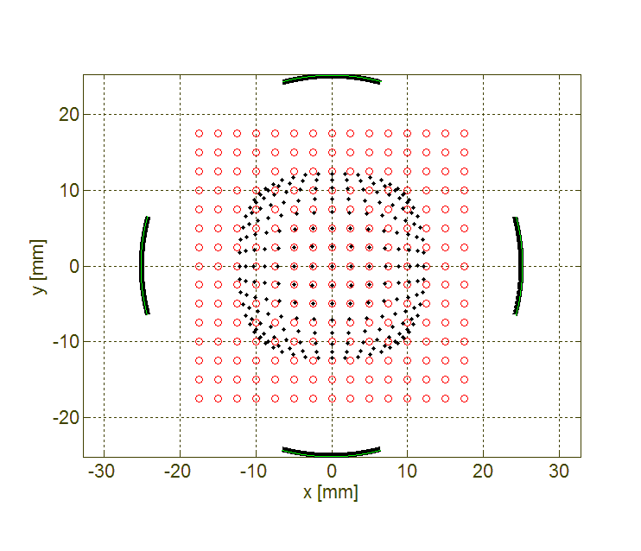
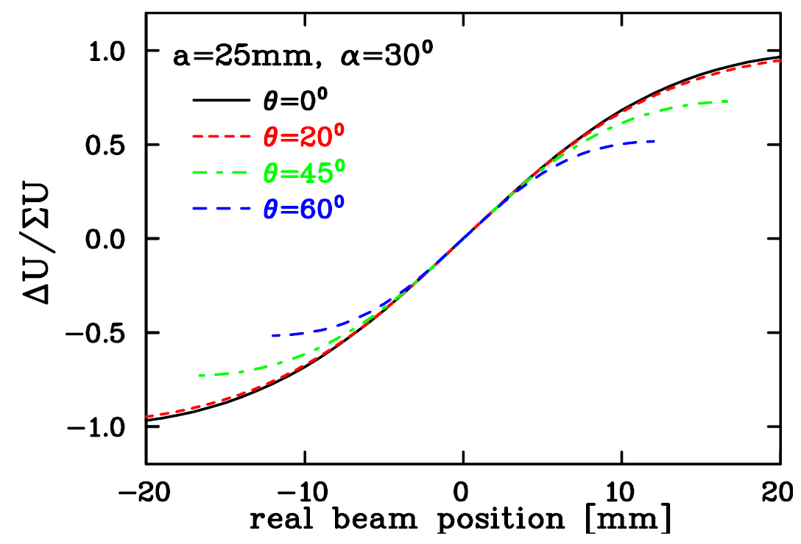
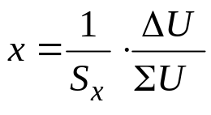
2-dim Model for Button BPM
Ideal 2-dim model: Non-linear behavior and hor-vert coupling:
Sensitivity: x=1/S∙ΔU/ΣU with S [%/mm] or [dB/mm]
For this example: center part S=7.4%/mm ⇔ k=1/S=14mm
button
The measurement of U delivers: → here S_{x} = S_{x}(x, y) i.e. non-linear.
In addition, frequency dependence can be calculated by analytic model or numerically.

Slide 21
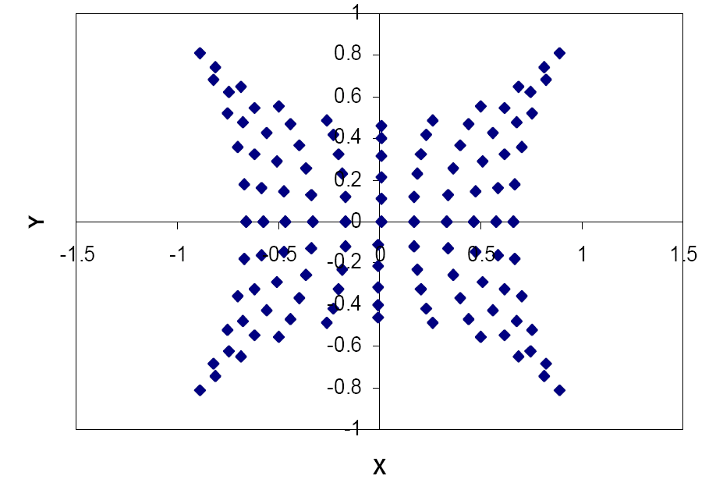
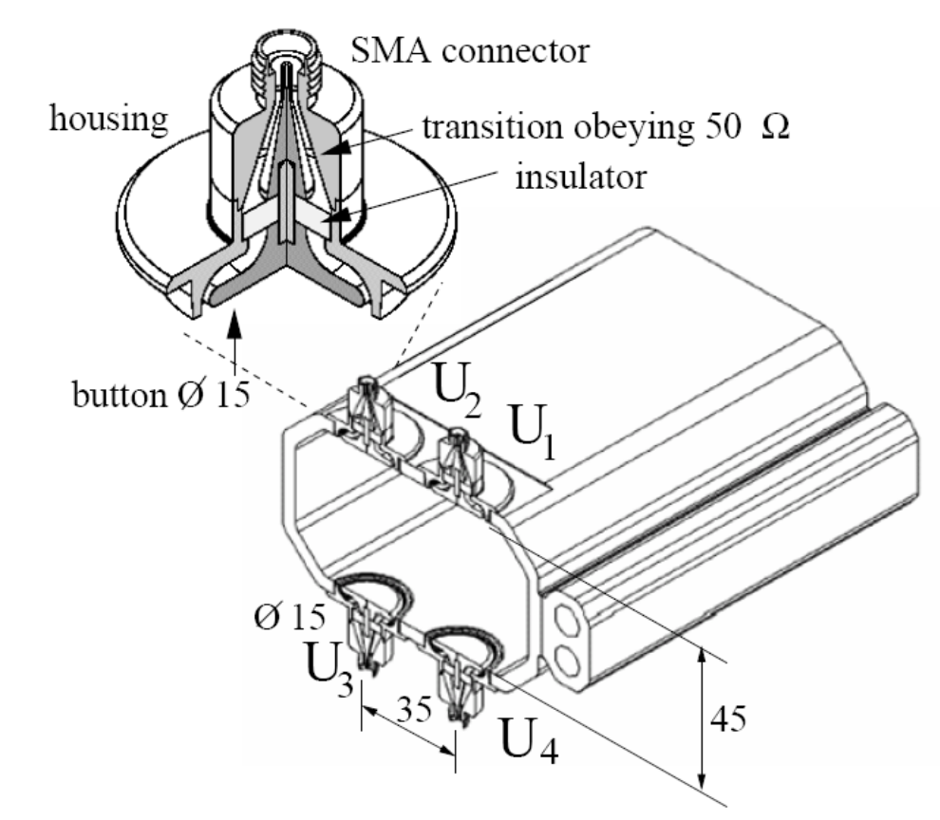
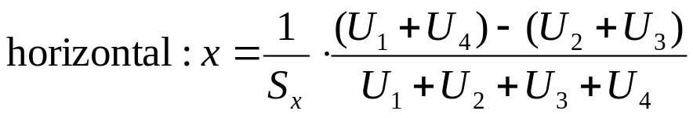
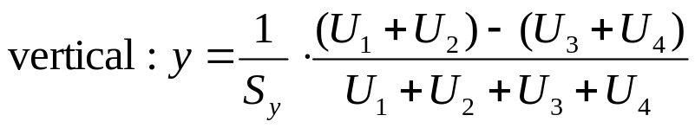
Button BPM at Synchrotron Light Sources
Due to synchrotron radiation, the button insulation might be destroyed
buttons only in vertical plane possible ⇒ increased non-linearity
Optimization: horizontal distance and size of buttons
Beam position swept with 2 mm steps
Non-linear sensitivity and hor.-vert. coupling
At center S_{x} = 8.5%/mm in this case
From S. Varnasseri, SESAME, DIPAC 2005

Slide 22
Comparison Shoe-Box and Button BPM
 | Shoe-Box BPM | Button BPM
Precaution | Bunches longer than BPM | Bunch length comparable to BPM
BPM length (typical) | 10 to 20 cm length per plane | ∅1 to 5 cm per button
Shape | Rectangular or cut cylinder | Orthogonal or planar orientation
Bandwidth (typical) | 0.1 to 100 MHz | 100 MHz to 5 GHz
Coupling | 1 MΩ or ≈1 kΩ (transformer) | 50 Ω
Cutoff frequency (typical) | 0.01… 10 MHz (C=30…100pF) | 0.3… 1 GHz (C=2…10pF)
Linearity | Very good, no x-y coupling | Non-linear, x-y coupling
Sensitivity | Good, care: plate cross talk | Good, care: signal matching
Usage | At proton synchrotrons, f_{rf} < 10 MHz | All electron acc., proton Linacs, f_{rf} > 100 MHz

Slide 23
Outline
Principle, Applications of BPMs
Functional Specifications (FS)
Sensors + Sensor Signals: stripline BPMs
Electronics
Synchronization, accelerator timing
From precision to accuracy
Outlook

Slide 24
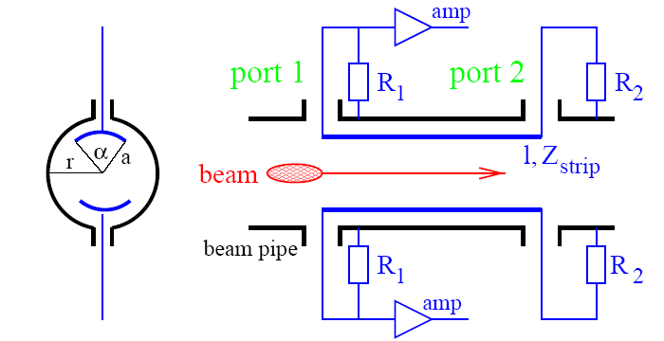
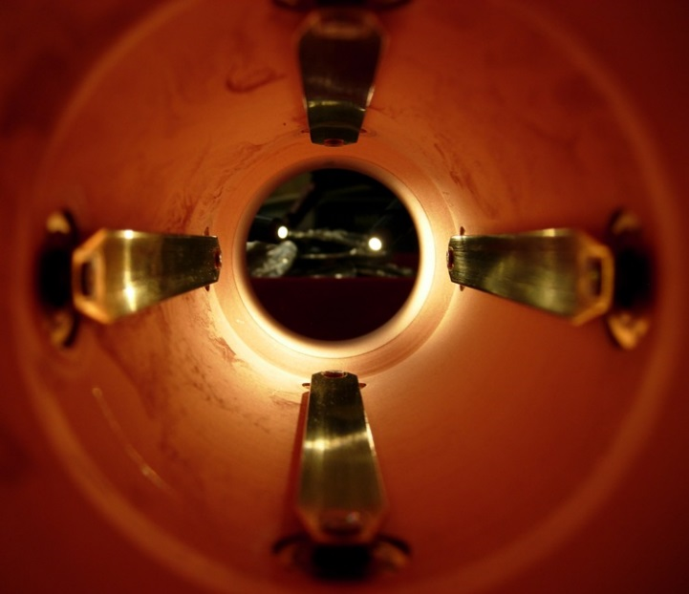
Stripline BPM: General Idea
For short bunches, the capacitive button deforms the signal
Relativistic beam β≈1 ⇒ field of bunches nearly TEM wave
Bunch’s electro-magnetic field induces a traveling pulse at the strips
Assumption: Bunch shorter than BPM, Z_{strip}=R₁=R₂=50 Ω and v_{beam}=c_{strip}.
LHC stripline BPM, l=12 cm
From C. Boccard, CERN

Slide 25
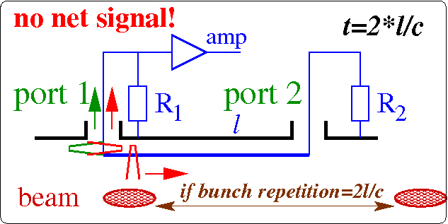
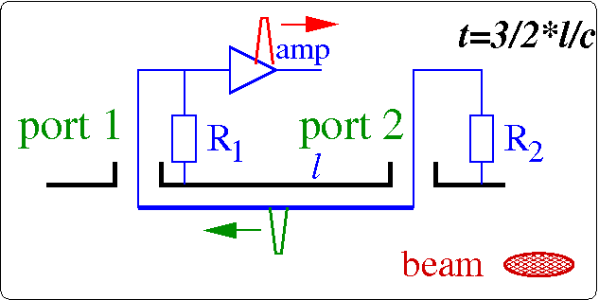
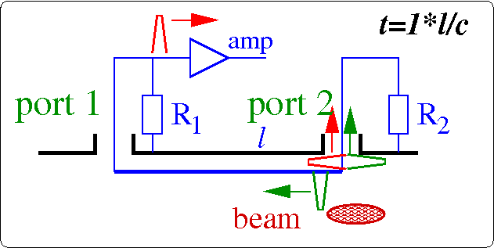
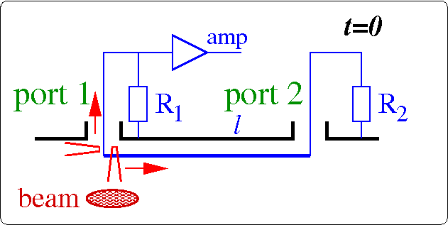
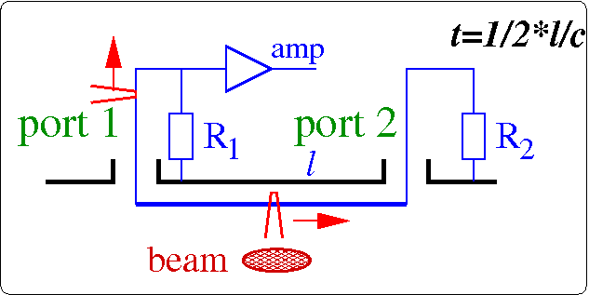
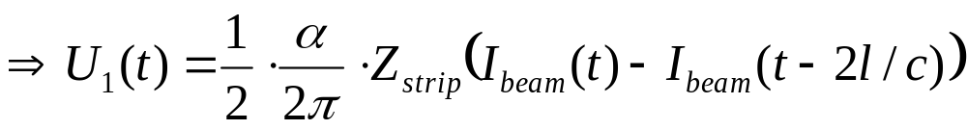
Stripline BPM: General Idea
For relativistic beam with β≈1 and short bunches:
Bunch’s electro-magnetic field induces a traveling pulse at the strip
Assumption: l_{bunch}<< l, Z_{strip}=R₁=R₂=50 Ω and v_{beam}=c_{strip}
Signal treatment at upstream port 1:
t=0: Beam induced charges at port 1:
→ half to R₁, half toward port 2
t=l/c: Beam induced charges at port 2:
→ half to R₂, but due to different sign,
it cancels with the signal from port 1
→ half signal reflected
t=2∙l/c: reflected signal reaches port 1
If beam repetition time equals 2∙l/c: reflected preceding port 2 signal cancels the new one:
→ no net signal at port 1
Signal at downstream port 2: Beam induced charges cancels with traveling charge from port 1
⇒ Signal depends on direction ⇔ directional coupler: e.g. can distinguish between e⁻ and e⁺ in collider

Slide 26
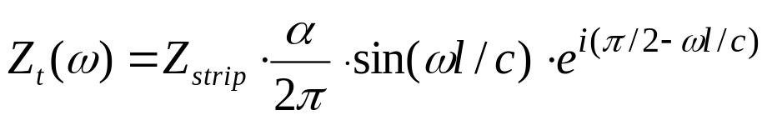
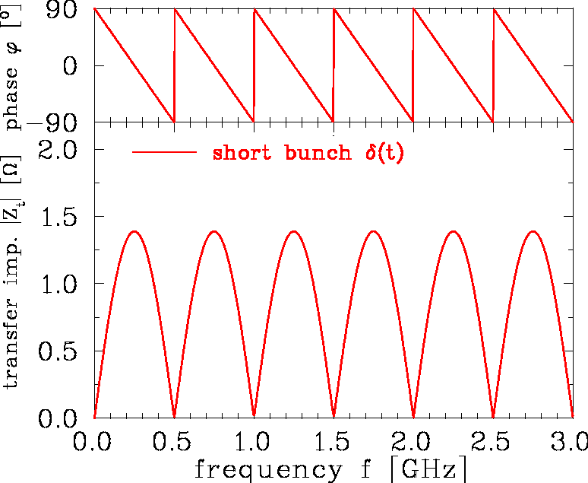

Stripline BPM: Transfer Impedance
The signal from port 1 and the reflection from port 2 can cancel ⇒ minima in Z_{t .}
For short bunches I_{beam}(t) → Ne ∙ δ(t):
Stripline length l=30 cm, α=10⁰
Z_{t} show maximum at l=c/4f=λ/4 i.e. ‘quarter wave coupler’ for bunch train
⇒ l has to be matched to v_{beam}
No signal for l=c/2f=λ/2 i.e. destructive interference with subsequent bunch
Around maximum of |Z_{t}|: phase shift φ=0 i.e. direct image of bunch
f_{center}=1/4 ∙ c/l ∙ (2n-1). For first lope: f_{low}=1/2∙f_{center}, f_{high}=3/2 ∙ f_{center} i.e. bandwidth ≈1/2∙f_{center}
Precise matching at feed-through required t o preserve 50 Ω matching.

Slide 27




Stripline BPM: Finite Bunch Length
The signal at port 1 for a finite bunch of length σ: .
Stripline length l=30 cm, α=10⁰
Caution: Z_{t} depends on beam’s bunch length σ
Z_{t}(ω) decreases for higher frequencies
If total bunch is too long (±3σ_{t}>l) destructive interference leads to signal damping
Cure: length of stripline has to be matched to bunch length

Slide 28



Realization of Stripline BPM
20 cm stripline BPM at TTF2 (chamber ∅34mm)
And 12 cm LHC type:
From . S. Wilkins, D. Nölle (DESY), C. Boccard (CERN)

Slide 29
Outline
Principle, Applications of BPMs
Functional Specifications (FS)
Sensors + Sensor Signals: stripline-BPMs
Electronics
Synchronization, accelerator timing
From precision to accuracy
Outlook

Slide 30








Cavity BPM: Principle
High resolution on t < 1 μs time scale can be achieved by excitation of a dipole mode:
For pill box the resonator modes given by geometry:
monopole TM₀₁₀ with f₀₁₀
→ maximum at beam center ⇒ strong excitation
Dipole mode TM₀₁₁ with f₀₁₁
→ minimum at center ⇒ excitation by beam offset
Detection of dipole mode amplitude
TM₀₁₀
TM₀₁
U / V
Application:
small e⁻ beams
and short pulses < ns
(ILC, X-FEL…)
‘δ-excitation’
→oscillation with
Q ≈ 1000 and τ =2Q/2πf ≈ 100 ns
TM₀₂₀
TM₀₂
TM₀₁₁
From D. Lipka,
DESY, Hamburg
TM₁₁
f / GHz
U~Q
U~Qr
U~Q

Slide 31


Cavity BPM: Example of Realization
Basic consideration for detection of Eigen-frequency amplitudes:
Dipole mode f₁₁₀ separated from monopole mode
but to finite quality factor Q ⇒ Δf=f/Q
Frequency f₁₁₀ ≈ 1…10 GHz
Waveguide house the antennas
  (task: suppression of TM₀₁₀ mode signal)
Ampl.
Antenna for
dipole mode
f₀₁₀
f₁₁₀
frequency
FNAL realization:
Cavity: ∅ 113 mm
Gap 15 mm
Mono. f₀₁₀=1.1GHz
Dipole. f₁₁₀=1.5GHz
Q_{load} ≈ 600
With comparable BPM
⇒0.1 μm resolution
within 1 μs
Waveguide input for dipole mode
Cavity Ø113mm
Gap
15 mm
Beam pipe
Ø39mm
Antenna for
dipole mode
Antenna for
monopole mode
From M. Wendt (FNAL)

Slide 32



Courtesy of D. Lipka & Y. Honda
Cavity BPM: Suppression of monopole Mode
Suppression of mono-pole mode: waveguide that couple only to dipole-mode
due to f_{mono} < f_{cut} < f_{dipole}
Mono-pole mode
Dipole-pole mode
Monopole Mode
Dipole Mode
wave guide
Courtesy of D. Lipka,
DESY, Hamburg
Courtesy of D. Lipka,
DESY, Hamburg
Courtesy of D. Lipka and Y. Honda
Prototype BPM for ILC Final Focus:
Required resolution of 5 nm (yes nano!) in a 6×12 mm diameter beam pipe
Achieved world record resolution of 8.7 nm ±0.28(stat)± 0.35(sys) nm
at ATF2 (KEK, Japan).
Notes:
32

Slide 33
Comparison of BPM Types (simplified)
Type | Usage | Precaution | Advantage | Disadvantage
Shoe-box | p-Synch. | Long bunches f_{rf} < 10 MHz | Very linear No x-y coupling Sensitive For broad beams | Complex mechanics Capacitive coupling between plates
Button | p-Linacs, all e⁻ acc. | f_{rf} > 10 MHz | Simple mechanics | Non-linear, x-y coupling Possible signal deformation
Stipline | colliders p-Linacs all e⁻ acc. | best for β≈1, short bunches | Directivity ‘Clean’ signal Large signal | Complex 50 Ω matching Complex mechanics
Cavity | e⁻ Linacs (e.g. FEL) | Short bunches Special appl. | Very sensitive | Very complex, high frequency
Remark: Other types are also some time used, e.g. wall current, inductive antenna,
BPMs with external resonator, slotted wave-guides for stochastic cooling etc.

Slide 34
Outline
Principle, Applications of BPMs
Functional Specifications (FS)
Sensors + Sensor Signals: capacitive sensors
Electronics
Synchronization, accelerator timing
From precision to accuracy
Outlook

Slide 35

The Ideal BPM Read-out Electronics!?
BPM pickup
(e.g. button, stripline)
Very short
coaxial cables
Digital BPM electronics
(rad-hard, of course!)
ADC
ADC
ADC
FPGA
Fiber
Link
Beam
ADC
DAQ
CLK
PS
“Ultra” low
jitter clock!
“Super” ADCs
“Monster” FPGA
Time multiplexing of the BPM electrode signals:
  Interleaving BPM electrode signals by different cable delays
  Requires only a single read-out channel!

Slide 36
BPM Building Blocks
BPM Pickup
feedback bus
(if applicable)
control
system
(LAN)
Minimize?!
position
data
CAL
Analog Signal Conditioning
ADC
Digital Signal Processing
Data Acquisition
CLK
Power Supply & Misc.
BPM pickup
  RF device, EM field detection,
  center of charge
  Symmetrically arranged electrodes,
  or resonant structure
Read-out electronics
  Analog signal conditioning
  Signal sampling (ADC)
  Digital signal processing
Trigger & Timing
Control
timing,
trigger
signals
  Data acquisition and control system interface
  Trigger, CLK & timing signals
  Provides calibration signals or other drift compensation methods

Slide 37
Signal Processing & Normalization
Extract the beam position information from the electrode signals: Normalization
  Analog using Δ-Σ or 90⁰-hybrids, followed by filters, amplifiers mixers and other elements, or logarithmic amplifiers.
  Digital, performing the math on individual digitized electrode signals.
Decimation / processing of broadband signals
  BPM data often is not required on a bunch-by-bunch basis
    Exception: Fast feedback processors
    Default: Turn-by-turn and “narrowband” beam positions
  Filters, amplifiers, mixers and demodulators in analog and digital to decimate broadband signals to the necessary level.
Other aspects
  Generate calibration / test signals
  Correct for non-linearities of the beam position response of the BPM
  Synchronization of turn-by-turn data
  Optimization on the BPM system level to minimize cable expenses.
  BPM signals keep other very useful information
  other than that based on the beam displacement, e.g.
    Beam intensity, beam phase (timing)

Slide 38
For the “Oldies”: Analog Signal Processing Options
AGC
on Σ
D I G I T I Z E R
MPX
Heterodyne
Synchronous
Detection
POS = (A-B)
no turn by turn
Hybrid
Δ / Σ
Heterodyne
Homodyne
Detection
POS = Δ / Σ
Electrodes
A, B
Switch. gain
Amplifier
Sample,Track,
Integr. & Hold
POS = Δ / Σ or
= (A-B)/(A+B)
Individual
Treatment
Logarithm.
Amplifiers
Differential
Amplifier
POS = [log(A/B)]
= [log(A)-log(B)]
Legend:
/ Single channel
Wide Band
Narrow band
turn by turn
Passive
Normaliz.
Amplitude
to Time
Limiter,
Δt to Ampl.
POS = [A/B]
Amplitude
to Phase
.
Limiter,
φ to Ampl.
POS = [ATN(A/B)]
Normalizer
Processor
courtesy G. Vismara (BIW 2001)
Active
Circuitry

Slide 39


New member of analog orbit measurements:
Further development of “BBQ”-tune measurement system (M.Gasior, CERN)

Slide 40



Compensated Diode Detector for BOM
courtesy M. Gasior
Sub-micrometre resolution can be achieved with relatively simple hardware and signals from any position pick-up.
To be used for the future LHC collimators with embedded BPMs.

Slide 41
Digital BPM Signal Processing
Why digital signal processing?
  Better reproducibility of the beam position measurement
    Robust to environmental conditions,
    e.g. temperature, humidity, (radiation?)
    No slow aging and/or drift effects of components
    Deterministic, no noise or statistical effects on the position information
  Flexibility
    Modification of FPGA firmware, control registers or DAQ software to adapt to different beam conditions or operation requirements
  Performance
    Often better performance,
    e.g. higher resolution and stability compared to analog solutions
    No analog equivalent of digital filters and signal processing elements.
BUT: Digital is not automatically better than analog!
  Latency of pipeline ADCs (FB applications)
  Quantization and CLK jitter effects, dynamic range & bandwidth limits
  Digital BPM solutions tend to be much more complex than some analog signal processing BPM systems
    Manpower, costs, development time

Slide 42
BPM Read-out Electronics
A-Electrode Analog Conditioning
C
A-Electrode Analog Conditioning
C
BPF
BPF
Att
Att
BPF
LPF
B
B
A
A
Ctrl
Ctrl
LO
D
Do we need this
analog section?
D
B, C, D Analog same as A
B, C, D Analog same as A
raw
raw
MEMORY
MEMORY
WB
Σ
WB
CLK & Timing
Σ
CLK & Timing
NB
CIC
NB
CIC
FIR
FIR
Coordinate
Transformation
Coordinate
Transformation
A Data
I-Channel
A Data
ADC
I-Channel
ADC
NCO
90⁰
NCO
90⁰
Q-Channel same as I
Q-Channel same as I

Slide 43





“Ringing” Bandpass-Filter (BPF)
Single Bunch Responses:
BPM electrode signal energy
is highly time compressed
  Most of the time: “0 volt”!
A “ringing” bandpass filter “stretches” the signal
  Passive RF BPF
    Matched pairs!
  f_{center} matched to f_{rev} or f_{bunch}
    Quasi sinusoidal waveform
  Reduces output signal level
    Narrow BW: longer ringing, lower signal level
  Linear group delay designs
    Minimize envelope ringing
    Bessel, Gaussian, time domain designs
Stripline BPM:
Bessel
f_{center}: 500 MHz
BW: 25 MHz
Button BPM:
Bessel
Stripline BPM:
Butterworth

Slide 44








“Ringing” BPF & Multi-Bunches
Bunch spacing < BPF ringing time:
  Superposition of single bunch BPF responses
  More continuous “ringing”, smearing of SB responses
Bunch spacing < BPF rise time
  Constructive signal pile-up effect
    Output signal level increases linear
    with decreasing bunch spacing

Slide 45






Analog Digital Converter
Quantization of the continuous input waveform at equidistant spaced time samples
  Digital data is discrete in amplitude and time
LSB voltage (resolution)
  E.g. 61 μV (14-bit),
  15 μV (16-bit) @ 1 volt V_{FSR}
Quantization error
(dynamic range)
  E.g. 84 dB (14-bit), 96 dB (16 bit)
SNR limit due to
aperture jitter
  E.g. 62 dB@500 MHz, 0.25 psec
  (equivalent to EOB=10.3)
M=3-bit ADC

Slide 46

ADC Technology
 | Type | Res. [bit] | Ch. | Power [W] | f_{s} (max) [MSPS] | BW [MHz] | SNR @ f_{in} [dB @ MHz]
AD | AD9652 | 16 | 2 | 2.2 | 310 | 485 | 72 @170
AD | AD9680 | 14 | 2 | 3.3 | 1000 | 2000 | 67 @ 170
LT | LTM9013* | 14 | 2 | 2.6 | 310 | 300* | 62 @ 150
TI | ADC16DX370 | 16 | 2 | 1.8 | 370 | 800 | 69 @ 150
TI | ADS5474-SP | 14 | 1 | 2.5 | 400 | 1280 | 70 @ 230
* has an analog I-Q mixer integrated, 0.7 GHz < f_{in}< 4 GHz
Dual Channel
  I-Q sampling with separate ADCs
Pipeline architecture
  Continuous CLK
  Data latency
A-D mixed designs
  Mixers, gain, filters, etc.

Slide 47







Sampling Theory
A band limited signal x(t) with B=f_{max}
can be reconstructed if
  Nyquist-Shannon theorem
  The exact reconstruction of x(t) by x_{n}=x(nT):
Aliasing of a sampled sin-function
  Samples can be interpreted by
courtesy Wikipedia
to be avoided!

Slide 48






I-Q Sampling
Vector representation of sinusoidal signals:
  Phasor rotating counter-clockwise (pos. freq.)
Q
A
Q
φ₀
I
I
I: in-phase
component
Q: quadrature-phase
component
I-Q sampling at:
A=1.33
I(t₁)
Q(t₀)

Slide 49

I-Q Demodulation of BPM Signals
Digitized sinusoidal waveform data is sampled, or undersampled at f_{s}/n = 4xf_{in}
  Also called digital down-converter (DDC)
  Gives amplitude and phase of the input signal
    Phase reference could be f_{s} (CLK),
    of a separate reference signal
n=2

Slide 50

Digital Down-Converter
Goals
  Convert the band limited
  RF-signal to baseband
  (demodulation)
  Data reduction (decimation)
DDC Building blocks:
  ADC
    Single fast ADC
    (oversampling)
  Local oscillator
    Numerically controlled oscillator (NCO)
    based on a direct digital frequency synthesizer (DDS)
  Digital mixers (“ideal” multipliers)
  Decimating low pass (anti alias) filters
    Filtering and data decimation.
    Implemented as CIC and/or FIR filters
courtesy T. Schilcher

Slide 51


Signal/Noise &
Theoretical Resolution Limit
Minimum noise voltage at the 1st gain stage:
  With the stripline BPM and Bessel BPF example:
  R = 50 Ω, Δf = 25 MHz ➔ v_{noise} = 4.55 μV (-93.83 dBm)
Signal-to-noise ratio:
  Where Δv is the change of the voltage signal
  at the 1st gain stage due to the change
  of the beam position (Δx, Δy).
  Consider a signal level v ≈ 22.3 mV (-20 dBm)
    Bessel BPF output signal of the stripline BPM example
  22.3 mV / 4.55 μV ≈ 4900 (73.8 dB) would be the required dynamic range to resolve the theoretical resolution limit of the BPM
    Under the given beam conditions,
    e.g. n=1e10, σ=25mm, single bunch, etc.
    The equivalent BPM resolution limit would be: Δx=Δy=0.66μm
    (assuming a sensitivity of ~2.7dB/mm)

Slide 52
S/N & BPM Resolution (cont.)
Factors which reduce the S/N
  Insertion losses of cables, connectors, filters, couplers, etc.
    Typically sum to 3…6 dB
  Noise figure of the 1st amplifier, typically 1…2 dB
  The usable S/N needs to be >0 dB,
  e.g. 2.3 dB is sometimes used as lowest limit. (HP SA definition)
  For the given example the single bunch / single turn resolution limit reduces by ~10 dB (~3x): 2…3 μm
Factors to improve the BPM resolution
  Increase the signal level
    Increase BPM electrode-to-beam coupling,
    e.g. larger electrodes
    Higher beam intensity
  Increase the measurement time, apply statistics
    Reduce the filter bandwidth (S/N improves with 1/√BW)
    Increase the number of samples (S/N improves with √n)

Slide 53
BPM Read-out Electronics
A-Electrode Analog Conditioning
A-Electrode Analog Conditioning
A-Electrode Analog Conditioning
C
A-Electrode Analog Conditioning
C
C
C
BPF
BPF
BPF
BPF
Att
Att
Att
Att
BPF
LPF
B
B
B
B
A
A
A
A
Ctrl
with analog downconverter
Ctrl
Ctrl
Ctrl
LO
LO
D
D
D
D
B, C, D Analog same as A
Typical BPM read-out scheme
  Pipeline ADC & FPGA
    14-16 bit, >300 MSPS, ~70 dB S/N
  Separate analog signal processing for the channels
B, C, D Analog same as A
B, C, D Analog same as A
B, C, D Analog same as A
raw
raw
MEMORY
MEMORY
WB
Σ
WB
CLK & Timing
Σ
CLK & Timing
Choices:
  Analog downconverter?!
  RF locked (sync) CLK & LO signals?!
    No I-Q required
NB
CIC
NB
CIC
FIR
FIR
Coordinate
Transformation
Coordinate
Transformation
A Data
I-Channel
A Data
ADC
I-Channel
ADC
NCO
90⁰
NCO
90⁰
Q-Channel same as I
Q-Channel same as I

Slide 54
Analog Downconverter vs. Direct Digital Under-Sampling
ADC dynamic range is limited to ~70 dB
  Not sufficient for most BPM applications
  Need for analog signal attenuator / gain stages
    Requires calibration signal to avoid “electronic offsets”
Analog downconverter
  Certainly necessary for the conditioning of cavity BPM signals
  Allows sampling in the 1st Nyquist passband
  (no undersampling)
  Relaxes input RF filter requirements
  Relaxed ADC and CLK requirements
  May relax cable requirements and improve S/N
    Analog hardware installation near the BPM pickup
    Transfer analog IF signals out of the tunnel
  Additional analog hardware required
  Generates additional image frequencies
    Consider image rejection analog mixer!

Slide 55
Example: ATF DR BPM Signal Processing
average NB data
with n/f_{power}
latch
VME
NB Sums
50Hz
reset
Σ
32 Registers
8 ch
/
NB Filter
1.4kHz output
16 Bits/ch
32 ch
/
VME
NB Data
DDR RAM
NB Data
TBT Data
Raw Data
ADC Input
14 Bits
71.4 MHz
NB Gate
VME
TBT Data
TBT Filter
8 ch
/
WB Gate(s)
VME
Raw Data
reset
latch
DAQ SM
Ch delays (clocks)
Gates in Turns
WB Gate(s)
Trigger
VME
IRQ
NB Gate

Slide 56
ATF BPM Narrowband Signal Processing
Process 8 ADC channels in parallel up to FIR filter
  Digitally downconvert each channel into I,Q then filter I,Q independently
  CIC Filters operating in parallel at 71.4MHz
    Decimate by 17KSPS to 4.2KSPS output rate
  1 Serial FIR Filter processes all 32 CIC Filter outputs
    80 tap FIR (400 Hz BW, 500 Hz Stop, -100 db stopband) -> 1KHz effective BW
    Decimate by 3 to 1.4 KSPS output rate -> ability to easily filter 50Hz
  Calculate Magnitude from I,Q at 1.4KHz
    Both Magnitude and I,Q are written to RAM
    Also able to write I,Q output from CIC to RAM upon request
NCO (sin, cos)
24 Bits Phase
(~1 Hz)
Select
Significant
Bits
I
CIC
5 Stages
R=17001
Bit
Shift
FIR (80 taps)
LPF 500Hz
Decimate 3
I
X
ADC Input
14 Bits
69 MHz
Q
DDC
Q
16 Bits
24 Bits
4.2 KSPS
20 Bits
4.2 KSPS
16 Bits
1.4 KSPS
- Denotes Peak Detectors to optimize scaling

Slide 57






ATF DR Turn-by-Turn Beam Studies
Beam optics studies with 96 BPMs in the ATF damping ring
β function measurement
β beating measurement
ϕ measurement
courtesy Y. Renier

Slide 58


Libera BPM Electronics
courtesy
Instrumentation
Technologies
Analog & digital
crossbar switch
  Compensation of long term drift effects in the analog sections

Slide 59



Libera BPM Performance
Beam
Current
Dependence
Libera Brilliance +
Electron beam position measurements
< 0.5 µm RMS at turn-by-turn data rate
40 nm RMS at 10 kS/s data rate (0.01 – 1 kHz)
10 nm RMS for slow monitoring
sub-micron longterm stability
Temperature drift < 200 nm / °C
Full Fast Orbit Feedback implementation with magnet output
Fast Interlock detection (< 100 µs)
Clean turn to turn measurement using Time-Domain Processing
courtesy P. Leban

Slide 60
Outline
Principle, Applications of BPMs
Functional Specifications (FS)
Sensors + Sensor Signals: capacitive sensors
Electronics
Synchronization, accelerator timing
From precision to accuracy
Outlook

Slide 61
Synchronization, accelerator timing
Needs in itself a complete talk…
Three major tasks:
1) clocking of front-end electronics →
distribution of clock reference via copper or fibre links
continuous synchronization of local PLL circuits for clocking
2) fast accelerator related timing →
identification of bunches around machine
3) slow accelerator related timing →
indicates machine state transitions (injection…acceleration, dump)
Typically provided over one link as encoded messages, which are modulated onto a carrier frequency (=clock)
In most labs this service is provided by the controls team
Lesson: Always have an acquisition mode, which does not depend on the timing system (self trigger)…most essential during commissioning

Slide 62





























Beam Threading
Threading the beam round the LHC ring (very first commissioning in 2008)
  One beam at a time, one hour per beam.
  Collimators were used to intercept the beam (1 bunch, 2×10⁹ protons)
  Beam through 1 sector (1/8 ring)
    correct trajectory, open collimator and move on.
Beam 2 threading
BPM availability ~ 99%
Courtesy of CMS
Courtesy of ATLAS

Slide 63
Outline
Principle, Applications of BPMs
Functional Specifications (FS)
Sensors + Sensor Signals: capacitive sensors
Electronics
Synchronization, accelerator timing
From precision to accuracy
Outlook

Slide 64
From Precision to Accuracy
BPM sensor:
- matching of sensor pairs
- mechanical pre-alignment to nearest quadrupole magnetic axis
(~100 um); further refinement of offsets with k-modulation of quadrupole
- linearization of response by post-processing based on characterization of BPM response on a measurement bench
- thermal stabilization of BPM body (= one of the reasons for top-up injection)
BPM electronics (prior to beam)
- measurement of insertion losses and phase errors of whole RF signal path
- calculation/measurement of coupling impedance to beam
- measurement of gain factors of each acquisition chain
Various setups in order to inject calibration tones as close to the sensor as possible
-> button systems: inject in one button + capacitive coupling to 2 adjacent buttons
-> stripline couplers: use 2nd unused port for calibration tone injection
-> use coupling transformers in RF-frontend
Thermal stabilization of (analog) readout electronics
Crossbar switches in the RF front-end: Periodically reassign input signals to the different acquisition chains. Deduce gain factors from signal changes
→ show a few examples (also taken from this conference):

Slide 65



Long-Term Drift Compensation (as used in MANY LIGHTSOURCES)
Libera crossbar switching technique
  <100 nm stability over 14 hours
courtesy P. Leban
courtesy N. Eddy
Calibration tone technique (only in narrowband
operation)
ATF (KEK)

Slide 66


STEP 1, Mapping of BPM head
All BPMs were mapped at a test bench with a movable antenna .
Test bench for the mapping
result for mapping
LER
HER

Slide 67



Button BPM at Synchrotron Light Sources
2-dim electro-static simulation:
d_{AB}=24 mm
d_{AB}=24 mm
horizontal
2 mm distance between dots
d_{AB}=24 mm
Result:
Hori. S_{x}= 8.5%/mm
Vert. S_{y} = 5.6%/mm
x&y dependent polynomial fit possible
d_{AB}
vertical
Beam position swept with 2 mm steps
From S. Varnasseri, SESAME, DIPAC 2005

Slide 68


STEP 2, Alignment of BPM heads against to the Q-magnets
Measurement of the mechanical offsets of the BPM heads to the Q-magnets.
Photograph of Measurement tool
Results of alignment of BPM heads against to the reference plane of the Q-Magnets

Slide 69


STEP-3, Gain calibration of the electronics
Attenuation of cable, switch, electronics, etc.
We measured the distribution of signal attenuation of the all electronics
We used a dummy head instead of BPM heads.
Results for ration between output signal B,C and D against to A in all electronics
A
B
C
D
Output signals: A, B, C, D

Slide 70
Beam based calibration
Beam Based Alignment
Measurement of the offset of BPM to the field center of the adjacent Q-magnet using the beam.
Beam Based Gain Calibration
Calibration of the gain imbalance among four outputs of a BPM using the beam.

Slide 71

Beam based alignment(BBA)
- Principle -
BBA is searching for the beam orbit which is insensitive to the change of field strength in the quadrupole
= magnetic axis of this quad.
The measured beam position for this orbit corresponds to origin offset of the BPM.
The offset gets introduced into correction tables for the BPM readings.
ΔXm=0 then δxm offset

Slide 72


Actual procedure for BBA
Bump orbits: -8, 0, 8[mm]
I_{Q} : -4, -2, 0, 2, 4 [A]
-current of correction coil
from figure (a),(b),(c),
Δx/ΔI_{Q} and x (I_{Q}=0),
where x=x_{m}
Offset
X=0.4913[mm]
Alternative method (sinusoidal modulation of q-current at low frequencies) + synchronous detection of orbit variations at the modulation frequency….

Slide 73

Gain mapping
Slides provided by: D. Rubin, Cornell University
8-September 2015
Button to button gain errors
Any difference in the effective
button gains, electronic or physical,
couple real horizontal dispersion
into measured vertical dispersion
(and the horizontal dispersion is large)

Slide 74




Characterization of BPM Gain Errors
Signal at each button depends on bunch current (k) and position (x,y)
Signals on the four buttons are related by symmetry
Combining sums and differences we find the following relationship, good to second order
B3
B4
B1
B2

Slide 75




Gain mapping with turn by turn data
A single beam passage gives a measurement of intensity at each of four button electrodes
N beam passages gives
The gains are the set of that minimize

Slide 76

Turn by turn data
1024 measurements
Fitted gains g₁₋₄ = (1.007,1.016,0.9434,1.035)

Slide 77
Outline
Principle, Usage of BPMs
Functional Specifications (FS)
Sensors + Sensor Signals
Electronics
Synchronization, accelerator timing
From precision to accuracy
Outlook
- new LHC orbit system for LHC-LS3 (2024)
- Electro-optical BPMs → Intrabunch Measurements for <ns bunches

Slide 78
LHC BPM Timing Specs – 1st thoughts
Upgrade of the LHC BPM electronics (for HL-LHC):
  Keep existing infrastructure
    Beam pickups, cables, fibers, VME system, etc.
  Upgrade of analog, DAQ and trigger electronics
    Minimalistic analog front-end
      Preferable time-multiplexed single channel for 2 BPM electrodes
    Digital direct downconversion (DDC) technique
      Convolution integral or I/Q mixing?
    Internal ADC and FPGA clocks with ultra-low sub-ps jitter!
    External RF bucket tagging trigger!
Relaxed external timing requirements:
  RF bucket synchronous trigger signals in 2.5 ns increments
    Jitter & drift effects <<1 ns
    Needs to be supplied to each BPM DAQ electronics
      Of course separate trigger signals for B1 and B2

Slide 79
Conceptual Idea
convolution
based DDC
or
I/Q mixer
delay
line
BPF
filtering &
decimation
B
A
Att
LNA
ADC
CIC
CIC
FIR
FIR
Ctrl
single
or
dual (I/Q)
BPF response
waveform
or
NCO
analog signal conditioning
CLK & Timing
beam pickup
digital direct downconversion:
- convolution integral
- I/Q mixing
Brute-force digitalization
  E.g. TI ADC12J4000
    12-bit, 4 GSPS, SFDR ≈ 67 dBFS, SINAD ≈ 55 dBFS (@350MHz)
    Intergraded DDC, decimation by 4 or 8 (400MHz pass-band)
      SFDR ≈ 75 dBFS, SINAD ≈ 63 dBFS (@600MHz)
  Internal CLKs for ADC and FPGA
  External 40 MHz trigger (2.5ns steps) for bunch tagging (memory)
Single analog processing channel
  Based on delay-line networks and band-pass filters

Slide 80




Analog Signals
d_{pipe}: 25 mm
d_{button}: 10 mm
beam pickup signal
Gaussian bunch:
  n=1E10, σ=25mm, v=c₀
  vertical offset=1mm
BPM sensitivity:
  e.g.: 2.7 dB / mm
conditioned analog signal
up
down
up
down
400 MHz delay-line filter network
12.5 ns delay-line
25 ns
25 ns

Slide 81


Waveform Sampling Options
4 GSPS = 250 ps sample spacing
  100 samples per 25 ns with single ADC
    50 samples per electrode signal, but only 20…24 samples ≠ 0
  200 samples per 25 ns with two interleaved ADC in I/Q operation
Requires low CLK jitter within 25 ns time interval
  E.g. t_{a} = 0.15 ps -> 68.5 dB@400 MHz
  (equivalent to EOB=11.1)

Slide 82



Schematic of EO-BPM
See also: S.Gibson (RHUL this conference)

Slide 83

All optical BPM laser lab set-up
laser light
to fibre coupling
EO-Crystal
GRIN lenses
Analyser
(in-fibre) Polariser

Slide 84

Possible Detection scheme
Wide-Band Improvement on RF Hybrid Junction: (MSM)
Sum Σ and Difference Δ signals are computed in electro-optical domain
  Aim at 12+ GHz Bandwidth

Slide 85

Instead of a summary: Thank You for Your Patience

