Slide 1


Semi-conductor Detectors
HEP and Accelerators
Geoffrey Taylor
ARC Centre for Particle Physics at the Terascale (CoEPP)
The University of Melbourne

Slide 2
Outline
Semiconductor Detectors
  A Brief Overview
  Radiation Damage
Silicon Strip Detectors
Pixel Detectors
  Hydrid Pixel Detectors
  Integrated Devices
    MAPS
    DEPFET
    HV-CMOS and HR-CMOS
  3D geometry
Diamond Detectors
LHC
SuperKEKB
Outlook

Slide 3
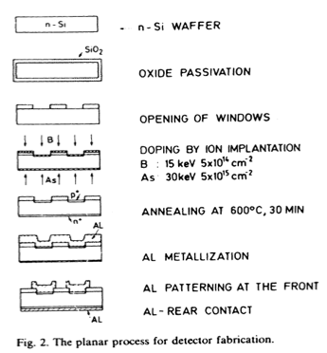
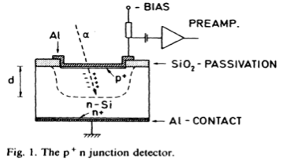
Basics
Basic Semiconductor materials:
  Silicon
  Ge
  GaAs
  CdTe
  CdZnTe
  Diamond
  Silicon Carbide, …
Kemmer Process (eg. NIM 226 (1984) 89-93)

Slide 4
Semiconductor Detectors
Semiconductor Diode detectors have been used, and highly evolved for decades.
Technology highly developed but high specialised.

Slide 5
Sophisticated integration …

Slide 6
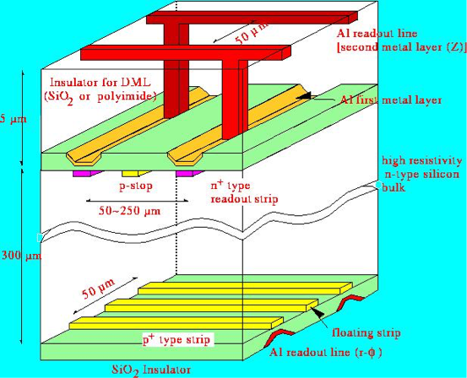
Double-sided Silicon Detectors

Slide 7
n-side (back-side)
  positive (fixed) charge at SiO2 - Si interface attracts electrons to n-side.
  Electron accumulation shorts n-side electrodes
  p⁺ “isolation” required
Oxide layer
e⁻ accumulation layer

Slide 8
Radiation Damage
Three main macroscopic effects are seen in high-resistivity diodes following energetic hadron irradiation:
Change of the doping concentration with severe consequences for the operating voltage needed for total depletion.
Fluence proportional increase in the leakage current, caused by creation of recombination/generation centres
Deterioration of charge collection efficiency due to charge carrier trapping leading eventually to a reduction in the signal height produced by mip’s.

Slide 9

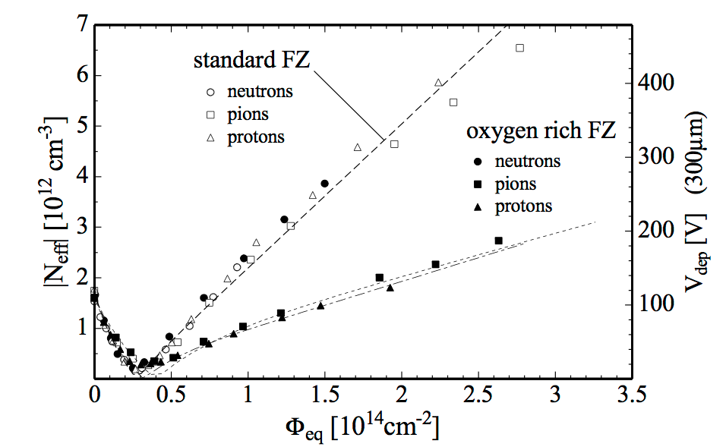
Defect Engineering
Thin detectors
High Bias Operation

Slide 10
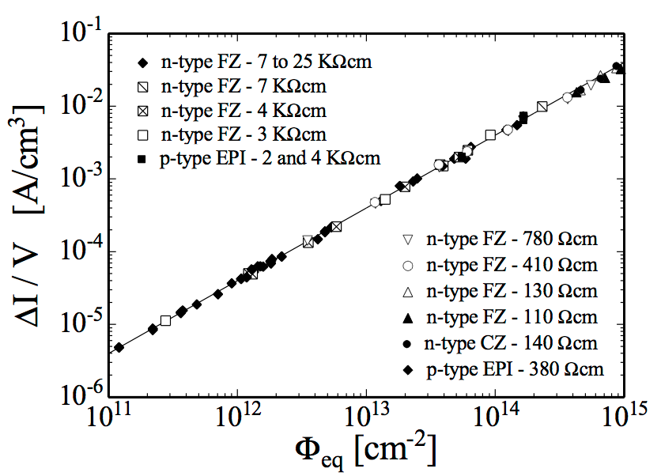

Slide 11

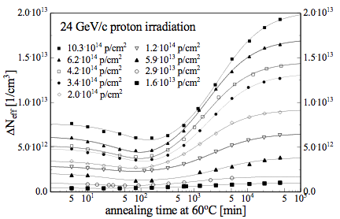
Effect of Temperature
Strong current reduction with reduced temperature.
(also Current Annealing)
Reverse Annealing of Effective Carrier concentration

Slide 12
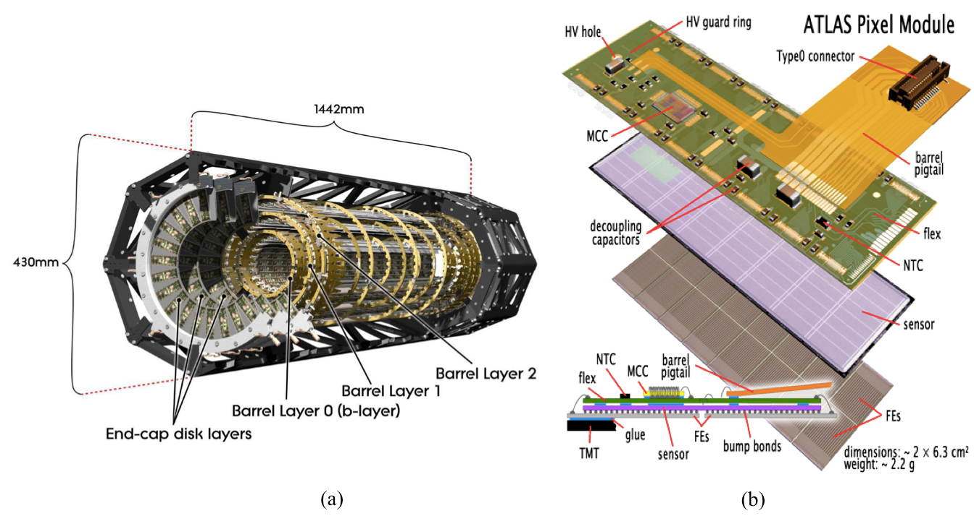
Hybrid Pixel Detectors
Electronics chip and sensor chip independently produced, bump bonded

Slide 13
Integrated Pixel Detectors - MAPS
Electronics and detector element on a single substrate

Slide 14
Silicon Drift Detectors
Positive Electrodes set up Drift Potential
Electrons drifted to readout anode pads.
Time/position -> 2D position.
F. Hartmann, Springer, 2009

Slide 15
Integrated Pixel Detectors - DEPFET
Belle II Pixel detector

Slide 16
Thinning of silicon detectors
eg. Belle II PXD
Rather complicated process.
Major benefits

Slide 17
Integrated Pixel Detectors: HV-CMOS and HR-CMOS
With a High Resistivity Substrate, the deplection region can be increased over that of the MAPS detectors.
CMOS processing widely available, adaptable to HV and HR modification

Slide 18
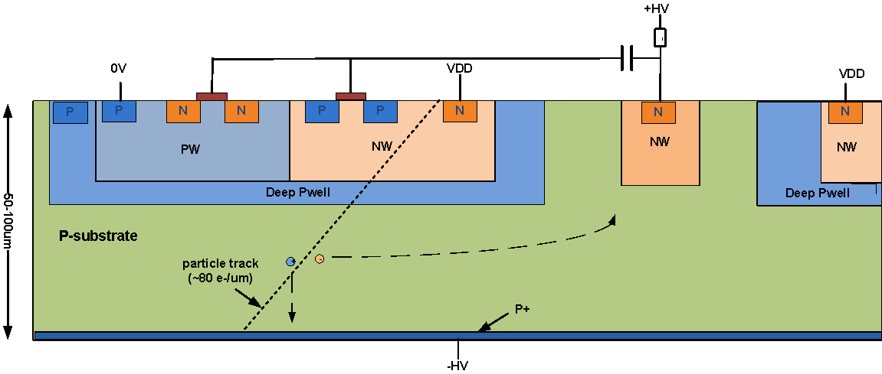
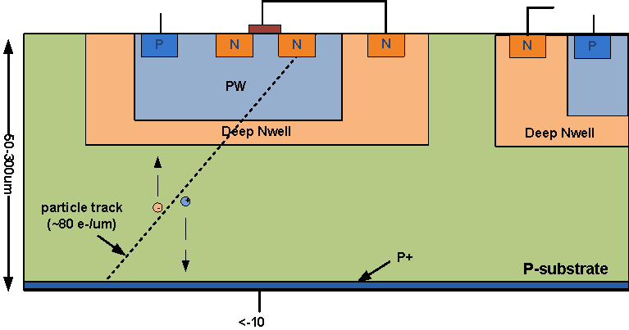
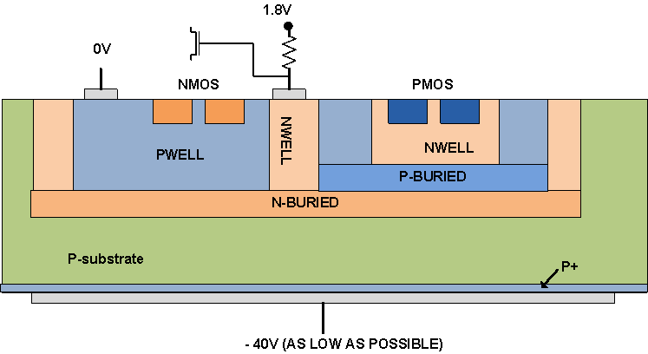
HR-CMOS Options
Drift structure
Simple well structure
Triple Well Structure

Slide 19
Integration Possibilities, HV-CMOS/HV-CMOS
Hybrid Pixel Development
Amplifier / Discriminator (~100 transistors) per Pixel, Bonded to Digital R/O Chip (>100M transistors)
Long-term aim: full integration on single, depleted substrate:
F.Hugging, Bonn - AIDA-2 15/4/2014

Slide 21
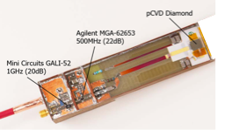
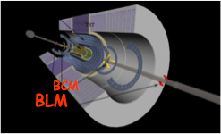
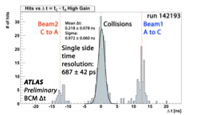
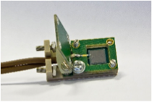
ATLAS Diamond Beam Condition Monitor and Beam Loss Monitor

Slide 22
Diamond Beam Monitor
Diamond offers advantages:
  radiation hardness
  fast signal response
  simple processing

Slide 23
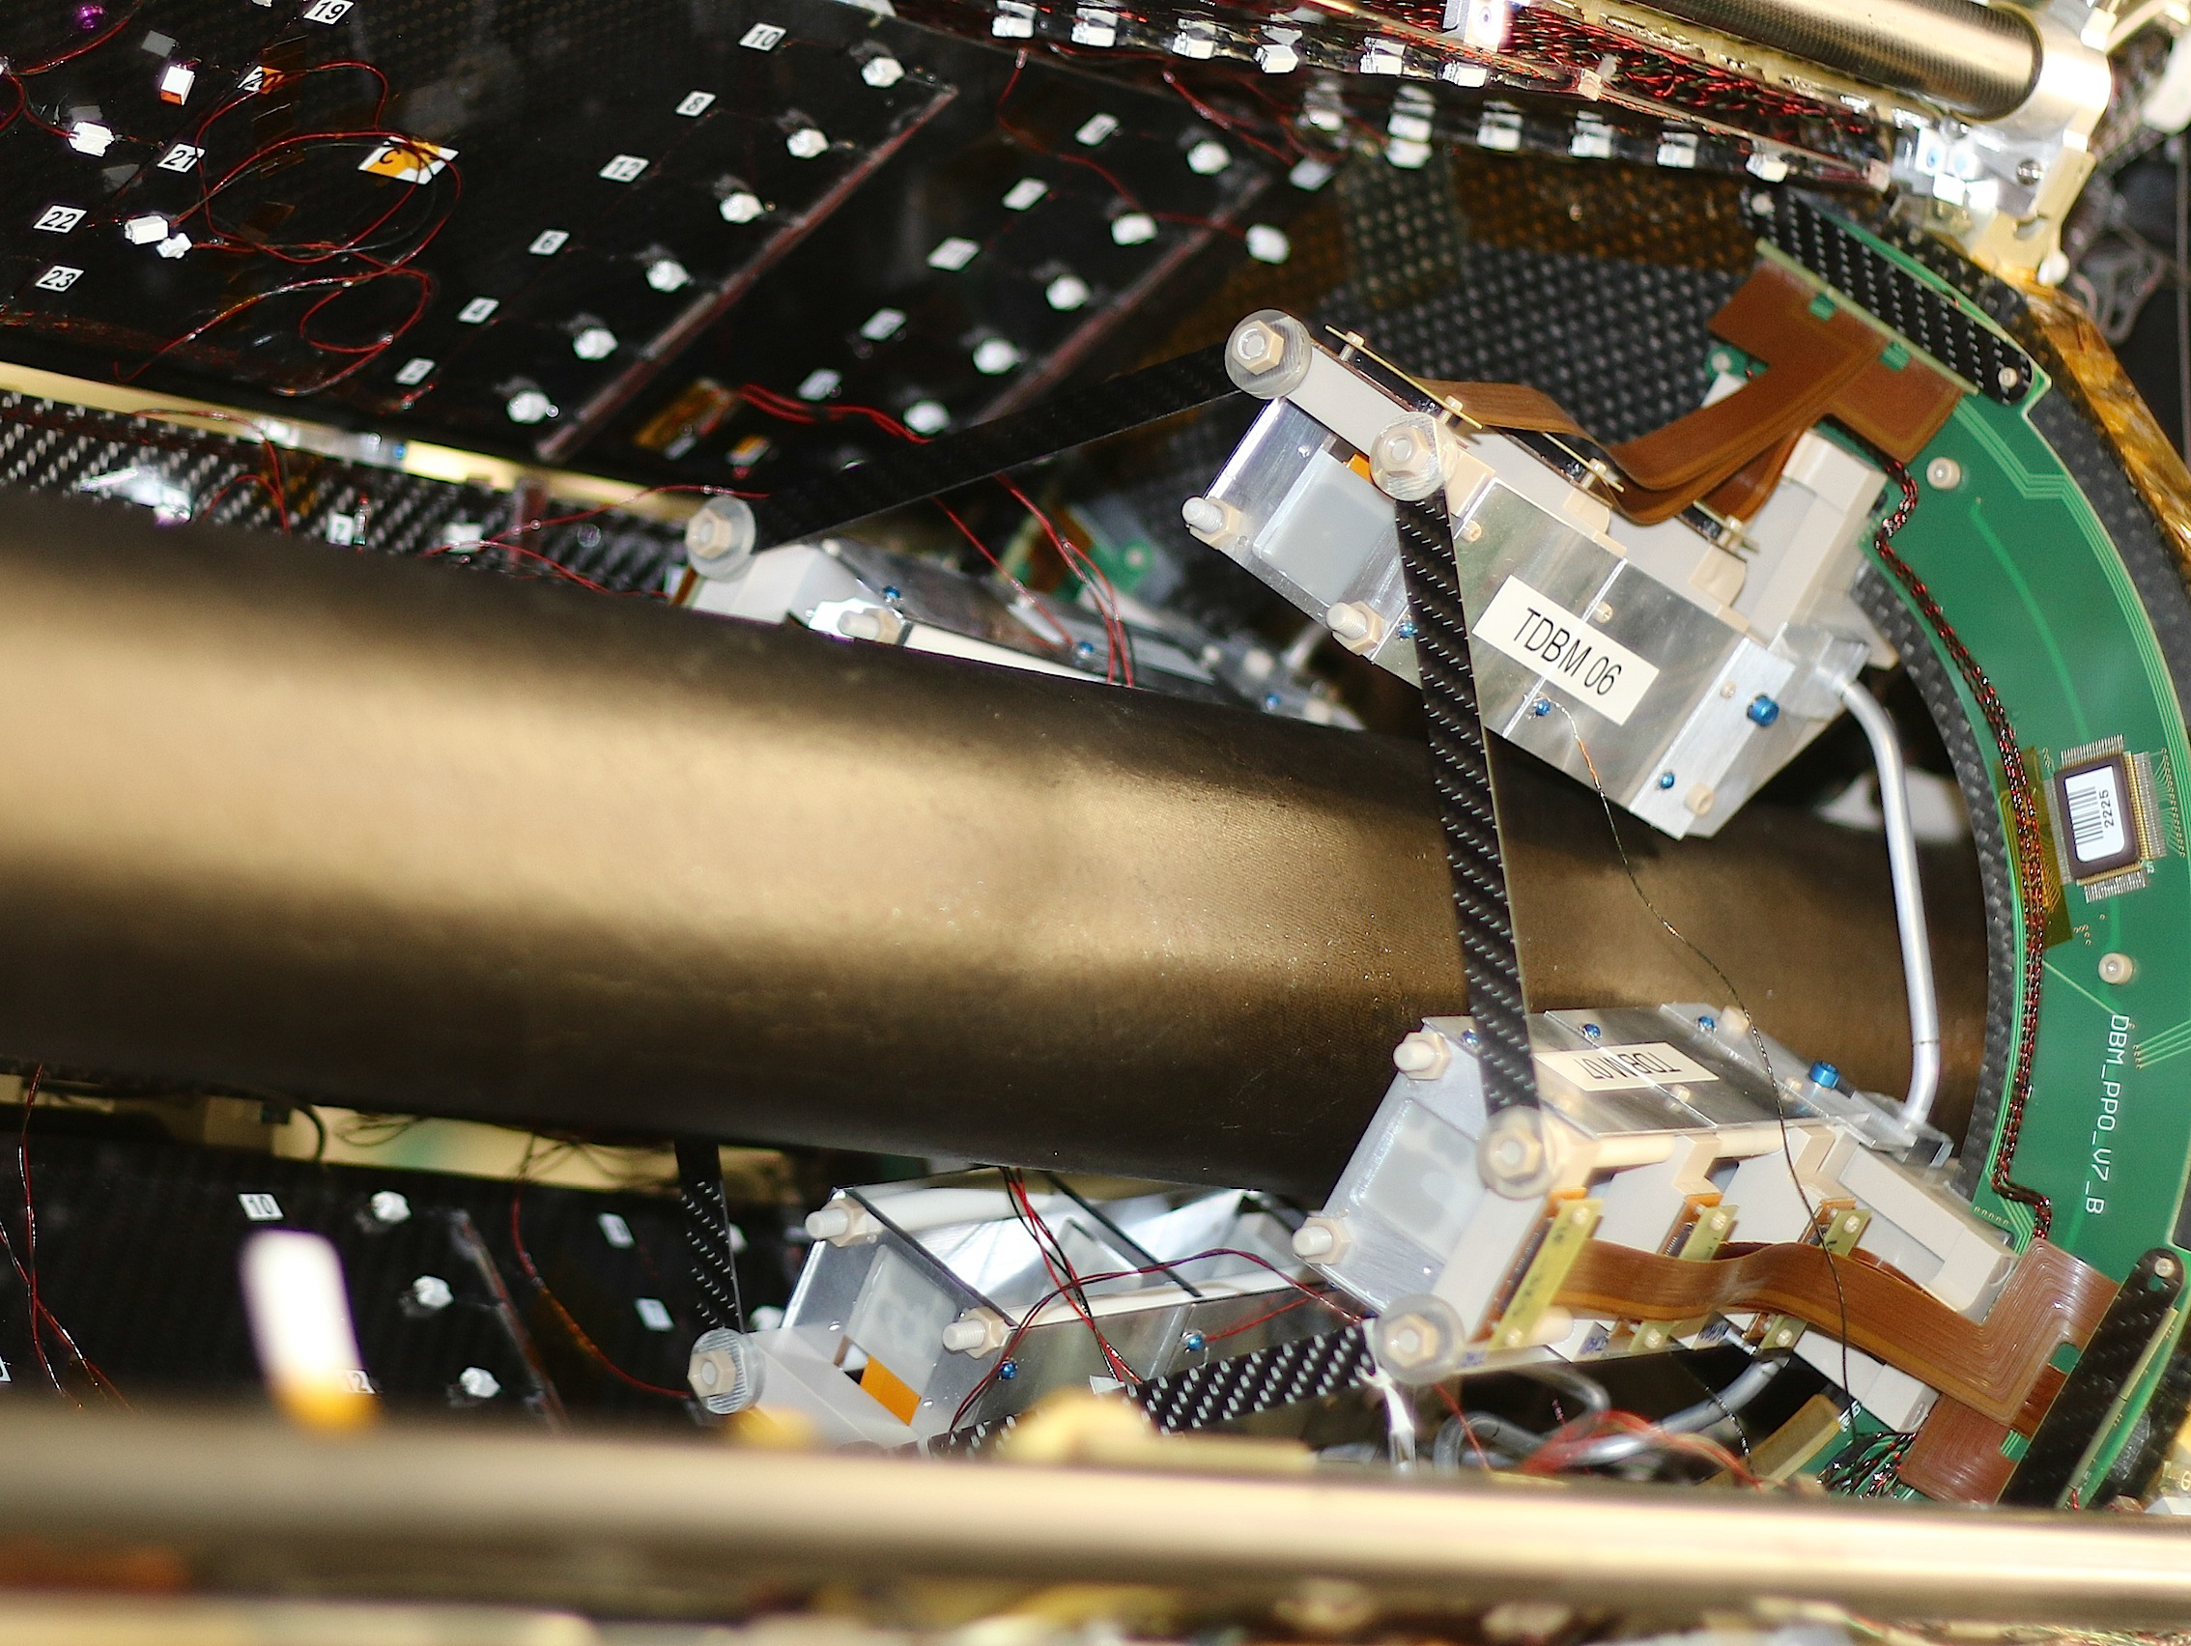
Diamond Detectors
Diamond Beam Monitor
IBL Pixel Layer

Slide 24
Si/Diamond as Cryogenic BLM
Both seem capable of operation at LHe temperatures
Suggest operation of BLM within magnet cryostat
Kurfurst et al., NIM A782 (2015) 149

Slide 25
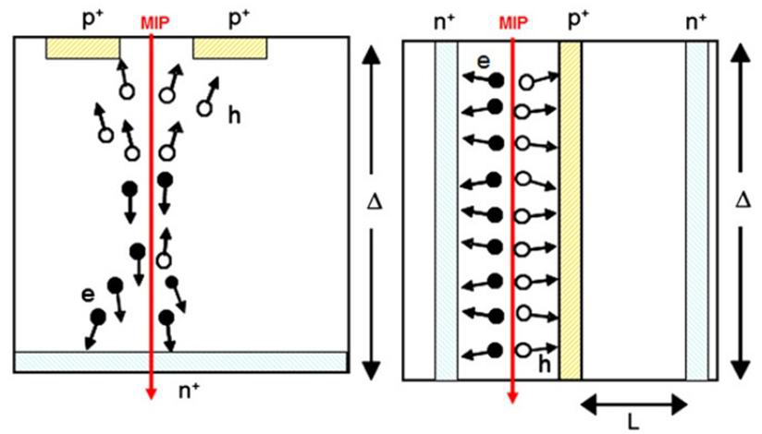
LHC
Diamond detectors in beam monitoring.
3-D Detectors in ATLAS vertex detector

Slide 26
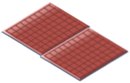
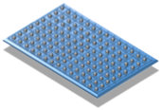
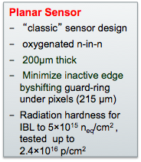
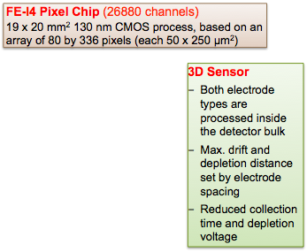
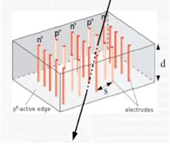
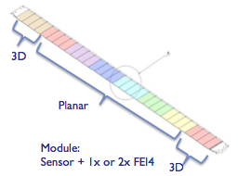
From talk, J. Lange, ATLAS 3D Group
RD50 Workshop 22-24 June, 2015

Slide 27
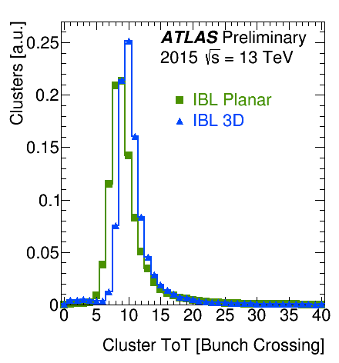
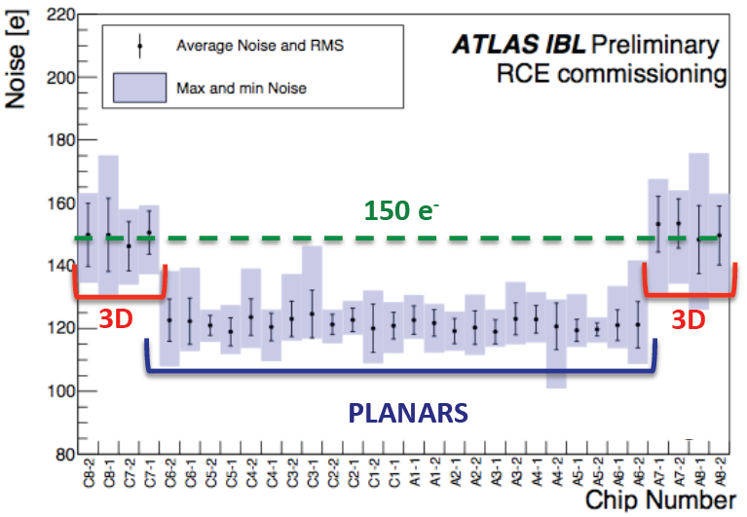
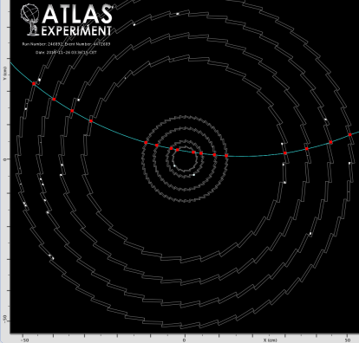

Slide 28

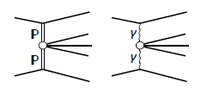
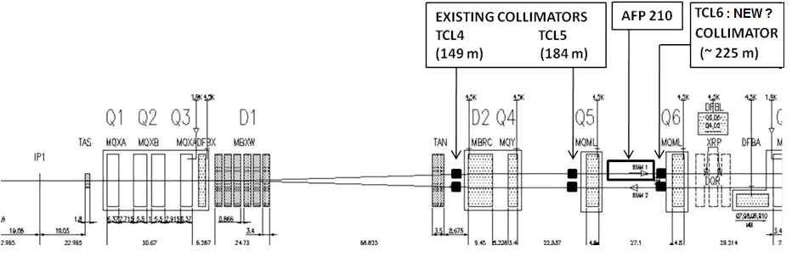
“Forward” Physics Detectors
Very small angle proton scattering:
  Good spatial resolution (~10um)
  Sensitivity close to edge.
  Good radiation intolerance.
  3D detectors very promising.

Slide 29
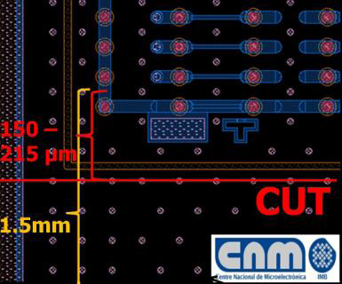
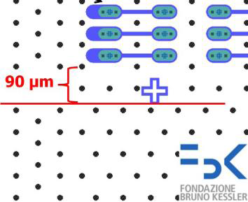
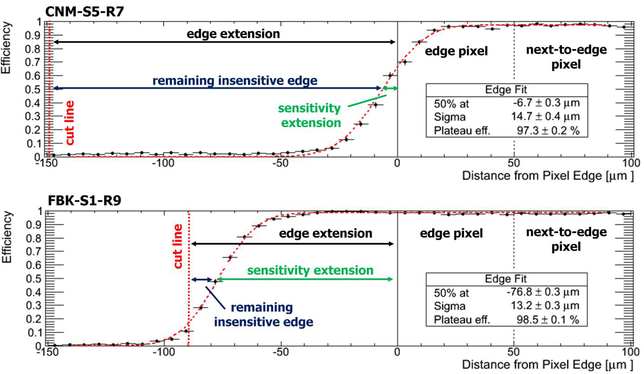
J. Lange et al., JINST 10 (2015) C03031

Slide 30
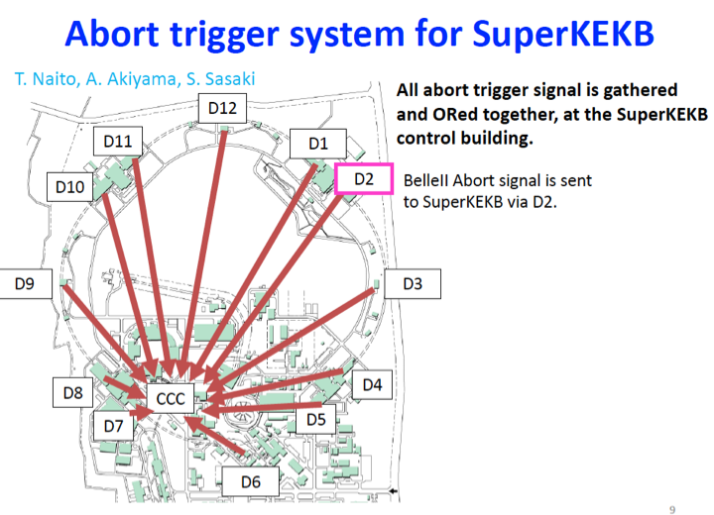

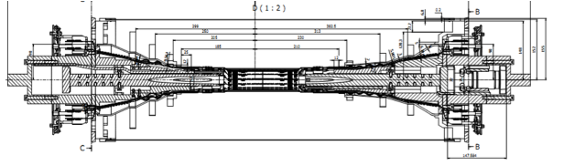
SuperKEKB - Diamond Beam Monitor
Belle II Pixel and Strip Vertex Detector (VXD) Abort monitors

Slide 31

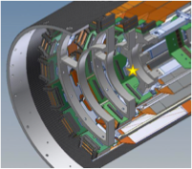

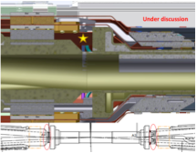

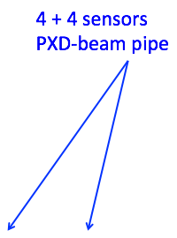

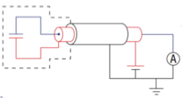

Belle II PXD Beam Abort

Slide 32
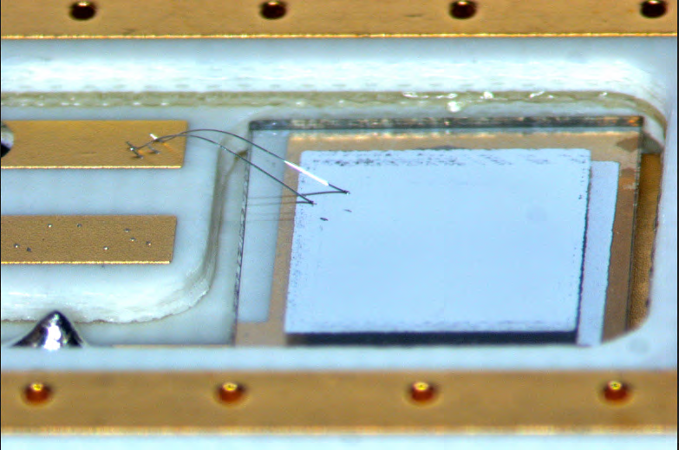
– Based on experience from Belle, BaBar, CDF, LHC
– scCVD diamond sensors, measurement of currents:
          - typical pCVD sensor @ 500V:
                1nA = 7 mrad/s = 70 μGy/s
          - Noise a few pA, in current measurements

Slide 33
Outlook
Silicon and Diamond detectors effective for both HEP detectors and Beam Monitoring / Beam Loss role.
Pixel devices essential for high rate / high luminosity environments (SuperKEKB, LHC, HL-LHC)
Si and Diamond capable of cryogenic operation
HR-CMOS, HV-CMOS offer future technology for significant integration options.

