Slide 1

HTc-SQUID
Beam Current Monitor at the RIBF
HTc: High Critical Temperature
SQUID: Superconductive Quantum
Interference Device
T. Watanabe*, N. Fukunishi, M. Kase
RIKEN Nishina Center
S. Inamori, K. Kon
TEP Corporation
IBIC 2015
16 September 2015
MCEC MELBORNE

Slide 2
Preview
Purpose and Importance
How to measure?
What Can the HTc SQUID Monitor Do?
Improvement of Magnetic Shield
Conclusion

Slide 3



Purpose and Importance of High-Tc SQUID Monitor
What do we measure?
The current (position) of the DC beam
What are the advantages of measuring a beam using a SQUID?
(1) Nondestructively, (2) Accurately, (3) In real time
Why do we need a SQUID monitor?
  For high-energy heavy-ion beams,
    If a beam is stopped by a Faraday cup,
    (1) the beam can no longer be used;
    (2) there is a danger of melting and activating of cup;
    (3) it is difficult to completely suppress secondary electrons.
HTc SQUID monitor can address all these problems !
Why

Slide 4

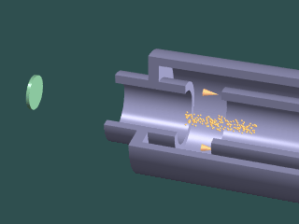


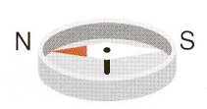
Motivation
- Why we decided to conduct present work -
Why SQUID?
  DC Current Transformer => Sensitivity ~1μA
Why High-Tc superconductor?
Brain
Environmental
Noise
Earth’s magnetic field
Heart
1 nA Beam
@10 cm
10⁻⁵
10⁻⁶
10⁻¹⁰
SQUID
10⁻¹³
10⁻¹⁵
T
1/10¹⁰ !!
0.1 μA Beam
Operation
Temperature
Lq. He ⇒ Lq. N₂
4.2 K ⇒ 77.3K
Superconductor
Downsizing System
SQUID
Reduction of running costs
Estimation using Japanese price

Slide 5
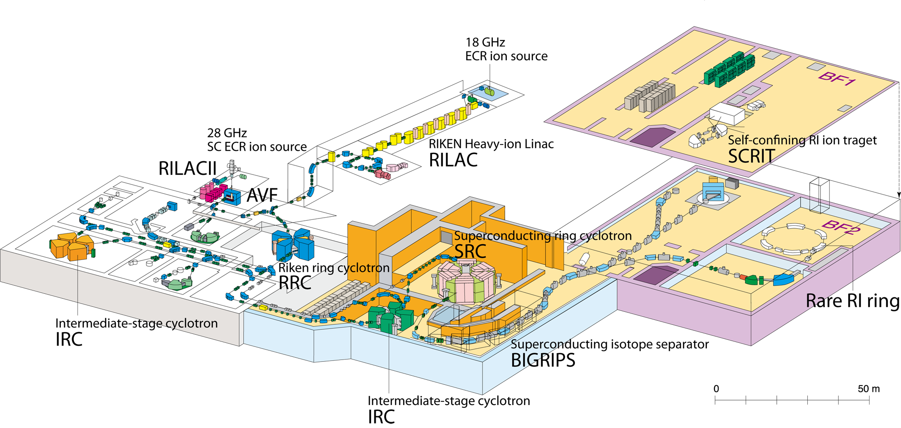
Where is the SQUID Monitor?
SQUID Monitor
ECR Ion Source Ar
RRC A01 Ar
IRC H11 (NOW) Ca, Zn, Kr, U

Slide 6

Purpose and Importance
How to measure

Slide 7
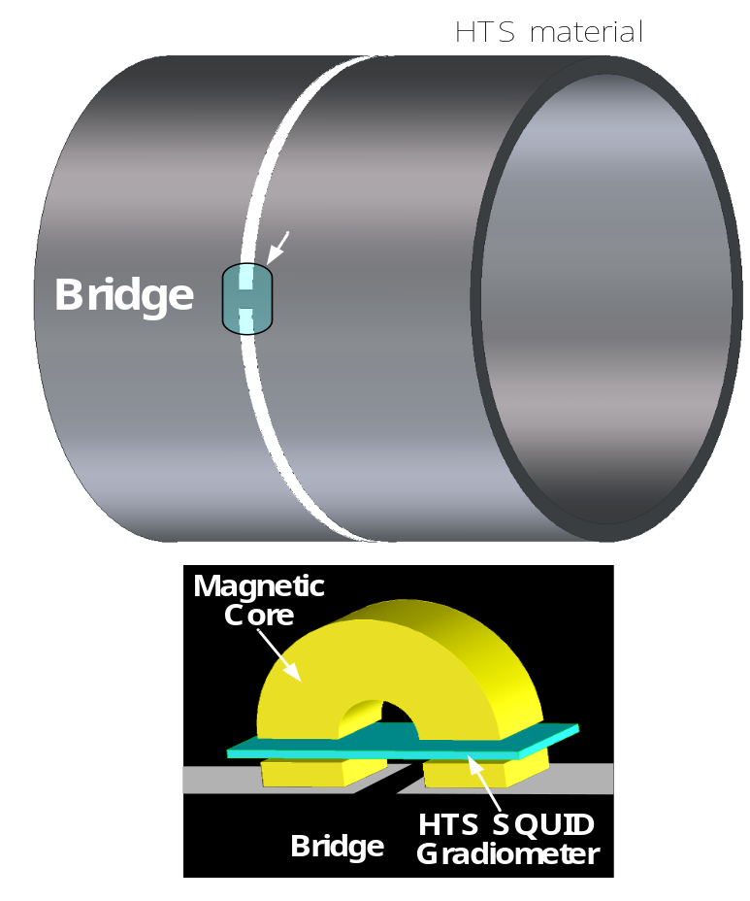

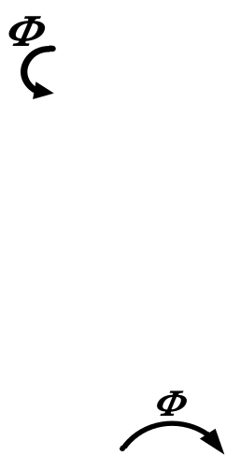

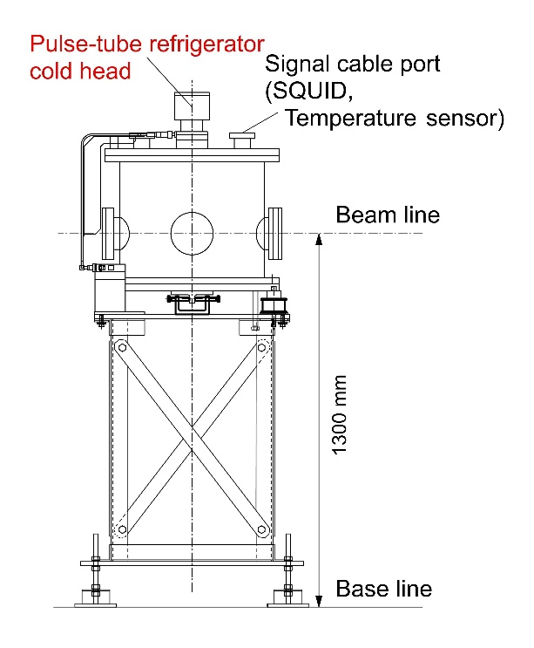
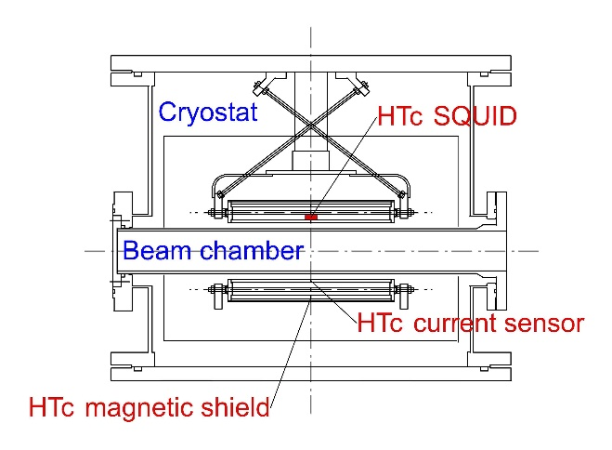
Principle of HTc SQUID monitor
Irradiation of beam
Superconductor: Bi(Pb)₂-Sr₂-Ca₂-Cu₃-O_{x} (Bi2223)
Substrate: 99.9% MgO ceramic
Shielding current is produced
by Meissner effect
Designed to have a bridge circuit
Current is concentrated in bridge circuit
SQUID can detect Φ with high S/N ratio
Concentrated

Slide 8

How to measure
What can the HTc SQUID Monitor Do?

Slide 9
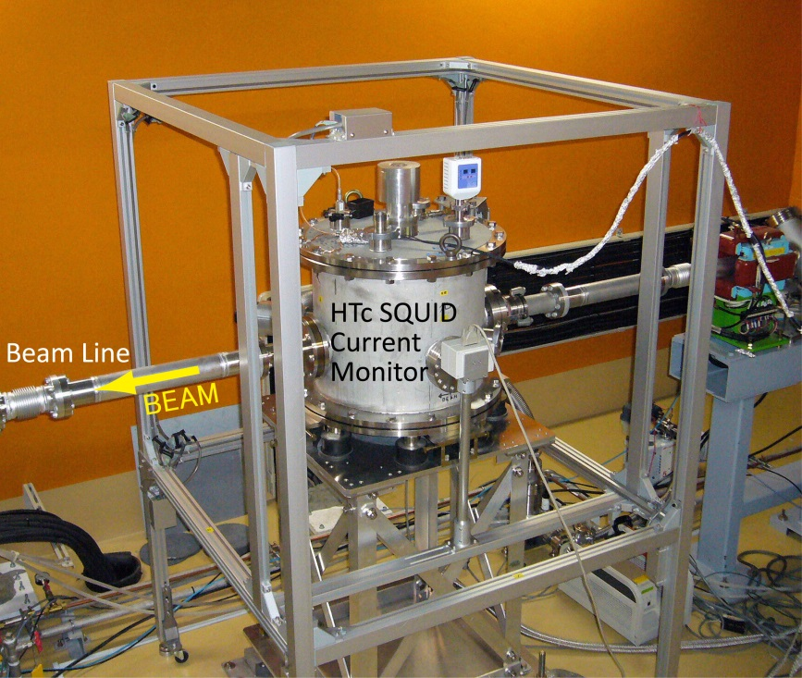
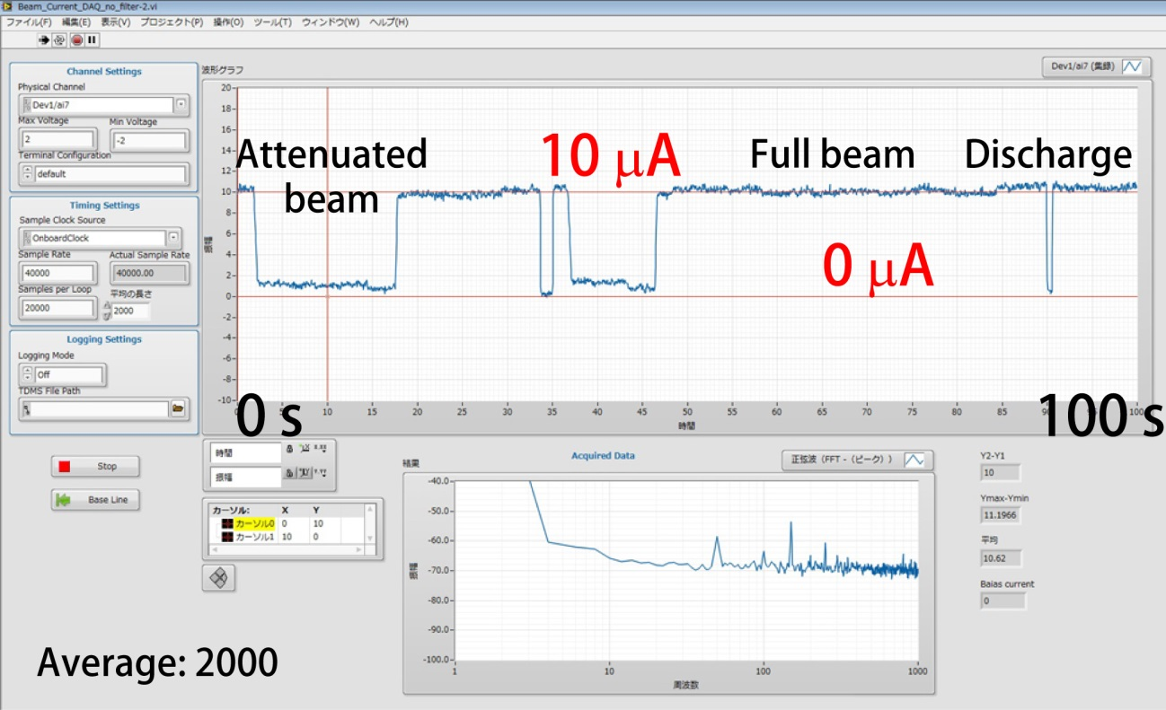
Measurement for
heavy ion beams (2014)
Beam: ⁴⁸Ca⁺²⁰ (45.5 MeV/u)
HTc SQUID monitor installed in the IRC beam line
2014/12/10 19:22

Slide 10
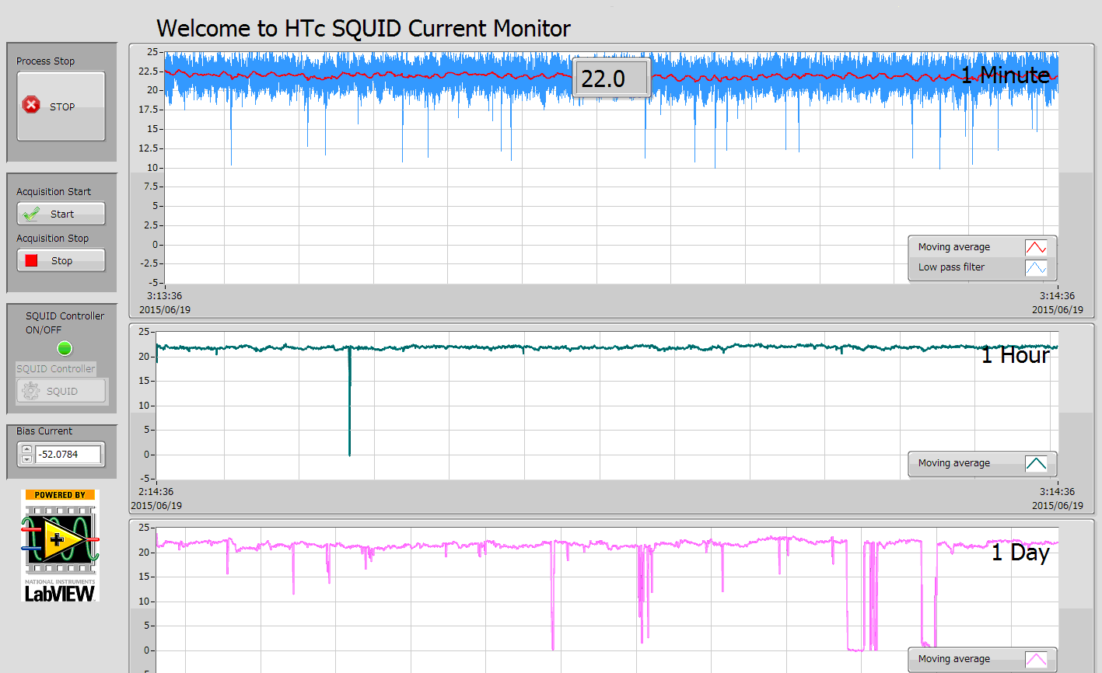
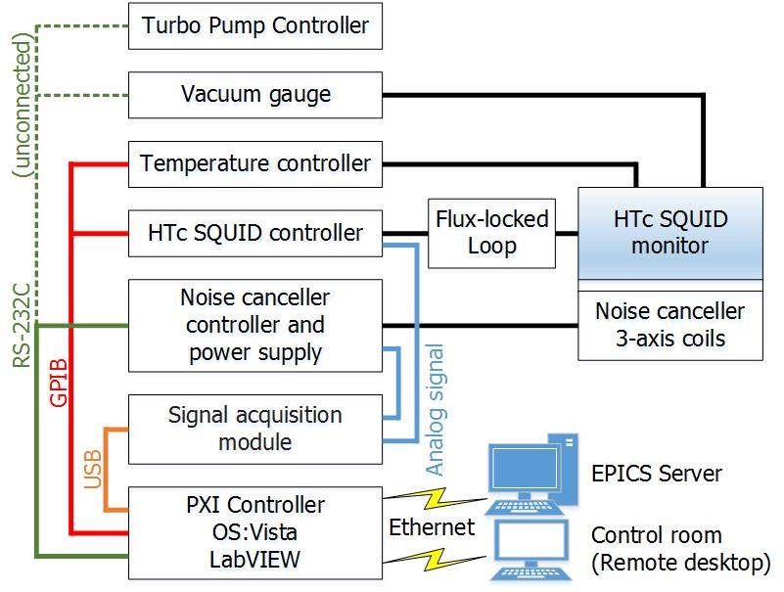
Measurement for
heavy ion beams (2015)
Beam: ⁷⁸Kr⁺⁶⁰ (50.0 MeV/u)
Programed by LabVIEW
2015/ 6/19

Slide 11
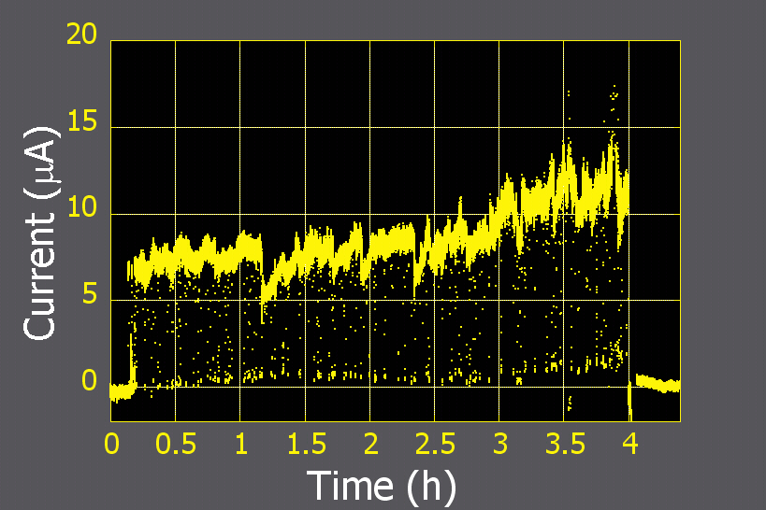
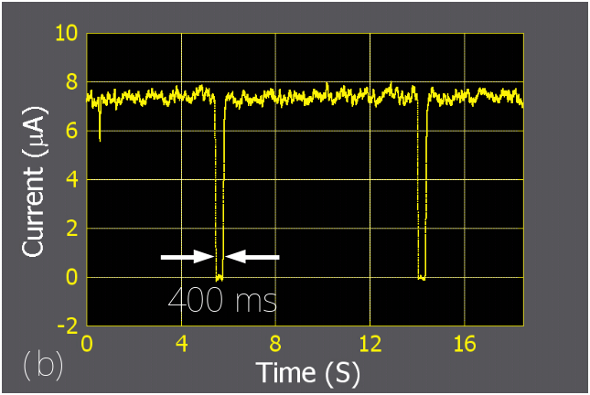
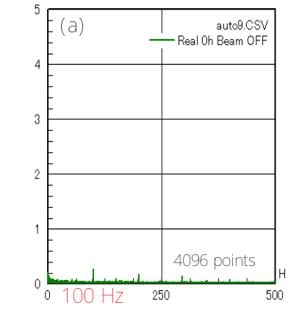
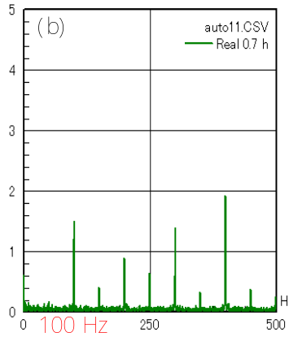
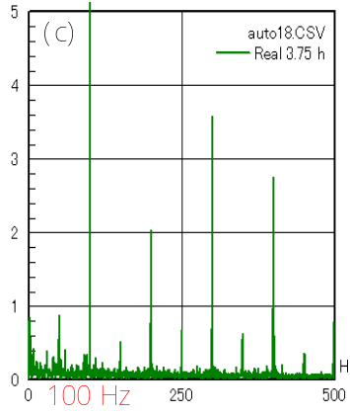
FFT analysis
Beam: ⁴⁰Ar⁺¹⁵ (63 MeV/u)
Discharge of ECR ion source
Close up
Amplitudes of ripples in modulated beam
Measurements and analyses
In real time
Without interrupting beam user’s experiments
0 hour (beam off)
0.7 h
3.8 h

Slide 12
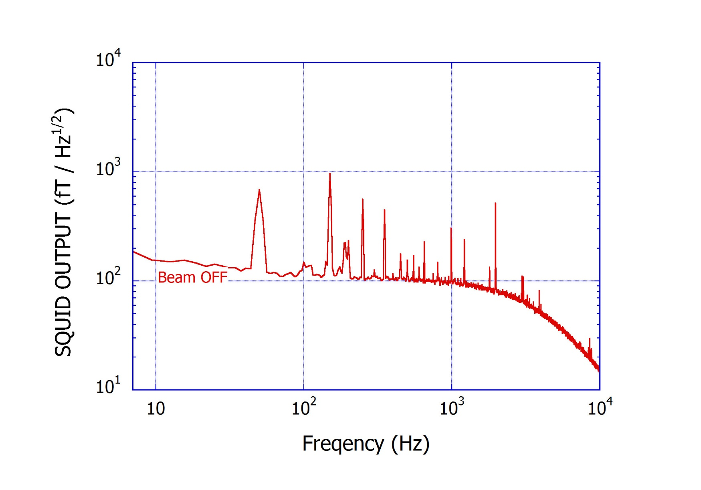
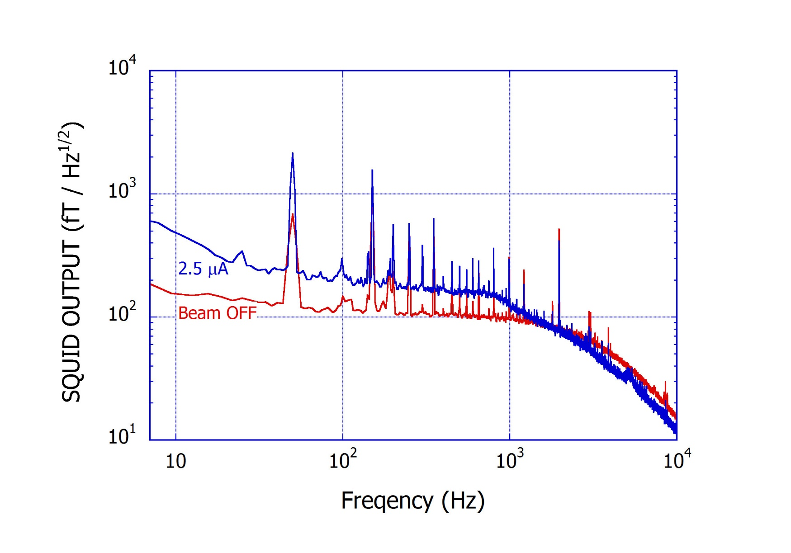
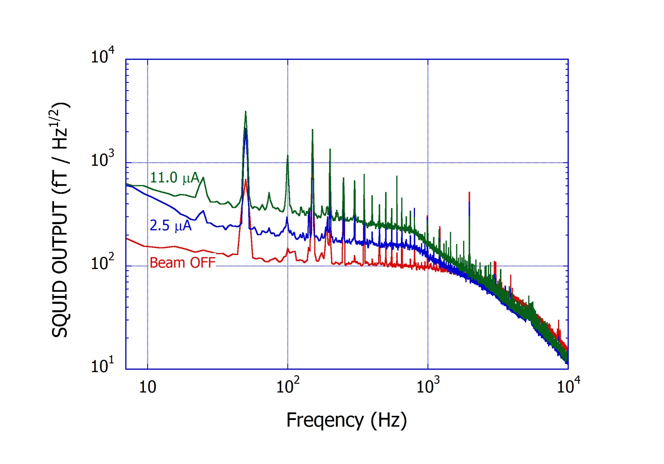
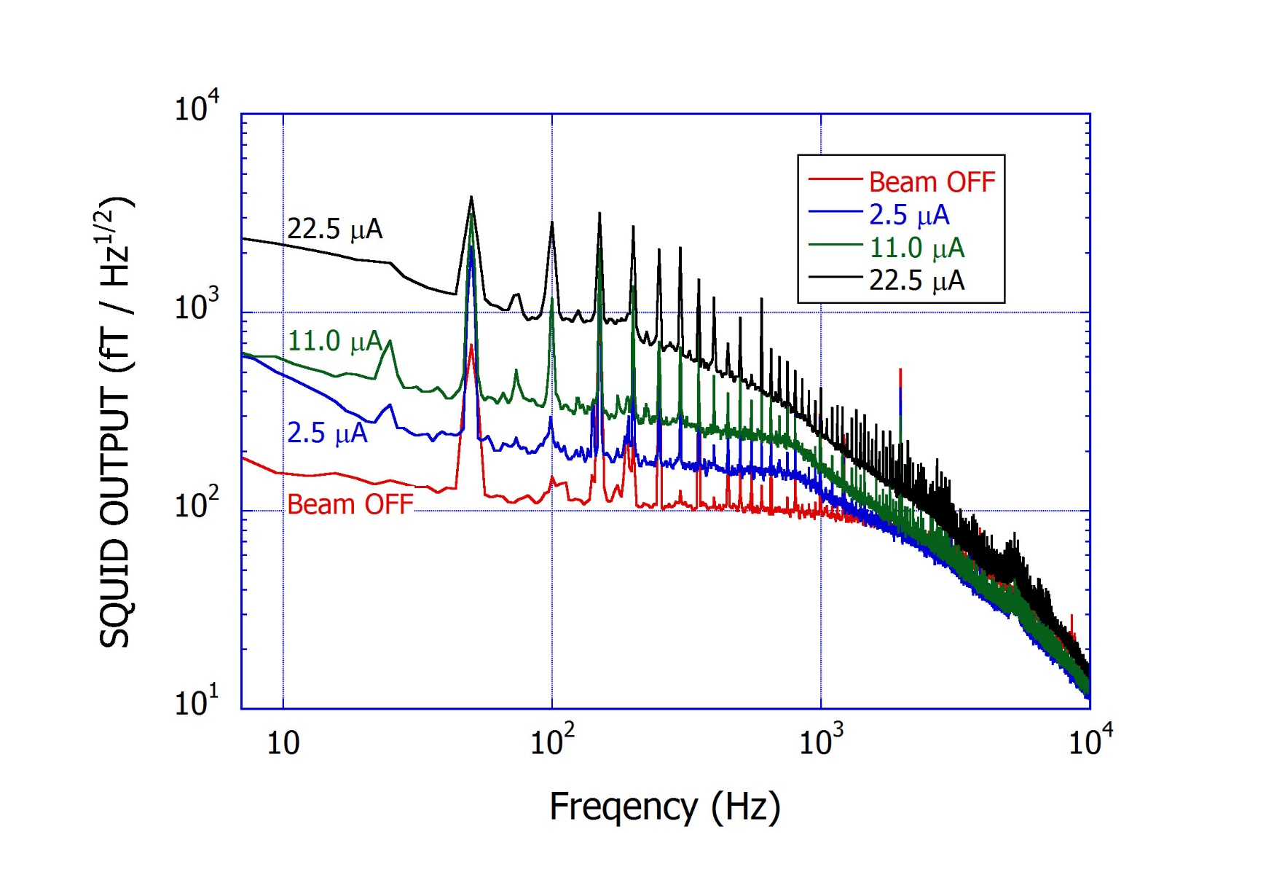
FFT analysis
Beam: ⁷⁸Kr⁺⁶⁰ (50.0 MeV/u)

Slide 13

What Can the HTc SQUID Monitor Do?
Improvement of Magnetic Shield

Slide 14
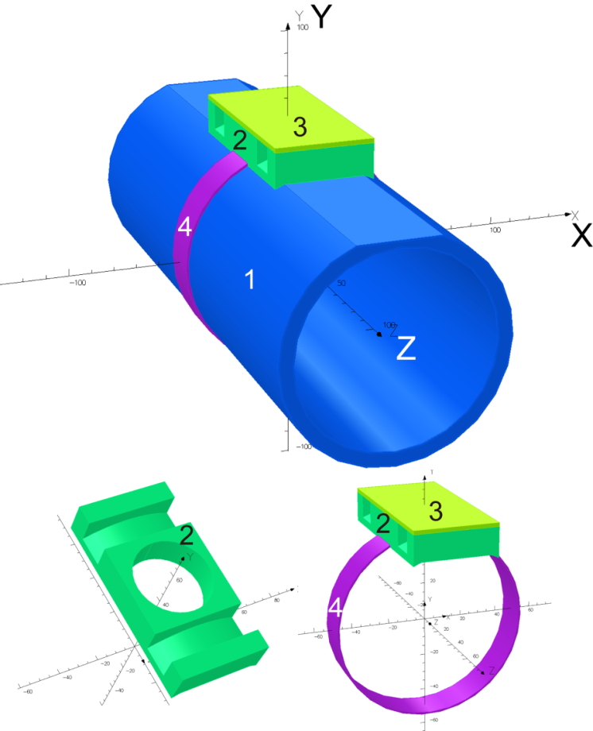
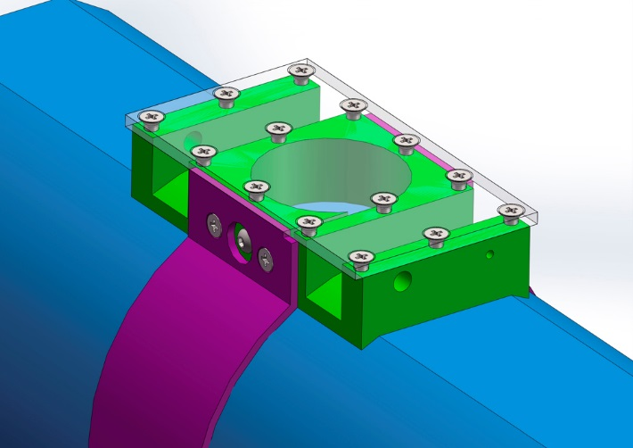
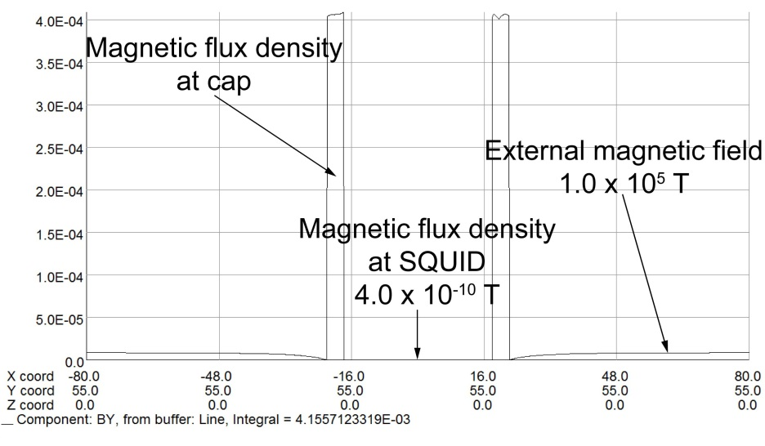
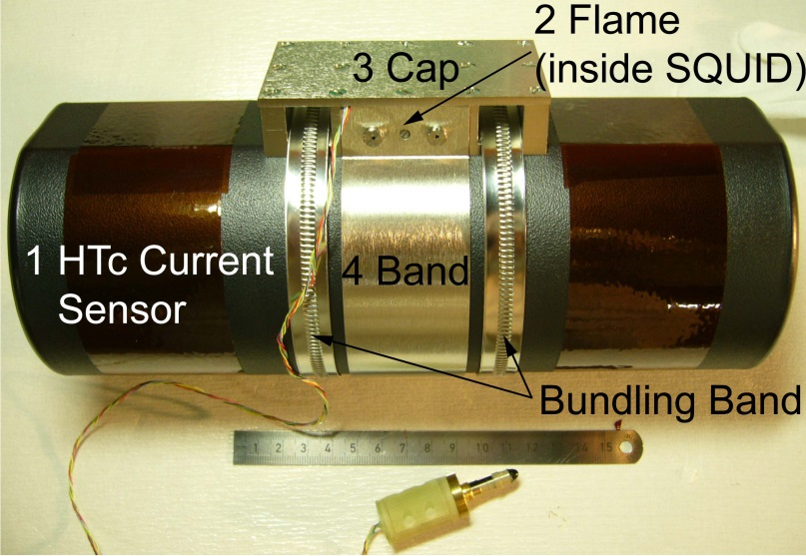
Hybrid magnetic shielding system
Calculated result by Opera-3d
External
Magnetic Field
1.0 x 10⁻⁵ T
3(4) x 10⁻¹⁰ T
1. HTc current sensor with
Ferromagnetic
shielding materials,
2: frame, 3:cap and 4: band.

Slide 15
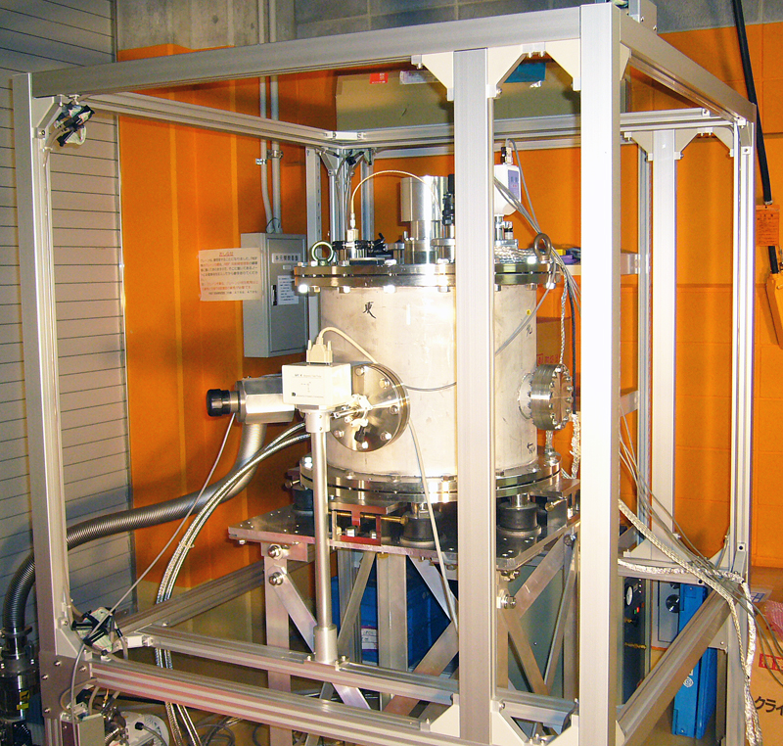
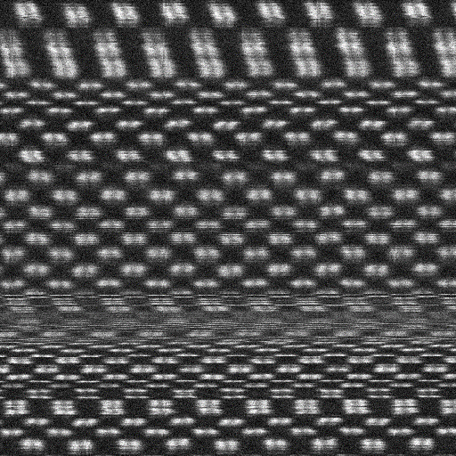

Active noise canceller system
Specifications
Field attenuation -40 dB
Max. compensation 6 μT
Bandwidth DC(0)～1,000 Hz
AD/DA converter 16 bit
Magnetic sensor DC : 3 axis Flux gate
Magnetometer
*JEOL Ltd. http://www.jeol.co.jp/en/
Hexahedron
3-axis Helmholtz Coil Cage
HTc
SQUID
Monitor
Surface of Si [110]
3 axis Magnetic Sensor
Canceller OFF
Canceller ON

Slide 16
Measurement for
heavy ion beams
Beam: ⁷⁸Kr⁺⁶⁰ (50.0 MeV/u)

Slide 17
Conclusion
To measure the DC current of heavy-ion beams non-destructively, we have developed a SQUID monitor for practical use in acceleration operation.
We strongly reinforced the magnetic shielding system.

Slide 18
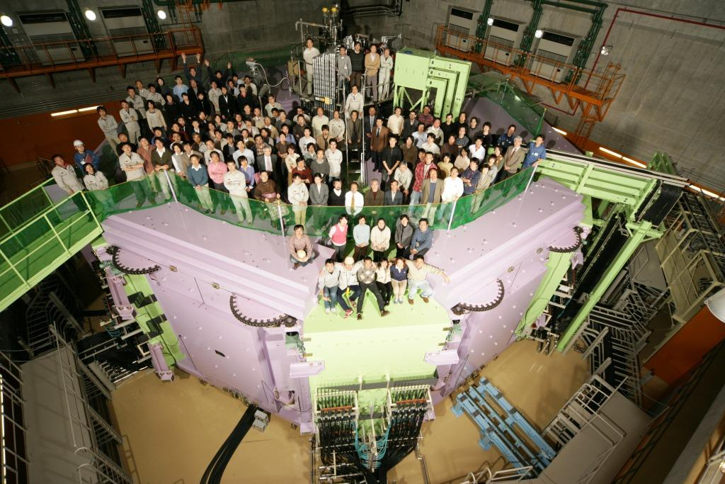
Thank you for
your kind attention
Tamaki Watanabe
* This work is supported by JSPS KAKENHI Grant Number 15K04749.

