Slide 1



Commissioning of the New Online-Radiation-Monitoring-System at the New European XFEL Injector with First Tests of the High-Sensitivity-Mode for Intra-Tunnel Rack Surveillance
Frank Schmidt-Föhre, DESY
Notes:
… thank you Mr. Chairman for the kind introduction
… and the opportunity to present this talk …
… hello everybody …
… I will report on a short commisioning status overview of the new radiation-monitoring-system for the European XFEL …

Slide 2
Overview
Short overview of the European XFEL
The online machine dosimetry purposes at the XFEL
  Radiation monitor positions along the XFEL
  System design goals
Overview of the DosiMon Online-Radiation-Monitoring system
  system concept & topology
  components and connections
  RadFet & TLD sensors at different locations
DosiMon test setup at the XFEL injector
DosiMon system commisioning at the FLASH gun
Cs-137 calibration measurement
Test setup at DESY2 booster ring
Results of tests and measurements
Outlook
Overview

Slide 3
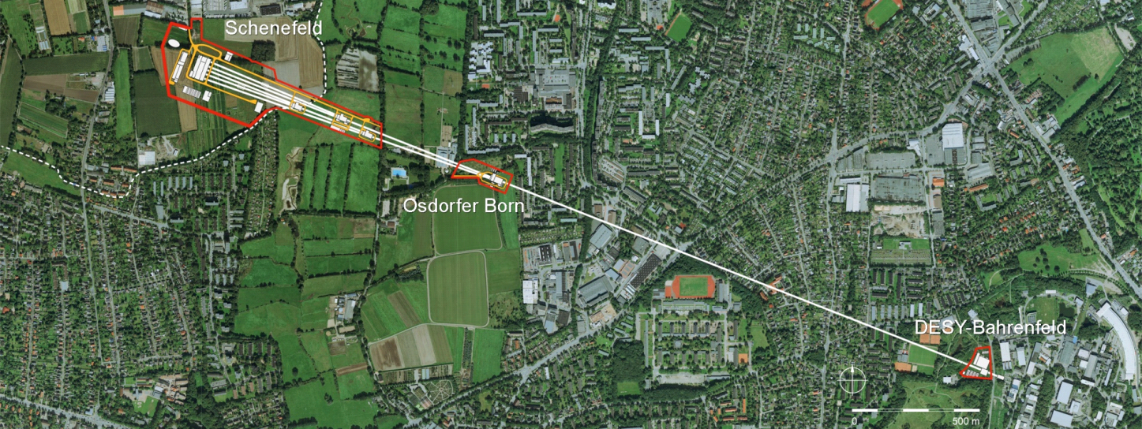
European XFEL at a Glance
International project realised in Hamburg, Germany
17.5 GeV superconducting linac, almost 1 MW beam power
27000 pulses per second in 10 Hz burst mode
Three variable gap undulators for hard and soft X-rays
Initially 6 equipped experiments
Experimental Hall
Photon Beam Lines
Beam Dumps
Undulators
3.3 km
Electron Beam Distribution
Collimation
Linear Accelerator
Bunch
Compressors
Inject or
(Courtesy W. Decking, DESY)
Notes:
At the beginning … a very brief overview about the European-XFEL …

Slide 4
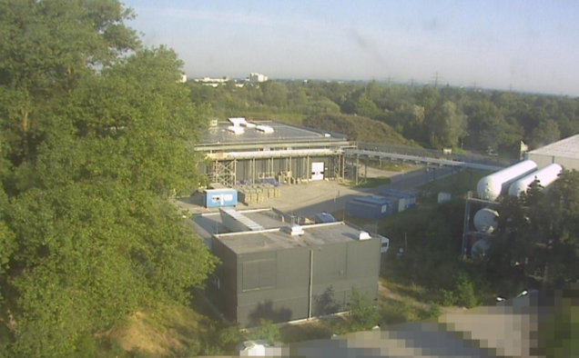
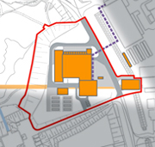
Infrastructure & Injector
On DESY campus
Primary access to accelerator
Linear accelerator infrastructure
Injector
(Courtesy W. Decking, DESY)
Notes:
A look onto the XFEL site …
Goes from DESY campus across the border of Hamburg into the adjacent state of Schleswig-Holstein …
Direct access to Injector and the Linear accelerator infrastructure from the DESY site possible …

Slide 5
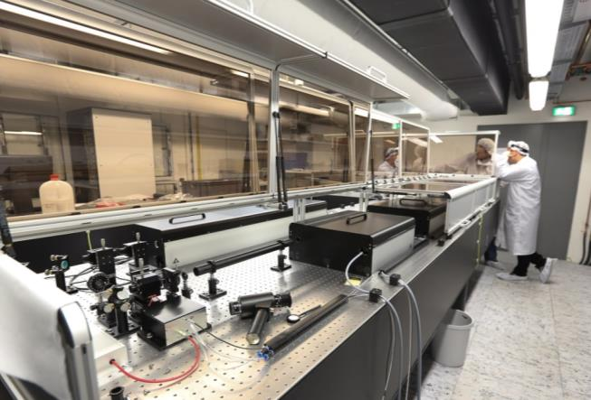
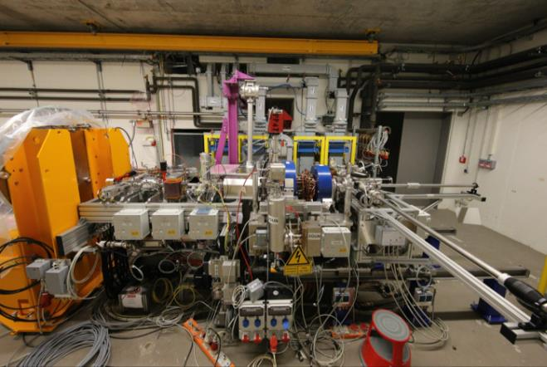
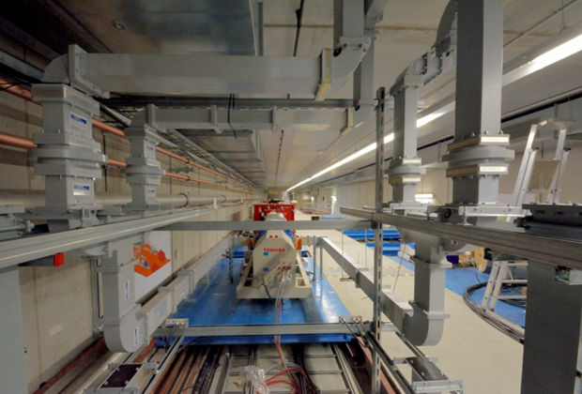
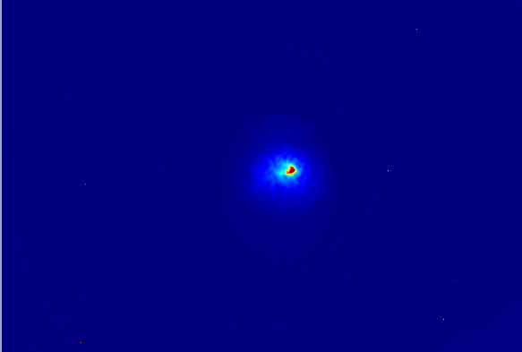
RF Photo Injector
Laser
Photo Injector
High-power RF system
10.02.2015:
First photoelectrons at XFEL
About 3 nC, 20 bunches, 10 Hz
(Courtesy W. Decking, DESY)
Notes:
A short look at the RF Photo Injector …
With Laser, Injector and High-Power RF-system
First photoelectrons were seen in a first run at the beginning of this year

Slide 6
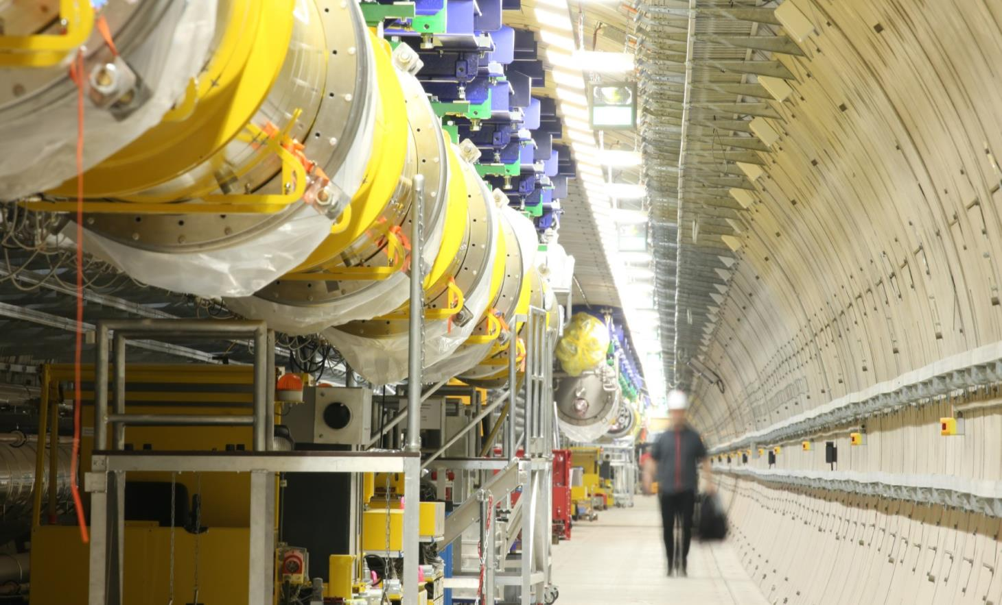
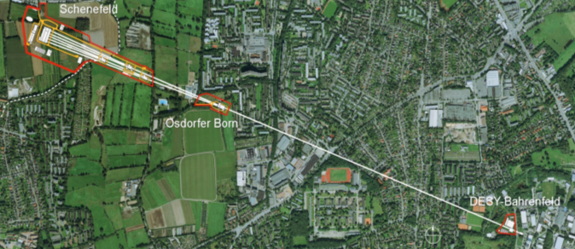
Tunnel installation status of today
Bunch
(Courtesy W. Decking, DESY)
Notes:
This is what the tunnel looks like today … installation work is heavily underway and many of the main components are already in place (like most of the superconducting acceleration modules)

Slide 7
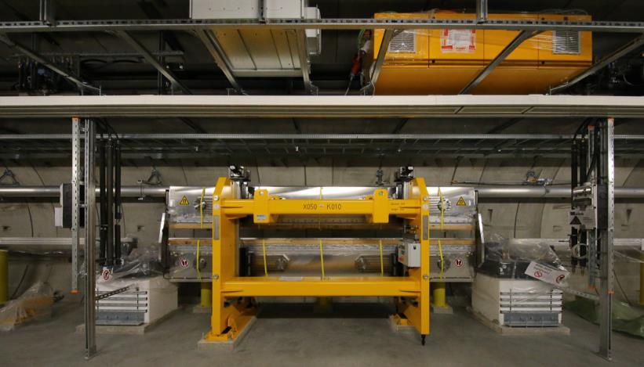
Undulator
Bunch
First undulator installed in the tunnel
(Courtesy W. Decking, DESY)
Notes:
… also the installation of the undulators in the first undulator section has started …

Slide 8
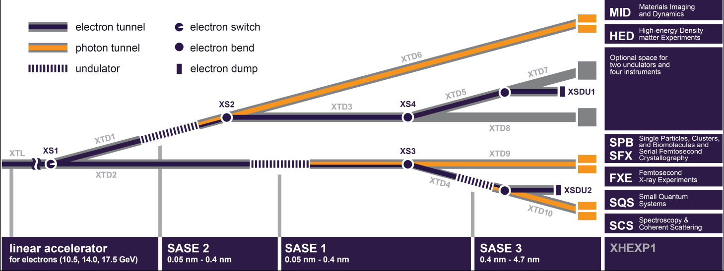
Photon System
Bunch
3 SASE sections (SASE1, SASE2, SASE3) with ~35 undulators each
ror chamber
Photon beam lines vacuum system
(Courtesy W. Decking, DESY)
Notes:
… and here is an overview of the Photon System part of the XFEL …
3 SASE sections with ~35 movable-gap undulators each deliver photons with at variable wavelength and bunch patterns to the beamlines
-> 2 RadFet sensors per Undulator for measurement and estimation of the absorbed gamma dose in each undulator

Slide 9
Radiation monitor positions along the XFEL
(External sensors ...)
Undulators (~100 pcs., 2 sensors per undulator): ~200 sensors
Linac section, cold (25 RF-stations incl. LLRF, ~4 sensors per RF-station):
~100 sensors
Linac section, warm (~ 10 sections incl. Bunch Compressor,
~4 sensors per section): ~ 40 sensors
Beam stop (D3) permanent magnets: 16 sensors
(Internal sensors ...)
Machine Protection System (MPS) modules: ~150 sensors
Modular BPM Units (MBU, PSI): ~180 sensors
=> Total: 340 external sensors + 330 internal sensors
Radiation monitors (estimation) foreseen at …
Notes:
… a brief overview of the intended radiation measurement points along the XFEL …
… divided into external monitoring positions, that are located outside the electronic racks - along the XFEL
- at different frontend measurement positions
… and internal monitoring positions - inside of electronic racks – all along the XFEL for the surveillance of the deposited dose at the electronics, that is completely located inside of the XFEL tunnel …

Slide 10
The radiation monitoring system – features list
System integrates internal & external sensors (**)
Use of small, self-integrating (by physical nature) radiation sensors
γ-dose range (external sensors): 0.1 Gy – 2 kGy (***)
(up to 10 kGy => reduced resolution)
γ -dose range (internal sensors): 0.01 Gy – 10 Gy (***) +18V bias mode!
Internal sensor for estimation of integrated n fluence -> under development
Reference temperature logging at internal & external radiation sensors
Scalable frontend (# of channels, # of readout electronics, cabling)
Alarm generation into the machine protection system (dose rate, dose limits)
Plug-in readout-module on standardized small form factor mezzanine (FMC)
Compatible to XFEL machine protection system host board (DAMC2)
Easily integratable into other host systems (e. g. PSI MBU carrier board)
DosiMon system design goals (*)
(*) Only main features listed important for integration into typical XFEL environment (host systems, frontend)
(**) Internal/external = inside/outside of electronic racks (shielded)
(***) Exact feasable limits currently under investigation (design ongoing)
Notes:
Before you start editing the slides of your talk change to the Master Slide view:
Menu button “View”, Master, Slide Master:
Edit the following 2 items in the 1st slide:
1) 1st row in the violet header:
Delete the existent text and write the title of your talk into this text field
2) The 2 rows in the footer area: Delete the text and write the information
regarding your talk (same as on the Title Slide) into this text field.
If you want to use more partner logos position them left
beside the DESY logo in the footer area
Close Master View

Slide 11
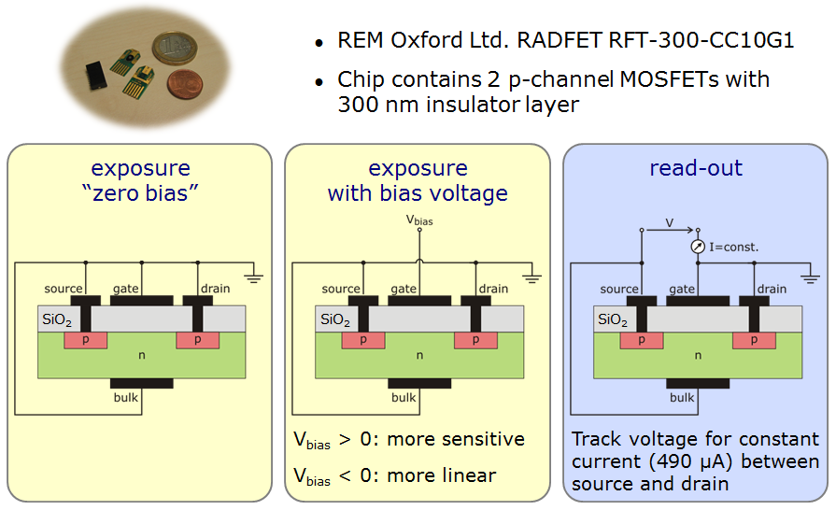
P-channel MosFet - principle
Thanks for your attention!
(Courtesy L. Fröhlich, DESY)
Notes:
A RADFET is basically a p-channel MOSFET with an
unusually thick layer of silicon dioxide below the gate electrode
(Fig. 1). Ionizing radiation causes the removal of
electrons, leaving behind a stationary positive space charge
in the oxide layer. The build-up of this space charge can
be substantially enhanced by applying a positive bias voltage
to the gate electrode, but it also takes place when all
electrodes are short-circuited (under zero bias).
The more dose is deposited on the dosimeter, the higher
is the amount of positive charge stored in the oxide layer.
The presence of this positive electric potential makes it
harder to put the MOSFET into its conductive state – in
other words, a stronger negative potential has to be applied
to the gate electrode in order to create a conductive inversion
layer in the bulk silicon below the oxide. The readout
system (or reader) uses this effect by forcing a welldefined
constant current through the transistor: The higher
the threshold voltage (Vt) needed to obtain this current, the
higher the dose absorbed by the RADFET.

Slide 12
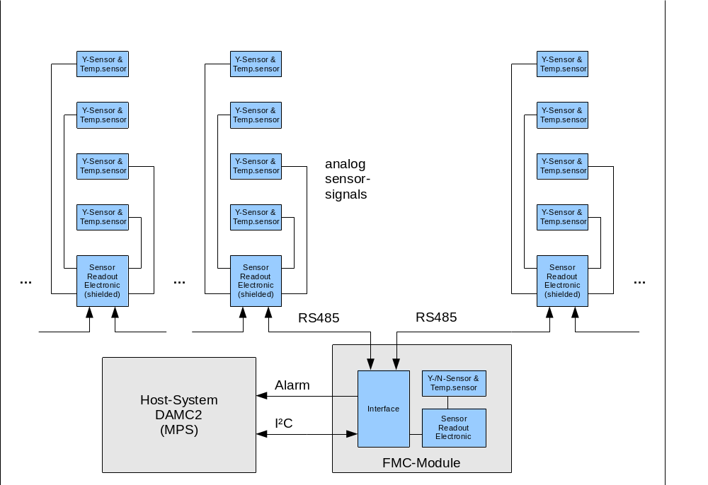
DosiMon system concept & topology
Scalable frontend :
- # of channels
- # of readout
modules
- cabling
external dosimetry sensors
(e. g. at undulators)
Frontend readout electronic
module
External
(outside of electronic rack)
Example: (MPS-) carrier module for connection to the XFEL control system
internal dosimetry sensors
Internal
(inside electronic rack)
Frontend module connections and cabling
Notes:
… and this is, how the system is build up …
This schematic block diagram shows the concept & topology of the system …
The system is modular and scalable to fit to the needs at each position along the accelerator
each DosiMon system is divided into 2 parts – separated by the horizontal dashed ------ line in the middle …
1. (below the line …) internal parts, located inside of the crate, rack & shielding …
→ the heart of the each DosiMon system beats on a so-called FMC module
→ FMC module is a mezzanine card, mounted on a carrier card with a FMC standard mezzanine slot
→ register driven interface between FMC and host card logic → based on I2C bus
→ hw alarm lines are available for notification of certain events (e. g. dose or dose rate above thresholds) to the machine-protection-system (MPS)
→ FMC is able to carry 1 RadFet gamma radiation sensor and 1 TLD reference sensor → THIS SETUP IS USED FOR RACK-SURVEILLANCE OPERATION
→ FMC provides a slot for 1 optional Neutron sensor (currently under development)
→ in the XFEL system, the Machine-Protection-uTCA card (D-AMC-2) and a special carrier card inside the Modular-BPM-Units (MBU) of PSI serve as host cards for the DosiMon FMC
2. (above the line …) all External parts, located outside of the electronics in the uTCA crate
→ external readout electronics box(es) - called DosiBox – pretty much alike the FMC electronics, but mounted in a box – for readout of up to 4 radiation sensors is connected to the FMC → THIS SETUP IS USED FOR EXTERNAL SENSORS OPERATION (e. g. at the Undulators in the SASE sections of XFEL)
→ DosiBox is also able to carry a RadFet gamma radiation sensor and a TLD reference sensor
→ provides a slot for optional Neutron sensor (currently under development)
Both parts → connected by a generic digital bus system …
→ master/slave system
→ electrically based on RS485
→ telegram driven generic protocol
→ ring-topology gives built-in redundancy → i. e. if a connection from one side of an external DosiBox fails, DosiBox can still be processed from the other side of the ring → the system remains working and the point of failure can be detected online and serviced afterwards

Slide 13
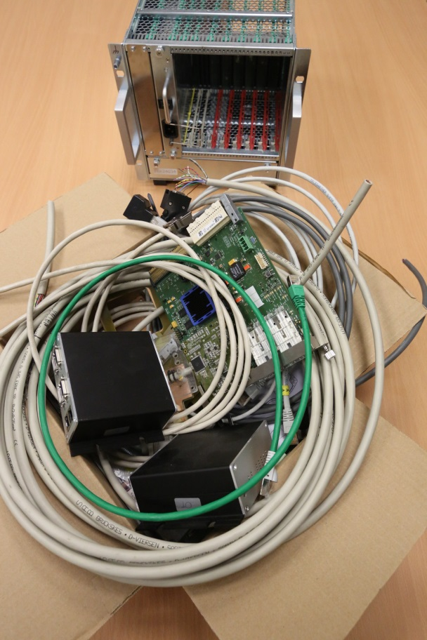
DosiMon system – out-of-the-box …
Scalable frontend :
- # of channels
- # of readout
modules
- cabling
external dosimetry sensors
(e. g. at undulators)
Frontend readout electronic
module
External
(outside of electronic rack)
Example: (MPS-) carrier module for connection to the XFEL control system
internal dosimetry sensors
Internal
(inside electronic rack)
Frontend module connections and cabling
Notes:
… and this is how it looks like, when it comes out-of-the-box … ;-)

Slide 14
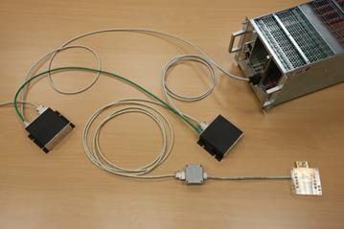
DosiMon system – components & connections
Scalable frontend :
- # of channels
- # of readout
modules
- cabling
external dosimetry sensors
(e. g. at undulators)
Frontend readout electronic
module
External
(outside of electronic rack)
Example: (MPS-) carrier module for connection to the XFEL control system
internal dosimetry sensors
Internal
(inside electronic rack)
Frontend module connections and cabling
Notes:
… when you tidy-up a little and connect the components, you will see this …
FMC, plugged on the carrier card, inside a slot of the crate, with a RadFet gamma sensor and an optional TLD reference sensor on it
2 DosiBoxes (external readout electronics), connected by a hydra-cable (remember … the snake with the two heads) to the FMC, connected by a single cable together to close the ring topology
In this example system … 1 external sensor-holder-set holding a RadFet sensor and an optional TLD reference sensor for an Undulator measurement point

Slide 15
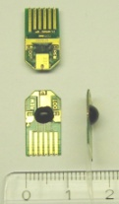
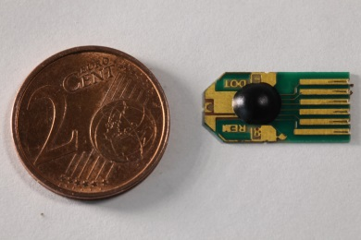
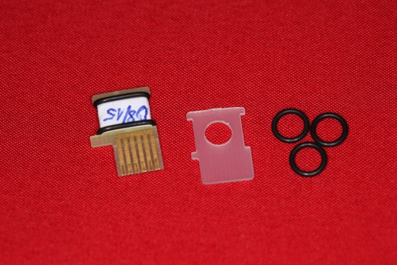
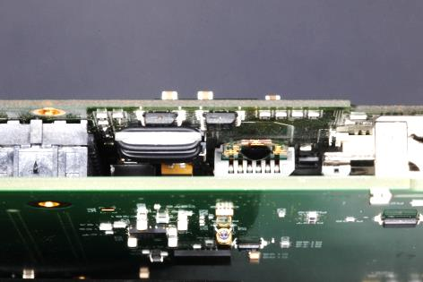
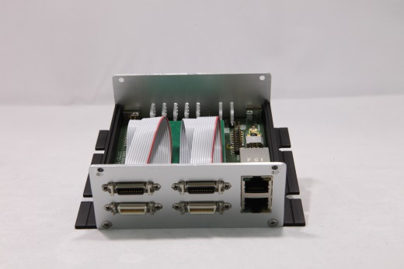
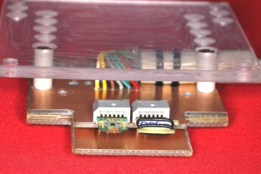
RadFet & TLD sensors at different locations
Very small RadFet Sensor,
type RFT-300-CC10G1
(REM Oxford Ltd.), 2 channels,
integrated diode
RadFet of comparable size as the well-known TLD-type reference
reference sensors used
1 RadFet/TLD pair located
on the DosiMon FMC
1 RadFet located in each DosiBox
1 RadFet/TLD pair located
on the external sensor-holder

Slide 16
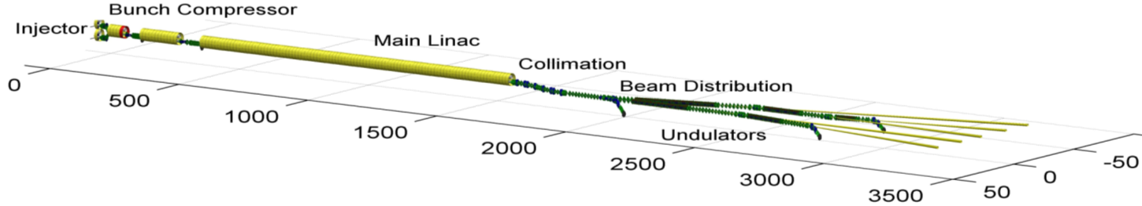

Timeline for the XFEL project
Hence, a decision was made, to test the DosiMon high-sensitivity mode at other machines and environments!
First RF-Gun opera-tion
2015
2016
2017
2018
Next RF-Gun opera-tion
First e-beam out of RF gun installed at XFEL
Injector cooldown
Linac tunnel closed
SA1
SA3
SA2
Start user operation
Full TDR performance
1st lasing possible
Injector com. up to full XFEL performance (varying charges and bunch patterns)
Initial linac com. with reduced performance
Continued accelerator com. to full performance (high beam power, bunch length flexibility, multiple bunch properties per rf-pulse, full wavelength tuneability, ….)
e⁻
Gun and injector laser com.
γ
Beam line and experiment com.
. First user operation
(Courtesy W. Decking, DESY)
Notes:
… and this is the timeline for the XFEL project …
… especially interesting for the information presented here are the two main milestones in 2015 …
We had first electron-beam out of the RF-gun in the beginning of this year …
And we will encounter the Injector Cooldown --- preparing for the Commissioning of the 65m long Injector part up to the Injector dump … in November this year !
A short look at the XFEL timeline shows, that the next run after the installation of the DosiMon system at the XFEL injector will be after XFEL injector commissioning start at November 2015 …
Hence we needed
to test the DosiMon high-sensitivity mode at other machines and environments …

Slide 17
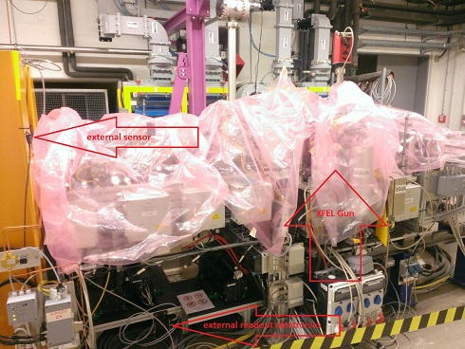
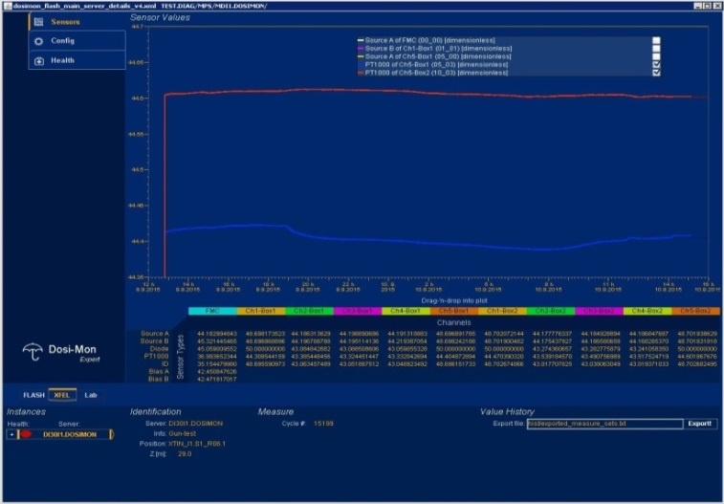
DosiMon test setup at the XFEL injector
DosiMon test setup at the XFEL injector …
… today only noise on RadFet radiation channels + operating temperature
measurement
… next beam not before November 2015 (injector commisioning)
Hence, a decision was made, to test the DosiMon high-sensitivity mode at other machines and environments!
… DosiMon +18V bias test setup at XFEL injector operational since mid of August 2015 …

Slide 18
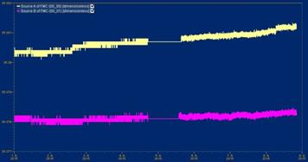
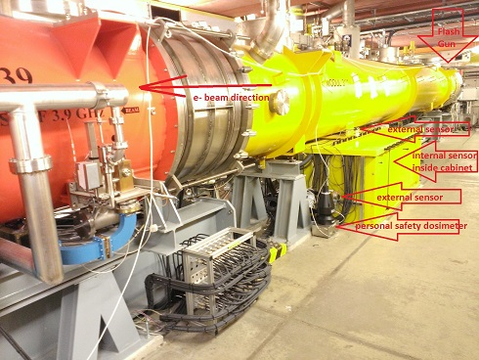
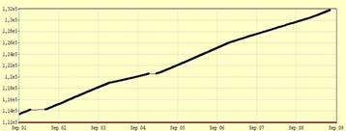
DosiMon system commisioning at the FLASH gun
full +18V bias system setup at
the FLASH RF-Gun Rack (FMC
with RadFet & TLD100 ref. sensor)
DosiBox behind rack shielding
2 external RadFet with TLD100s
                example: uncorrected RadFet threshold
                voltages vs time show increasing signal
                (interrupted due to archive work)
                dose level [uSv] vs time (personal safety online dosimeter, ‘Pandora’)
DosiMon system at FLASH gun in operation since mid of August 2015
(The energy of FLASH at that position (~130 MeV) and the bunch timing is similar to the XFEL)
approx. 18 mSv
per 8 days
(data analysis ongoing, based on calibration measurement presented in this talk)
Notes:
similar conditions between FLASH and XFEL
-> at that position (~130 MeV) and
-> bunch timing is similar
Datta analysis is ongoing -> based on the calibration measurement presented later in this talk

Slide 19
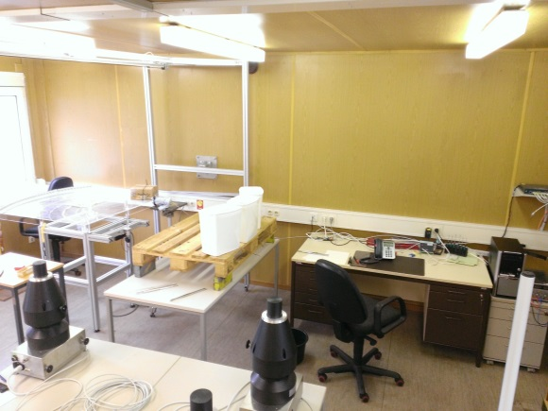
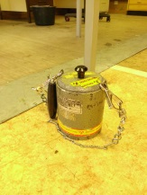
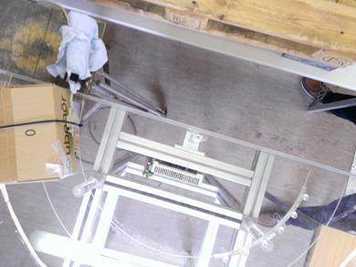
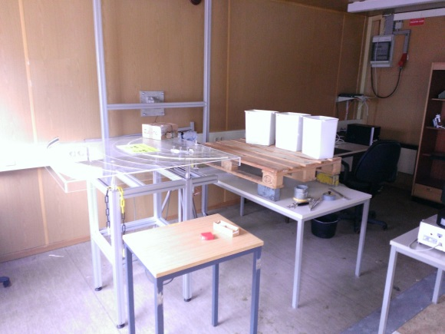
Cs-137 calibration measurement (1)
RadFet (RF) sensors have been irradiated at +18V bias mode by a Cs-137 calibration source over 2 weeks…
PC for stand-alone data readout
4(-6) TLD100 reference sensors
Cs-137 source position (pellet)
Readout
electronics
(similar to
DosiMon series system)
Cs-137 calibration setup (top view)
dist.
30 cm
Cs-137 calibration
setup
2 TLD100 reference sensors in direct vicinity to RadFets
4(-6) TLD100
reference sensors

Slide 20
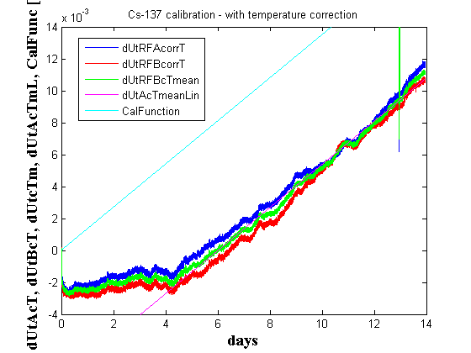
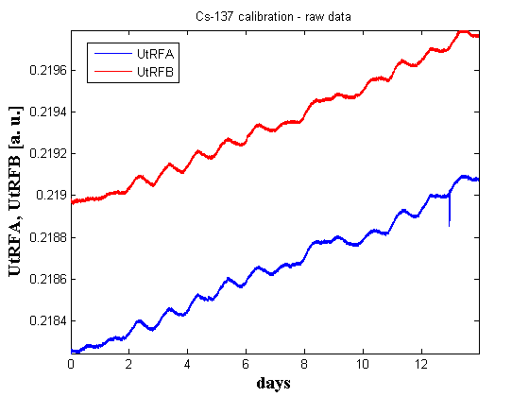
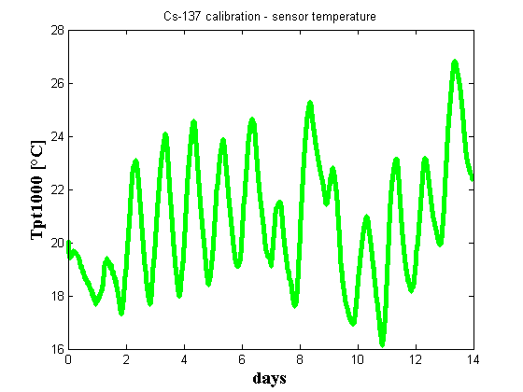
Cs-137 calibration measurement (2)
correction of electronical errors
correction of ambient temperature at the RadFet
yet no correction of statistical errors
good compliance former positive bias
calibration measurements achieved
Estimation of the Sensitivity in the startup-
range yields an initial sensitivity < 20-30 mGy
Results of Cs-137 calibration measurement at +18V bias-mode …
(TLD reference sensors are calibrated against dose in Sv;
a relative error below 0.1% due to short breaks during the irradiation phase the was neglected in the calibration)
5.639 Sv/V
RadFet threshold voltage raw data (both channels)
Constant irradiation up to 105 mSv
after
13.7 days
RadFet ambient temperature vs time
Temperature-corrected threshold voltage vs time
(startup phase 0-4 days yet not clearly understood)

Slide 21
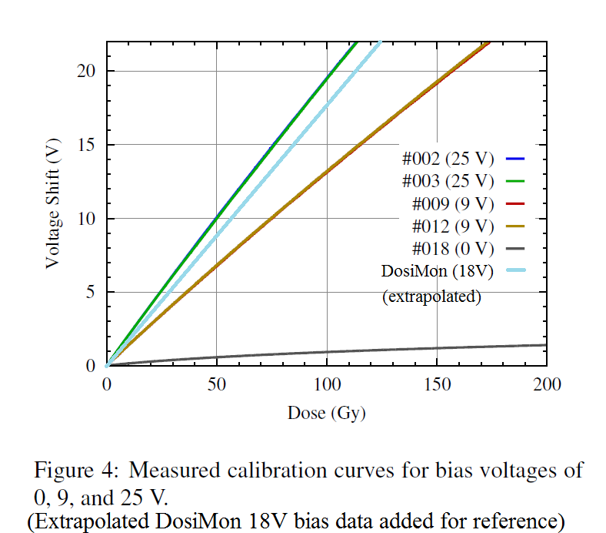
Cs-137 calibration measurement (3)
Estimated calibration factor
of 5.639 Sv/V for DosiMon
+18V calibration
Quality factor for equivalent
dose in Gy was estimated
to be ~ 1
As expected, this result
falls in between the
measurements of
+9V and +25V bias
Cs-137 calibration measurement at +18V bias-mode in comparison to other bias measurements …
L. Fröhlich, S. Grulja, and F. Löhl,
DOSFET-L02: An advanced online dosimetry system for RADFET sensors.
Proc. IBIC'13, pp. 481–484, Oxford, UK, September 2013.

Slide 22
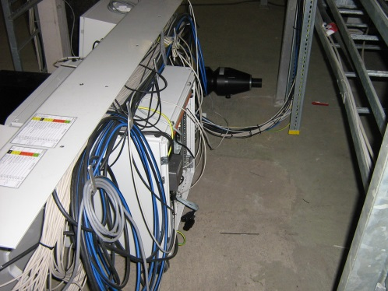
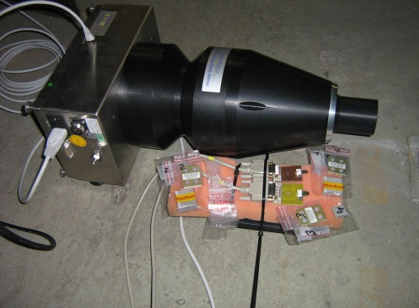
Test setup at DESY2 booster ring
Normal accelerator operation with long breaks during regular service times
Goal: study and estimation of fading effects at +18V bias mode,
at low dose levels up to 100 mGy, high energy (6GeV)
and high bunch rate (1MHz)
System seems to show plausible results corresponding to irradiation status
Data interpretation is
hampered by strong
neutron dose at this
position
TLD100 reference sensors
are influenced by neutrons
TLD reference results have been corrected
data analysis based on these corrected reference values is ongoing
Desy2 long-term measurement at +18V bias ongoing since April 1, 2015 …

Slide 23
Test and measurement results
The DosiMon system has shown a sufficient dynamic range at the high-sensitivity mode (+18V bias) based on the extrapolation of dose-range from the calibration data
A single calibration measurement with a Cs-137 gamma source showed overlaying effects in the startup region of the +18V bias in the DosiMon system, that have to be investigated in further measurements. Estimation of the Sensitivity in the startup-range yields an initial sensitivity < 20-30 mGy, sufficient for XFEL rack-surveillance
Overall sensitivity of the +18V bias mode has been estimated on the assumption of an ideal physical model for the used RadFet sensors. It showed reasonable results in comparison to former measurements of zero bias, +9V bias and +25V bias mode
A 1st complete installation of the DosiMon system inside the XFEL injector shows reasonable data without beam -> system performance will be investigated with beam after start of the XFEL injector commissioning in November 2015
An installation of a complete DosiMon reference system at the FLASH RF-gun rack shows reasonable results – data analysis based on calibration presented here is ongoing
Further tests of fading effects at the +18V bias mode at the Desy2 accelerator have been hampered by strong neutron radiation – TLD reference sensor performance was evaluated for such conditions
The +18V bias mode in the DosiMon system has proven to be adequate for rack-surveillance at intra-rack measurements in the XFEL
Results

Slide 24
Outlook
Commisioning of the DosiMon system at the XFEL injector with beam (Nov. 2015)
Measurements for the estimation of impact from the readout timing on RadFet response
Release of the pre-series design for series produktion of components
Additional calibration measurements for the external and the high-sensitive internal mode must be done (removal of statistical errors, clarification of the overlaying effects at the startup range of the high-sensitiity mode)
Measurements for the estimation of fading influence on the measured dose values in external sensor- and high-sensitivity internal sensor-mode
Calibration measurements in high-sensibility mode at Co-60 source for improved calibration up to 1.2MeV energy range
Measurements for the estimation of neutron impact on RadFet response
Measurements for the estimation of energy impact on RadFet response
Outlook

Slide 25
Acknowledgements
Sincere thanks to the whole XFEL online-radiation-monitoring team …
J. Pflüger, WP71 team (all XFEL GmbH)
F. Hellberg, A. Hedqvist (all Stockholm University, Sweden)
A. Holmes-Siedle (REM Oxford Ltd.)
W. Decking, D. Nölle, K. Wittenburg, L. Fröhlich, R. Susen, B. Lemcke, J. Neugebauer, J. Jaeger, S.Karstensen (all DESY Hamburg)
… and all those who might have been forgotten (sorry!)
… and many more helping hands!
Acknowledgements

Slide 26
Thanks for your attention!

Slide 27
Thanks for your attention!

Slide 28
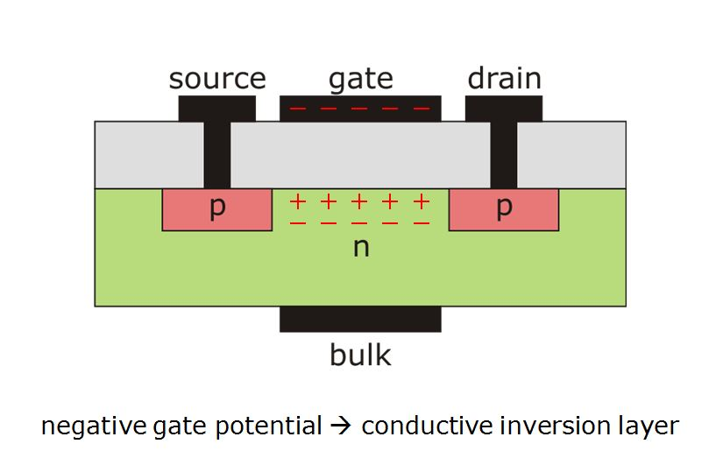
P-channel MosFet - principle
Thanks for your attention!
(Courtesy L. Fröhlich, DESY)

Slide 29
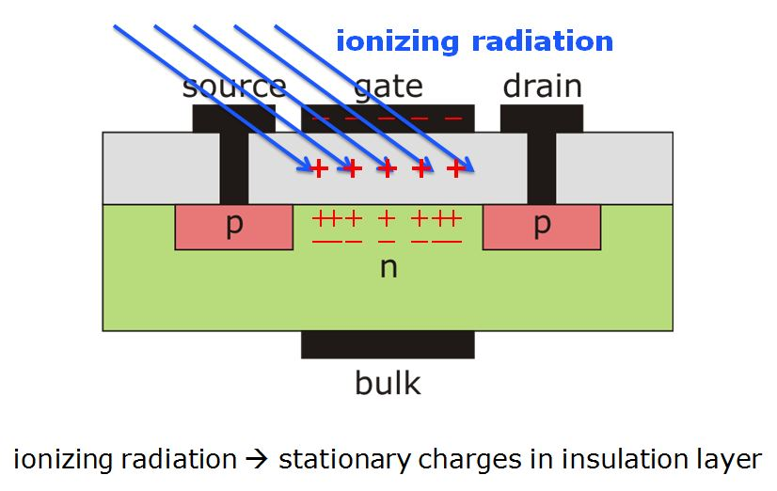
P-channel MosFet - principle
Thanks for your attention!
(Courtesy L. Fröhlich, DESY)

Slide 30
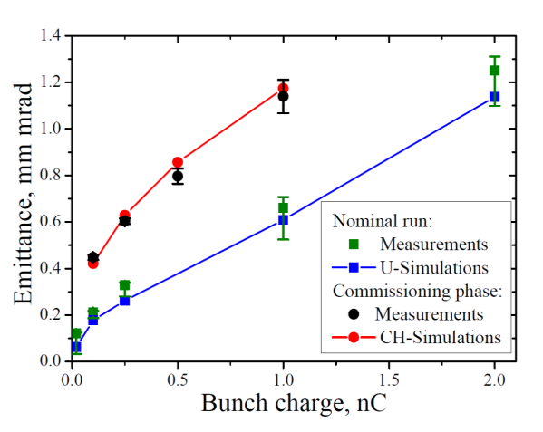
Injector parameters
Gain material | Yb:YAG
Intra burst rate | 4.5/n MHz, n≥1
Pulse properties | Short pulse: < 3 ps (FWHM), > 0.7 µJ per pulse Long pulse: ~10 ps (FWHM), > 3 µJ per pulse Shaped 20 ps with 2 ps rising edges (Phase 2)
Type | 1.3 GHz, 1.6 cell nc cavity
Cathode | CsTe
Peak Power | 6.5 MW (5.5 MW during fist operation) 0.02 C– 1 nC
Average Power | 60 kW
Charge | 0.02 nC – 1 nC
Proj. emittance (PITZ)
System | Modulator in separate building Long HV pulse cable Pulse Transformer Multi beam klystron
Parameters | 1.3 GHz, 10 Hz, 1.3 ms., 10 MW
Waveguide | Four 50 m long air-filled, 1.5 MW each
See G. Vashchenko, MOD04
(Courtesy W. Decking, DESY)
Notes:
Here are the injector parameters …
A 1.3 GHz RF-system with 10 Hz macropulse repetition rate
Injector is capable of delivering bunch pulses
… at charges between nominal 20 pC and 1 nC
… and at a bunch rep rate of stepwise up to 4.5 MHz

Slide 31
Thanks for your attention!

Slide 32
Thanks for your attention!

Slide 33
Thanks for your attention!

