Slide 1
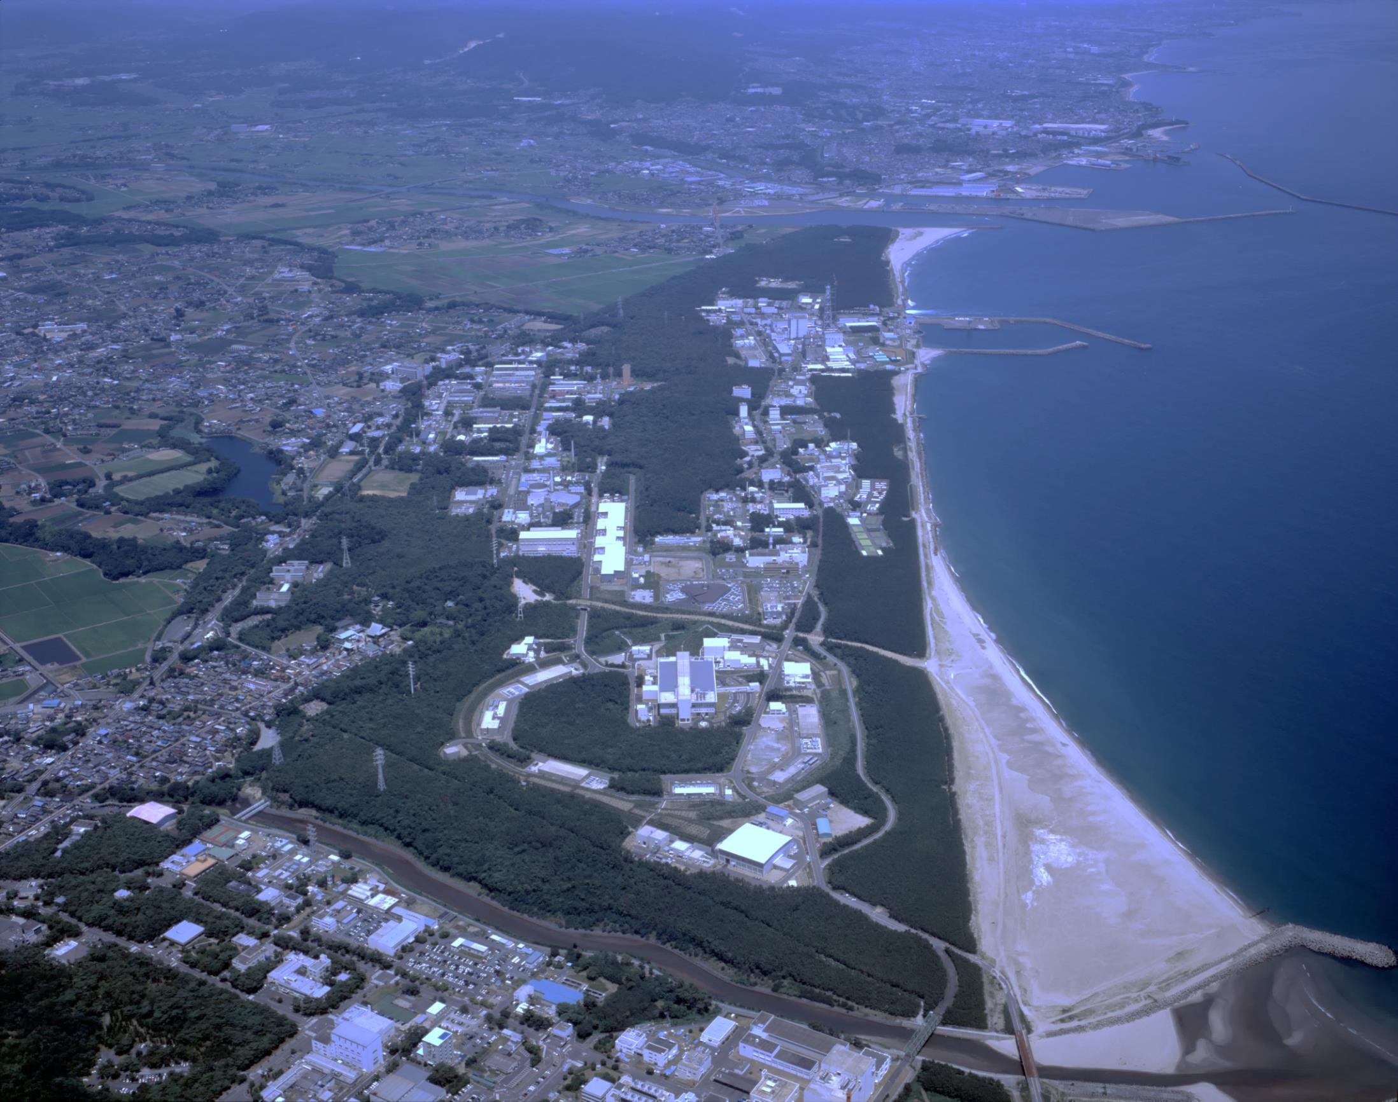
Development of the beam loss monitor for beam halo measurement in the J-PARC RCS
Masahiro Yoshimoto* , Hiroyuki Harada, Shinidhi Kato, Kota Okabe, Michikazu Kinsho
Japan Atomic Energy Agency, JAEA / J-PARC

Slide 2
Outline
Introduction
Transverse beam halo measurement in the RCS.
  Wire scanner type with beam loss monitors
  Correction formula
  Reconstruction of the beam profile
New BLM development for the Intra-bunch beam halo measurement
  Scintillation-type BLM of lead glass
  Cherenkov-type BLM of quartz or UV acrylic
  Trial beam test
Conclusion

Slide 3
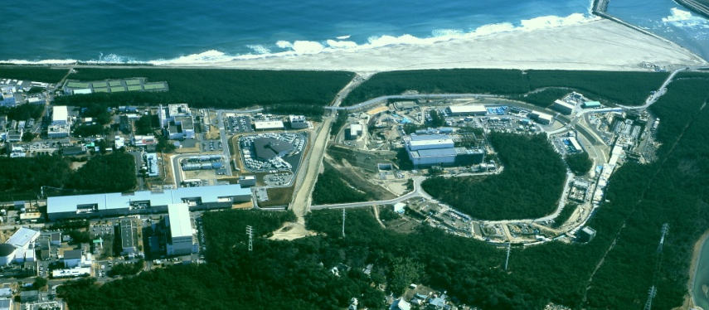
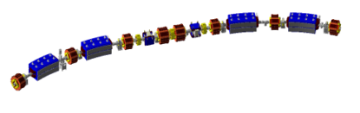
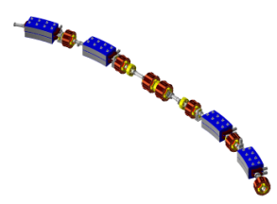
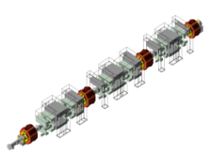
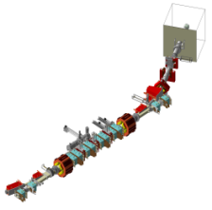
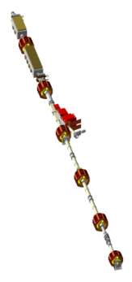
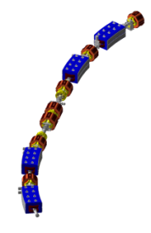
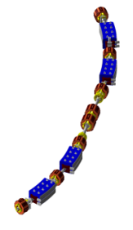
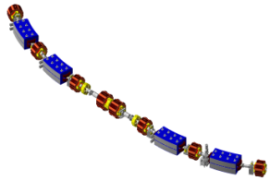
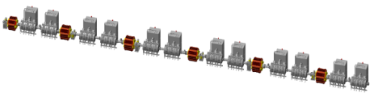
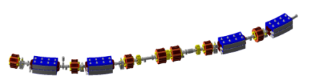
Overview of J-PARC 3GeV RCS
Configuration of the Accelerator Complex of J-PARC
Neutrino Experimental Facility
Hadron Experimental Hall
J-PARC = Japan Proton Accelerator Research Complex
Three accelerators:
  400MeV LINAC / 3GeV RCS / 50GeV MR
Multi purpose research facility with high power proton beam
  Nuclear and Particle Physics
  Material and Life Science
3GeV Rapid Cycling Synchrotron (RCS)
Transmutation Experimental Facility
400MeV Linac
Materials and Life Science Facility (MLF)
50GeV Proton synchrotron (MR)
Extraction scheme:
  Fast extraction with kicker and septum magnet
3GeV - RCS
1st arc
section
Injection
section
from LINAC
RCS beam parameter
Circumference 348.333m
Superperiod 3
Harmonic number 2
Injection energy 400MeV
Extraction energy 3GeV
Repetition rate 25Hz
Particles per pulse 8.3e13
Average current 333mA
Output beam power 1MW
Extraction
section
2 bunched structure
H⁻
multi-intermediate pulse structure formed by the RF chopper
3rd arc
section
H⁺
Injection scheme:
  Charge-exchange multi-turn injection with stripping foil
to MLF
RF section
2nd arc
section
to MR

Slide 4
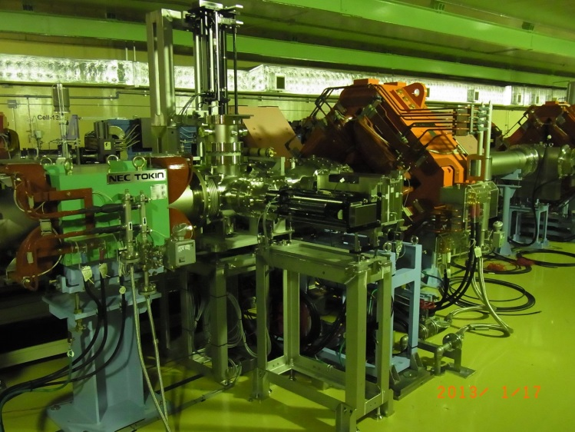
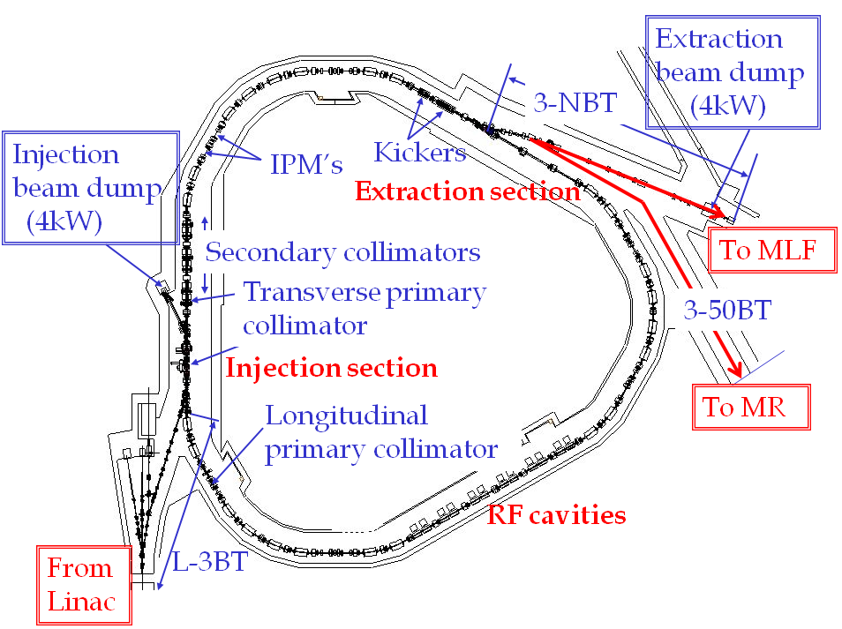
Beam Halo Measurement
The J-PARC RCS successfully achieved 1-MW beam acceleration in January 2015.
To provide such a high power proton beam for the MR and MLF, it is required to improve the extraction beam quality, namely to achieve the Low-Halo and High-Intensity beam by finer beam tuning in the RCS.
Therefore the measurement of the transverse beam profile including both of the beam core and the beam halo is one of the key issues for the high power beam operation in the RCS.
Beam halo monitor
RCS beam halo monitor is installed at the extraction beam transport line (3NBT).
Beam halo monitor

Slide 5
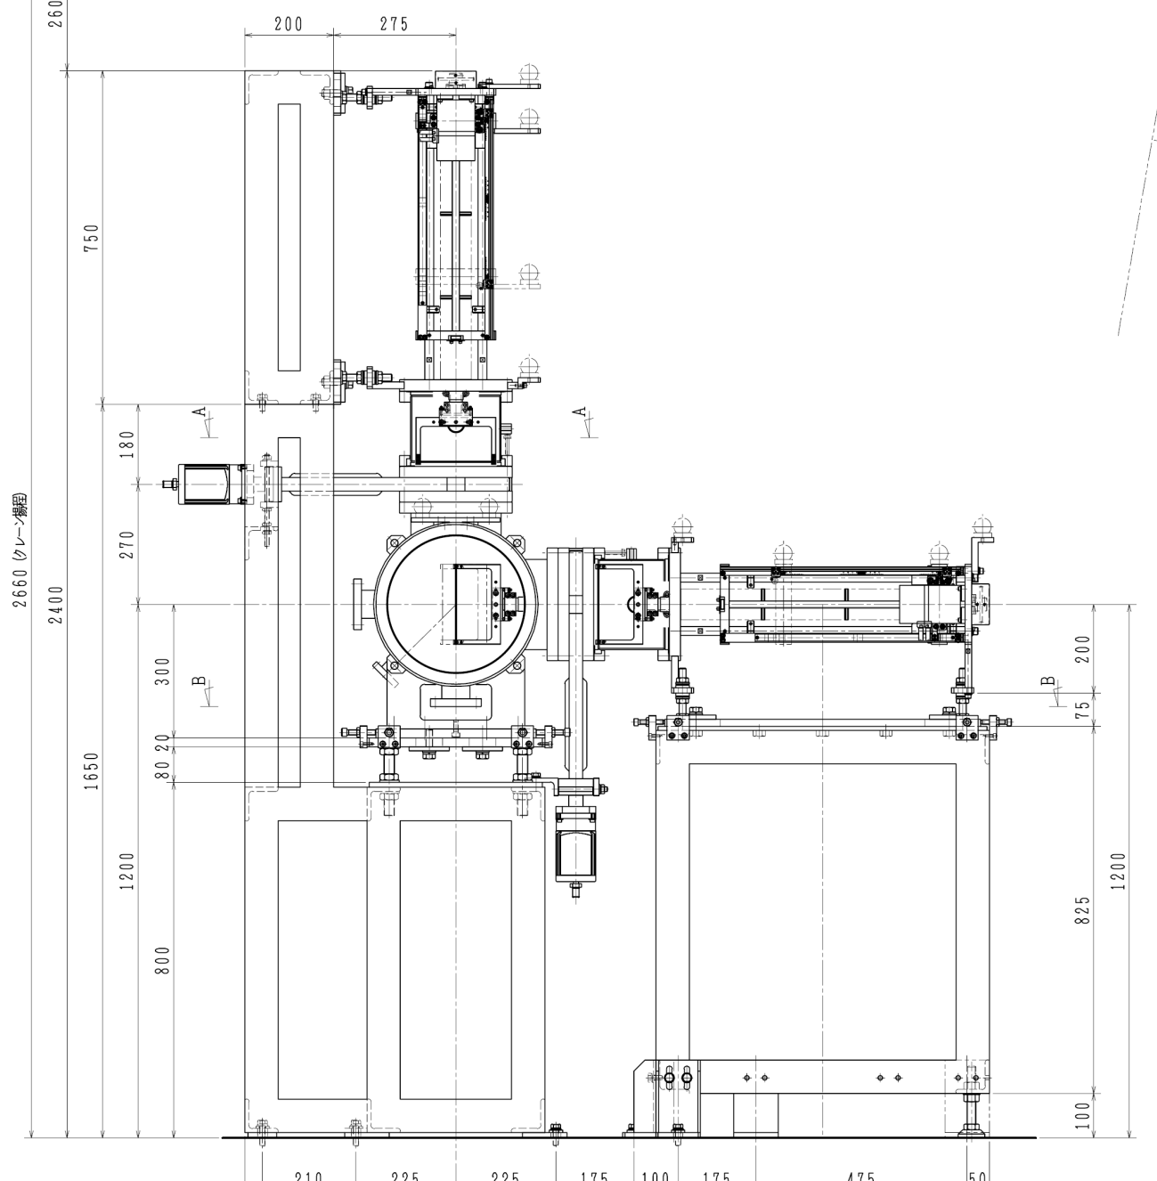
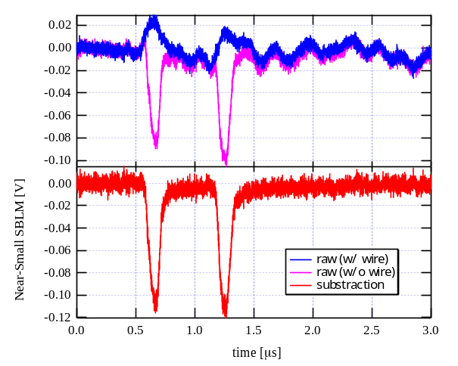
Beam Halo Monitor in the 3GeV-RCS
Beam halo monitor is combined a wire scanner and several beam loss monitors.
By using several BLMs with the various sensitivities, the ultra-wide dynamic range can be achieved.
Vertical
scanning device
retracted wire scanner
= background signal
wire scanner scraper
inserted wire scanner
= whole signal
radiation
pure beam loss signal at the wire scanner
Extraction
beam
subtraction
Horizontal
scanning device
BLM detects the whole radiations which are generated at the various place around the monitor.
By subtracting the background signal from the whole signal, pure beam loss signal at the wire scanner can be obtained.
Several beam loss monitors
with various sensitivities

Slide 6
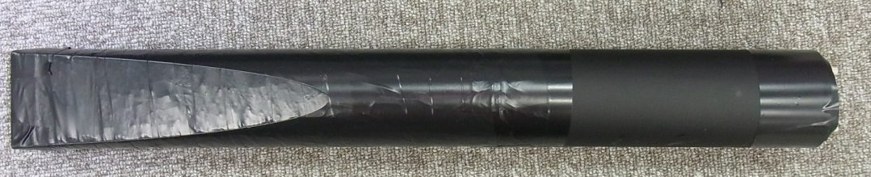
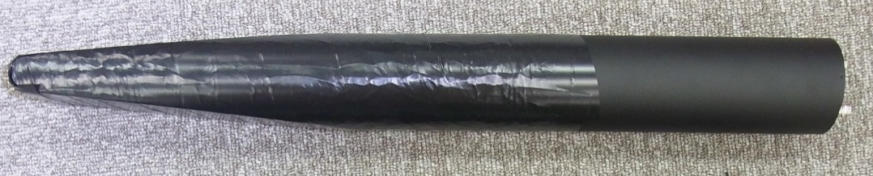
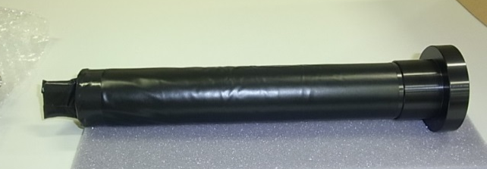
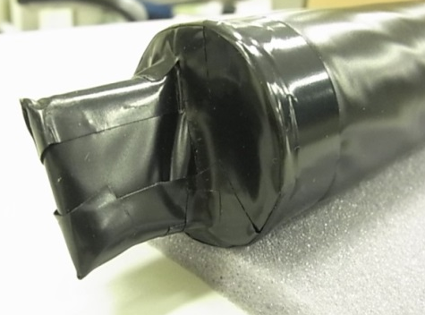
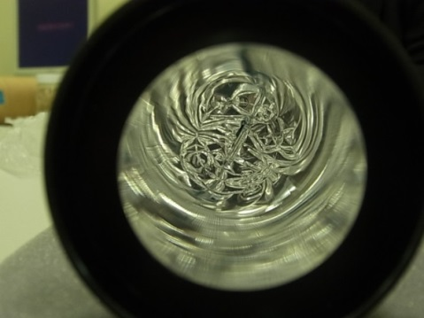
Various sensitivity of BLMs (I)
Large scintillator BLM
Plastic scintillator and photomultiplier (PMT) assemblages were adopted as the BLMs with quick time response.
H=300mm
Scintillator
PMT: H6410
L=100mm
φ=60mm
W=20mm
Small scintillator BLM
In order to achieve the ultra-wide dynamic range, we need to control the sensitivities of the BLMs.
By changing the volume of the plastic scintillator, the sensitivity-difference can be achieved.
scintillator
Light guide
T=2mm
Viewing from interior of the light guide
W=30mm
Scintillator
H=32mm(2mm inside in the light guide）

Slide 7
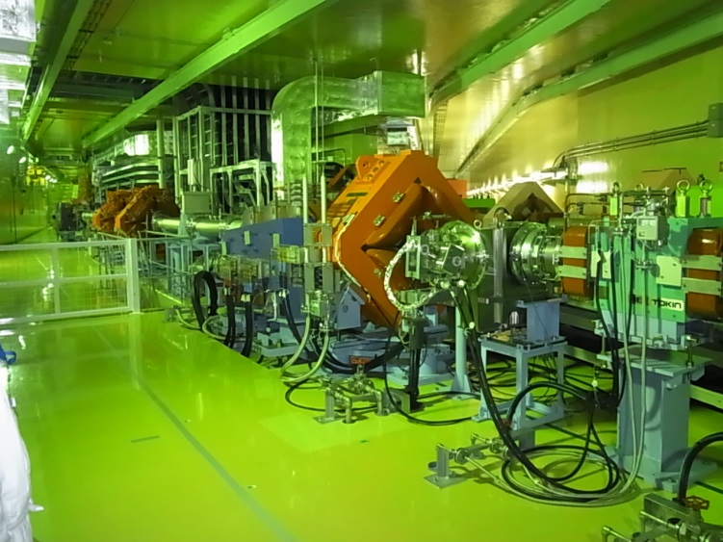
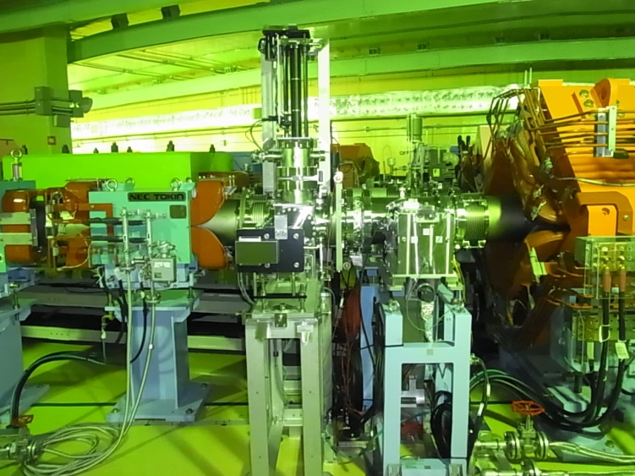
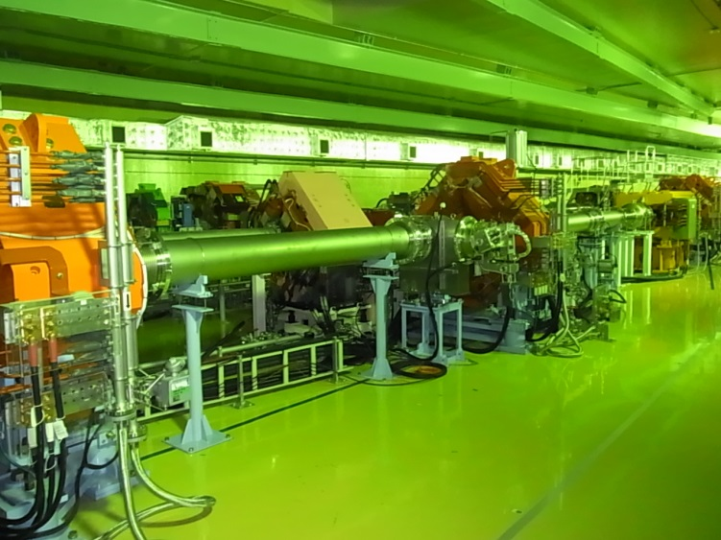
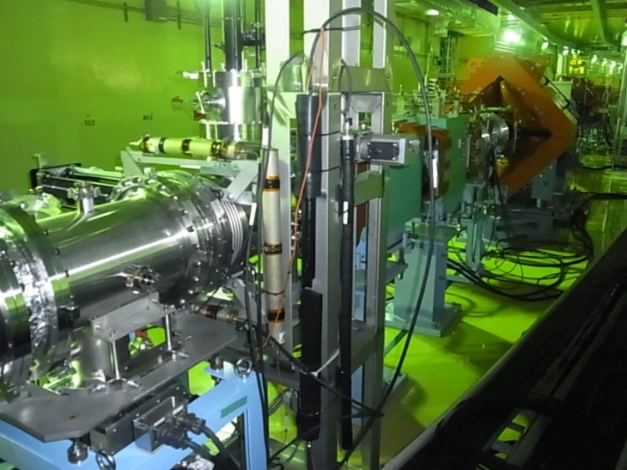
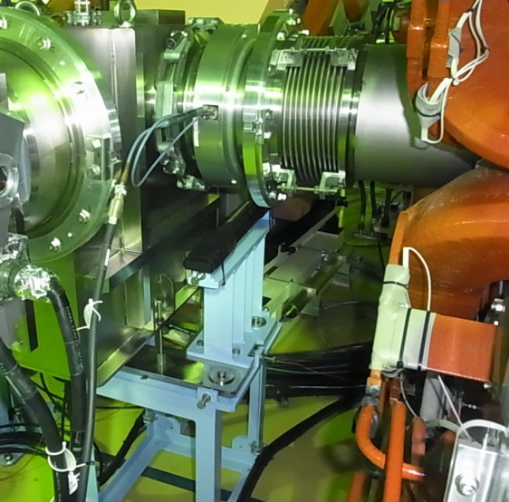
Various sensitivity of BLMs (II)
Another method to achieve the sensitivity difference is changing the distance from the wire scanner to the BLMs.
Beam halo monitor
To MLF TGT
From RCS
To 3MBT-BD
Near from WS
Far from WS
Small PS-BLM
Low sensitivity
High sensitivity
Large PS-BLM
Large PS-BLM
Low sensitivity

Slide 8
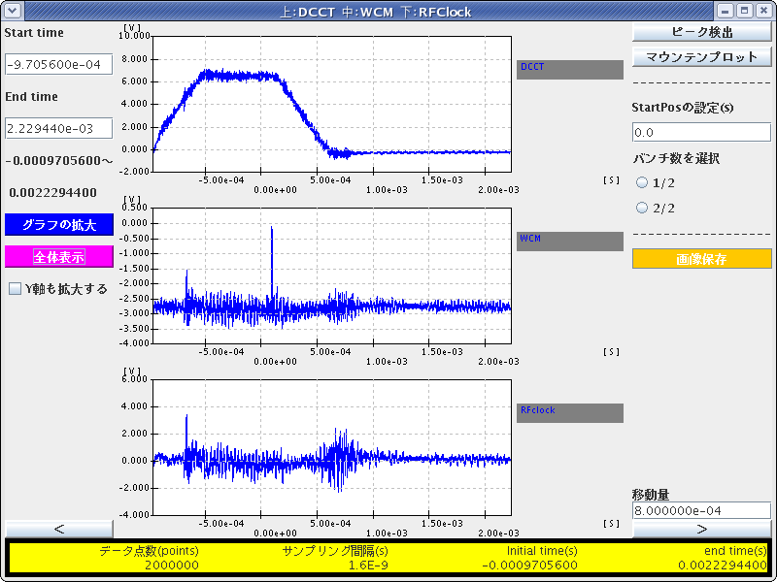
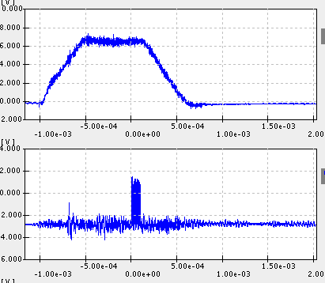
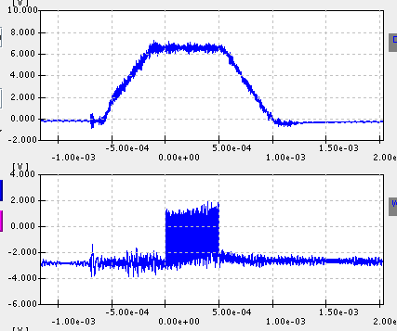
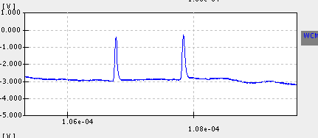
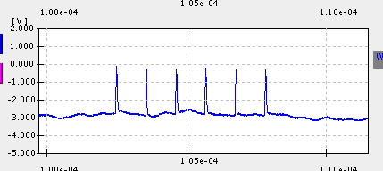
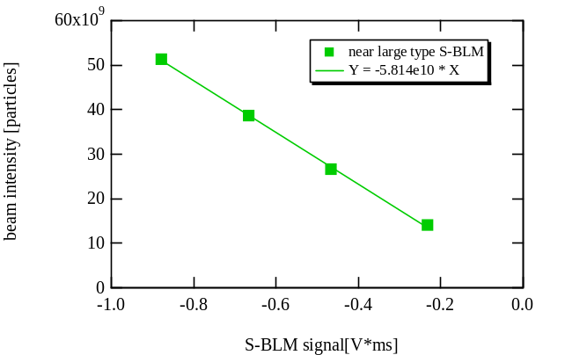
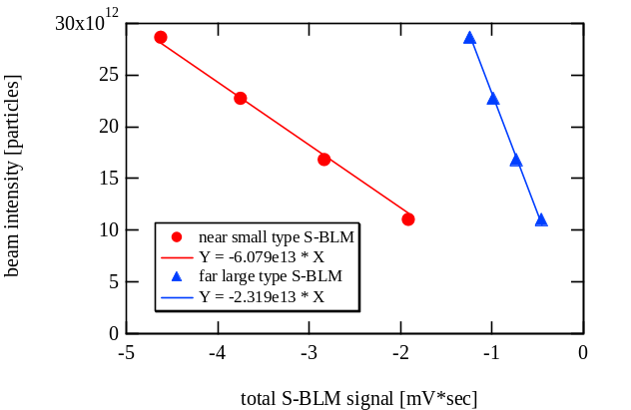
Calibration of Beam Loss Monitors
In this system, BLMs can detect the only radiations caused by hitting the beam into the wire scanner.
Thus BLMs signal should be proportional to the number of the hitting particles.
Calibration formula (N_{particle} / S_{BLM}) for each BLM can be obtained by using the matched beam intensity with each sensitivity.
High sensitivity detector:
Low sensitivity detector:
Injection bump
Injection bump
I-BPM
I-BPM

Slide 9
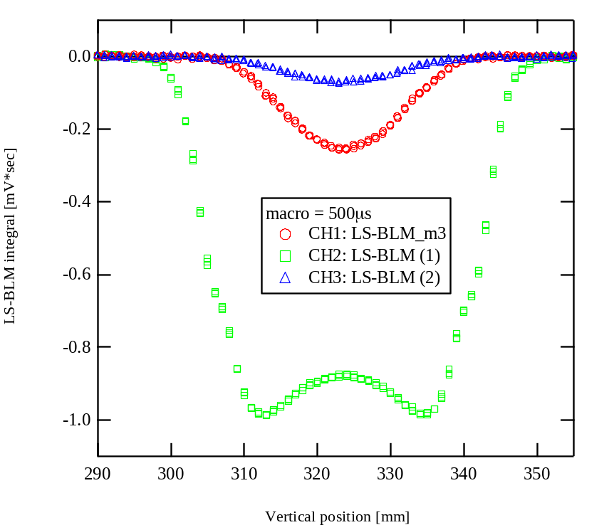
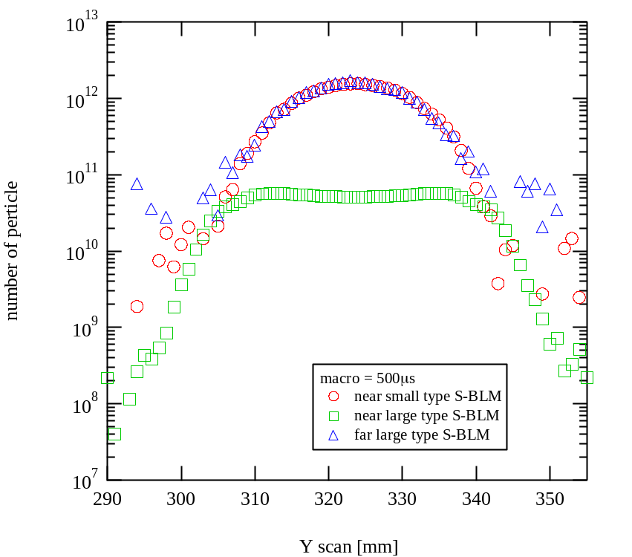
Reconstruction of the transverse profile
Raw data
After calibration
Using each sensitivity calibration formula
Only by using sensitivity calibration formula for the each BLM, transverse profile including both the beam core and beam halo can be reconstructed directly.
( Any other correction is not necessary to join together all measured plots.)
In this scheme, it is possible to expand the dynamic range by using the higher sensitivity BLMs.

Slide 10
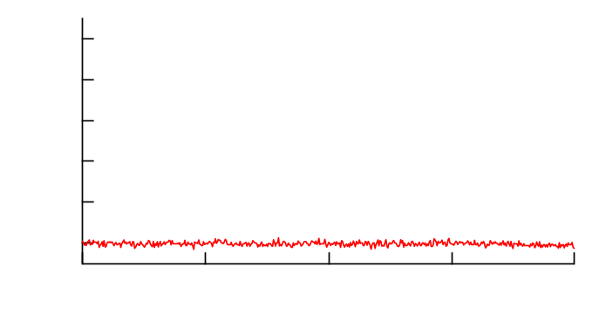
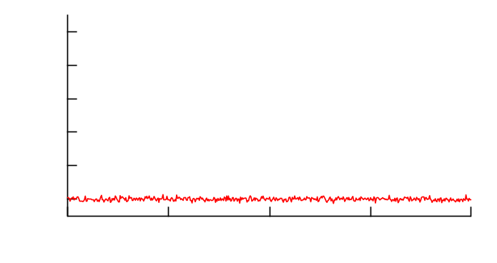
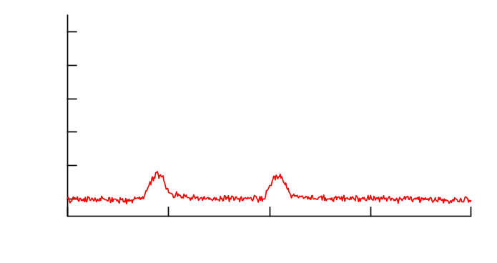
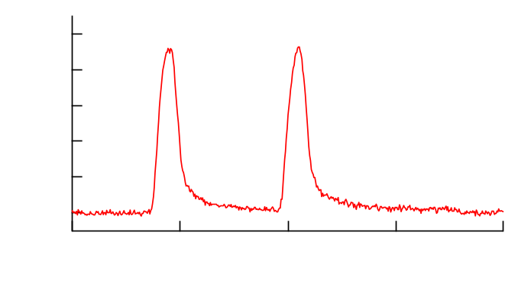
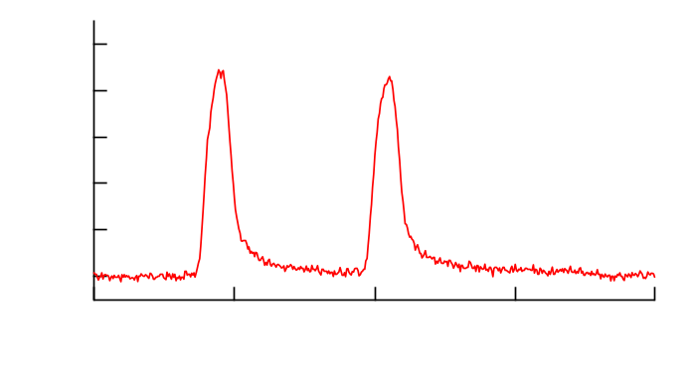
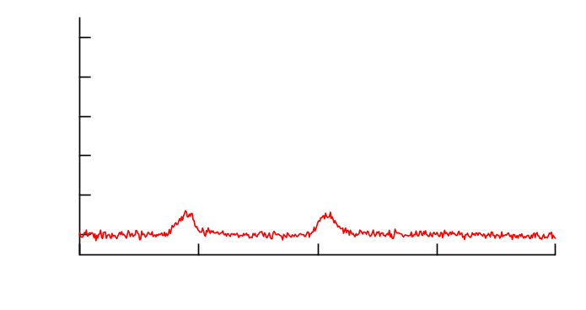
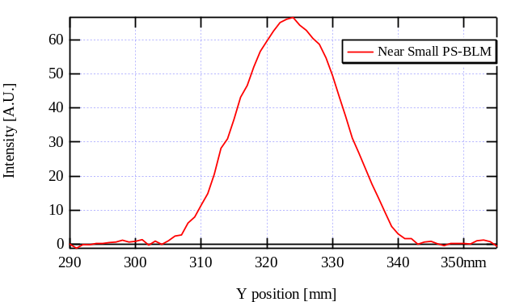
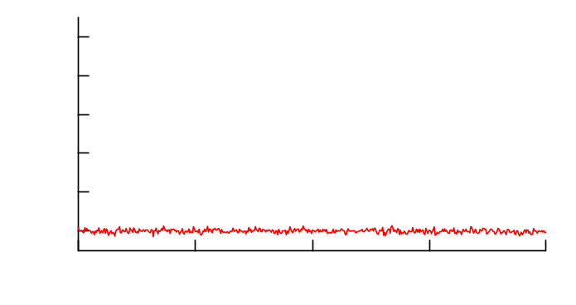
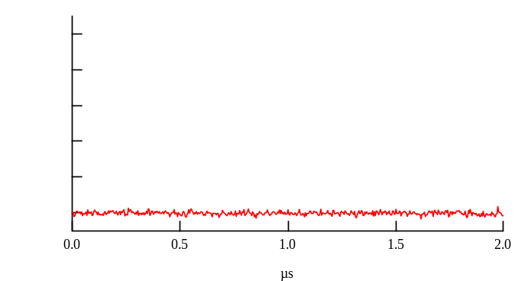
Intra-bunch beam halo measurement
The beam halo monitor, which is combined with the wire scanner and several BLMs with various sensitivities, can reconstruct the transverse beam profile including both the beam core and halo.
Our final goal of this halo monitor is also to measure the intra-bunch beam halo of extracted two bunches from the RCS.
BPM signal
Transverse beam profile
projection
Wire scanning
time
projection
Intra-bunch beam profile

Slide 11
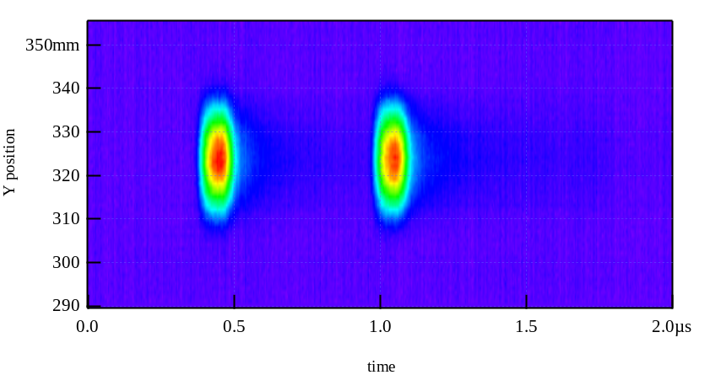
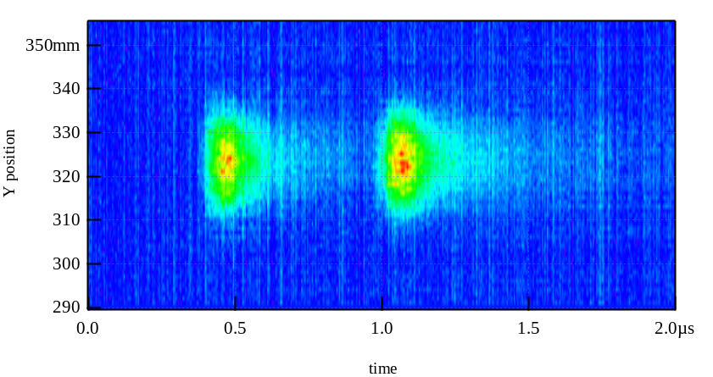
Reconstruction 2D-profile
2D-profiles ( bunch length vs beam size ) were reconstructed from the two BLMs with low sensitivity.
Near Small
PS-BLM
Far Large
PS-BLM
Two 2D-profiles differ in the time distribution. ⇒ why ?

Slide 12
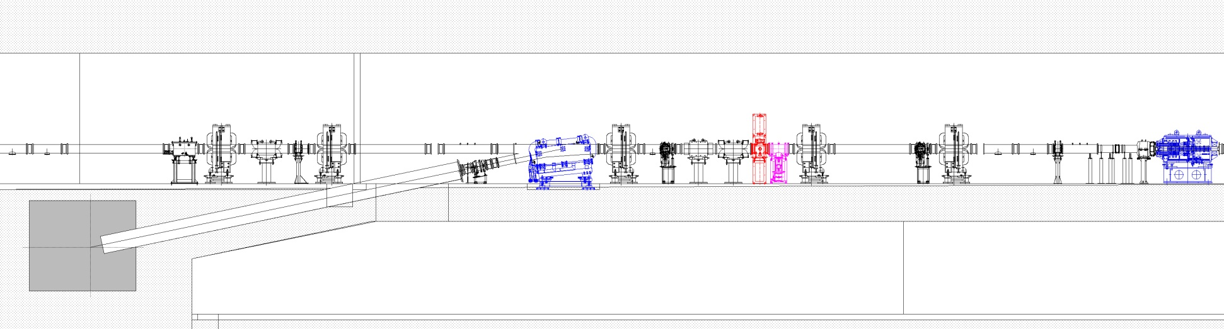
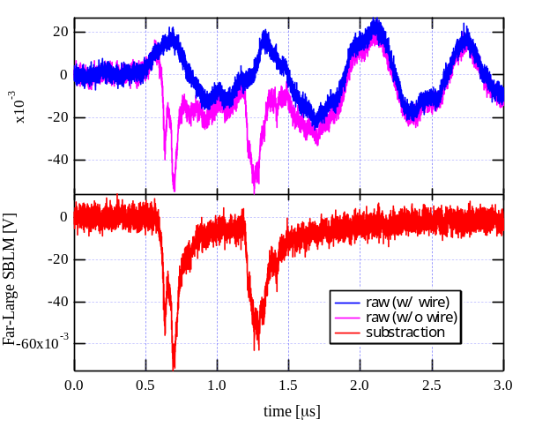
Distortion of the bunch signal
Wire scanner
MLF-TGT
3GeV-RCS
( 3GeV proton beam )
The plastic scintillator BLMs detected not only the radiation from the wire but also reflected one from other devices and wall.
subtraction
subtraction
To obtain the bunched beam structure from the BLM clearly, it is necessary to suppress these reflected radiation.
Therefore we develop new-type BLMs, which are scintillation-type BLM of lead glass and Cherenkov-type BLM of quartz or UV acrylic.

Slide 13
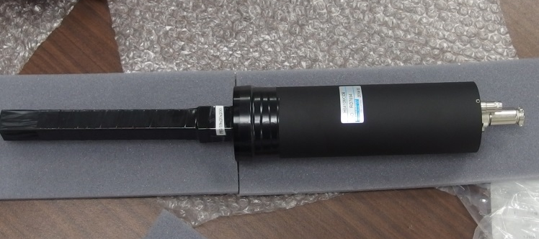
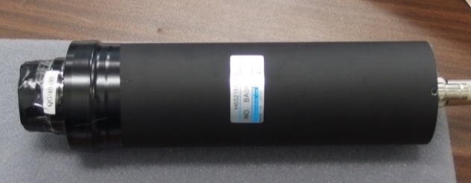



new-type BLMs
Scintillation-type BLM of lead glass
Cherenkov-type BLM of quartz or UV acrylic
QG
PMT: H6521
LG
PMT: H6410
UVA
PMT: H6521
200mm
30mm
QG
19mm
φ40mm
QG
LG
60mm
LG
20mm
UVA
φ40mm
UVA
These new-type of BLMs have high sensitivity toward the faster gamma-ray or electron.
Thus the suppression of the reflected radiations may be expected.

Slide 14

Trial beam test with new-type BLM
To see if the new-type BLMs work as they were expected to, they were installed near the wire scanner and trial beam tests were carried out.
(Particle simulation with GEANT4 is starting now.)
Wire scanner
MLF-TGT
( 3GeV proton beam )
3GeV-RCS
3NBT-BD
To enhance the effect of the reflected radiation, the beam destination from the RCS switched from MLF-Target to 3NBT-Beam Dump.
At first, the ultra-low intensity beam was used to prevent the saturation of the BLM.
Next, the high intensity beam was used for the high power beam commissioning.
UVA
QG
LG

Slide 15




Ultra-low intensity beam test
Ultra-low intensity beam (1-intermediate bunch with thin chopped width)
By switching the beam destination from MLF-TGT to 3NBT-BD
Plastic scintillator
UV acrylic
Lead Glass
Quartz Glass
All new-type BLMs can suppress the reflected radiation drastically.

Slide 16




High intensity beam test (I)
High intensity beam test (747kW-eq.)
Bema destination is fixed to 3NBT-BD, compare between inserted and retracted the wire scanner.
Plastic scintillator
UV acrylic
Lead Glass
Quartz Glass
All bunch signals measured by new-type BLM were almost not distorted.
⇒ The transverse profile can be measured in the 3NBT-BD operation.

Slide 17




High intensity beam test (II)
Transverse beam profiles were measured with new-type BLM in the 3NBT-BD operation with various beam intensity (138 ~ 747kW-eq).
Plastic scintillator
UV acrylic
Lead Glass
Quartz Glass
The Plastic scintillator signal was saturated due to the reflected radiation from the 3NBT-BD, and transverse profile was distorted.
New BLM signals can obtained the beam profiled.

Slide 18





Trial of the reconstruction
Calibration formula of the each new-type BLM were calculated roughly
The transverse beam profiles were reconstructed .
Rough calibration formulas
Beam power: 747[kW-eq.]
550[kW-eq.]
343[kW-eq.]
138[kW-eq.]
Transverse beam profile can be obtained in the 3NBT-BD operation.
⇒ It is good advantage for beam commissioning in the RCS.

Slide 19
conclusion
The transverse beam profile including both the beam core and beam halo can be reconstructed by using the several BLMs with the various sensitivities.
Only by using sensitivity calibration formula for the each BLM, transverse profile including both the beam core and beam halo can be reconstructed directly.
In this scheme, it is possible to expand the dynamic range by using the higher sensitivity BLMs.
The time structure of the bunch signal measured by the plastic scintillator was distorted, because of the reflected the radiation.
The new-type BLMs, which are scintillation-type BLM of lead glass and Cherenkov-type BLM of quartz or UV acrylic, can be reduced the reflected radiation drastically.
In order to achieve the intra-bunch beam halo measurement, the new-type BLMs have to progress.
Thank you for your attention !

