Slide 1



The Role of Beam Diagnostic in the Fast Commissioning of TPS
Pei-Chen Chiu
On behalf of the Control and Diagnostic Team
NSRRC
Notes:
Good Morning. The Chairman and everyone.
On behalf of control and diagnostic team, I will talk “The role of beam diagnostic in the fast commissioning of TPS”.

Slide 2
Outlines
TPS Timeline and Diagnostics System
Intensity Monitors
Screen Monitors
BPM System
Feedback System
  Orbit Feedback System
  Bunch-by-Bunch Feedback System
Synchrotron Radiation Monitors
  Visible Light, X-Ray Pinhole, Streak Camera, TCSPC, ...
Beam Loss Monitor
Summary
Notes:
First, I’ll overview the TPS commissioning timeline. Diagnostic system.
Next, we look at more detail of the diagnostic device including intensity monitor, screen monitor, BPM, Feedback System, Synchrotron Radiation Monitor, Machine Protection System .
And then the summary at the end.

Slide 3
TPS Timeline
2007 Mar. Funding approval (230M USD Acc & Civil)
2010 Feb. Ground-breaking
2013 Oct. Phase I Accelerator installation started
2014 Aug. Phase I Accelerator system test and commissioning started
2015 Mar. Phase I Accelerator commissioning completed
  up to 100 mA beam current with PETRA RF cavities & Optimization of basic machine parameters
2015 Apr. SRF, IDs and Beamline installation started
2015 Sep. Phase II commissioning with SRF, IDs and Beamline would start
  up to 500 mA beam current with Superconducting RF
  Insertion Devices Commissioning
  Beamlines Commissioning
2016 Open to users
  Beam quality control, Top-up injection, high beam intensity issues
Notes:
For TPS project, we took three and one half years to complete civil construction, one year for accelerator installation.
To catch up the delayed schedule, system integration and booster commissioning decided to progress at the same time last Aug.
This March, we achieved 100 mA beam current with PETRA RF cavities.
This month, the phase II commissioning with SRF, ID and also Beamline start.
We plan to open to users on the next year.

Slide 4
TPS Phase I Commissioning with Petra RF cavity
Linac & LTB Commissioning
  2011 Linac (from Research Instruments) pre-test in test-site
  2014 Jun. Moved to TPS site from March to June, 2014
  2014 Aug. Permission to test
Booster Commissioning with hardware improvement
  Aug. 15 Hardware improvement ex: BR power supply overheat, kicker pulse residual field (5% to 0.5%)
  Sep. First turn & multi-turn beam soon obtained after steering
  Sep.~Oct. Re-alignment of chambers & magnet, individual dipole trim install
  Nov. 12 Found relative permeability of pipes too large (1.2-2), uninstall for
  heat treatment
  Dec. 11 finished pipes demagnetization (permeability <1.001) More than 50 ms survival beam.
  Dec. 12 stored beam after RF on
  Dec. 15 ramping tested and ramped to 2.5 GeV
  Dec. 16 ramped to 3 GeV
Storage Ring Commissioning
  Dec. 24 extracted 3 GeV beam and found DC septum leakage field
  Dec. 29, accumulated beam at 1.5 GeV with kicker scan
  Dec. 30, extracted 3 GeV after enforcement of DC septum shielding and two more local correctors
  Dec. 31, 2014 5 mA stored beam, the first synchrotron light was observed
Notes:
Linac commission go quite smoothly.
But we met some troubles during booster commissioning.
After some hardware improvement such as power supply overheat and kicker residual field,
//the dipole power supply burned on fire on the first long-term ramping test. Actually I had witnessed nearby.
we had first & multi-turn after some corrector steering, but beam cannot be stored.
We shad truggled for two month. People first questioned the alignment because the corrector setting three times larger than expected.
Then suspected the dipole field error so the individual dipole trim installed,
Finally, Some magnet team found vacuum chamber could attract the strong magnet and then verified its permeability too large.
Pipe then uninstalled for heat treatment. After we ramp beam to 3GeV in 4 days.
For storage commissioning, the major problem is DC septum leakage field would affect booster beam, after shielding, we got 5 mA stored beam in two days.

Slide 5
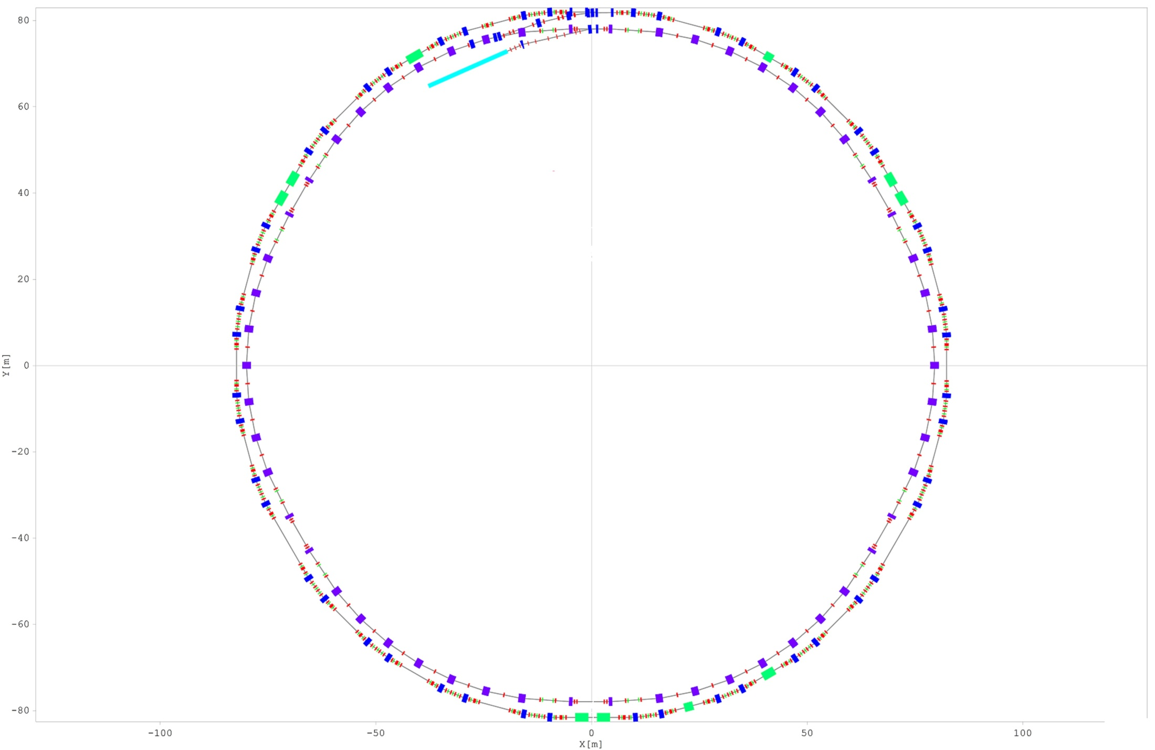
TPS Diagnostic Devices Overview
 | LTB | BR | BTS | SR | Status
BPM | 7 | 60 +1 | 6 | 167+6
Screen Monitor | 5 | 6 | 4 | 2+3
SRM (Visible + X-Ray) | - | 2 | - | 2
NPCT | - | 1 | - | 1
FCT | 2 | 1 | 1 | -
ICT | 1 |  | 2
Beam loss monitor |  | Many |  | Many | Work in progress (PIN diodes, RadFET, Scintillator+PMT)
Beam excitator |  | H x 1 V x 1 |  | H x 1 V x 2 | BR: Magnetic shaker SR: Striplines
Notes:
During commissioning, diagnostic system provided a lot of beam information for improving or tuning subsystem so that progress could advance very quickly.
This table summarize the number of various diagnostic device at different location.

Slide 6
Intensity Monitor

Slide 7
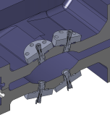
Layout of the TPS Intensity Monitors
ICT-CF4”
BPM Based Intensity Monitor:
1. Beam current monitor (~ 5 % accuracy – interlock purpose).
2. Bunch current monitor (0.5 % accuracy – filling pattern control).
- Average Intensity
- Injection Efficiency
- Bunch Current
FCT-CF4”
ICT-CF4”
ICT-CF6”
ICT
FC2
TCSPC Monitor:
Bunch current monitor (0.5 % accuracy – filling pattern control).
Isolated bunch purity
(> 10⁶).
FC1
FCT-CF6”
WCM
RI Research Instruments GmbH
NPCT-175-HR x 1 (SR)
NPCT-CF2”-HR x 1 (BR) – In-flange
ICT-CF4” x 2 (BTS)
FCT-CF4” x 1 (BTS)
FCT-CF4” x 2 (BR) - In-flange
ICT-CF6” x 1 (LTB) - In-flange
FCT-CF6” x 2 (LTB) - In-flange
FCT-CF4”
NPCT-CF2”-HR
(DCCT)
WCM: Wall Current Monitor
FC: Faraday Cup
ICT: Integrating Current Transformer
FCT: Fast Current Transformer
DCCT: DC Current Transformer
NPCT-175-HR
Notes:
Intensity Monitor Layout.
Linac is a turkey system providing wall current monitor, two faraday cup, one ICT
LTB with two FCT, one ICT,
Booster has one FCT, and one DCCT
BTS : two ICT and one FCT.
Storage ring has one DCCT.
photon counter to measure bunch current and purity.

Slide 8
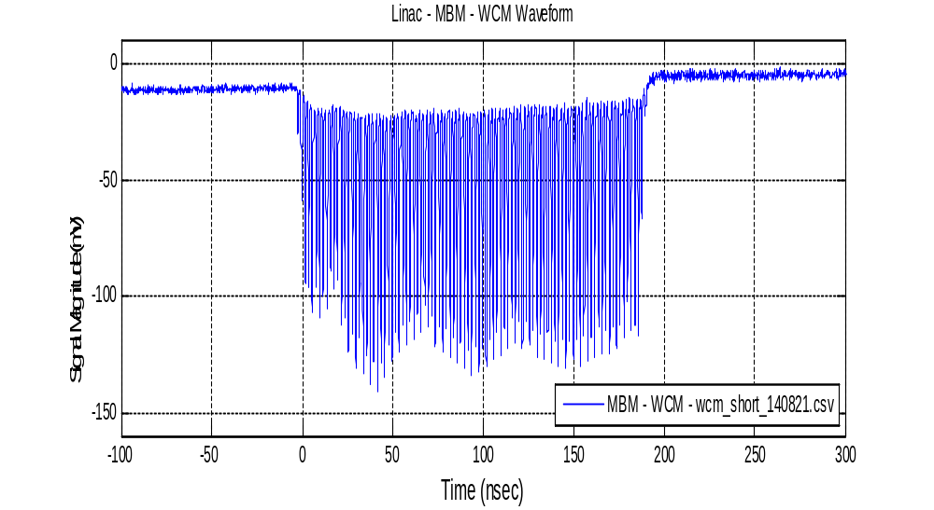
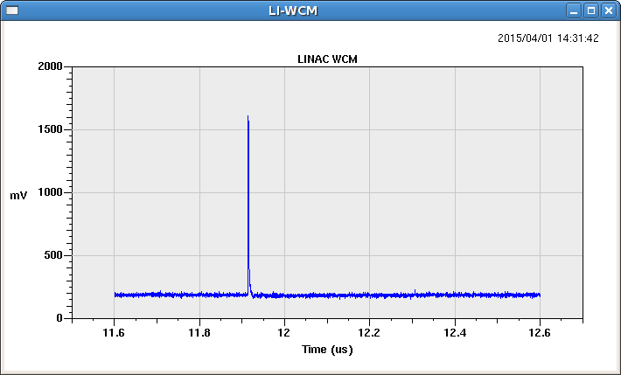
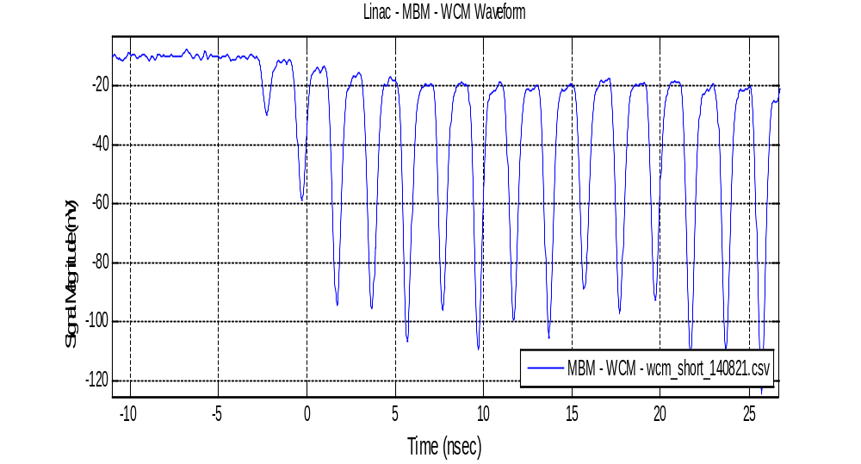
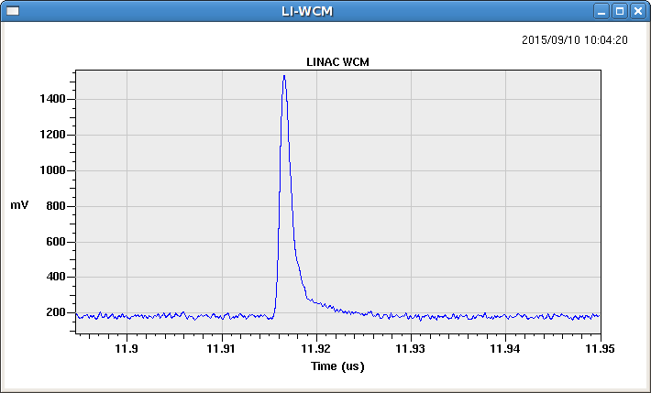
Linac – WCM Measurement
Multi-bunch
Single-bunch
Zoom in
Zoom in
Notes:
Warm Current Monitor for Multi-bunch mode and single bunch mode.
The below figures are their zoom-in.

Slide 9
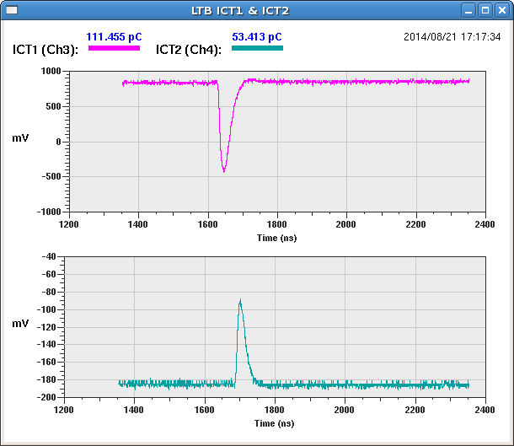
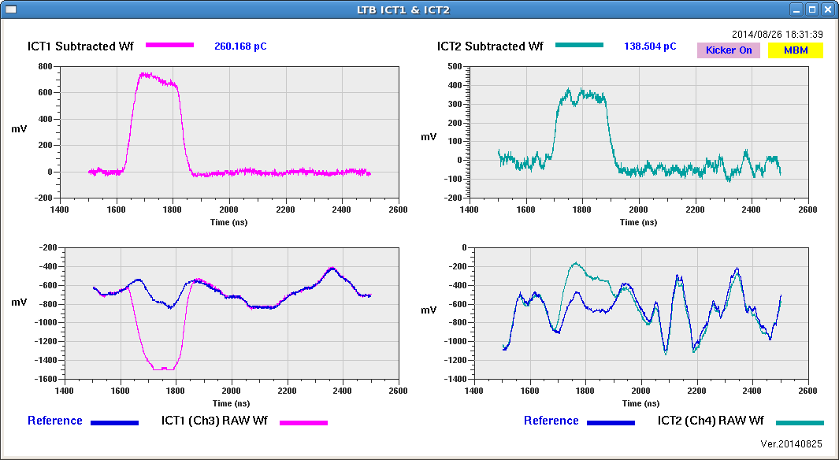
LTB ICT Beam Test
Single Bunch
Difference of the below two curves
Multi Bunch
(Kicker Disturbance)
Without beam
With beam
Notes:
ICT readings on LTB at commission beginning, transmission efficiency around 50% estimated from two ICT before optimization.
We found the ICT readings will be interfered when kicker fired.
This blue line is disturbance pattern without beam when kicker on; the pink one is with beam.
The difference of these two curves is as the measured beam current.

Slide 10

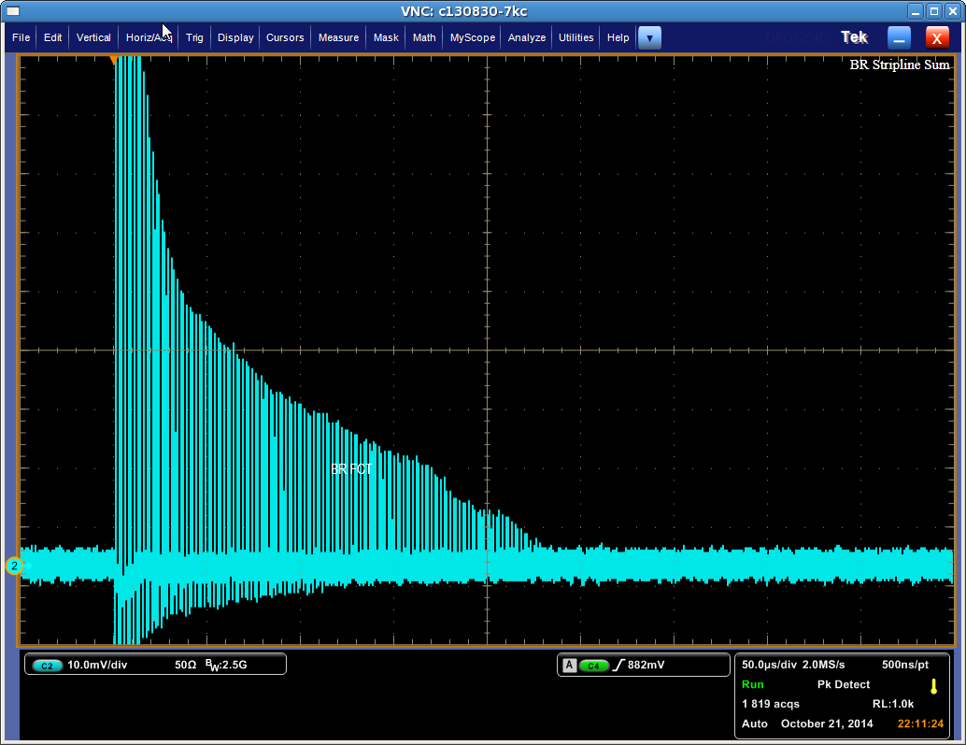
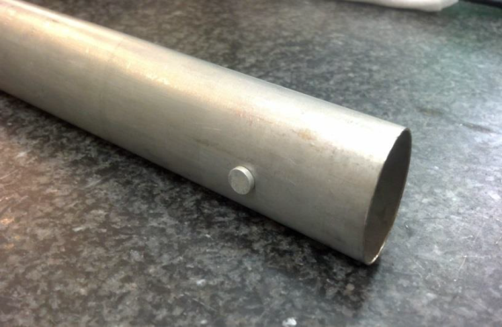
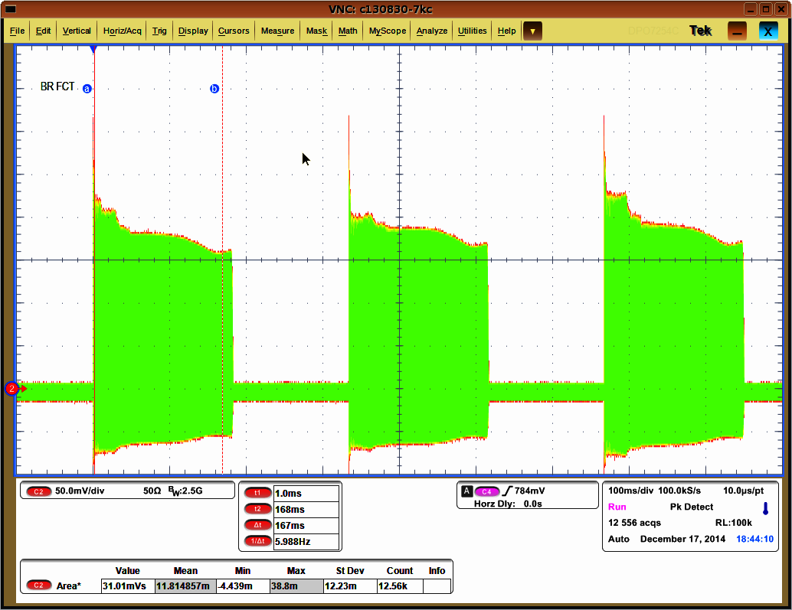
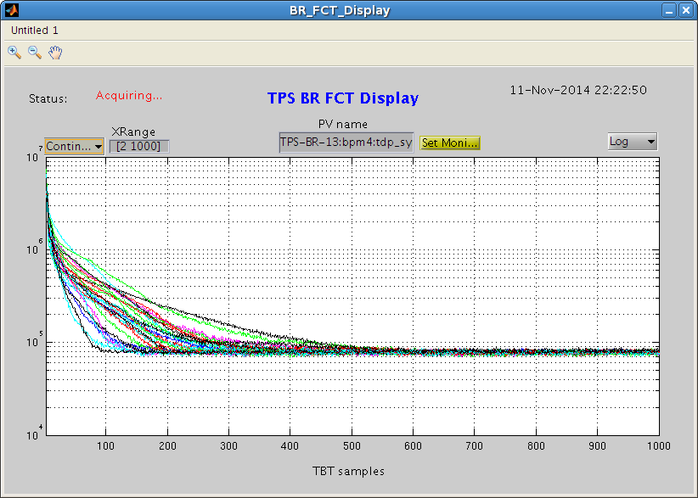
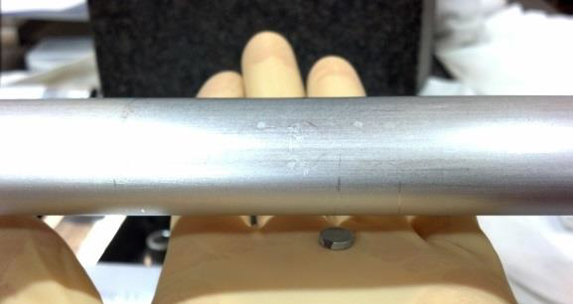
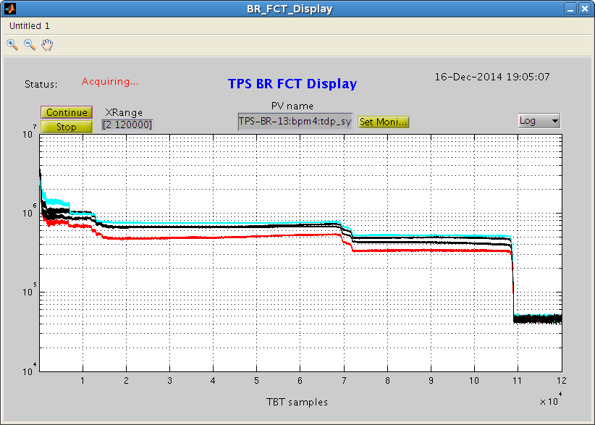
Booster Beam Intensity Observation by FCT
un-annealed chamber
annealed chamber
NbFeB magnet
Notes:
FCT first observed beam was exponentially decay quickly and cannot be stored before chamber demagnetized.
After chamber annealed, we have the stored beam.
This small piece of strong magnet could be a more useful and lower cost tool than other expensive diagnostic device in our experience.
But in all seriousness, I think it’s some of communication than technical issue.
Magnet group had chamber sample sfrom vacuum team but not been reminded to verify its permeability.
//Others hardly conceive the chamber’s permeability could be a problem.

Slide 11
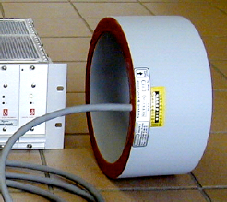
Implementation of the DCCT IOC
EPICS Ethernet
(3 Hz rate)
EPICS IOC
ADLINK cPCI CPU
BPM VLAN
SUM signals from several BPM
@ 10 Hz rate
For Beam Current Safety Check
Stop Injection Trigger:
Current Achieve Target Value
DCCT Failed
EPICS IOC Failed
EVR (CPCI6U-EVR-300)
TEWS
TCP201 IP Carrier
Hytec IP ADC
24 bits, 16 channels
IP-ADC-8417
Heartbeat
Detector
Trigger
3 Hz @ TZERO
To
Machine
Protection
System
DMM
Beam Trip Detector
High precision digital multi-meter
Orbit Interlock Threshold
Lock-in Amplifier
Threshold
Relay
10 kHz sampled data averaged into 3 Hz rate
Lifetime calculation updated in 3 Hz rate
I
Tau
I x Tau
Accumulated I x Tau
Transfer efficiency form booster synchrotron to storage ring
2 μA, 5/10 kHz
Tone Loop
Storage Ring DCCT
Notes:
This slide shows implementation of DCCT IOC.
It calculate lifetime, injection efficiency, also for injection control.
Tone Loop is to detect if DCCT is life or alive,
Output is connected to Machine Protection System.

Slide 12
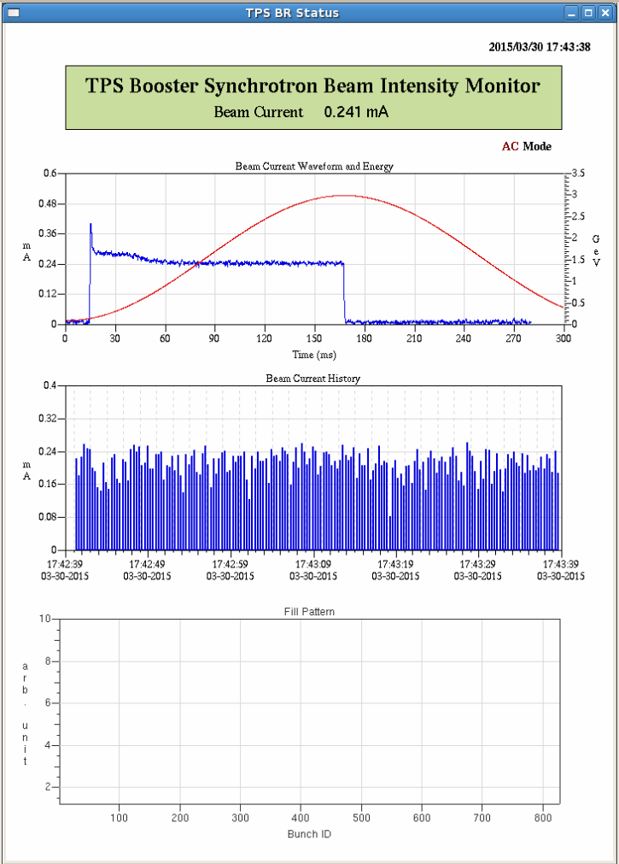
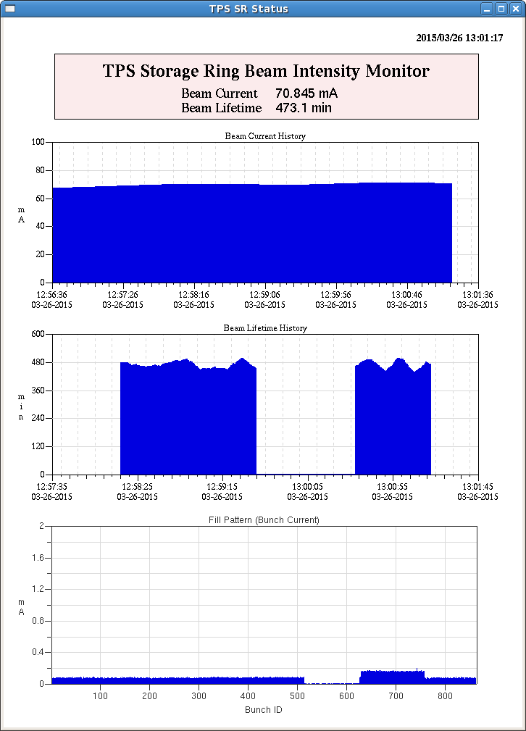
Current Measured from DCCT
Current
Current waveform
Current at 60 msec
Beam lifetime
Notes:
DCCT measurement
The Left side is Booster current. Beam loss of booster around 30%-40% and mostly happed at injection beginning.
It could be related to the energy acceptance problem. Physics team is still trying to improve.
The right side is Storage DCCT readings, lifetime.

Slide 13
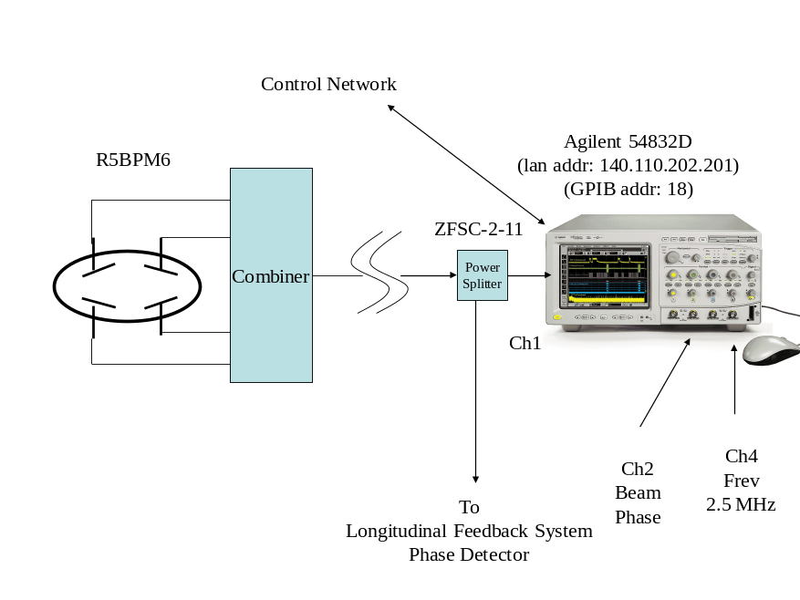
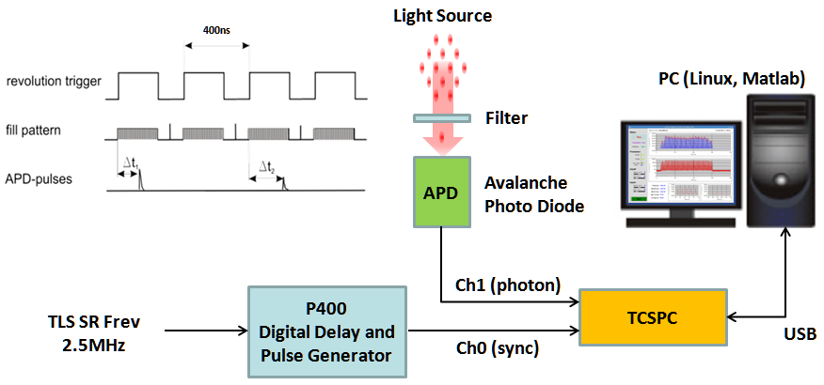
Filling Pattern (Bunch Current) Diagnostics and Control
Filling Pattern
BPM Pickups - Button Pick-up + Fast Digitizer (Oscilloscope, etc.)
(Better than 1 %)
Visible Light or X-ray: APD + TCSPC ( >10⁶ Dynamic Range for Isolated Bunch)
Filling Pattern Control
Integrated with Control System for Filling Pattern Control
Notes:
There are two ways to measure filling pattern
Signals from button pickup plus fast digitizer & the other is from visible light by photon diode & photon counter.
It’s also for filling pattern control

Slide 14
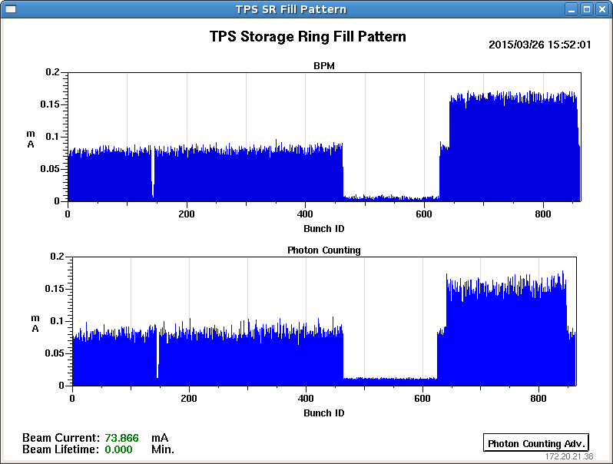
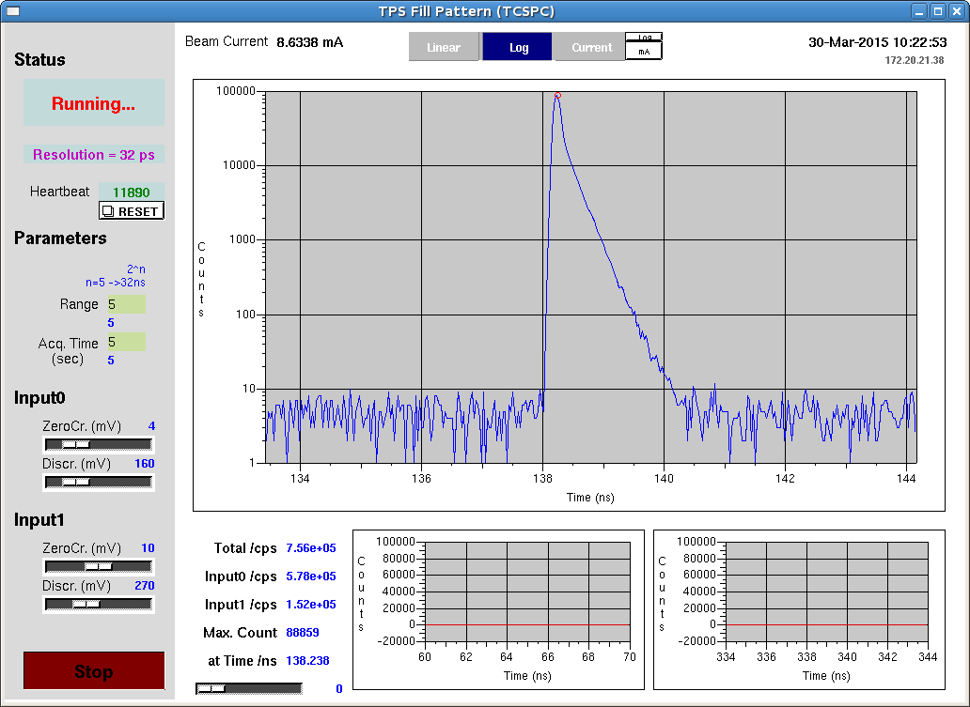
Filling Pattern Measurement at TPS
TCSPC for Bunch Purity Measurement
Pickup: Dynamic Range ~ 10²
TCSPC: Dynamic Range > 10⁵
Notes:
The upper plot is filling pattern measured from button pickup.
The lower one is from visible light.
These two measured results are quite consistenet.
Photon counter with larger dynamic range to measure bunch purity.

Slide 15
Screen Monitor

Slide 16
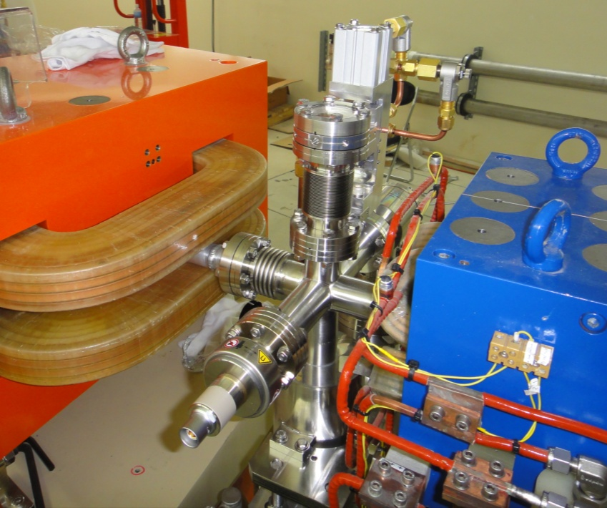
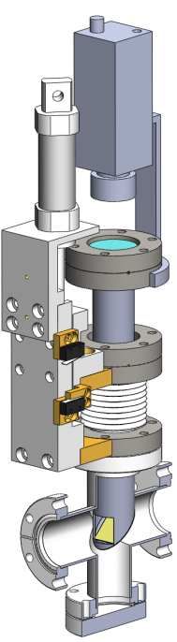
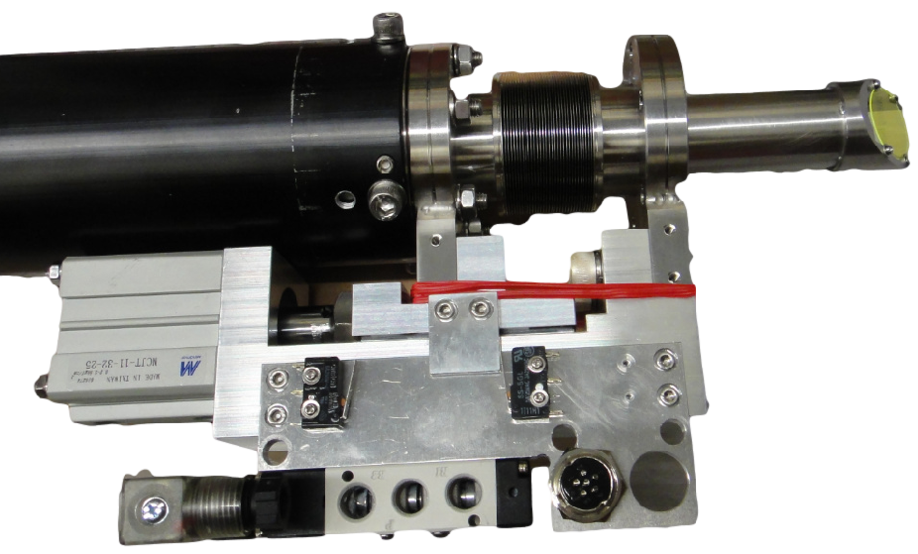
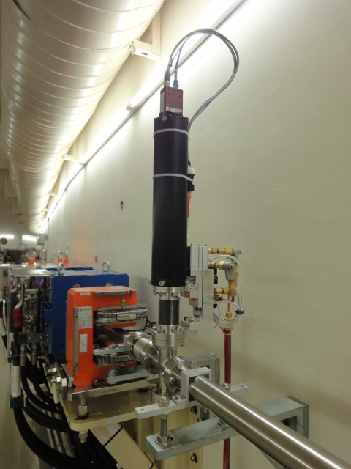
Screen Monitor – LTB, Booster Synchrotron, BTS
Camera
Lens
View Port
Pneumatic Actuator
YAG Screen
e⁻
Notes:
For LTB, booster & bts.
There are three major components: YAG screen,actuator and camera.
There are photos on site.

Slide 17
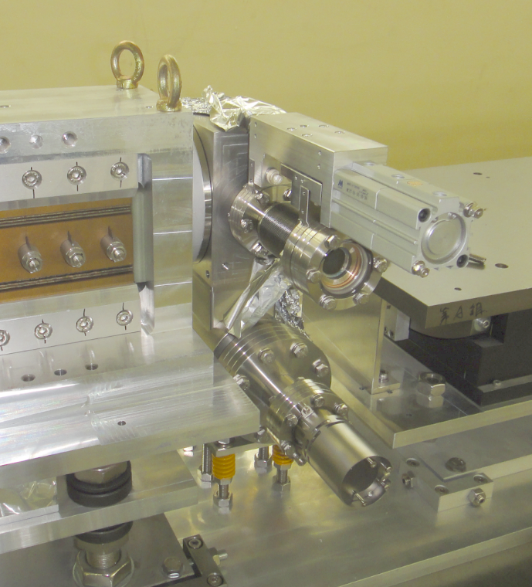
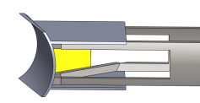
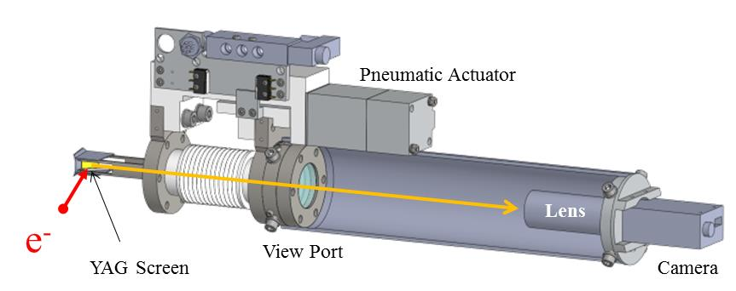
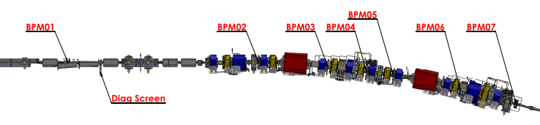
Screen Monitor – Storage Ring
Out
Position 1
Injection Beam
Position 2
First Turn Beam
Notes:
For storage ring,
The design has three positions, enable to observation of injection beam and first turn beam.
It’s location after septum and its pphotos and drawings.

Slide 18
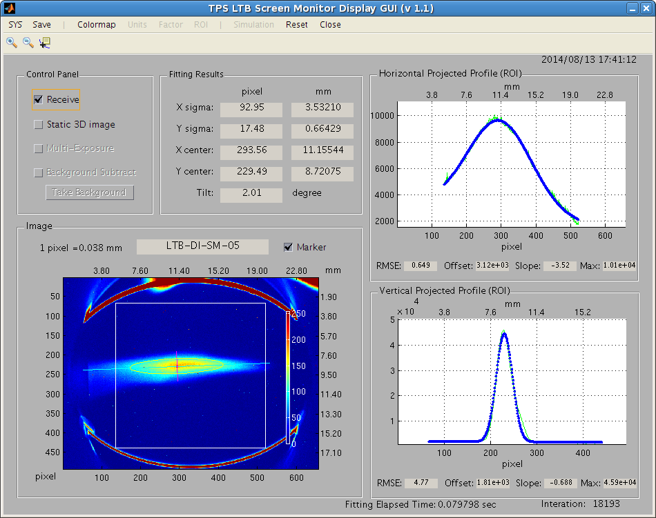
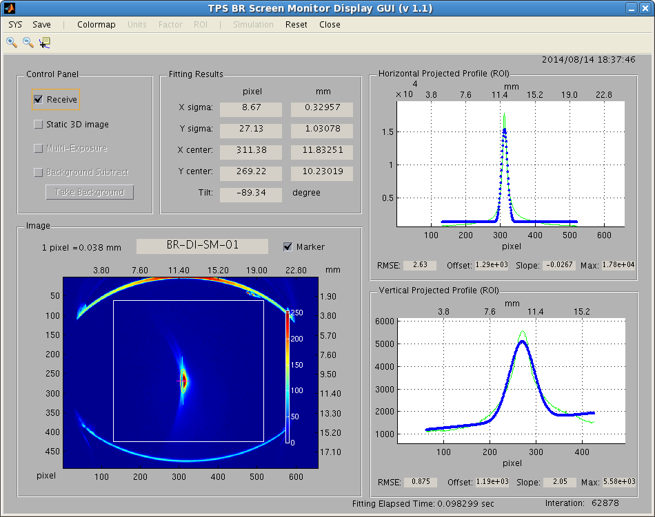
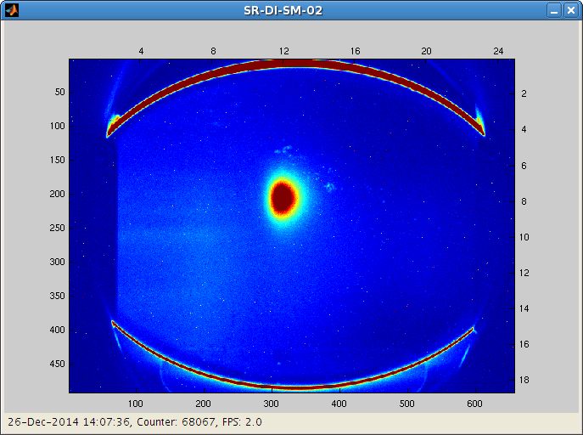
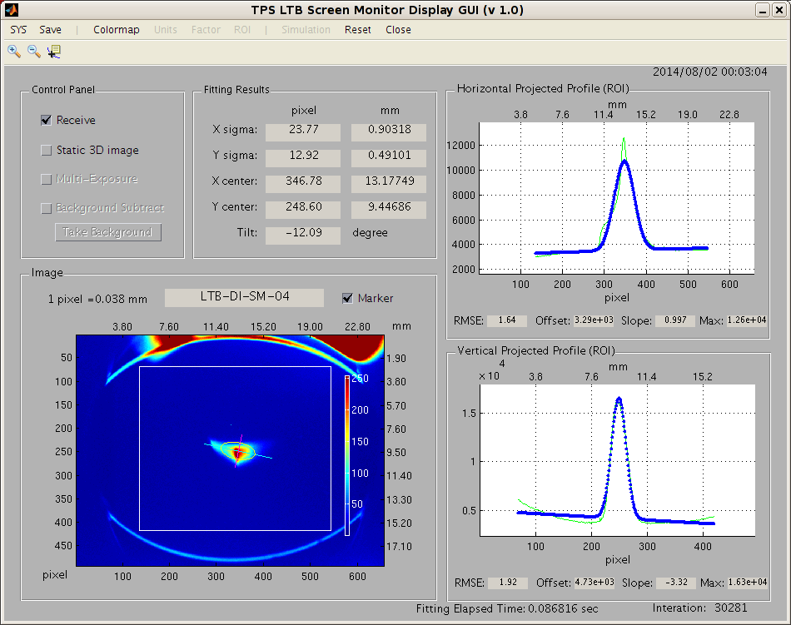
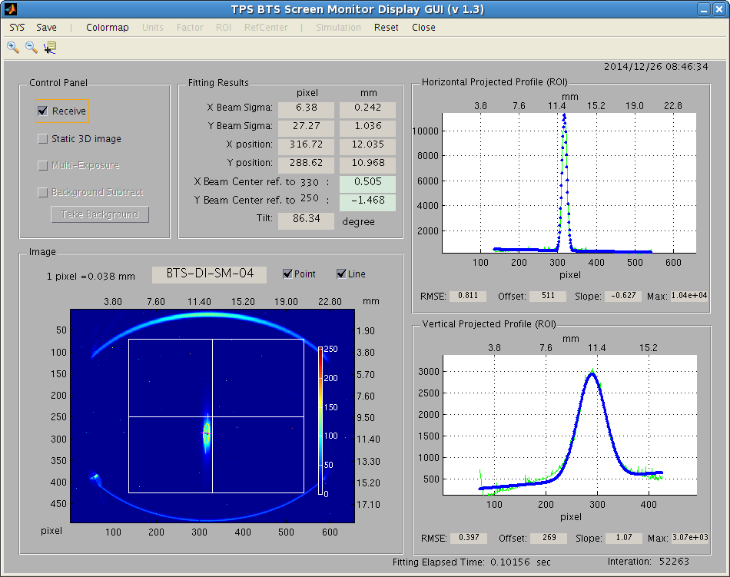
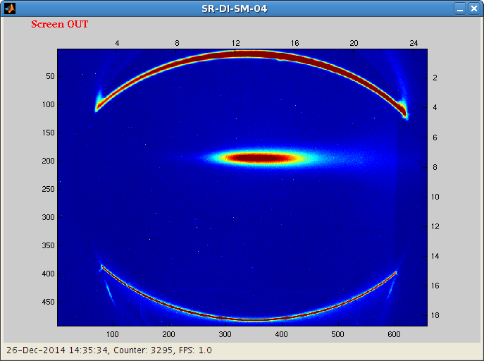
Screen Monitor Images
Screen image at Linac
Screen image at Booster
Screen image at SR scn4
Screen image at LTB
Screen image at BTS
Screen image at SR scn4
Notes:
These are screen monitor images at different location from Linac to Booster to Storage ring.
Exposure time & CCD gain should be set correctly to avoid saturation.
//Else the accuracy of beam size calculation could be incorrect.

Slide 19
BPM System

Slide 20
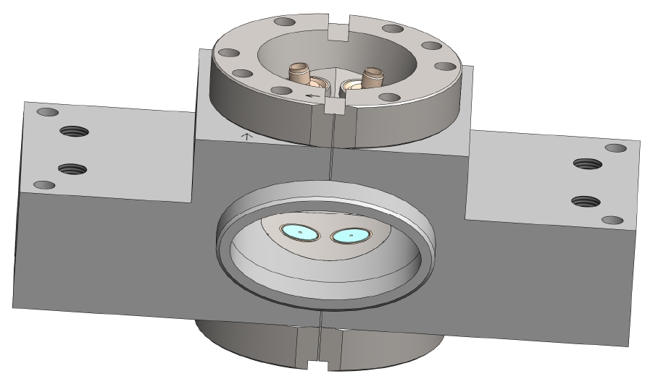
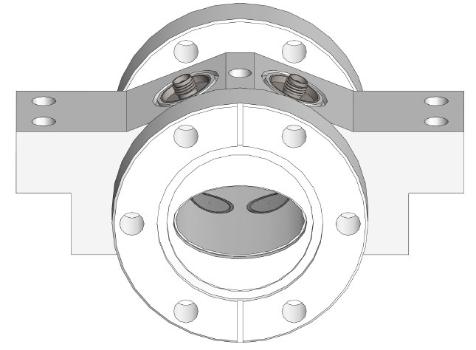
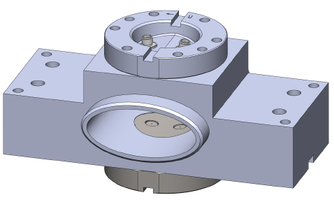
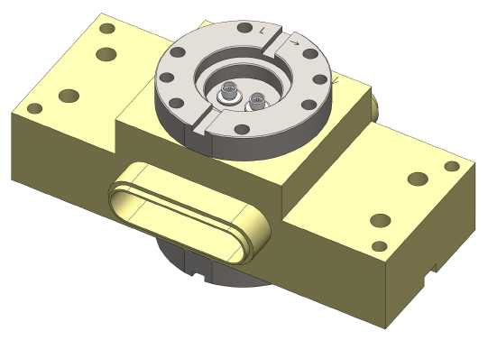
Summary of the BPM Types Used in TPS Project
 |  | Chamber profile | Size (mm) | φ button (mm) | Kx/Ky (mm) | Remarks
Linac (0) |  | - | - | -
LTB (7) |  | Elliptical | 56 x 28 | 10.2 | 15.20/10.95 | Libera Single Pass Brilliance
Booster (60) |  | Elliptical | 35 x 20 | 10.7 | 8.25/9.66 | Libera Brilliance Plus
BTS (6) |  | Elliptical | 35 x 20 | 10.7 |  | Libera Single Pass Brilliance
Storage Ring Standard BPM (120 + 3) |  | Elliptical | 68 x 30 | 7.4 | 13.8/12.73 | Libera Brilliance Plus
Storage Ring Primary BPM (46 - 3) |  | Racetrack | 64 x 16 | 7.4 | 6.58/8.89
IU22 (2 + 1) |  |  | 68 x 20 | 7.4 | 8.99/9.63
EPU48 (1) |  |  | 68 x 8 | < 5 | ~ 4/4
Notes:
This Summarize several different BPM type used in TPS.
All are designed by vacuum team.
For electronics, Libera Brilliance Plus for storage ring and booster; Libera Single Pass Brilliance for transportline.

Slide 21
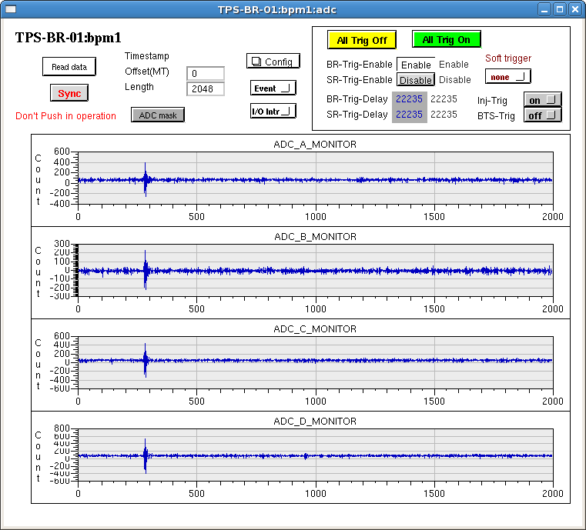
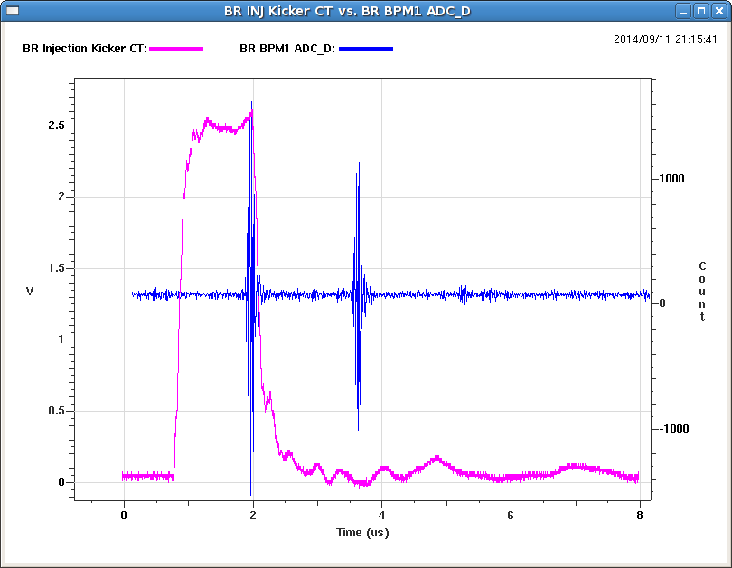
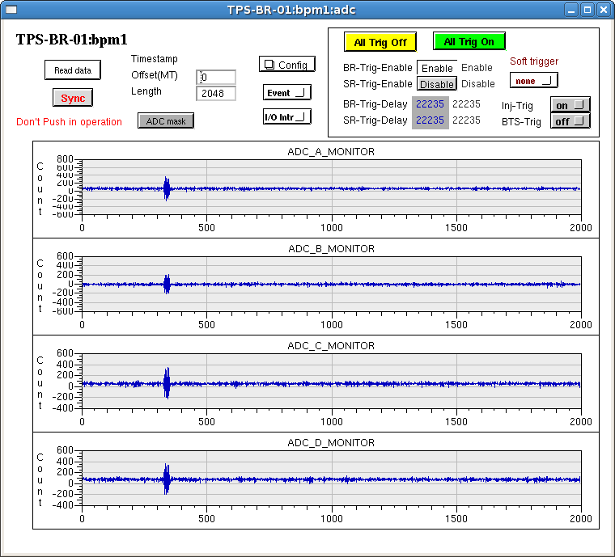
Booster BPM: ADC
Button Signals (Single Bunch)
Adjust kicker trigger delay
so that the 2nd turn of beam would not overlap on the kicker residual tail
Button Signals (200 nsec Bunch)
Residual field tail
Notes:
These are BPM ADC data observed on the first day.
We use these adc data for fine tune of timing.
Because kicker pulse had residual field tail and could affect the second turn beam,
We adjust trigger timing and move the beam close to the pulse falling edge so that the second beam could not overlap on the tail.

Slide 22
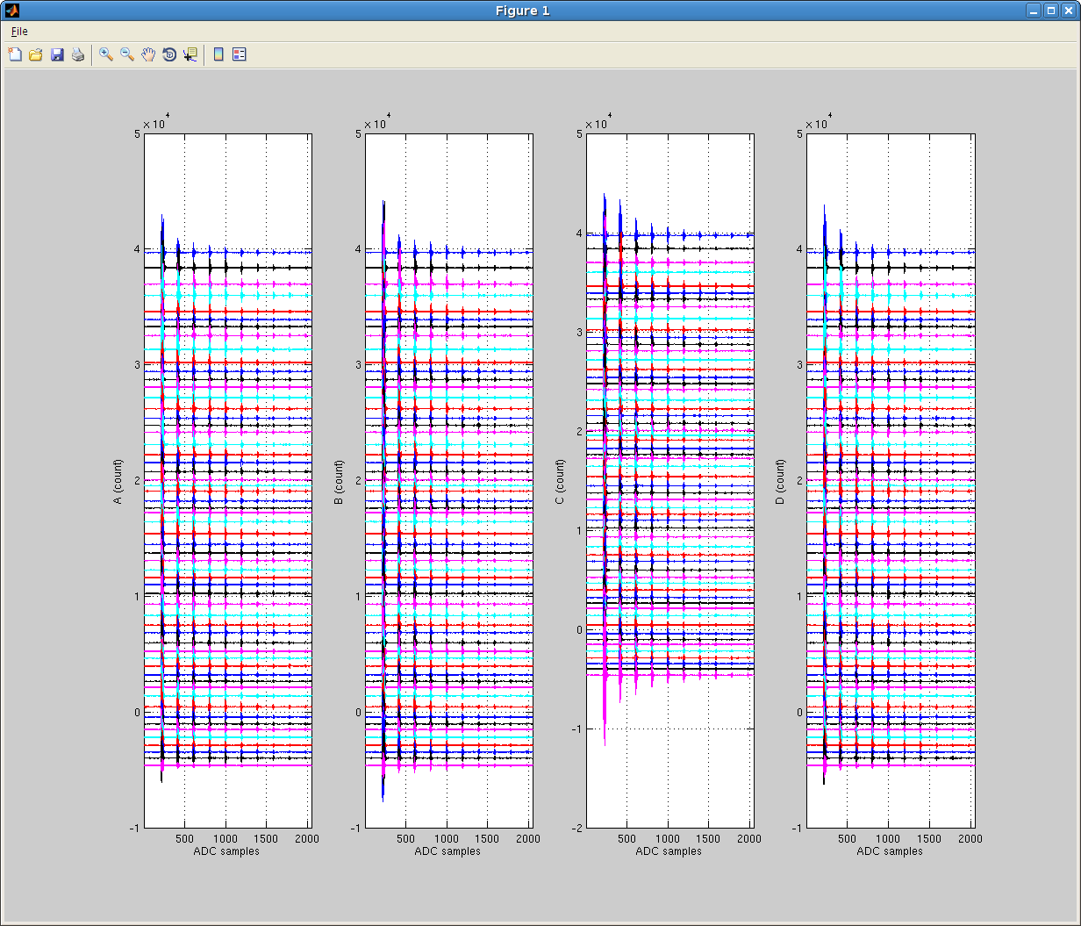
Booster BPM ADC data after Phase Alignment
Notes:
These are all 60 BPM ADC data after phase alignment.
All BPMs are looked in the same phase.

Slide 23
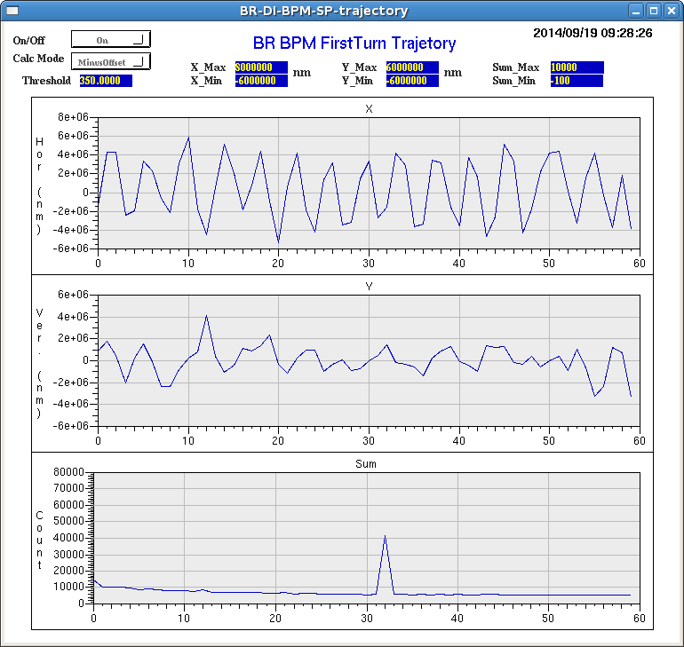
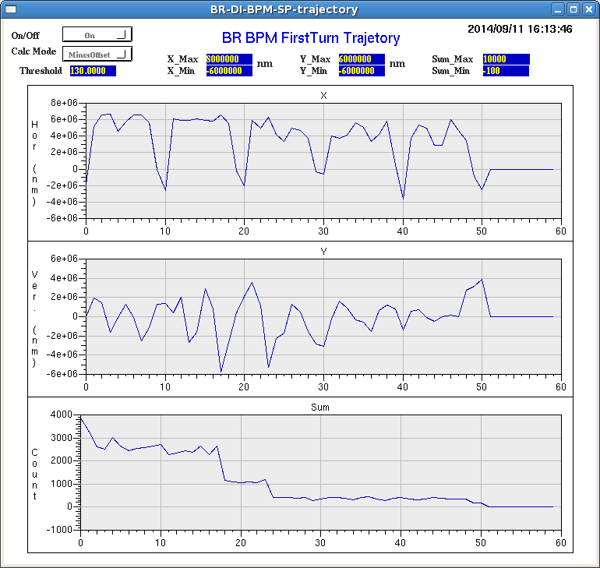
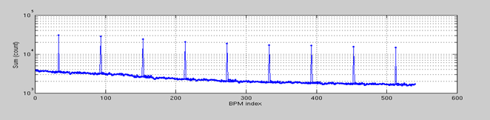
First turn & Multi-turn
First-turn display GUI
At early commissioning, linac modulator was not stable, energy drift could be observed from the first turn trajectory in horizontal.
BPM403 with amplifier for tune measurement
9 turns sum of all BPMs.
Beam loss along booster chamber uniform before demagnetized.
Cable phase match :±3˚
Cable loss diff: less 0.1 dB
Notes:
This is first turn display. X, y position and Sum. It’s one BPM with amplifier for tune measurement
At early commissioning, linac modulator was not stable, energy drift could be observed from the first turn trajectory.
For examples, this first turn shapes like dispersion when injection beam with lower energy.
This is 9 turns sum signal form BPM.
Because BPM cables are trimmed, cable loss difference is less than 0.1 dB.
It’s sum could indicate beam intensity.
We look the beam loss along booster chamber quite uniform.
TDR:Time Domain. Reflectometry (phase)
E5071C(loss)Network Analyzer

Slide 24
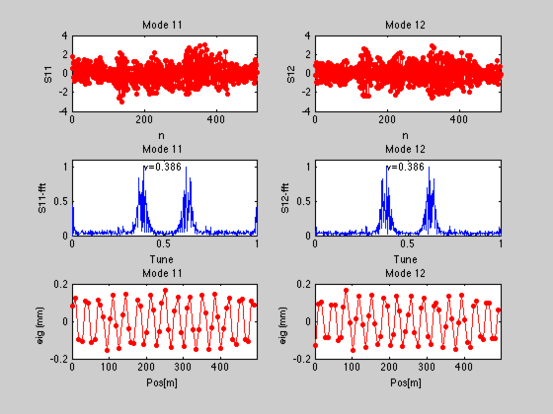
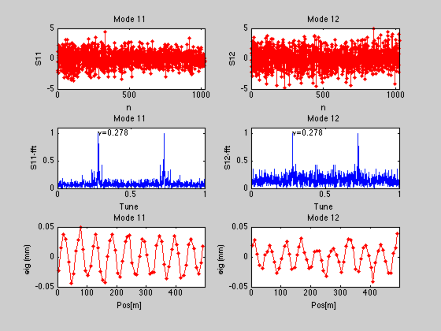
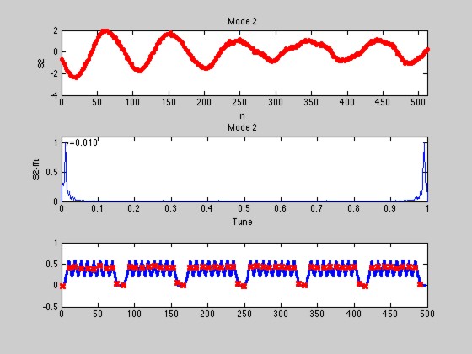
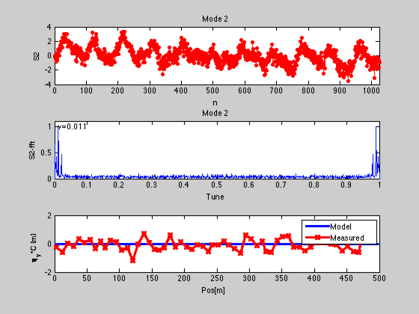
Booster BPM: TBT Data & Analysis
Horizontal
Vertical
Betatron Motion
Measured beta Functions in both planes.
Synchrotron Motion
Syn. Frequency
Syn. Frequency
Dispersion Measured by Turn-by-Turn Data.
Provided by H. J. Tsai
Notes:
BPM provided TBT data is used for many physics application.

Slide 25




Booster Tune Monitor and GUI
Booster Tune Monitor Block Diagram
Implemented on an dedicated EPICS IOC
Add waveform generator, excitation on/off control, Data, Time, ……
Select BPM source,
Average, subtraction, persistence display , fraction tune, frequency, ….
Booster Tune Monitor
Tune resolution of TDP (Time domain processing ) better than DDC (Digital down conversion).
Notes:
TBT data also used for tune measurement.
Magnetic shaker now replaced by stripline kicker excite beam.
From BPM TBT data, tune is extracted.
At first, tune variation as shown was quite large during ramping.
It would be cross the resonant line, make much beam loss.
After tune correction, variation improved and have lower beam loss.
These are histogram comparison of two TBT data chains from TDP and DDC.
Time domain processing and Digital Down Conversion
TDP at the right had better resolution than DDC at left because it could distinguish clearly with the continuous but different turns.

Slide 26


Booster tune monitor at injection
Stability of booster main power supply improved from 0.5% to 0.2% at low current.
Relation between beam survival rate, tune and QF/Dipole err at injection.
Notes:
Initially, the booster beam current was not stable. We found that one of the reason was the stability of booster main power supply at low current not good enough.
Quadruple to dipole relative err would effect tune and when tune drift to the improper working point, it would have lower beam current.
After Stability of power supply improved, stability of beam current was also improved.

Slide 27



Booster Orbit during Ramping observed from BPM 10kHz data – 141218
150MeV
3GeV
orbit brow-up +4/-2 mm in X-plane and +/- 1 mm in Y-plane during ramping
Orbit correction during ramping would be done in phase II commissioning
Notes:
This slide shows the booster orbit change during energy ramping observed from BPM 10kHz data.
Initial orbit variation during ramping was 6mm in horizontal and 2 mm in vertical at maximum.
The orbit correction during ramping will be performed in phase II commissioning

Slide 28


TPS Storage Ring BPM-Problems
Cabling Problem
  Button B and C of two BPMs 04_4 & 17_7 were cross connected.
  The cables of BPM 24_4 and 24_6 were in wrong order.
Calibration Problem:
The BPM sensitivity factors were incorrectly set to the configuration of the primary type
BPM while they should have set to standard type configuration.
Notes:
During storage ring commissioning, there were some cable problem.
Button B & C of two BPM are cross connected.
//It was discovered that the diagonal button A & C should not have decreased or increased at the same time.
The cables of two BPM in wrong order
//was found when dispersion measurement.
There are also three sensitivity factors incorrectly set to the configuration of the primary type
BPM while they should have set to configuration of standard type.
These problems were all found very soon during physics optical measurement

Slide 29


TPS Storage Ring Beam Stability from FA data
Before turbo-pumps turned off, 29 Hz dominated—girder vibration
After turning off the pumps, the noise level was much decreased.
Water turbulence in vacuum chambers is another source of noise.
Notes:
Beam spectrum of storage ring was measured.
There was noise around 29 Hz identified from turbo-pump vibration.
Water flow in vacuum chambers is another noise source.
Integrated noise from dc to 500 Hz is 5 um for horizontal and three um for vertical
We will need more work to improve orbit stability in the future including orbit feedback.

Slide 30



Beam Based Alignment (BBA)
By using any corrector magnet to position the electron beam at different position in quadrupole magnet.
Determine the position which minimizes the orbit distortion when the quadrupole field is varied. (BPM-Quad center offset—BBA)
2015/03/10
$$f(θ_{cm})=\frac{1}{166}\sum_{i=1}^{166}{{(x_{i}\left(+∆k\right)−x_{i}\left(−∆k\right))}^{2}}$$
θ_{cm} : the strength of the corrector magnet
x_{i}(Δk) : orbit after changing the quadrupole by Δk
i : BPM index
X: 0.344 mm ( rms )
Y: 0.346 mm ( rms )
Provided by C. C. Kuo
Notes:
The BPM-quad center offsets were obtained by Beam Based alignment.
Offset is around 0.34 mm rms for x an y position.
There are several BPMs with larger offset required further investigation.
It could be due to misalignment in longitudinal plane.

Slide 31

Interlock
BPM 10 kHz data used for interlock including position and angle
7 long straight line (EPU & IU) required first
Interlock activate condition under discussion
Functionalities test 4th quarter 2015
Notes:
BPM 10 kHz data are also for beam interlock protection including position and angle.
7 straight line with installed ID is required first.
Interlock activate condition is still discussion (0.2~2mm,0.1~0.3 mrad).
We will test interlock functionalities in the phase II commissioning.
The GUI is angle interlock page.

Slide 32
Feedback System

Slide 33




Feedbacks
Kind of Feedbacks | Status
SOFB | Apply during 4th quarter 2015 with ID commissioning Updating rate at 10Hz
FOFB | Fast corrector installed in June 2015 Firmware under modification and test Planned to operate in 2016
Bunch-by-bunch | Preliminary beam test at January 2015. Hor. and Ver. kickers installed in June 2015 Commissioning on 4th quarter 2015 .
FOFB parameters:
Corrector bandwidth ~ 300 Hz
Vacuum Chamber bandwidth ~ 500 Hz
Noise suppression bandwidth ~300 Hz.
Notes:
Out fast correctors just installed this June. The feedback firmware modification is still underway.
The slow orbit feedback would first provided.
FOFB planned to operated next year. The suppression bandwidth around 300 Hz limited by corrector bandwidth.
Preliminary beam test of bunch by bunch feedback done this January with prototype vertical kicker.
These are new kickers installed this June.
The bunch by bunch feedback electronics adopt Dimtel iGp12.
Commissioning with new kickers would be this forth quarter.

Slide 34






Infrastructure for FOFB
Control Network
TPS
Control System
Timing Master IOC
Server to check if
fast corrector closed to saturation
Master Clock
On-line Console
Slow corrector settings
Path length compensation
Cell 2
CPSCs+ PSs
Cell 1
CPSC s+ PSs
Fast Corrector installed at bellows
10 kHz rate interface. Each cell has 2 links
for hor. and ver. Loop respectively.
Cell 24
CPSCs+ PSs
BPM Group 1
BPM Group 2
TPS Ring
BPM Group 24
10 kHz orbit data link
Notes:
The slide shows fast orbit feedback infrastructure.
The BPM 10 kHz data stream is transmitted by fiber link. Each BPM platform could acquire the whole orbit data.
Feedback computation modules installed on each BPM platform, would calculate the feedback correction, sent to the power supply controller.
One server would transfer the fast correctors DC settings to slow correctors, avoid saturation.

Slide 35





Prototype Bunch-by-Bunch Feedbacks
Filling Pattern
Feedback OFF
growth/damping experiment at 90 mA
Bunch cleaning by feedback
Feedback ON
Notes:
This slides shows the preliminary vertical bunch by bunch feedback measurement results.
It could be also for filling pattern measurement.
The vertical instability were suppressed on feedback on observed from pinhole camera .
We also get better bunch purity by bunch cleaning of this feedback.
These are bunch mode and growth/damping time analysis.
//damping rate greater than growth rate so that ensure beam is stable

Slide 36
Synchrotron Radiation Monitor

Slide 37



Layout of the Booster SRM Station
Energy (GeV) | 0.150 | 3
ε_{x} (nm-rad) | 167 | 9
ε_{y} (nm-rad) | 167 | 1
σ_{x} (mm) | 0.7 | 0.15
σ_{y} (mm) | 1.5 | 0.1
SRM port A:
Streak camera & CCD to measure visible light
Reserved for future
Side-view of SRM port A
Notes:
For booster, there are two synchrotron radiation monitor station.
Port A is at first cell of booster.
Port B is on cell 4, the opposite side of the ring, reserved for future application.
This is side view of the optical layout of the port A station.

Slide 38



TPS booster synchrotron radiation profiles during energy ramping
Beam size change during ramping
Beam position change during ramping
Notes:
These are beam profile changed with energy ramping observed from synchrotron radiation monitor.
Beam size shrink as energy increases due to radiation damping.
Beam position change was also observed.

Slide 39




Layout of the Storage Ring SRM Station
Top view of streak camera
Beam size σ_{x,y} and beam divergence σ_{x’,y’} for 1 % coupling. Natural horizontal emittance is 1.6 nm-rad.
Source point | σ_{x} (μm) | σ_{x’} (μrad) | σ_{y} (μm) | σ_{y’} (μrad)
Straight center | 165.1 | 12.4 | 9.8 | 1.6
Long straight center | 120.8 | 17.2 | 5.1 | 3.1
Dipole (1 degree source point) | 39.7 | 76.1 | 15.8 | 1.1
Side view of X-ray pinhole camera
Port 40
1 º Source
Visible Light SRM
* Streak camera
Be Mirror
Pinhole
X-ray SRM
* Pinhole camera
Notes:
For storage ring, on a diagnostic beamline, streak camera is applied to observe visible light.
There is also pinhole to observe X-ray.
These are the optical layout for pinhole camera and for streak camera.
The steak camera photo on site.

Slide 40




X-ray Pinhole Camera Test for SR
Beam size larger then expected
After focus adjustment
Found that the mirror was moved so that focal length changed
Resolution measure by knife
edge test ~ 5 um
Beam size change as beam current increased
Notes:
At the first day of beam stored in SR , the beam size measured by pinhole camera was larger then expected.
Later it was found that mirror was moved so that focal length changed.
After adjustment, we had the correct result.
Resolution of pinhole camera is measured around 5 um.
Beam size changes as current increased.

Slide 41





Booster Beam – Streak Camera Observation
Before Linac optimization, side bunches (3 GHz) were observed.
They would merge for synchrotron motion.
Bunch length and phase variation during the energy ramping process. Bunch length changes around 85 psec, bunch phase change around 45 degree.
100 us
Single Bunch Mode
150 Mev
3 GeV
700 ps
Satellite bunch
Satellite bunch observed at LTB FCT
Notes:
booster beam observed from streak camera
Before Linac prebuncher well tunning, there were several s-band bunch observed. They gradually merged because RF modulation.
The bunch phase change when energy ramping.
This is the satellite bunch due to impurity bunch at single much mode.
It could be also observed on FCT.
This plot is bunch length and phase variation during the energy ramping derived from streak camera image.
(adiabatic & radiation damping, quantum excitation effect)

Slide 42





Storage Ring – Streak Camera Observation
Longitudinal instability before RF problem of amplitude loop found.
Bunch length as function of bunch current
Single bunch profile distortion for longitudinal impedance calculation.
Longitudinal instability happened ~82 mA in multi bunch mode.
Notes:
Longitudinal instability observed before RF feedback loop correct tuning, the instability became stronger as beam current increased.
After resolve the RF problem, beam current could be accumulated to 100 mA.
Instability also occurred when beam current greater than the threshold value (~82 mA).
This figure shows the bunch length increase as bunch current increase.
This is normalized beam profile at different current.
Profile distortion are measured for longitudinal impedance calculation.

Slide 43
Beam Loss Monitor

Slide 44




Beam Loss Monitor (BLM)
Configuration of RadFET BLM system
Configuration of dual PIN-diode BLM system
Injection
Extraction
Dual PIN-diode BLM
Beam loss pattern of booster ring.
RadFET
Notes:
In the booster ring, RadFET is installed before the booster bending magnets.
In SR, both of RadFETs and Bergoz’s PIN-diode beam loss monitor were installed in each cell.
At the original design stage ofr RadFET, there were many spikes due to the grounding noise.
The ground of the cirsuit are separate into several part to improve noise interference.
This show the beam loss pattern distributed along the booster.

Slide 45


Summary
Work in progress
Phase II commissioning with SRF before delivery to users.
Final check of the interlock functionalities.
Prepare for bunch by bunch feedback system
Slow orbit feedback would be first provided this 4th quarter.
System integration test and firmware debug of the fast orbit feedbacks continues.
Summary
Diagnostics helps to improve subsystem, optimize machine and accelerate TPS commissioning.
Further modification and expansion continues during Phase II commissioning.
Notes:
We will go on the Phase II commissioning with SRF this month.
During phase II commissioning, we will check interlock function.
Prepare for bunch by bunch feedback system with new installed kicker
Slow orbit feedback will deployed later.
For FOFB, system integration test and firmware debug will continue.
Diagnostic system had aided TPS Phase I commission succeed.
Further modification will continue during Phase II commissioning.

Slide 46
Acknowledgement
Many helps direct or indirect from diagnostics communities. IBIC2015 is the best occasion to express our deepest appreciations to You.
Especially help from
Jean-Claude Denard, Gunter Rhem (DLS), Ubaldo Iriso (ALBA), T. Nakamura (SPring-8), Bob Hettel (SLAC), …
Help from NSRRC machine groups is a key to success!
Notes:
We got many helps direct or indirectly from diagnostics communities.
On this occasion, we would like to express our deepest appreciations to everyone.
Especially thanks for these experts.
We hope that the experience we met could help the community in the future.
Thank you.

