Slide 1
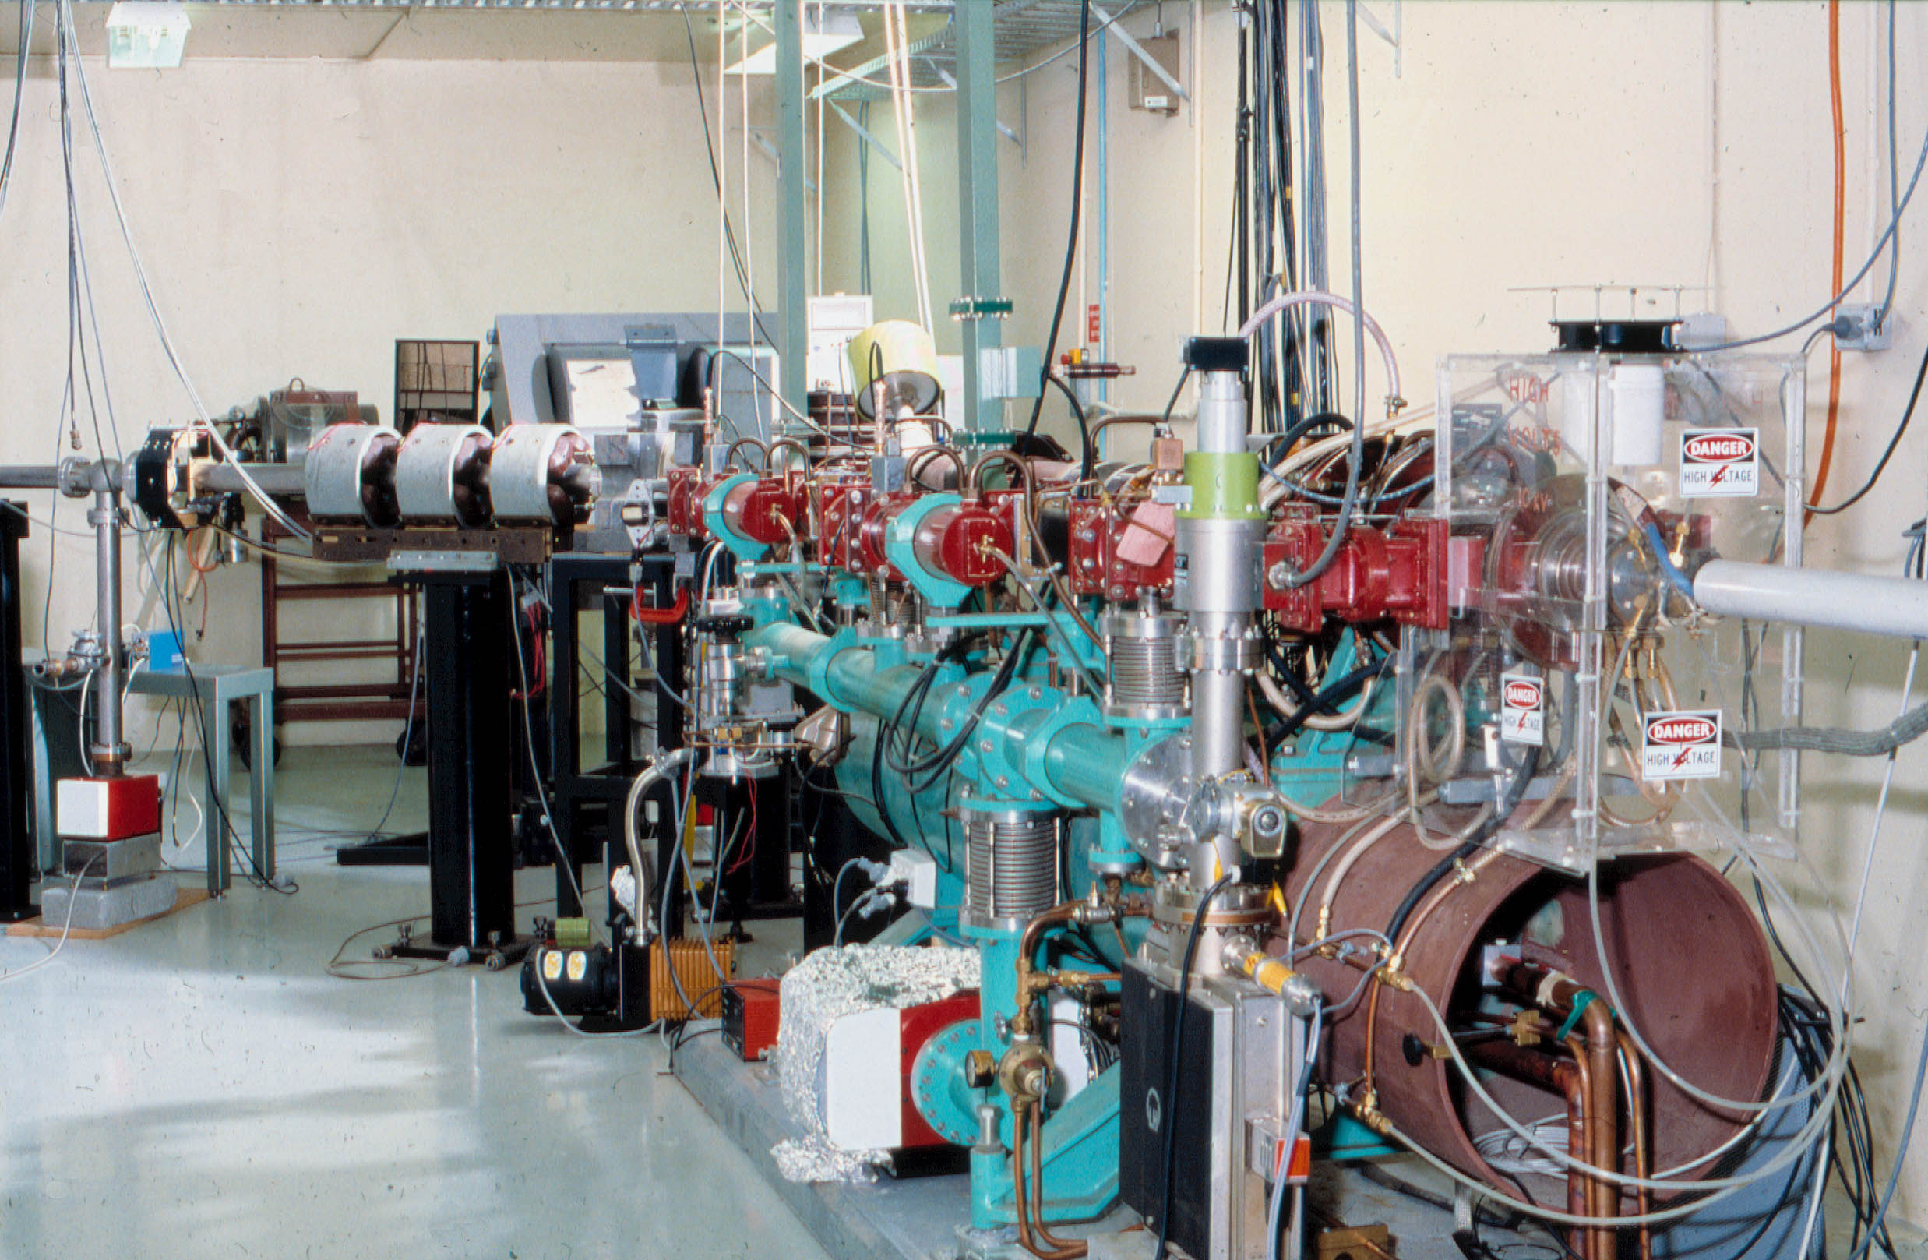
Radiation damage considerations in accelerator beam environments
DAVID V WEBB PhD (ret’d)
Ex-Aust. Radiation Protection & Nuclear Safety Agency
Yallambie, Victoria, Australia

Slide 3
Overview
The impact of radiation upon equipment used on accelerator beam lines is a continuing concern.
Materials, cabling and instrumentation will experience aging and degradation and even failure
Damage depends on the nature of the radiation and the intensity of the fields.
This discussion will review
  The fundamentals of radiation interactions
  Damage mechanisms
  Strategies to minimise or delay the effects of radiation damage

Slide 4
Classification of radiation
Non-ionizing
Directly ionizing (charged particles)
Electrons, protons, etc.
Radiation
Ionizing
Indirectly ionizing (neutral particles)
Photons, neutrons

Slide 5
Types of radiation
 | Radiation (E_{ke} = 1 MeV)
Characteristic | Photon (γ or X-ray) | Neutron | Beta (β) or electron | Proton | Alpha (α)
Ionization | Indirect | Indirect | Direct | Direct | Direct
Rest Mass (amu) | -- | 1.008665 | 0.000548 | 1.007276 | 4.0027
 |  | (940 MeV) | (0.511 MeV) | (938 MeV) | (3730 MeV)
Speed (rel. to c) | 100% | 4.60% | 94.10% | 4.60% | 2.30%
Range in air* | 82,000 cm | 39250 cm | 319 cm | 1.81 cm | 0.56 cm
* range based on a 99.9% reduction

Slide 6
Radiation Processes
Excitation and ionization processes through interactions:
Photons (mainly):
  Photo-electric effect
  The Compton effect
  Pair and triplet production and positron annihilation
  Photo-nuclear effect
Electrons
    Coulomb interaction with a charged particle
    Atomic excitations
    Bremsstrahlung (X-rays)
  Protons
    Coulomb interaction with a charged particle
    Recoil ions
    Nuclear reactions
  Neutrons
    Nuclear reactions
    Recoil ions

Slide 7
Radiation | Impurity Production | Atomic Displacement | Ionization
Neutron | Directly by absorption reactions (mostly thermal n's), also may lead to more reactions | High energy neutrons can cause displacements | Indirectly
Alpha | He buildup can cause pressurization problems | May cause atomic displacement | Causes sizeable ionization
Proton | H buildup, nuclear reactions | Some displacement | Yes
Beta or e |  | Some displacement | Yes
Photon | Nuclear photoreactions | Rare displacements (via Compton) | Yes, indirectly

Slide 8
Macroscopic damage mechanisms
Transient Charge Generation - direct or indirect ionization
Structural Damage - displacement, scission
Impurities - nuclear reactions (e.g. secondary production by neutrons)
Dose Effects
Single Event Effects (SEEs)
Dose Rate Effects

Slide 9
In the case of electron accelerators producing electron or photon beams
  Ionization effects will tend to dominate
  If the energies are high enough,
    secondary charged particles and neutrons created
    cause atomic displacements and impurity production.
  Scattered beam sources
    Variable spectra and intensity

Slide 10
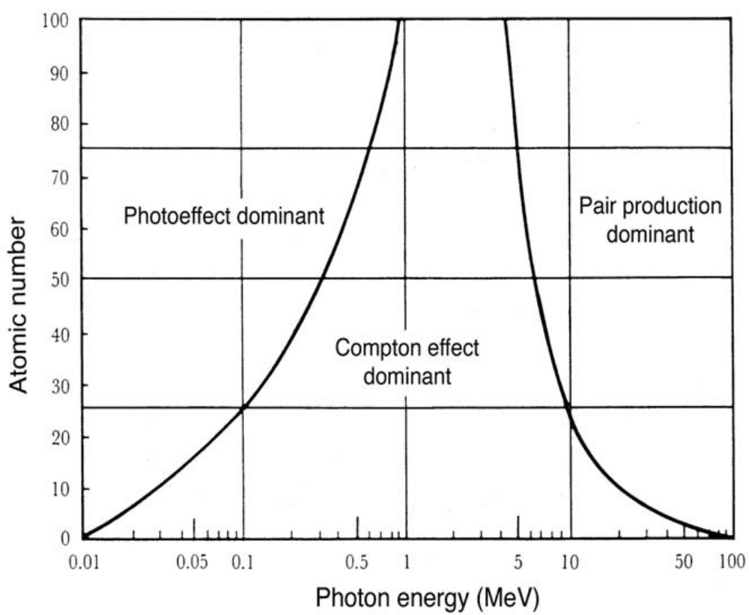
Z dependence
Ge
Si

Slide 11
Absorbed dose distributions
Photon beams
  Inverse square
  energy dependent dose maximum depth (zero up to 500 kV)
  Secondary electrons deposit dose
Electron beams
  Coulomb interactions with orbital electrons and nuclei
  Build-up of secondary electrons
  Rapid fall off beyond dose maximum, highly scattered
  Bremsstrahlung tail

Slide 12
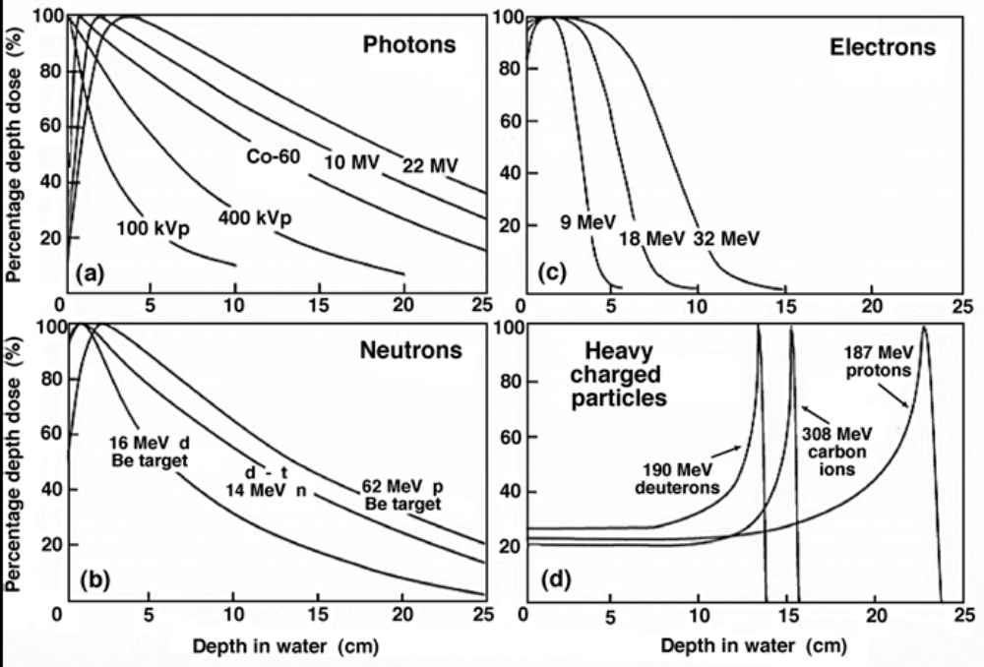

Slide 13
Absorbed dose distributions
Neutron fields
  Produced by nuclear reactions
    Photons/electrons > 8-10 MeV – max. yield from “giant” resonance ~20MeV
  Release protons and heavier nuclei
  Secondary charged particles deposit dose
  14 MeV neutron beam similar depth-dose to ⁶⁰Co beam
Proton beams
  Coulomb interactions with orbital electrons
  Nuclear reactions
  Bragg peak – distinct range

Slide 14
How much ionization?
Linear Energy Transfer (LET) units of eV/cm; often called Stopping Power
LET is dependent on the particle, its energy and the material traversed
        LET proportional to z²/E
Specific Ionization (pairs/cm)
S.I. = LET/w (eV/cm)/(eV/ip)
w is the average Energy expended to create an (electron-hole) ion pair
Material | Air | Si | Ge | GaAs | SiO₂
w (eV/ip) | 34 | 3.6 | 2.8 | 4.8 | 17

Slide 15
Radiation tends to be increasingly damaging in the following order of molecular formation (largely due to the ability of ionization to disrupt the bonds)
  Metallic bond (least damaged)
  Ionic bond
  Covalent bond (most damaged)
Since biological (organic) tissue is characterized by substantial covalent bonding, generally more susceptible to radiation damage than metallic-bonded structural components
Degradation of polymers by splitting molecules or causing branching is known as scission

Slide 16
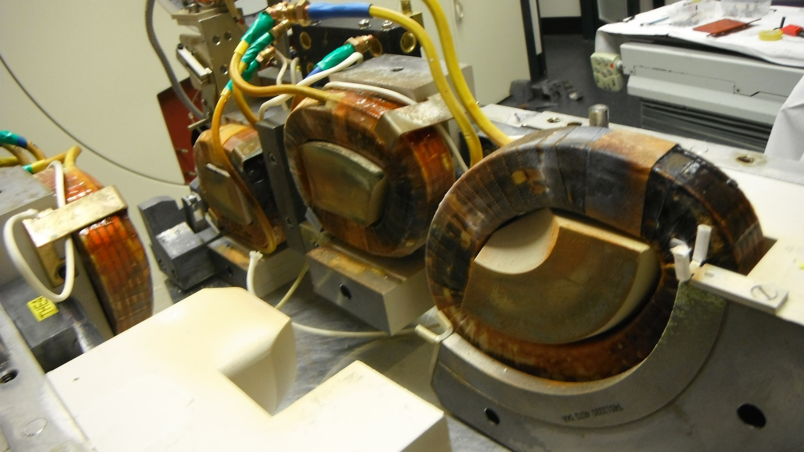
Insulation damage
Cables – particularly coax, triax
Magnet windings

Slide 17
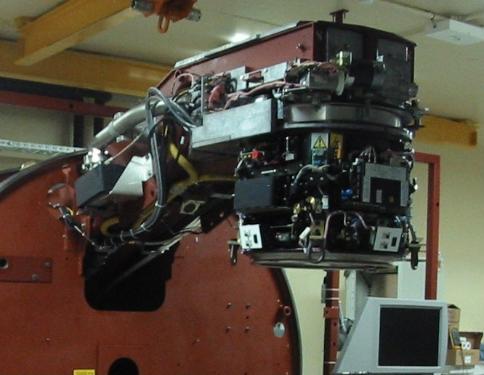
Neutrons from therapy treatment facilities
Therapy treatment heads have high Z materials
  Copper targets
  Tungsten collimators
  Steel filters
  Lead shielding
Neutron production
  Produced by high-energy photons and electrons incident on these components.
  Threshold X-ray and electron energies > 10 MeV, particularly > 18 MeV
  (γ,n) reaction cross sections (probability 10x (e,n) reactions)
  Bounce around until thermalise and are captured or decay.
  (n, γ), (n,p) reactions, activate linac head components, treatment table and patient.

Slide 18
Neutron damage to CCD devices
Due to their high sensitivity and signal-to-noise ratio, charge-coupled devices (CCDs) are widely used in CCTV cameras. However, a drawback is their extreme vulnerability to radiation.
While charged particle fields and photons, can create significant effects, neutrons are also effective due to their ability to produce knock-on charged particles and other nuclear interactions.
These effects include increased bulk dark current, surface dark current and inversion threshold voltage shifts. Results in increased pixel intensity.

Slide 19
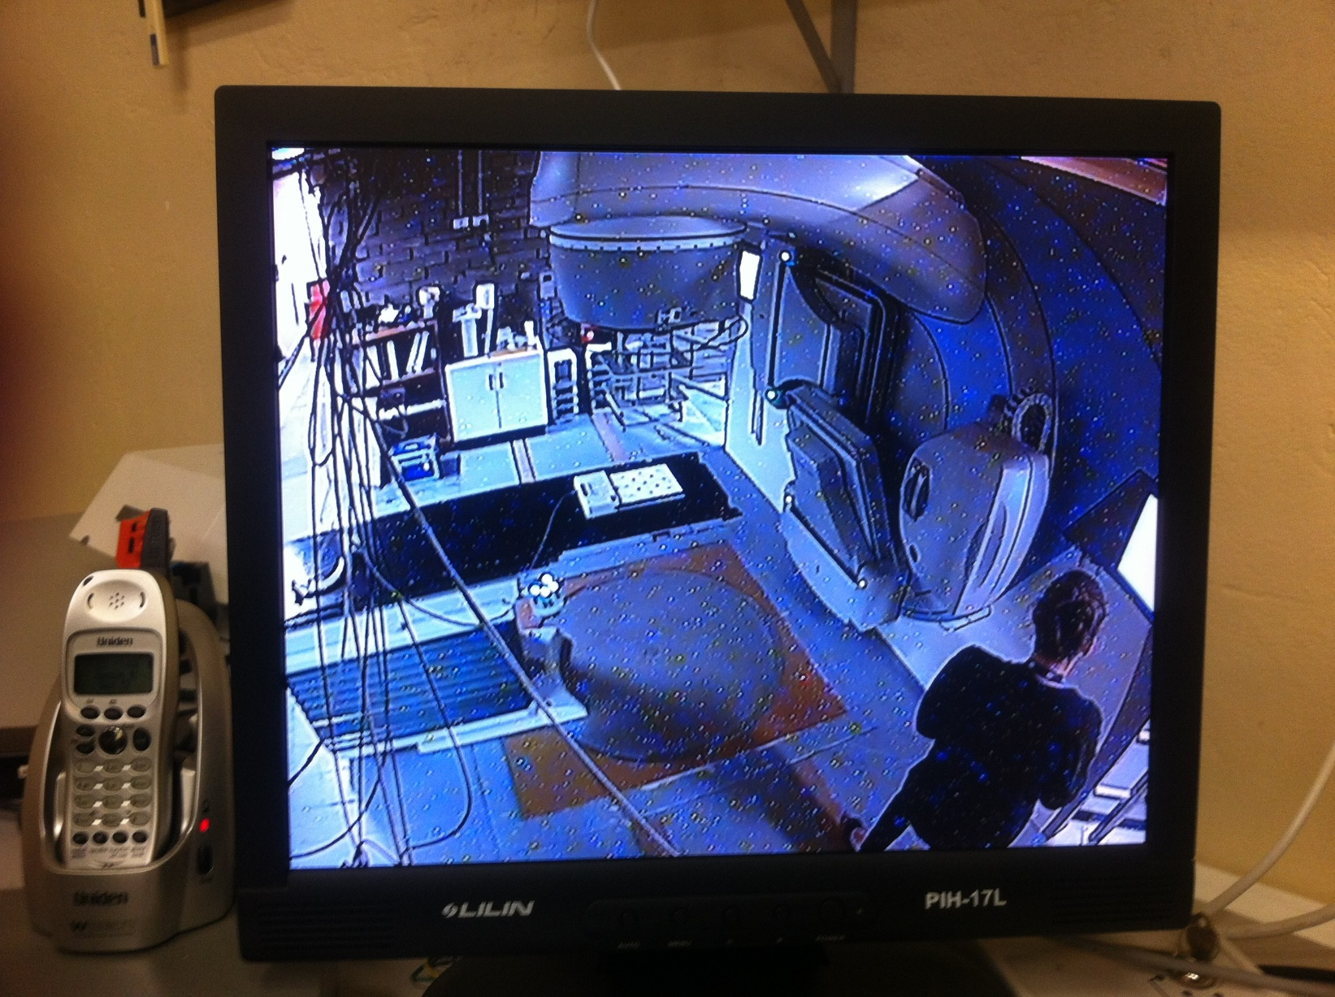
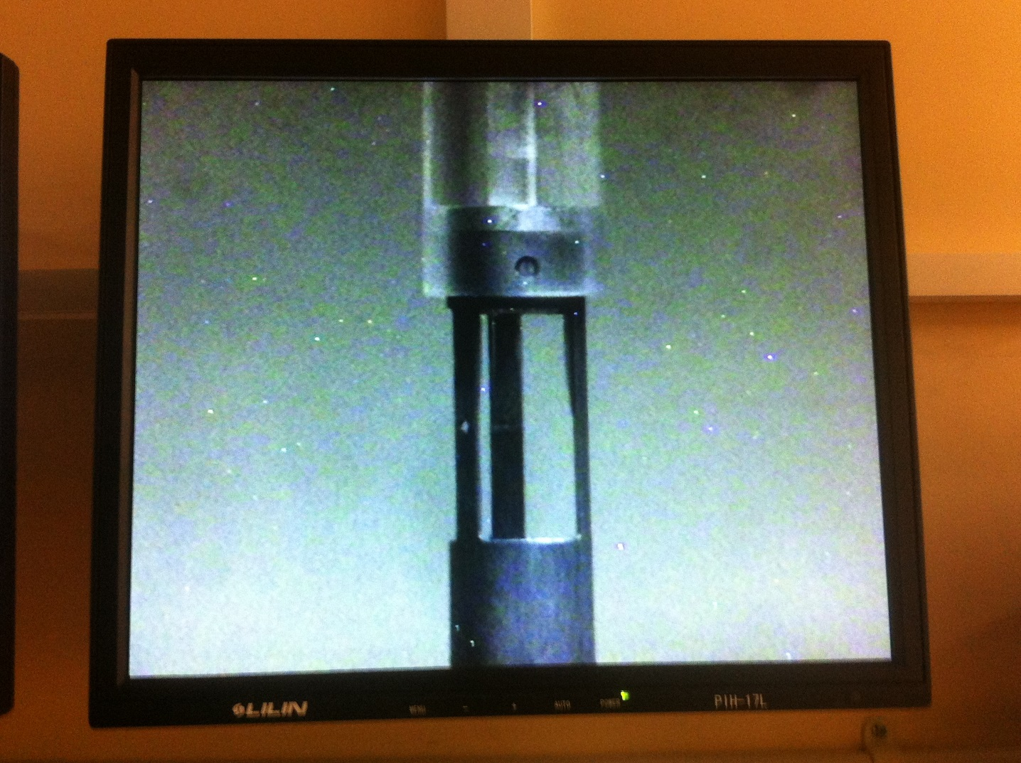
Neutron damage to CCD CCTV cameras

Slide 20
Neutron damage to CCD devices
Traditional mitigation can be by shielding or increased separation. The latter is difficult in scattered neutron fields which can persist for some time (neutron t_{1/2} ~ 10 minutes).
Techniques such as cooling and annealing are generally not feasible for commercial cameras.
Old technology such as Uvicon tubes are radiation resistant but less light sensitive (and usually black & white).

Slide 21
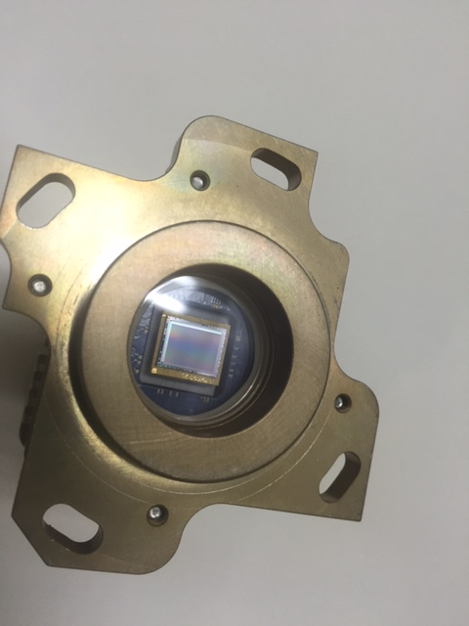
MLC alignment camera
Measures positioning of the leaves in a multi-leaf collimator
Uses Charge Injection Device (CID) technology
Less sensitive to radiation damage due to PMOS semiconductor structure (many CCDs use NMOS)
Differs from CCD in that charge is not transferred from a pixel on readout so readout is non-destructive
Peltier cooled to reduce dark currents
Failed after being in use for several years

Slide 22
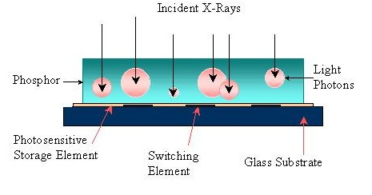
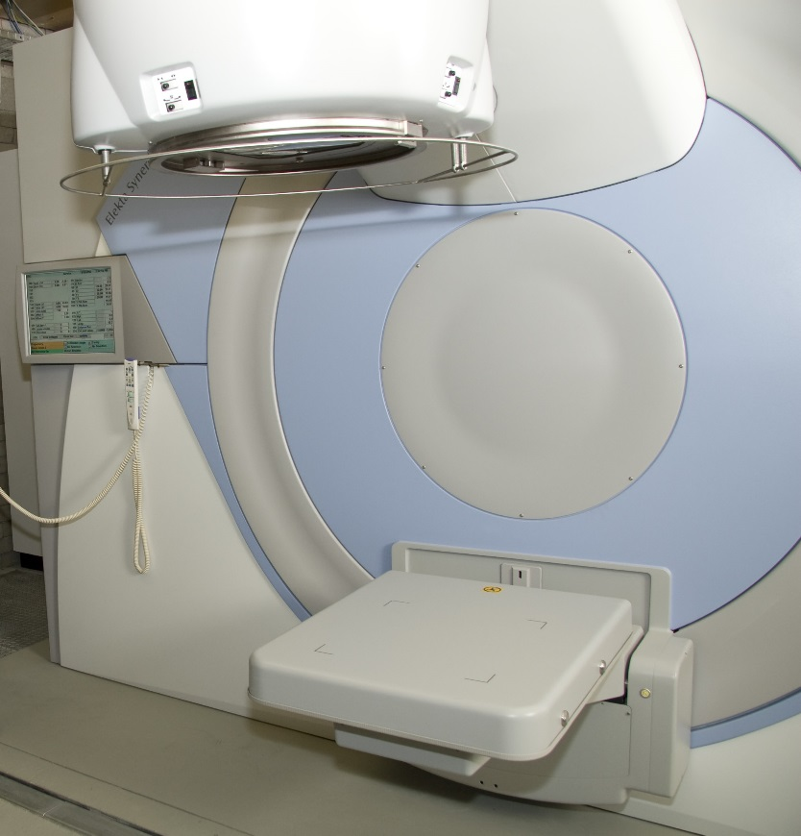
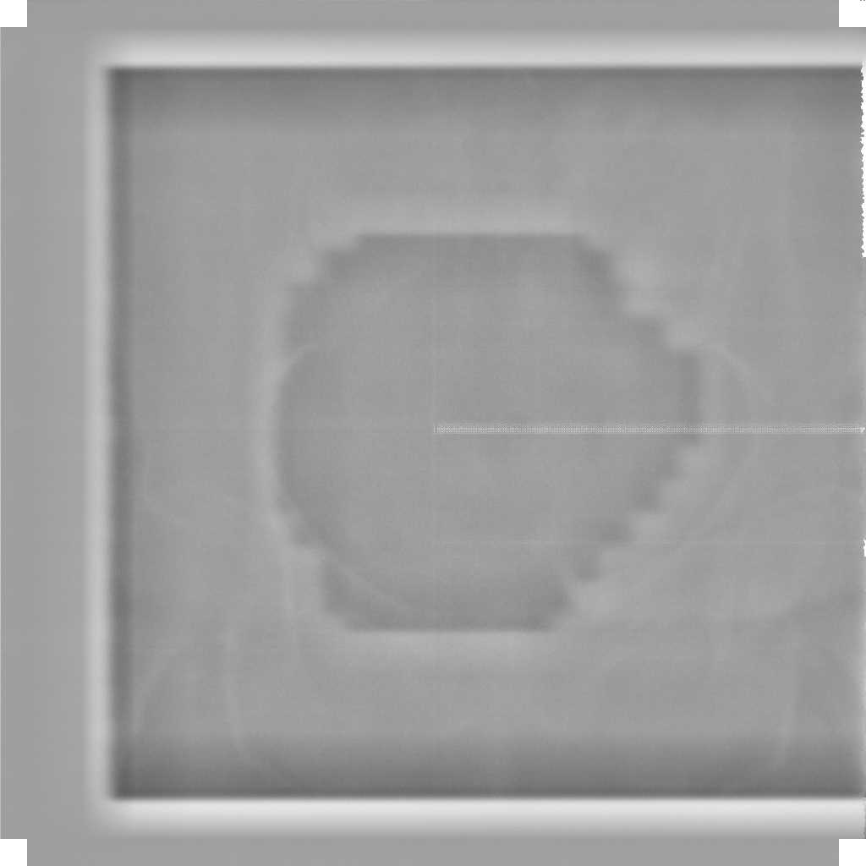
Amorphous Silicon portal imager
Artifact from damage to edge electronics

Slide 23
For instrumentation, radiation damage can be divided into electromagnetic and bulk damage components.
Ionizing radiation such as X-rays, gammas, electrons and protons, create free charge in materials which affects properties and performance.
Neutrons, protons, alphas and pions (hadrons) can also produce bulk damage.
Detectors are sensitive to both but bulk effects are often more important.

Slide 24
Total Ionizing Dose (TID)
Accumulated radiation exposures (poss. chronic) over time
  Control and detector components around particle accelerators can be exposed to up to 100 kilogray/year of absorbed dose (100 kGy = 10 Mrad)
  Absorbed dose is in the oxides/insulators
    Commercial integrated circuits can stand up to 100 Gy
    Bipolar integrated circuits have higher tolerance than CMOS
    Hardened circuits (SOI or SOS substrates) might withstand 10 kGy
  Device parameters will shift as a function of dose
  Parameter shifts are quasi-permanent

Slide 25
Semiconductor Detectors
Vulnerable to bulk damage due to large volumes and uniform crystalline structure (e.g. GeLi, HPGe)
Significant effect from heavy charged particles and neutrons
Normally minor effect from photons or electrons (minimum energy of 250 keV)
Common type is Frankel defect
  atom displaced to an interstitial site
  vacancy is a trapping site for charge carriers
Consequences are higher leakage current, degraded resolution

Slide 26
Radiation effects in electronics
Solid state electronics because of thin sensitive layers tend to be most sensitive to ionization and the associated accumulation of charge in the material.
Two mechanisms dominate
  Lattice displacement - neutrons, protons, alpha particles and high energy photons/electrons
    change arrangement of atoms in in the crystal lattice, create lasting damage and increase number of recombination centres
    Depletes minority carriers, worsens analog properties of junctions
  Ionization effects – primary and secondary charged particles down to low energies
    Usually transient, creates glitches and soft errors
    Can lead to destruction if other processes are triggered
    Can include photo-current effects from X-rays and UV

Slide 27
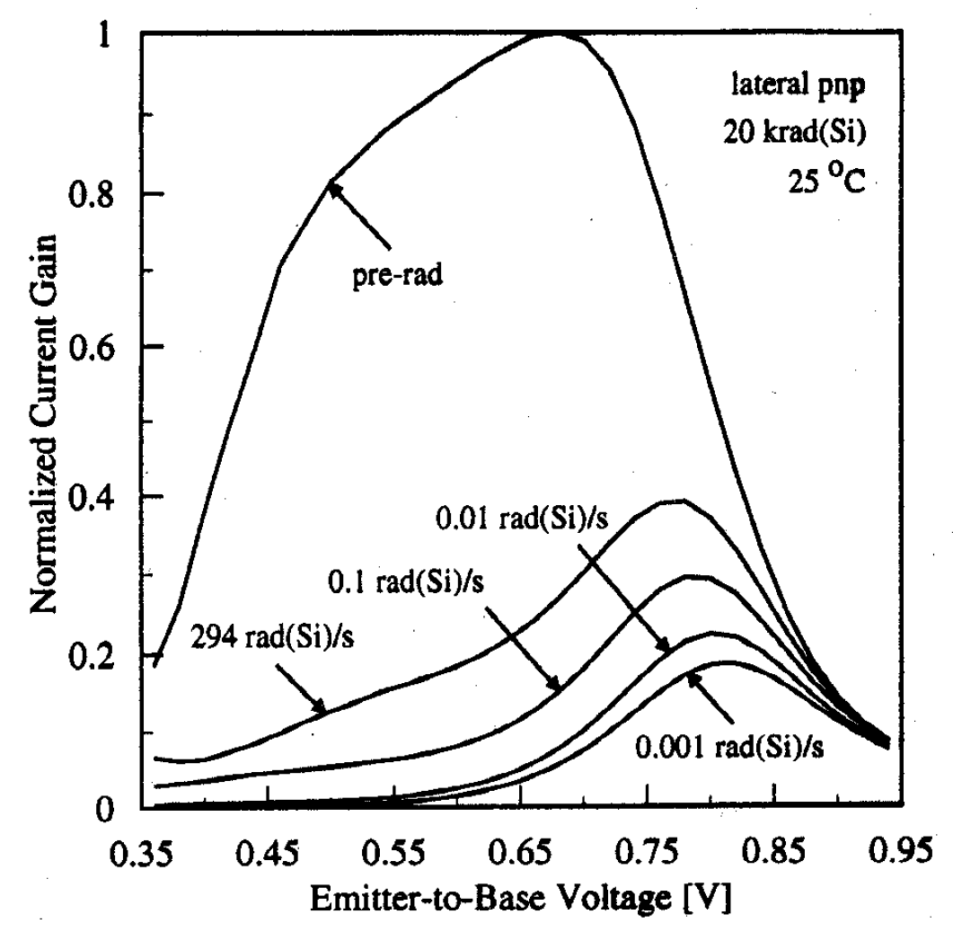
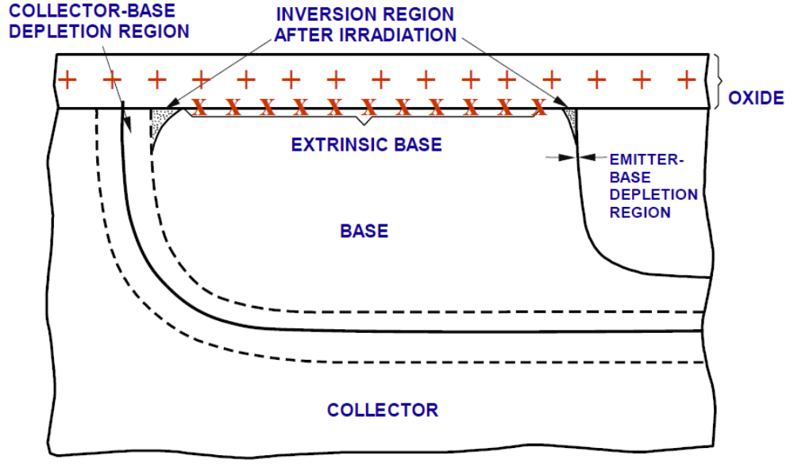
TID in Bipolar Transistors
(200 Gy)
Lowest DOSE RATE gives highest degradation
β = I_{c} /I_{b} ; I_{b}~ R_{surface}

Slide 28
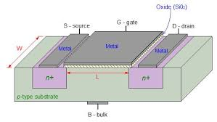
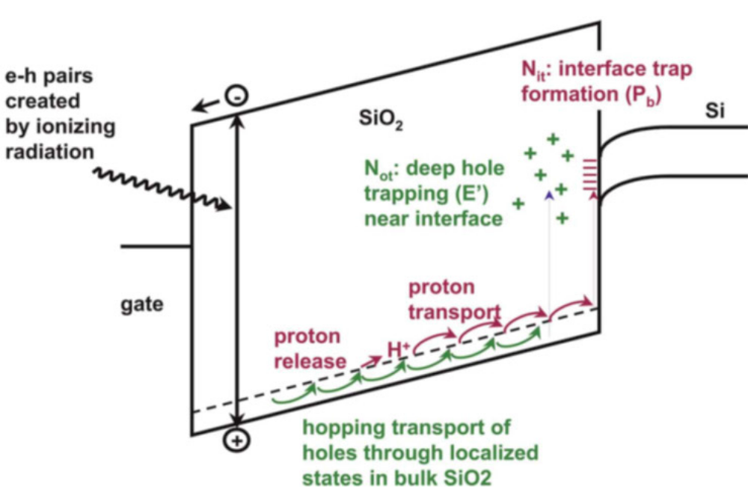
CMOS technology
Layered structure widely used in
modern high density electronics
Radiation creates electron-hole
pairs at the silicon oxide layer
that migrate at different rates.
Holes are trapped at the Si-SiO₂
interface to generate shifts in
operating thresholds.
PMOS and NMOS have different
damage behaviour – holes in PMOS
attracted to the gate rather than
the channel.

Slide 29
Micro-electronics
Single event effects dominate
Usually caused by high-energy particles leaving an ionized track behind.
Mostly affects only digital devices
  Upsets (SEU) – state changes in memory and register bits, often reversible
  Latchups (SEL) – CMOS devices, PNPN structures
  Transient electrostatic discharge (SET) – spurious signals
  Snapback – similar to SEL in N-channel MOS transistors - avalanches
  Burnout (SEB) – power MOSFETs
  Rupture (SEGR) – MOSFET gates

Slide 30
Mitigation by design
Physical
  Insulating substrates, e.g. Silicon on Insulator (SOI)
  Choice of wide band gap substrates, e.g. SiC or GaN - reduces sensitivity to deep-level defects, improves latchup tolerance.
  Bipolar ICs rather than CMOS
  Rewriteable, non-volatile memory, such as magneto-restive RAM
  SRAM rather DRAM
  Annular “edgeless” MOSFETS
  Buried isolation layers
Logical
  Memory error correction
  Redundancy at both circuit and system levels
Radiation hardened technology
  Can have higher costs
  Can impact performance

Slide 31
Evolution of technology
As the transistor feature size reduces, less charge required to cause state change
Single event effects become more significant
DRAM/SRAM particularly at risk
BUT
Scaling can also reduce dose deposited, increased tolerance
Over a decade DRAM/SRAM bit sensitivity has reduced by possibly 2 orders of magnitude correlated with technology node size (currently at 22 nm as defined by the ITRS)

Slide 32
What else?
Instrument environment
  Map scatter fields
  Monte Carlo modelling - which code?
    If photons/electrons – EGSnrc, Penelope, Geant4, MCNPX `
    If protons – Geant4/Topas, MCNPX, Fluka
    If neutrons – MCNPX, Fluka, MORSE, Geant4 (only for high energies)
      Good example: Roesler et al, SLAC-PUB-8490 (2000)
Shielding
  Choice of materials
  Geometry
Replacement program
  survival probabilities – difficult to assess, usually empirical
  Maintenance contract

Slide 33
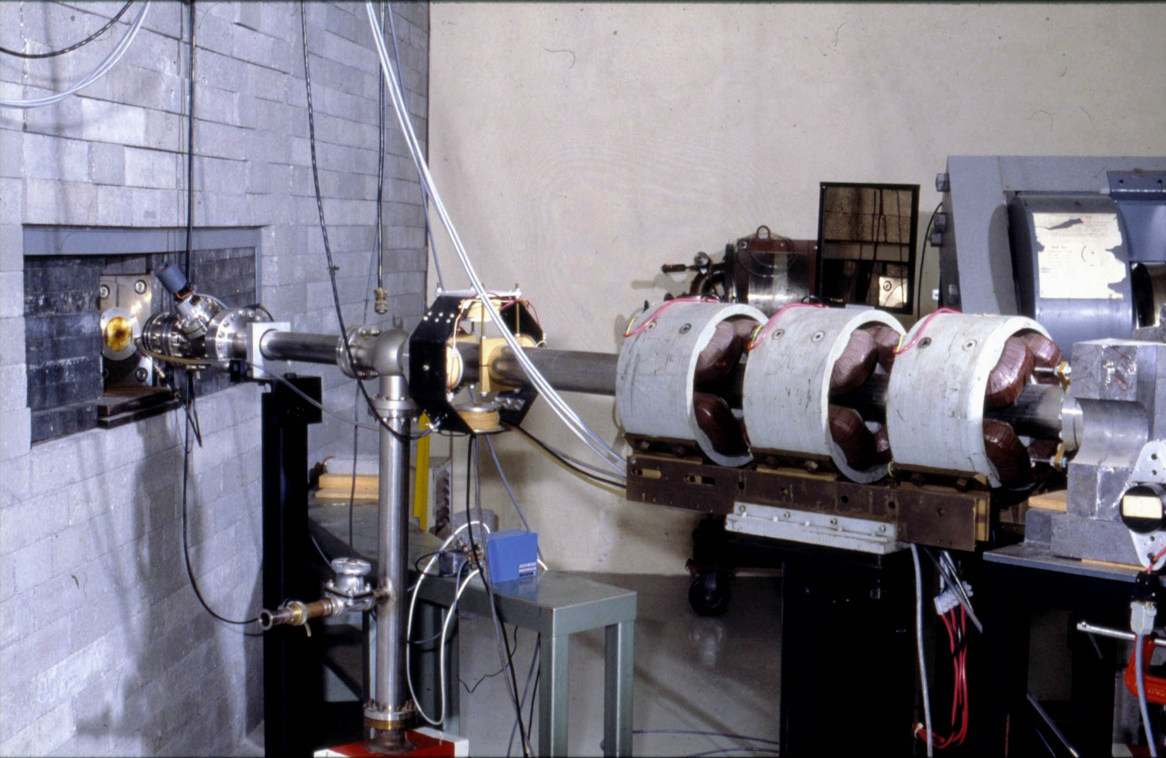
THANK YOU

Slide 34
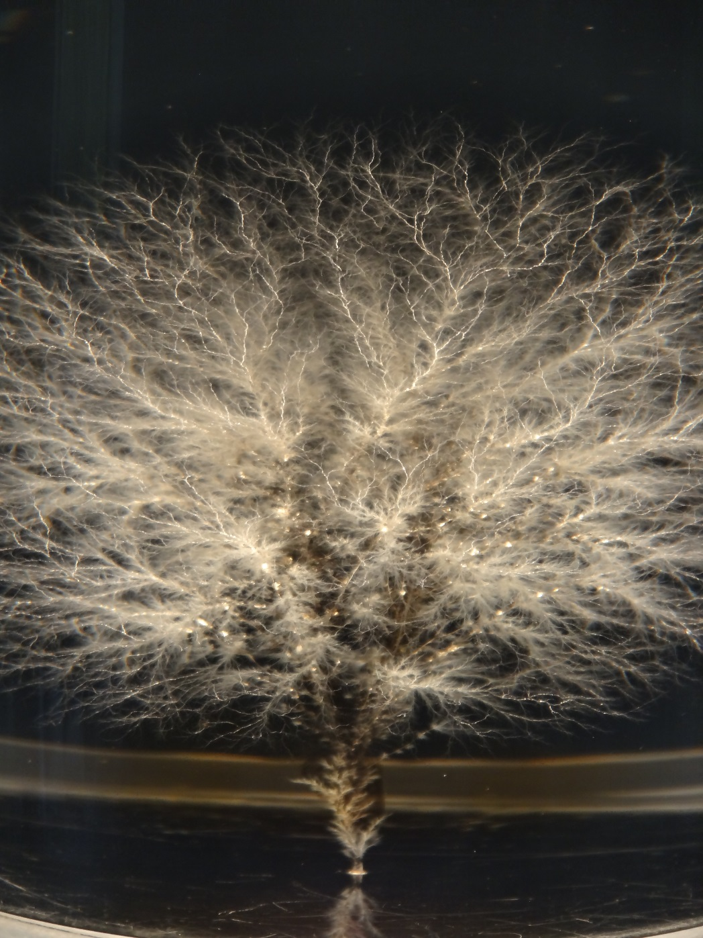
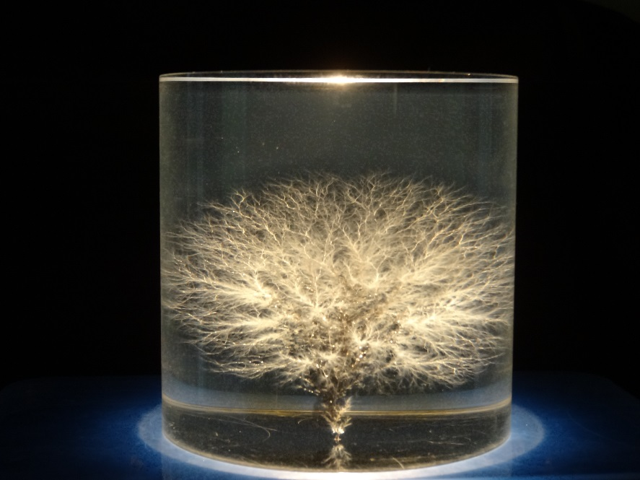
Discharge of stored electrons from an e-beam incident on PMMA
~7 cm

