Slide 1

Status of the Intra-bunch Feedback at J-PARC Main Ring
Takeshi Toyama
KEK / J-PARC
IBIC2015, Sep 12-17 2015, Melbourne Australia
Notes:
Thank you Mr. Chairman. Good afternoon, ladies and gentleman.
I will be talking about “Beam diagnostic system of the main ring synchrotron of J-PARC”.

Slide 2



Collaborators
Keigo Nakamura
Kyoto University
Makoto Tobiyama, Masashi Okada,
Yong Ho Chin, Takashi Obina, Tadashi Koseki
KEK
Yoshihiro Shobuda
JAEA
Notes:
Thank you Mr. Chairman. Good afternoon, ladies and gentleman.
I will be talking about “Beam diagnostic system of the main ring synchrotron of J-PARC”.

Slide 3
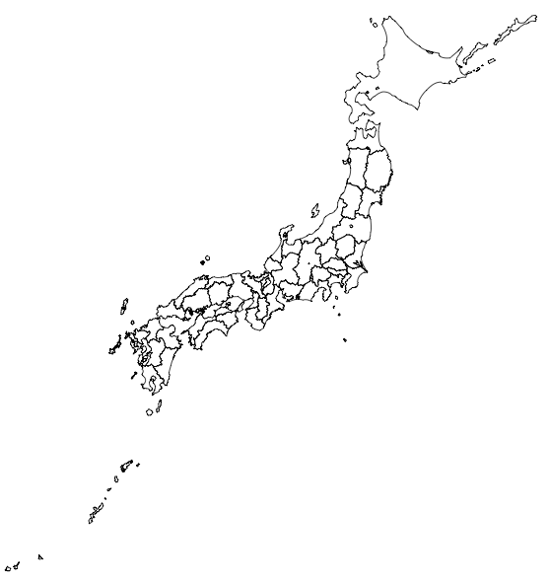
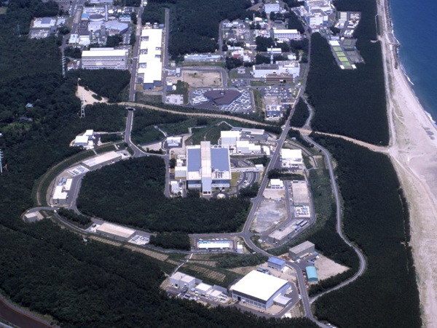
Japan Proton Accelerator Research Complex
Tokai, Ibaraki
295 km
Kamioka
LINAC
40mA
(50mA)
3 GeV RCS
500 kW
(1MW)
← operation
← one shot
ν detector
Kamioka
MLF
30 GeV MR
350kW
(750kW) ← goal
Hadron hall

Slide 4
Outline
Introduction
  Upgrade history of the J-PARC MR transverse feedback
Feedback during acceleration
  Timing slip
  Timing matching
  Initial result
Summary and prospect

Slide 5
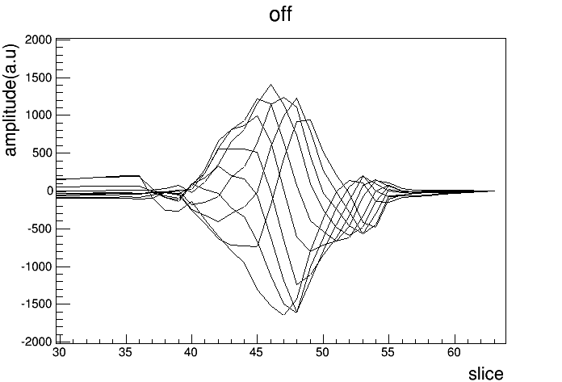
J-PARC MR parameters
Circumference 1567.5 m
Injection Energy 3 GeV
Extraction Energy 30 GeV
Revolution at injection 5.384us(185.7kHz) RF 1.67MHz
  at extraction 5.231us(191.2kHz) RF 1.72MHz
Harmonic number 9
Repetition time for fast extraction 2.5 s
At high beam power
Collective motion causes beam losses,
other than non-linear resonances (due to space charge).
Transverse oscillation
without FB

Slide 6
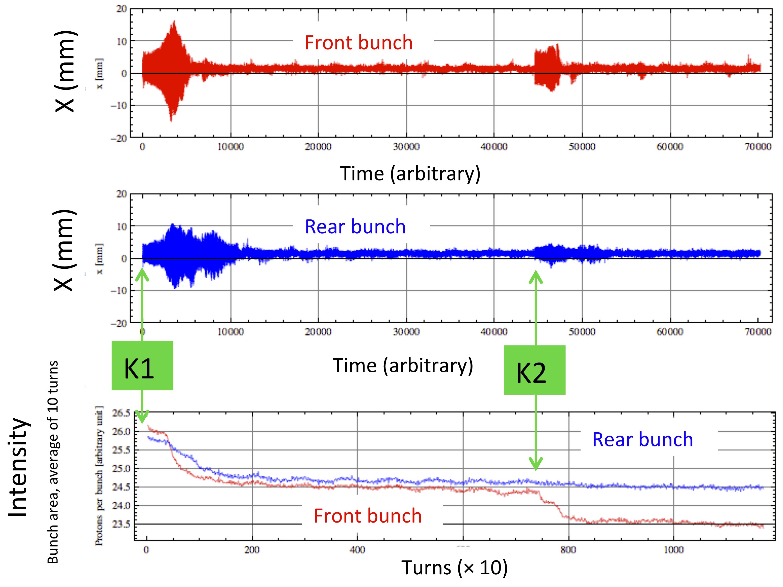
Two obstacles
(1) Injection error & succeeding collective motion
N_{B} ~ 1.67x10¹³ ppp
2 bunches
ξx ~ -7.5
ξy ~ -7.0
circulating beam is kicked by kicker pulse-tail & reflection
Injection from the RCS:

Slide 7
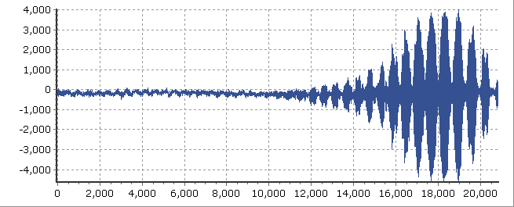

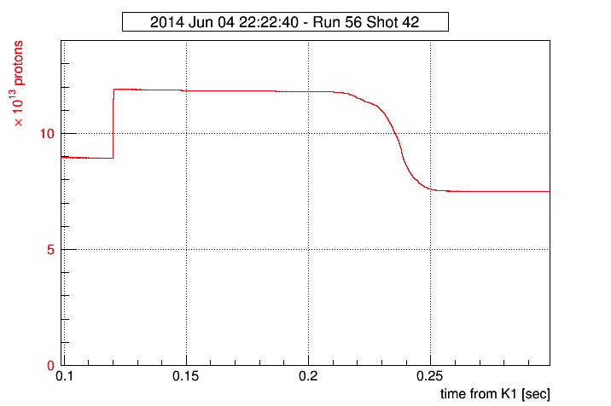
(2) Instability during acceleration
Vertical betatron oscillation amplitude
Instabilities has been observed at the beam
power 230kW, with chromaticity ξy=-0.3 .
We avoid this instabilities by tuning chromaticity
ξy=-3.2 .
turn
Observed bunch motion
DCCT output
acc. start
Keigo Nakamura, et al., IPAC2014, Dresden, Germany
Notes:
To increase intensity, the reduction of beam loss is very important.
One of the souce of loss is beam instabilities.
This shows intensity and betatron oscillation ampltitude observed in J-PARiC.
if instabilities occur, betatron amplitude grows and causes the beam loss. [*]
We avoid it by tuning chromaticity xiy=-0.3 to xiy=-3.2.
But large chromaticity also cause beam loss by resonance.
So, we have to suppress instabilities for small choromaicity by some way.
This is the delta signal during the instabilities.
you can see delta signal have internal bunch motion.
so, we think supresstion of internal motion will lead to reduction of beam loss.
----- 会議メモ (2014/06/14 18:43) -----
内部振動を抑える->ビームロスにつながる
----- 会議メモ (2014/06/16 14:39) -----
every 4 turns ploted

Slide 8
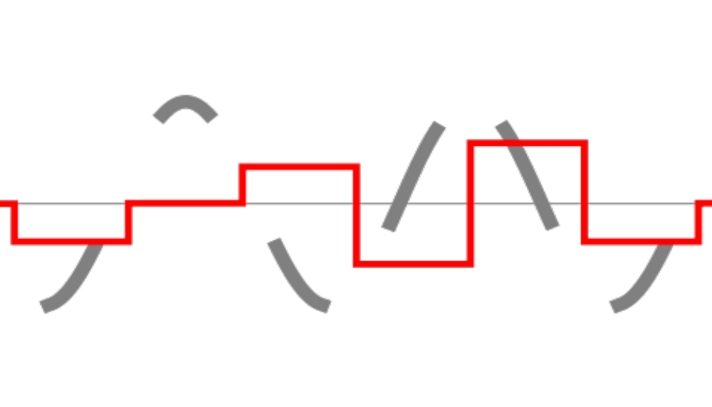
B x B feedback
Bunch-by-bunch (BxB) feedback
slice ~ 590 ns
Kick
Beam bunch

Slide 9
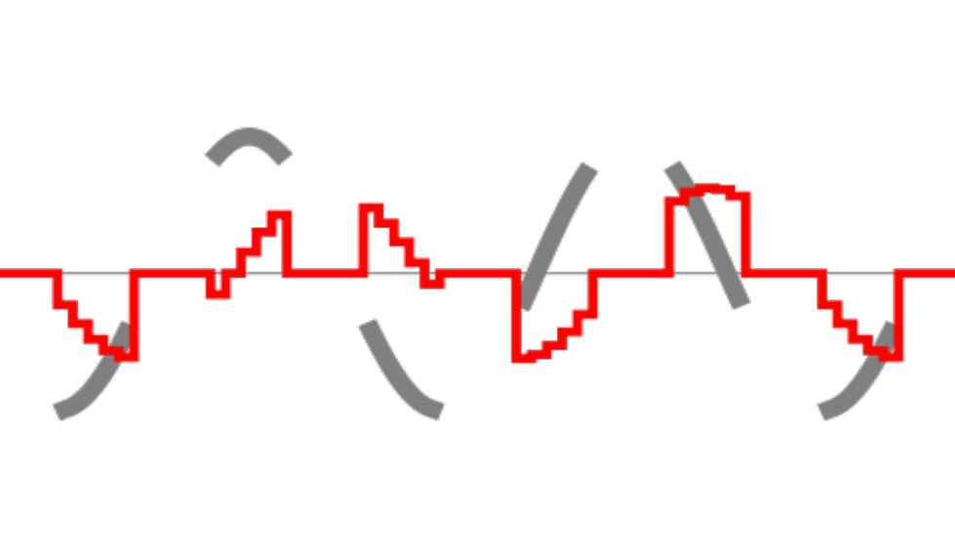
Intra-bunch feedback
Intra-bunch feedback
slice ~ 10 nsec
Kick
Beam bunch
FIR filter
in iGp12

Slide 10
Schematic view
For the horizontal (x) plane
X+
Stripline BPM
50Ω
Beam
Stripline kicker
X-
50Ω
oscilloscope
Attenuator
Hybrid
100KHz-200MHz
ADC+
iGp12
DAC-
ADC-
DAC+
Power Amp.
100KHz-100MHz
DC offset
x2
clock
RF clock
x64
revolution
injection timing
revolution clk
trig. for timing table
Same as the vertical (y) plane
Notes:
装置の図、写真

Slide 11
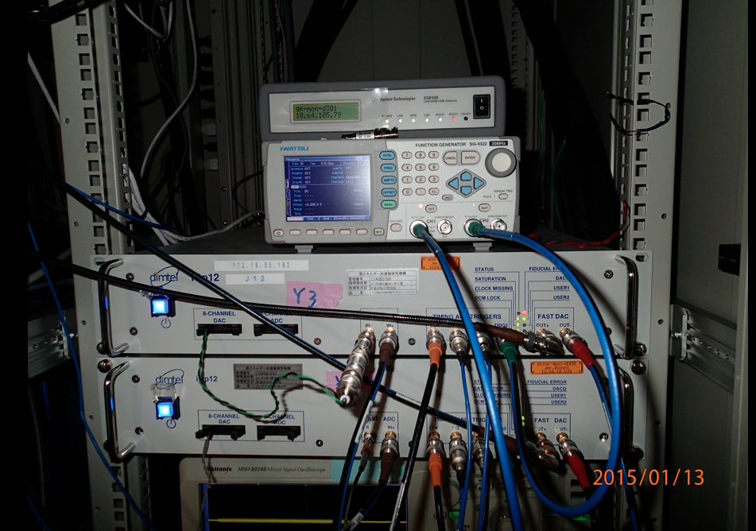
Trigger
for timing table
iGp12 for y
iGp12 for x

Slide 12
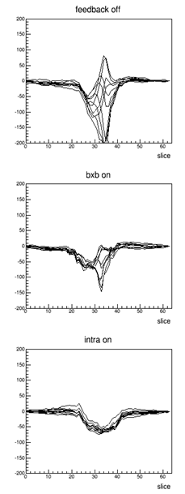
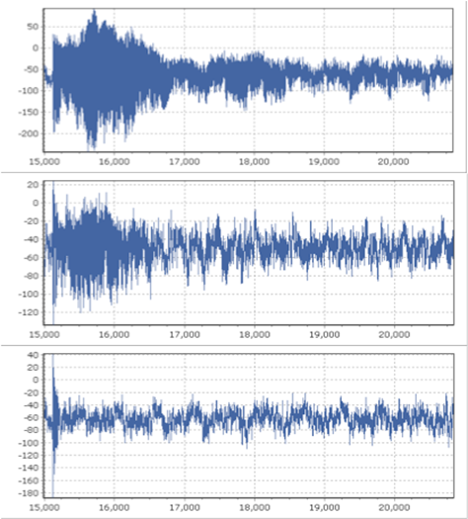
3 GeV injection flat bottom
Bunch signal every 5 turns
Oscillation of one bunch slice
Without FB
Without FB
BxB on
BxB FB on
+ intra-B on
+ intra-bunch FB on

Slide 13
Timing slip
Parameters are changing during acceleration upto 30 GeV
Δφ_{B}(t) beam transit time
Beam
Acc. RF cavity
BPM
Tr. kicker
φ_{syn}(t) synchronous phase
RF AMP
RF AMP
length:
ℓ
ℓ'
RF CNTL
iGp12
ℓ"
Observing
the beam and
the RF kick
simultaneously
f_{RF} (t)
Oscillator

Slide 14
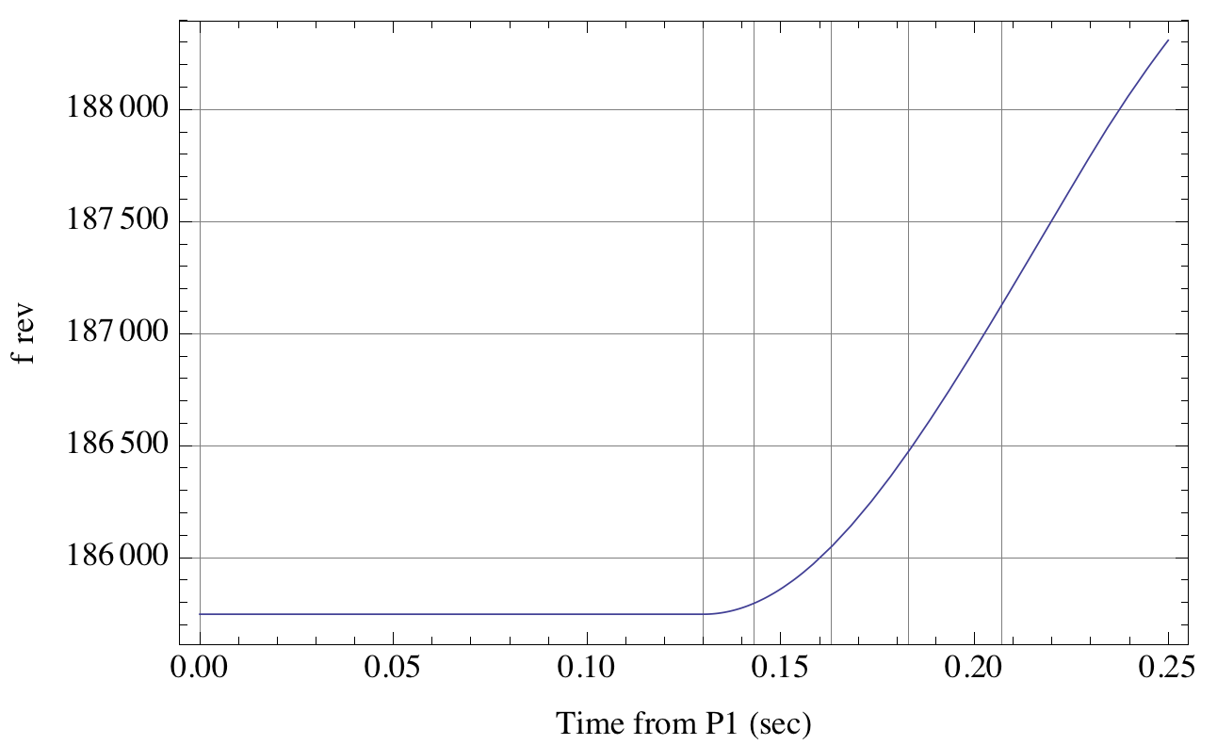
Example of revolution frequency
f_{rev} = 185.7kHz → 191.2kHz

Slide 15
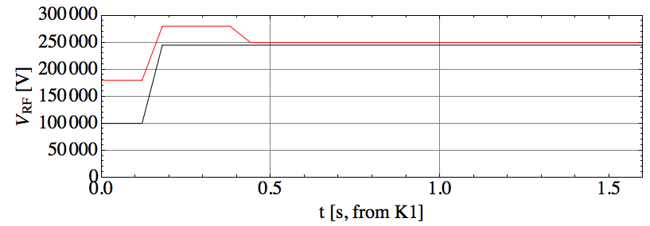
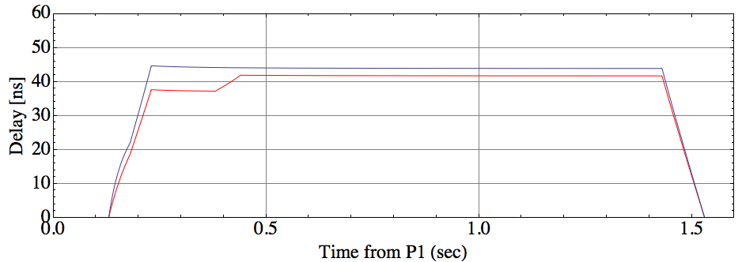
Example of synchronous phase
Subject to change depending on the beam tuning
Synchronous phase
We need rapid parameter optimization

Slide 16
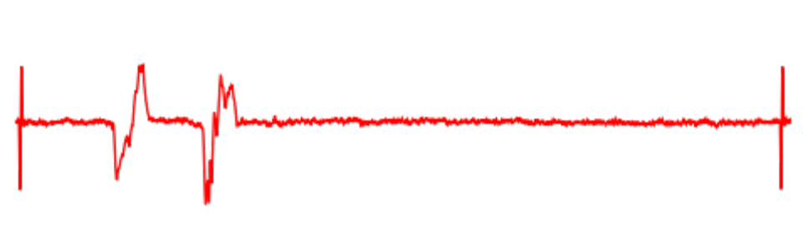
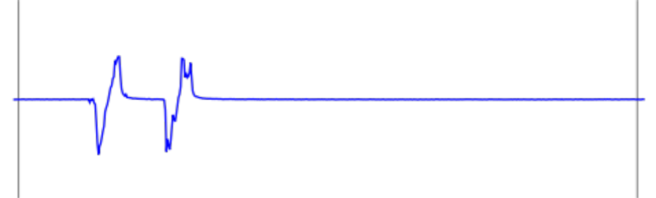
Sampled by iGp12 ← Compare → signals on the stripline kicker
Δφ_{B}(t) beam transit time
Beam
Beam
Acc. RF cavity
BPM
Tr. kicker
Stripline kicker = directional coupler
can observe
beam signal
RF power from the feedback system
φ_{syn}(t) synchronous phase
RF AMP
RF AMP
length:
ℓ
ℓ'
marker
@slice#5
marker
@slice#570
RF CNTL
iGp12
ℓ"
Σ –signal of stripline kicker
f_{RF} (t)
Oscillator
Sampled signal @iGp12
slice#5
slice#570

Slide 17

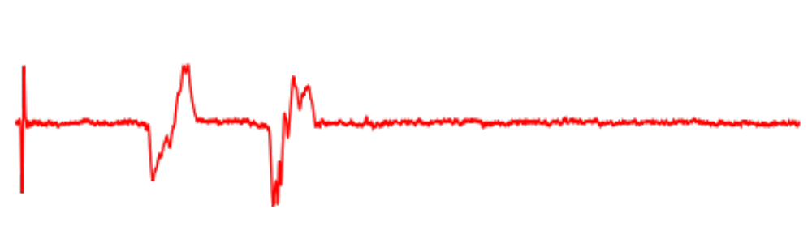
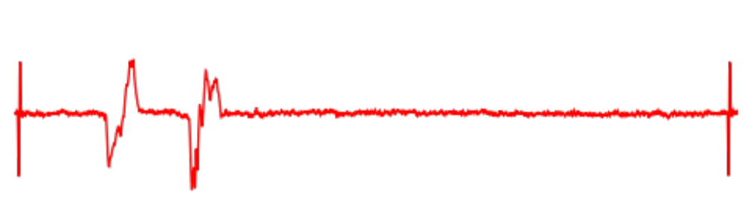
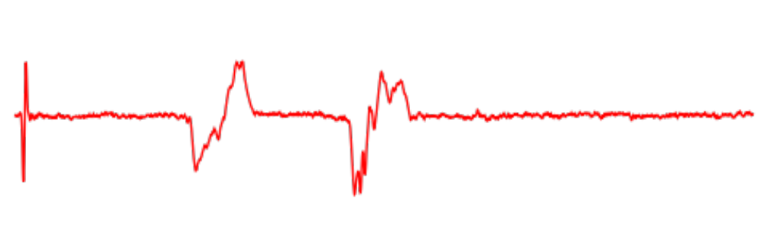
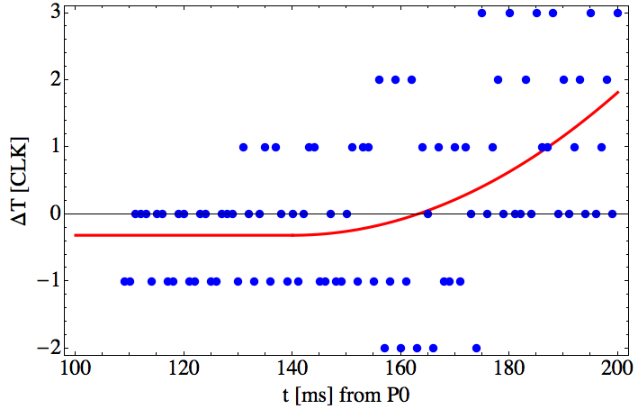
Unit in oscilloscope (kicker) = time (sec)
Referencing the marker #5, 570
scaling and shift
Unit in iGp12
RF CLK x 64
Finally superpose the beam signal by shifting horizontally
the amount of shift = the delay time that we want
Acceleration

Slide 18
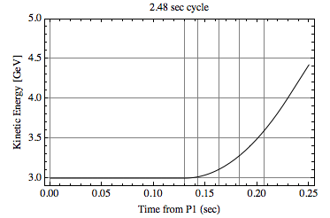
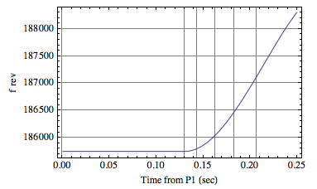
Timing CNTL by preset table
STATE 1 2 3 4 5 . . . . .
External trigger initiates each "STATE"
STATE specifies the delay, filter gain, phase, # of tap
a function of "iGp12"

Slide 19
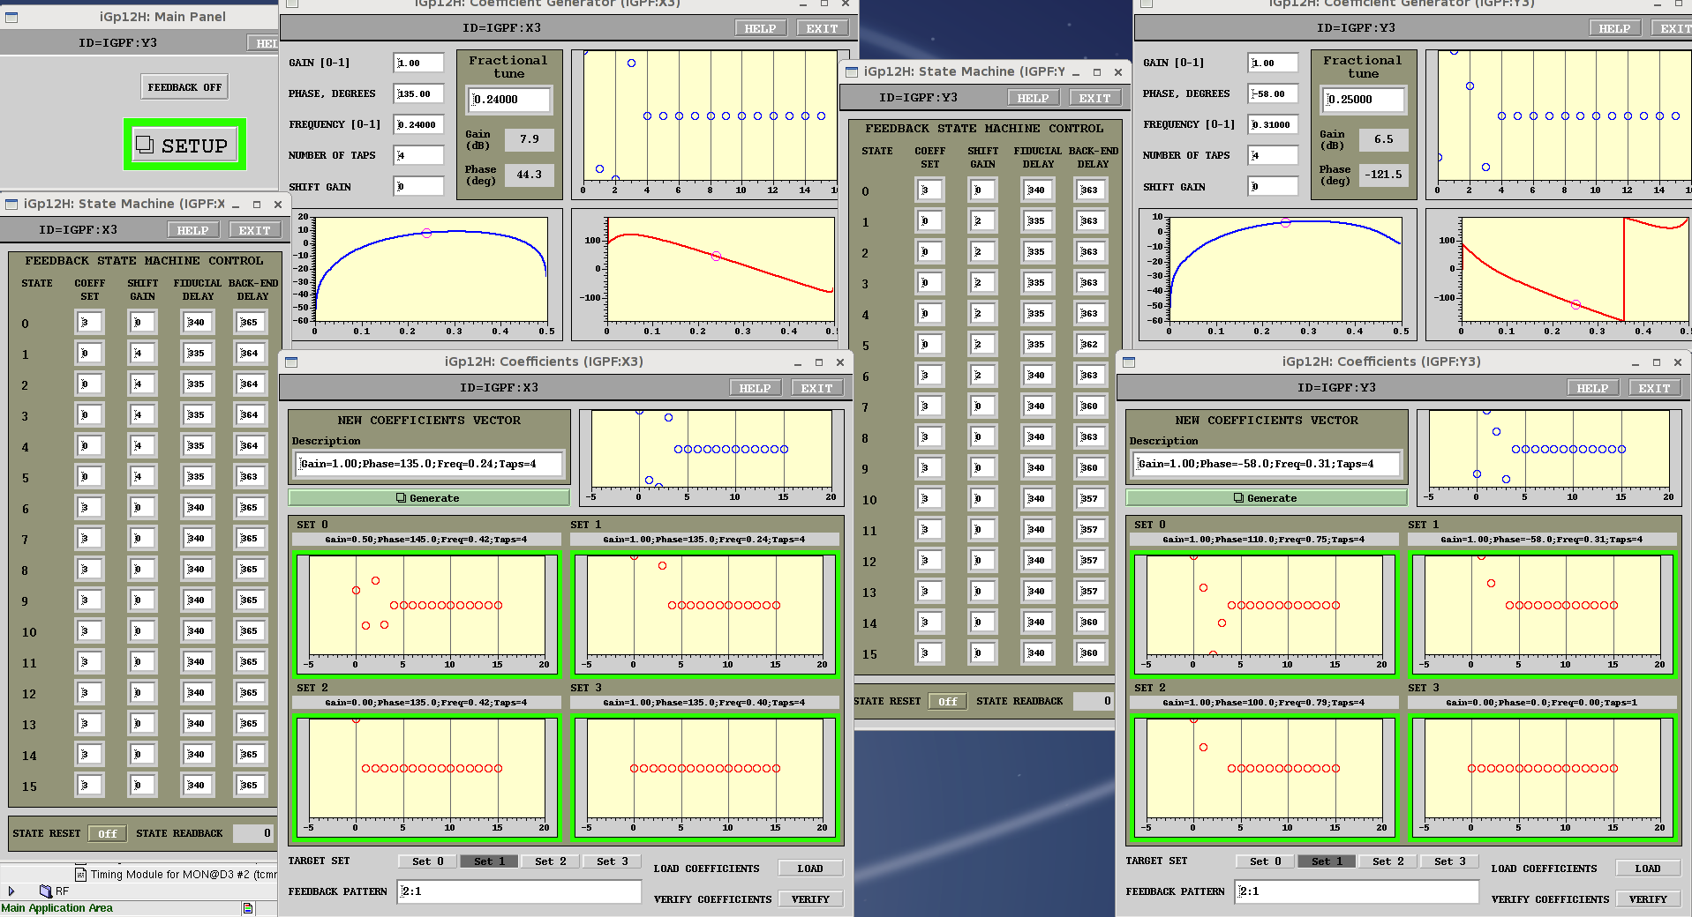
iGp12 parameter settings
X
Y
Injection flat bottom
Injection flat bottom
FIR filter parameters
This trial
Acceleration
FIR filter parameters
This trial
Acceleration

Slide 20
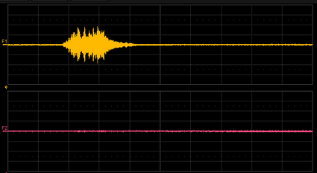
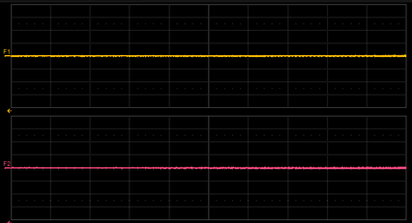
2015. 7. 1
2 bunches, ~80kW, ~4.2x10¹³ p
STATE
1
STATE
2
STATE
3
STATE
4
STATE
5
STATE
. . .
Δｘ
BEFORE
shot513300
Δｙ
ξx ~ -5.9
ξy ~ -5.2
20 ms/div
P1+100ms
P2
Acceleration
Δｘ
AFTER
shot513301
Stabilized
only by switching on
STATE 2
Δｙ

Slide 21
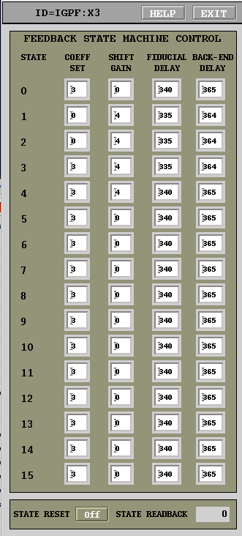
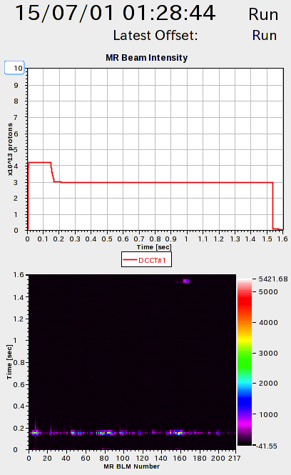
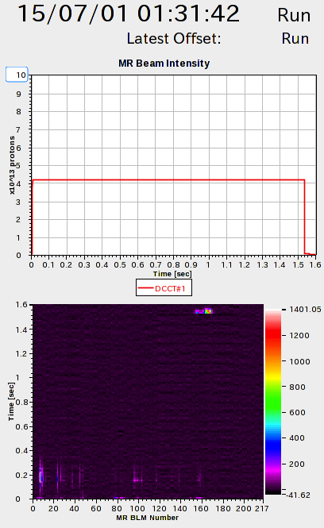
BEFORE
shot513300
AFTER
shot513301
Beam Intensity
Beam Intensity
Beam Loss
Beam Loss

Slide 22
Summary
Transverse intra-bunch feedback during acceleration period
was successful upto P2 + ~80 ms.
・ Horizontal instability at the beginning of acceleration
was suppressed.
・ Stable parameters (delay, gain, frequency) are obtained
Further parameter optimization for further accel. period
Stability check both with experiments and simulations
Contribute high beam intensity upgrade
Prospect

