Slide 1



Direct Observation of Ultralow Vertical Emittance Using a Vertical Undulator
Kent P. Wootton
The University of Melbourne
Notes:
Thank-you very much. Firstly, I would like to acknowledge and thank the Program Committee for inviting me to speak to you about our vertical emittance measurements using a vertical undulator.
In this talk, I plan to:
Put the present work in context
Describe techniques used at AS, summarising results of measurements
Discuss some of the counter-intuitive aspects

Slide 2
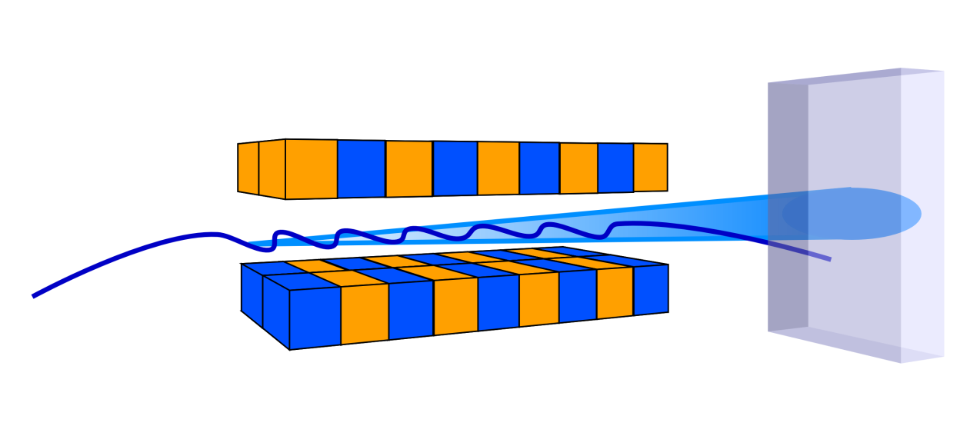
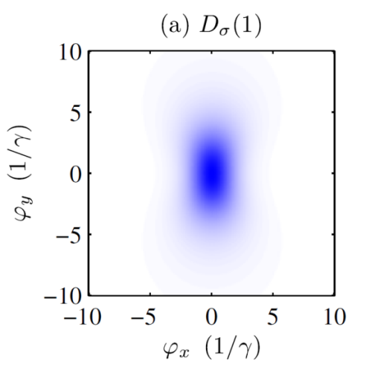
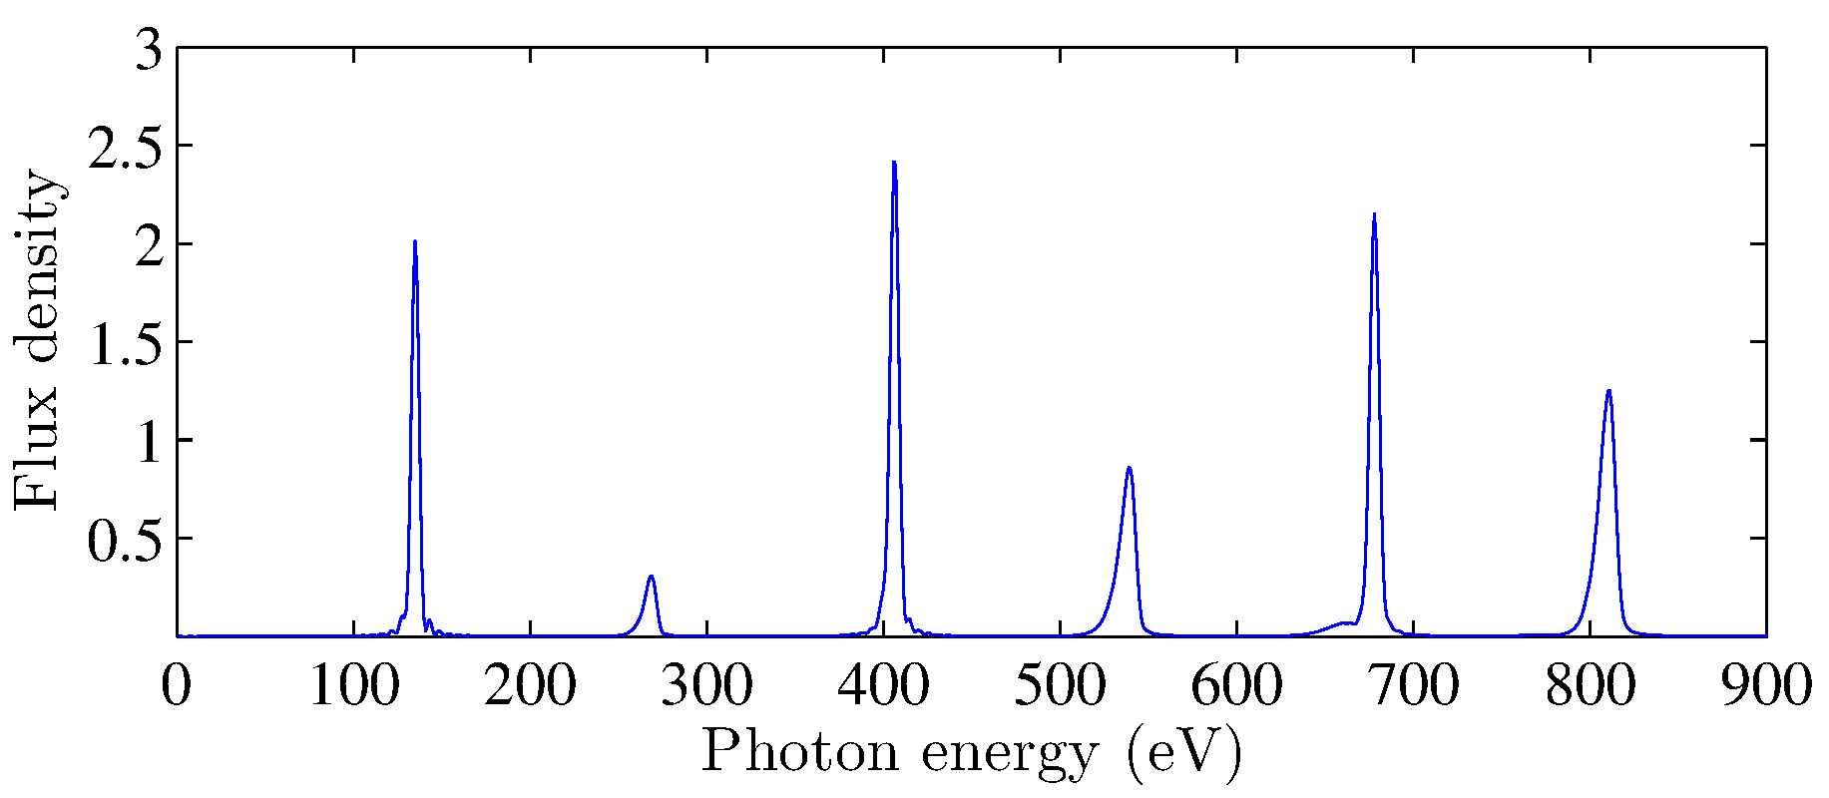
Undulator radiation – horizontal
Wootton, et al., PRSTAB 17, 112802 (2014)
Notes:
Imagine a planar undulator in an electron storage ring, producing undulator radiation.
Plotted here is the radiation spectrum passing a pinhole, from a linear polarised undulator. Basically the brilliance.
Usually think of undulator radiation as bright odd harmonics, and null even harmonics.
If we look at the first harmonic, shown here is the angular distribution of radiation for the first harmonic, in units of 1/(Lorentz factor).
Relatively large distribution. Using the first harmonic limits the minimum electron beam emittance we can deconvolve from a measured photon distribution.

Slide 3
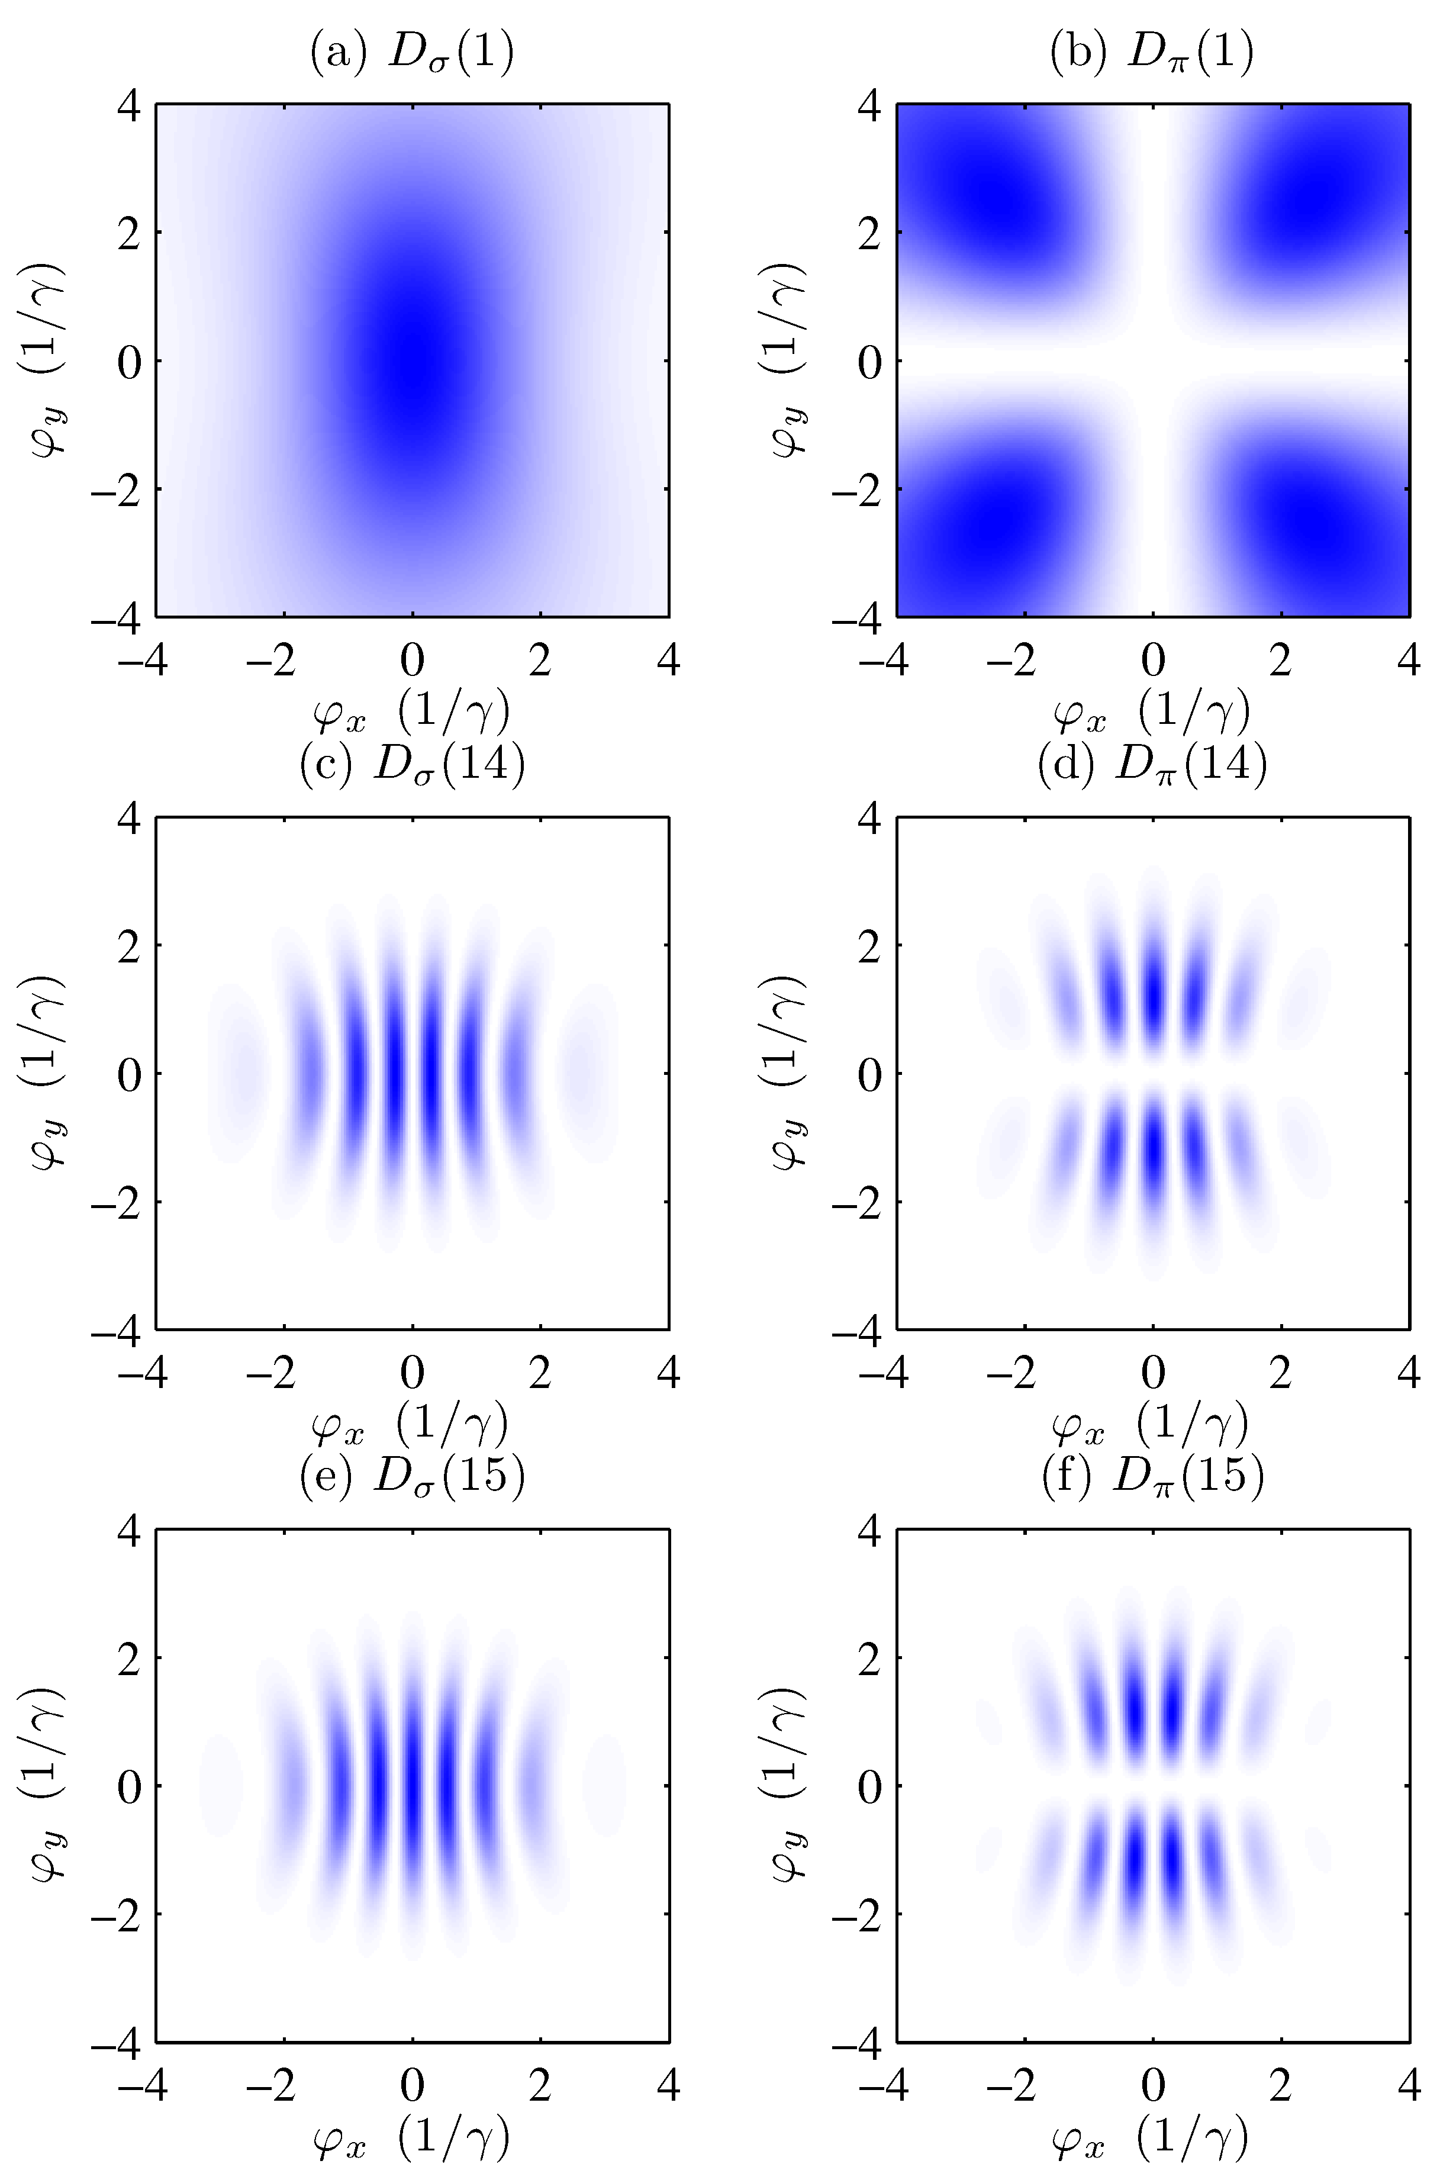
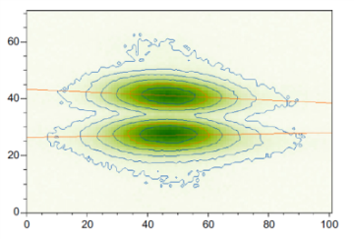
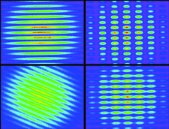
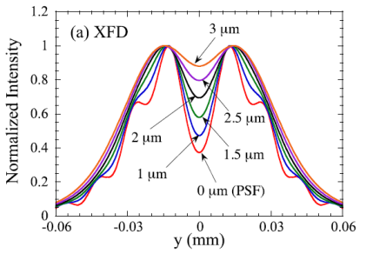
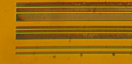
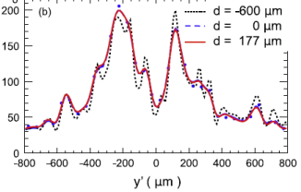
Undulator radiation – horizontal
Andersson, NIMA 591, 437-446 (2008)
Masaki DIPAC01, PS17 (2001)
Wootton, et al., PRSTAB 17, 112802 (2014)
Masaki PRSTAB 18, 042802 (2015)
Alexander, NIMA 748, 96 (2014)
Notes:
Picture is different at high undulator harmonics. Plotted here is the angular distribution of undulator radiation from a horizontal undulator for 14th and 15th harmonics. Fine structure of narrow interference pattern, with minima on axis for even harmonics, and maxima on axis for odd harmonics.
Similar to several other emittance diagnostics where the electron beam distribution is convolved with a narrow interferometric distribution.
Pi-polarisation technique
Synchrotron radiation interferometery
X-ray Fresnel diffraction
Coded aperture
This distribution for horizontal undulator (electron beam wiggled horizontally). Can imagine that if the electron beam were wiggled vertically, the distribution is rotated, and could be used to measure vertical emittance.

Slide 4
Motivation
  Calibration of a vertical undulator for direct measurement of pm rad vertical emittance in a storage ring
  Previous experiments, simulations show undulator radiation sensitive to pm rad emittance
  Upcoming DLSRs, also pm rad horizontal emittances
Notes:
The motivation of this work was the direct measurement of pm rad vertical emittances.
We know from previous experiments and simulations that undulator radiation very sensitive to pm rad emittance.
Could also be very relevant for upcoming diffraction-limited storage rings.

Slide 5
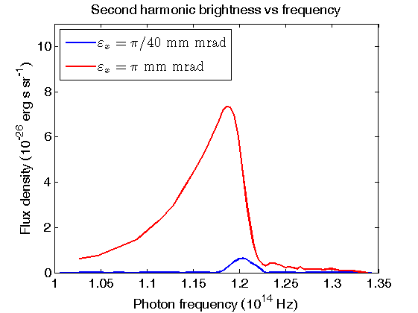
Undulator spectra and emittance
‘It is evident that the second-harmonic brightness is proportional to the beam emittance …’
  Dattoli PRE 52, 6809-17 (1995)
Where does this emittance dependence come from?
Dattoli PRE 52, 6809-17 (1995)
Notes:
To put the current work in context, it has long been known that even harmonic brightness proportional to beam emittance.
Where does this emittance dependence in the spectrum come from?

Slide 6
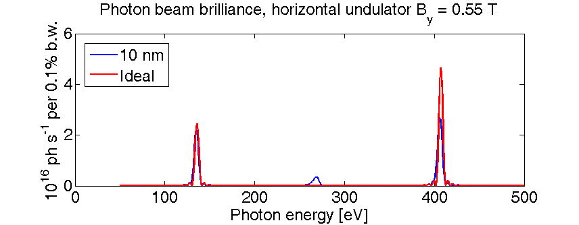
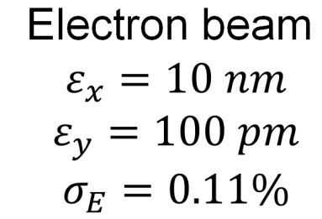
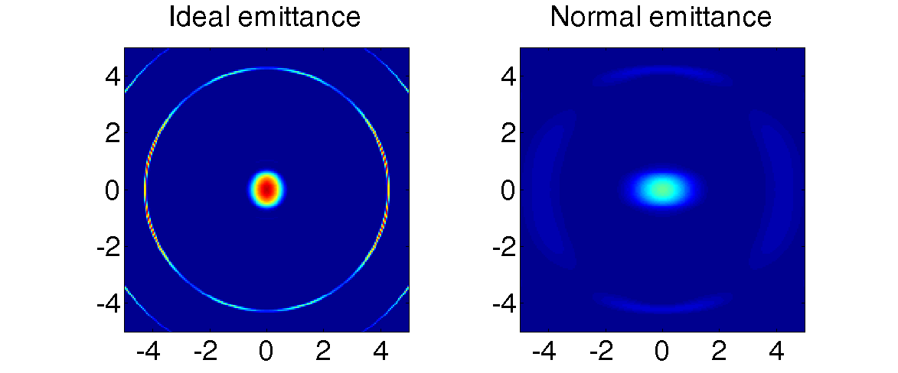
Undulator beam projection
Horizontal Undulator
25 periods
75 mm period
K = 3.85
Pinhole
50 x 50 um
15m distance
How do we measure photon beam brilliance?
Tanaka & Kitamura, JSR 8 1221 (2001)
Notes:
Need to also look at the angular distribution of undulator radiation.
Plotted here are simulations of radiation angular distribution for the 3rd harmonic from a horizontal planar undulator for a filament electron beam, and for an electron beam with realistic emittances. Convolving the angular distribution of radiation with the electron beam angular distribution has the effect of smearing out the distribution, which changes the brilliance of the spectrum.

Slide 7
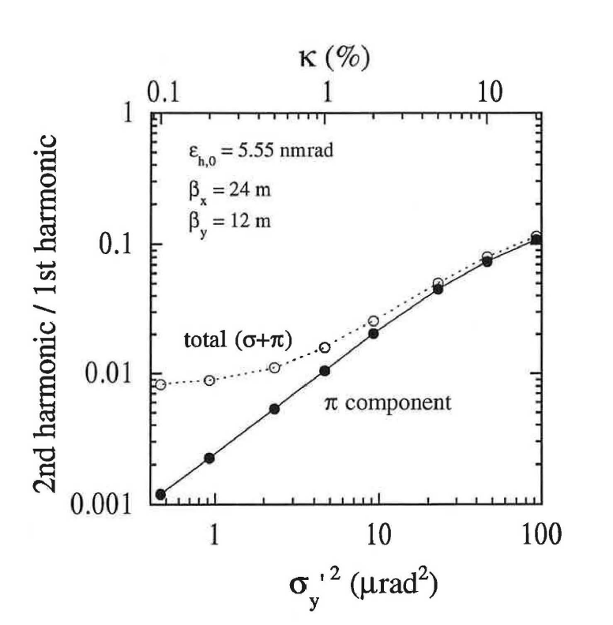
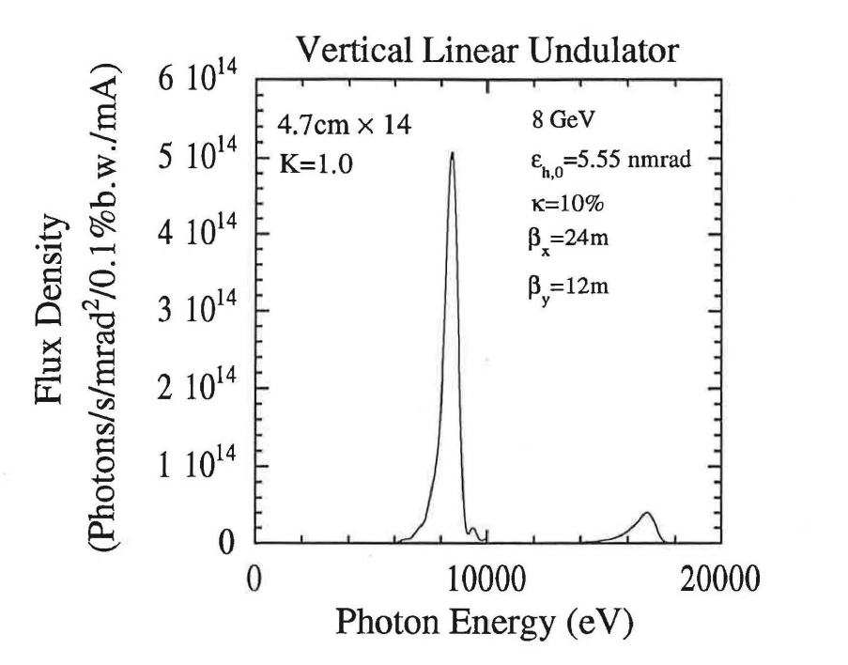
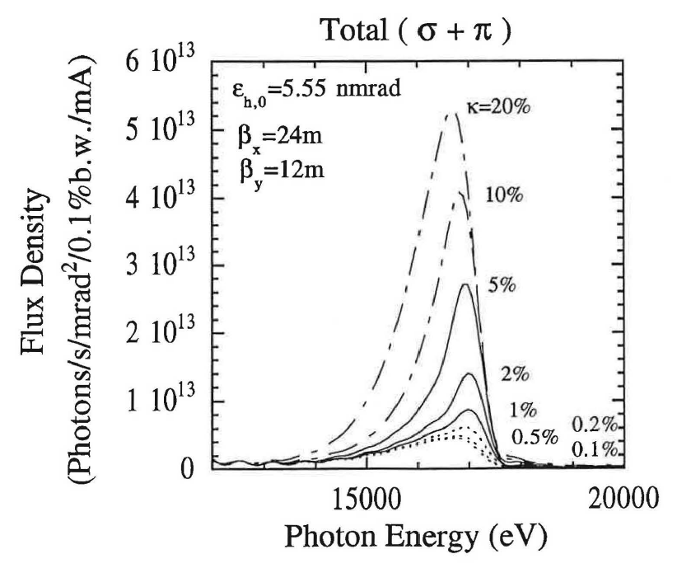
Vertical undulator diagnostic
F₂ / F₁
First simulations S. Takano, 1997
F₁
F₂
Takano, KEK Proc. 97-20, p. 18 (1997)
Notes:
The idea to use a vertical undulator to measure vertical emittance was first proposed by Shiro Takano in 1997. Simulations of the spectrum of undulator radiation for a short (1 m) vertical undulator in the SPring-8 storage ring were presented.
The first plot illustrates the brilliance of vertical undulator radiation, for the first and second harmonics. We see an intense odd harmonic, and a dim second harmonic.
If we zoom in on this second harmonic, the second plot shows that the brilliance of the second harmonic is directly dependent upon the vertical emittance, plotted here as a ratio of the horizontal emittance. So the intensity of the even harmonic can be used to measure the vertical emittance.
But it is difficult to make an absolute measurement of brilliance.
The trick is to measure the ratio of the peak height of the dim even harmonic, to the bright odd harmonic (F₂/F₁), which is much easier.

Slide 8
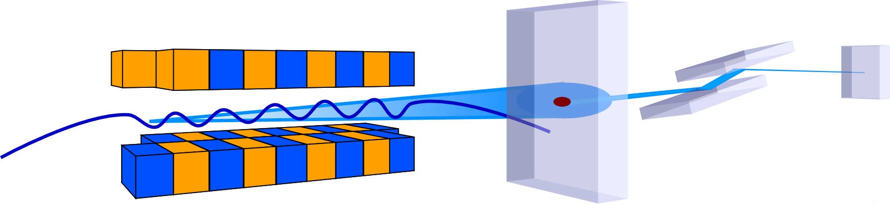
Vertical undulator diagnostic
undulator pinhole monochromator photodiode
Very similar to:
Bahrdt, et al., PRL 111, 034801 (2013)
Wootton, et al., PRSTAB 17, 112802 (2014)
Notes:
So we can imagine an experimental layout to measure vertical emittance.
Vertical undulator, pinhole, monochromator, and photodiode.
Very similar arrangement to work characterising vortices created by a pair of APPLE-II undulators.

Slide 9
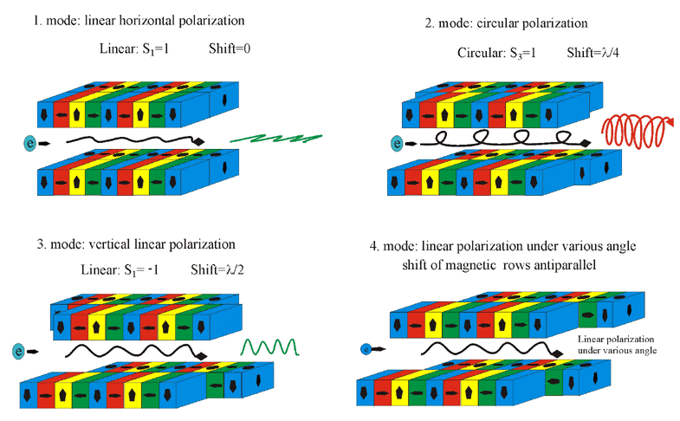
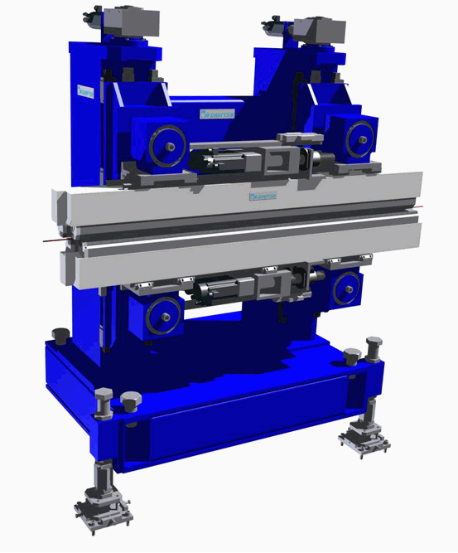
Advanced Planar Polarised Light Emitter-II
Modes of operation
Sasaki, NIM A 347, 83 (1994)
Notes:
But very few rings have vertical undulators – very rare. Very simple reason of needing to maintain a large dynamic aperture for injection. Instead, an APPLE-II undulator was used. An APPLE-II undulator has four rows of undulator magnets, which can be phased individually to produce arbitrary elliptical polarisation. The row phases were configured to produce a horizontal magnetic field, wiggling the electrons vertically. This produces vertically polarised undulator radiation.

Slide 10
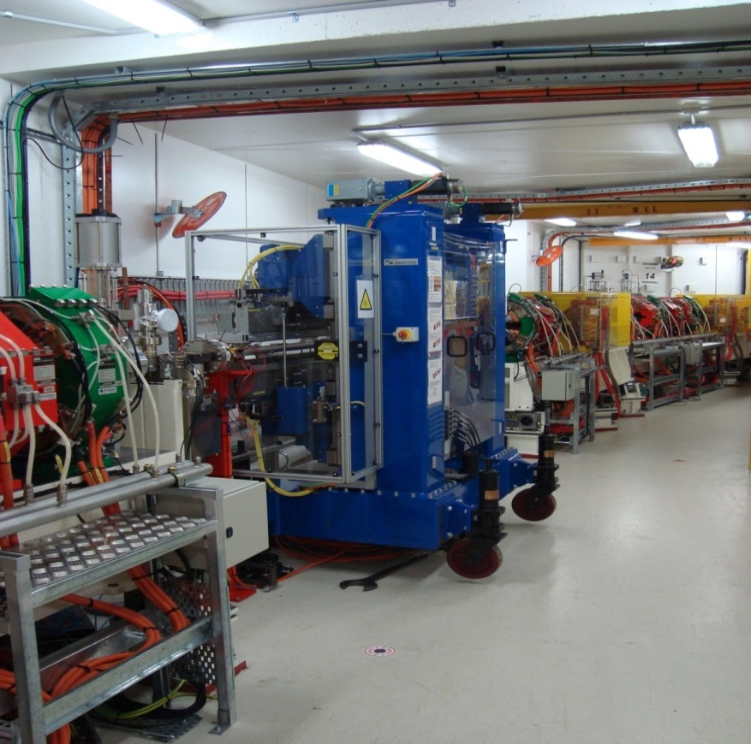
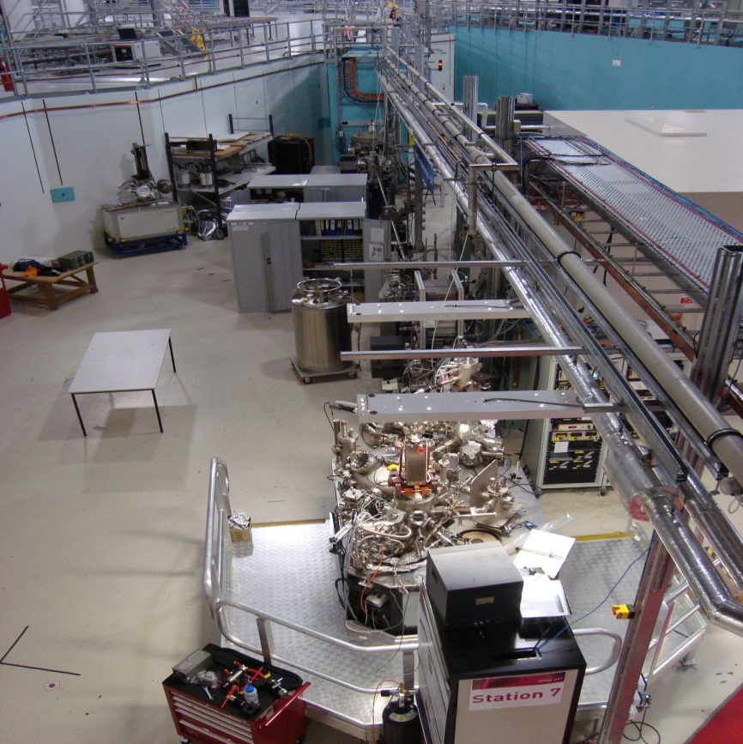
Soft x-ray undulator beamline
Notes:
This is a photo of the APPLE-II insertion device at the Australian Synchrotron storage ring, and the Soft X-ray Spectroscopy user beamline.

Slide 11
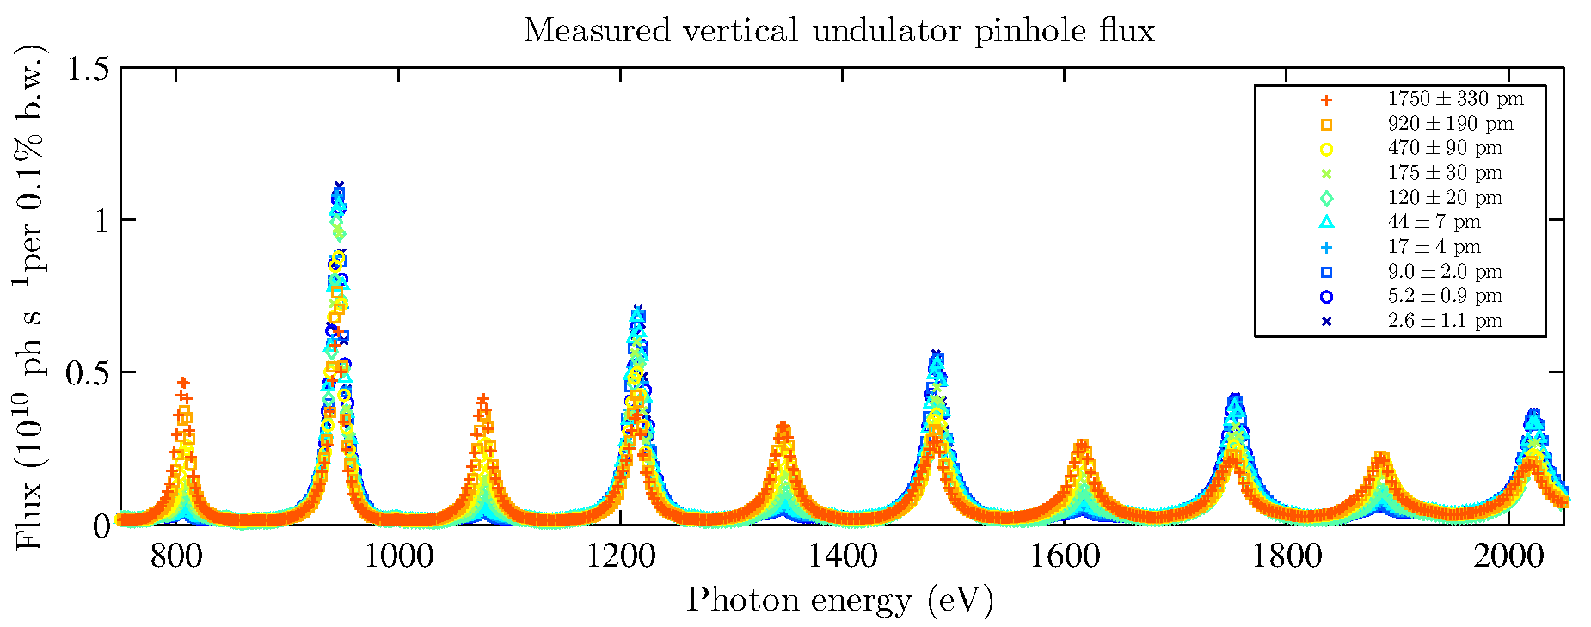
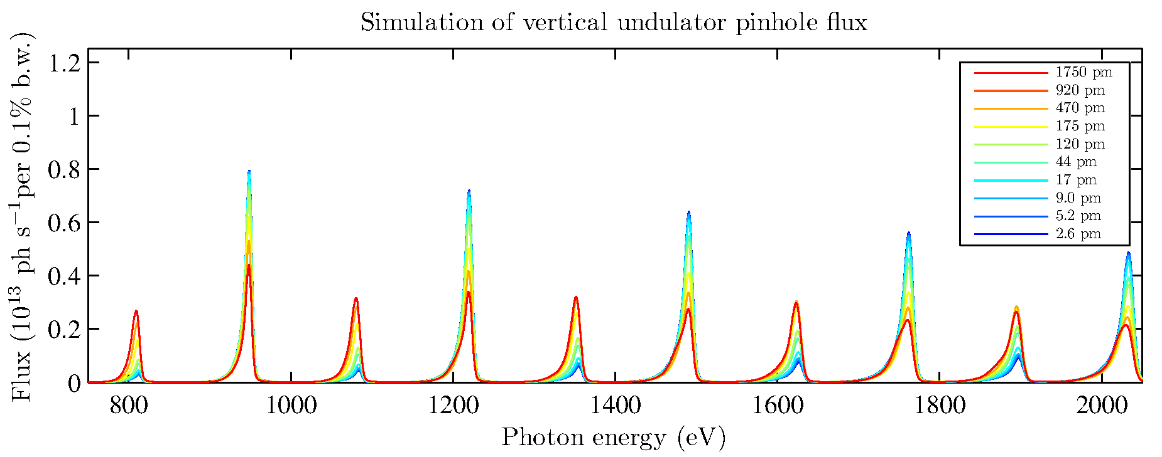
Measured undulator spectrum
Measured
Modelled
F₇
Flux ratio
F_{n-1} / F_{n}
F₆
Wootton, et al. PRL 109, 194801 (2012)
Notes:
In the earliest experiments, measured the undulator spectrum. Plotted here is the measured brilliance spectrum of high harmonics (6 to 15), over a range of vertical emittances from 2 pm rad up to 2 nm rad.
Compared these measured brilliances with modelled brilliances. This was evaluated by comparing the ratio of the brilliances of adjacent even and odd harmonics.

Slide 12
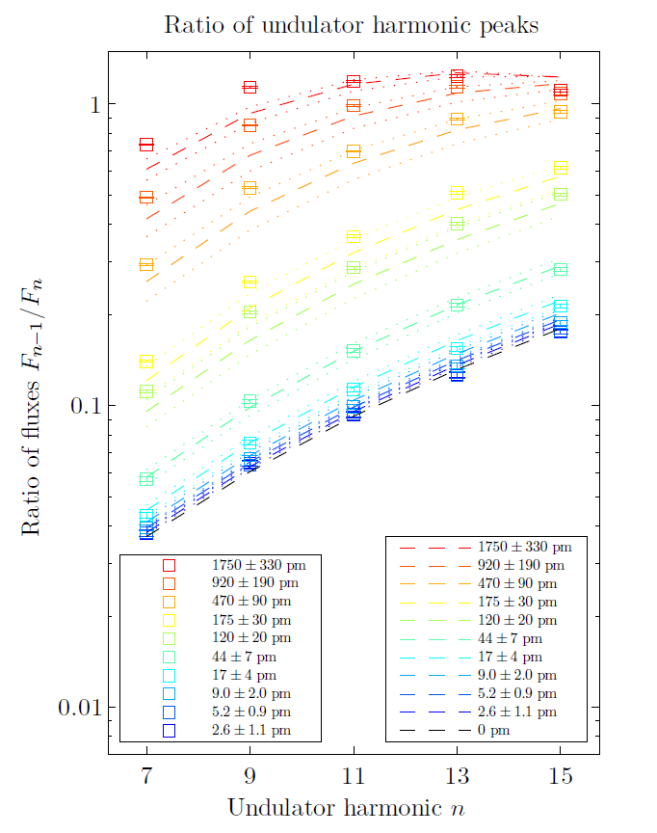
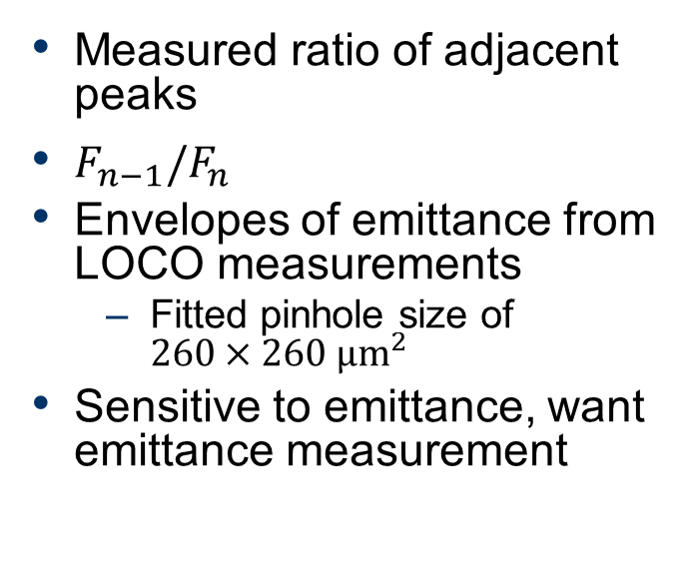
Emittance envelopes
Measured ratio of adjacent peaks
$F_{n−1}/F_{n}$
Envelopes of emittance from LOCO measurements
  Fitted pinhole size of $260×260 μm^{2}$
Sensitive to emittance, want emittance measurement
Wootton, et al. PRL 109, 194801 (2012)
Notes:
Plotted here is the summary of measured and modelled ratios of all those harmonics, with the ratio plotted on the vertical axis, over all the measured pairs of undulator harmonics on the horizontal axis.
Basically, a high ratio corresponds to a high vertical emittance, and a low ratio corresponds to a low vertical emittance.
In that initial experiment, didn’t have a measurement of the vertical pinhole size, so fitted one.
The result was that we could tell that vertical undulator radiation was a very sensitive probe to vertical beam size, but needed pinhole size to make it a measurement.

Slide 13
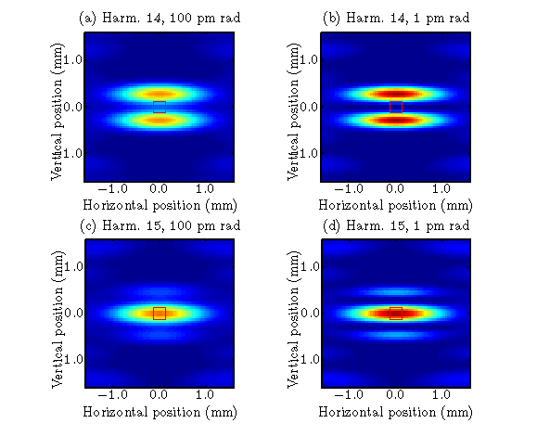
Undulator projection measurements
Vertical undulator
Ideal model for undulator magnetic field
Ideal distribution of undulator radiation
Pinhole dimension fitted
How can this be refined?
Notes:
Basically, using an ideal model for the undulator magnetic field, got ideal distribution of undulator radiation, to which fitted a pinhole.
So with the undulator set for maximum deflection parameter, measured the on-axis brilliance for high harmonics, and how it varied with vertical emittance.

Slide 14
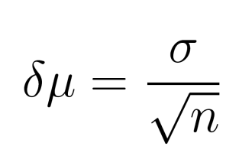
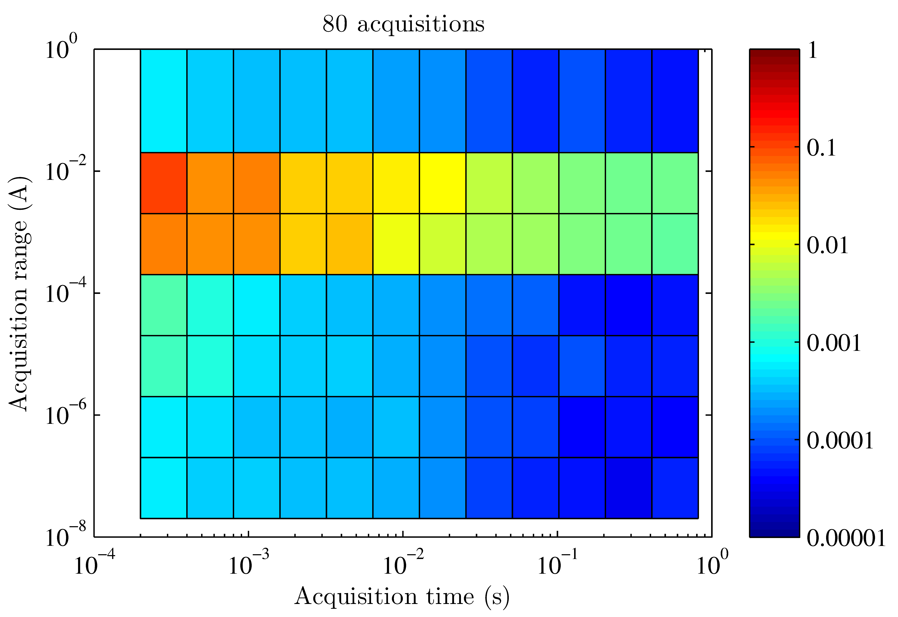
Time averaging
n acquisitions, mean
Minimises statistical uncertainty
Systematic uncertainty (pinhole position) remains
Assumes beam not changing with time
Wootton, et al. IBIC13, TUPF18 (2013)
Notes:
Instead of a single measurement, repeat acquisitions of a quantity minimises statistical uncertainty.
Can meaningfully reduce the statistical uncertainty by orders of magnitude, but systematic uncertainty remains.
Additionally, assumes that the beam is not changing with time.

Slide 15
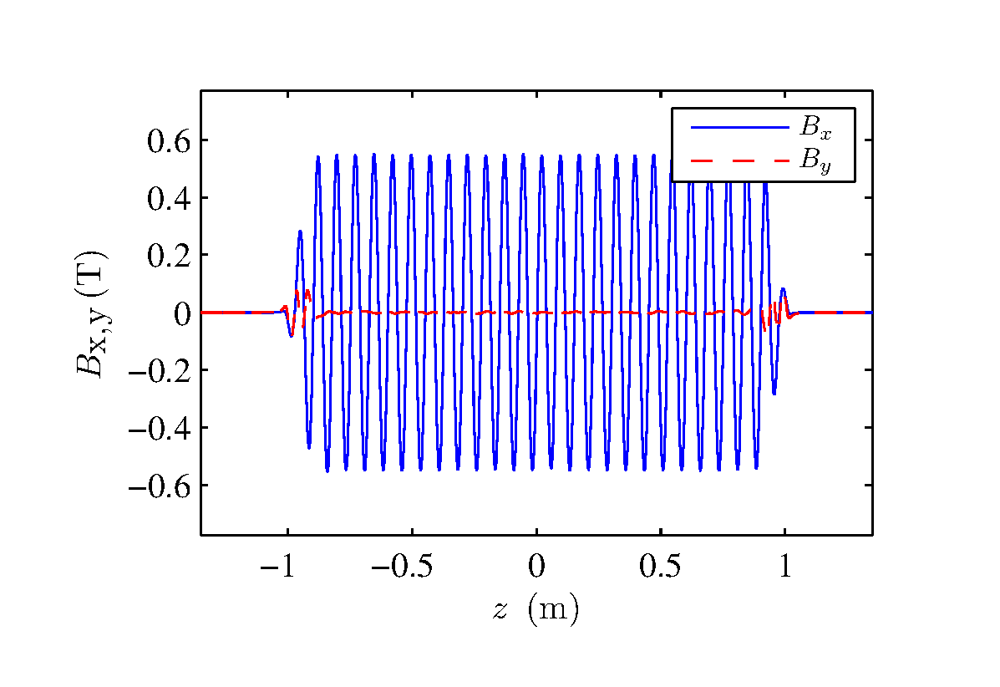
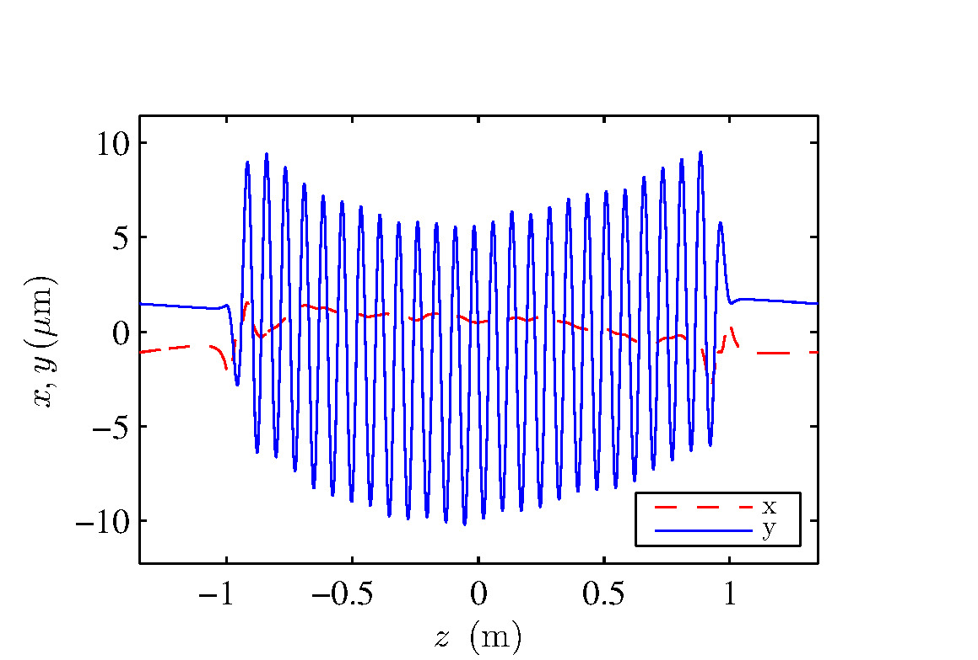
Refined magnetic model
Measured magnetic field
Simulated trajectory
Ostenfeld, et al., PAC 2007, TUPMN006 (2007).
Notes:
This could be significantly refined by using the measured magnetic field map for the undulator. The magnetic field of this undulator was measured using a three-axis Hall probe when the insertion device was accepted.

Slide 16
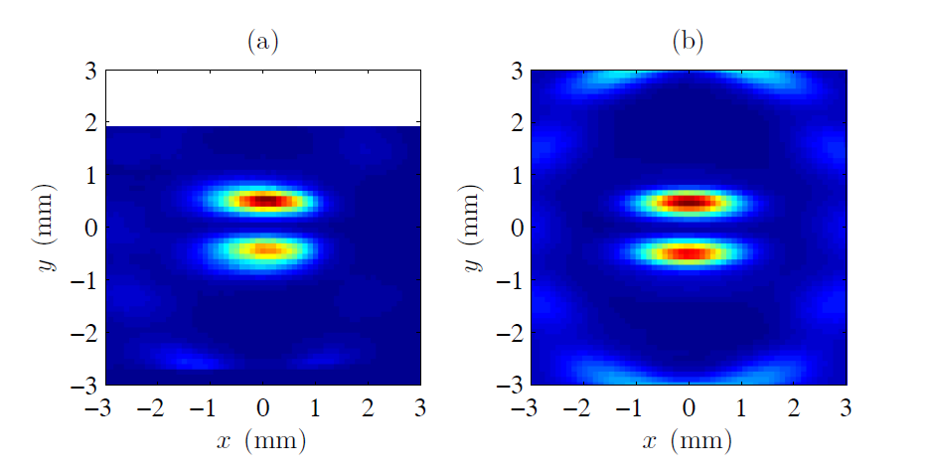
Refined magnetic model – results
Measured profile
Simulation, measured field map
Wootton, et al. IBIC13, TUPF19 (2013)
Notes:
Can use that trajectory in simulations of the undulator radiation produced.
By scanning the position of the pinhole, can measure the angular distribution of undulator radiation at high harmonics.
Here, measured angular distribution of the 6th harmonic, and simulated distribution using the measured magnetic field map.
Reproduces the vertical assymmetry in the radiation distribution.

Slide 17
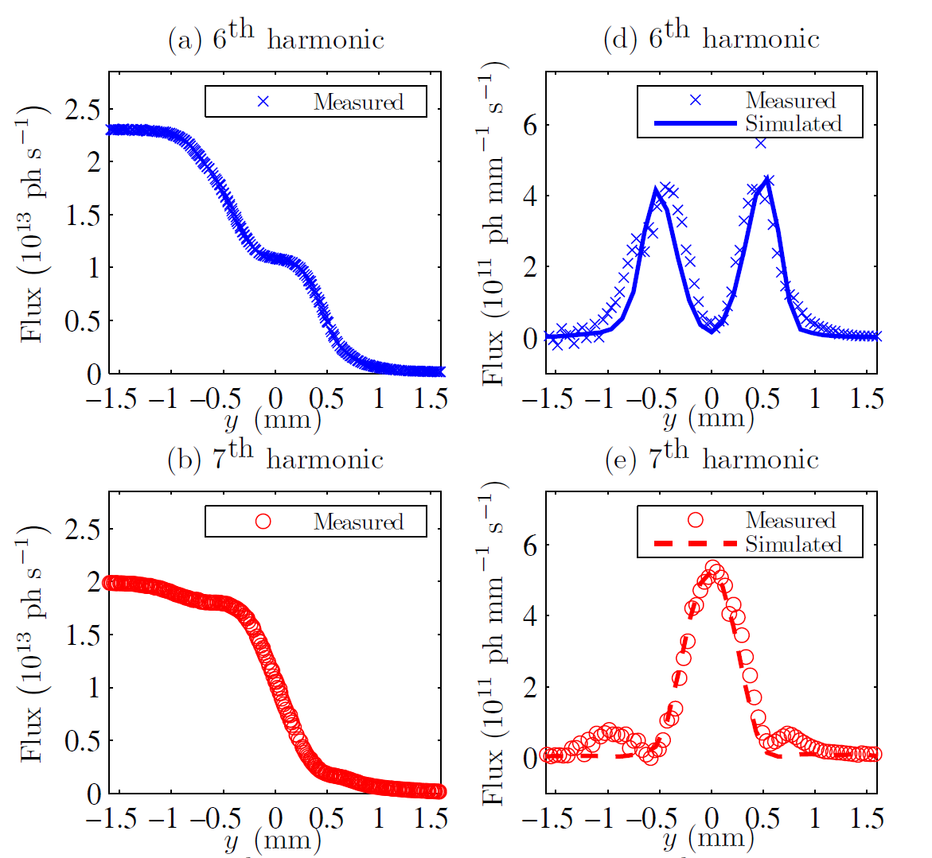
Blade scans
Wootton, et al. IBIC13, TUPF19 (2013)
Notes:
Another approach was blade scans, scanning a blade through the radiation profile.
Measured the passing flux, and by differentiating with respect to position, recover the angular profile of radiation.
Plotted here are an odd and even harmonic.

Slide 18
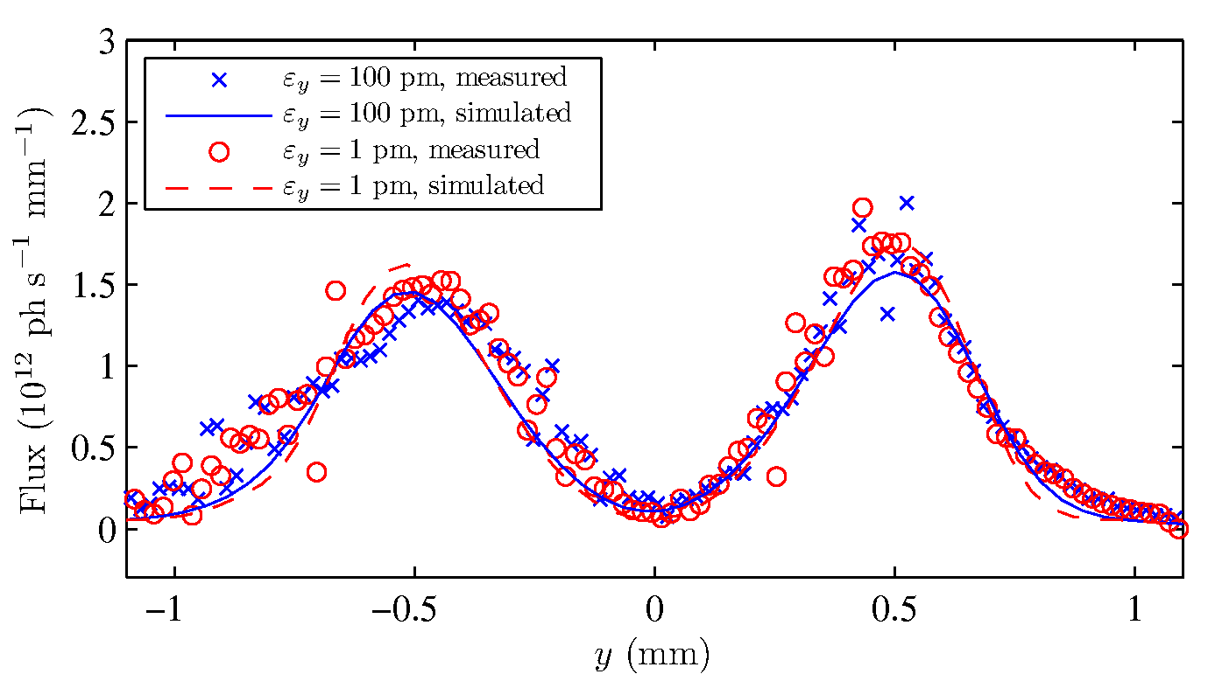
Blade scans – results
Not sufficiently sensitive to pm rad emittances
Notes:
How does this work for different ultralow emittances?
In practice, not sufficiently sensitive over the (ultralow) emittance range of interest.
There is a measurable, but small difference between the measured undulator radiation profile for 100 pm, and 1 pm.

Slide 19
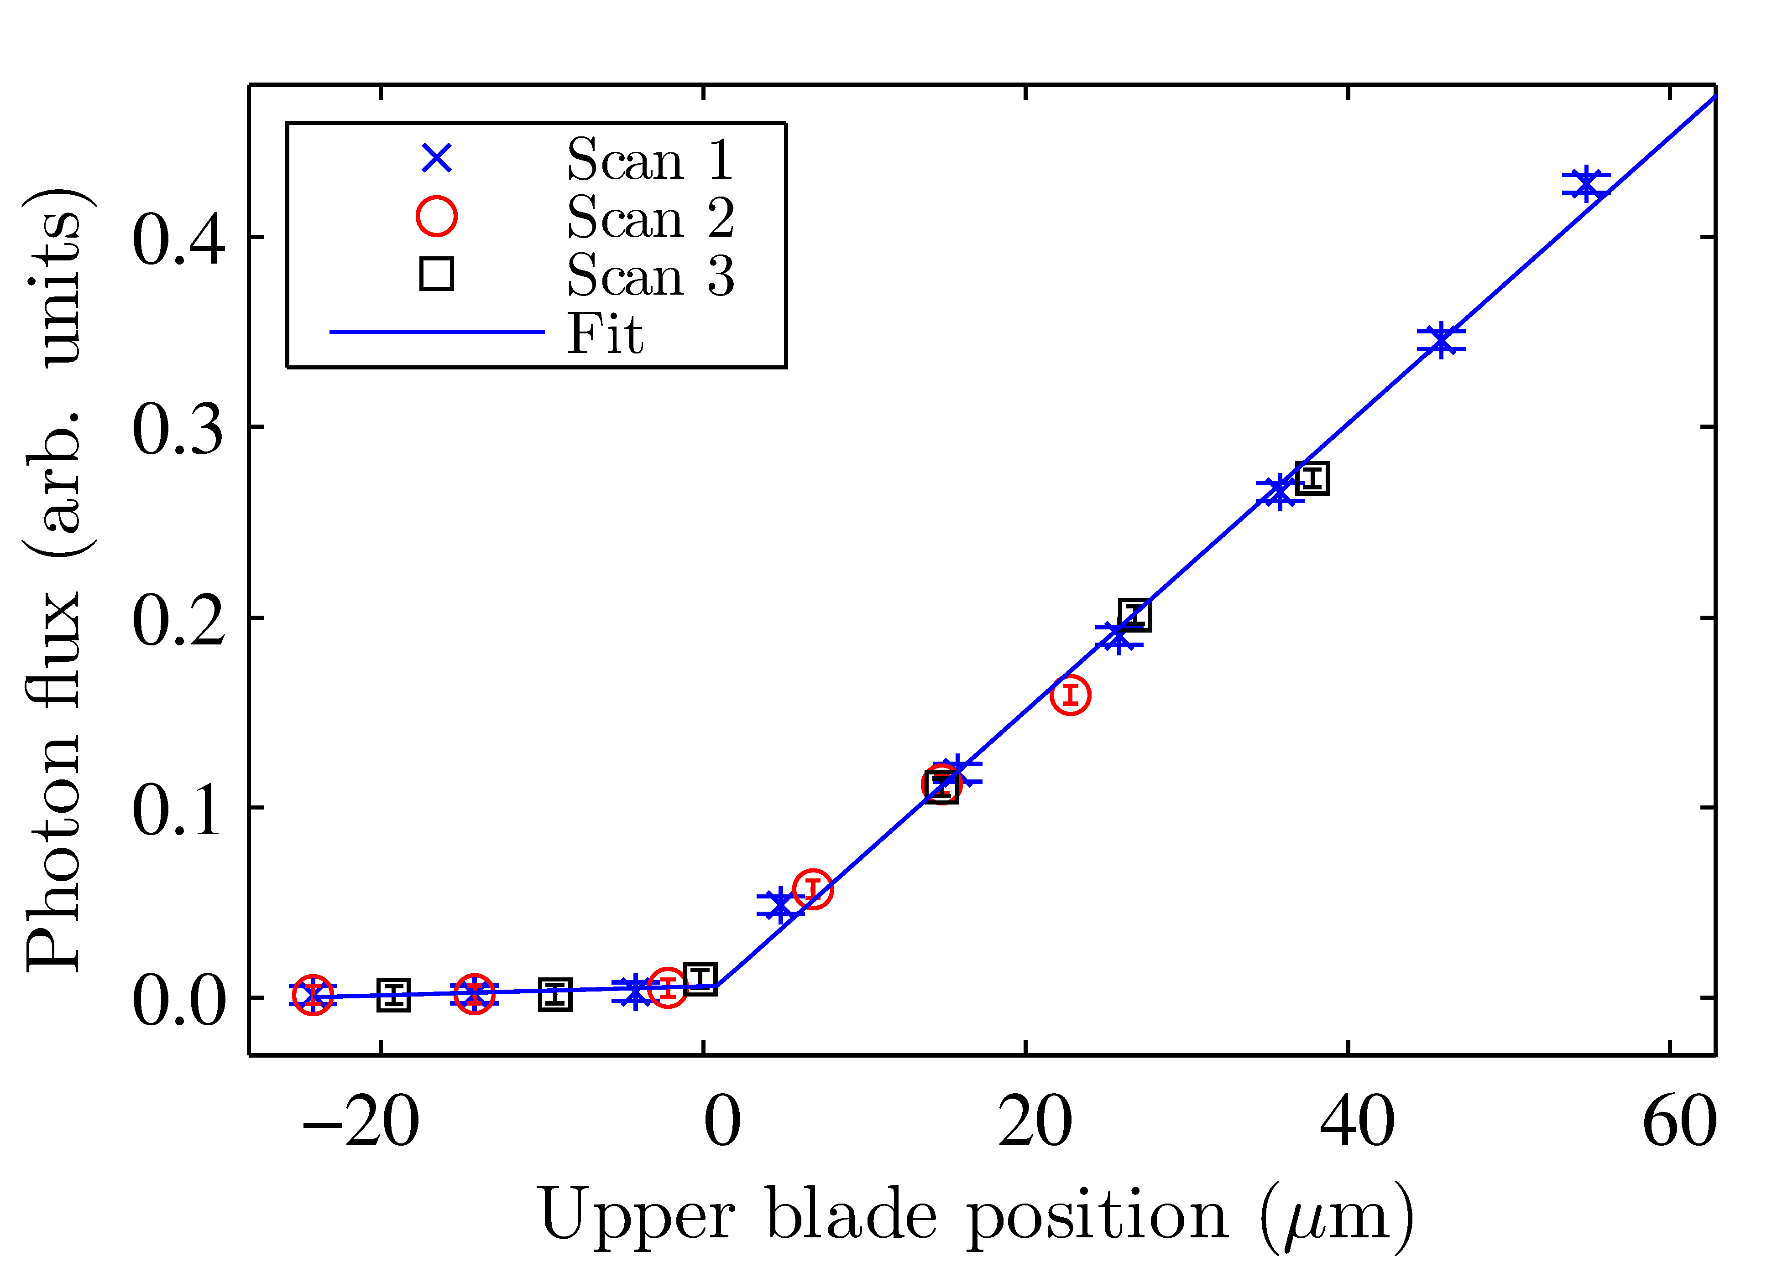
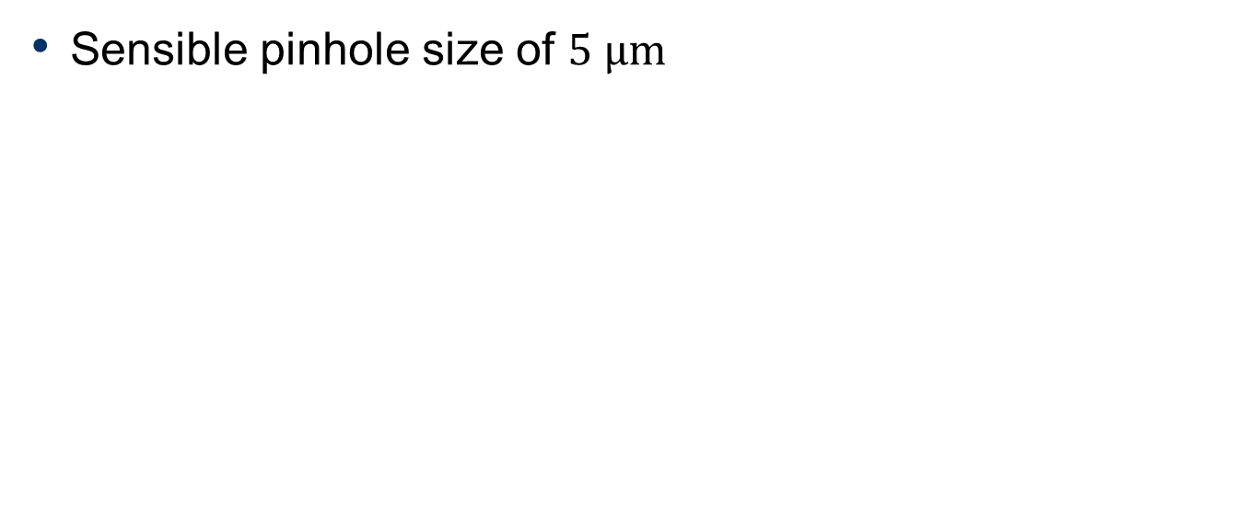
Orbit bumps – pinhole size
Sensible pinhole size of $5 μm$
Wootton, et al. PRSTAB 17, 112802 (2014)
Notes:
But these blade scans opened a different opportunity. Able to address one of the significant systematic uncertainties of the original experiment by minimising the pinhole size. With one blade fixed, closed the other until the flux was extinguished. In this way, could get a pinhole size of 5 um height. But then, how does one optimise the pinhole position?

Slide 20
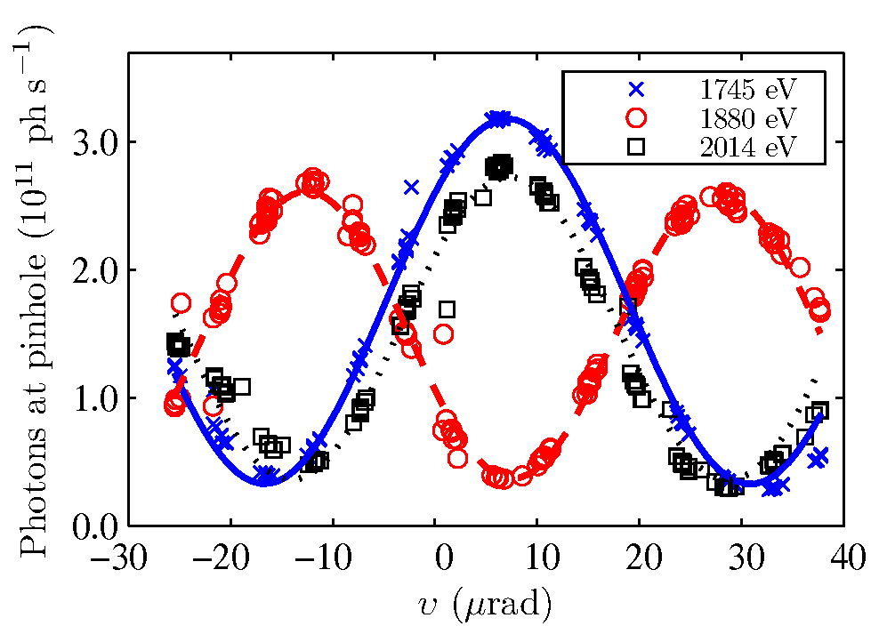
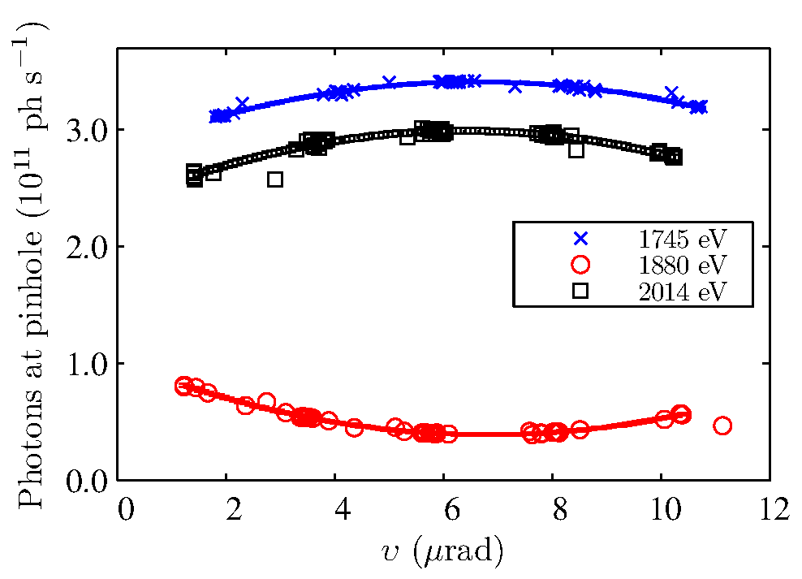
Orbit bumps
Wootton, et al. PRSTAB 17, 112802 (2014)
Notes:
In practice, the most reproducible technique was to scan the pinhole position by scanning the electron beam angle through the insertion device.
Illustrated schematically, the electron beam was steered vertically through the insertion device, and the flux passing the pinhole was measured, to recover the radiation distribution.
In this way, it was possible to measure the minimum flux ratio, centred on the distribution.

Slide 21
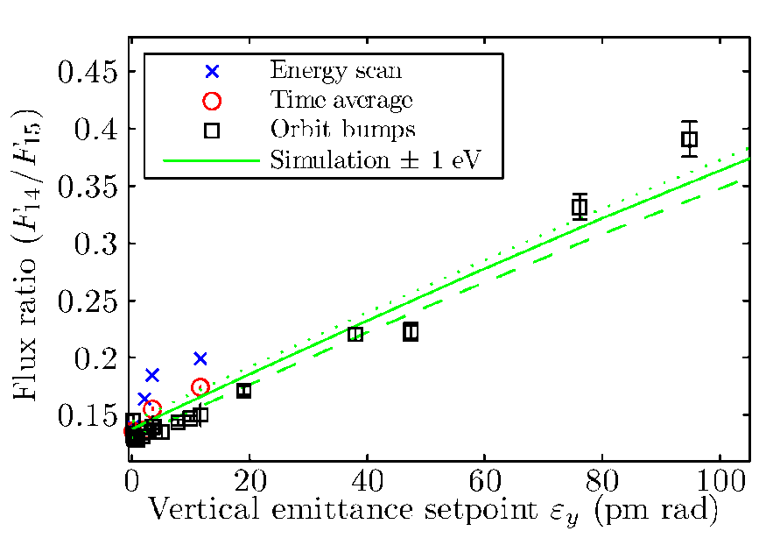
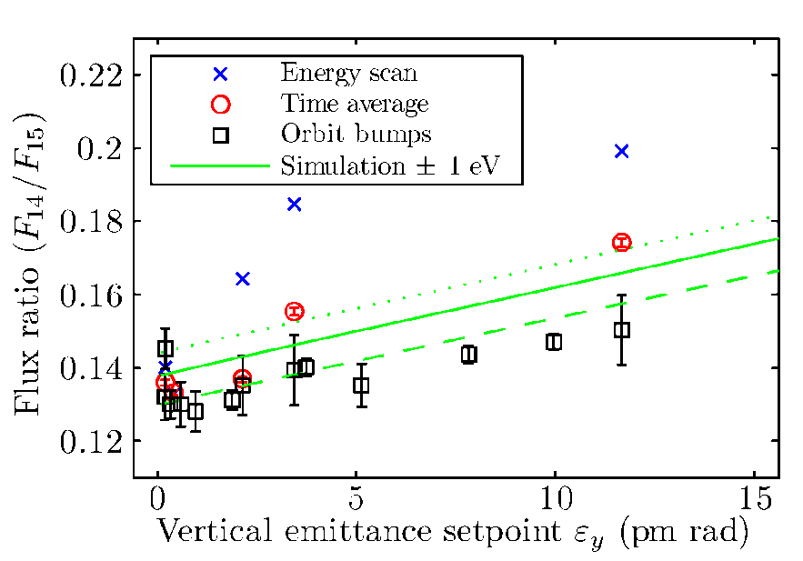
Emittance measurement
Flux ratio measured using several approaches
Simulated using measured field map
Wootton, et al. PRSTAB 17, 112802 (2014)
Notes:
So for each of these techniques, energy scans, time averaging and orbit bumps, the flux ratio of the 14th to 15th harmonics was measured for different emittances. This could be compared to simulations of undulator radiation using the measured magnetic field map.
These measured flux ratios and the simulation are plotted here for vertical emittances up to 100 pm rad, and zooming in on the plot below 15 pm rad.
Of these, the technique with the lowest measured flux ratio is orbit bumps through the insertion device, and it fits model well up to 100 pm rad.

Slide 22
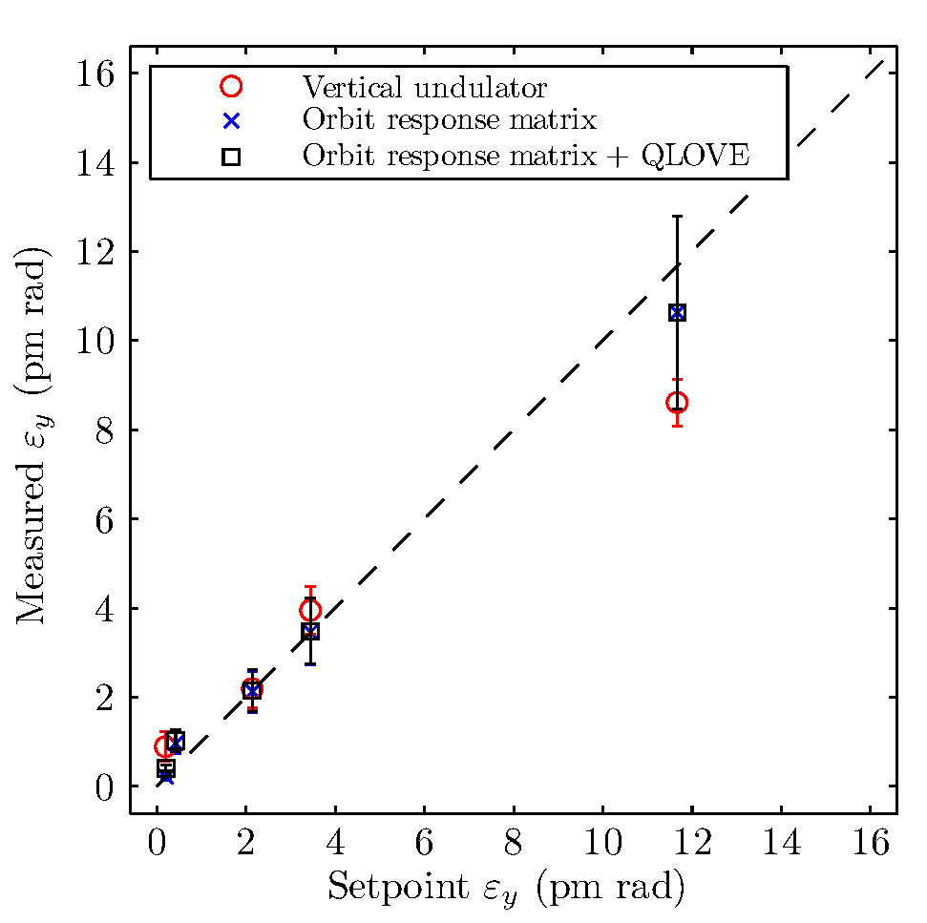
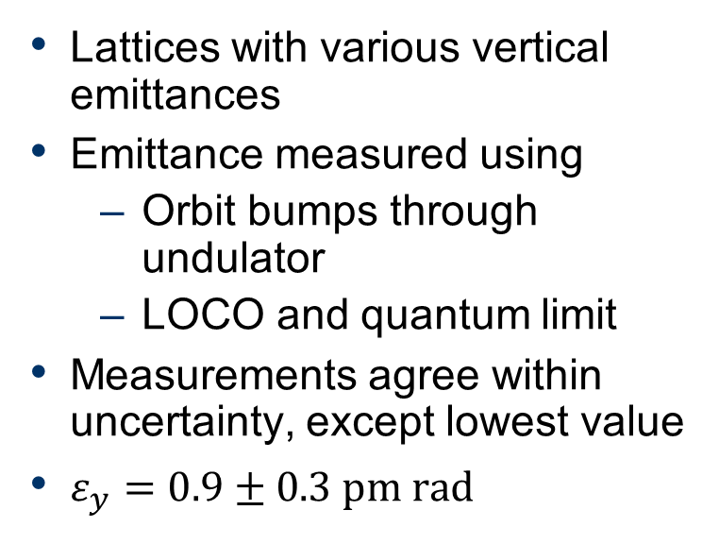
Emittance measurement
Lattices with various vertical emittances
Emittance measured using
  Orbit bumps through undulator
  LOCO and quantum limit
Measurements agree within uncertainty, except lowest value
$ε_{y}=0.9±0.3 pm rad$
Wootton, et al. PRSTAB 17, 112802 (2014)
Notes:
Looking at results below 15 pm rad.
Set up several lattices with vertical emittance below 15 pm rad.
Emittance measured using:
Orbit bumps through insertion device
LOCO, in quadrature with the quantum limit
Measurements in agreement within experimental uncertainty, except the lowest value. LOCO suggests the vertical emittance is lower than the direct measurement using vertical undulator.
Smallest vertical emittance measured is 0.9 +- 0.3 pm rad, equal to SLS record.

Slide 23
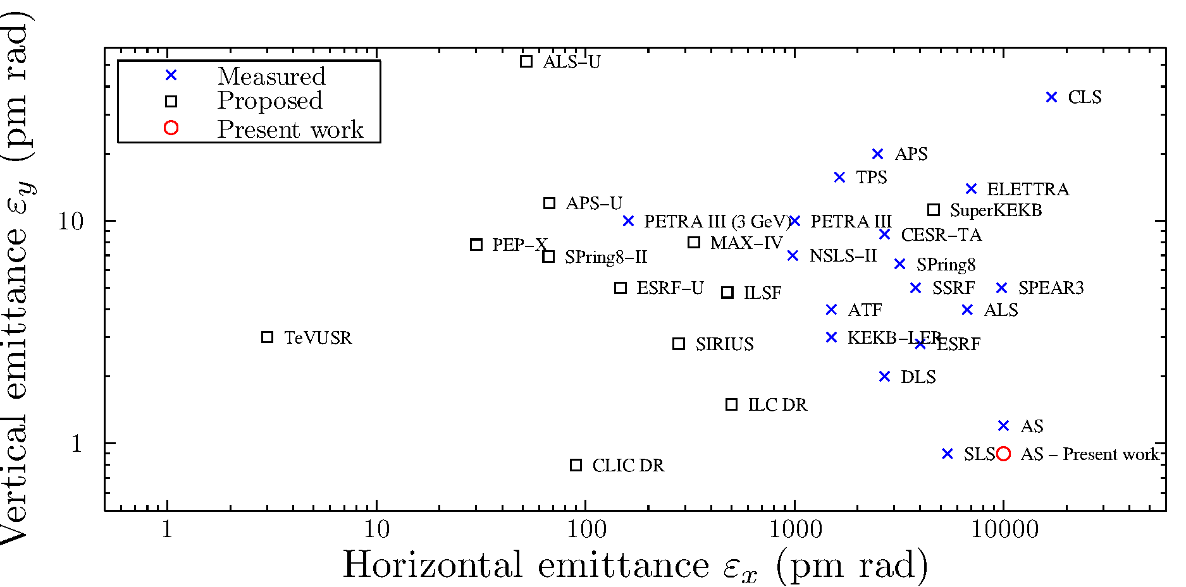
Discussion – present result
Notes:
Where does this result sit in the context of other emittance measurements?
Plotted here are measured emittances of existing machines.
Puts the present result equal to the SLS in vertical emittance.
Also plotted are some machines which are proposed or under construction, several of which are MBA rings, with horizontal emittances as low as present vertical emittances.

Slide 24
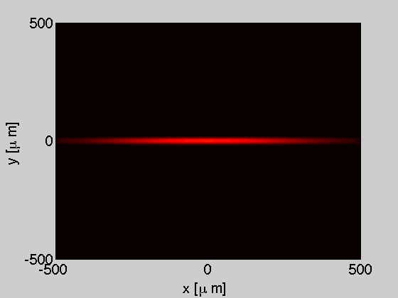
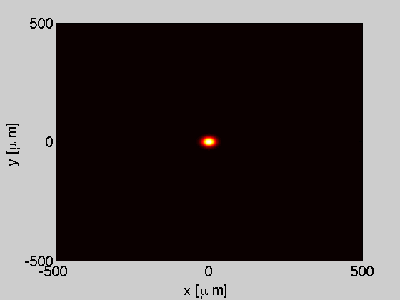
Discussion – DLSRs
Electron beam
Undulator radiation
Brilliance-optimised DLSRs
  High undulator harmonics
  Angular profile of undulator radiation departs significantly from typical Gaussian distributions
Are photon beamlines prepared?
APS Report LS-334 (2014)
Notes:
I think this may be a challenge to brilliance-optimised proposed diffraction limited storage rings.
Plotted here is a typical example of the change in electron beam distribution for the APS MBA upgrade, with approximately 100 pm emittances in both horizontal and vertical dimensions.
The angular profile of undulator radiation at high harmonics departs significantly from typical Gaussian distributions.
Are photon beamlines prepared for this?

Slide 25
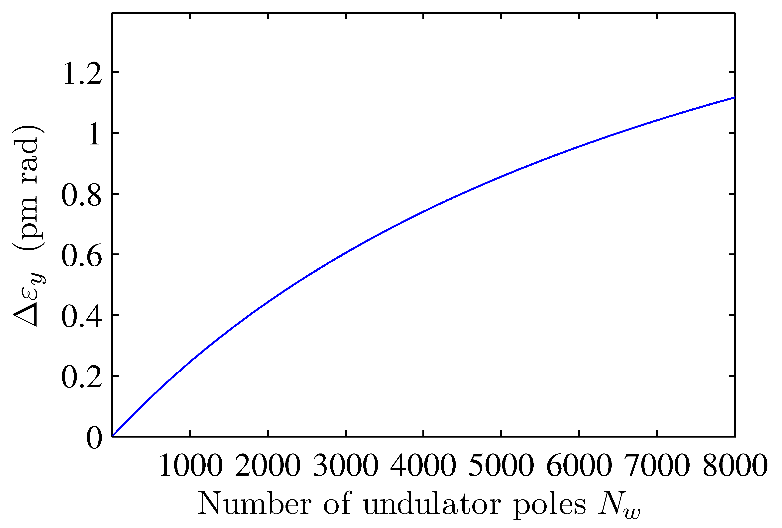
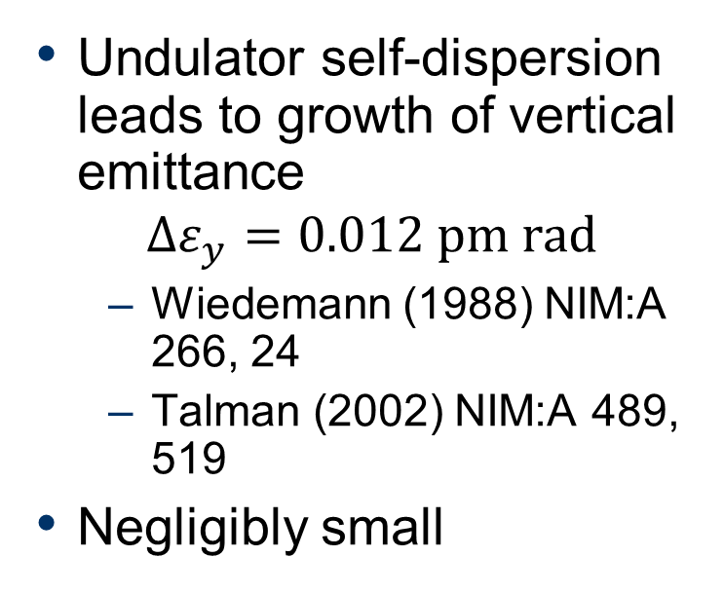
Discussion – self-dispersion
Undulator self-dispersion leads to growth of vertical emittance
$$Δε_{y}=0.012 pm rad$$
  Wiedemann (1988) NIM:A 266, 24
  Talman (2002) NIM:A 489, 519
Negligibly small
1 pm rad?
6500 undulator poles
240 m
Notes:
Misnomers with regard to vertical emittance measurement.
Vertical undulator self-dispersion increases vertical emittance.
Whilst true, in practice, negligibly small.

Slide 26
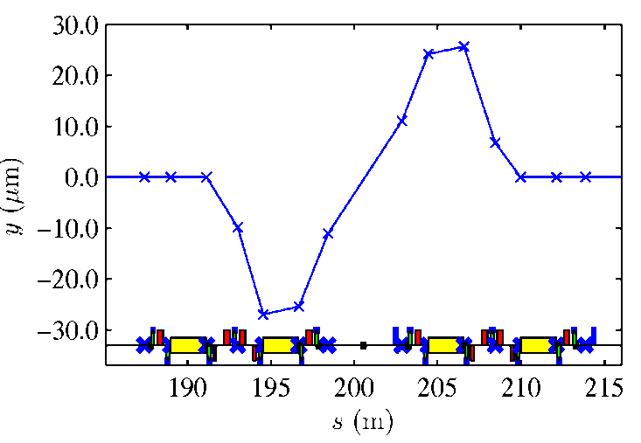
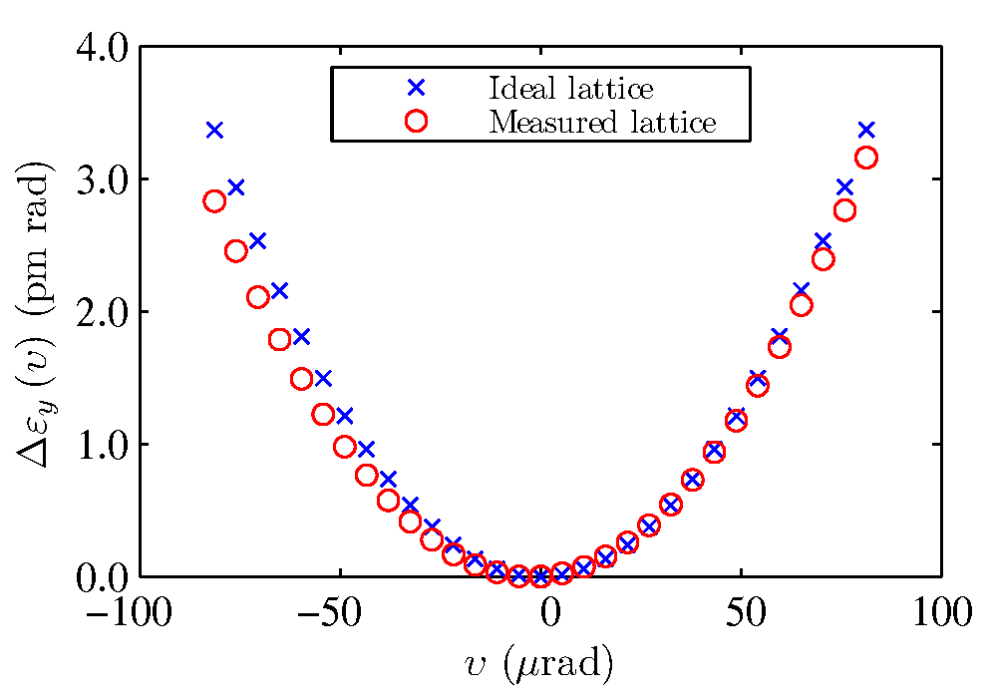
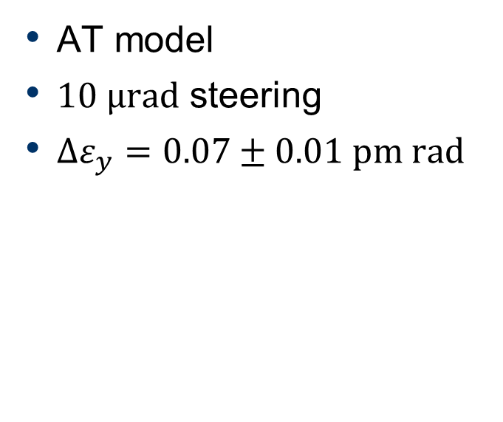
Discussion – Orbit steering
Steering electron beam off-axis through sextupoles
AT model
$10 μrad$ steering
$Δε_{y}=0.07±0.01 pm rad$
Wootton, et al. PRSTAB 17, 112802 (2014)
Notes:
Misnomers with regard to vertical emittance measurement.
Closed, local orbit bump through adjacent sectors including sextupoles and skew quadrupoles.
Increase in vertical emittance can be modelled in AT.
Whilst true, in practice, negligibly small.
1 pm rad? Much larger orbit bump than is useful.

Slide 27
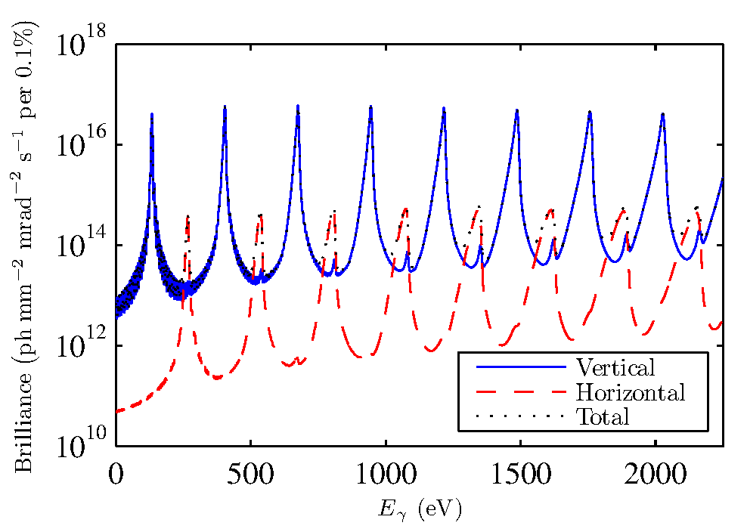


Where to? Polarisation
Fixed pinhole diameter
Linear polarisation
Undulator shimmed for vertical polarisation

Slide 28


Where to? Polarisation
Fixed pinhole diameter
Linear polarisation
Need undulator shimmed for vertical polarisation

Slide 29

Summary
Direct emittance measurement based on vertical undulator
Emittance evaluated from peak ratios
  Smallest measured, $ε_{y}=0.9 ±0.3 pm rad$
Angular distribution of undulator radiation departs from Gaussian approximations
  Diffraction-limited light sources should be aware

Slide 30


Thank-you!
wootton@slac.stanford.edu

Slide 31
References
Alexander, et al., Nucl. Instrum. Methods A, 748, 96 (2014)
Åndersson, et al., Nucl. Instrum. Methods A, 591, 437-446 (2008)
APS Report LS-334, Argonne National Laboratory https://www1.aps.anl.gov/icms_files/lsnotes/files/APS_1438860.pdf
Bahrdt, et al., Phys. Rev. Lett., 111, 034801 (2013)
Dattoli, et al., Phys. Rev. E, 52, 6809-17 (1995)
Masaki & Takano, Proc. DIPAC01, Grenoble, France, PS17 (2001)
Masaki, et al., Phys. Rev. ST Accel. Beams 18, 042802 (2015)
Moreno, et al., J. Synchrotron Radiat., 19 179-84 (2012)
Ostenfeld, et al., Proc. PAC 2007, TUPMN006 (2007)
Sasaki, Nucl. Instrum. Methods A, 347, 83 (1994)
Takano, Proc. of the Workshop on Precise Measurements of Electron Beam Emittances, KEK Proceedings, Vol. 97-20, p. 18 (1997)
Talman, Nucl. Instrum. Methods A, 489, 519 (2002)
Tanaka & Kitamura, J. Synchrotron Radiat. 8 1221 (2001)
Wiedemann, Nucl. Instrum. Methods A, 266, 24 (1988)
Wootton, et al., Phys. Rev. Lett., 109, 194801 (2012)
Wootton, et al., IBIC12, MOCB04 (2012)
Wootton, et al., IBIC13, TUPF18 (2013)
Wootton, et al., IBIC13, TUPF19 (2013)
Wootton, et al., Phys. Rev. ST Accel. Beams, 17, 112802 (2014)

