Slide 1


First Results of Solaris Synchrotron Commissioning
Adriana I. Wawrzyniak
Accelerator Operation and Development Coordinator
adriana.wawrzyniak@uj.edu.pl
Solaris National Synchrotron Radiation Centre
Jagiellonian University
Czerwone Maki 98
30-392 Krakow, Poland
www.synchrotron.uj.edu.pl

Slide 2

Outline
Solaris Overview
  Time schedule
Designed Machine Parameters
Beam commissioning
  Linac
  Storage ring
    Summary

Slide 3
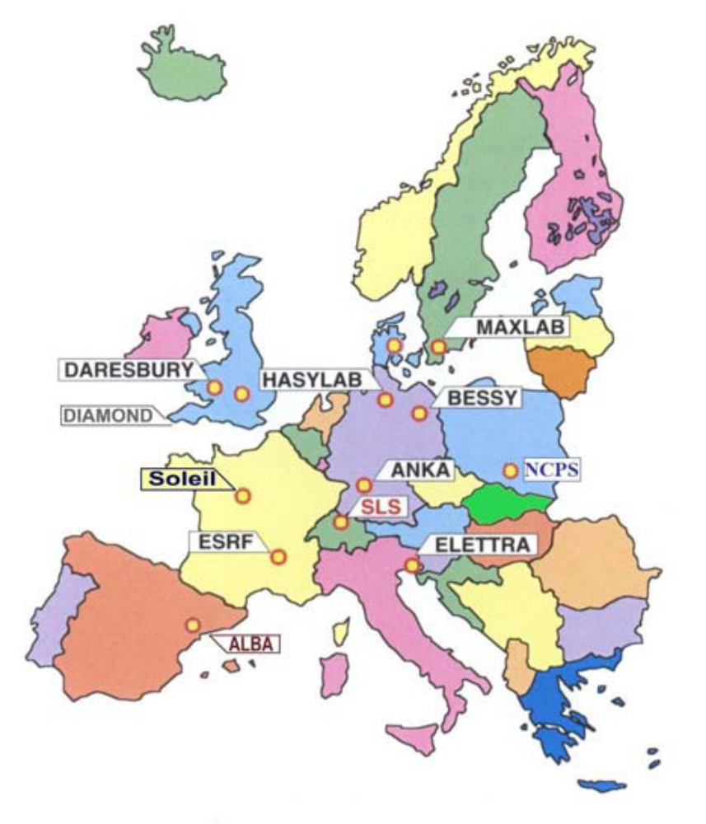
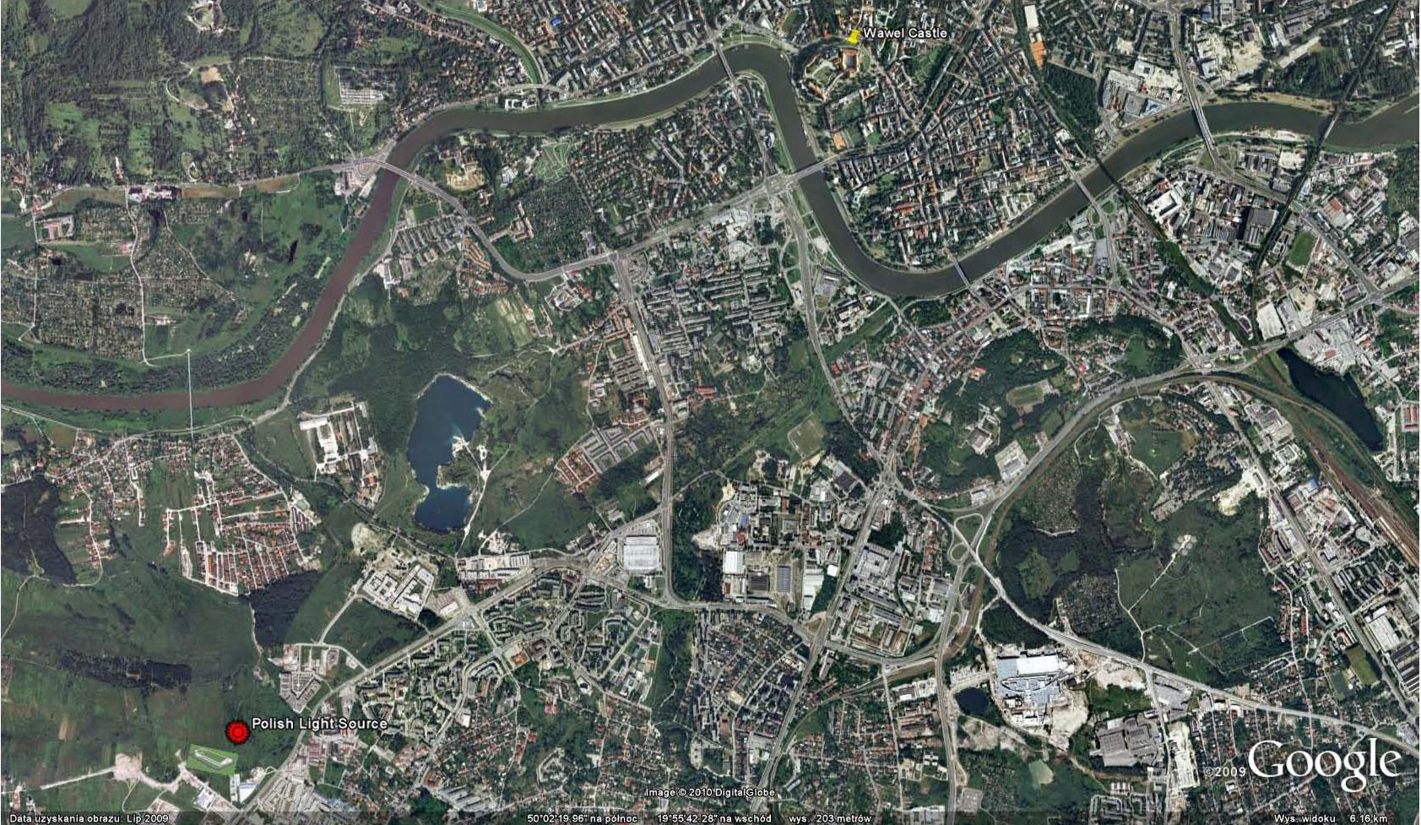
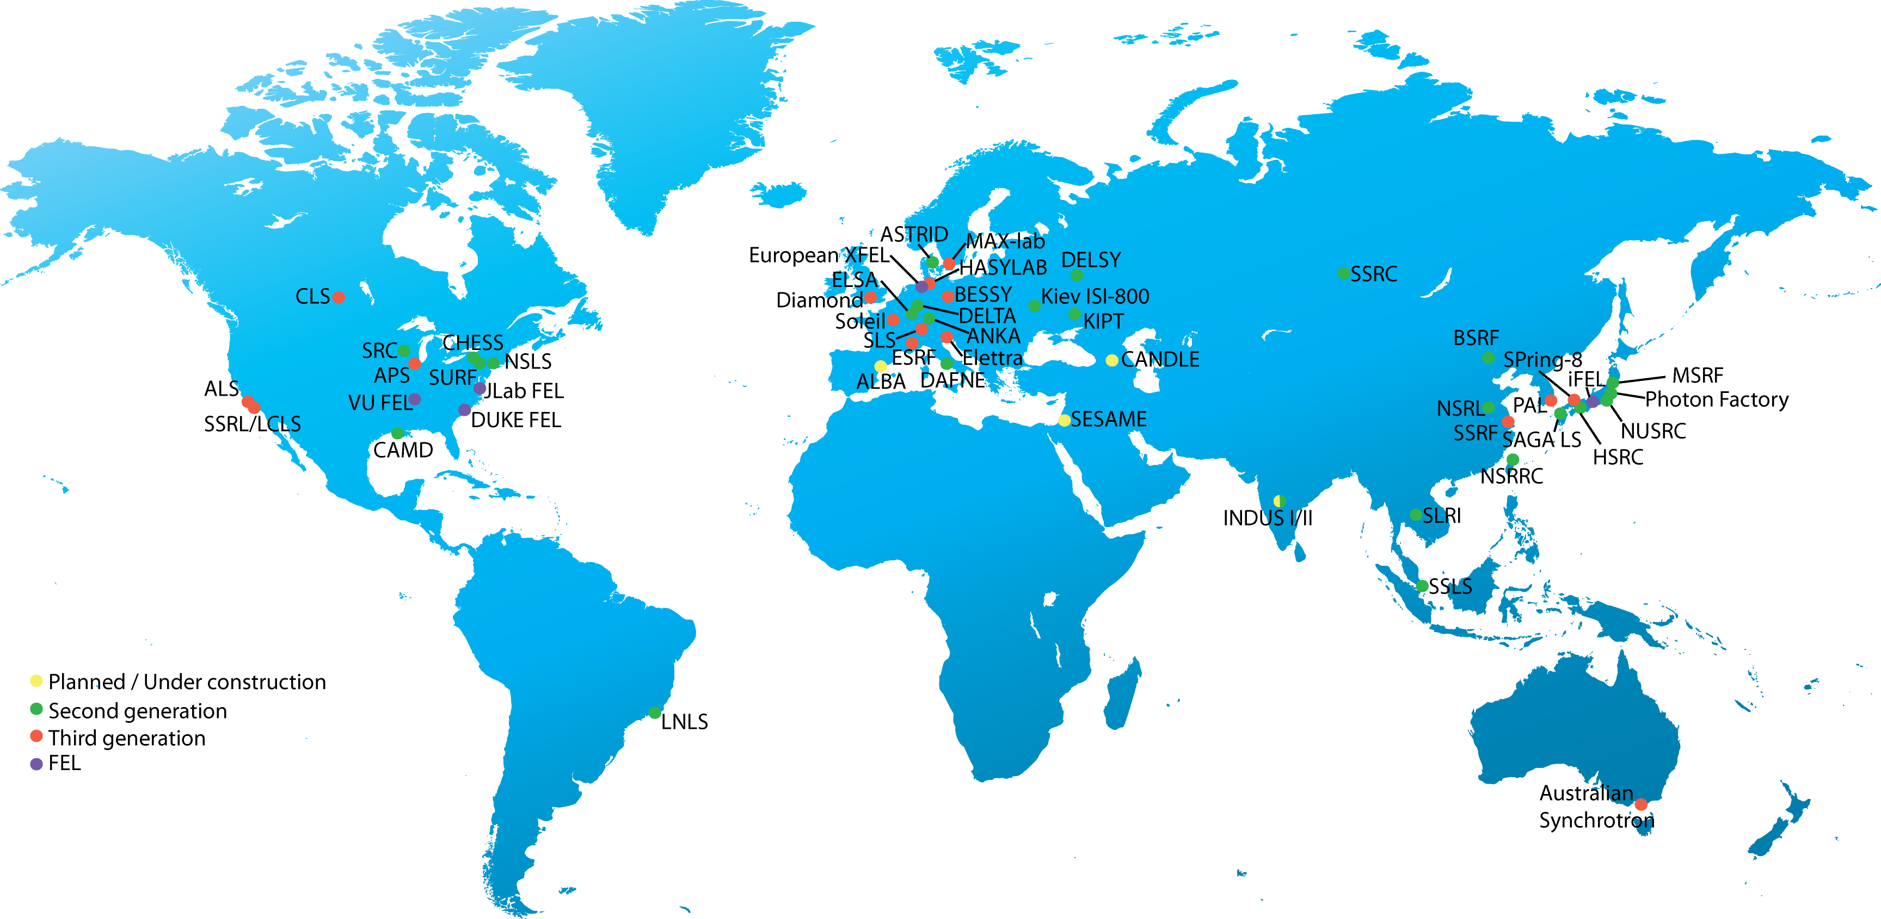

Overview
SOLARIS @ Jagiellonian University new Campus:
ul. Czerwone Maki 98, Kraków 50º01’21” N:19º53’37” E

Slide 4
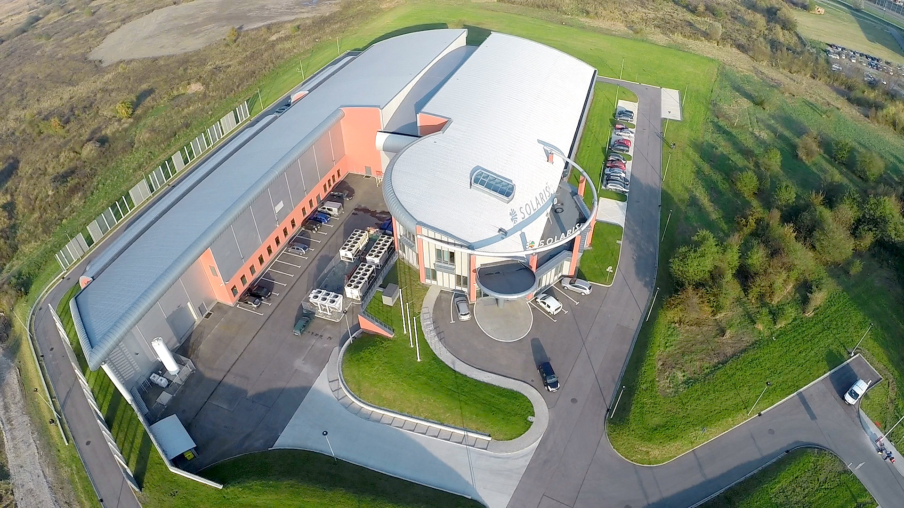
Overview
SOLARIS - 3rd generation light source facility built in Krakow, Poland at the Jagiellonian University Campus.

Slide 5
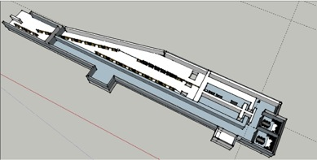
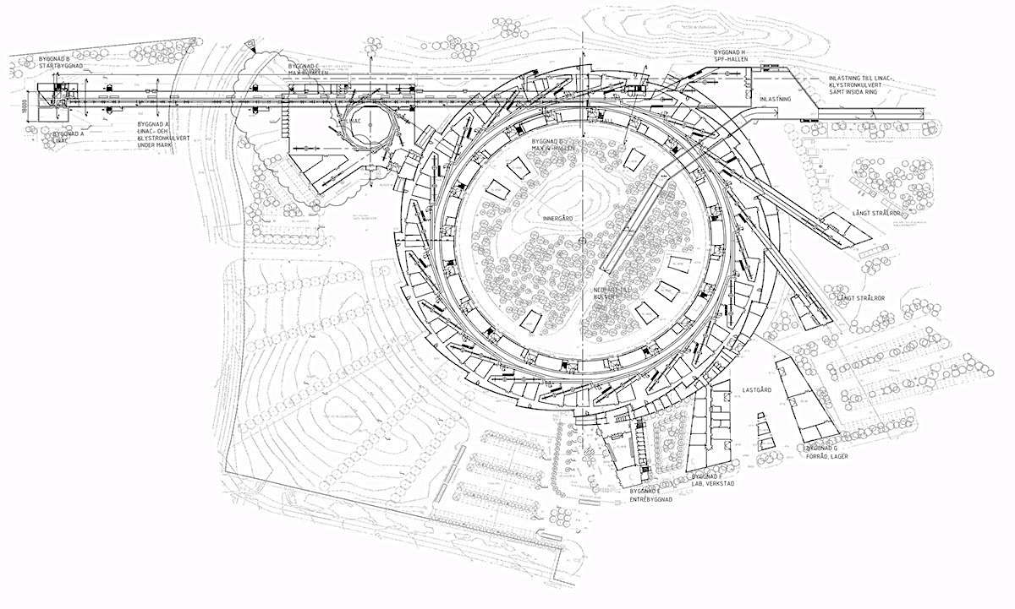
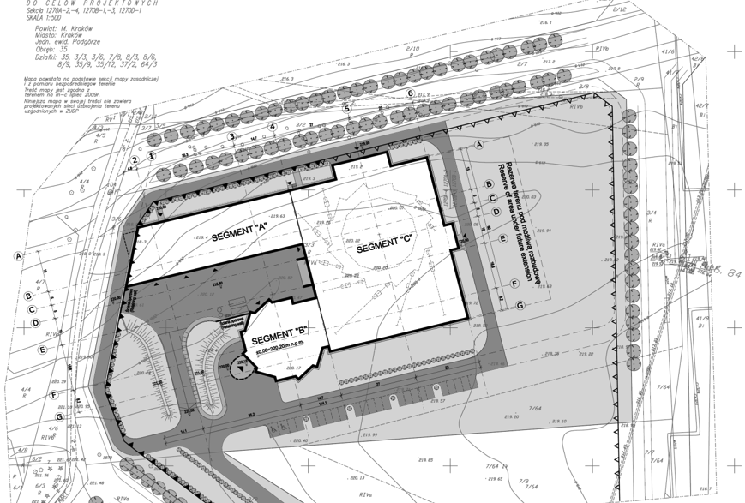
Overview
Tight collaboration with the MAX IV Laboratory in Lund, Sweden to design and built 1.5 GeV storage ring .
  Agreement established between Jagiellonian and Lund Universities for mutual cooperation in the construction of Solaris based on MAX IV design .
High Brightness Gun
3 GHz Warm Linac & SLED Cavities
Solid State Modulators
Short pulse facility
(FEL)
Short Pulse Facility
1.5 GeV ring
3 GeV ring
of relevance to Solaris
Solaris
MAX IV Accelerators – Lund, Sweden
3.0 GeV ring 20 straights (ε=0.23 nmrad) 528 m circumference
Courtesy: M. Eriksson, S. Thorin
1.5 GeV ring 12 straights (ε=6.0 nmrad) 96 m circumference
3.0 GeV linac Injector + Short Pulse Facility
+ potential FEL

Slide 6
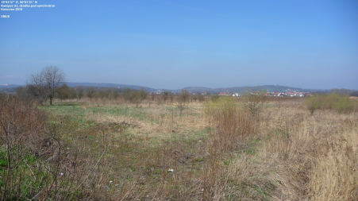
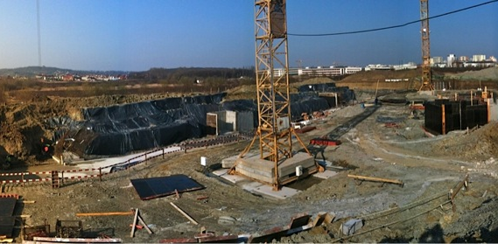
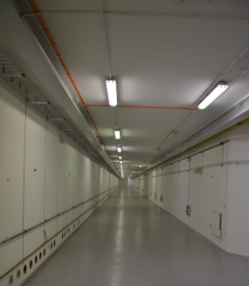
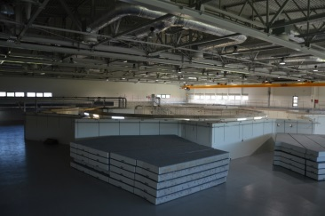
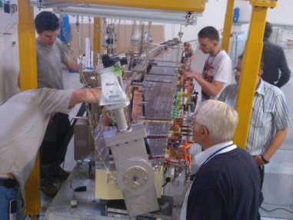
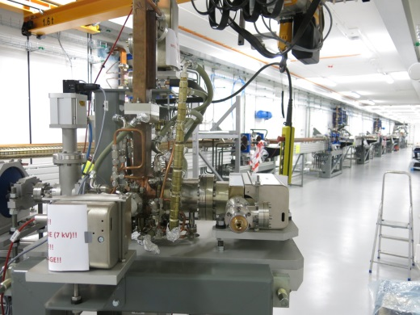
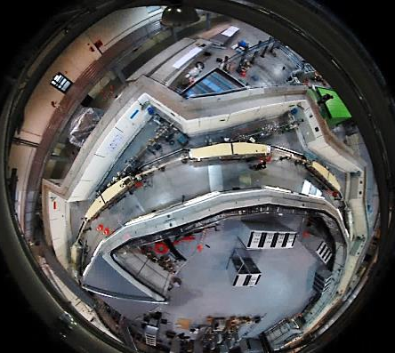
Time Schedule
April 2010 – project start
January 2012 – start of the building construction
May 2014 – building handover
June 2014 machine installation
November 2014 linac conditioning start
April 2015 Storage ring installation done
May 2015 Solaris commissioning start
19 June 2015 first light observed in Solaris
December 2015 end of the project

Slide 7
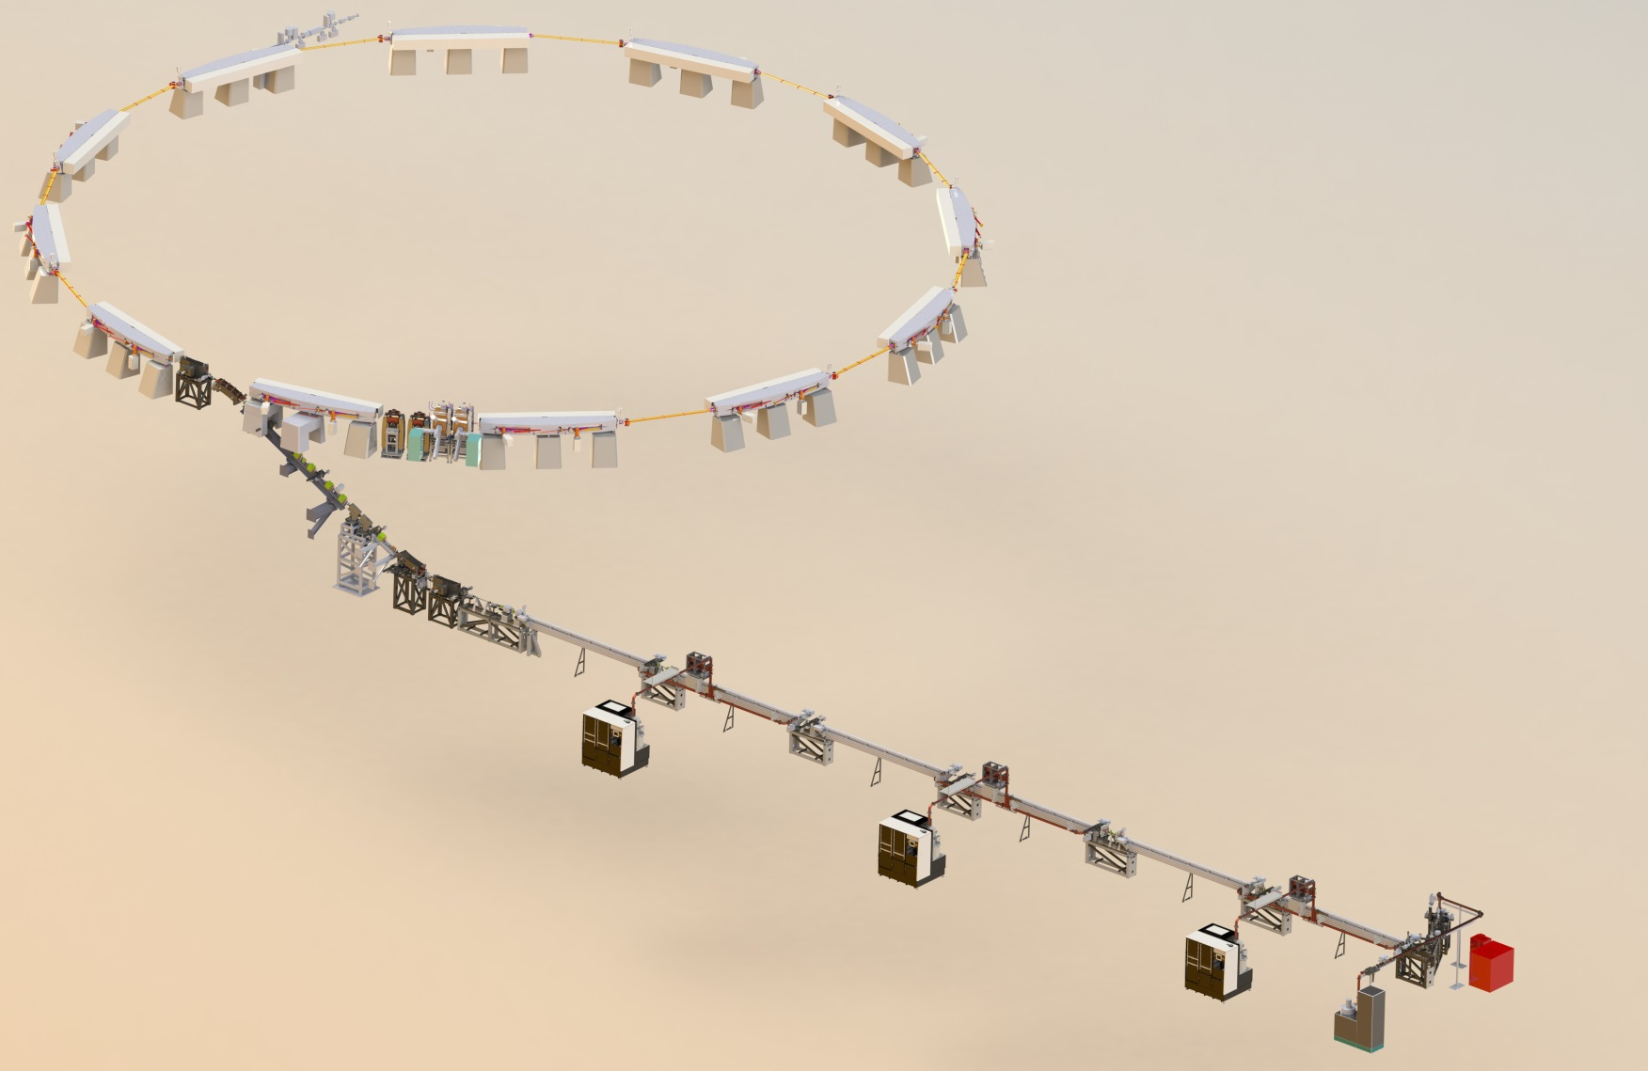
Machine Parameters
600 MeV Injector:
Thermionic RF Gun
6 s-band accelerating structures
Transfer line with DC septum
Normalized emittance 10mm mrad
Energy spread <0.2%
1.5 GeV Storage Ring
12 DBA magnet blocks
100 MHz RF system
300 MHz Landau Cavities
Injection dipole kicker
Ramping
2 Beamlines
Energy | 1.5 GeV
Current | 500 mA
Circumference | 96 m
Emittance (bare lattice) | 5.982 nm rad
Tunes Q_{x}, Q_{y} | 11.22, 3.15

Slide 8
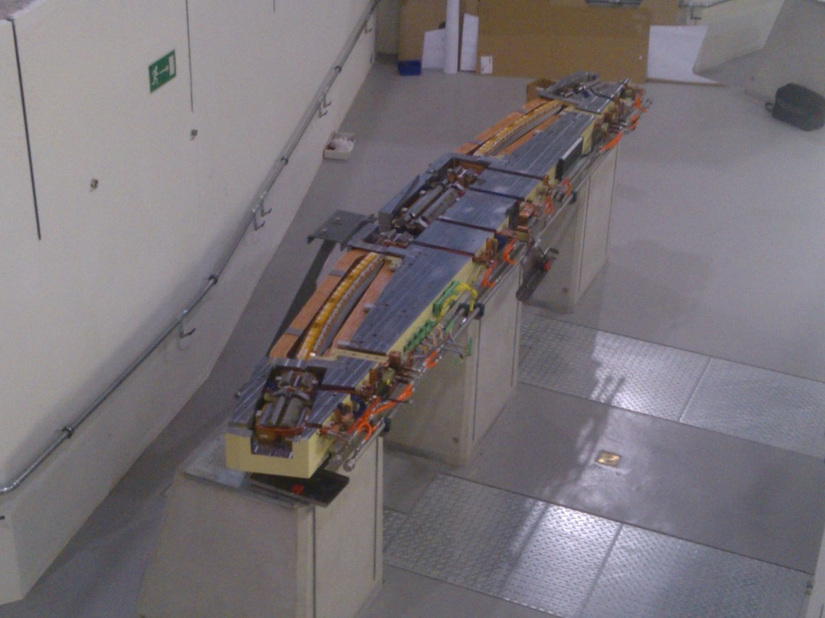
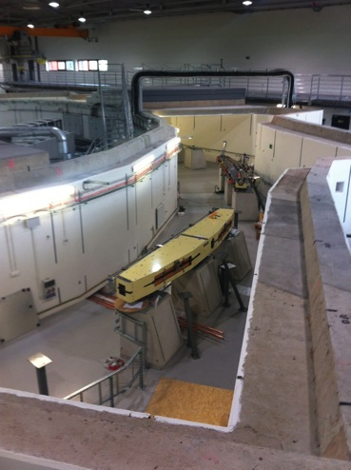
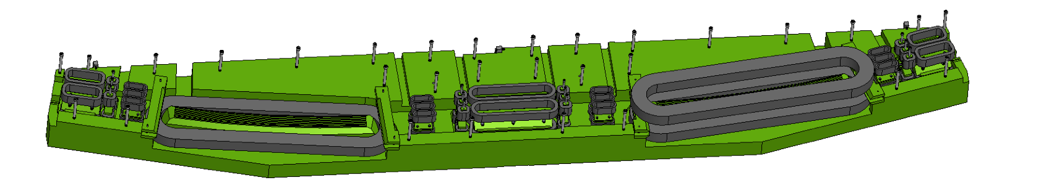
Magnets
Storage Ring – Magnets (mirror symmetric)
Machined from solid iron, 2 half slabs, ~4.5 m, ~4 Tons each slab
Multi-coil correction magnets (COD, Skew quads, aux. sextupoles)
Combined focusing quadrupole-sextupole magnets
Gradient bending magnet
with pole-face strips
Defocusing sextupole magnets
Magnets designed by M. Johansson - MAXIV

Slide 9
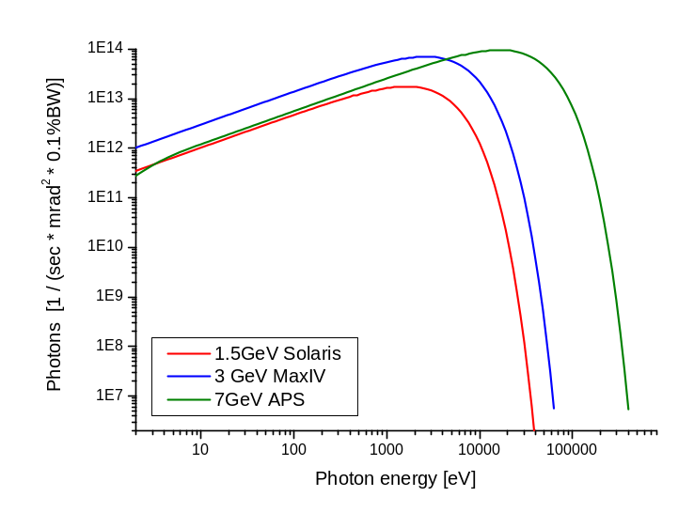
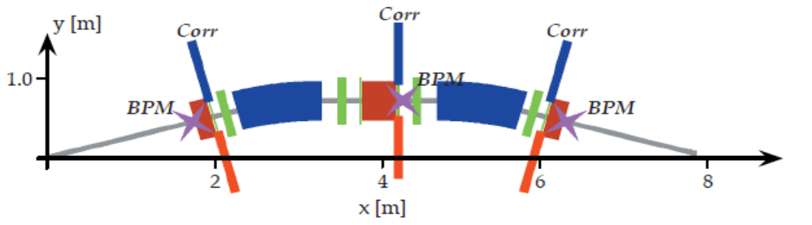
Designed Parameters
Bending magnet source size (σ):
Horizontally x vertically= 44μm x 30μm
22
0.3
20
0.2
Straight section source size (σ):
Horizontally x vertically= 180μm x 13μm
18
0.1
16
0.0
14
-0.1
12
Dispersion [m]
Betafunctions [m]
-0.2
10
8
-0.3
6
-0.4
4
-0.5
2
-0.6
0
0
1
2
3
4
5
6
7
8

Slide 10
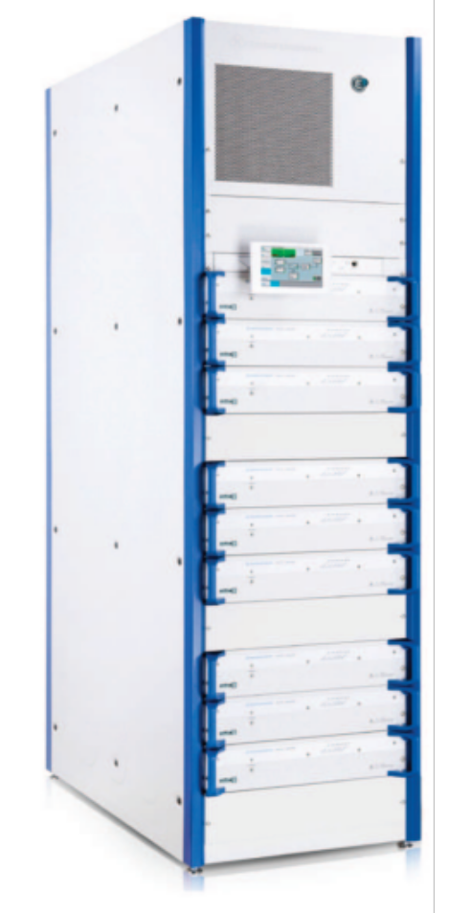
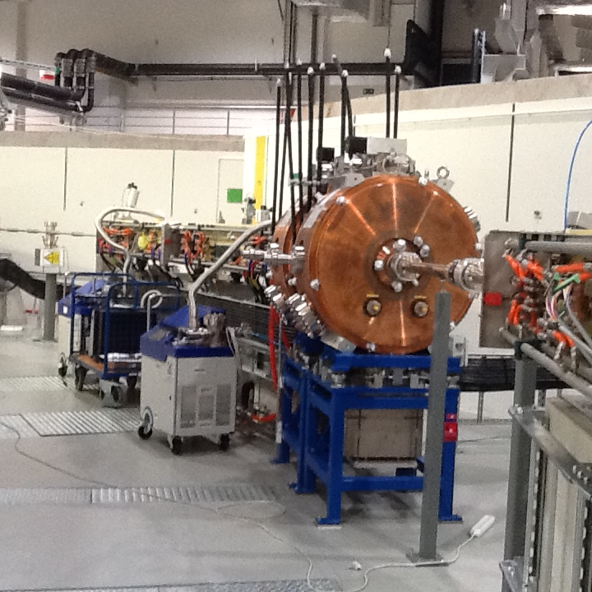
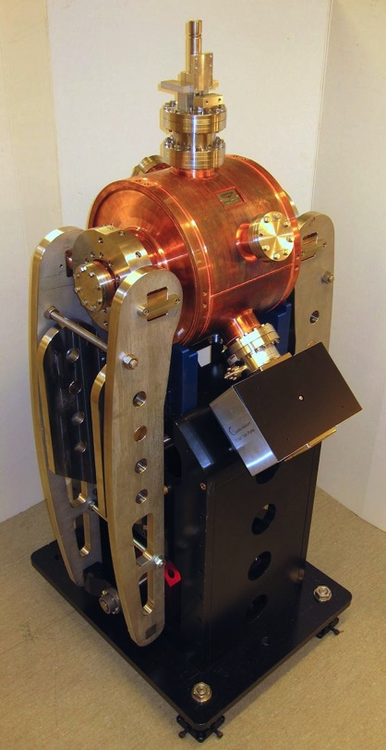
RF System
Two 100 MHz cavities.
Power source –Rohde& Schwarz – solid states units 2x60 kW
300MHz Landau Cavities
100 MHz main cavities in SR
300 MHz Landau cavity

Slide 11
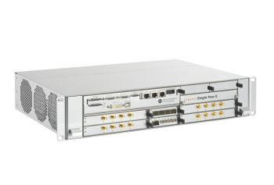
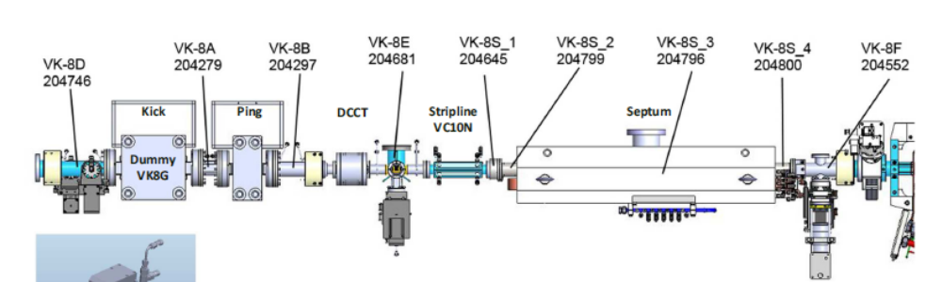
Beam Instrumentation
Injector
YAG screens with Basler cameras and Tokina lenses – (10+2)
Stripline BPMs with Libera Single Pass – (8)
Current transformers with RTO oscilloscopes – (4)
Faraday Cup connected to oscilloscopes – (2+1)
Stripline chopper with 500 MHz signal generator
Storage ring
36 button BPMs (3 per cell) with Libera Brilliance+ (SOFB at 10Hz, with future upgrade to 10kHz FOFB)
Vertical and Horizontal scrapers
NPCT current transformer probe
Electrostatic Stripline for tune measurement
YAG screen with CCD Basler camera
Pinger magnet
Kicker magnet in 3rd straight

Slide 12
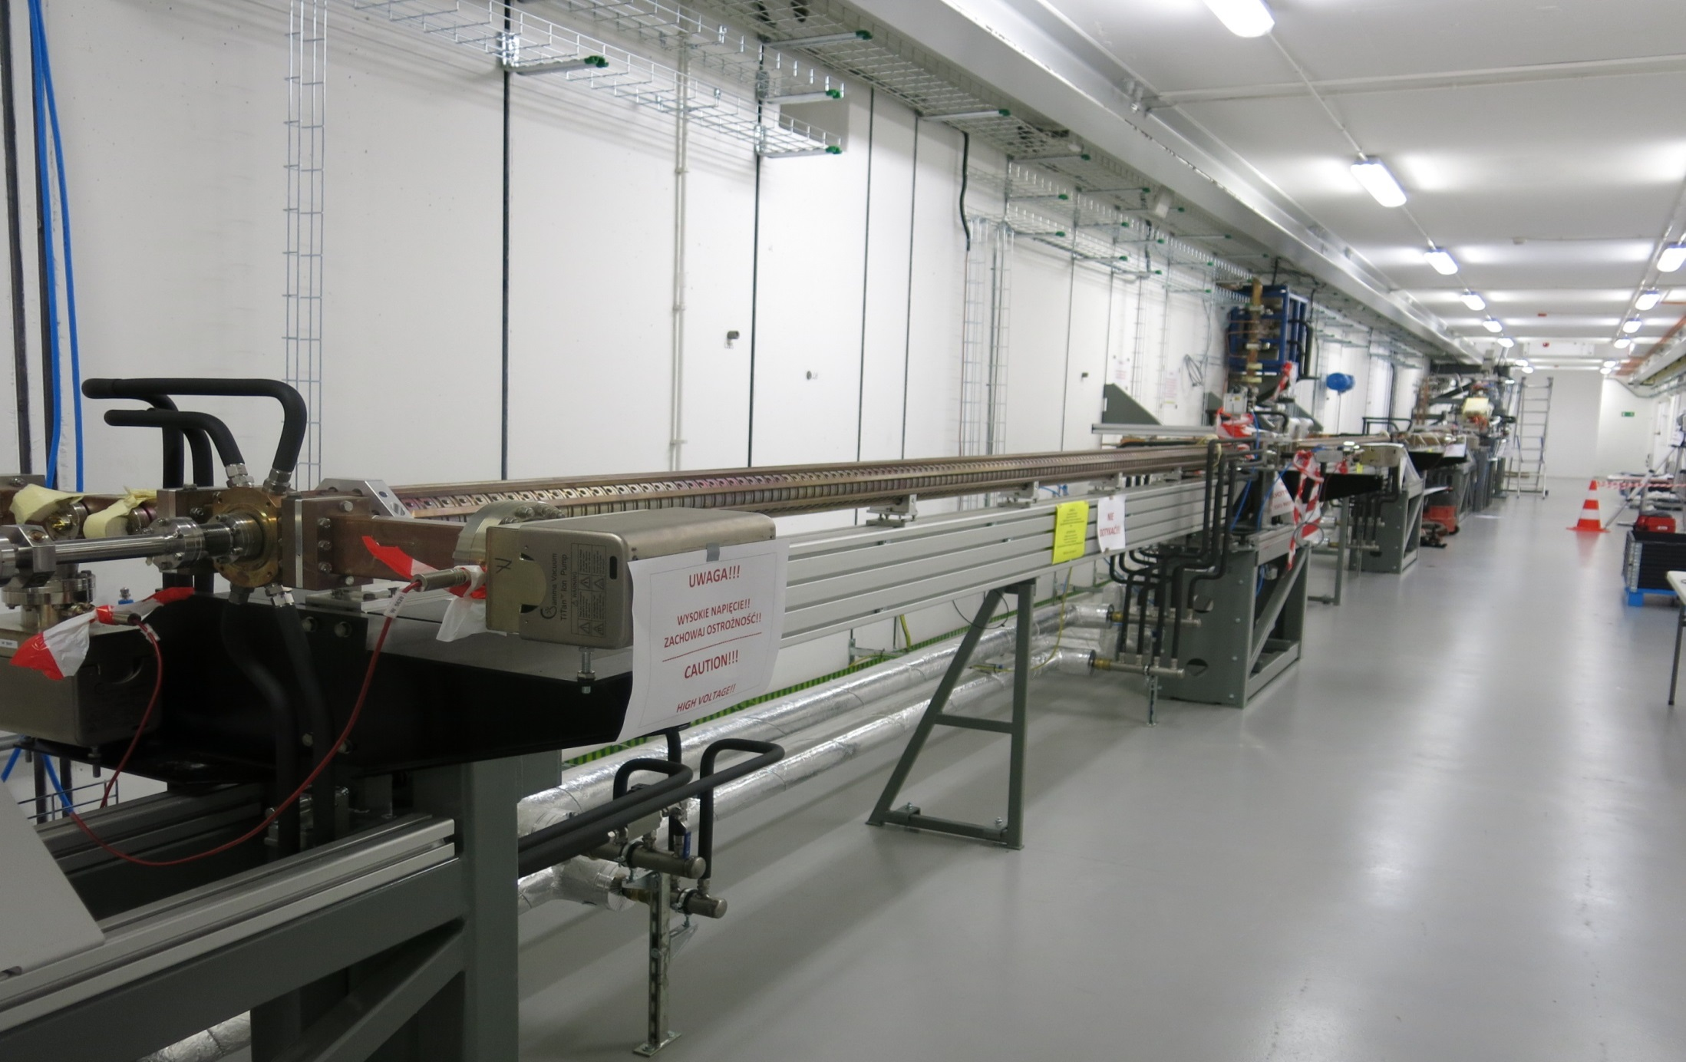
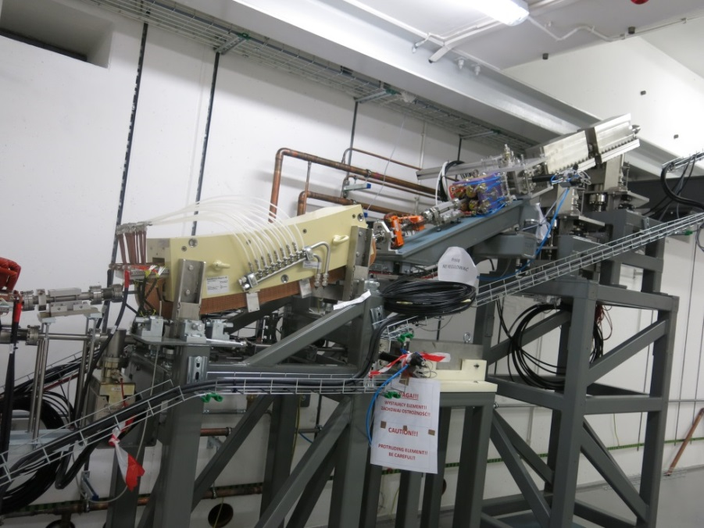
Linac Commissioning
Subsystem Tests
October-Mid November2014
RF Units Conditioning
17th of November 2014
Gun sytem conditioning
Beg. December 2014
Commissioning Mid December 2014 – 23rd February 2015

Slide 13
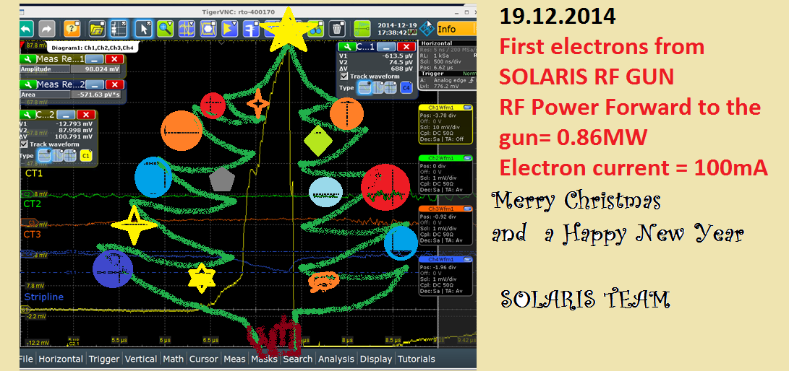
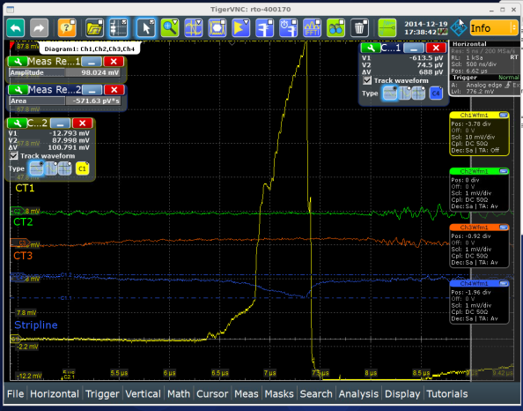
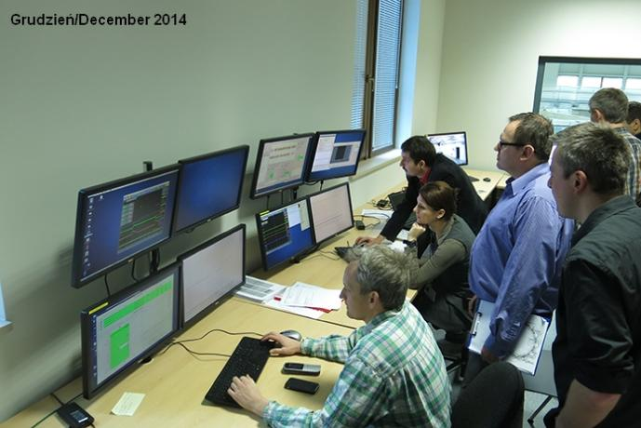
First electrons @ Solaris

Slide 14
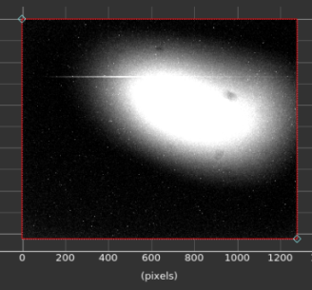
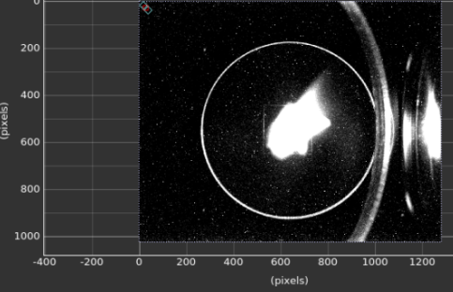
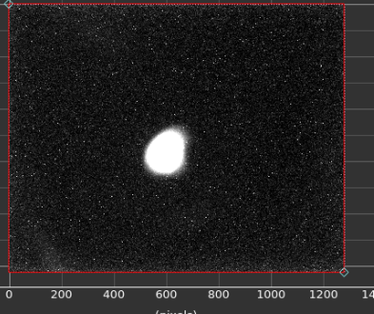
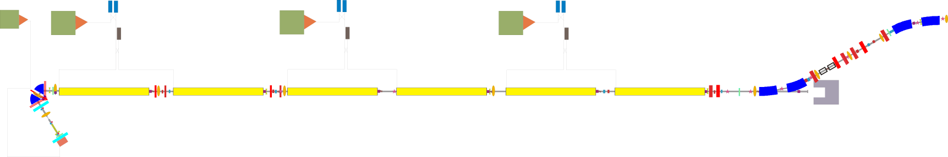
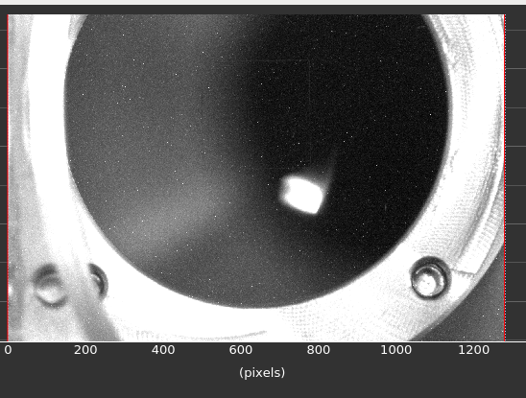
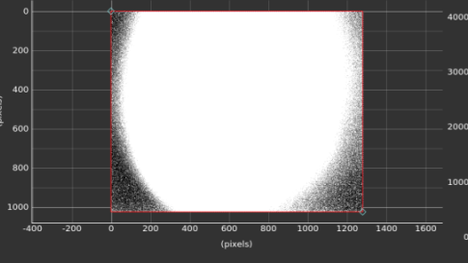
Injector
11.02.2015
Beam at the entrance
to the linac
20.02.2015
Beam after 1st Unit
22.02.2015
Beam after 3rd unit
23.02.2015
Beam at the end of linac!
9.02.2015
Beam at 1st YAG after the gun
Estimated energy: 300 MeV

Slide 15
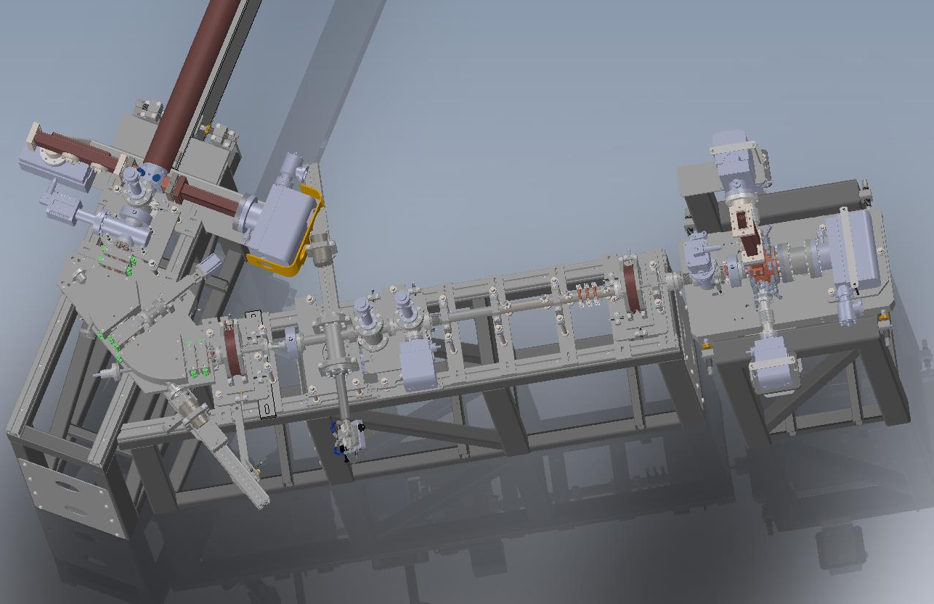
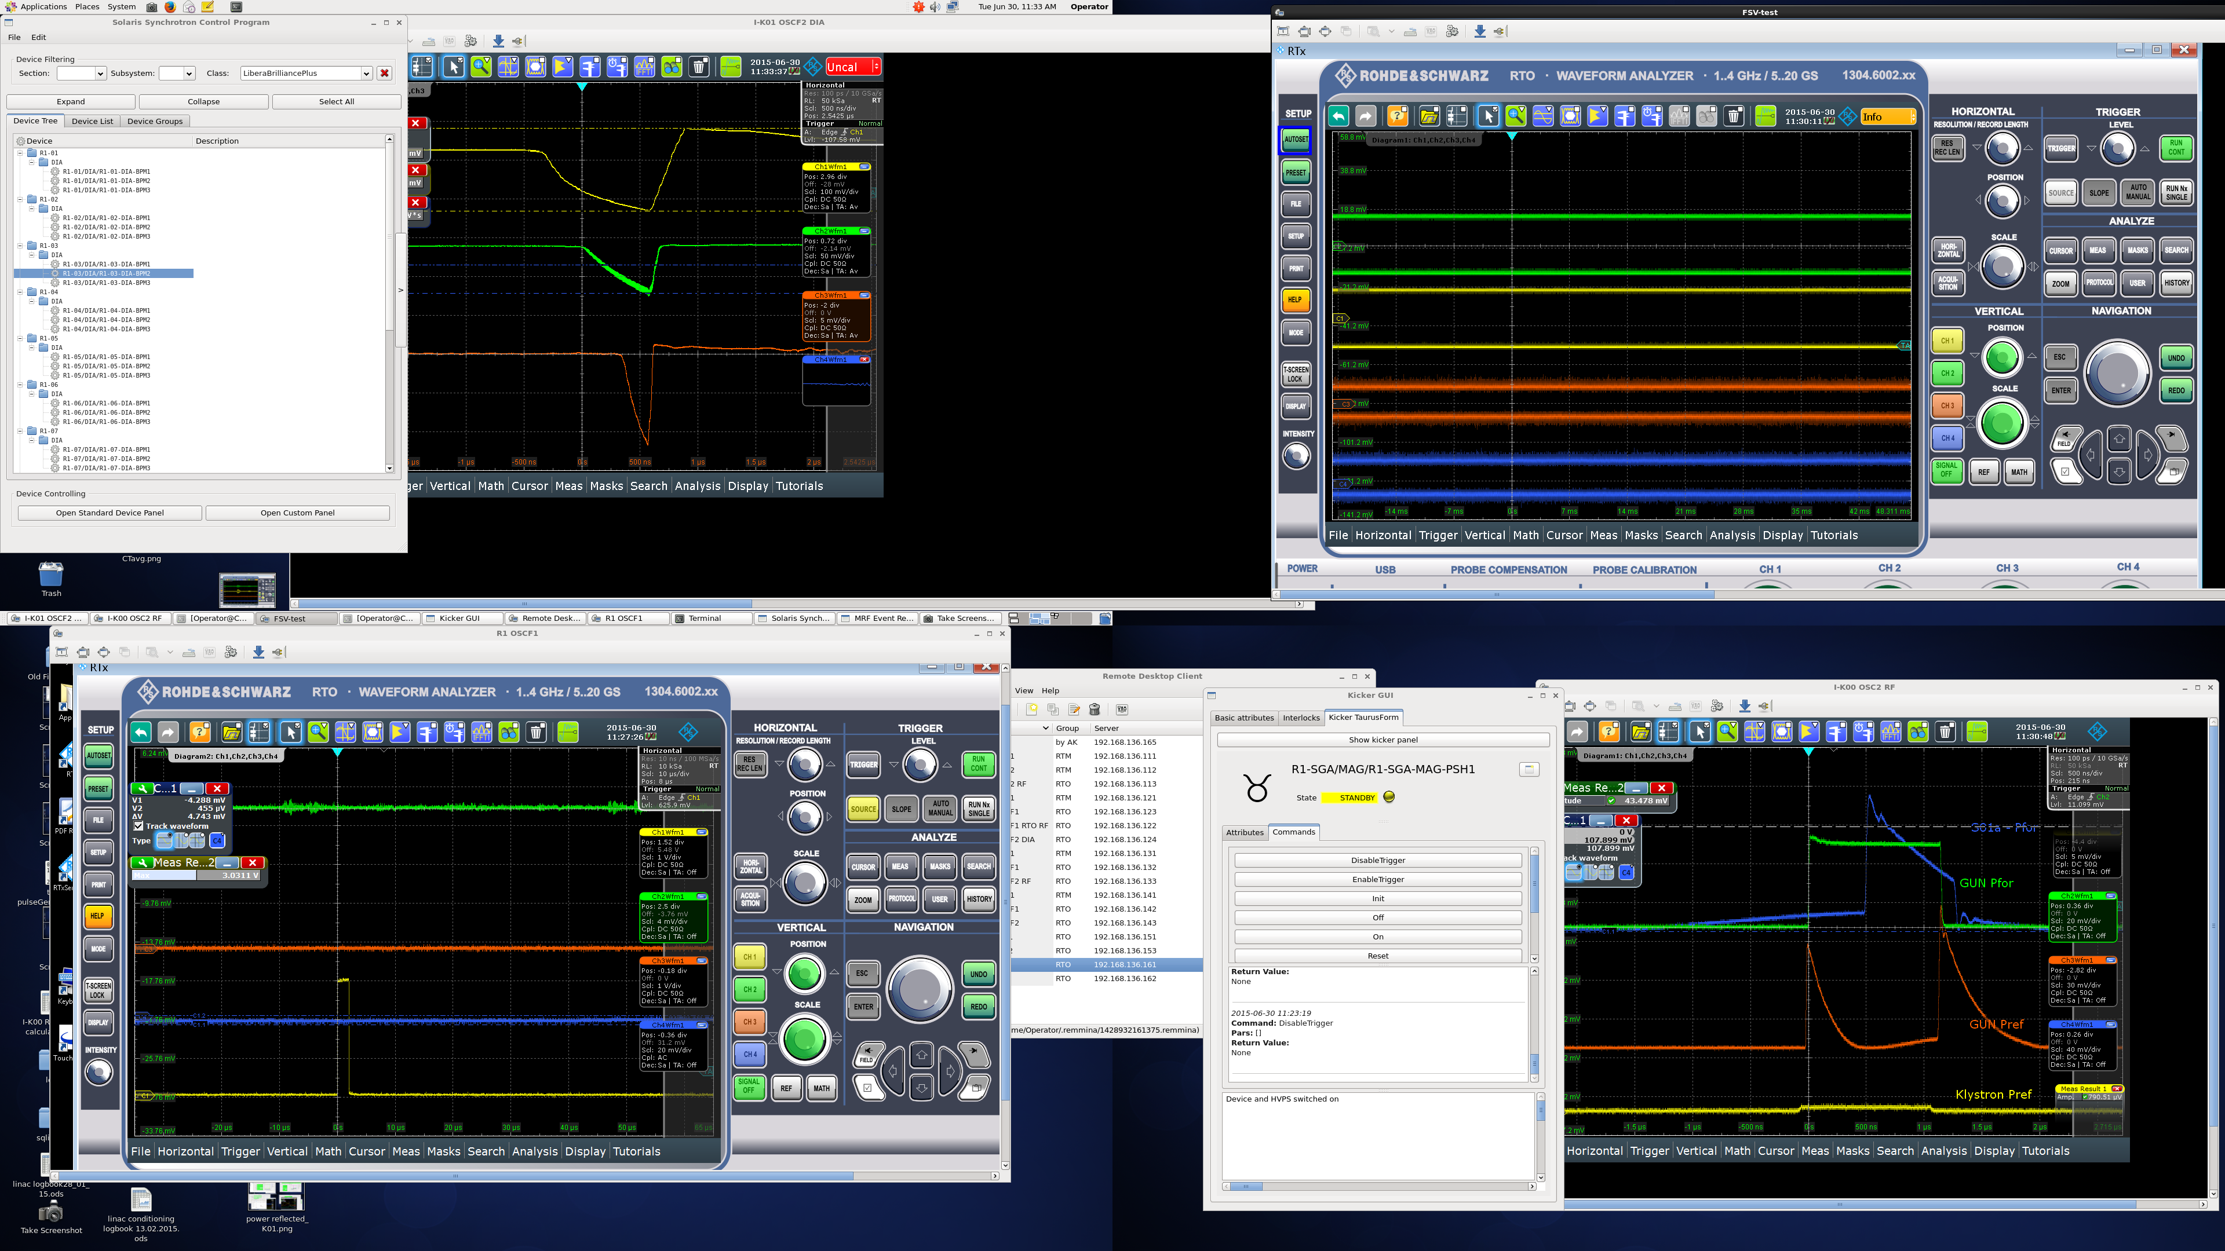
Beam Current
Beam energy 2.8MeV
200 mA
CT3
50 mA
CT1
12 mA
CT2

Slide 16
Commissioning plan
Phase I May-July2015
Phase II September-November 2015
Phase III January-March 2016…
Storage Ring
Phase I
The goal is to obtain stored beam of sufficient quality that beamline installation can use the synchrotron radiation for alignment
Transfer line commissioning
Phase II
The goal is to reach the design parameters of the bare lattice, beam current excepted.
Activities
Phase III
Injection
First turn
Acumultaion
Ramping
Stored beam
Orbit correction & BPM calibration
Linear optics correction
Vacuum conditioning
Notes
Beam position stable over long term
Varying beam sizes
No IDs should be installed
Ring tunnels generally inaccessible; some open periods likely
Halls accessible
The goal is to reach the usable beam current for the bare lattice
-
Optimisation of the lattice with undulator in place
Lattice optimisation with Landaus in place
Lifetime improvements
FOFB impelementation

Slide 17
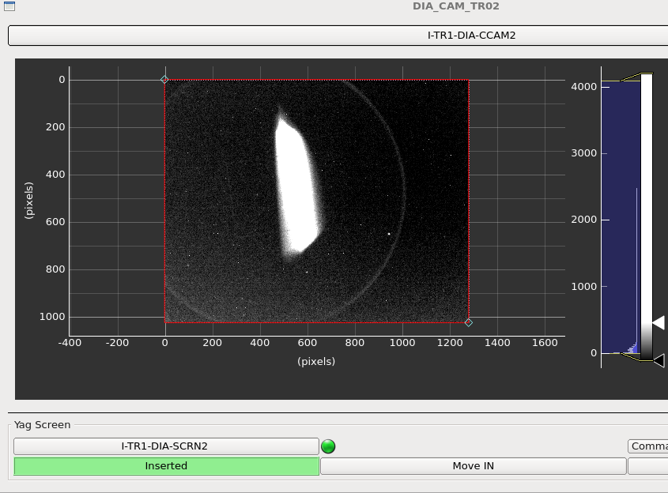
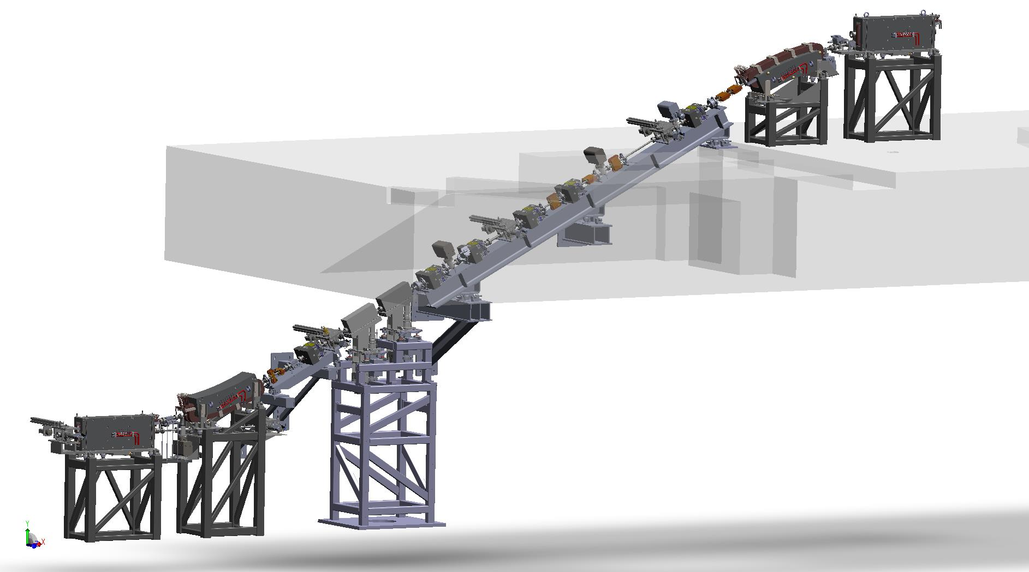
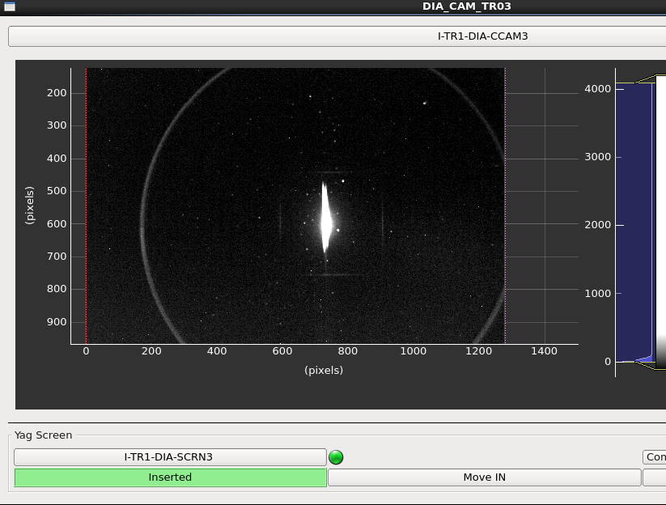
Transfer Line
BPM
26.05.2015
CT
23.02.2015
YAG
BPM
Beam stoppers
YAG
CT
BPM
YAG
BPM
26.05.2015

Slide 18
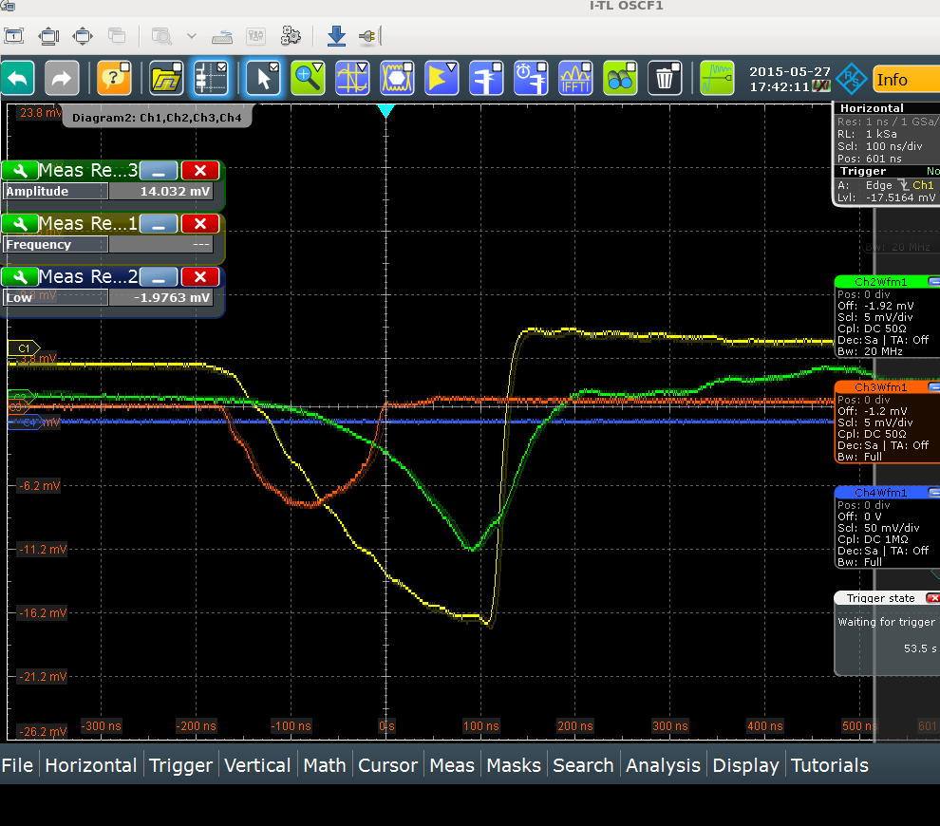
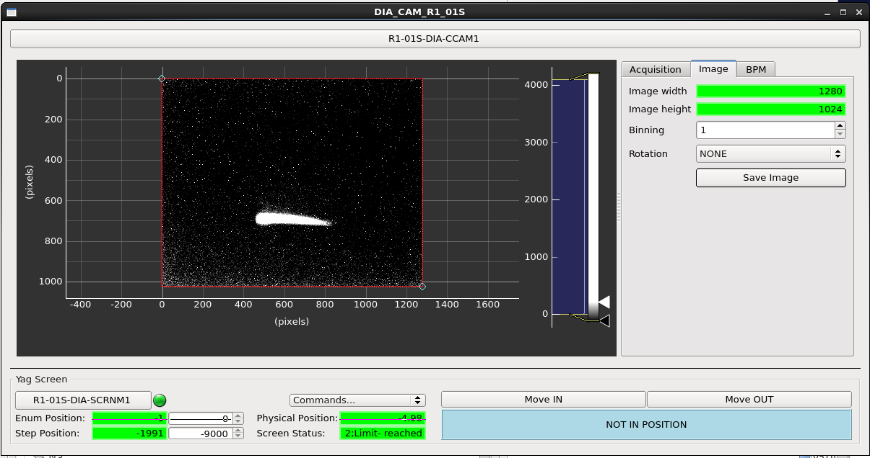
First beam in Solaris
storage ring
Current:
at the entrance to the transfer line (yellow)
Between bottom septum and dipole magnet (green)
In the beam stoppers area (orange)
27.05.2015
Beam in the storage ring
Energy 320 MeV
Charge 1.5 nC
rep rate 10Hz

Slide 19
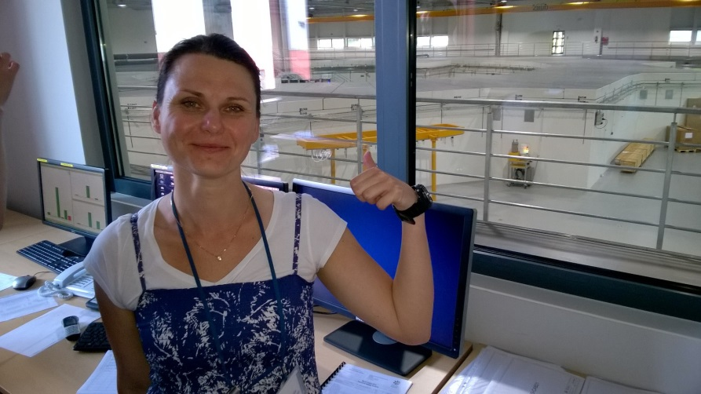
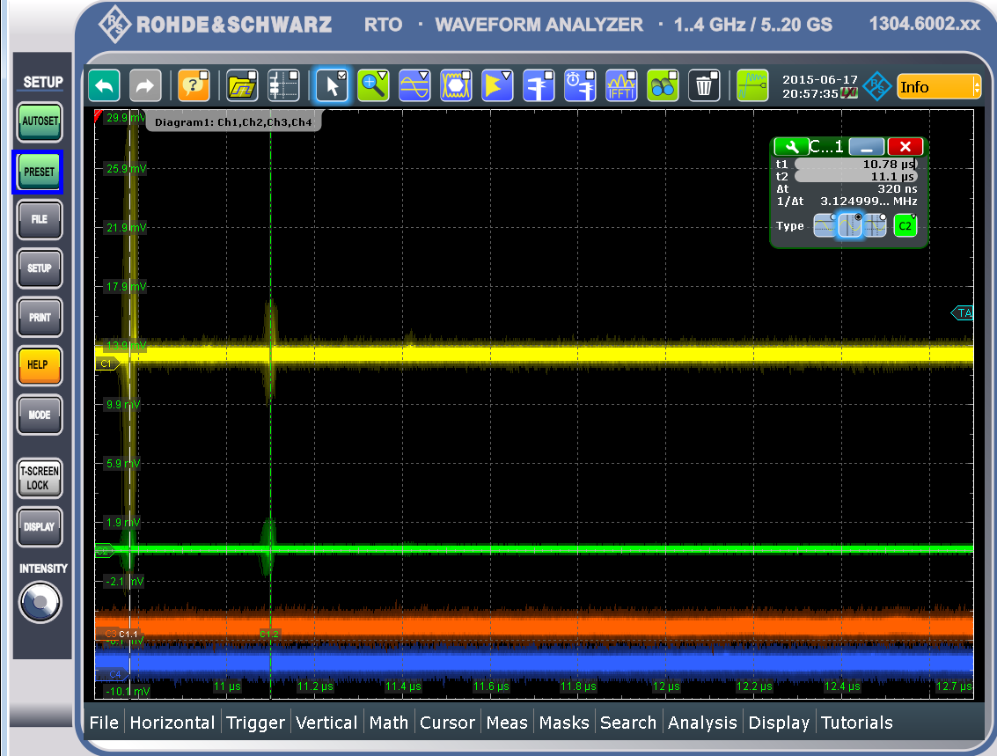
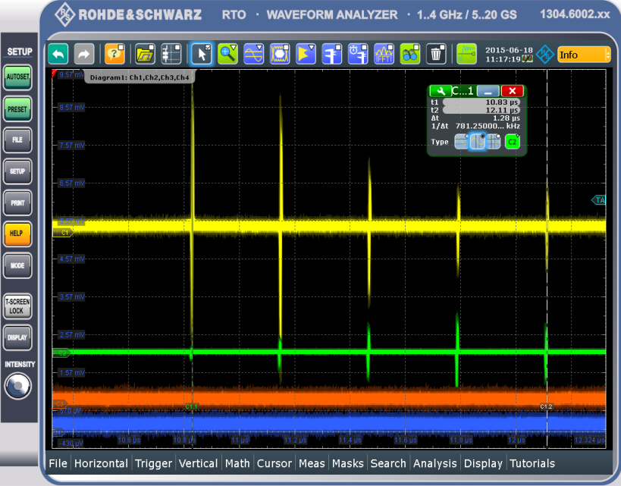
Storage Ring Commissioning
11.06.2015 – First turn
16.06.2015
2 turns (2 yellow peaks 320 ns apart) was observed
6 turns

Slide 20
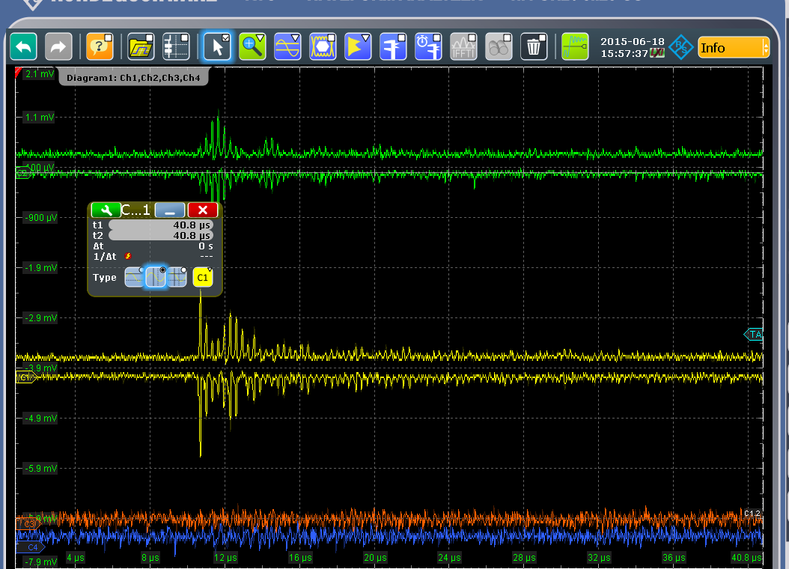
Kicker & Multiturn
17.06.2015
Fired the kicker
Get multiturns
Rep. Rate 10 Hz
Energy 360MeV
Injection energy 360 MeV
Injection rep. rate 1 Hz

Slide 21
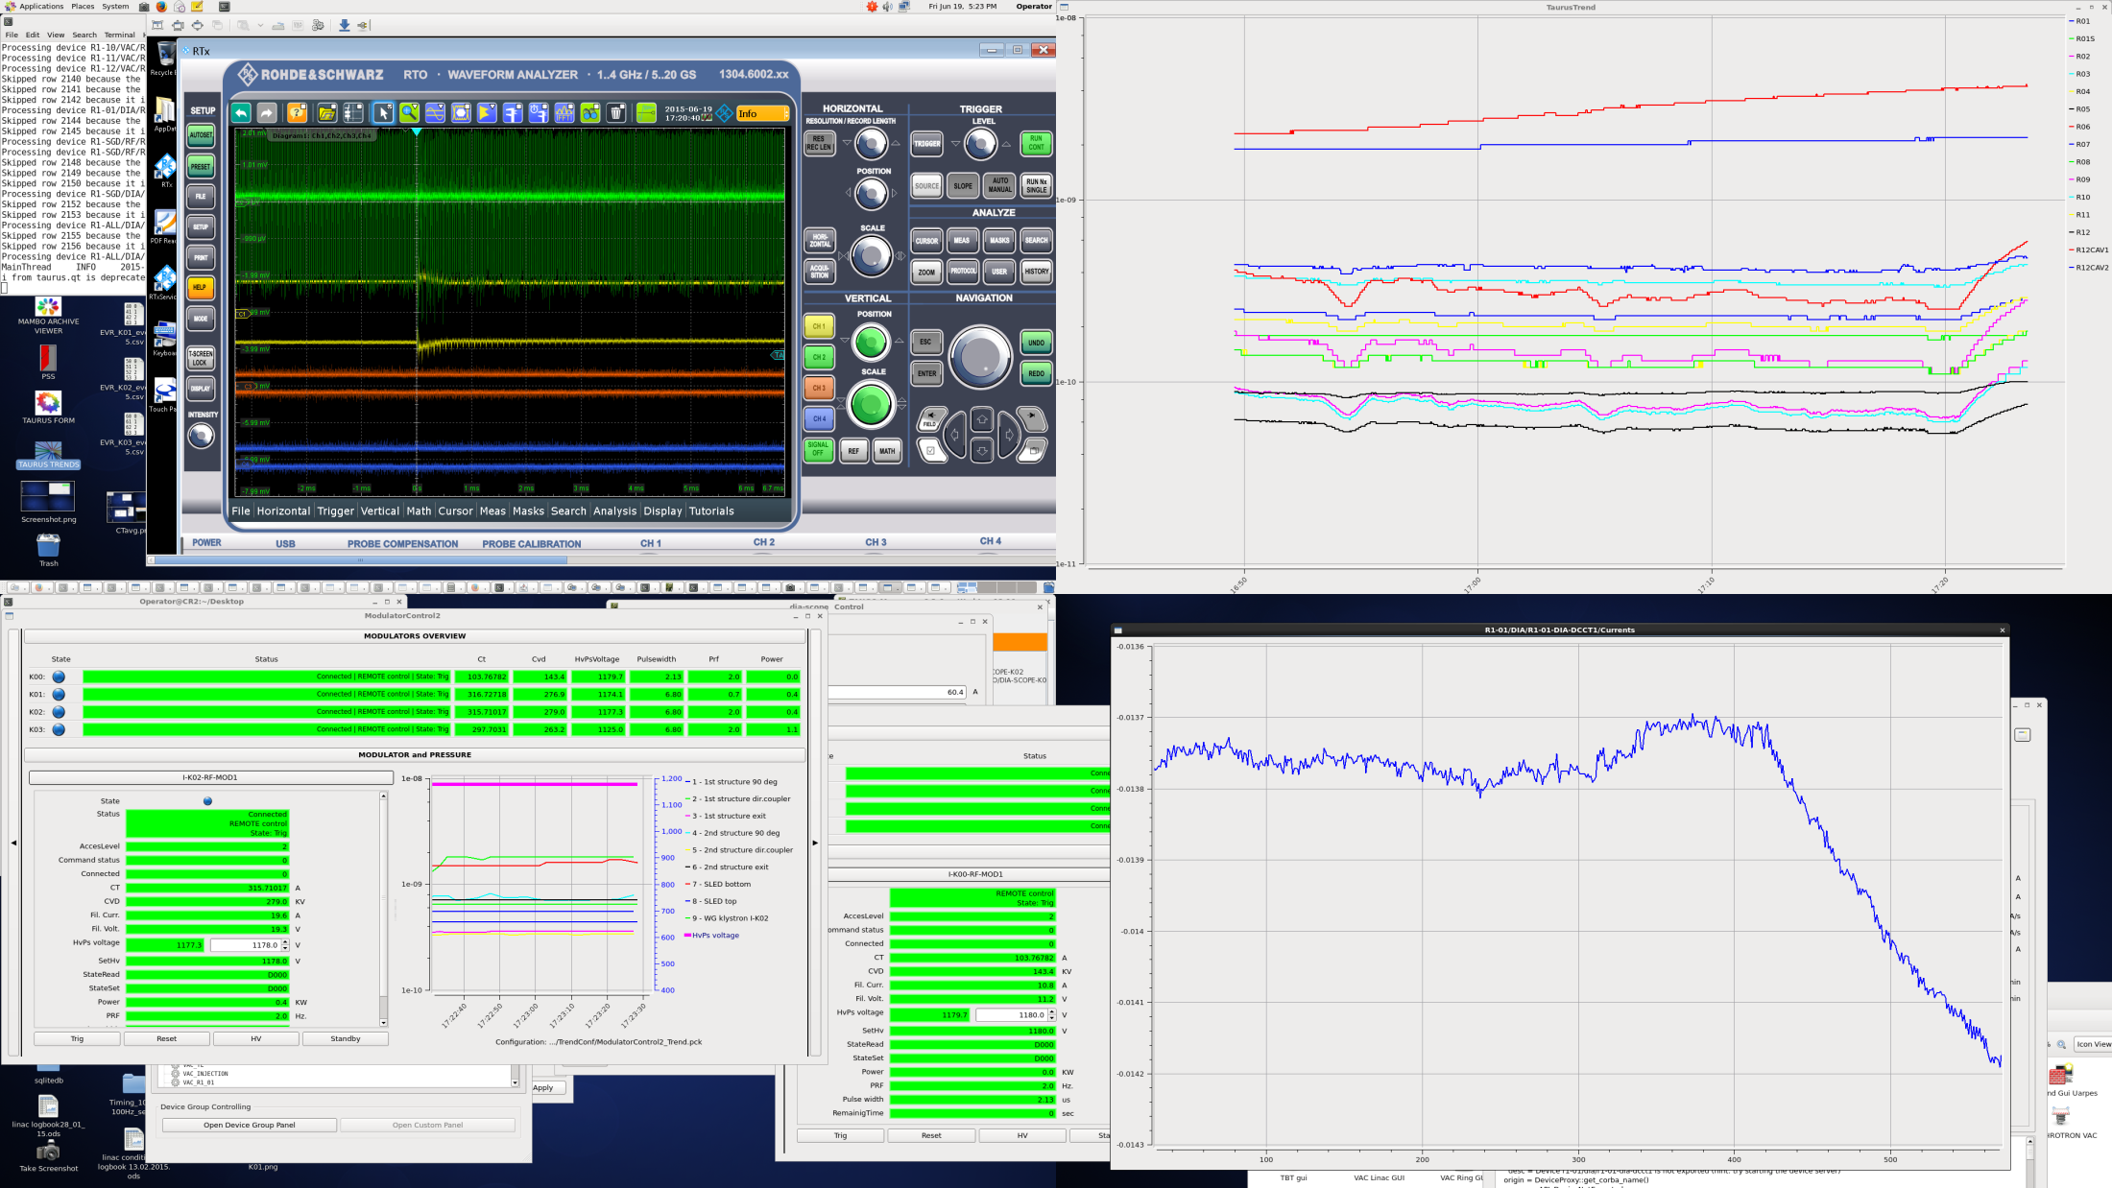
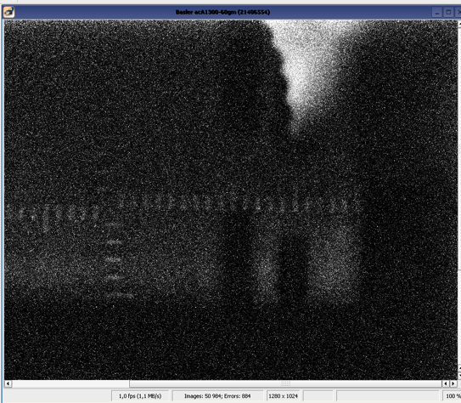
Accumulation &
Stored beam
Injection energy 360MeV
Rep. Rate 0.5Hz
Vacuum
I= 7µA
Current
First photons at Solaris!

Slide 22
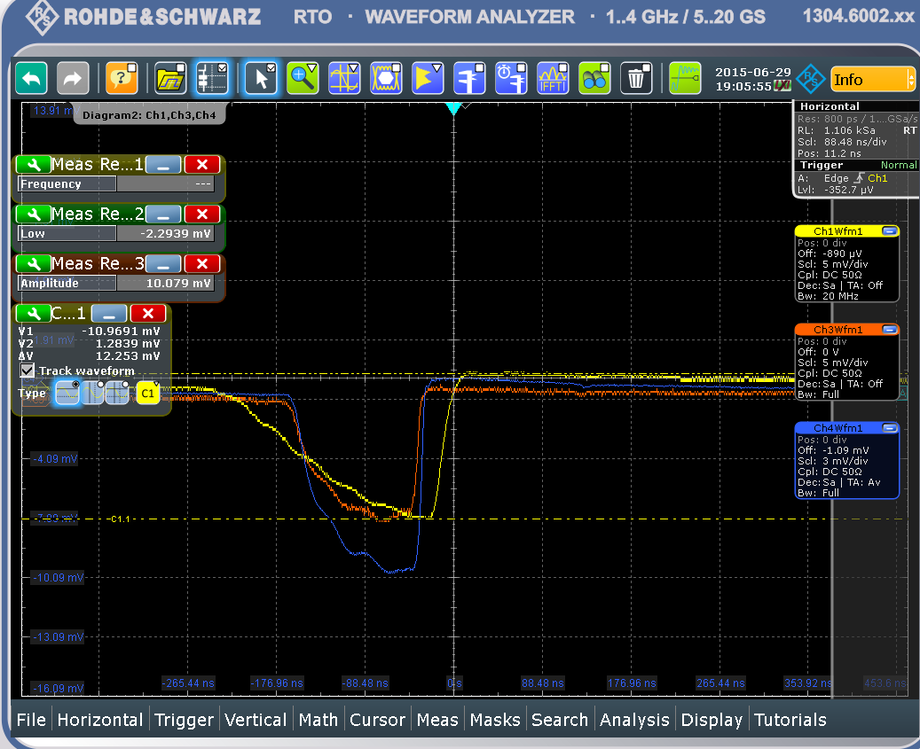
Linac tuning
The phase difference between linac structures around 20 deg – mechanical phasing
SLED tuning
Synchronisation of units (delays and RF phase)
Beam energy at the end of linac increased from 360MeV to 490MeV
10 mA beam current / 150 ns bunch train
at the end of transfer line

Slide 23


Stored current and lifetime
13.2 mA
6 mA
1.5 mA
32 min
10 min
6 min

Slide 24

Closed orbit and Tune
x_{rms}=2.281mm
y_{rms}=0.701mm
Q_{x}=10.78
Q_{y}=3.6
Nominal values:
11.22; 3.15

Slide 25

Ramping
490MeV
712MeV
743MeV

Slide 26
SUMMARY
The RF systems of linac and storage ring have not reached their full performance and are still being conditioned.
Injection to the storage ring is done at 490 MeV with a repetition rate of 2 Hz maximum and single dipole kicker scheme.
The injection efficiency is low and is being optimised.
The ramping to full energy is under tests.
For the present the storage ring does not operate at its nominal optics but is expected to do so as commissioning progresses with full characterisation of the optics and closed orbit correction.

Slide 27









Acknowledgments
MAX IV TEAM
Elettra, Sincrotrone Trieste
Machine Advisory Committee
Scientific Advisory Committee
Polish Synchrotrons Users’ Society
Special thanks to Dieter Einfeld &
Guenther Rehm
…

Slide 28

Solaris First Light
Thank you for the attention!
Photon beam at PEEM front-end seen on fluorescent monitor

