Slide 1
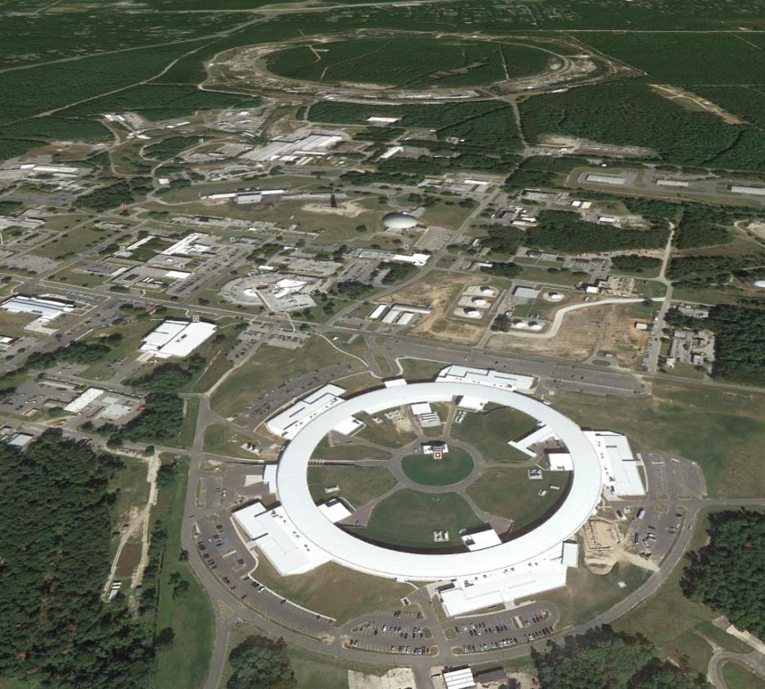
Characterization of NSLS2 Storage Ring Beam Orbit Stability
RHIC
NSLS
NSLS2
Weixing Cheng#, Kiman Ha, Joe Mead, Boris Podobedov, Om Singh, Yuke Tian, Li-hua Yu
NSLS-II, Brookhaven National Laboratory, Upton, NY 11973, USA
Present at 4th International Beam Instrumentation Conference (IBIC’2015),Melbourne, Australia, September 13 - 17, 2015

Slide 2
Outline
NSLS2 BPM system introduction and its performance
  Types of button BPM and sensitivity
  BPM electronics data flow
  Resolution measurement
  RF attenuator dependency and calibration
  Current and fill pattern dependency
Beam orbit spectrum
  Compare with mechanical vibrations
  FOFB ON/OFF
  Compare with xBPM spectrum
Long term stability
Summary

Slide 3
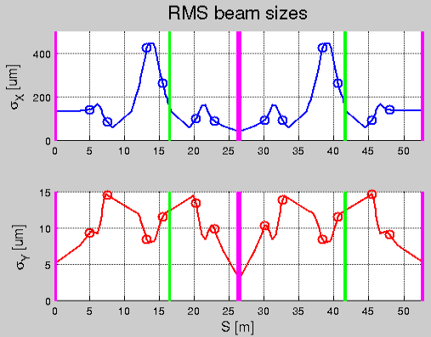
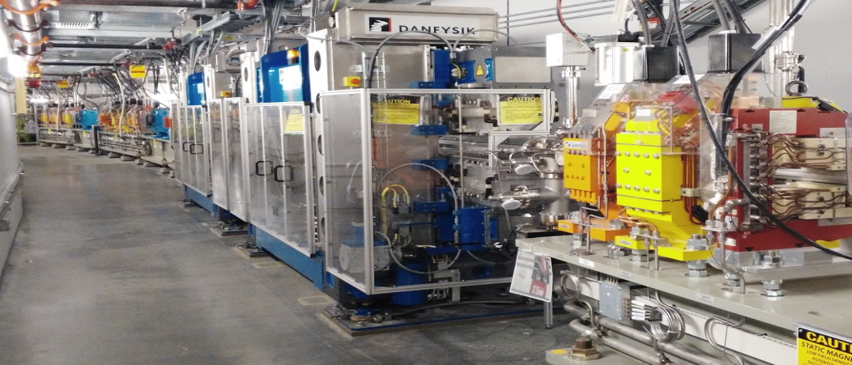
NSLS2 storage ring main parameters
Energy 3.0 GeV
Circumference 792 m
Number of Periods 30 DBA
Length Long Straights 6.6 & 9.3m
Emittance (h,v) <1nm, 0.008nm
Momentum Compaction 0.00037
Dipole Bend Radius 25m
Energy Loss per Turn <2MeV
Energy Spread 0.094%
RF Frequency 499.68 MHz
Harmonic Number 1320
RF Bucket Height >2.5%
RMS Bunch Length 15ps-30ps
Average Current 500mA
Current per Bunch 0.5mA
Charge per Bunch 1.3nC
Touschek Lifetime >3hrs
Top-Off Injection 1/min
Beam sizes in one super period calculated using
ε_{x} = 0.9 nm.rad, ε_{y} = 8 pm.rad; ΔE/E = 0.09%
Source point | Long ID | Short ID | 3PW | BMB
σ_{x} [um] | 135.0 | 40.3 | 153.0 | 133.1
σ_{y} [um] | 5.2 | 3.0 | 12.4 | 12.5
DBA
Orbit stability requirements:
< 10% of beam size and divergence
DW

Slide 4
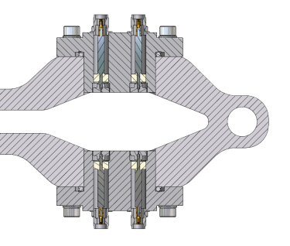
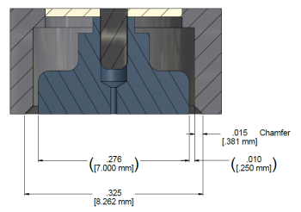
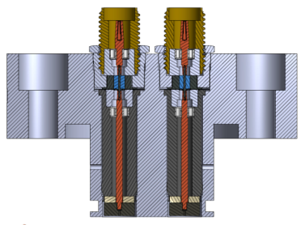
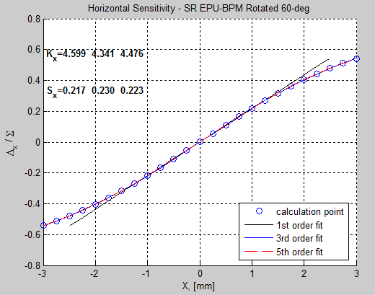
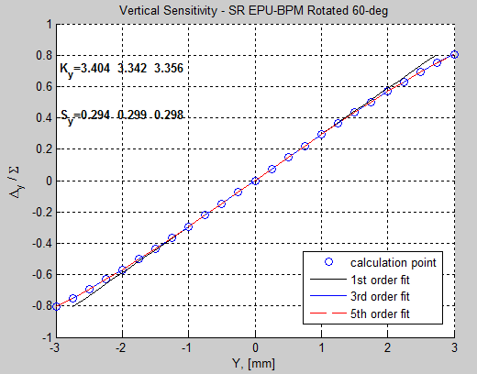
Types of NSLS2 button BPM:
  SR Large Aperture BPM
  SR Large Aperture BPM, 64-deg rotated
  SR Small Aperture BPM - DW, 60-deg rotated
  SR Small Aperture BPM - EPU, 60-deg rotated
  Special injection straight BPMs
  LINAC BPM
  LtB/BtS BPM - round type
  LtB/BtS BPM - elliptical type
  Booster BPM - Type-I
  Booster BPM - Type-II
Button BPM sensitivity nonlinearity – 1D fitting
Button BPM sensitivity nonlinearity – 2D fitting
LA-BPM
Button diameter – 7mm
Button center distance – 16mm
Gap between button and body – 250μm
Button thickness – 2mm
SA-BPM
Button diameter = 4.7mm
Button gap = 250μm
Button thickness = 2mm

Slide 5
BPM signal flow
y
x - positive x point outside of the ring
y - vertical position
z - beam direction, goes into the page
A
B
x
D
C
Jumping cable
SiO2
(*4)
SDI fiber network
LMR240 cables (4) to BPM electronics, ~100 feet
BPM electronics
PTC
C.C.
To PS
6 BPMs + ID BPMs per cell
One LMR240 cables for pilot tone injection, ~100 feet
Control network
PTC - pilot tone controller
will band pass filter the button BPM signal (fc=499.68MHz, BW=+/-10MHz)
Pilot tone signal combiner using diplexer
BPM electronics includes AFE + DFE
AFE: BPF + Amplifier + Var. Att + ADC
DFE: Xilinx Virtex 6, integrated uBlaze, SRAM
Local SDI and global SDI network share the 10kHz data around the ring
30 cell controllers for FOFB calculation, corrector settings send to PS
Same SDI 10kHz data is used for Active Interlock
BPM IOC
BPM configure
On-demand waveform data
10Hz streaming data

Slide 6
Digital BPM data type (NSLS2 ring)
Fs = 117.349MHz
raw ADC data
(First turn, single pass)
y
ADC
A
B
Frev = 378.55 kHz
TbT, Lattice characterization, injection optimization and many other machine studies
x
1/310
D
C
9.96 kHz
1/38
FA, used for fast orbit feedback, active interlock
9.96 Hz
1/1000
SA, for orbit display and correction
Frf = 499.68 MHz, harNum = 1320, Frev = 378.55kHz
F_adc = 117.349MHz = 310 * Frev
F_if = Frf - 4* F_adc = 1320*Frev - 4*310*Frev = 80* Frev. The 499.68MHz beam signal is in the 9th Nyquist zone with sampling rate of 117.349MHz.

Slide 7
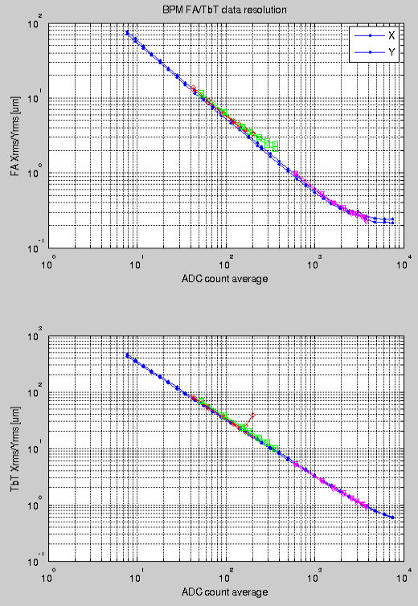
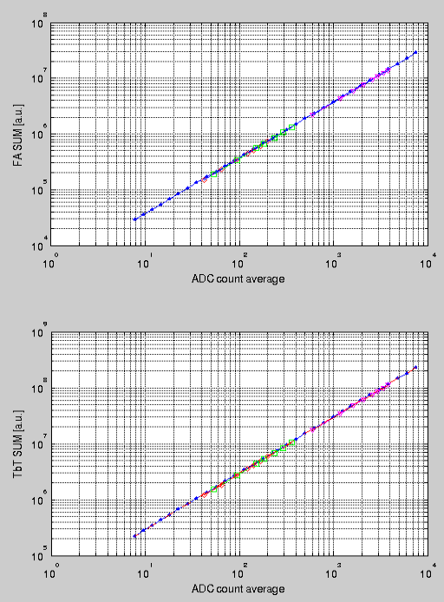
BPM Resolution vs. ADC counts (after BPF)
Blue – PT, C30 BPM1
Red – single bunch, C30 BPM1
Green – 20 bunches, C30 BPM4
Magenta – 1000 bunches, C28 SBPM1
Use C30 SBPM4
20 bunches, orbit was not stable
Resolution ~ 1/sqrt(38)
~ 200 nm resolution achieved
Beam was unstable at high single bunch current of 0.7mA
ADC count average = sum(abs(adc))/N
Sub-um resolution for TbT data

Slide 8
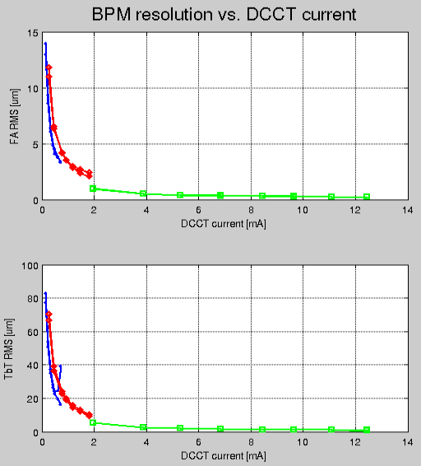
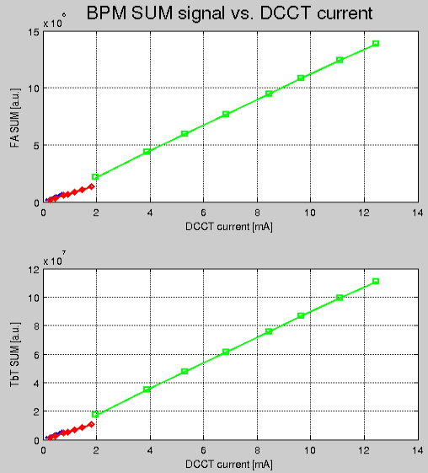
Blue – single bunch, C30 BPM1
Red – 20 bunches, C30 BPM4
Green – 1000 bunches, C28 SBPM1
BPM electronics resolution is determined by ADC average counts. It depends on beam current, button sensitivity, attenuator settings etc.
BPM Sum signal could be useful for total current/lifetime measurement. More studies needed as SUM signal may depends on bunch length, fill pattern, beam position, RF attenuator settings etc.

Slide 9
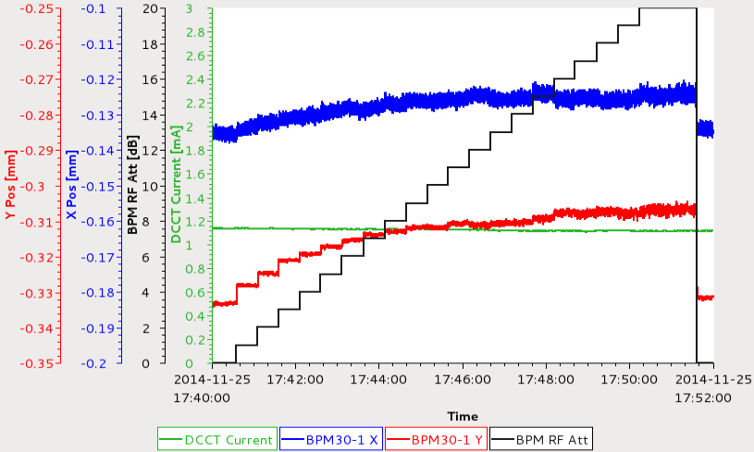
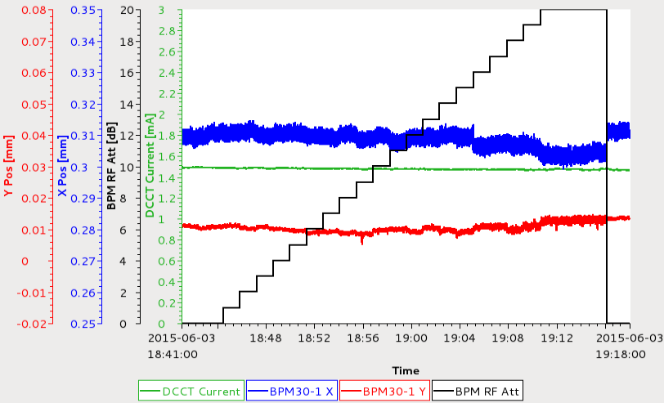
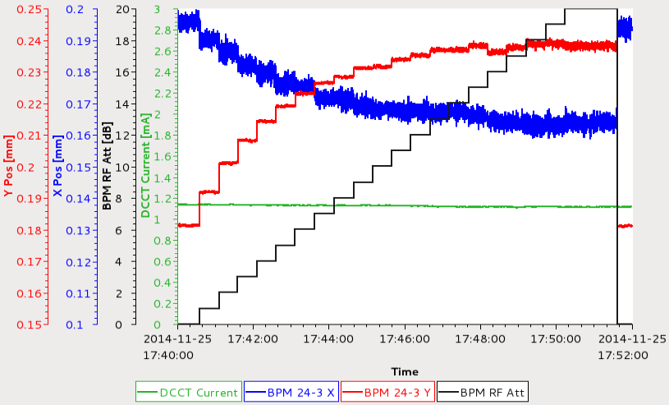
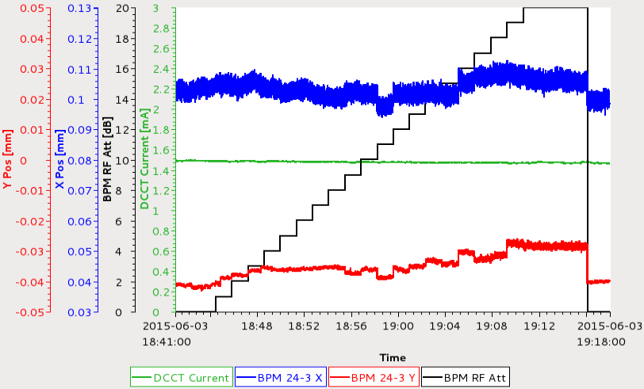
Old LUT
Beam based LUT
BPM 30-1
BPM 30-1
100um
BPM 24-3
BPM 24-3
With the new static gain calibration LUT, most of the BPMs has RF attenuator dependency less than 10um, while attenuator varied from 0 to 20dB in 1 dB steps. Note that the LUT was generated in Nov 2014 and it’s still working in months, with different current and fill pattern.

Slide 10
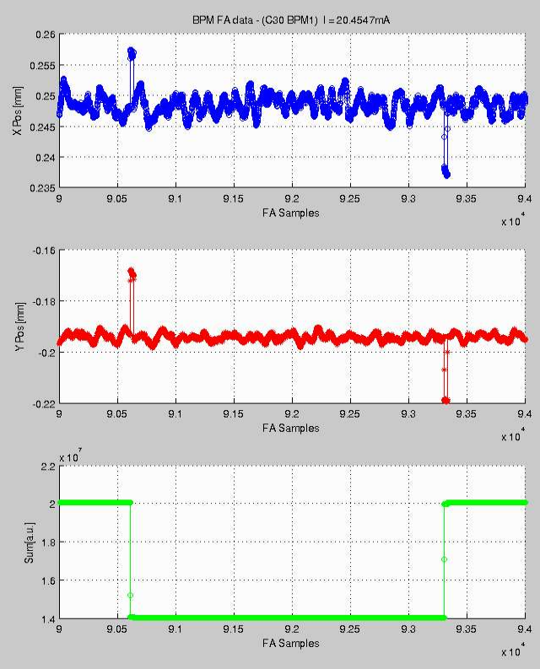
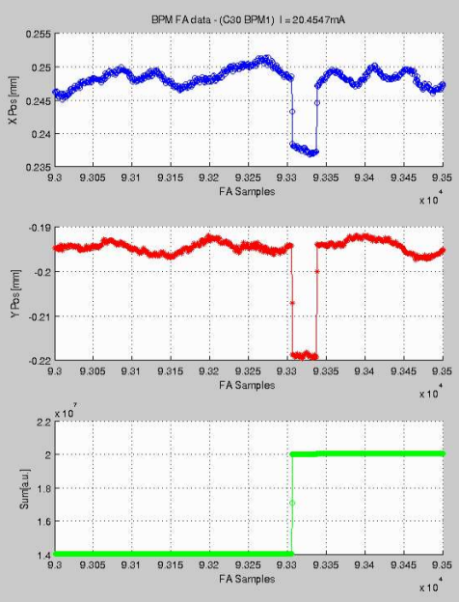
Glitches while change the BPM attenuator settings
Vary Att 0 to 3 dB during the period. It’s clear that when Att was changed, there was a glitch on FA position readings. The glitch last for ~32 FA samples.
Note the position reading is not changing at 0dB and 3dB, which is because of good RF attenuator calibration.
Turn AGC OFF for user operation, especially when FOFB turned ON
0dB
3dB
0dB
First observed on BPM TbT data, verified with FA data

Slide 11
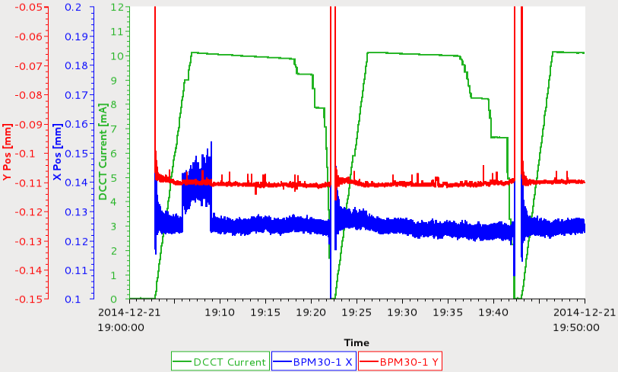
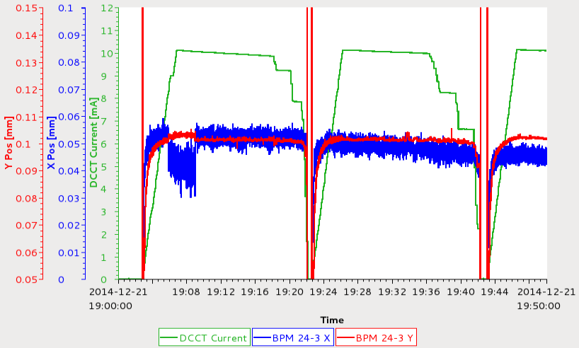
Current and Fill Pattern Dependency
100 bunches
200 bunches
350 bunches
10um
Three different fills to the same total beam current of 10mA distributed in 100, 200 and 350 bunches. Pretty small fill pattern dependency.
Knock out the bunches in steps to have different fill patterns.
BPMs near RF cavity section see larger current dependency, due to leaked noises at Frf. The issue is dominant for single bunch studies when Ib < 0.2mA. Typically not a problem when the beam current is high.
10um

Slide 12
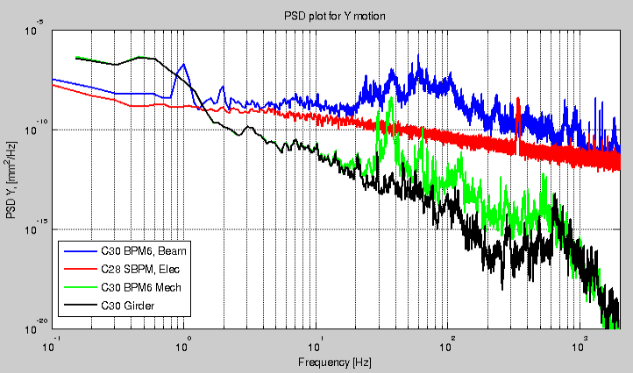
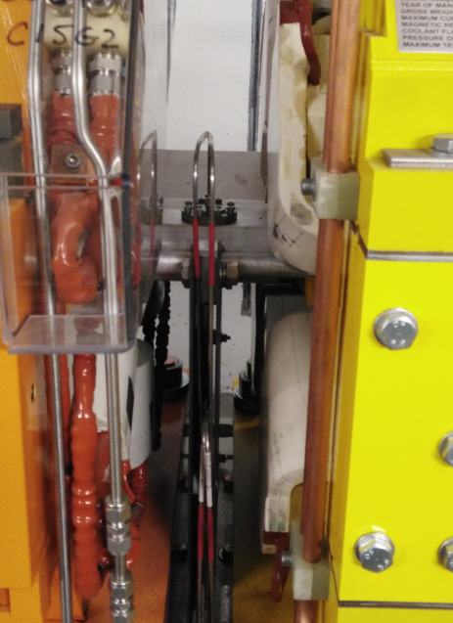
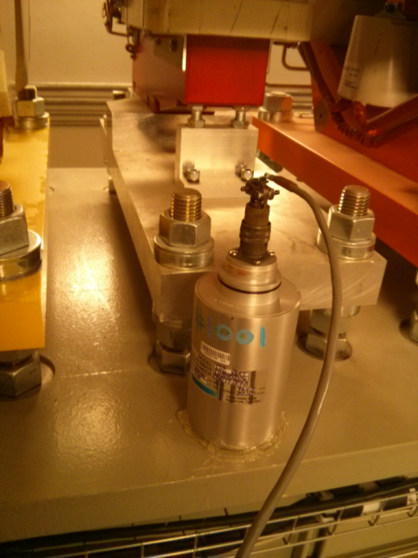
Beam motion spectrum together with mechanical vibrations
BPM and its mounting
C30 Slow corrector #6
Geophone setup inside the tunnel to collect vibration data for two weeks, with beam.
Black – C30 Girder 6
Green – C30 BPM 6, sensor mounted on chamber surface near the BPM
BPM FA data collected during beamline commissioning (4.6mA, multi-bunch fill)
Blue – C30 BPM6
Red – C28 SBPM1 (combiner/splitter)

Slide 13
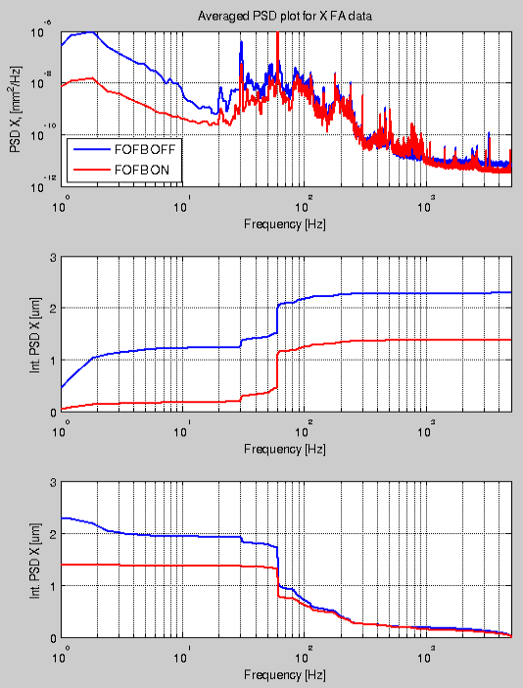
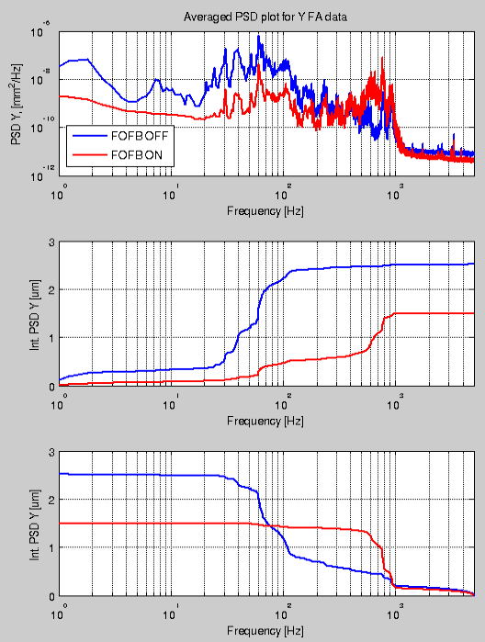
Beam spectrum with FOFB ON/OFF
Exclude dispersive BPMs from the averaged spectrum calculation

Slide 14
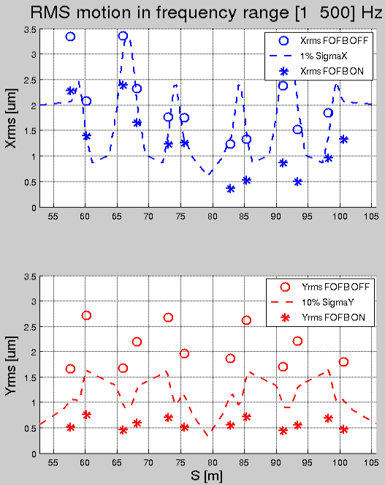
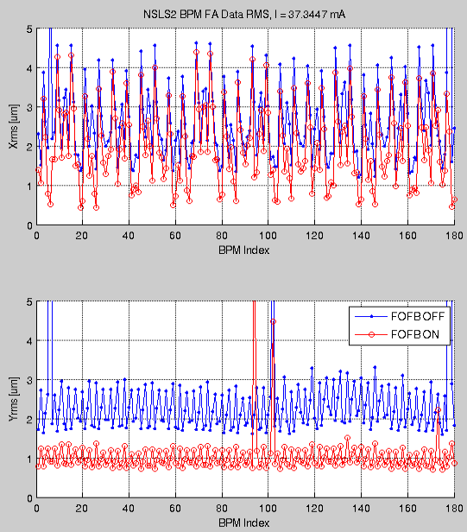
RMS Motions Along the ring

Slide 15
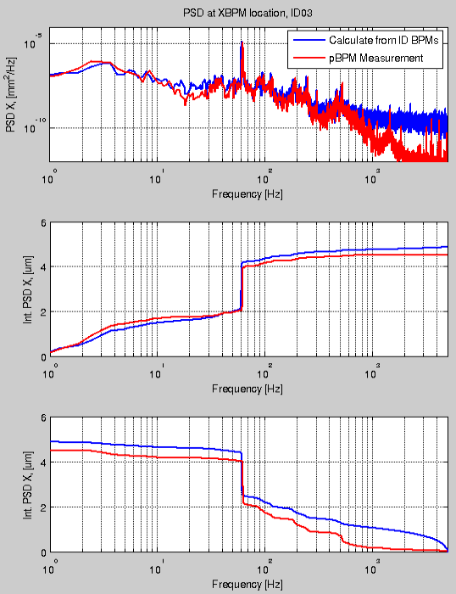
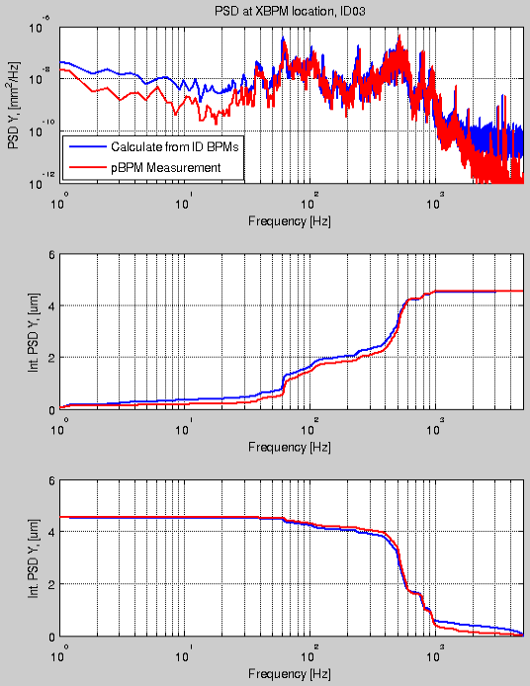
Comparison of PSD spectrum (calculated from ID BPMs vs. pBPM measurement)
Looks like pBPM electronics has less noise, especially for >1kHz range.

Slide 16
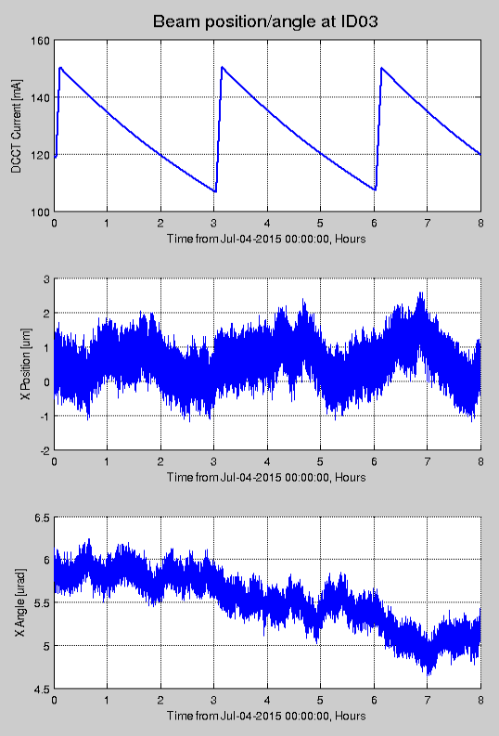
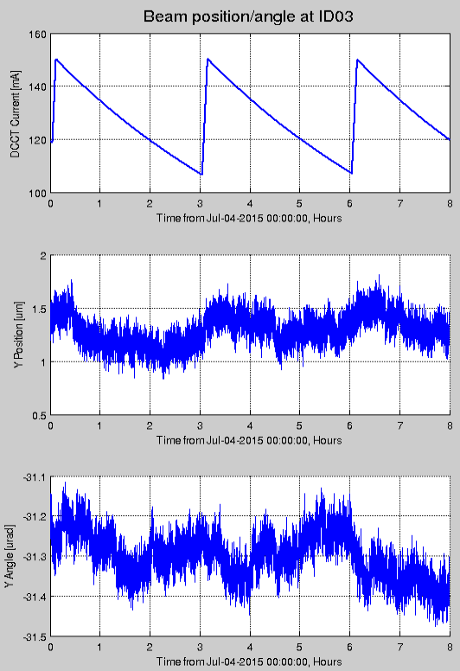
Long term stability at ID source point
X RMS = 0.613 um
Y RMS = 0.145 um
X’ RMS = 0.317 urad
Y’ RMS = 0.056 urad

Slide 17
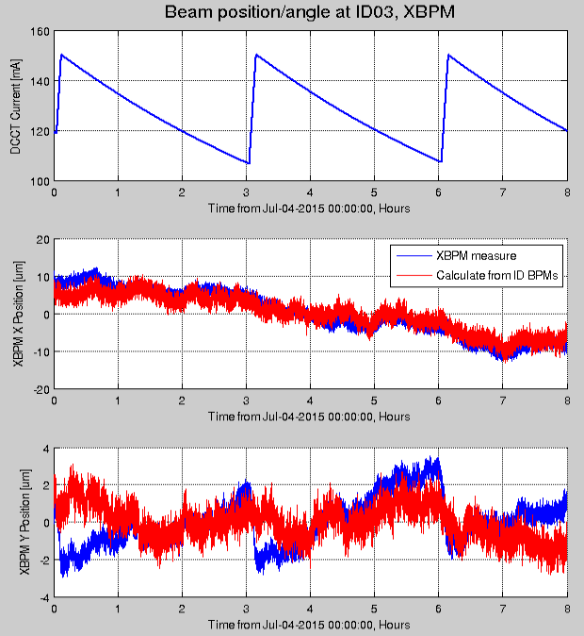
Long term stability @ C03 pBPM
C03 ID gap fixed at 5.92mm
150mA user operation, beam current in 110 – 150mA range. Refill every 3 hours
xBPM position can be calculated from two ID BPMs on ends of the IVU, compared to xBPM direct measurement.

Slide 18
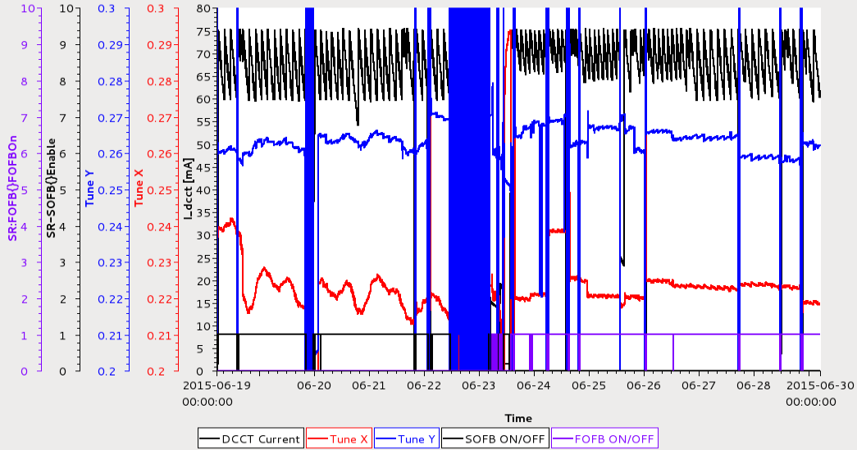
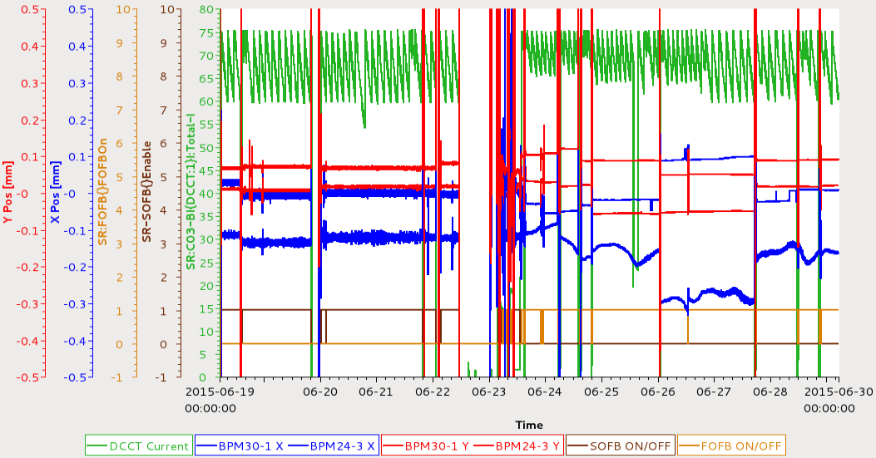
Tune/Orbit history with SOFB and FOFB
SOFB ON
FOFB ON
Jun 19-29 Tune history
SOFB ON, ν_{x} saw daily drift pattern.
FOFB ON, tune is more stable, doesn’t see the daily drift pattern anymore.
Dispersive BPMs saw the daily pattern with FOFB ON. Note dispersive BPMs are excluded from Horizontal FOFB.
C24 BPM3 X

Slide 19
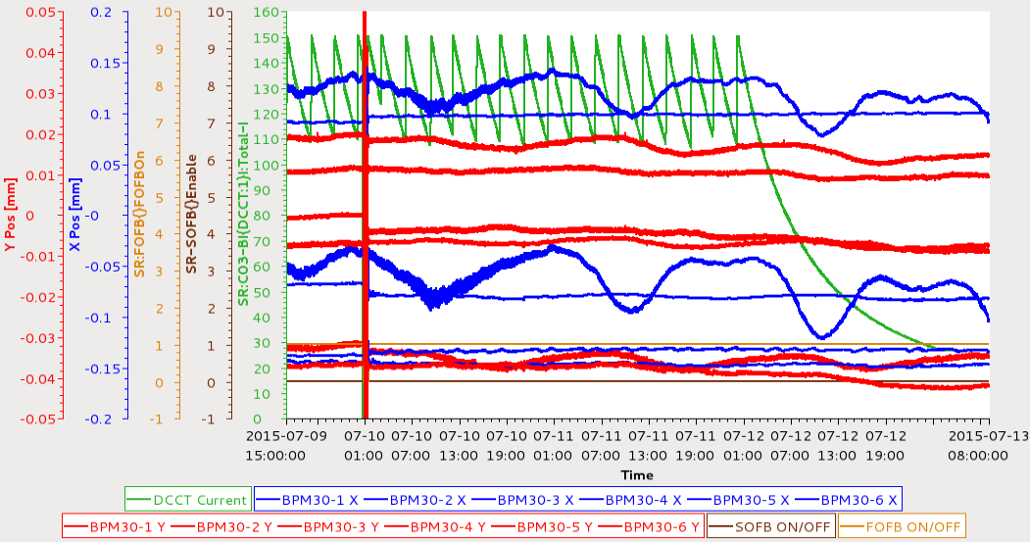
Orbit history data during 150mA user run (Jul 9-13, 2015)
Beam decay to ~20mA due to a booster dipole PS failure.
6 BPMs X/Y positions from C30 were plotted
Dispersive BPMs (BPM 3,4) saw clear daily drift pattern. Not weather or tunnel temperature related.
Max. drift ~ 50 um at BPM #3 with dispersion ~ 0.424m. This gives energy mis-match ΔE/E = 1.18e-4, which is corresponding to ring circumference change of 34 um (ΔFrf = 21 Hz)
Drift valleys seems agrees with the nearby harbors high tides. One valley observed but there should have two high tides daily. Continue investigating …

Slide 20
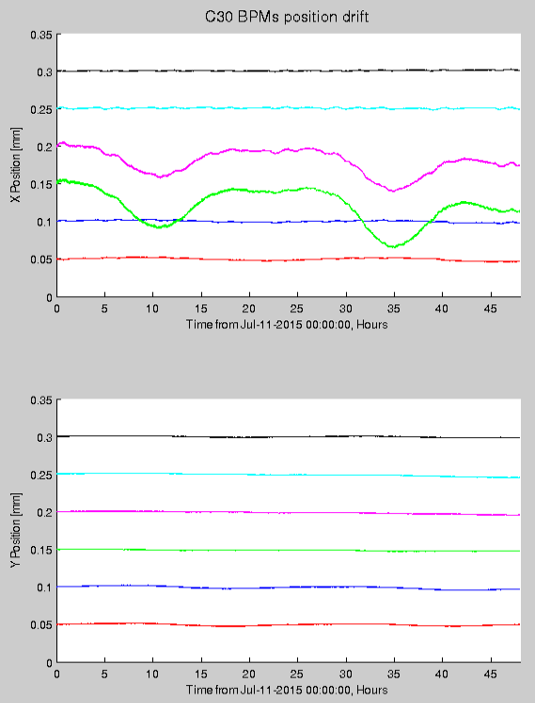
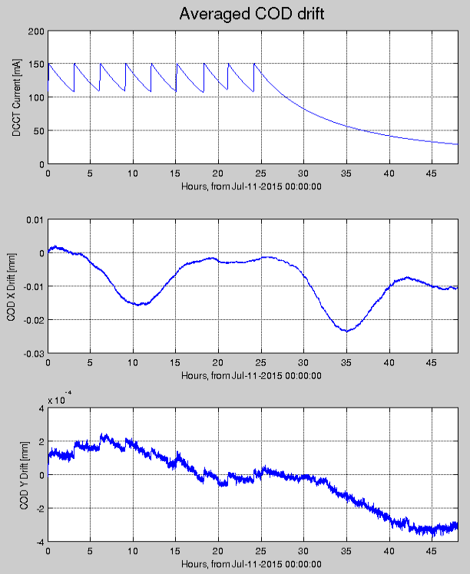
<dX> = <X – X_{ref}>
<dY> = <Y – Y_{ref}>
C30 six BPMs X/Y positions for two days
Vertical offset adjusted to see the drift pattern easier
Averaged COD drift, take first COD as reference, check the COD drifting for two days.
X/Y are vectors including 180 BPMs readings

Slide 21
Summary
In-house developed NSLS2 BPM performs well during machine commissioning and operations.
Beam orbit spectrum has been characterized with BPM FA data. Without FOFB, beam RMS motion was ~20% of vertical beam sizes. Once FOFB commissioned, the RMS motion is suppressed to ~5% of beam sizes.
Beam stability at ID source point has been analyzed using two ID BPMs, and compared to xBPM direct measurement.
Excellent long term stability (~8 hours) was observed at ID center (Y_{rms} < 200 nm, peak to peak ~500nm). Dispersive BPMs saw daily drift pattern which is likely due to tidal effect.

