Slide 1
SNS Beam Diagnostics:
Ten Years After Commissioning
A. Aleksandrov
Oak Ridge National Laboratory,
USA

Slide 2
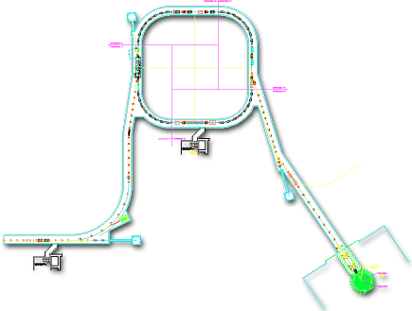


Spallation Neutron Source Accelerator
1 GeV LINAC
Accumulator Ring: compress 1-msec long pulse to 700 nsec
Collimators
Front-End:
Produce a 1-msec long, chopped, H- beam
Injection
Extraction
RF
<1 μsec
186 MeV
1000 MeV
RTBT
2.5 MeV
HEBT
Front-End
Warm LINAC
Cold LINAC
Liquid Hg Target
Chopper system makes gaps
38A
945 ns
mini-pulse
Current
Current
38mA
1 ms macropulse
1ms
1 ms macropulse
1 ms

Slide 3
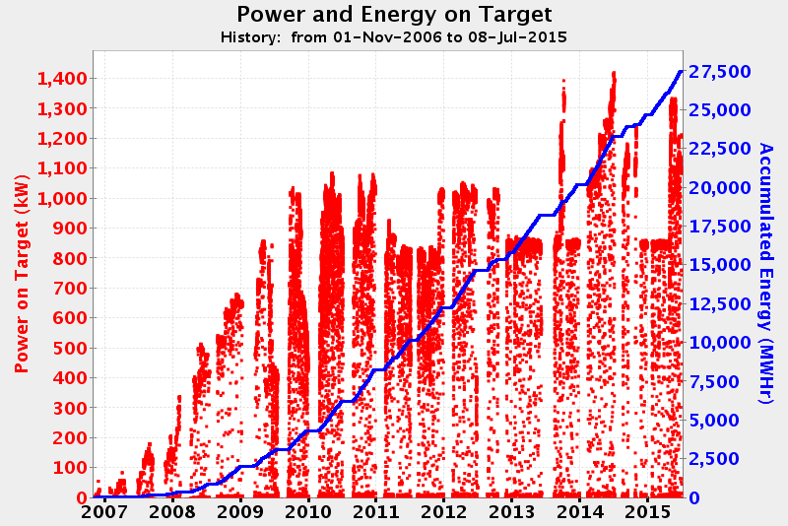
History plot of SNS beam power
design power
BIW2010, SNS Beam Diagnostics Experience and Lessons Learned
~ 4700 hours/year

Slide 4
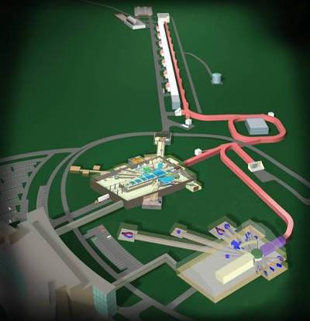
Second Target Station Project:
Double beam power to 2.8 MW
Increase energy from 1GeV to 1.3GeV by adding 36 Super Conducting linac cavities
Increase beam current by 50%
Enables second target station in 2020s
Beam Instrumentation Group Involvement
  more of the same: BCM, BPM, WS
  Intra-bunch ring feedback system
  laser stripping injection

Slide 5
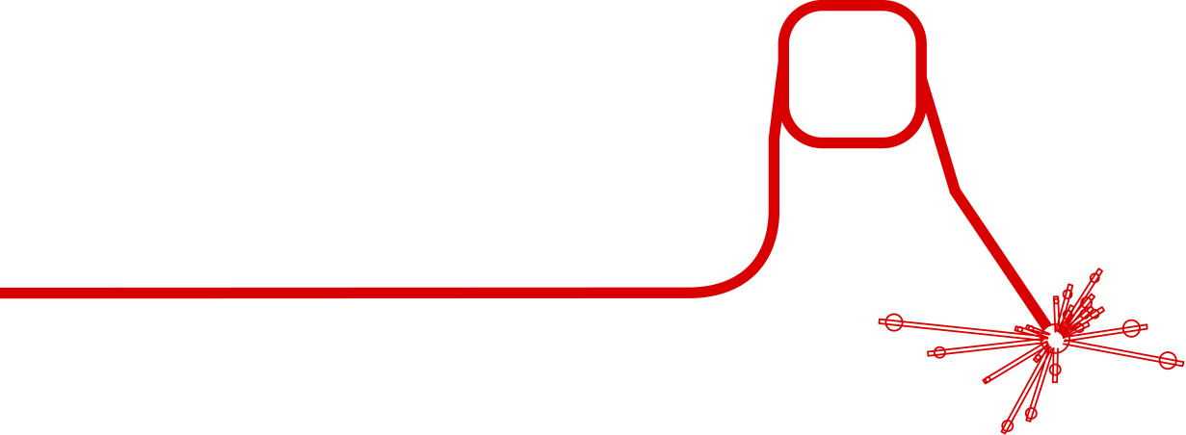
SNS Beam Instrumentation Systems
are Numerous, Diverse and Growing in Number
IDump
3 Position
1 Wire
6 Loss
2 Current
2 Video
RING
44 Position
54+ Loss
1 Current
12 Fast Loss
5 Electron Detectors
2 Electron Profile Scanner
2 Transverse BTF
BCM, BLM, BPM, BSM, WS….
15+ systems, 400+ IOCs
MEBT
6 Position and Phase
2 Current
5 Wires
1 CHUMPS
1 Emittance
1 Laser longitudinal profile
CCL
10 Position and Phase
9 Wires
48 Loss
1 Faraday Cup
4 Bunch Shape
10 Neutron Detectors
HEBT
29 Position and Phase
26+ Loss,
3 Fast Loss
10 Wires
4 Current
2 Bunch Shape
6 Scrapers Charge
1 Laser emittance
EDump
1 Current
4 Loss
1 Wire
MDump
4 Loss
2 Current
1 Wire
LDump
6 Loss
6 Position
2 Wire
RTBT
17 Position
26 Loss
5 Wires
4 Current
1 Harp
3 Fast Loss
1 Target Imaging
DTL
10 Position and Phase
5 Wire
4 Loss
5 Faraday Cup
6 Current
18 Neutron Detectors
SCL
34 Position and Phase
33+ Loss
9 Laser Wire
24 Neutron Detectors

Slide 6
SNS Beam Diagnostics Performance Assessment
now
1-2 years
3-5 years
Model based machine tuning
 | Function | Neutron Production | Machine Tuning | Single particle model | RMS model | Hi Res model | Obsolescence problem
BCM (18) | current
BLM (360) | radiation |  |  |  |  |  | ♪ 0.5M$
BPM (160) | Position x, y, z |  |  |  |  |  | ♪ 1.5M$
Target Harp (1) | Transverse profile, 1D
WS (40) | Transverse profile, 1D |  |  |  |  | ♪
Laser WS (10) | Transverse profile, 1D
BSM (6) | Longitudinal profile, 1D
Laser BSM (1) | Longitudinal profile, 1D
2.5 MeV emm (1) | Transverse emittance, 2D
1 GeV emm (1) | Transverse emittance, 2D |  |  |  |  | ♪

Slide 7
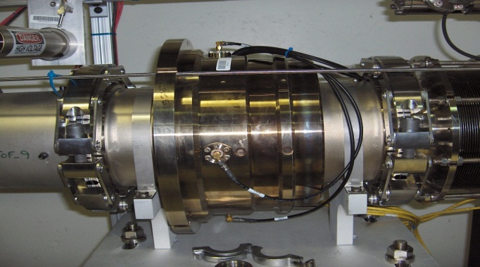
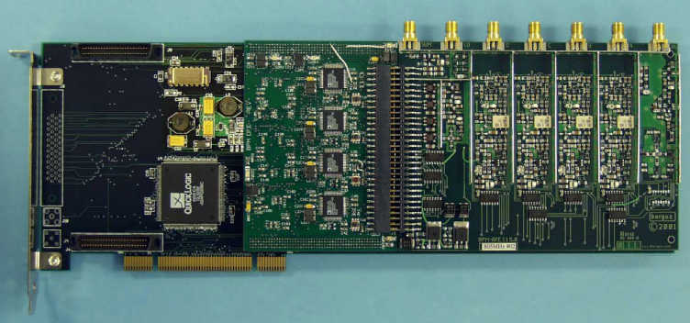
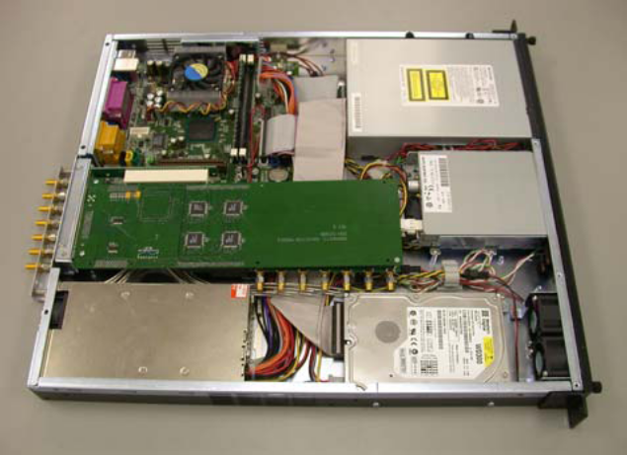
Beam Position and Phase Monitors (BPMs)
Main tool for machine tuning and troubleshooting
  Phase measurements for linac tune-up
  Position measurements for trajectory correction, injection set-up and centering beam on dumps and target
160 strip-line pick-ups
  96 “linac type” operate at 402.5MHz and 805MHz
  64 “ring type” operate at low frequency, 5MHz BW
Custom made PCI analog front-end and digital cards
LabView software under embedded Windows XP on individual PCs (one per pick-up), 1Hz trigger rate
Meets all accuracy specs but reliability is not stellar
BPM pick up
PCI board
Hardware obsolescence is major problem
  Parts, cards, PC motherboards, OS upgrades
Short term solution: stock up on spares
Long term solution: new system
BPM PC chassis

Slide 8
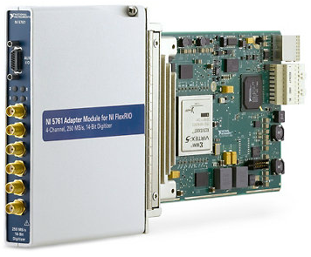
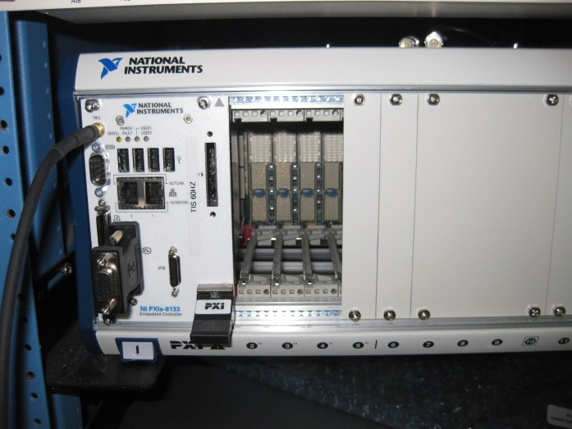
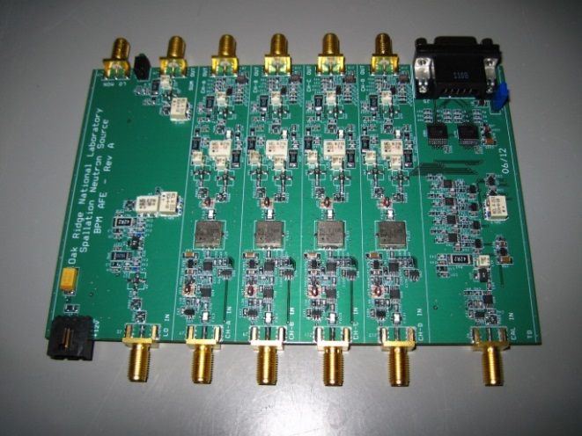
Our approach to all new electronics designs is to minimize in-house design efforts
In-house design
Commercial Off-The-Shelf (COTS)
General Purpose FPGA
Analog Front-End
Analog-To-Digital
Conversion
Crate and controller
High Level Language Programming

Slide 9
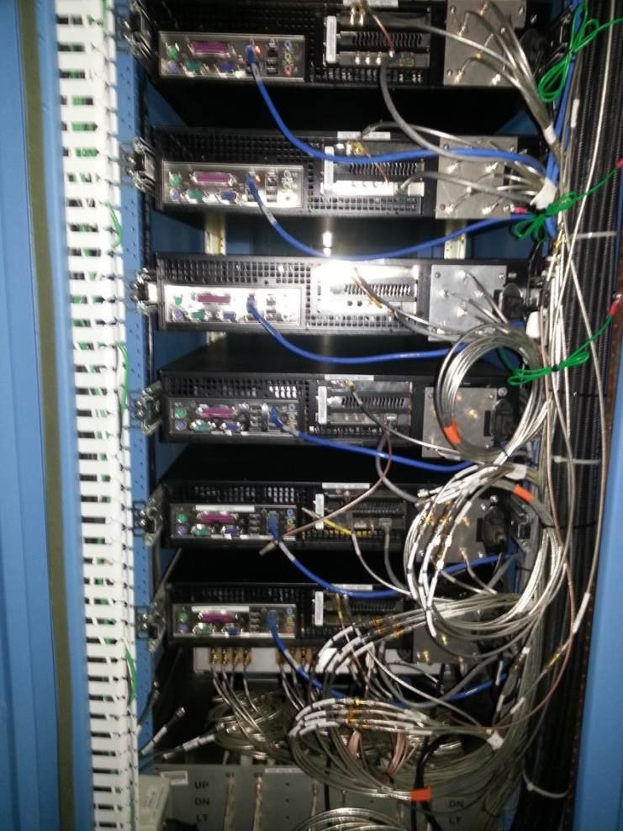
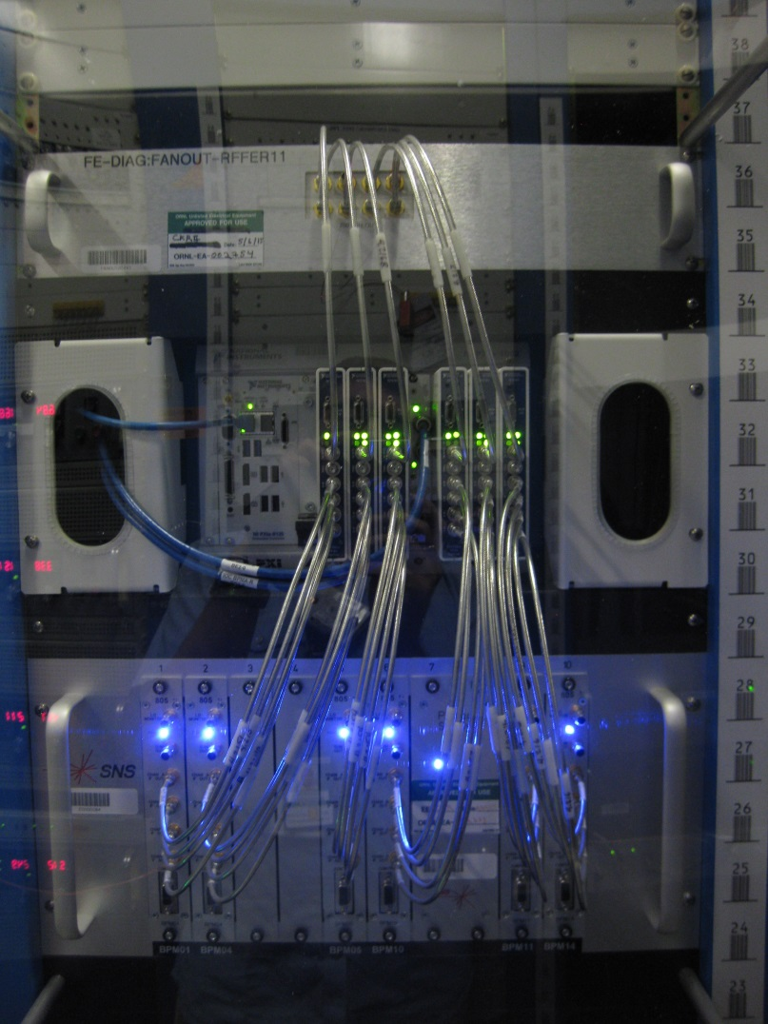
Linac BPM electronics in the field
AFE and digital
Digital
AFE
Old BPM electronics
1 BPM per chassis
New BPM electronics
6 BPMs per crate

Slide 10
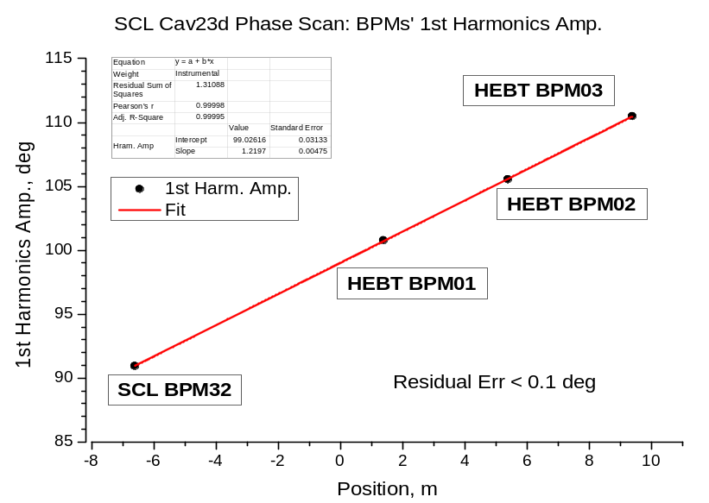
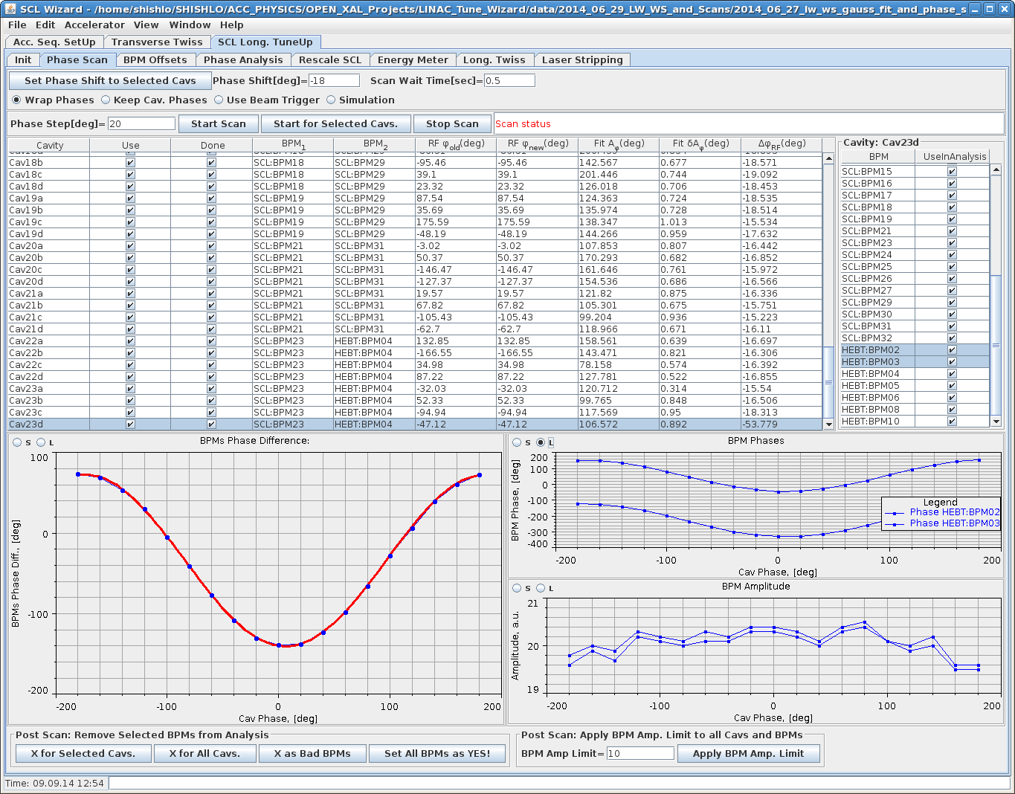
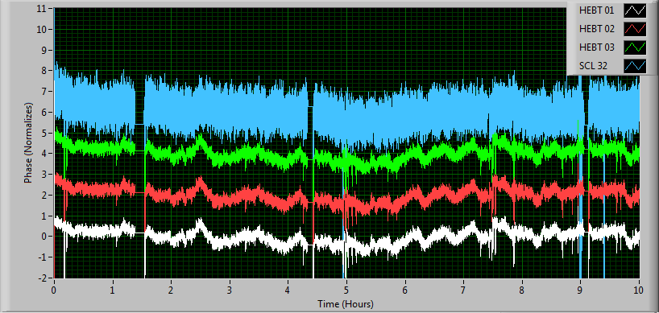
New BPM electronics tested with beam
Courtesy of C.Long and A.Shishlo

Slide 11
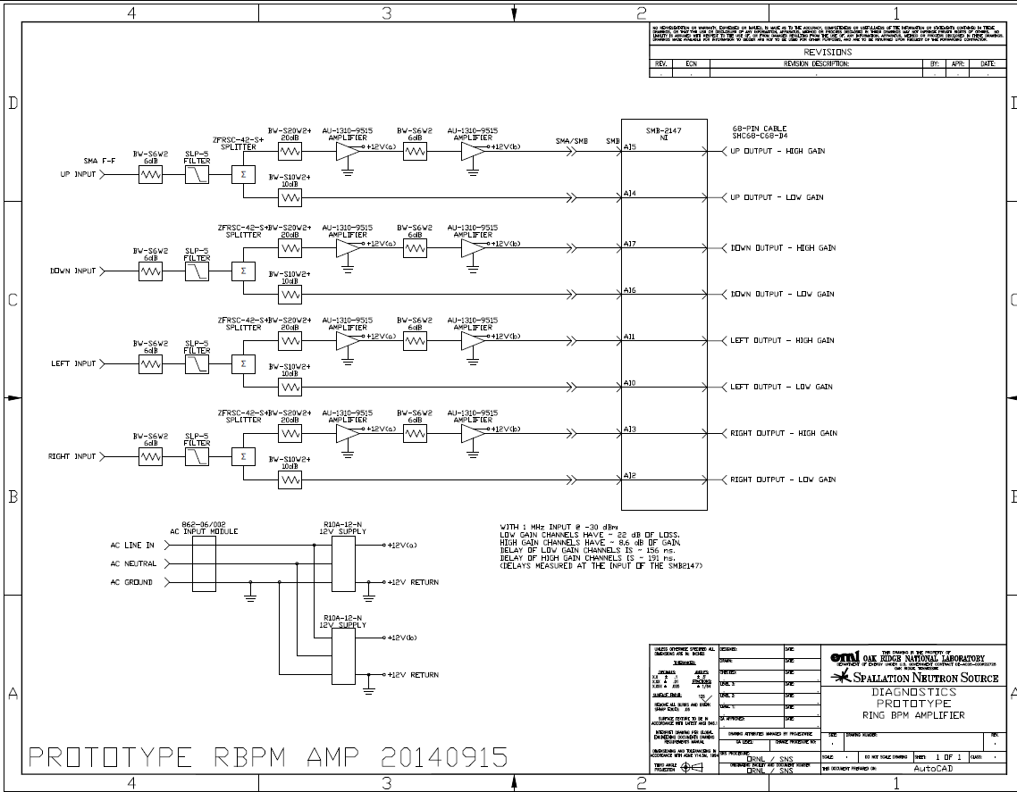
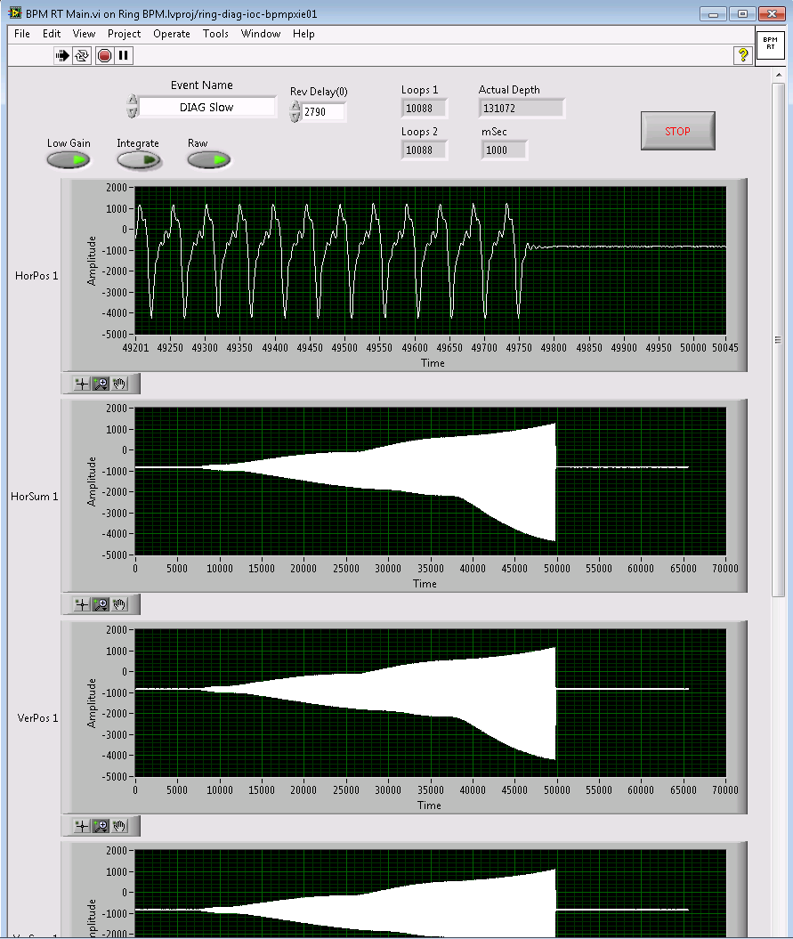
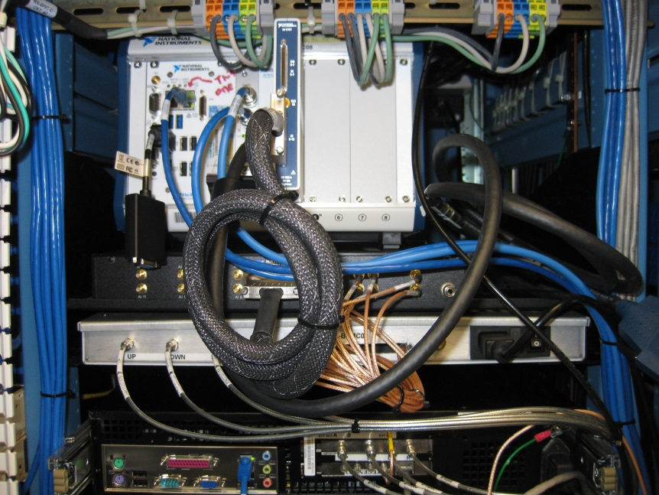
Ring BPM prototype electronics
8 BPMs per crate
Parallel “high” – “low” gain channels combined in FPGA to cover 60dB dynamic range (instead of fast gain switching in the current design)
AFE prototype developed
One BPM set tested with beam
PCB is being designed
Courtesy of R. Dickson

Slide 12
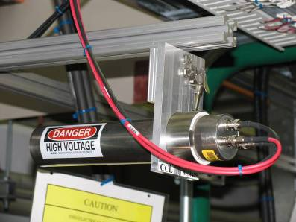
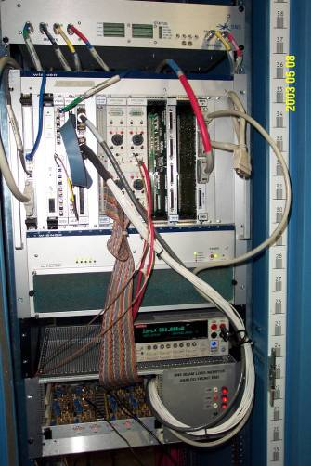
Beam Loss Monitors (BLMs)
Major tool for machine protection and tuning
Ionization Chamber Detectors (307)
Scintillation Detectors (55)
  Neutron detectors
  Fast loss detectors
Multi-channel analog front-end VME cards
Digital electronics in VME crate
VxWorks software
Very reliable
Hardware obsolescence is becoming a problem
Short term solution: stock up on spares
Long term solution: new electronics

Slide 13
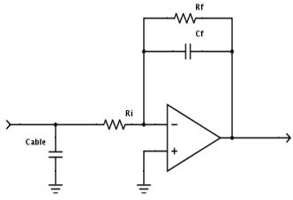
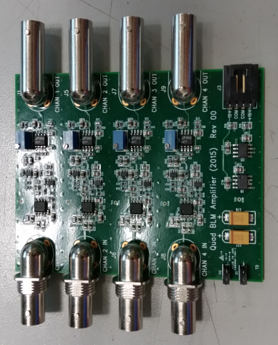
“Next BLM” system concept
Detectors and cabling shell stay the same
Analog electronics should be as simple as possible
  Four different flavors of chassis
  Two flavors of custom 4-channel front end card
Unification of the chassis, boards, power supplies
Sig A
Output A
Sig B
Output B
Sig C
Output C
Sig D
Output D
Power
Flavor | Purpose | # Signals | # HV | # MPS | Amplifier | Comment
ITSF | PMTs in ITSF | 8 | 8 | 1 | None | Will have just one MPS channel
Ion Chamber | Regular BLM | 16 | 4 | 16 | IC Amp | Standard IC in accelerator
Target BLM | Target Facility | 8 | 8 | 0 | Target Amp | Sensitive DC amplifier for target people
Neutron Detector | NDs | 8 | 8 | 8 | IC Amp | Standard ND in accelerator
Amplifier | Gain (Ohm) | Min Current (nA) | BW (Hz) | Sampling (kS/s)
IC Amp | 600k | 2 | 200k | 1000
Target Amp | 100M | 0.01 | 1 | 100
Courtesy of A. Zhukov

Slide 14
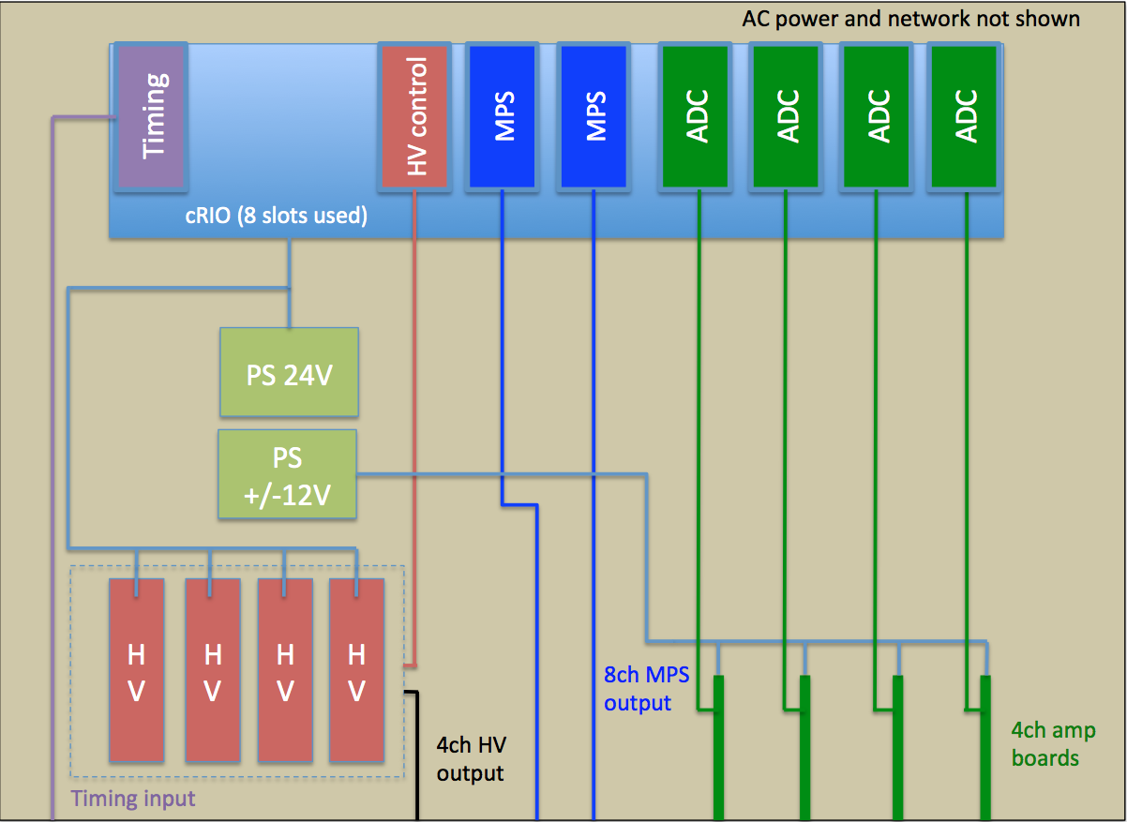
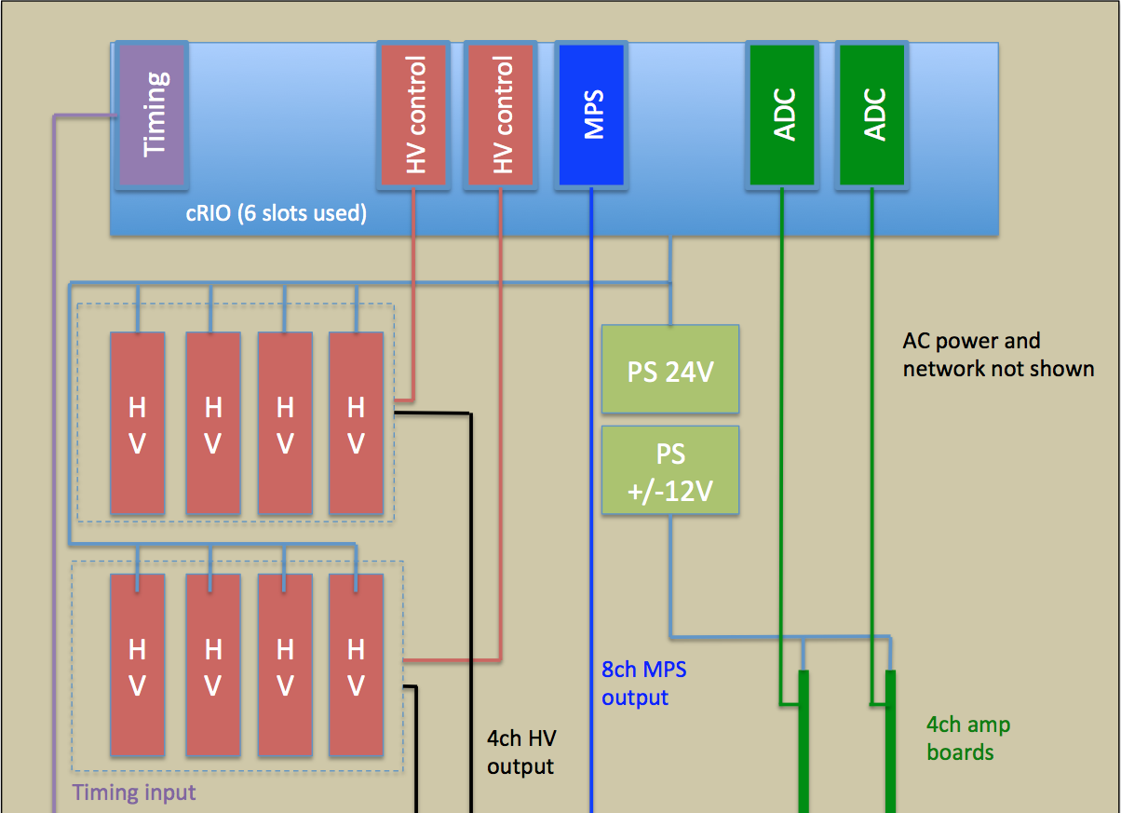

4U Chassis layout for ITSF
ITSF PMT
Ion Chamber
Neutron Detector
Courtesy of A. Zhukov

Slide 15
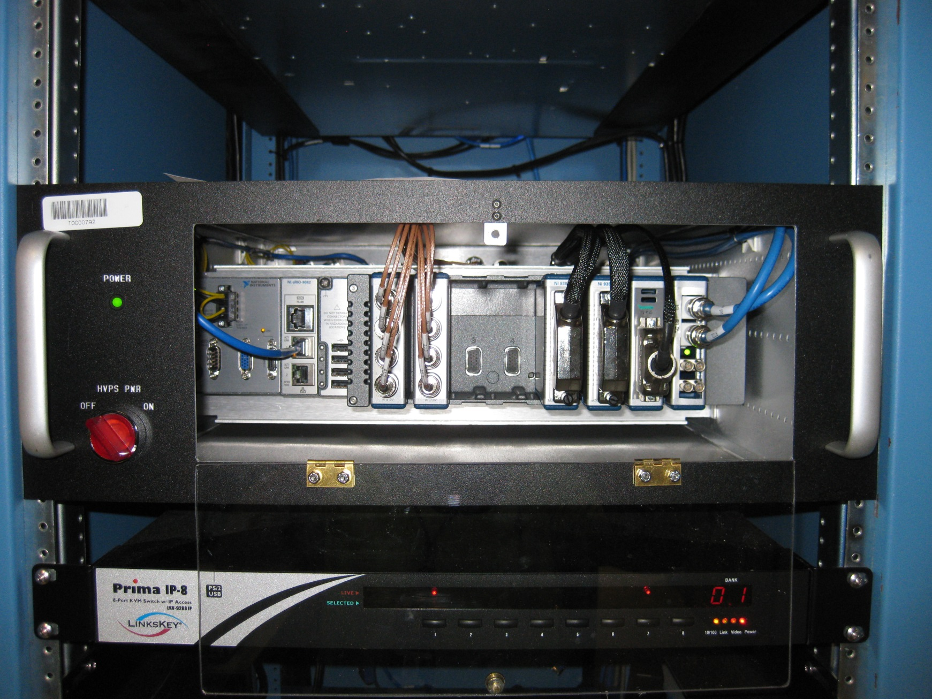
8 channels PMT BLM chassis in the field

Slide 16
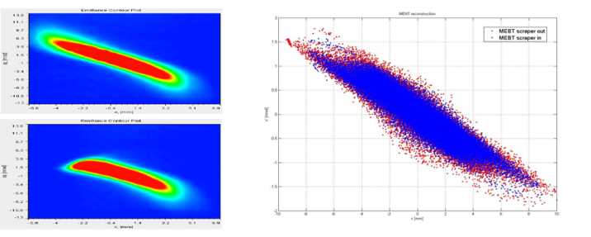
High resolution PIC model development
Request for emittance measurements (2-D at least)
  At as many locations as possible: 2.5MeV, 1GeV, in between
  High dynamic range: 10⁴ - 10⁶
2.5MeV measurement
with scraper out
1 GeV measurement (sort of) with scraper out (red) and in (blue)
2.5MeV measurement
with scraper in
An example of beam transport measurement with ~10³ dynamic range

Slide 17
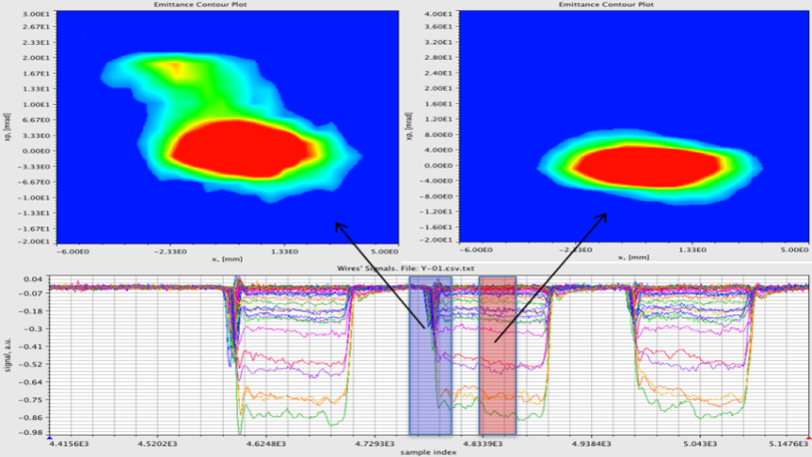
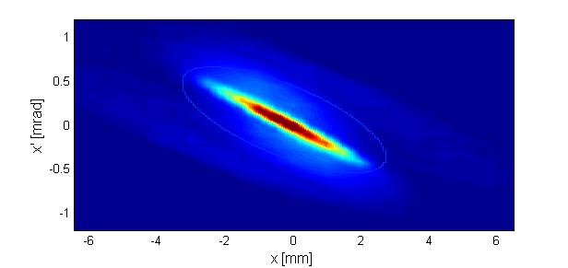
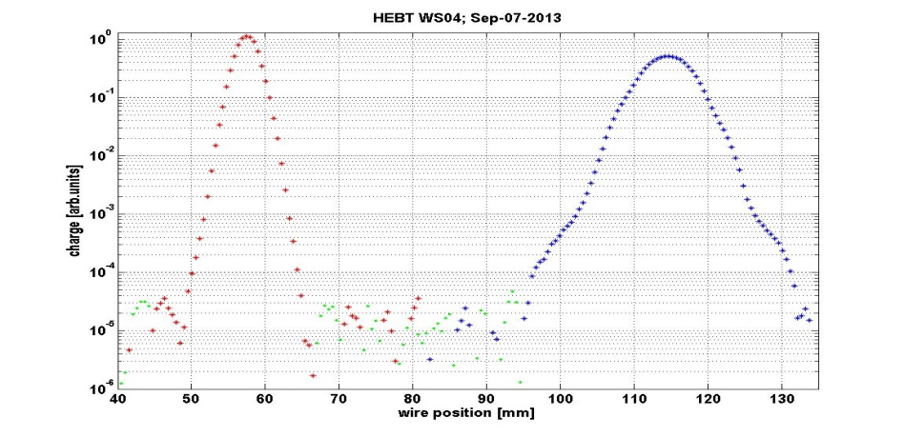
Available large dynamic range diagnostics
2.5 MeV slit-slit emittance scan
  10⁴-10⁵ dynamic range
  20ns temporal resolution
1 GeV laser emittance scan
  10³ dynamic range
  10ns temporal resolution
Wire scanners
  10⁵ dynamic range
  50us time resolution
Need to learn using wire scanners for phase space measurements

Slide 18
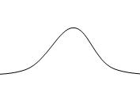
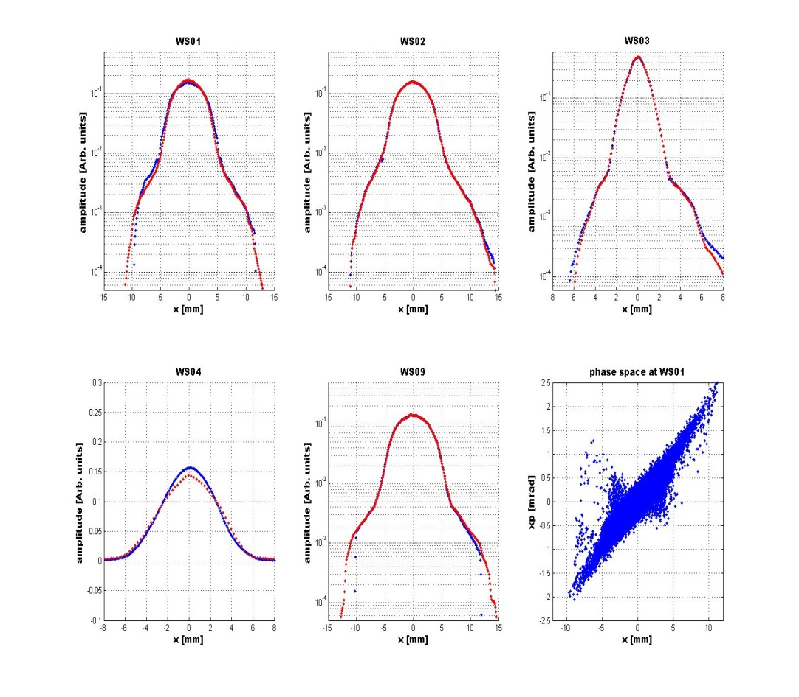


MENT Tomographic Reconstruction of 2-D Emittance from 1-D Profiles
Comparison of measured and reconstructed profiles
Reconstruction seems to works very well in HEBT
  Need to verify using laser emittance measurements
  High resolution reconstruction requires iterative procedure. 10³ dynamic range demonstrated
Plan to extend to SCL, Warm Linac, MEBT
  Requires good transport model
  Problem of space charge
Reconstructed 2-d distribution

Slide 19
Many thanks to SNS Beam Instrumentation Team members who provided material for this talk:
Wim Blokland, Richard Dickson, Cary Long,
Yun Liu, and Sasha Zhukov
and
Thank you for your attention!

