Slide 1

Transverse Profiling of an Intense FEL X-Ray Beam Using a Probe Electron Beam
Patrick Krejcik
SLAC National Accelerator Laboratory

Slide 2
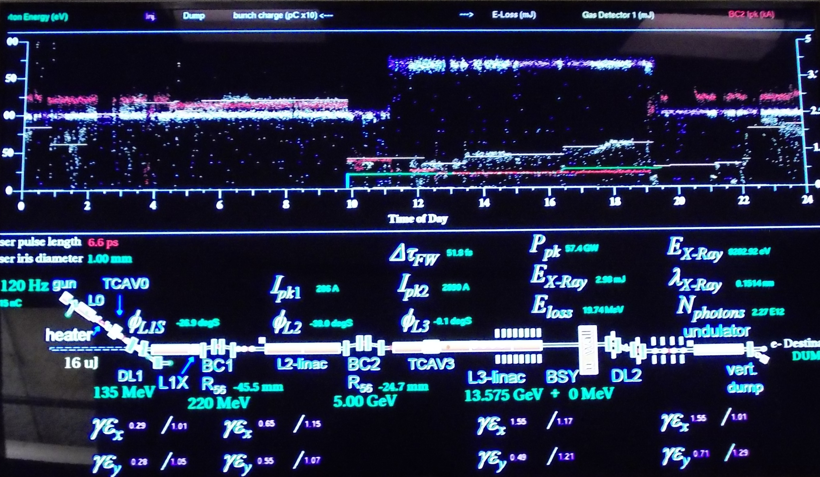
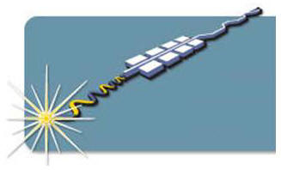
Diagnostics Requirements for Intense X-ray FEL Beams
The pulse to pulse energy output of an FEL is:
  A critical experiment parameter for the X-ray users
  It varies greatly shot to shot because of the stochastic nature of SASE FELs
  It depends on the electron drive beam charge, emittance, bunch length, peak current, energy, energy spread …
  And is the bottom line tuning parameter for optimization of the accelerator
  The transverse profile of the X-rays determines the source properties for all X-ray imaging experiments.

Slide 3
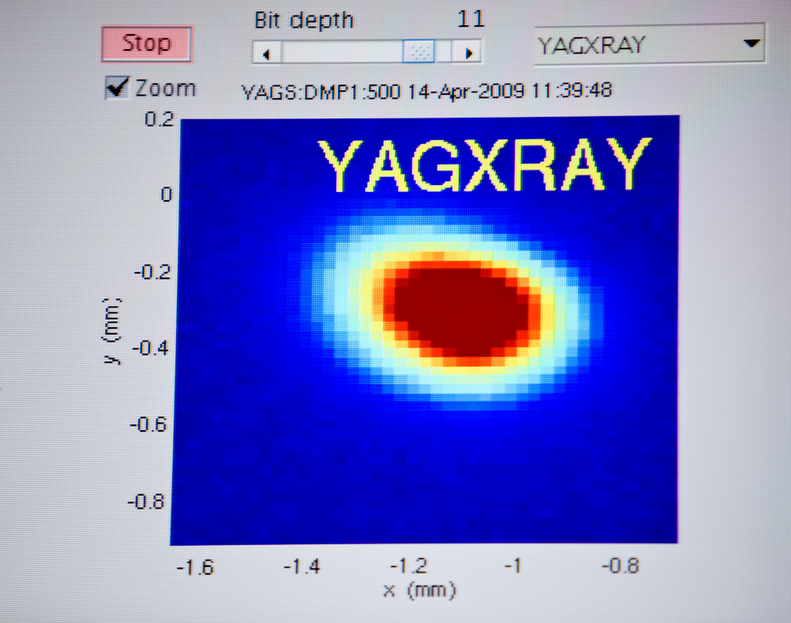
Difficulties in Diagnosing Intense X-ray FEL Beams
Insertable fluorescent YAG screen:
  Single shot measurement of transverse profile and intensity
  Invasive
  Limited in repetition rate by readout rate of camera
  Limited in single shot intensity by screen damage

Slide 4
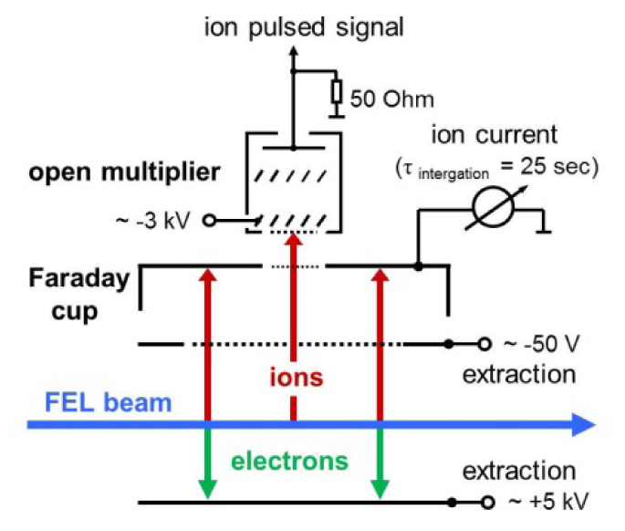
Difficulties in Diagnosing Intense X-ray FEL Beams
Gas cell monitor:
  Single shot measurement of intensity
  Non-Invasive
  But no beam size measurement
  Limited in repetition rate by ionization build up in the gas
    Not suitable for 1 MHz pulse repetition rate at LCLS-II
    Transients at the start of pulse trains
K. Tiedtke et al "Absolute pulse energy measurements of soft x-rays at the Linac Coherent Light Source," Opt. Express 22, 21214-21226 (2014);

Slide 5
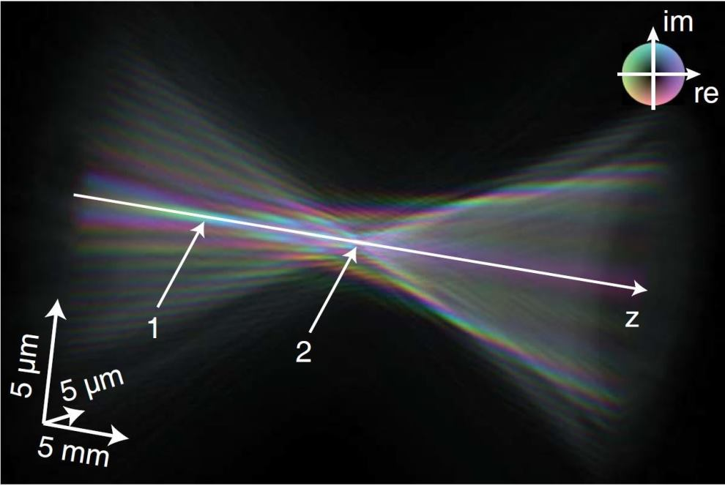
An Ideal FEL X-ray Diagnostic?
Should be:
  Single shot measurement of intensity
  Measure transverse profile
  Non-invasive
  Not susceptible to damage
  Not limited in repetition rate
  Not limited in intensity
  Also suitable for focused beams
Wave field of a focused X-ray pulse at SLAC's LCLS, with colors indicating the phase of X-ray waves and amplitude encoded by brightness. (Credit: Andreas Schropp, Nature Scientific Reports)

Slide 6
An Electron Probe Beam to Measure the X-rays
A finely focused beam of electrons is scanned across the X-ray beam
  The number of scattered electrons is a direct measure of the photon intensity
  A “free electron wire scanner”
e- Detector
direct
e- Detector
scattered
θ
y
X-ray
Photons
x
z
Electron
Gun

Slide 7
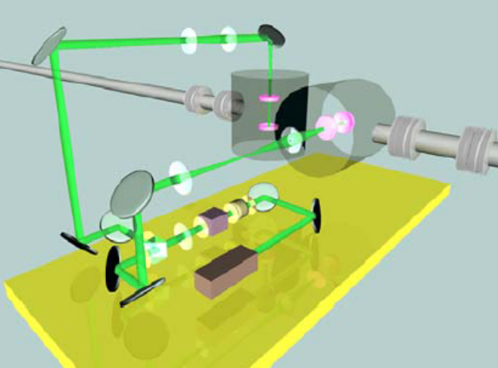
Think of it as the converse to a laser-wire
Rather than probe a high energy electron beam with a laser,
we probe the X-ray laser beam with a low energy electron beam.
But instead of detecting the downstream Compton scattered photons, it is more practical to detect the scattered electrons
ATF laser-wire system

Slide 8
An Electron Probe Beam to Measure the X-rays
Located downstream of the undulator and electron dump
  The problem is that the photon pulse is very short duration, so the electron beam current density must be high to get sufficient interaction
Probe
e- beam
Drive
e- beam
FEL Undulator
Dipole
X-ray
beam
Detector
e- Dump

Slide 9
Backscatter geometry
Probe electron beam geometry backscattered from the x-ray photons over an interaction length, L.
Electrons that lose energy due to scattering can be measured in this spectrometer arrangement.
e- Detector
direct
e- Detector
scattered
Dipole 2
x-rays
Interaction length, L
Dipole 1
Electron
gun

Slide 10
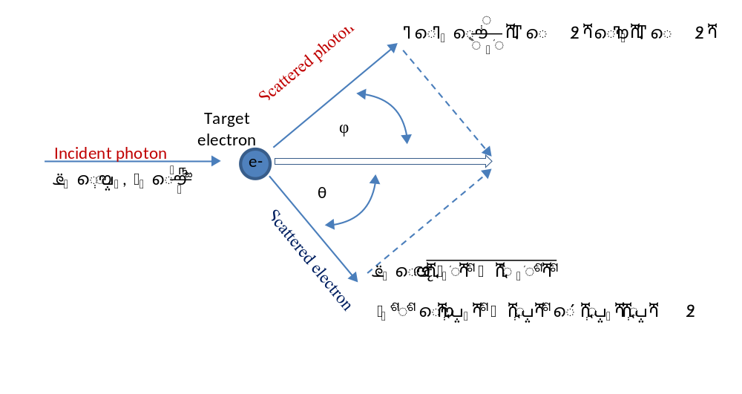
Electron-Photon Interaction
Compton scattering geometry

Slide 11
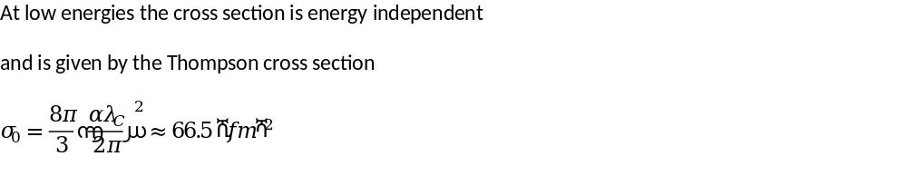
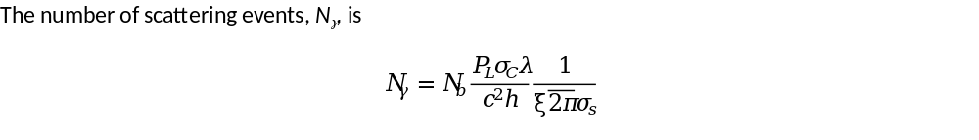
Electron-Photon Cross-section
where N_{b} is the number of electrons in the bunch
(or overlapping in time with the photon pulse)
σ_{s} is the beam overlap area.

Slide 12
The First Experiment
Use a backscatter geometry with complete overlap of the two beams
The number of scattered electrons is therefore a direct measure of the photon intensity
Simple setup without the need to focus the electrons to a small spot, or scan the electrons across the beam.
Compare the measurement with gas cell monitor on a low repetition rate machine like LCLS-I

Slide 13
Alternative schemes
Q: why not use an ion beam instead of electrons?
A: X-ray photons interact only with the electrons in an ion, so it is more a question of how to get the most electrons into the path of the x-ray beam.
and it is easier to generate high electron beam current densities than ion

Slide 14
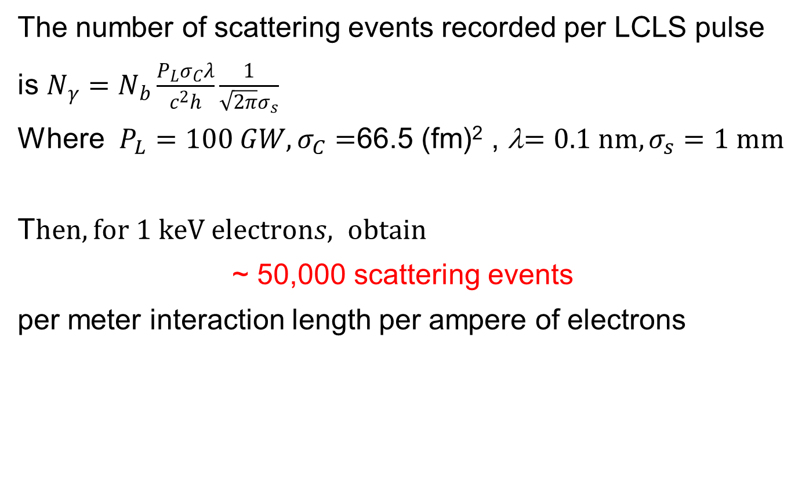
Typical parameters for an experiment at LCLS
The number of scattering events recorded per LCLS pulse is $N_{γ}=N_{b}\frac{P_{L}σ_{C}λ}{c^{2}h}\frac{1}{\sqrt{2π}σ_{s}}$
Where $P_{L}=100 GW, σ_{C}=$66.5 (fm)² , λ$=0.1 nm,σ_{s}=\text{1 }\text{mm}$
T$hen, for 1 keV electrons, obtain$
~ 50,000 scattering events
per meter interaction length per ampere of electrons

Slide 15
Conclusion
A rich parameter space can be explored for measurement configurations
The yield of scattered electrons can be increased by
  Increasing the interaction length
  Lowering the energy of the electrons
  Increasing the peak current of the electrons

Slide 16

Thank you!

