Slide 1
Beam Arrival Time Monitors
Josef Frisch, IBIC Sept. 15, 2015

Slide 2
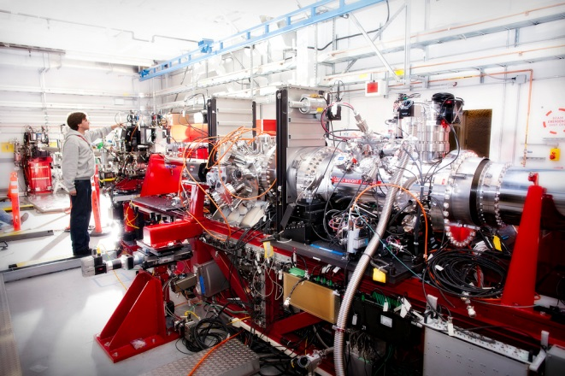
Arrival Time Monitors
Timing is only meaningful relative to some reference, and in general what matters is the relative timing of two different systems
Pump / Probe experiments (FELs, UED etc.) are generally the most critical, with requirements down to a few femtoseconds.
Proton HEP experiments can require few picosecond coincidence detection, but bunch lengths are typically long, so precision arrival times are not needed.
CXI experiment at SLAC
Laser pump / XFEL probe

Slide 3

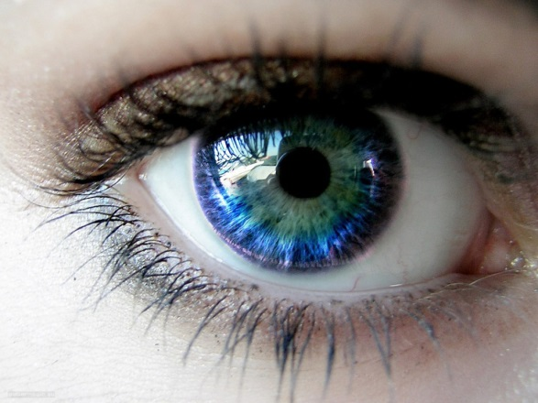
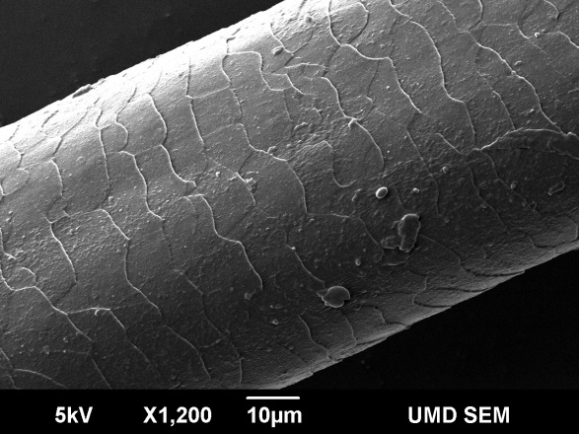
Femtoseconds are REALLY SMALL
70fs
½ human hair
at C
Bryan Bandli, Scanning Electron Microscopy Laboratory, University of Minnesota
Eye blink
0.1 second
5000 Years
70 femtoseconds
1 Meter of typical engineering material will change length by 30fs/°C. Optical fibers change path length by ~50fs/℃
Ultra-relativistic beams and photons in vacuum are the only things where timing stabilization is not required for long distances
Fortunately accelerator tunnel lengths are quite stable – the bedrock temperature changes very slowly.

Slide 4
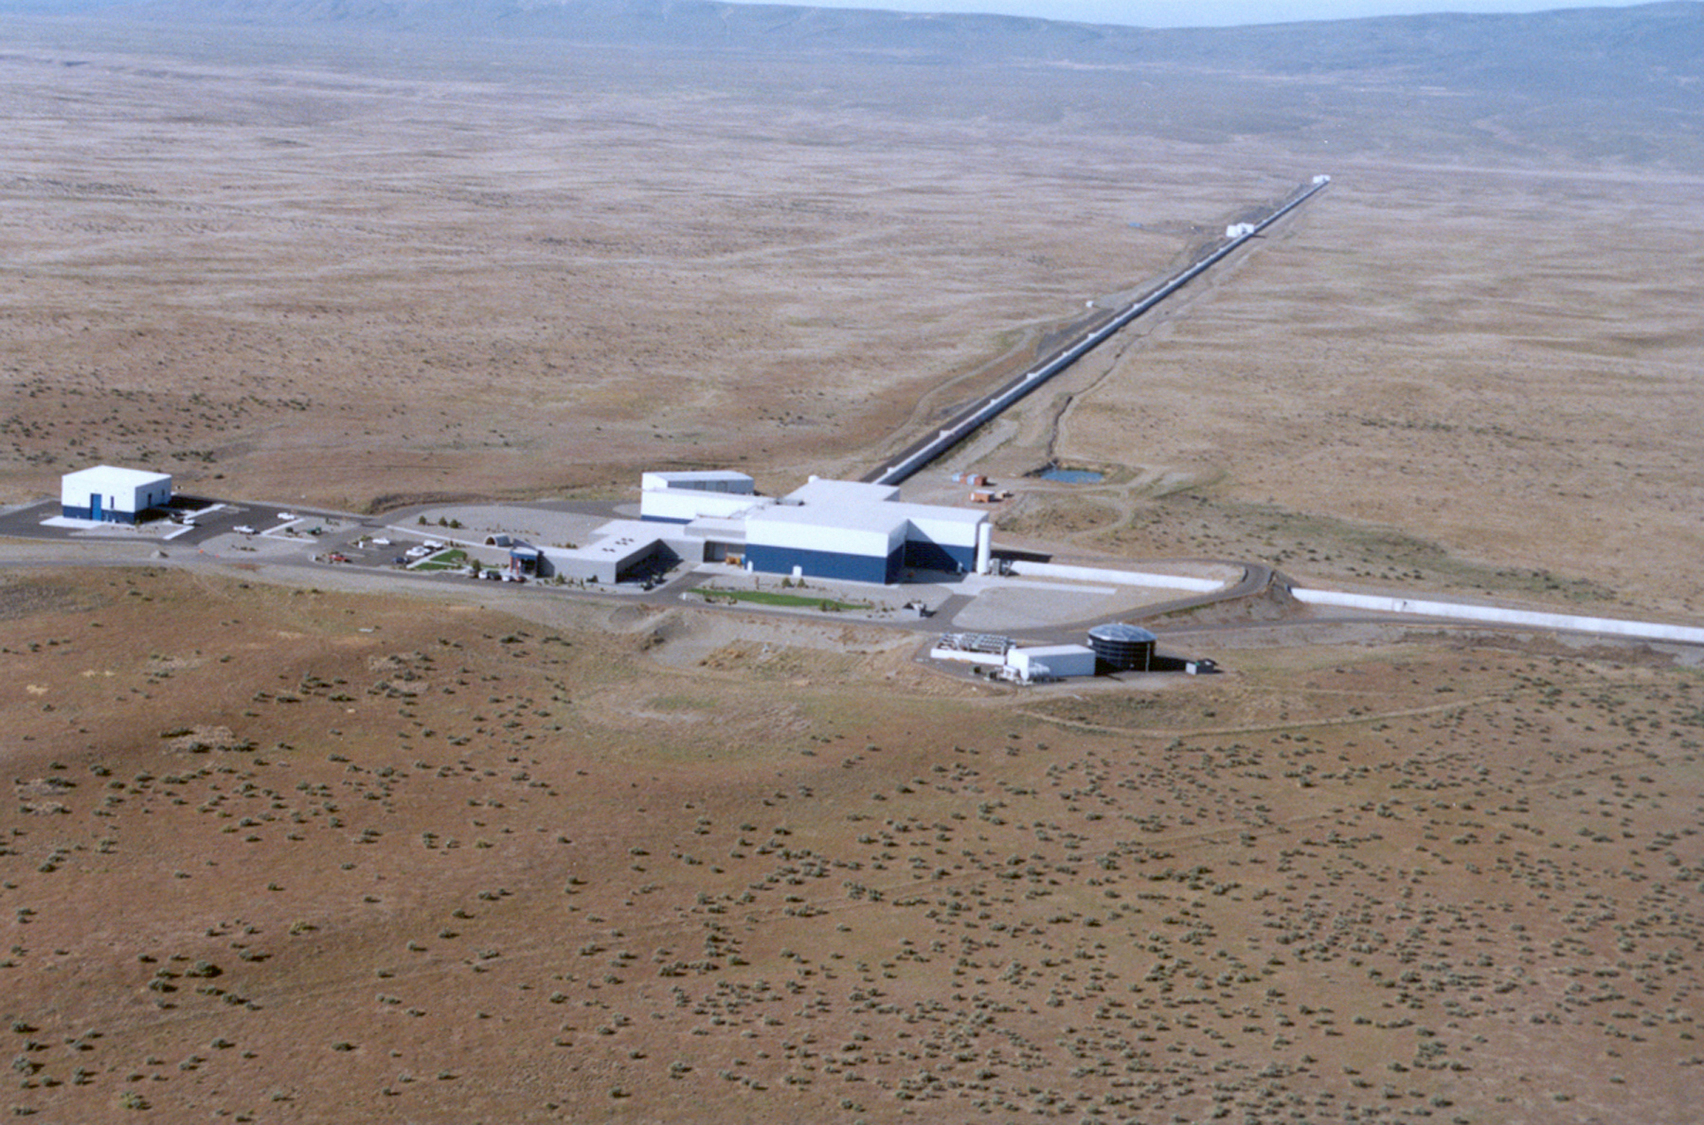
Engineering tradeoffs! You don’t need the “best”.
LIGO: <10⁻²⁸ seconds noise over 4km!
The Arrival Monitor systems described in this talk perform at <30fs RMS, and are usually not the “weak link” in a femtosecond timing system

Slide 5
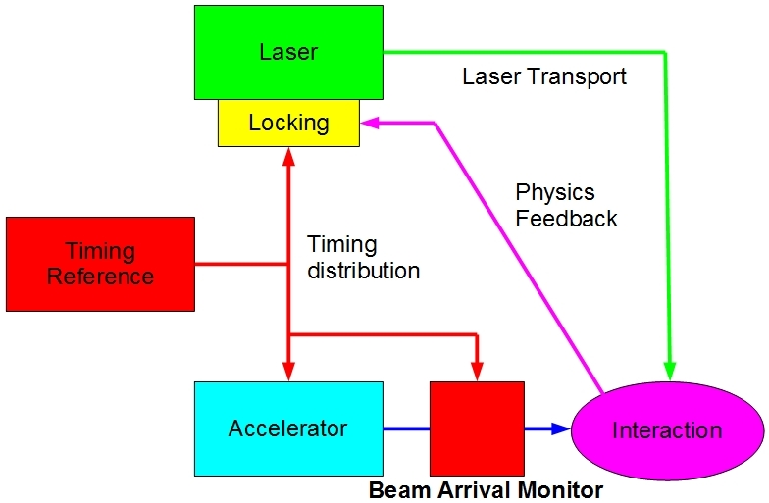
Typical Timing System
Beam arrival monitor can provide timing feedback and / or pulse tagging for offline experiment data correction

Slide 6
Arrival Time Monitor Use
Used for feedback to reduce the timing jitter of the accelerator
  Needs a high frequency machine – superconducting
  Used at DESY / FLASH
Used to correct for timing drifts in the reference signal from the accelerator to the experiments .
  Used at SLAC / LCLS
Used to correct experiment data for accelerator timing jitter.
  On low rate machines like LCLS (120Hz) the shot to shot jitter cannot be corrected but the arrival time monitor can record the timing for offline data correction.

Slide 7
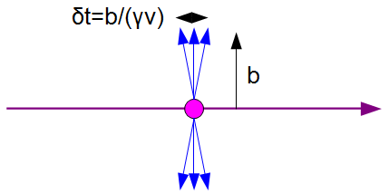
Detect timing from the beam electric or magnetic field.
Electron bunches are usually shorter than the response time of conventional electronics.
Relativistic effects usually allow the high frequency signals to get to the beampipe.
For 6GeV (XFEL), 1cm beam pipe:
Pulse width = 2 fs
For 6 MeV (UED) 1cm beam pipe
Pulse Width = 2ps
For conventional electronics we need to low pass filter.
Signal pickoffs to cables are typically limited to ~<50 GHz.
For pulsed laser fiber systems can in principal use bandwidth to ~100fs.

Slide 8
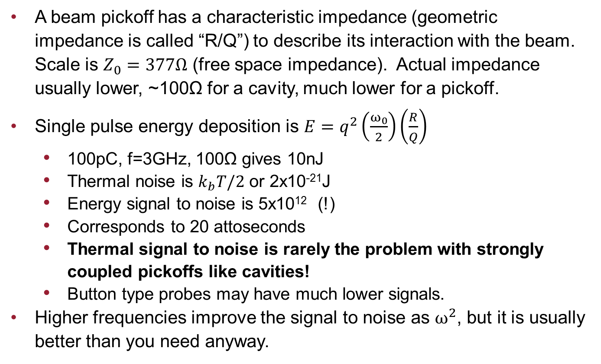
Signal Levels
A beam pickoff has a characteristic impedance (geometric impedance is called “R/Q”) to describe its interaction with the beam. Scale is $Z_{0}=377Ω$ (free space impedance). Actual impedance usually lower, ~100Ω for a cavity, much lower for a pickoff.
Single pulse energy deposition is $E=q^{2}\left(\frac{ω_{0}}{2}\right)\left(\frac{R}{Q}\right)$
  100pC, f=3GHz, 100Ω gives 10nJ
  Thermal noise is $k_{b}T/2$ or 2x10⁻²¹J
  Energy signal to noise is 5x10¹² (!)
  Corresponds to 20 attoseconds
  Thermal signal to noise is rarely the problem with strongly coupled pickoffs like cavities!
  Button type probes may have much lower signals.
Higher frequencies improve the signal to noise as $ω^{2}$, but it is usually better than you need anyway.

Slide 9
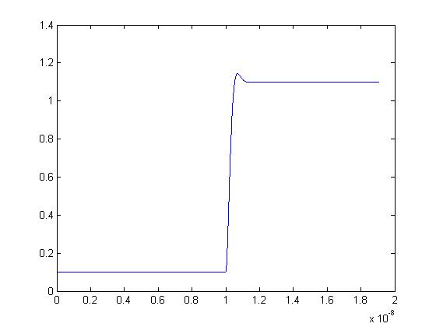
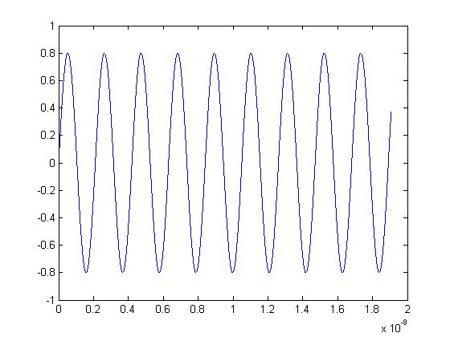
Broadband vs Narrowband
Conventional electronic triggers only good to ~1ps.
Laser based systems can measure to femtoseconds
Using repetitive signals to average timing measurements on millisecond timescales will allow X1000 improvement using GHz clocks
Selection of frequency and bandwidth have a strong impact on the system design

Slide 10
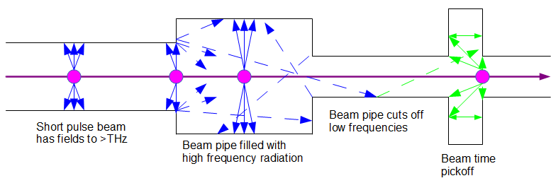
Where to the fields come from [IMPORTANT]
Fields generated by the beam can propagate down the beam pipe if they are above cutoff : 1.8412C/(2πR) = 9GHz for a 1cm radius pipe.
Signal seen at a pickoff is a combination of local fields from the beam, and propagating fields.
Some of these fields depend on the beam position upstream, so a measurement will combine position and timing -> useless.
Working below cutoff solves all this but limits you to frequencies around a few GHz
  Very small beam pipes are usually not allowed for wakefield / stay-clear issues

Slide 11
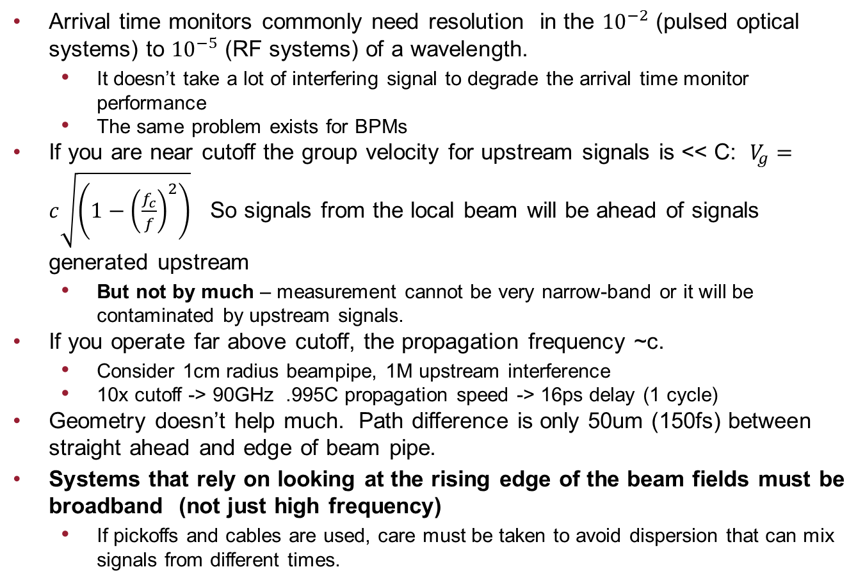
High Frequency: Working above cutoff
Arrival time monitors commonly need resolution in the ${10}^{−2}$ (pulsed optical systems) to ${10}^{−5}$ (RF systems) of a wavelength.
  It doesn’t take a lot of interfering signal to degrade the arrival time monitor performance
  The same problem exists for BPMs
If you are near cutoff the group velocity for upstream signals is << C: $V_{g}=c\sqrt{\left(1−{\left(\frac{f_{c}}{f}\right)}^{2}\right)}$ So signals from the local beam will be ahead of signals generated upstream
  But not by much – measurement cannot be very narrow-band or it will be contaminated by upstream signals.
If you operate far above cutoff, the propagation frequency ~c.
  Consider 1cm radius beampipe, 1M upstream interference
  10x cutoff -> 90GHz .995C propagation speed -> 16ps delay (1 cycle)
Geometry doesn’t help much. Path difference is only 50um (150fs) between straight ahead and edge of beam pipe.
Systems that rely on looking at the rising edge of the beam fields must be broadband (not just high frequency)
  If pickoffs and cables are used, care must be taken to avoid dispersion that can mix signals from different times.

Slide 12

Above Cutoff – Here there be Dragons!
Has been done successfully at DESY with some of the best performance in any system. F. Loehl et. al, “Electron Bunch Timing with Femtosecond Precision in a Superconducting Free-Electron Laser” Phys. Rev. Lett. 104, 144801 – Published 5 April 2010
But great care is required in order to design a broadband system that can work on the very rising edge of the pulse.
The instrumentation landscape is littered with failed attempts to work above beam pipe cutoff for RF beam instrumentation.

Slide 13
Frequencies and Bandwidths
High frequency operation
  Implies operation above beam pipe cutoff.
  Operation above cutoff -> broadband detection to see the signal before all the junk from upstream arrives
  Use a Broadband pickoff to highest practical frequency measurement.
Low frequency operation
  Requires narrow bandwidth to get enough signal averaging for good resolution
  High Q resonant cavities provide beam coupling and filtering.
    Temperature sensitivity is a big issue – more on this later.
Medium frequency operation:
  Probably a bad place to be
  Above cutoff, so forced to use broadband detection
  Frequency not high enough for good single shot measurements.
If you are going to go above cutoff, go FAR above cutoff.

Slide 14
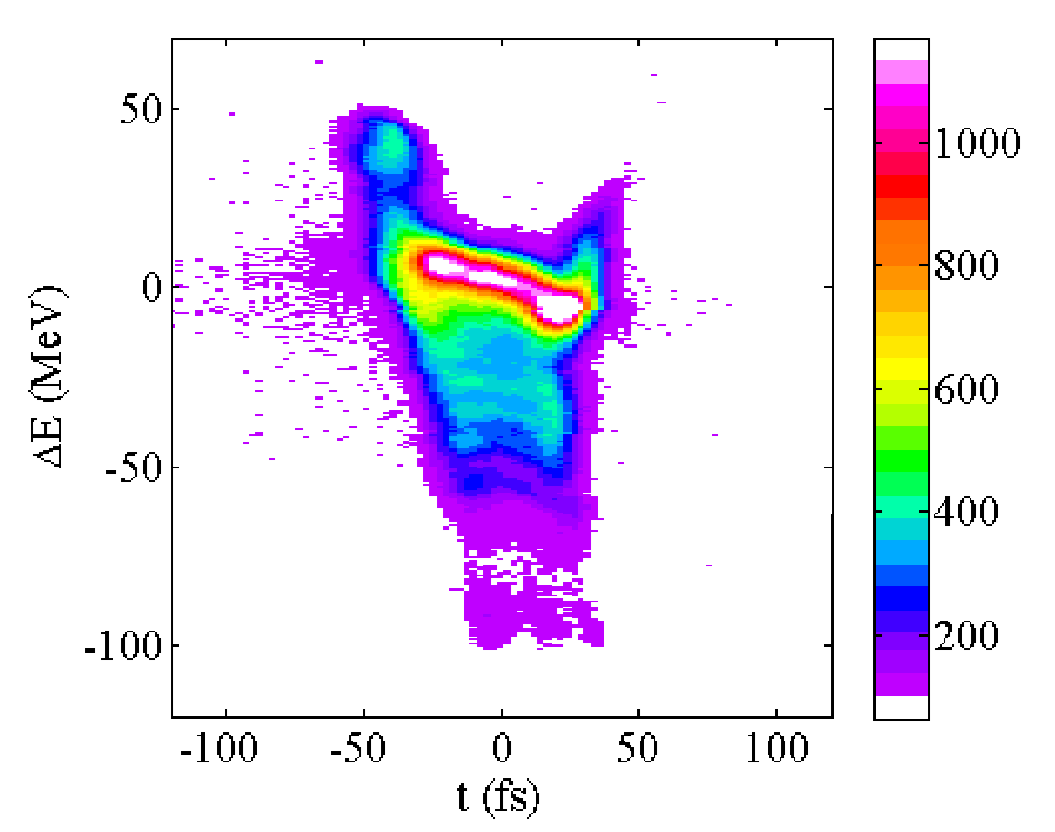
Dark Current and Halo
Most accelerators produce some unwanted beam
  Charge in incorrect buckets from gun or structure field emission
  Charge in a defocused halo or tails that may arrive at a different time.
Beam pickups will see this dark current and it can interfere with the timing measurement.
  10⁻³ charge out of time in a 3GHz arrival time monitor can produce a 50 femtosecond error.
Generally we don’t really want the average of the entire beam, just the “useful” part
Narrowband and low frequency systems are more susceptible to dark current / halo issues.
TCAV image from SLAC / LCLS showing that the centroid of the energy extraction (X-ray pulse) is not at the centroid of the charge

Slide 15
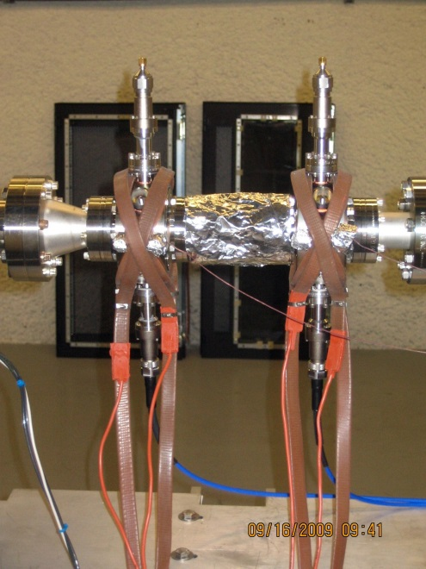
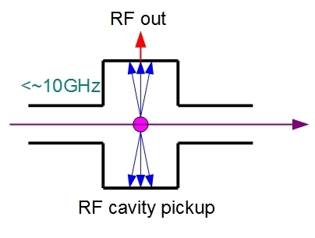
Beam Pickup - Cavity
Generally limited to <10GHz to stay below beam pipe cutoff with an acceptable beam aperture
Cavity provides high Q ~10,000 and good beam coupling
Mechanically robust and reliable
High dynamic range
Modest frequency electronics uses conventional RF engineering.
Extreme temperature sensitivity requires compensation algorithm
SLAC / LCLS

Slide 16
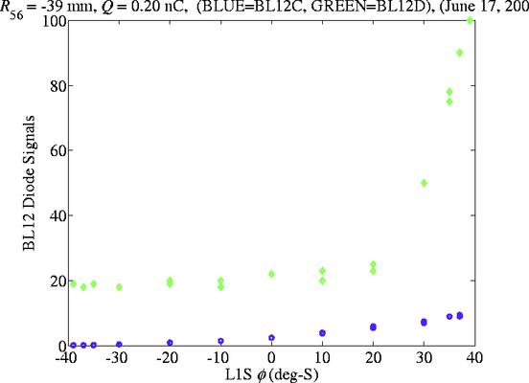
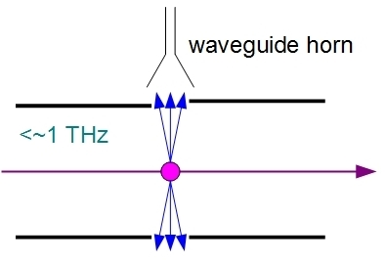
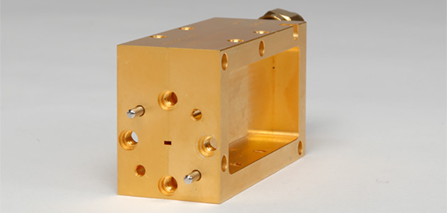
Beam Pickup – High Frequency Waveguide
Millimeter wave mixers are available (up to ~1THz)
Mm-wave signals from gaps have been used at LCLS for bunch length measurement.
Potential application for arrival time monitor working above beampipe cutoff
Usual cautions about above-cutoff apply!
Not aware of this having been tested
300GHz
Diode / gap

Slide 17
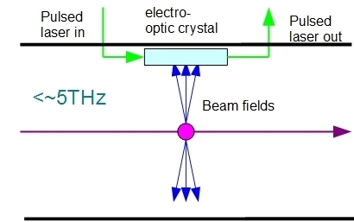
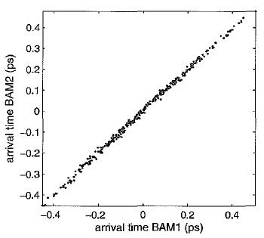
Beam Pickup – Electro Optical
Bandwidth is limited by available electro-optical materials and the electron bunch length.
Readout is by interacting with a femtosecond laser
  Direct intensity modulation through crossed polarizers
  Spectral modulation of a chirped pulse
Extremely high bandwidth!
Directly interfaces to fiber timing system
Electro-optical crystal near the beam presents challenges
  Radiation damage
  Dynamic range
F. Loehl et al
DESY/FLASH
6fs RMS (maybe 3 achieved?)

Slide 18
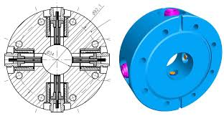
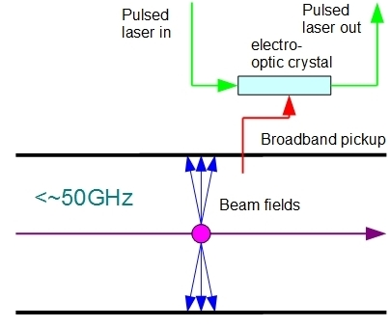
Indirect Electro Optical pickoff
Use a high frequency pickup and cable, and an external electro-optical modulator.
Reduces bandwidth to <50GHz for practical feedthroughs
Eliminates radiation and beam stay-clear issues.
Directly interfaces to fiber timing system
Planned for the EURO XFEL
M. K. Block et al. DESY

Slide 19
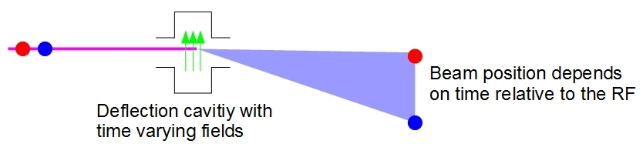
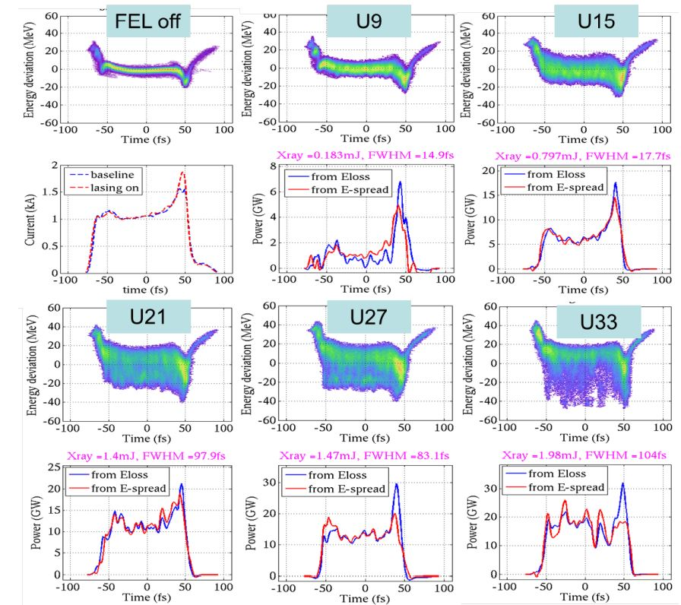
Transverse Deflection Cavities
Single shot temporal imaging resolution to <1fs demonstrated.
Timing measurement limited by stability of RF in the cavity
  In most cases this is no better than the ability to measure the beam induced signal
  For very low charge beams this can have better resolution than a beam pickup
If combined with an energy spectrometer, a TCAV can provide additional information – for example what part of a bunch is lasing in a FEL
VERY EXPENSIVE – Usually not worth building as a timing diagnostic, but can be used for that if it is already needed for other functions.

Slide 20
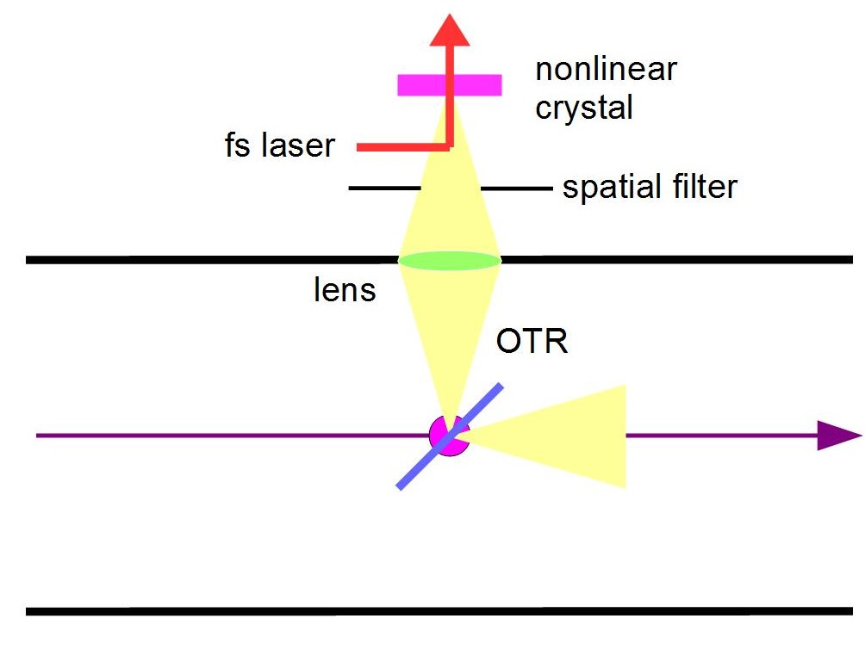
Free Space Radiation
The electron beam can be made to radiate into free space through the use of Optical Transition Radiation or an Undulator.
  This allows the a signal with the full bandwidth of the beam to interact with a femtosecond laser
  Typical FEL electron beams will be radiating in a 1-100THz band that is not very convenient for optical techniques
  Spatial filtering can be used to reduce interference from upstream radiation.
OTR
  Simple and broad bandwidth, can be optically filtered to narrow-band
  Invasive
Undulator
  Provides a narrow band at the desired wavelength
  Expensive., Parameters may not be practical for high energy beams
  May be invasive due to coherent effects.
Potential for very high resolution measurements
More complex than conventional EO systems.
(see S. Kovalev’s talk)

Slide 21
X-ray vs. Laser Timing
For X-ray FELs we can directly measure the quantity of interest: X-ray vs experiment laser time
  Provide feedback to beam timing
  Provide shot by shot data for offline correction
Still need a conventional arrival time monitor
  Temporal range is usually small, so these systems have to be used in conjunction with a conventional arrival time monitor
  Greatly reduces the requirements on the conventional system.
  These systems may not work under all FEL operating conditions.
When usable, direct X-ray / optical measurement will generally provide the highest performance.
The design of these systems is beyond the scope of this talk – will just give an example.

Slide 22
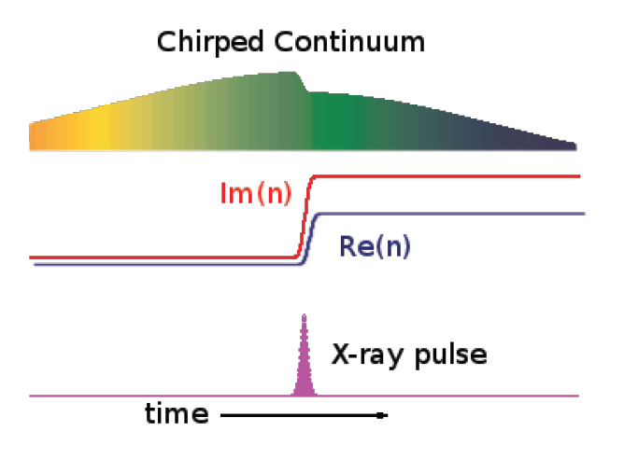
X-ray / Optical timing at SLAC / LCLS
Multiple labs have used these techniques, using SLAC / LCLS design as an example.
X-rays change the transmission and refractive index of a foil.
This change is detected as a spectral change on a chirped continuum pulse generated from the experiment laser
fs laser
Continuum
generation
Chirp
X-rays
SiN
foil
Spectrometer

Slide 23
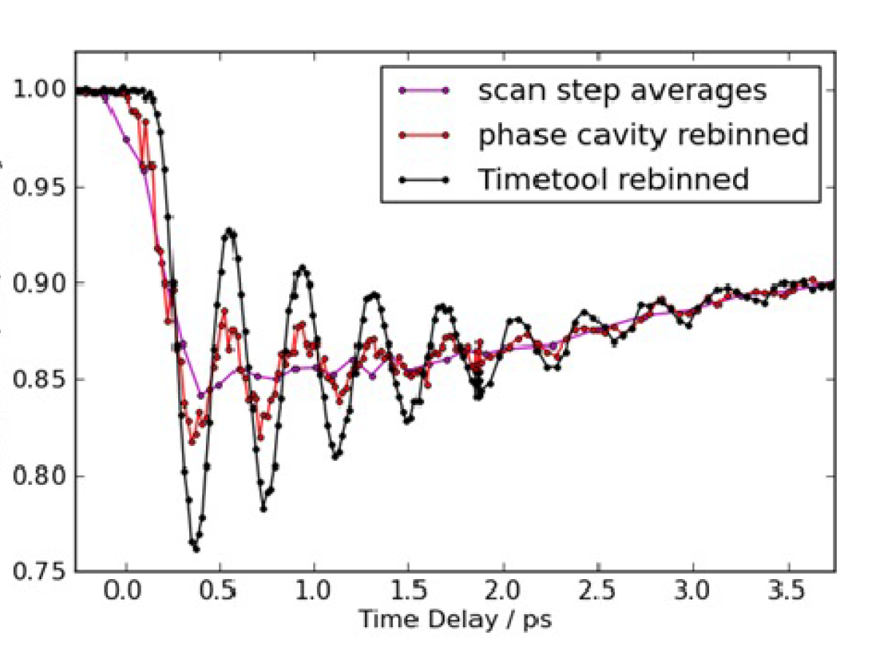
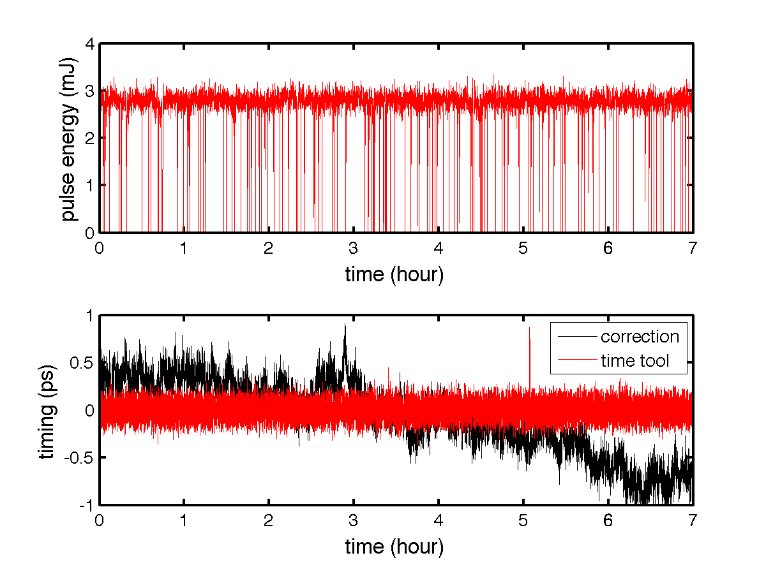
“Time Tool” X-ray / Optical cross correlator results
Phase cavity (Bunch Arrival Monitor) improves jitter.
Time tool makes a large additional improvement.
H. Lemke, M. Weaver, et al., Proc. SPIE, 87780S (2013)
Time tool data used in feedback to eliminate drift from the conventional timing system.

Slide 24
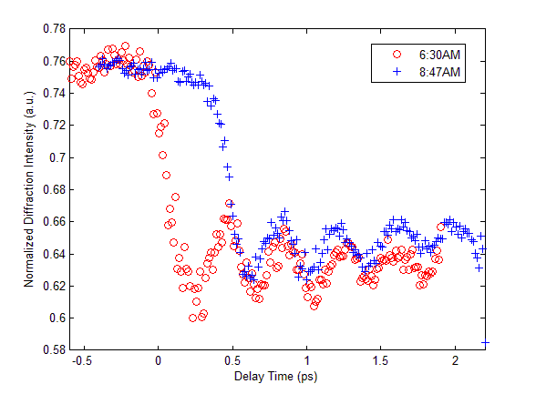
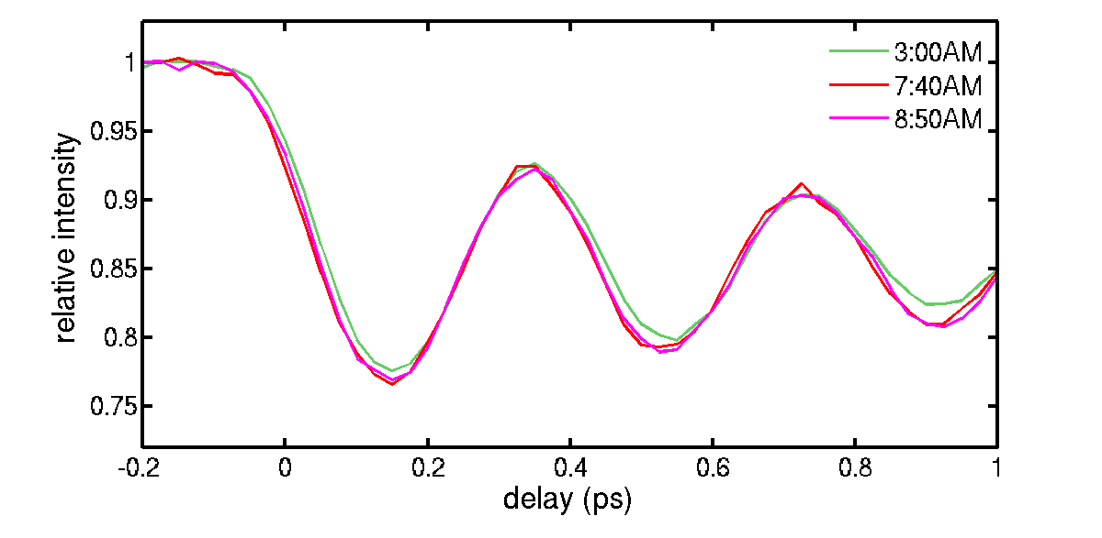
LCLS Timing System With and Without Time Tool
Without time tool, 100fs/hour drifts are seen on experiments from a combination of
  Arrival Monitor
  Timing Distribution System
  Laser Locking System
  Laser Transport System
With Time Tool active the drift is <15fs
D. Zhu et al

Slide 25
Selecting an Arrival Time Monitor - Guidelines
The Arrival Monitor is rarely the performance limiting, or most expensive part of a precision timing system: Evaluate the entire design of your timing system.
For low frequency systems operating below beam pipe cutoff, RF cavities are very attractive.
For high frequency systems:
  Operating above cutoff requires careful thought to avoid contamination from upstream signals
  Optical systems generally have the highest bandwidth
  Its not worth going a little above cutoff
  These systems can be very high performance, but it is easy to get it wrong!
Other schemes like TCAVS, undulators etc, may be useful in unusual situations.
A physics based arrival time monitor at the experimental chamber will be better than ANY external timing system.
  This is the best option if available.

Slide 26

This is a job for Engineers, not Students (and not Scientists!).
L. Nikodym
Its like building a bridge – you don’t want to have to re-invent engineering!

Slide 27
RF Cavity Arrival Time Monitor: SLAC / LCLS
Example of a RF cavity based arrival time monitor
  LCLS is a X-ray FEL facility, operating since 2007
    15 GeV electron beam from 1/3 of the old SLAC high energy physics LINAC
    New gun and bunch compressors
    1.7km total length
    Undulator
    15GeV, 20-250pC, 10-100 fs electron bunches, 120Hz.
Arrival time monitor located after the undulator.
  Provides femtosecond timing to the X-ray experiments.
  In use since 2007

Slide 28
SLAC / LCLS Timing System
FEL
Experiment
RF from accelerator
Phase feedback to PLL
δΦ
X
PLL
reflect
Average of forward and reflected phases is constant
Phase
average
Laser
Arrival monitor
electronics
Feedback
pickup cavity
Time Tool
experiment
The RF reference from the accelerator is stabilized by the arrival time monitor. The resulting signal is transmitted to the experiment by a bi-directional RF line using phase averaging to correct for drift. The “time tool” X-ray / optical cross correlator provides precision timing. All long distance transmission is at 476MHz. 1/6 of the main accelerator frequency

Slide 29
Arrival Time Monitor Cavities
The LCLS uses beam pickup cavities at S-band, 2805MHz
  Different from the GUN and Accelerator RF of 2856MHz to avoid measuring dark current
Cavities are high Q (~7000) copper.
  Couplers are NOT designed to reject dipole modes – no measurement of position sensitivity has been performed. (expected to be fairly small, and cavities are located after the undulator where the orbit is very stable).
  Two cavities are used, each has a heater for calibration.

Slide 30
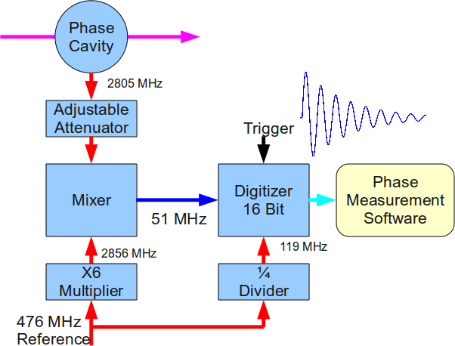
Arrival Time Monitor Electronics
The electronics mixes the 2805MHz from the cavity with 2856 (6X the 476MHz reference).
The resulting IF is digitized at 119MHz (locked to the reference).
High linearity electronics used throughout to reduce amplitude -> phase conversion.
Electronics is 8 years old, could be improved, but it is not the performance limiting part of the timing system.
Note that the frequencies were chosen based on available hardware and are not optimal.

Slide 31
Temperature Correction
Temperature coefficient of timing:
  The high Q cavities ring at ~3GHz for ~10⁴ radians
  The thermal expansion of Copper is ~2x10⁻⁵/℃
  Expect 10ps/℃ temperature sensitivity without correction!
The ringing frequency is directly proportional to temperature, in fact it is the change in frequency that is causing the problem in the first place
Measure the changing resonant frequency and use it to correct the timing
Calibrate the effect by heating first one cavity, then the other, and fitting the change in delay times relative to measured cavity frequencies.
See poster “Implementation of Phase Cavity Algorithm for Beam Arrival Time Monitoring System for LCLS”, MOPB076, K. H, Kim et al.
  Unfortunately that was yesterday so you will need a time machine….

Slide 32
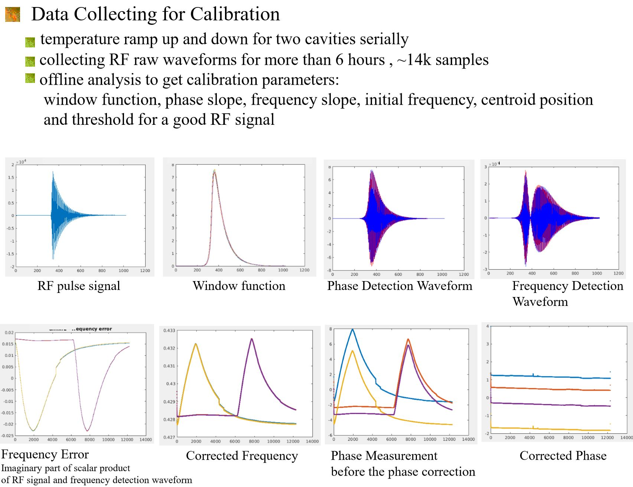
Correction Algorithm
K.H. Kim

Slide 33
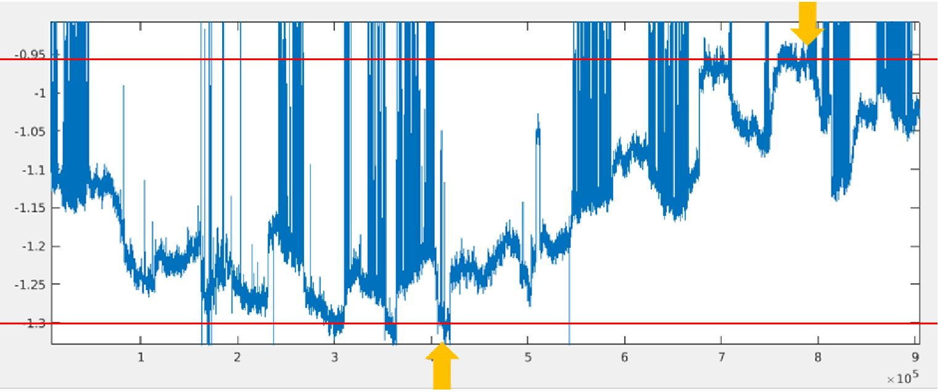
Arrival Time Monitor Performance
RMS difference between measured timings for two cavities: 13fs RMS for a 1 minute measurement.
Drift difference between timings for two cavities: 340fs pk-pk for 2 week measurement.
(note the LCLS tunnel temperature is very stable ~0.1℃)
350fs
2 weeks
Note that the drift is not diurnal, typically < 100fs / day.

Slide 34
Where Does the Remaining Drift Come From?
The drift is not diurnal and does not match the time structure of the temperature in the undulator hall:
Humidity: Water has a high dielectric constant at RF frequencies. Water absorption in cables can change their phase length
Physical motion: The 300fs drift corresponds to 100um motion. The cavity mounts could move due to changes in air pressure acting on bellows
Beam conditions: changing satellite bunches, dark current etc. could cause timing changes.
In the end it doesn’t matter – Other timing drifts are larger and the Time Tool fixes everything.

Slide 35
RF Arrival Time Monitor Reliability
The SLAC / LCLS arrival time monitor has been in near continuous use since 2007.
One hardware failure (loose connector caused 100fs jitter increase)
  Automatic fail-over to redundant system allowed experiments to continue without loss of performance.
Significant problems with real time communication of the measured arrival times to the experiment data acquisition system.
Overall the system has been very robust and maintenance free!

Slide 36
Pulsed Fiber Arrival Time Monitor – DESY / FLASH / European-FEL
Several variants of a common design concept have been used or are under development for FLASH and the European FEL.
  Will show a “generic” version
System uses a pulsed fiber laser as a master source.
Arrival time monitor uses high frequency RF pickups which drive commercial electro-optical modulators
Designed for 20pC to 1nC, with beam burst rates to MHz.
This is the result the work of many groups at a wide variety of laboratories around the world.
F. Lohl et al, “Electron Bunch Timing with Femtosecond Precision in a Superconducting Free-Electron Laser” Phys. Rev. Lett. 104, 144801

Slide 37
Pulsed Fiber Timing System
Optical to optical correlator
Fiber length feedback
Laser Feedback
Pulsed Fiber Laser
Adjustable Delay
Optical to optical correlator
Experiment Laser
Optical to optical correlator
Fiber length feedback
Arrival time data
Fast beam pickup
Adjustable Delay
Optical to RF correlator
Fiber lengths are stabilized by comparing the forward and reflected pulse times with an optical correlator (nonlinear crystal)

Slide 38
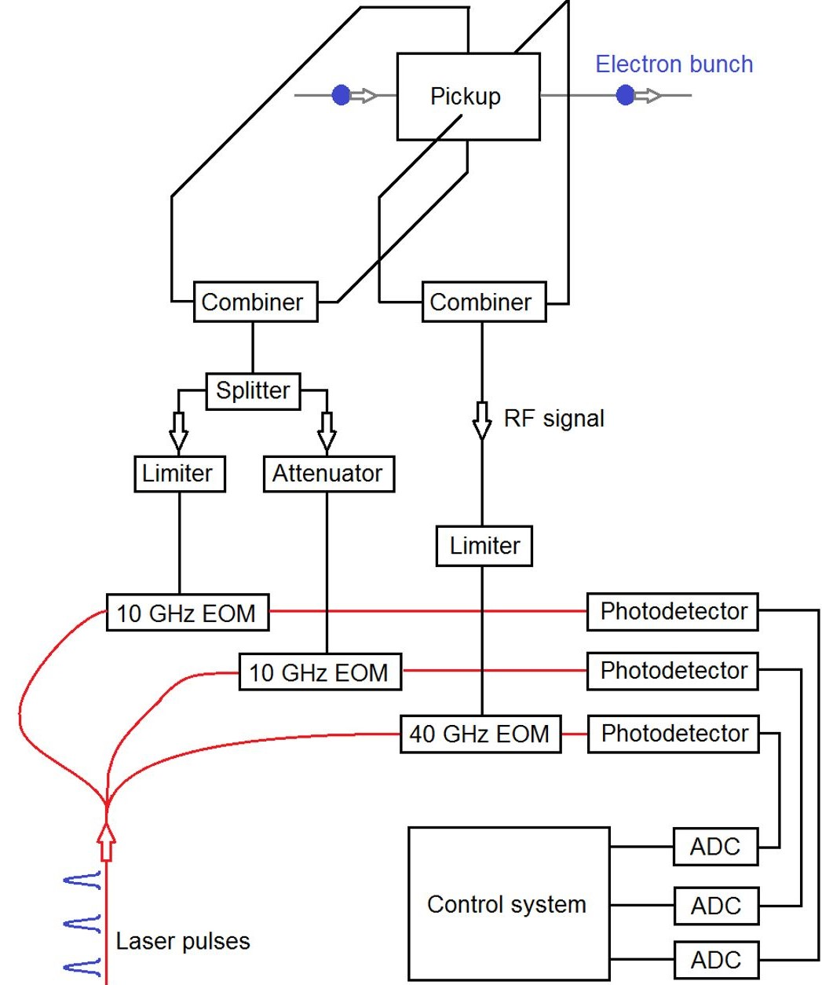
Fiber Arrival Time Monitor Front End
“Coarse” 10GHz Channel
“Fine” 40GHz Channel
High frequency EO modulation of pulsed fiber laser intensity by the beam signal
Intensity modulation detected by low bandwidth photo receivers.
High bandwidth allows detection of the first zero-crossing of the 40GHz RF and reduces sensitivity to propagating beam pipe modes
Large dynamic range requires the use of limiters / attenuators.
  Care is needed to maintain good linearity and avoid amplitude -> phase conversion.
A. Kuhl et al.

Slide 39
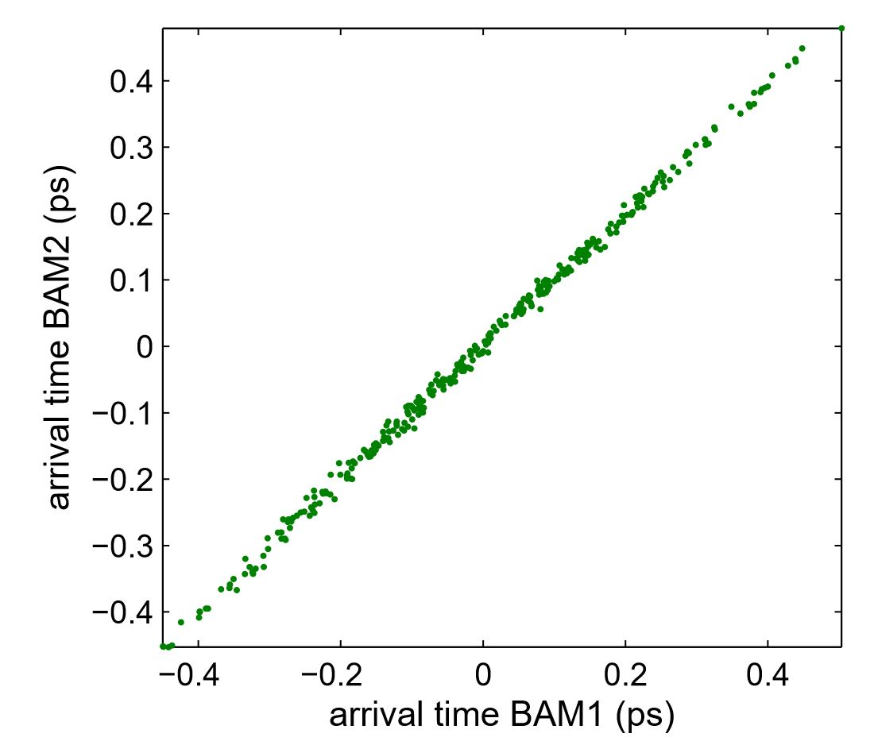
Fiber Arrival Time Monitor Results
Results from 2008 gave 9.5fs RMS difference between two monitors over 1 minute.
  This was for an earlier lower bandwidth system, the 40GHz system is expected to have better performance.
Long term drift is expected to be good.
F. Loehl et al

Slide 40
Fiber vs RF
RF based systems
  Simple and low cost
  Straightforward RF engineering.
  Very rugged with excellent reliability
  Performance sufficient for many applications (<15fs jitter, <500fs multi-week drift)
Electro-optical systems
  Very good performance. <10fs jitter (3fs? – discussed but can’t find in the literature).
  Couple directly to high performance pulsed timing distribution systems.
Experiment timing: X-ray / optical correlators
  This changes everything. These will be better than any indirect system, but may not be applicable everywhere.

Slide 41

The Timing Chain – Conclusions
Are the electrons you are measuring the ones that contribute to the physics?
  Dark current? Tails? Does the entire beam laser in the FEL?
Arrival Time Monitor?
Timing transport system?
Laser locker?
Laser amplifier and compression chain?
Laser transport of the experiment?
It is easy (and good) to get excited about building the best possible arrival monitor.
Just remember that it is experiment timing that matters, and the BAM is usually not the limit.

