Slide 1
Recent Progress in
X-ray Emittance Diagnostics at SPring-8
S. Takano, M. Masaki, and H. Sumitomo *
JASRI/SPring-8, Hyogo, Japan
SES, Hyogo, Japan *
Notes:
Thank you, chairman.
Today I would like to talk about recent progress in X-ray emittance diagnostics at our synchrotron radiation facility, SPring-8.

Slide 2
Outline
Introduction
X-ray Pinhole Camera
X-ray Fresnel Diffractometry Monitor (XFD)
Conclusions
Notes:
After brief introduction,
I would like to talk about the X-ray pinhole camera recently installed at SPring-8.
Then I would like to present X-ray Fresnel Diffractometry Monitor developed at SPring-8,

Slide 3
Introduction
Light Source Facilities are Competing to
Achieve Lower Emittance and Emittance Coupling Ratio for Higher Brilliance.
Serious and Elaborate Efforts are being Paid for
Upgrade Plans of Existing Rings or New Plans of Low Emittance Rings.
X-ray Synchrotron Radiation (SR) is
Key Diagnostic Probe for Non-Destructive Beam Emittance Measurement.
Both Direct Imaging and Interferometric Technique
can Resolve the Micrometer-order Transverse Beam Size.
Emittance is Obtained from the Measured Size
with Other Knowledge (Betatron and Dispersion Functions, Energy Spread).
Notes:
Light source facilities are now competing to achieve lower emittance and emittance coupling ratio for higher brilliance.
Serious and elaborate efforts are being paid for upgrade plans of existing rings or new plans of low emittance rings.
X-ray synchrotron radiation is a key diagnostic probe for non-destructive beam emittance measurement.
Both direct imaging and interferometric techniques
can resolve the micrometer-order transverse beam size.
Emittance is obtained from the measured size with other knowledge of betatron and dispersion functions, and beam energy spread.

Slide 4
Introduction
Two Alternative Targets of X-ray Emittance Diagnostics at Light Source Rings
Dipole Magnet Source and Insertion Device Source (Undulator)
It Seems from the View Point of Machine Operation that
Emittance Diagnostics of Dipole Source is Necessary and Sufficient
for Tuning the Beam of the Accelerator
Nonetheless,
Diagnostics of Undulator Source Emittance Cannot be Avoided
Because the Undulator is Just the Source of Light Delivered to Experimental Users
Two X-ray Instruments for Emittance Diagnostics Recently Implemented at SPring-8
Dipole Source: X-ray pinhole camera
Undulator source: X-ray Fresnel Diffractometry monitor (XFD)
Notes:
For X-ray emittance diagnostics at light source rings, we may have two alternative targets.
A dipole magnet source and an insertion device source (Undulator).
It seems from the view point of machine operation, that emittance diagnostics of dipole source is necessary and sufficient for tuning the beam of the accelerator.
Nonetheless, diagnostics of undulator source emittance cannot be avoided
because the undulator is just the source of light delivered to experimental users
Two X-ray instruments for emittance diagnostics have been recently implemented at SPring-8 .
One for a dipole source is the X-ray pinhole camera.
The other for an Undulator source is the X-ray Fresnel Diffractometry monitor (XFD)

Slide 5
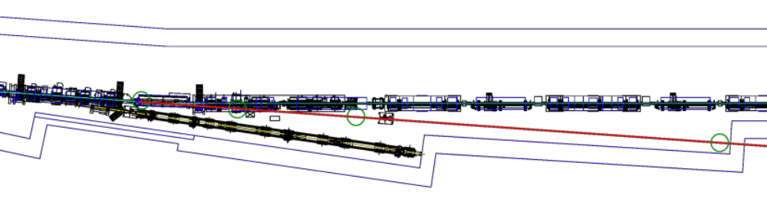
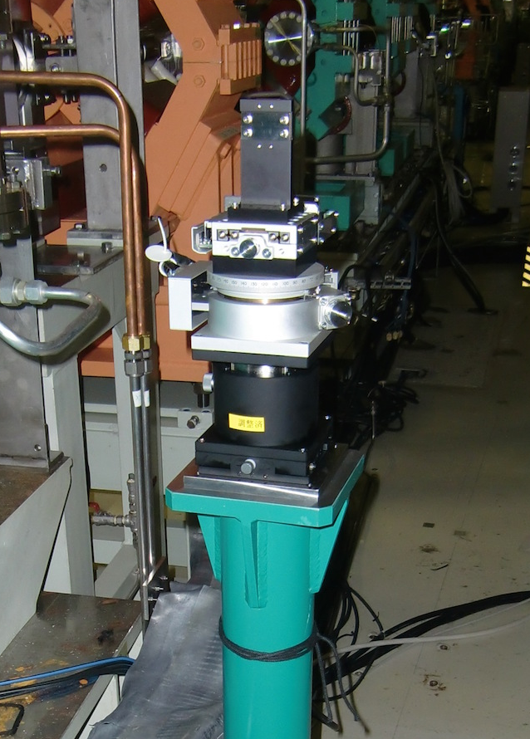
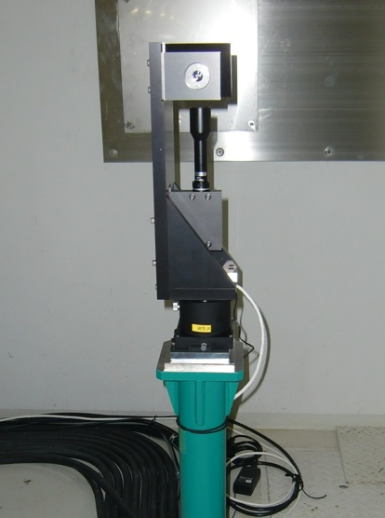
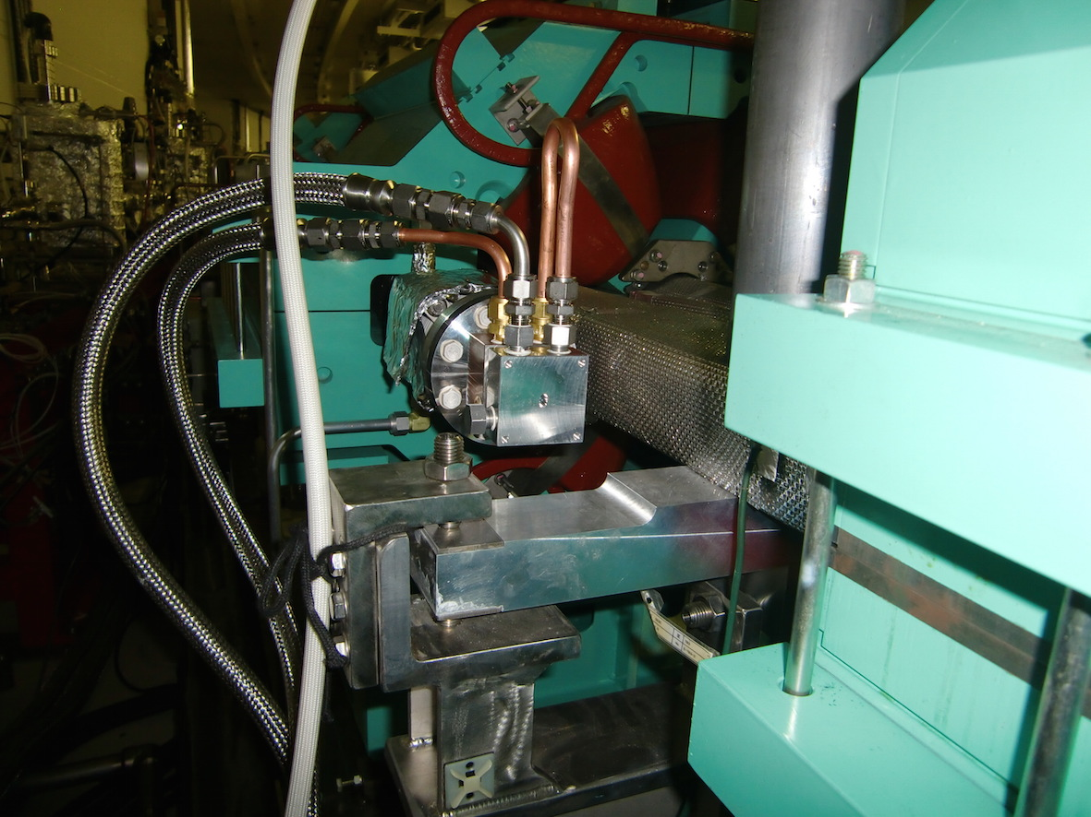
X-ray Pinhole Camera @ SPring-8
Layout
Source:
Dipole (29B2)
X-ray Window
@ 6.24 m
Pinhole @ 11.43 m
Scintillator @ 34.31 m
Notes:
OK, Let me start the first topic, X-ray pinhole camera.
The layout of the SPring-8 X-ray pinhole camera is shown here.
Source dipole magnet, X-ray window, pinhole and scintilator.

Slide 6
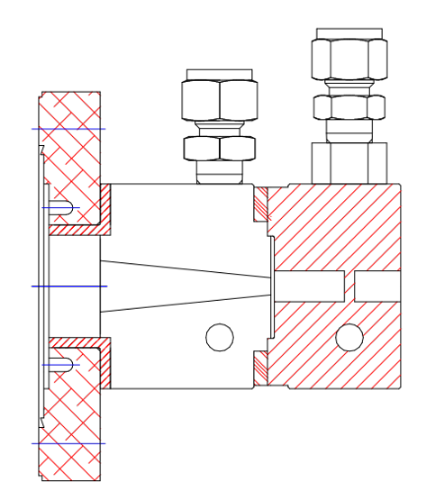
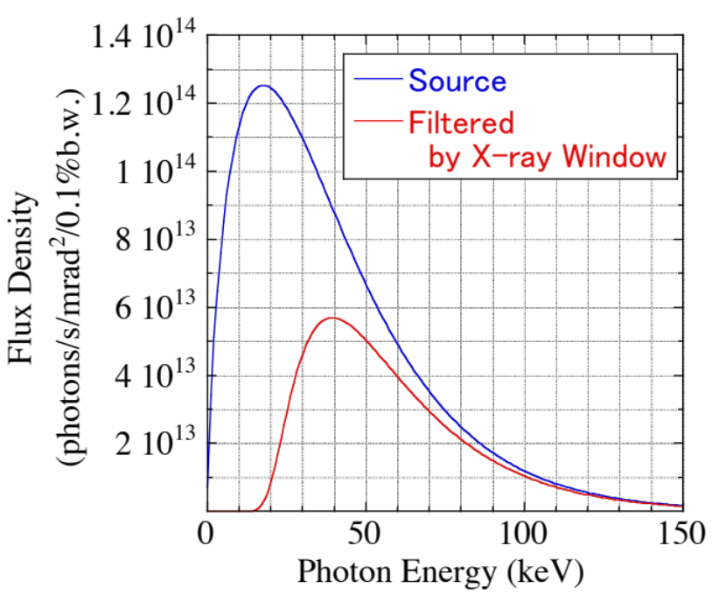
X-ray Pinhole Camera @ SPring-8
Source: Dipole (29B2)
B = 0.5 T Ec = 21.1 keV
X-ray Window @ 6.2 m
Aluminum
3mm thick
X-ray
Alminum 5052
OFHC mask
1mm (H) X 5mm (V)
Notes:
The source is a dipole magnet (29B2).
The magnetic field at the source point is 0.5 T. And, the critical photon energy of emitted X-rays 21.1 keV.
The X-ray window is located at a distance of 6.2 m from the source.
The window material is aluminium of 3 mm thickness.
The window separates the ultra-high vacuum and the atmosphere.
The X-rays go out to the atmosphere through the window.

Slide 7
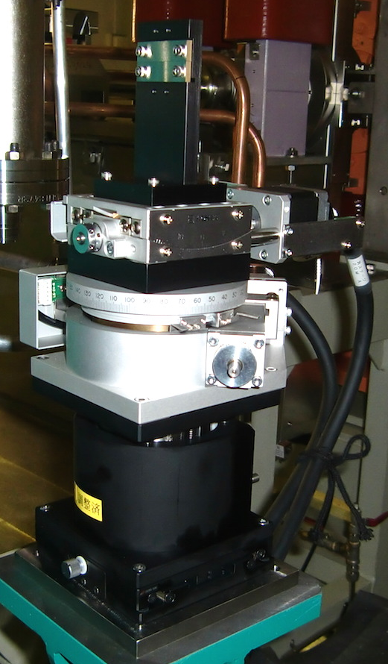
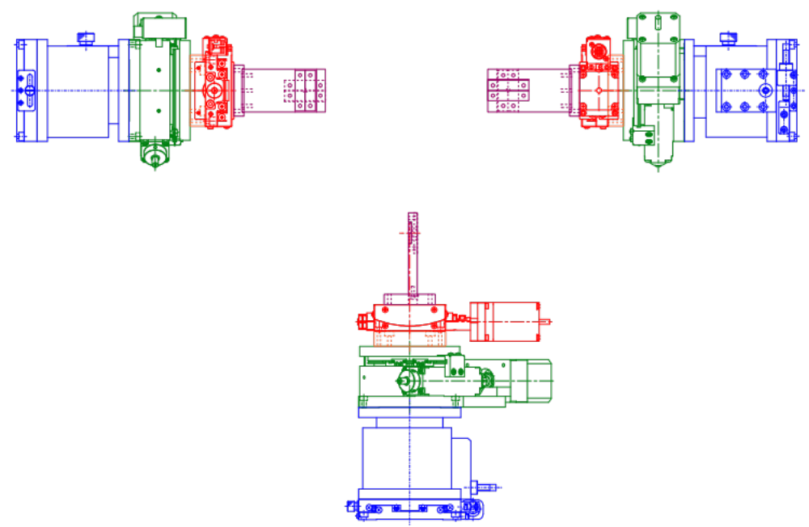
X-ray Pinhole Camera @ SPring-8
Pinhole Assembly @ 11.4 m
Aperture: 20 μm x 20μm
Y slit
Tungsten 3mm thick
X slit
Tungsten 3mm thick
gonio stage
X-ray
rotary stage
manual XZ stage
Notes:
The pinhole assembly is located at a distance of 11.4 m from the source.
It is composed of combined narrow X and Y slits made of tungsten.
The thickness of each slit is 3mm, and the aperture size of the pinhole is 20 um x 20um.
The pinhole assembly is equipped with remote controllable gonio and rotary stages for adjustments of pitch and yaw of the pinhole.
It is mounted on a manual XZ stage for alignment.

Slide 8
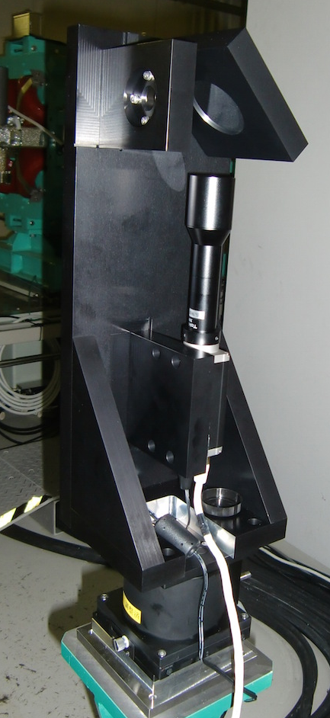
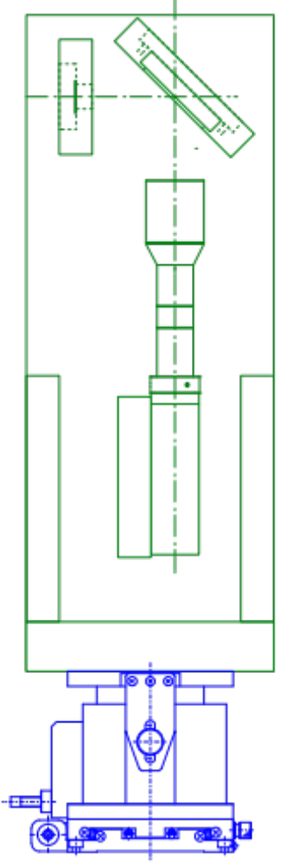
X-ray Pinhole Camera @ SPring-8
Scintillator & Camera Assembly@ 34.3m
Mirror
X-ray
Scintillator
CdWO₄ (CWO)
0.5mm thick
Lens
object-space telecentric
x2 magnification
W. D. = 111 mm
CCD Camera (Basler piA2400-17gm)
GigE interface
2448 x 2050 pixels
3.45 μm x 3.45 μm pixel size
manual XZ stage
Notes:
The scintillator is located at a distance 34.3 m from the source.
Therefore the magnification factor of the pinhole is two.
The scintillator is made of CdW₄O(CWO) with a thickness of 0.5mm.
The visible beam image obtained by the scintillator is measured by a CCD camera through a lens.
The lens is object-space telecentric with a magnification factor of two.
The CCD camera is connected to a remote computer through the Gig-E (Gigabit Ethernet) interface.

Slide 9
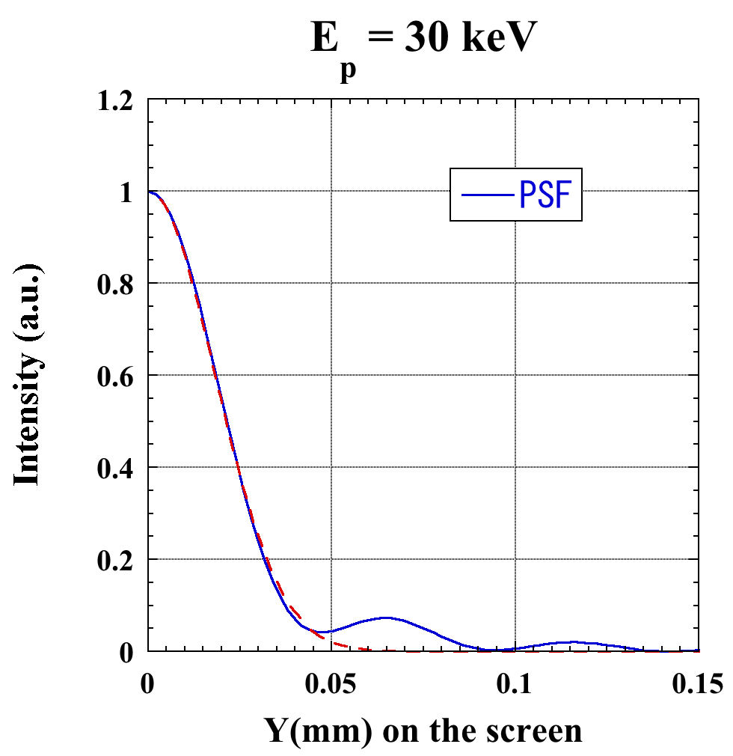
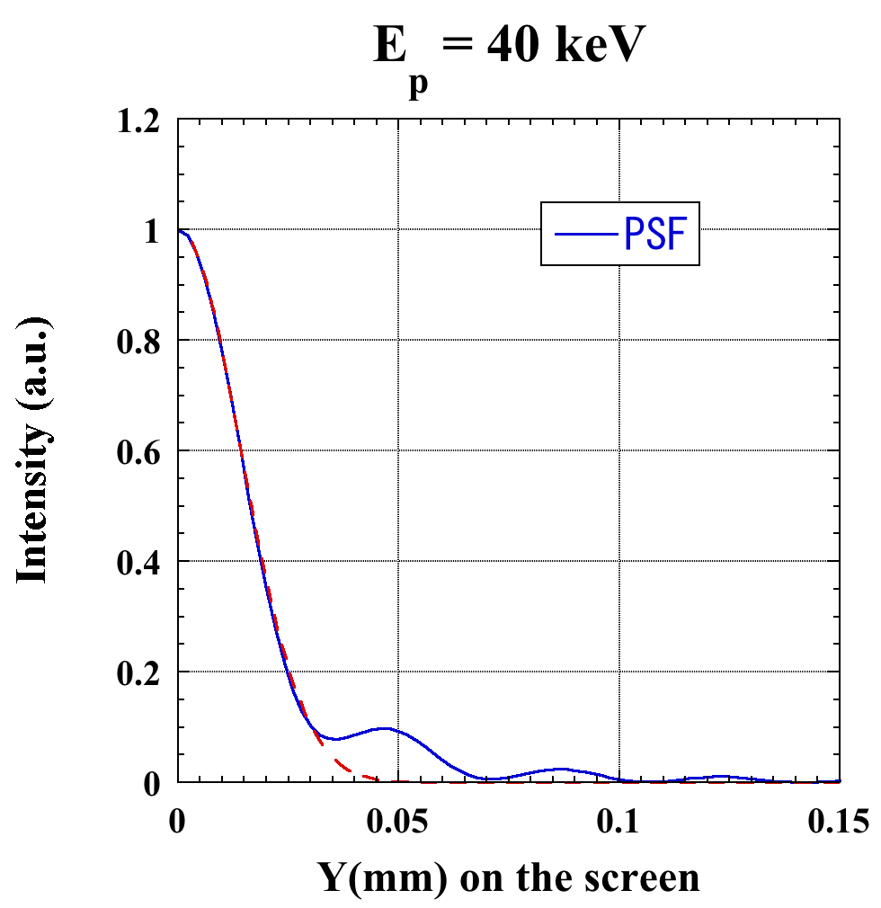
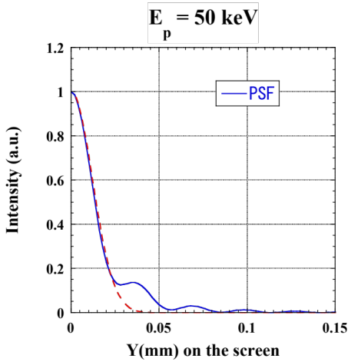
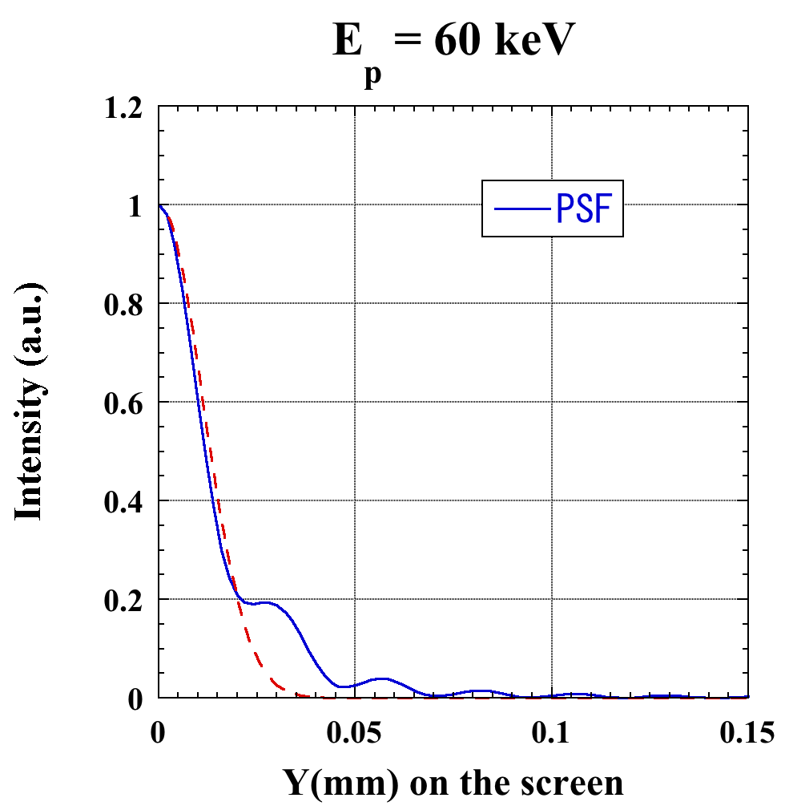
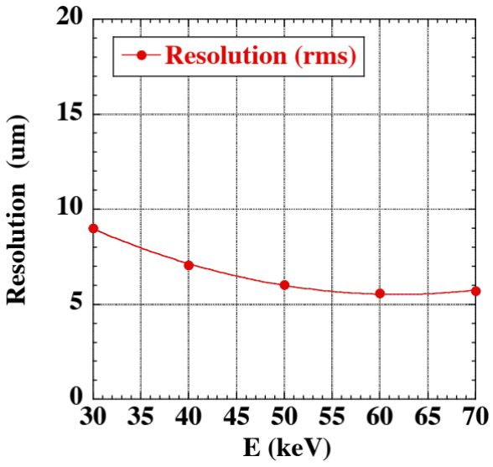
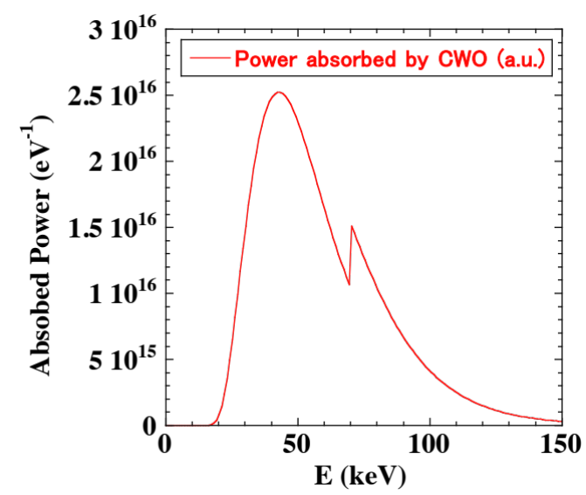
X-ray Pinhole Camera @ SPring-8
Resolution of Pinhole ( PSF calculation based on Wave Optics )
Pinhole Resolution (rms)
σ_{diff} = 6.9 μm
@ 42 kev
Notes:
The pinhole resolution was evaluated according to numerical calculation of the point-spread function (PSF) based on wave optics by using diffraction formula.
The resolution was defined by width of a Gaussian curve fitted to the PSF.
The monochromatic pinhole resolution as a function of the X-ray energy is shown here.
Spectral power absorbed by the scintillator was calculated by the calculation code SPECTRA, and found to peak at an X-ray energy of 42 keV.
The resolution of the pinhole was evaluated to be 6.9 um from the width of the monochromatic PSF at 42 keV.

Slide 10
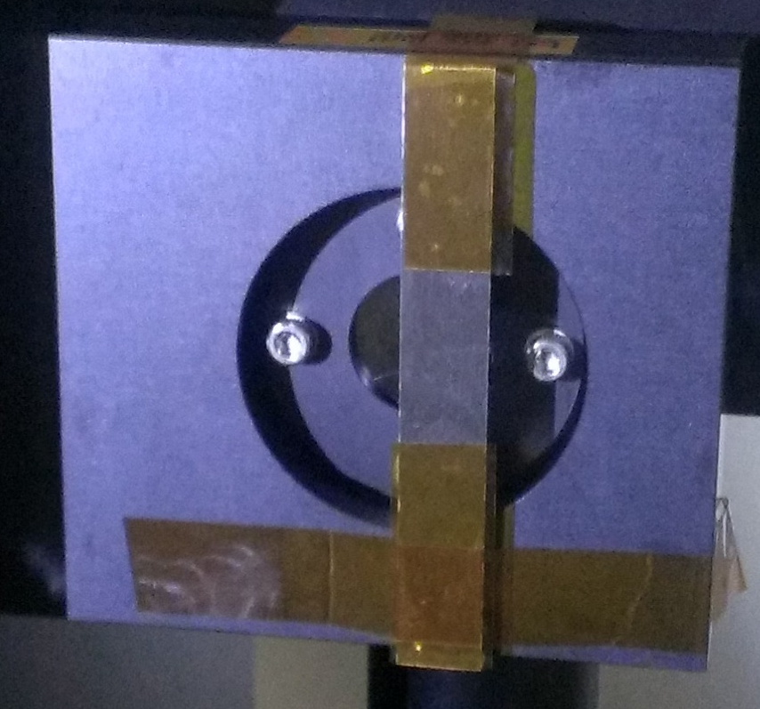
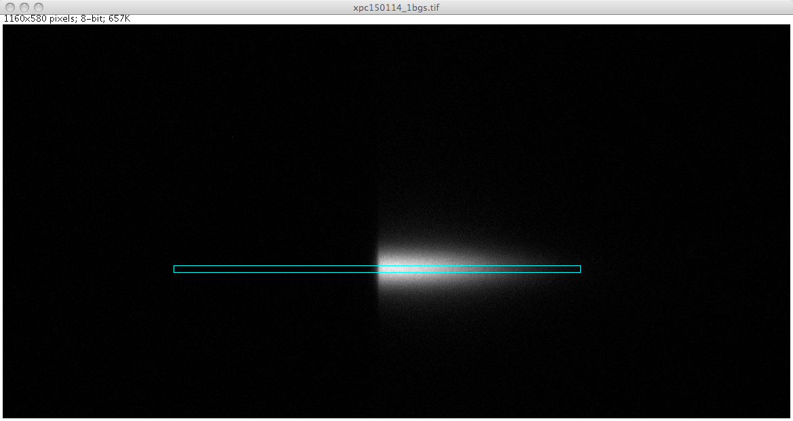
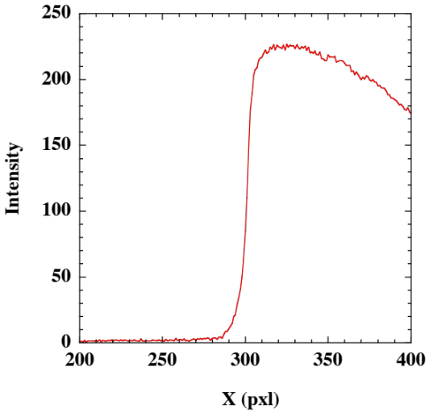
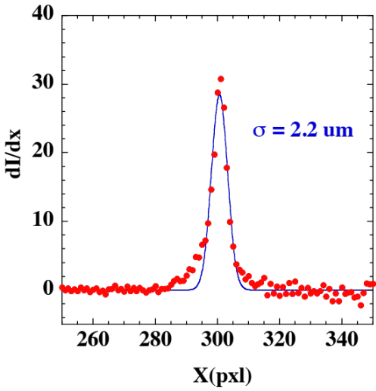
X-ray Pinhole Camera @ SPring-8
Scintillator & Camera Assembly
Resolution Calibration
sharpness of edge of W bar
placed in front of scintillator
measured
Resolution (rms) of
Scintillator & Camera Assembly
σ_{CAM} = 2.2 μm
Notes:
The resolution of the scintillator and camera assembly was calibrated by the sharpness of the observed edge of a tungsten bar placed in front of the scintillator.
The profile of the observed edge and its derivative are shown here.
The resolution of the scintillator and camera assembly was evaluated as 2.2 um on the coordinate of the beam (4.4 um on the scintillator).

Slide 11
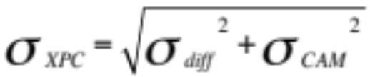
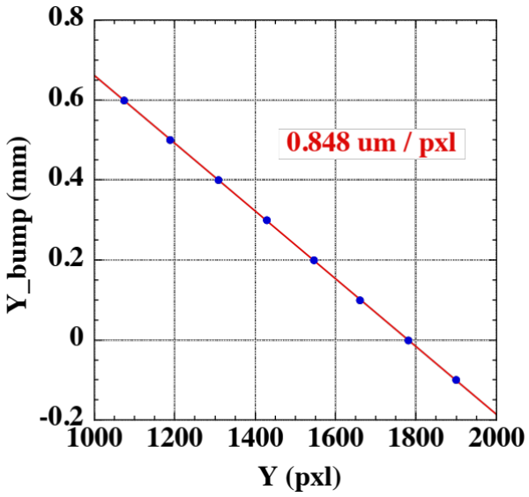
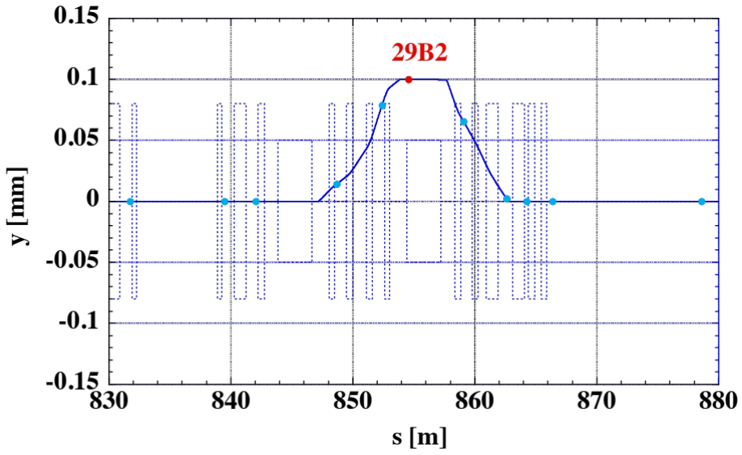
X-ray Pinhole Camera @ SPring-8
Total Spatial Resolution σ_{XPC} (rms)
= 7.2 μm
Pinhole σ_{diff} = 6.9 μm
Scintillator & Camera σ_{CAM} = 2.2 μm
Scale of Camera Pixel to Beam Coordinate
measured by introducing vertical bump orbits
consistent with
designed value 0.8625 μm/pixel
Notes:
The total spatial resolution of the pinhole camera is 7.2 um. It is determined by combination of diffraction of the pinhole and the resolution of the scintillator and camera assembly.
The scale of the camera pixel to the beam coordinate was measured by introducing vertical bump orbits.
The calibrated scale is consistent with the designed value within the manufacturer’s specified accuracy of the lens magnification factor.

Slide 12
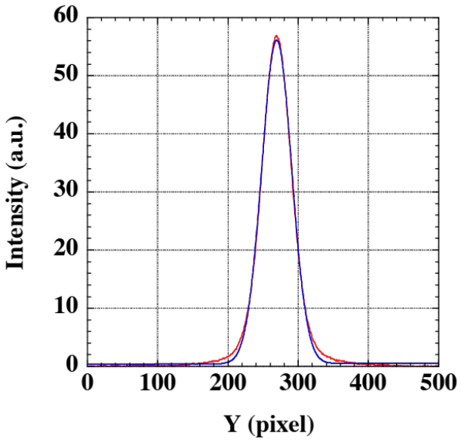
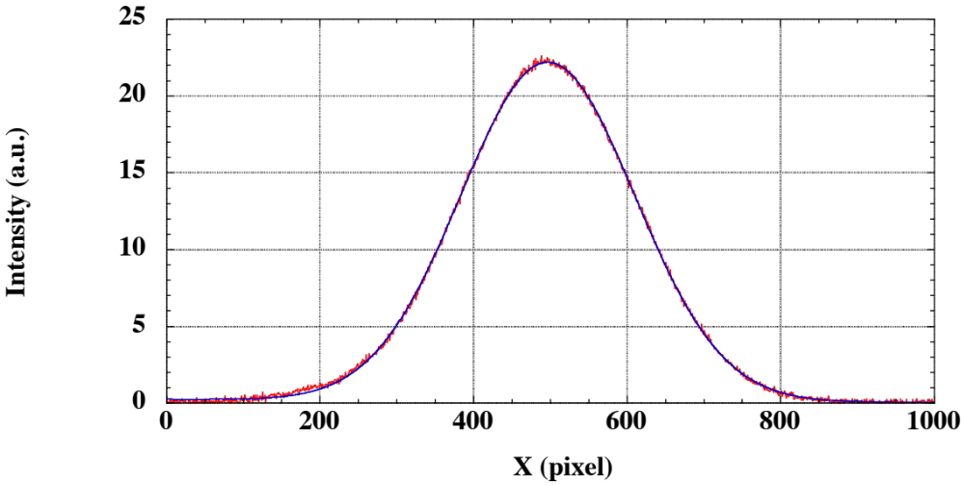
X-ray Pinhole Camera @ SPring-8
Example of data I = 100 mA, exposure time 1 ms
Projected σ_{y} =
21.3 pixels
Projected σ_{x} =
113.5 pixels
Projected profiles
(horizontal and vertical)
consistent with
Gaussian profiles
Projected Beam Size
σ_{x} = 96.0 μm
σ_{y} = 16.6 μm
(resolution subtracted)
Notes:
This is an example of observed beam image, with projected profiles in the horizontal and the vertical directions.
The projected profiles are consistent with Gaussian.

Slide 13
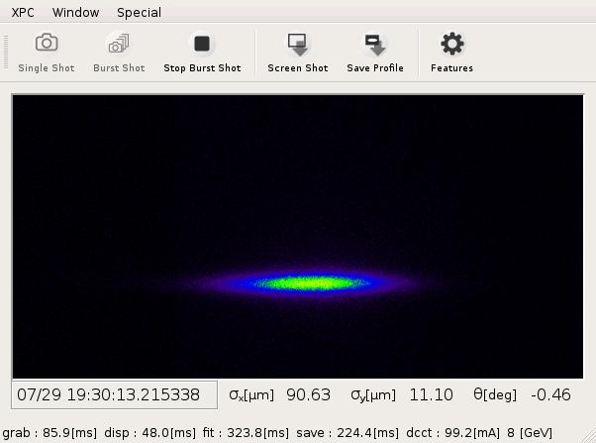
X-ray Pinhole Camera @ SPring-8
Control Room Display
Live Beam Image View
~ 15 fps
Parameters of Beam Profile
beam size σ_{x} and σ_{y}
beam tilt angle θ
Continuously Logged
to SPring-8 Control Database
By Periodical Image Analysis
(1s cycle time)
2D Gaussian Profile is
Fitted to Beam Image Data
ε_{y} = 7.5 pm.rad
(coupling 0.3%)
Notes:
This is the display for the X-ray pinhole Camera in the SPring-8 control room.
Live beam image view is available with the refreshing rate of approximately 15 frames per seconds.
Parameters of the beam profile are continuously logged to the control database,
By periodical image analysis.
Two-dimensional Gaussian profile is fitted to the beam image data.

Slide 14
X-ray Pinhole Camera @ SPring-8
Control Room Display
Live Beam Image View
~ 15 fps
Parameters of Beam Profile
beam size σ_{x} and σ_{y}
beam tilt angle θ
Continuously Logged
to SPring-8 Control Database
By Periodical Image Analysis
(1s cycle time)
2D Gaussian Profile is
Fitted to Beam Image Data
ε_{y} = 7.5 pm.rad
(coupling 0.3%)
Notes:
This is an example of fast-forwarding movie of live beam image view.
Several undulators are closing the gaps.
And the vertical beam size and beam tilt angle are changed as betatron coupling is induced by error fields of undulators.

Slide 15
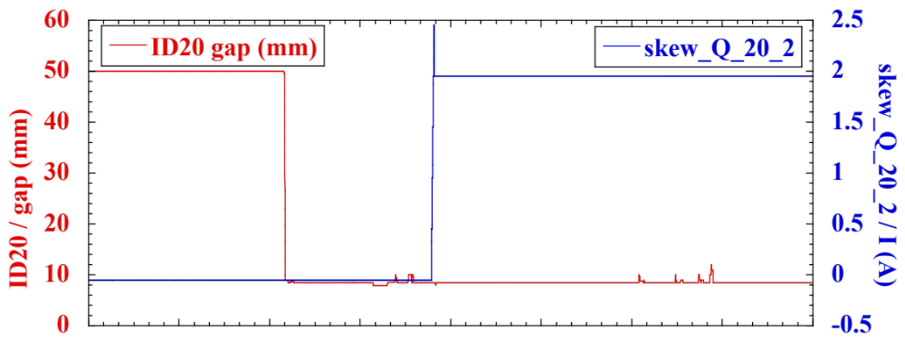
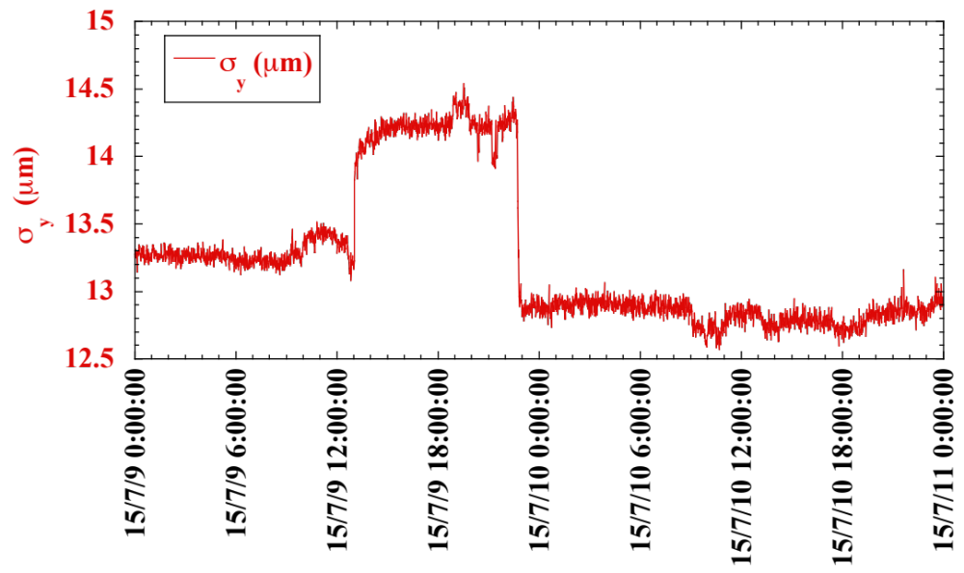
X-ray Pinhole Camera @ SPring-8
Diagnostics for User Operation: Betatron Coupling induced by ID20
gap opened
ID error fields excite
betatron coupling
in user operation.
Betatron coupling
is corrected
by tuning
skew Q parameters.
gap closed
skew Q correction
Notes:
The X-ray pinhole camera at Spring-8 now is indispensable for user operation.
Betatron coupling induced by error magnetic fileds of undulators is corrected by tuning the skew Q parameters with real-time observation with the pinhole camera.

Slide 16
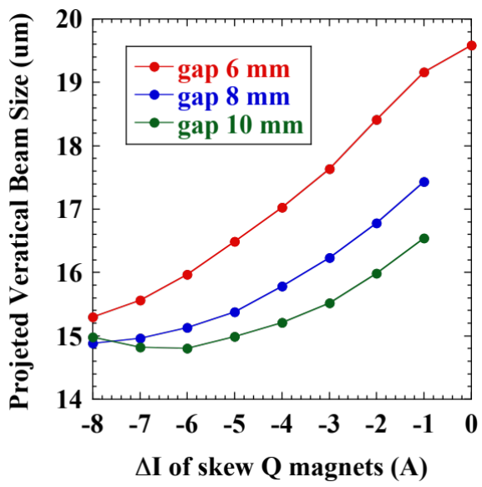
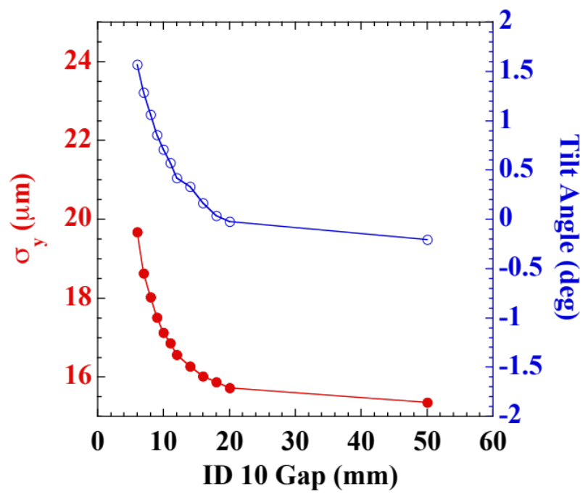
X-ray Pinhole Camera @ SPring-8
Diagnostics for Machine Tuning: Betatron Coupling induced by ID10
Gap 6 mm
Gap 50 mm (full-open)
Search for
Correcting skew Q parameters
* radiation induced-demagnetization
of ID10 suspected,
and B field readjusted in March 2015
Notes:
This is another example of data obtained by the X-ray pinhole camera.
An undulator, ID10 excited larger betatron coupling than other undulators.
Parameters of Skew Q magnets were surveyed with real-time observation with the pinhole camera.
For this ID10, radiation induced-demagnetization was suspected, and later the magnetic fields were readjusted in March 2015.

Slide 17
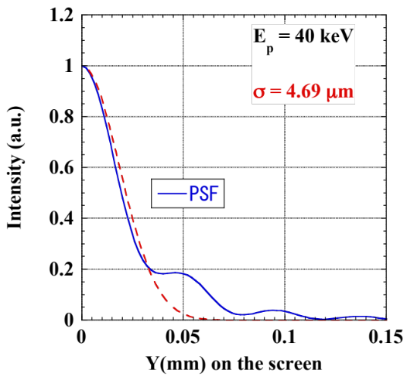
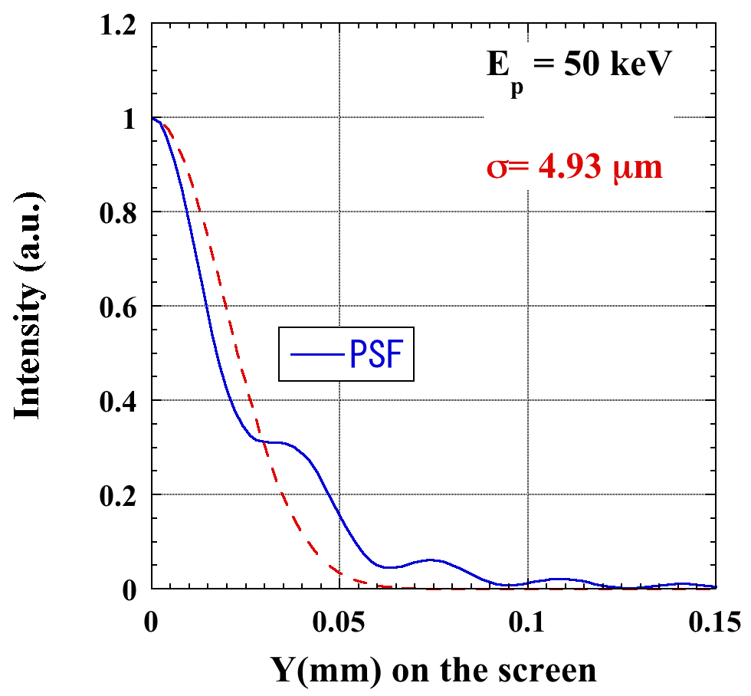
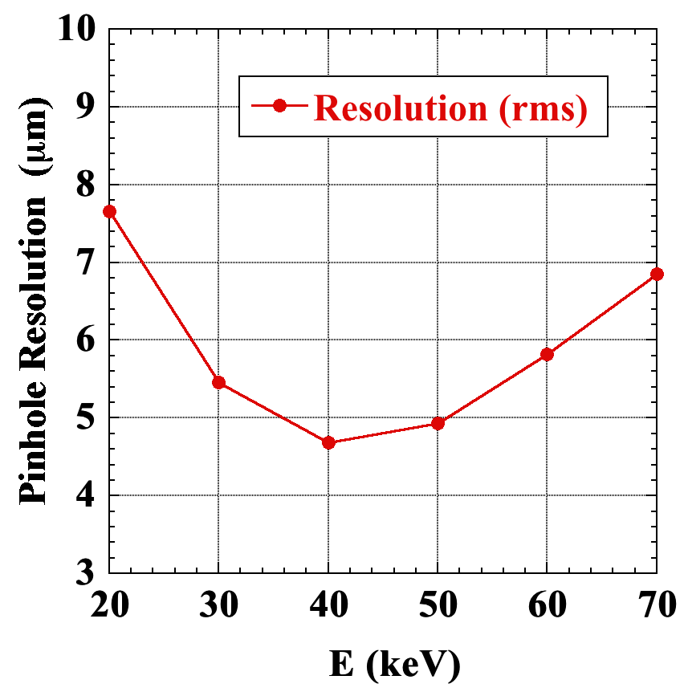
X-ray Pinhole Camera @ SPring-8
Preliminary Plan for SPring-8 Upgrade (SPring-8-II)
Source: Dipole Magnet
Layout (distance from source)
Pinhole: 6.5m, Scintillator: 32m
Pinhole
Magnification ： x 3.9
Size： 20 μm x 20 μm
Point Spread Function ( Wave Optics Calculation )
Pinhole Resolution (rms) better than 5 μm
feasible for 40 – 50 keV X-rays
Resolution of Present Scintillator Assembly
scales to 1.1 μm
Notes:
We have an upgrade plan of SPring-8, to replace the present ring with a so-called diffraction-limited storage ring.
The beam size in a dipole magnet is going to be about 5 um in both the horizontal and the vertical directions.
By placing the pinhole closer to the source than present,
resolution of the pinhole better than 5 um will be available.

Slide 18
X-ray Pinhole Camera @ SPring-8
Summary
Live Beam Image View @ Control Room ~ 15 fps
Parameters of Beam Profile Continuously Logged to SPring-8 Control DB
Indispensable for Beam Tuning and User Operation
Resolution (rms) Better than 5 μm Feasible for Upgrade Plan of SPring-8
Specifications of the SPring-8 X-ray Pinhole Camera
Light Source | Bending Magnent (29B2)
Pinhole | Distance from Source (m) | 11.4
 | Aperture Size (μm) | 20 x 20
Scintillator | Distance from Source (m) | 34.3
 | Material | CdWO₄
Camera | Number of Pixels | 2448 x 2050
 | Pixel Size (μm) | 3.45 x 3.45
Magnification Factor | x 4 ( Pinhole: x 2, Lens: x 2 )
Resolution (rms) (μm) | 7.2 ( Pinhole: 6.9, Scintillator & Camera: 2.2 )
Notes:
This is a summary of the SPring-8 X-ray pinhole camera.
The specifications of the pinhole camera is shown in the table.
Live beam image view is available with the refreshing rate of approximately 15 frames per seconds.
Parameters of Beam Profile are Continuously Logged to SPring-8 Control Database
It is now indispensable for beam tuning and user operation
For the planned upgrade project of SPring-8, resolution (rms) better than 5 um is feasible.

Slide 19
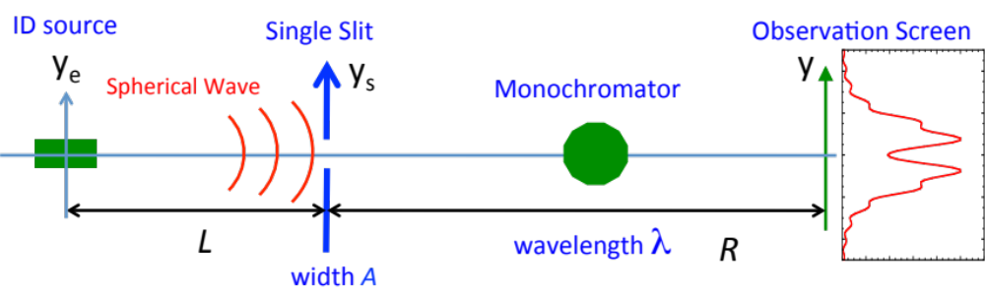
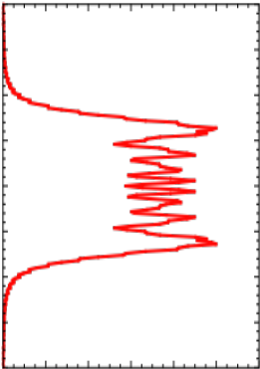
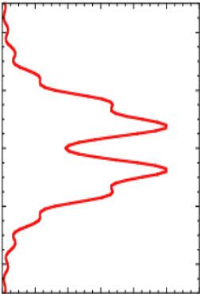
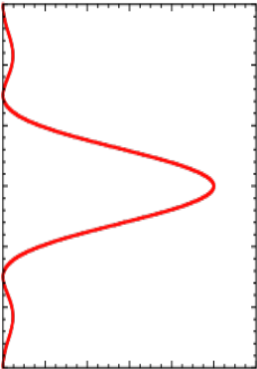
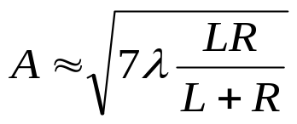
X-ray Fresnel Diffractometry Monitor (XFD)
Principle
M. Masaki et al., IBIC2014 TUCZB1 (2014).
M. Masaki et al., Phys. Rev. ST Accel. Beams 18, 042802 (2015).
Diffraction patterns depending on a width A of the slit
Fresnel Diffraction
wide slit (A² > Rλ )
Double-Lobed
Fresnel Diffraction
Fraunhofer Diffraction
narrow slit (A² << Rλ)
optimum slit width
for the deepest dip
The depth of a median dip correlates with a light source size.
Notes:
Let me start the second topic.
X-ray Fresnel diffractometry monitor (XFD) is a diagnostic technique to measure vertical beam size at an undulator source point.
The principle is shown here.
It employs a single slit and a monochrometer and an imaging device (X-ray camera).
Diffraction patterns on the screen of the imaging device depend on a width A of the slit.
By adequately tuning the slit width, a double-lobed Fresnel diffraction pattern is available.
The optimum slit width for the deepest median dip is expressed by this formula.
The depth of the median dip correlates with the light source size.

Slide 20
XFD @ SPring-8
Setup for Initial Experiments
L = 26.8 m
R = 65.4 m
ID05
- N_{u}=51
- λ_{u}=76 mm
Slit
Monochromator
X-ray camera
- P43 Screen
- lenses
- CCD camera
min. exp. time: 1ms
resolution σ_{res}: 6.8 μm
optimum slit width A
for the deepest dip
Notes:
This is the setup for the initial XFD experiment at SPring-8.
The source is an planar undulator (ID05) with 51 magnetic periods of 76 mm long.

Slide 21
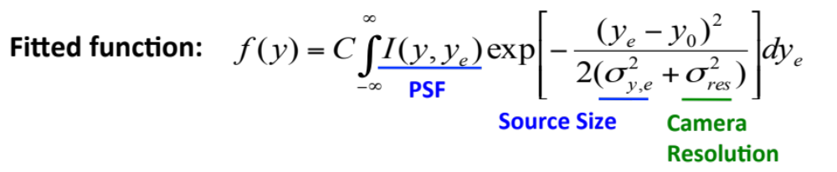
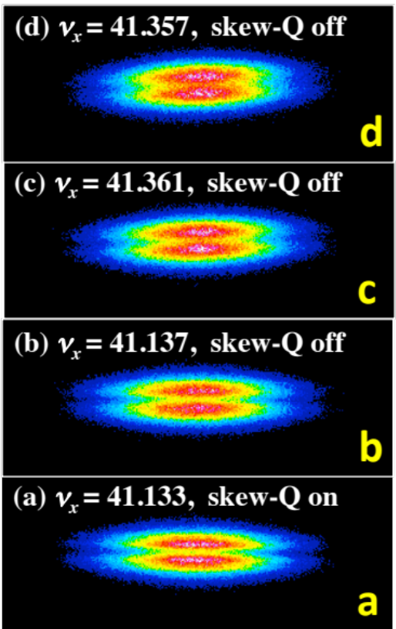
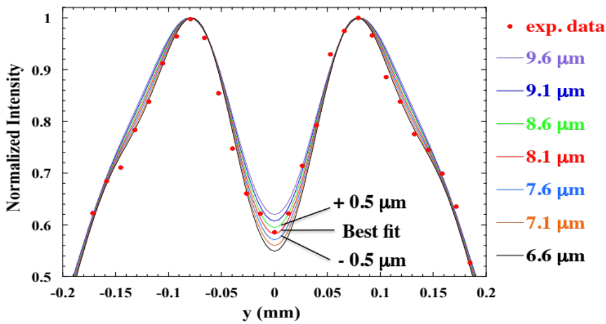
XFD @ SPring-8
Initial Results
M. Masaki et al., IBIC2014 TUCZB1 (2014).
M. Masaki et al., Phys. Rev. ST Accel. Beams 18, 042802 (2015).
X-ray energy 7.2 keV
slit width ΔY = 150 μm
deeper dip
Undulator source size smaller than 10 μm
successfully resolved
Notes:
In the initial experiment, we observed clearly the double-lobed diffraction patterns in the vertical direction.
In the horizontal direction, the diffraction patterns are smeared out due to the large horizontal emittance of the storage ring.
This is the vertical line-projected profile for the data with the deepest dip (a).
The best fitted result was 8.1 um.
The light source size smaller than 10 um was successfully resolved, and the resolution was in the order of sub-microns.

Slide 22
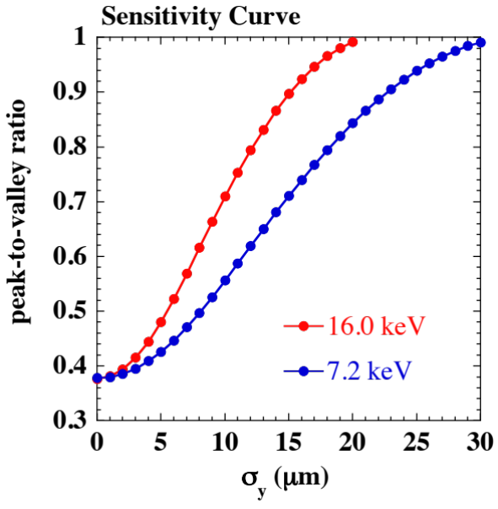
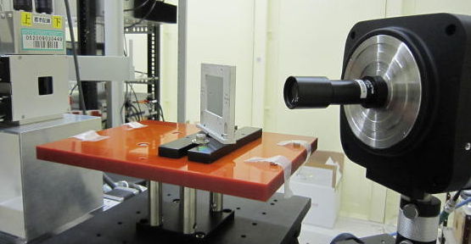
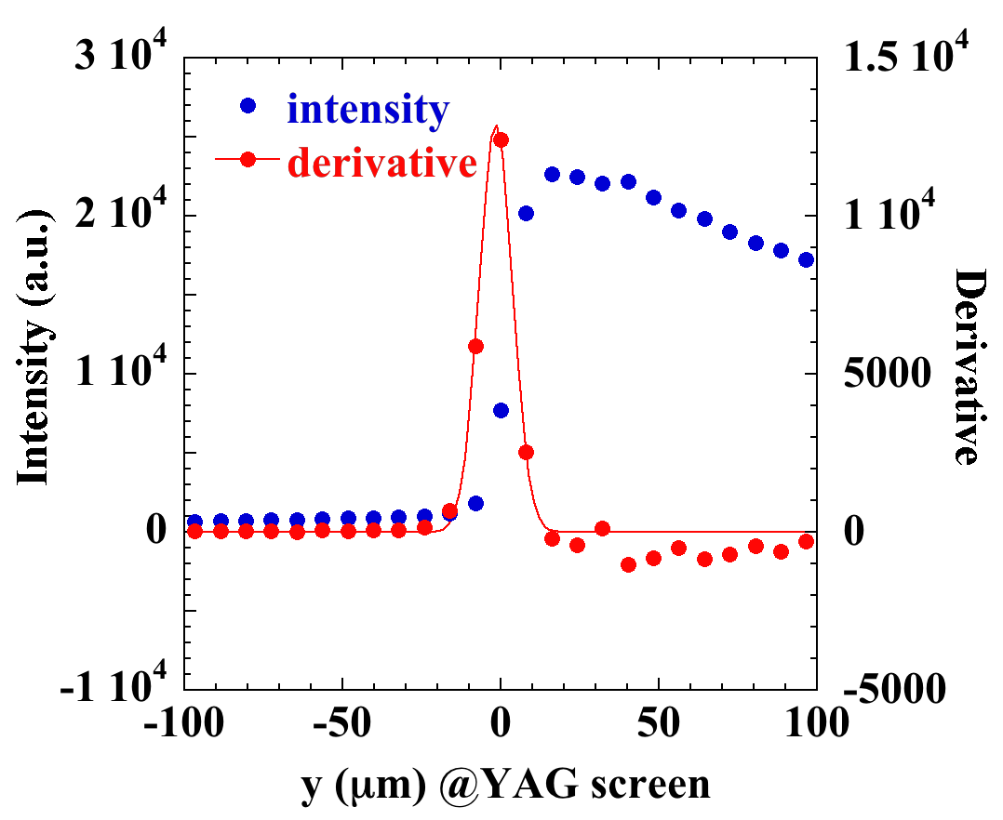
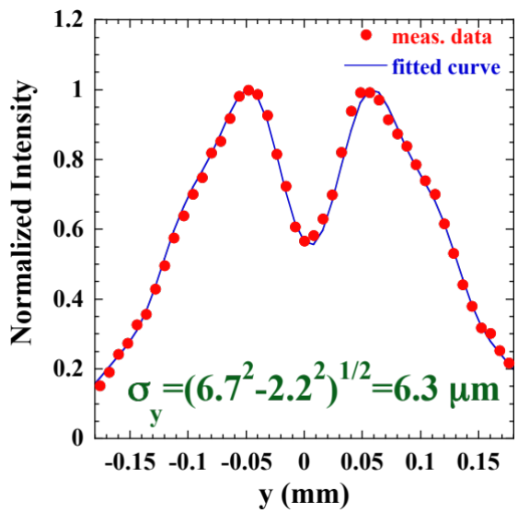
XFD @ SPring-8
Recent Progress
Increased Observing Energy: 16 keV
New X-ray Imaging Setup
Screen: YAG(Ce), 50 μmt
Ta slit
X-ray
previous
Lens: x20
Camera： pixel size 16x16 μm
min. exp. time 0.2 ms
Imaging Resolution (rms) @ Source Point:
2.2 μm <- 6.8 μm (previous)
Result
exp. time
0.5 ms
source size
6.3 μm (rms)
Edge of Ta slit
ε_{y} = 7.9 pm.rad
(coupling 0.3%)
Notes:
To improve the performance of the XFD, we have recently replaced the X-ray imaging device and increased the observing photon energy.
This is the new x-ray imaging setup.
The new screen material is YAG(Cerium) of 50 um thick.
The resolution of the new X-ray imaging device was calibrated to be 2.2 um, which is three times better than the previous device.
The sensitivity curve, peak-to-valley-ratio of the median dip as a function of vertical beam size, is shown here.
Improvement of the sensitivity for small beam size below 5 um is evident for the increased observing energy of 16 keV.
This is an example of diffraction pattern observed with the new setup.
By fitting a theoretical model function to data, vertical beam size (rms) of 6.3 um was deduced.

Slide 23
XFD
Summary
Diagnostic technique for light source rings
to measure small beam size at ID (undulator) source point
Able to resolve beam size smaller 5 μm
Requires only
slit, monochromator, and imaging device (X-ray camera)
Has potential universal availability to ID beamlines of the
diffraction limited storage rings (DLSRs)
Notes:
The XFD developed at SPring-8 is a diagnostic technique for light source rings to measuresmall beam size at undulator source point.
It is able to resolve beam size smaller than 5um.
It requires only slit, monochromator, and imaging device.
So, it has potential universal availability to ID beamlines of the diffraction limited storage rings.

Slide 24
Conclusions
SPring-8 X-ray Pinhole Camera
Resolution (rms) ~ 7 μm
Live Beam Image View @ Control Room ~ 15 fps
Beam Parameters Logged to Control DB by Periodical (1s cycle) Image Analysis
Indispensable for Beam Tuning and User Operation of SPring-8
X-ray Fresnel Diffraction (XFD) Monitor
Diagnostic Technique for Light Source Rings
to Measure Small Beam Size at ID (Undulator) Source Point
Requires Only
Slit, Monochromator, and Imaging Device (X-ray Camera)
Able to Resolve Beam Size smaller 5 μm
Notes:
The SPring-8 X-ray pinhole camera has resolution of about 7 um.
Live beam image view is available in the control room with the refreshing rate of approximately 15 frames per seconds.
Beam parameters are continuously logged to control database by periodical image analysis.
It is indispensable for beam tuning and user operation of SPring-8
The XFD developed at SPring-8 is a diagnostic technique for light source rings to measure small beam size at undulator source point.
It requires only slit, monochromator, and imaging device (X-ray camera).
It is able to resolve beam size smaller than 5 um (rms).

Slide 25
Acknowledgements
Many thanks to
colleagues of SPring-8/SACLA and SES
For their help in
vacuum, alignment, control and operation etc.

Slide 26
Thank you for your attention !

