Slide 1
Design of Coronagraph for the observation of beam halo at LHC
Toshiyuki Mitsuhashi (KEK),
Enrico Bravin,
Rhodri Jones,
Federico Loncarolo
Hermann Schmickler,
Georges Trad (CERN)

Slide 2
Agenda for my talk
What is the coronagraph
Plan of observation of beam halo with coronagraph in the LHC
Diffraction analysis for phase 1 coronagraph
Mie-scattering noise from optical component surface
Arrangement of phase 1 coronagraph on B2 optical table
Phase 2 coronagraph

Slide 3
What is the coronagraph?
an introduction

Slide 4
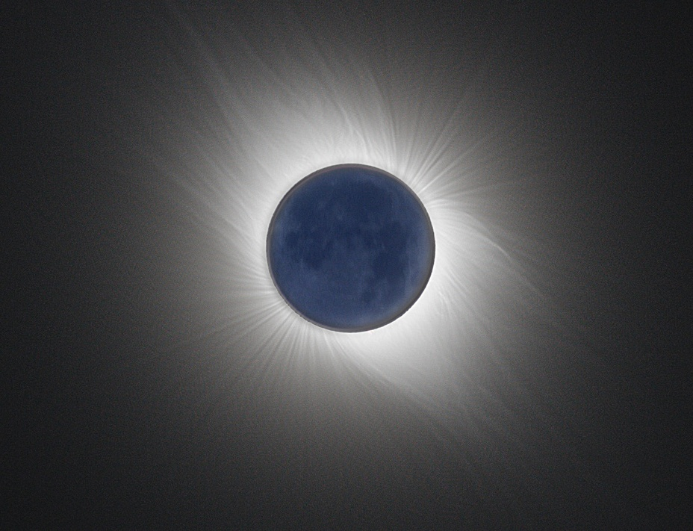
Everything was start with astronomer’s dream……
Eclipse is rare phenomena, and only few second is available for observation of sun corona, prominence etc.
Artificial eclipse was dream of astronomers, but……..

Slide 5
The coronagraph to observe sun corona
Developed by B.F.Lyot in 1934 for a observation of sun corona by artificial eclipse.
Special telescope having a
“re-diffraction system” to eliminate the diffraction fringe.

Slide 6
Optical system of Lyot’s corona graph
Field lens
Relay lens
Baffle plate (Lyot stop)
Objective lens
Opaque disk
Baffle plates to reduce reflection

Slide 7
3 stages-optical system in the Lyot’s coronagraph
1st stage : Objective lens system
2ed stage : re-diffraction system
3ed stage :
Relay lens

Slide 8
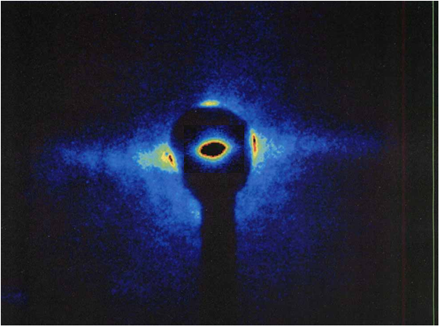
Observation inPF,KEK 2005
Beam core + halo (superimposed)

Slide 9
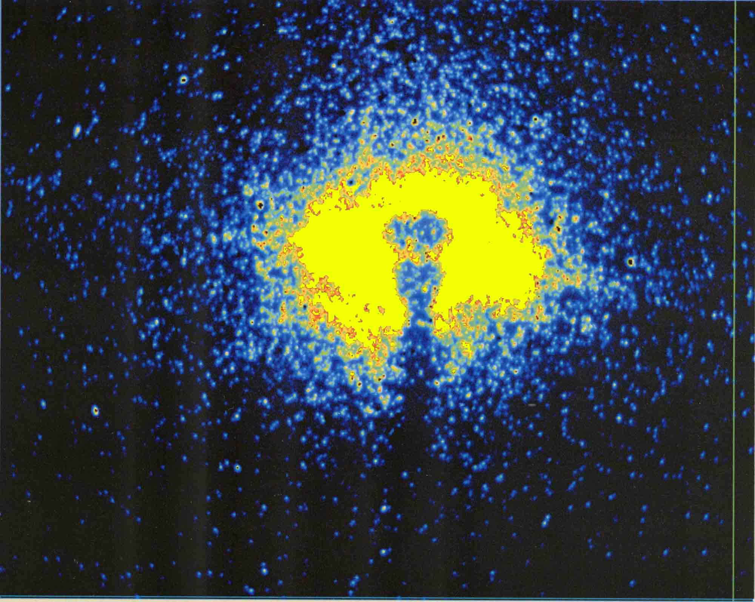
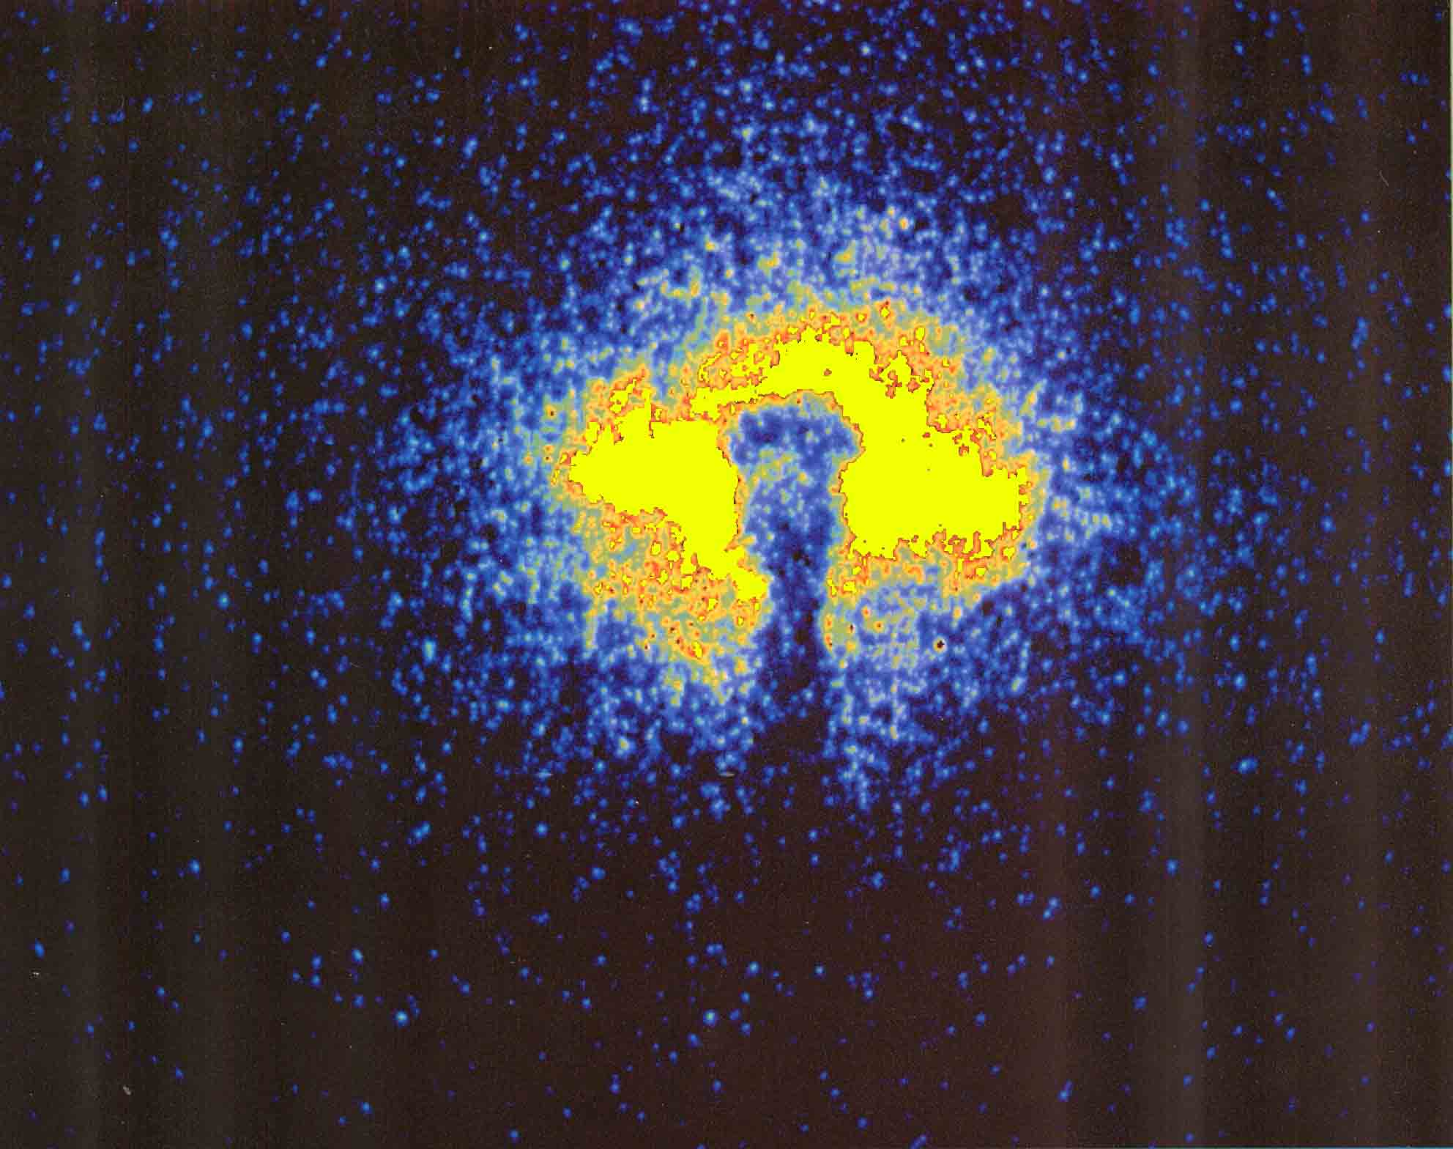
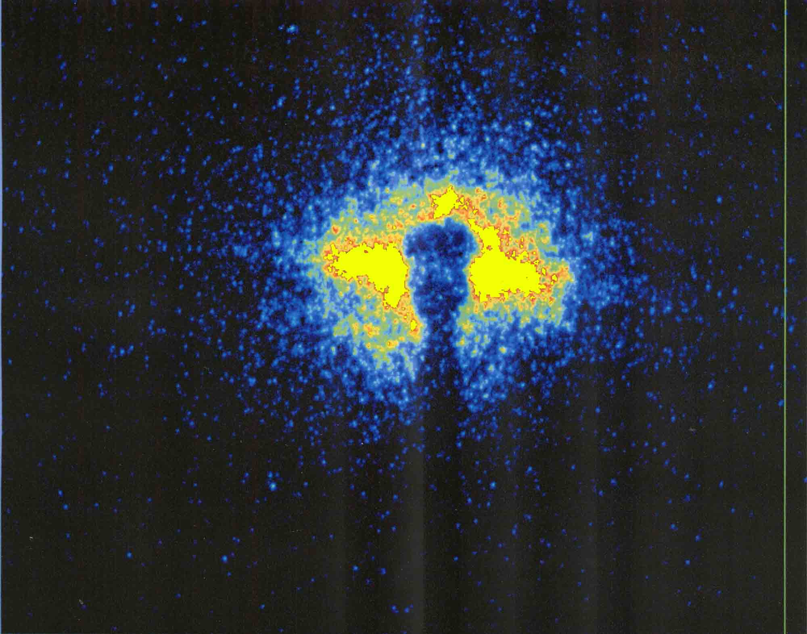
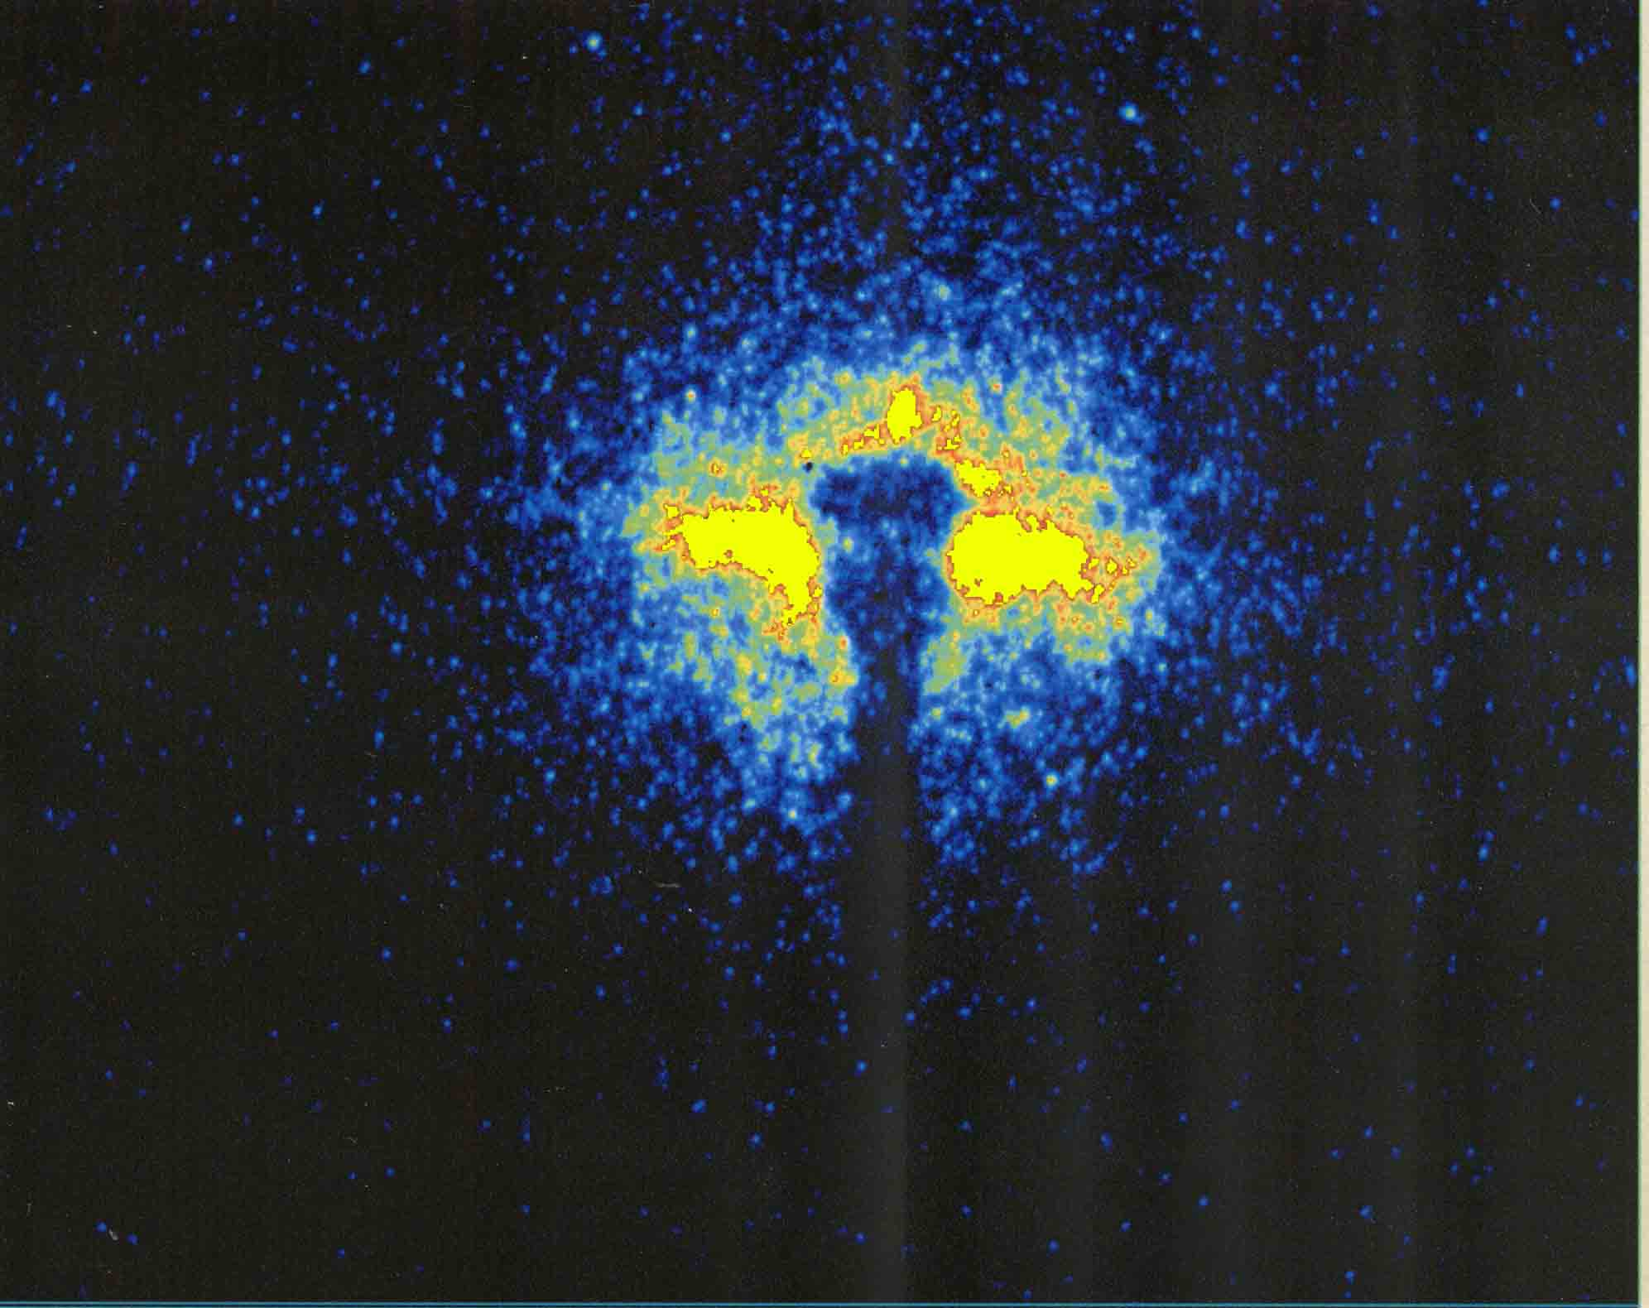
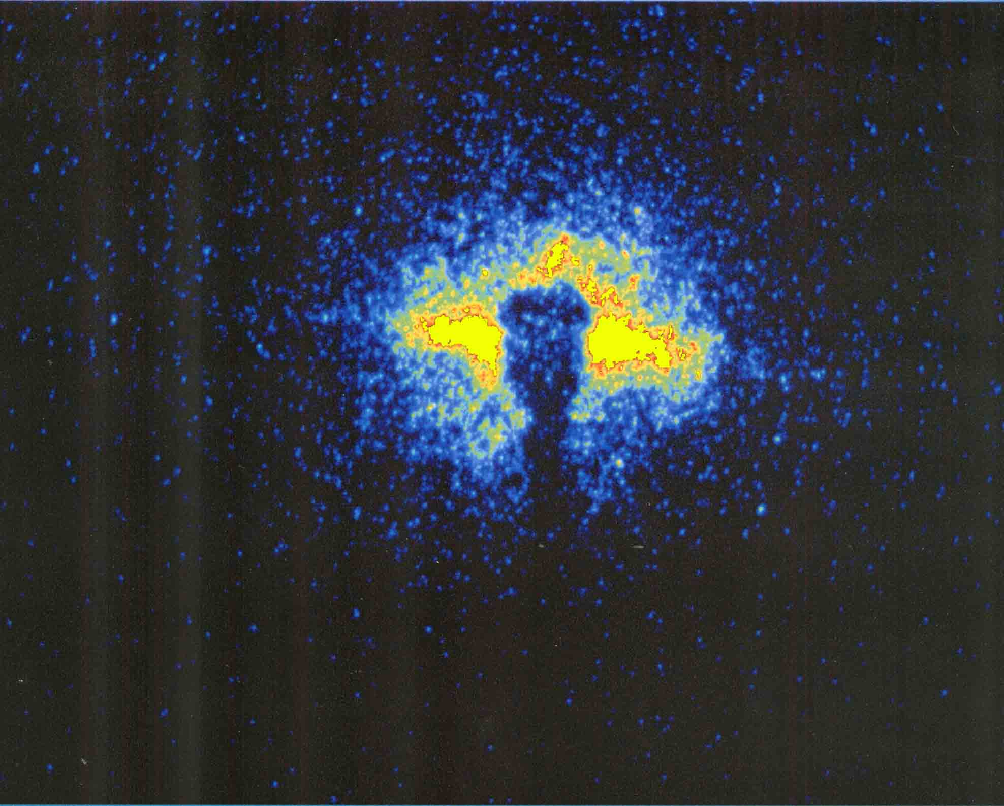
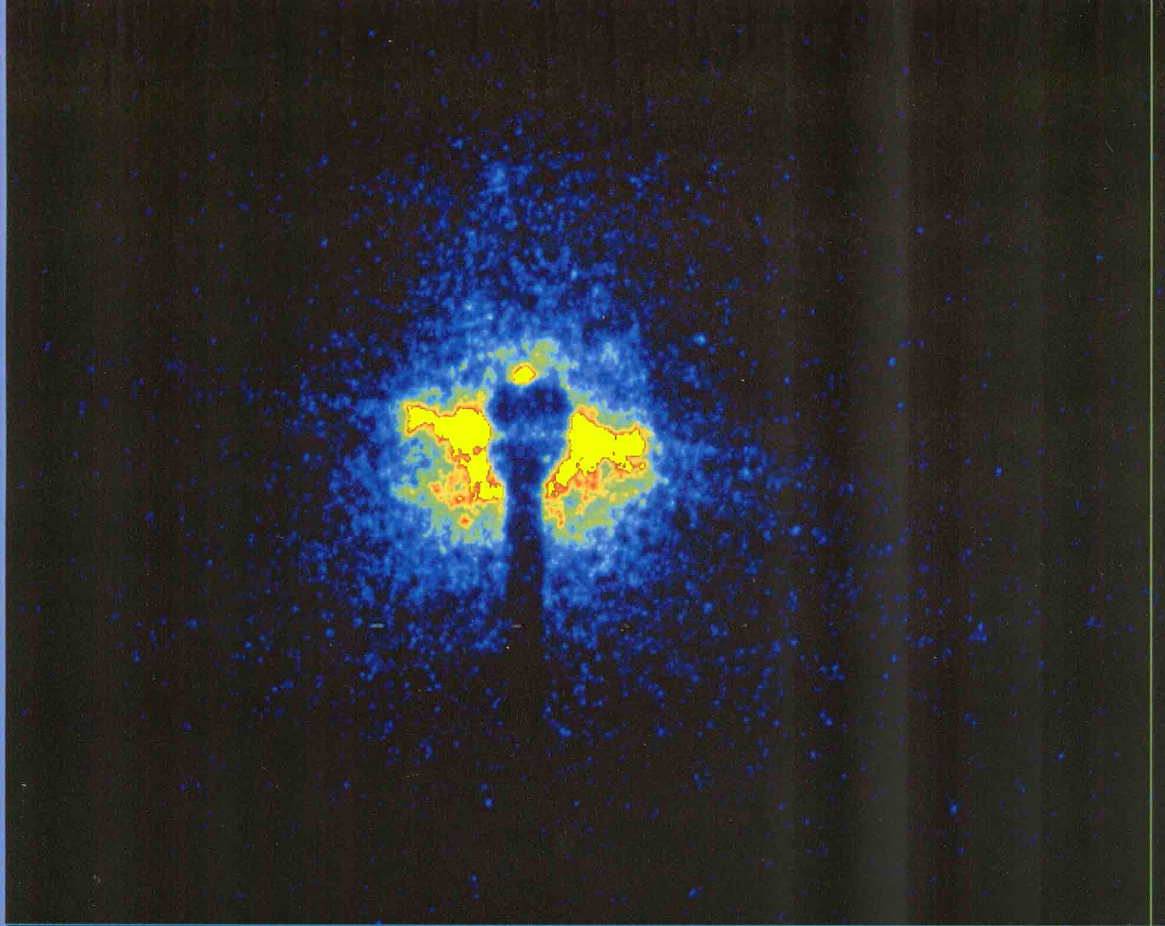
Beam halo images in the single bunch operation at the KEK PF measured at different current 2005.
65.8mA
61.4mA
54.3mA
45.5mA
35.5mA
396.8mA
Multi-bunch
bunch current 1.42mA

Slide 10
2. Plan of halo observation by using the coronagraph in LHC
The coronagraph is planned to apply for an observation of beam halo image in the LHC. This project will perform by two phases.

Slide 11
Phase1: Test observation,
Designed and constructing a coronagraph by modifying the optical design of coronagraph constructed in 2005 in the KEK.
Aiming a halo observation with 10³ to 10⁴ contrast to the beam core, and it will set in B2 SR monitor line.
Phase2: Design and construct an optimum coronagraph for the LHC,
aiming 10⁵ to 10⁶ contrast.

Slide 12
Table1: Key conditions for design the coronagraph
at PF (2005) and LHC (2015).
 | PF (BL28) | LHC(B2)
Distance between source point and objective lens | 8.0m | 28.5m
Beam size in horizontal (1σ of beam core) | 263μm | 330μm/3.75μmrad 270μm/2.5μmrad
Beam size in vertical (1σ of beam core) | 80μm | 430μm/3.75μmrad 350μm/2.5μmrad
Minimum size of opaque disk against beam core | 6σ of beam core | 5 σ of beam core

Slide 13
Table2: The optical design of previous
and phase 1 coronagraph.
 | PF (BL28) | LHC(B2)
Focal length of objective lens | 2000mm | 2000mm
Objective lens aperture | 50 x 50mm | 25 x 25 mm
Transverse magnification | 0.333 | 0.0754
Opaque disk size in radius | 0.5mm | 0.110-0.162mm
Focal length of field lens | 500mm | 800mm
Movable range of Lyot stop | 2 x 2mm to 20 x 20 mm | 2 x 2mm to 20 x 20 mm
Focal length of relay lens | 36mm | 500mm

Slide 14
3. Diffraction analysis
for
Phase 1 Coronagraph

Slide 15
Diffraction from first objective system
The entrance pupil of the objective lens

Slide 16
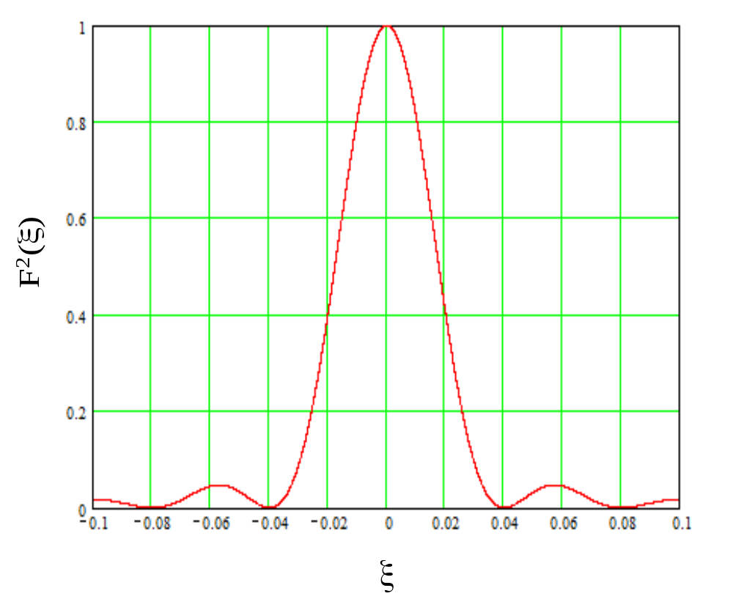
Diffraction in first stage λ=500nm
Magnification of objective system=0.0754

Slide 17
Opaque disk
Function of the field lens : make a image of objective lens aperture onto Lyot stop
Field lens
Objective system
Re-diffraction optics system
Re-diffraction optical system
Opaque disk

Slide 18
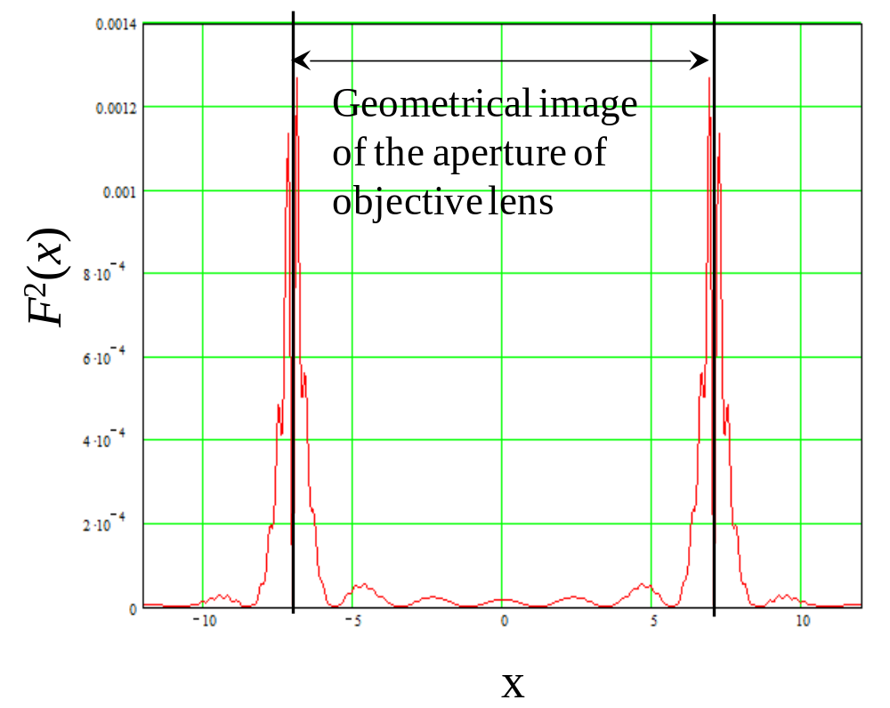
Diffraction in re-diffraction system

Slide 19
Opaque disk
Blocking diffraction fringe by
Lyot stop
Objective
lens
Re-diffraction optics system
Re-diffraction optical system
Opaque disk

Slide 20
Lyot stop at +/-5mm

Slide 21
Diffraction background in final image plane

Slide 22
Overflowed fringe inside of Lyot stop
?
Blocking diffraction fringe by
Lyot stop

Slide 23
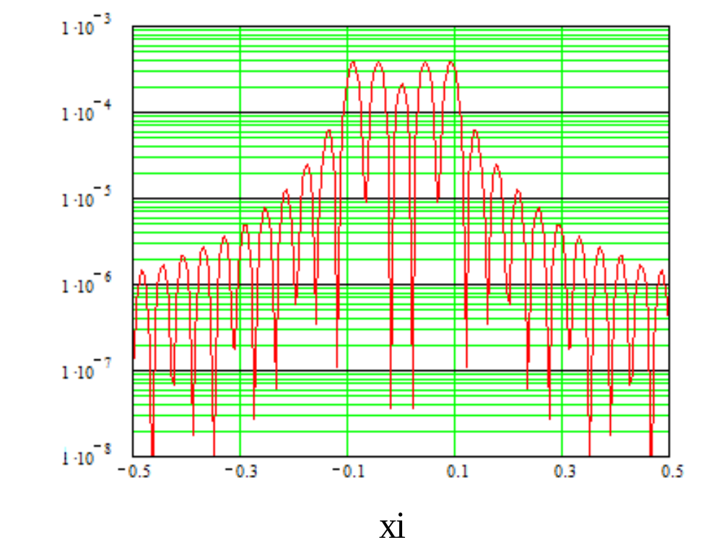
Diffraction background at 3ed stage
in log scale
3.7x10⁻⁴

Slide 24
Diffraction pattern will be localized in Vertical and horizontal plane, we can possibility to distinguish halo from diffraction by rotating field.

Slide 25
Diffraction pattern will be localized in Vertical and horizontal plane, we can possibility to distinguish halo from diffraction by rotating field.

Slide 26
4. Mie-scattering noise from optical component surface

Slide 27
Background source in coronagraph
Noise from defects on the lens surface (inside) such as scratches and digs.
2. Noise from the optical components (mirrors) in front of the coronagraph.
3. Reflections in inside wall of the coronagraph.
4. Noise from dust in air.
5. Rayleigh scattering from air molecule.

Slide 28
Background source in coronagraph
Noise from defects on the lens surface (inside) such as scratches and digs.
2. Noise from the optical components (mirrors) in front of the coronagraph.
3. Reflections in inside wall of the coronagraph. Apply baffles
4. Noise from dust in air. Apply dust filter
5. Rayleigh scattering from air molecule.
Not significant in few ten meter optical path

Slide 29
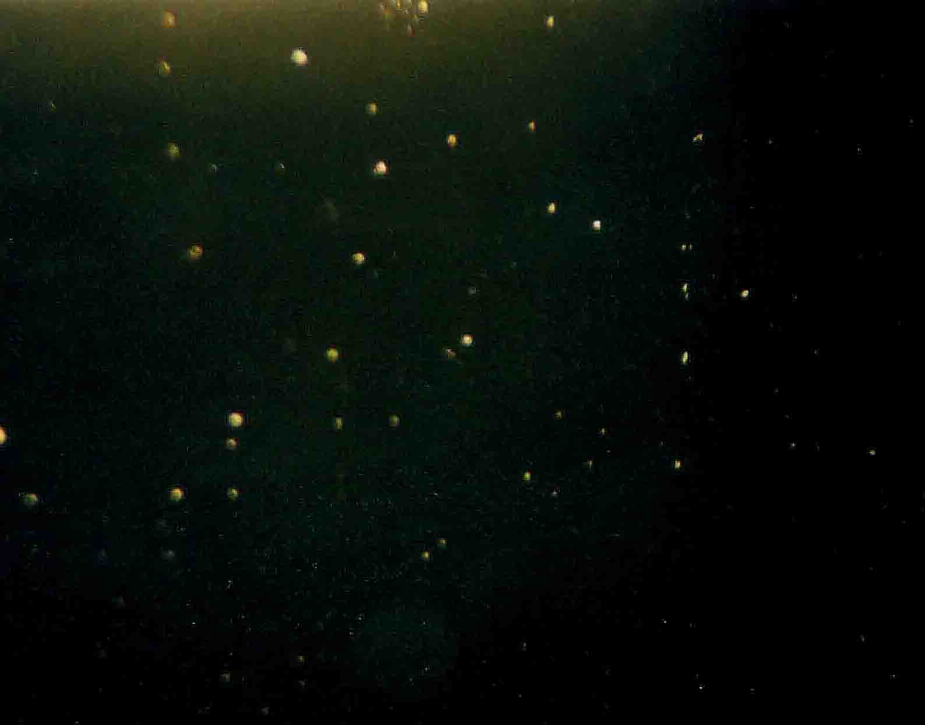
Digs on glass surface of scratch & dig 60/40
The optical surface quality 60/40 guarantees no larger scratches than 6μm width, and no larger dig than 400μm.
200μm
5mm

Slide 30
Noise source in the pupil has two effects,
Refraction in noise source
phenomena in sun or moon halo is produced by this effect.
Mie scattering by noise source
opaque dust or dig on lens or on any optical components are classified this effect.
Dust in air also has same effect.

Slide 31
Mie scattering,
it’s diffraction treatment

Slide 32
Case 1. Noise source in the entrance pupil of
objective lens
P(x, y): pupil function with assembly of diffraction noise sources on the lens
d₀
d_{i}

Slide 33
Let us approximate i-th noise source in the pupil as a opaque disk having a diameter of r₀ , Using the Babinet’s principle,
=
i-th noise source which spread in the aperture
Then pupil function having many noise source is given by,

Slide 34
When the mean distance of noise source is longer than 1st order transverse coherent length , pupil function with noise sources is simply given by,
Then the impulsive response on the image plane is given by,
in here, M=d_{i} /d₀ denotes geometrical magnification.

Slide 35
The intensity of diffraction from noise sources is inverse-proportional to extinction rate,
Extinction rate = entrance pupil aperture area
/ total area of noise source
To escape from noise produced by the objective lens is most important issue in the coronagraph!!

Slide 36
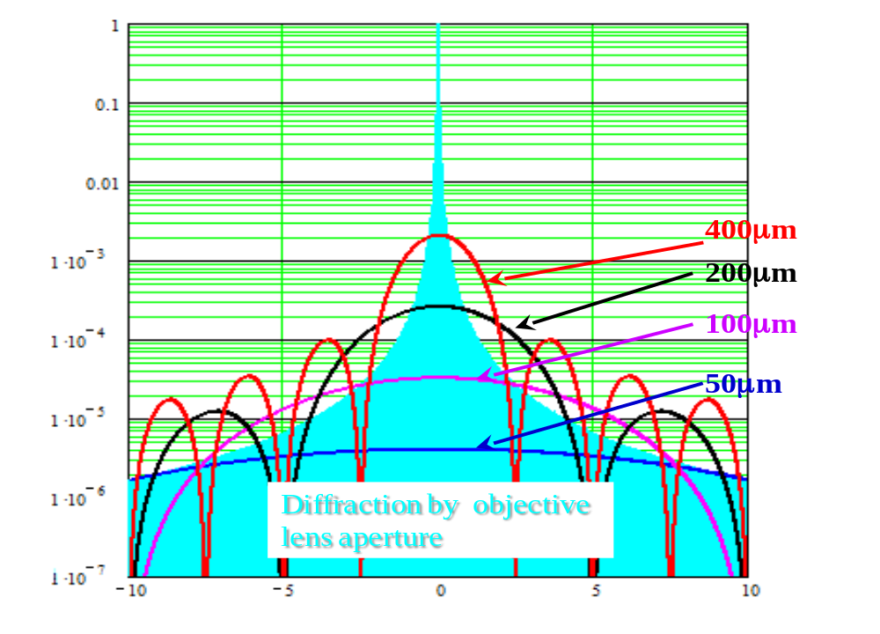
Simulation result of background produced by dig on objective surface

Slide 37
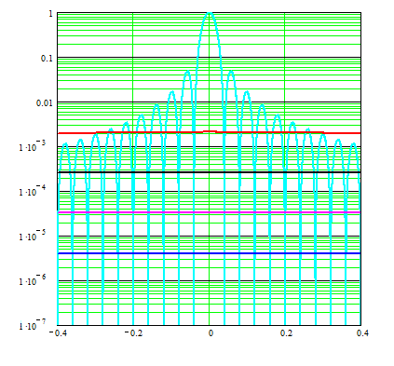
A zoom up plot near Airy disk
400μm
200μm
100μm
50μm

Slide 38
How to eliminate Mie scattering??
A careful optical polishing for the
objective lens.
Reduce number of glass surface.
use a singlet lens for the objective lens.
3. No coating (Anti-reflection, Neutral density etc.) for objective lens.

Slide 39
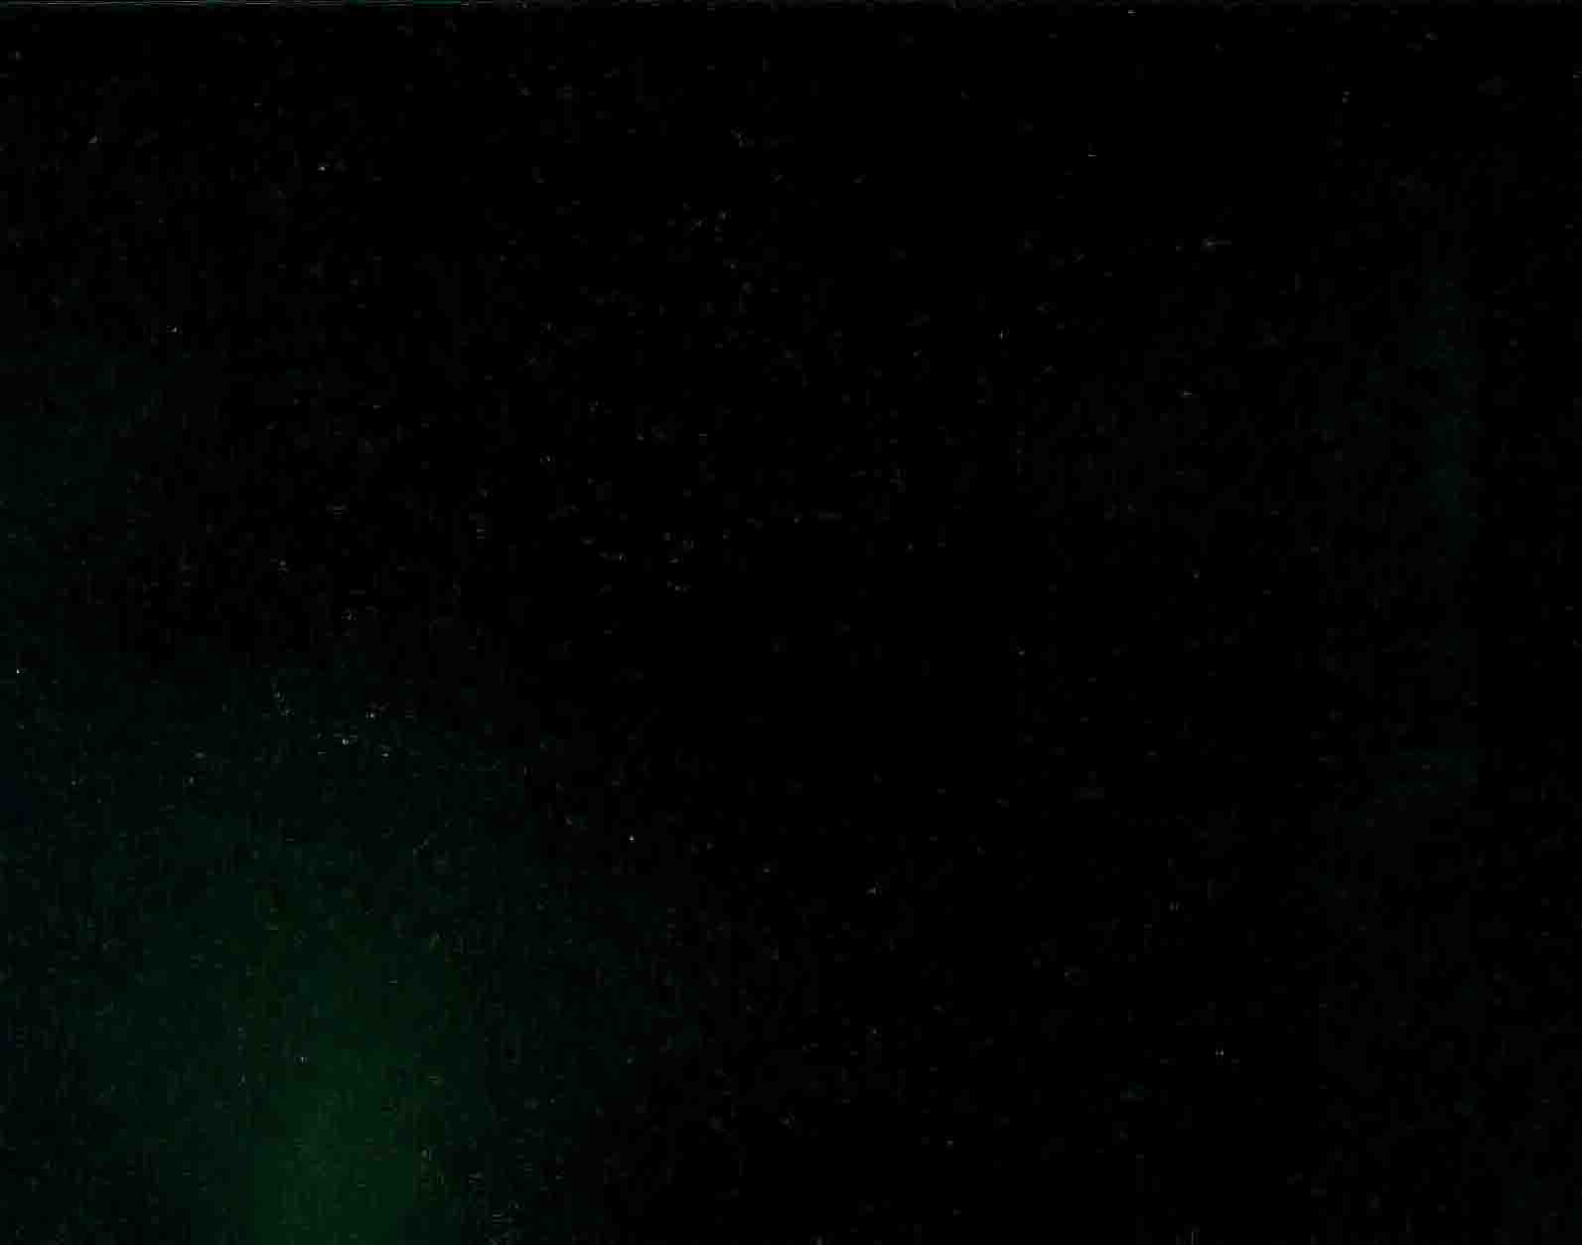
Comparison between normal optical polish and careful optical polish for coronagraph
S&D 60/40 surface of the lens
Surface of the coronagraph lens

Slide 40
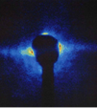

Example of Mie-Scattering noise

Slide 41
5. Arrangement of phase 1 coronagraph on B2 optical table

Slide 42
Present Layout B2
Imaging line
Calibration line

Slide 43
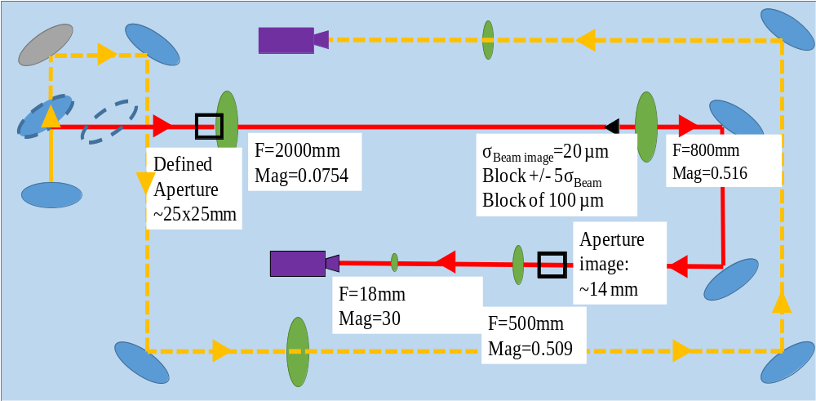
Arrangement of the Phase 1 coronagraph

Slide 44
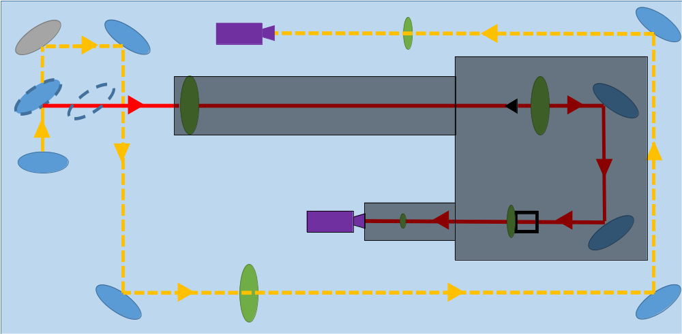
Surrounding dark box and tubes

Slide 45
Summary for phase 1 coronagraph design
Coronagraph optics for phase 1 observation of beam halo is designed for B2 SR monitor beam line at LHC.
From diffraction analysis the background in phase1 coronagraph from leakage of diffraction fringe is estimated to 3.7x10⁻⁴. Other of 2 fringes in the centre, most of diffraction fringes have intensities of 10⁻⁵ to 10⁻⁶ range.
The digs having a diameter smaller than 100mm are the majority. An order of 10⁻⁴ to 10⁻⁵ background can be appeared phase 1 using the B2 SR monitor line.

Slide 46
Thank very much for your attention!

Slide 47
Case 2. Noise source in front of the objective lens
P_{a}
P_{l}
U₀
U_{a}
U’_{a}
U_{l}
U’_{l}
U_{i}
d₀
d_{a}
d_{i}

Slide 48
Noise source in front of the lens
P_{a}
P_{l}
U₀
U_{a}
U’_{a}
U_{l}
U’_{l}
U_{i}
d₀
d_{a}
d_{i}
Free space propagation
Fresnel transfer
Lens transfer
Fresnel transfer

Slide 49
After tired calculations,

Slide 50
After tired calculations,
Diffraction by noise source
Diffraction by lens pupil

Slide 51
P_{a}
P_{l}
U₀
U_{a}
U’_{a}
U_{l}
U’_{l}
U_{i}
d₀
d_{a}
d_{i}
Noise source to objective lens Fresnel like diffraction
Then this input is re-diffracted by objective lens pupil
d_{a} is shorter : out of focus image of noise source +Fresnel like diffraction
d_{a} is longer : quasi-focused image of noise source +Fraunhofer like diffraction

Slide 52
Phase 2 coronagraph
1. The leakage of diffraction fringe reduces by increase of opaque disk diameter.
We can realize better contrast with bigger image size of the beam core.
We should design the focal length of objective lens longer.
2. Chromatic shift on optical axis is given by focal length divided by the Abbe number, designing long focal length means increase of chromatic foal shift.
We should apply reflector focusing system for the objective instead of the objective lens system in phase 2.

Slide 53
Coronagraph having a magnification of 0.5
Opaque disk
Lyot stop
16000mm
8000mm
8000mm
4000mm
5000mm
5000mm
Objective lens
Field lens
relay lens

Slide 54
Reduction the actual length of long focus of the simple objective lens with a combination of focus and defocus lenses.
Telephoto type lens

Slide 55
Telephoto type with reflectors
First mirror
concave
Focus of first mirror
Synthesized focus of two mirrors
Second mirror
convex

Slide 56
Optical design
Entrance pupil for the first stage
First mirror
concave
R=4000mm
Objective mirror system f=8000mm
Magnification ≈0.5
1700mm
Field lens
5200mm
Second mirror
convex
R= -800mm
Entrance pupil for re-diffraction system
5000mm
5000mm
Relay lens
Magnification =1
Lyot stop
8mm x 8mm

Slide 57
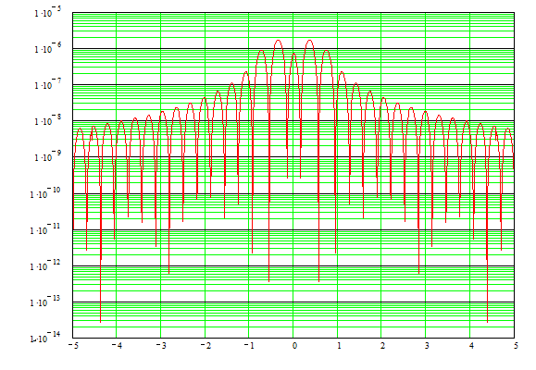
Diffraction background at 3ed stage
In Log scale 2x10⁻⁶ to 10⁻⁷

Slide 58
Possibility of appodization at aperture of relay lens
(may be new idea for coronagraph)
Since normal appodization at objective lens aperture is not applicable because it’s Mie scattering noise.
We can apply an appodization at relay lens aperture which is conjugated point to objective lens aperture.

Slide 59
As in previous slide, the diffraction pattern produced by the field lens aperture has two kind of period;
Rough period come from diameter of opaque disk
Fine period come from outer diameter of the field lens.
The measure leakage of diffraction fringe in inside of Lyot stop is mainly come from the 1st one.

Slide 60
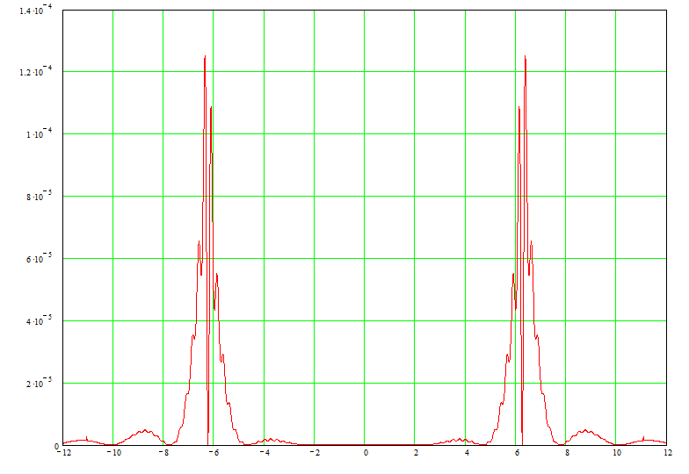
Lyot stop at +/-4mm

Slide 61
This leakage of diffraction fringe is the measure source of background in final imaging plain.
Therefore, we can reduce this background by killing the leakage of diffraction fringe using appodization for final lens aperture.
Please take care this kind appodization will reduce spatial resolution at final imaging plane in the same time!

Slide 62
Opaque disk
Lyot stop
16000mm
8000mm
8000mm
4000mm
5000mm
5000mm
Objective lens
Field lens
relay lens
Gaussian appodization filter at relay lens aperture

Slide 63
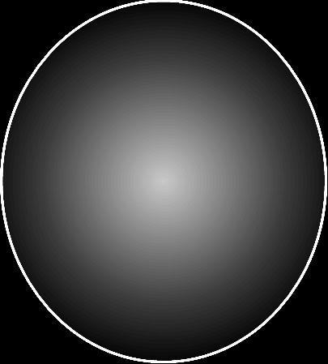
Appodization of Gaussian graduation
On relay lens aperture

Slide 64
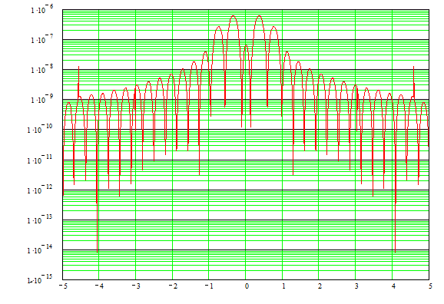
Gaussian appodization a=3mm

Slide 65
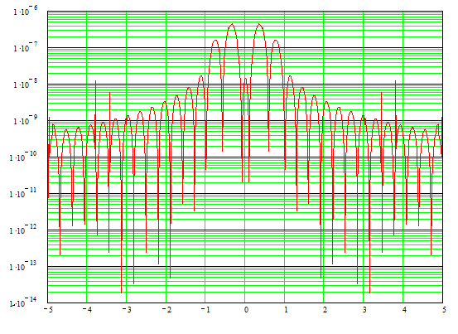
Gaussian appodization a=2.5mm

Slide 66
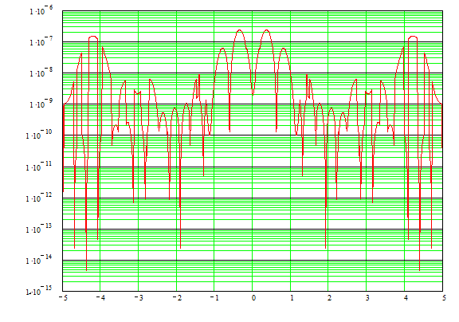
Gaussian appodization a=2mm

Slide 67
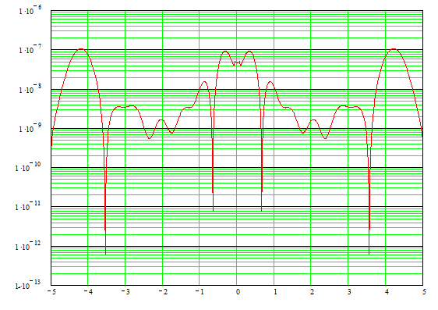
Gaussian appodization a=1.5mm

Slide 68
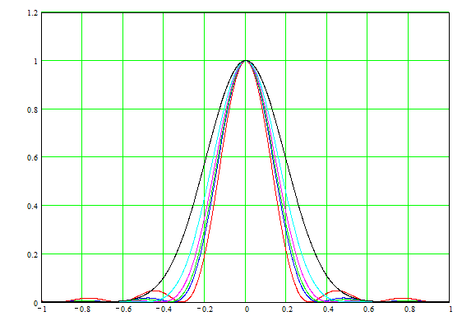
Diffraction in halo with Gaussian appodization

Slide 69
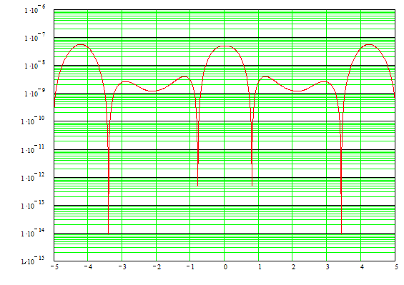
Gaussian appodization a=1mm

Slide 70
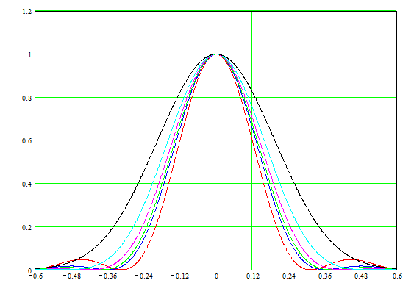
1.5mm
4mm

Slide 71
Conclusion from Gaussian appodization
Gaussian appodization at relay lens aperture can improve the contrast of noise diffraction.
Such appodization increase width of diffraction for halo image, and will reduce spatial resolution.
Appodization also reduce illumination from halo onto the relay lens aperture and reduce the intensity of halo image. So careful comparison of contrast between noise diffraction and halo image will necessary

Slide 72
Background level for 1:1 magnification
I wrote following discussion for more general possibility of the coronagraph.
Since the entrance aperture is limited by the opening of the SR, following discussion is meaning less.
Following simulation is assumed 1:1 magnification with same diffraction width. This condition means the entrance aperture must be enlarge proportional to the magnification.
This is meaningless discussion for LHC, but one possibility to improve the coronagraph for exo-planet observation (it needs 10⁻¹⁰ background level).

Slide 73
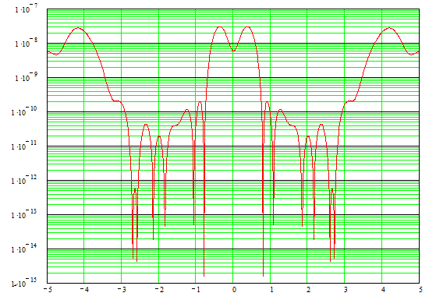
1.5mm

Slide 74
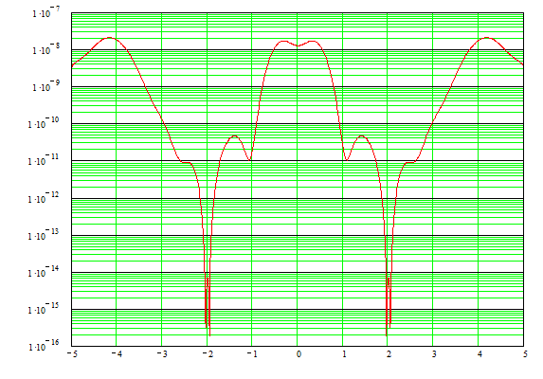
1.2mm

Slide 75
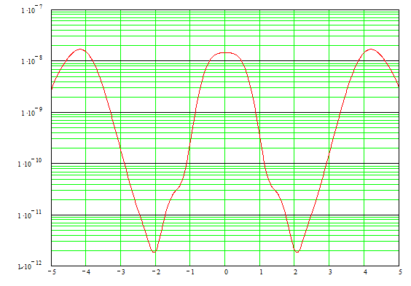
1.0mm

Slide 76
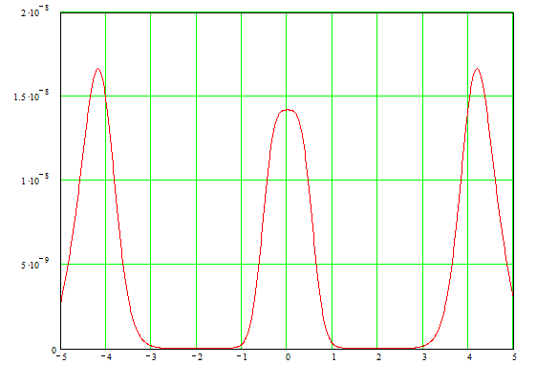
Linear scale plot

Slide 77
Conclusion of further discussion of appodization for final lens aperture
To choosing a higher magnification and enlarge the diameter of entrance aperture, we can improve the background level smaller than 10⁻¹⁰.
It should be one of possible design for the coronagraph to exo-planet observation.
Please note this discussion is only for the theoretical background produced by diffraction phenomena. Reducing practical backgrounds such as Mie scattering from optical components are other issues.

