Slide 1


Slide 2
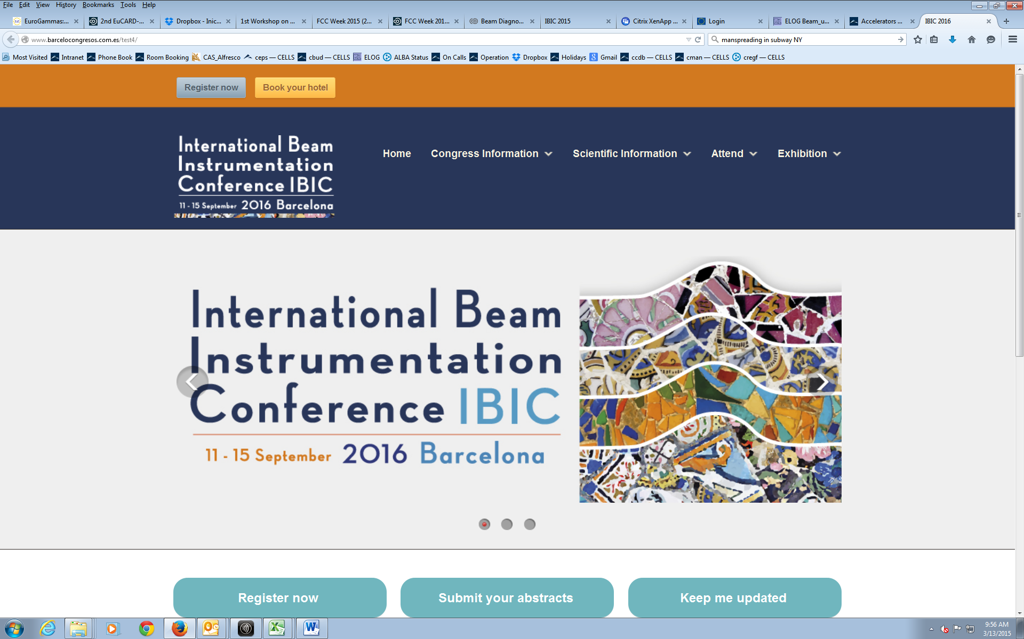
Alba
www.ibic2016.org

Slide 3
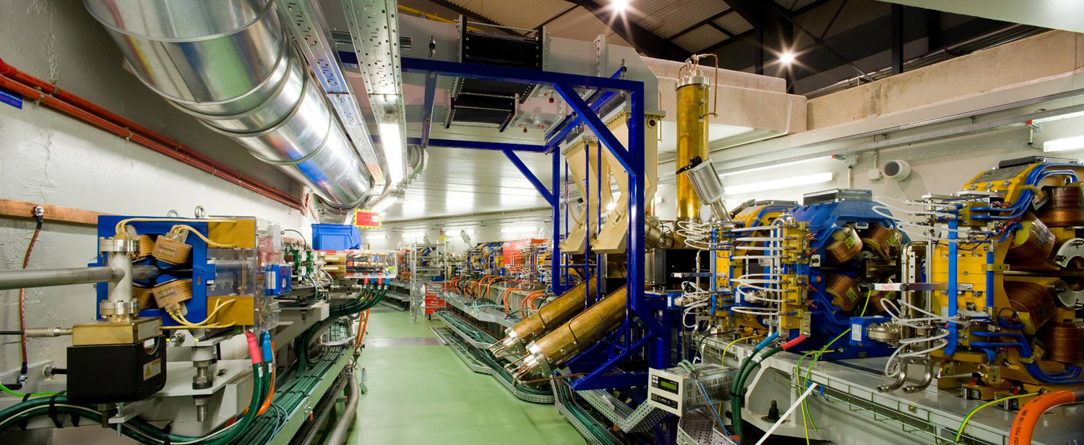
Hosted by
ALBA Synchrotron Light Source
Francis Perez

Slide 4
Barcelona
Population (urban area) | 4.0 Milions
Average Beer Cost | 1.8 € / 33cl
Average meal price | [10 – 25] €
Subway single ticket price | 2.15 €
Average Temperature | 22 ºC
# visitors in 2013 | 7.5 Milions
# of hotels | 352
Airport Traffic | 35 Milions passengers / year

Slide 5
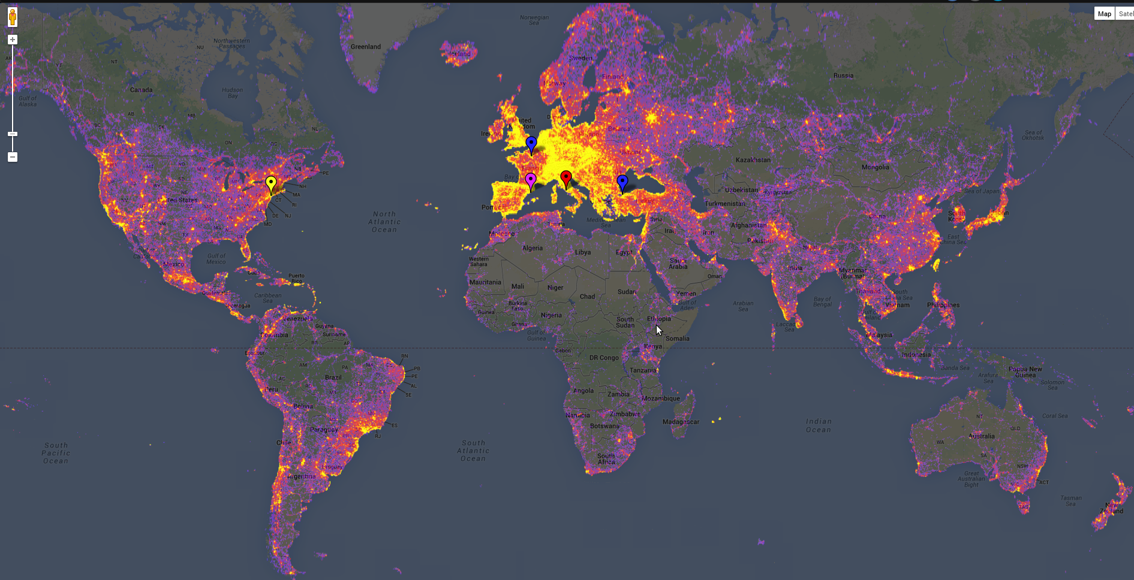
Colormap about most pictured places in the world
New York (USA)
Rome (Italy)
Barcelona (Spain)
Paris (France)
http://www.sightsmap.com/

Slide 6
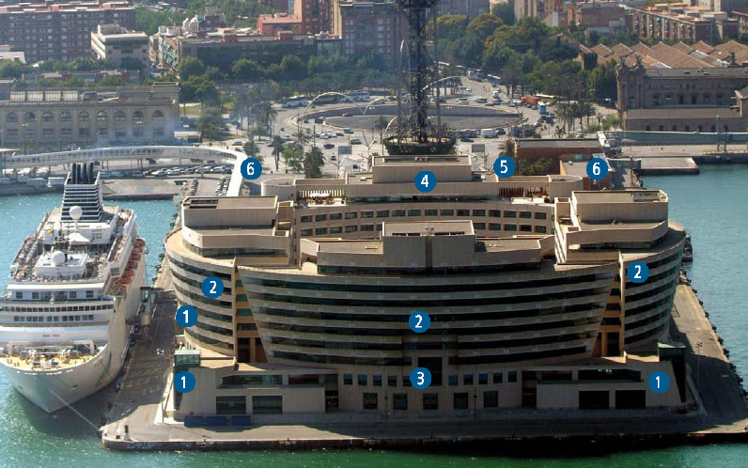
The Venue
World Trade Center Barcelona
Located in the sea port of Barcelona
Near the downtown
Well communicated and near to a great amount of hotels

Slide 7
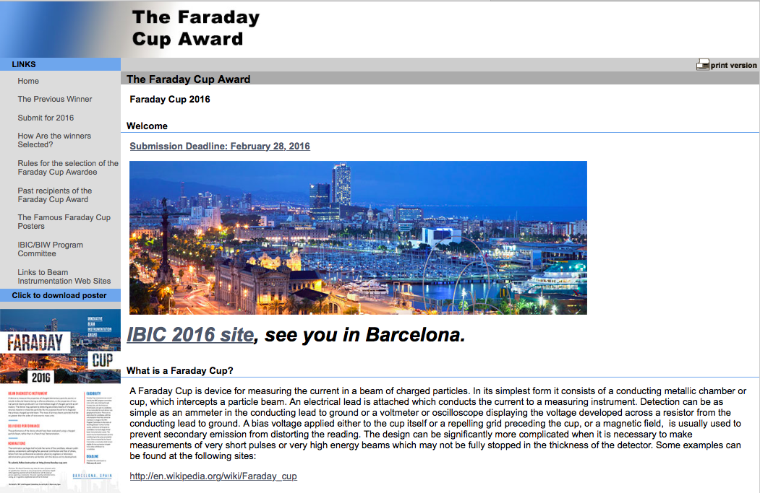
www.faraday-cup.com

Slide 8
Thank you
and
hope to see you in Barcelona
www.ibic2016.org

