Slide 1
Australian Synchrotron ATF Workshop
EPICS 101 - basic EPICS
.
Andrew Starritt
29 October 2020

Slide 2
Outline
Some house keeping information
Topic covered
Schedule
  Tea breaks, lunch etc.
Actual presentation and exercises.
Wrap Up
  On line resources such as tech-talk
  Open Q&A session … time permitting

Slide 3
Housekeeping
This is a zoom session
  Your microphone and camera are off (unless otherwise allowed)
  Use the Q and A channel for question. Andraz will field your questions in the first instance.
  Use the chat channel to chat amongst yourselves.
  The course will be a mixture of slide presentation and practical hands-on experience.

Slide 4
Topics Covered
A basic overview of EPICS
  Channel Access (CA) Protocol
  Channel Access Servers
  Channel Access Clients
The anatomy of an IOC
  Construction, records, record processing.
Clients – command line and graphical
Mini project – conference talk count down timer

Slide 5
Schedule
Session 1: 9.00 - 10:30
Coffee/tea break: 30 minutes
Session 2: 11.00 - 12:30
Lunch: 90 minutes
Session 3: 2.00 - 3:30
Coffee/tea break: 30 minutes
Session 4: 4.00 - 4:30

Slide 6
Overview: What is EPICS ?
EPICS is a set of Open Source software tools, libraries and applications developed collaboratively and used worldwide to create distributed soft real-time control systems for scientific instruments such as a particle accelerators, telescopes and other large scientific experiments.
  EPICS Base – core functionality, including:
    IOC (Input/output Controller) – allows control and monitoring of devices.
    Channel Access (CA) server and standard CA client libraries (used by most clients).
    Basic command line clients: caget, caput, cainfo, camonitor.
  Many “third” party items, some are quazi-“core”, some on the “fringe”, e.g.:
    ASYN framework, used in IOCs to support device drivers.
    AreaDetector – standard camera/detector control and data processing framework.
    Archivers
    motorRecord – provides standard interface for controlling motors.
    Display managers (clients) - EDM/MEDM/EPICS-Qt
    Alarm handlers (clients) - ALH/SCRAM/Beast
    PyEPICS – Python wrapper around CA client libraries.
    synApps – Synchrotron Applications - a distriubtion of many modules
    Many-many more.

Slide 7
Channel Access - Introduction
Channel Access (CA) is the protocol that allows Channel Access clients to communicate with Channel Access servers.
  PV Access is a new protocol for structured data – not covered.
CA uses a combination of UDP and TCP.
Works “out-of-the-box” but is configurable by use of environment variables.
We will not address PV Access – a new protocol with structure and introspection

Slide 8
Channel Access – PV Names
CA uses Process Variable (PV) names to identify a channel:
  PV names should be unique, and are essentially a string of bytes. CA makes no utf-8 or uni-code etc. interpretation.
  While the CA protocol is very flexible, EPICS IOCs place restrictions on record names and hence PV names.
  For an IOC the PV names are: record name + “.” + field name.
  Record names <= 60 characters and should consist of the following chars: A-Za-z0-9_- , and should start with a letter.
  Other characters are currently allowed, but moves are afoot to generate warnings, and maybe errors eventually.
    NSLS-II make use of ‘{‘ and ‘}’ – they might be included.

Slide 9
Channel Access – Data Types
CA provides basic types, as scalars or arrays.
  Data types are:
    String – up to 39 chars.
    Char – 8 bit signed
    Short – 16 bit signed
    Long – 32 bit signed
    Float – IEEE 32 bit floating point
    Double - IEEE 64 bit floating point
    Enum – 16 states, each enum string up to 25 chars.
  Does not distinguish between a scalar and an array of 1 element.

Slide 10
Channel Access – Meta Data
CA data supported by meta data. This includes:
  Timestamp (UTC, nS resolution), alarm severity and alarm status.
  Precision – float types only – a guide to display managers.
  Units – numeric types only – engineering units – up to 7 chars.
  Lower/Upper display limits – a guide to display managers.
  Lower/Upper control limits – a guide to display managers.
  Alarm limits and warning limits.
  Enum strings – for the enum type
For IOC PVs, meta data if often defined by the record’s fields – more later.

Slide 11
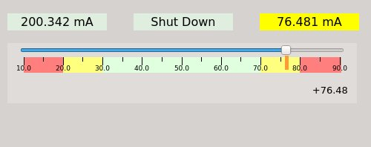
Cannel Access – Meta Data in use

Slide 12
Channel Access – What happens?
Client UDP broadcasts “who has this PV”?
One (and hopefully just one) server says “I have it”.
Client established a TCP circuit to server (if one does not already exist), and the channel now established.
Client performs some of /all of the following:
  Client requests data – server responds
  Client subscribes for updates – server sends on-going updates
  Client writes data – optional, server confirms when complete.

Slide 13
Channel Access Servers
EPICS IOCs – main/typical server.
  The PVs are defined by loading records at run time.
EPICS CA gateways
  Theses are both clients and servers
  Allows inter-VLAN EPICS communication
  Provides access control and optional PV renaming.
PCAS – Portable Channel Access Server
  A tool to allow the building of CA Servers
  Binding available to other languages, e.g. Python
Others, e.g. caproto – a native Python implementation

Slide 14
Channel Access Clients
These fall into the following broad categories:
  GUI display managers
  Alarm handlers
  Archivers
  Gateways
  Command line tools/scripts
  SNL State Machines

Slide 15
EPICS CA Display Managers
There are many of these, including
  EDM – Extensible Display Manager – old but still in use.
  MEDM – Motif Editor and Display Manager – ditto.
  CSS/Phoebus – Control System Studio – Java based
  caQtDm – from PSI – a Qt clone of MEDM
  EPICS Qt – a Qt based display manager.
    We will use this for our hands-on exercises
    EPOCS Qt was developed at the Australian Synchrotron.

Slide 16
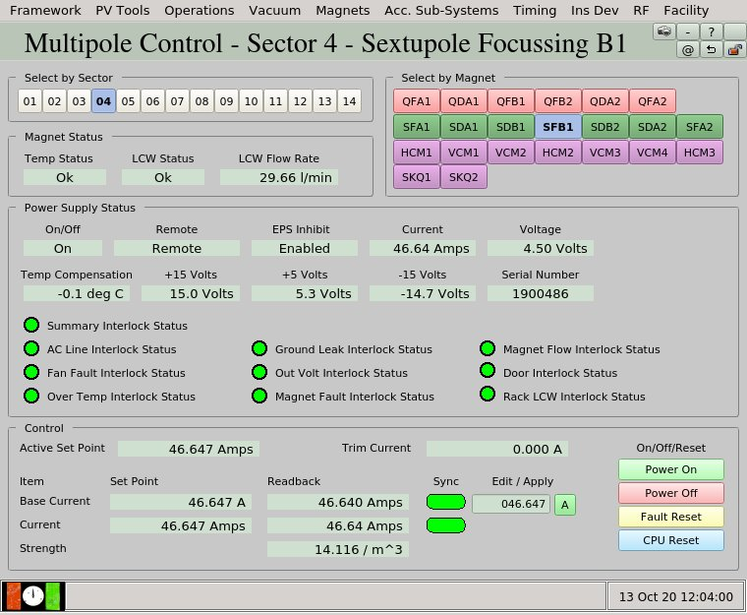

Slide 17
Alarm Handers
GUI clients specifically dedicated to display alarms
Each EPICS PV can be in one of four (or sort of 5) states:
    No Alarm – all well - grey
    Minor alarm – sailing “close to the wind” - yellow
    Major alarm – something is wrong - red
    Invalid – no meaningful value available - white
    Disconnected - “E”
Examples include
  ALH – old but still in use at the Synchrotron.
  BEAST – Integrated into CSS/Pheobus

Slide 18
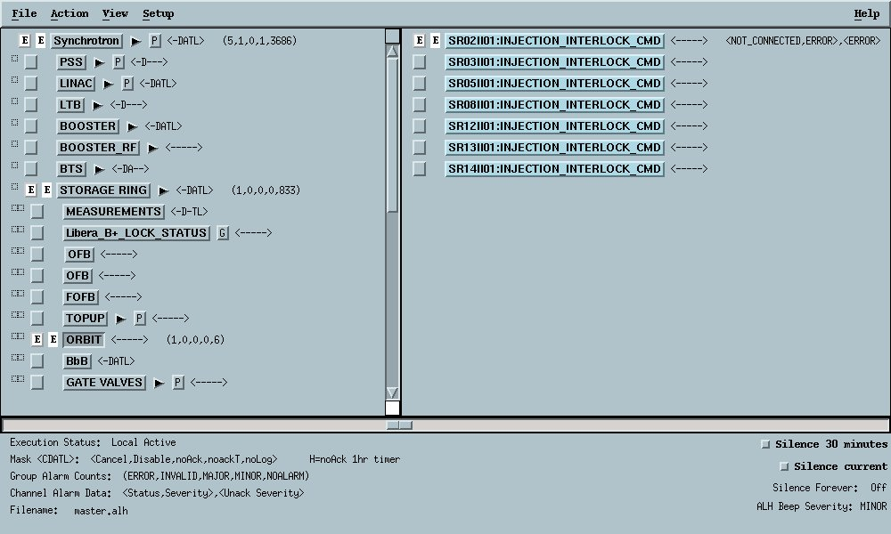

Slide 19
Archivers
These store PV values in a database for later retrieval.
Examples include:
  Channel Access archiver – old, but still in use. Uses bespoke data file format to store PV data, and xml to define configuration data.
  EPICS Archive Appliance – new and aims to archive millions of PVs. Uses google protocol buffers to store PV data, and MySQL to store configuration data. Has an excellent web interface.
EPICS Qt (and others?) have integrated access to both of these archivers.

Slide 20
Command line tools
EPICS base comes with command line tools including:
  caget – allows a PV read on the command line.
  camonitor – allows a PV to be monitored
  caput – writes a value to a PV
  cainfo – provides details about a PV
These are “rock-solid”.
Can be used to verify your environment if/when other clients do not work.

Slide 21
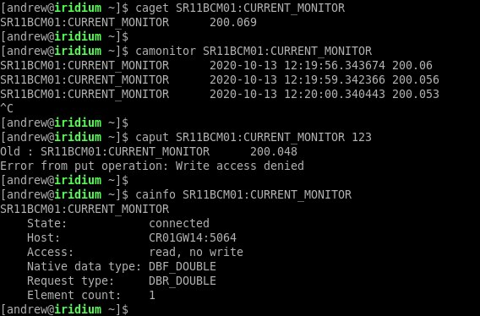

Slide 22
Other Clients
State Machines (not covered)
  A finite state machine, written in SNL (state notation language) and compiled using SNC (state notation compiler).
  Based on C with extras.
  Advantages – it starts when the host IOC starts, and can invoke any standard C function.
pyepics (not covered)
  A python binding around the CA client libraries
  Popular, in common use.
  Easy to use, good documentation

Slide 23
Anatomy of an IOC - Topics
Accessing the Australian Synchrotron Computing Infrastructure (ASCI)
Setting up the environment
  Linux command line
Exercise 1 – creating an IOC with one record.
Setting, getting and monitoring the PV.

Slide 24
Accessing ASCI
Logging on to ASCI
  The URL is https://asci.synchrotron.org.au/
  Your username (email) and password are as you signed up with.
  Click on the ….
  The environment is CentOS 7
  It uses the MATE desktop
  Available editors: vi, pluma and ???

Slide 25
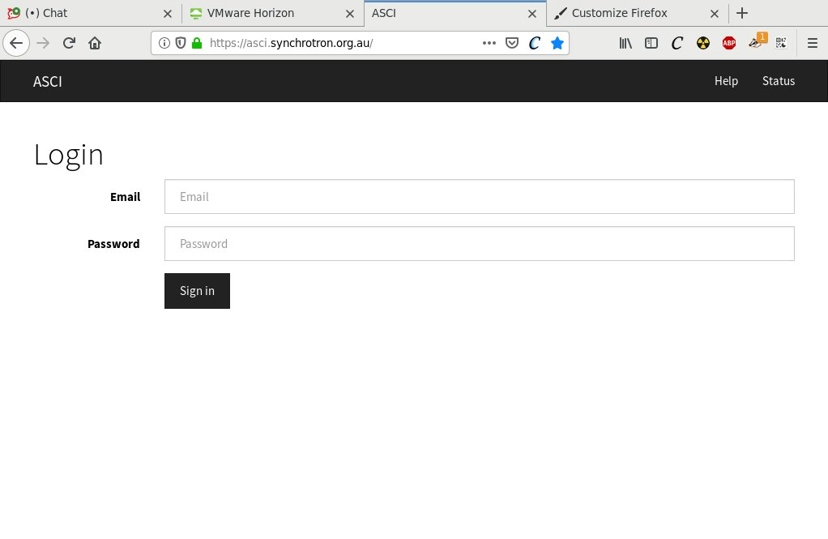

Slide 26
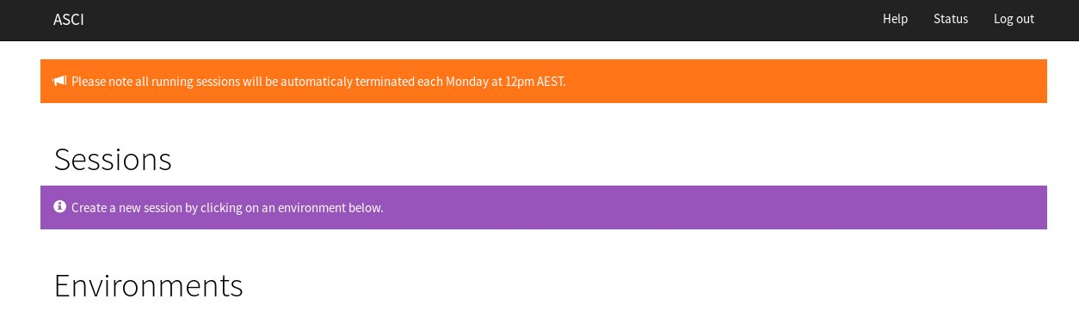

Slide 27
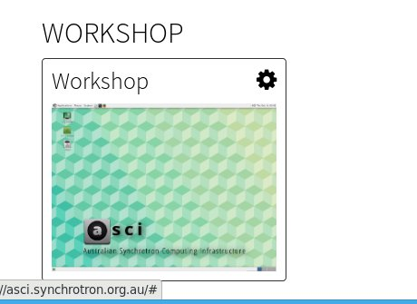

Slide 28
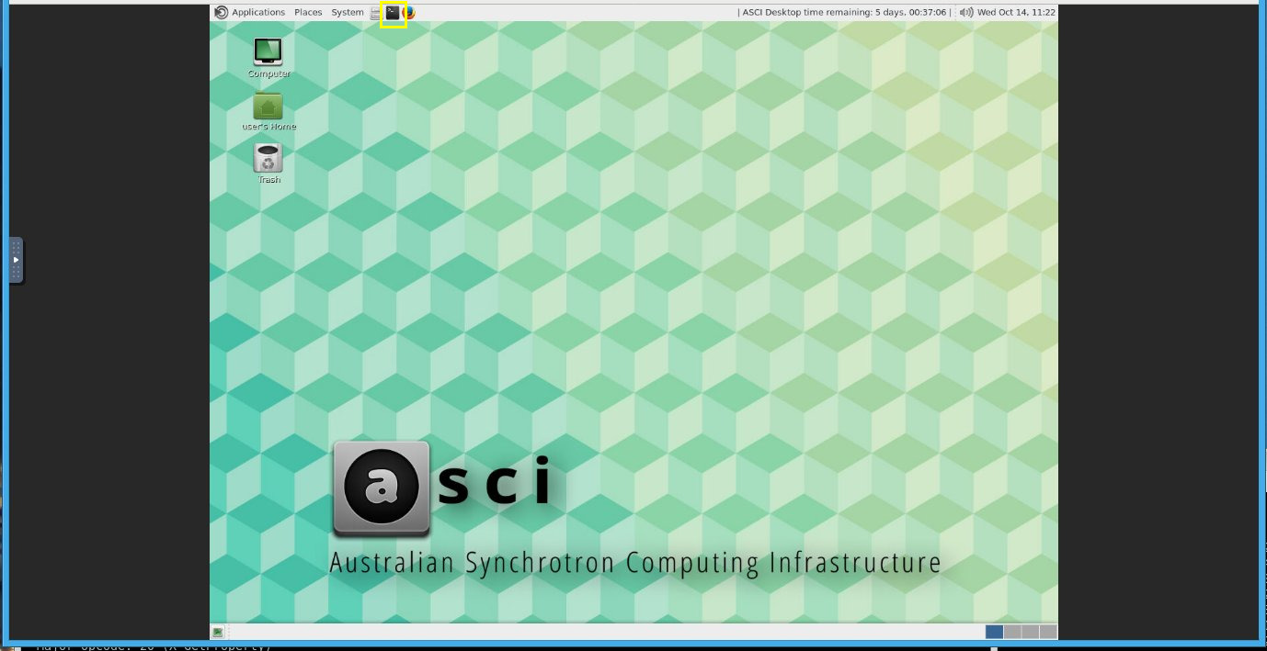

Slide 29
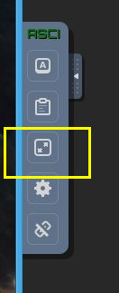

Slide 30
Some basic commands
cd x change to directory x. Uses “/” as separator.
ls, ls x list contents of current directory, directory x
ll list long – provides details
cat x type file x to the terminal
pwd print current directory
vi x, pluma x , code x - edit file x. x will be created
mkdir x, rmdir x create/delete directory x
rm x delete file x

Slide 31
Setting up your environment
Start a terminal (icon – top next, next to the Firefox icon)
Set screen resolution to suit your monitor
  asci-resolution 1800 1000 # example
  Do NOT set too small
Execute the following command to setup your environment
  /data/workshop/epics_october_2020/setup.sh
  . ~/.bashrc
Check setup
  echo $EPICS_HOST_ARCH
  linux-x86_64
Now we are ready to start the first exercise.

Slide 32
Exercise 1
We are going to create an EPICS IOC with a single record.
  We will use makeBaseApp.pl to create an IOC framework
  Then create a simple EPICS database file
  Next we will use the make command to build the IOC.
  We will modify the st.cmd file to load our data base file
  Next will then start the IOC.
  Then use the command line tools to set and get values.
  We will use qegui to monitor and update the PV.
  I will run through it first, then you can try.
  The help/instructions available by typing: ex_notes 1

Slide 33
PVs, Records and Fields
A PV is a name to access/write data via Channel Access.
A record is a object within an EPICS IOC.
  E.g. the Exercise1:Real record from the exercise.
  A record processes, typically to fetch, calc or write a value.
A record has a number of fields
  E.g. DESC, SCAN, EGU, VAL
  The VAL field provides the value, and is the default field.
    caget Exercise1:Real.VAL and
    caget Exercise1:Real are effectively the same.
  All fields have a default value, so need not be specified.
  Most fields can be read as PVs, many can be written to at run time.

Slide 34
Record Types from EPICS base
ai/ao – analog input, analog output – double value
bi/bo – binary in, binary out – boolean enum value
longin/longout – signed int 32 bit value
stringin/stringout – string value – up-to 39 chars.
int64in/int64out – signed int 32 bit value – CA will use double.
mbbi/mbbo – multibit input/output – enumeration, up-to 16 values.
fanout - effectively 17 FLNK fields (older versions have 7)
calc/calcout – performs calculations from up-to 12 inputs
seq – sequence record – can read from/write to up-to 16 PVs.
event – declares an event
Many more.

Slide 35
Often Used Common Fields
All records support a common number (~30) of fields.
  SCAN – controls how the record processes – more later.
  PINI – process on initialisation
  PROC – request processing being written to
  DESC – provides a description/comment
  NAME – provides the name of the record
  RTYP – a pseudo field that provides the record type.
  DTYP – associated device driver – default: Soft Channel
  SEVR – severity, NO_ALARM, MINOR, MAJOR, INVALID
  STAT – status NO_ALARM or severity qualifier, e.g. HIHI
  FLNK – forward link
See the record reference manual – the URL is on the last slide.

Slide 36
Fields common to many record types
Many records, esp. numeric records, have these fields:
  VAL - all records have a VAL field, double, long, binary, enum, string
  INP or OUT – input/output address for data.
  interpretation is based on DTYP.
  EGU – engineering units, e.g. mA, Hr, uSv/Hr
  PREC – precision – guidance to display mangers
  note: this does not round the value.
  ADEL/MDEL – dead band values
  LOPR/HOPR – operating range
  DRVL/DRVL – drive range for output record type (ao, longout, etc)
  LOLO/LOW/HIGH/HIHI – alarm thresholds
  LLSV/LSV/HSV/HHSV – associated severities.

Slide 37
~/exercise1/dbd/Exercise1.dbd
Provides meta data to the IOC about record types, device types, enumeration value etc. Essentially beyond scope of today’s training.
Enum values must be exact, the answers are in the dbd file:
menu(calcoutOOPT) {
choice(calcoutOOPT_Every_Time, "Every Time")
choice(calcoutOOPT_On_Change, "On Change")
choice(calcoutOOPT_When_Zero, "When Zero")
choice(calcoutOOPT_When_Non_zero, "When Non-zero")
choice(calcoutOOPT_Transition_To_Zero, "Transition To Zero")
choice(calcoutOOPT_Transition_To_Non_zero, "Transition To Non-zero")
}

Slide 38
Record Processing - Topics
SCAN Methods
Passive Scanning
INPut and OUTput links
The calc record

Slide 39
Record Processing
Records can process in a number of ways.
  Self scanning (as in Ex 1). The available scan periods are: .1, .2, .5, 1, 2, 5 and 10 seconds, e.g. field (SCAN, ".2 second")
  SCAN set to “I/O Intr” - record it interrupted by its associated device driver.
  SCAN set to “Event”. In this case the EVNT field defines the event name to which the record will respond.
  SCAN set to “Passive”. In this case the record will process when stimulated by another record or by a CA Client.
  Write to the record’s .PROC field.
  Define: field (PINI, "YES") – to process once at IOC initialisation.

Slide 40
Processing Passive Records 1
Forward link. Each record has an FLNK field and may reference another record:
  record (ai, "REC1") {
  field (SCAN, "1 second")
  field (FLNK, "REC2")
  }
  record (ai, "REC2") {
  field (SCAN, "Passive")
  }

Slide 41
Processing Passive Records 2
By using the PP (process passive) input/output link qualifier:
  record (ai, "REC1") {
  field (SCAN, "Passive")
  }
  record (calc, "REC2") {
  field (SCAN, "1 second")
  field (INPA, "REC2 PP") # default in NPP
  }
More about the calc record later

Slide 42
Processing Passive Records 3
By using the CP input/output link qualifier:
  record (ai, "REC1") {
  field (SCAN, "1 second")
  field (MDEL, "0.2") # accumulative change
  }
  record (calc, "REC2") {
  field (SCAN, "Passive")
  field (INPA, "REC2 CP") # Becomes CA link
  }

Slide 43
Processing Passive Records 4
For ao, bo, mbbo, longout, stringout, int64out and other output records, can write to the VAL field, e.g. :
  record (ao, "CURRENT_SP") {
  field (DESC, "BTS Corrector magnet")
  field (SCAN, "Passive")
  }
  [user]$ caput CURRENT_SP 2.357

Slide 44
Processing Passive Records 5
By writing to the .PROC field:
  record (ai, "REC1") {
  field (SCAN, "Passive")
  }
  [user]$ caput REC1.PROC 1
  # any number in range 0 – 255 will do

Slide 45
Link Qualifiers Summary
These are:
  NPP – No Process Passive – default
  PP - Process Passive – referenced record will process
  CA – Channel Access – forces a CA link even if in the same IOC.
  CP – CA Monitor – record processes when it gets an update.
  CPP – Never used it, could not get my head around this one ;-)
Also:
  NMS – No Maximise Severity – default
  MS – Maximise Severity (no alarm, minor, major, invalid)
  MSI - Maximise Severity Invalid (new, since 3.15-ish))

Slide 46
The calc record
The are 34 record types in EPICS base
  These are described in the record reference manual.
  Many more record types available – many from synApps.
The calc record is used to do algebraic, relational and logical operations on values form other (calc) records.
  Useful here to for training as it only requires “Soft Channel” device support.
  It will be the basis of exercise 2 and the mini-project.

Slide 47
The calc record - Inputs
The calc record has 12 inputs, INPA to INPL.
The may be soft channels, i.e. other PVs or numerical constants. Example:
  record (calc, "EX:CALC") {
  field (INPA, "REC1")
  field (INPB, "REC2.SEVR CP")
  field (INPC, "REC3 PP")
  field (INPL, "EX:CALC")
  field (INPH, "3.141592653")
  field (INPI, "42")
  }

Slide 48
The calc record - calculations
The calculation specified in the CALC field (up-to 79 chars)
Uses ‘variables’ A to L in the expressions:
  field (CALC, "28") # Constant
  field (CALC, "A*(B-C)") # Mathematical
  Field (CALC, "A & (B | C") # Bit wise
  field (CALC, "MAX(H, L)") # Functions
  field (CALC, "SIN (A/H") # Trig functions
  field (CALC, "(A>3.6) && H < L ? A+B : B-C")
  # Logical/ternary
  Use rec_ref command to show record reference manual.

Slide 49
The calc record – heartbeat example
record (calc, "HEART_BEAT_CALC") {
field (DESC, "IOC heartbeat sent to EPS PLC”)
field (SCAN, "1 second”)
field (INPA, "HEART_BEAT_CALC")
field (CALC, "(A+1)%3600")
field (LOPR, "0")
field (HOPR, "3600")
field (FLNK, "SEND_HEART_BEAT")
}
# This record sends heat beat to the PLC
# details beyond scope of this training.
record (longout, "SEND_HEART_BEAT"){
}

Slide 50
Exercise 2 – calc records and links - 1
We are going to create an EPICS IOC like before:
  Create a database with 4 records
  Exercise2:rec1 is an ai, written to by user and forward links (FLNK) to calc rec4
  Exercise2:rec2 is a Passive calc record that counts up module 10.
  Exercise2:rec3 also a calc record that scans at 10 seconds, and counts up in 100s module 1000.

Slide 51
Exercise 2 – calc records and links - 2
Exercise2:rec4 is a calc record, with three inputs, i.e. Exercise2:rec1, Exercise2:rec2 and Exercise2:rec3.
  is itself a passive record
  it forces Exercise2:rec2 to process (uses the PP qualifier)
  it monitors Exercise2:rec3 and processes when it is sent an update (by using the CP qualifier)
  it sums the three inputs,
  enters the HIHI/MAJOR alarm state when the value is >= 800
The help/instructions available by typing: ex_notes 2
Get the full “answer” by typing: ex_notes 2b

Slide 52
Graphical User Interfaces
Very brief introduction to Qt’s designer to allow creation of a GUI form that can be displayed using EPICS Qt’s qegui.
Widgets are drag-and-dropped onto the form.
Widget properties modifiable in designer
Widgets of interest are the EPICS Qt framework widgets:
  QELabel – displays a PV value textually
  QELineEdit – allows arbitrary value to be written to a PV
  QEPushButton - allows a fixed value to be written when clicked.
These all have a “variable” property for the PV name.
  Otherwise the default property values will do.

Slide 53
Creating a Graphical User Interface.
This part of the training will consist of:
  Slides – showing you what to do.
  A live demonstration using designer – we will be using the PVs from exercise 2 – so leave the Ex2 IOC running.
  You then get to have a go.
  If you are really stuck, use the command getui 2
  to get a working ui file.
Using qegui to display the ui file.
  Entering values.
  Pushing buttons

Slide 54
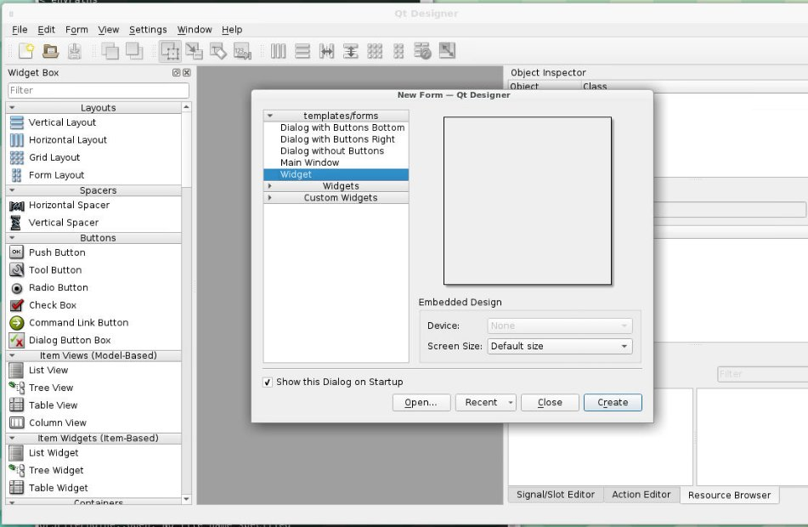

Slide 55
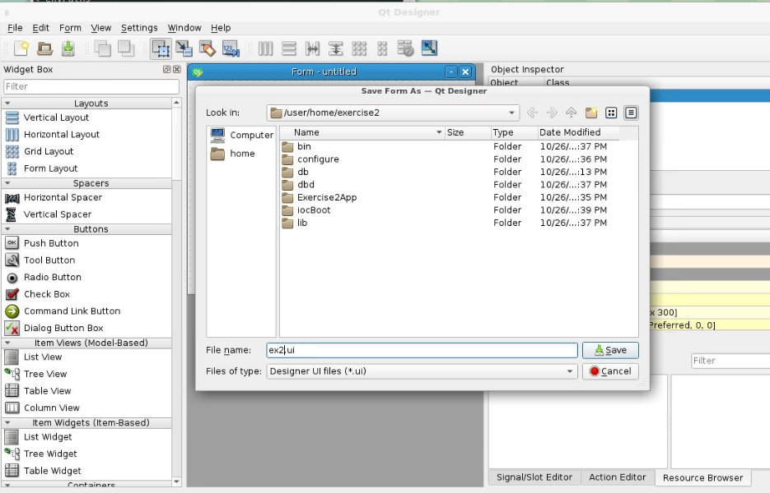

Slide 56
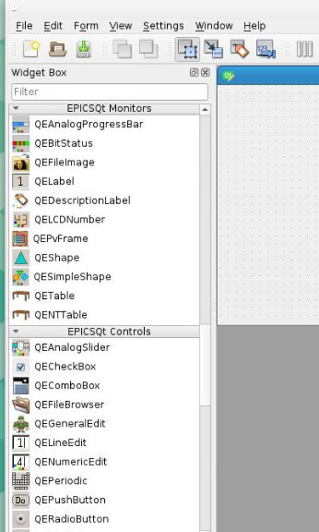

Slide 57
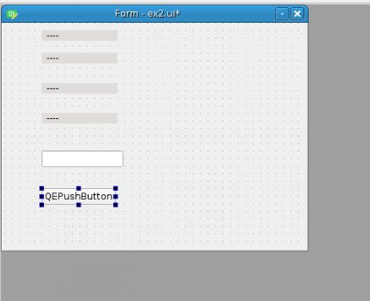

Slide 58
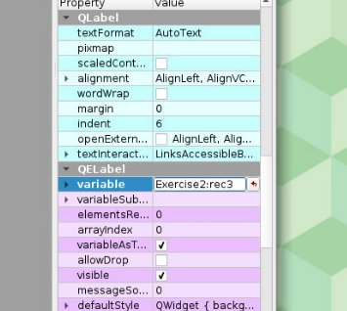

Slide 59
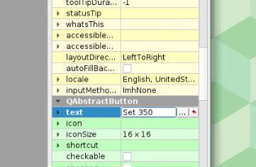

Slide 60
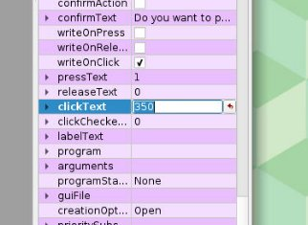

Slide 61


Slide 62
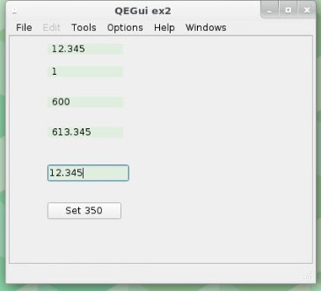

Slide 63
Mini project –conference count down
Specification:
  Create an EPICS IOC database to count down to zero.
  Provide 3 records viz: EX3:HOURS, EX3:MINUTES, EX3:SECONDS
  that that show the count down.
  These records will enter the MINOR alarm state when 60 seconds left, and enter the MAJOR state when 5 seconds left.
  The talk time set by writing a value (in seconds) to EX3:START
  Create a GUI to display the hours minutes and seconds.
  The GUI should also have two start buttons: a short talk (say 2 minutes) start and a long talk (say 30 minutes) start.

Slide 64
Hints - 1
For count down timer
  use a record that takes itself as an input.
  scan at 1 second
  stop the count down when get to zero: MAX () or “A>0 ? … : …”
  define the alarm thresholds and severities on this record.
Use three calc records, for hours, minutes and seconds
  Use the MS qualifier to match the alarm levels.
  The calculations might make use of % operator and FLOOR function.
Create a start talk record
  This can be ao or longout
  Use the OUT filed to write to the timer record.

Slide 65
Hints - 2
Use these record names (so that pre-prepared ui file will work):
  EX3:TIMER
  EX3:SECONDS
  EX3:MINUTES
  EX3HOURS
  EX3:START

Slide 66
Hints - 3
Use designer to create the form
  Create three QELabels to display the hours, mins and seconds
  Create two QEPushButtons to start the short and long talk.
Run using qegui exercise3.ui
The help/instructions available by typing: ex_notes 3
Get the full “answer” database file: ex_notes 3b
Get the ui file by typing: getui 3

Slide 67
URL/Other References
https://epics.anl.gov/ - original EPICS web site => tech-talk
https://epics-controls.org/ - new EPICS web site
https://epics.anl.gov/base/R7-0/4-docs/RecordReference.html
- record reference manual
https://qtepics.github.io/ - EPICS Qt web site
https://ozepics.slack.com/ - Australian EPICS Slack Channel
  These slides are at on ACSI at:
  /data/workshop/epics_october_2020/slides/ATF_Workshop_EPICS_101.pptx

Slide 68
Open Q&A session

