Slide 1
Development of CAS-ASD Standards
CAS Design & Construction Guide G-7375
Presented on Behalf of CAS-ASD
David Button dbu@ansto.gov.au

Slide 2
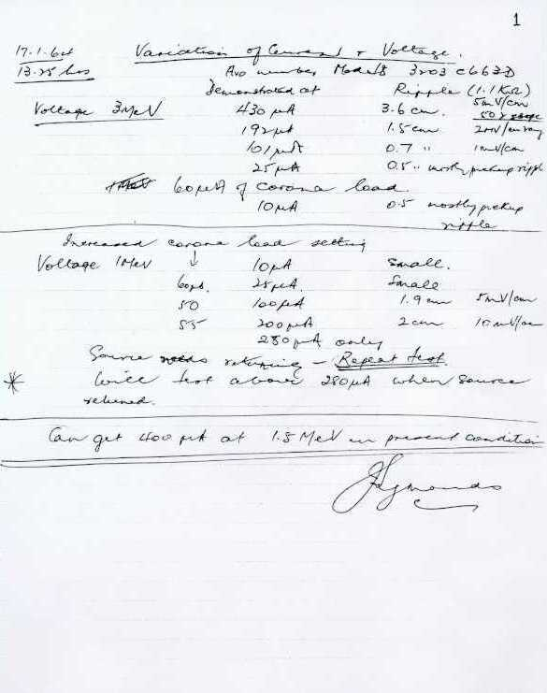
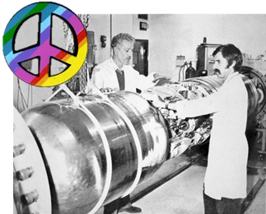
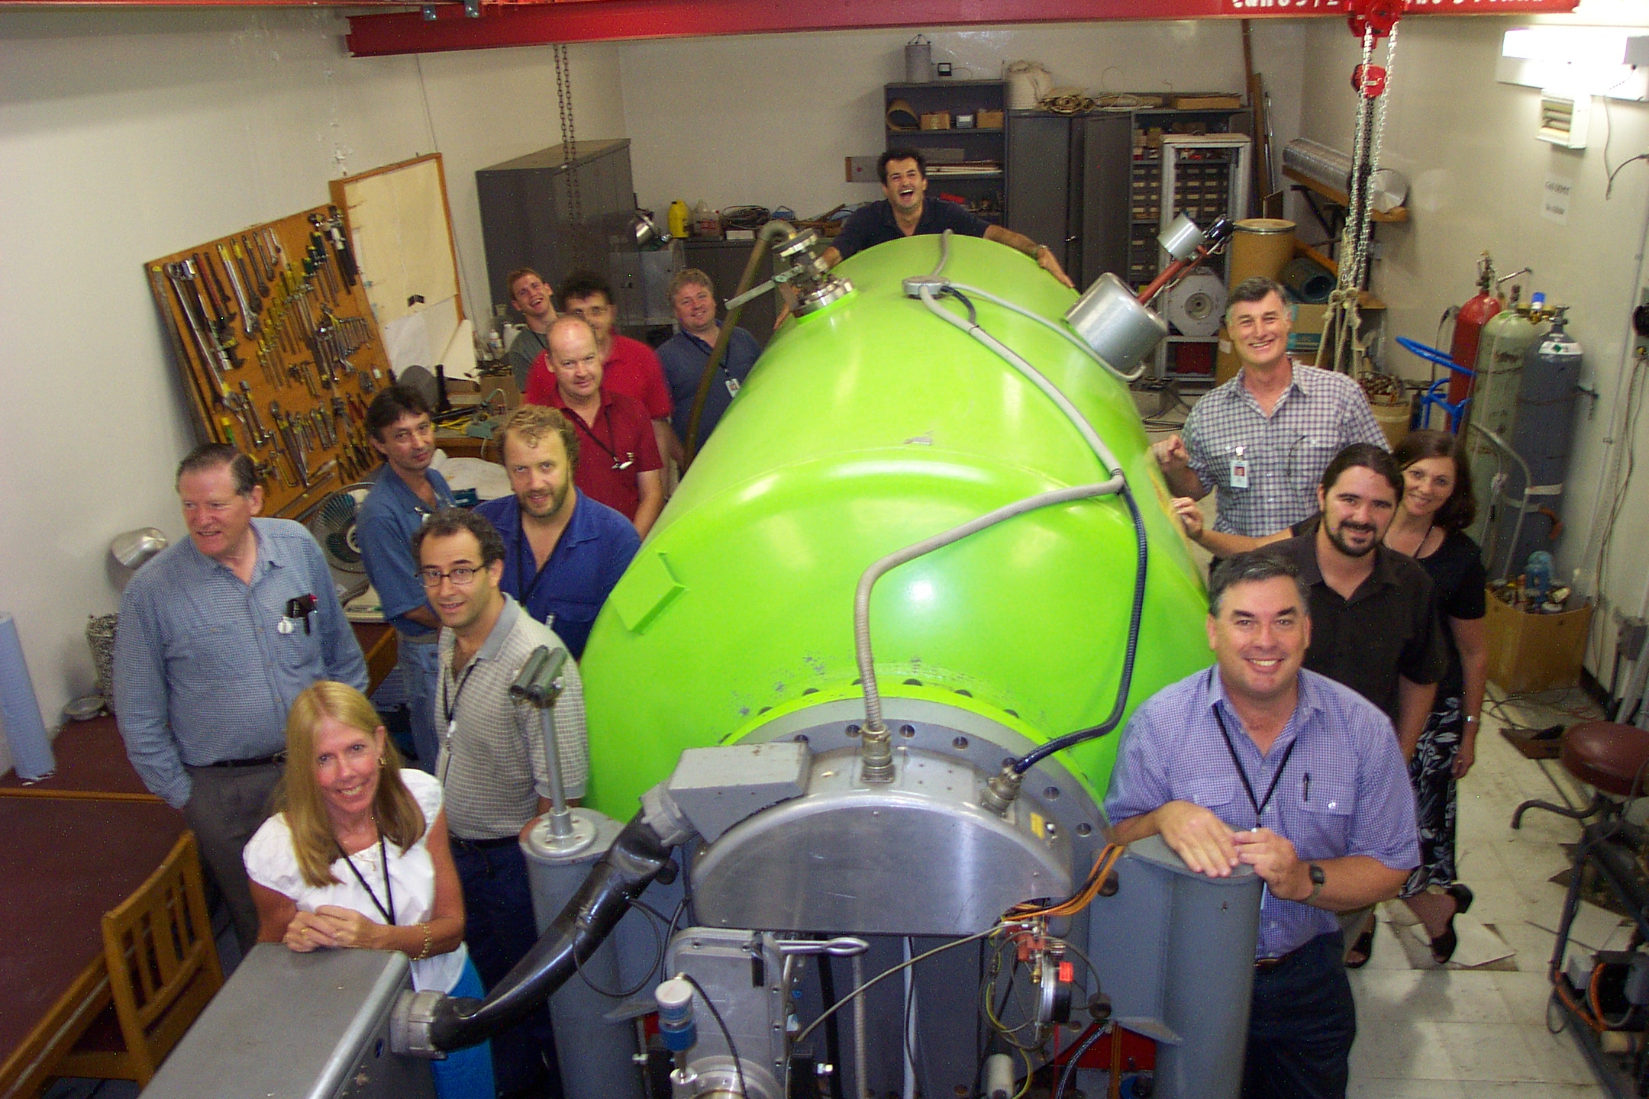
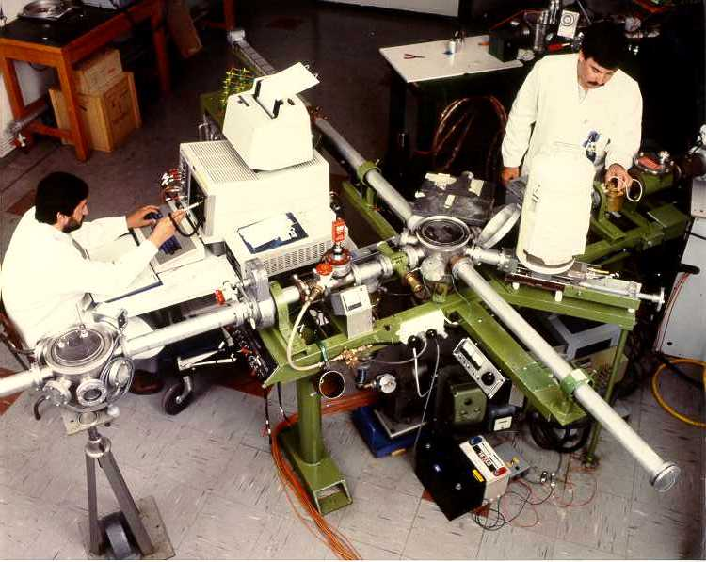
Why are we giving this talk?
Centre for Accelerator Science (CAS) origins date back to 1964 when ANSTO was known as the Australian Atomic Energy Commission AAEC.
1964
2004

Slide 3
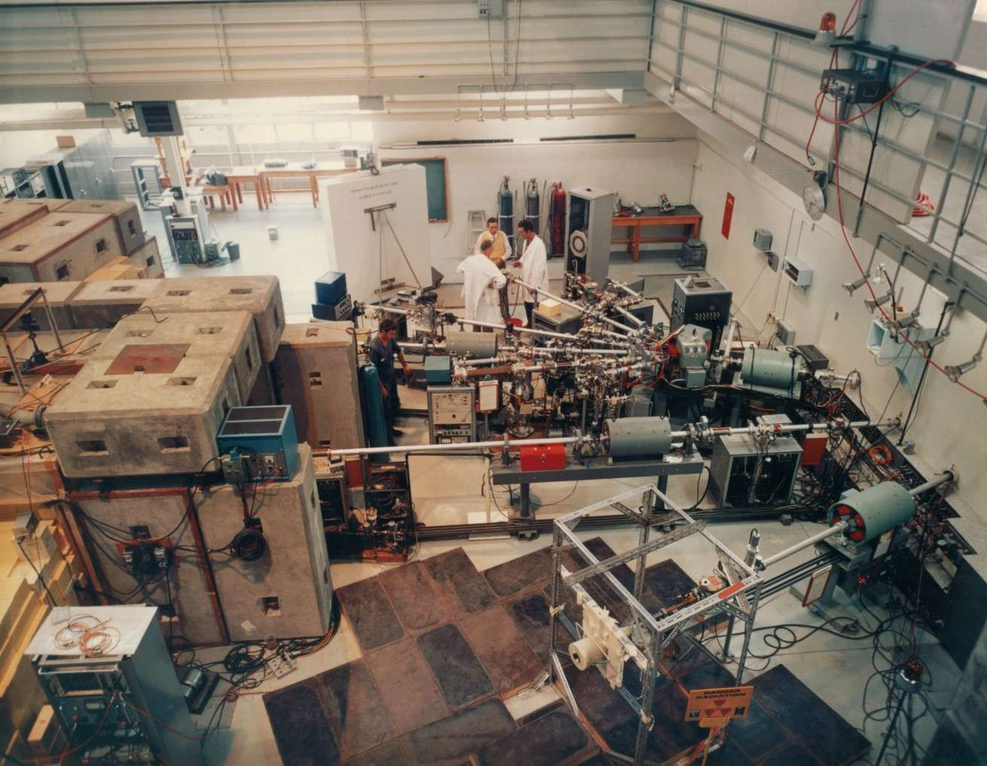


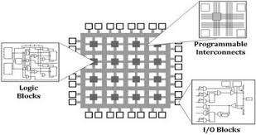
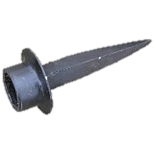
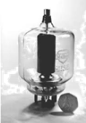
The technological expanse
The life time of electrostatic accelerators typically branches over decades.
Facilities may have complete staff turn over multiple time in their lifetime.
Capability development is an ongoing process.
Technologies available may have matured or advanced over time, and new products available to our market place.
Some technologies or products may have discontinued.
Regulation requirements may change, or required to meet standards.
Diverse teams can also mean diverse solutions which may have pros and cons.

Slide 4
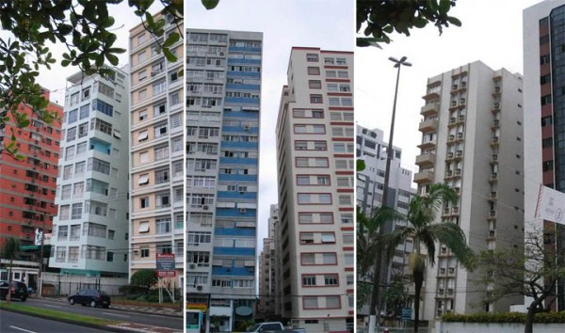
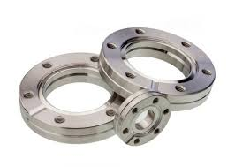
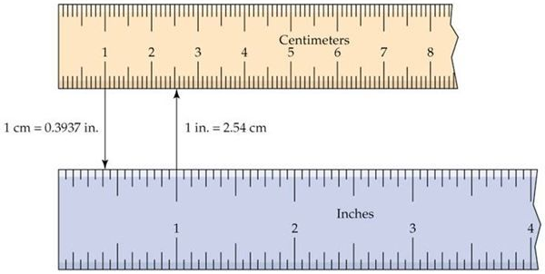
Why the need to move to standards and guidelines?
Typical business response would be:
  Reducing Costs
  Efficiency
  Mitigating Risk
  Consistency
  Customer Confidence
  Uniformity
  Eliminate Trade Borders
  Universal Vendor Requirements
Syntax Error Line 42

Slide 5




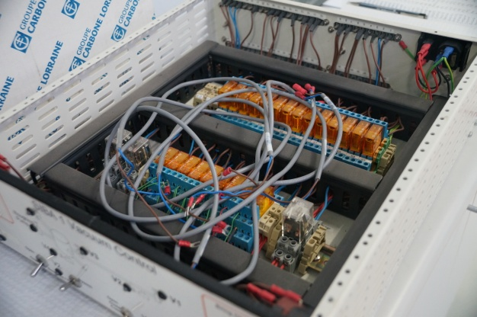


Why the need to move to standards and guidelines?
We want our facilities
  Mutual understood by group members (Unification across disciplines where possible)
  Serviceable by more than one staff member (Reduce unicorns)
  Predictability, and prescriptive where possible (Safety, Maintainability, Harmonization)
  Knowledge transference to new group members easily and rapidly to become effective
  Simplification of range of solutions to support
  Automate processes where possible
  Reproducibility (Supports quality systems)

Slide 6

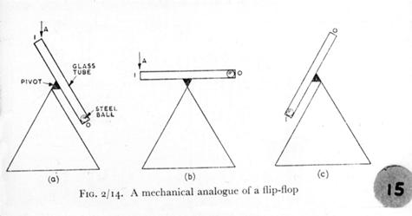
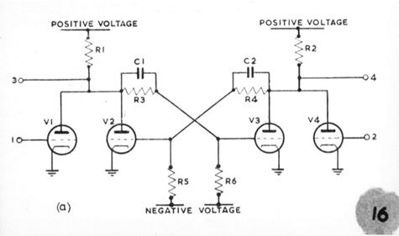
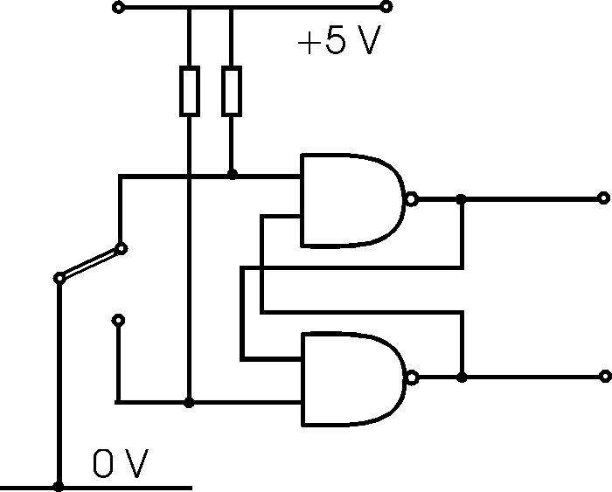
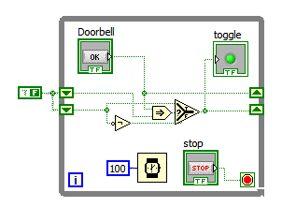
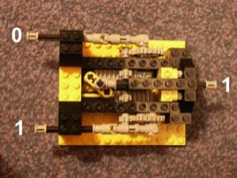
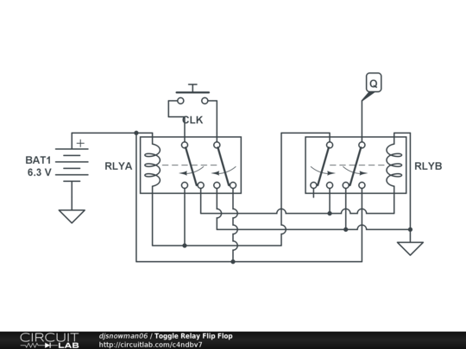
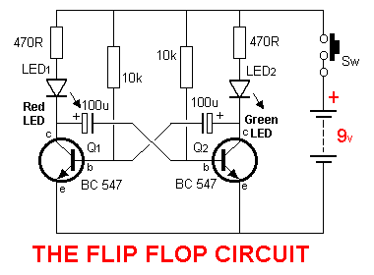
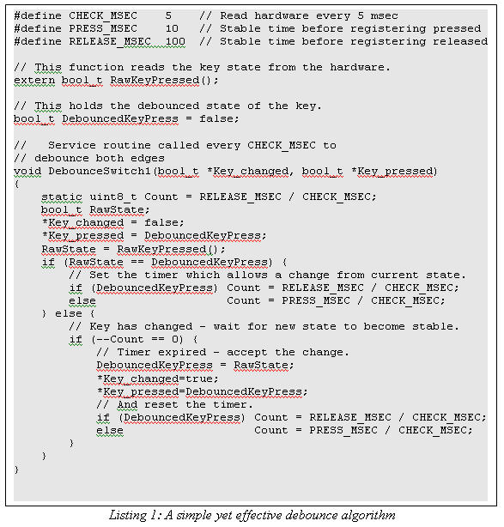
More than one way to skin a cat!
Choice and Decision…..

Slide 7


Standard and guideline….good intensions
Not a tool to crush innovation
Not a comment against anyone's competency or expertise
Not to undermined anyone's value or security
Not to take away anyone’s input
Not to suppress anyone’s development
This Presentation
You

Slide 8
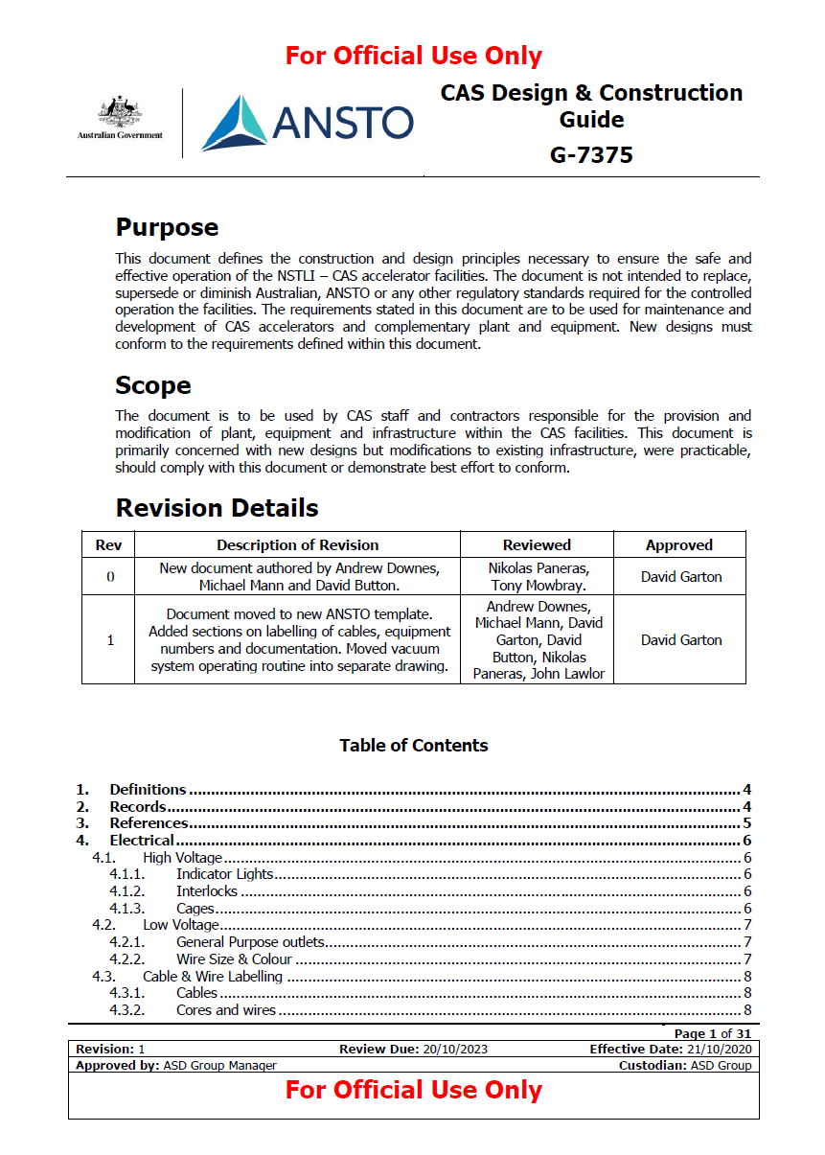
Covers the Following Areas
Electrical
Information Technology
Control Systems
Vacuum
Compressed Gases
Chilled Water
Radiation
Racks & Cabinets
Labels & Signs
Indicator Lights
Paint
Nomenclature
Documentation
Design Change Approval

Slide 9
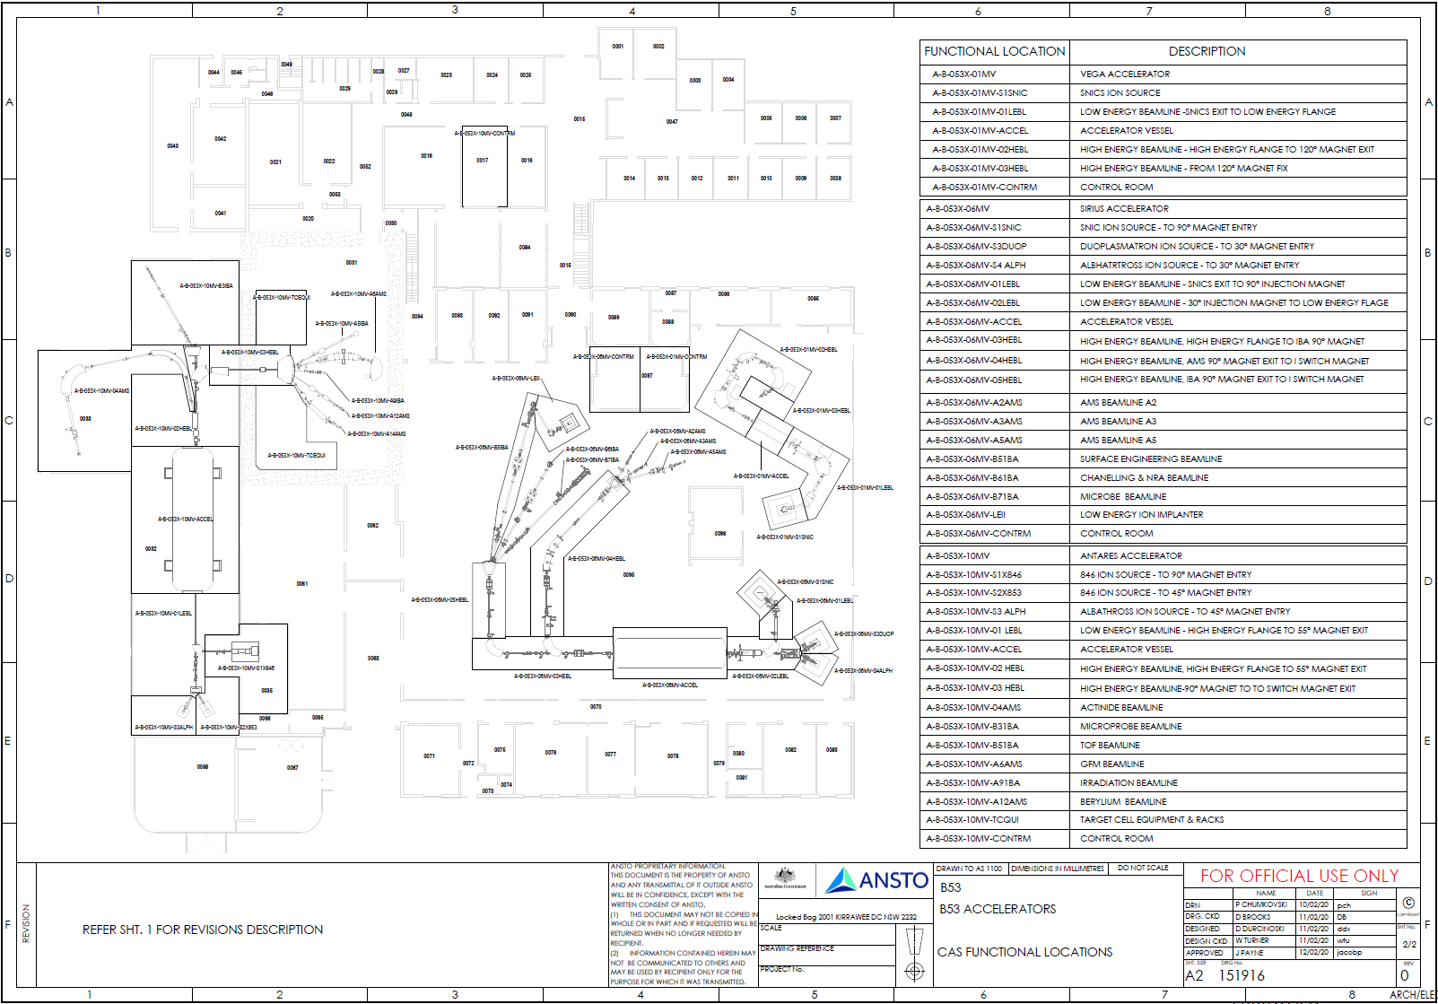
SAP based maintenance system

Slide 10
Functional Locations…setting the scene
FUNCTIONAL LOCATION DESCRIPTION B53
A-B-053X-01MV VEGA ACCELERATOR
A-B-053X-01MV-S1SNIC SNICS ION SOURCE
A-B-053X-01MV-01LEBL LOW ENERGY BEAMLINE -SNICS EXIT TO LOW ENERGY FLANGE
A-B-053X-01MV-ACCEL ACCELERATOR VESSEL
A-B-053X-01MV-02HEBL HIGH ENERGY BEAMLINE - HIGH ENERGY FLANGE TO 120° MAGNET
A-B-053X-01MV-CONTRM CONTROL ROOM
A-B-053X-01MV-03HEBL HIGH ENERGY BEAMLINE - FROM 120° MAGNET FIX
A-B-053X-06MV SIRIUS ACCELERATOR
A-B-053X-06MV-S1SNIC SNICS ION SOURCE - TO 90° MAGNET ENTRY
A-B-053X-06MV-S3DUOP DUOPLASMATRON ION SOURCE - TO 30° MAGNET ENTRY
A-B-053X-06MV-01LEBL LOW ENERGY BEAMLINE - SNICS EXIT TO 90° INJECTION MAGNET
A-B-053X-06MV-S4 ALPH ALPHATROSS ION SOURCE - TO 30° MAGNET ENTRY
A-B-053X-06MV-02LEBL LOW ENERGY BEAMLINE - 30° INJECTION MAGNET TO LOW ENERGY
A-B-053X-06MV-ACCEL ACCELERATOR VESSEL
A-B-053X-06MV-03HEBL HIGH ENERGY BEAMLINE, HIGH ENERGY FLANGE TO IBA 90° MAGNET
A-B-053X-06MV-04HEBL HIGH ENERGY BEAMLINE, AMS 90° MAGNET EXIT TO I MAGNET
A-B-053X-06MV-05HEBL HIGH ENERGY BEAMLINE, IBA 90° MAGNET EXIT TO I MAGNET
A-B-053X-06MV-A2AMS AMS BEAMLINE A2
A-B-053X-06MV-A3AMS AMS BEAMLINE A3
A-B-053X-06MV-A5AMS AMS BEAMLINE A5
A-B-053X-06MV-B51BA SURFACE ENGINEERING BEAMLINE
A-B-053X-06MV-B61BA CHANELLING & NRA BEAMLINE
A-B-053X-06MV-B71BA MICROBE BEAMLINE
A-B-053X-06MV-LEII LOW ENERGY ION IMPLANTER
A-B-053X-06MV-CONTRM CONTROL ROOM
A-B-053X-10MV ANTARES ACCELERATOR
A-B-053X-10MV-S1X846 846 ION SOURCE - TO 90° MAGNET ENTRY
A-B-053X-10MV-S2X853 846 ION SOURCE - TO 45° MAGNET ENTRY
A-B-053X-10MV-01 LOW ENERGY BEAMLINE - HIGH ENERGY FLANGE TO 55°
A-B-053X-10MV-S3 ALPH ALPHATROSS ION SOURCE - TO 45° MAGNET ENTRY
A-B-053X-10MV-ACCEL ACCELERATOR VESSEL
A-B-053X-10MV-02 HEBL HIGH ENERGY BEAMLINE, HIGH ENERGY FLANGE TO 55° MAGNET EXIT
A-B-053X-10MV-03 HEBL HIGH ENERGY BEAMLINE-90° MAGNET TO SWITCH MAGNET EXIT
A-B-053X-10MV-04AMS ACTINIDE BEAMLINE
A-B-053X-10MV-B31BA MICROPROBE BEAMLINE
A-B-053X-10MV-B51BA TOF BEAMLINE
A-B-053X-10MV-A6AMS GFM BEAMLINE
A-B-053X-10MV-A91BA IRRADIATION BEAMLINE
A-B-053X-10MV-A12AMS BERYLIUM BEAMLINE
A-B-053X-10MV-TCQUI TARGET CELL EQUIPMENT & RACKS
A-B-053X-10MV-CONTRM CONTROL ROOM

Slide 11
Controls aspects of guidelines
Information Technology
Network Devices
IP Address
Host Name
Domain Name
Labelling
Communications
Optic Fibre
Copper
Identification
Network Identification
Colours
Passwords
Control Systems
  EPICS
    PV Names
  PLC
    Device Identification

Slide 12
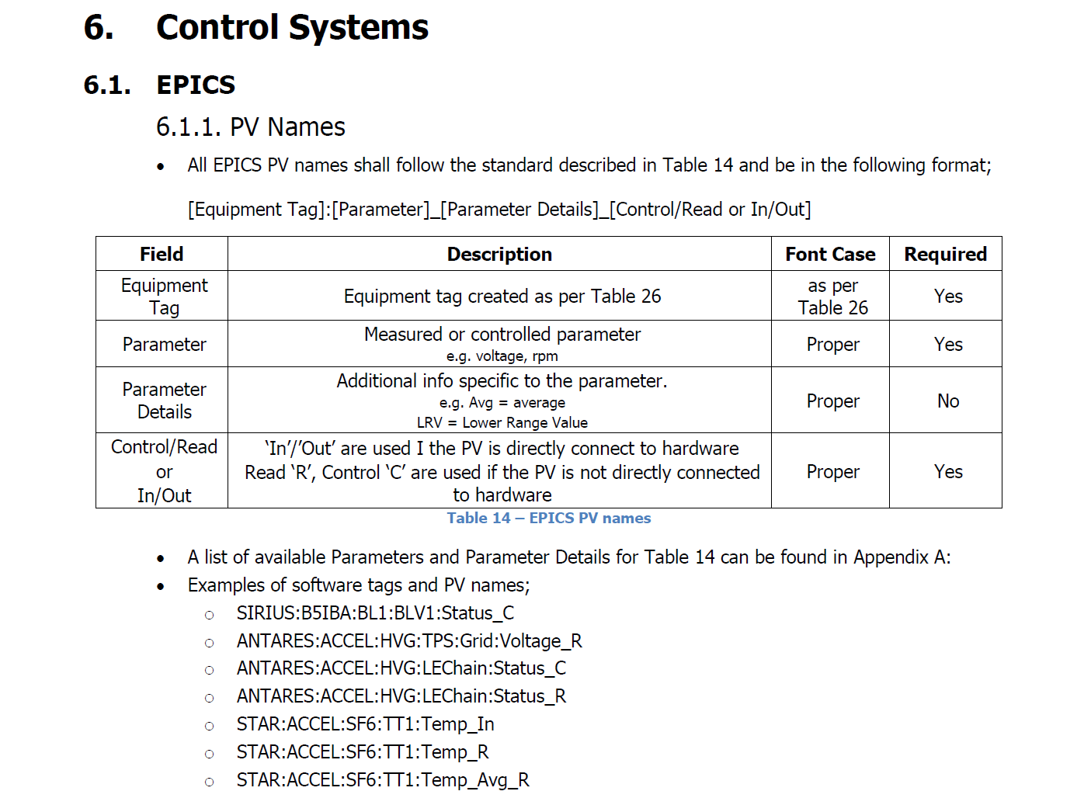
Prescriptive PV names
Example of Legacy EPICS PV’s
c14smfco
c14tgtfcc
hefc1c
hefc1i
antares:gfm:quad1:remLocStatus
antares:gfm:quad1:setCurrent
antares:gfm:quad2:Iout
antares:gfm:quad2:Iset
tapss
tasdi
tstdno
tstupo
Antares_HighEnergy_Pressure_Value
Antares_PressureVessel_MassConversion_AvMass
Antares_PressureVessel_MassConversion_AvMass24Hr
Antares_PressureVessel_MassConversion_Mass

Slide 13
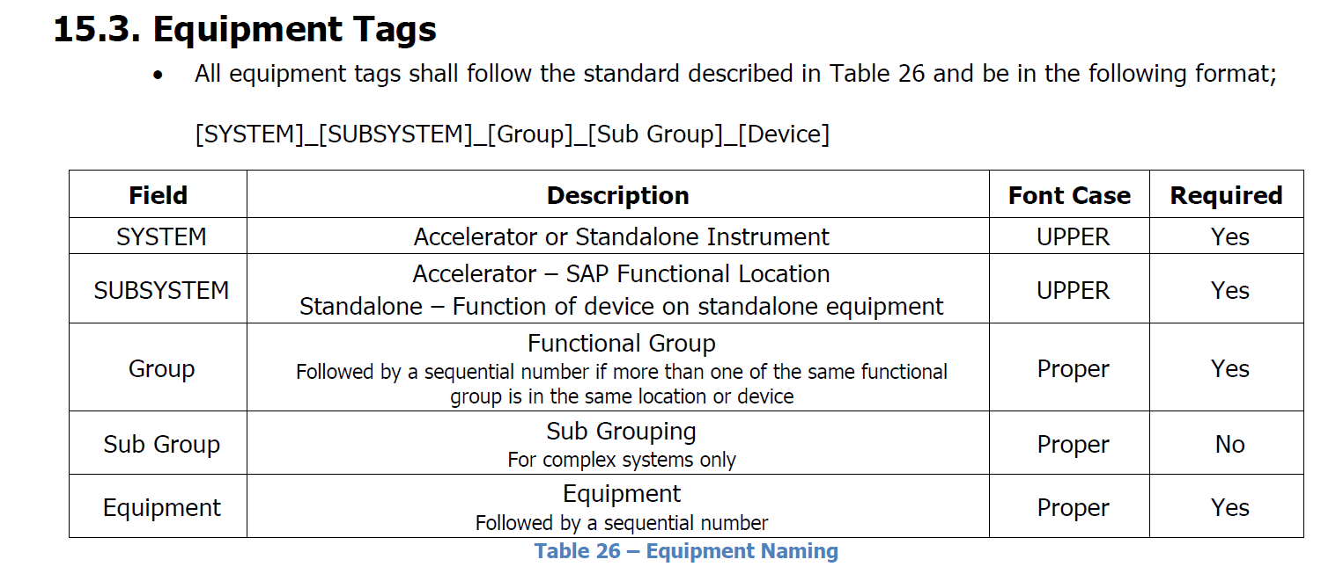
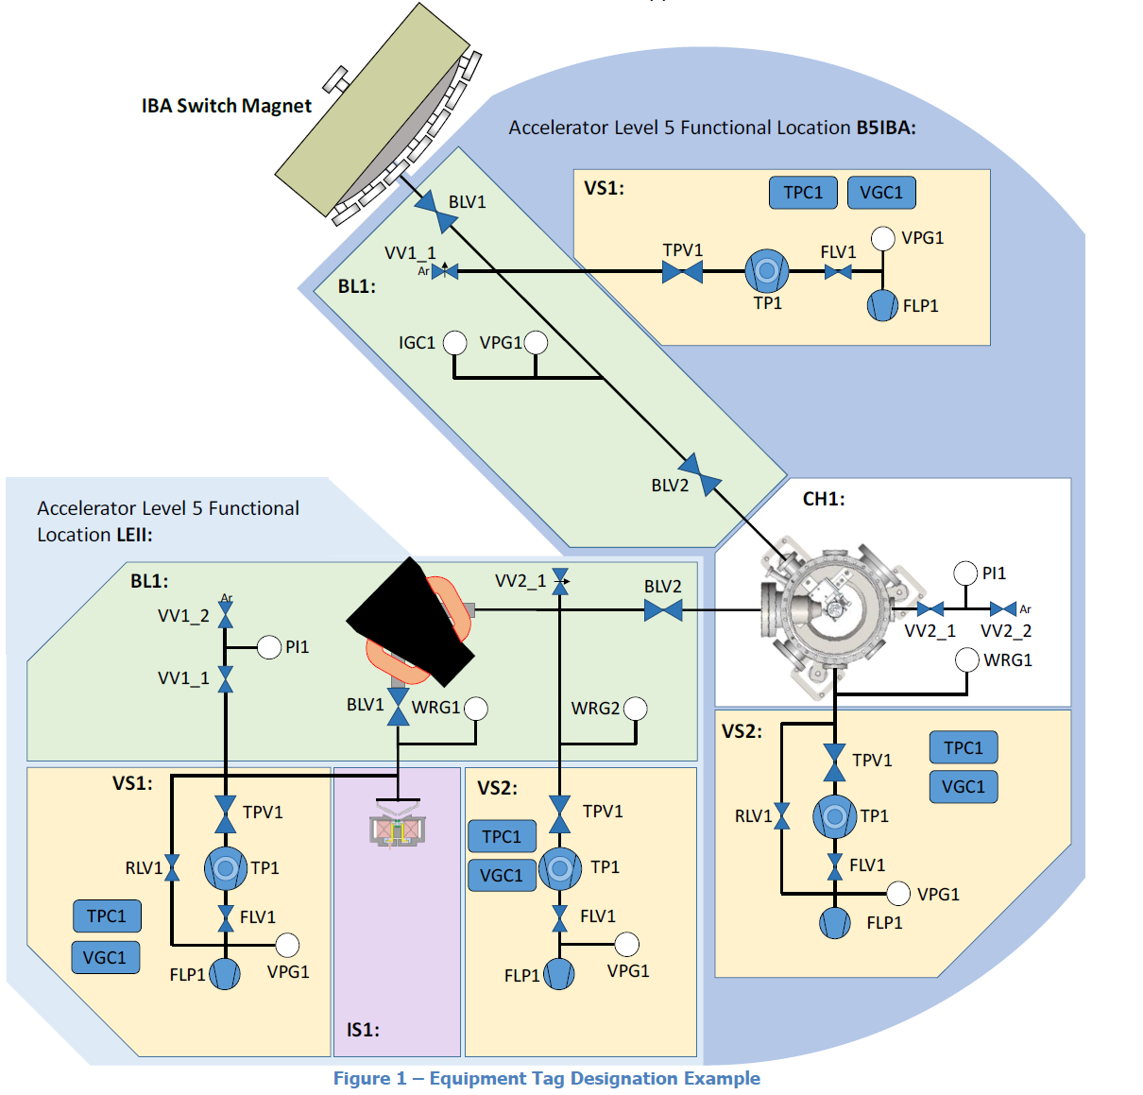
Example PV:
SIRIUS:B5IBA:BL1:BLV1:Status_C
Parameter

Slide 14
Standardised equipment codes

Slide 15

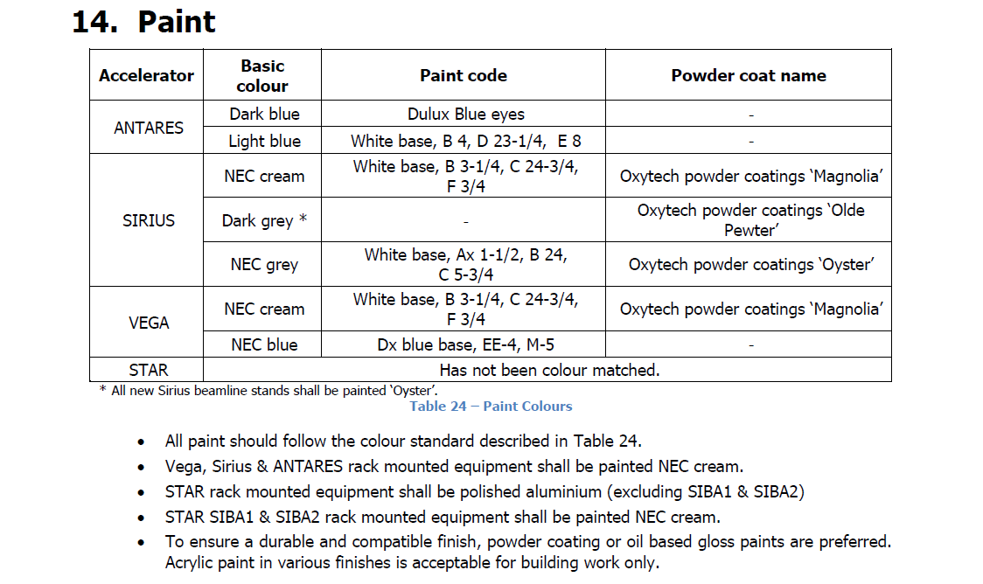

Standardised the bigger issues…

Slide 16

Finial brief thoughts….
Having this guide is helping unify our group with common language and approach to the facilities.
The document has undergone is first revision which has benefited from wider input of the documents users.
Our group is happy to share and discuss our standards and guidelines with those who are interested.
We look forward to being able to have more productive conversations in the future with members of this community as we improve our understanding of each other through interactions such as this meeting.

Slide 17

Thank you
We need you to help fight Unicorns!

