Slide 1
Safety PLCs at the Australian Synchrotron

Slide 2
Safety Systems at Australian Synchrotron
Personnel Safety Systems (PSS) utilise Safety PLCs for radiation and electrical safety interlocks in accelerator areas and beamlines.
Dedicated PSS for Machine (accelerator) and individual beamlines
Existing PSS based on PILZ Safety PLCs has reached End-of-Life that affects availability of the machine and beamlines.
Need to expand the Machine PSS to accommodate new Bright beamlines/front-ends PSS requirements
Need to develop PSS for New beamlines
Overhaul of safety PLC platform design that will bring state-of the- art technology and associated benefits
Notes:
Most of the PILZ PSS-3000 hardware and software is no longer available, supported or repairable.

Slide 3
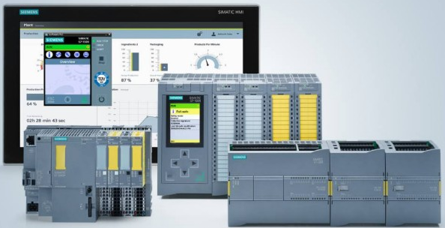
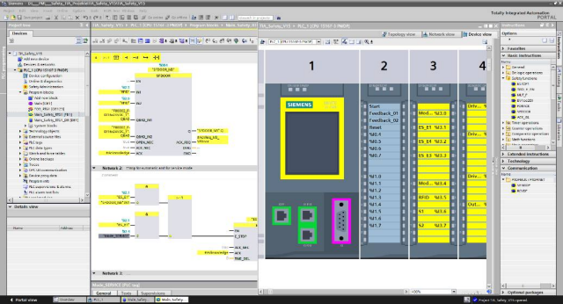
SIEMENS Integrated safety technology
SIEMENS Integrated safety technology chosen as standard platform for Equipment Protection and Personnel Safety Systems (EPS/PSS)
Integrated EPS/PSS on one controller based on Totally Integrated Automation (TIA)
Fail-Safe program blocks with password protection & CRC based change management
Reduced PLC hardware and wiring costs
Testing without hardware using PLCSIM simulation
Modular, scalable design using ET200SP Profinet I/O system
Safety PLC hardware/software certified in accordance with IEC-62061 to SIL3 and ISO-13849-1 to PLe

Slide 4
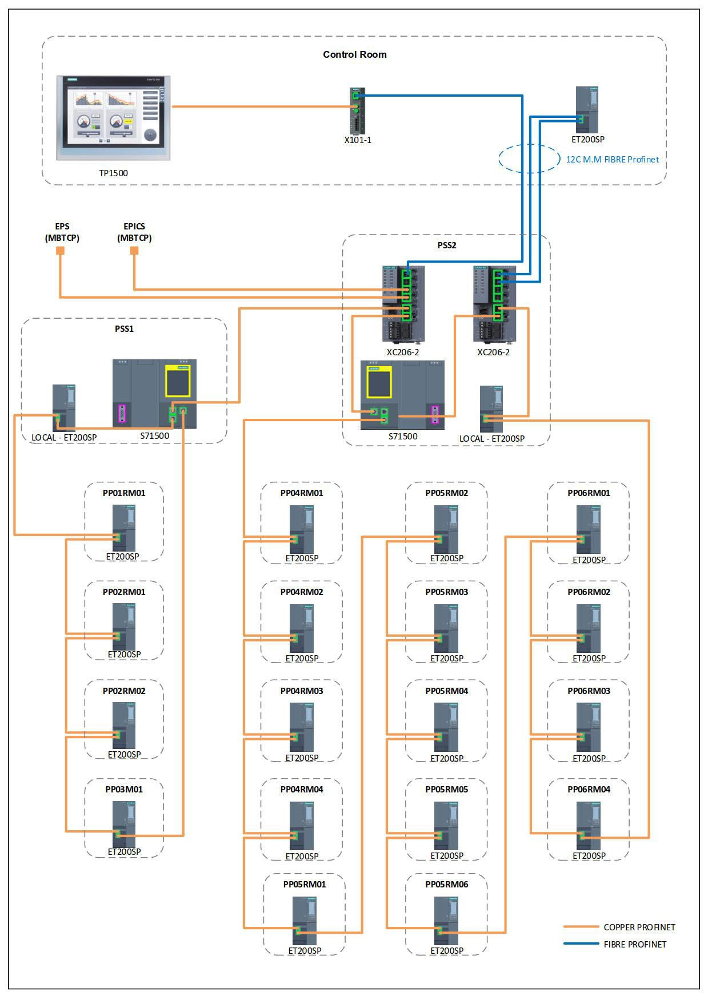
Machine PSS
Responsible for personnel safety interlock and access control within accelerator areas (Storage Ring and Injection System)
Previous PSS has reached End of Life and is upgraded to Siemens S7-1500F +ET200SP distributed safety PLC platform
Support for new Bright beamlines/front-ends PSS requirements
A systematic cut-over process under a tight timeline
The PSS PLC program was fully tested using simulation system
Upgrade project completed successfully with minimum issues.

Slide 5
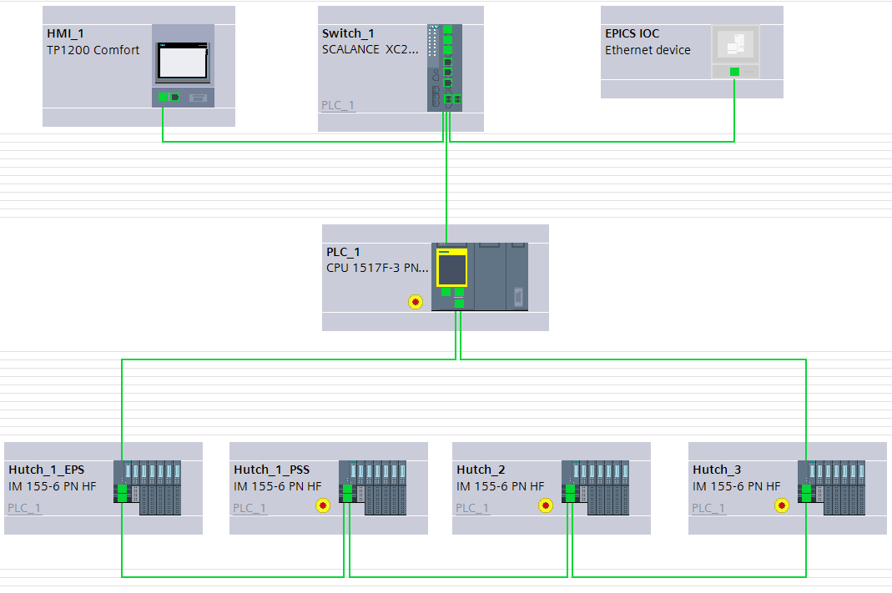
Bright Beamlines EPS/PSS
Same platform as Machine PSS
In-house development
EPS/PSS I/O on the same node
PROFINET I/O network with MRP redundancy carrying both PROFINET and PROFIsafe data
Communication with EPICS via OPC-UA on a separate physical Ethernet interface
PSS PLC program will be fully tested using SIMIT simulation platform
Comfort Panel HMI provides user friendly GUI with advanced diagnostic tools

Slide 6
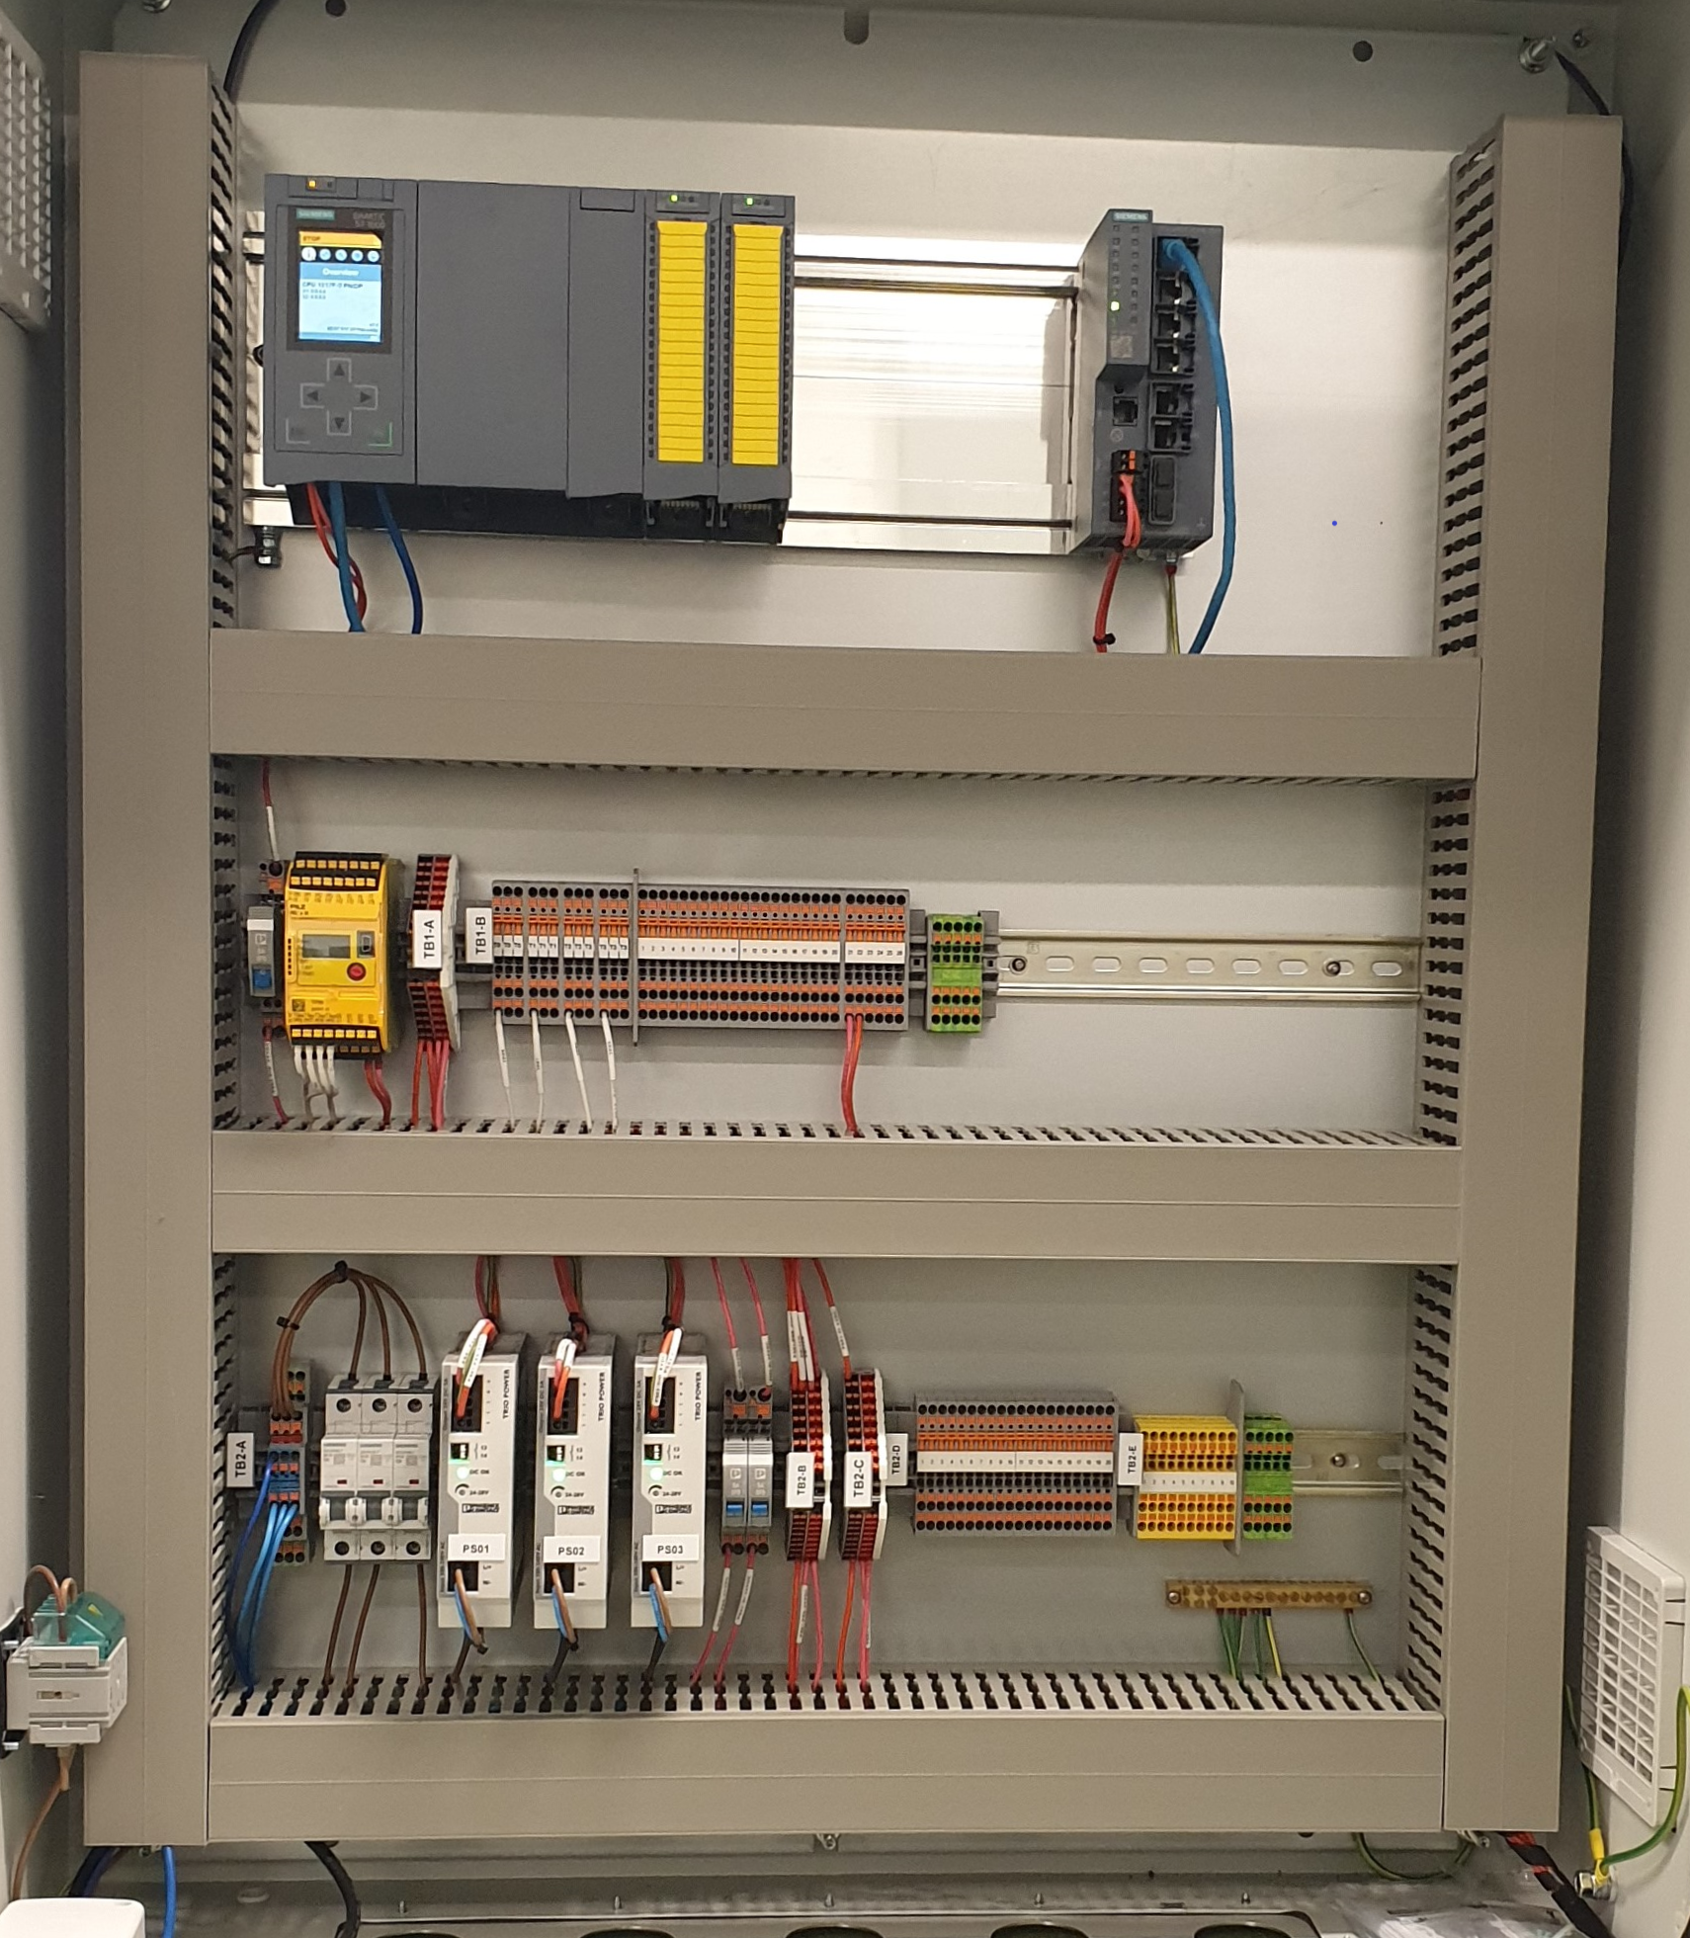
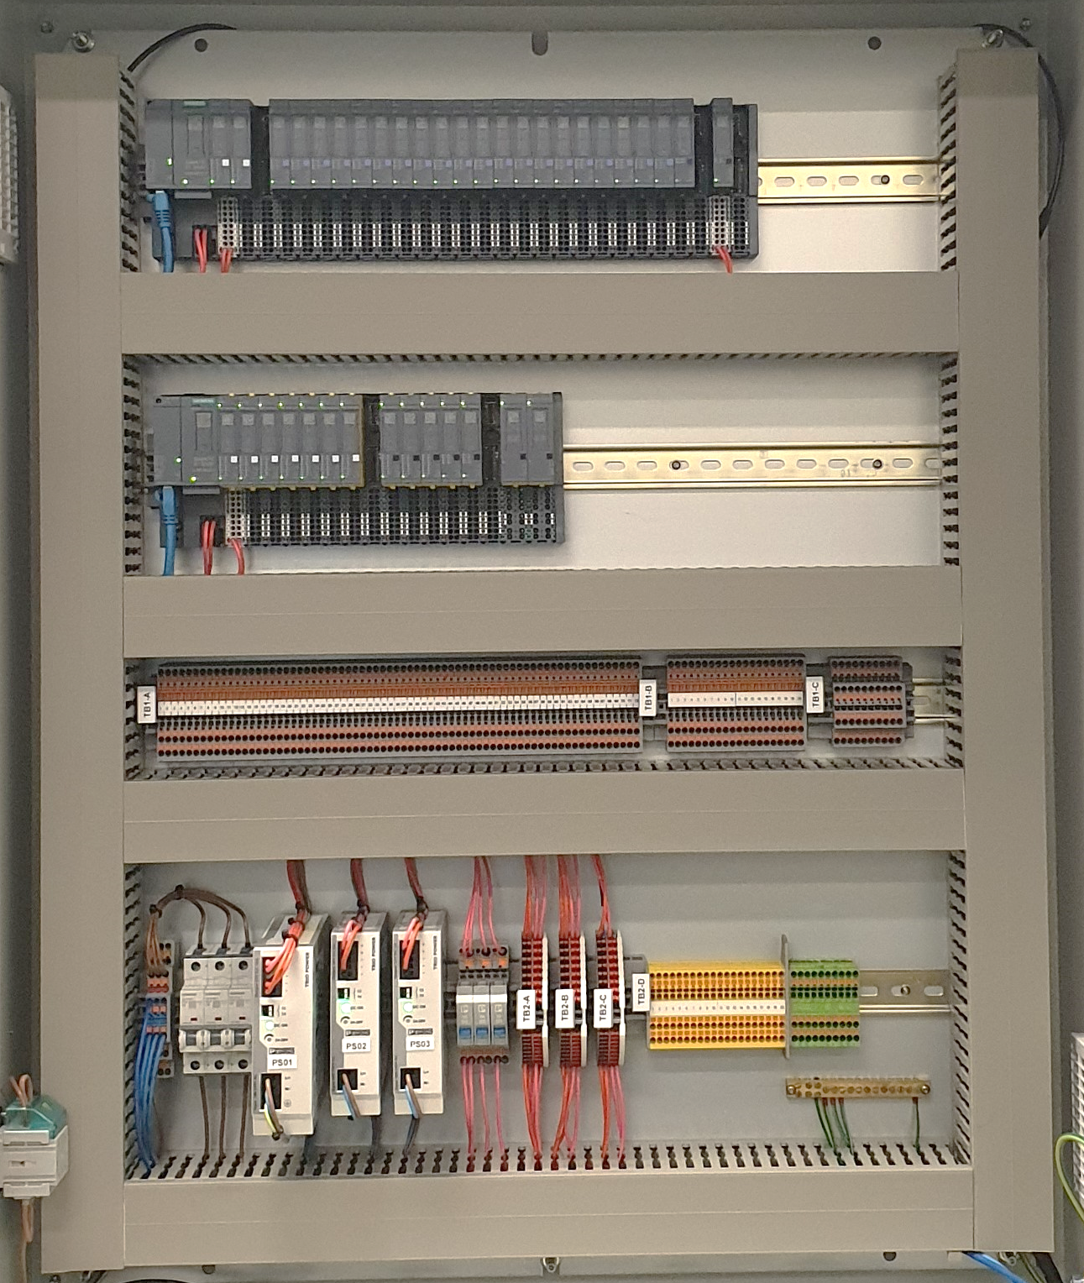
Bright Beamlines EPS/PSS
CPU Cabinet
Remote I/O Cabinet
Notes:
Simulation Server
▪ Multi-PLC emulation via Siemens PLC-SIM Advanced
▪ HMI display and control via Siemens WinCC Runtime Advanced
▪ PLC monitoring and programming environment via Siemens STEP 7 Professional
▪ Dual monitors to enable concurrent viewing of STEP 7 and WinCC HMI
Simulation Client:
Plant floor device simulation (e.g. E/Stop buttons, Gate switches, Search & Secure buttons, isolation contactors, indicator lights, etc) is provided via Siemens SIMIT Professional v9.1 (or v10). These will be displayed as a graphical environment to provide intuitive navigation and control of the simulation environment.

Slide 7
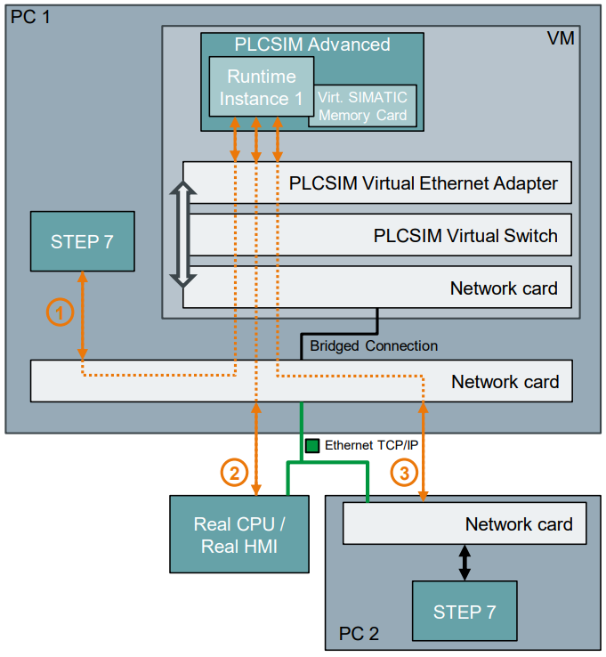
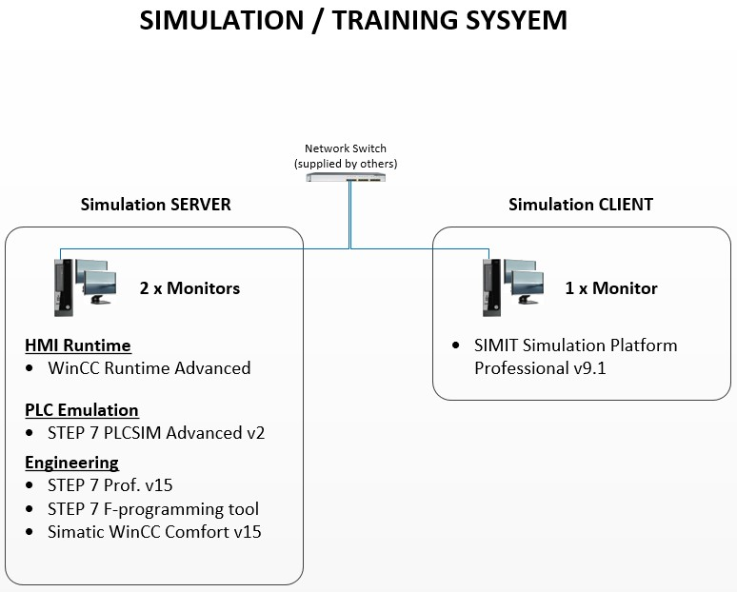
Simulation Platform
SIMIT simulation platform from SIEMENS with connectivity coupler to PLCSIM Advanced
PLCSIM Advanced can create virtual controllers for simulation of S7-1500 or ET200SP CPUs.
The simulated process image can be manipulated through APIs or simulation software such as SIMIT.
Capable of simulating S7-1500F systems with Standard and Fail-safe local and remote I/O
Notes:
Simulation Server
▪ Multi-PLC emulation via Siemens PLC-SIM Advanced
▪ HMI display and control via Siemens WinCC Runtime Advanced
▪ PLC monitoring and programming environment via Siemens STEP 7 Professional
▪ Dual monitors to enable concurrent viewing of STEP 7 and WinCC HMI
Simulation Client:
Plant floor device simulation (e.g. E/Stop buttons, Gate switches, Search & Secure buttons, isolation contactors, indicator lights, etc) is provided via Siemens SIMIT Professional v9.1 (or v10). These will be displayed as a graphical environment to provide intuitive navigation and control of the simulation environment.

Slide 8
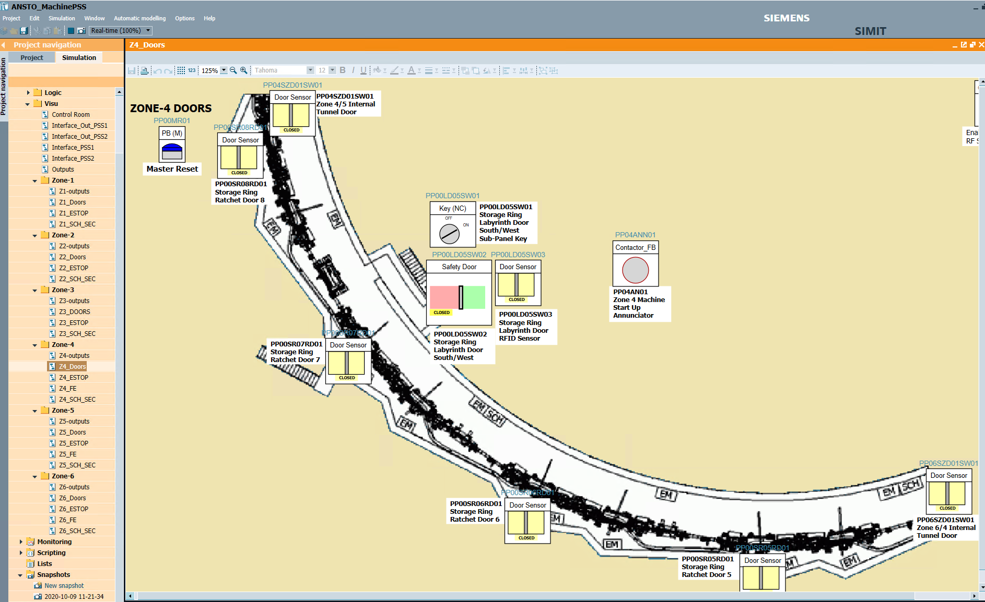
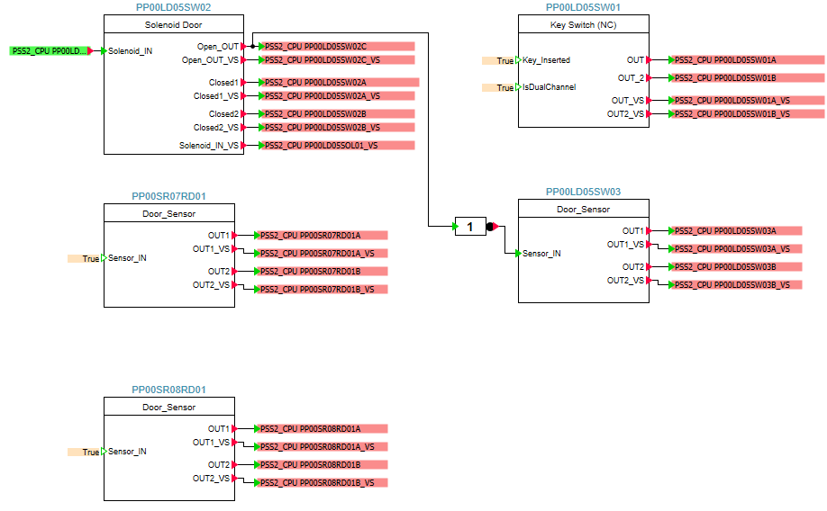
SIMIT Simulation Software
SIMIT simulation software for virtual commissioning and operator training
Coupling to real Simatic PLCs or emulated PLCs (e.g. using PLCSIM Advanced)
VISU module for visualising simulated plant environment
Logic module for developing simulated plant behaviour
Notes:
Simulation Server
▪ Multi-PLC emulation via Siemens PLC-SIM Advanced
▪ HMI display and control via Siemens WinCC Runtime Advanced
▪ PLC monitoring and programming environment via Siemens STEP 7 Professional
▪ Dual monitors to enable concurrent viewing of STEP 7 and WinCC HMI
Simulation Client:
Plant floor device simulation (e.g. E/Stop buttons, Gate switches, Search & Secure buttons, isolation contactors, indicator lights, etc) is provided via Siemens SIMIT Professional v9.1 (or v10). These will be displayed as a graphical environment to provide intuitive navigation and control of the simulation environment.

Slide 9


PLC/EPICS Communication via OPC UA
OPC UA (Open Platform Communications – Unified Architecture)
Vendor-independent and platform-neutral
Secured communication directly in the protocol with no additional hardware
Simple Ethernet-based networking, uses existing Industrial Ethernet infrastructure
High performance thanks to fast communication
OPC UA support has been developed within EPICS community

Slide 10
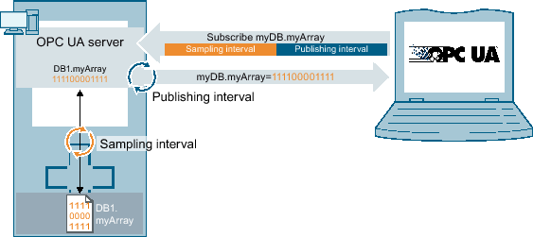
PLC/EPICS Communication via OPC UA
Embedded OPC UA server on S7-1500 PLCs
Support in TIA Portal without programming
Symbolic addressing allows adding data points to the interface with minimum effort
Wide range of standard and user-defined data types
Server and device timestamps available
Fast scanning/publishing interval as low as 10ms (1517/1518 CPUs)
Data exchange via polling or subscription
Notes:
1-A licence is required depending on size of the CPU
2-Enable the OPC UA by selecting a licence option
3-Especially when combined with UDF, e.g. a valve data template could be defined based on PLC valve UDF, every time a valve is added just the valve name needs to be shared with EPICS support.
7-Client subscribes to a selection of nodes and lets the server monitor these items. In case of changes the client is notified. This mechanism greatly reduces the amount of transferred data and is the recommended mechanism to “read” information from a UA Server.

Slide 11
Thank you

