Slide 1
PV Archiving at the Australian Synchrotron
Andraz Pozar
ATF Controls Meeting - 30/10/2020

Slide 2
Agenda
Previous Archiving Paradigm
  Room for improvement
Archiver Appliance
  Quick presentation of features
  Setup at the AS
Archiving Paradigm
  Overview of the new process
Questions

Slide 3
Previous Archiving Paradigm

Slide 4
Previous Archiving Paradigm
2 Channel Access Archivers
  8 beamlines
  the machine
Manual maintenance of XML archiving configuration files
Archiver engines pick up the changes once a day, around 12.30AM

Slide 5
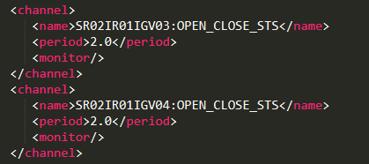
Room for Improvement
Too much input from the controls engineers is required:
  Each new PV required 5 lines to be added to the configuration file
  Do we even want it archived? How?
This leads to:
  Only the bare minimum of PVs being archived
  No longer existing PVs don’t usually get removed from the configuration file

Slide 6
Room for Improvement
Only data for a certain amount of time can be retrieved due to the way reindexing works.
No support for PV Access
With only one host, there is a single point of failure
No one, except for possibly Andy, really understands how the hell CA Archiver actually works
With the new beamlines on the horizon, adding thousands of new PVs into a file seems like a tedious task

Slide 7
Archiver Appliance (AA)

Slide 8
AA – Sales Pitch
Developed at SLAC to be able to archive millions of PVs
Support for PV access
Support for easy scaling
Focused on fast retrieval of data in many formats
Management access through scripting
Webpage for administration and viewing of data
Integration of old CA Archivers for old data

Slide 9
AA – Storage
The storage is temporally divided in three parts:
  STS – Short Term Storage
  MTS – Medium Term Storage
  LTS – Long Term Storage
These storages can be anything (RAM, SSD, network drive, ...)
This separation is hidden from the user

Slide 10
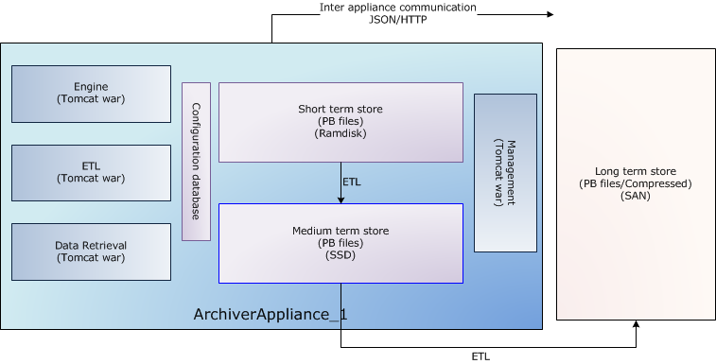
AA – Single Appliance Architecture
Four Tomcat containers per appliance:
  Mgmt – website and business logic
  Engine – actual data collection and archiving
  ETL – moving the data between different storages
  Retrieval – serving data to clients
MySQL database:
  Holds some basic archiving config
ProtocolBuffers for storage:
  Data is saved as binary files using
  Google’s ProtocolBuffers

Slide 11
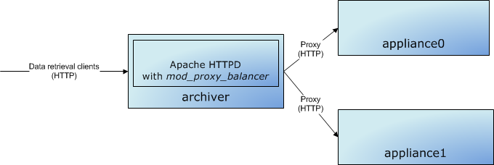
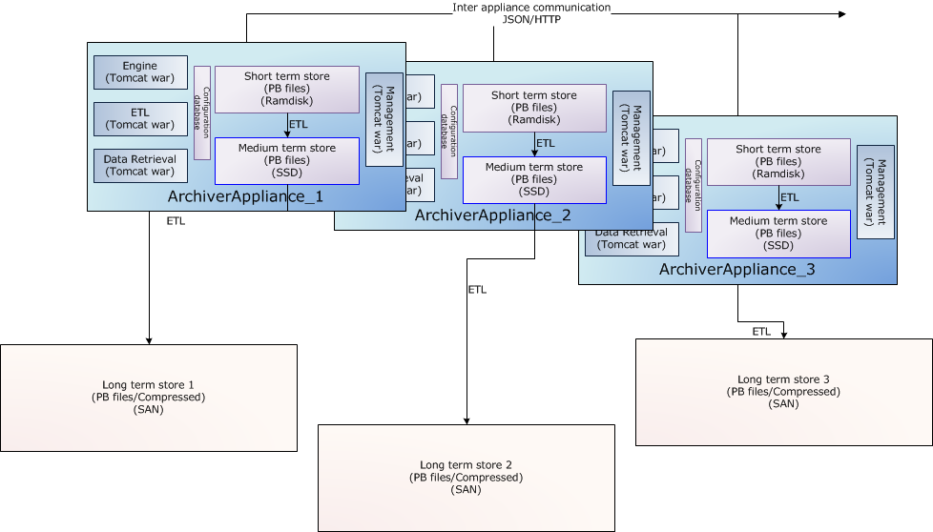
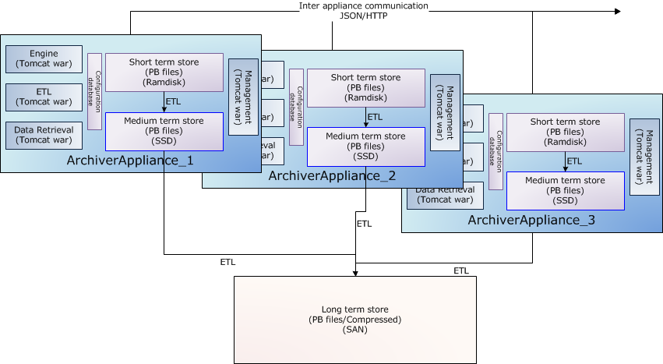
AA – Clustering

Slide 12
AA – Data Retrieval
Data is retrieved via HTTP as:
  JSON
  CSV
  MAT
  RAW
  TXT
  SVG
Post processing can be requested when requesting the data: mean, min, median, plot binning, every n-th value, ...

Slide 13
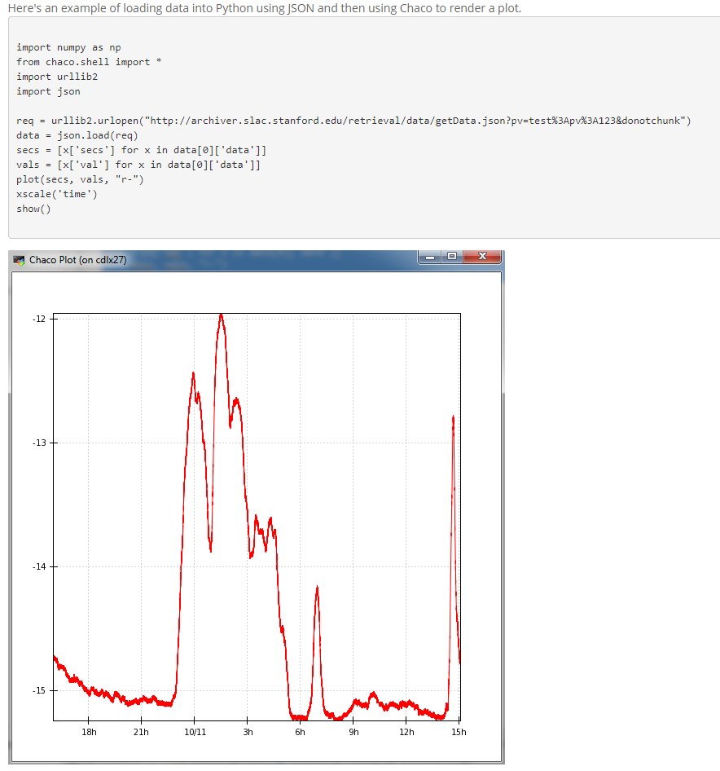
AA – Data Retrieval

Slide 14
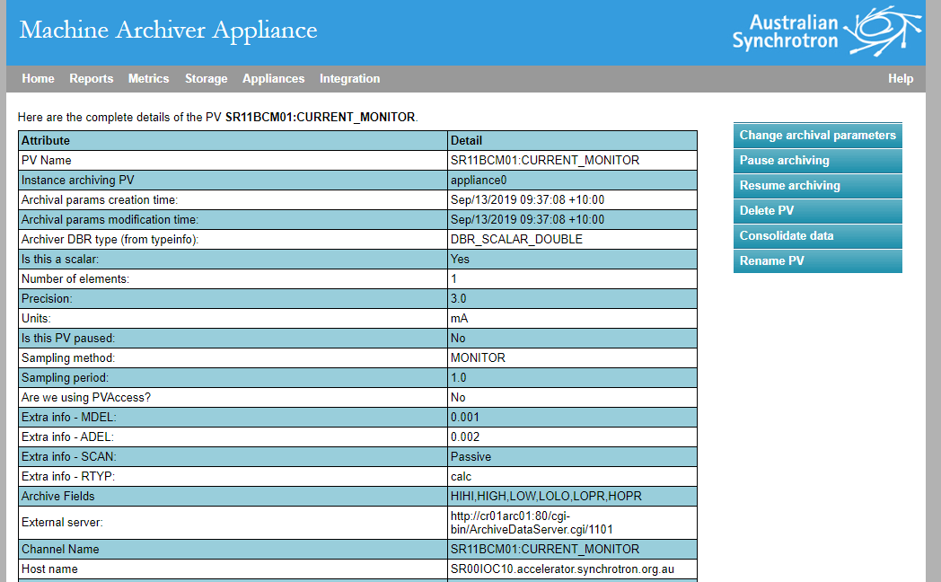
AA – Admin Webpage
Add/modify/pause/resume/delete/rename PVs

Slide 15
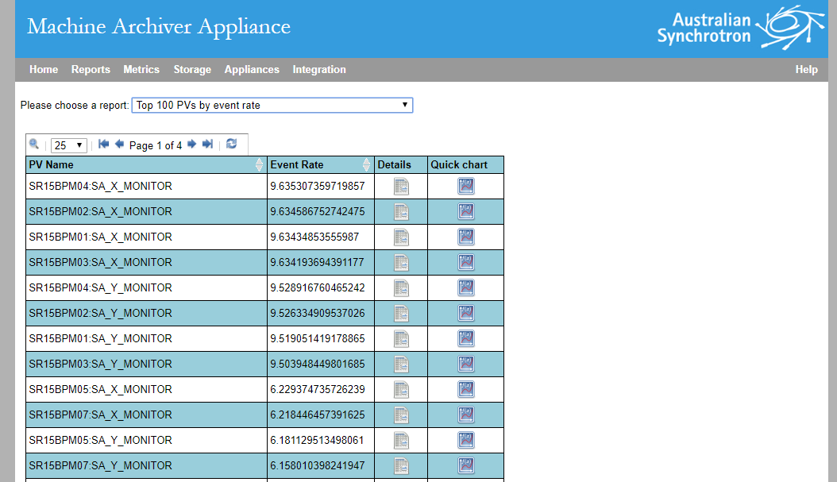
AA – Admin Webpage
Get reports about PVs with highest data rate, highest event rate, disconnected, ...

Slide 16
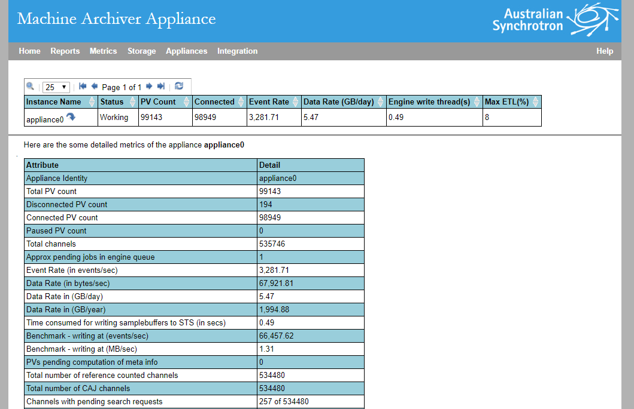
AA – Admin Webpage
Get AA metrics

Slide 17
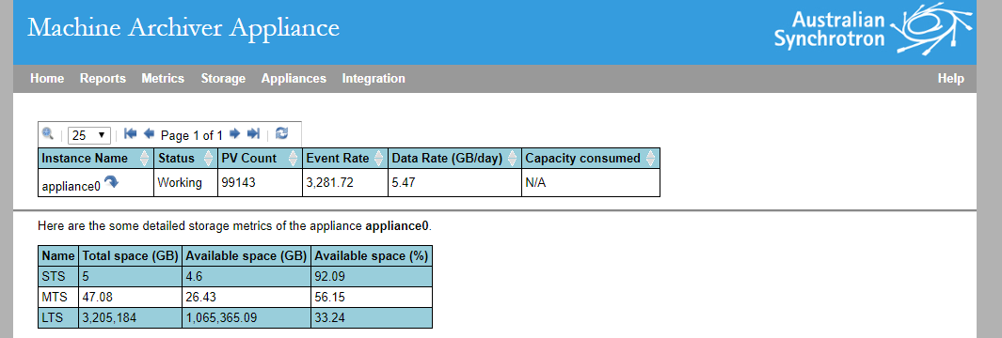
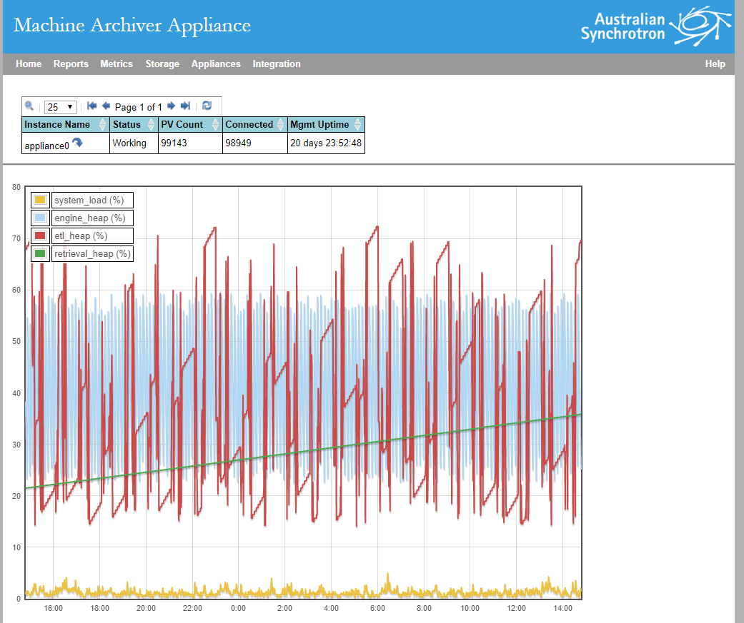
AA – Admin Webpage
Storage information
Tomcat containers info

Slide 18
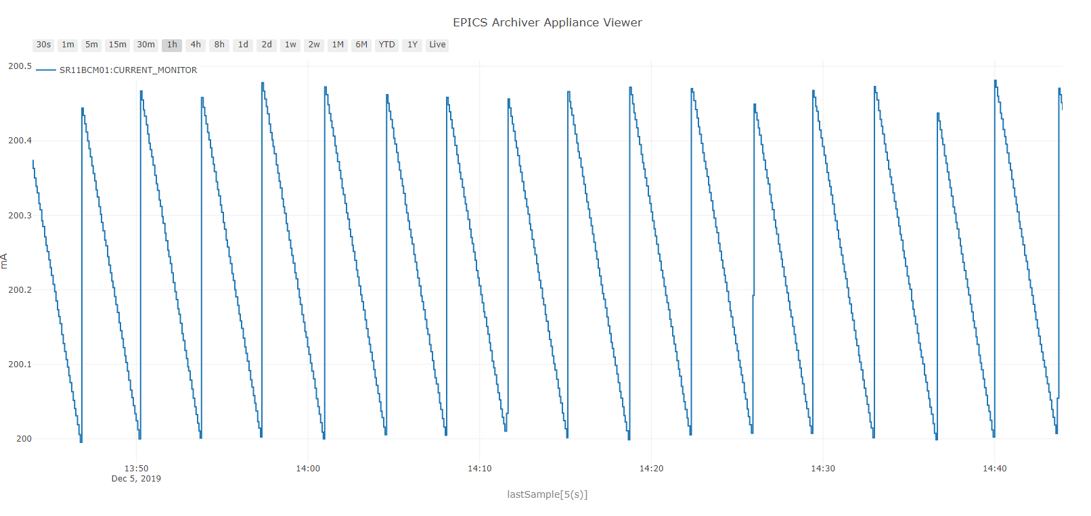
AA – Data Viewer

Slide 19
AA at the AS
No clustering for now as we’re not archiving that many PVs
One AA per operational area
Storage
  STS – Ramdisk – 4 hour of the latest data
  MTS – Local disk – the next 7 days
  LTS – ASSAN03 – data older than what’s in MTS
AA Clients
  In house developed EPICS Qt

Slide 20
Ownership
Infrastructure: Accelerator Controls and Support Systems group
  Setup
  Updates
  Maintenance
  Possible re-scaling
  Parameter tweaking
What is archived and how: Controls engineers and beamline staff
  Whitelist and blacklist
  Making sure host environments are setup correctly to sync the dbl files

Slide 21
AS Archiving Paradigm

Slide 22
New Archiving Paradigm
Goals
  To automatically archive a vast majority (there is some filtering) of live PVs with minimal human interaction
  To automatically pause PV archiving if the PV hasn’t been live for a certain time and resume when it comes back to life
  To give users the ability to override archiving parameters, exclude PVs from being automatically archived, archive PVs even if automatic archiving filters them out

Slide 23
New Archiving Paradigm – Adding PVs
IOC hosts side:
  A cron job, running every 30 minutes which will run a script that syncs all dbl files of IOCs that are currently running on that host to the destination directory
Archiver side:
  A cron job, running every 30 minutes which will run a script which
    takes all dbl files
    gets PVs from them
    finds the ones that are not yet archived
    applies a few filters and restrictions
    adds the PVs that have remained to the archiver with a default archiving period and archiving method

Slide 24
New Archiving Paradigm – Filter
We won’t automatically archive records of the following types:
  fanout
  event
  compress
  seq
  sseq
  stat
  stringin
  stringout
  scan
  sscan
  libera
  liberaSignal
  compress
  waveform
  concat
  mca
  aai
  aao

Slide 25
New Archiving Paradigm - Blacklist
You can pass a path to a blacklist to the script that adds new PVs in which you define which PVs SHOULDN’T get automatically archived. Regular expressions are supported
Machine blacklist:
# Fill pattern monitoring
#
@SR07BM01FPM01:FILL_PATTERN_ELEMENT_[0-9]*_EXTRACT
# FOFB
@SR00FPGA01:._CTRL_PARAM_.._EXTRACT
# Booter Ring Libera Electron.
#
@BR01BPM[0-9][0-9]:SA_[X-Y]_EXTRACT
# Injection system ramping magnets
#
@PS-.*:RAMP_GAIN_EXTRACT
@PS-.*:NMB_ENTRY_EXTRACT
# Dimtel Bunch by Bunch
#
@IGPF:[XYZ]:MAX1202:CH[0-7]_EXTRACT
@IGPF:[XYZ]:FREQ_CNT:RAW:CH[0-4]

Slide 26
New Archiving Paradigm - Whitelist
You can pass a path to a whitelist to the script that adds new PVs in which you define which PVs SHOULD get automatically archived. This overrides the filter and blacklist. Regular expressions are supported
You can also use this file to define different from default archiving period and method
# PV or regular expression METHOD[SCAN, MONITOR] PERIOD
#
SR11BCM01:CURRENT_MONITOR SCAN 0.1
@SR[01][0-9]BPM0[1-7]:SA_[XY]_MONITOR MONITOR 0.05
# end

Slide 27
New Archiving Paradigm – Pause/Resume
Host side:
  Nothing
Archiver side:
  Pause:
    A cron job running once a day which will get a list of all currently disconnected PVs and pause the ones that have been disconnected for more that a certain amount of days
  Resume:
    A cron job running every 30 minutes which will get a list of all currently paused PVs and resume them if they are currently live

Slide 28
New Archiving Paradigm – Host Setup
cron should be installed
Every IOC should have the directive that dumps the dbl command output into a file in the standard location. If using bluecat, you get that for free
/controls_sw/tools/integ_scripts should be on ics user’s path
Ideally /san_data/controls/sw/opa/<your_opa> should be mounted but that’s not a show stopper

Slide 29
Questions?

