Slide 1
Platform Management at the AS
Andraz Pozar 30/10/2020

Slide 2
Platform Management Mission - What
Develop standards so that the majority of hosts have will the same:
  operating system;
  minimal software packages installed;
  consistent naming convention;
  directory structure;
  backup strategy; and
  diagnostics capabilities.

Slide 3
Platform Management Mission - How
Develop tools that will streamline new host creation
and configuration, and ensure that standards are implemented.

Slide 4
Desired Outcomes
Quick host setup
  Users shouldn’t worry about disk partitioning, file systems, which software to install, ...
Everything works out of the box
Same look and feel on most of the hosts - any controls engineer can work on any host

Slide 5
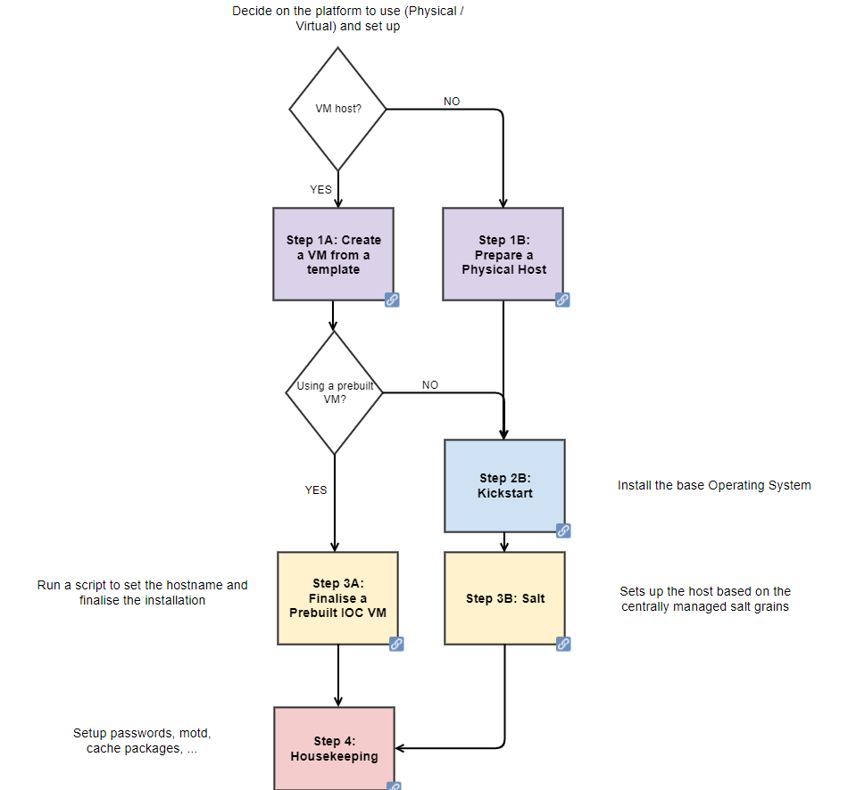
Quick Host Setup

Slide 6
Quick Host Setup

Slide 7
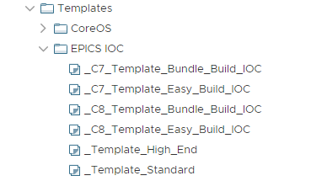
Quick Host Setup - VM From a Template
vSphere for virtualization
Templates:
  Clean VM templates (HW config only)
  Pre-built VM templates (OS and software installed)
Pre-built templates
Clean templates

Slide 8
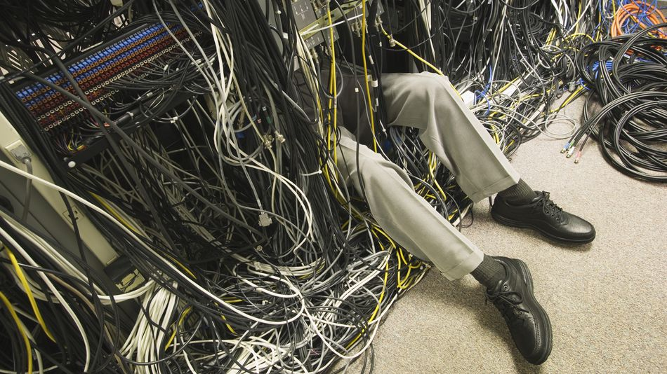
Quick Host Setup – Physical Host
Get a screen, keyboard, mouse
Connect to the network
Enable ‘boot from the network’

Slide 9
Quick Host Setup

Slide 10
Quickish Host Setup – The Slow Route
Clone a VM (6 minutes) or power up a physical host
Run kickstart which installs the OS and prepares some files
(12 minutes on a VM)
Run a script that installs and sets up everything (20 minutes)
Total time: 38 minutes (not amazing)

Slide 11
Quick Host Setup

Slide 12
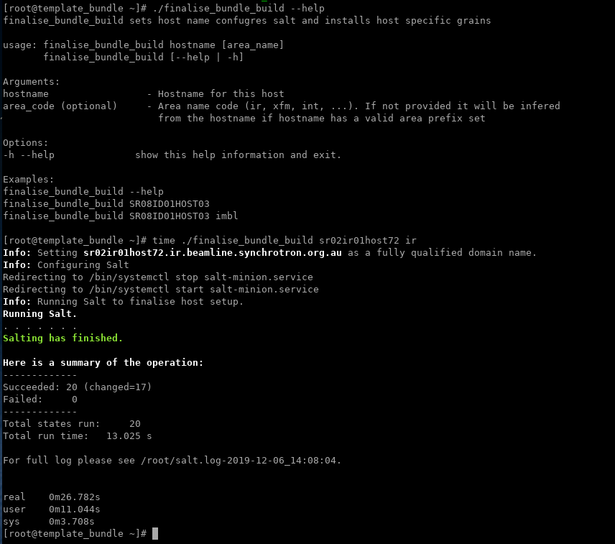
Quick Host Setup - Finalise the Build

Slide 13
Quick Host Setup – Pre-built VM Templates
Clone a VM (6 minutes)
Run a script that sets up hostname, configures salt and runs salt (30 seconds)
Total: 6 minutes 30 seconds

Slide 14
Quick Host Setup

Slide 15
Quick Host Setup - Housekeeping
Set new passwords
Update message of the day (MOTD)
Cache the bundle to disk

Slide 16
What Do You Get? - Software
NTP
NFS
autofs
Users
Updated sudoers file
VMware tools if this is a VM
Python and pip 3.5 or 3.8, pyepics, virtualenv, click, jinja2
XWindow server, KDE, GNOME, Firefox, Sublime Text, Atom
autofs configuration to mount controls software
script that sets lots of environment variables
LDAP authentication
Zabbix
Perforce
Development tools (GCC, make, binutils, …)
Some cronjobs – autosave file backups, archiving support
Miscellaneous packages (vim, rsync, net-tools, telnet, …)

Slide 17
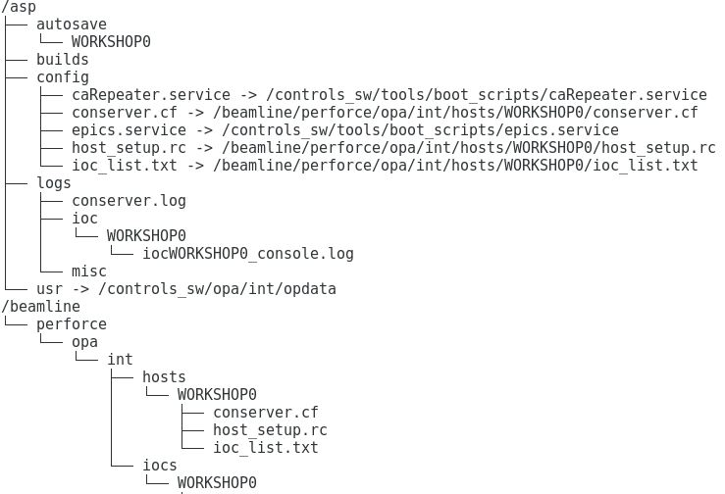
What Do You Get? – Directory Structure
Host specific configuration
Submit to Perforce and label
IOCs

Slide 18
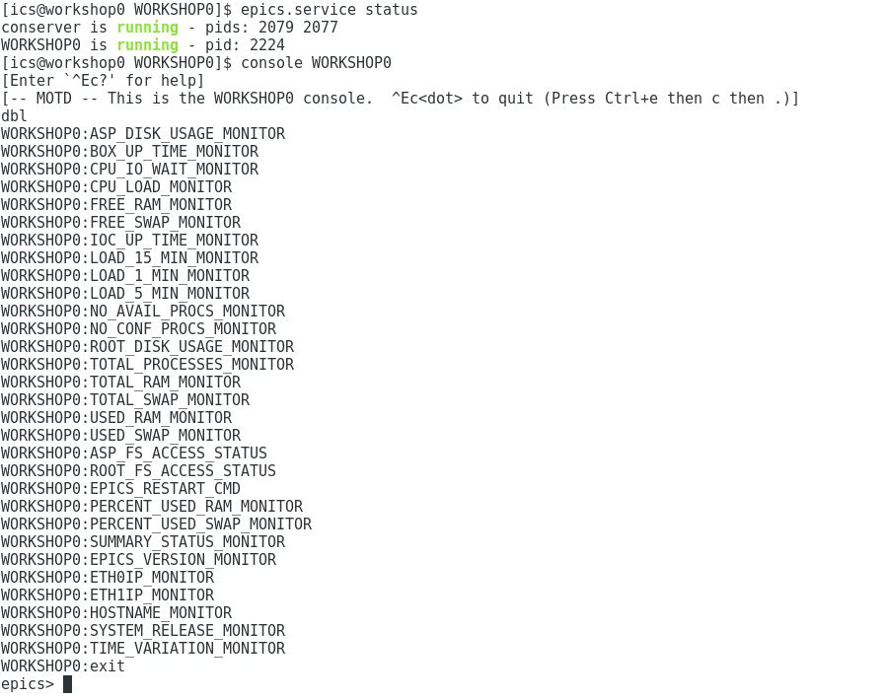
What Do You Get? – A Status IOC

Slide 19
Platform Management Mission - What
Develop standards so that the majority of hosts have will the same:
  operating system;
  minimal software packages installed;
  consistent naming convention;
  directory structure;
  backup strategy; and
  diagnostics capabilities.

Slide 20
Questions?

