Slide 1
CAS Future Controls Direction and Development
Upgrades and Introduction of New Infrastructure
Presented on Behalf of CAS-ASD
David Button dbu@ansto.gov.au

Slide 2
Opportunities for improvement
Cyber Security
Network architecture
Virtualization of hardware
Upgrade of ANTARES control system
ANTARES control room redevelopment
Unification of VEGA & SIRIUS into EPICS system
Archiving
Templates
Technical staff engagement
Development Platforms

Slide 3

Cyber Security
Review
Recognise that our existing flat broadcast domain for our controls issue
  Other systems on the same subnet impact on our overall security
Need to improve on access control
Improved engagement with IT, to assist with reviewing

Slide 4
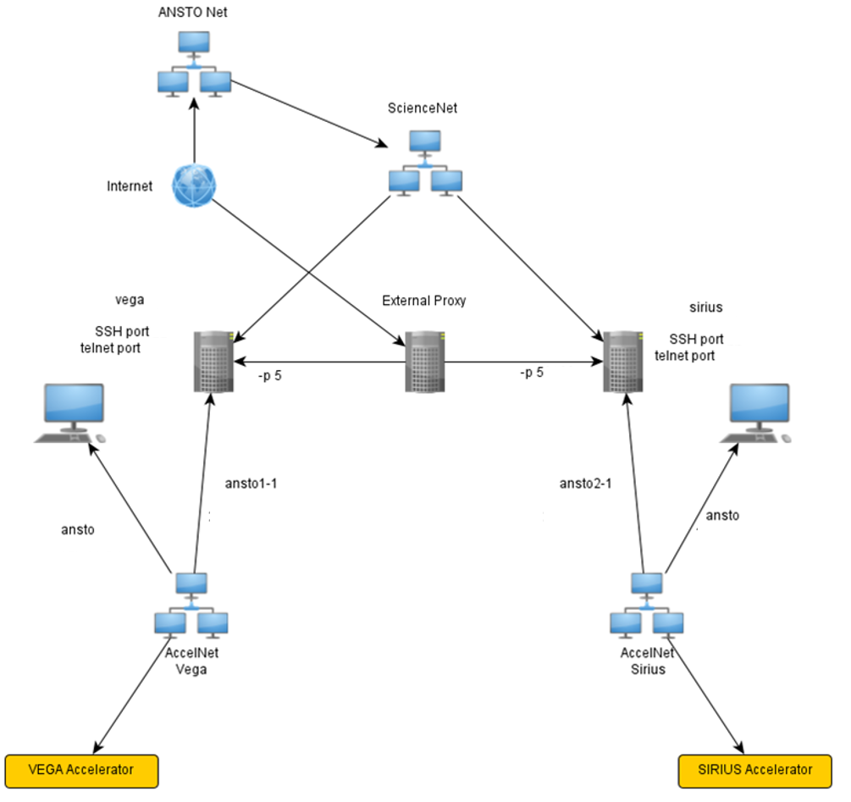
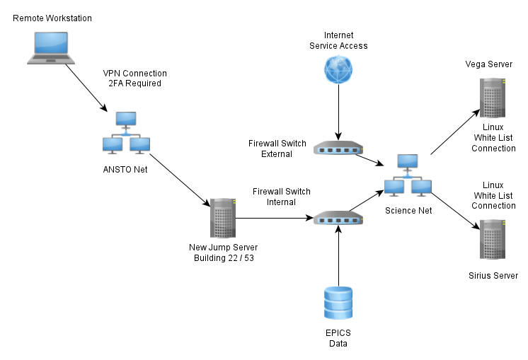
Cyber Security
Remote Access
Current Access
Next step

Slide 5




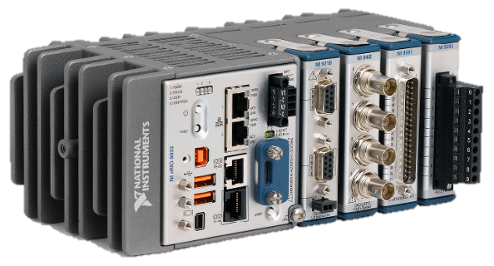

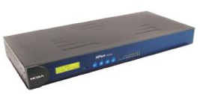
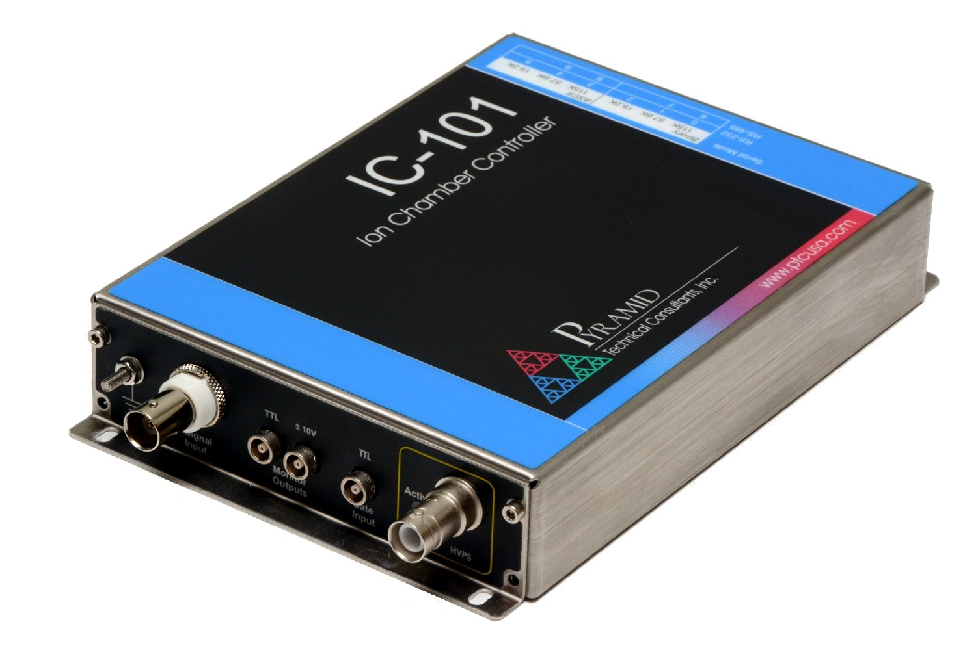
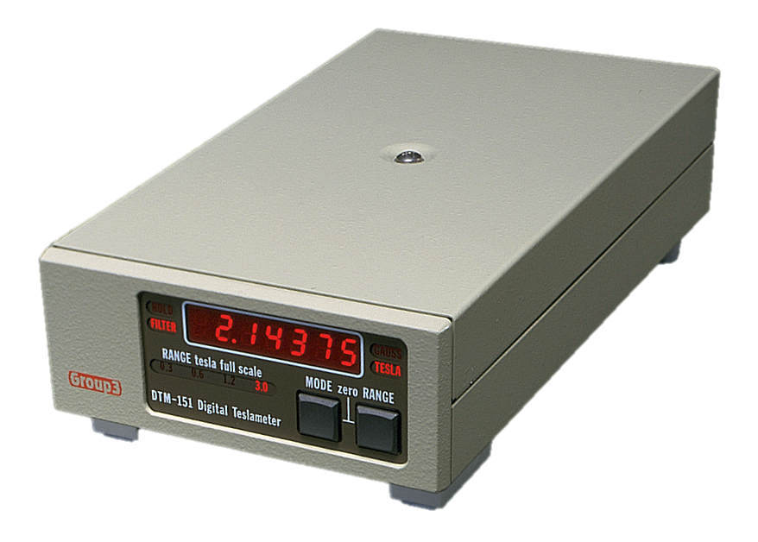
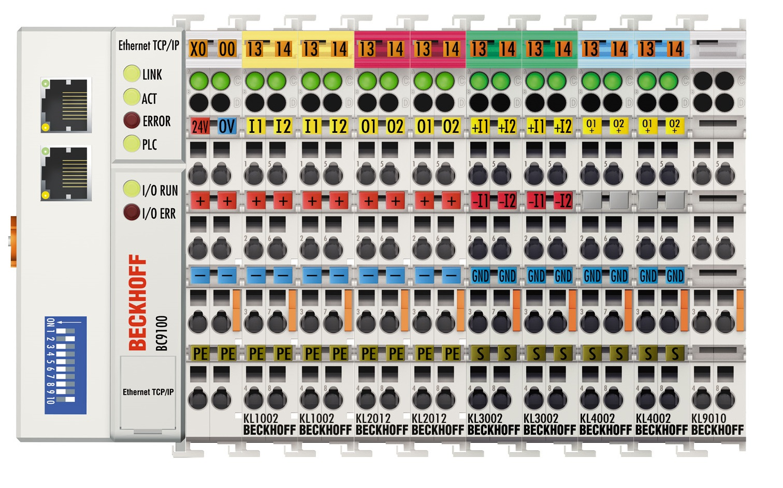
Network architecture
AnstoNet
Science Net
i
Control Desk

Slide 6
Virtualization of hardware
Intel 2RU Server Chassis - including: 2 x Gold 5118 12 core 2.3Ghz, 128GB 1 RAM, 2x 1.9TB S4510 NVMe, Full Hardware RAID with 1GB Cache, Redundant Power Supplies, Remote MGMT, 2 x 10GbE, Rail Kit,
IOC | Facility | Process Manager | Current Host | Description | Proposed location | Notes
antDailyLog | ANTARES | screen | antcont | Sign on screen system for ANTARES | Virtual | Does not connect to hardware on antcont
ExBPS | ANTARES | screen | antcont | ExB Power Supply (55deg Beamline) | Virtual | Does not connect to hardware on antcont
actMagField | ANTARES | screen | antcont | Atnitites Magnet Control | Virtual | Does not connect to hardware on antcont
switchMagField | ANTARES | screen | antcont | Switch Magnet Control | Virtual | Does not connect to hardware on antcont
analysingMagField | ANTARES | screen | antcont | Analysing Magnetic Control | Virtual | Does not connect to hardware on antcont
analysingMagPS | ANTARES | screen | antcont | Analysing Magnet Power Supply | Virtual | Does not connect to hardware on antcont
injMagPS | ANTARES | screen | antcont | Injectrion Magnet Power Supply | Virtual | Does not connect to hardware on antcont
injMagField | ANTARES | screen | antcont | Injection Magnet Control | Virtual | Does not connect to hardware on antcont
combinedMagPS | ANTARES | screen | antcont | 55deg + Switch Magnet Power Supply | Virtual | Does not connect to hardware on antcont
beta | ANTARES | screen | antcont | General Control High Energy Area
alpha | ANTARES | screen | antcont | General Low Energy Control
gfm | ANTARES | procServ | antcont | Gas Filled Magnet Beamline Control
sampleChanger | ANTARES | procServ | antcont | 846 Ion Source Control
vacuumGauge | ANTARES | procServ | antcont | Low Energy Vacuum | Virtual | Does not connect to hardware on antcont
massSpecScan | ANTARES | procServ | antcont | Mass Spectrum Scan for 846 Ion Source (AMS) | Virtual | Does not connect to hardware on antcont
softTask | ANTARES | procServ | antcont | Redundant - old terminal read averaging |  | Delete
ANTARES High Energy | ANTARES |  | ANTARES-SCADA | Runs high enegry, 1 vacuum guage | Virtual
ANTARES Terminal | ANTARES |  | ANTARES-SCADA | ANTARES Stripper control | Virtual
SF6 Monitoring | Gas Plant |  | ANTARES-SCADA | Monitors SF6 stock qantaty | Virtual
ANTARES HVG | ANTARES |  | ANTARES-SCADA | ANTARES High Voltage Poterntial Stabaliser Control | Virtual
ANTARES GFM | ANTARES |  | ANTARES-SCADA |  | Virtual
ANTARES Low Energy | ANTARES |  | ANTARES-SCADA | Currently running 3 power supplies, steering | Virtual
ANTARES Main (looks at PLC status) | ANTARES |  | ANTARES-SCADA | Internal PLC Monitoring | Virtual
STAR ACCEL | STAR |  | ANTARES-SCADA | SF6 Monitoring currently | Virtual
STAR Main | STAR |  | ANTARES-SCADA | Internal PLC monitoring | Virtual
VEGA ACCEL | VEGA |  | ANTARES-SCADA | SF6 Monitoring currently, and interlocking pressure and temp | Virtual
VEGA Main | VEGA |  | ANTARES-SCADA | Internal PLC Monitoring | Virtual
scanner |  | procServ | aecm | ? | Virtual ?? | What does this do?
aecm |  | procServ | aecm | ANTARES Either Cat Master |  | Remove. All IO to be moved to new ANTARES Beckhoff PLC.
AccelNetConnect | SIRIUS + VEGA | procServ | rho | Tag to PV gateway | Virtual
starZeroIOC | STAR | procServ | rho | Redundant - Monitor Magnets and Oxygen on STAR |  | Remove
starLowEnergyGa | STAR | procServ | rho | Low Energy Gamma Monitor | Virtual | Combine into 1 IOC for STAR radiation
starHighEnergyG | STAR | procServ | rho | High Energy Gmma Monitor | Virtual | Combine into 1 IOC for STAR radiation
starSwitchMagGa | STAR | procServ | rho | Switch Magnet Gamma Monitor | Virtual | Combine into 1 IOC for STAR radiation
starDailyLog | STAR | procServ | rho | STAR Usage Logging System | Virtual
starSwitchMagFi | STAR | procServ | rho | Redundant - Switch magnety magnetic field readback |  | Remove - Not required
nec1MVDailyLog | VEGA | procServ | rho | Vega Usage Logging System | Virtual
starRecombMagFi | STAR | procServ | rho | Redundant - |  | Remove - Not required
siriusRadMon | SIRIUS | procServ | rho | SIRIUS - All gamma monitors | Virtual
siriusDailyLog | SIRIUS | procServ | rho | Sign on screen system for SIRIUS | Virtual

Slide 7
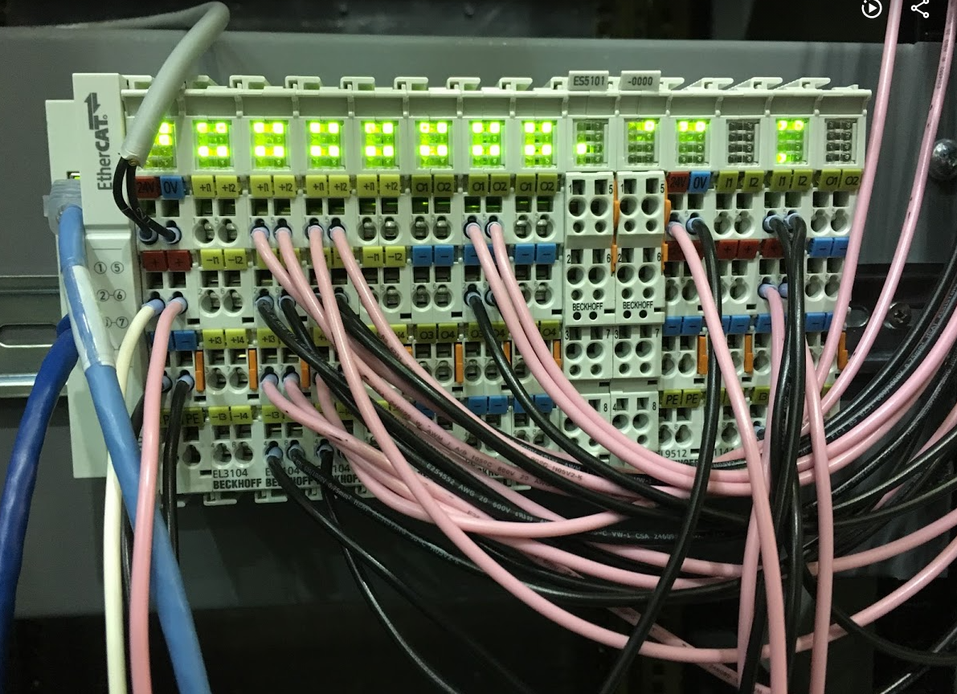
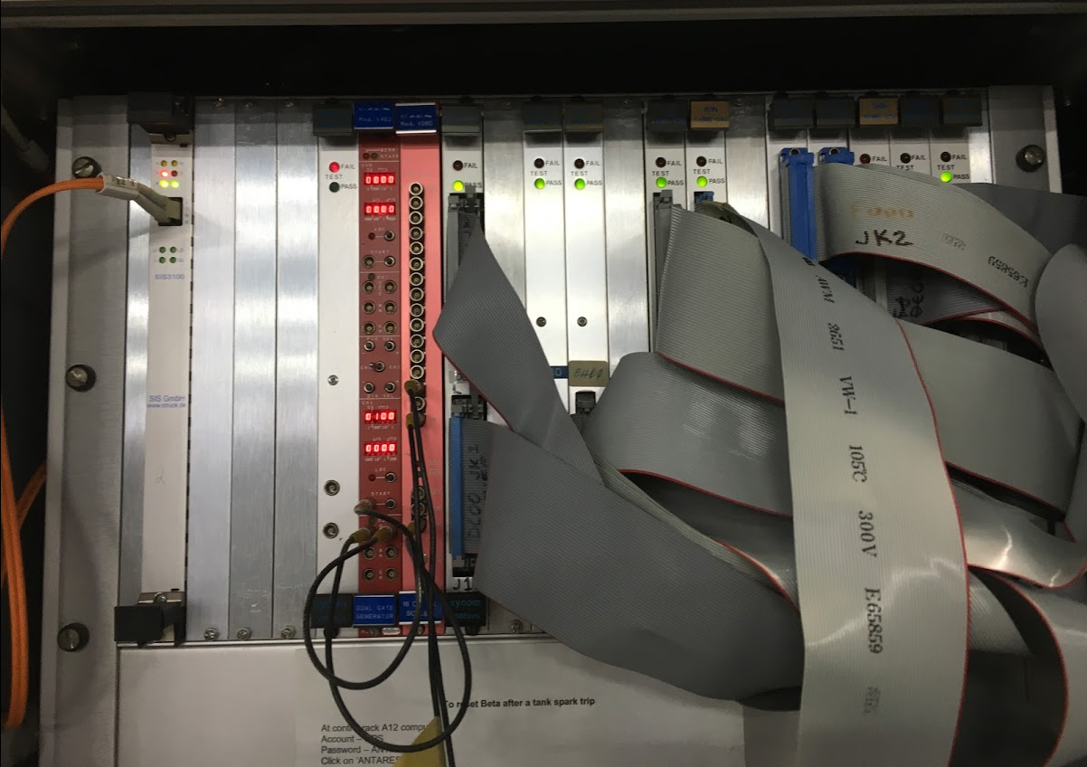
Upgrade of ANTARES control system

Slide 8
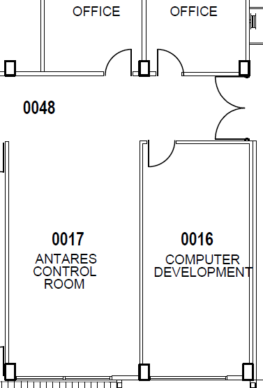
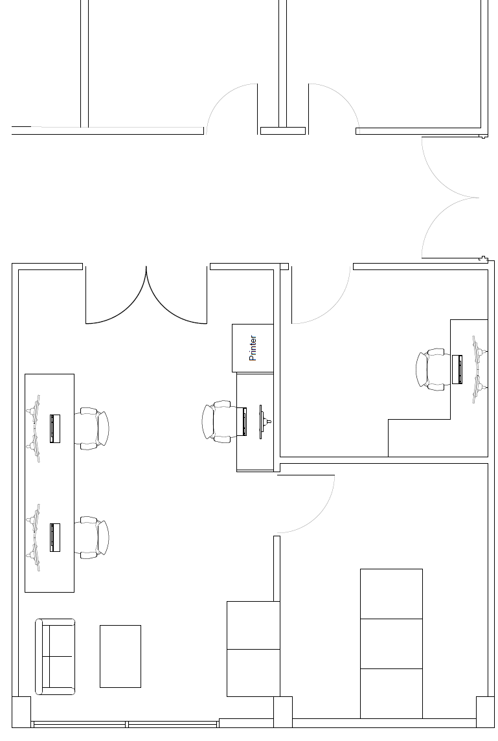
ANTARES control room redevelopment

Slide 9
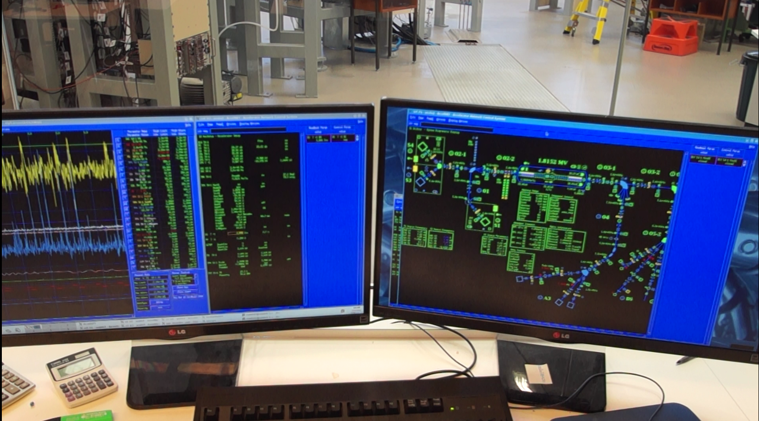
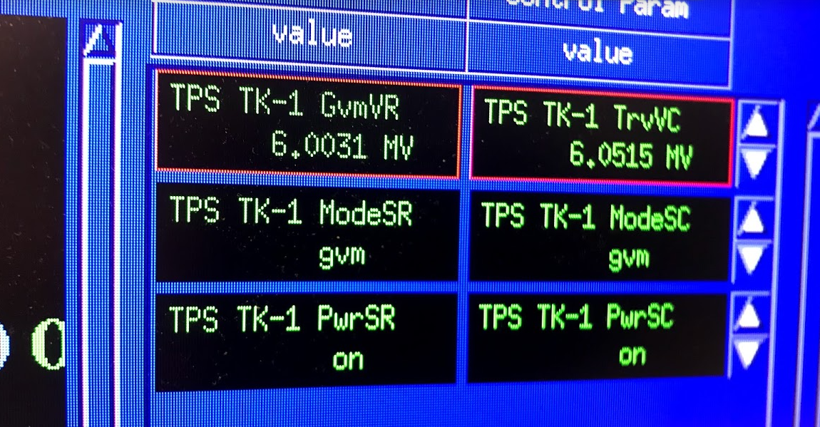
Unification of VEGA & SIRIUS into EPICS system
AccelNet Tag <> EPICS PV

Slide 10
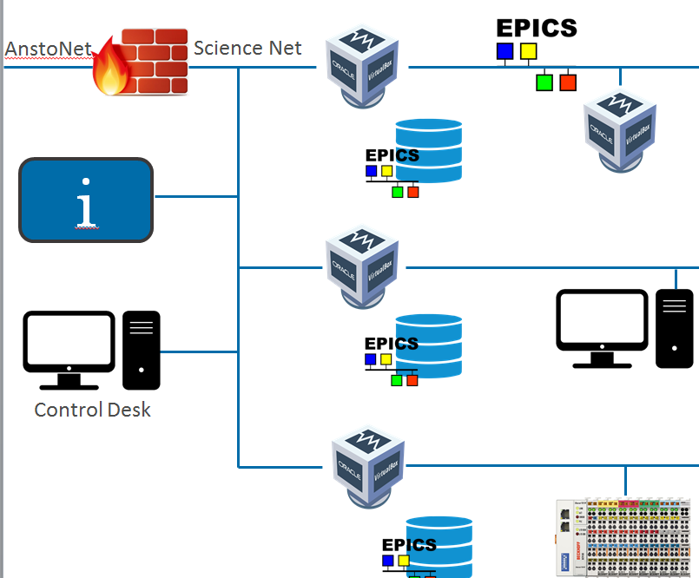
Archiving
Automation of archiving up keep, and PV ledger

Slide 11
Templates
Vacuum
Code | Description
VBG | Baratron Gauge
BLV | Beamline Gate Valve
CCG | Cold Cathode Gauge
CP | Cryogenic Pump
FLP | Foreline Pump
FLV | Foreline Valve
IGC | Ionization Gauge Cathode
MV | Mass Flow Valve
NRV | Non Return Valve
PGV | Pumping Gate Valve
RLP | Roughing Line Pump
More “caned” solution for systems
Objects which just need configuration such as standard vacuum management system

Slide 12

Technical staff engagement
We want to see wider training in controls within our group
Continue reviewing and building local standards
Greater engagement with local community
  More buddies and other facilities ☺

Slide 13
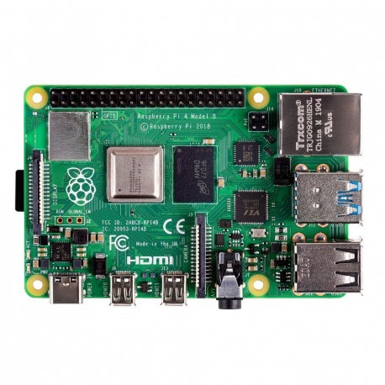
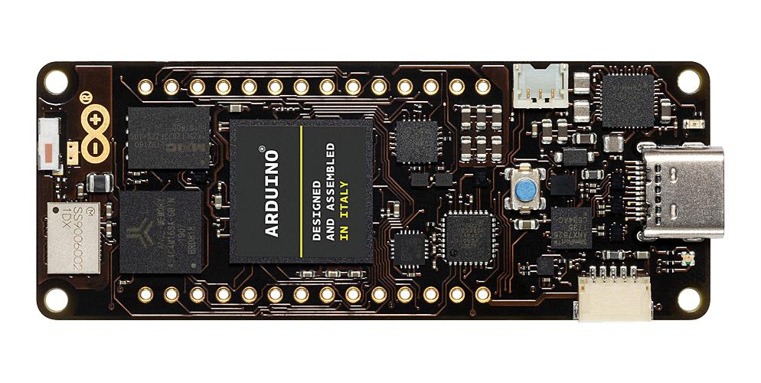
Development Platforms
Raspberry Pi 4
Arduino, Portenta H7 Module Microcontroller
PH7 has two processors in one, run parallel tasks in different languages

Slide 14
Thank you

