Slide 1
Accelerate Scientific Computations with FPGA
Simin Chen
30/Oct/2020
Notes:
Traditional processors are hitting the clock frequency limit and thus, future significant increases in performance must come from parallel computations. FPGA has been shown to have the potential to speedup highly parallel applications. In addition, recent semiconductor technology provides sufficient FPGA resources to tackle scientific applications on large-scale parallel systems.

Slide 2
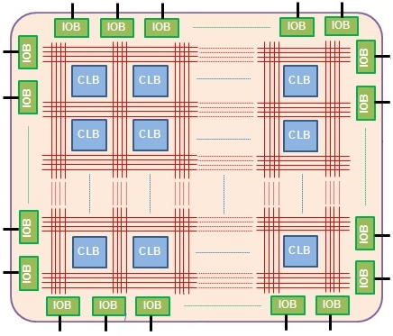
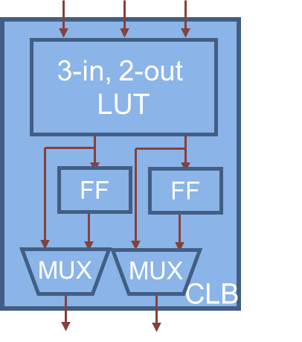
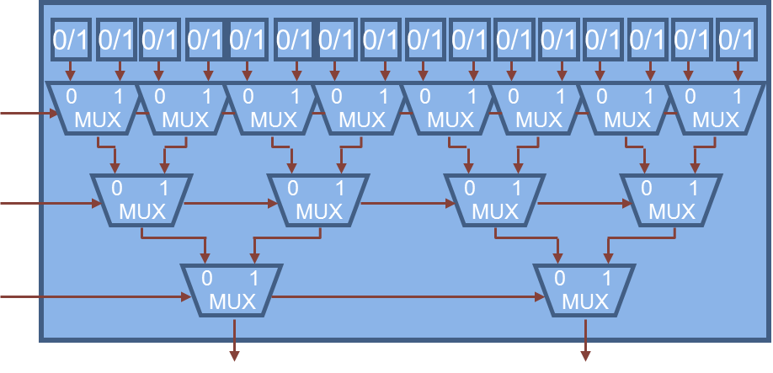
What is FPGA?
FPGA – Field-Programmable Gate Array
  Field-Programmable – configured after manufacturing
  Gate – basic elements
  Array – internal architecture
LUT
CLB: Configurable Logic Block
IOB: Input/Output Block
LUT: Look-Up Table
MUX: Multiplexer
FF: Flip-Flop

Slide 3
How it works?
Example 1: 1-bit full adder S = A + B + Cin
Truth Table
3-input, 2-output LUT
Inputs |  |  | Outputs
A | B | Cin | S | Cout
0 | 0 | 0 | 0 | 0
0 | 0 | 1 | 1 | 0
0 | 1 | 0 | 1 | 0
0 | 1 | 1 | 0 | 1
1 | 0 | 0 | 1 | 0
1 | 0 | 1 | 0 | 1
1 | 1 | 0 | 0 | 1
1 | 1 | 1 | 1 | 1
0 | 0
1 | 0
1 | 0
0 | 1
1 | 0
0 | 1
0 | 1
1 | 1
0
1
1
0
1
0
0
1
0
0
0
1
0
1
1
1
A
Cin
0 1
0 1
0 1
0 1
0 1
0 1
0 1
0 1
B
MUX
MUX
MUX
MUX
MUX
MUX
MUX
MUX
Cin
B
0 1
0 1
0 1
0 1
MUX
MUX
MUX
MUX
A
0 1
0 1
MUX
MUX
LUT
S
Cout
S
Cout

Slide 4
How it works?
Example 1: 1-bit full adder S = A + B + Cin
Truth Table
3-input, 2-output LUT
Inputs |  |  | Outputs
A | B | Cin | S | Cout
0 | 0 | 0 | 0 | 0
0 | 0 | 1 | 1 | 0
0 | 1 | 0 | 1 | 0
0 | 1 | 1 | 0 | 1
1 | 0 | 0 | 1 | 0
1 | 0 | 1 | 0 | 1
1 | 1 | 0 | 0 | 1
1 | 1 | 1 | 1 | 1
0 | 0
1 | 0
1 | 0
0 | 1
1 | 0
0 | 1
0 | 1
1 | 1
0
1
1
0
1
0
0
1
0
0
0
1
0
1
1
1
A
Cin=0
0 1
0 1
0 1
0 1
0 1
0 1
0 1
0 1
B
Cin
B=0
0 1
0 1
0 1
0 1
A=0
0 1
0 1
LUT
S=0
Cout=0
S
Cout
0 + 0 + 0 = 0 0
A B Cin S Cout
Notes:
Now let’s see how does it work. Suppose all of the 3 inputs are 0, then according to the truth table, both of the two outputs are 0. Inside the LUT, all of the MUX pin 0 is connected to the MUX output, so the two stored 0s in static RAMs are transfer to the two outputs.

Slide 5
How it works?
Example 1: 1-bit full adder S = A + B + Cin
Truth Table
3-input, 2-output LUT
Inputs |  |  | Outputs
A | B | Cin | S | Cout
0 | 0 | 0 | 0 | 0
0 | 0 | 1 | 1 | 0
0 | 1 | 0 | 1 | 0
0 | 1 | 1 | 0 | 1
1 | 0 | 0 | 1 | 0
1 | 0 | 1 | 0 | 1
1 | 1 | 0 | 0 | 1
1 | 1 | 1 | 1 | 1
0 | 0
1 | 0
1 | 0
0 | 1
1 | 0
0 | 1
0 | 1
1 | 1
0
1
1
0
1
0
0
1
0
0
0
1
0
1
1
1
A
Cin=1
0 1
0 1
0 1
0 1
0 1
0 1
0 1
0 1
B
Cin
B=0
0 1
0 1
0 1
0 1
A=1
0 1
0 1
LUT
S=0
Cout=1
S
Cout
1 + 0 + 1 = 0 1
A B Cin S Cout

Slide 6
How it works?
subtracter
Example 2: 1-bit full subtracter D = A - B - Bin
Truth Table
3-input, 2-output LUT
Inputs |  |  | Outputs
A | B | Bin | D | Bout
0 | 0 | 0 | 0 | 0
0 | 0 | 1 | 1 | 1
0 | 1 | 0 | 1 | 1
0 | 1 | 1 | 0 | 1
1 | 0 | 0 | 1 | 0
1 | 0 | 1 | 0 | 0
1 | 1 | 0 | 0 | 0
1 | 1 | 1 | 1 | 1
0 | 0
1 | 1
1 | 1
0 | 1
1 | 0
0 | 0
0 | 0
1 | 1
0
1
1
0
1
0
0
1
0
1
1
1
0
0
0
1
A
Bin=1
0 1
0 1
0 1
0 1
0 1
0 1
0 1
0 1
B
Bin
B=1
0 1
0 1
0 1
0 1
A=0
0 1
0 1
LUT
D=0
Bout=1
D
Bout
0 - 1 - 1 = 0 1
A B Bin D Bout

Slide 7
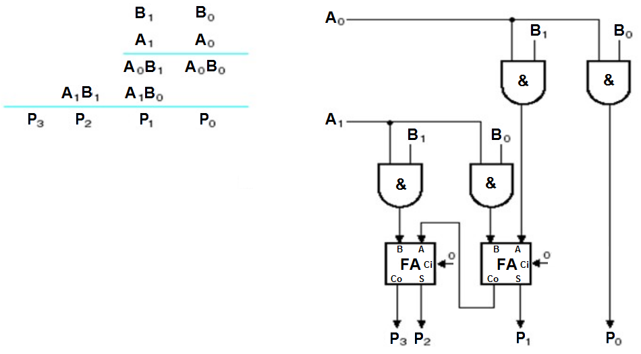
How it works?
Example 3: 2-bit multiplier P = A * B
AND gate
1-bit full adder

Slide 8
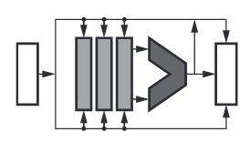
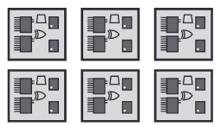
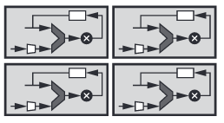
Why choose FPGA?
Scalar processor Programmable logic Vector processor
(e.g., CPU) (e.g., FPGA) (e.g., DSP, GPU)
Complex algorithms
Fully parallelism
Domain-specific parallelism
(Video and image processing)
Decision making
Latency critical workloads
(Real-time processing)
Computer vision
Programmable I/O
Machine Learning

Slide 9
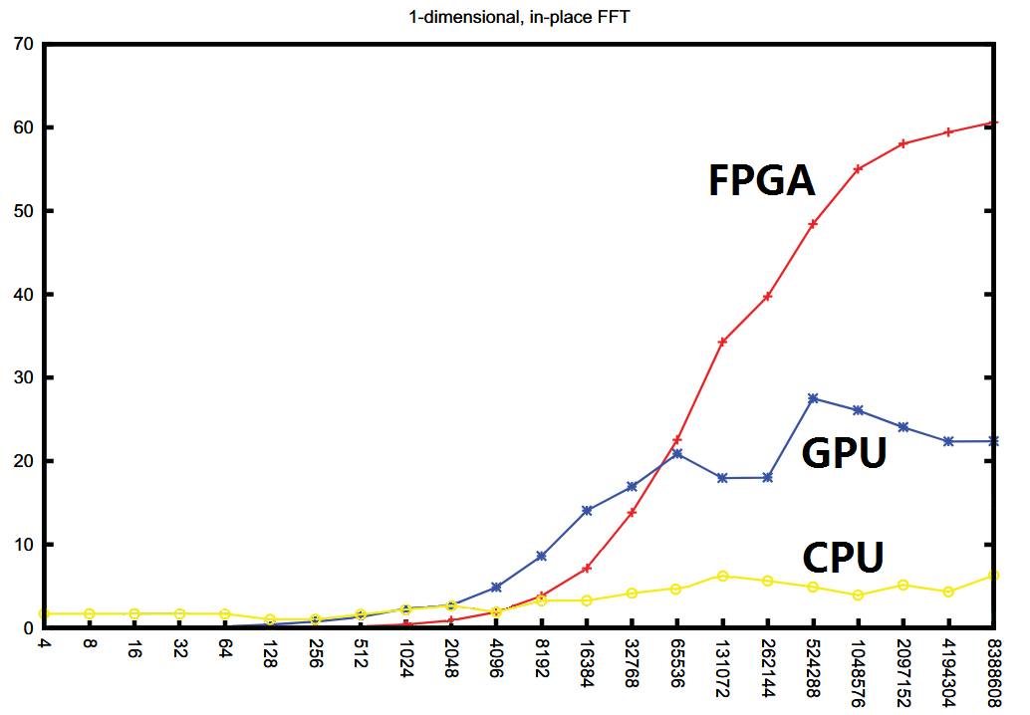
Why choose FPGA?
FFT test platform
CPU: Intel Xeon E5420 Quad-Core
GPU: nVidia Tesla C1060
FPGA: Xilinx V5LX330T
GFLOPS
Citation: B. Betkaoui, D. B. Thomas and W. Luk,
“Comparing Performance and Energy Efficiency of
FPGAs and GPUs for High Productivity Computing”,
International Conference on Field-Programmable Technology
FFT size

Slide 10
Why choose FPGA?
Monte-Carlo simulation, 1,000,000 cycles
Implementation | Execution time |  | Acceleration ratio
 | Single precision | Double precision | Single precision | Double precision
CPU single-threaded | 8,333 ms | 14,727 ms | 0.53x | 0.57x
CPU multi-threaded | 4,446 ms | 8,378 ms | 1x | 1x
GPU Tesla C1060 | 440 ms | 1,078 ms | 10x | 7.7x
FPGA Xilinx V5LX330T | 115 ms | 471 ms | 38.6x | 17.8x
Monte-Carlo test platform
CPU: Intel Xeon 5138 Dual-Core
GPU: nVidia Tesla C1060
FPGA: Xilinx V5LX330T
Citation: B. Betkaoui, D. B. Thomas and W. Luk, “Comparing Performance and Energy Efficiency of FPGAs and GPUs for High Productivity Computing”, International Conference on Field-Programmable Technology

Slide 11
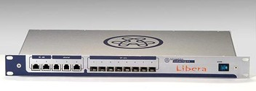
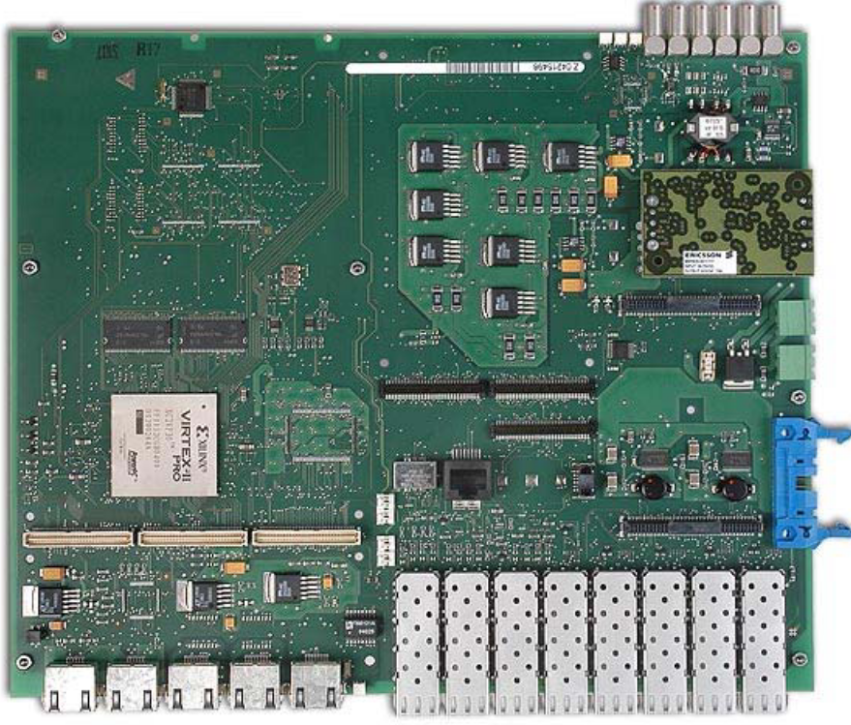
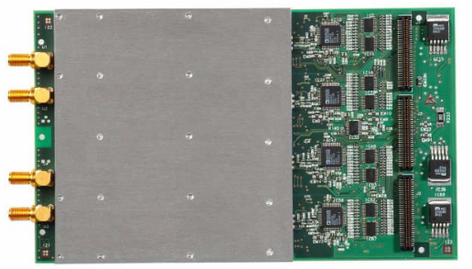
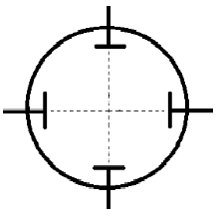
Applications at the AS (1)
Libera Electron Beam Position Monitor (BPM) x 98
1st generation of BPMs at the AS
Xilinx Virtex II Pro FPGA as the processor
  Introduced in 2002, 90 nm process technology
  Real-time processing data stream @ 117 MSamples/s x 12 bits x 4 channels x 2 (I & Q) = 11.23 Gb/s
  32 MBytes circular buffer
  3.125 Gb/s Rocket IO transceivers
Virtex II Pro
vacuum tube
ADC
4 channels
Y
X

Slide 12
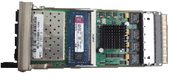
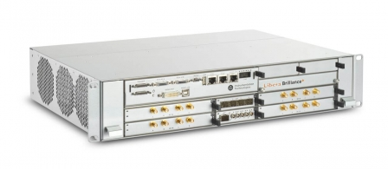
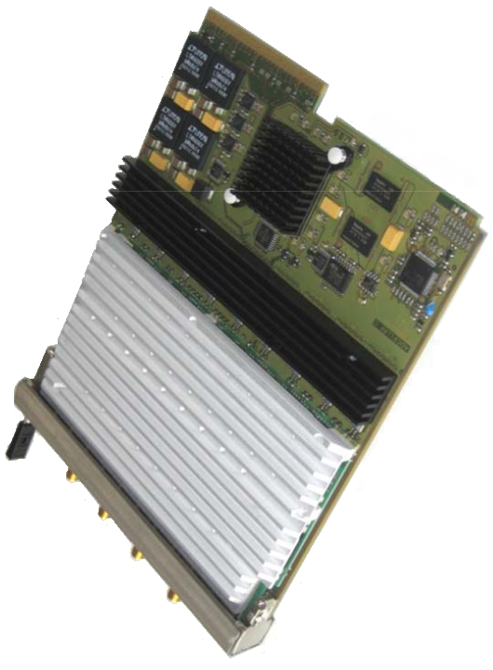
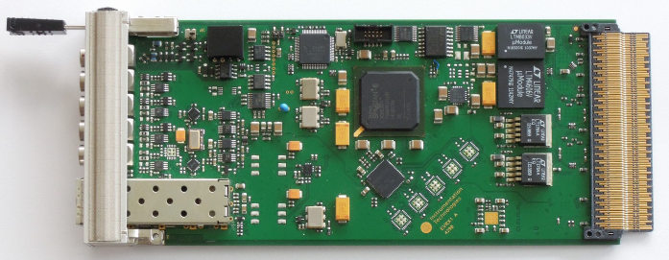
Applications at the AS (2)
②
Virtex 6
Libera Brilliance+ BPMs x 98
2nd generation of BPMs at the AS
4 BPM modules in a 2U 19” chassis
Xilinx Virtex 6 FPGA as BPM & GDX processor
  Introduced in 2009, 40 nm process technology
  Real-time processing data stream @ 250 MSamples/s x 16 bits x 4 channels x 2 (I & Q) = 32 Gb/s
  4 GBytes buffers
  6.5 Gb/s Rocket IO transceivers
Xilinx Spartan 6 FPGA as EVR processor
  Introduced in 2009, 45 nm process technology
①
③
Spartan 6
①
②
Virtex 6
ADC
4 channels
③

Slide 13
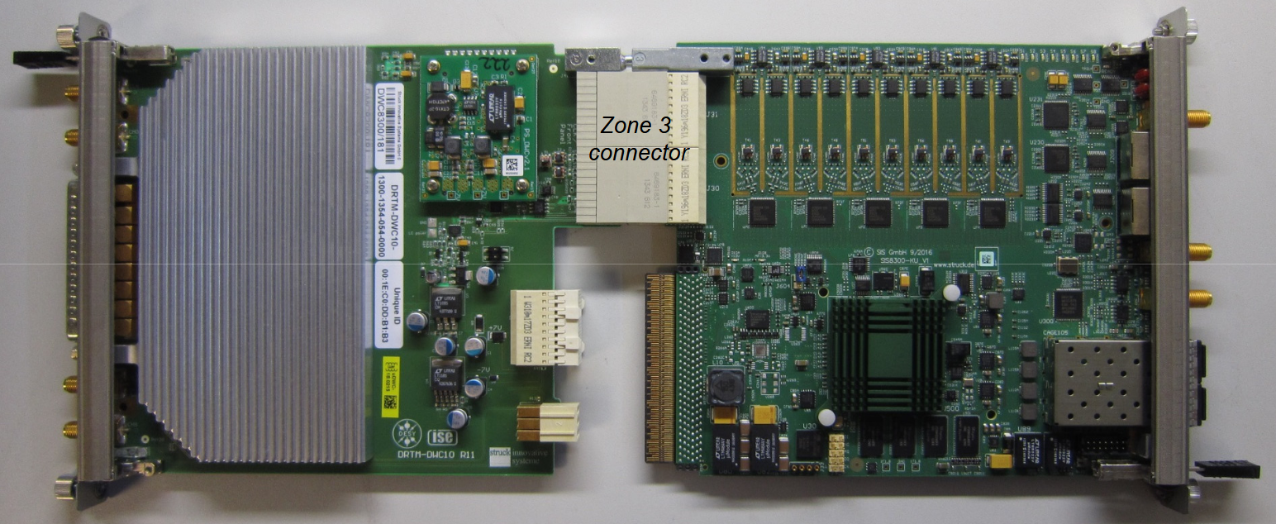
Applications at the AS (3)
Linear Accelerator (LINAC) waveguide diagnostics
Xilinx Virtex 6 FPGA as the processor
  10 channels x 125 MSamples/s x 16 bits x 2 (I & Q) = 40 Gb/s data processed in real-time
  Waveform storage length = 16us
Phase resolution < 0.1 degree
Phase stability < 0.1 degree RMS
Amplitude resolution < 0.1 % full scale
Amplitude dynamic range > 40dB
Virtex 6
Signal in
3 GHz
IF
50 MHz
LO in
2.95 GHz
ADC
X 10
. . .
Trig
PCIe
bus
FPGA

Slide 14
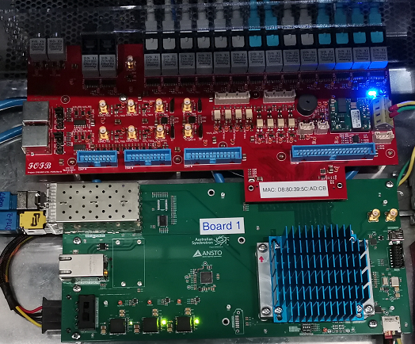
Applications at the AS (4)
Fast Orbit Feedback (FOFB) + Enhanced Orbit Diagnostics (EOD) in one SoC
Xilinx ZYNQ Ultrascale+ SoC (FPGA+CPU) as the processor
  1Gbit/s fast acquisition (FA) data stream processed in real-time
  GbE interface for EPICS control
  With EOD features, 5 output modes available:
    FOFB correction data
    White Gaussian noise (WGN) stream
    FOFB & WGN superposition
    Sinusoidal stream
    FOFB & Sinusoidal superposition
ZYNQ Ultrascale+
FOFB
To
Corrector
PSU
+
WGN
Sinusoidal

Slide 15
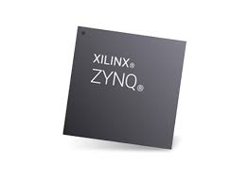
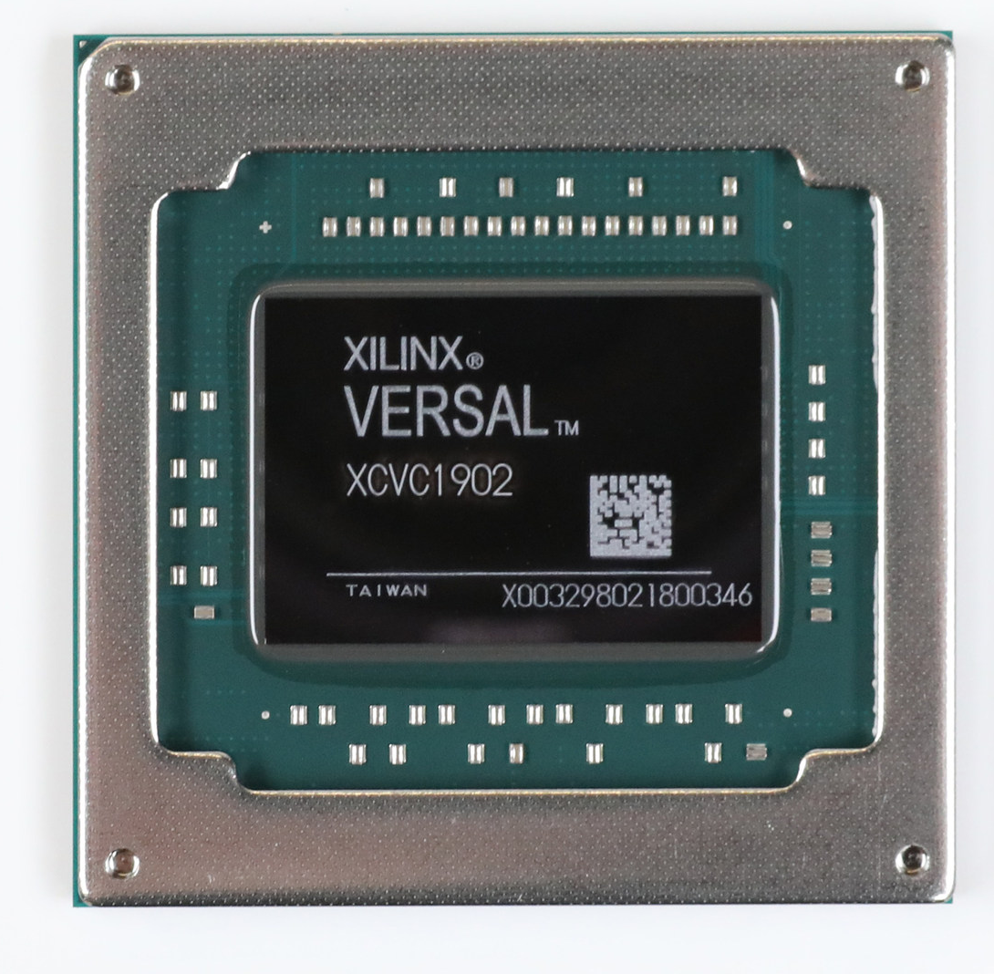
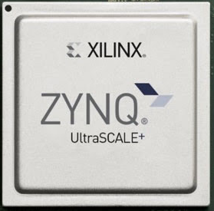
Summary
Lowest engineering cost – CPU
Speed booster – GPU
Ultimate solution – FPGA
Right job, right person – FPGA+CPU, FPGA+CPU+DSP/GPU
FPGA + CPU
FPGA + CPU + DSP

