Slide 1
Fast-Scanning Ptychography
and other scanning probe methods
Cameron M. Kewish
cameronk@ansto.gov.au

Slide 2
Outline of the presentation
Introduction to ptychography and recent developments
Fast-scanning ptychography at the XFM Beamline
  Synchronising data streams
  User interface
  Behind the scenes
  Fast scanning achievements
Application examples: geophysical exploration, fatigue cracking
New mapping capabilities: micro-beam SAXS & diffraction
Capabilities of the BRIGHT Nanoprobe

Slide 3
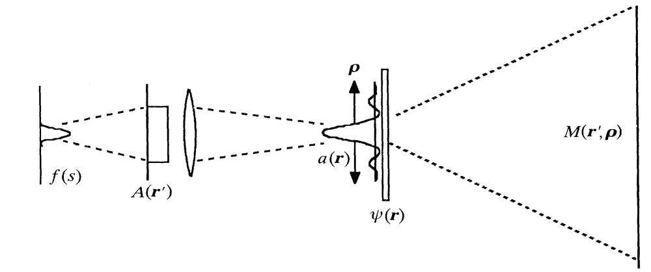
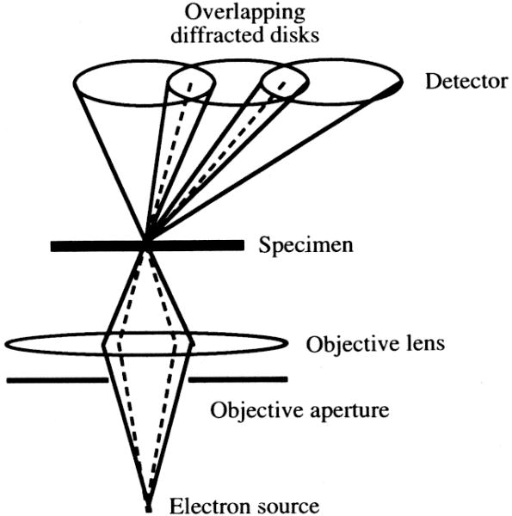
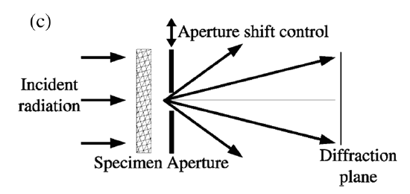
Introduction to ptychography
Super-resolution microscopy by moving aperture
J. M. Rodenburg & R. H. T. Bates, Phil. Trans. R. Soc. Lond. A 339, 521 (1992)
P. D. Nellist, et al., Nature 374, 630 (1995)
H. M. L. Faulkner & J. M. Rodenburg, PRL 93, 023903 (2004)

Slide 4
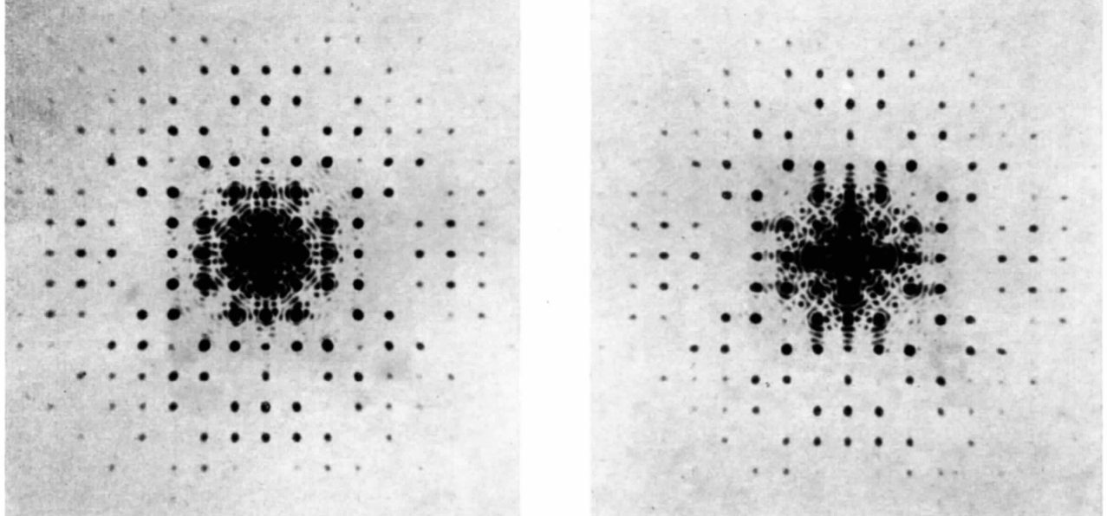
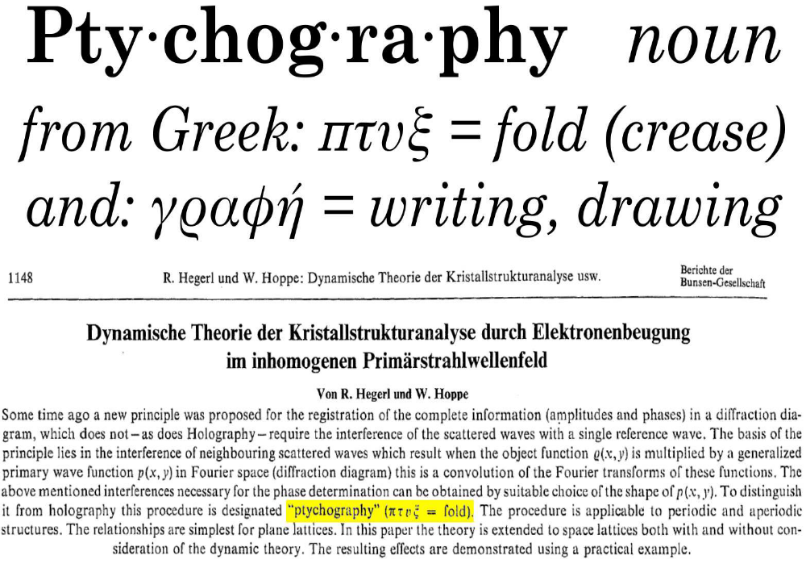
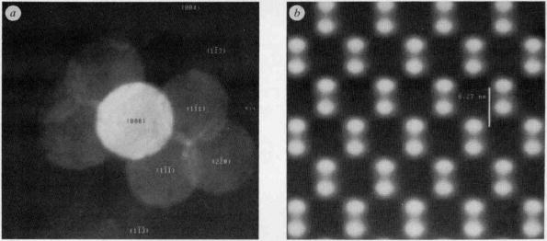
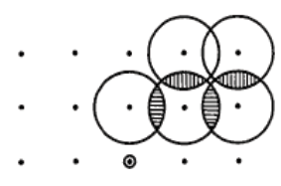
Introduction to ptychography
Crystals illuminated with tightly focused beams produced overlapping Bragg peaks, which allowed analytical phasing
The data include both aperture and object functions ‘folded’ together
W. Hoppe, Acta. Cryst. A 25, 508 (1969)
W. Hoppe & G. Strube, Acta. Cryst. A 25, 502 (1969)
R. Hegerl & W. Hoppe, Ber. Bunsen-Ges. Phys. Chem 74, 1148 (1970)
P. D. Nellist, et al., Nature 374, 630 (1995)

Slide 5

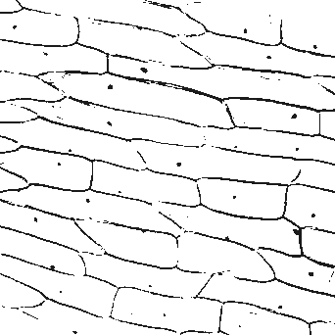
Introduction to ptychography
monochromatic X-rays
X-rays
coherent X-rays
focusing lens
condenser zone plate
focusing optics
fluorescence photons
photo-
electrons
fluorescence photons
sample scanning stage
objective
zone plate
coherent diffraction
X-ray detector
CCD or hybrid pixel
array
CCD camera
STXM, SPEM, XFM
TXM
SXDM, or ptychography

Slide 6
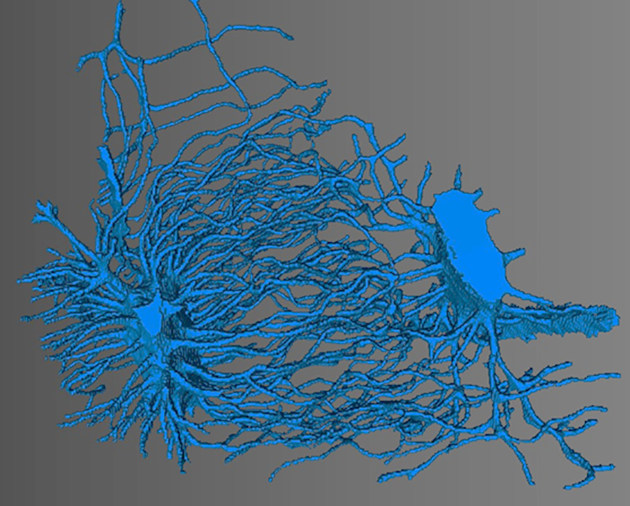
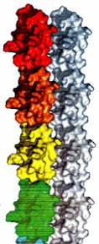
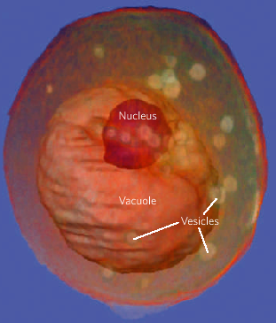
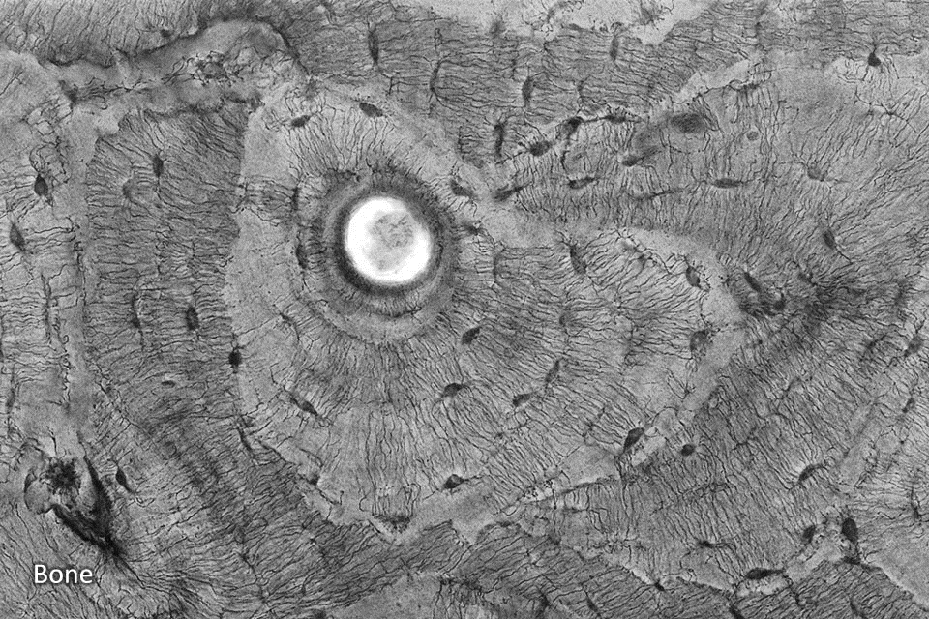
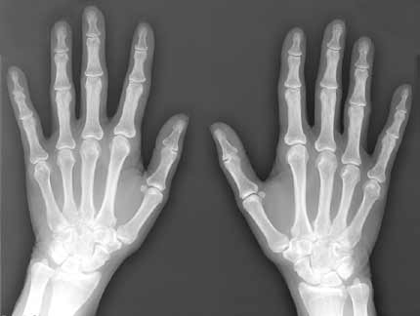
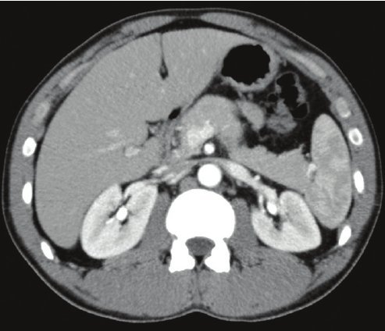
Imaging at hierarchical length scales
Synchrotron
Laboratory
Hospital
1 Å 10 nm 1 µm 1 mm 1 m
electron microscopy
visible light microscopy
scanning probe microscopy
X-ray radiography & tomography
X-ray crystallography
X-ray microscopy & µCT
(Hard) X-ray advantages:
High penetration power
Chemical specificity
No vacuum required
X-ray coherent diffractive imaging

Slide 7
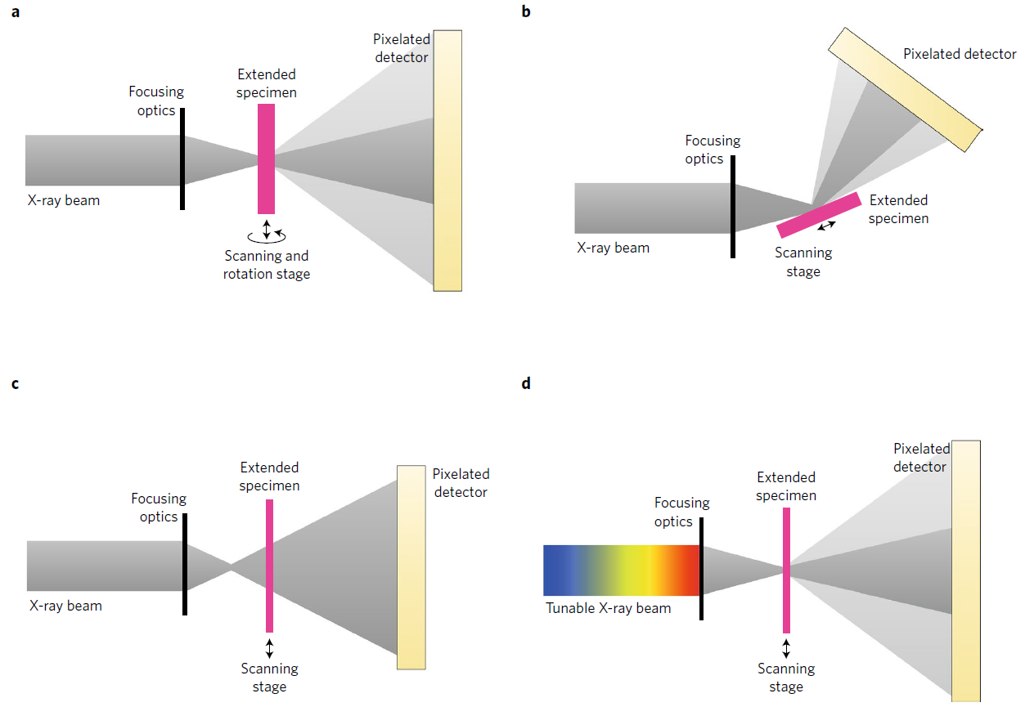
Developments in the last decade
Ptychographic X-ray computed tomography
Bragg ptychography
Fresnel (near field) ptychography
Spectroptychography
Review: F. Pfeiffer, Nat. Photonics 12, 9 (2018)

Slide 8
Developments in the last decade
Ptychographic methodology developments: PXCT, Fresnel, Bragg, …
Algorithmic developments
  Difference Map with probe retrieval: Thibault (2009)
    optics characterisation & alignment: Kewish/Guizar-Sicairos/Schropp (2010)
  Nonlinear Optimisation:
    maximum likelihood refinement: Guizar-Sicairos (2011)
  “Ptychographical Iterative Engine” (PIE):
    PIE variants: pPIE, ePIE, mPIE, 3PIE, etc.: Rodenburg group/PhaseFocus
  Mixed states solutions: Thibault & Menzel (2013)
Experimental advances:
  position refinement, resonance, multimodal, flyscans…

Slide 9
Optimised bidirectional scanning
Raster step scan
Unidirectional or bidirectional
Movement overhead ~0.1-1s/point
Up to 99% of scan time wasted
Large area scans unfeasible
Line flyscan
Fast flyback or step to next line
Movement overhead ~0.3-2s/line
Up to 6-30% of scan time wasted
Rascan
Mathematically optimized trajectory
Turnaround time ~0.045s/line
Less than 1% of scan time wasted
Megapixels per hour is feasible
N. Afshar et al., Proc. ICALEPCS2017, WEBPL07 (2017)
Example: 50 x 50 µm², 100 nm step, 10 ms dwell
Total measurement time: 500² x 0.01 s = 2500 s

Slide 10
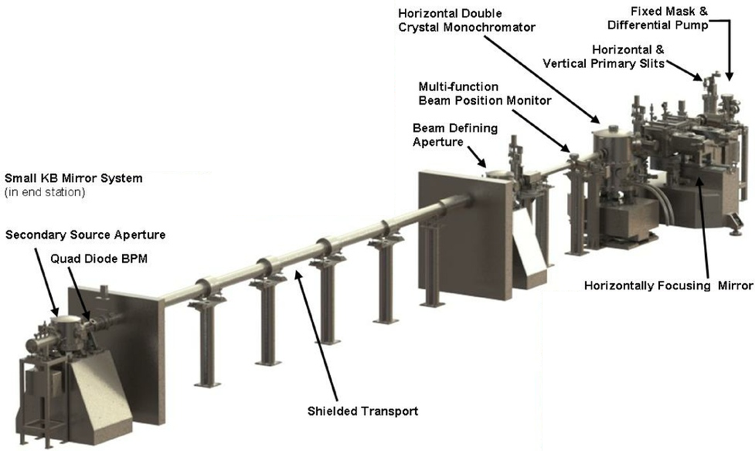
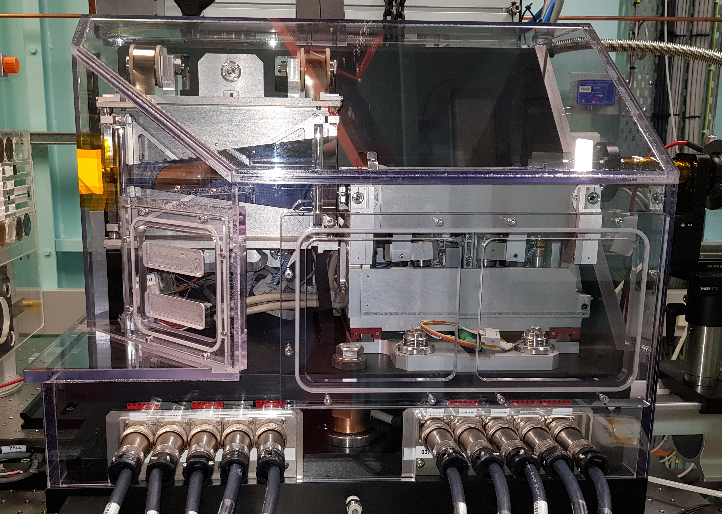
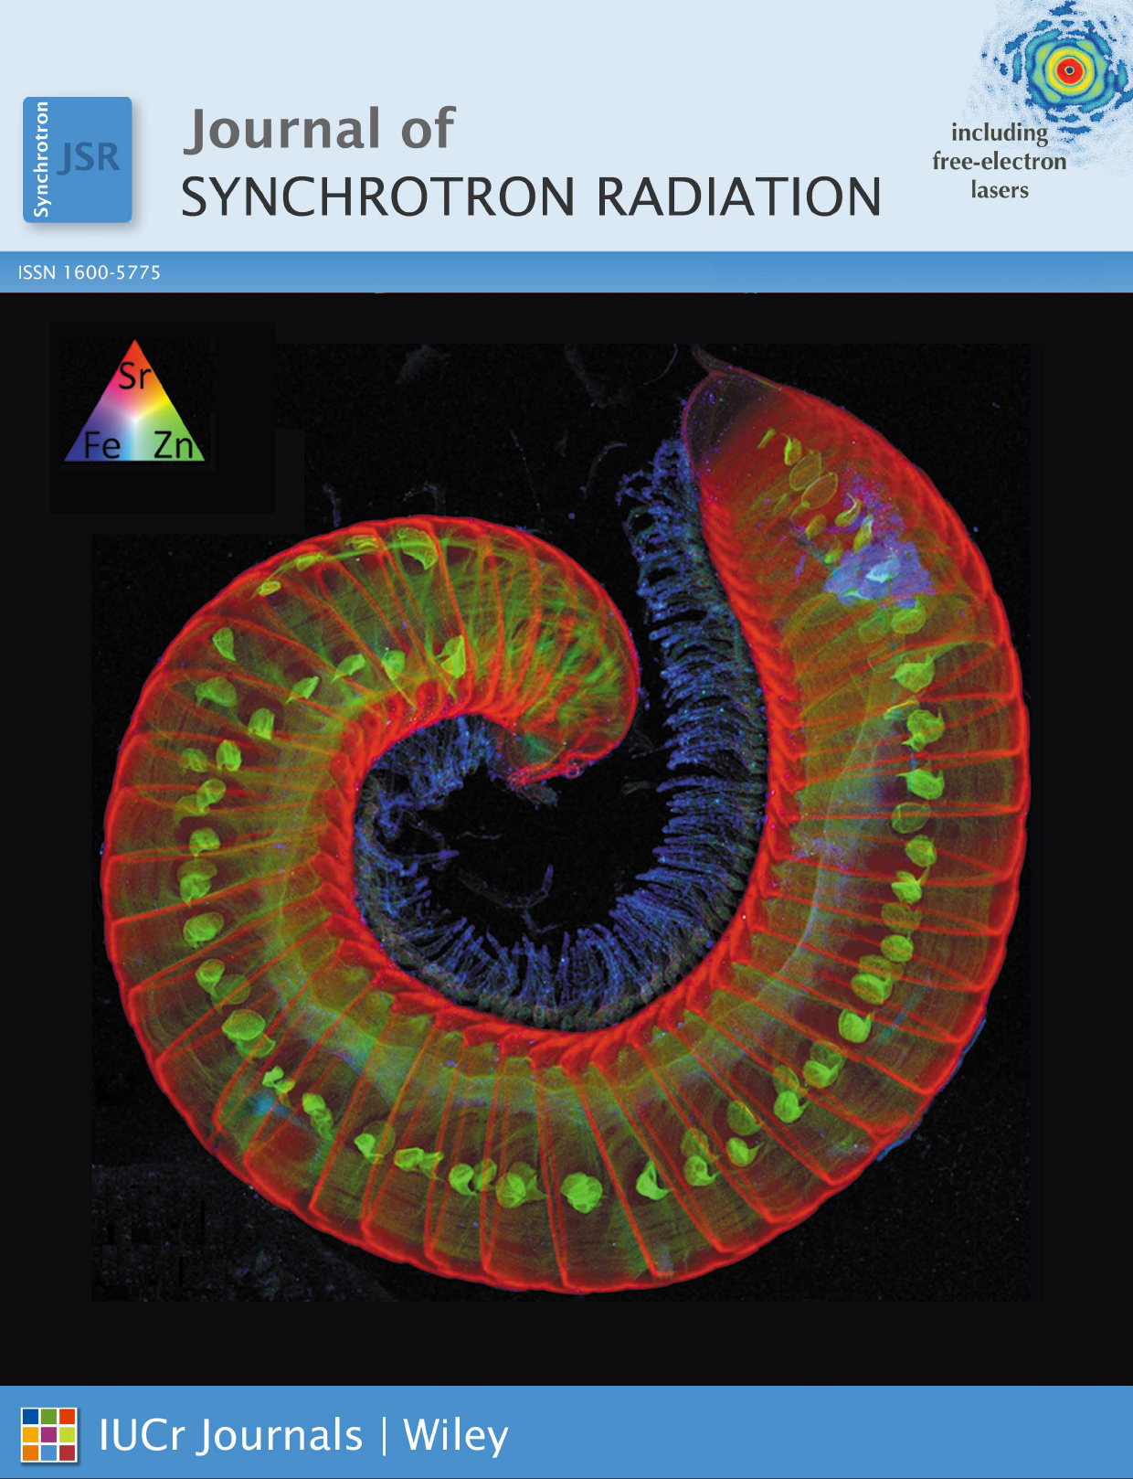
XFM: X-ray Fluorescence Microscopy
Fast-scanning hard X-ray microprobe – mapping chemistry:
MAIA detector in backscatter geometry
4-27 keV energy range (up to Cd-K)
Milliprobe: Secondary source aperture defines 100 µm beam
Microprobe: KB-mirrors focus to approx. 2×2 µm beam size
Flyscanning megapixels per hour, XANES imaging
Small KB Mirror System
(in endstation)
recently refurbished
with new mirrors, motors
and enclosure
Secondary
Source
Aperture
Microprobe
instrument
Double Multilayer
Monochromator
(coming soon)
Shielded transport
“Milliprobe”
instrument
See recent XFM beamline article in JSR:
“The XFM Beamline at the Australian Synchrotron”
D. L. Howard, et al., J Synchrotron Rad 27, 1447 (2020)

Slide 11
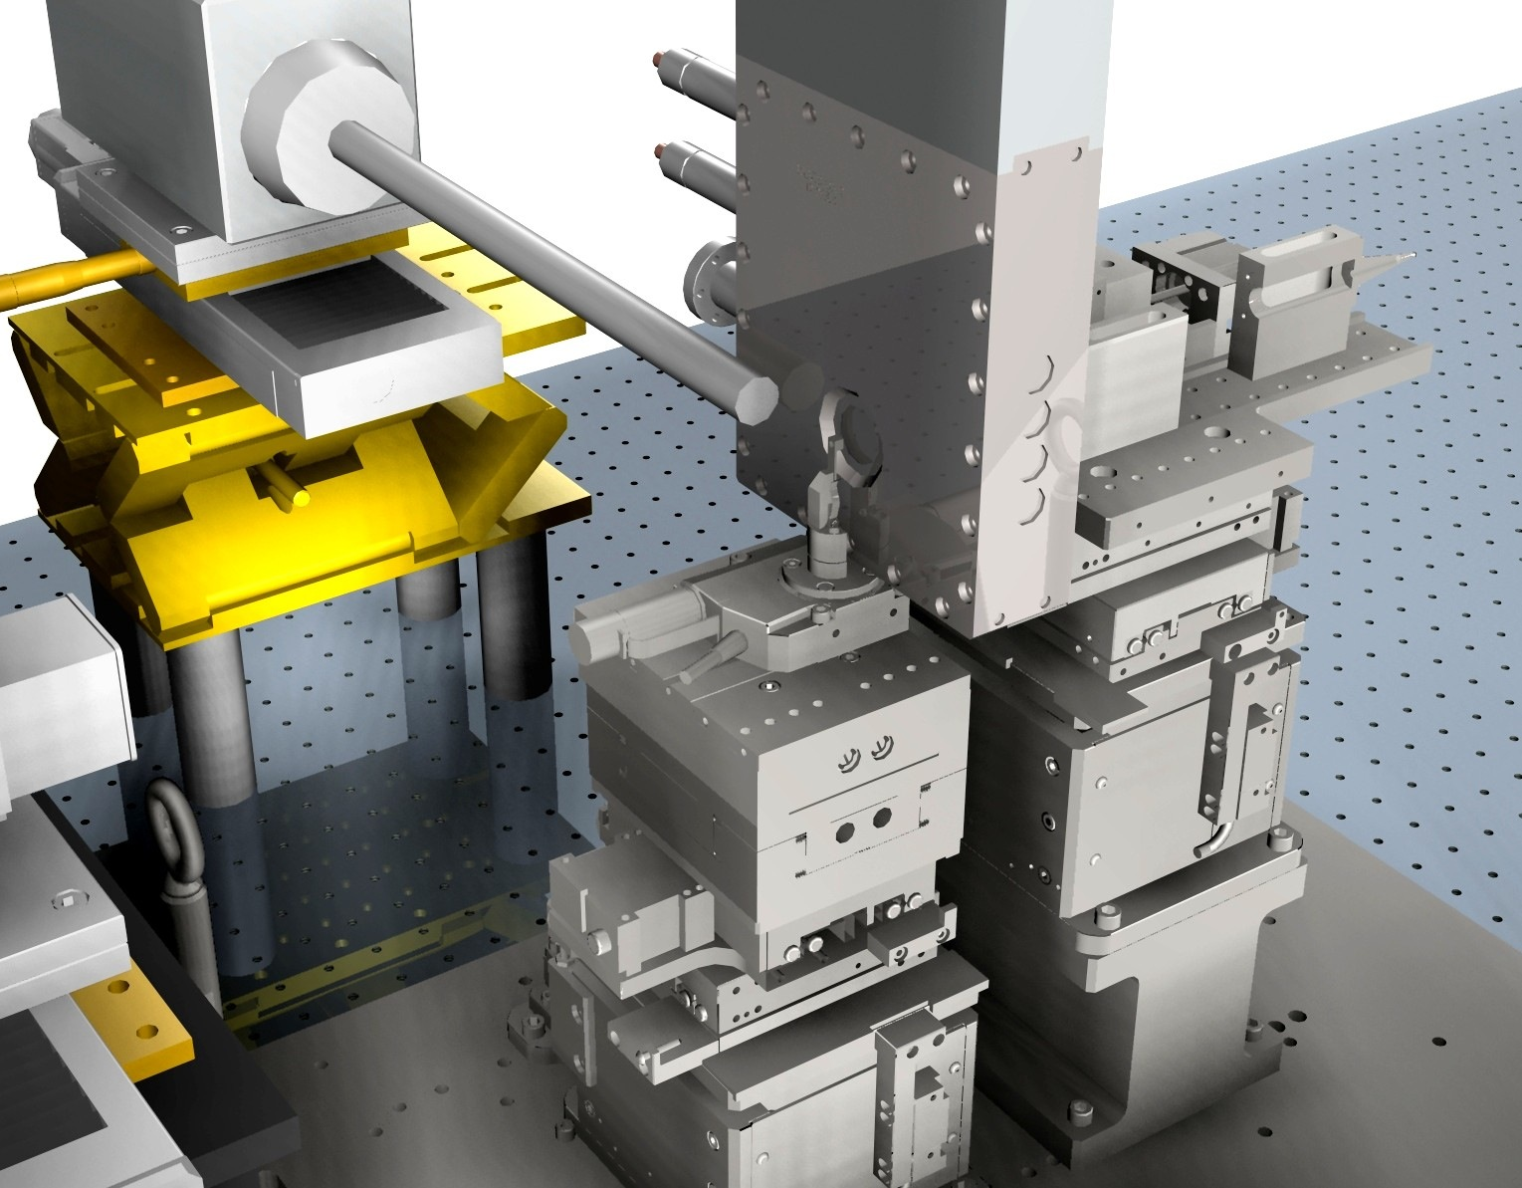
XFM: Microprobe instrument schematic
VORTEX ME3
detector
MAIA 384D detector
Beam is focused by
K-B mirrors onto the sample, which is scanned through the micron-sized beam while detectors record fluorescence and diffraction
Incident beam
K-B mirrors
Transmitted beam continues
to SXDM
detector
High speed servomotor
sample scanning system

Slide 12
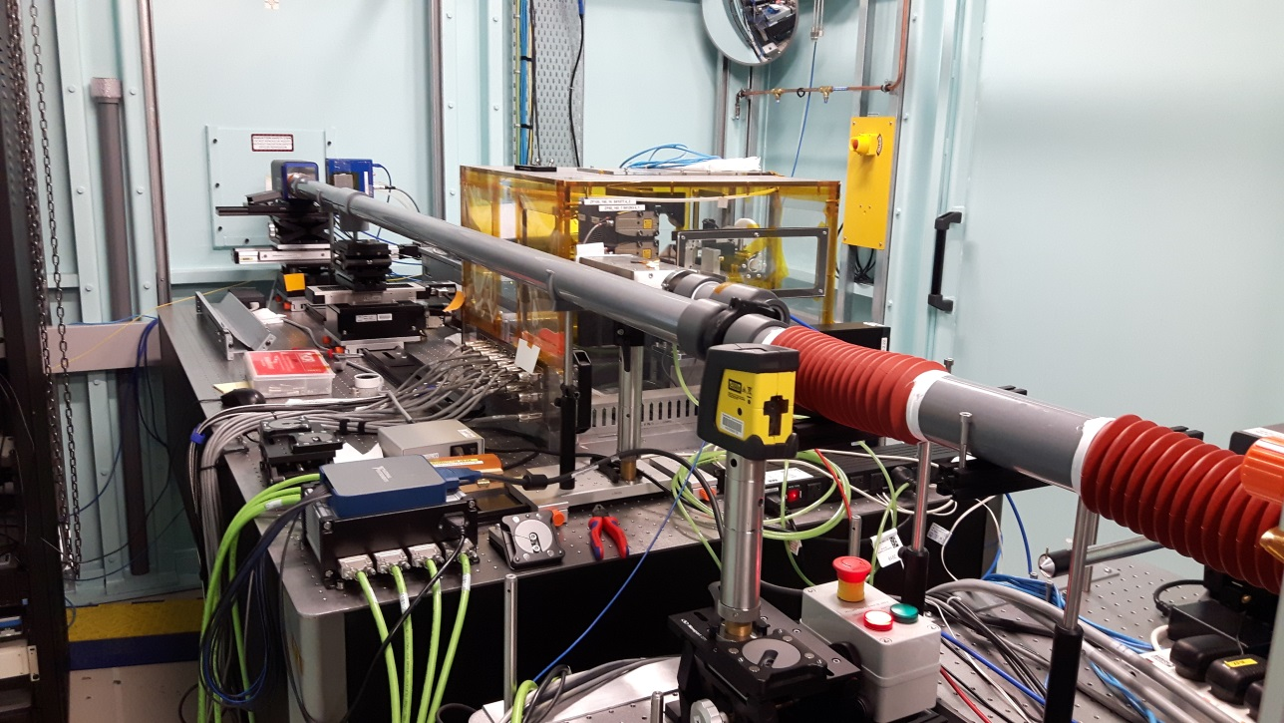
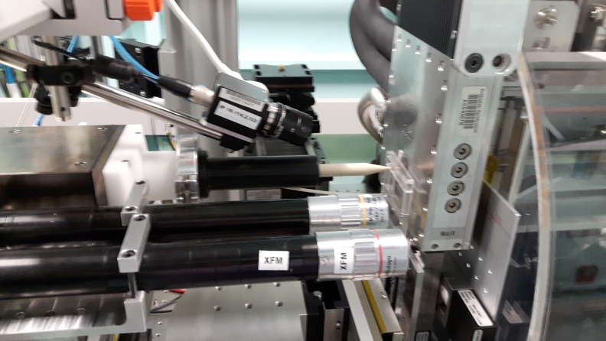
Ptychography installation at XFM
SXDM detector
sample
He tube
coherent
focused
X-ray beam
SXDM detector positioned as far as achievable (3.85 m) downstream of sample
X-ray beam travels inside a helium-filled ‘flight tube’
Sample is scanned orthogonal to beam behind the MAIA detector permitting simultaneous XFM + SXDM experiments
Detector events are recorded into the MAIA data stream

Slide 13
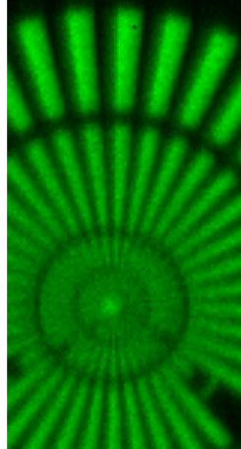
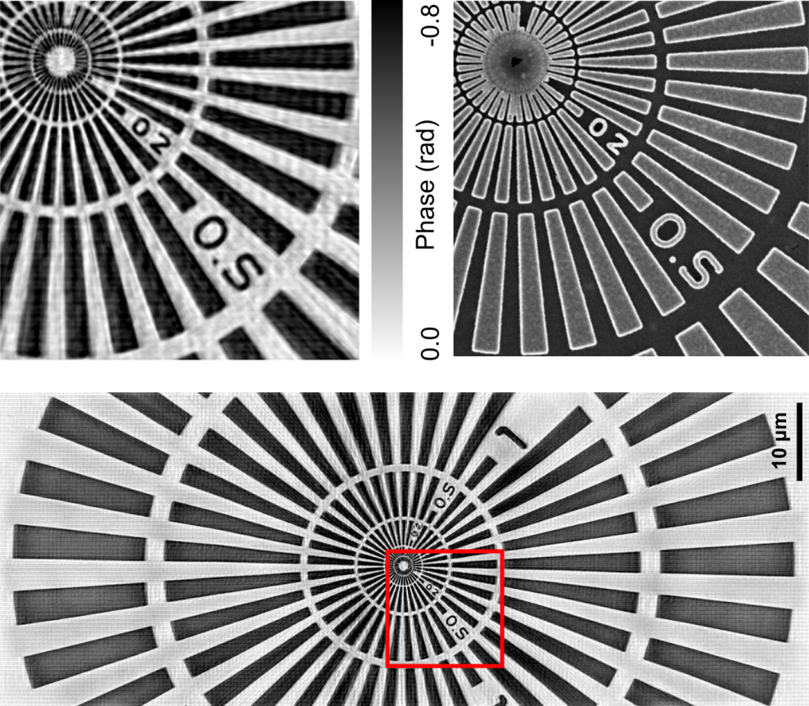
Correlated XFM:Ptychography test
Ptychography absorption contrast
Cr XFM
2015: Dectris loaned a EIGER 1M detector
Flyscan ptychography data was measured
simultaneously with XFM data
Imaging
length
scale:
bars are
0.5 µm
wide at
inner
edge of
“0.5” ring
M. W. M. Jones et al., J. Synchrotron Rad. 23, 1151 (2016)

Slide 14
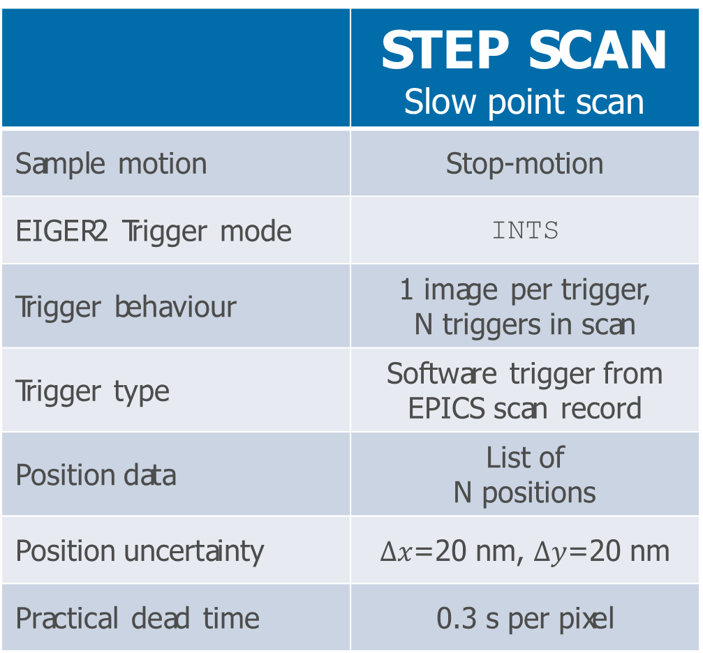
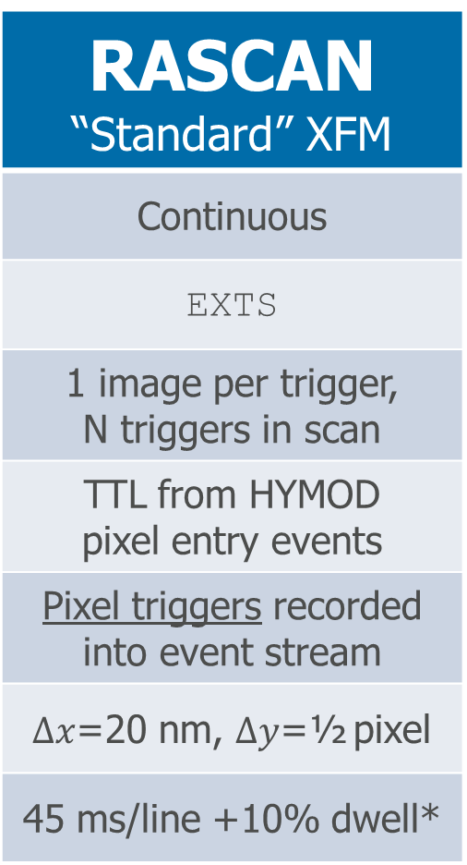
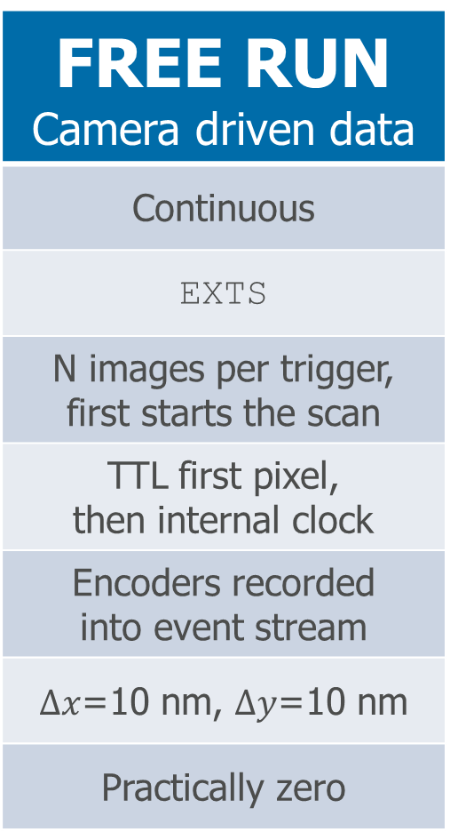
Flyscan at Australian Synchrotron: XFM
 | STEP SCAN Slow point scan
Sample motion | Stop-motion
EIGER2 Trigger mode | INTS
Trigger behaviour | 1 image per trigger, N triggers in scan
Trigger type | Software trigger from EPICS scan record
Position data | List of N positions
Position uncertainty | $Δx$=20 nm, $Δy$=20 nm
Practical dead time | 0.3 s per pixel
RASCAN “Standard” XFM
Continuous
EXTS
1 image per trigger, N triggers in scan
TTL from HYMOD pixel entry events
Pixel triggers recorded into event stream
$Δx$=20 nm, $Δy$=½ pixel
45 ms/line +10% dwell*
FREE RUN Camera driven data
Continuous
EXTS
N images per trigger, first starts the scan
TTL first pixel, then internal clock
Encoders recorded into event stream
$Δx$=10 nm, $Δy$=10 nm
Practically zero

Slide 15
List mode: synchronising data streams
“Pixel Triggered” acquisition
Rascan trajectory
pixel array
X Pixel transit event TTL
  EIGER “EXT IN” = start acquisition
EIGER “EN OUT” = acquisition in progress
  Rising edge = frame event
  …
  End of scan
X
X
X
X
X
X
X
X
X
X
X
“Frame events” are recorded in list mode with MAIA data: provides 1:1 correspondence between EIGER frames and scan pixels.
New May 2019: “Stage encoder” events implemented by CSIRO for subpixel synchronisation of positions
20 nm encoder grid
N. Afshar et al., Proc. ICALEPCS2017, WEBPL07 (2017)
C. G. Ryan et al., Synchrotron Radiation News 31, 21 (2018)

Slide 16
Camera-driven acquisition:
“Freerun” acquisition
Rascan trajectory
pixel array
X Trigger sent to EIGER at scan start
  EIGER “EXT IN” = start acquisition
EIGER “EN OUT” = acquisition in progress
  Rising edges = frame events
  …
  End of scan
X
Avoids race condition of arriving at the next pixel while still acquiring, due to velocity variations
Position symmetry is broken, avoiding “raster grid pathology” artefacts in ptychography
Freedom to alter frame length, changing overlap between X position compared to pixel array
20 nm encoder grid

Slide 17
Position Interpolation
Encoder
Pixel

Slide 18
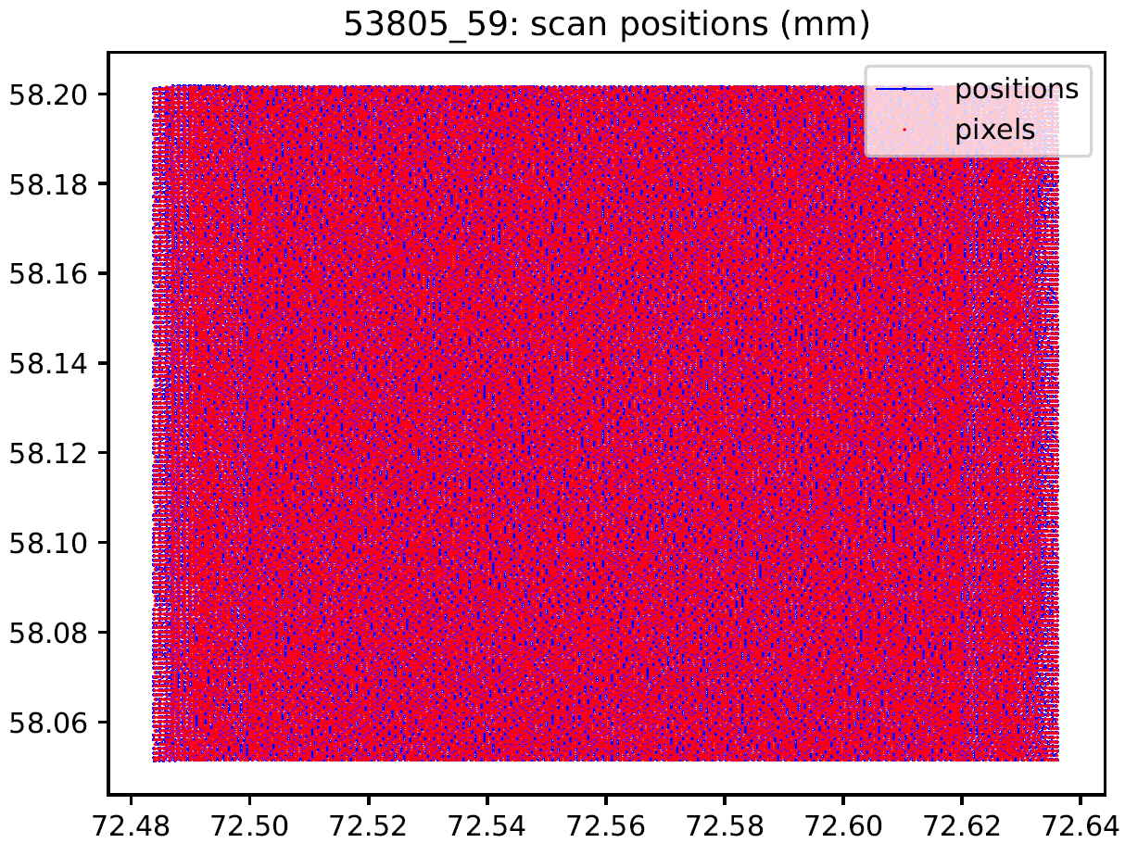
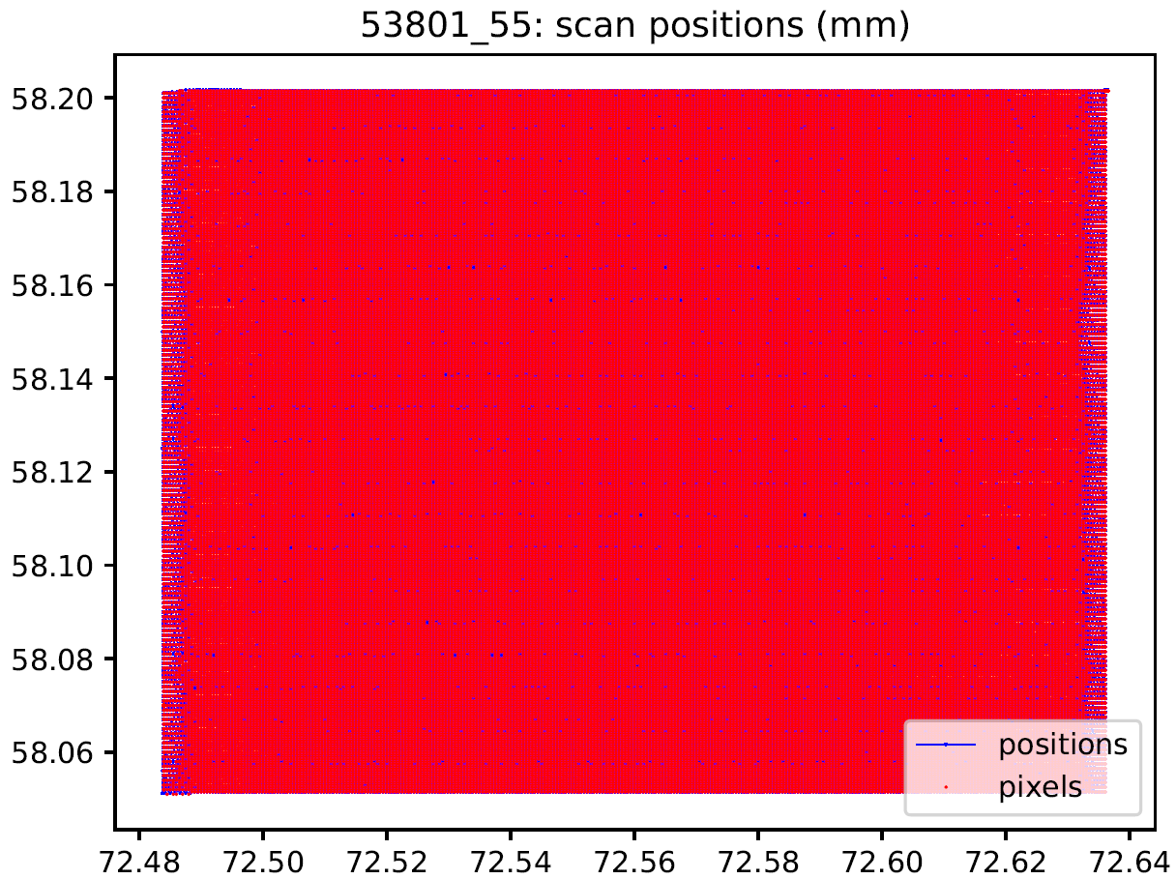
Pixel triggering vs freerun acquisition
Exposure time and pixel transit time creates race condition:
Small variations in scan velocity can lead to missed triggers
pixel triggered scan: frame_time set to 0.99 × dwell
freerun scan: frame_time set to 1.00 × dwell

Slide 19
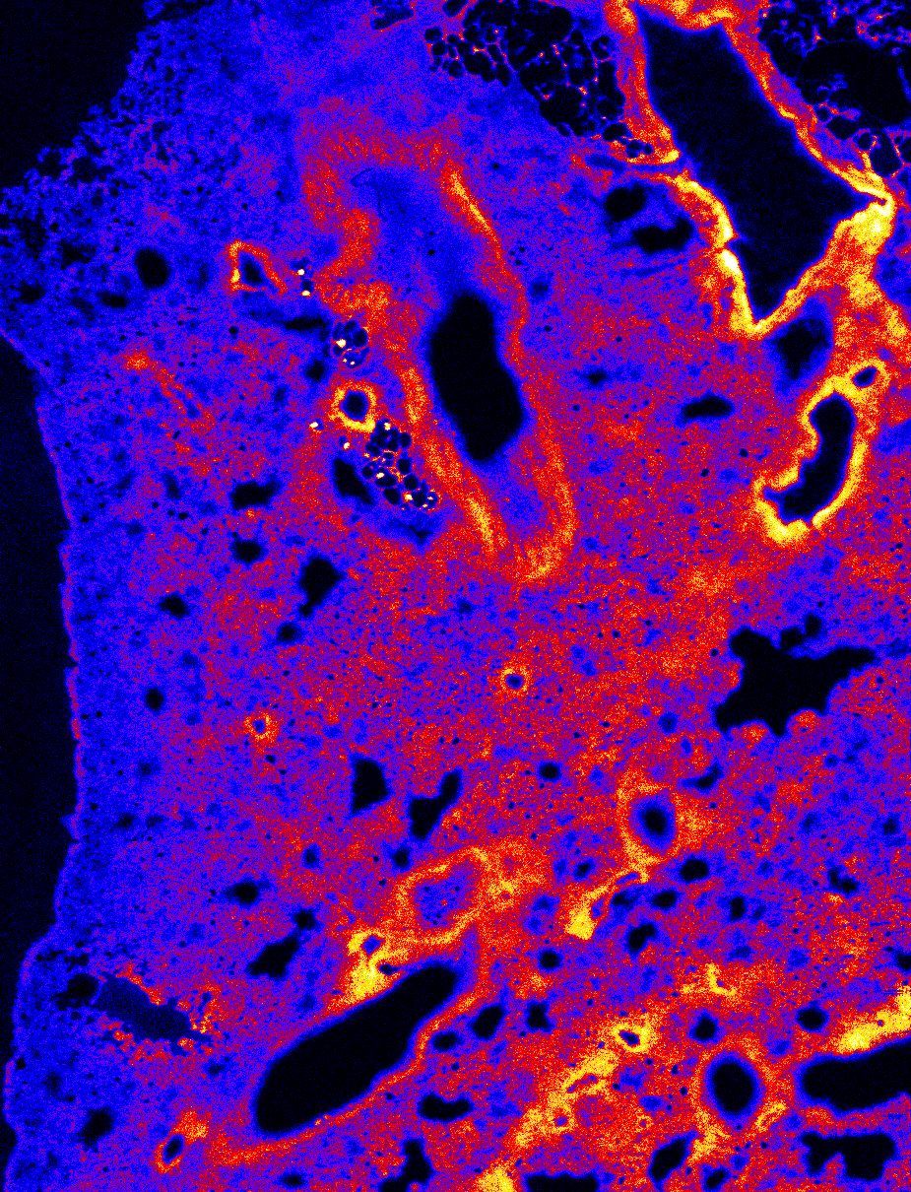
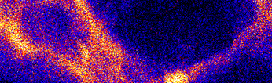
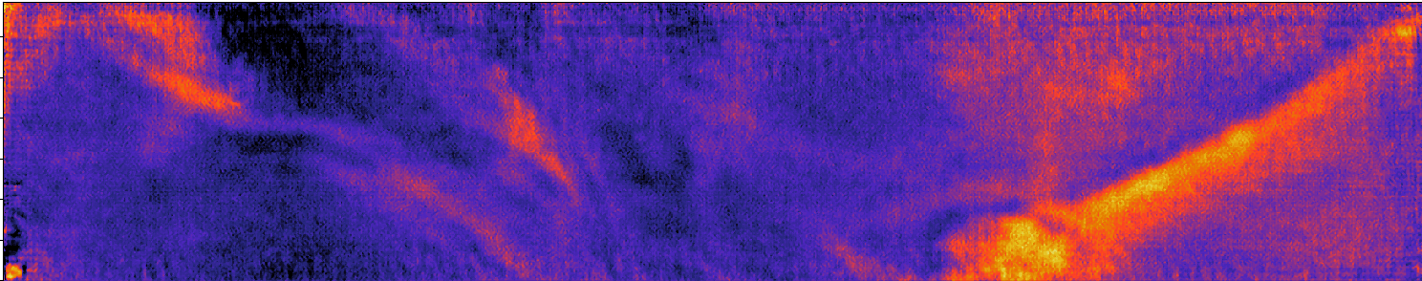
Correlated XFM + SXDM
SXDM implemented at XFM with an X-ray photon counting detector in 2017
Mouse lung: 10 µm-thick section provided by Godfrey group, Doherty Institute
XFM – K
10 µm pixel size
XFM – K
100 nm pixels
250 μm
2 μm
SXDM – phase
25 nm pixels
C. M. Kewish et al., SPIE Nanophotonics 10456, 51 (2017)

Slide 20
Upgrade detector – EIGER X at XFM
Original detector was cost-effective but slow, data poor, analysis troublesome
  Slow readout: significant dead-time between exposures
  Slow dynamics: XFM beam had to be heavily attenuated, wasting beam time
  Sensor charging: intensity- and time-varying bias, frequent power cycling
Collaboration: ANSTO – La Trobe University
  Provide an EIGER2 X 1M detector to the XFM beamline
    Loan EIGER1 detector provided by Dectris during 2018 during development of EIGER2 X
  Develop an optimised automated data analysis pipeline
    Roll-out of software in 5 Phases, providing prompt access to SXDM for XFM ‘early adopter’ users
  Provide computing infrastructure for SXDM
    Collaboration with IT/SciComp to optimise hardware/software for HPC imaging

Slide 21
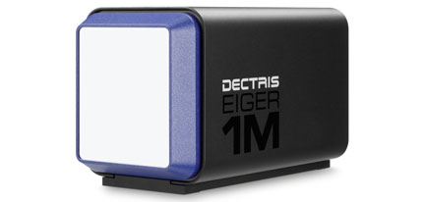
Upgrade to EIGER2
 | Original detector | EIGER1 X | EIGER2 X
Date | Delivered 2016 | Loan June 2015 (4 weeks) Loan May 2018 (48 weeks) | Delivered May 2019
Area [mm²] | 31 × 25 | 77.2 × 79.9
Readout time [µs] | 8,000 | 3 | 0.1
Max intensity per pixel [photons/s] | 10⁵ | 10⁶ | 10⁷
Robustness | Poor: Power cycling to disperse charge every ~1 h takes ~5 min, crashes if triggered during acquisition, cannot transfer data during scan | Excellent: Acquisitions >100 million frames: OK Stable operations >8 weeks without initialization
Capabilities enabled | SXDM, STXM | SXDM, STXM, µ-diffraction, µ-SAXS

Slide 22
Upgrade – Data Analysis Pipeline
The major steps in SXDM analysis comprise:
confirm the X-ray beam intensity and illumination conditions pre-scan;
carry out one or more scans using XFM maia_scan IDL architecture;
transfer EIGER data from detector control unit (DCU) to beamline fileserver;
extract pixel visit data and/or stage events from the list-mode data;
convert positions to laboratory coordinates using metadata from maia_scan;
locate the beam centre in EIGER frames;
apply valid pixel mask, and extract region of interest (ROI) from each frame;
save list of positions and EIGER ROIs as input for SXDM reconstruction, and;
reconstruct SXDM images.

Slide 23
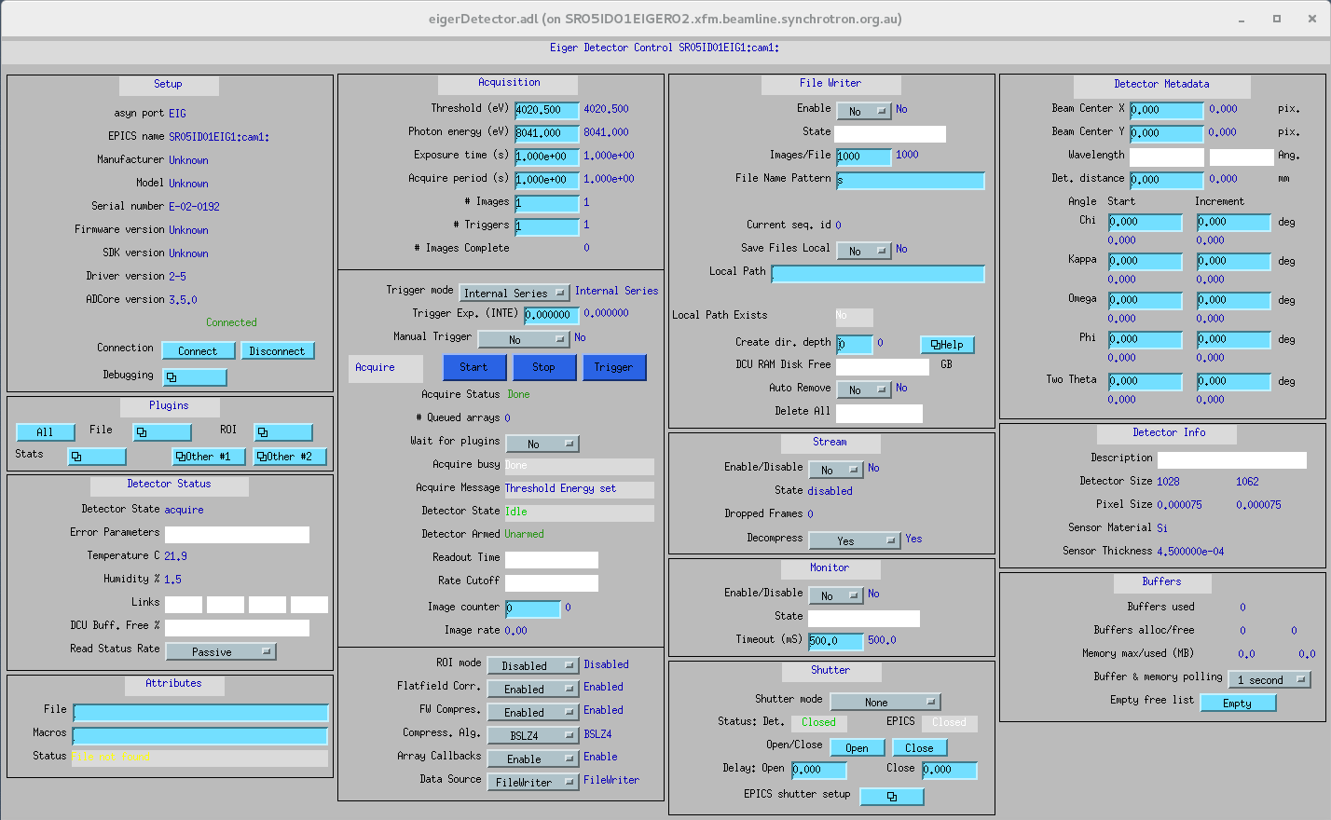
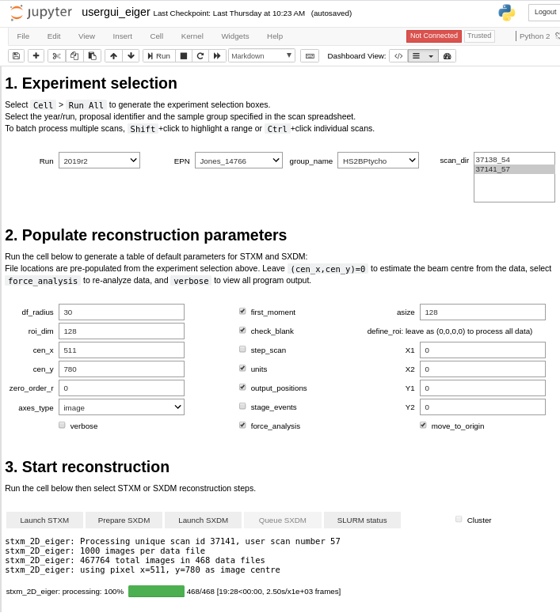
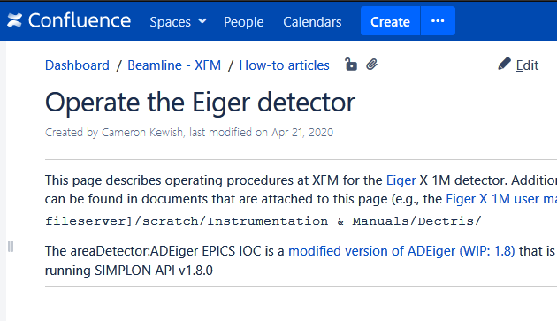
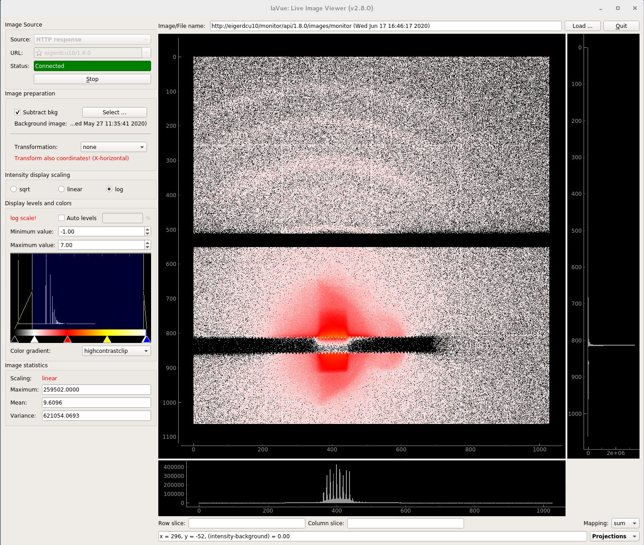
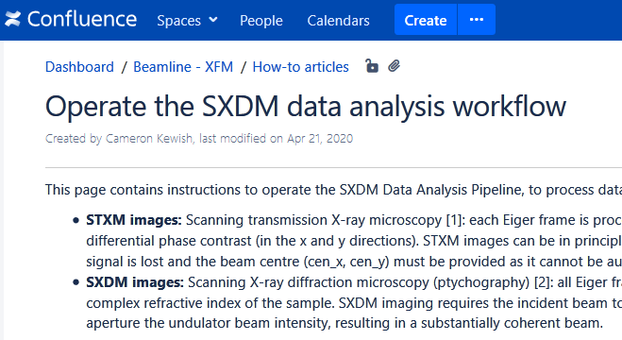
Upgrade – Integration & Automation
What users & scientists see:
Most of the program code is hidden to flatten the learning curve for the users
XFM Users configure scans as normal in Excel sheet, maia_scan with “/camera” keyword to activate EIGER
EPICS areaDetector control GUI
EIGER Data Analysis GUI
Confluence pages
EIGER realtime view

Slide 24
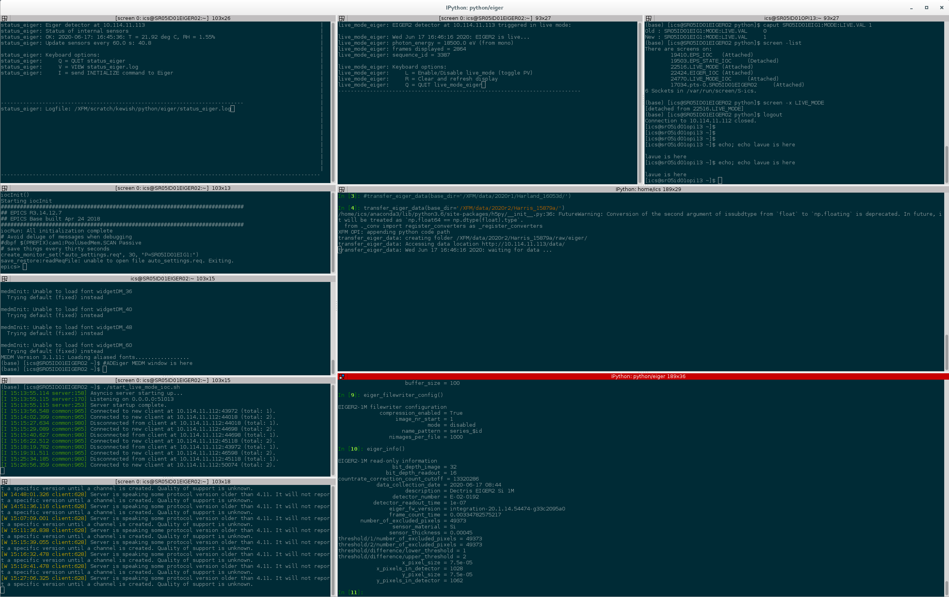
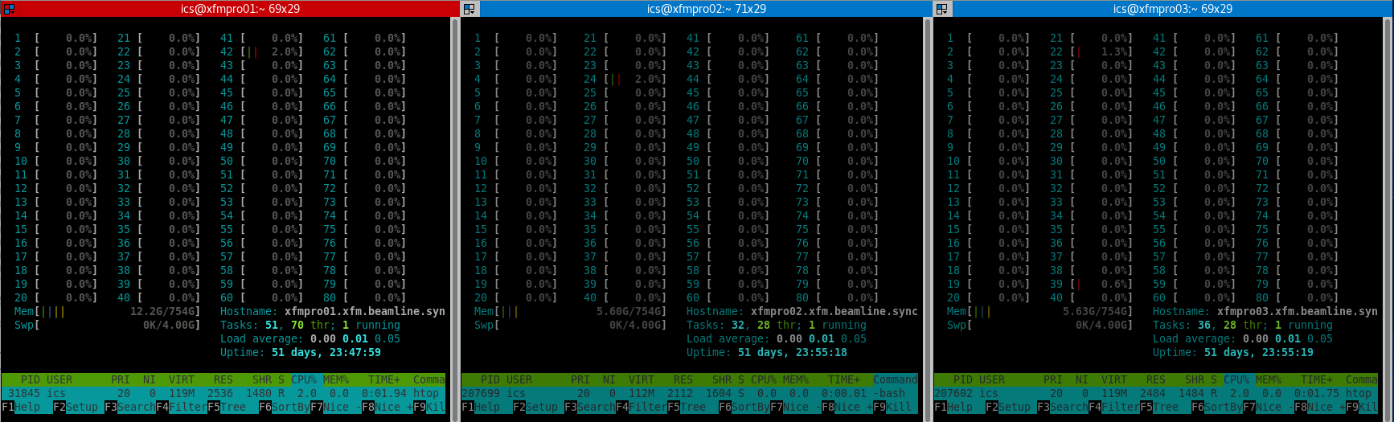
Upgrade – Integration & Automation
Behind the scenes:
Control and monitoring software runs on a virtual host
Data analysis pipeline is implemented both on ASCI and the SXDM cluster “xfmpro”
ASCI is accessible from anywhere
xfmpro is currently accessible only from onsite/VPN
EIGER temp & humidity
status logging
live mode status
live view console
areaDetector:ADEiger IOC
ADEiger MEDM console
data transfer daemon
xfmpro01
xfmpro02
xfmpro03
live mode control IOC
cluster status
EPS status IOC
status logging

Slide 25
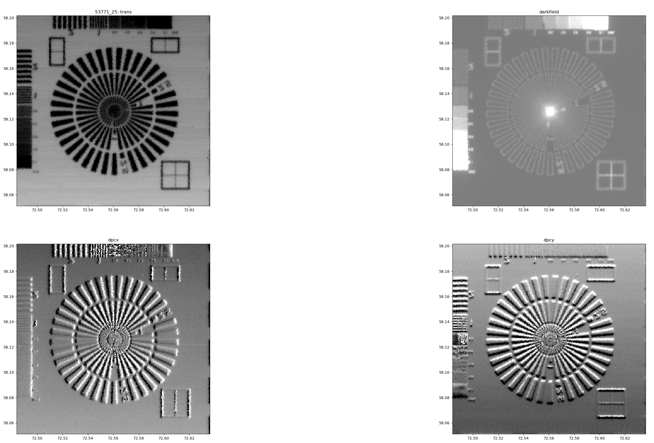
Scanning transmission X-ray microscopy
STXM - resolution (point spread function) defined by beam
  image size determined by scan points
  each frame yields 1 pixel:
Transmission
  integrated intensity in each frame
Darkfield
  integrated scatter outside beam
Differential phase contrast (DPC)
  vertical and horizontal displacement
  gradient of the refractive index
transmission
darkfield
horizontal DPC
vertical DPC
A. Menzel et al., Ultramicroscopy 110, 1143 (2010)

Slide 26
Fast scanning achievements
Scanning speeds (and data quantities) have increased by orders of magnitude
In development, 20 x 20 µm² area could take >1 hour, at 1 µm/s scan velocity
EIGER2 high intensity capability and dead-time free framing permits >250 µm/s
Gigapixel nanoscale imaging of geosamples and biosamples is achievable
Frame rate
10 Hz
20 Hz
40 Hz
50 Hz
160 Hz
300 Hz
2500 Hz
5 gigapixel ptychography
image acquired in 179 min

Slide 27
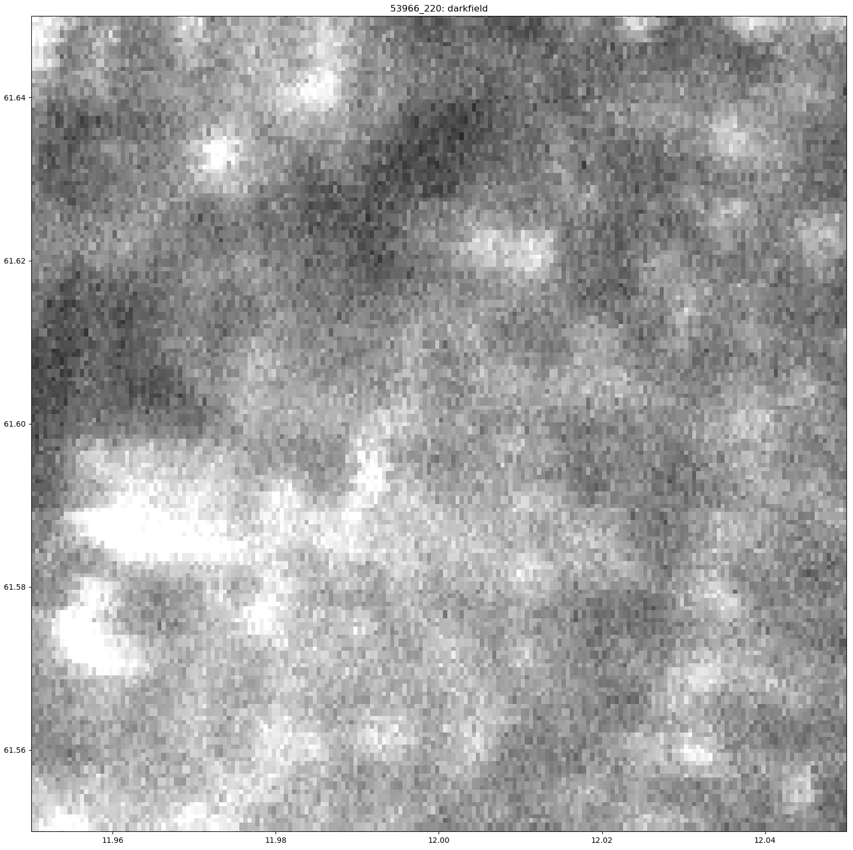
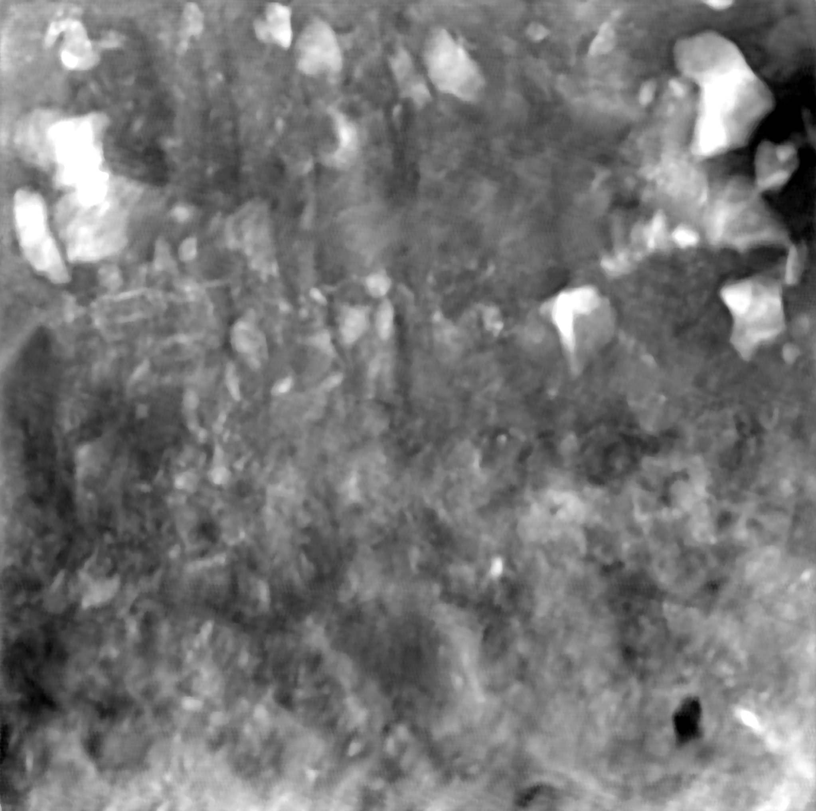
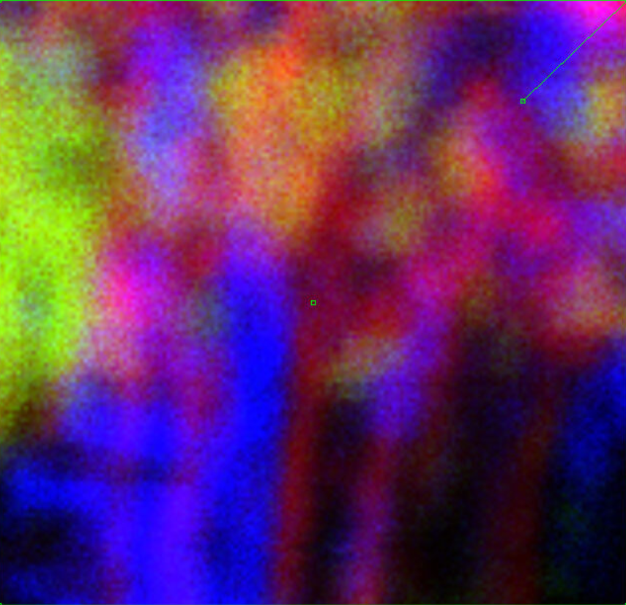
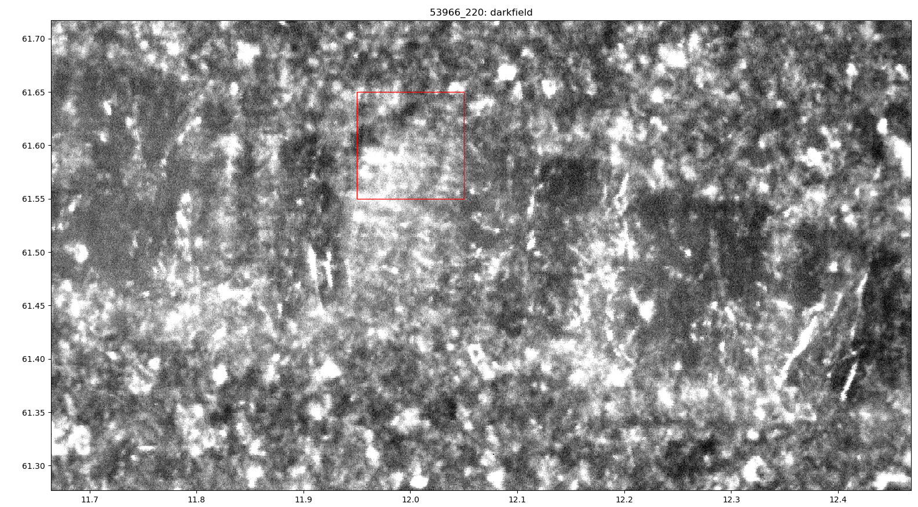
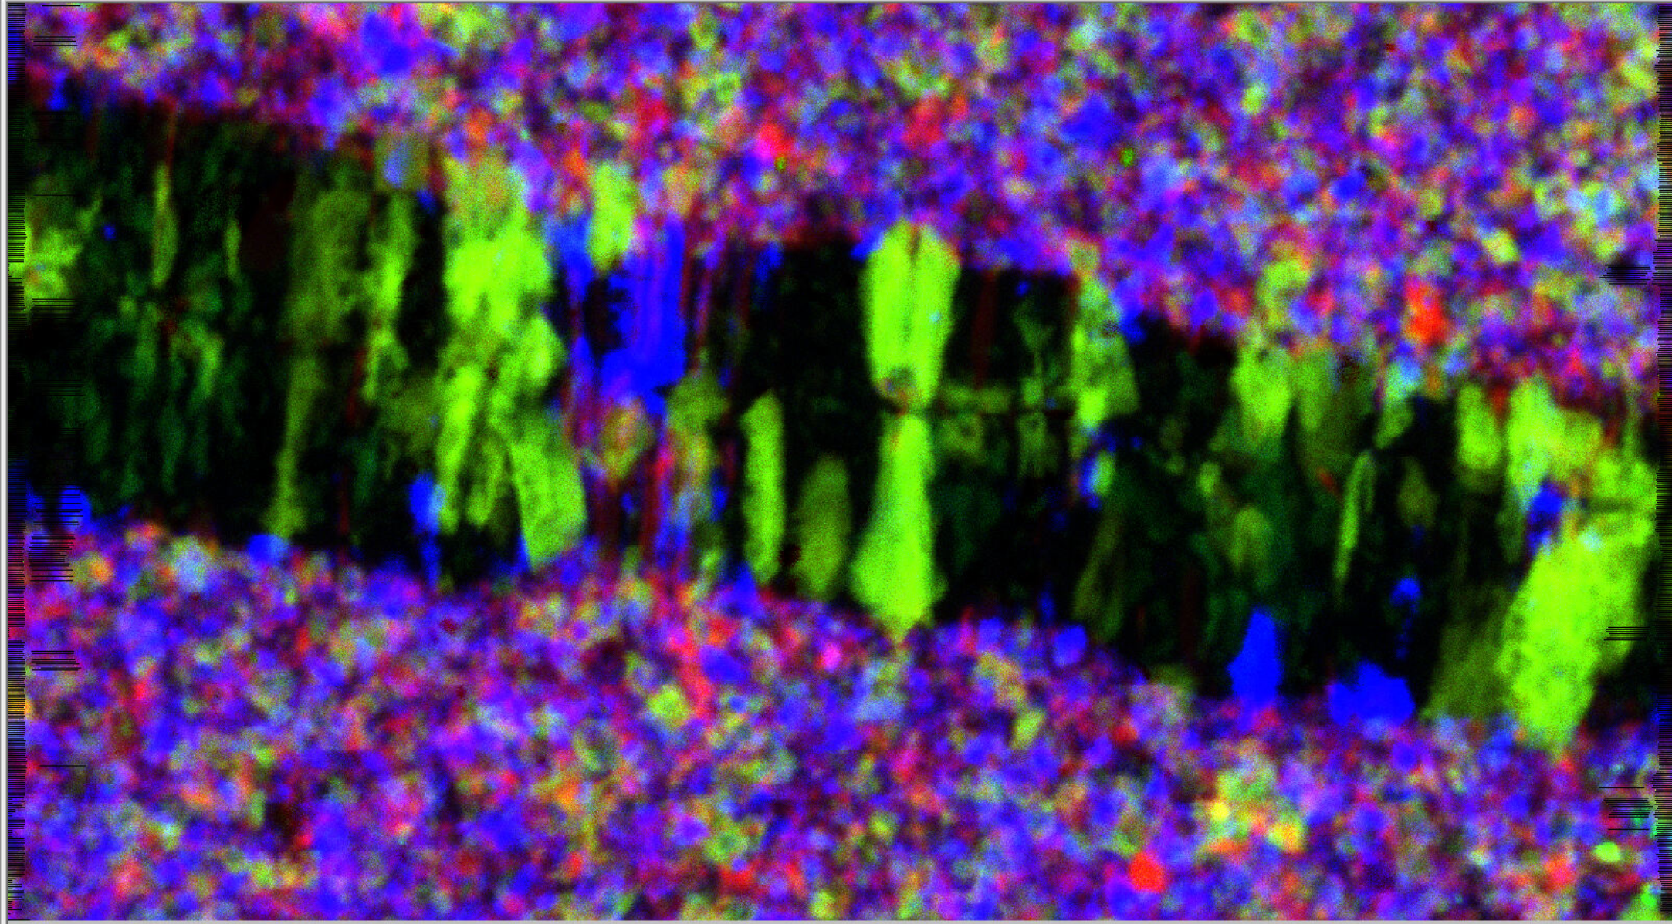
Large area, high resolution
Sample from C. Schrank (QUT)
19 micron thin section of geosample
Scan area: 800 × 440 µm²
Scan velocity: 150 µm/s
Exposure time: 3.33 ms (300 Hz)
Total scan time: 79 min
Total data: 1.4 million diffraction patterns
Ptychography total image size: 523 megapixels
SXDM phase – 25 nm pixels
XFM - FeMnK
STXM darkfield – 0.5 µm pixels
100 µm
20 µm

Slide 28
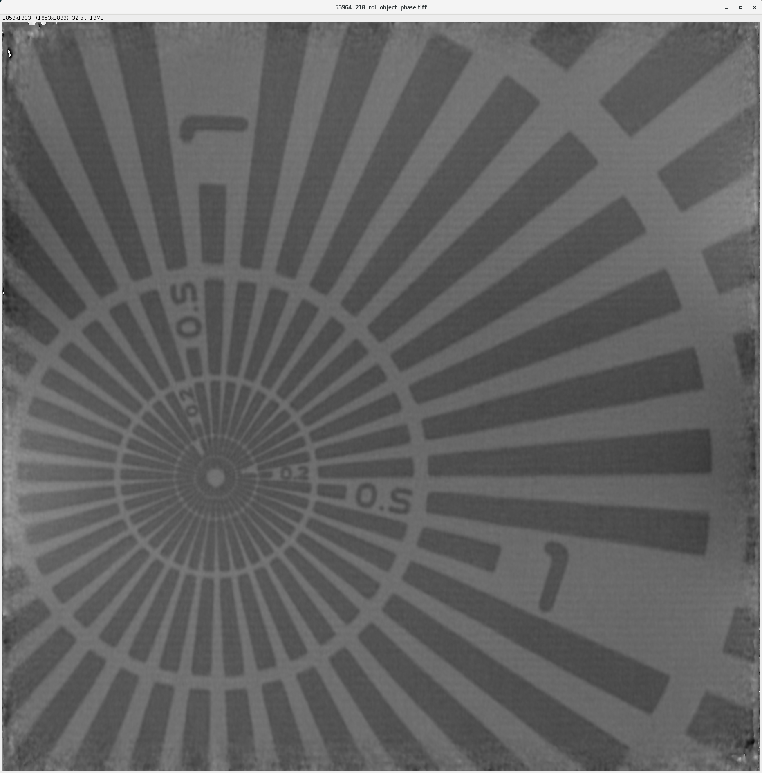
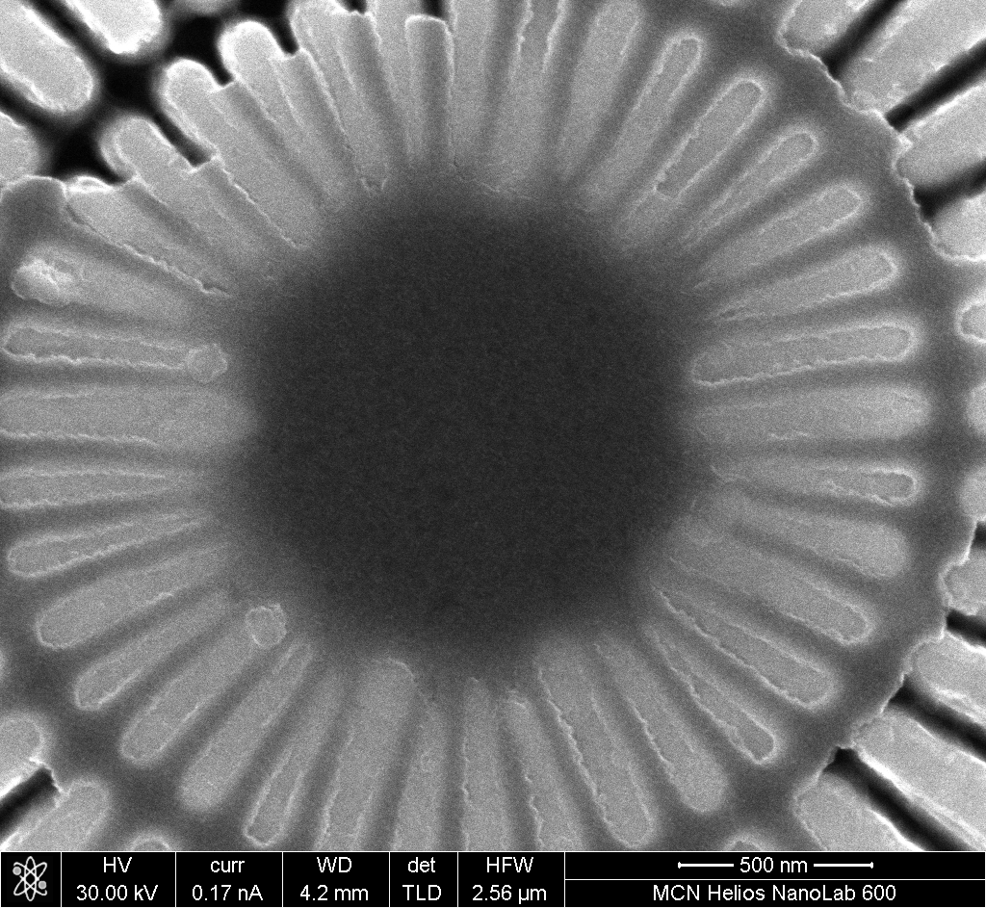
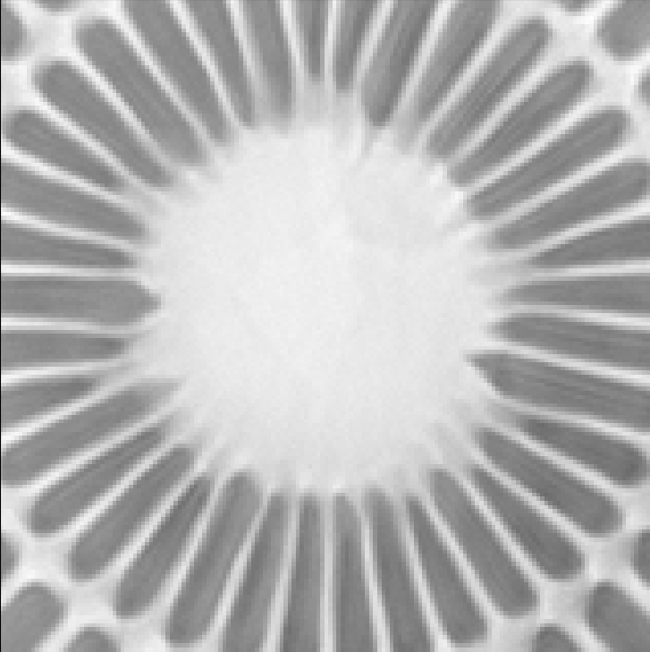
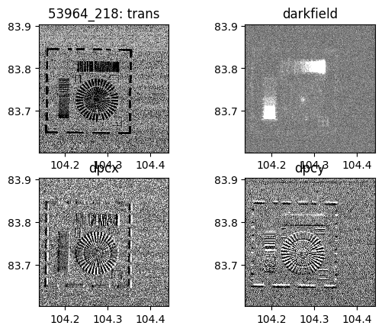
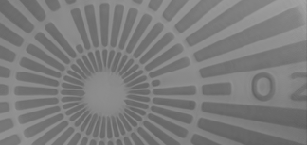
Fast scanning ptychography
300 nm-thick Au-Cr Siemens star
Scan area: 300 × 350 µm²
Scan velocity: 250 µm/s
Exposure time: 0.4 ms (2500 Hz)
Total scan time: 12.5 min
Total data: 1.86 million diffraction patterns
SXDM phase
0.2 µm ring can be clearly resolved
from scans with 0.4 ms exposures
SEM
14 nm pixels
STXM transmission
Each EIGER frame is integrated to give a transmission pixel.
Average intensity: 14500 photons/frame including direct beam
8-bit readout:
intensity was
<6e5 ph/pixel/sec
All features including <50 nm are resolved with 20 ms exposures
100 µm

Slide 29

Geoscience – Correlated XFM & phase
M. W. M. Jones¹, C. Schrank¹, G. A. van Riessen², C. M. Kewish³
Formation of calcite veins in shale:
Solid arrows in C and D show a break in the nano-crystallites accommodating the fibrous calcite growth that coincides with small Zn-rich grains.
Thin arrows highlight an interface of calcite grains with euhedral quartz crystals decorating the vein surface. This interface has a width of ~250 nm and served as fluid pathway for Cu mineralization.
XFM – Ca
10 µm pixels
microscope
¹ Queensland University of Technology
² La Trobe University
³ ANSTO Australian Synchrotron
SXDM
47 nm pixels
XFM
100 nm pixels

Slide 30



Dynamic processes – fatigue cracking
SXDM – phase
50 nm pixels
G. N. Hinsley¹, G. A. van Riessen¹, C. M. Kewish²
Fatigue fracture in sub-micron Ni thin films:
Ni film on thin Kapton, secured in a loading rig. One end is attached to a stepper motor, controlled via EPICS IOC on a Raspberry Pi.
SXDM repeated after N load-unload cycles consisting of X% film length increase. Time between scans is 3 minutes.
Darkfield quantifies total scatter at each point
A sub-micron crack is observed appearing
crack
STXM – darkfield
300 nm pixels
¹La Trobe University
²ANSTO Australian Synchrotron
(manuscript in preparation)

Slide 31






New XFM capabilities
In addition to SXDM, EIGER2 enables: µ-diffraction and µ-SAXS experiments
Detector distances from 3.88 m (SXDM/µ-SAXS) → 0.03 m (<3Å µ-XRD) have been used
P. Berntsen¹, C. Darmanin¹, B. Abbey¹, T. Greaves², A. Martin², C. M. Kewish³
sample
0.8 m
EIGER2
XFM controls
XFM setup
EIGER2 data
online view
µSAXS
profile
stable sample jet with
ASU
injector
HPLC pump
sample
injector
Preliminary result: pressure dependence in peaks from monoolein (LCP) Pn3m phase
HPLC pressure data recorded with each EIGER2 frame
Background
corrected
EIGER2
µSAXS
data
¹ LTU
² RMIT
³ ANSTO

Slide 32



ANSTO Australian Synchrotron
3 GeV machine: 4000+ research visits/year
10 Beamlines: Operational since 2008
IMBL: Imaging and Medical Therapy
IRM: High-Resolution Infrared Microspectroscopy
THz: Terahertz/Far-Infrared Fourier Transform Spectroscopy
PD: Powder Diffraction
MX-1/2: Macromolecular Crystallography 1 & 2
SXR/SXR-I: Soft X-ray Spectroscopy & Imaging
SAXS-WAXS: Small Angle X-ray Scattering/Wide Angle X-ray Scattering
XAS: X-ray Absorption Spectroscopy
XFM: X-ray Fluorescence Microspectroscopy & Ptychography
ADS Building
Project BRIGHT: 2018-2026
MCT: Micro Computed Tomography
MEX-1/2: Medium Energy X-ray Absorption Spectroscopy 1 & 2
BioSAXS: Biological Small-Angle X-ray Scattering
ADS-1/2: Advanced Diffraction and Scattering 1 & 2
MX-3: Macromolecular Crystallography 3
Nanoprobe: Multimodal Fluorescence Nanospectroscopy & Ptychography
Nanoprobe Satellite Building
https://www.ansto.gov.au/research/facilities/australian-synchrotron/project-bright

Slide 33






Nanoprobe
Capability targets
  XANES spectroscopy
  Elemental Mapping
  Multi-element mapping
  @ sub-100-nm resolution
Zn K Se
  Elemental Tomography
  XANES fingerprinting of chemical coordination environment
SAXS of ellipsoidal microvoids
Window scatter
(isotropic)
  Advanced high-resolution methods
Beam stop
WAXS of (0002) graphitic planes aligned along the fibre
Diffraction, nano-WAXS
Industrial insights
Ultra-high resolution ptychographic imaging
  Complementary & emerging methods
Fluorescence tomography

Slide 34

  Mapping sensitivity & resolution
Simultaneous mapping of 10+ elements:
Hard X-ray range: 5-17 keV (DMM)
K-edge: Si – Sr; L-edge: ~Ag – Po
Extremely High sensitivity: ppb; sub-µM
XFM (DMM)
ppb
LA-ICP-MS
Sensitivity
Nanoprobe
XFM (today)
EJ New Dalton Trans
(2013), 42(9) pp 3210
LMD-LA-ICP-MS
Native contrast: no dyes or contrast agents necessary
can be used to provide functional/biomarker information
Quantitative
Non-destructive / minor damage
Extended penetration & depth-of-field:
intact cells, organisms & tissue sections
ppm
PIXE
SEM-EDX
0.1 μm
1 μm
10 μm
100 μm
Spatial resolution
Sensitive to chemical speciation via XANES (DCM)
K-edge: Ti – Sr; L-edge: Cd(L_{III}) – Po
Notes:
This sensitivity corresponds to about 120,000 Fe atoms within the ~200 nm focus

Slide 35
Quantitative 3D elemental microtomography of Cyclotella meneghiniana at 400-nm resolution
PNAS (2010)
35 h of measurement in 2010
Targeting 8 h at Nanoprobe

Slide 36

Ptychography – resolution beyond the probe size
Chlamydomonas (green algae) frozen-hydrated
  ~25 nm
  90 nm
Elemental distributions
Ptychographic imaging of ultrastructure provides key correlative insights
J. Deng, et al., Scientific Reports 7, 445 (2017)

Slide 37

  User Communities
  by
  Field-of-Research
  Earth
  Sci
  Cultural Heritage
  Agriculture
  Technology
  Engineering
  Physical
  Medical
  Chem
  Bio
  A large cross-section of XFM users can explore their samples in higher resolution at Nanoprobe
  Enviro
  XFM user FoRs

Slide 38


Nanoprobe
IMBL
ADS

Slide 39
Capability targets
  A high-end x-ray fluorescence Nanoprobe will commence operation @ the AS in mid-2024.
  The Nanoprobe will bring multiple tools for interrogating
  high-nano-scale elemental distributions (Z>14, Si) and
  ultra high resolution ultrastructural imaging
  Now is the time to develop capabilities & skills, and
  to establish requirements with the Nanoprobe.
  email: as_nano@ansto.gov.au
  website: https://www.ansto.gov.au/x-ray-fluorescence-nanoprobe-beamline
  XANES spectroscopy
  Elemental Mapping
  Multi-element mapping
  @ sub-100-nm resolution
Zn K Se
  XANES fingerprinting of chemical coordination environment
SAXS of ellipsoidal microvoids
Window scatter
(isotropic)
Beam stop
  Elemental Tomography
  Advanced high-resolution methods
WAXS of (0002) graphitic planes aligned along the fibre
Insights into Industrial processing
  Complementary & emerging methods
Ultra-high resolution ptychographic imaging
Fluorescence tomography

Slide 40
Acknowledgments
D. Paterson, D. Howard, N. Afshar, M. de Jonge, J. Reinhardt
ANSTO: Controls, Sci Comp, IT, SAXS, Elec Eng, Stores, PMO, Finance, Legal
CSIRO MAIA team: R. Kirkham, C. Ryan
La Trobe University: van Riessen group, Abbey group
PtyPy Developers: B. Enders, P. Thibault, A. Parsons, et al.
XFM Ptychography Power Users:
G. van Riessen & G. Hinsley, M. Jones, N. Phillips
Early Adopter Users of ptychography at XFM:
La Trobe, QUT, RMIT, Deakin, ANU,
Univ. Paris, Univ. BC
BRIGHT Nanoprobe team
Questions & comments:
cameronk@ansto.gov.au

