Slide 1
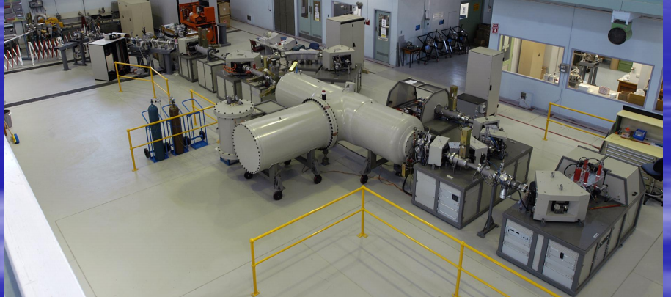
Computer Control System for STAR@ANSTO
Outline
Introduction of STAR
Computer Control System
Development and Operation
The Plan of Development in the Future

Slide 2
Introduction of STAR Facility
STAR is a 2MV tandetron accelerator that can perform both IBA and AMS analyses from HVEE.
STAR has three ion sources which include two duoplasmatron sources for hydrogen and helium, and a solid target sputter source used primarily for ionising carbon samples for AMS.
The STAR accelerator currently has 3 beamlines, a multi-elemental surface analysis beamline (SIBA1), a high-resolution depth profiling and irradiation beamline (SIBA2), and a 14C beamline (AMS).

Slide 3
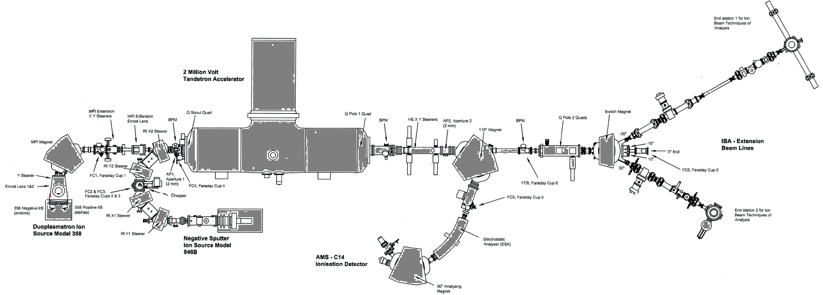
Introduction of STAR Facility

Slide 4
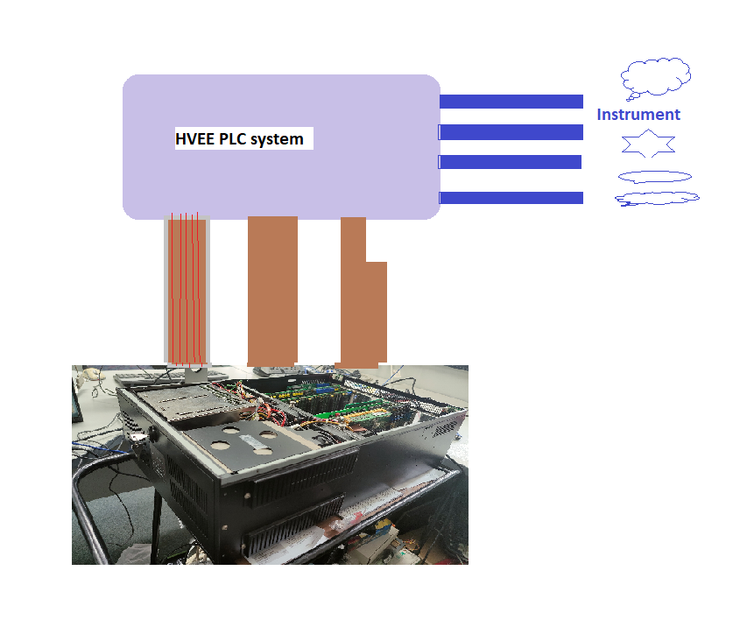
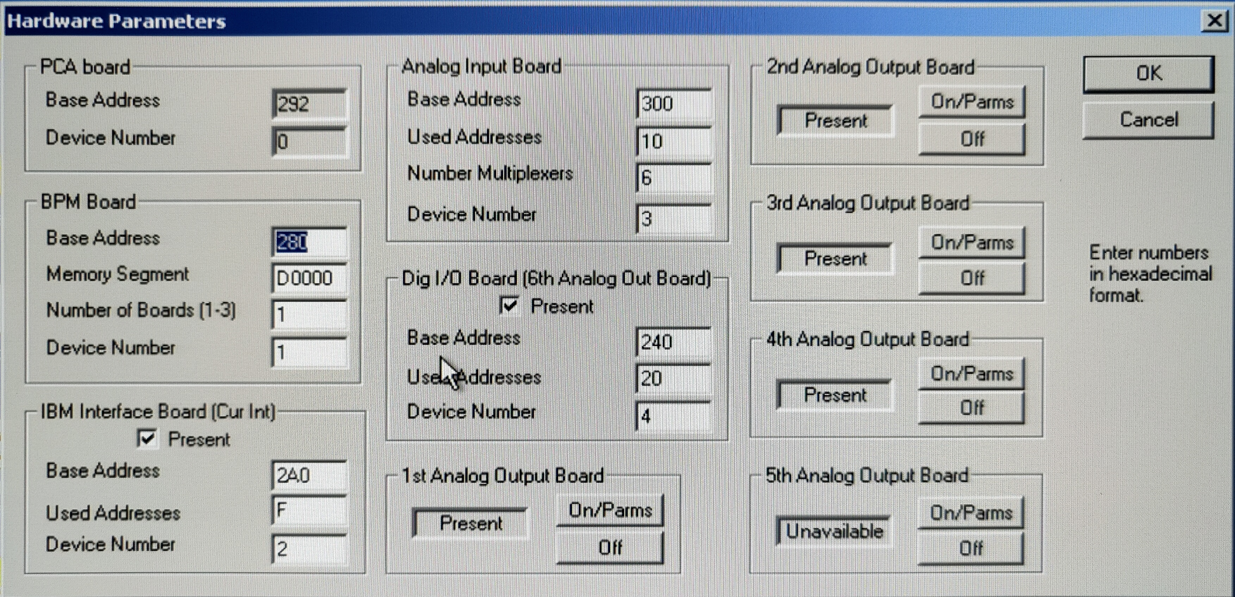
Computer Control System
Optical Cables
STAR Control System includes
  Main and AMS ion source control computer
I/O boards
  Analogue Input/Output, PCL 726/818
  Digital Input/Output, PCL 722
  Serial communication
  BPM input board
  Trump 2K Data analysis board
  Galil motion boards
Control about 230 PVs
Instrument and PLC are connected by optical cables
All-In-One

Slide 5
Computer Control System (cont’d)
Original Control System
  Pentium III CPU with single board computer + backplane,
  Windows NT + Visual C++ 6 for devel,
  HVEE provided Executable control program packages,
  HVEE C14-OS and WinRT instrument driver package,
    C14-OS, C14-OS settings, IO configure, Ion source control,
    HVEE provide limited technical support.
  All Input/output are legacy ISA cards,
  Limited development for same type control instrument.
  Special power supply with -5 Volts for ISA boards

Slide 6
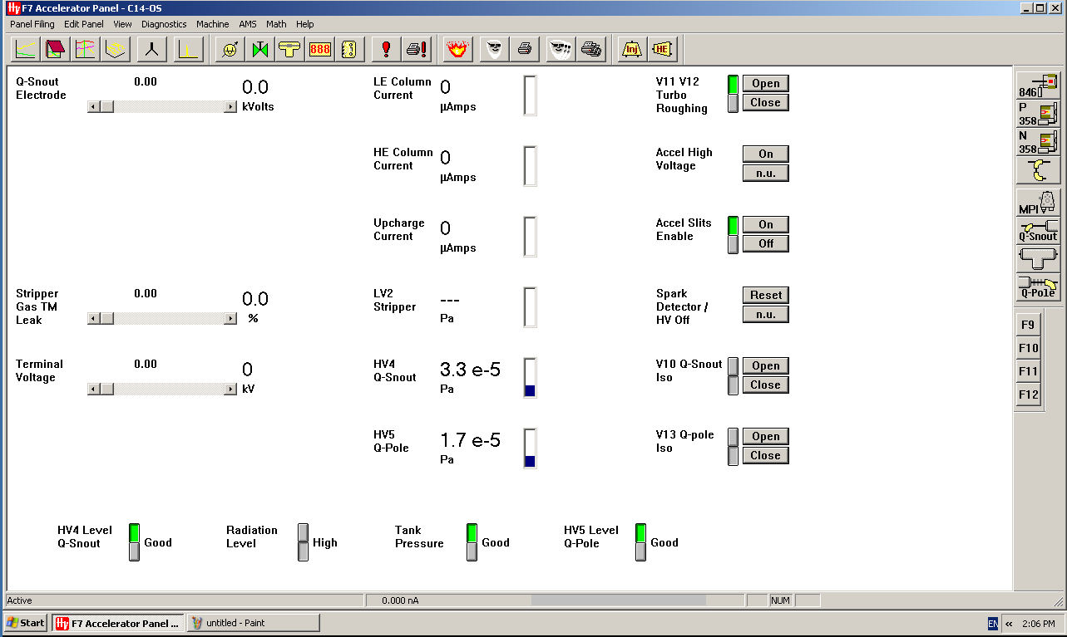
C14-OS Graphic Operation

Slide 7
Computer Control System (cont’d)
Upgrading From Windows NT -> Windows XP in 2010
Requested C14-OS source code from HVEE,
Purchased WinRT driver package for Win XP,
Migrated all code for Visual C++ from 6.0 to 9.0 in Visual Studio 2008.
New Chassis, new backplane, new SBC with Intel Core 2 Due CPU.
Created new drivers for all IO boards in “New WinXP” using HVEE WinRT package. WinRT is also a support package for C14-OS.
Developed new interfaces for different hardware such as vacuum gauge.
Fixed various problems during hardware adopted for new system.
Developed 110 degree magnet control by field value using CNA device from Group3.

Slide 8
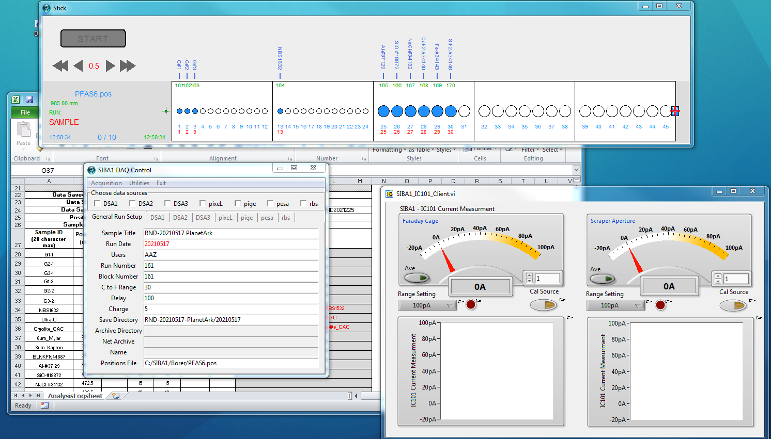
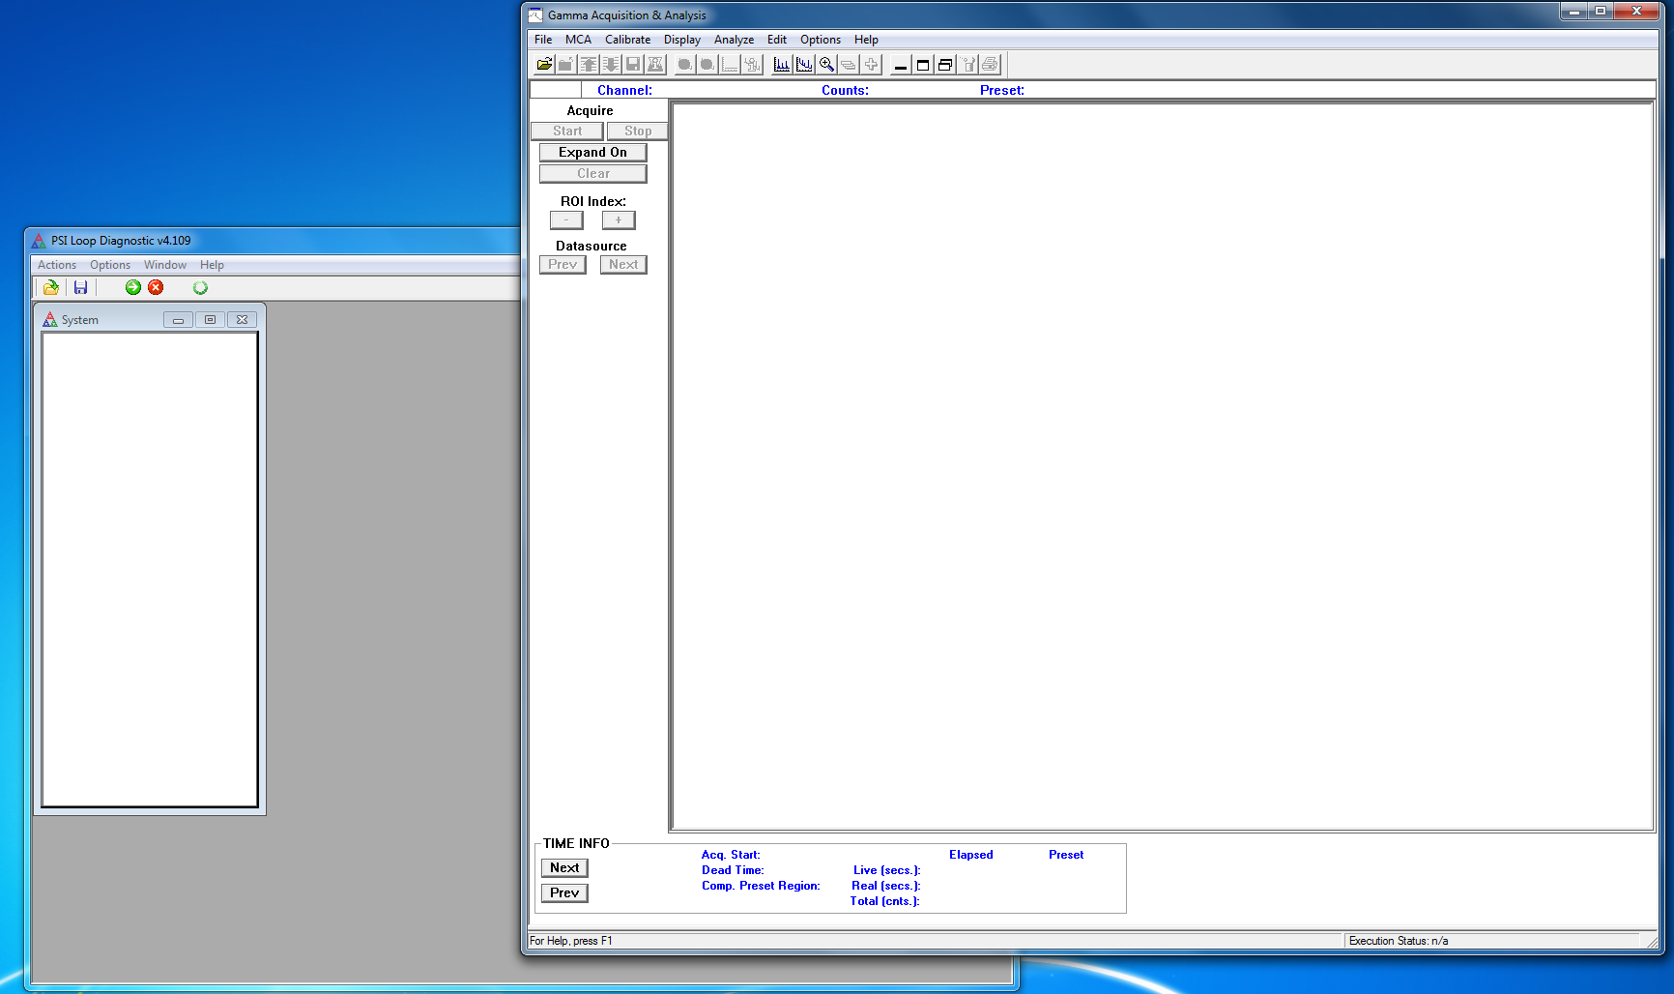
DAQ Control System for Each End Station
SIBA1 – Ion Beam analysis using PIXE,PIGE,PESA,RBS.
SIBA2 – Time of Fly and Irradiation.
C14 AMS Measurement
  C14-OS built in AMS analysis Package
SIBA1
SIBA2

Slide 9
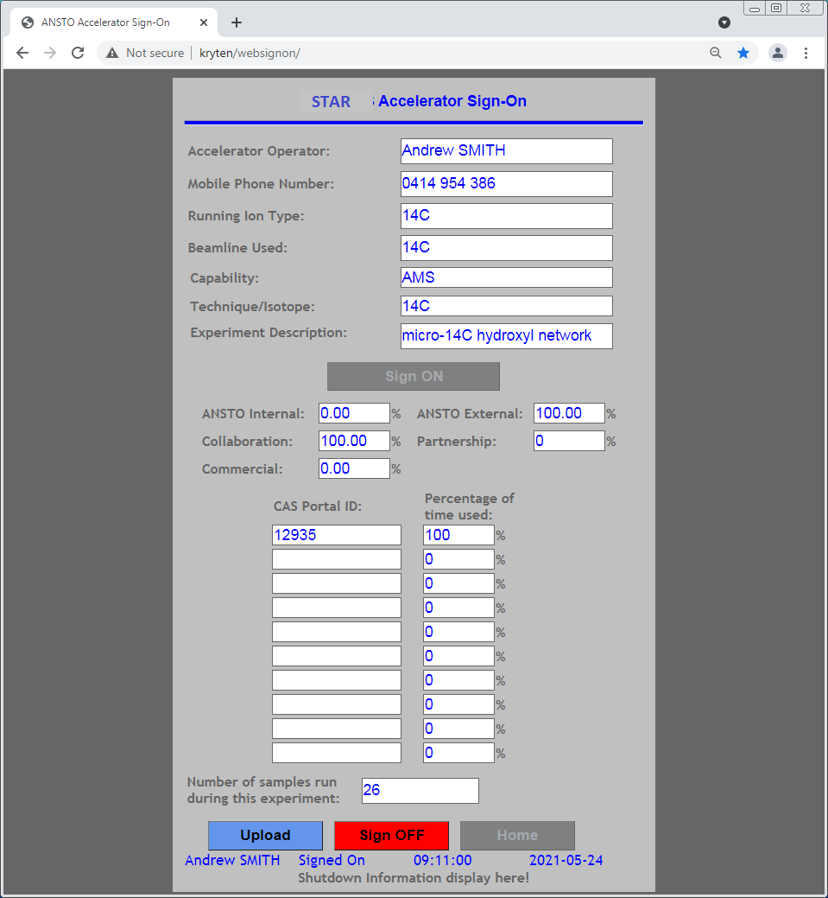
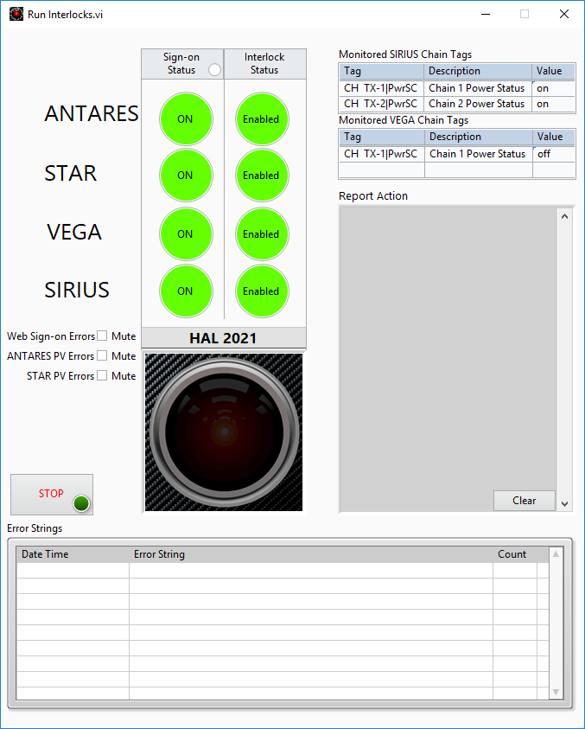
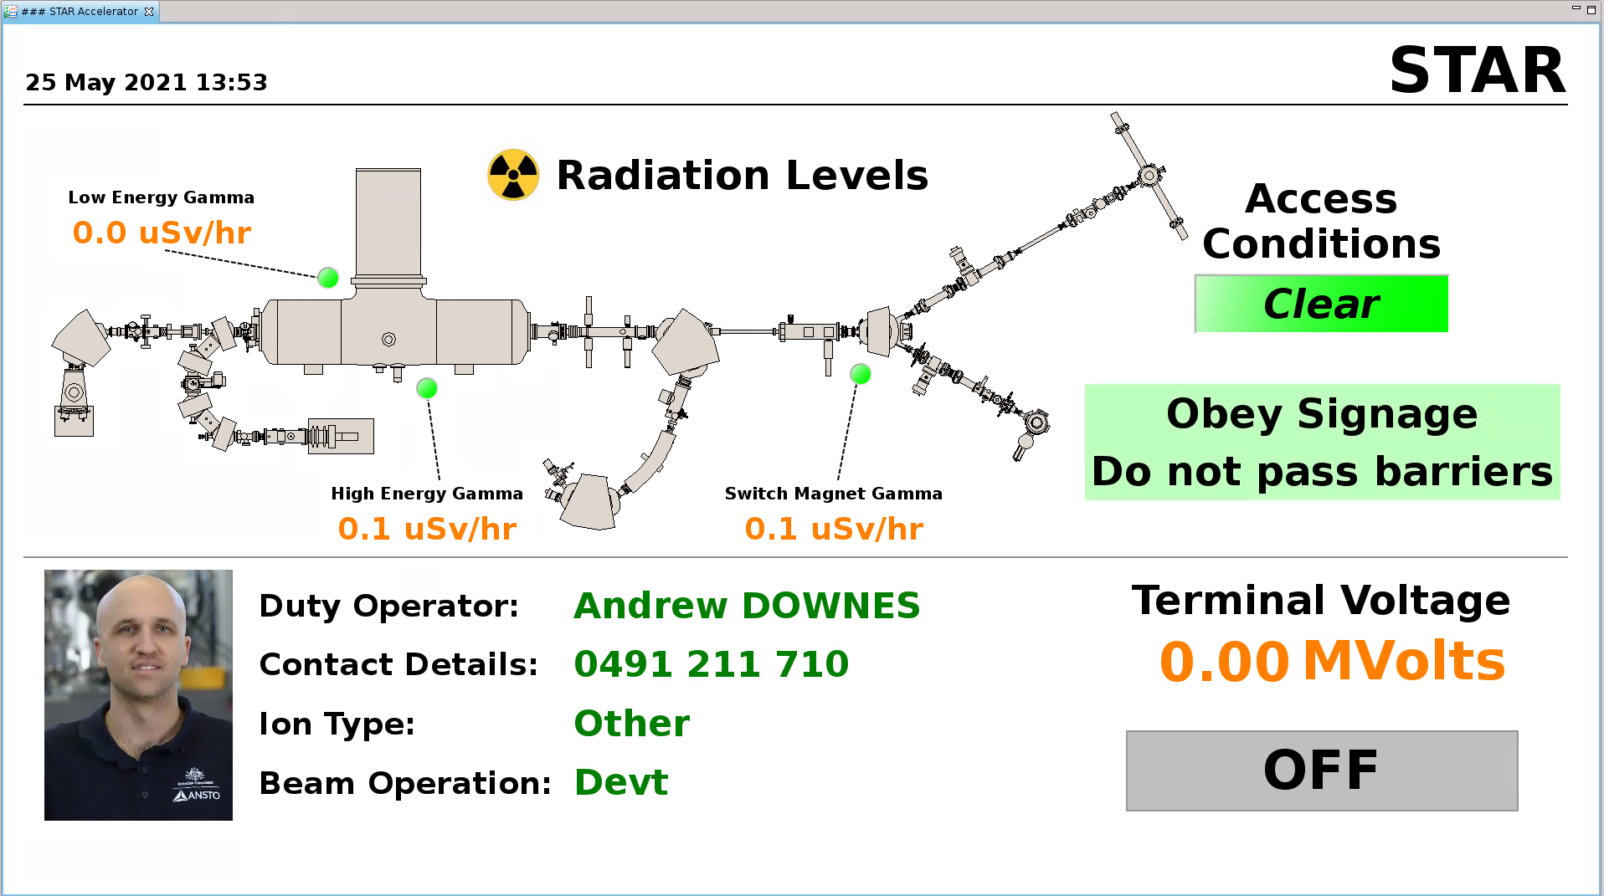
Operation and Development
Accelerator Sign-On system
  Accelerator usage Data collection
  Operation display
  System inter-lock
C14-OS Operation
  Operated by licensed people,
  Different DAQ system in SABA1 and SIBA2.
Failed to building in EPICS CA server.
More devels from user’s requirement.
System backup and maintenance regularly.

Slide 10
Experience and Lessons from Opt&Devel
It is not a good Idea that Control System is built up with All-in-One.
Main control and several sub-stations can be easy for operation and maintenance.
Legacy equipment is also a issue to upgrade and maintenance.
Analogue I/O PCL boards requires multiple voltage ranges: ±10V, ±5V, 0-5V, 0-10V and 2-20 mA current loop.
Latest most of PSU without -5V power supply, We got troubles in weeks ago.

Slide 11
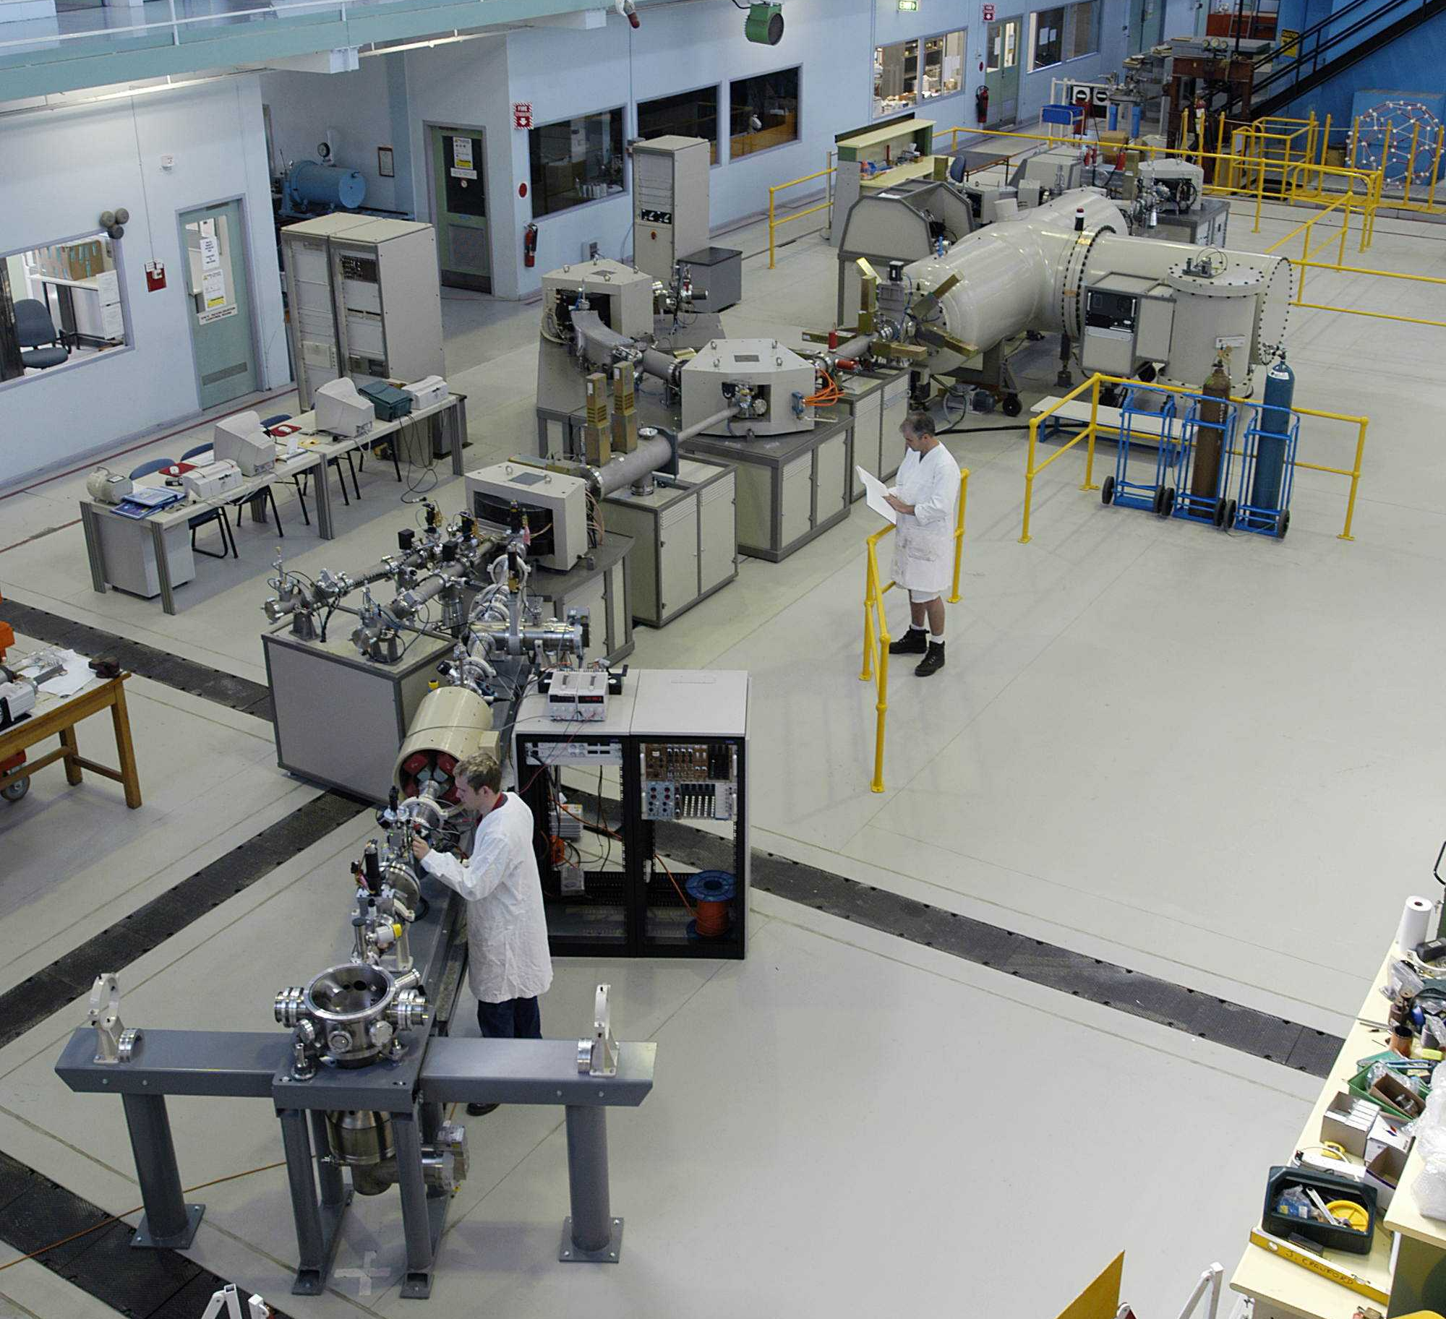
STAR Control System Future Upgrade Plan
STAR Control System Upgrade will be considered within EPICS frame
  Option 1: Windows + EPICS + TwinCAT PLCs + EtherCAT
    We have already set up ANTARES, Gas Plant control using Ligo Tcioc package but we have some issues with consistence in different version. We need to fix issues even we select this option.
  Option 2: Linux + EPICS + TwinCAT PLCs + EtherCAT
    European Spallation Source had some previous works.
  Option 3: Linux + EPICS + Siemens S7 PLCs + EtherCAT
    PSI has already made some previous work. We can follow PSI project to make new development.
  Option X ????

Slide 12

