Slide 1

Script based GUI builder for instrument control and data treatment
Norman Xiong @ ACNS

Slide 2
What, Who and Why
A framework that loads simple Python code, and creates GUI accordingly.
Instrument scientists are the main users.
Allow users to contribute more in coding and features.

Slide 3
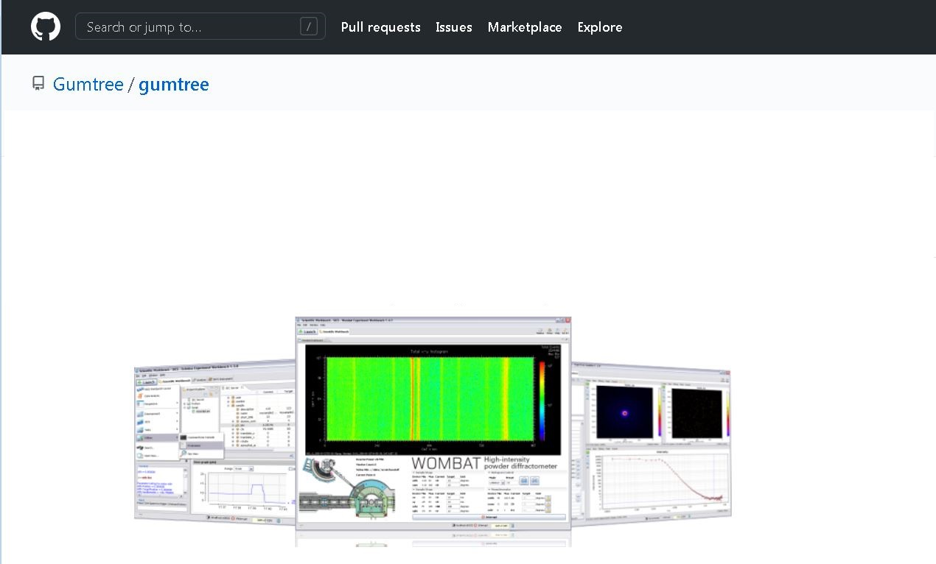
Java application framework for neutron scattering
Experiment control and data treatment
Has a server counterpart
Python scripting interface
Eclipse based IDE

Slide 4
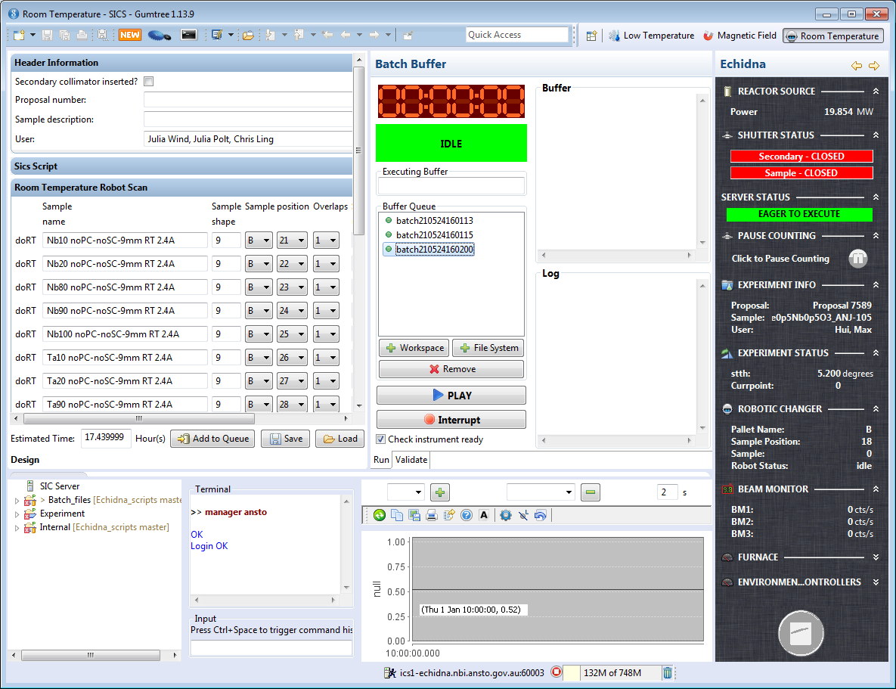
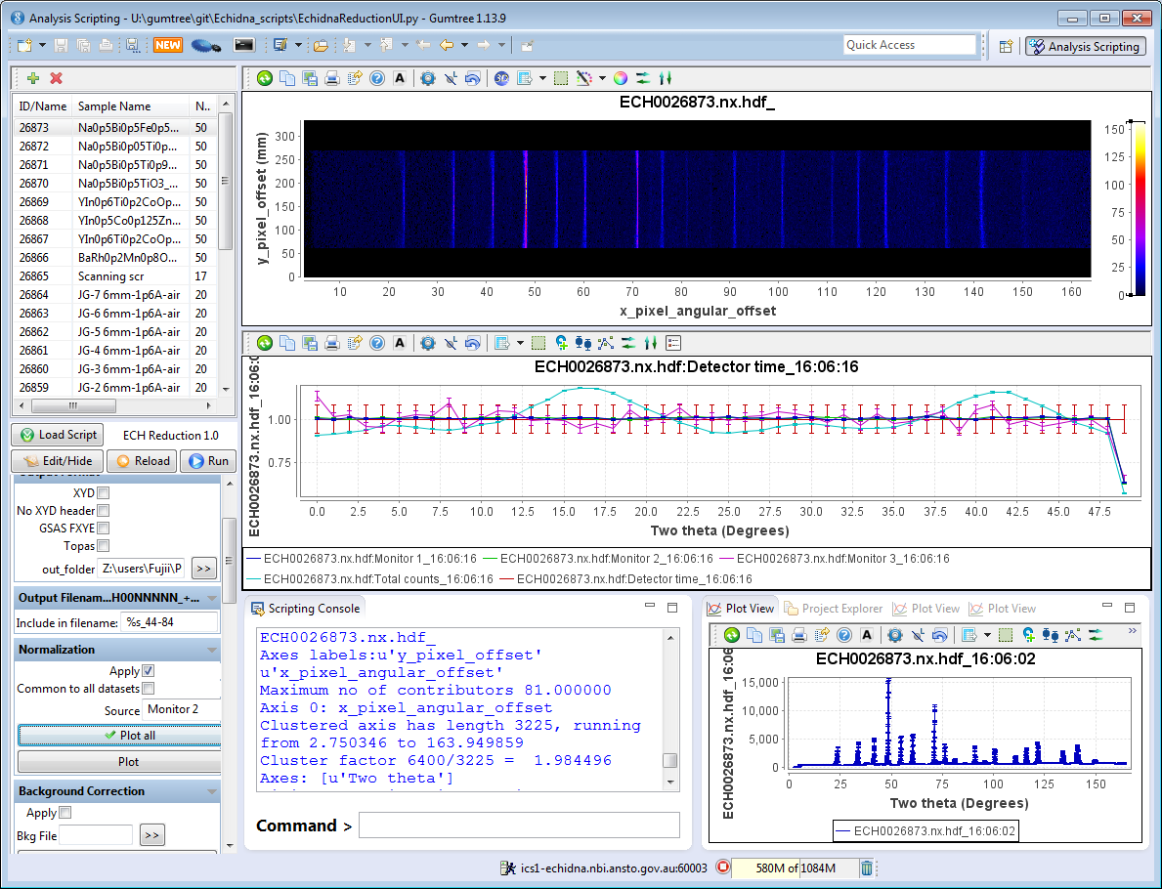
Gumtree workbench for the Echidna instrument

Slide 5
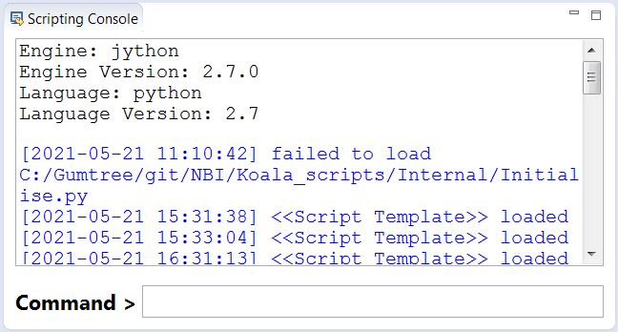
Python scripting interface
Jython (Java based Python) vs Jep (Java embedded CPython)
Numpy support

Slide 6
Example scripting code
Load raw data and create empty array:
Slicing and indexing
ds = df[61495] # load a 4-dimensional data
a = zeros([421, 421]) # create a 2-dimensional data
d0 = ds[0, 0] # get a 2D slice
ds[:, :, ::2, :] = 0 # set at every other slice
for d in ds : # iterate through 1st dimension
print d.shape
Access metadata
Export data to file storage
print ds.stth # get stth values
ds.save_copy(“D:/61459.rd.hdf”)

Slide 7
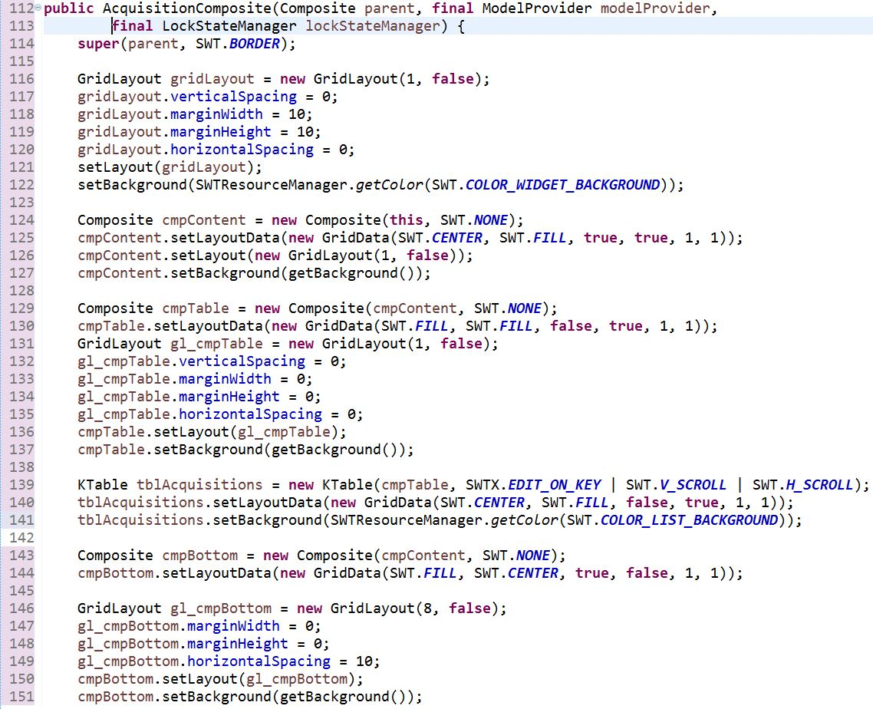
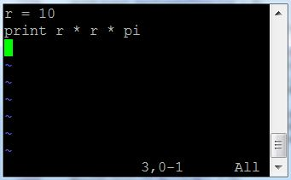

Help scientists to write their own code
Programmer’s GUI code
Scientist’s code
We want to offer this

Slide 8
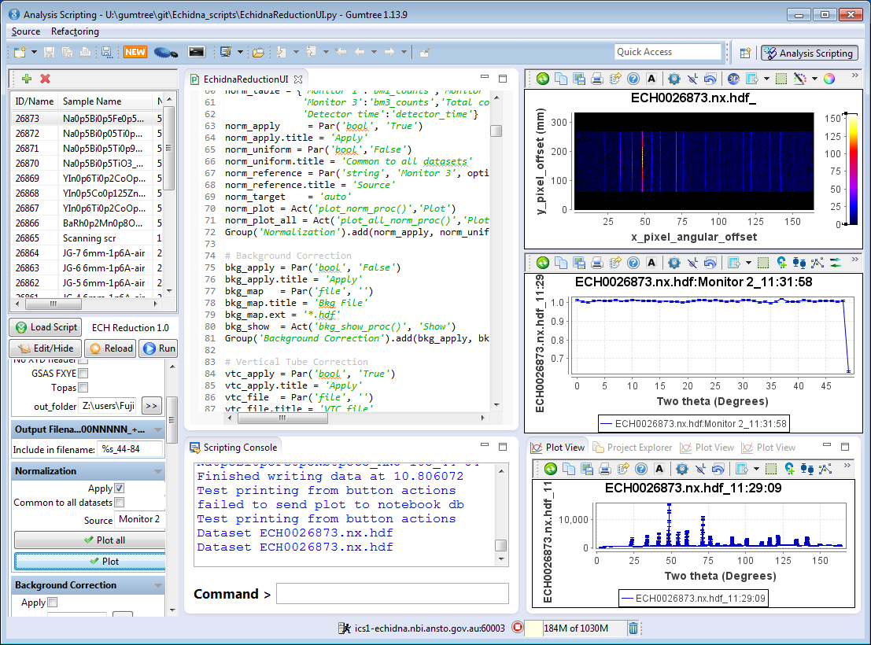
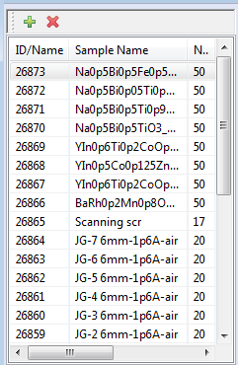
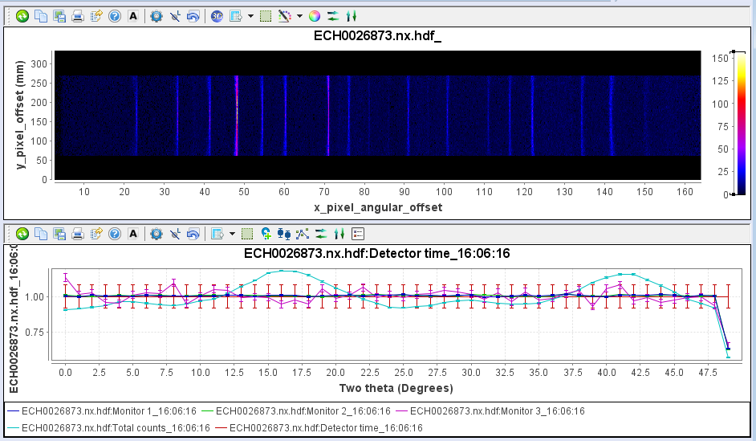
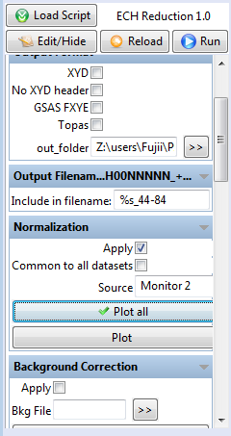
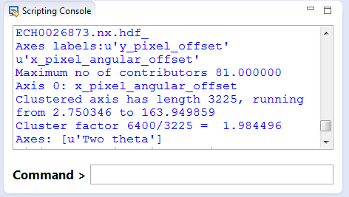
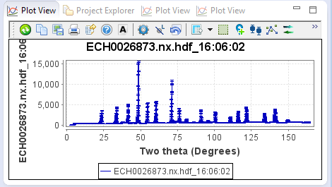
GUI scripting framework
Data file list
Plotting area
Control panel
Command line console
Multi-purpose area

Slide 9
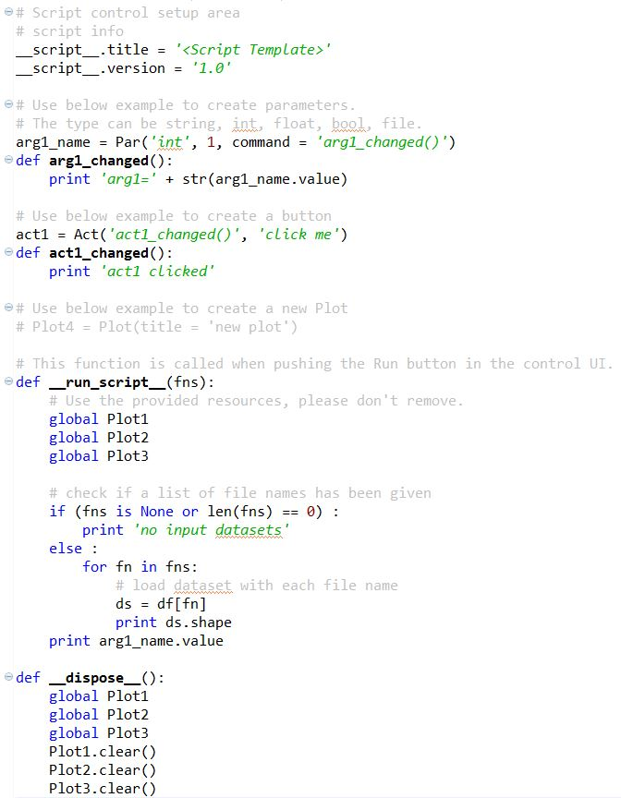
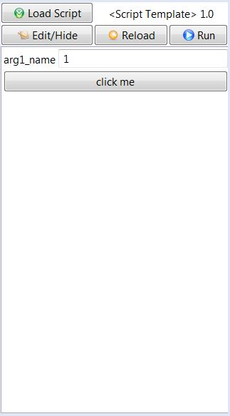
Script template

Slide 10

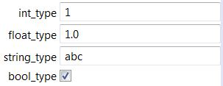

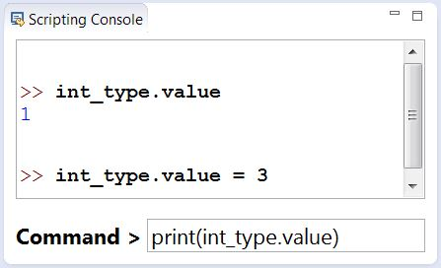

Frequently used GUI components
Par: for value inputs
  Construction
  Drop-down list
  Call the instance in the code

Slide 11

Frequently used GUI components 2
Act: for action buttons

Slide 12
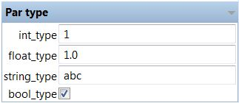
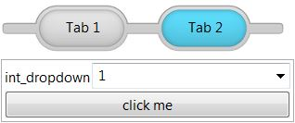
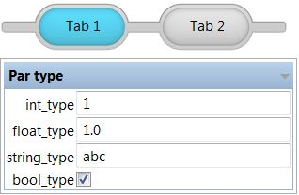
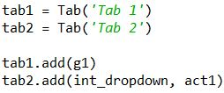
Group and tab
Group
Tabs

Slide 13
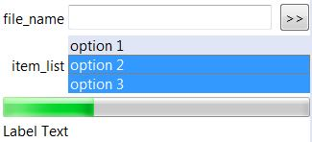

Other GUI components
File browser
Multi-selection list
Progress bar
Labels

Slide 14



Additional properties of Par objects
par.title
par.enabled
par.highlight
event handling
  onchange
  onfocus
  onblur

Slide 15


Additional properties of Act objects
act.title
act.tool_tip
act.highlight
act.enabled
event handling

Slide 16


Advanced GUI control
Add or remove GUI items at runtime
GUI alignment
  grid layout
  numColumns, colspan, rowspan, width, height …
Change colours
  .hightlight property
Error handling
  .error perperty

Slide 17

Instrument control objects
Control object
  device model
  scan interface

Slide 18
Data treatment library
Scientific computing library: more than numpy
  multi-dimensional array object
  mathematical operations
  error propagation
  carrying axes information
Easy access to HDF files.
Plotting library
Fitting support

Slide 19
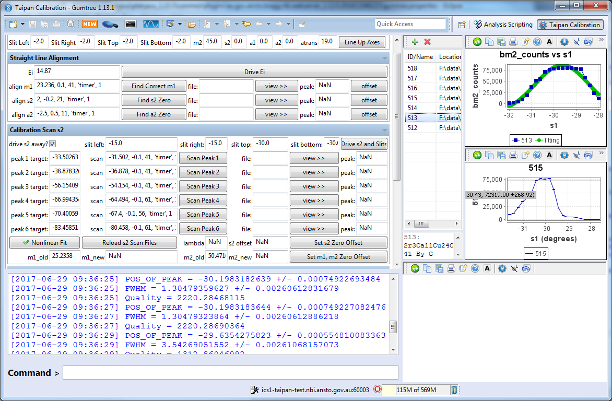
Example of applications

Slide 20
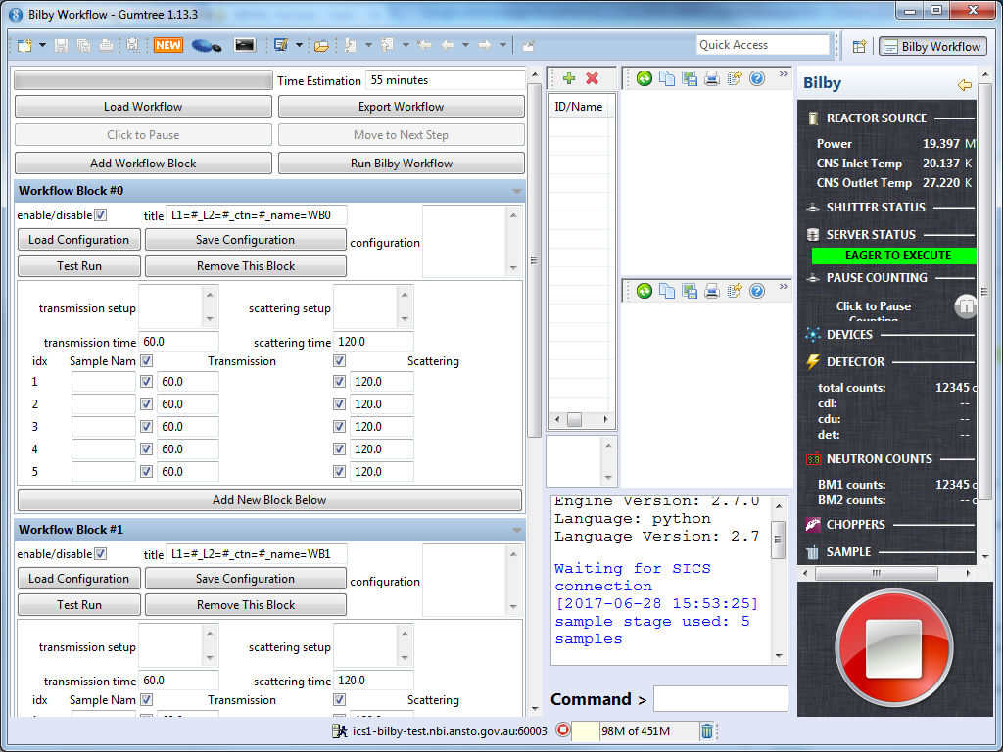
Example of Bilby workflow

Slide 21
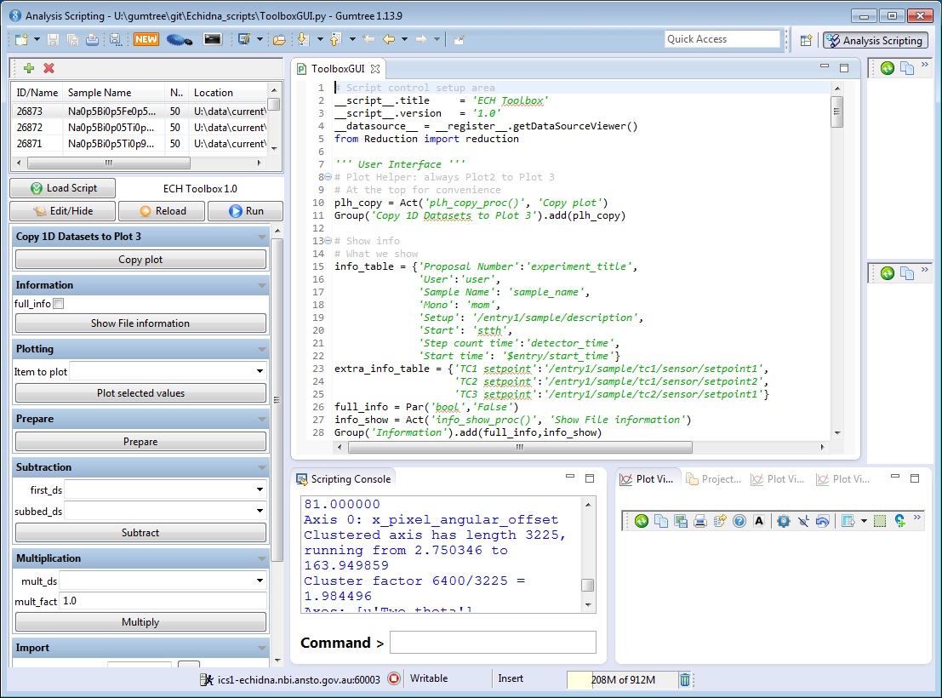
User’s code

Slide 22
Benefits
More user friendly interface
Add new features at runtime
Fix issues without re-deploying
Scientists are more interested in coding features

Slide 23
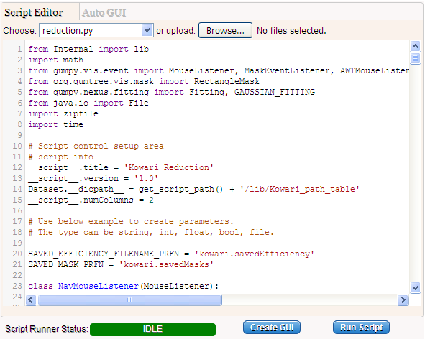
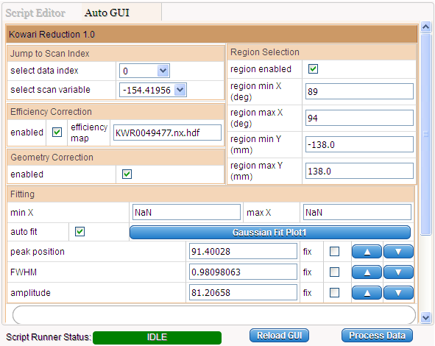
Data treatment in Cloud

Slide 24
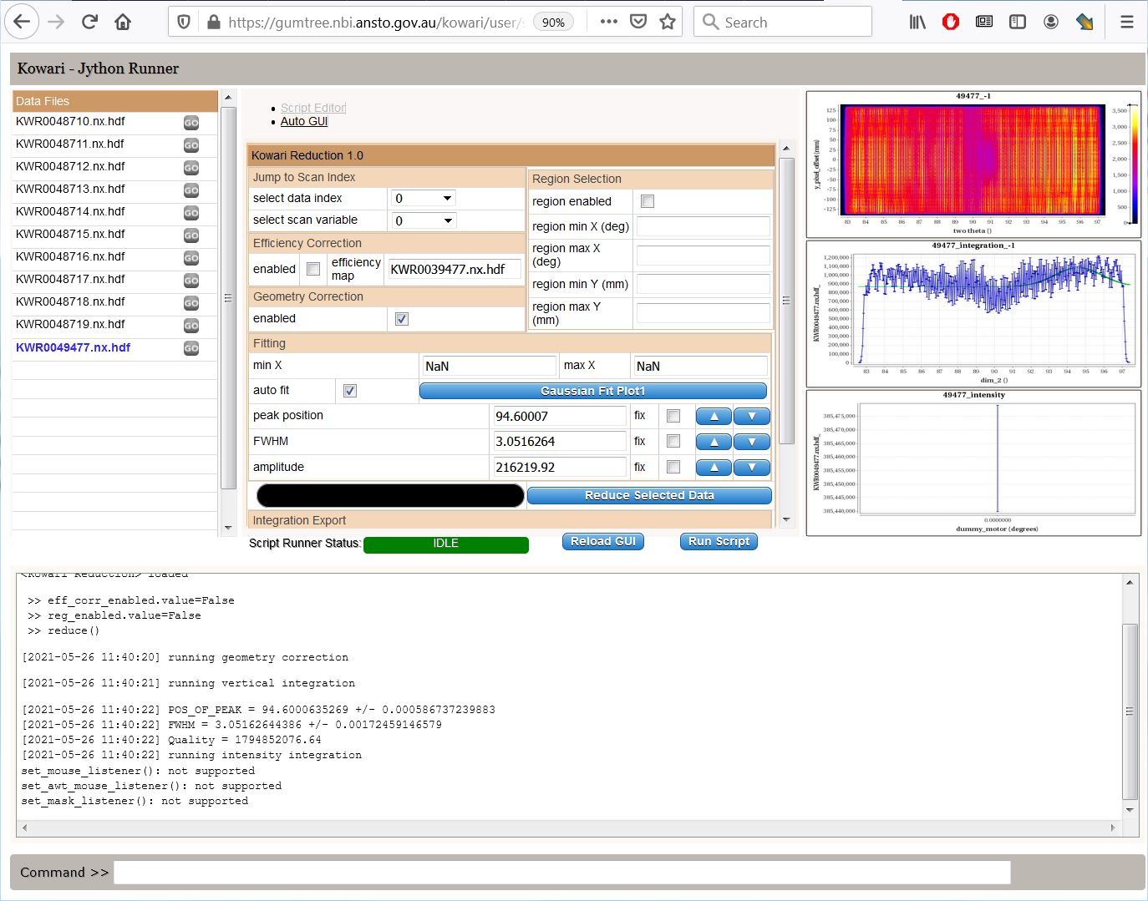
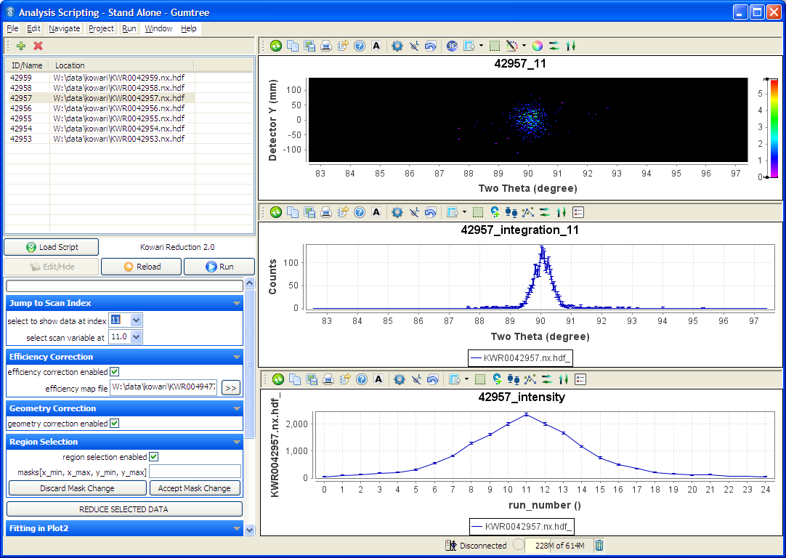
Share scripts with Gumtree Workbench

Slide 25
Scope for improvement
Debugging support
Smart parameter constructor
Publish to E-Logbook app

