Slide 1
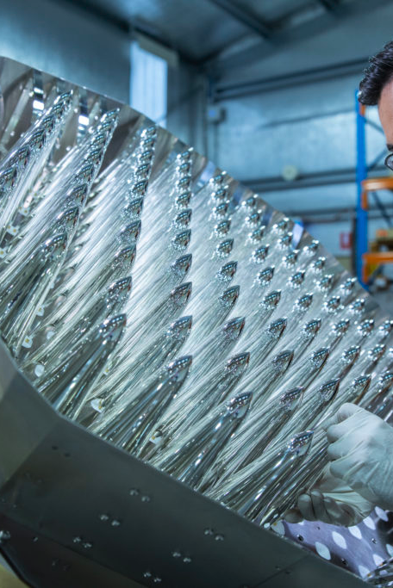
Caproto with PyOpenCL for Parkes Cryo-PAF Beamformer
Euan Troup and Andrew Bolin | 28th May 2021

Slide 2
CASS Develops Beamformers for Radio Astronomy
A beamformer is a complex weighted sum of antennas
  “software defined pixels”
  Digital version allows for multiple science outputs
    Pulsar search, Pulsar Timing, SETI, Spectroscopy survey …
Parkes Cryo-PAF (800-1800MHz) and SKA Low (50-350 MHz)
  Lots of overlap in beamformer operation and design
  Using the same DSP and networking platform
CASS uses EPICS and SKA uses TANGO for control system frameworks
  Can we share software?
    TANGO has PyTango – for EPICS we can use caproto for Python IOCs

Slide 3
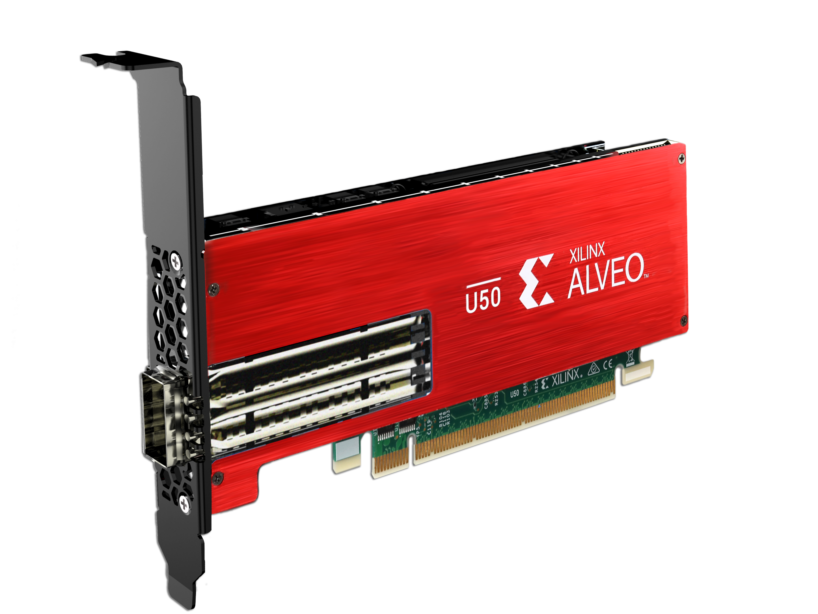
Xilinx Alveo DSP Platform
COTS platform
Will be used in both Parkes and SKA Low Beamformers
100 Gbps networking I/O, PCIe Gen4, and HBM
OpenCL interface
Linux driver and management software

Slide 4
EPICS Alveo Card Monitoring
Xilinx provided driver populates /sys virtual filesystem with monitoring values in files
/sys/devices/pci0000:24/0000:24:00.0/0000:25:00.0/0000:26:14.0/0000:2b:00.1/xmc.u.18874372/xmc_fan_temp
Polled updates
  Thread updates caproto records
  I/O Intr scanning

Slide 5
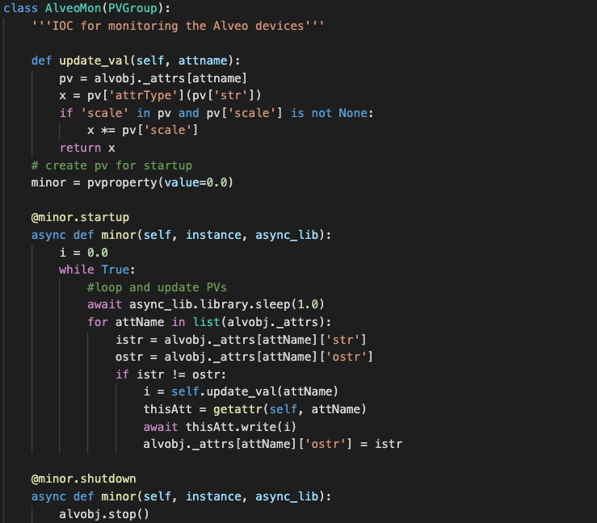
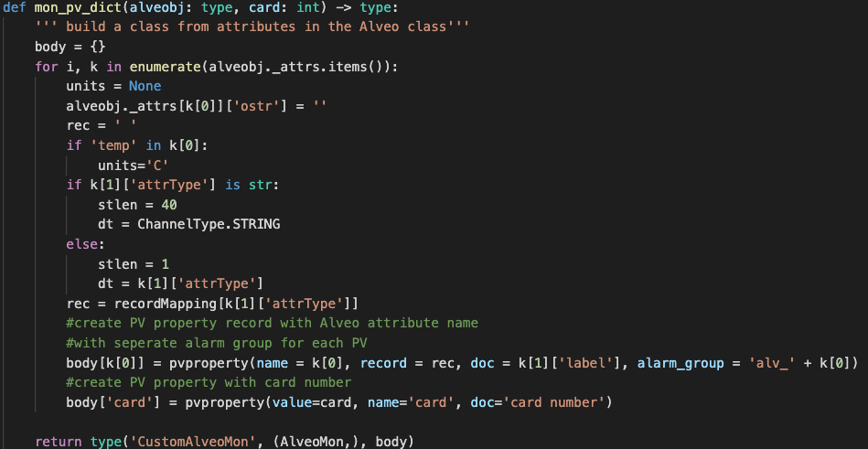
EPICS Alveo Card Monitoring

Slide 6
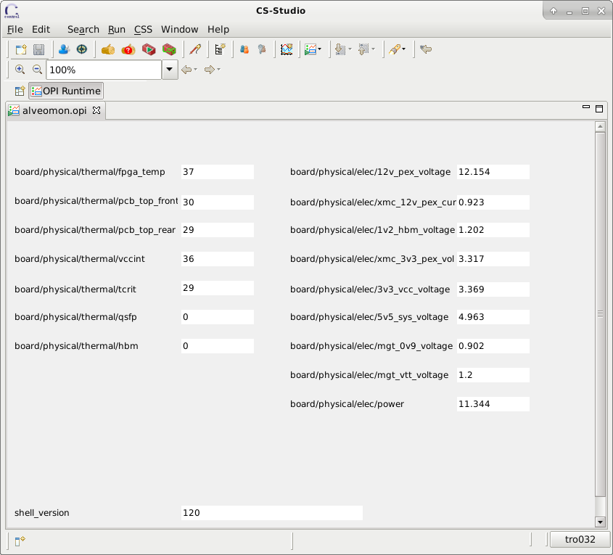
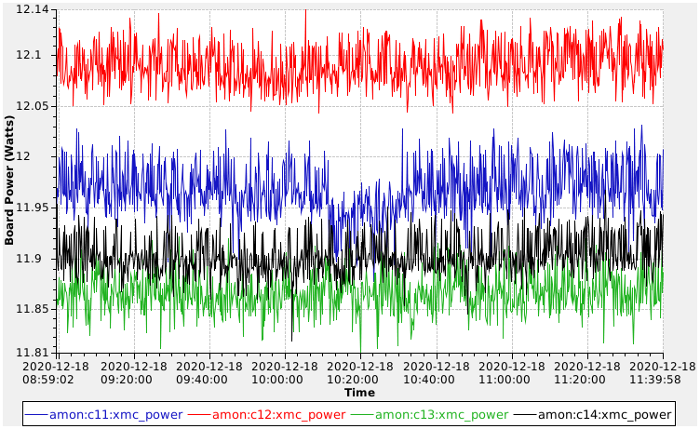
EPICS Alveo Card Monitoring

Slide 7
AlveoCL – Python Interface to FPGA Registers
Find Xilinx OpenCL “platform” (driver), choose a “device” (card)
Load firmware image
  (if not already loaded - checked automatically by driver)
Read FPGA addresses 0, 1 for magic number and version
Using version from FPGA, load the matching map file
Extract the relevant parts of the map for our desired peripherals

Slide 8
ICL - More Abstraction!
We want to use higher-level operations
  We call this the “Instrument Control Layer” (ICL)
Control system agnostic wrapper around AlveoCL
  By default, this exposes all registers as attributes - less typing!
  icl_fpga.packetiser.control_vector = 0xA

Slide 9
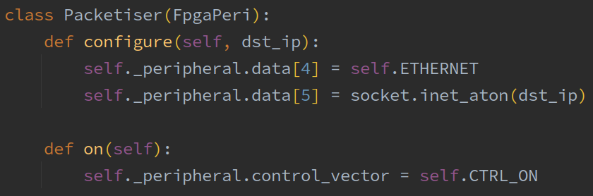
ICL – More Abstraction!
  We can (optionally) write a simple class to handle peripheral operations
  icl_fpga.packetiser.configure(“10.1.1.1”)
  icl_fpga.packetiser.on()

Slide 10
Thank you
CSIRO Space & Astronomy
  Euan Troup
  Senior Developer
    +61 2 9372 4660
    Euan Troup@csiro.au

