Slide 1
Machine Vision Applications
ICC Meeting Autumn 2021
Centre for Accelerator Science
Prepared By Matthew Rees

Slide 2
What is Machine Vision?
Systems Engineering
Automating the process of extracting useful data from images of a real-world object or environment
Aid to Decision Making
Not “Computer Vision”
Notes:
A Systems Engineering discipline
Term is most often used in industrial automation
A precise definition is hard to pin down, but to paraphrase the Wikipedia Article on Machine Vision… Essentially it’s about Automating the process of extracting useful data from images of a real-world object or environment.
The useful data is often used as an aid to decision making.
e.g. Do the qualities of the object(s) in the image meet our expectations?

Slide 3
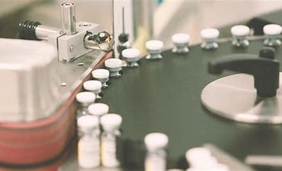

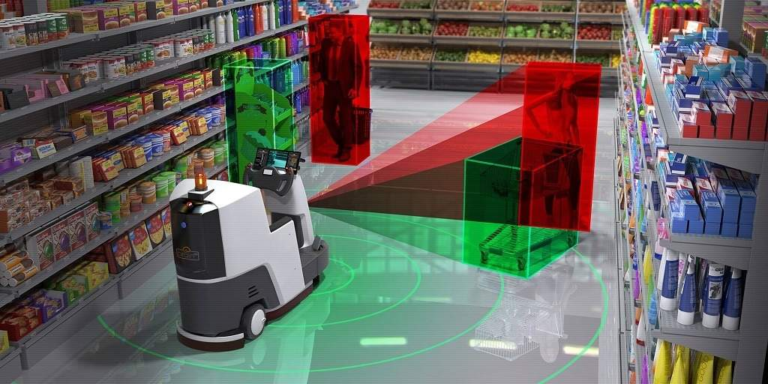
Applications
Automated Inspection
  Object Presence
  Dimensions
  Colour
Robotic or Process Guidance
  Navigation
  Barcodes and Identification
Safety & Security
  Remote Monitoring
  Movement Detection
Notes:
Applications
Automated Inspection
Object Presence
Dimensions
Colour
Robotic or Process Guidance
Navigation
Barcodes and Identification
Safety & Security
Remote Monitoring
Movement Detection

Slide 4
Steps
Image Capture
  camera | scanner | 2D/3D | visible spectrum or other
Image Processing
  filtering, stitching, threshold
  edge, blob, pattern detection
  counting, measuring, OCR, barcode
Decision Making
  comparison, categorisation, pass/fail
  action response

Slide 5
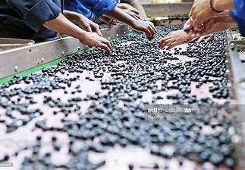
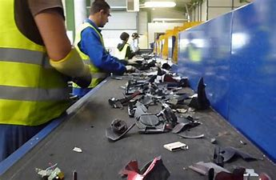
Benefits
Automating tedious tasks
Safety
Consistency

Slide 6
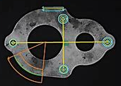
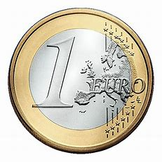

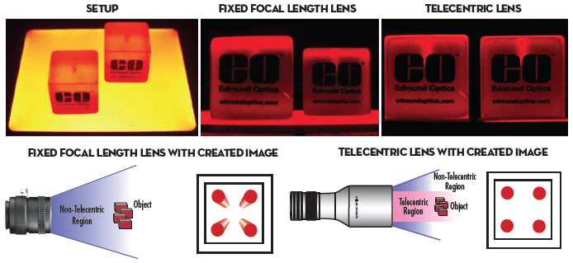
Challenges
Lighting
  colour and contrast
Optics
  clarity and metrology
Variation
  reliabiity

Slide 7
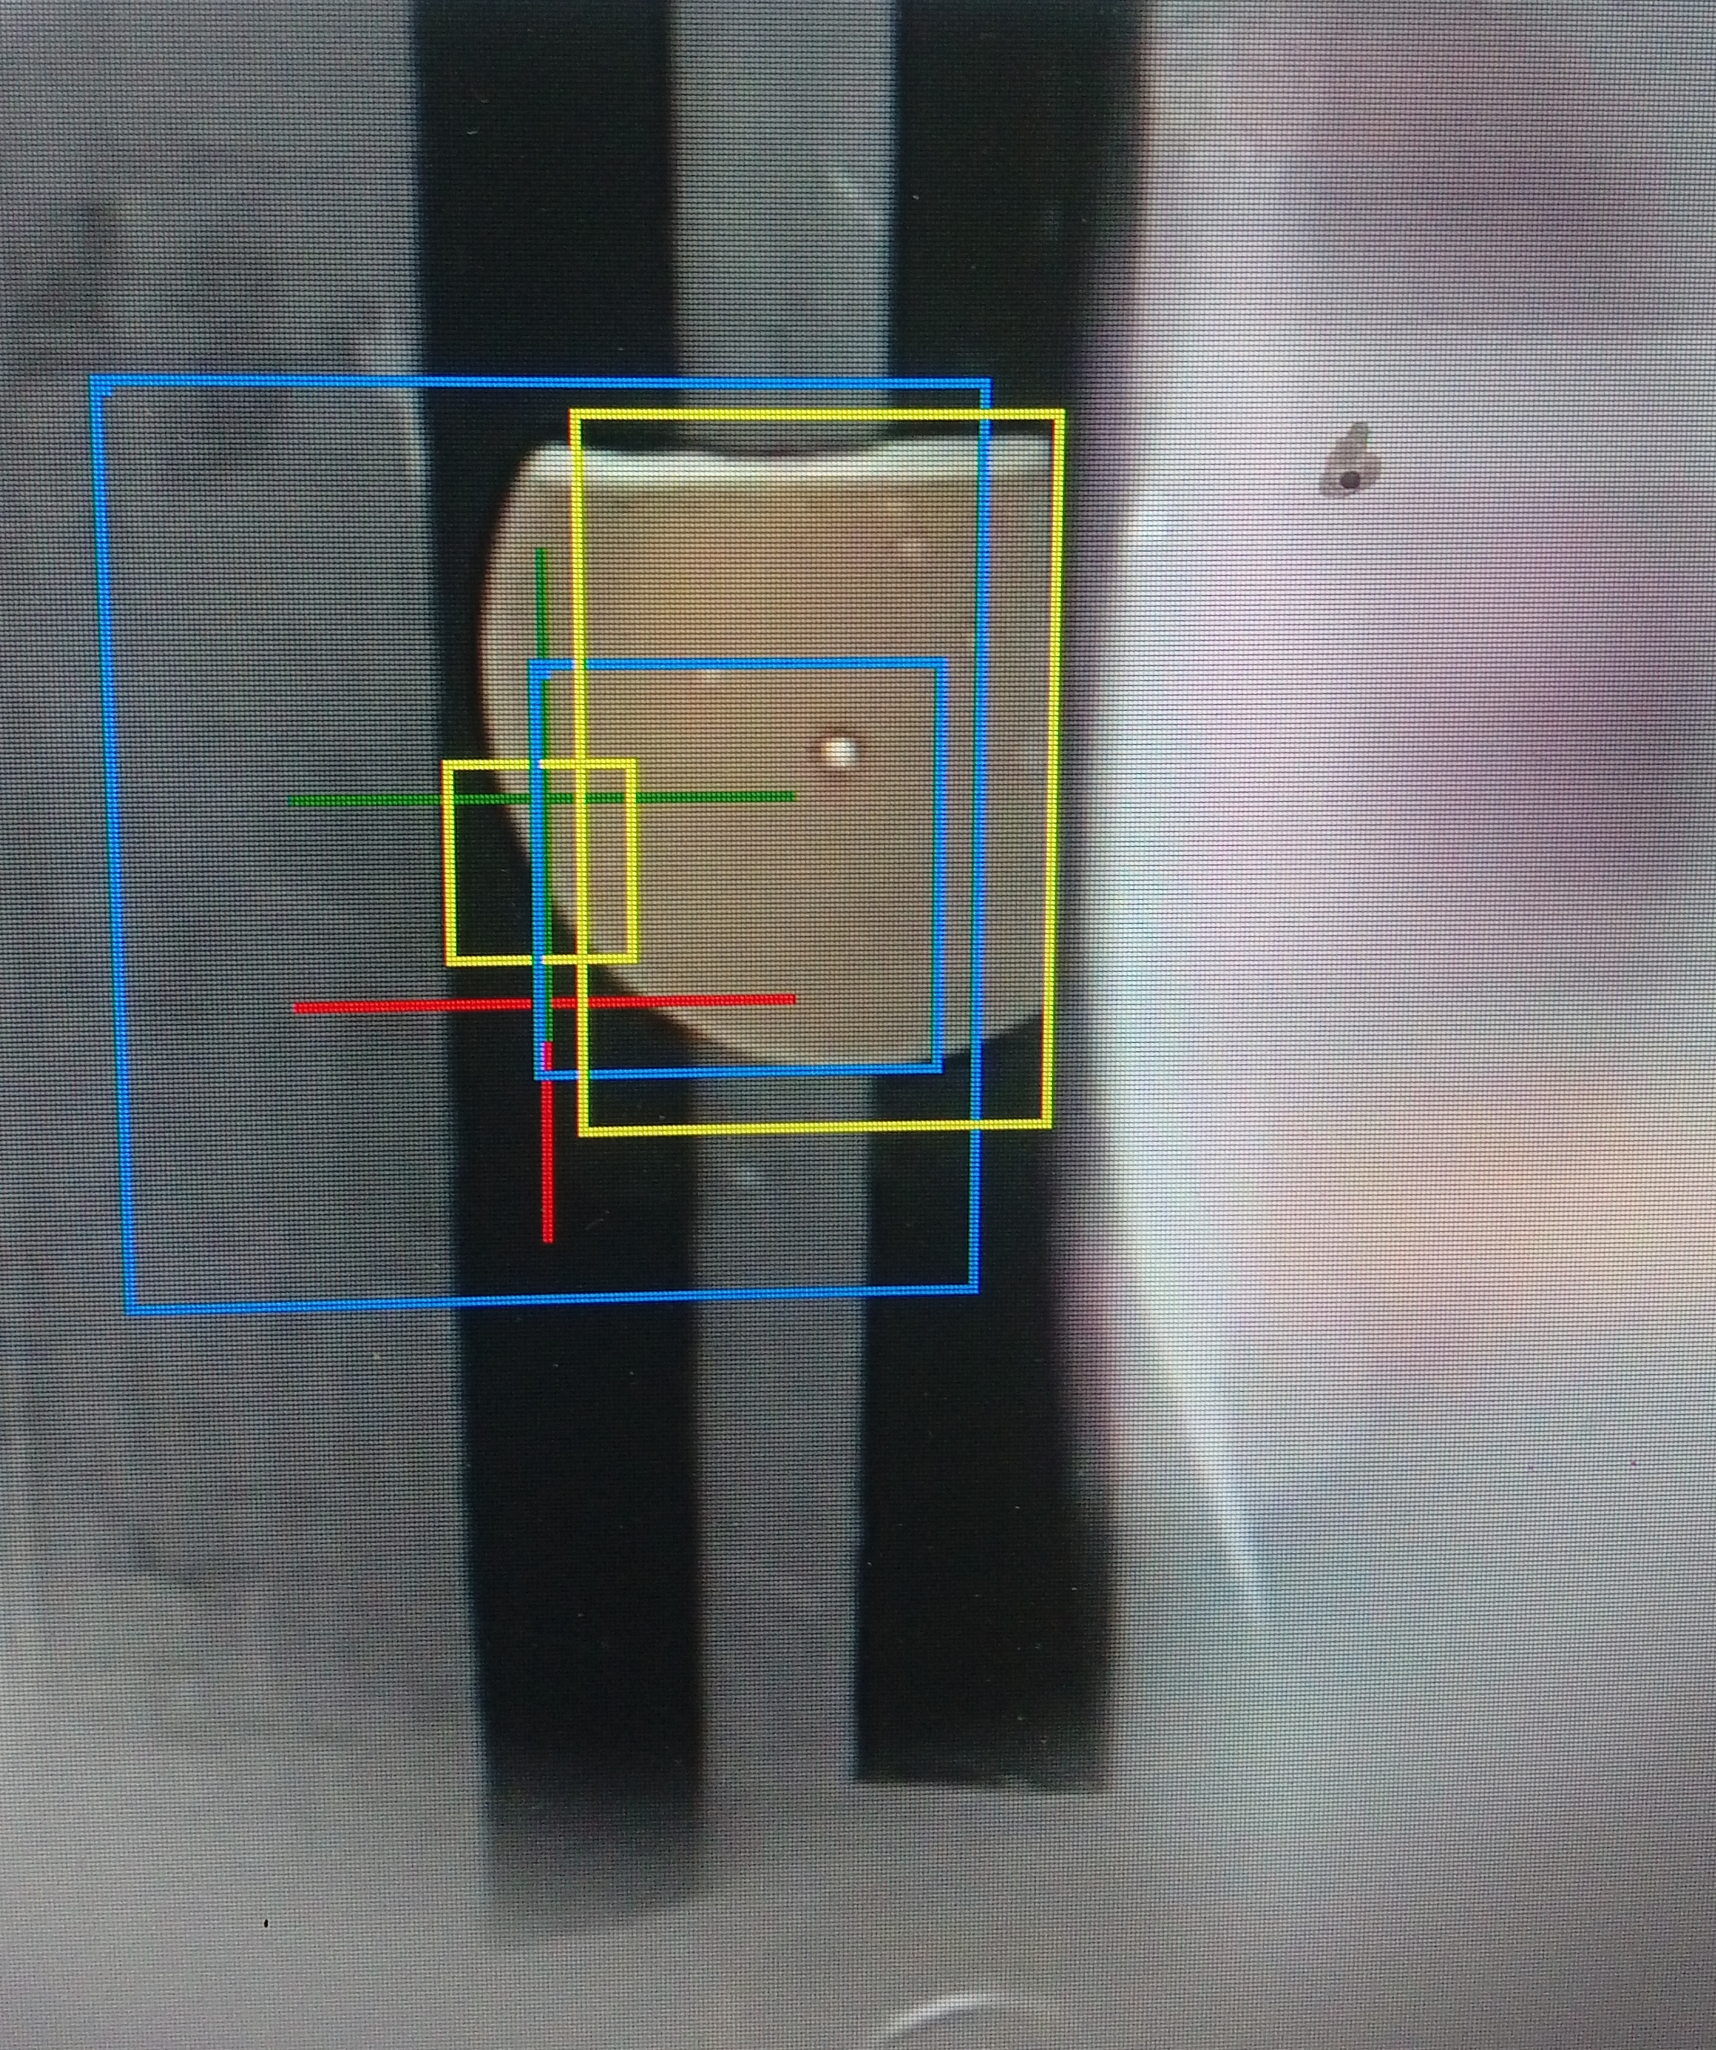
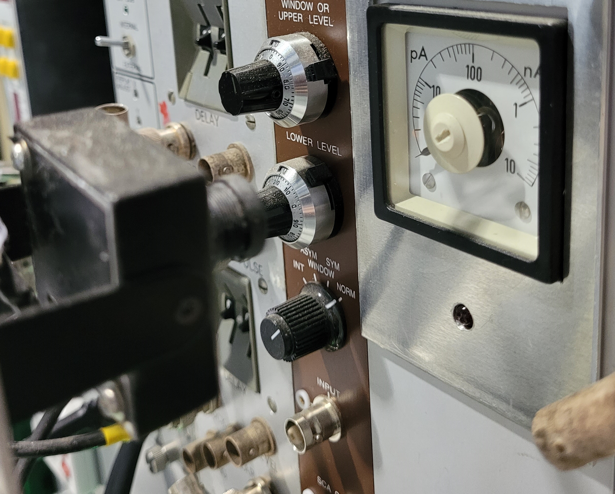
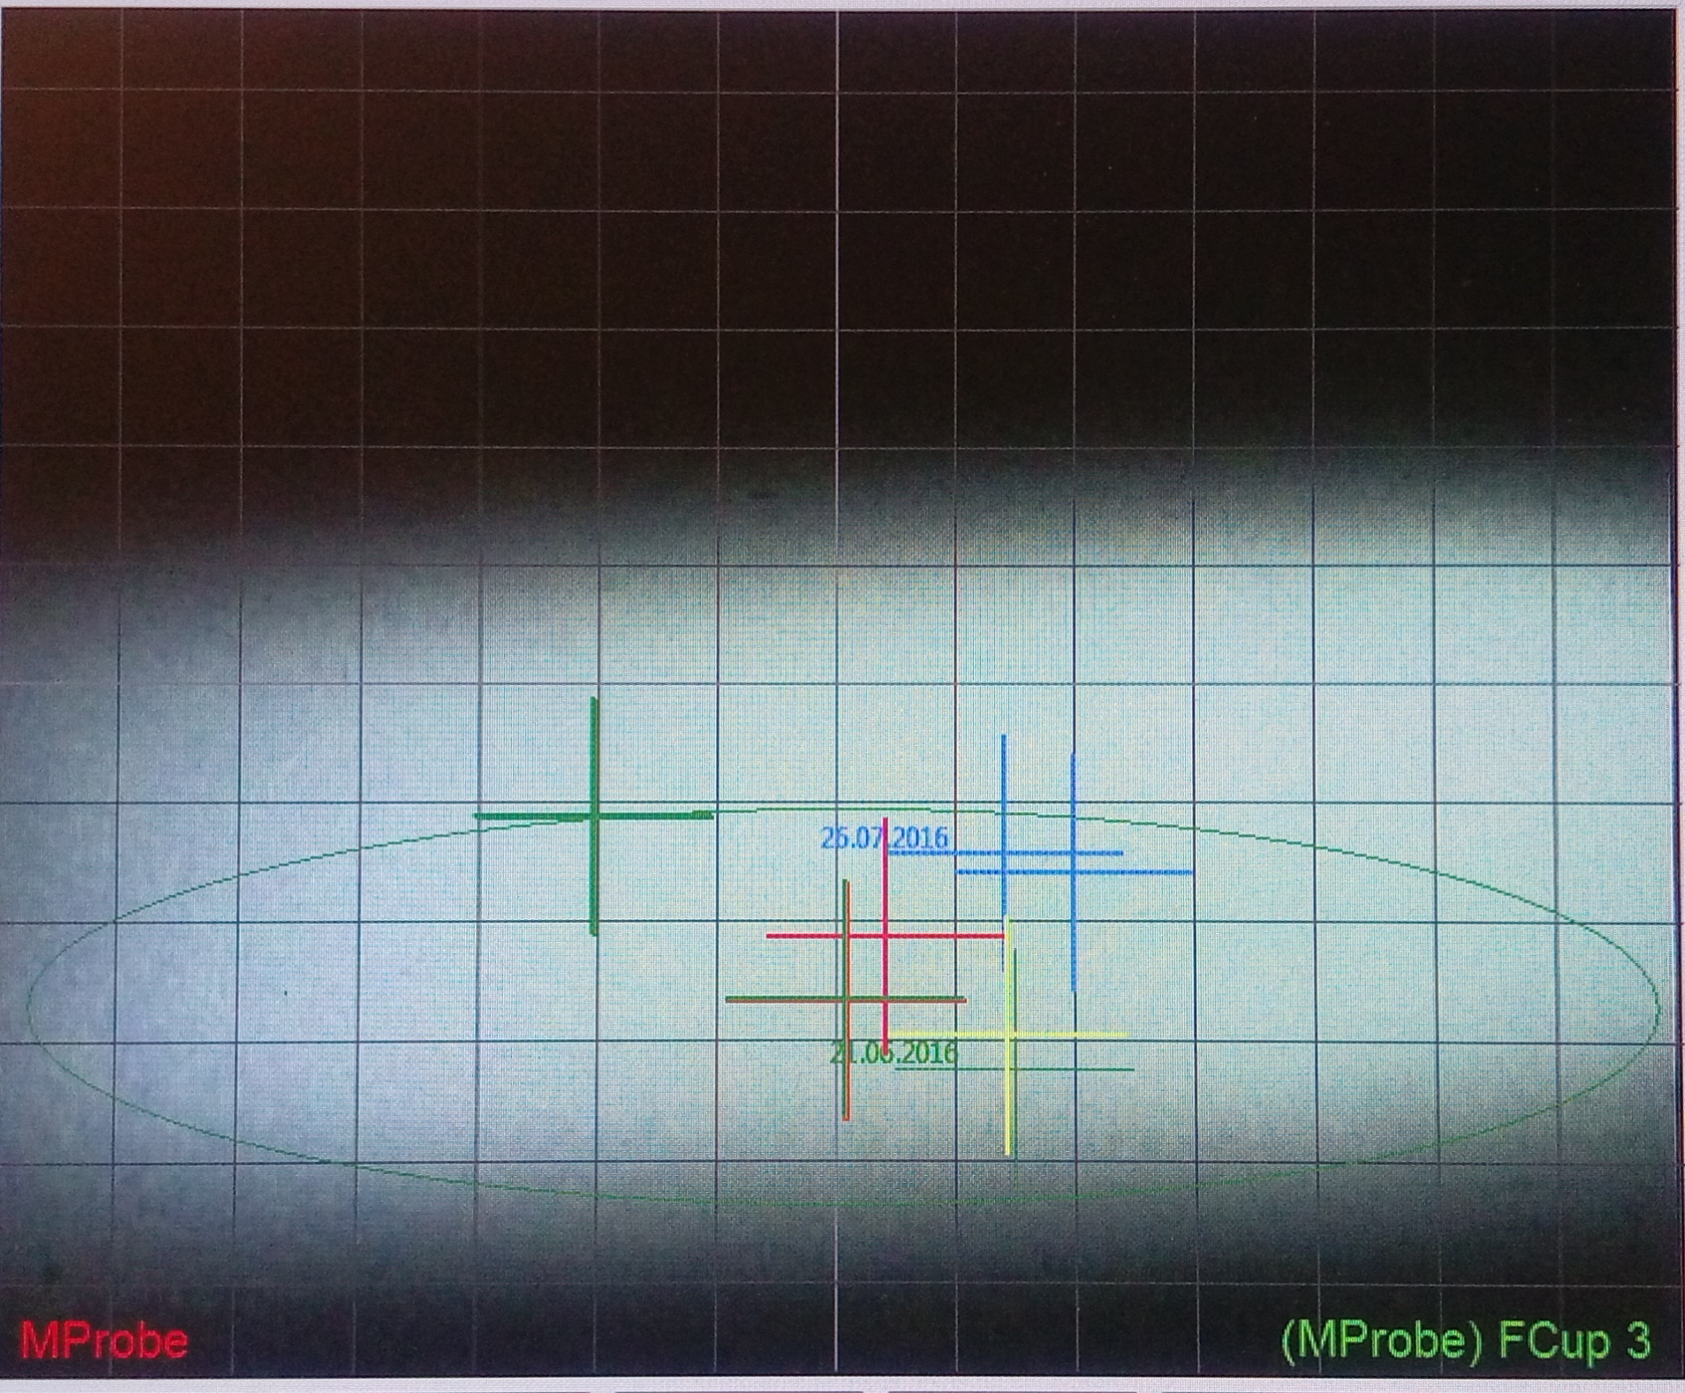
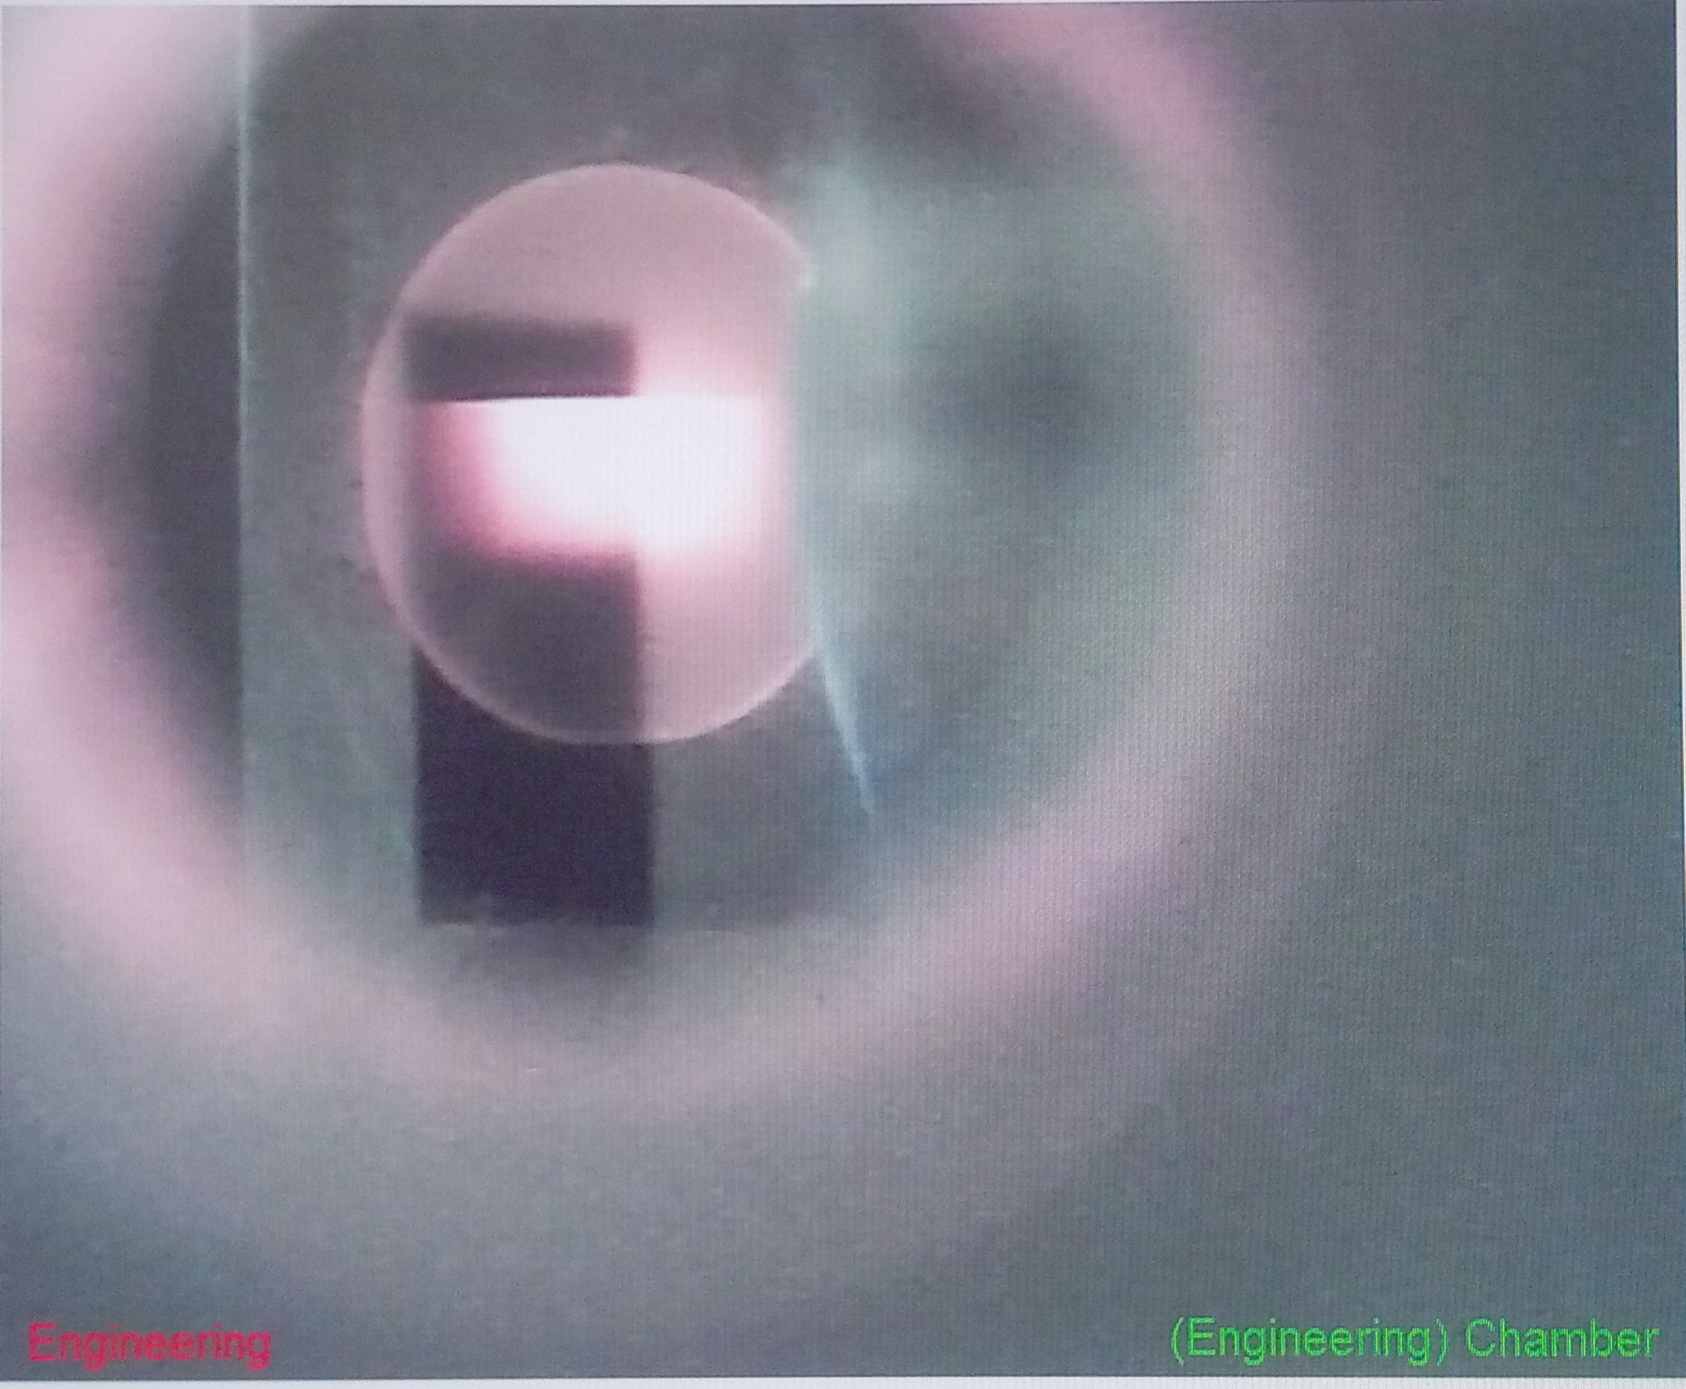
Cameras @ CAS
Remote Monitoring
  Visual Reference
  Human Interface
Gauge Cameras
Beamline Cameras

Slide 8
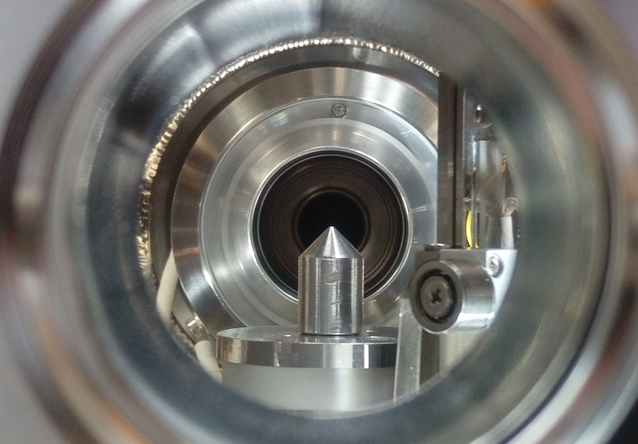
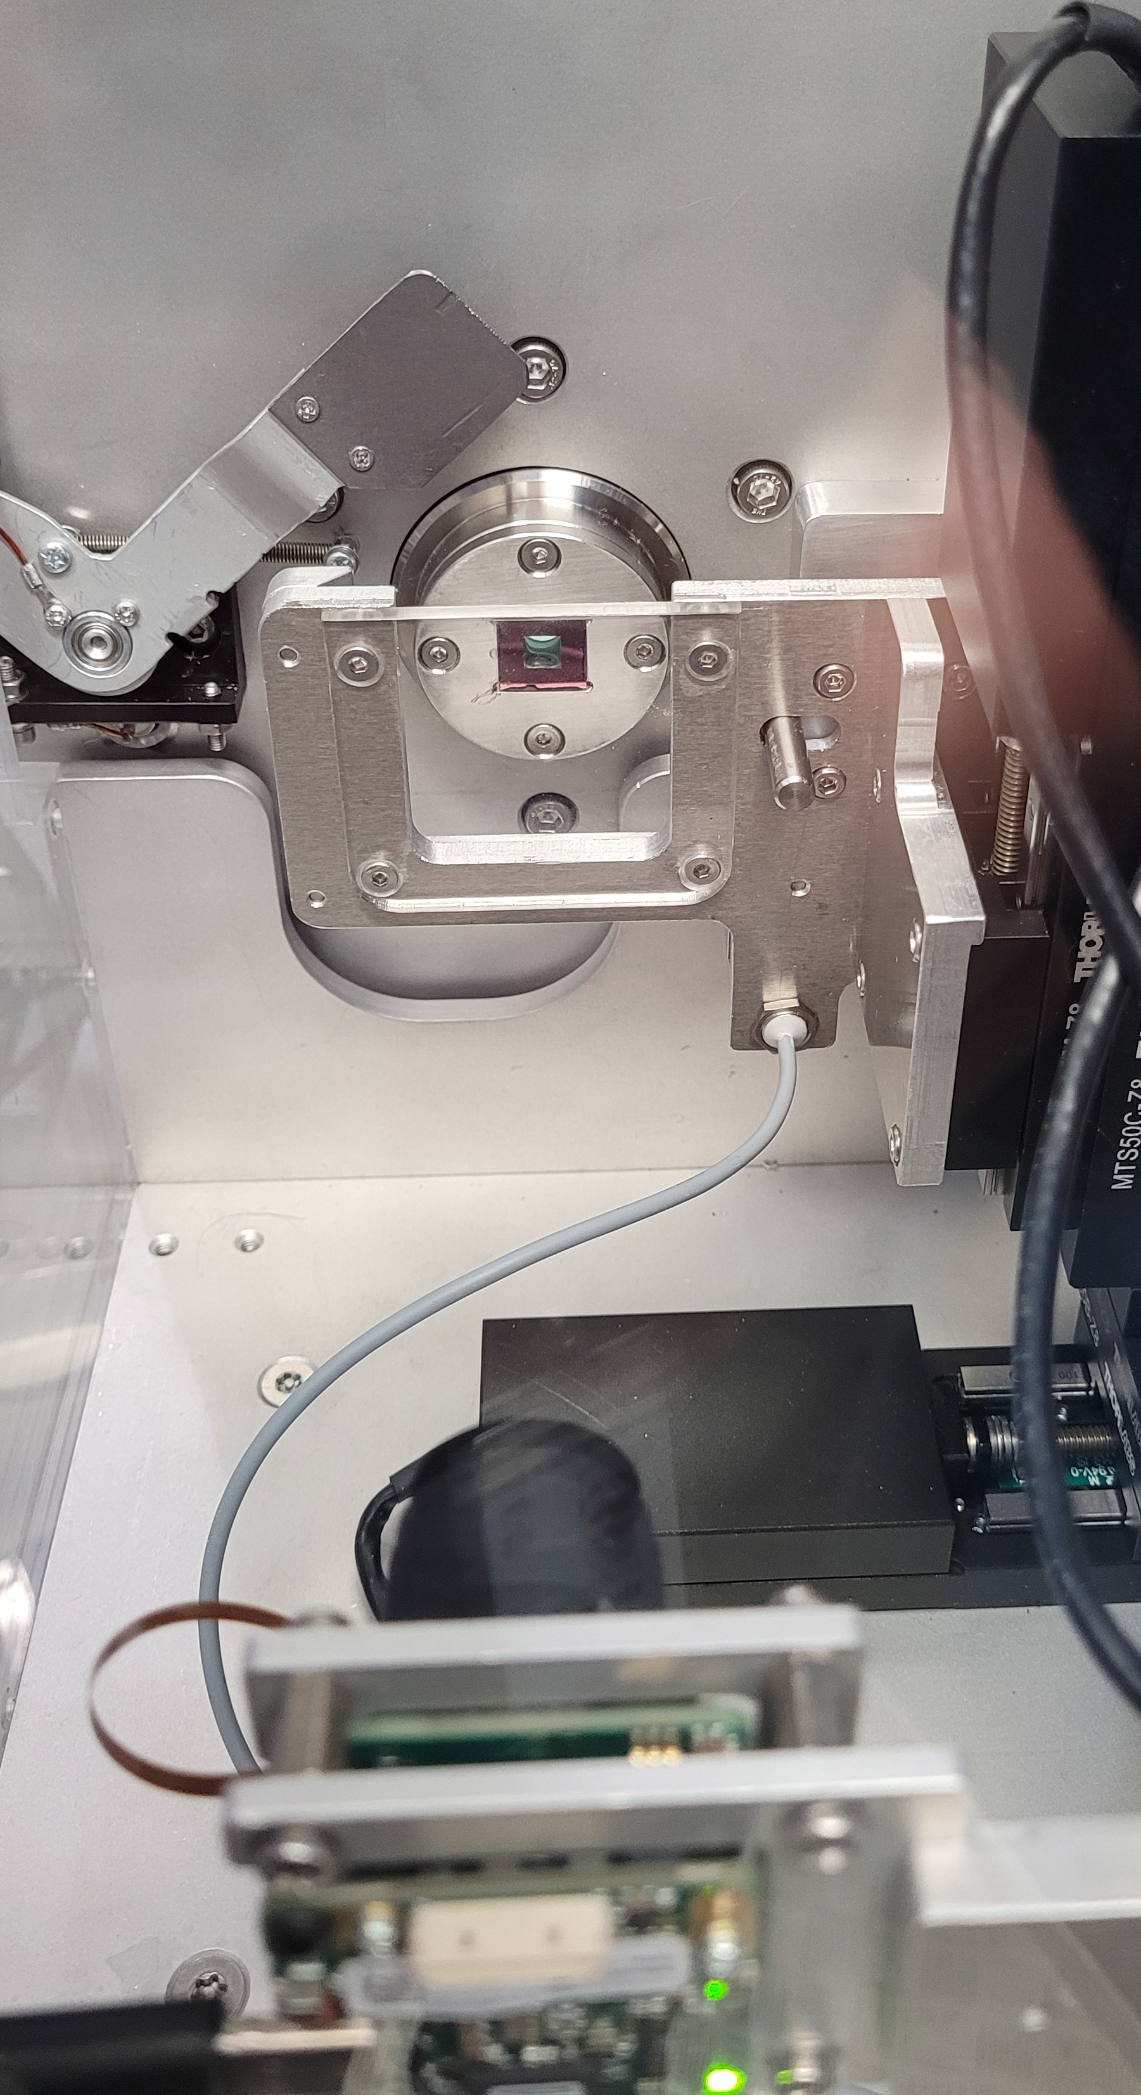
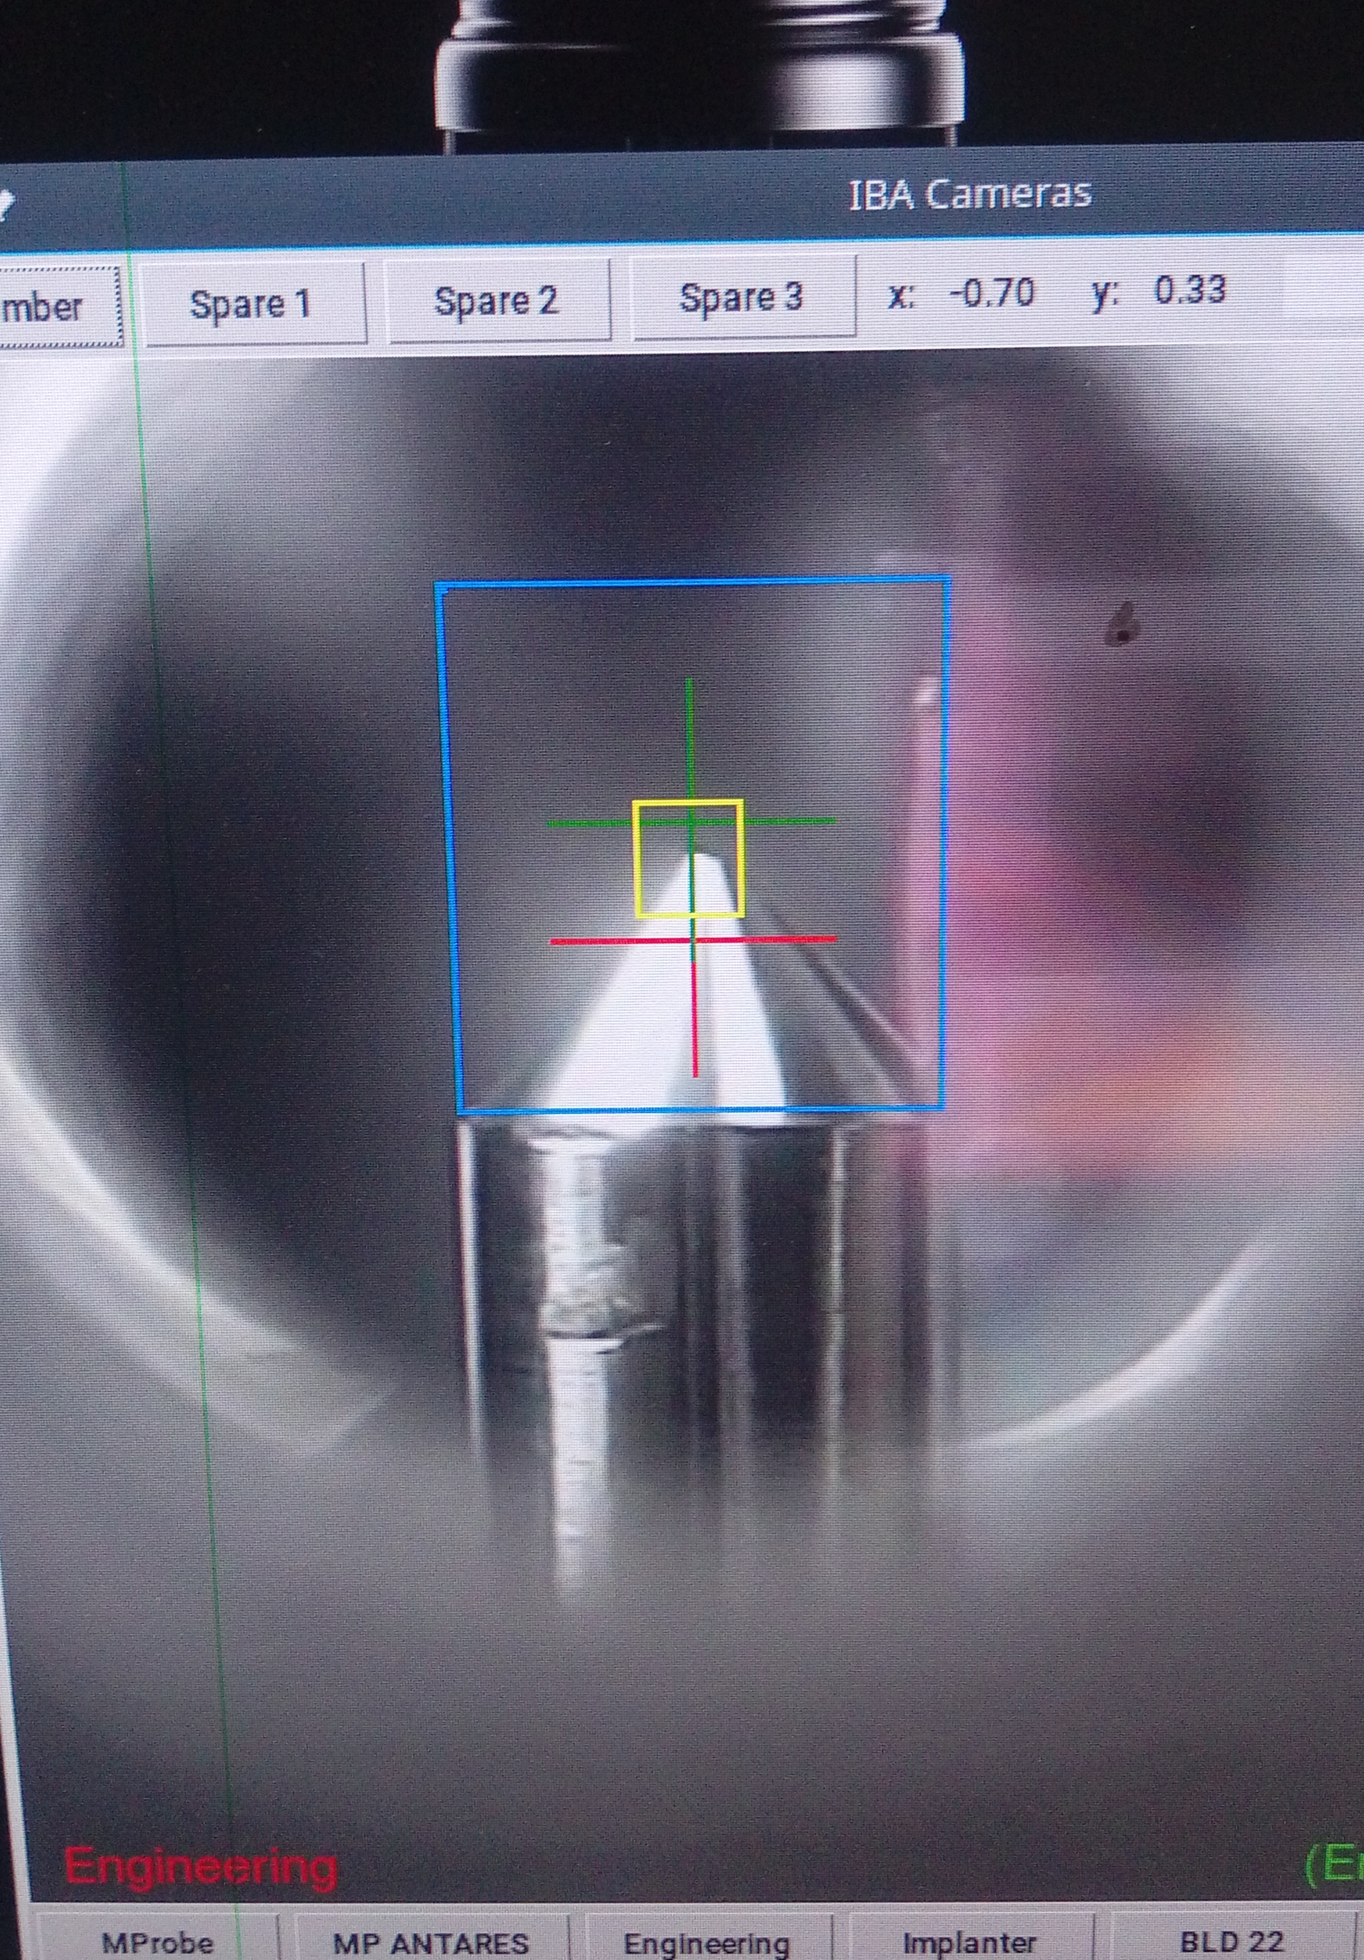
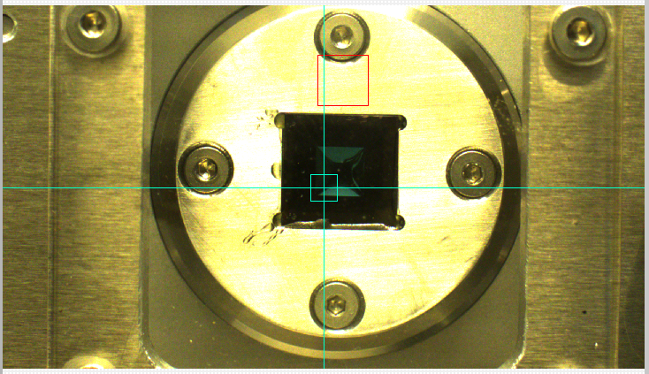
Recent Developments
LEII Implanter
External Beam Chamber
ASP Filter Photography

Slide 9
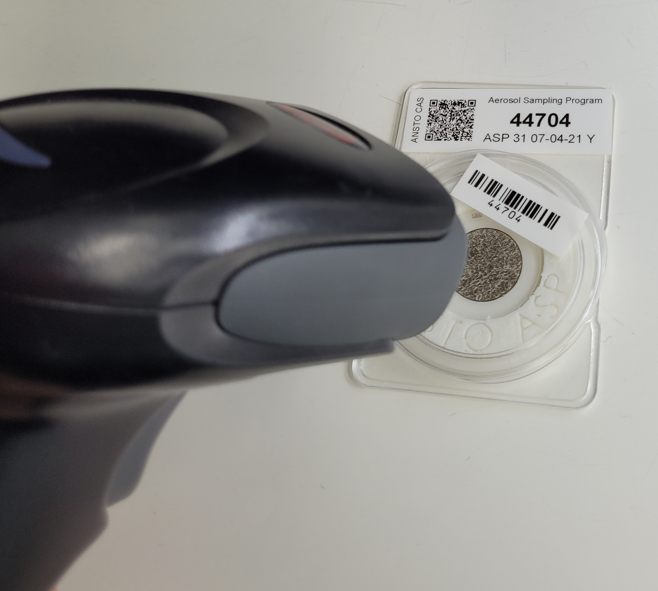
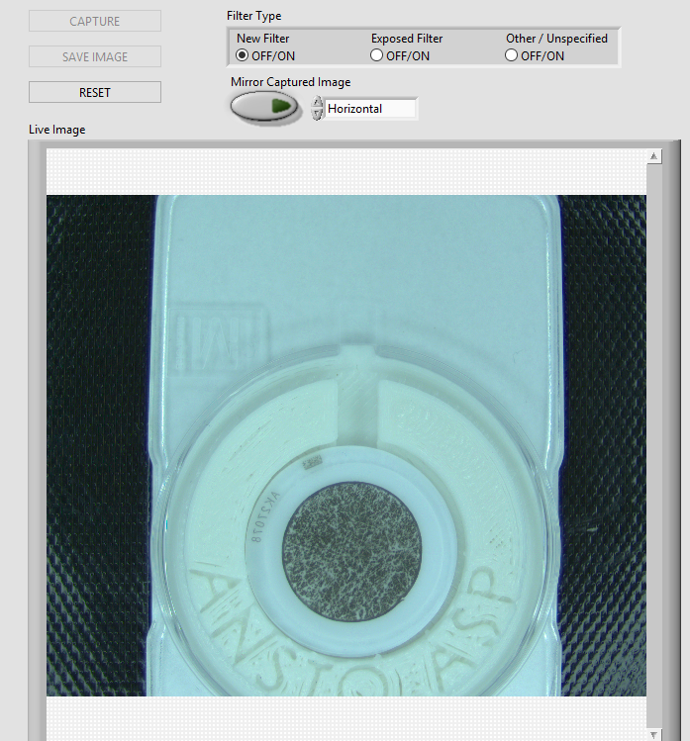
Notes:
Aerosol Sampling Program

Slide 10
Possible Future Applications
Automated Sample Positioning
Batch Sample Processing
End Station Beam analysis
Machine safety interlocks

Slide 11
Questions?
Thanks For Listening ☺

