Slide 1
The Australian Synchrotron
Control System Breakdown Structure (CSBS)
Instrumentation and Controls Autumn '21 Meeting
Rosemary Waghorn
Notes:
Hi Everyone.
My name is Rosemary Waghorn and I am a software developer in the scientific software team here at the synchrotron. I implemented the Control System Breakdown Structure that I will be talking about today.

Slide 2
Glossary
Term | Definition | Examples
OPA | Operational Area – another name for a beamline. | Infrared Beamline
Host | Computer used as a host | Virtual machine
IOC | EPICS application. Uses internal database | Area Detector, Motor,
Assembly | Collection of devices which are physically, functionally or logically connected. Can have multiple levels of sub assemblies | Vertical focusing mirror (VFM), Linear Stage
Controller | Implements and interprets the communications protocol to and from the IOC. It reads and controls the devices. | Motor controller, Temperature controller,
Device | Usually physical hardware to measure or control some physical property. Usually linked to a PV | Thermocouple, Motor, axis Gauge, Detector
Component | Component in an OPA, also called an Instance | Controller, Device
Type | Component type, also called a Class | Controller Type, Device Type
Notes:
First of all, I wanted to go through some of the items that will be mentioned in the talk.
OPA is what we call the control systems view of a beamline. The Integration Lab where testing is done is also considered an OPA.
Host is what the IOC is run on. Can be a VM or physical computer.
IOC is pretty straightforward. It is part of the basics of EPICS
With assemblies, there are multiple ways of creating a hierarchy of assemblies. We are mostly using physically connected assemblies in our definitions.
When I show you the Assembly hierarchy screenshot later in the talk, you will be able to see some examples of how we are using this.
Hosts, IOCs, Assemblies, Controllers and Devices are all considered components in an OPA.
In the CSBS, the term currently used for these is Instances ( but will be changed? )
Each component has a component type, for instance, a device will have a device type.
In the CSBS, the term currently used for these is Classes ( but will be changed? )

Slide 3
Why now
The BRIGHT project consists of building several new beamlines at the synchrotron. It includes a budget for common systems.
This allowed us the time and funding to create common systems software that is useful for all new beamlines.
Notes:
Why design the CSBS now, you may ask
Existing OPAs had some of this information in an ad hoc format as they had grown organically over time. Many things had to be hand coded, and were difficult to change.
And most OPAs had slightly different ways of doing things from each other.
Recently the Bright project was started. It is a large capital project for 8 new beamlines where completion was planned to be spread out over 4 years.
There was funding for common systems, and there was some lead time before the first beamline was expected to be ready.
This provided us an opportunity to create frameworks like the CSBS for entering data into systems in a common way that would be useful for all new beamlines.

Slide 4
Why is a system like the CSBS needed
To avoid data entry errors
To show the relationships between components in an OPA
To ensure all component names use the naming convention
To use same component types across all of the new OPAs
To have a standard output API
Notes:
And why would such a system be needed.
There are several reasons.
1. We want to avoid data entry errors that happen by entering the same data multiple times or in multiple places.
2. It is useful to be able to visualize the multiple ways that components can be are related to each other.
We focus on the control hierarchy and the assembly hierarchy in the CSBS.
3. We want all the component names in the new OPAs to use our naming convention, without exception;
rather than drifting from the convention like what happened with the existing OPAs.
4. To use same component types across all of the new OPAs for consistency.
5. The data from this system will be needed by other applications so we need a defined API
for extracts from the CSBS.
Lets go though this requirements at a time.

Slide 5
Solution for data entry errors
Single location for data entry
Make it easy to enter data.
Notes:
Its pretty straight forward.
We obviously need a single application for data entry. The system is designed to not allow changes from other sources.
We used website pages for data entry since it is more flexible and can be viewed and edited anywhere, including on mobile devices like mobile phones and ipads.
We also used best practices for User Experience (UX) so that it is similar to other well known webpages and therefore intuitive to use.
And of course if it is easy to use, people are more likely to ensure data is always up to date..

Slide 6
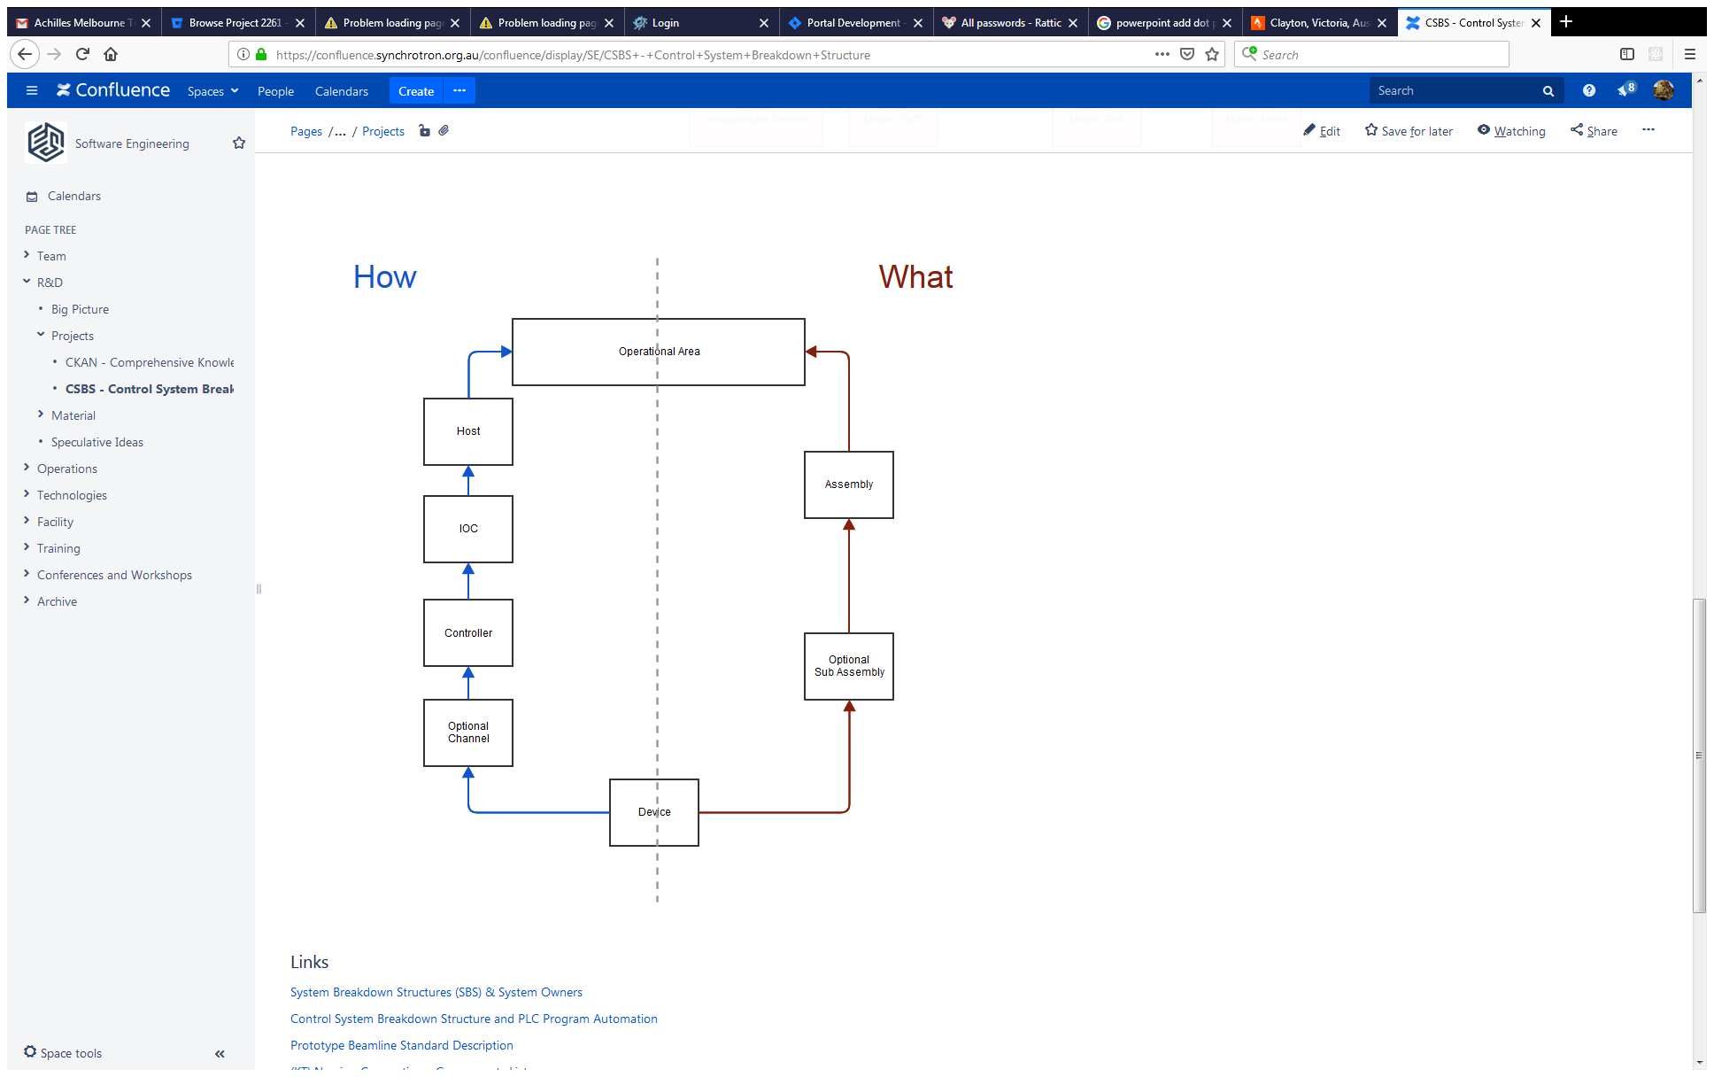
Hierarchies / Relationships
Control hierarchy
Assembly Hierarchy
Notes:
This diagram is an indication of some of the relationship possibilities for the control and assembly hierarchies.
Several other examples are
Device directly under IOC
Controller with an assembly parent.
More than two levels of assemblies.
In the data entry page

Slide 7
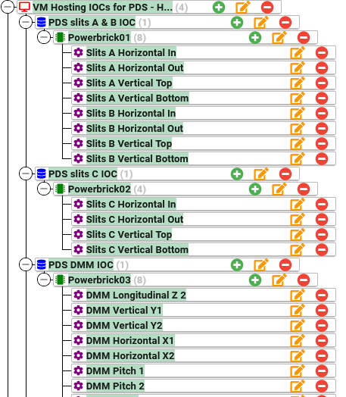
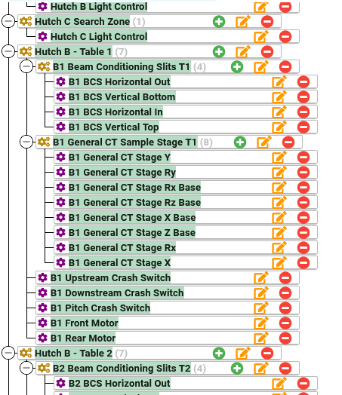
Hierarchies / Relationships
Control Hierarchy
Assembly Hierarchy
Notes:
The control group at the synchrotron have started using the CSBS to define the components in the OPAs that they are working on. The above images show part of the hierarchies for the MCT beamline. There are 3 OPAs that have been started, though none are complete yet.
Hosts, IOCs, Assemblies, Controllers and Devices all have a different icon and color to make it visually easy to understand what you are looking at.

Slide 8
Use the naming standards
We auto generate component names, allowing only the two digit distinction number to be configured by the user.
We changed our naming convention to allow IOC / controller /device movement changes without affecting component name.
Note: Naming convention info on Synchrotron Confluence page
Notes:
We auto generate component names to enforce the naming convention.
We changed the naming convention to rely on parts on the hierarchy that are unlikely to changes, rather than those where that might.
This allow more flexibility when there is a need to resign part of the hierarchy.

Slide 9
Component Types
When creating / updating a component, all component types are chosen from a dropdown list.
And by having a small number of people allowed to administer these types.
Consistent logic for Abbreviation
Notes:
When creating or updating the components, we don’t allow free text for entering the type information
We use dropdowns to force a choice from the existing types
If a new type is needed, a request must be made to one of the staff in the Type Keeper group.
Type Keeper group are responsible for keeping internal logic for the Abbreviation assigned to each Component Type.
This is important since it is a part of the auto generation of the component name.
When creating / updating a component, all component types are chosen from a dropdown list.
No free text, choice from dropdown items when creating / updating a component

Slide 10
Extract APIs
API - List of details of all components in an OPA in the current released version.
API - List of all component types and their attributes
API - Reverse lookup of component name to get relevant details about it for reporting, metadata etc.
Notes:
The main categories of Extract APIs.
Most applications will be only interested in one OPA at a time.
This extract will include their component type, component name, hierarchy parents and any other attributes.
There will be filters available in a subset is needed. E.g. all motor controllers
In some cases, only the component types will be needed.
All Components Names must be unique in an released version of an OPA, so reverse lookup will give a single result.
These are the main categories of APIs.
There is room for expansion in this section.
If any new application needs an extract from the CSBS, and none of the current ones suit, then a new extract may be created.

Slide 11
Applications using API extracts
There is a website that has already been created which uses an extract that contains components and component types for a given OPA from CSBS and then adds ui resource data on top of it.
Andraz Pozar will explain more in the next talk.
Notes:
Andraz’s talk is directly after mine, and he will explain further.

Slide 12
Future Applications using API extracts
Because it is the single source for the data, the CSBS can be used as a data feed for confluence / internal wiki pages or other documentation pages.
There is a plan for asset management for the control team which will link to the CSBS as well as other
Notes:
Include list of PVs for Bluesky plans?

Slide 13
Other considerations
Modern programming languages and frameworks like python, reactjs, fastapi
The primary end user for the data entry will be the controls group, so we use to use common terminology.
Notes:
Quick learning curve, since a lot of people already know these languages.
Easy to create / maintain / add features to the system since there are a lot of resources about how to do things.
Multiple people in the scientific computing team have knowledge of the languages and frameworks used, so less reliance on one person if quick fixes are needed.
Common terminology is important to avoid misunderstanding

Slide 14
CSBS User Roles and Permissions
CSBS User Role | Users | Login required | Has write access to | Has read access to
Other | Anyone with access to the website | NO | Nothing | Everything
Controls Engineer | Control Systems, PLC and Accelerator Controls and Support teams | YES | Create/update/delete components including hierarchies. Finalising drafts and changing the released version of an OPA. | Everything
Type Keeper | Accelerator Controls and PLC Manager | YES | Create/update/delete components types and components plus all the same permissions as a Controls Engineer. | Everything
Note: Website is only available when connected on the Synchrotron network
Notes:
Basic Permissions.
The Website is available only on the synchrotron network. Which means logged in on site at the synchrotron or through VPN. Firewall rules.
Creating/updating/removing components of types prepared by Type Keepers, and placing those instances in hierarchies on all OPAs.
Finalising drafts and changing the released version of an OPA.
Read access to everything includes,
View all component types,
View all components for an OPA
Can switch between Draft and Final
Can switch between different types of Hierarchy

Slide 15
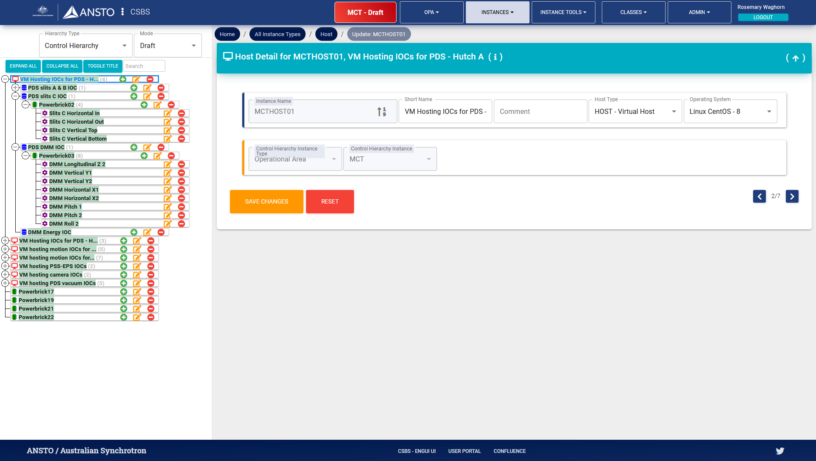
Data Entry - GUI
Notes:
Main sections
Top Menu
Hierarchy Panel on the left
View/Edit/List Details on the right
Footer

Slide 16
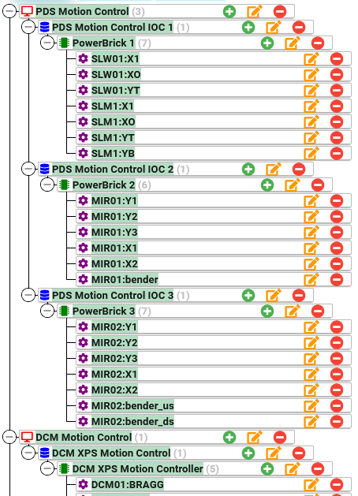
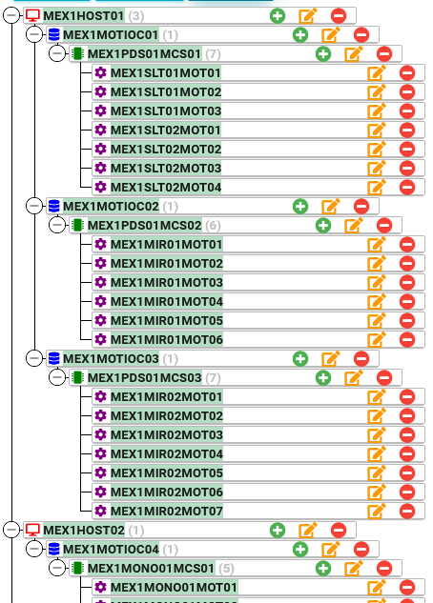
Toggle Title
Notes:
While the component names are useful, they are not very friendly. So we allow the switching between the component name and a more friendly name.
This is a view od the same section of an OPA. I’m sure you can guess which is which?

Slide 17
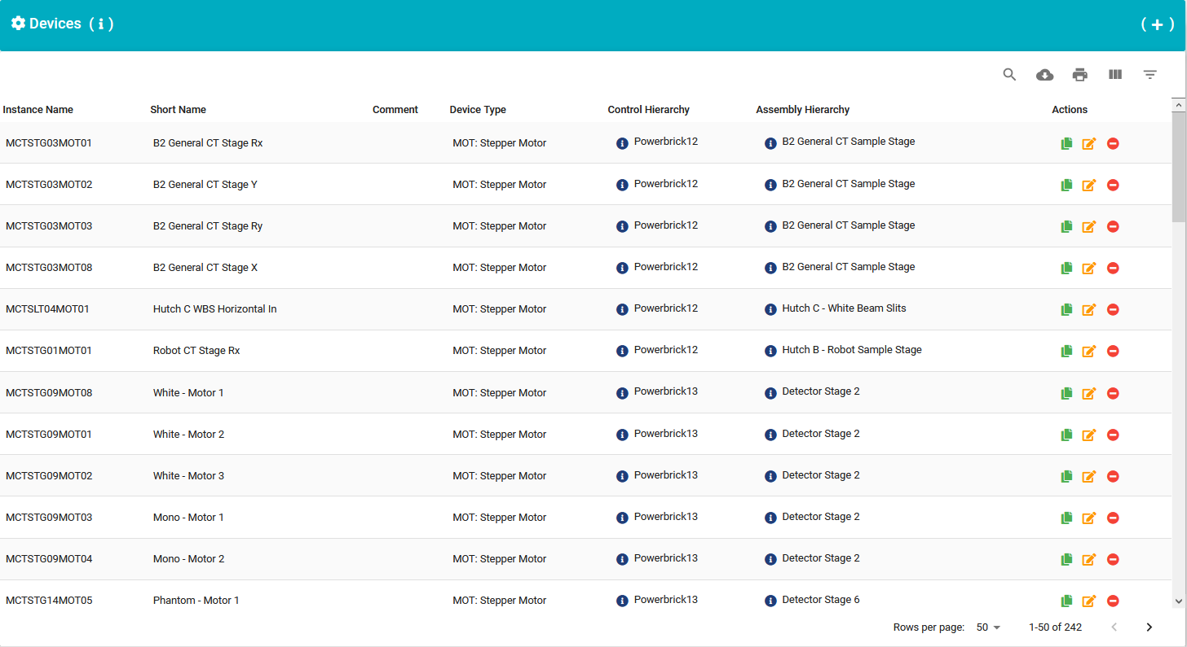
Data Entry - List
Notes:
Example of how List pages for components and types look.
Clone / Edit / Delete buttons
+ Add button on top right

Slide 18
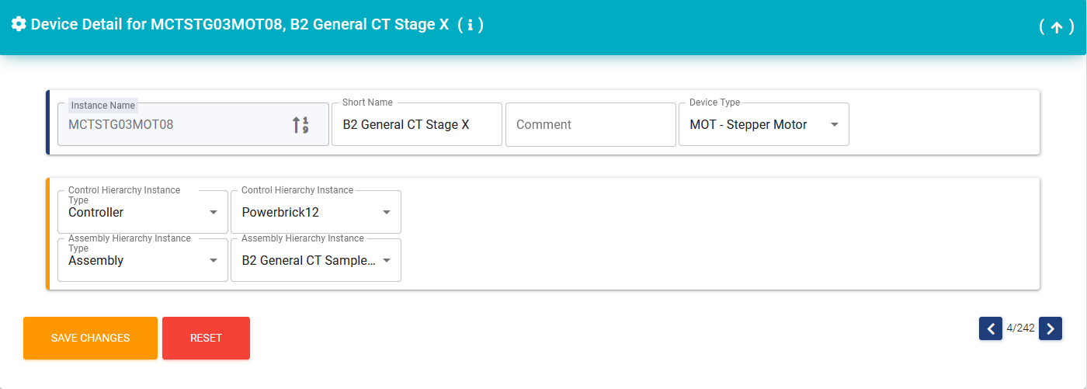
Data Entry - Edit
Notes:
Instance name is auto generated, though you can click on the icon on the right to change the two digit number at the end.
There will be a pop with all the numbers that are not currently used.
There are also some restrictions. Certain devices can only have certain controllers, so after the device type is chosen or changes, the available controllers in the dropdown will change.
Choose Hierarchy Instance Type first, then Hierarchy Instance dropdown will be populated.

Slide 19
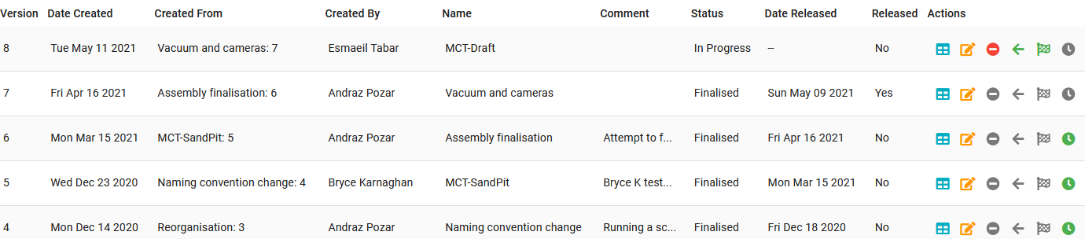
Versions
Notes:
Each OPA has a released version of the data in the CSBS, and these are the components that are in the API extract data.
This released version is not editable in the CSBS
If changes are required, there must be a draft version of the OPA made as well.
It will start as a copy of the current released version, but then components can be created / updated / deleted.
Once it is ready to be released, the user can click on the Finalise button, which will set it as finalised ( no longer editable), as well as setting it as the current released version. If there is any problem with the released version, it is always possible to set any other finalised version to be the current released version.
----------------------------------------------------------------------------------
The creation of a Draft and then release is an important workflow of the CSBS.
What happens is that a user
Chooses an OPA
Clicks on ‘Create a draft’
Enter info for ‘Name’ and ‘Comment’ text fields and Click ‘Save’
Then a copy of the components in the current released version is made.

Slide 20
Summary
CSBS Provides
Single source of truth
Consistency across all OPAs, including name convention
Extract API available to underpin experiment control

Slide 21
Thank you
Questions and Comments
Notes:
Any questions or comments ?

