Slide 1
Docker For IOC Deployment and Management
Stephen Mudie
Senior Scientist SAXS/WAXS Beamline
Australian Synchrotron

Slide 2

IOC Lifecycle
Design
Develop
Define
Build
Deploy
Manage

Slide 3

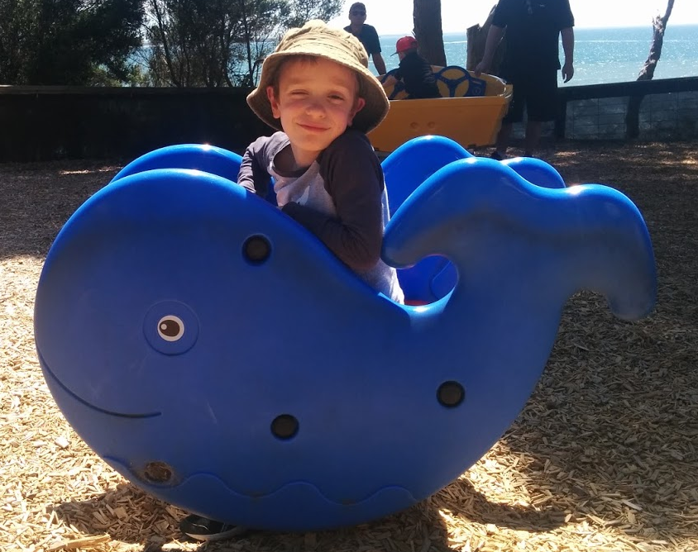
Docker Overview
Virtual Machines
Docker Containers
Framework for deployment and management of containers
Containers are isolated Linux environments
  Uses host kernel
  Resource prioritisation
  Isolation
Much lighter than Virtual Machines
App
App
App
Guest OS
Guest OS
Guest OS
App
App
App
Hypervisor
Docker Engine
Host Operating System
Host Operating System
Host Hardware
Host Hardware

Slide 4
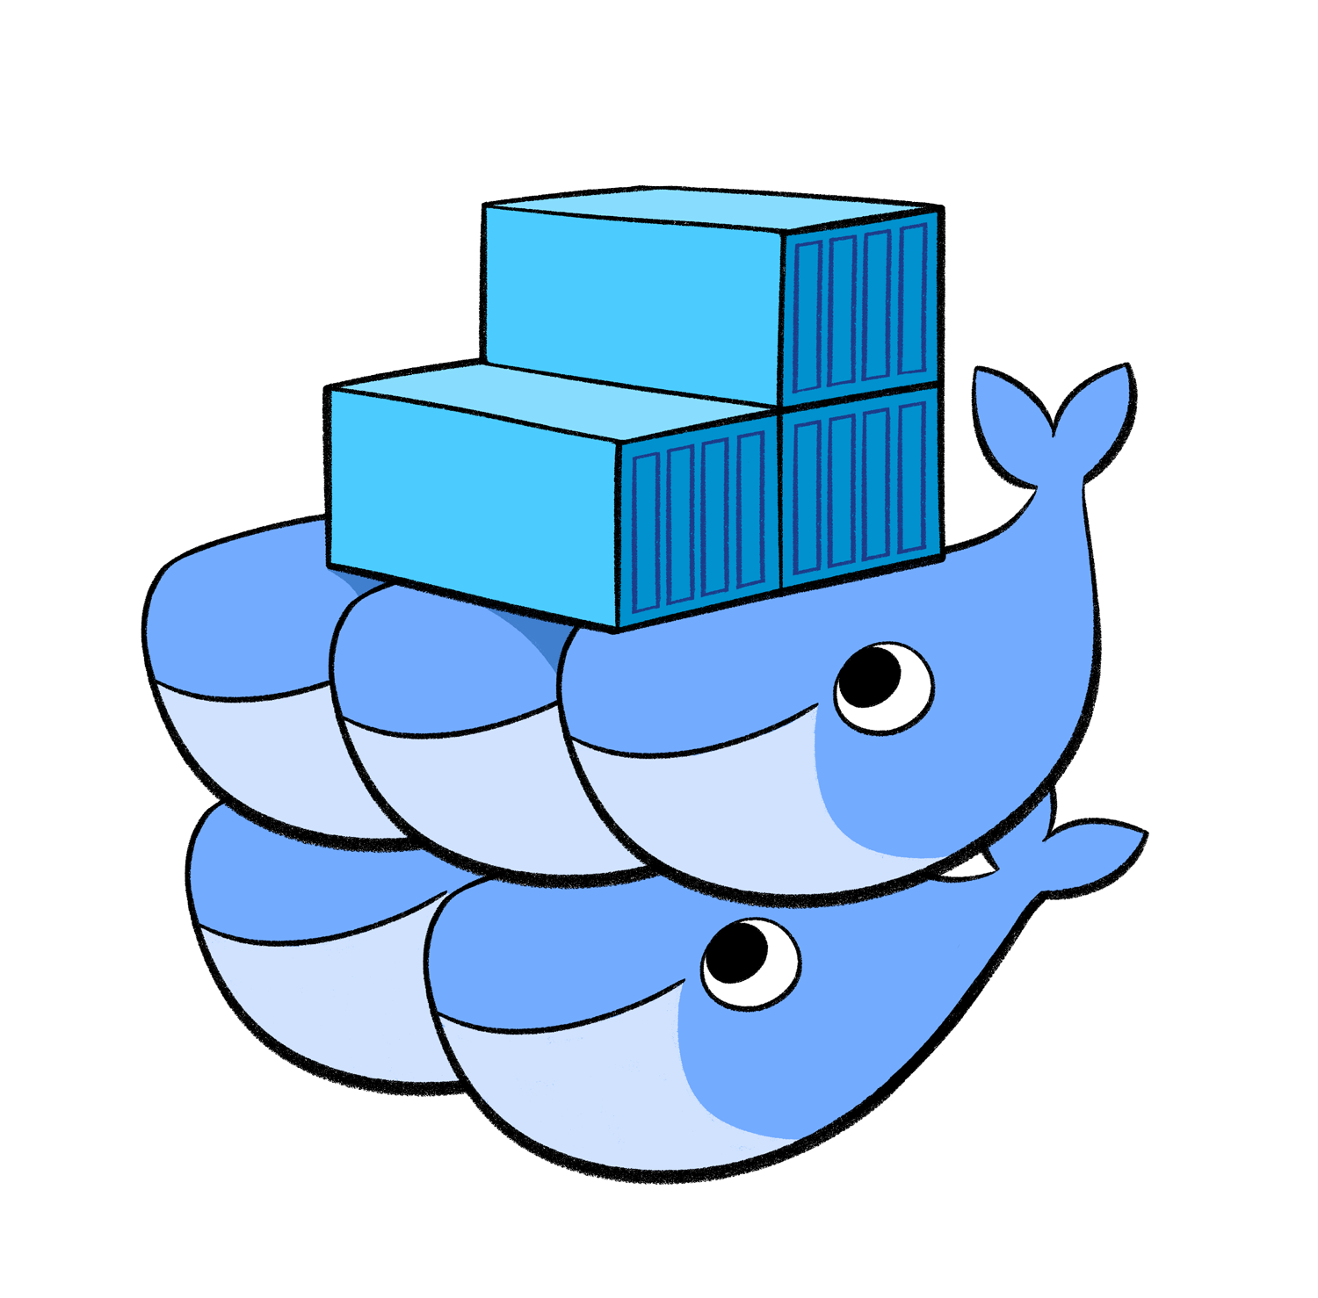
Docker Swarm - Orchestration
Cluster of Docker hosts (Nodes)
Docker “Services”
Load balancing, scaling, failover
Service discovery

Slide 5
Dockerfile → Define
Instructions for building a Docker Image
FROM <image>
  FROM python:3.6
  FROM python:2.7
  FROM python:alpine
RUN <command to run in image to create new image layer>
  RUN pip install numpy
  RUN mkdir /beamline
  RUN cd ioc && make install
COPY <file(s) to copy to path on image>
  COPY config.txt /configure
EXPOSE <port to expose>
  EXPOSE 8080
ENTRYPOINT <set executable and a parameters for runtime>
  ENTRYPOINT [“top”, “-b”]
CMD <extra parameters to executable>

Slide 6
Compose File → Deployment
<service_name>
image: <image_name>
volumes:
- <host/path>:<container/path>
- <host/path/2>:<container/path/2>
environment:
- <env_name>=<env value>
- <env_name_2>=<env value 2>
Define “Services” to be run on Docker or Docker Swarm

Slide 7
IOC Implementation – Host Architecture
Three Centos 7 Servers
  Total: 144 GB Ram, 28 Cores, 44 Threads
Dual Ethernet
  Beamline VLAN
  Motor Controller Non-Routed VLAN
Docker 20.10.6 – CE
GlusterFS replicated storage for sharing persistent state between nodes

Slide 8
IOC Implementation - Images
Reusable Docker Images:
  EPICS Base
  Galil Motor IOC
  areaDetector
    Flir Cameras (Spinnaker)
    Simulated Detector
  Generic IOC with common modules.
  Simulated Motor IOC
  Geobrick Motor IOC (tested, but not in production).

Slide 9
IOC Implementation – STATELESS
All parameters defining the IOC are injected at runtime
  Substitution Files
  DB
  CMD files
  Environment Variables
Files injected using volumes
Version controlled

Slide 10
EPICS Gateway
Require External access to Docker Services
EPICS Gateway already connects networks
Docker Image:
  https://hub.docker.com/r/dmscid/epics-gateway/
gateway –sip 10.138.11.41 –cip 172.18.255.255 –signore 172.18.0.1 -no_cache
One instance per node

Slide 11
Management
Beamline completely defined by Dockerfiles, Compose File, and Substitution/Injected files.
Single source for logs
Move as much as practically into Docker, not just IOCs. Integrated management of services.

Slide 12
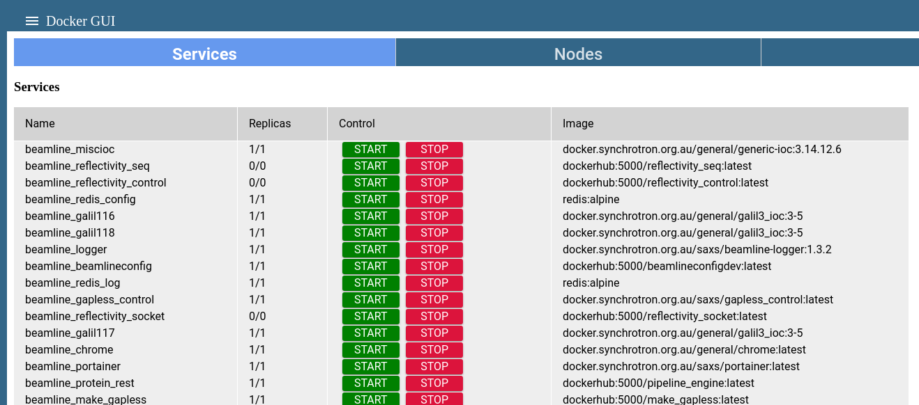
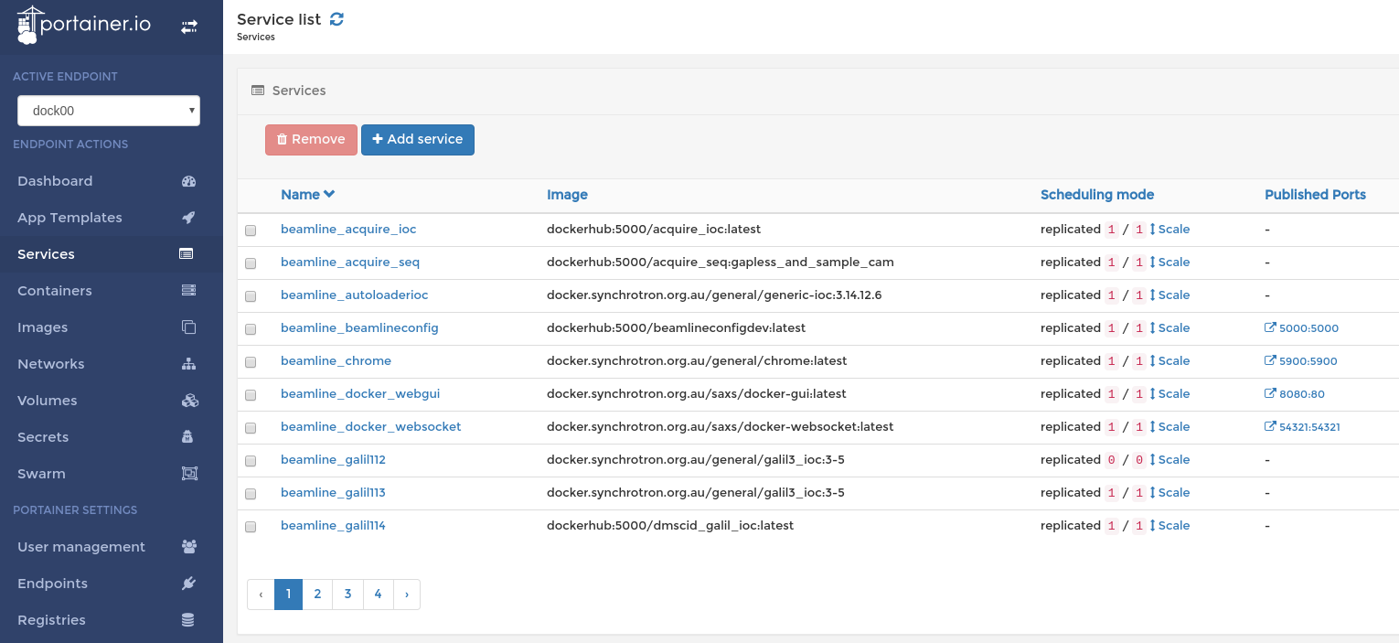
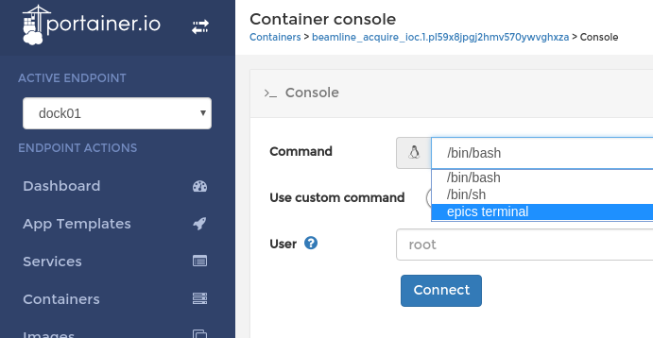
Graphical Interface

Slide 13
Issues
IOCs external to Swarm need to be enumerated to EPICS_CA_ADDR_LIST – i.e., no reverse gateway
Reconnection to PVs after IOC restart is slow.

Slide 14
Docker for Development
Simulated IOCs for testing
Docker Compose to define testing environment
Python development via VSCode

Slide 15
Thank-You
Questions?

