Slide 1
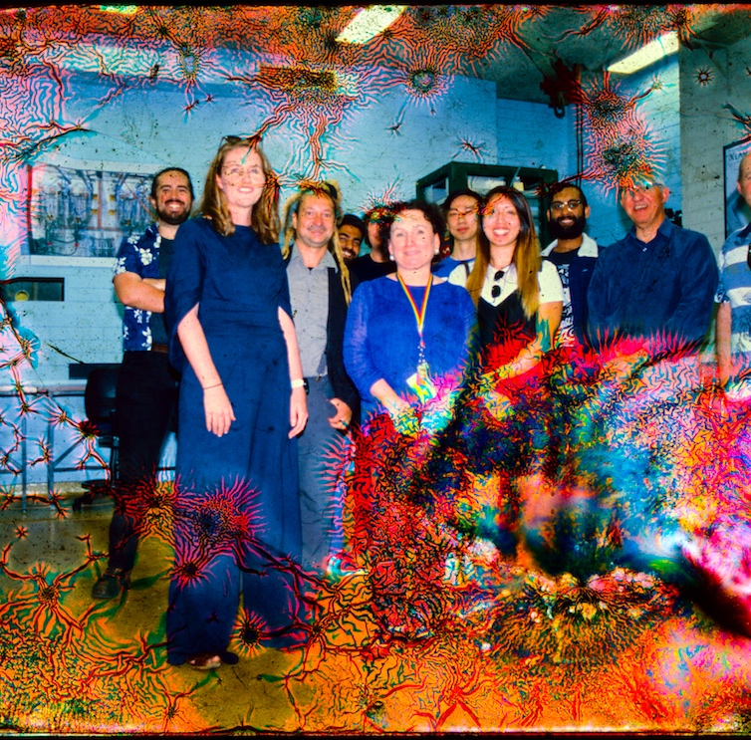
X-LAB: Plans for compact accelerator research in Australia
Dr. Suzie Sheehy
Senior Lecturer, University of Melbourne
Baker/ANSTO Fellow in Medical Accelerator Physics
suzie.sheehy@unimelb.edu.au
@suziesheehy
Image: M. Volpi

Slide 2
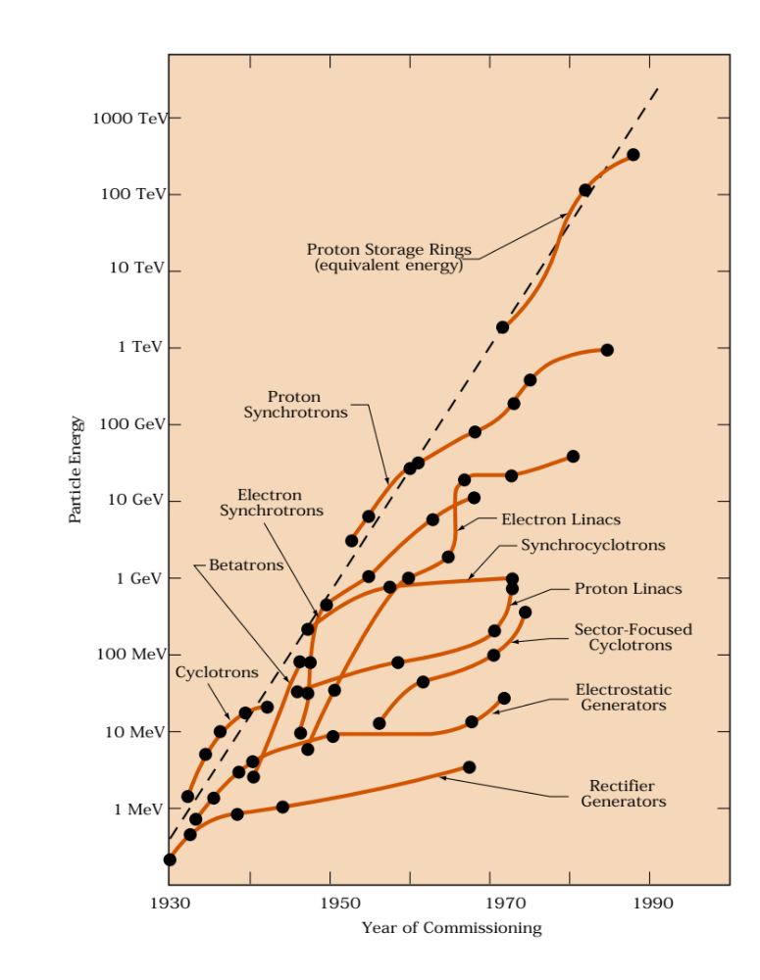
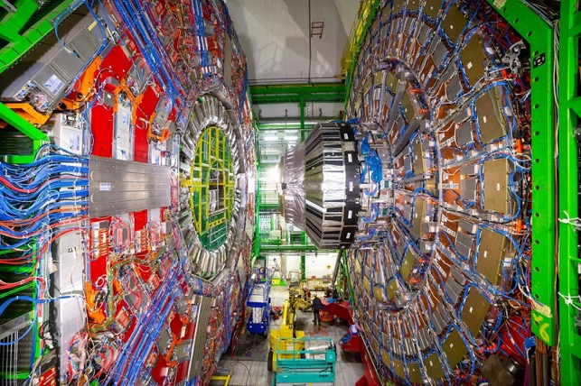
Where do breakthrough technologies come from?
Innovations come from interplay between curiosity driven research and societal applications
John Womersley, former CEO of STFC (UK) said:
“Particle physics is unreasonable. It makes unreasonable demands on technology. And when those technologies, those inventions, those innovations happen, they spread out into the economy, and they generate a huge impact.”
particle physics
vaccines, archaeology, etc…
proton therapy
radiotherapy, security
water, food, materials treatment, sterilisation
https://www.symmetrymagazine.org/article/october-2009/deconstruction-livingston-plot
Image: CMS, CERN
Notes:
(You could remove this one?)
Particle physics is a driver of new technologies. This was summed up nicely by John Womersley in the UK who said (quote).
It was in particle physics that accelerator physics first created accelerators with energies sufficient to make particle therpy a reality.

Slide 3
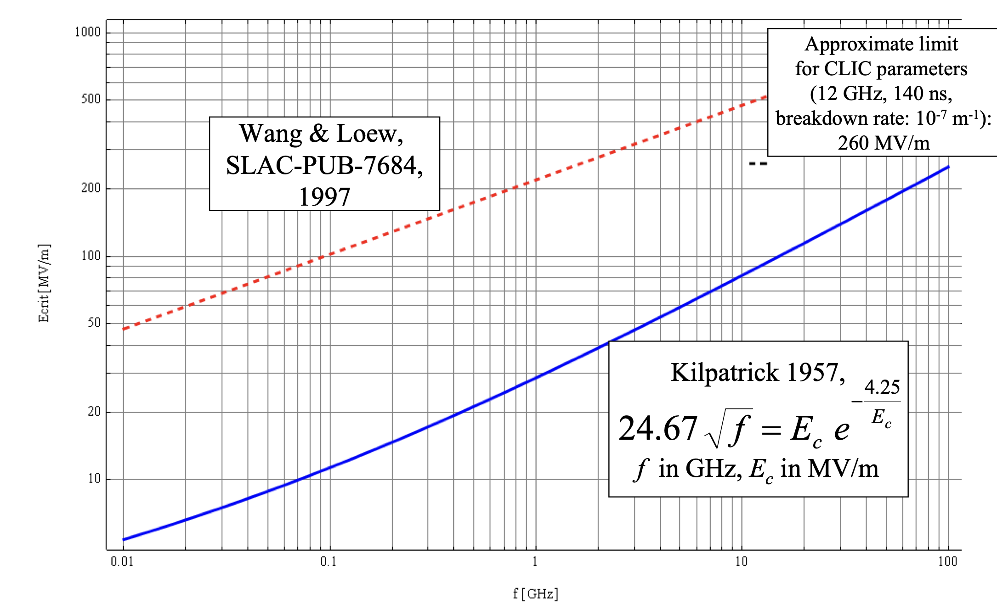
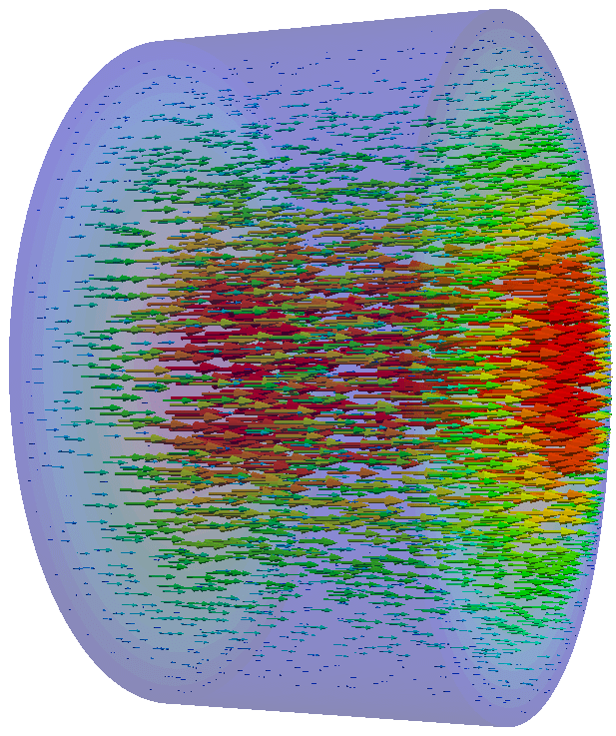
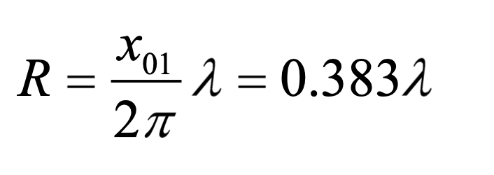
Why X-band accelerators?
1: COMPACT IN WIDTH
HIGHER FREQUENCY = SMALLER DIMENSIONS
2: COMPACT IN LENGTH
HIGHER FREQUENCY = CAN SUSTAIN HIGHER ELECTRIC FIELDS
R
Radius scales inversely with frequency

Slide 4
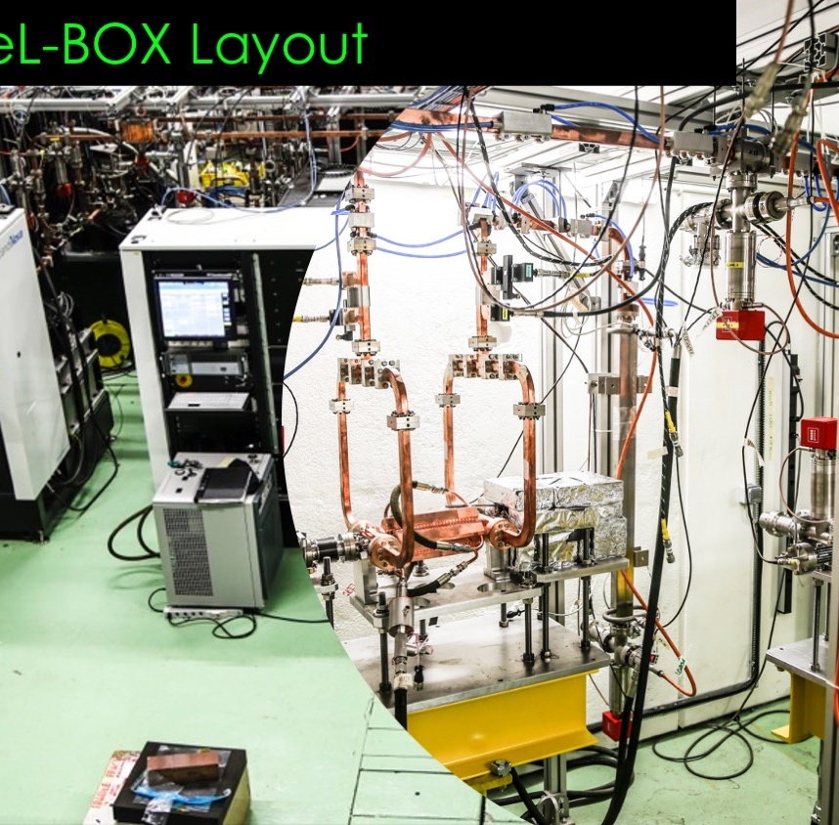
The “X-BOX3” formerly at CERN…
Total power < 50 MW
2 x Toshiba 6MW 5us klystron
2 x Scandinova Modulators
Nominal Rep Rate 400Hz
Developed for ‘CLIC’ Compact Linear Collider Project

Slide 5
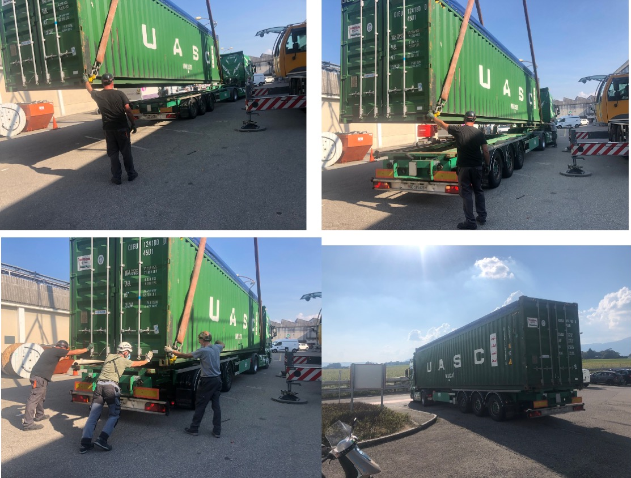
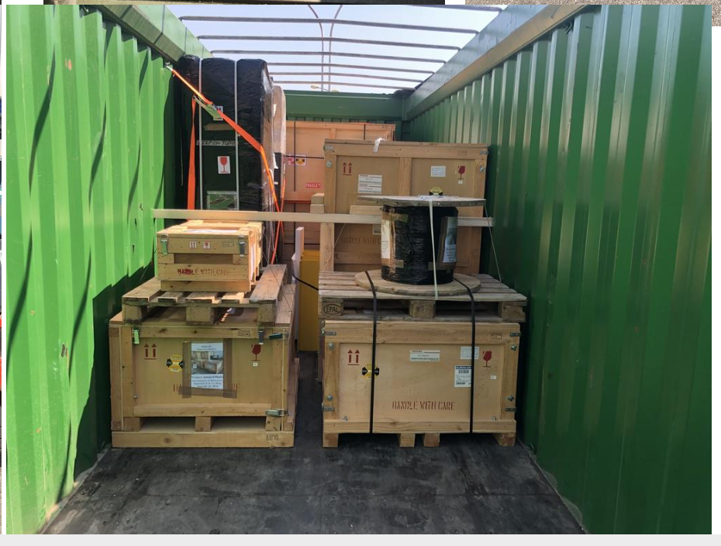
On it’s way in late 2020…

Slide 6
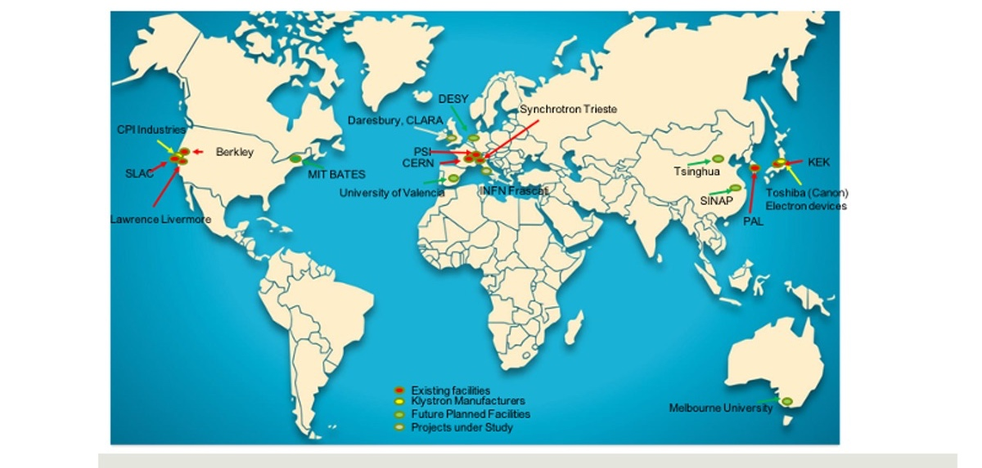
Melbourne is hosting the first high-frequency high-gradient accelerator lab in the Southern Hemisphere

Slide 7
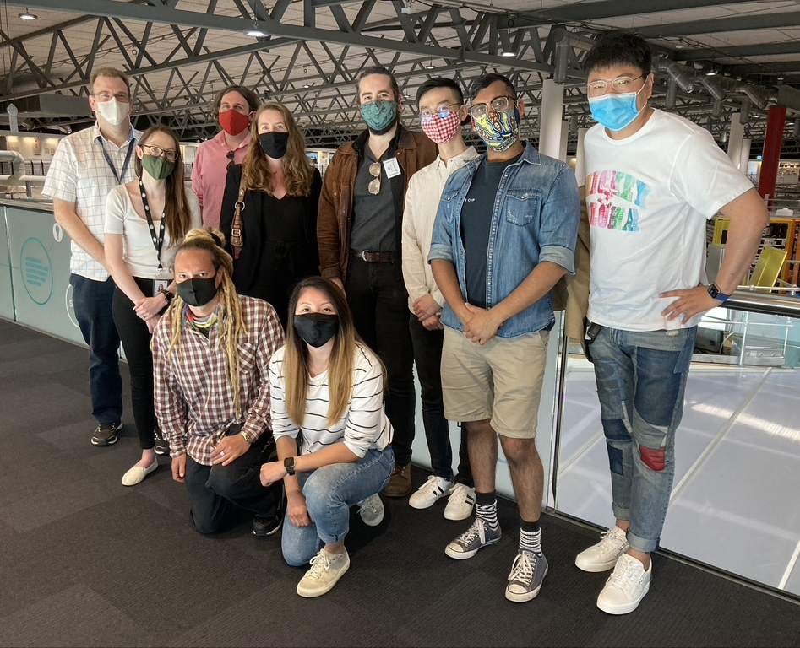
Accelerator Physics @ Melbourne University
“Our vision is to undertake world-leading research in accelerator physics in order to create positive societal impact – in Australia and globally. We will achieve this by creating a physics through to experimental demonstration pathway to take concepts from simulation to reality.”
Key aspects of the groups approach:
International collaborations
Multi-disciplinary research
Experimental and computational focus
Industrial connection
Some of the group visiting the Australian Synchrotron

Slide 8
The UniMelb Accelerator Group
X-band (Compact) Accelerators:
Dr. Matteo Volpi
Prof. Geoff Taylor
A/Prof. Roger Rassool
Scott Williams (PhD)
Paarangat Pushkarna (MSc)
James Dawkins (MSc)
Honorary Members:
Dr. Rohan Dowd (ANSTO)
Dr. Rebecca Auchettl (ANSTO)
Dr. Eugene Tan (ANSTO)
History of Accelerators:
Choiphy Zhao (Visiting PhD)
Hadron Therapy & Medical Accelerators:
Dr. Jacinta Yap
Greg Peiris (PhD)
Frank Zhang (PhD)
Adam Steinberg (PhD – Manchester)
Hannah Norman (PhD – Manchester)
Elodie Higgins (MSc – completed)

Slide 9
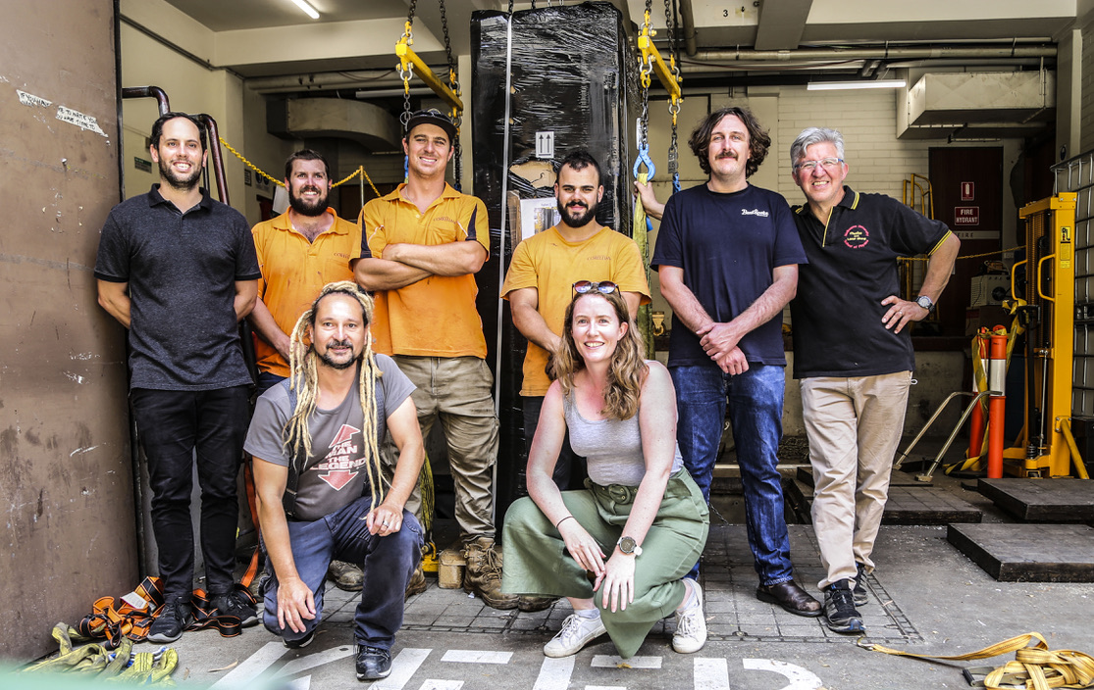
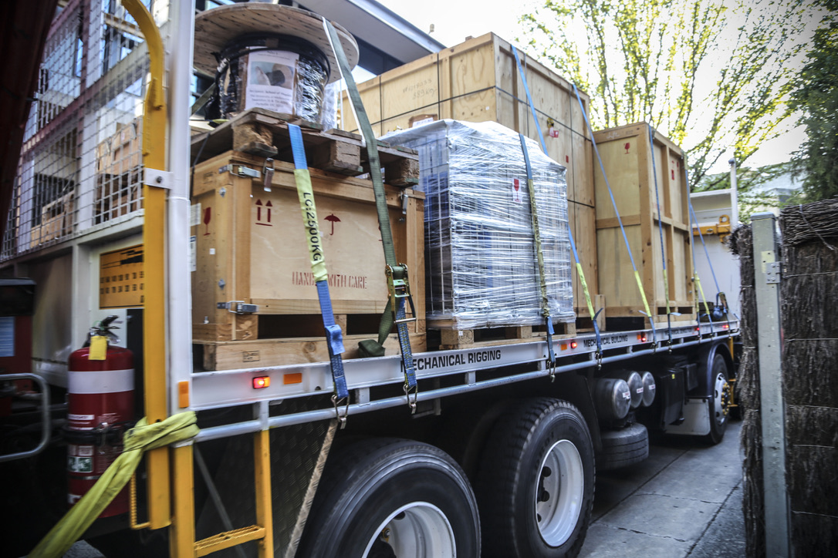
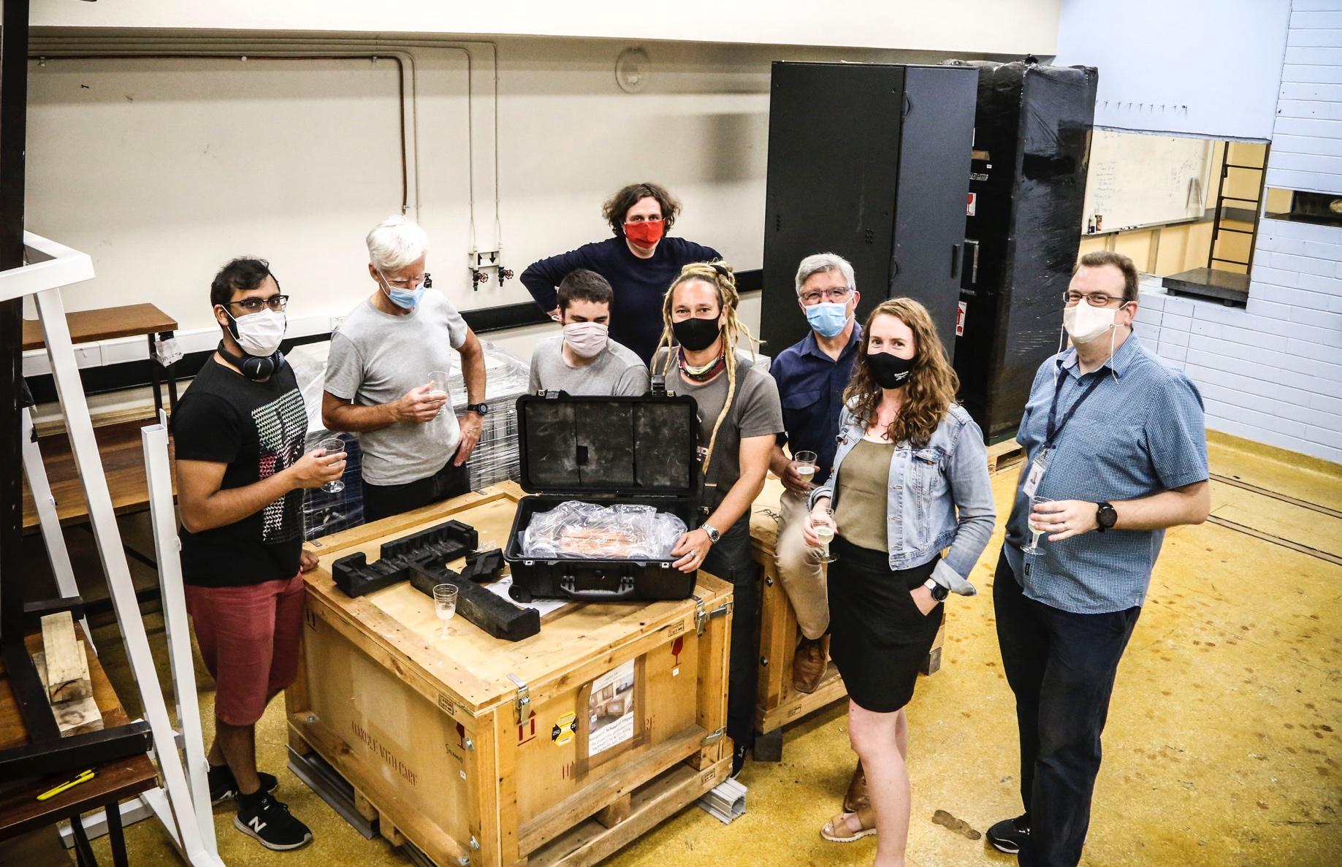
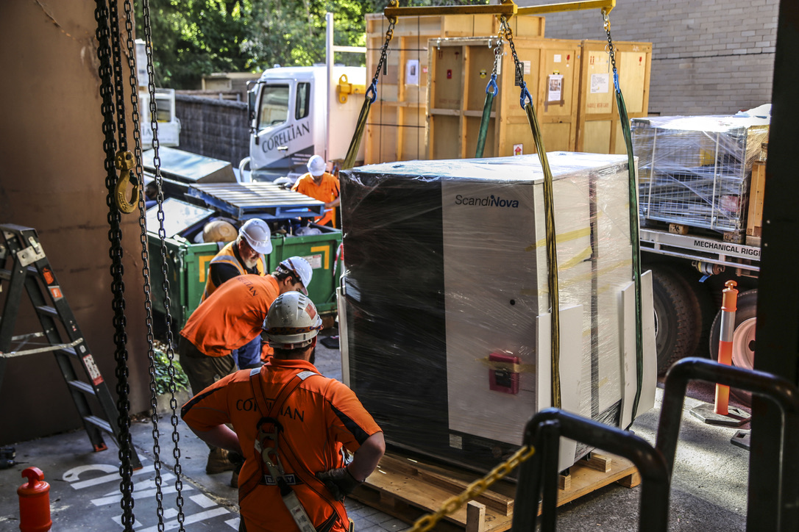
Arrival in Melbourne!

Slide 10
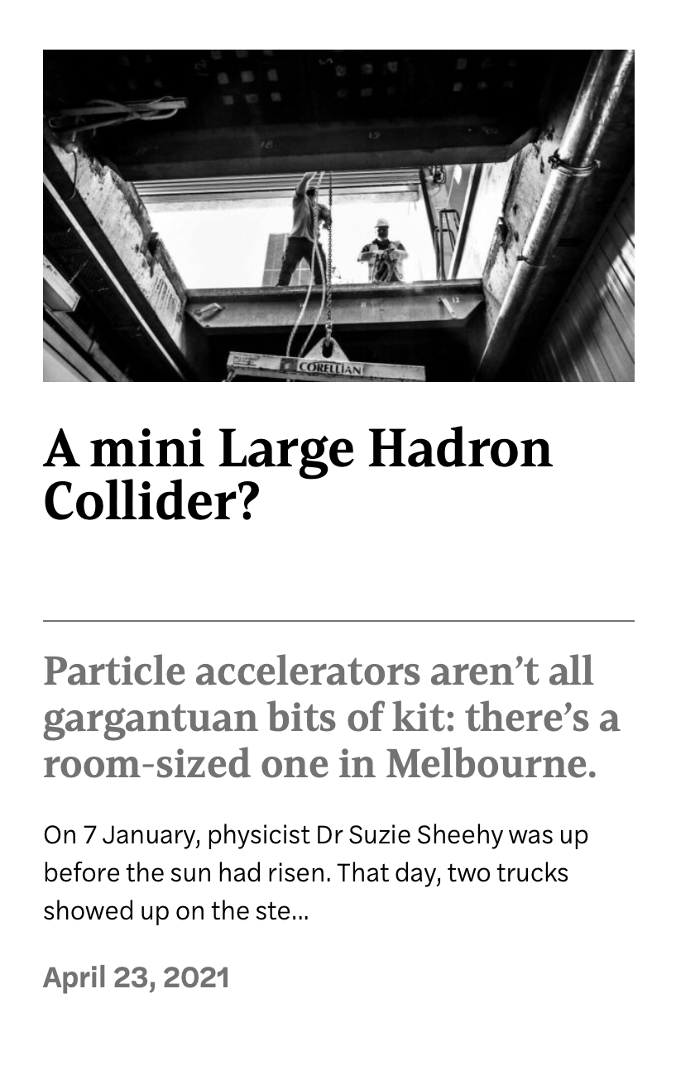
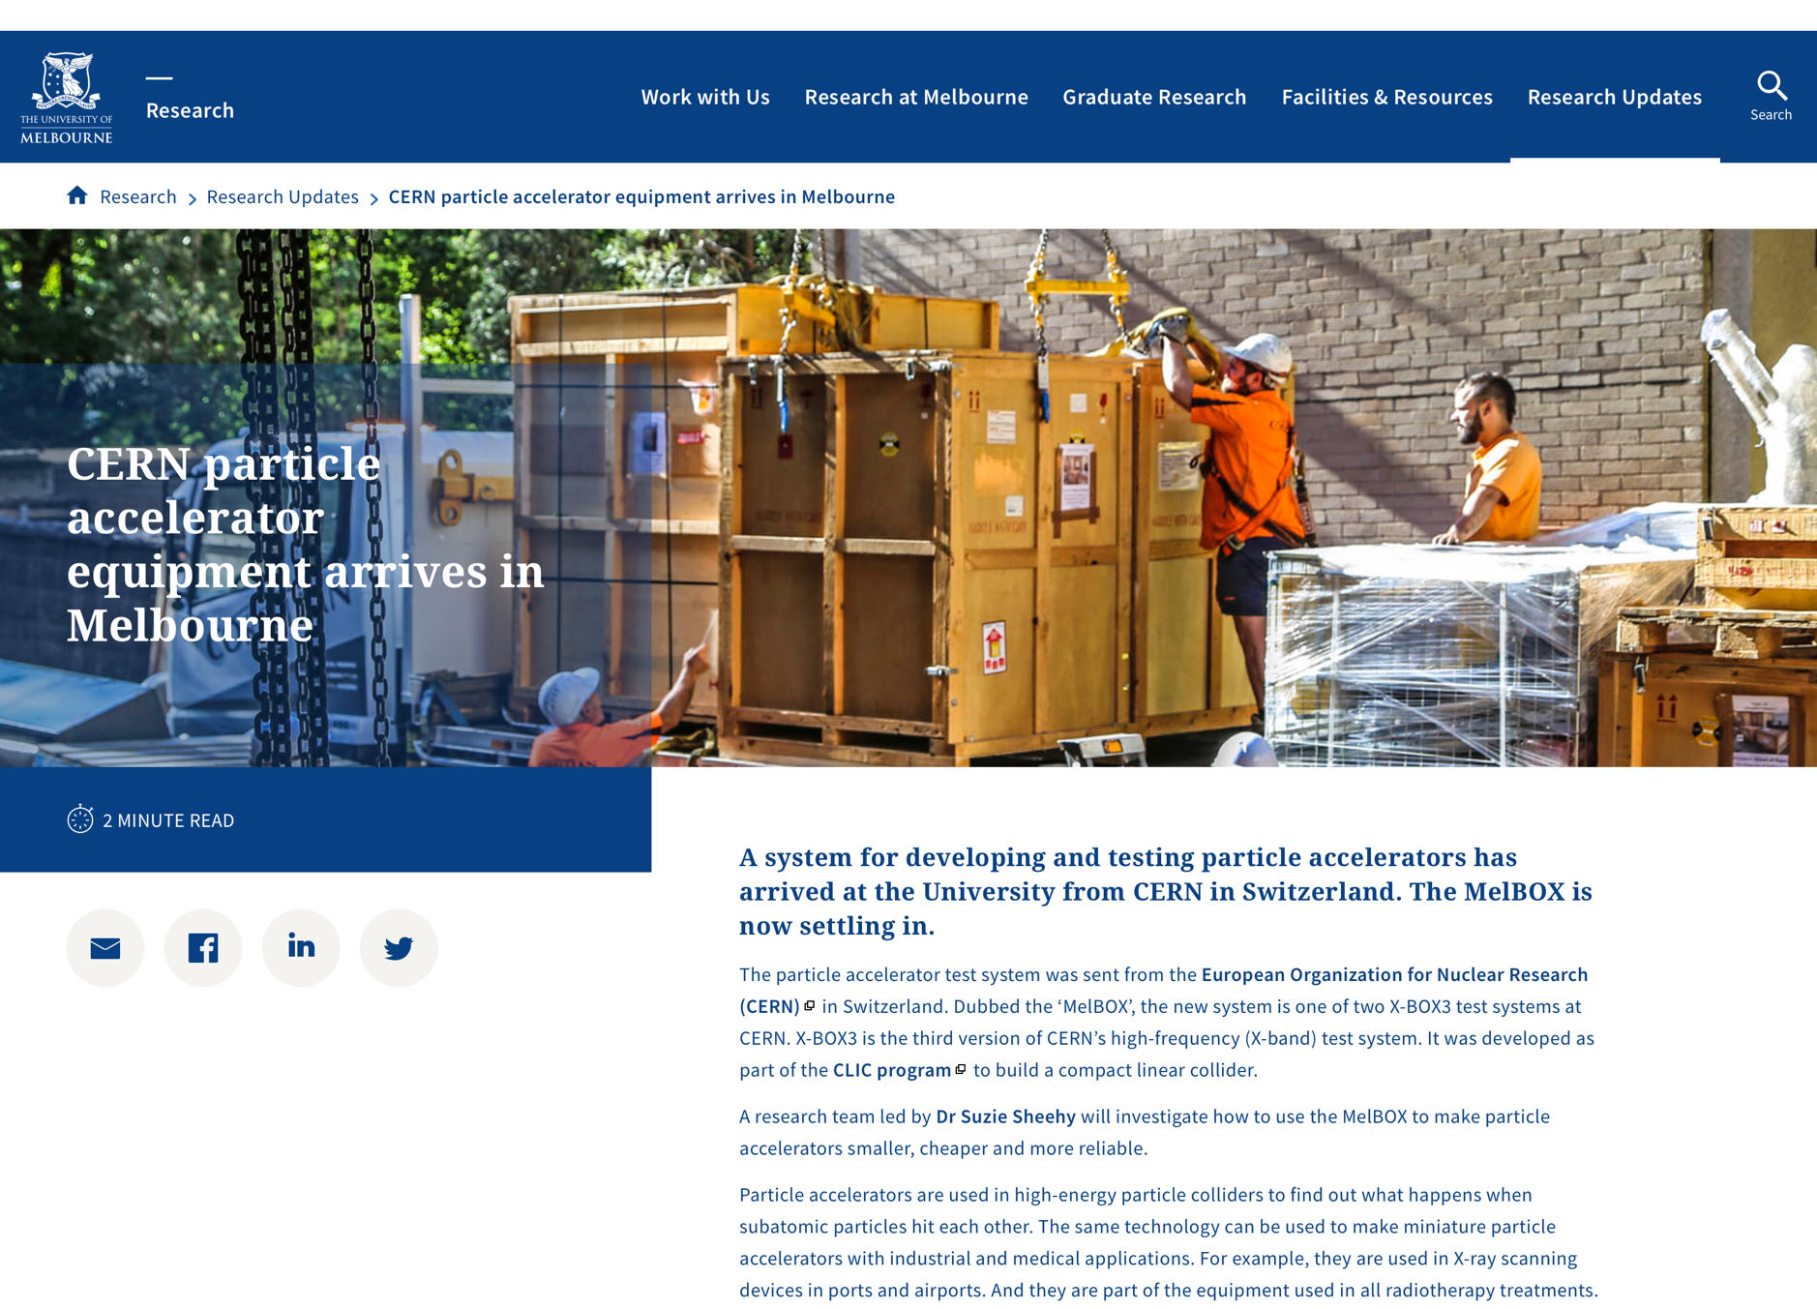
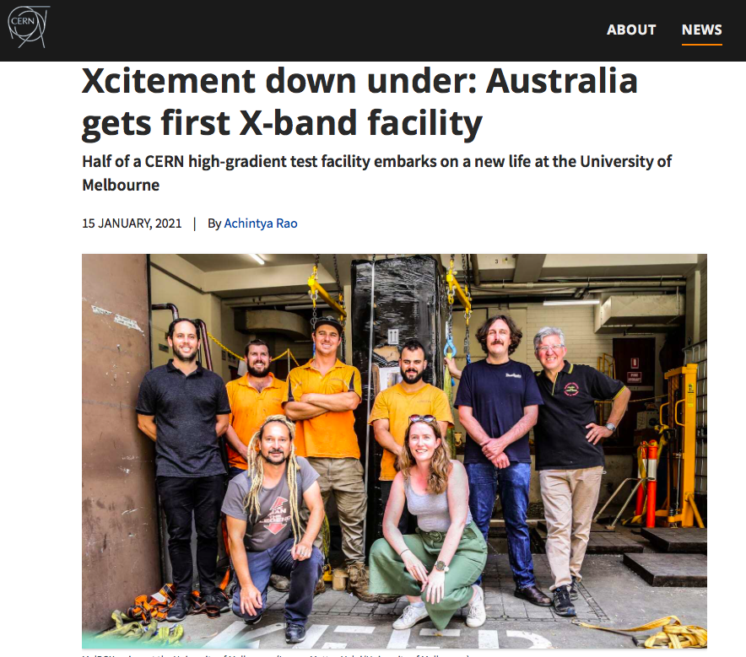
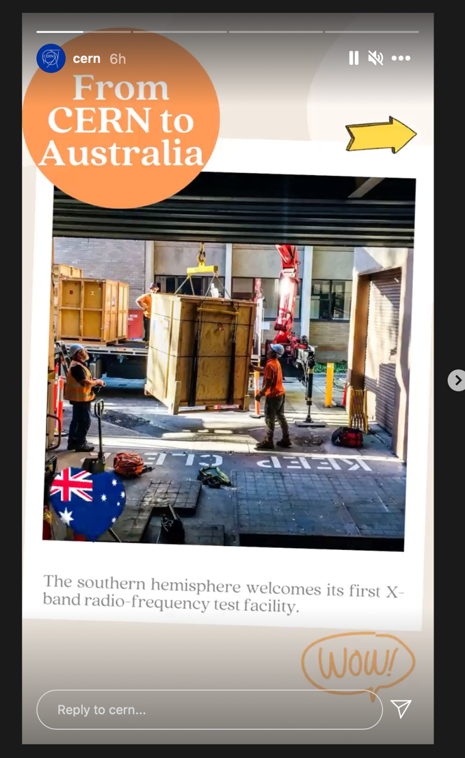
Just getting it here was a big achievement!
COSMOS magazine
CERN News
UniMelb News

Slide 11
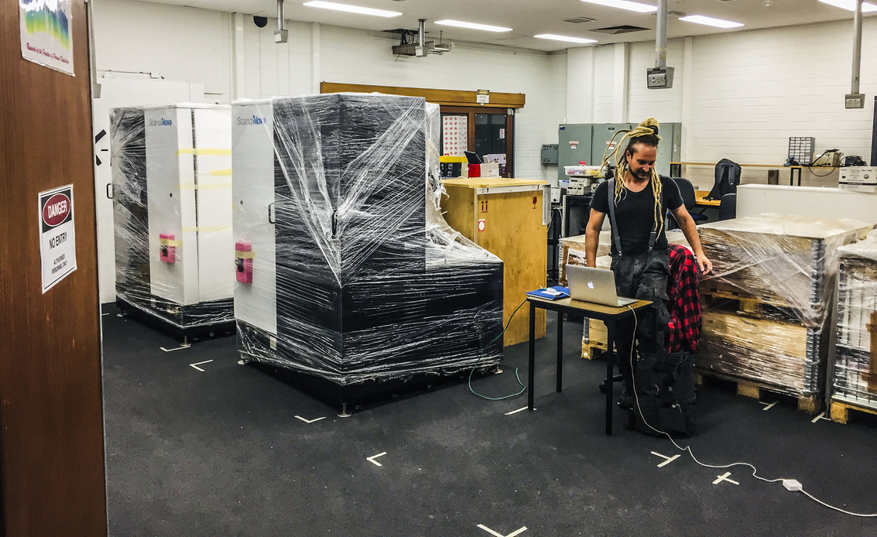
But now, the real work begins!

Slide 12


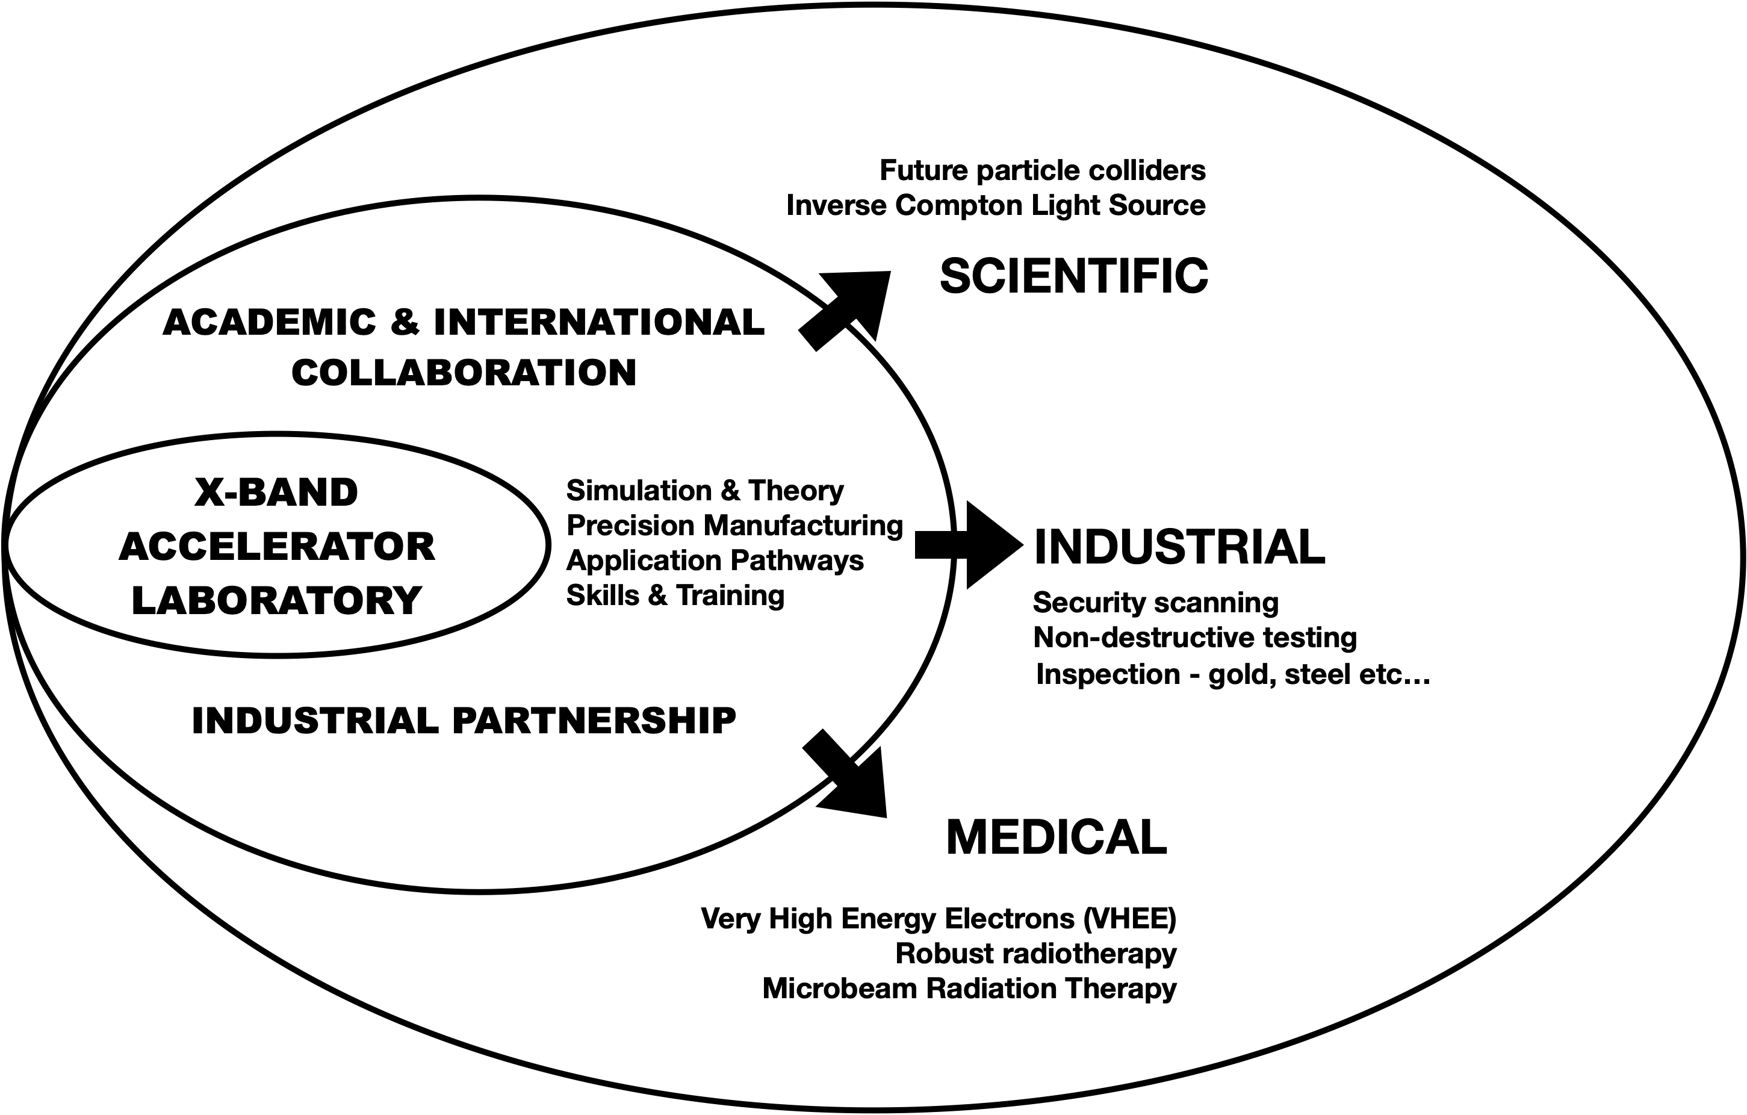






So… what will we do with it?
ARC Linkage Proposal: Outcome due July 2021

Slide 13
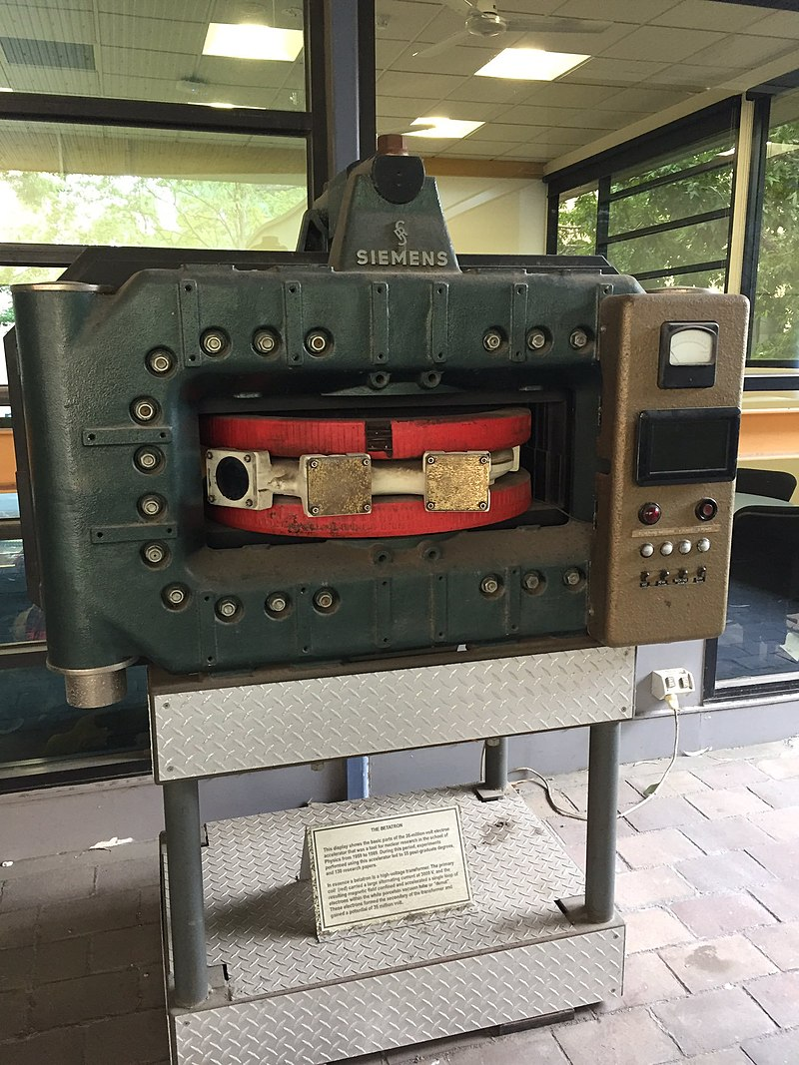
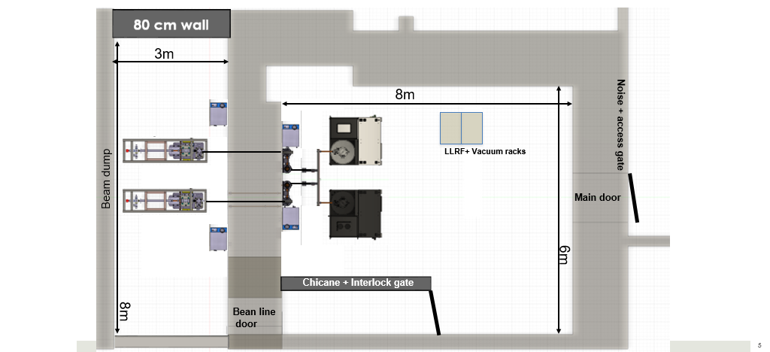
Phase 1: Accelerator Test Stand
Bunker used to house a 35 MeV betatron

Slide 14
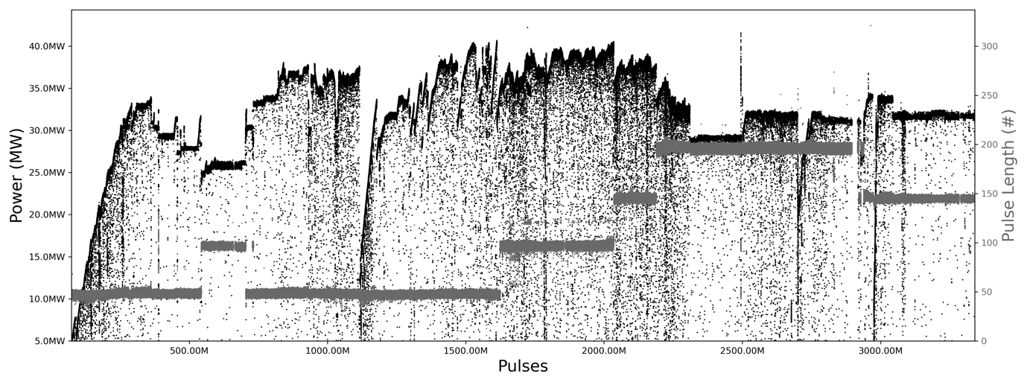
How to ‘break in’ X-band accelerators?
RF breakdown is destructive to beam & accelerator
accelerating structures must be ‘broken in’
need to be able to:
  predict breakdown
  Optimise “conditioning” (variation of input pulses over time)
Our aim: build a machine learning algorithm to optimize conditioning process
TD24 structure so far reached 40.45 MW (97.9 MV/m)
(ns)
CLIC structures high power tested so far.

Slide 15
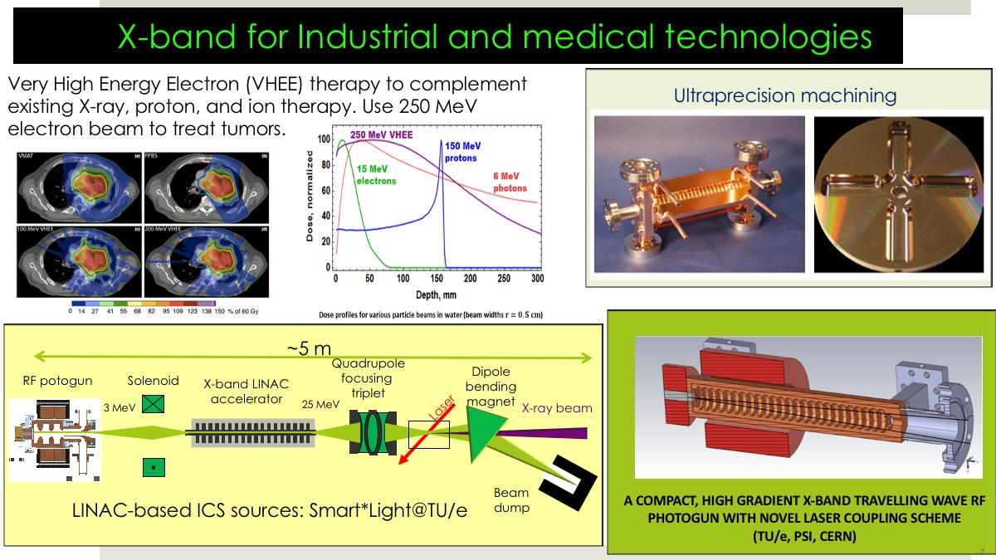
Ultra compact = challenging manufacturing!
Precision machining – to single micron level.
Successfully established links with ANFF (Adelaide) to produce the FIRST X-band high power RF components ever made in Australia
…now investing in $millions for a “nanomill”

Slide 16
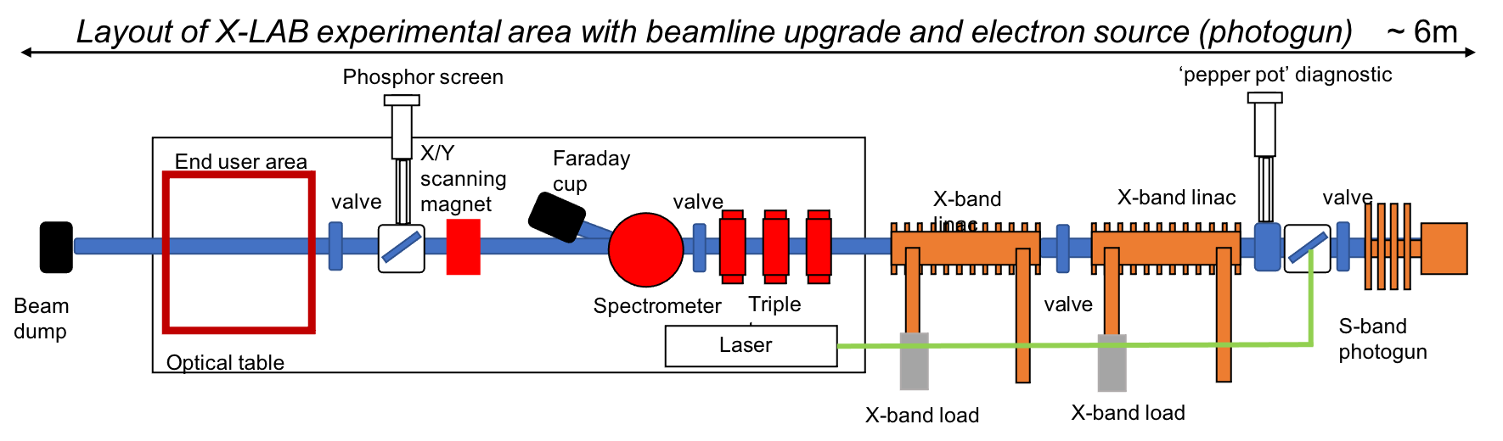
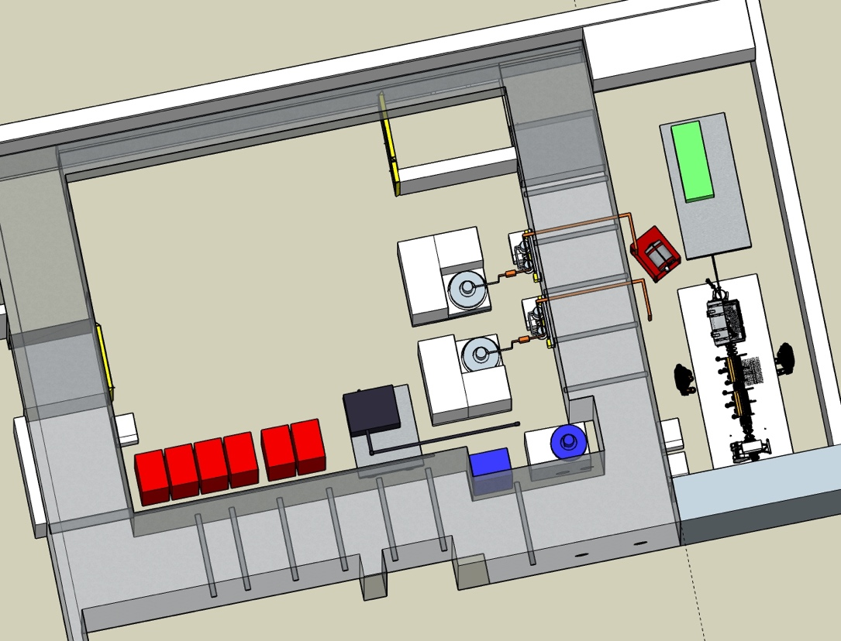
Phase 2: Electron beamline project
Co-develop accelerators for applications
Potential electron and X-ray users:
Biophysics studies
Electronics and dosimetry (space applications)
Diagnostics development
Novel radiotherapy technology
+ much more!
Accelerator developments:
Compact Light Source development
VHEE accelerating structures
Structures for in-field industrial scanning applications

Slide 17
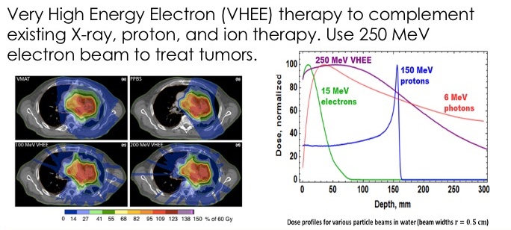
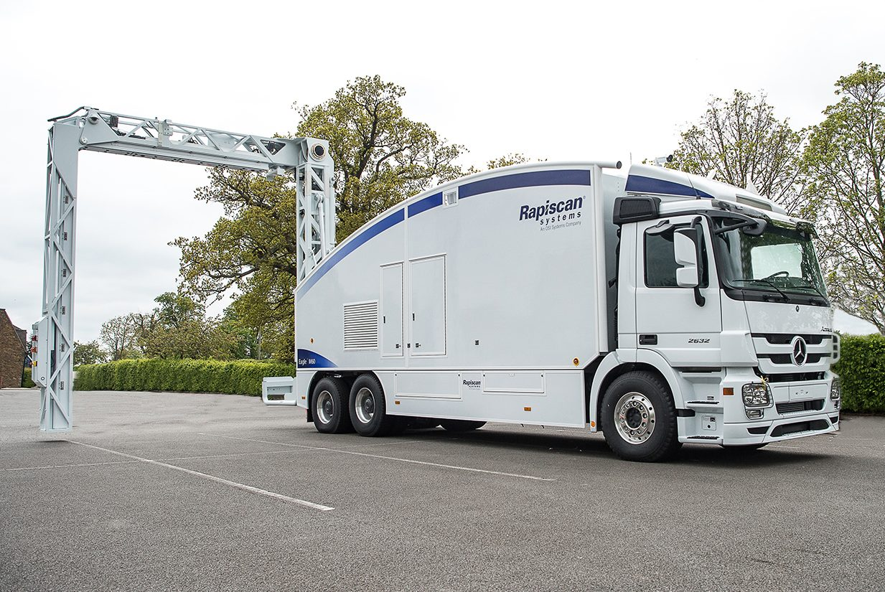
Other applications of X-band technology:

Slide 18
X-LAB: X-band Laboratory for Accelerators and Beams
PROGRAM 2021 - 2026
Conditioning of TD24 & algorithm
Design for applications
Reconfigure to accelerating mode
Rf pulses with beam
DRAFT
Phase 1: X-band Research & Establishment
ARC Linkage Proposal
R3, 2020
Design & simulation
Procurement of beamline
Beamline commissioning
Phase 2: 40 MeV tunable, pulsed electrons & applications
ARC LIEF proposal
R1 2021
w. ANSTO, Wollongong & Sydney
Progress application-based research: space dosimetry, biophysics, radiotherapy, etc…
2022
2023
2024
2025/6
Electron gun added
Compton light source experiments?
Heavy work, water & electricity completed
First X-band rf pulses
Notes:
Main Goal

Slide 19
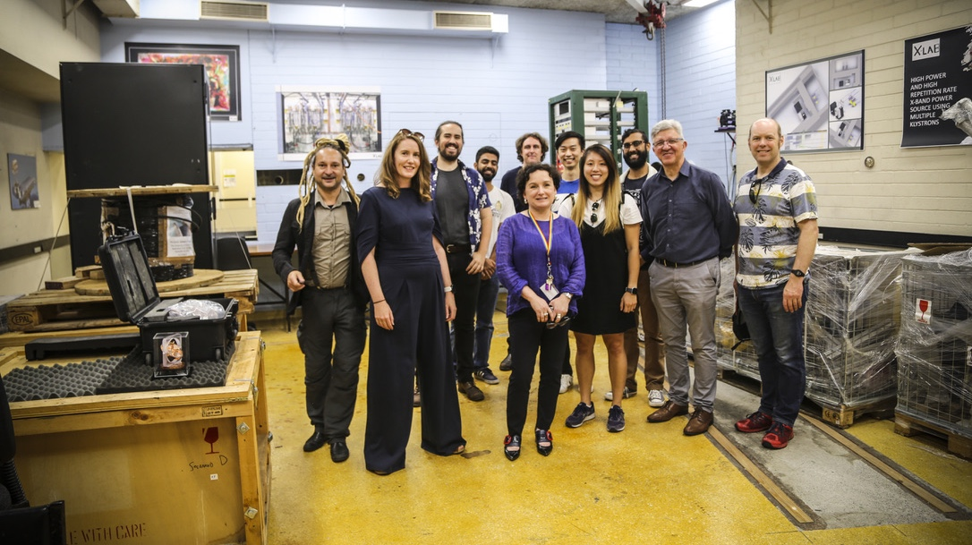
Thankyou
Dr. Suzie Sheehy
@suziesheehy
Pictured: X-LAB visit by Moira O’Bryan, Dean of Science, UniMelb (Photo: M. Volpi)

