Slide 1
User focused applications with epicsQt
Andrew Rhyder
Andrew Starritt
Notes:
I’m Andrew Rhyder, from the Australian Synchrotron.
I’ll be talking about developing applications using epicsQt.

Slide 2
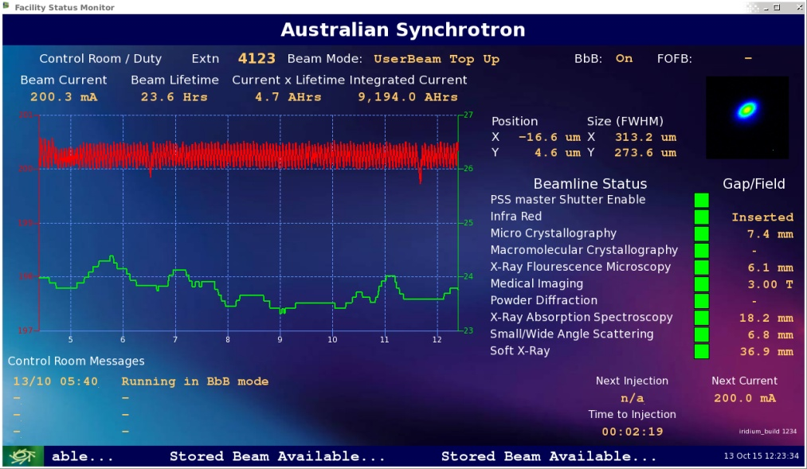
PRESENTATION SUMMARY
Qt and epicsQt overview
User focused GUI applications
Wish list
Notes:
I’m going to provide a very brief overview of Qt itself, then we’ll move on to the epcisQt framework and I’ll go into some detail about how epicsQt can be used for rich application development.
I’ll finish with a few items that I think are important for the future of epicsQt.

Slide 3

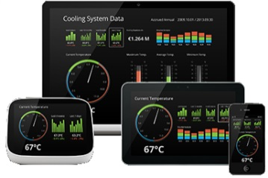
Qt OVERVIEW
Qt is a cross-platform application and UI framework for developers using C++.
It can be used under an open source licence.
Qt has had a 20 year track record of ongoing development and expanding use.
Notes:
What is Qt?
Qt is a cross-platform framework for developing applications and user interfaces,
It builds on C++,
and it’s open source.
It’s turned 20!, and you can now write a Qt application and deploy it on a wide range of platforms including Linux, Windows, Mac OS, IOS, Android and VXWorks
It has great community support, and it’s well documented.
A lot of binding to other languages.
It is well used in the EPICS community

Slide 4
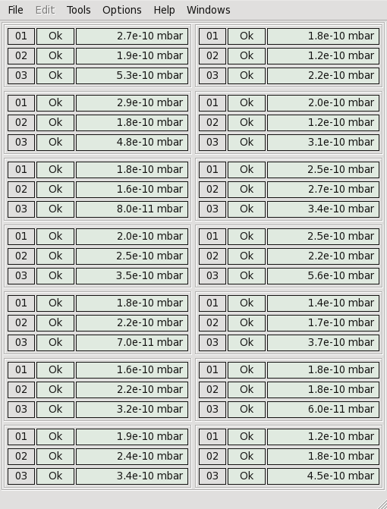
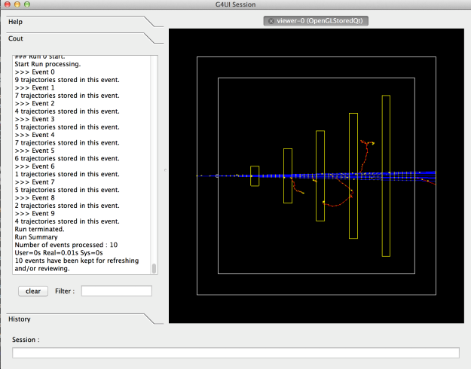
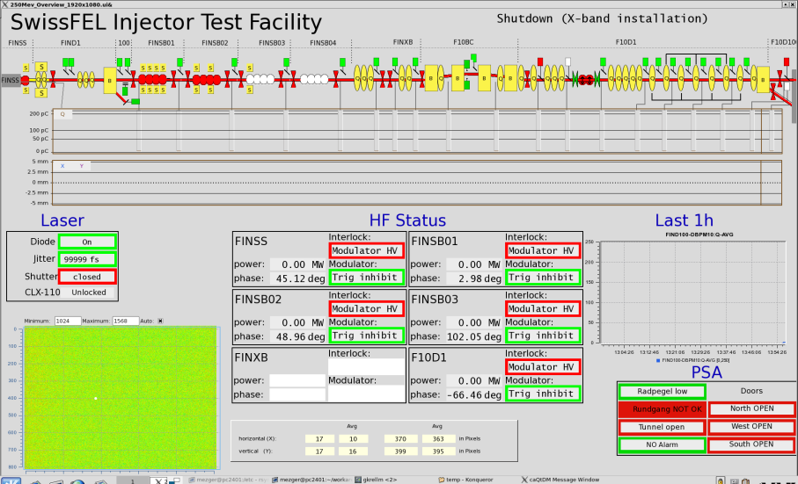
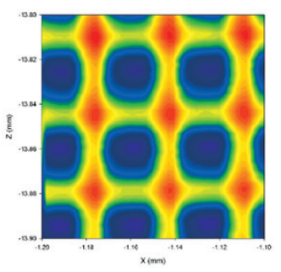
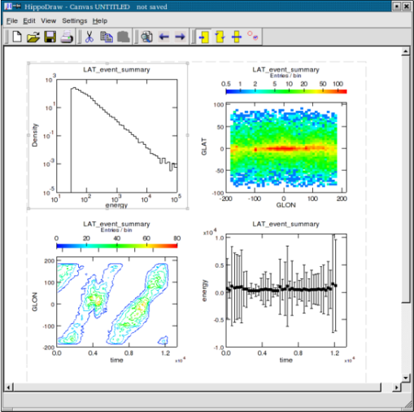
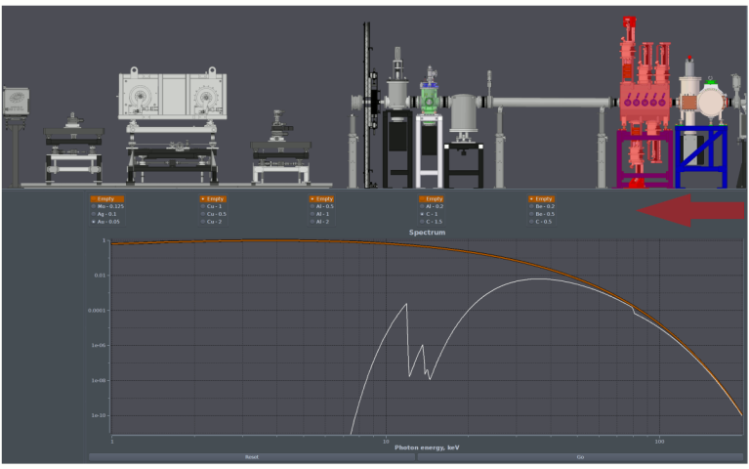
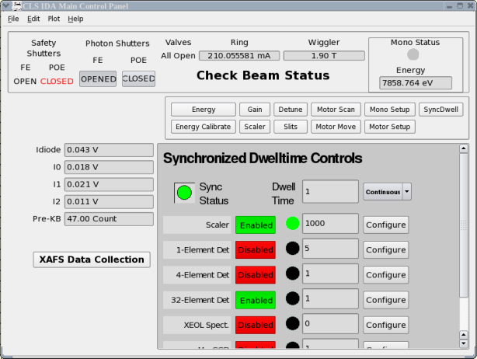
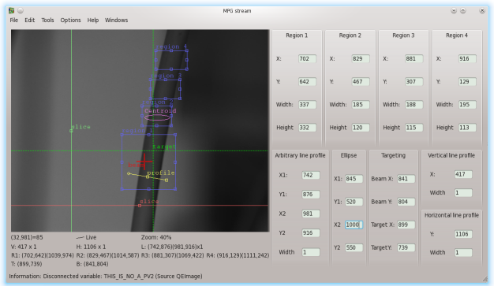
Qt OVERVIEW
Notes:
Already developers within our facilities are using Qt, and have been for a long time.

Slide 5
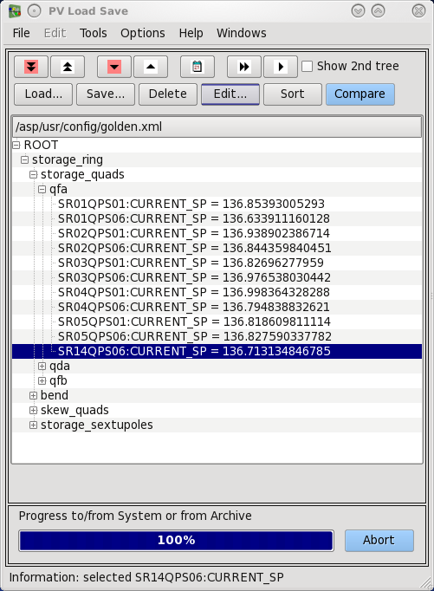
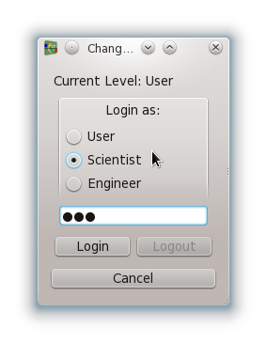
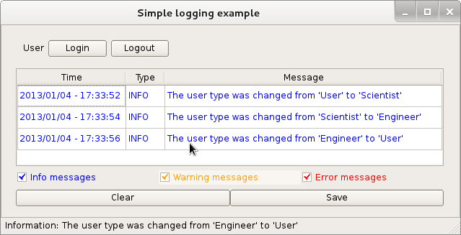
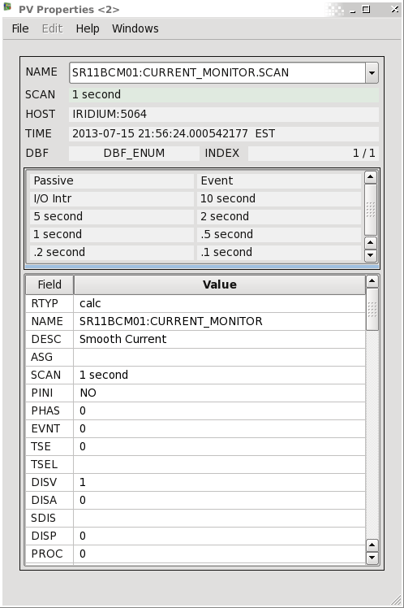
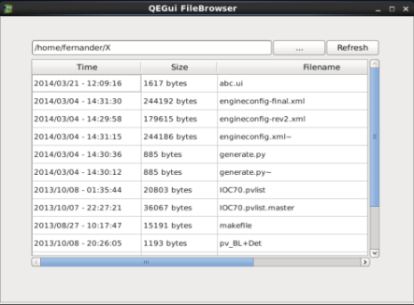
epicsQt OVERVIEW
Widgets – 51 of them
7 simple monitors
13 Controls
6 Graphical
18 Application support widgets
Notes:
epicsQt.
At a glance, epicsQt is a large collection of EPICS aware widgets and a display manager with associated tools.
It has a comprehensive set of monitor and control widgets
but the strength I would like to highlight today is how it supports application development.
A comprehensive set of monitor and control widgets allows easy creation a synoptic displays, but it is the application support widgets, along with supporting class libraries that enables user focused GUI application development.
We have tried to move moves the emphasis from a simple presentation of EPICS data to the production of GUI based applications that focus on users and their processes.

Slide 6
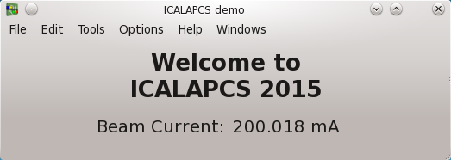
epicsQt OVERVIEW
Modes of use - Codeless
Notes:
Before I present those support widgets and classes,
I’ll make a short diversion to cover the different ways you can develop in epcisQt.
The framework supports several paths to application development.
And we have tried to keep the simplest path very simple.
In this scenario you don’t have to write any code. It’s just drag and drop.
This demo shows the Australian Synchrotron beam current. It doesn’t have much on it...

Slide 7
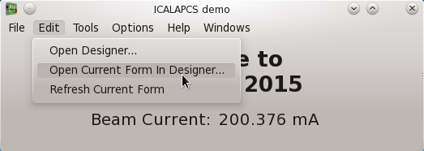
epicsQt OVERVIEW
Modes of use - Codeless
Notes:
So I’ll start the form editor...

Slide 8
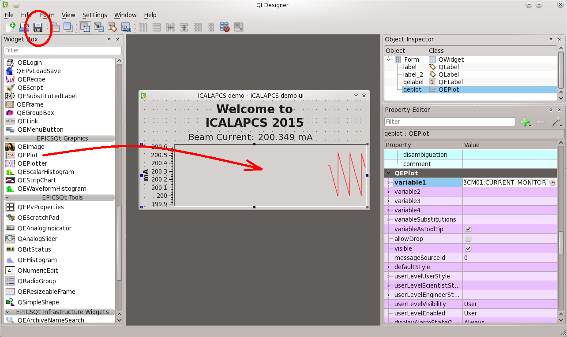
epicsQt OVERVIEW
Modes of use - Codeless
Notes:
Add a plot widget...

Slide 9
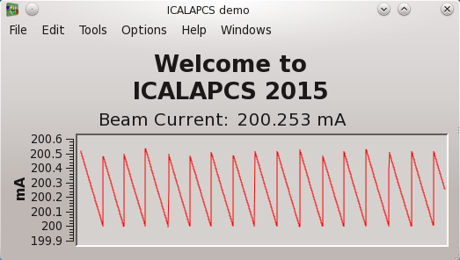
epicsQt OVERVIEW
Modes of use - Codeless
Notes:
And close the editor.

Slide 10
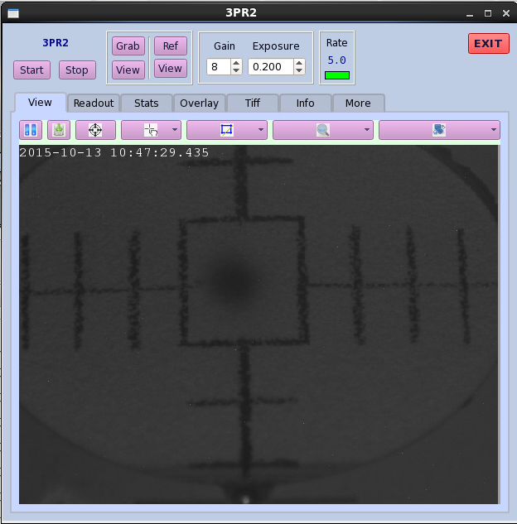

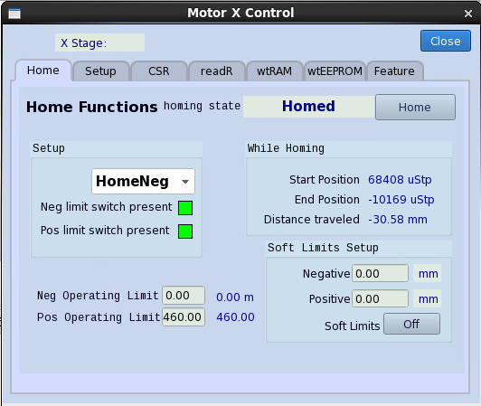
epicsQt OVERVIEW
Modes of use - Produce your own application
Notes:
If you have existing applications, or you just have to write your own, then the epicsQt framework supports that too.
The support is more comprehensive than just using the epicsQt widgets in your code. As far as possible, the features of the widgets and tools in epicsQt are public and can be incorporated in your own code.
So we have tried to ensure that it is not just the control and monitoring widgets that can be shared, but the functionality of our display manager and other tools.

Slide 11
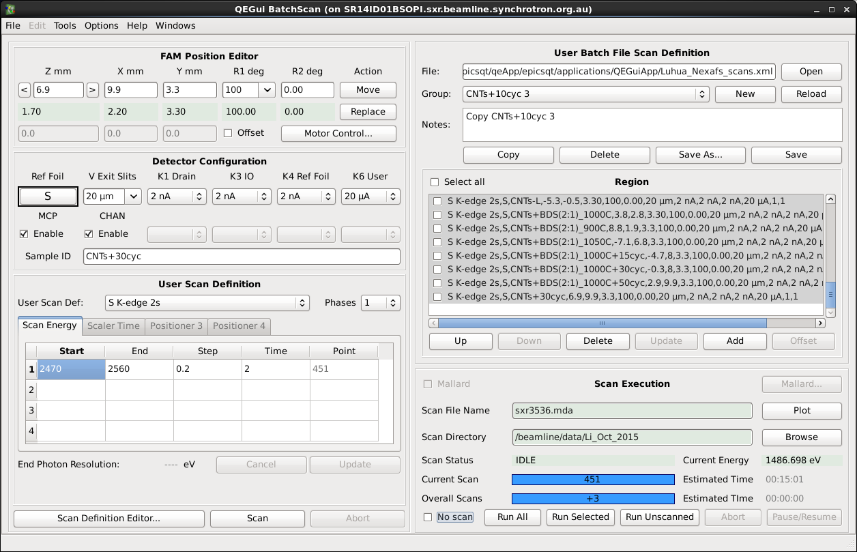

OVERVIEW - epicsQt
Modes of use –
Produce your own widgets
Notes:
Alternatively, if you are writing your own widgets you can incorporate epicsQt widgets, or use all the services available to epcisQt widgets thorough the epcisQt class libraries. Here are two very specific and fairly large widgets in use at the Australian Synchrotron. In these cases each is pretty much an entire application, but Qt widgets using epcisQt start at only a few dozen lines of code.
Importantly, you don’t need to modify the epicsQt framework code at all to add your own widgets that use the framework and sit alongside epicsQt widgets. You just build your widgets in your own Qt plugin and use whatever functionality you wish to include from epicsQt.
Your widgets themselves can then be used in codeless GUI design with the epicsQt display manager, or in your own applications.

Slide 12
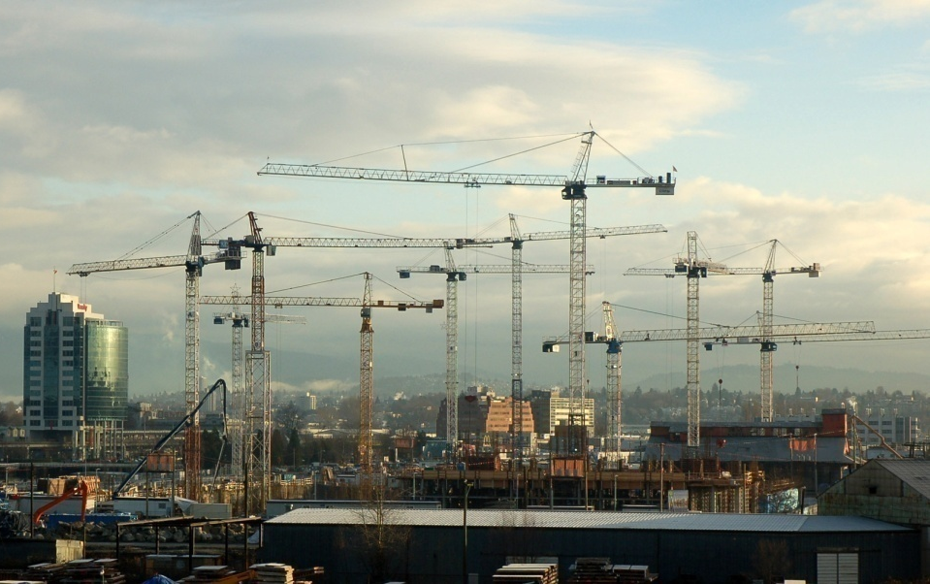
OVERVIEW - epicsQt
Application support
Menu customisation
Save/restore
Tool tips
Copy/Paste
Context menus
Launching windows and docks
Data sources
Integrated logging
Application support widgets
Notes:
Here is a summary of some the main supporting functions used within the epcisQt framework, and available to anyone writing applications or widgets based on the epicsQt framework.
I’ll spend a few seconds on each of these, but I’d like to point out that several of these are of particular interest when you are using a generic display manager like epicsQt’s QEGui.
A potentially limiting aspect of the model where a generic display manager opens GUI forms is that the functionality built into the display manager is generic and focused on the display manager, and objects within the forms being presented have limited scope beyond their own borders.
Building in any interaction between the objects being displayed and the application presenting the display ties them together so even introducing the concept of a button opening an associated display can bond the widget set to the display manager application.
To remove this limitation, epicsQt has a mechanism that allows widgets and applications to make requests of each other
while allowing the transient and limited relationship between and generic display manager and the contents of the forms being displayed.
So without even knowing what application it is being presented in an epicsQt push button can request a new window is created, or an epicsQt image widget can ask for its brightness and contrast control panel to be hosted in a dock. Likewise, a generic display application like QEGui can have a custom menu option added to ask for an epicsQt image it is displaying somewhere in a form to start or stop recording.

Slide 13
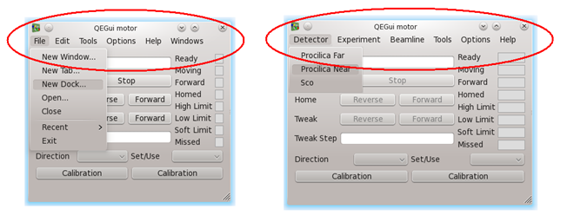
USER FOCUS
Custom menu bars
Notes:
So first on the list there was custom menu bars
The epicsQt framework display manager is called QEGui.
The framework includes a mechanism for customising menu bars which allows QEGui to perform more like a custom user application and less like a display manager.
Every application you use has a set of menus supporting the purpose of the application. If you select some text in word you expect to use the menu and toolbar to on the selected text.
So if a beamline user is looking at their sample positioning application they should see menus and toolbars related to sample positioning, not menus related to a GUI presentation tool.
For example, if an image is presented in a GUI, it should be possible to access the controls for the image such as zoom level or brightness and contract through the application menu bar and tool bar.
In this example, on the left is QEGui with its standard menu bar which allows you to drive the display manager, and on the right custom menus have been added that relate to the application.
This mechanism allows a custom menu item or tool bar button in the display application to do everything a button in a GUI can do. Open a new window, run a command. But it can also send a request to one of the widgets in a display it is presenting.
And it also allows widgets to interact with the menu bar. For instance, an image widget might contribute a zoom level menu. This is more significant when you think that the display manager will not even be aware it is opening a display containing an image widget.

Slide 14
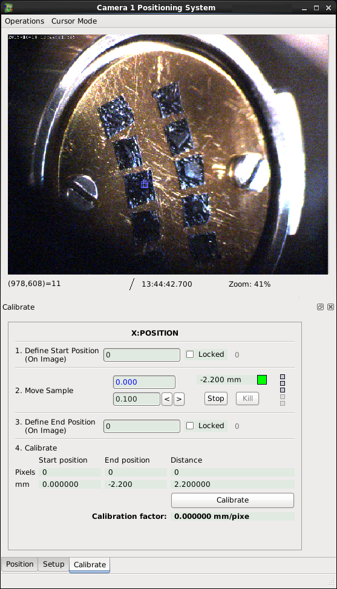
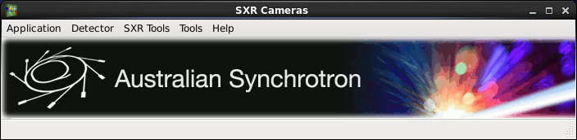
USER FOCUS
Custom menu bars
Notes:
A couple more GUIs with customised menus…

Slide 15
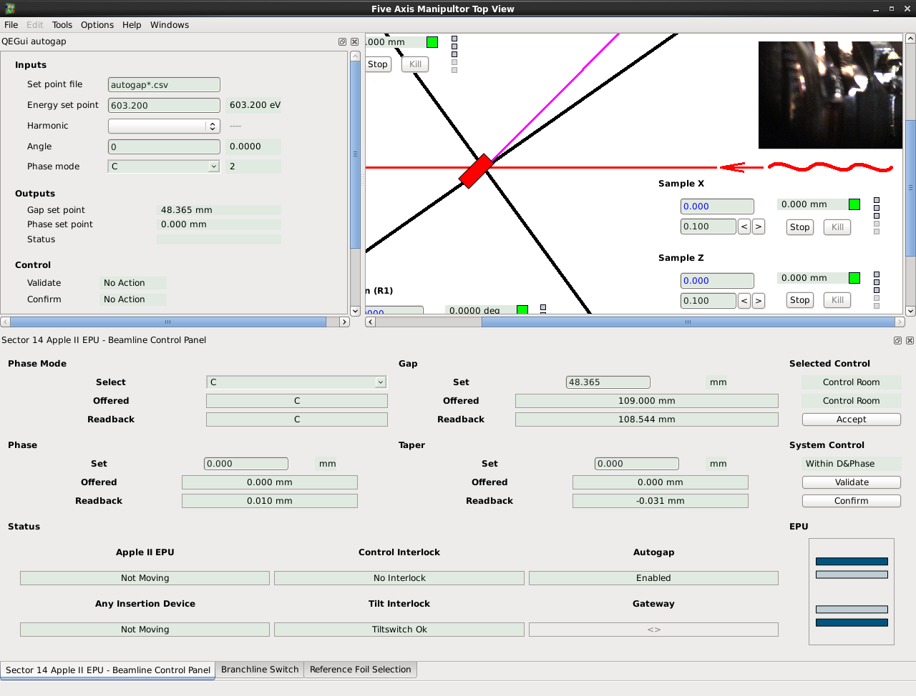
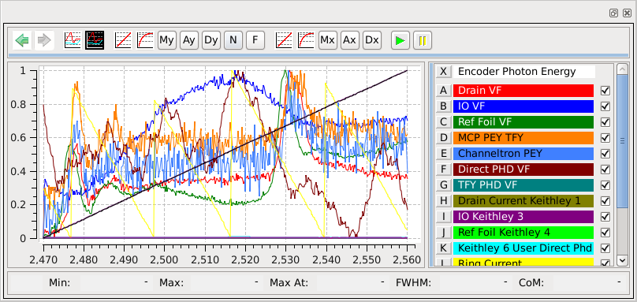
USER FOCUS
Windowing system integration
Notes:
There is a wide range of valid ways of using docks and windows to create an effective application.
We have tried to ensure that you can do whatever you like regardless of how you are using the framework.
So new windows, tabs, or docks can be created from push buttons, menu bars, tool bars, or widget’s context menus.
If you are writing your own widgets based on the epicsQt framework, you can, for example, use the framework to ask for the display manager to create a new window, but request that your widget keep a level of control over it. For example, you may have a button within your widget that launches a strip chart, but your widget wishes to be able to update the PVs being plotted.

Slide 16
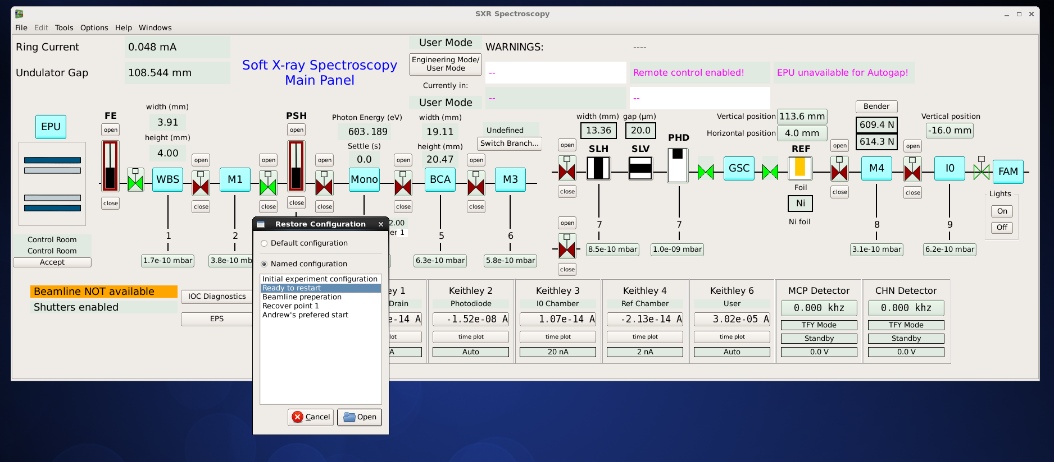
USER FOCUS
Configuration manager
Save / restore
Notes:
When you use the epicsQt framework as is, you can save and restore configurations.
Generally, this means you can, at any time save the arrangement of windows you are looking at and restore to that point at any time in the future.
I would like to expand on this a bit as it is a good an example of how epicsQt has been built with application development in mind.
When you choose to save the current configuration, a generic display application knows how many widows it has open, and where they are placed, but what about the zoom level of an image widget, or the contents of a scratch pad widget? It doesn’t even know it is displaying such stuff.
When a user asks for the configuration to be saved, the application asks the epicsQt framework to save the configuration.
The framework then asks any component that has registered an interest in the save / restore process to contribute what it would like to save. So the application might contribute information such as windows it has open. Individual widgets contribute whatever is important to them.
So an image widget may want to save its current zoom level, a scratch pad may want to save what PVs are currently being monitored, or your custom widget may want to save… whatever.
When a restoration is requested by an application, whatever the epcisQt framework saved is passed back to it, then individual widgets are independently provided with their saved information as they are created.

Slide 17
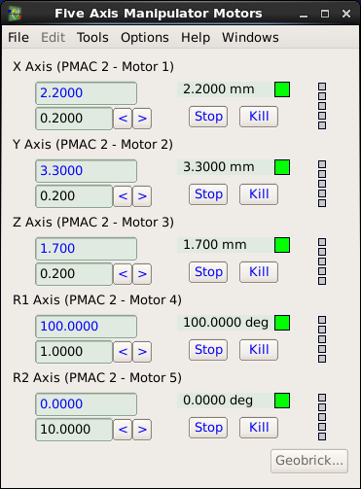
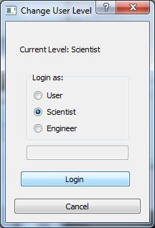
USER FOCUS
User levels
Simplification – the right information in front of the right person
Notes:
The epicsQt framework manages a system of user levels.
User levels are about simplification – the right information in front of the right person.
For example, a beamline user may be able to move a motor, but not reconfigure the motor driver.
Rather than provide a separate suite of GUIs for the beamline scientist, or supporting engineers, the same GUIs can be designed that provide subtle, or not so subtle differences depending on the user level selected.
In this example, the only difference is that the button to access the motor controller is disabled at ‘User’ level.
The framework manages the global user level, and provide tools to manipulate the user level, then the GUI designer can choose what that means for any widget.
Visible, enabled, large font, different color, whatever.

Slide 18
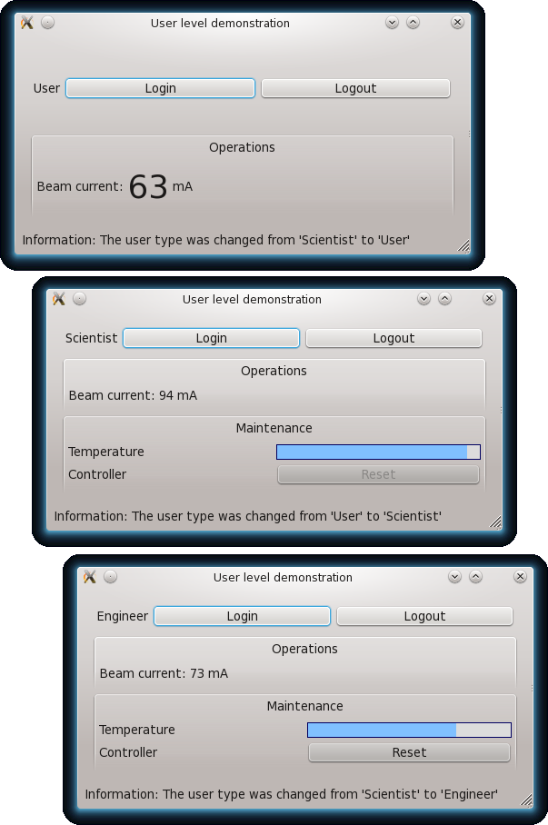
USER FOCUS
User levels
Simplification – the right information in front of the right person
Notes:
In this demo beam current is displayed in a large font to the user.
The beamline scientist has an extra Maintenance panel.
They can see the reset button there in the corner, but’s disabled, but only an engineer can press it! (as it should be)
The system of user levels can be managed completely through support widgets within the framework, or through class libraries if you are writing your own applications.

Slide 19
USER FOCUS
User Tools
Built in, but also available as widgets for developers to use.
Simplifies producing a comprehensive system for the user.
  PV properties
  Scratch pad
  Strip chart and plotter
  Message log
  PV load save
  Archiver status - Currently only talks to ‘standard’ CA archiver (Andy for version details)
  Archiver name search
Notes:
Earlier I pointed out the large number of application support widgets available in the framework.
To support application development these are written as standalone public widgets using public functionality that can be used in any application, and then used within our own display manager so any application can have the same functionality added easily.
These application support widgets include:
PV inspection and monitoring,
Charting and plotting,
User levels,
Logging, and
Archiver status

Slide 20
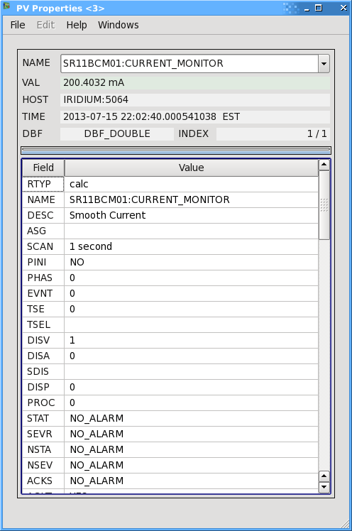
USER FOCUS
User Tools - PV Properties
Notes:
Here is the PV properties widget.

Slide 21
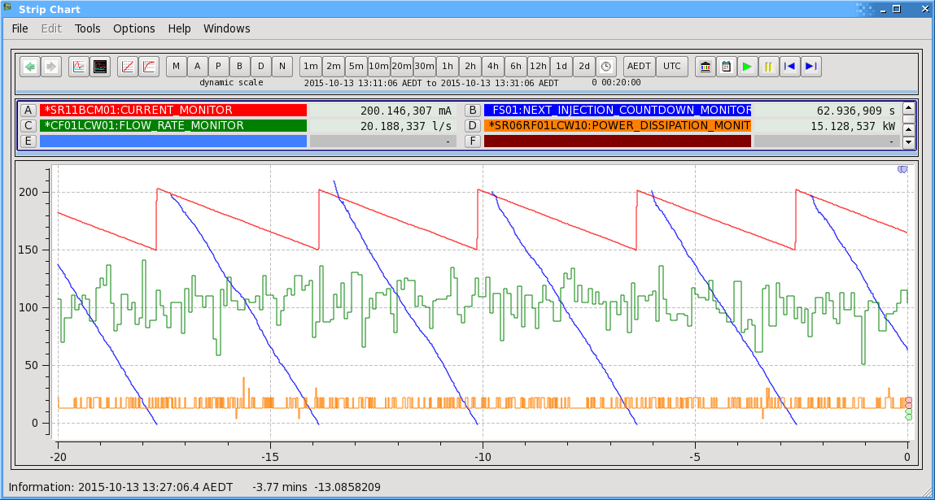
USER FOCUS
User Tools - Stripchart and Plotter
Notes:
Here is the strip chart and plotter.
For the users of the QEGui appication, these are just appear as built in functions, but the widgets can be used in any GUI or application.

Slide 22
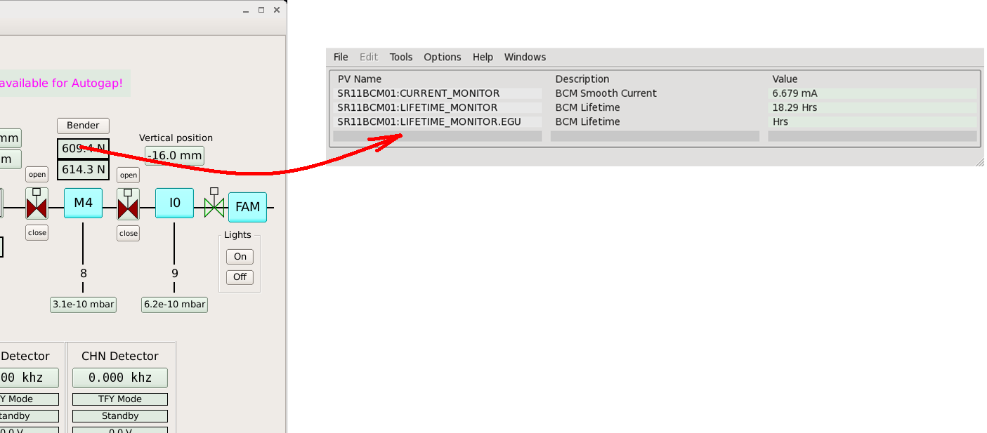
USER FOCUS
Tools - Scratch pad
Notes:
The scratchpad widget is a very handy tool for building a temporary collection of monitored PVs.
This is very useful for tasks like commissioning.
You just drag whatever you are interested in from a GUI to the scratch pad

Slide 23
USER FOCUS
User Tools - Message log
Notes:
epicsQt maintains a log for messages.
epicsQt widgets write to the log and this widget presents the log.
Any application or widget you write, however, can use the public epicsQt classes to generate log messages, or register an interest in receiving log messages.

Slide 24
USER FOCUS
User Tools - PV load / save
Notes:
PV load save helps users configure, or re configure their system.
A user can define a set of PVs. They can then take a snapshot of their values, and restore to that state at some time in the future.

Slide 25
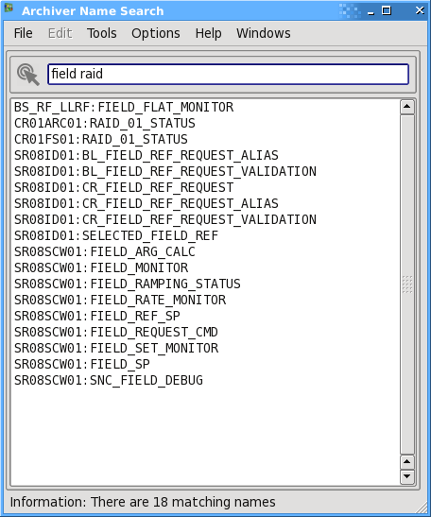
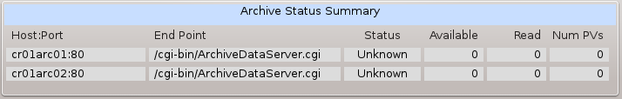
USER FOCUS
User Tools - Archiver status
and name search
Notes:
And there is a diagnostic tools for the old school channel access archiver.
And a PV name search tool that is not really about archiving, but makes good use of the archiver’s name list.
All these tools are widgets in the epicsQt framework, with associated support classes, so they are available in any application, or GUI not just as built in tools in the display manager.

Slide 26

WISH LIST
Python wrappers
Stronger integration with caQtDM
Collaboration
Notes:
There are always more widgets to add, but I’ve listed here a couple of things that I feel are not about incremental improvement of the epicsQt framework, but repositioning it.
Python is widely used on our beamlines. It is a popular language in many facilities. Qt and Python go well together. There are good tools for wrapping Qt widgets in python.
So there are lots of reasons to extend epicsQt into the python world.
This has been on my list for a long time.
Stronger integration with caQtDM.
We have two highly complementary tools sets that can already work together. I don’t see why anyone should have to be making a call on which one to use.
While widgets can be already be mixed and matched, there is application functionality that comes with only one or the other. In the epicsQt framework, most of this functionality (eg, configuration save/restore) is written to be reused in other applications and so is available for integration into packages like caQtDM.
The third point is, in my mind, the way the other two are going to happen. I did a quick search through my inbox and I have been in contact over the last few years with around 50 EPICS developers with queries about using the epicsQt framework, and there are around 150 people from the accelerator community registered at epicsqt.org.
That is a lot of interest, but I think it may take a significant project somewhere to kick start an effective collaboration on the above items.
If any one has any ideas on kick starting that sort of collaboration, let me know.

Slide 27
http://sourceforge.net/projects/epicsqt/
Questions?
Notes:
Questions please…

