Slide 1
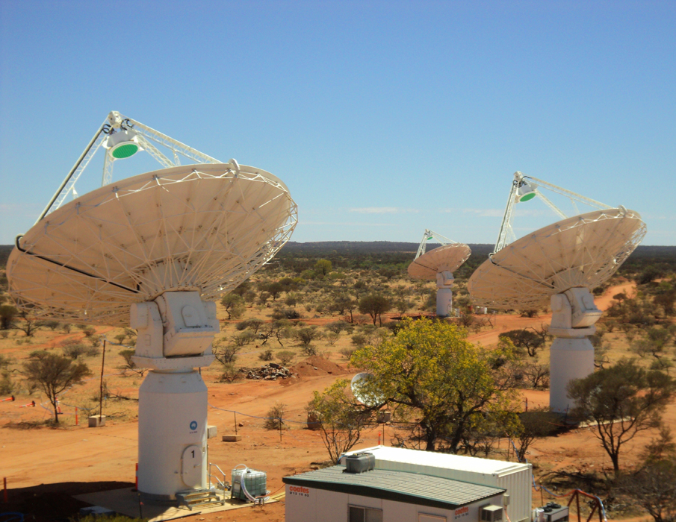
EPICS, Linux & NUMA I/O
An example
Euan Troup
15 October 2015
CSIRO Astronomy and Space Science

Slide 2
What are we doing?
Central Shielded Building
12b
Phased Array Feed
Signal Transport
7km
ADC
Filter Banks
Gain
Beamformer
Correlator
RFoF
Clock
system up to correlator custom data transmission
  Correlator is 8x12-card system UDP to control/monitor computer
  2628x36x216 32-bit complex numbers each 5s 12x1GE staggered on 10GE
  Reorder into frequency/product order & upload via 10GE staggered
  2 x dual-port 10GE on server

Slide 3
What are we doing with EPICS?
Soft IOCs controlling custom hardware & firmware
  Asyn port driver derived objects using ADE common library
  EPICS PVs provide parameters for common library methods (RPC)
    disconnect/connect
    startup/shutdown
    set frequency mapping
    specialised hardware setups
    …
  Data download triggered via asyn port driver event driver
  Upload to ingest using UDP and ASKAP/asyn port driver

Slide 4
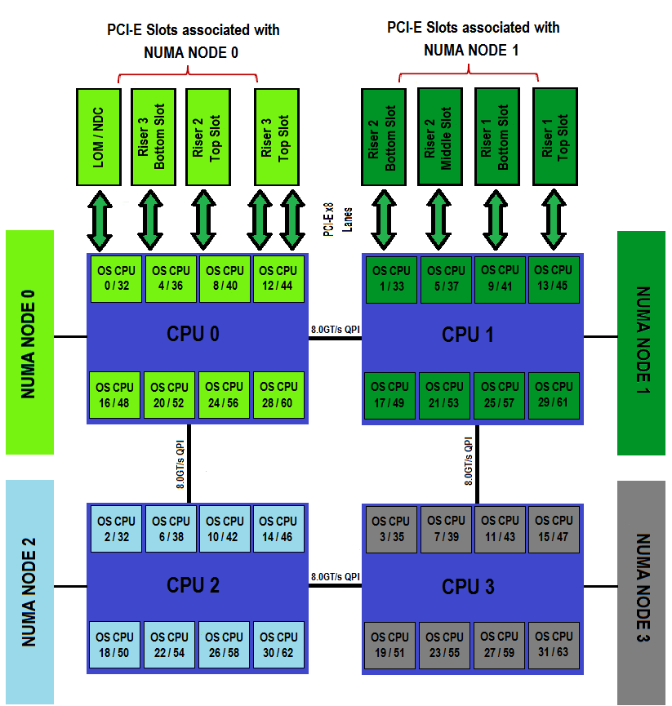
What are we doing on Linux?
Dell R820 4 8-core CPUs 128GB 2 x 2-port 10GE
Debian wheezy minimal system

Slide 5
What happens when it’s all combined?
Data streaming can’t be sustained
  Only 4-6 cards worth of data can be processed reliably
    Large network buffers used
    Network card driver parameters tuned
  As above diagram shows, compute load can be distributed symmetrically
  NUMA system is not symmetric
    Use numactl to schedule IOC on 1 node – no difference
  I/O load is not symmetric
    default scheduler setup is all interrupt service on CPU 0
    irqbalance also doesn’t help

Slide 6
What can be done to fix the problem?
Don’t use irqbalance
  Tie irqs to appropriate NUMA node
  Spread load across cores in the node
    cat /proc/irq/[nnn]/node
    echo [cpu mask] > /proc/irq[nnn]/smp_affinity
  irq numbers may change across reboots/device restart (eg ifup/ifdown)
  Tie EPICS app to the same NUMA node
    Use sched_setaffinity() in iocMain
    All threads will start on the selected cores of the node

Slide 7
References
http://events.linuxfoundation.org/sites/events/files/eeus13_shelton.pdf
https://queue.acm.org/detail.cfm?id=2513149

Slide 8
Thank you
CSIRO Astronomy & Space
  Euan Troup
    t +61 2 9372 4660
    E Euan.Troup@csiro.au
    w www.csiro.au/en/Research/Astronomy
CSIRO Astronomy and Space

