Slide 1
CS-Studio Collaboration Status
Eric Berryman
Controls Engineer

Slide 2
Overview
Collaboration Statistics
  Feedback from Issues
  4.2.x Issues
  Comments Activity
  Issues Activity
  Milestone Activity
Milestones Status
  4.2.x (testing->stable)
  4.3.x (unstable->testing)

Slide 3
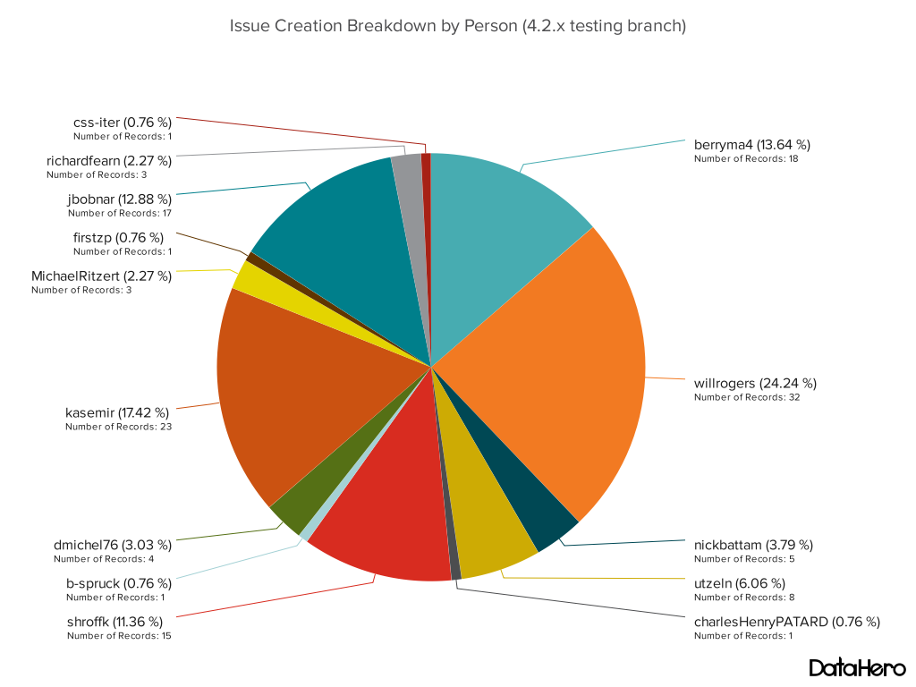
Feedback from Issues

Slide 4
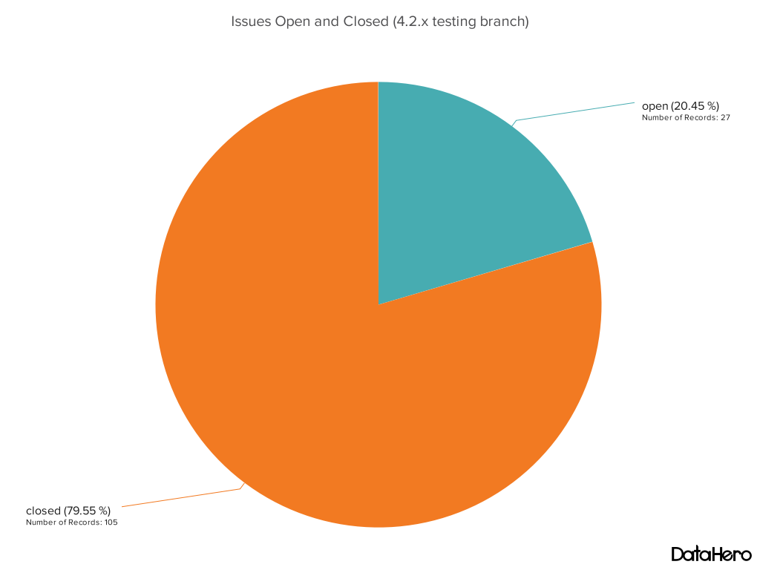
4.2.x Issues

Slide 5
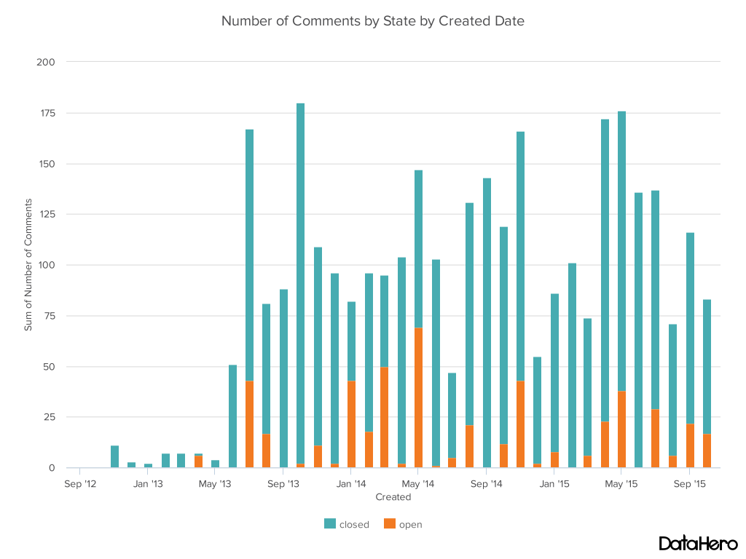
Comments Activity

Slide 6
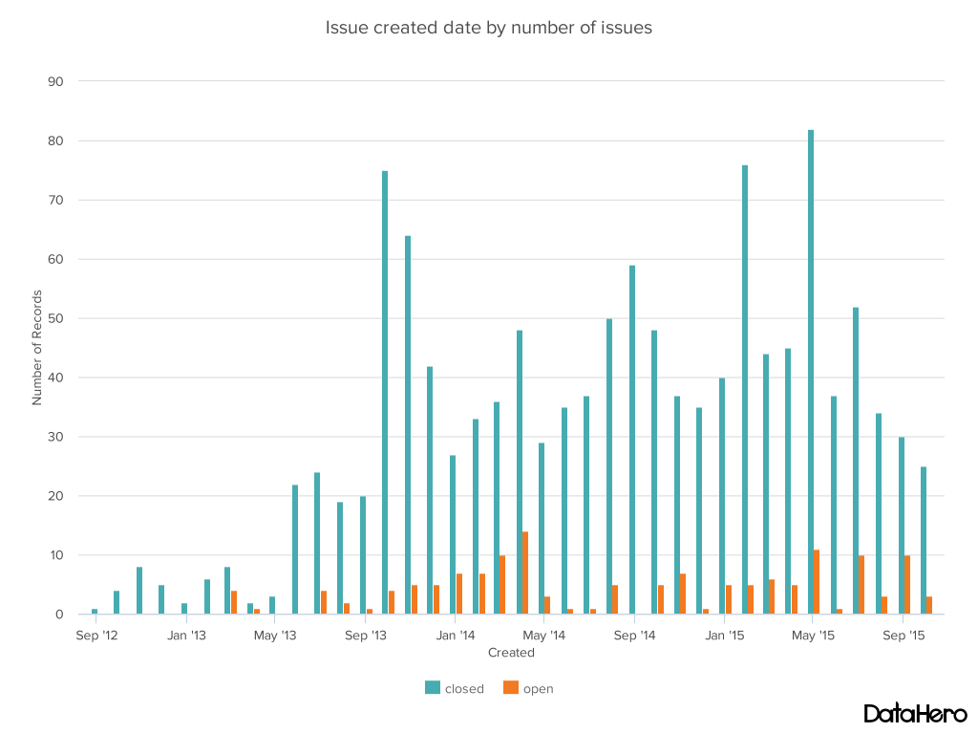
Issues Activity

Slide 7
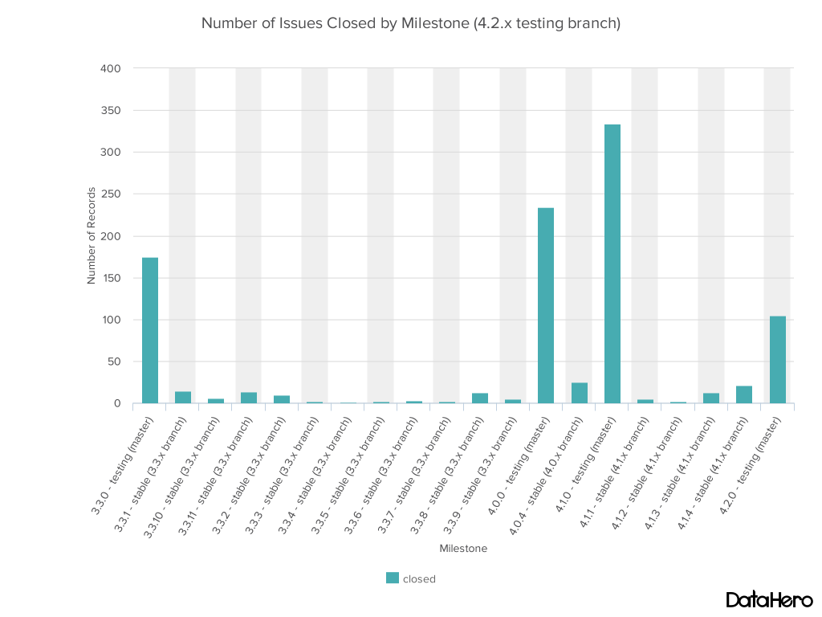
Milestone Activity

Slide 8
Closing 4.2.x (testing to stable)
4.2.x due date end of this month
  Standalone BOY windows (merged from Diamond)
  BOY windows are all “Views”, allowing utilization of Eclipse Perspectives
  Diirt 3
  Eclipse 4.5
  CS-Studio template product

Slide 9
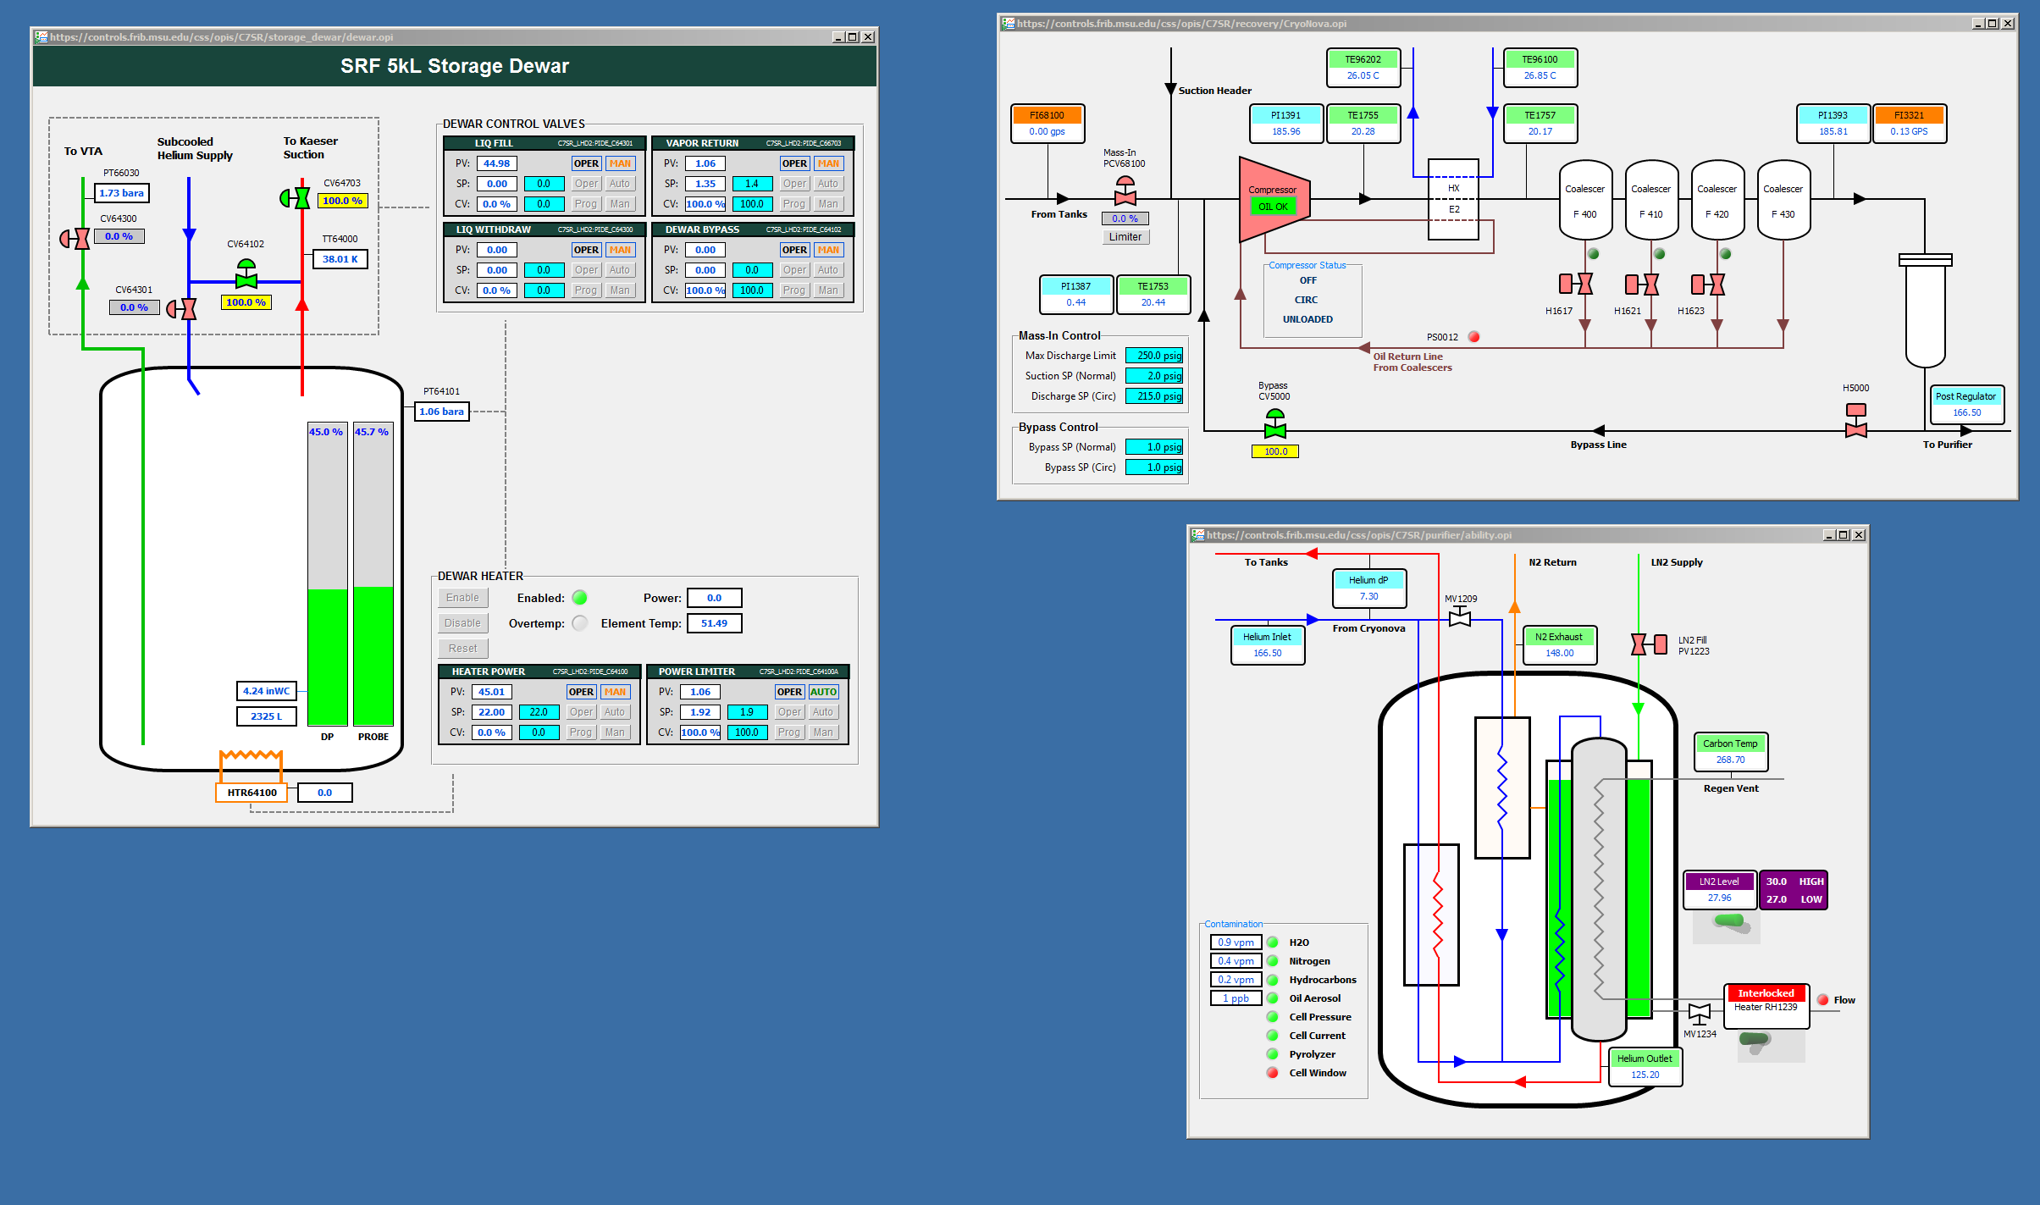
Standalone BOY Windows

Slide 10
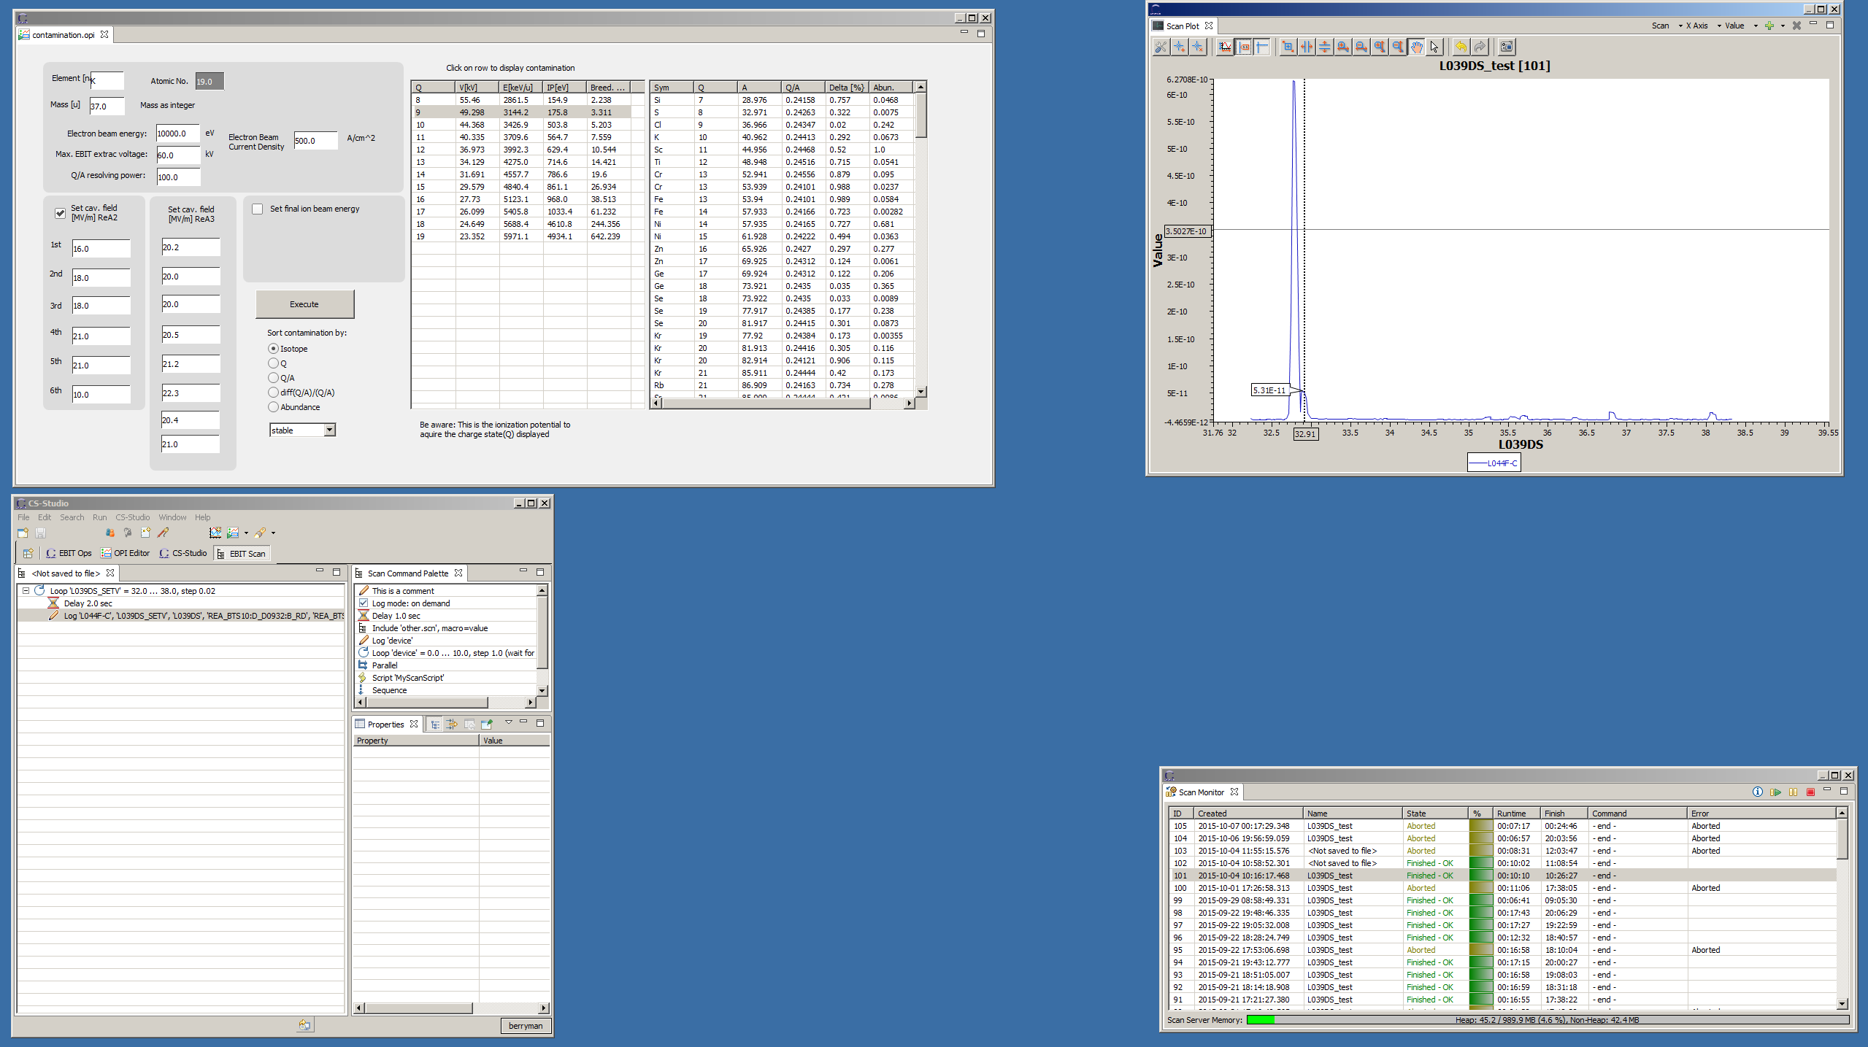
Eclipse Perspectives

Slide 11
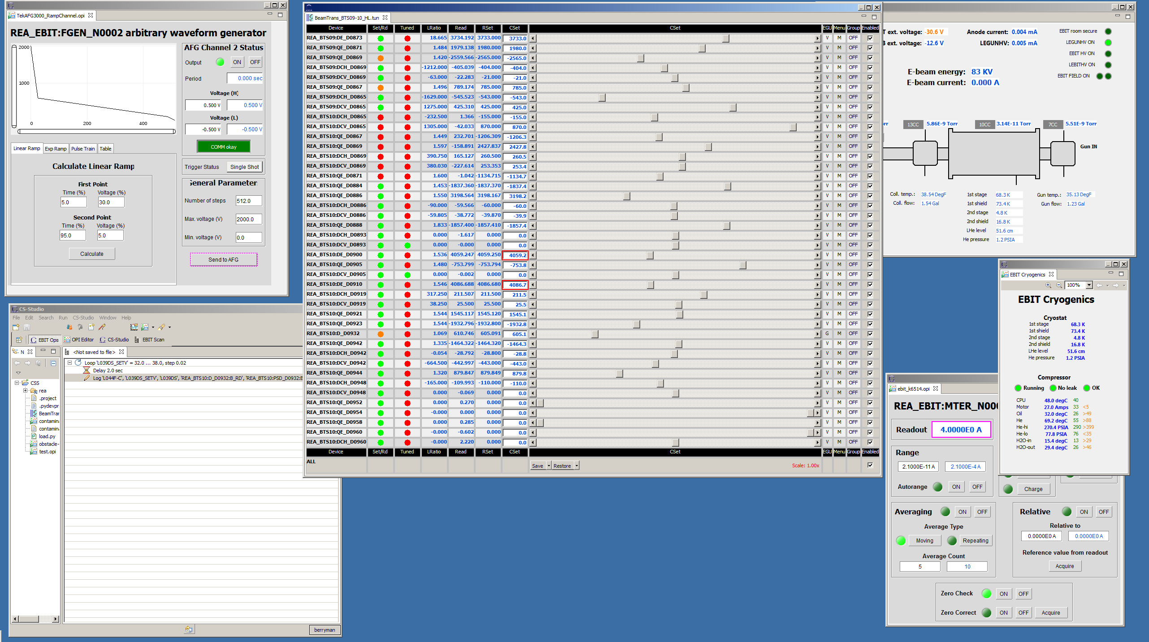
Eclipse Perspectives

Slide 12
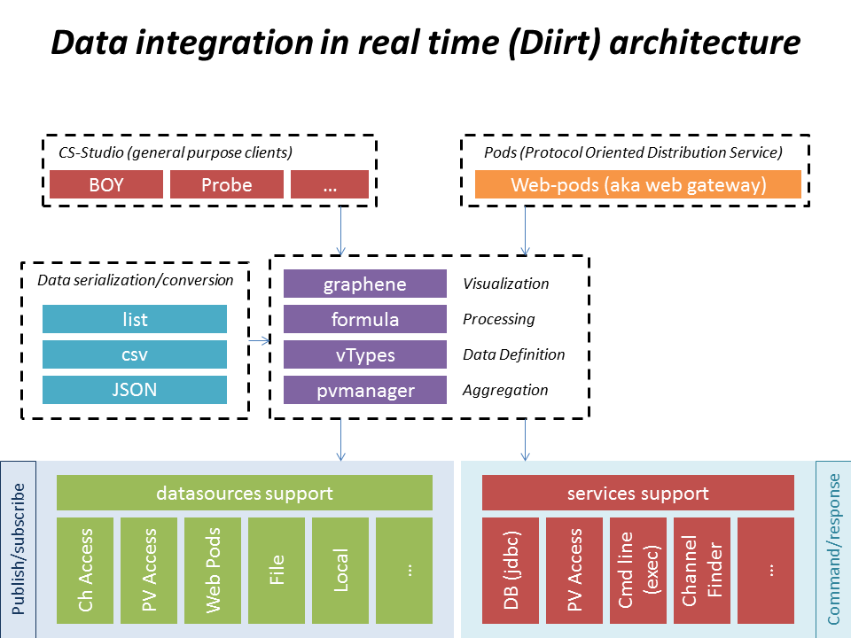
Diirt

Slide 13
Eclipse 4.5
Customize Perspective Dialog
UI responsiveness monitoring. Enabled, will put information about UI freezes, for example code that accesses files on the UI thread, into the log, so we can then fix frequent problems
SWT on Linux can use GTK+ 3 (GTK 2 is also still supported)
Mac OS X products are proper *.app

Slide 14
Template Product
A template product on github
  https://github.com/ControlSystemStudio/org.csstudio.template.product
Edit features for your product
  repository/cs-studio-template.product
Change icons if you like
  repository/icons
Add your site specific configurations
  features/org.csstudio.template.product.configuration.feature/
  rootfiles/configuration/
All binaries come from our P2 repository
  http://download.controlsystemstudio.org/updates/4.2
  Update the maven pom.xml file to change the update site to new versions

Slide 15
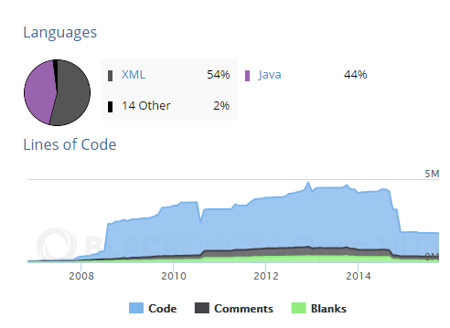
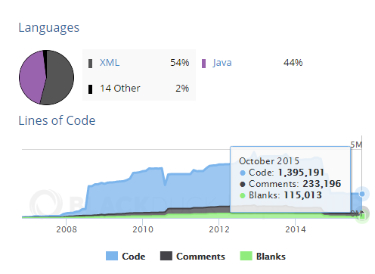
Still Keeping Clean

Slide 16
4.3.x (testing)
Have not had 4.3.x project meeting yet, which will be following the Management Review meeting
4.3.x due date latest June, projects at the present
  Simplify users ability to save, load, share, distribute perspectives
  New Display Builder prototype available for testing
  Save set restore UI, interface to work with git and MASAR

Slide 17
ISO 9001 Quality Standard
Following as a guideline to improve quality
    Management Review
    Quality Policy and Objectives
    Process Performance and Product Conformity
    Status of Corrective and Preventative Actions
    Customer Feedback Analysis
    Decisions and Actions for improvements
    Resource needs
Continual Improvement of the Quality System
Customers
Management Responsibility
Customers
Resource Management
Measurement, Analysis and Improvement
Satisfaction
Requirements
Product Realization
Product
information
activities
taken from ISO 9001

Slide 18
Registered Sites
Sites that have given a name and contact as “Site Representative”
  CSIRO
  CSNS
  DESY
  Diamond
  European Spallation Source (ESS)*
  Facility for Rare Isotope Beams (FRIB) at MSU
  GANIL/Spiral2
  ISIS
  ITER
  National Synchrotron Light Source II (NSLSII) at BNL
  Spallation Neutron Source (ORNL)

Slide 19
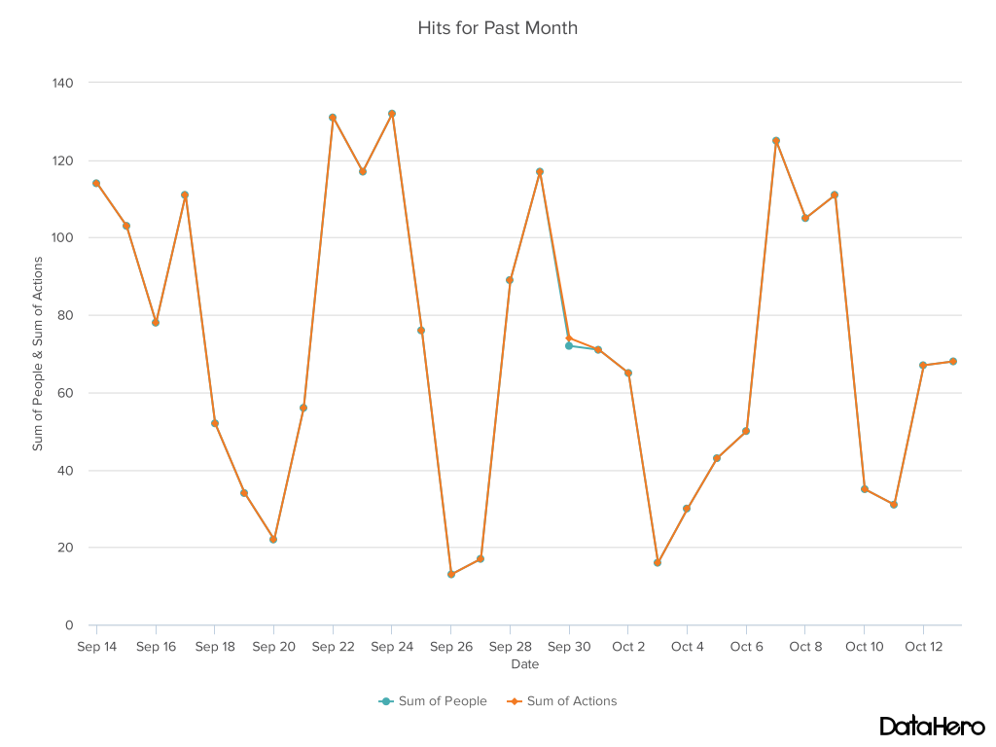
Website Statistics

Slide 20
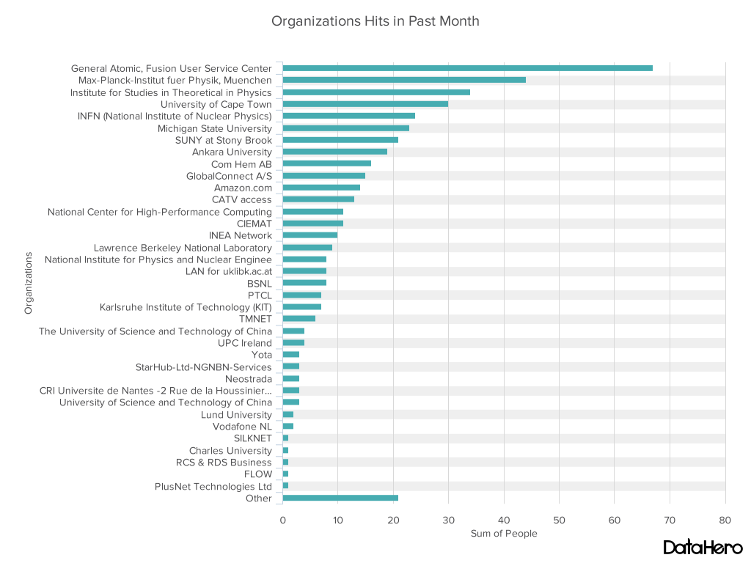
Website Statistics

Slide 21
How to Contribute
Fork us Github
  https://github.com/ControlSystemStudio/cs-studio
Pick an issue/feature or make one
  https://github.com/ControlSystemStudio/cs-studio/issues
Create a branch in your fork with the fix or feature
Make a Pull Request with the issue number in the title
Attend meetings, know the release schedule, subscribe to mailing list

Slide 22
Development Process
Github
Pull Request (must reference issue ticket)
Jenkins
Amazon S3
Product Build
Feature Owner Reviews
Commits as Needed

Slide 23
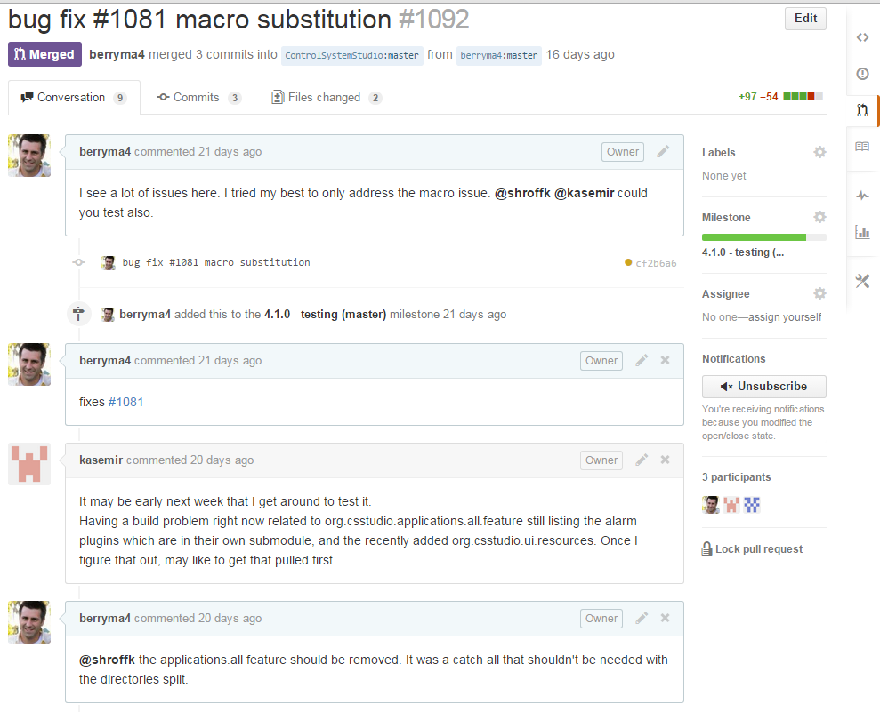
Development Process

Slide 24
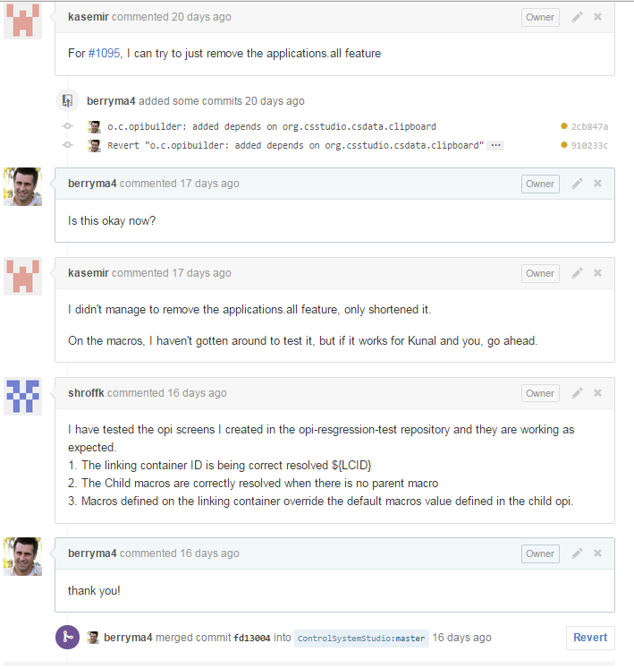
Development Process

Slide 25
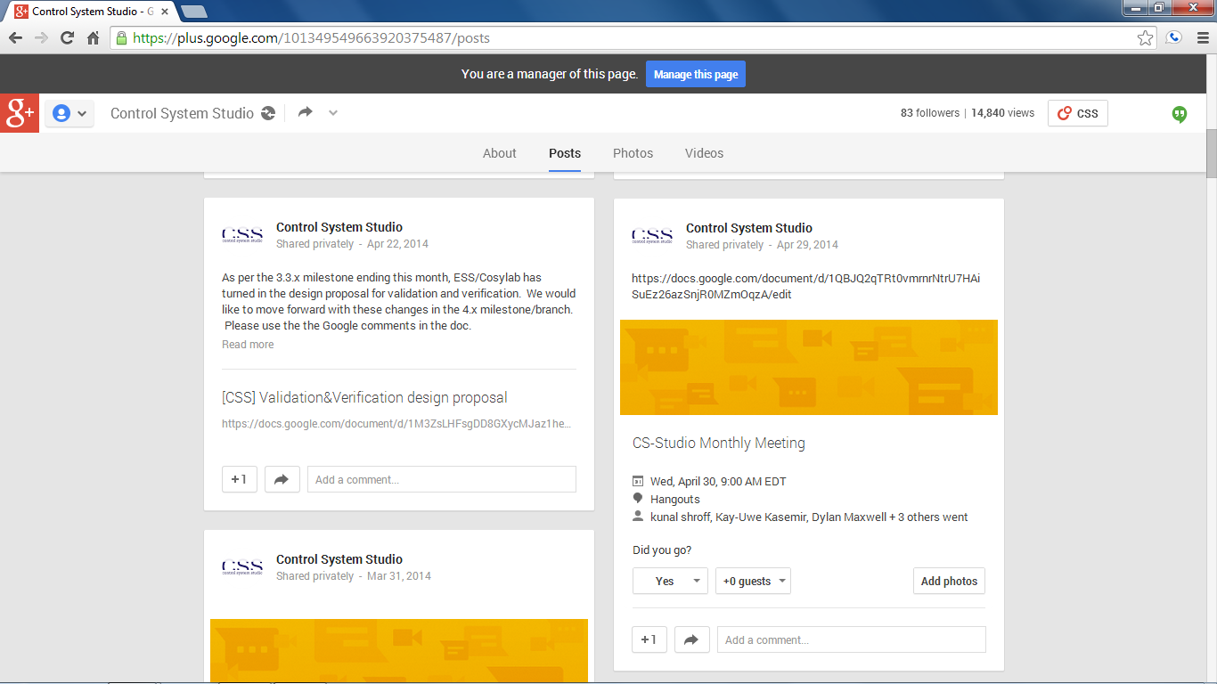
Attend Meetings
We use Google Hangouts to share our progress and discuss issues
  Follow us on Google Plus
  https://plus.google.com/101349549663920375487/posts
  Meetings are posted (viewable after being added to group)
  First Wednesday of the month (9am EST)
  Project group meet once a week when actively developing

Slide 26
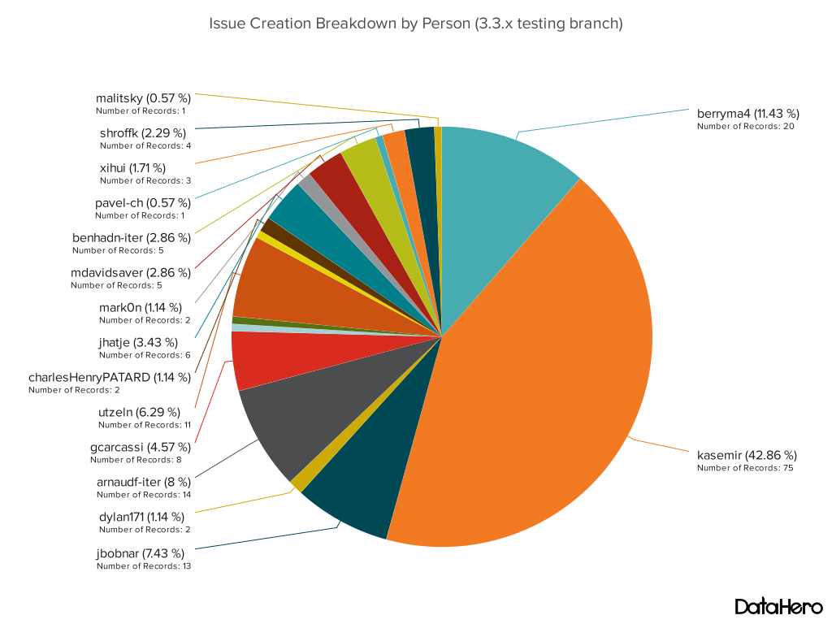
Feedback from Issues

Slide 27
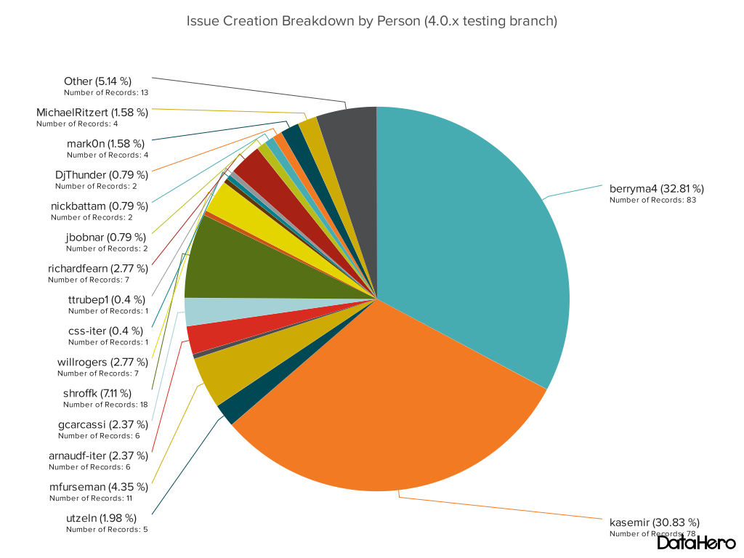
Feedback from Issues

Slide 28
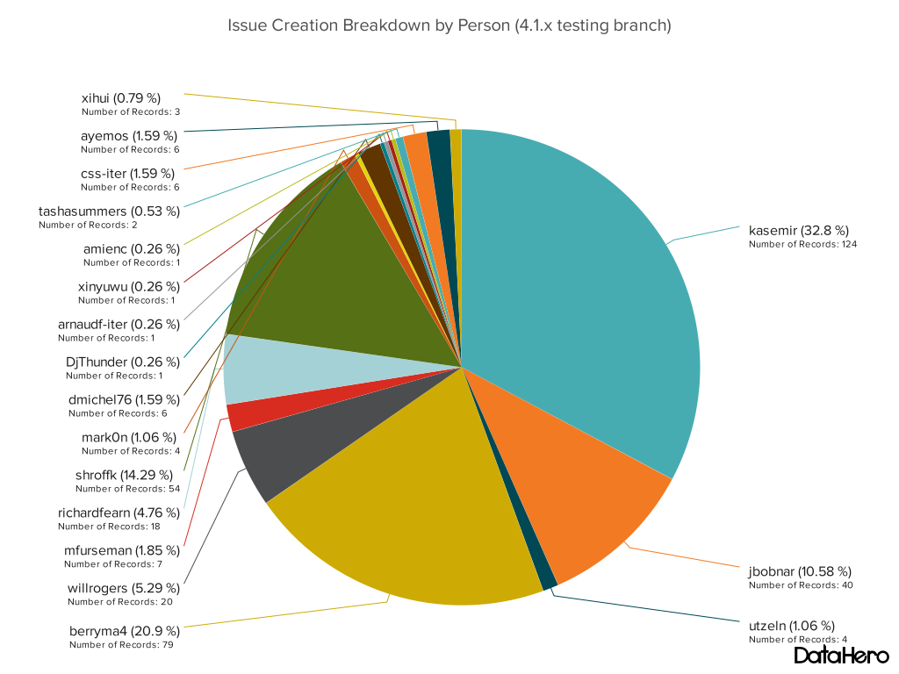
Feedback from Issues

Slide 29
Feedback from Issues

