Slide 1

Introduction to Model Based Systems Engineering
David Brodrick
Advanced Instrumentation Technology Centre
Research School of Astronomy and Astrophysics
2022-10-18

Slide 2
Overview
Why use Systems Engineering?
What is MBSE?
Overview of SysML diagram types.

Slide 3
Why Bother?
This is a fair question!
SysEng is a toolbox, you can select the right tools for your project.
SysEng tools provide a structured methodology for things we need to do anyway:
  Exactly what are we trying to build? (Requirements)
  How can we zero in on a more optimal design? (Design synthesis)
  How should we plan for testing it at the end? (Verification and validation)
  How can we make sure the subsystems will interoperate properly? (Interface control)
  etc.
In the past we might have been able to hold all this in our heads..
..but as our instrumentation projects grow more complex it is useful to introduce processes to help ensure we don’t drop too many balls.

Slide 4
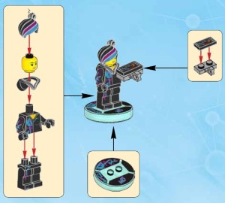
What is Model Based Systems Engineering?
Use of a software tool to capture the architecture, breakdown, interfaces, etc. of the instrument.
Most commonly based on the Systems Modeling Language (SysML) standard.
  Supported by various software tools.
May integrate executable models/simulations to help you see the effect of changing design parameters.
Helps maintain traceability between the requirements and the physical design.
Image from Minifig Price Guide.

Slide 5
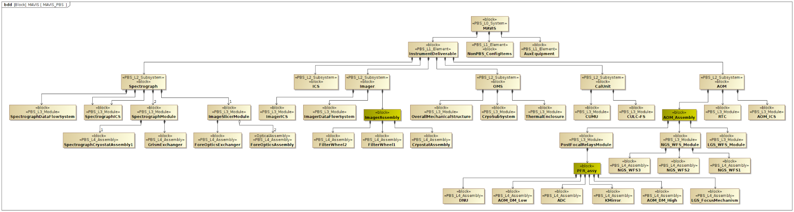
Product Breakdown Structure
The Block Definition Diagram reflects the PBS.
Use of Stereotypes to flag the PBS rank of system elements/blocks.

Slide 6
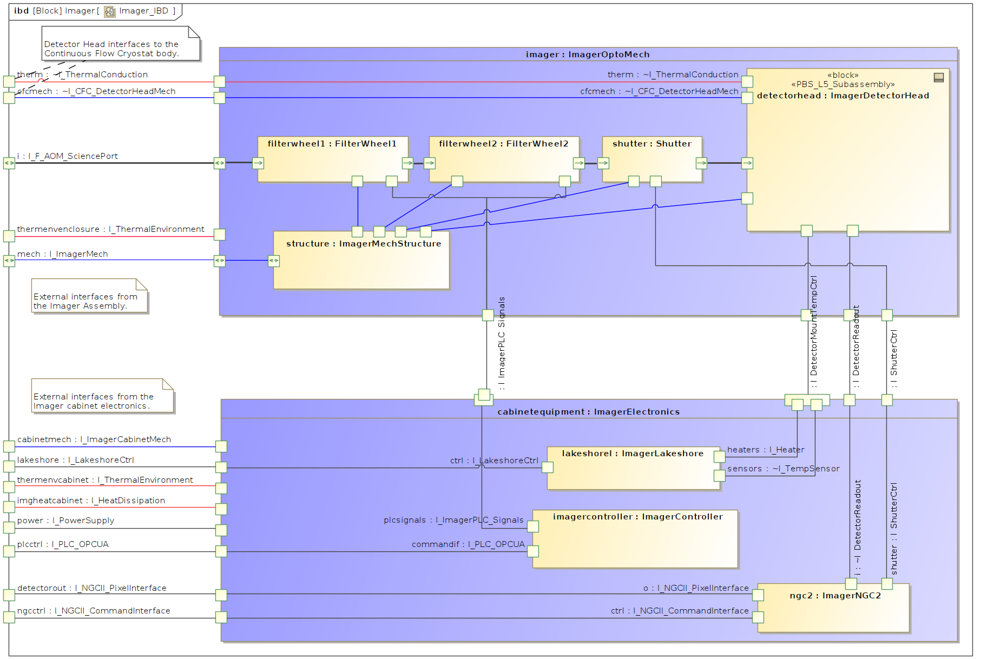
Architectural Model
Example Internal Block Diagram showing various components and interfaces of a subsystem.

Slide 7
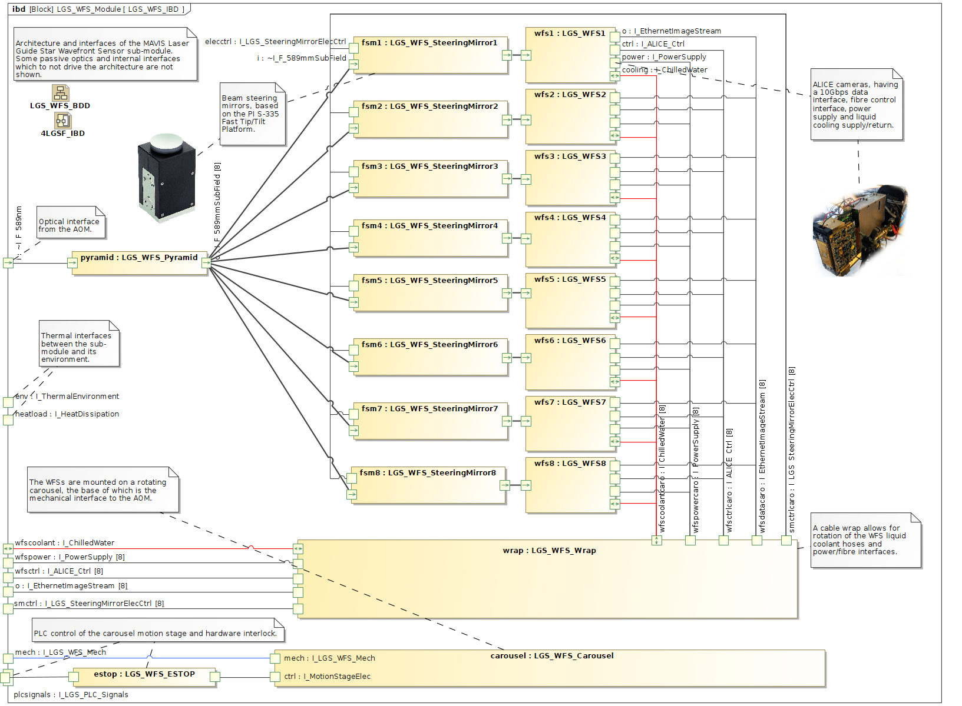
Interface Control
Port-based engineering.

Slide 8
Interface Control
Port-based engineering.

Slide 9
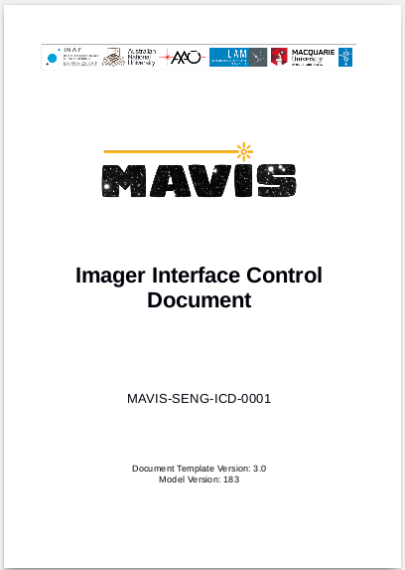
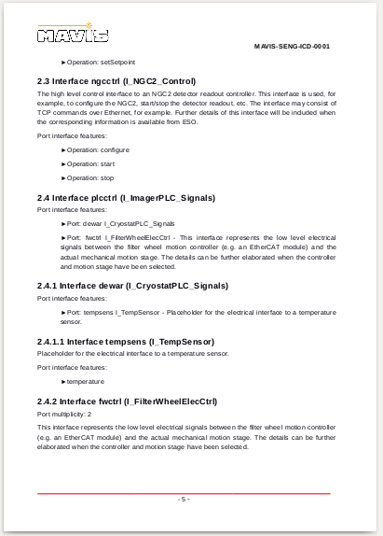
Interface Control Documents
SysML model used to generate formatted PDF ICD, including version information, etc.

Slide 10
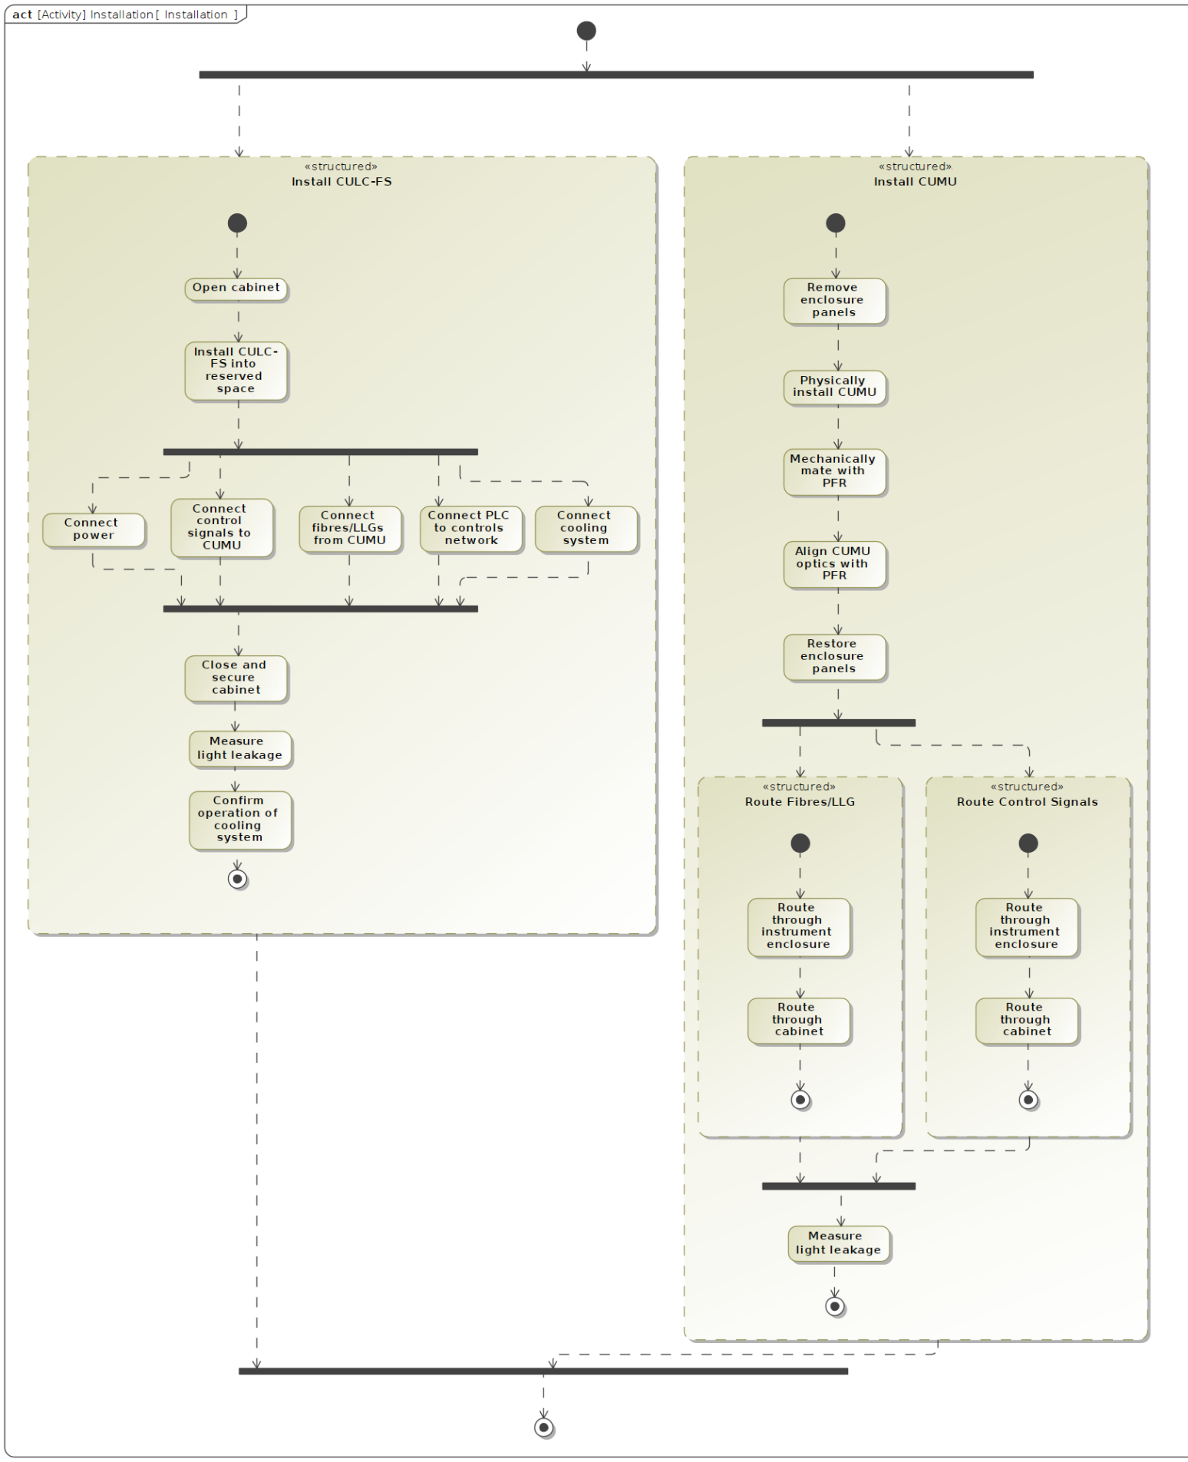
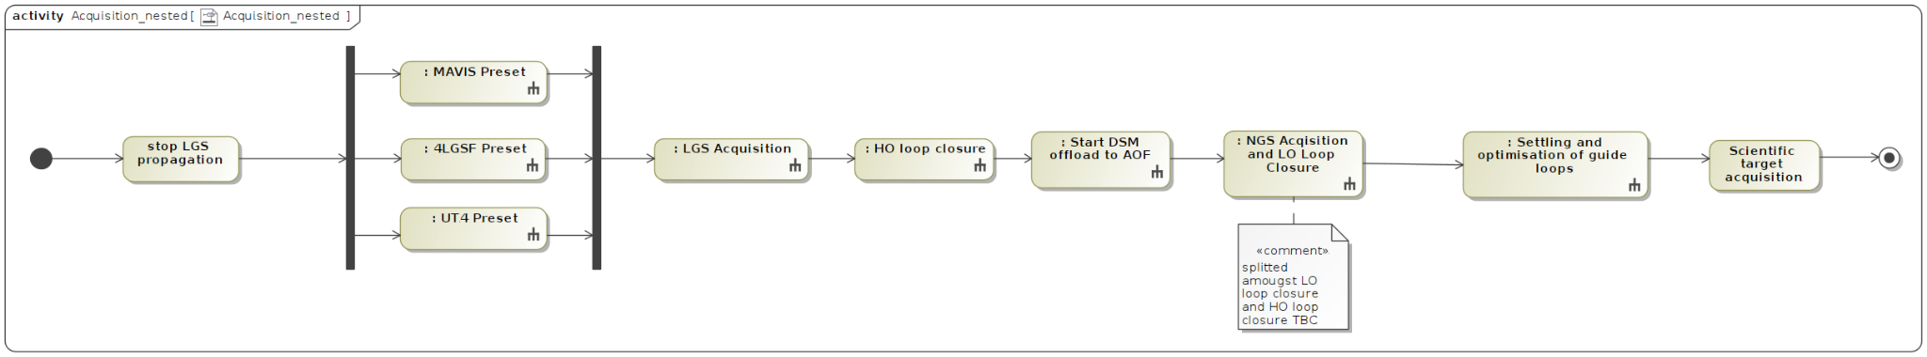
Activity Diagrams
These are used for representing sequences in a standard way.
  E.g. a startup procedure or installation process.
  Test procedures.
Useful for functional decomposition/logical design.
  Diagrams can be nested.

Slide 11
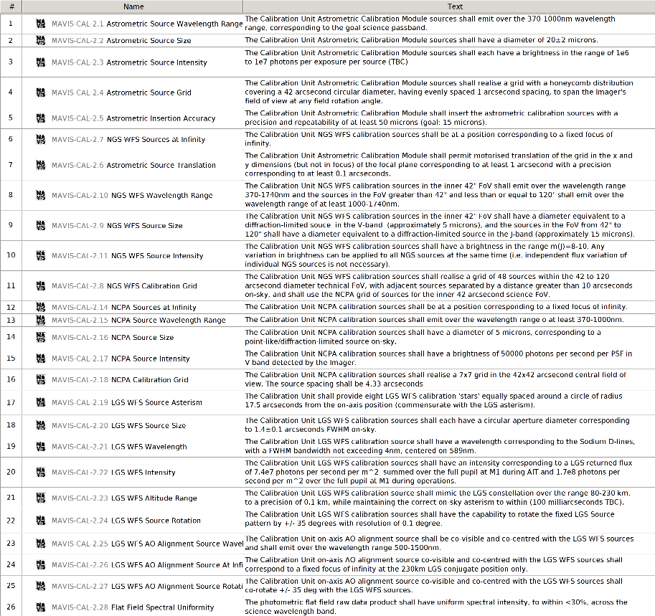
Requirements Management
There are numerous tools and diagrams for working with requirements.
In generally, high level requirements are ‘flown down’ to lower level system elements, becoming more specific in the process.
Can be linked with blocks in the physical design.

Slide 12
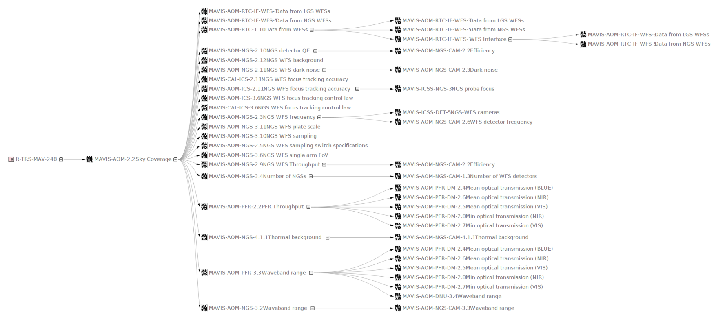
Requirements Traceability
Where does this requirement come from/what’s it affect?

Slide 13
Conclusions
Systems Engineering provides a set of processes and tools to manage the requirements, design, interfaces and verification of complex instrumentation.
SysML defines a number of standard diagram types to capture various aspects of the system.
The discussion about whether MBSE is the right way to go is now over (quote from SETE conference).
Quite a learning curve to get familiar with initially.
  Various training courses available within Australia.
Adopt a pragmatic approach that fits the project needs.

