Slide 1
ANTARES AMS DATA ACQUISITION SYSTEM
Current operation and Future Upgrade
  OUTLINE
  ANTARES Accelerator Facility
  Current ANTARES AMS DAQ system
  CAEN New Instrument and Software
  Upgrading Options of ANTARES DAQ system
  Conclusion
Jian Wang, Matthew Rees, David Button
ANSTO’s Centre for Accelerator Science, Lucas Heights, Sydney

Slide 2
ANTARES Accelerator

Slide 3
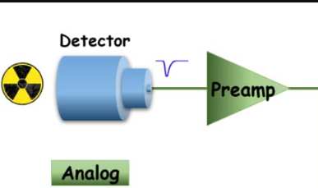
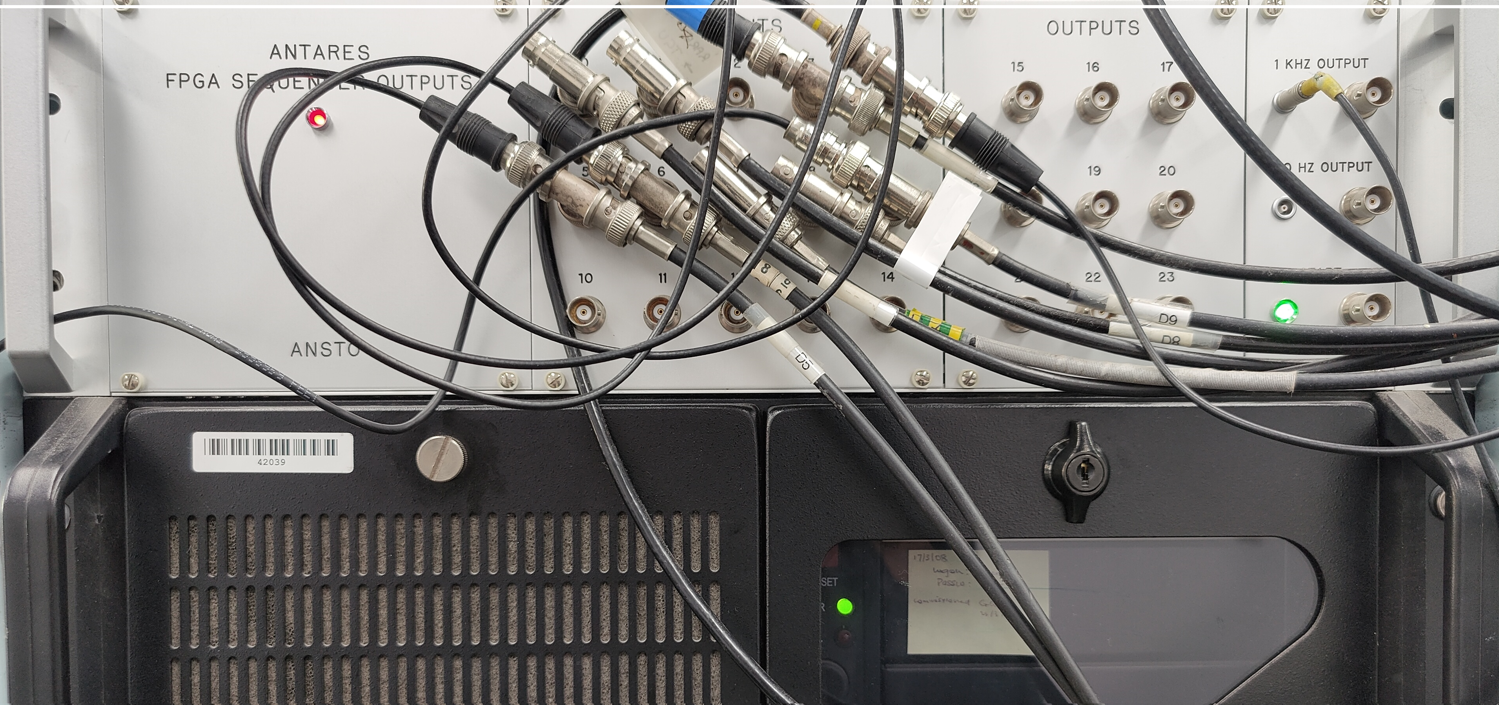
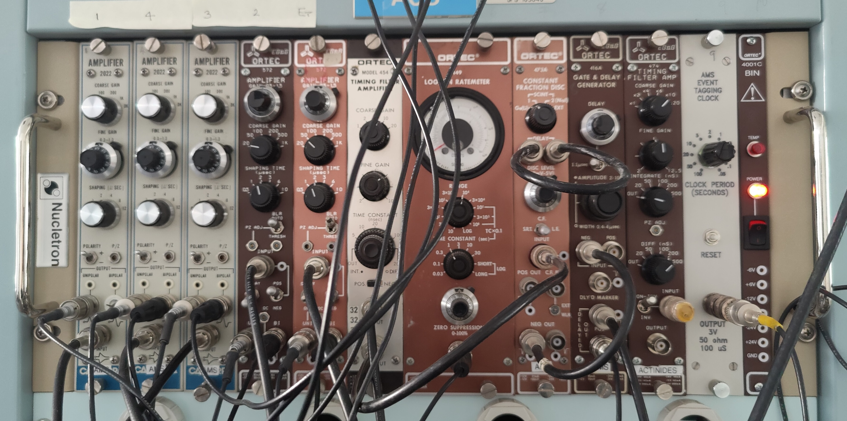
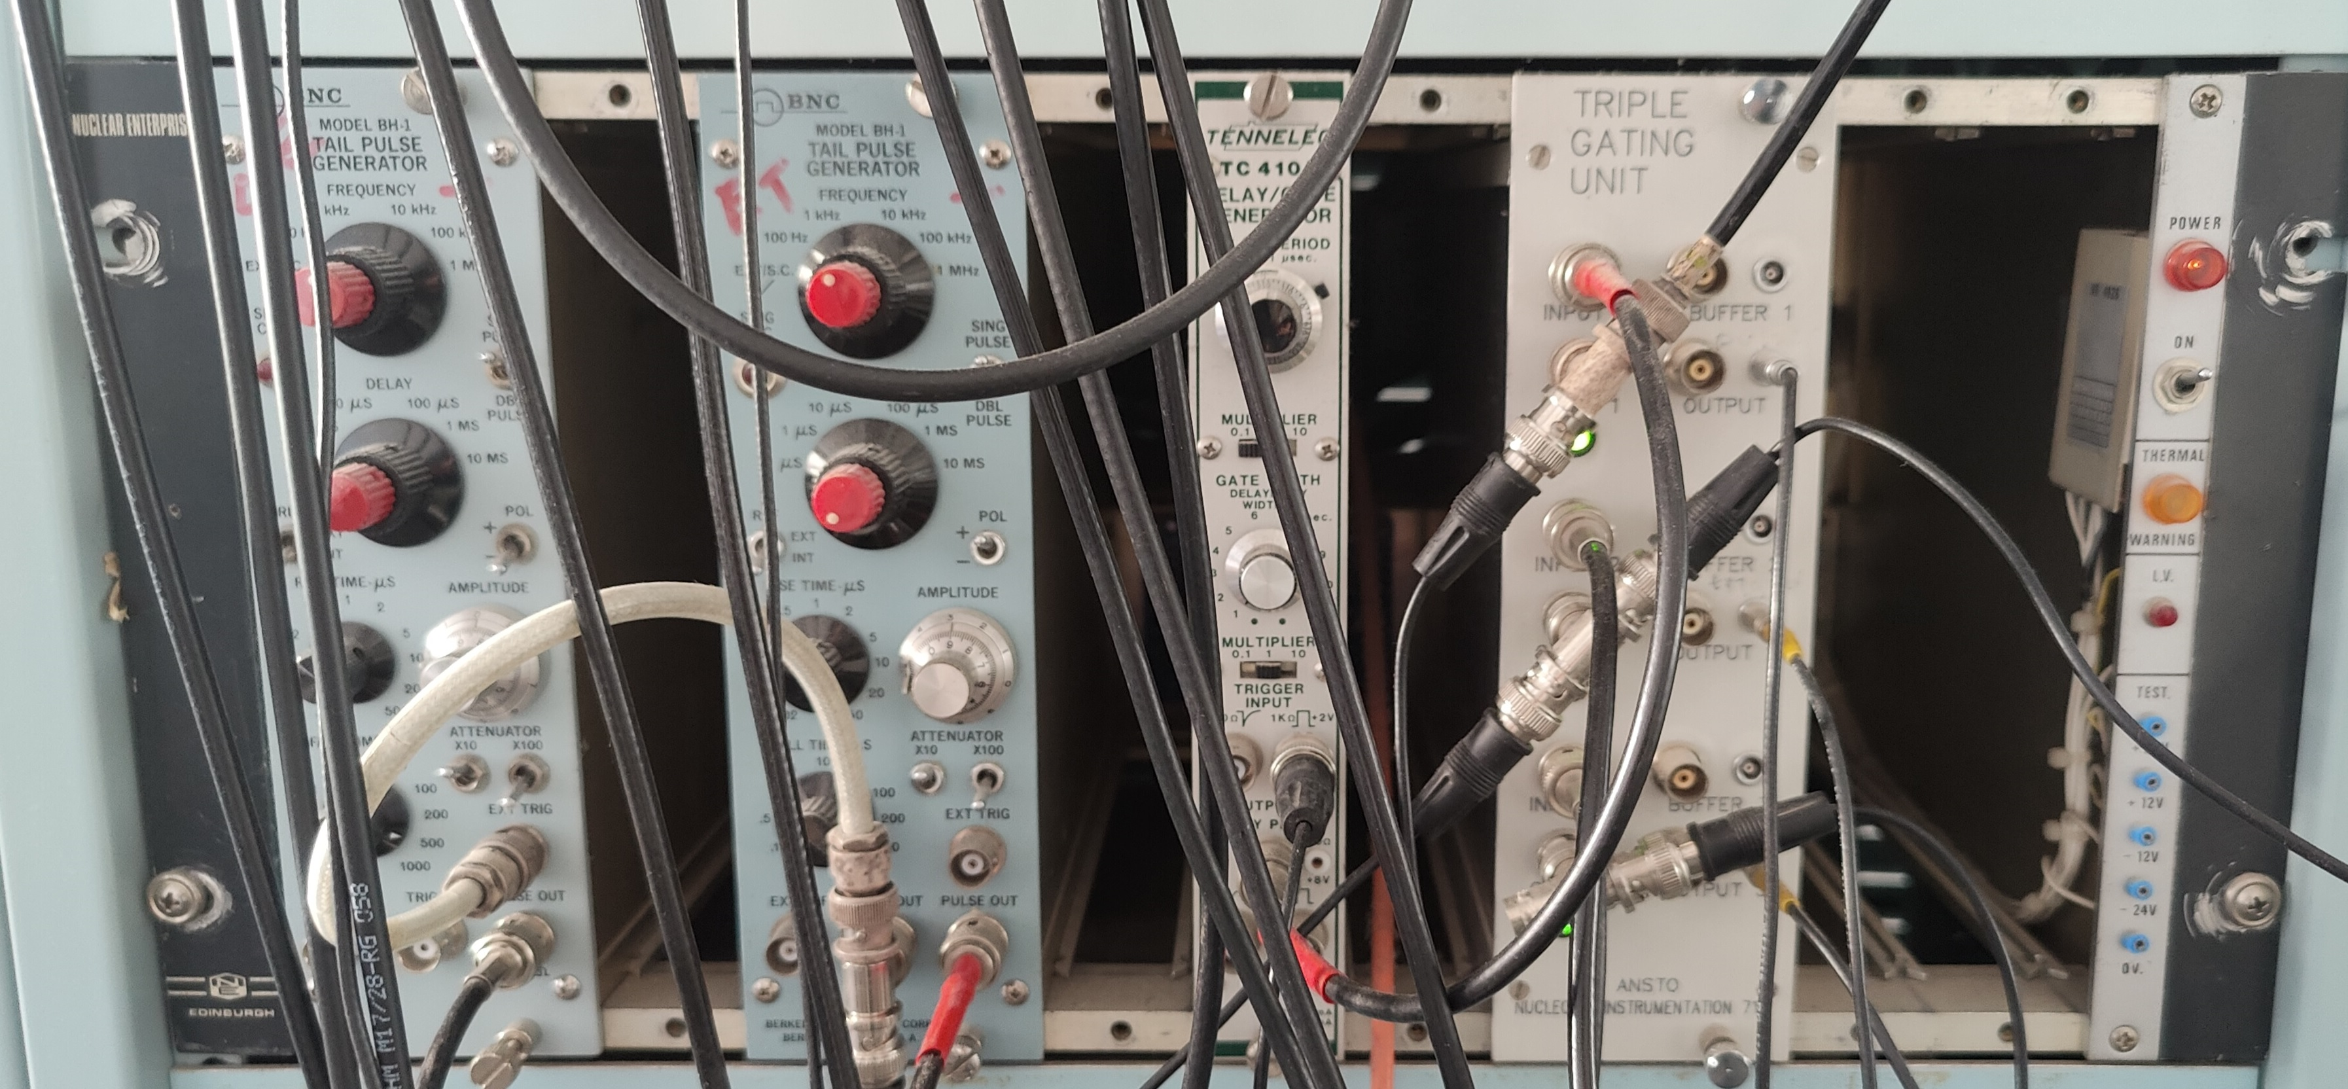
ANTARES AMS DAQ @ANSTO
Electronics
and Pulse process
Detector with gas filled pulse system
Pulse Pre-Amplify
FPGA sequence control,
NIM/CAMAC Electronics Trigger, gate, timing, amplifier, and tail pulse generator.
Old system was built up in 20 years ago.
Notes:
1. Charged high energy ion can create pulse in gas filled detector.
2. A pre-Amp set in detector
3. NIM/CAMAC electronics play signal amplify, timing process, trigger, tail pulse generator
4. VME chassis with Motorola CPU boards with OS/9 manage scaler and ADC pulse process.

Slide 4
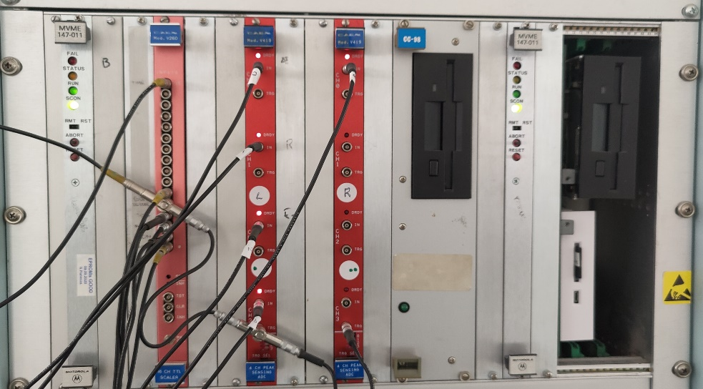
ANTARES AMS DAQ (cont’ed)
VME Chassis: Motorola CPU manage scaler and ADC pulse process,
MVME 147 CPU with OS-9 operate system,
Signal processed by CPU with program package “GetData” and “SendData” in OS-9 system
FPGA for channel input settings
CAEN scaler board, peak process(ADC) boards and data process.
A Linux workstation connect VME CPU boards through Ethernet.
Notes:
Two Motorola 147 CPU boards with OS/9 2.44 EPROM,
2. MVME CPU with 68030 processor
3. Scaler and ADC boards are configured in OS/9 system
4. "GetDate" and "SendData" are developed with C in OS/9

Slide 5
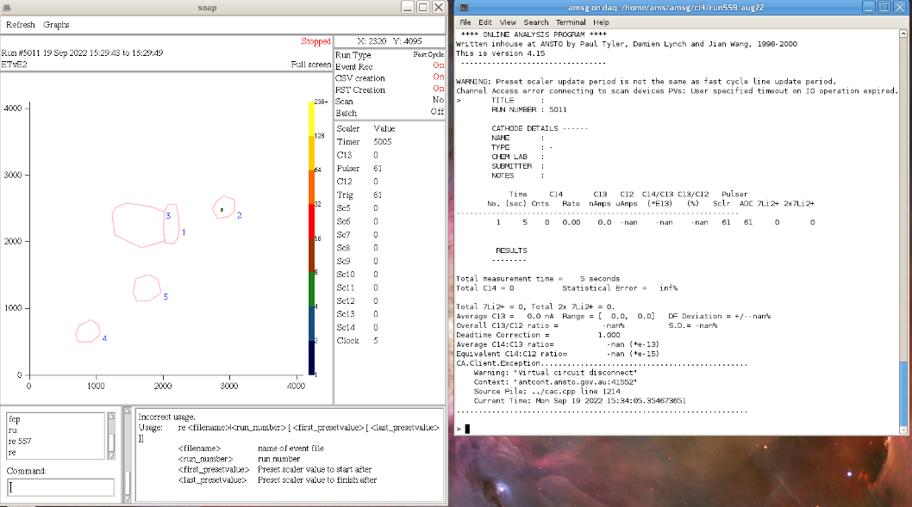
DAQ Linux System and SOAP
A openSUSE Linux Computer as DAQ control and Analysis machine.
SOAP Software for Sample change Control, Batch running manage, Data Acquisition, and Data Analysis.
SOAP can also make DAQ pre-Tuning, instrument scanning.
SOAP was developed by ANSTO based on Motif + C in 20 years ago.
SOAP has been updated time by time.
Notes:
1. SOAP must be upgraded with new GUI environment since Motif is discontinued.
2. Linux system should be also set with latest release version

Slide 6
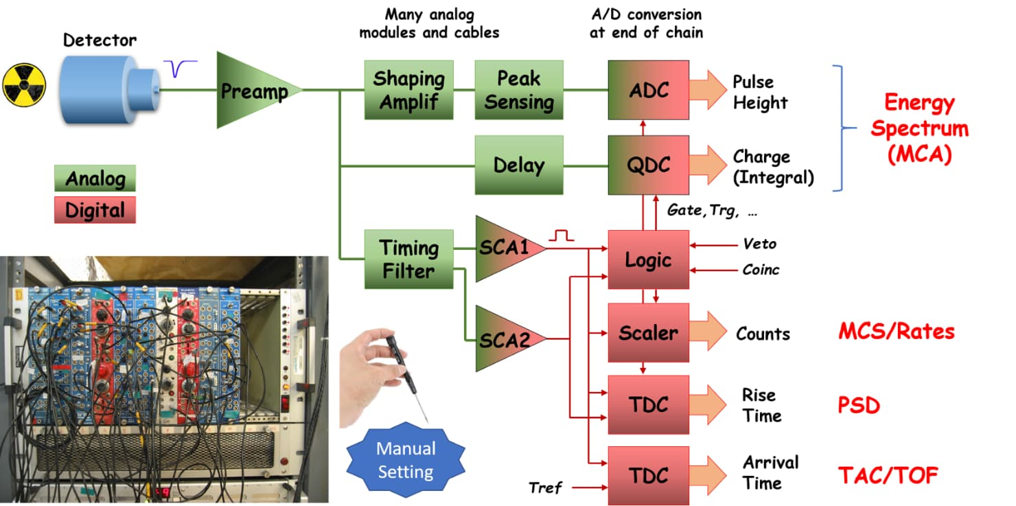
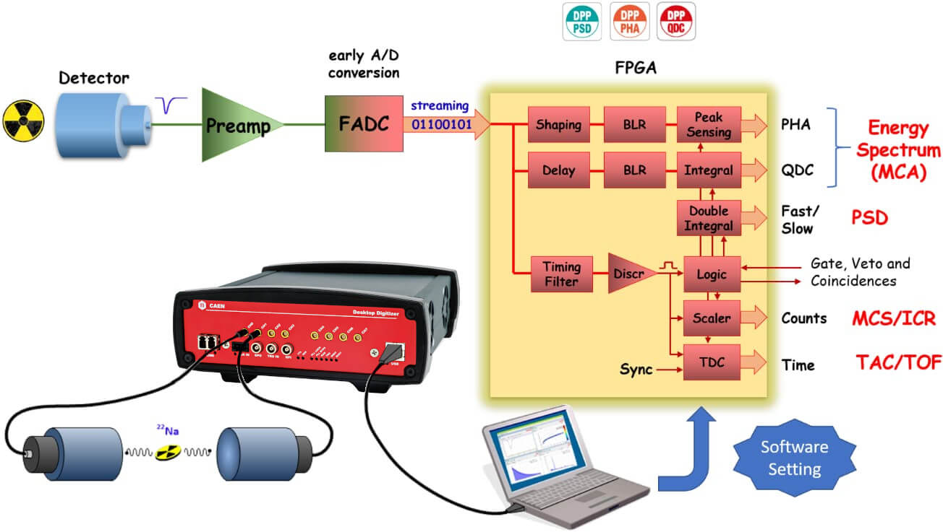
New Instrument from CAEN
Analog VS Digital
CAEN has developed a new type pulse process instrument
-- Digitizer
  From multiple boards, cables and manual adjustment.
  To a single multi-purpose board controlled by a software
  Flexibility, small size and weight, stability, scalability, good performances
Notes:
1. MVME CPU and OS/9 is hard to manage and upgrade.
2. The old DAQ control with electronics is not good for operation.
3. CAEN new instrument provides us a change to upgrade our DAQ system.

Slide 7
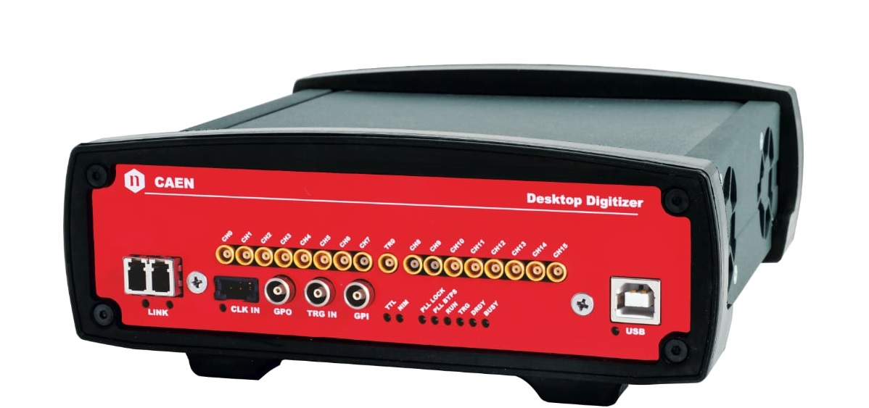
New Digitiser From CAEN
Improvement of Performances, Open FPGA and embedded ARM
More density, faster sampling rate, higher resolution for higher performances
Increased communication readout through 1/10 Gb Ethernet, USB 3.0 (yet keeping proprietary CONET)
Easier multi-board synchronization (clock and timing distribution)
Increase of acquisition memory buffer size: from SSRAM to DDR4 (=> from MBs to GBs)
Single FPGA (Xilinx Zynq US+ ) architecture => more resources for DPP algorithms and support for “Open FPGA”
Embedded quad-core ARM (Linux) => middleware, web interface. Possibility to run user Data Processing SW
Features
14-bit @ 500 MS/s
Analog inputs on MCX coax. connectors
VME64/VME64X (16/8 ch.), NIM (8 ch.) and Desktop (8 ch.) modules
0.5 and 2 Vpp selectable input dynamic range with programmable DC offset adjustment
Notes:
1. Digitizer box can perform functions better than MVME CPU + scaler board + ADC pulse process board.
2. Digitizer box is a mobile computer with quad-core Linux system.
3. Digitizer desktop version provides the great convenience for our timing, trigger, ADC pulse process
4. FPGA -- Fast Programming Gate Array.

Slide 8
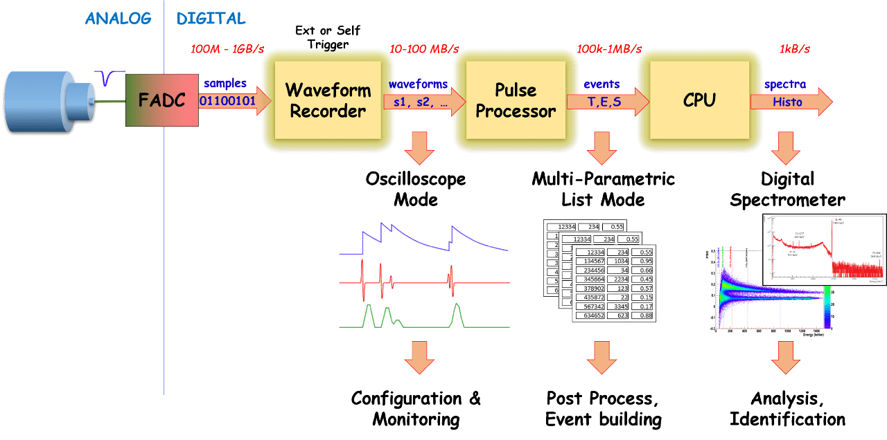
DIGITIZER PRINCIPLE OF OPERATION
Typical functions:
A single digitizer can replace multiple analog boards by performing several operations at the same time:
Waveform recording
TDC (Time to Digital Converter)
QDC (Charge to Digital Converter
PHA (Pulse Height Analysis)
PSD (Pulse Shape Discriminator)
Logic Units (Coincidence logic/Veto)
New technology from flash ADC (or switch capacitor ADC) and the programmable FPGA available onboard!
Notes:
Waveform inspector and recording
1. Input pulses are digitized into samples by the flash ADC
2. Detectors coupled with Charge Sensitive Preamplifier (like HPGe, Silicon, etc. ) typically generate “slow” signals with good energy resolution -> Required ADC frequency from 50 to 200 MS/s
3. Fast detectors coupled with PMT, SiPM, etc, typically generate signals with high timing resolution -> Required ADC from 250 MS/s to 1 GS/s and higher (like 5 GS/s with Switched Capacitor Arrays).
4. Raw waveform firmware acquires data with a global trigger (simultaneous among all channels). Data can be retrieved in multiple formats for further post-processing analysis

Slide 9
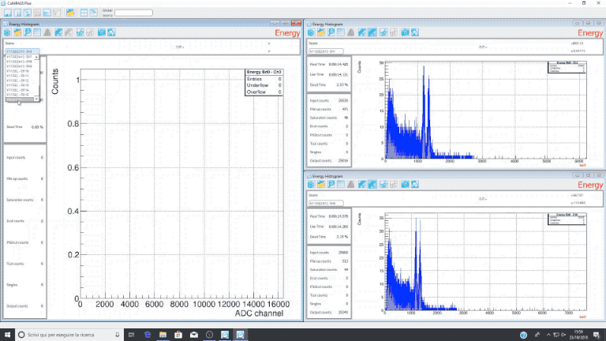
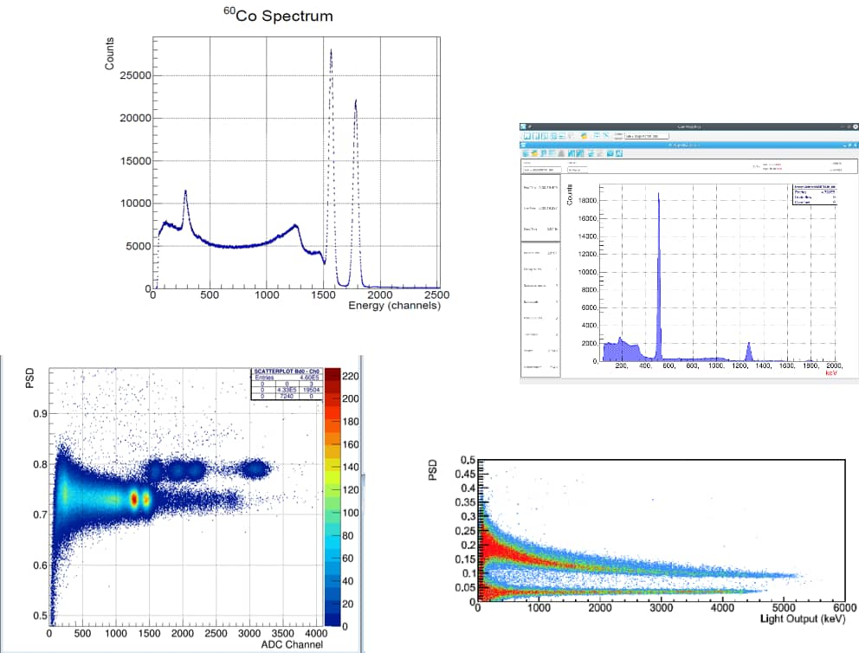
New Features from Digitiser
DIGITAL PULSE PROCESSING
DPP firmware¹ (Digital Pulse Processing) implements several algorithms running in real time in the FPGA.
The acquisition takes place with channel independent trigger. Each sampled waveform is analysed to extract the information of time, energy, PSD, etc.
Data is grouped into compact formats (List mode), thus allowing the board to have high throughput. The waveform too can be retrieved for further post-processing.
DPP – Gated QDC and Pulse Shape Discrimination
Typical input pulses from detectors with PMTs, without the use of preamplifiers, or at least with mid-fast preamplifiers.
The input pulse is analysed by the FPGA, in particular:
Baseline subtracted
Gate for charge integration
Double Gate for pulse shape discrimination
Digital CFD (Constant Fraction Discrimination) and LED (Leading Edge Discrimination) implemented onboard for a fine time stamp resolution.
Notes:
Energy resolutions:
3.0 % @ 137Cs for LaBr3
5-8 % @ 137Cs for NaI(Tl)
Typical PSD resolutions for n/g :FOM > 2.0 for E > 300 keV, FOM > 2.5 for E > 580 keV
FoM = centroid_difference/ (FPHM_gamma + FWHM_Neutron)
Fine time stamp steps of 1 ps for 751 family, 2 ps for 730, and 4 ps for 725 family
Time correlation among channels for Time of Flight (ToF)/ Start-Stop measurements, etc.
ToF resolution for 22Na with BaF2 detectors: 182 ps
ToF resolution for 60Co with BC501A detectors: 230 ps

Slide 10
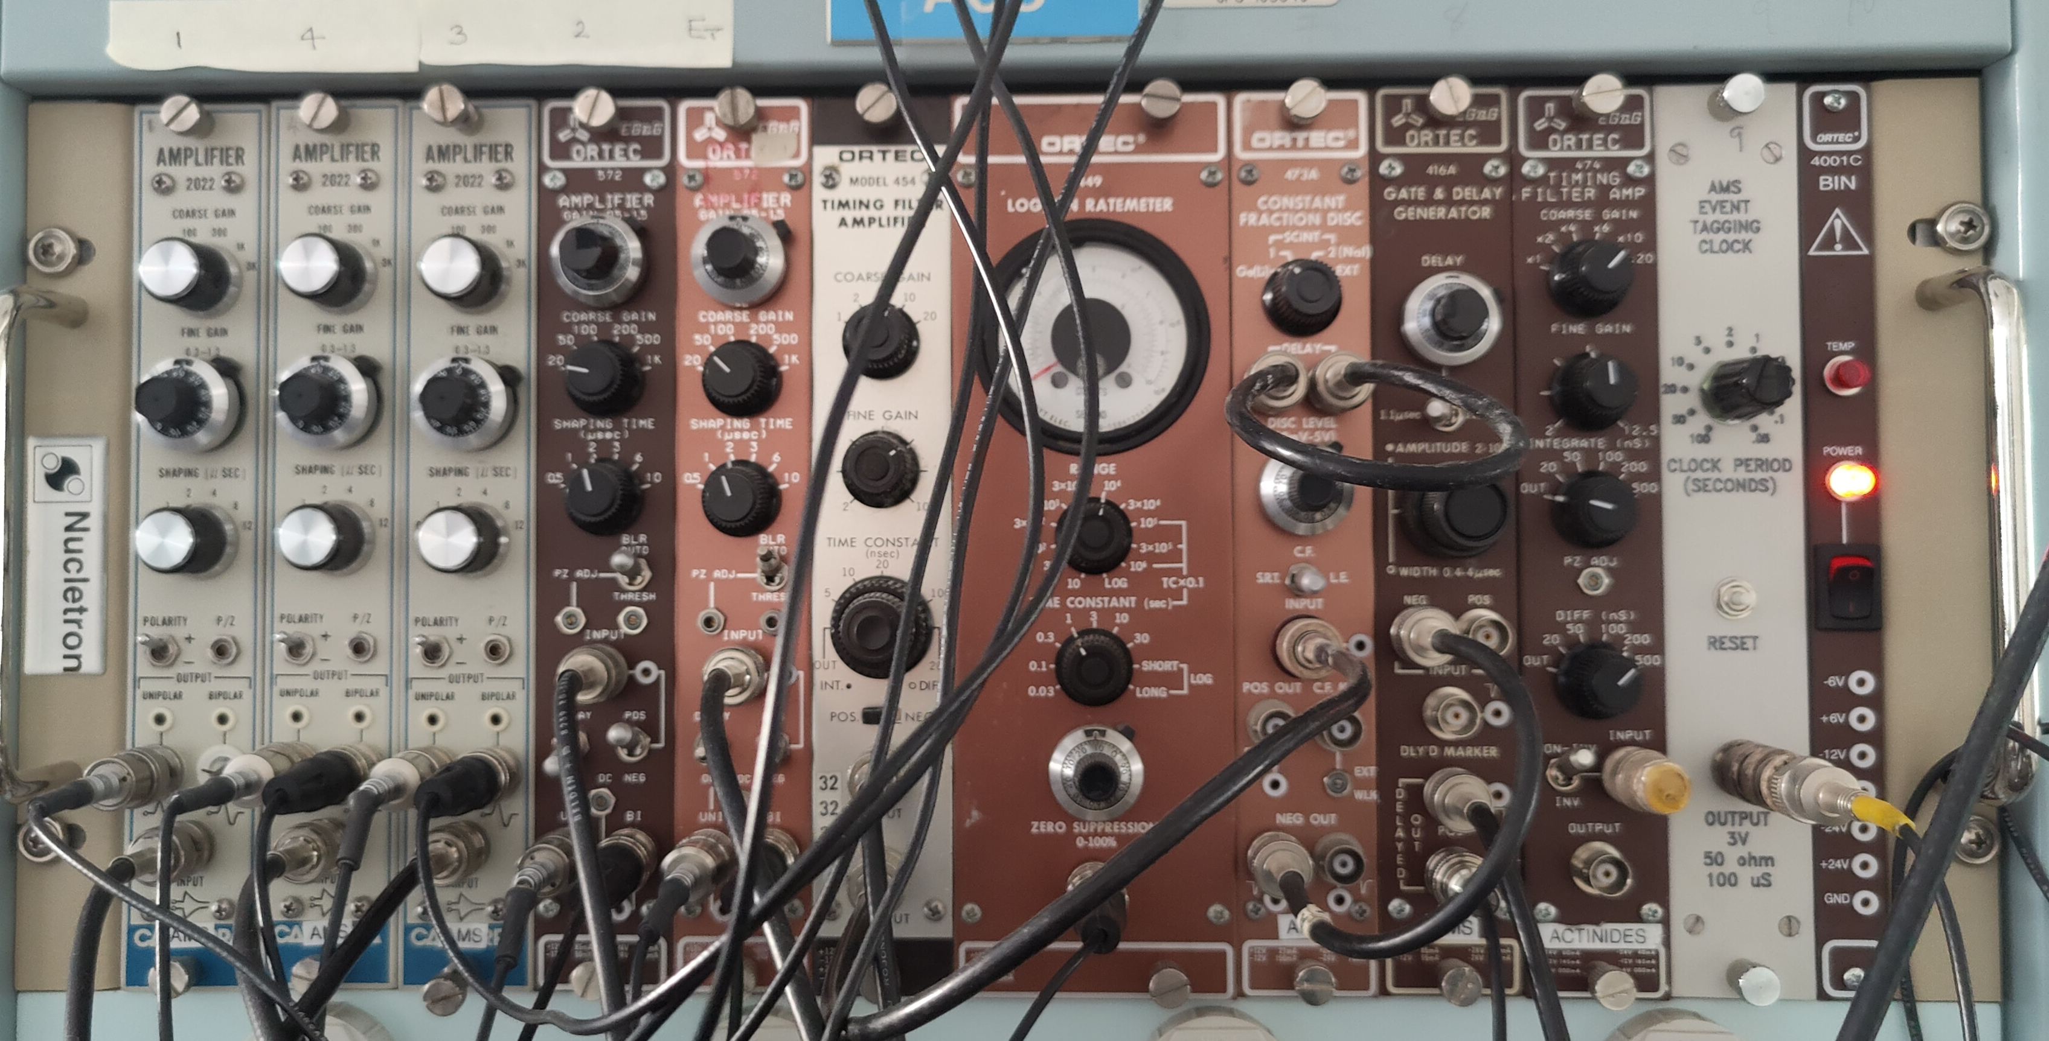
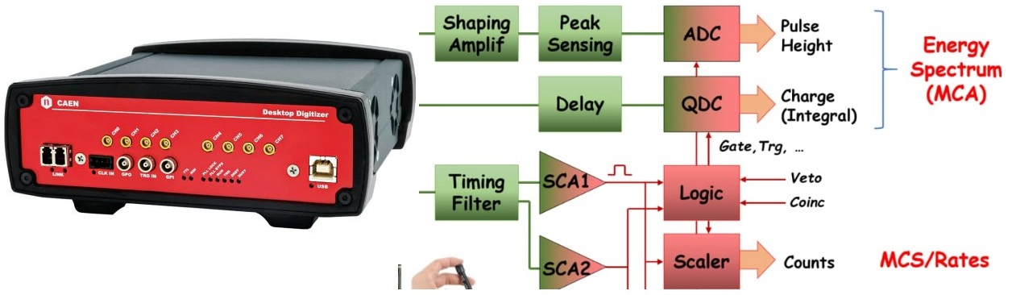
New AMS DAQ System
DAQ System Option: One
Remove VME crate, Keep some electronics. Ensure signal strong enough, CAEN software + ANSTO software.
DAQ System Option: Two
Remove all old instruments if conflict with new Digitizer,
Apply for all new parts from CAEN,
CAEN software + ANSTO software.
DAQ System Option: Three
  Modern VME CPU board and latest Linux to replace Moto CPU board and OS/9,
  Keep current VME scaler and ADC boards,
  Upgrade SOAP to QtSOAP.

Slide 11
Software – CoMPASS + QtSOAP
With Option One, A Linux Workstation will be equipped with following Packages and connected to Digitizer Box through Optical cable.
CoMPASS – from CAEN
CoMPASS can manage the acquisition of multiple boards with non-homogeneous DPP firmware
Easy manipulation of data:
  Multiple Spectra with ROI and statistics
  Runtime data correlation (energy and time filters/add back/PSD cuts, etc.)
  Data socket for user runtime analysis
  Compliant with ROOT
  Several output format
QtSOAP – ANSTO DAQ Software
  Connect to CoMPASS Socket,
  Qt GUI and C/C++,
  Localised analysis,
  Batch Running mode,
  Instrument scanning,
  DAQ pre-tunning,
  Localised chart process.

Slide 12

Conclusion
THANK YoU!
Upgrade is necessary for a VME system severed more than 20 years,
Keep some electronics is better to Ensure signal strong enough.
It is good to have modern DAQ computer and suitable operate system
Test with available options is very necessary to find the best combination.
Qt-SOAP development is a challenge.

Slide 13
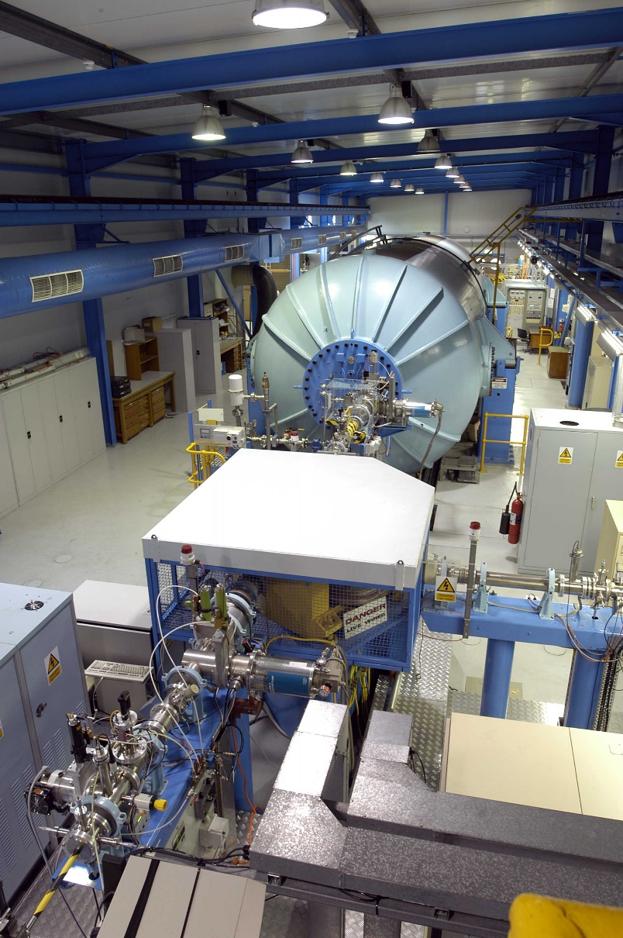
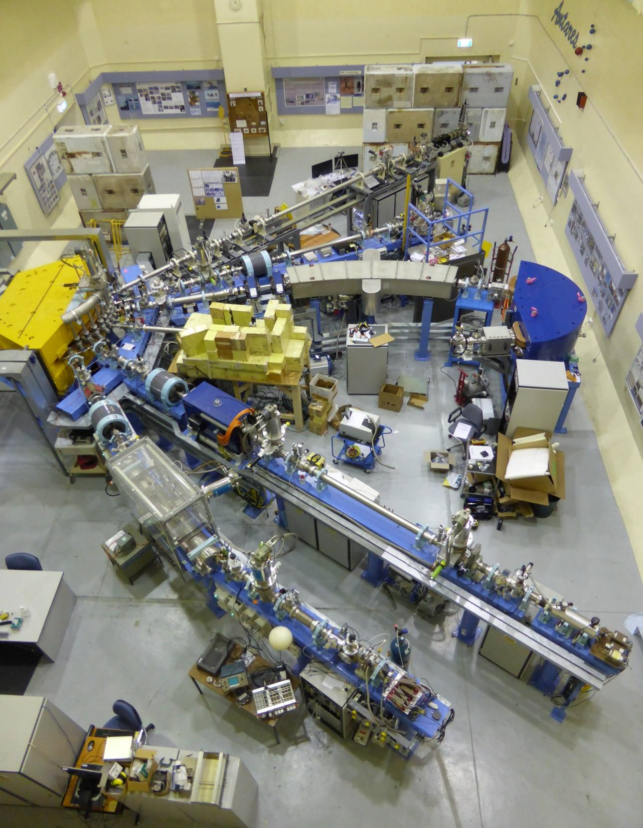
ANTARES Accelerator (cont’ed)

