Slide 1
Renewal of Computer Systems at Centre for Accelerator Science
IC CoP meeting – October 2022
ANSTO Centre for Accelerator Science
Prepared By Matthew Rees

Slide 2
Outline
History
Status Now
The Future ?

Slide 3
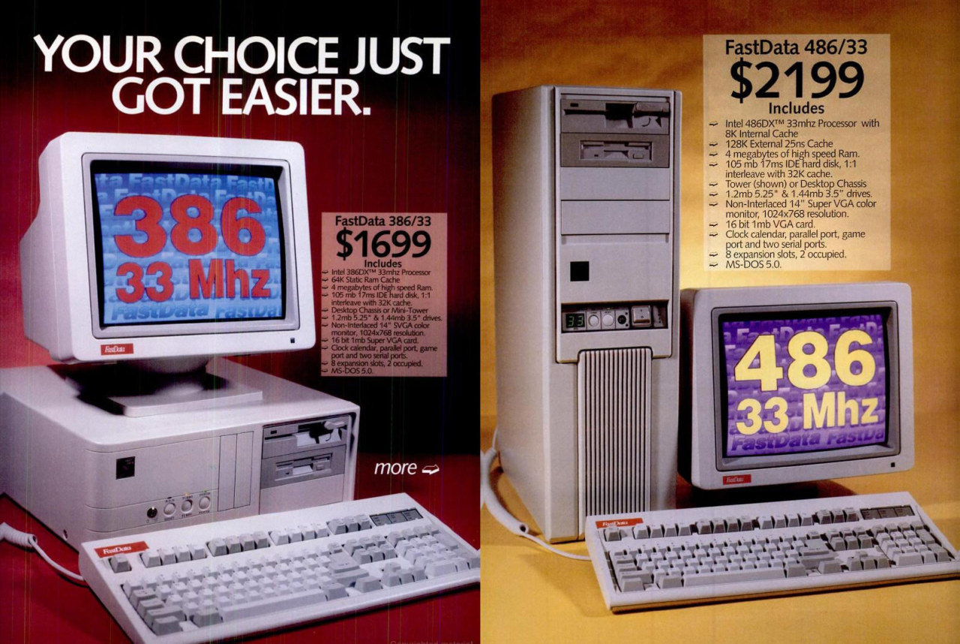
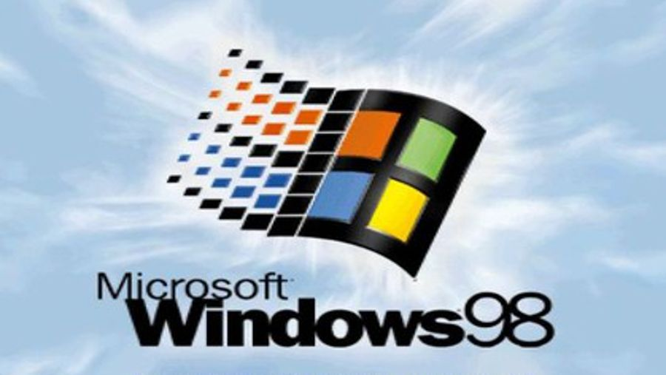
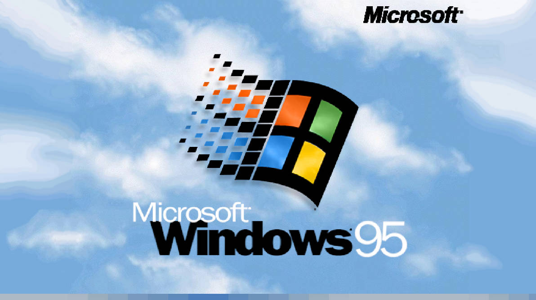
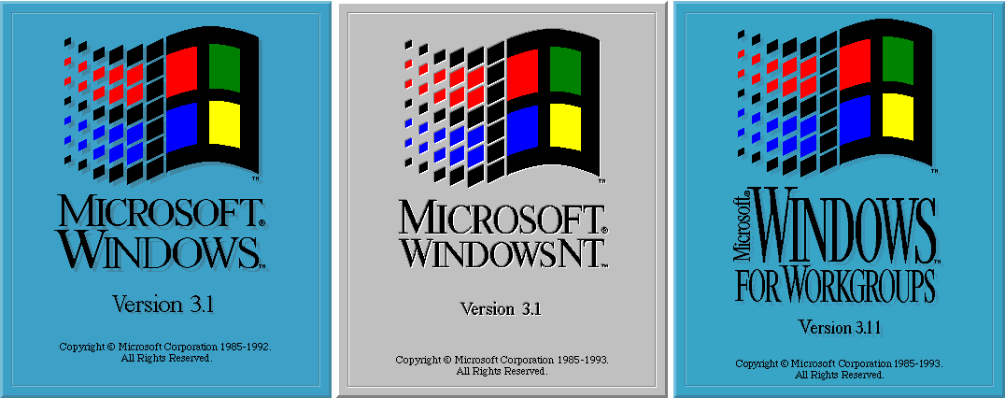
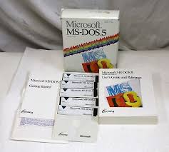
A Brief History
Our Story Begins….
1989 ANTARES comes to ANSTO
1990 ARPANET shuts down
  Gopher search
1992 ANTARES first operation
  MOSAIC created
  WWW is born

Slide 4
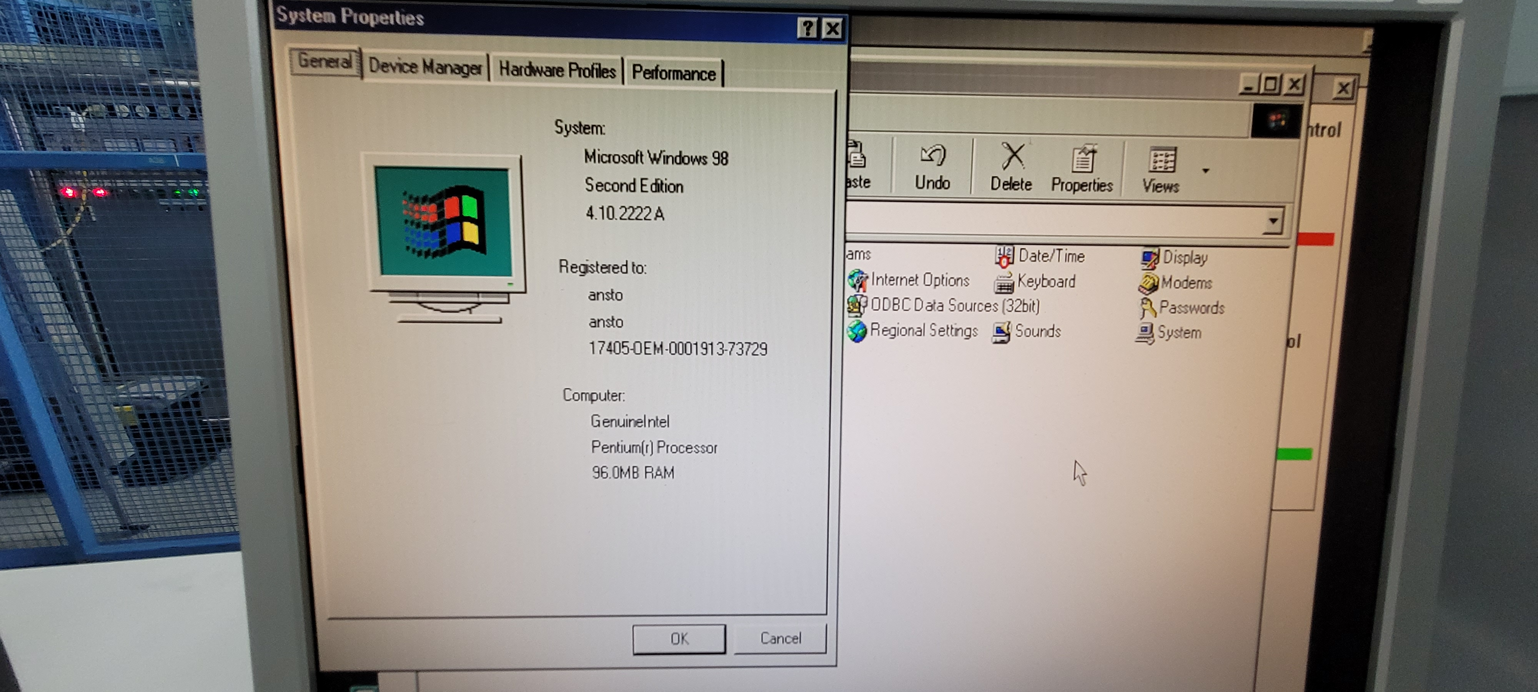
Present Day

Slide 5
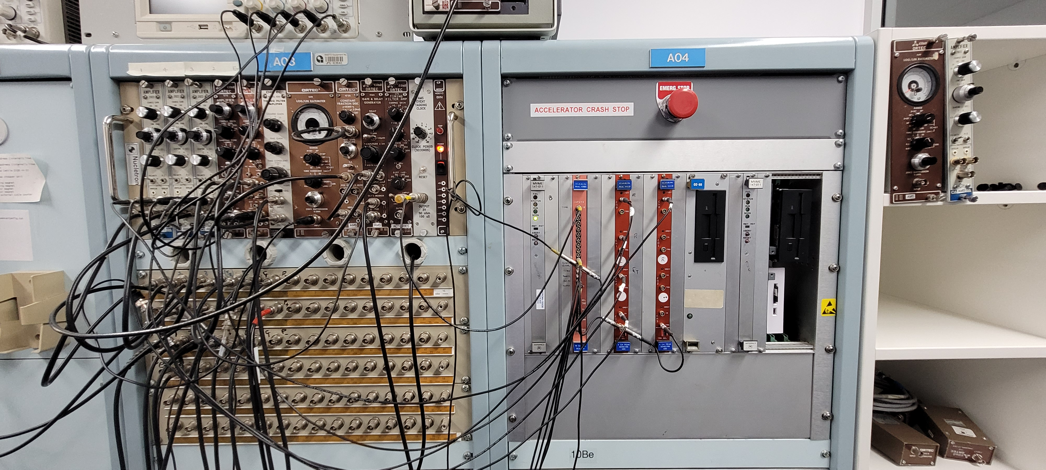
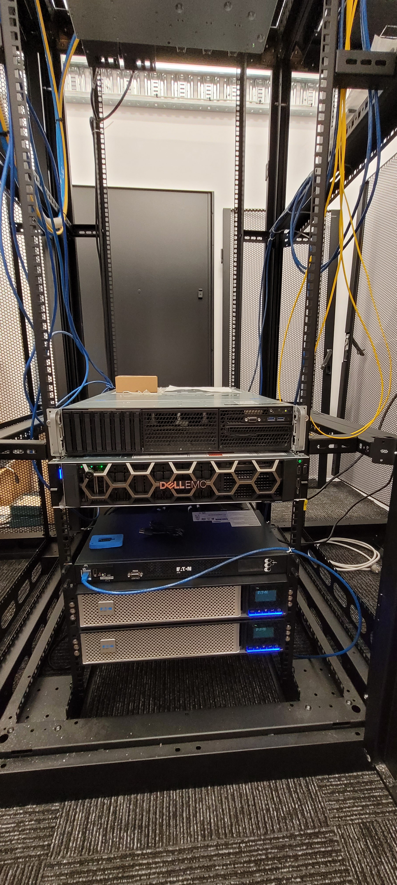
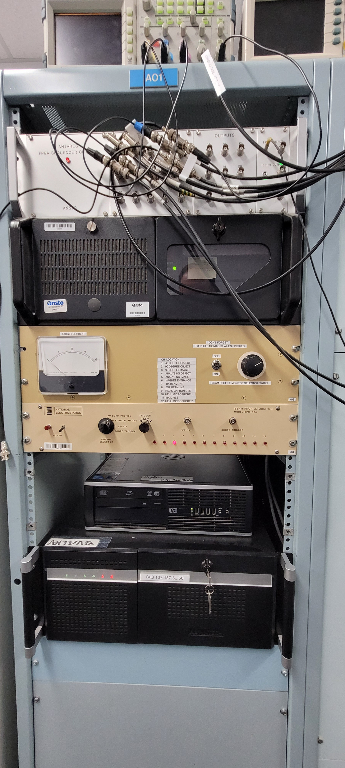
CAS Computers

Slide 6
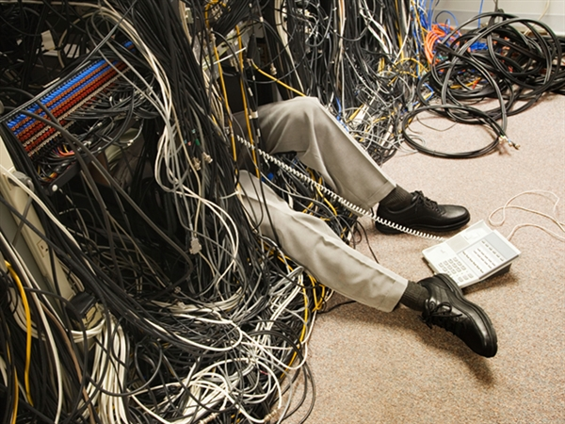
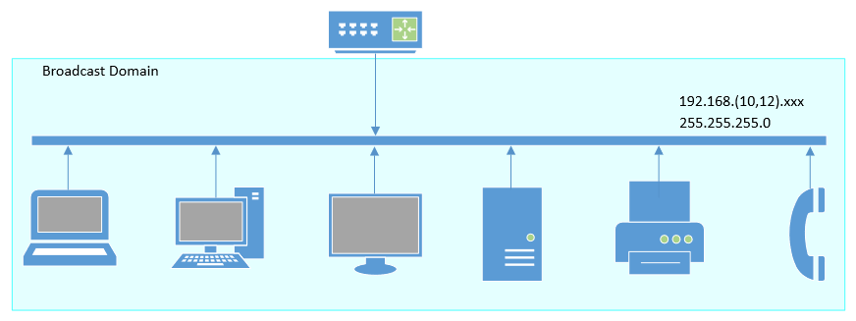
Networks

Slide 7

External Forces
Newtons First Law
  www.cyber.gov.au
  ANSTO IT Policy
Essential 8 Maturity Model
  Defence in Depth
  Granularity
Time
  Upgrade cycles
  System Usage Demands

Slide 8
Reaction
Network Segmentation
  VLANs
  System Virtualisation and Consolidation
Transition Management (asset protection)
  CAS Data Management

Slide 9
VLAN
Virtual Local Area Network
Multiple separated network domains hosted on a single device
Integrated with ANSTO IT systems
  Supported Infrastructure

Slide 10
VLAN Breakdown

Slide 11
VLAN Population

Slide 12
VLAN Matrix
Network access

Slide 13
Where are we now?
Coordinating with ANSTO IT Teams
  OT and Cybersecurity
  Infrastructure
In Progress
  Stage 1 network separation - corporate machines
  New VLAN switch allocated to CAS B53
  New VM host servers ready for commissioning
  Ongoing remediation of old machines
  New Dedicated Storage allocation for CAS

Slide 14
Thank You!

