Slide 1
Is there potential for a flatter potential?
ATF IC-CoP 17th to 19th October 2022
CAS-ASD
David Button

Slide 2
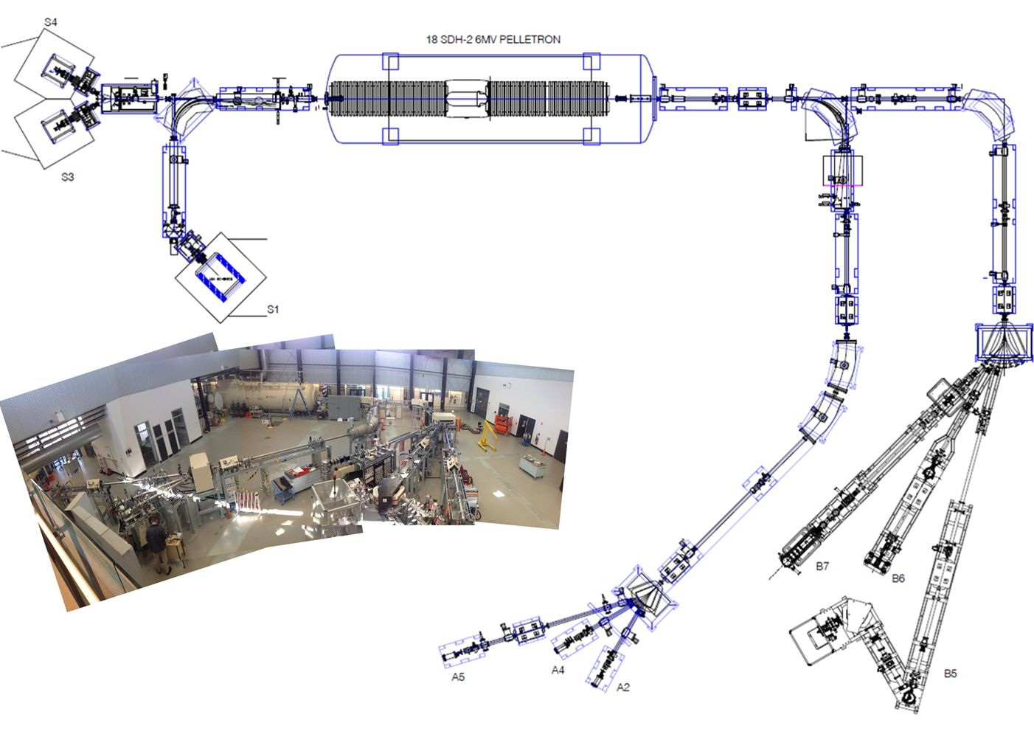
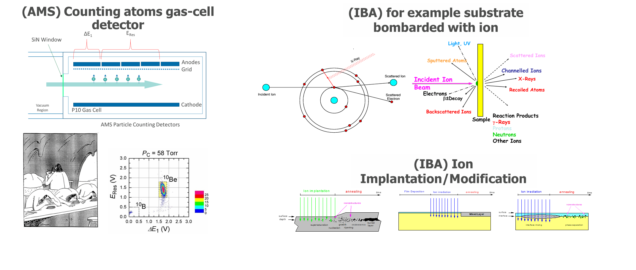
What are tandem accelerators and why the question about potential?
Tandem Accelerators are used to accelerator ion beams to a deterministic energy
Ion beams are used for;
  Accelerator Mass Spectrometry (AMS)
  Ion Beam Analyses (IBA)
  Materials Modification
  Irradiation

Slide 3

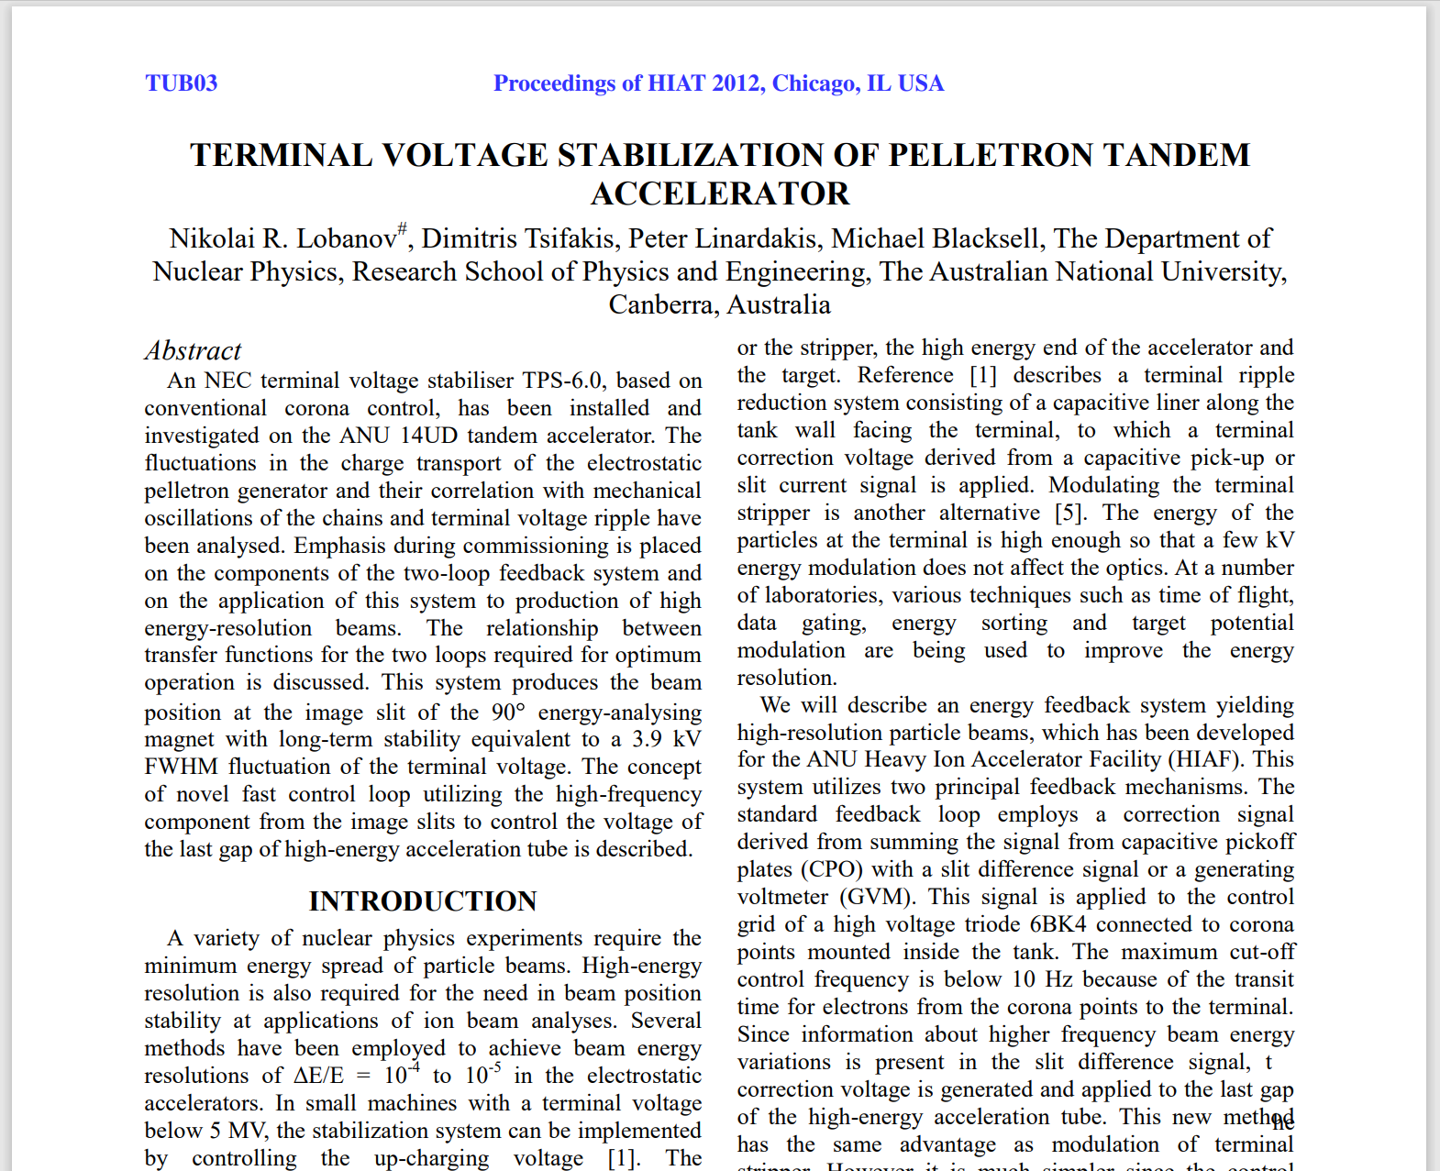
Some previous work ☺
Terminal Voltage Stabilization of Pelletron Tandem Accelerator
N. R. Lobanov, M. C. Blacksell, P. Linardakis, and D. Tsifakis, “Terminal Voltage Stabilization of Pelletron Tandem Accelerator”, in Proc. HIAT'12, Chicago, IL, USA, Jun. 2012, paper TUB03, pp. 124-128.
URL: https://jacow.org/HIAT2012/papers/TUB03.pdf

Slide 4


Manipulation ions
Electric Field
Magnetic Field (Field coming out of the page)
...............................................................................................................................................
F
F
v
v
v
v
F
F

Slide 5
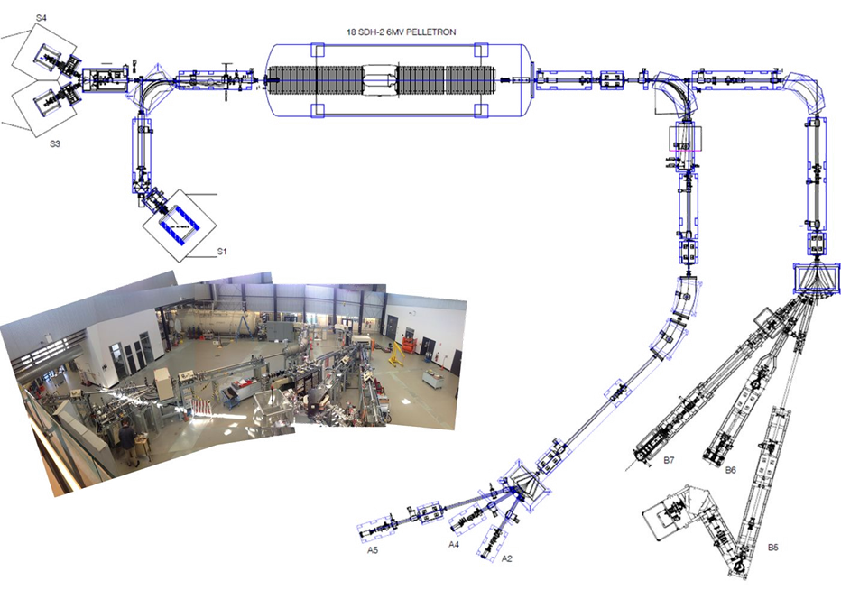
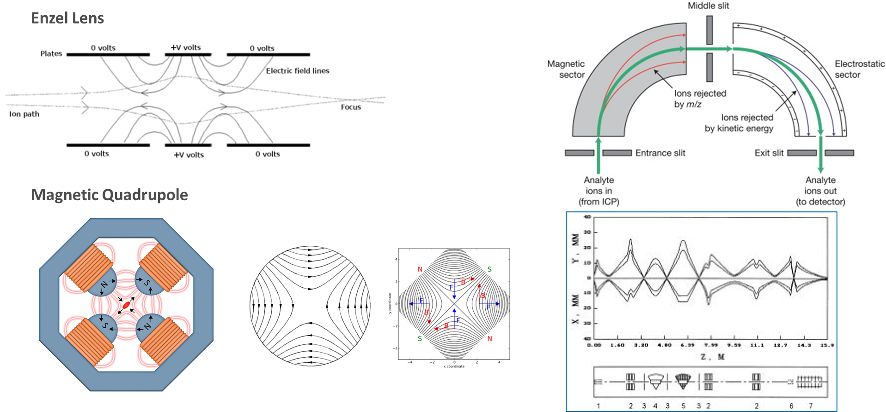
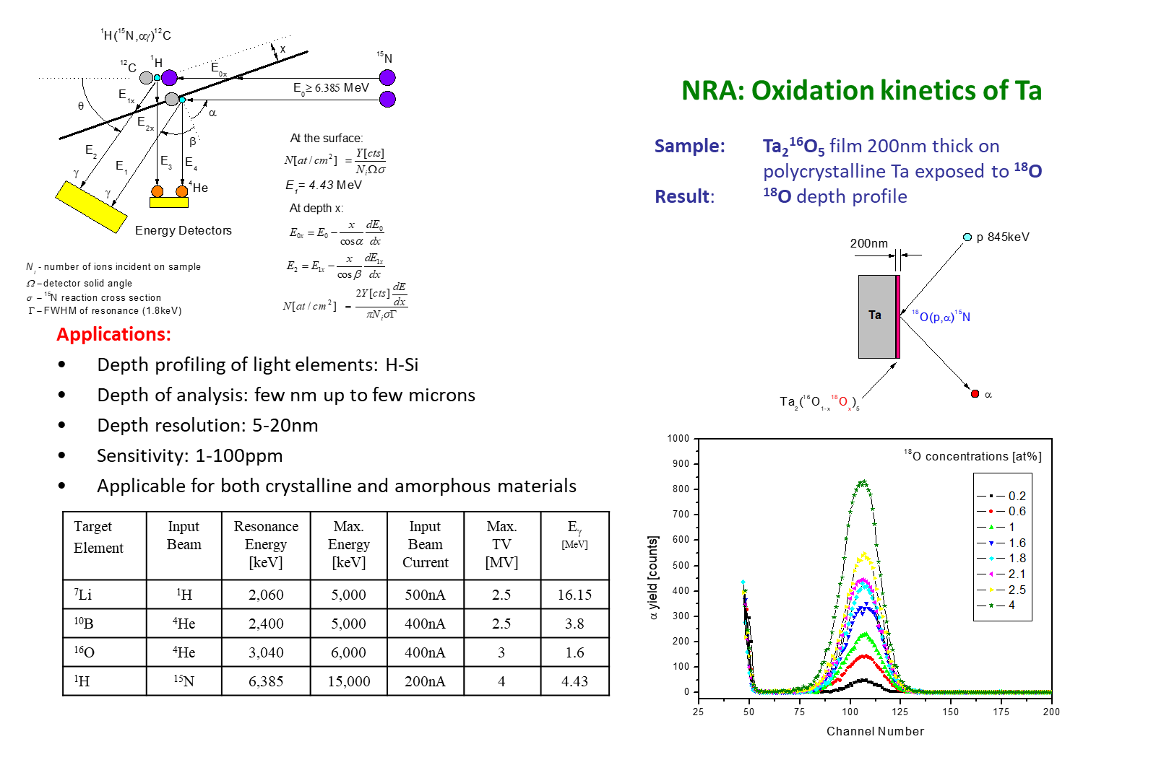
So why is stable energy important
Maintaining a known chromatic ion beam energy allows us to achieve;
  Good transmission of the ions from the ion source to the final target
  Accurate filtration and tailoring of the ions
  Deterministic control over the interactions with targets

Slide 6
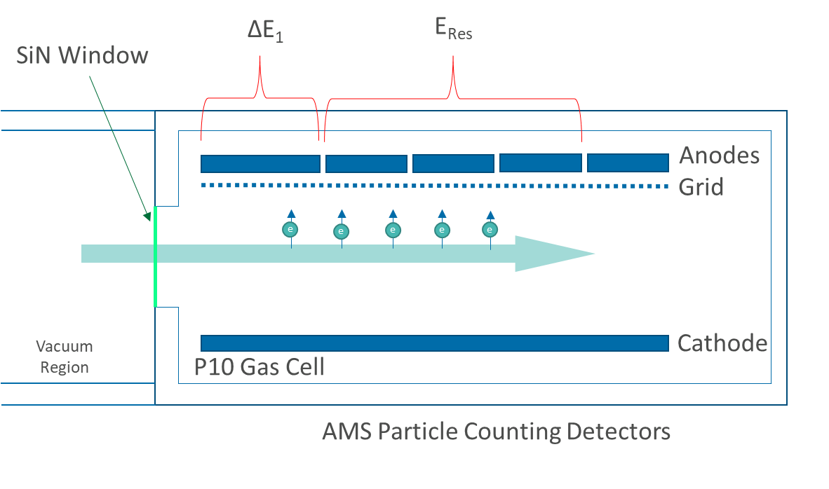
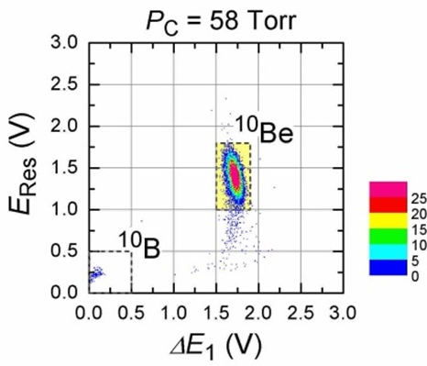
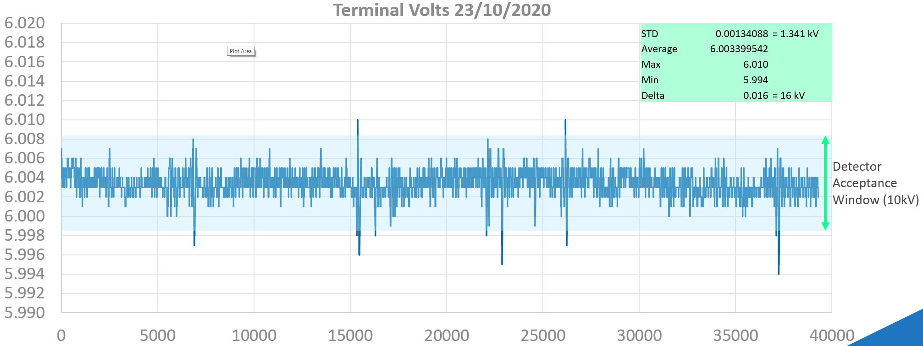

Slide 7


Tandem electrostatic accelerator
Tandem accelerators use static electric fields to accelerate particles as typically DC beams.
The Tandem process allows for energies greater than the terminal voltage to be generated.
 | Charge State (q) | Acceleration Voltage | Ion Energy Gain
Injection Energy | -1 | 100 kV | 100 keV
Low Energy | -1 | 3 MV | 3 MeV
High Energy | +3 | 3 MV | 9 MeV
Exit Energy |  |  | 12.1 MeV
SF₆ Pressure Vessel
E_{final} = E_{inj} + (1 + q) V_{terminal}
++++
Max Voltage
Terminal
Stripper
Ion Source
Neg potential deck
Low Energy Section
High Energy Section
Charging Chains
Charging Chains
Ion Source
Neg potential deck
Accelerate Negative Ions
q Change
Accelerate Positive Ions

Slide 8
Tandem electrostatic accelerator
High Voltage Terminal
Injection Magnet/Bouncer
Equal Potential Rings
Low Energy Section
CPO
Generating Volt Meter
High Energy Section
Tank (Pressure Vessel)
Analysing Magnet
Generator
Motor
++++
Stripper
Ion Source
Neg potential deck
SF₆ Pressure Vessel
Switch Magnet
Ion Source
Neg potential deck
Accelerate Negative Ions
q Change
Accelerate Positive Ions
Gas Stripper
(Recirculating gas)
Ion Source
Corona Probe
Charging Pelletron Chain
Some Parameters
Column Current, LE, and HE
Stripper Pressure, and Gas Type
Up Charge
Down Charge
Inductor and Suppressor Voltage and Current
Loss Charge
Corona Probe Position and Current
Corona Probe Grid Voltage Read Back

Slide 9
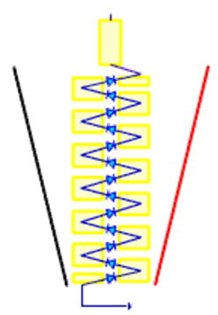
Tandetron electrostatic accelerator
High Voltage Terminal
q Change
Accelerate Positive Ions
Accelerate Negative Ions
Injection Magnet/Bouncer
Equal Potential Rings
Low Energy Section
CPO
Generating Volt Meter
High Energy Section
Tank (Pressure Vessel)
Analysing Magnet
Generator
Motor
++++
Stripper
Ion Source
Neg potential deck
SF₆ Pressure Vessel
Switch Magnet
Ion Source
Neg potential deck
Gas Stripper
(Recirculating gas
Ion Source
Diode Stack
HVG Driver (PWM 42kHz)

Slide 10
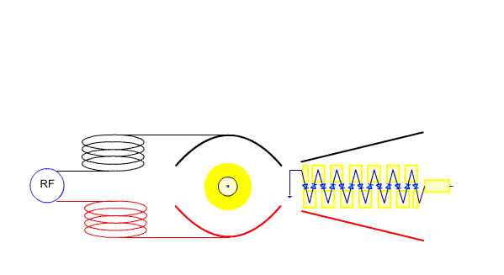
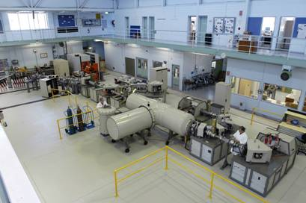
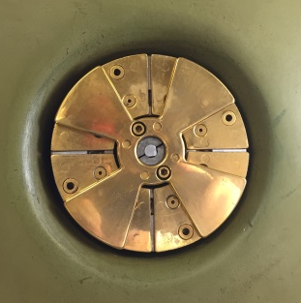
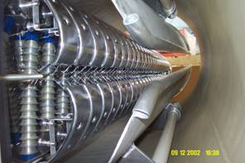
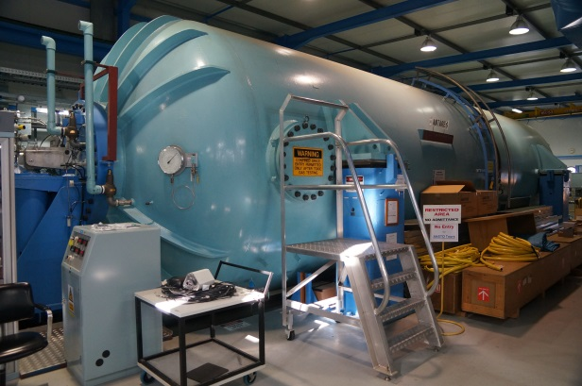
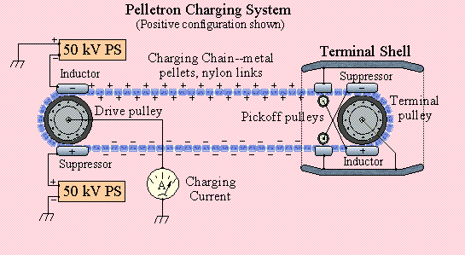
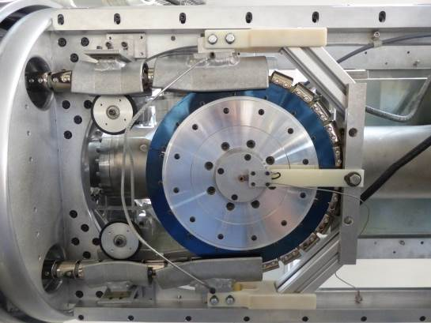
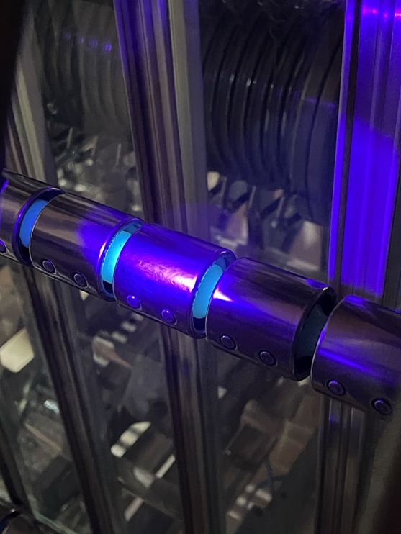
High Voltage Generators
Tandetron Solid-state Charging System
Generating Volt Meter (GVM)
Pelletron Charging System
Pelletron Chain
Diagram: http://www.pelletron.com/charging.htm

Slide 11
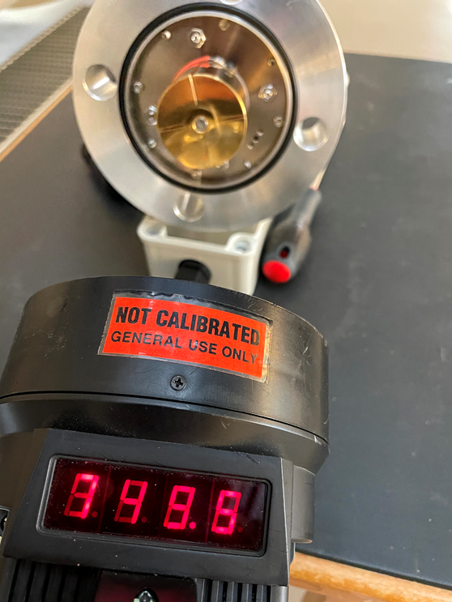

Monitoring and regulating the terminal potential
How do we measure absolute millions of volts?
Generating Volt Meter (GVM)
Generating Volt Meter (GVM), Old ANTARES Version

Slide 12


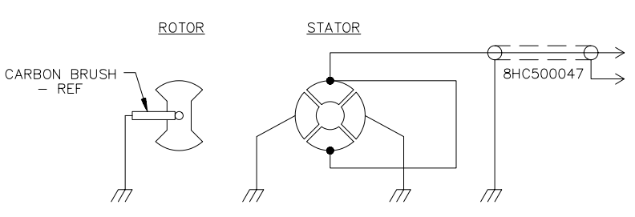
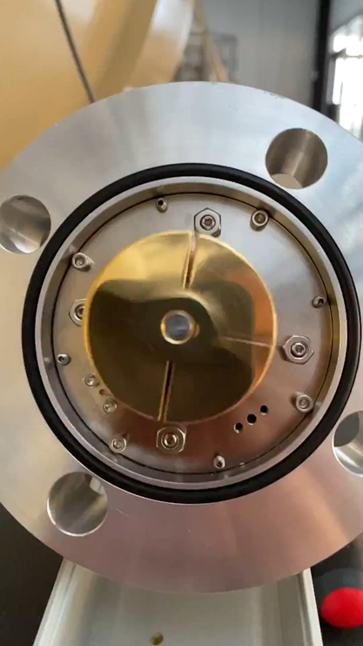
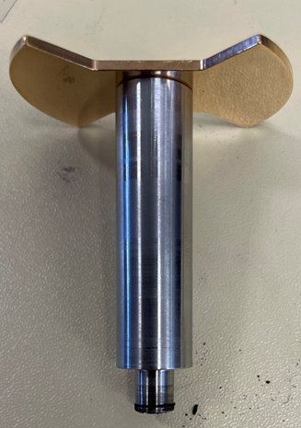

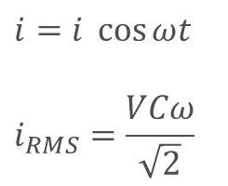
GVM Operation
C$=\frac{ε_{0}A}{d}$
Capacitance
Dielectric Constant
Area of Plates
Distance between plates
C$=\frac{q}{V}$
Capacitance
Charge
Voltage
i$=\frac{dq}{dt}=V\frac{dC}{dt}$
Current
Charge
time
Sulphur Hexafluoride (6 Bar)
Terminal
Tank Wall
Depth Representing
Voltage
Capacitance
$$i=i \cos{ωt}$$
$$i_{RMS}=\frac{VCω}{\sqrt{2}}$$

Slide 13
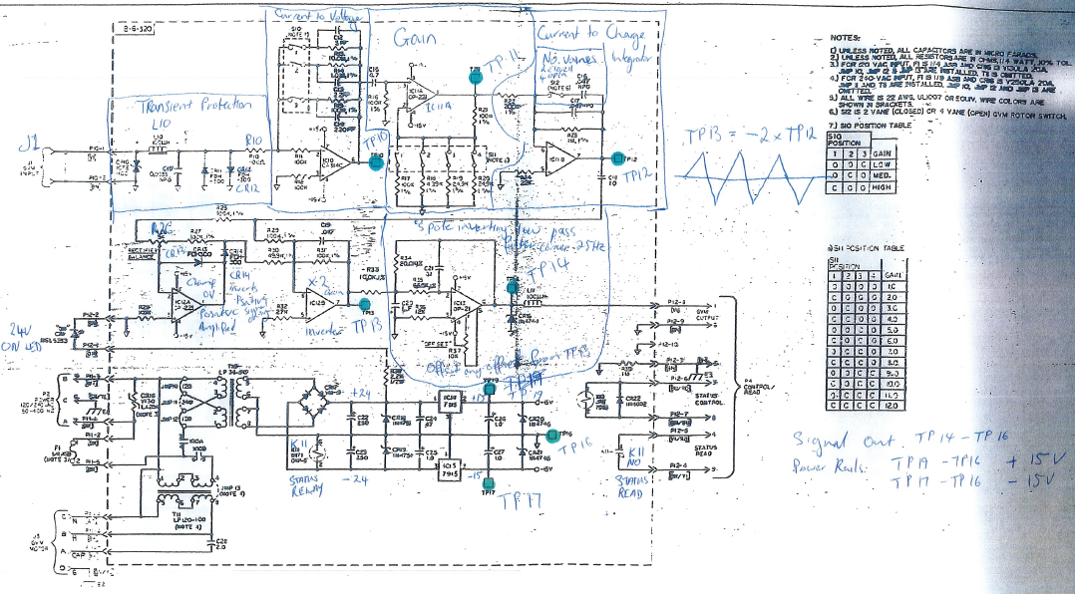
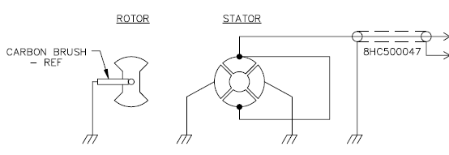
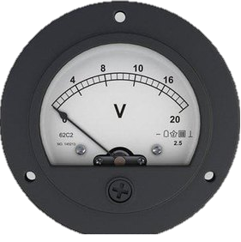
GVM Operation
M
Unipolar DC Signal (Approx. 20Hz Bandwidth), is calibrated and displayed as the absolute terminal voltage, and provided on many systems as a feedback to the power generator or Terminal Potential Stabiliser (TPS).

Slide 14
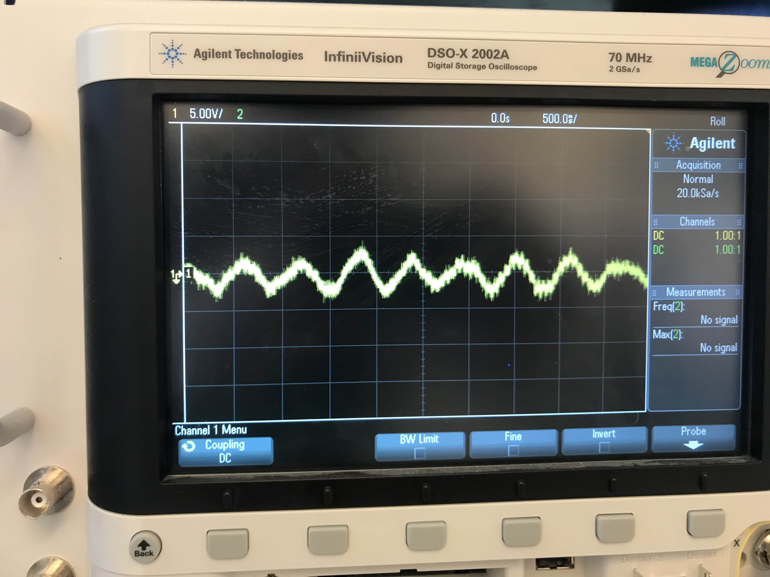
CPO Operation
As with other Terminal sensing devices, the Capacitive Pick Off CPO plate is lacked in the pressure vessel wall of the accelerator, and sits opposite the terminal. It consists of a simple disc. Though many are supplied as dual inputs which were intended to cancel mechanical motion, all our accelerators only use 1 channel.
The CPO compliments the slower GVM signal sensing the terminal ripple, and provides this signal as an input of the Terminal Potential Stabiliser (TPS)
How do we measure rate of change?
Depth Representing
Voltage
Capacitance

Slide 15
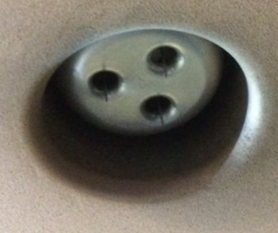
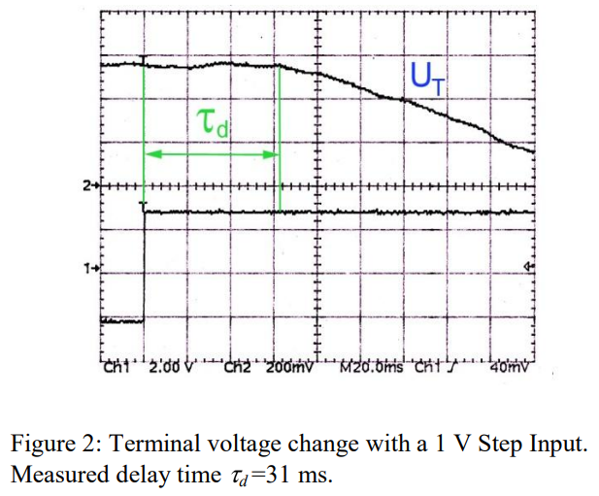
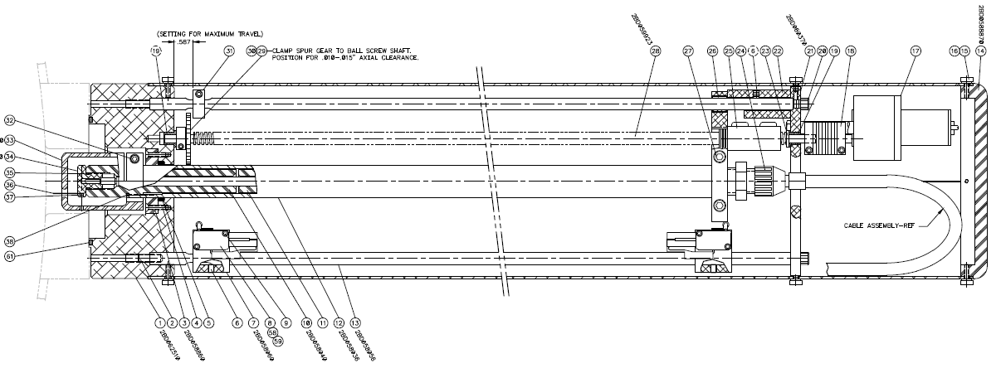
Corona Probe
How to remove chare from the terminal?
The Corona Probe is located on the wall of the pressure vessel, featuring pointed needle which are driven to an appropriate location to allow the emission of elections from the ground plane, through the gas to the terminal as a regulated corona discharge by a voltage controlled constant current source, emitting electrons from the tips of the needles. Typical NEC systems have 0-200 uA units operating typically between 5-20 uA.
N. R. Lobanov, M. C. Blacksell, P. Linardakis, and D. Tsifakis, “Terminal Voltage Stabilization of Pelletron Tandem Accelerator”, in Proc. HIAT'12, Chicago, IL, USA, Jun. 2012, paper TUB03, pp. 124-128.

Slide 16
Corona Probe
The Corona Probe can be adjusted from its initial position at the pressure vessel wall with adjustable linear movement reducing or increasing the gap between the needles and the high voltage terminal.
The emission of electron from the needles on the probe are contingent on their sharpness, and the strength of the electric field to emit electrons from the needle points.
The gap or distance between the needles and the terminal has to be adjust to be in the “goldilocks” zone as to have an electric field high enough to emit electrons, but not too high as to course external breakdowns, or damage to the corona probe cable.
Volts/mm
Consideration
Terminal
Terminal

Slide 17
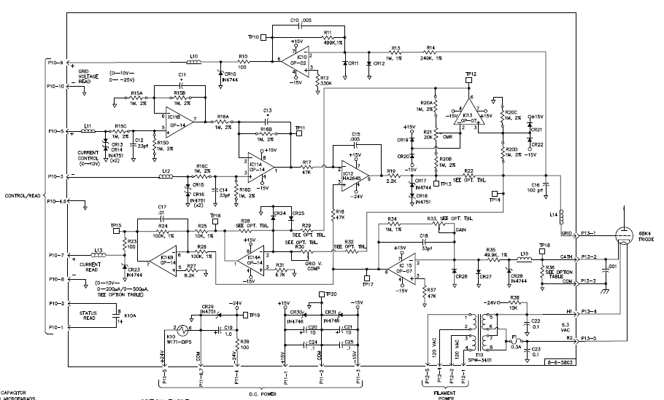
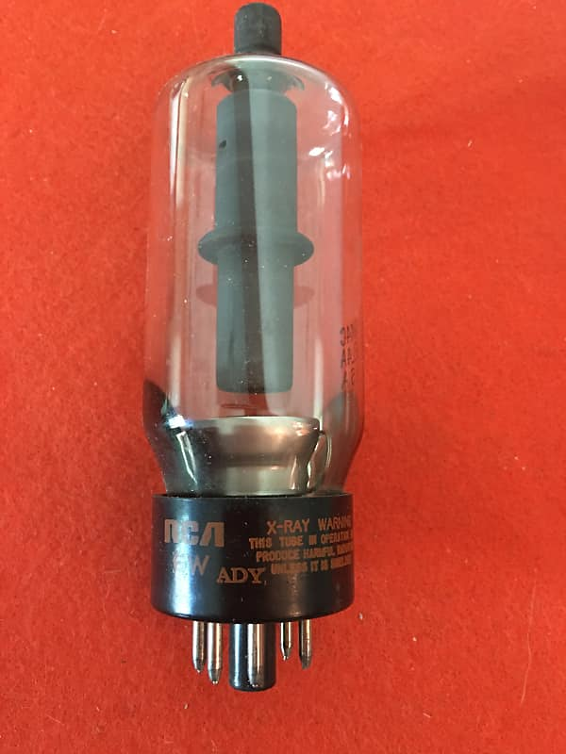
Corona Probe (V to I Regulator)

Slide 18
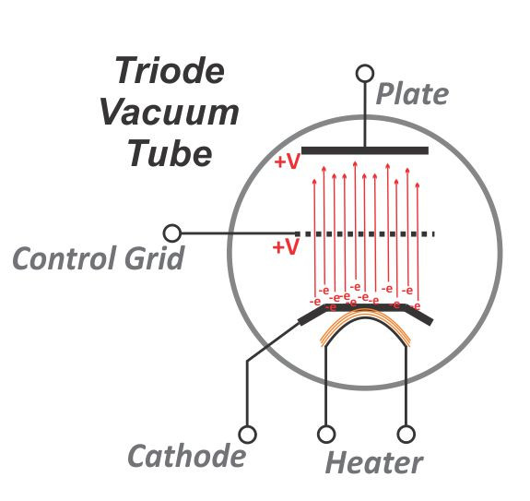
Corona Probe (V to I Regulator)
VACUUM TUBE, HIGH VOLTAGE BEAM TRIODE RCA/GE/SYLV #6BK4C (OR EQUIV)
To prevent an electron flow from the cathode to the plate the control grid is driven negative to suppress the electrons back to wards the cathode.
To allow a current to flow the grid is allowed to go more positive to allow electrons the transvers the tube to the plate.
The Control Grid Voltage is a key parameter to observe when adjusting and accelerator running conditions.
Note: due to the high voltage between the plate and the cathode, electrons can gain enough energy to generate some x-rays.

Slide 19
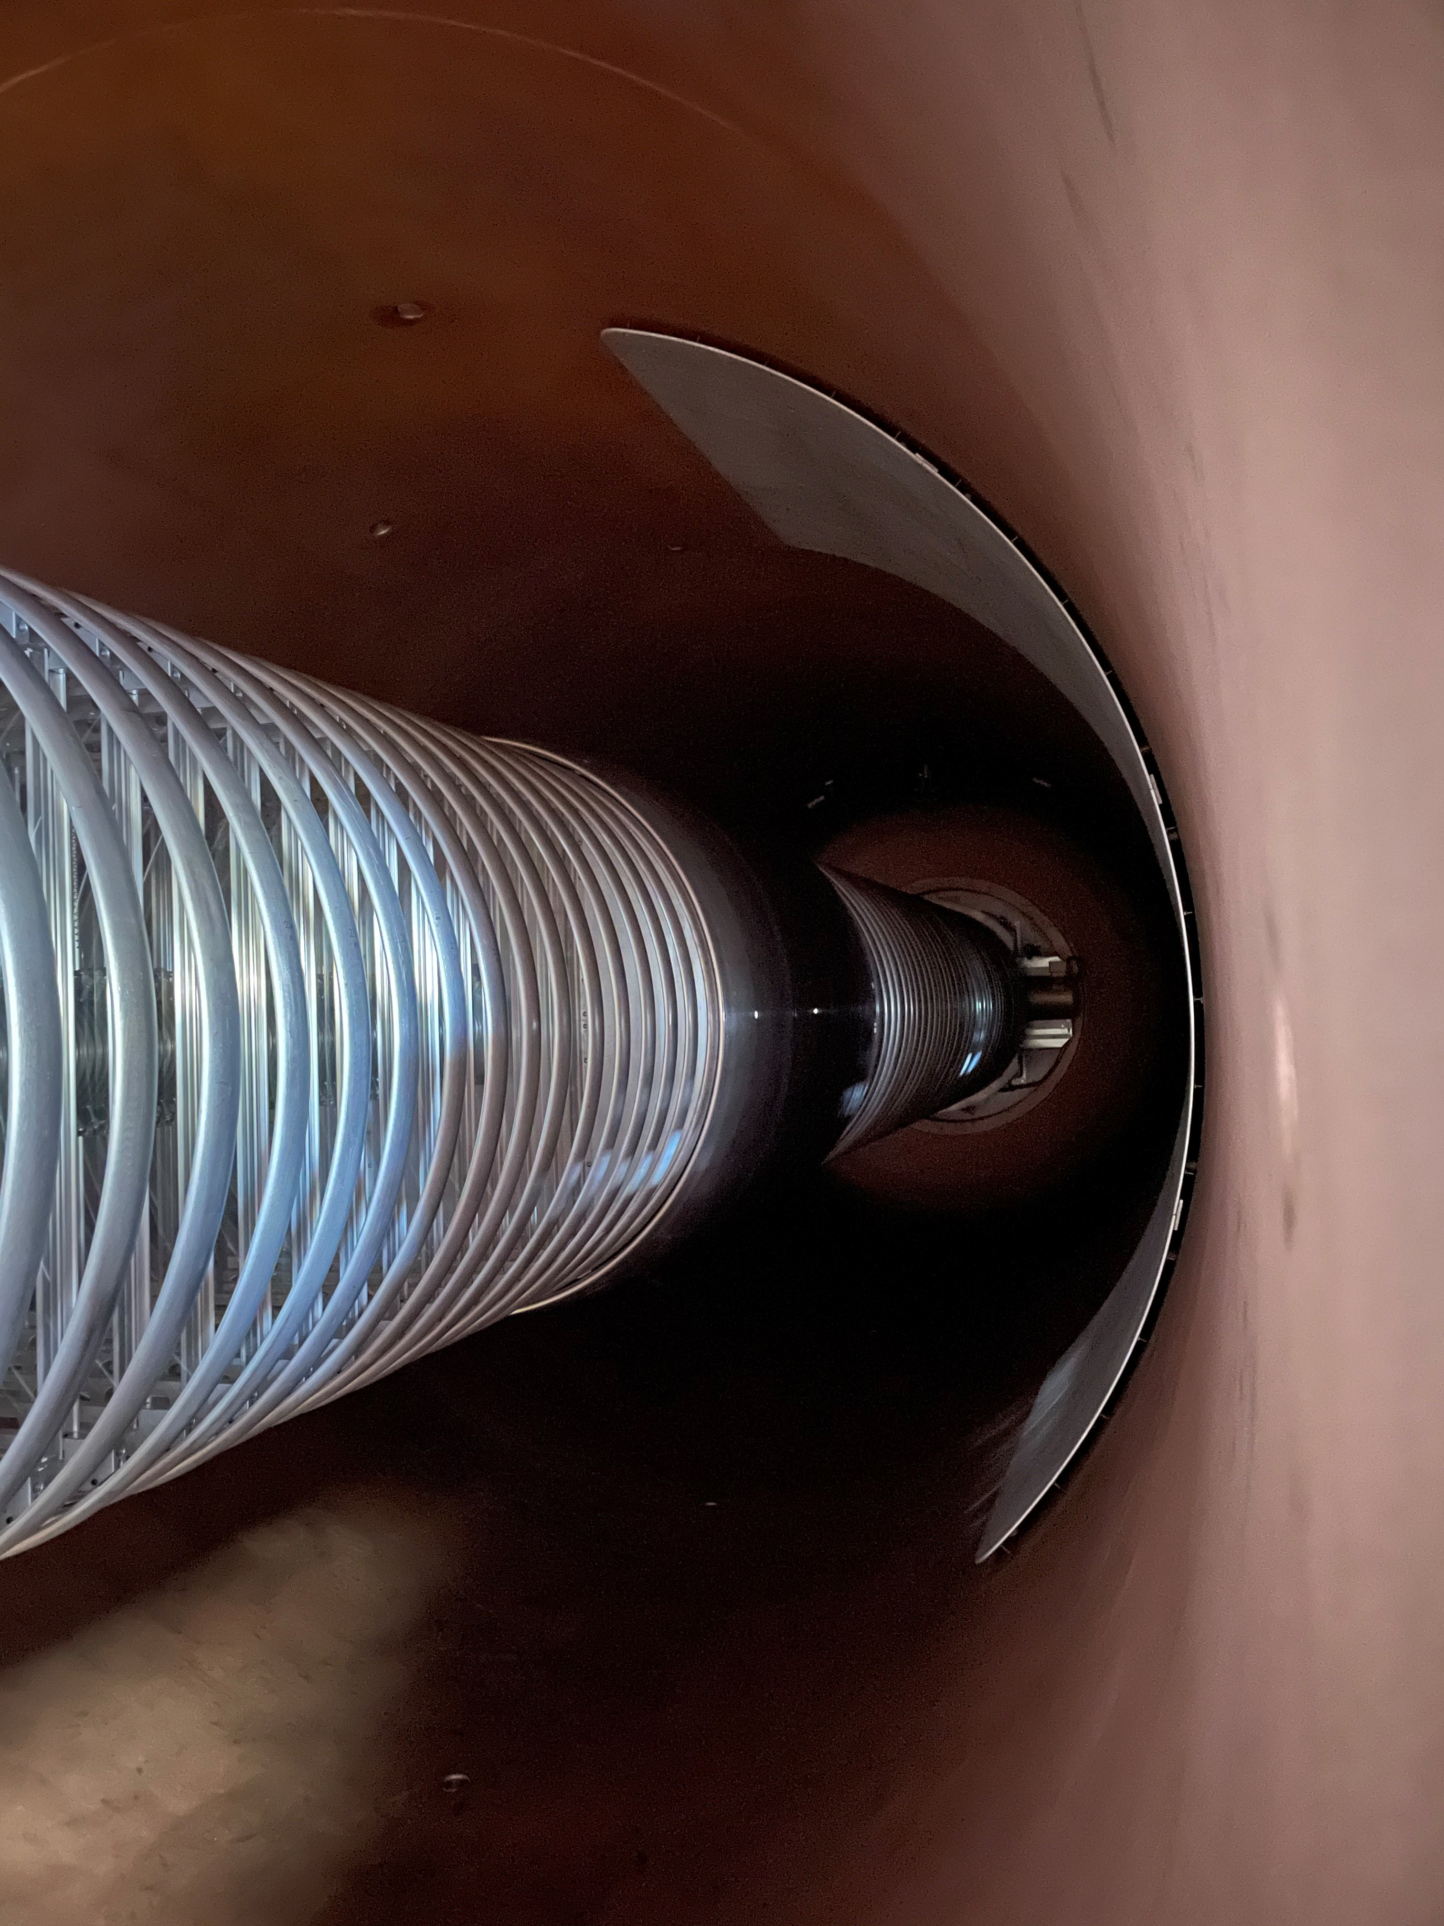
Liner
A liner is an insulated plate sitting opposite to the terminal which can push and pull the terminal capacitively driven by a bi-polar HV amplifier
The liner is suggested to be able to correct the terminal bandwidth of 100Hz

Slide 20
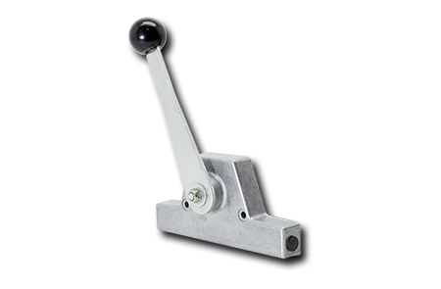
Regulation of Terminal Voltage
Stabilisation or Regulation of the terminal voltage is critical to the desire path the ions go through beam optic components such a magnets and electrostatic analysers which may also ensure that delivered beams to end-stations or detectors is of the correct energy and mass.
Terminal voltage fluctuation can lead to the beam moving left and right within magnetic bends, and not arrive on target, or within the physical window constraints of detectors etc.
There are typical 2 methods or levers in which the terminal voltage can be corrected;
Corona Loading + [Liner]
Change up charge to Terminal

Slide 21
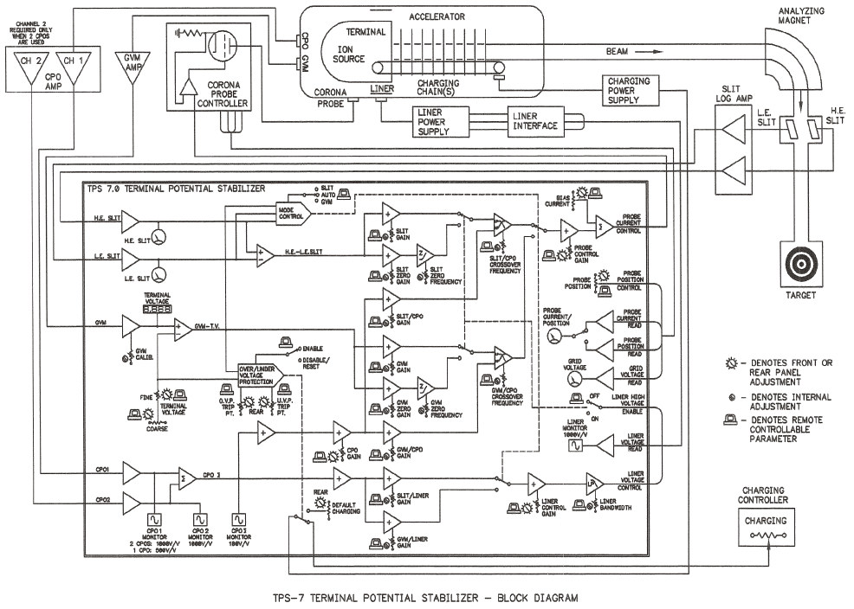
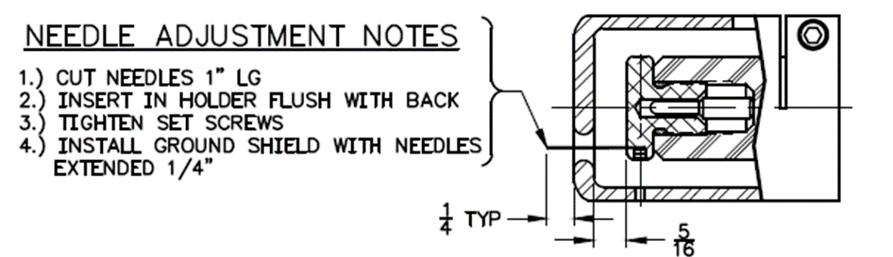
Terminal Potential Stabiliser
Terminal Potential Stabiliser (TPS)
Corona Prob Style Machines, Sirius and ANTARES

Slide 22



Conservation of charge
Charging Current
Set Level
Lost Current
Terminal Potential
Ion Beam Current
Leakage Current
Corona Current
Column Current

Slide 23
Conservation of charge
Charging Current
Set Level
Lost Current
Terminal Potential
Ion Beam Current
Leakage Current
Corona Current
Column Current

Slide 24
Conservation of charge
Example:
Charging Current
Set Level
Lost Current
Terminal Potential
Ion Beam Current
Leakage Current
Corona Current
Column Current

Slide 25
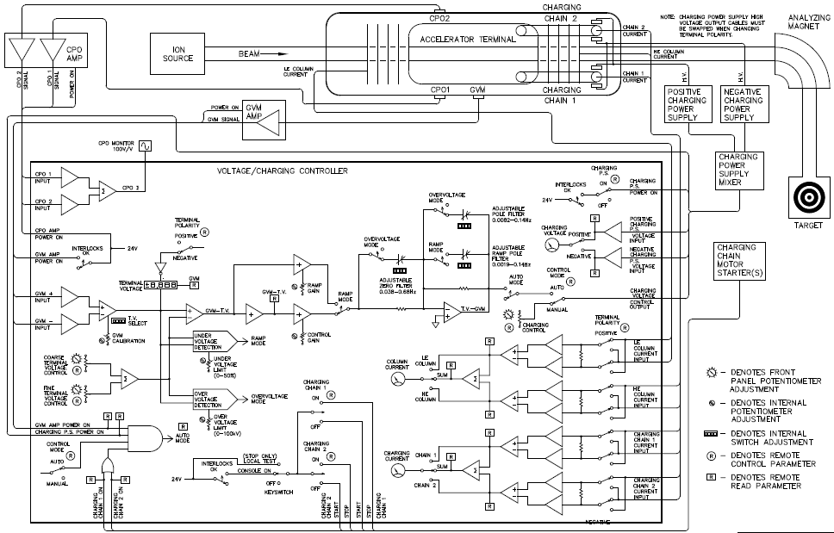
Voltage/Charging Controller
Charge Control systems used on Star and Vega
Note: Vega Example
Charge Controller

Slide 26
So what else can we do?
Firstly are our feedback signal responsive enough, and can we improve on these?
  Can the GVM provide a faster signal?
Corona control appears as been demonstrated to have inherent response delay in current transfer time.
Can another active element be used such as the Stripper Tube be modulated?
  What would a high speed telemetry system look like to achieve this?

Slide 27
Thanks
Don’t be strangers, feel free to visit us as ANSTO Lucas Heights ☺

Slide 28
Acknowledgement
Accelerator Systems Development Team
David Button
Philip Chatfield
Andrew Downes
David Garton
John Lawlor
Yasser Mafi Nejad
Michael Mann
Sam Micallef
Nikolas Paneras
Matthew Rees
Craig Thompson
Jian Wang
dbu@ansto.gov.au

