Slide 1
Bearings in Cryogenic Environments
Nick Herrald, David Chandler, John Hart (AITC, RSAA)
<number>
Notes:
<number>

Slide 2
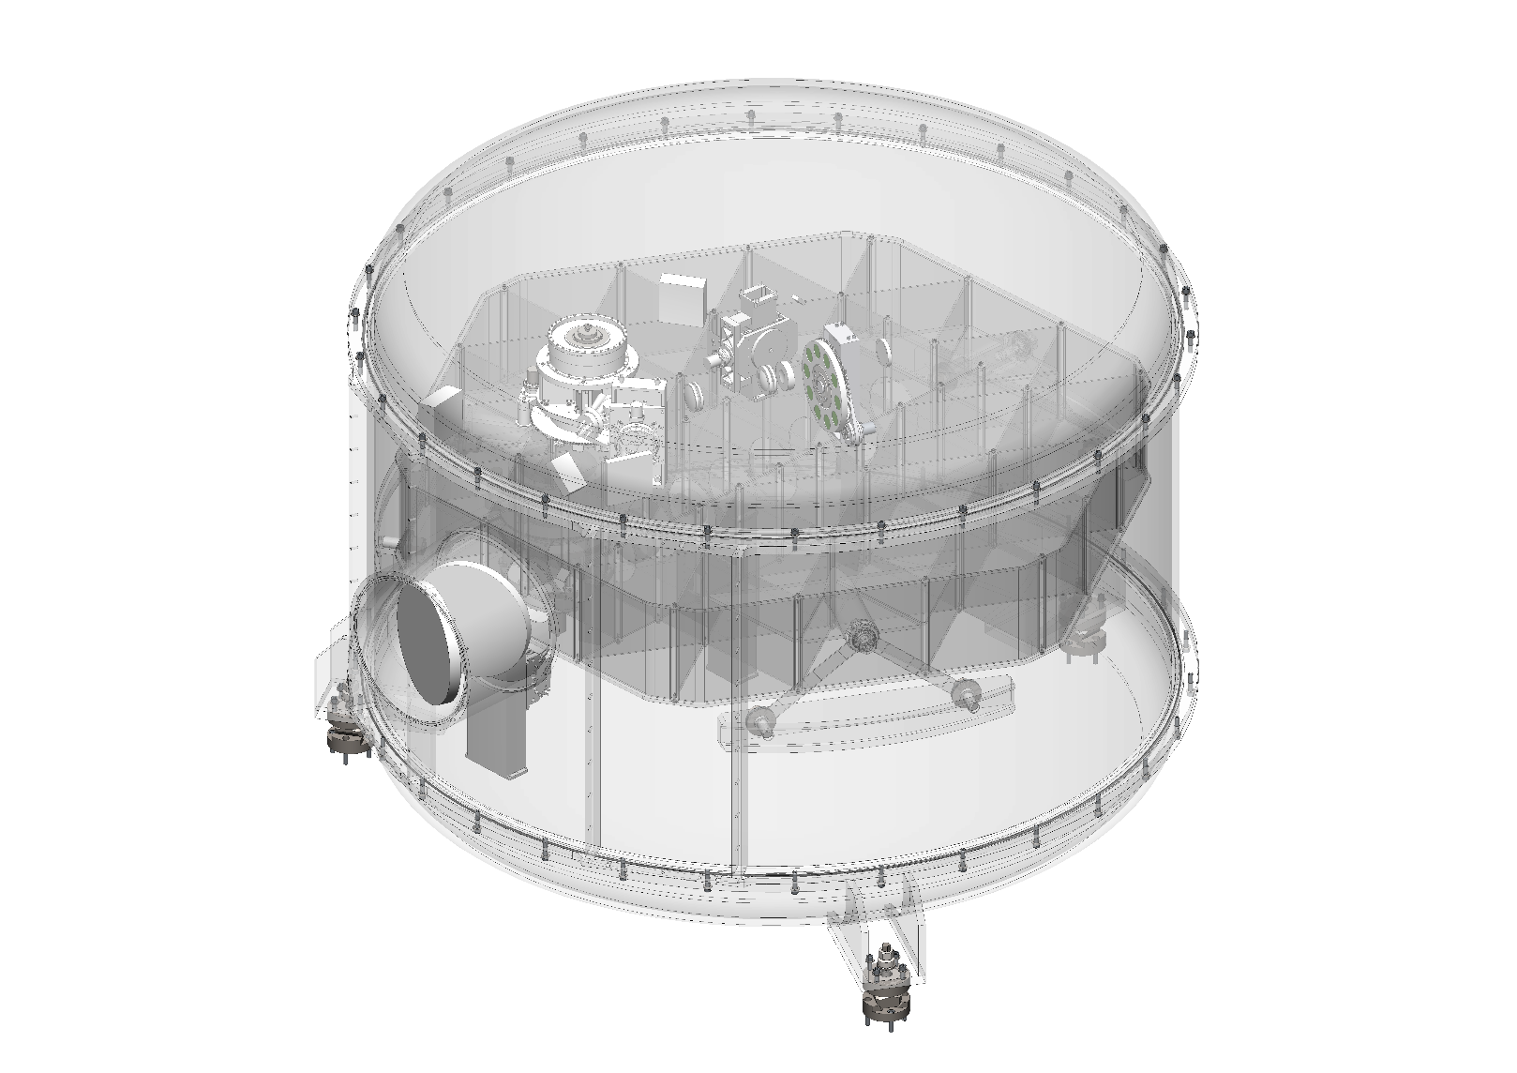
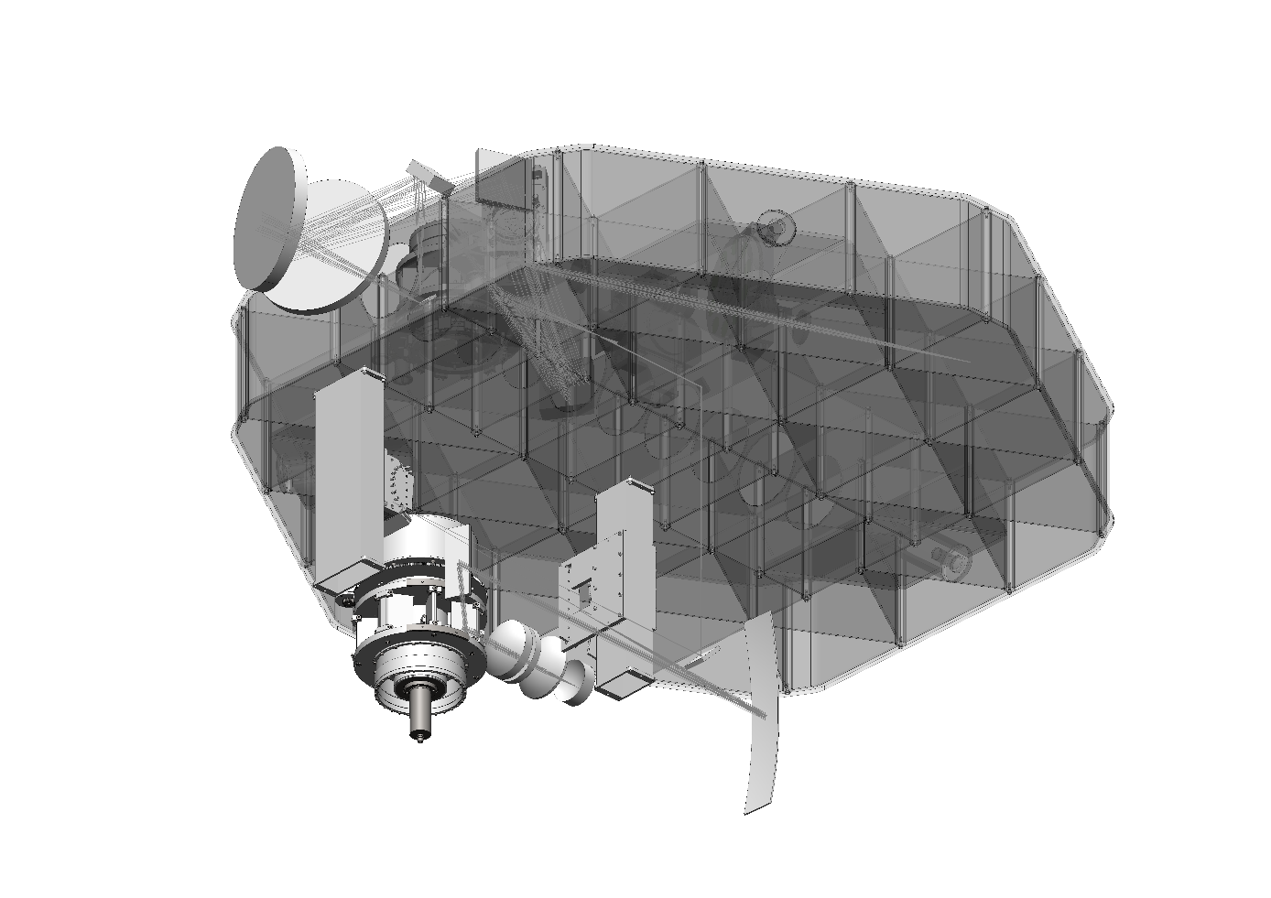
Cryogenic systems
<number>

Slide 3
Cryogenic lubrication
Molybdenum disulphide
Gold coating
Tungsten disulphide
Commonly used
Picks up water when exposed to atmosphere
Fragile
Ruby balls
Improved thermal conductivity
Thin and uniform film (1-2um)
Durable
Jean Louis Lizona, ESO
<number>

Slide 4
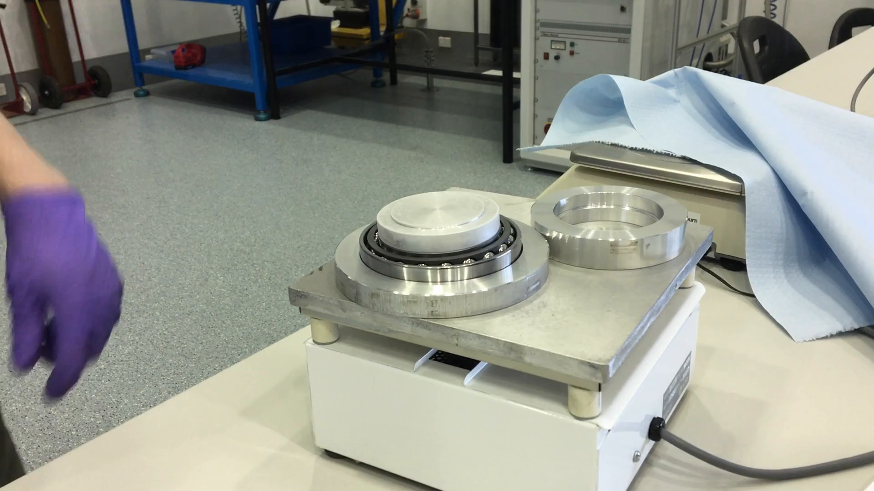
<number>

Slide 5
CTE mis-match
Integrated thermal strain, room temp to 70K
6061 Aluminium = -0.004 (typical housings)
304 Stainless Steel = -0.0028 (bearings)
100mm bearing H7 fit ~35um clearance
BUT:
Thermal strain on 100mm housing = -120um ☹
(Even worse for harder bearing steels)
<number>

Slide 6
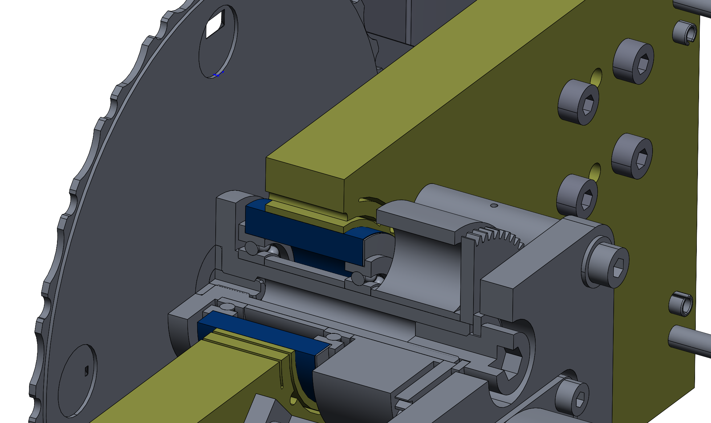

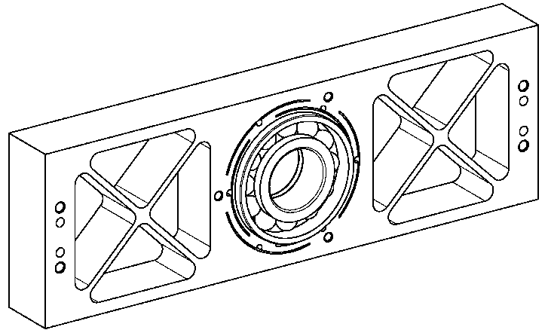
Athermalisation techniques
Symmetric arrangement of beam flexures
Thin inner ring absorbs thermal strain
<number>

Slide 7
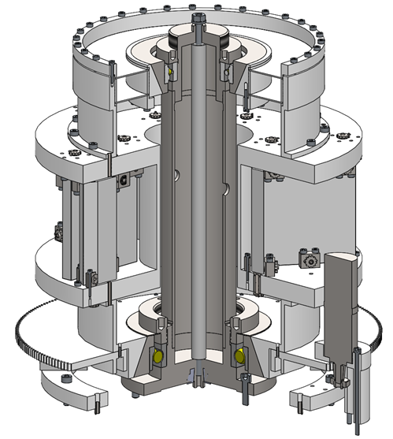
Cone vertices coincident: Anchor point
Dis-similar materials “slip” radially
(i.e. along cone surface)
Diametrical contraction matches longitudinal contraction, bearing pre-load is maintained, carousel centre position maintained
<number>

Slide 8
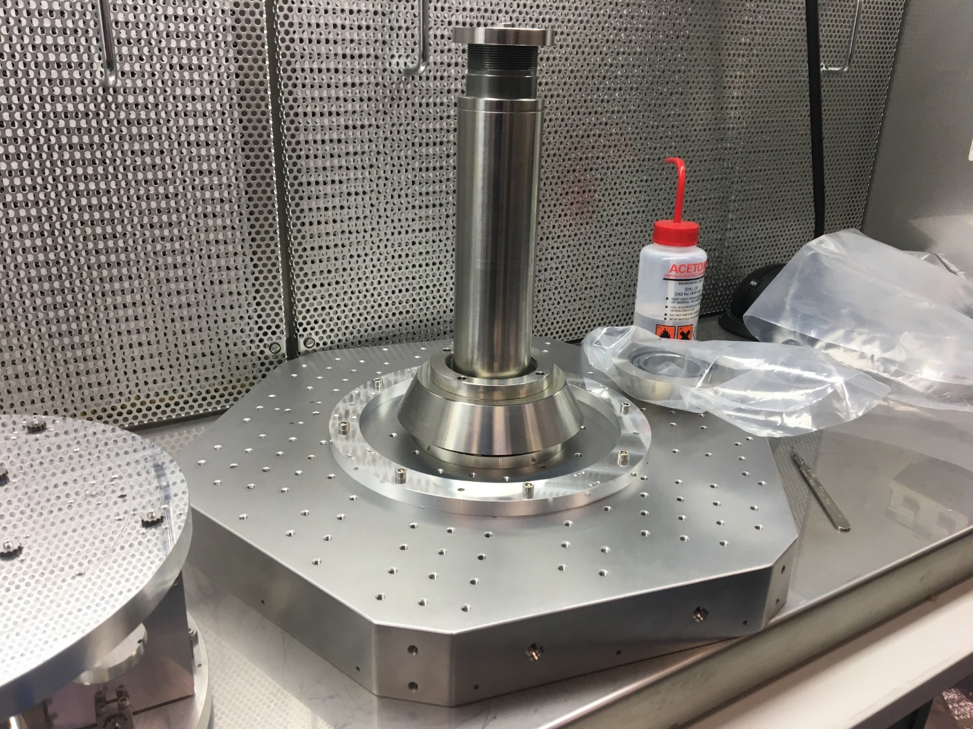
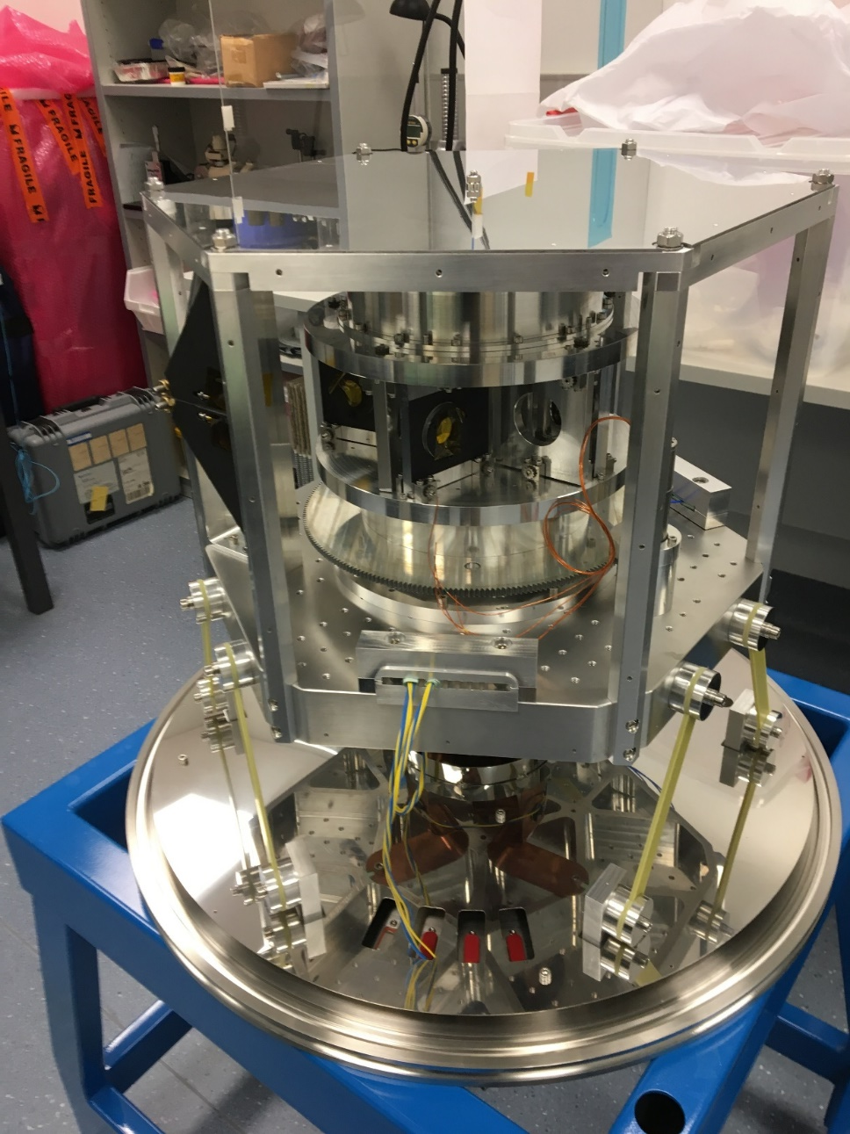
<number>

Slide 9
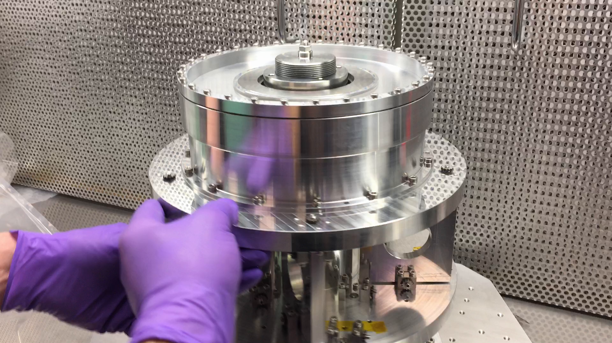
<number>

