Slide 1
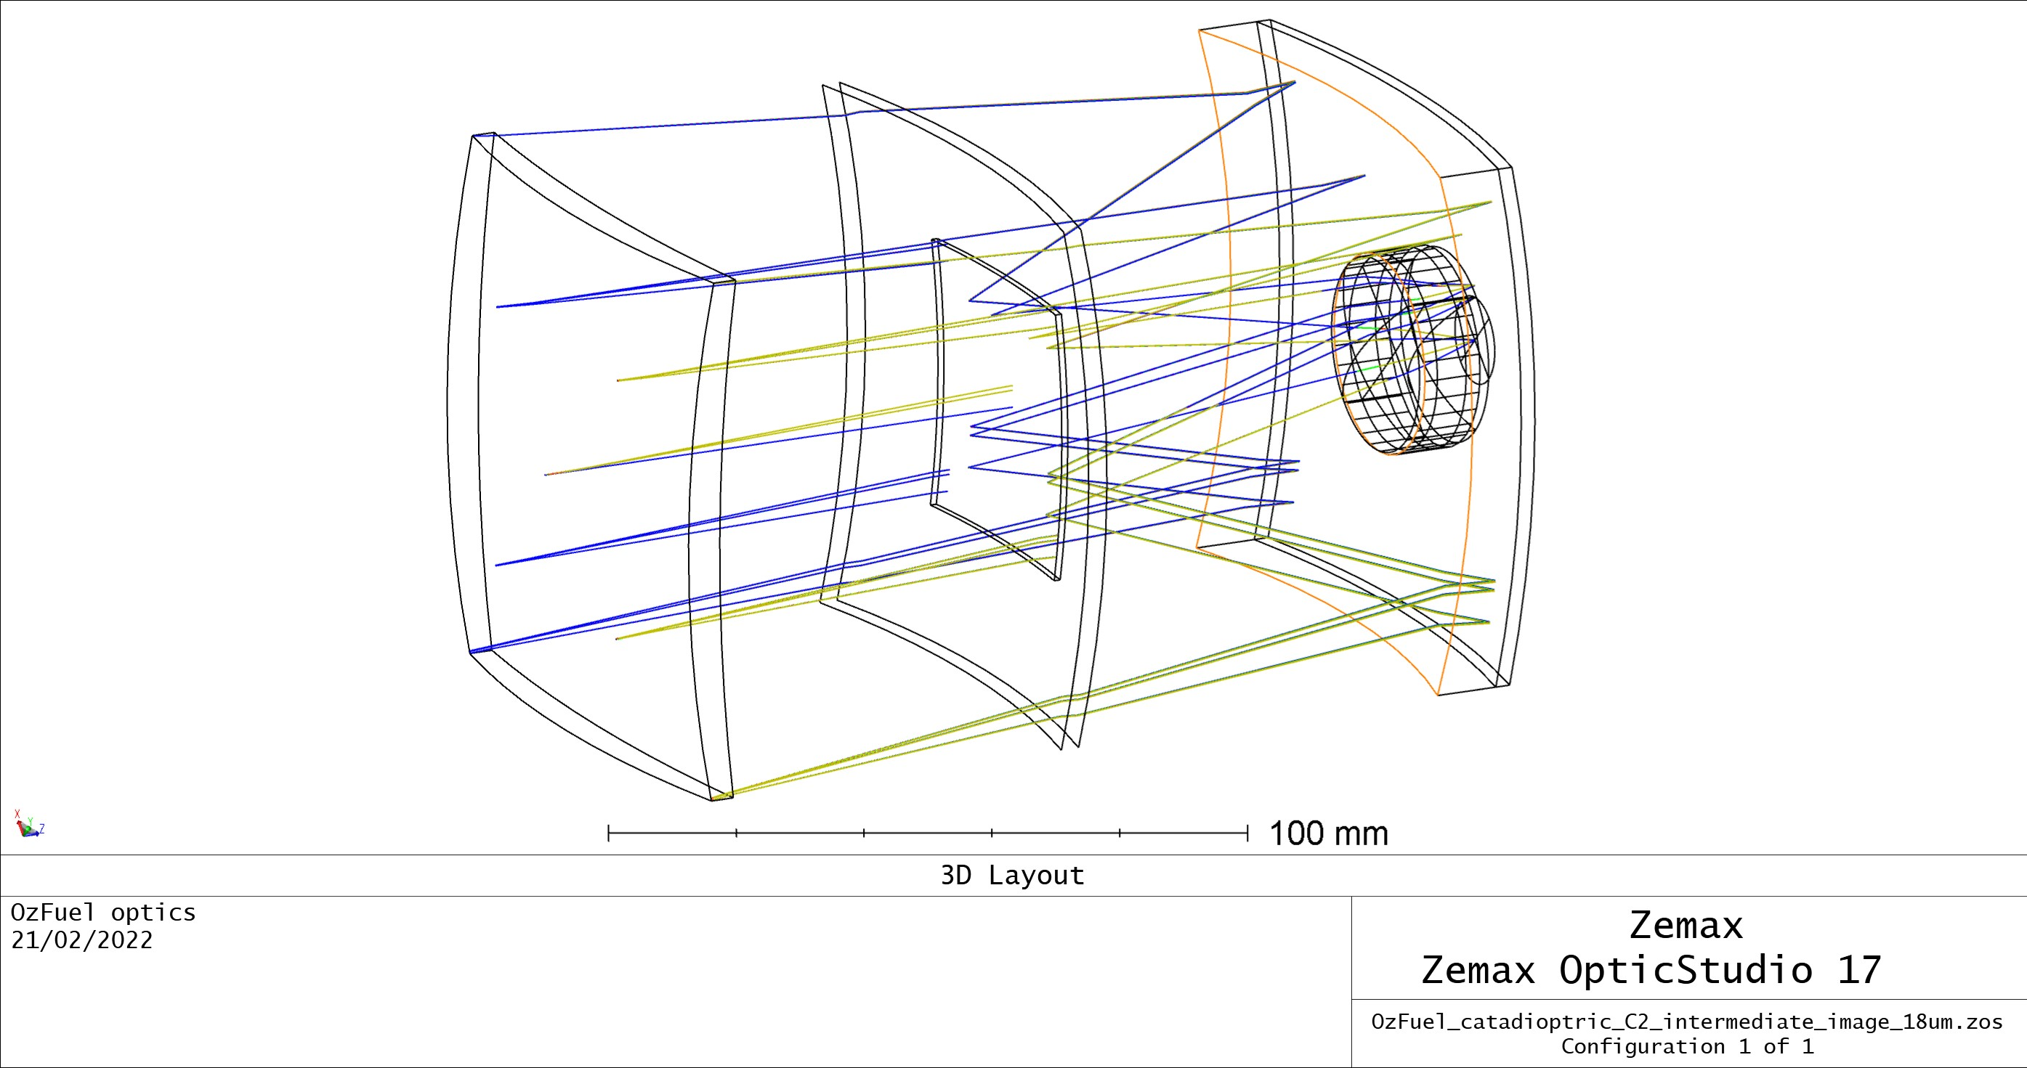
Optical Engineering
  An overview
  Israel Vaughn
  AITC@Mt Stromlo
  israel.vaughn@anu.edu.au
  Jamie Soon, Andy Kruse, Tony Galla,
  Jamie Gilbert, Rob Sharp, David Brodrick,
  Warrick Schofield, David Brodrick,
  David Chandler, Dionne Haynes

Slide 2
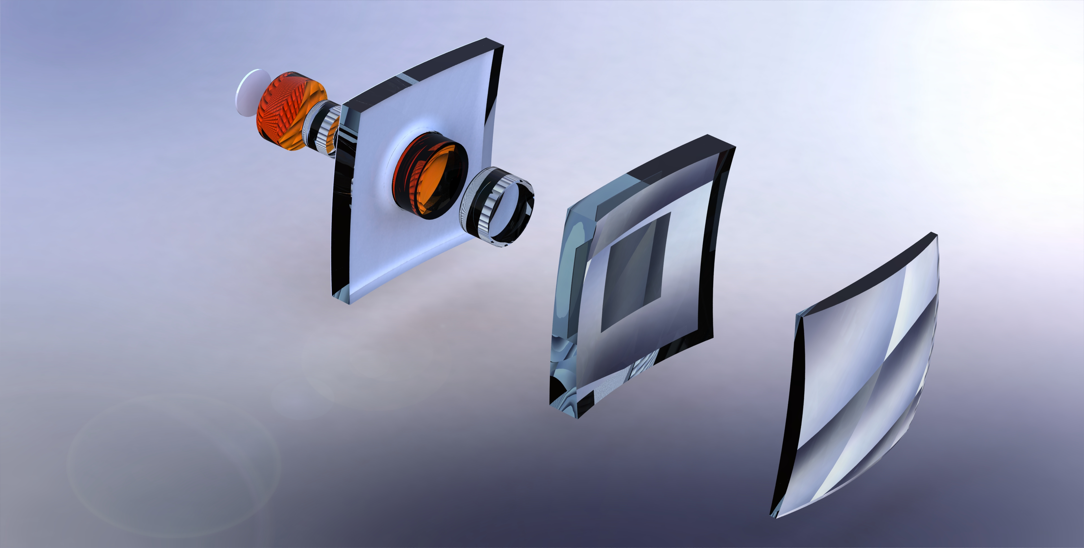

Slide 3
Summary
1 | Engineering Light
2 | Optical Design
3 | Optical Tolerancing
4 | Tips, tricks, and lessons learned

Slide 4
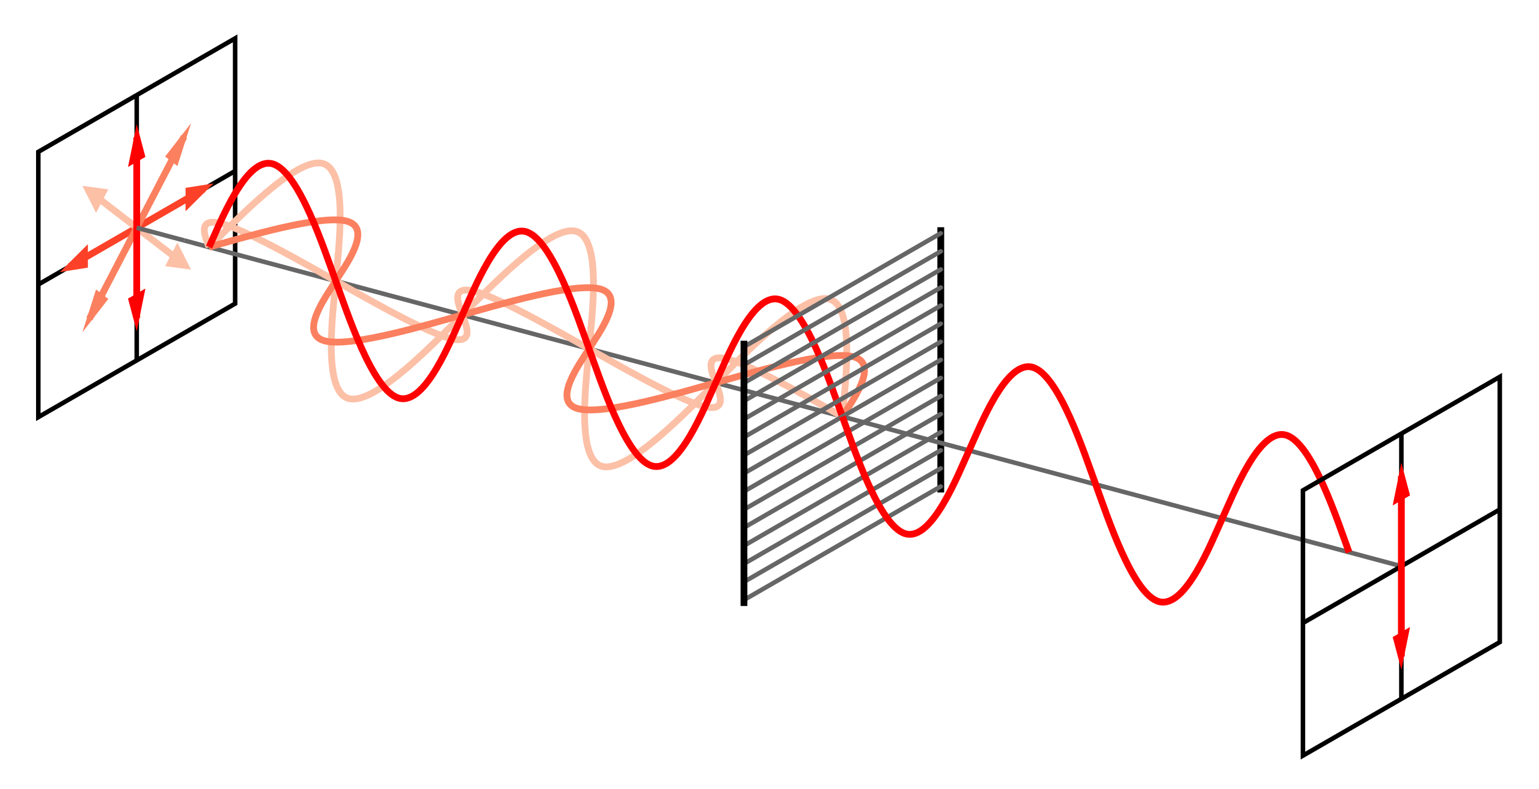
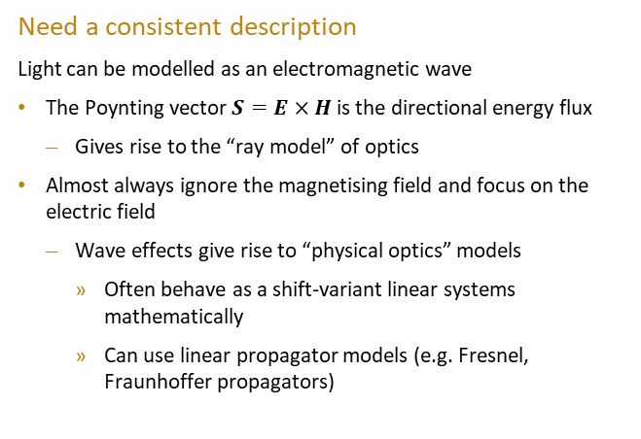
Engineering Light
Need a consistent description
  Light can be modelled as an electromagnetic wave
    The Poynting vector $S=E×H$ is the directional energy flux
      Gives rise to the “ray model” of optics
    Almost always ignore the magnetising field and focus on the electric field
      Wave effects give rise to “physical optics” models
        Often behave as a shift-variant linear systems mathematically
        Can use linear propagator models (e.g. Fresnel, Fraunhoffer propagators)
Credit: Wikipedia
Notes:
In the classical (non-quantum) description. H is magnetising field.

Slide 5
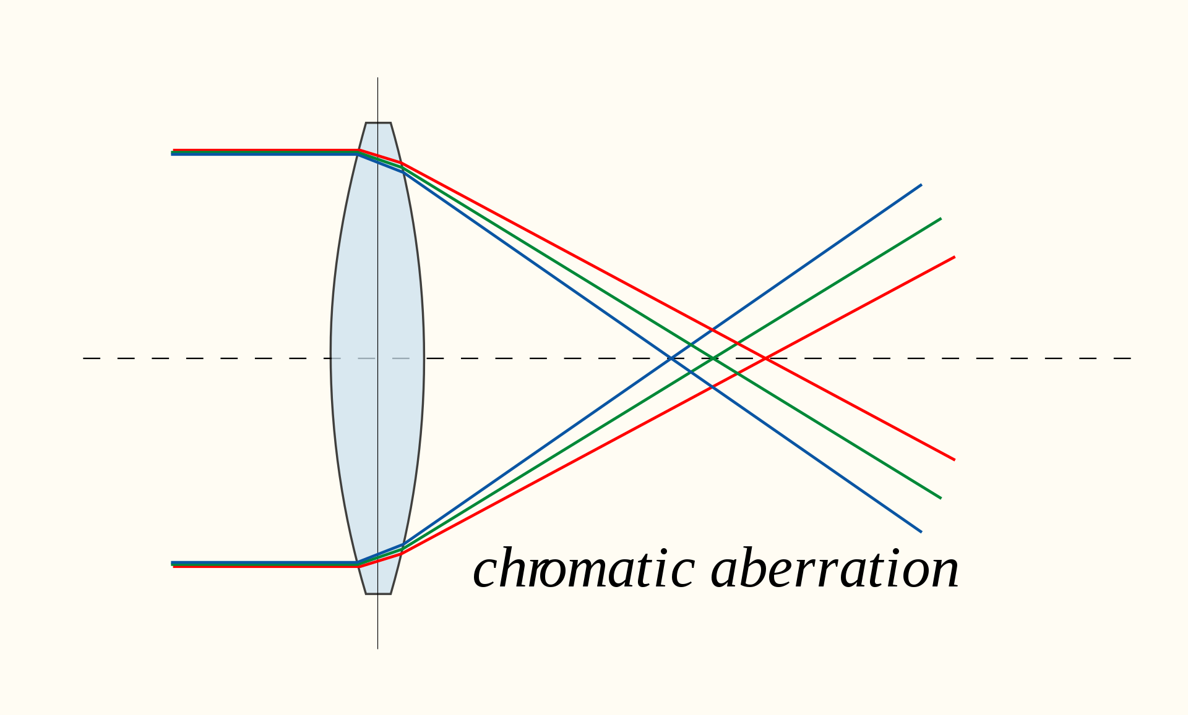
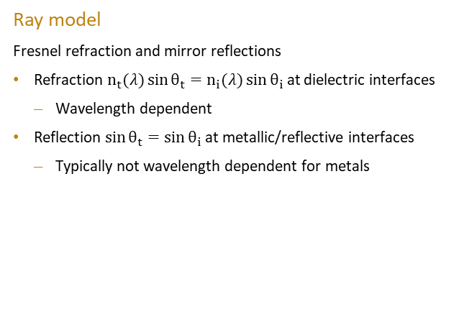
Engineering Light
Ray model
  Fresnel refraction and mirror reflections
    Refraction $n_{t}(λ)\sin{θ_{t}}=n_{i}(λ)\sin{θ_{i}}$ at dielectric interfaces
      Wavelength dependent
    Reflection $\sin{θ_{t}}=\sin{θ_{i}}$ at metallic/reflective interfaces
      Typically not wavelength dependent for metals
Credit: Wikipedia
Notes:
Notice the dependence on wavelength

Slide 6
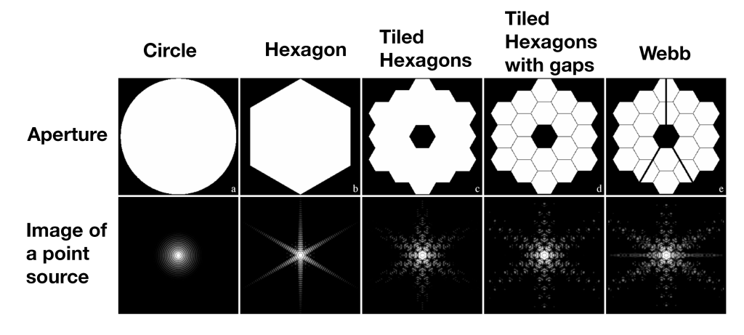
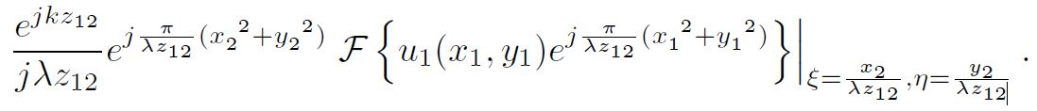
Engineering Light
Physical model
  Uses linear propagators and integrates over the electric field in a suitable way to accurately model physical reality
    Fresnel
      Coherence dependent
      Fourier transform like relationship
    Typically use ray model through elements like lenses, physical model for apertures or laser propagation
Credit: R. B. Makidon, S. Casertano, C. Cox & R. van der Marel, STScI/NASA/AURA

Slide 7
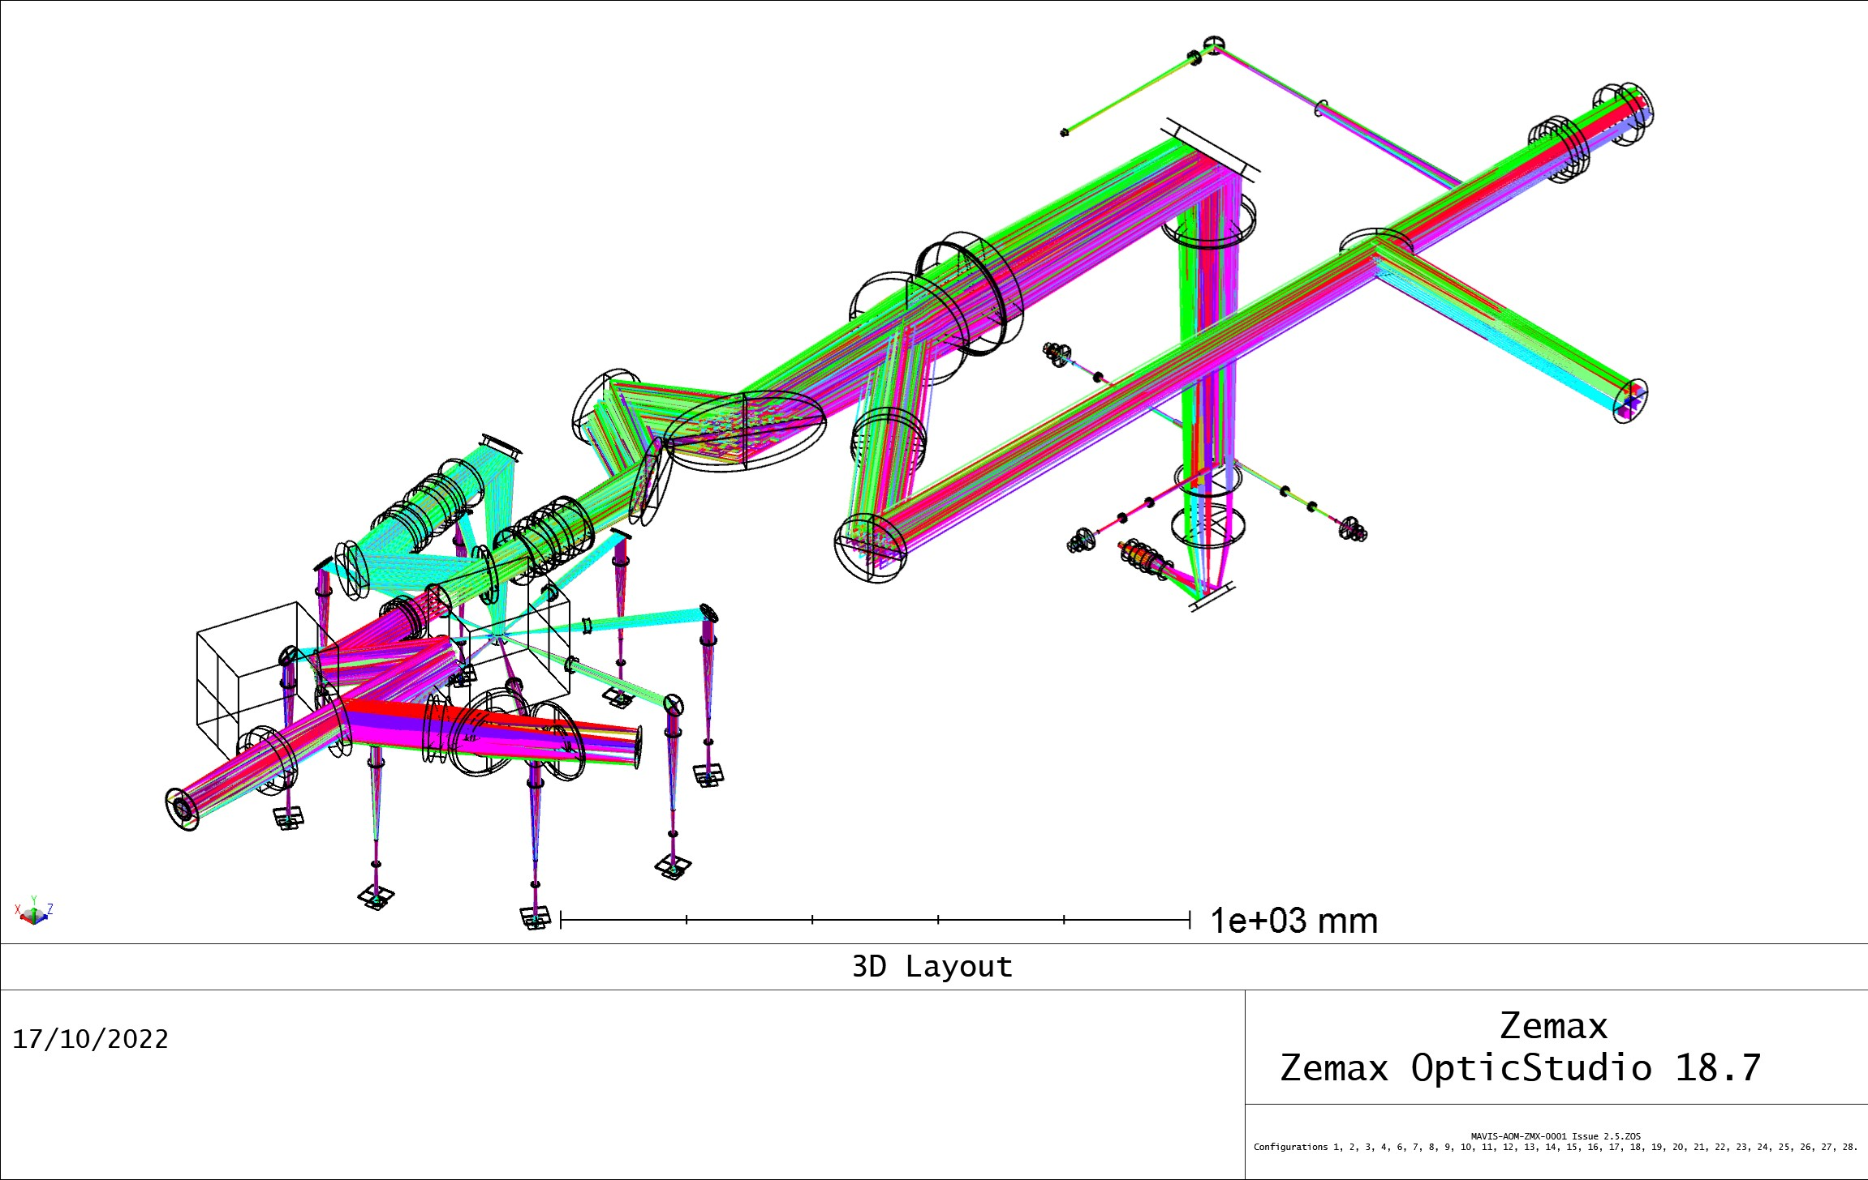
Optical Design
Design a manufacturable optical system which achieves a specific goal to within specific performance criteria.
  Covers many types of systems
    Cameras and telescopes
    Spectrographs, hyperspectral imagers, monochromators, multispectral, dispersion correction
    Illumination systems
    Lasers, etalons, cavity design
    Laser beam conditioning, beam propagation, adaptive optics, structured light remote sensing
    Optical tomographic systems (light is holographic)
    X-ray sensing systems
    Polarisation and polarimetric sensing
Credit: AITC

Slide 8
Optical Design
Design a manufacturable optical system which achieves a specific goal to within specific performance criteria.
  Covers many types of systems
    Cameras and telescopes
    Spectrographs, hyperspectral imagers, monochromators, multispectral, dispersion correction
    Illumination systems
    Lasers, etalons, cavity design
    Laser beam conditioning, beam propagation, adaptive optics, structured light remote sensing
    Optical tomographic systems (light is holographic)
    X-ray sensing systems
    Polarisation and polarimetric sensing
Credit: AITC

Slide 9
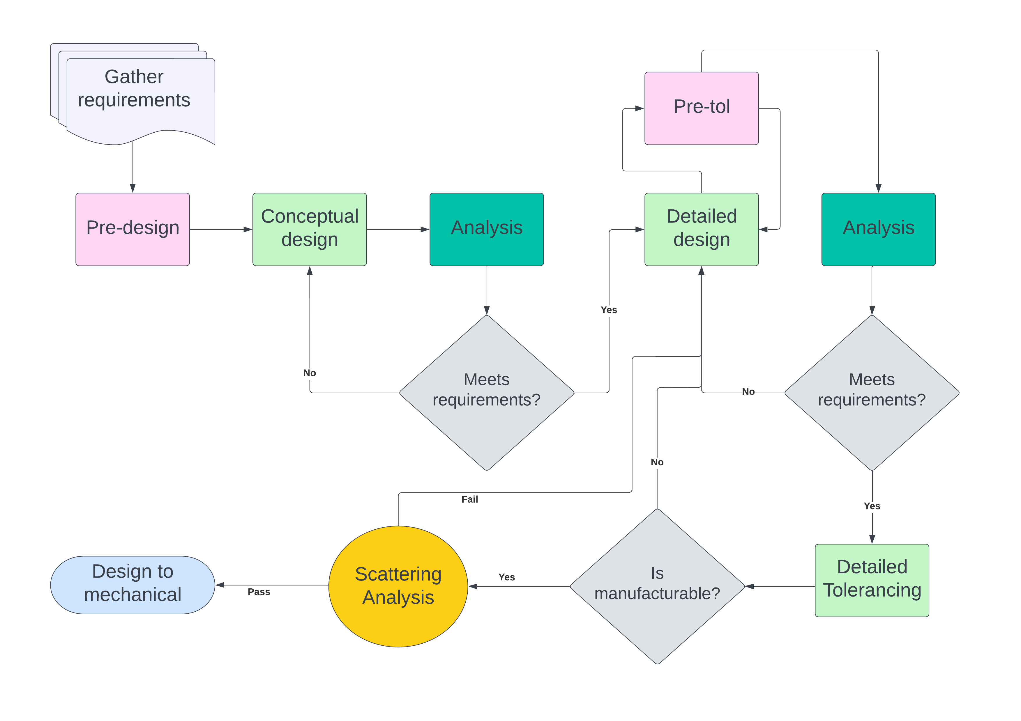
Optical Design
Process
    Ensure requirements and goals are clear (MBSE)
    Pre-design/design form/tradeoffs
    Conceptual design
    Analysis (and iterate)
    Detailed design (tolerance aware if possible)
    Detailed analysis (and iterate)
    Detailed tolerancing (and iterate)
    Scattering analysis
    Give design to mechanical (and usually iterate)
Credit: AITC

Slide 10
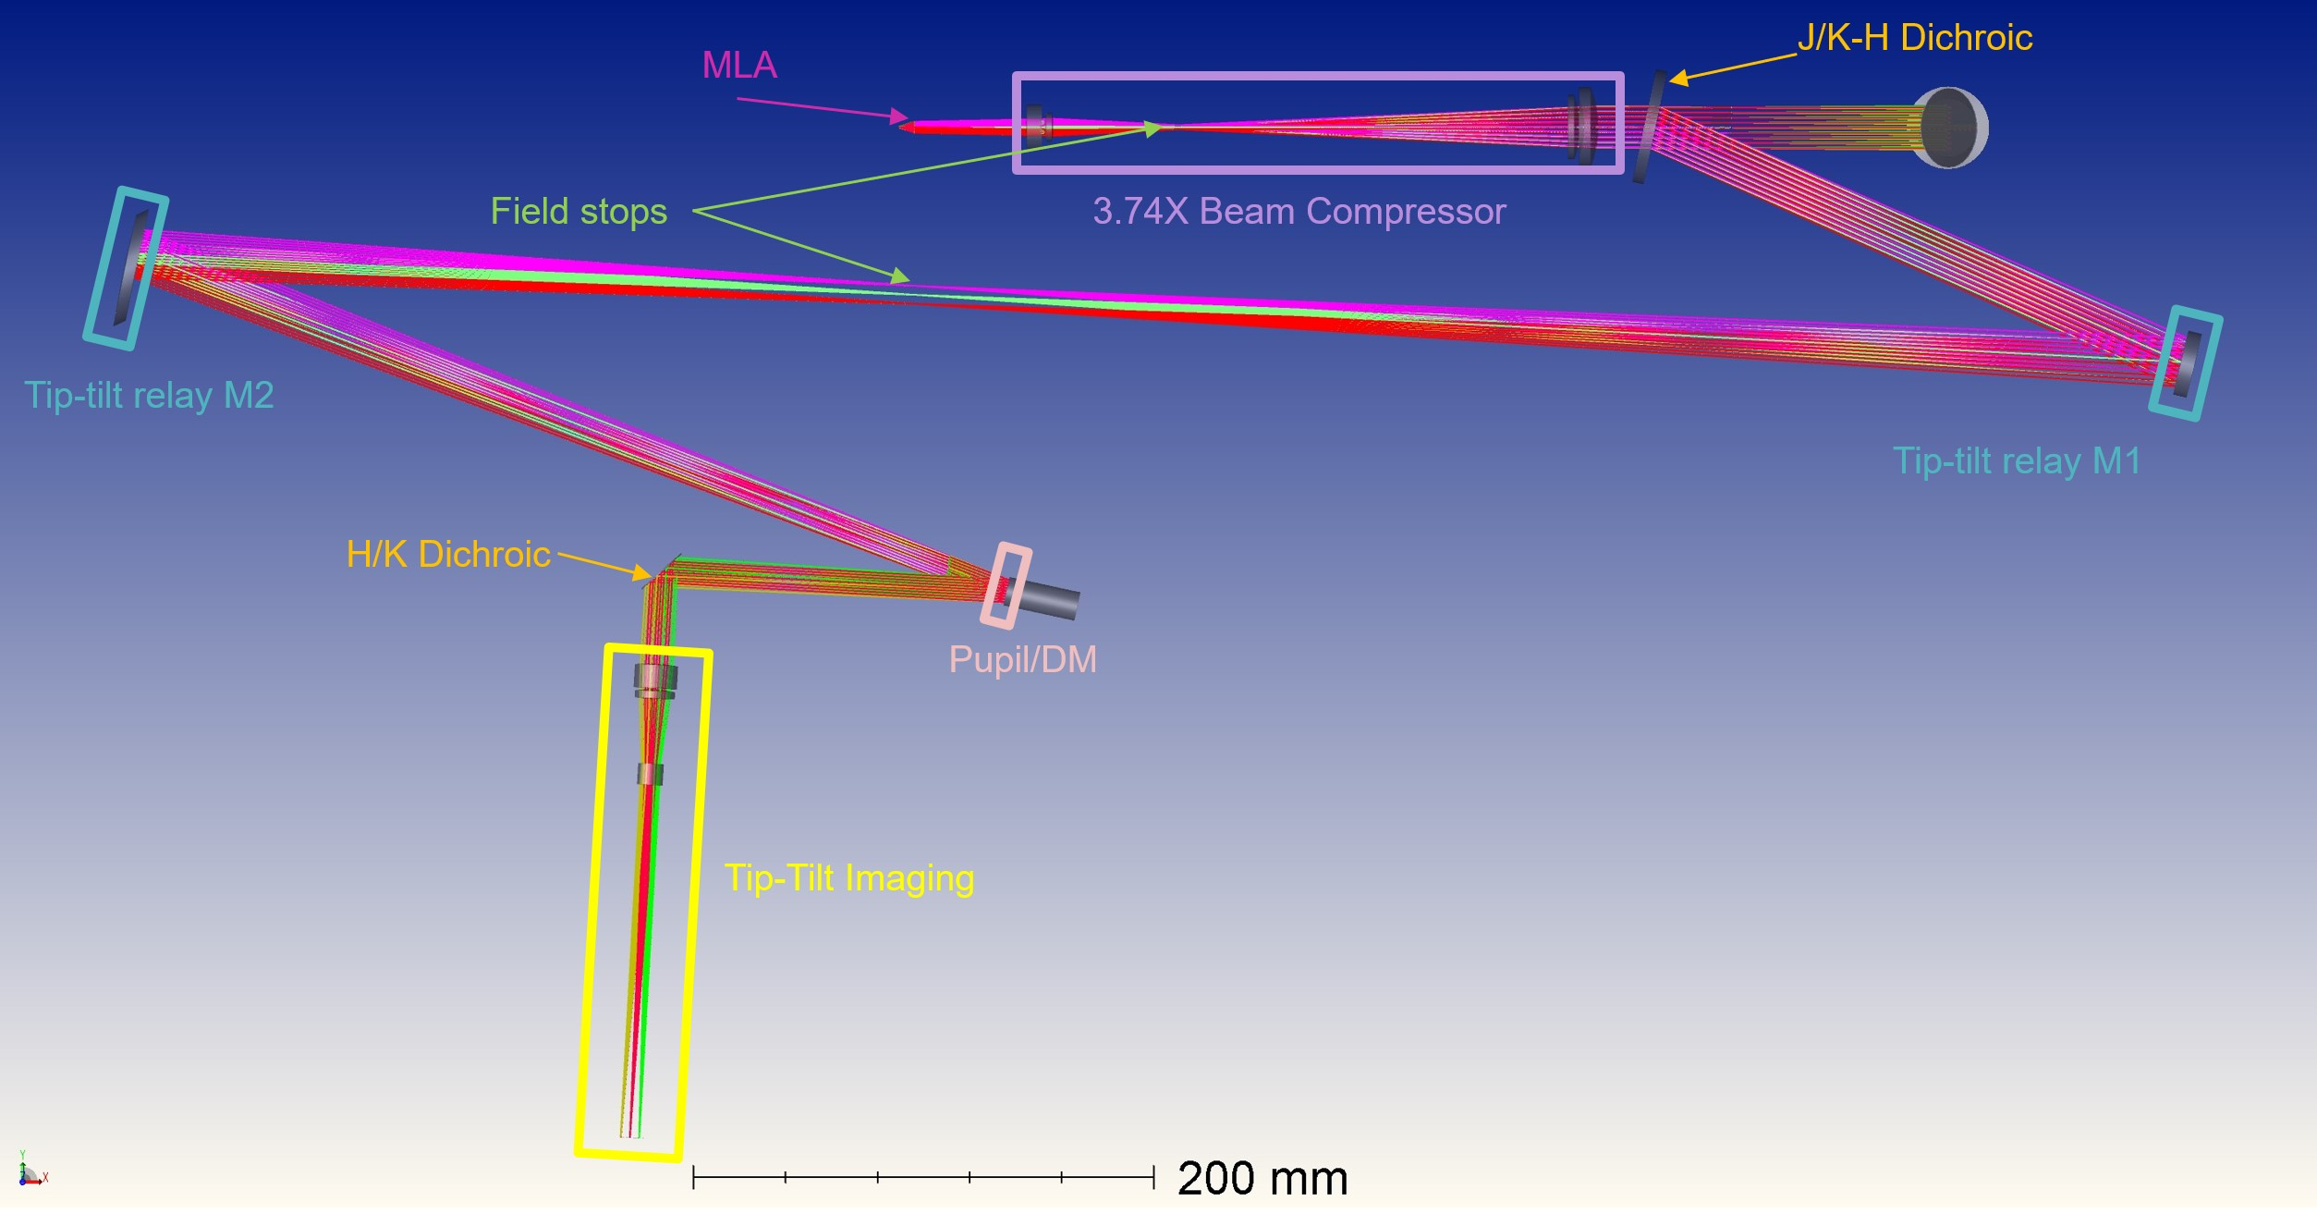
Optical Design
Optical ray-tracing software
  Industry is small, major packages
    Zemax (now ANSYS) OpticsStudio
    Code V
    FRED
    OSLO
    TracePro
    ASAP
Credit: AITC

Slide 11
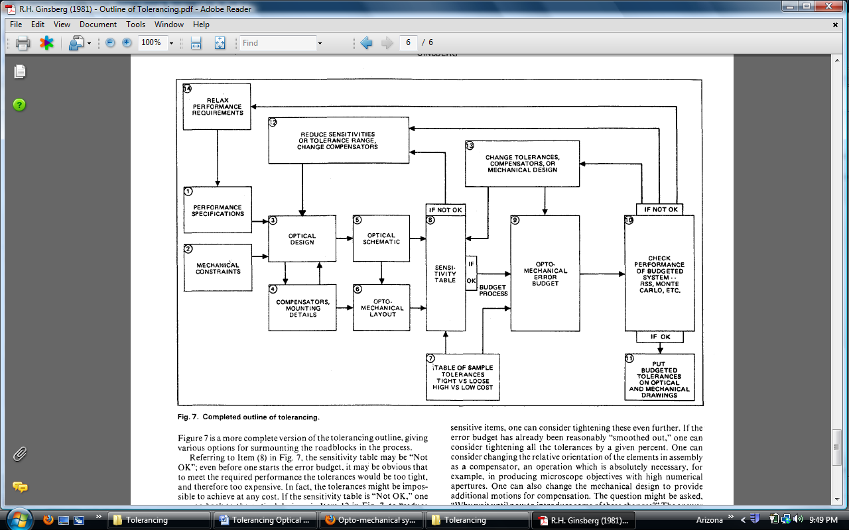
Optical Tolerancing
One of the most important design phases
  Downstream impacts on
    Optical element manufacturing cost
    Mechanical design and tolerances
    Mechanical manufacturing cost
    Performance
Credit: Ginsburg (1981)
Notes:
Exponential cost function on the tight tolerance end

Slide 12
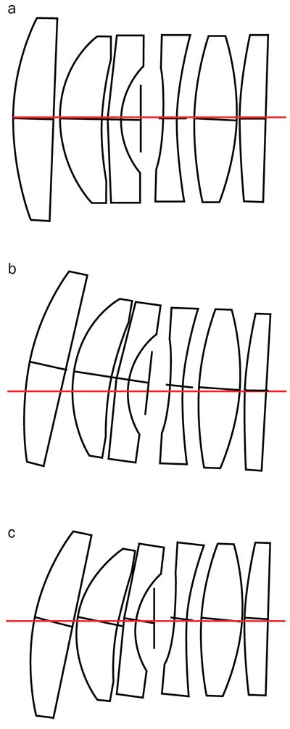
Optical Tolerancing
One of the most important design phases
  Downstream impacts on
    Optical element manufacturing cost
    Mechanical design and tolerances
    Mechanical manufacturing cost
    Performance
Credit: Schwertz and Ament

Slide 13
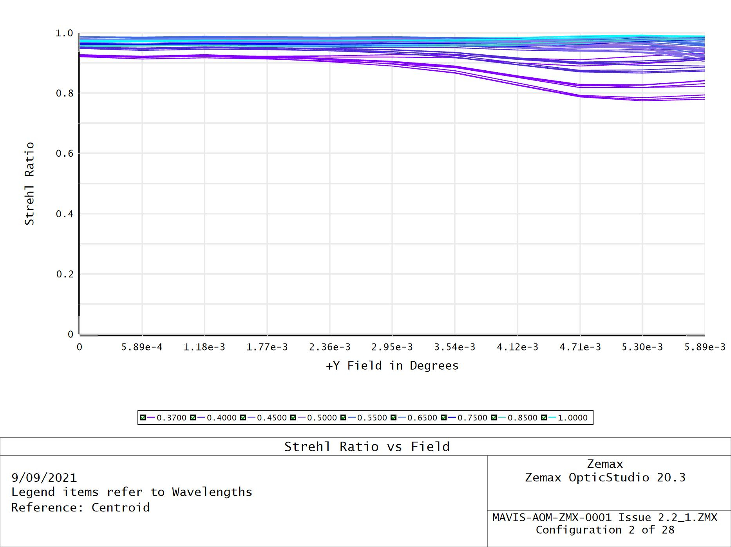
Optical Tolerancing
One of the most important design phases
  Downstream impacts on
    Optical element manufacturing cost
    Mechanical design and tolerances
    Mechanical manufacturing cost
    Performance
Credit: AITC
Notes:
Run statistical tolerancing analysis, monte carlo

Slide 14
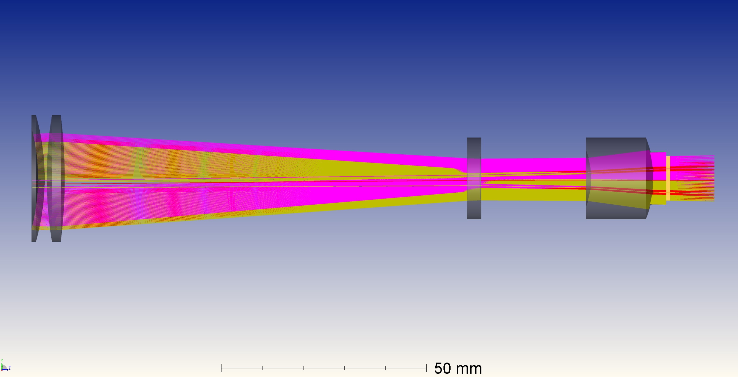
Optical Tolerancing
Tolerance aware design
  Optimise design incorporating tolerances
    Write optimisation cost functions that account for sensitivity (i.e. loosen tolerances)
    Takes more time during detailed design phase
    Saves in downstream costs
      Manufacturing costs
      Mechanical design difficulty
    Experience is required to find computationally tractable ways to do this
    New tools like machine learning may provide better/faster tolerance aware design methods
Credit: AITC

Slide 15
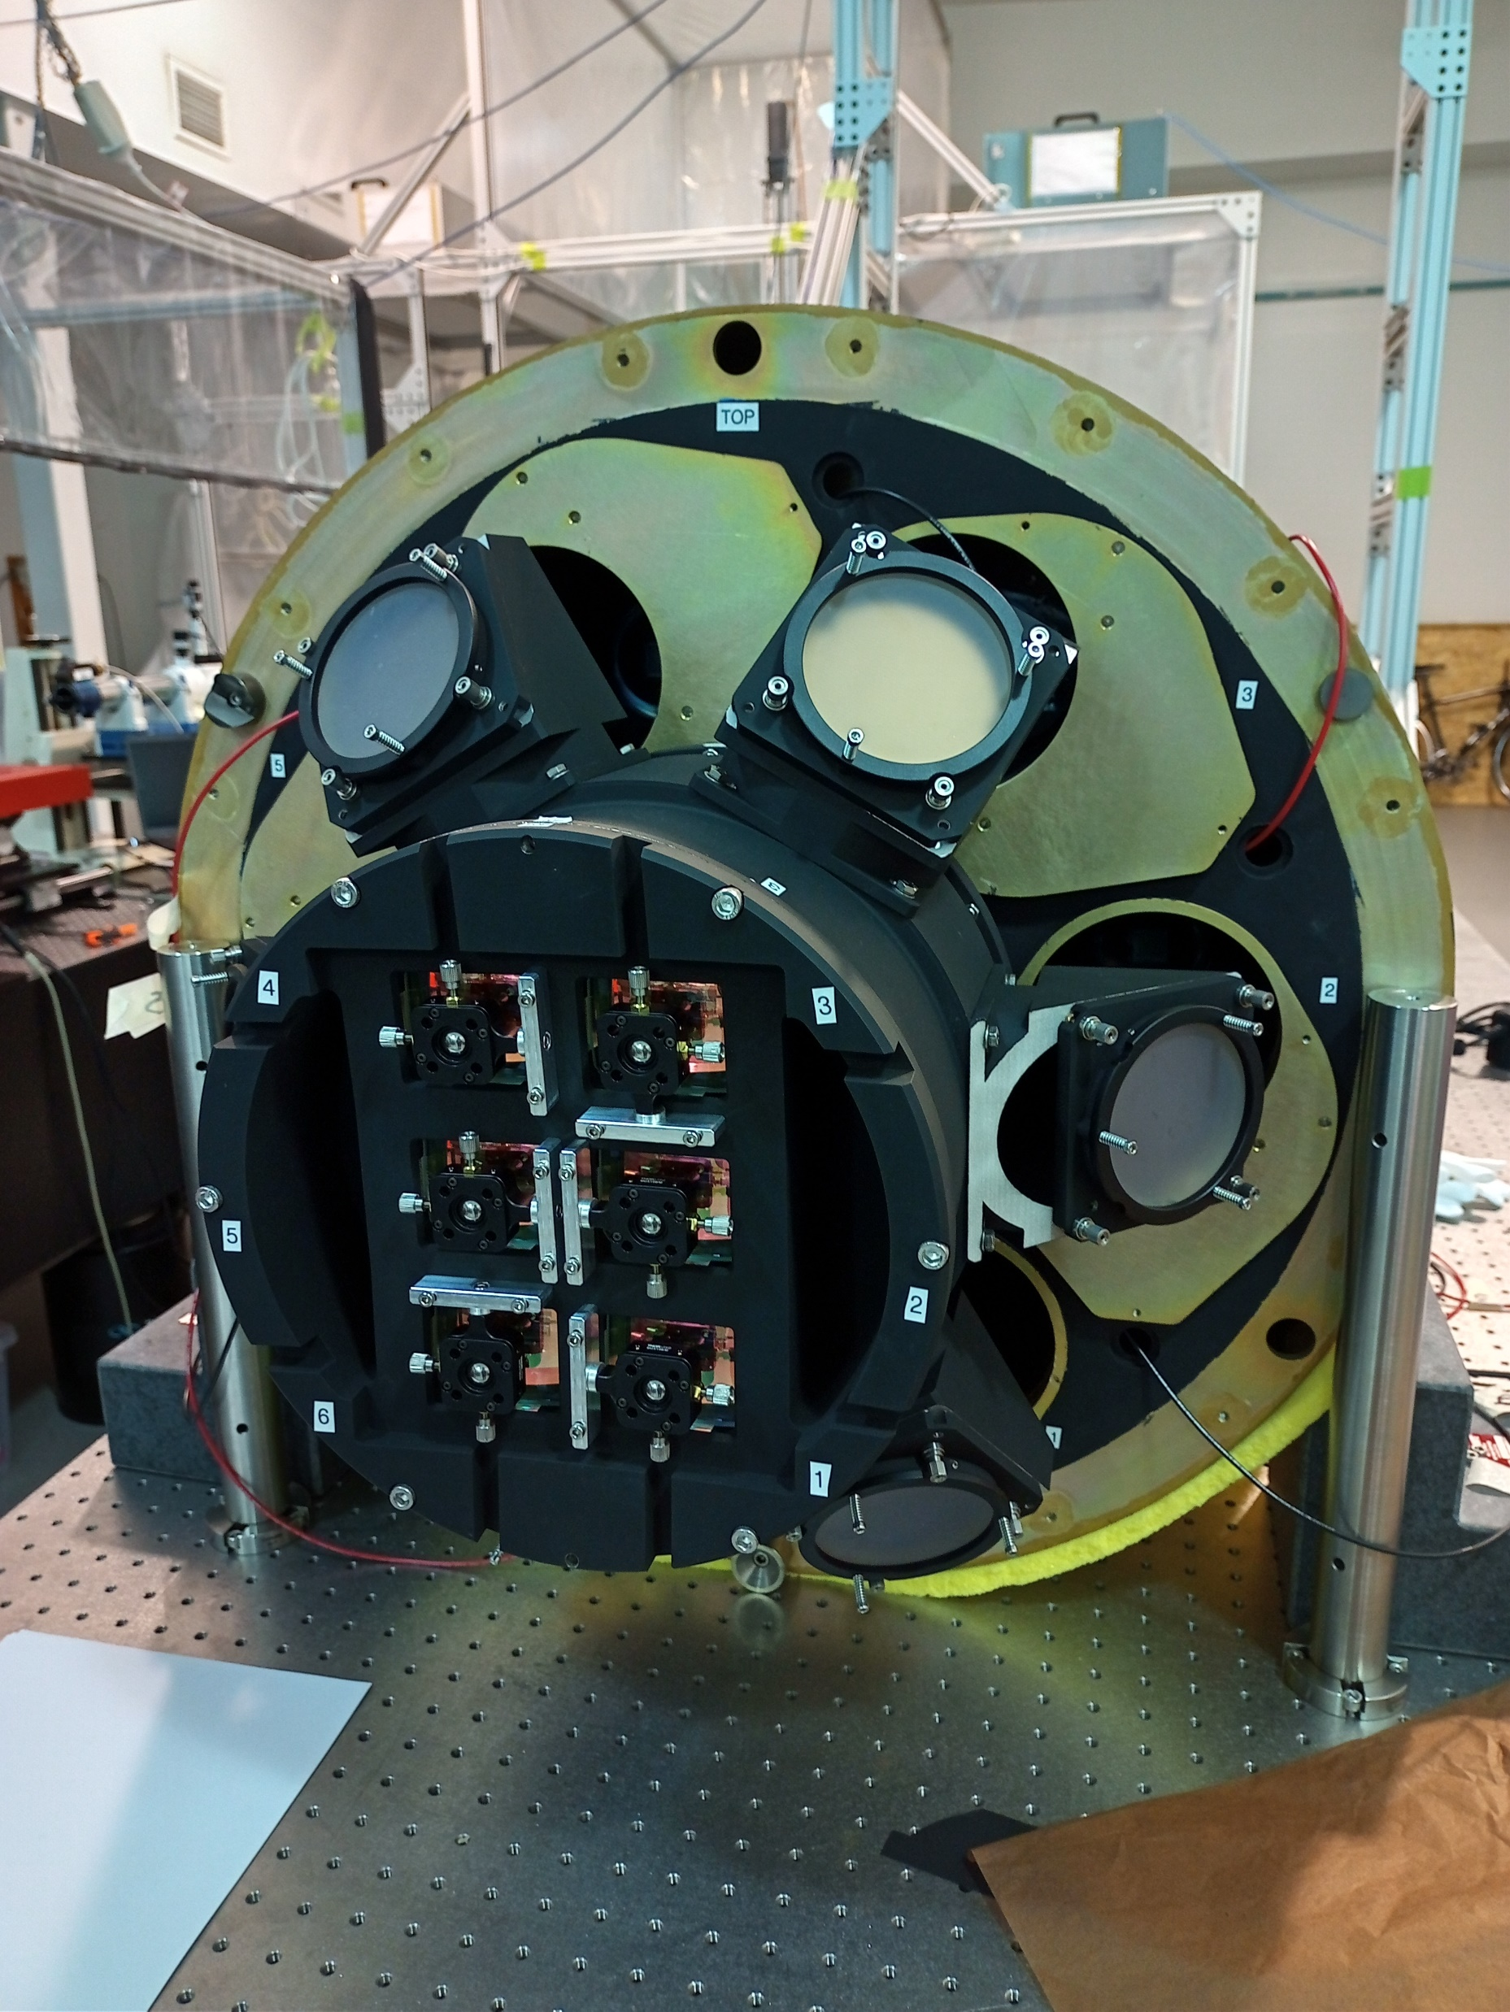
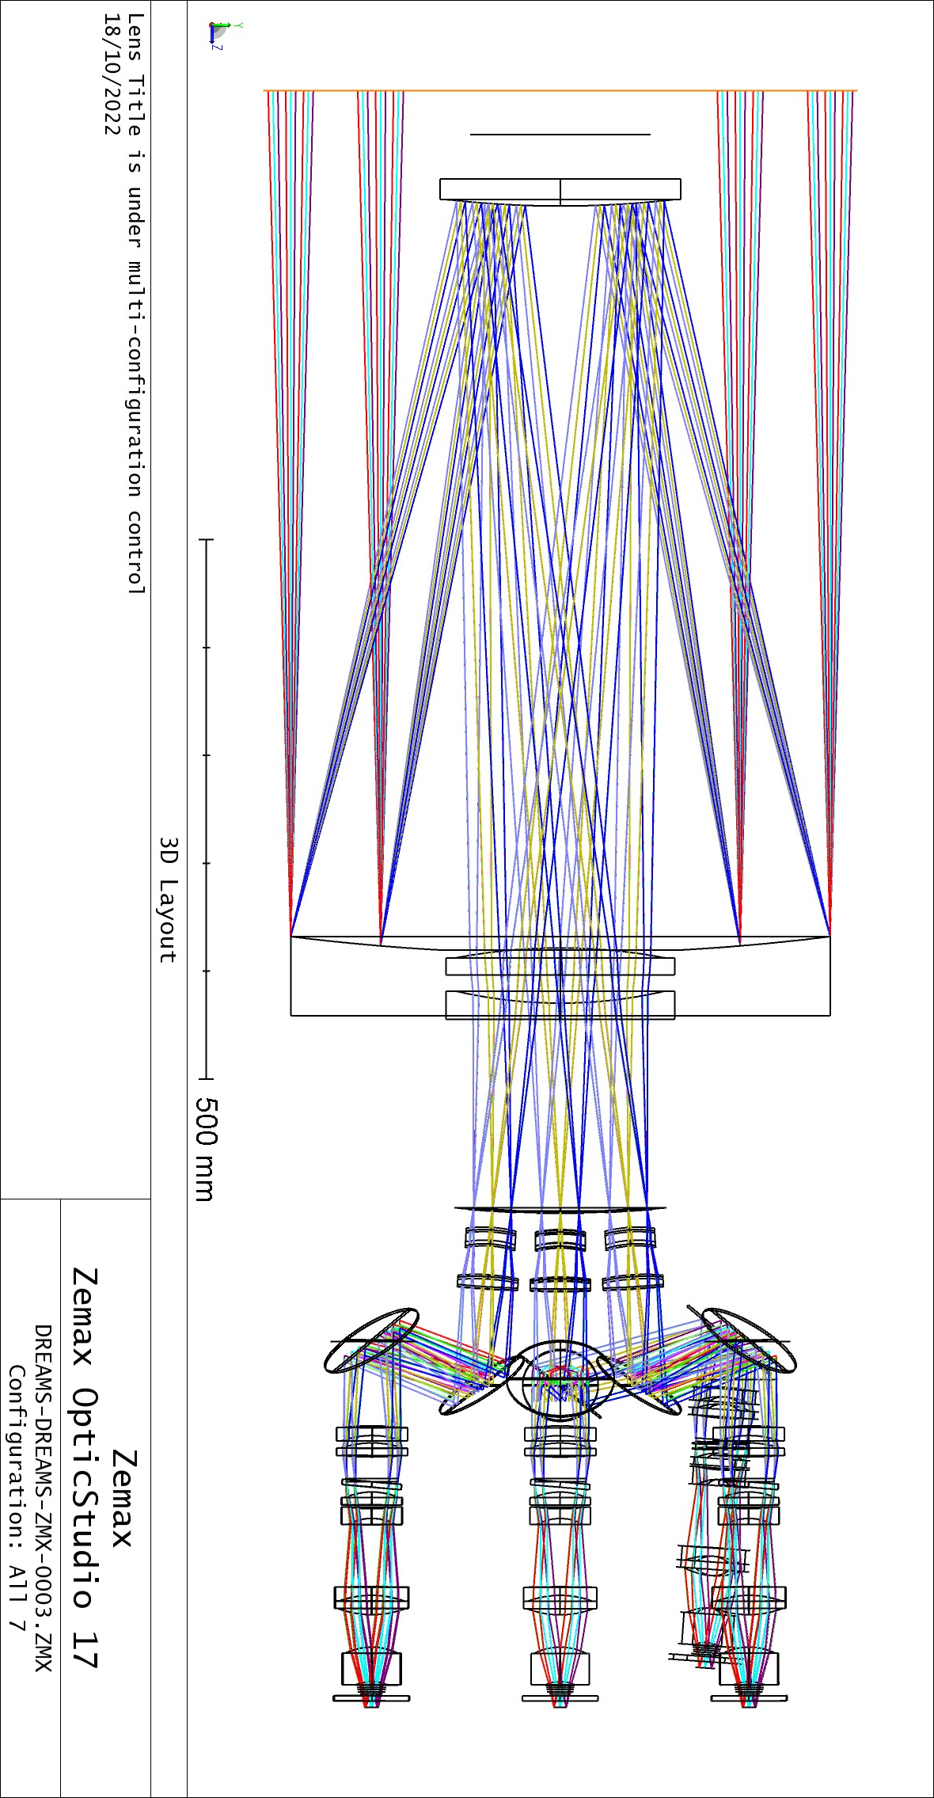
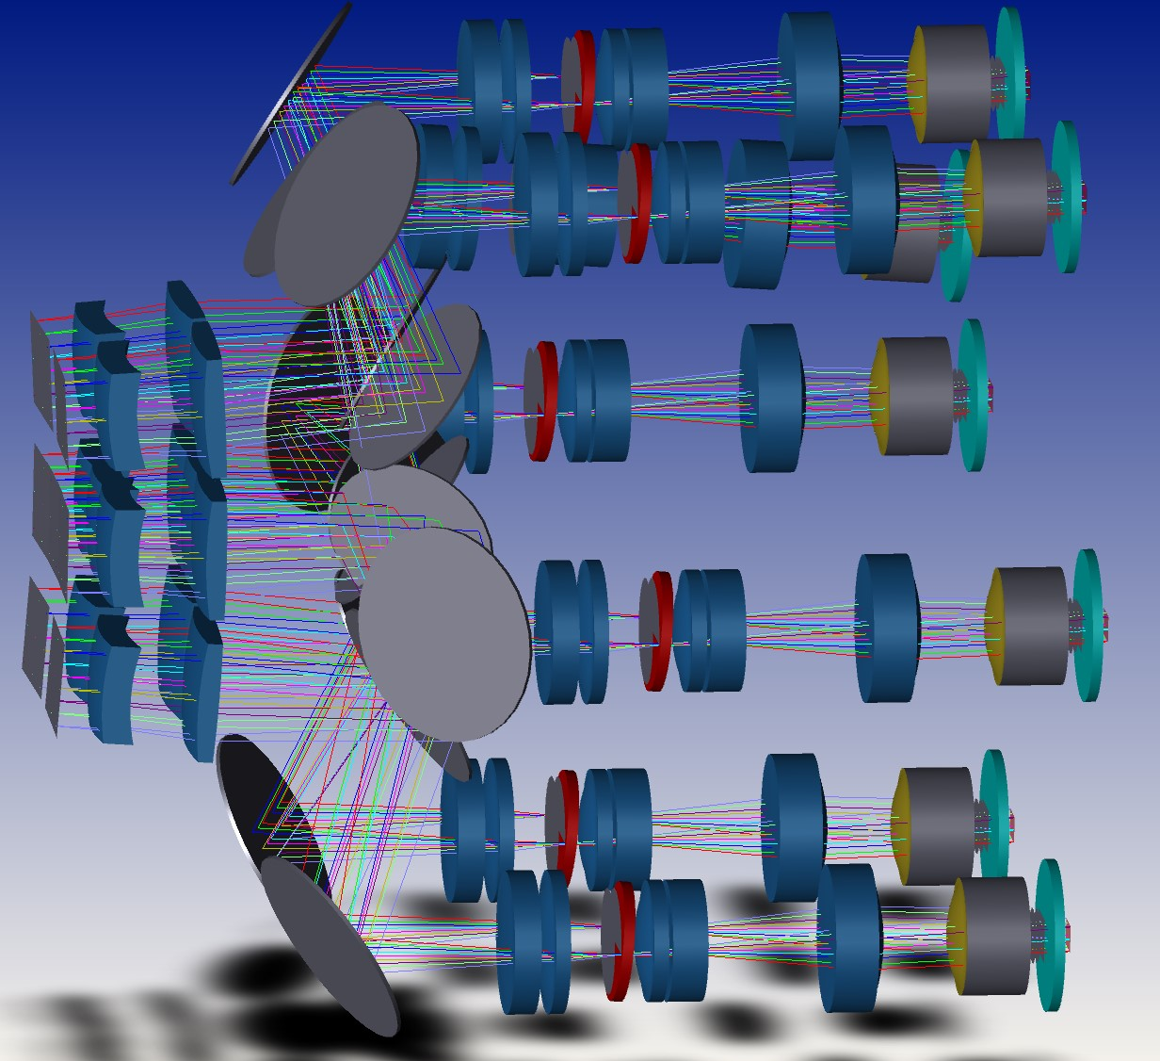
AIT
Design should incorporate AIT
  Fiducials, references, support fixturing, etc. should be considered earlier
    Work together with mechanical to ensure that there is enough room for metrology and alignment equipment during AIT
    Design alignment and test optical and mechanical in parallel to operational system
    Labour is expensive -> make design choices which decrease AIT time
    Think about fiducials and references on optical elements
Credit: AITC

Slide 16
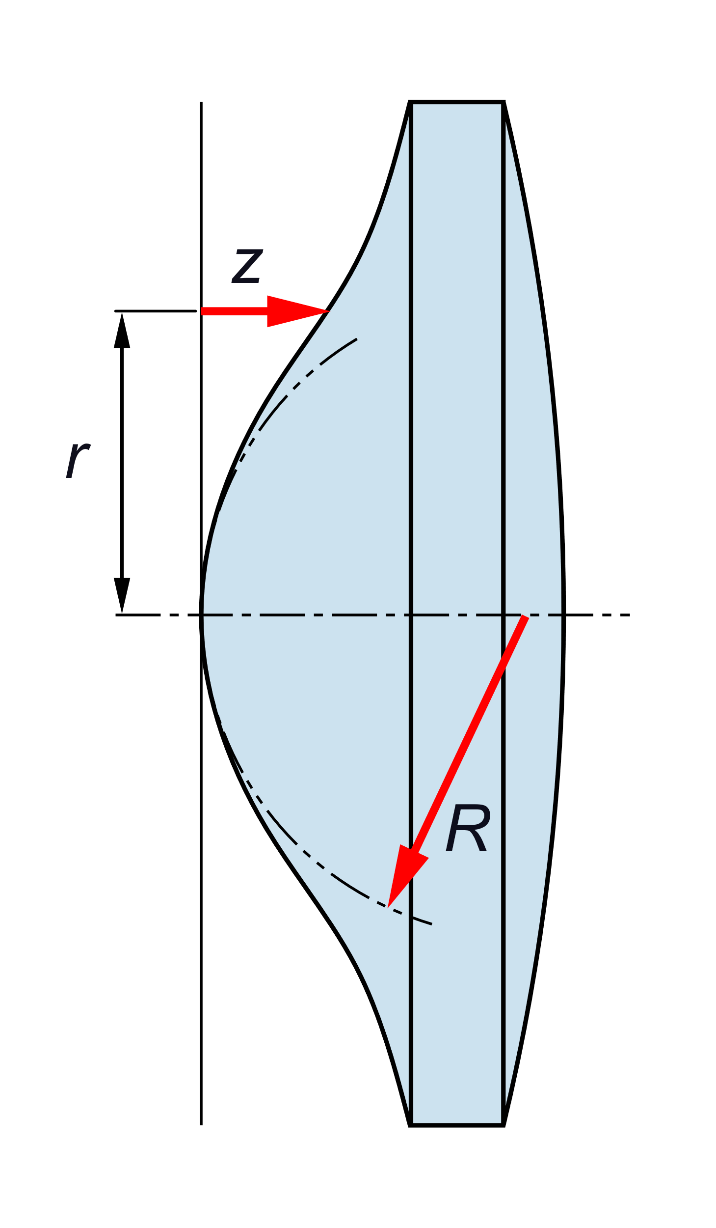
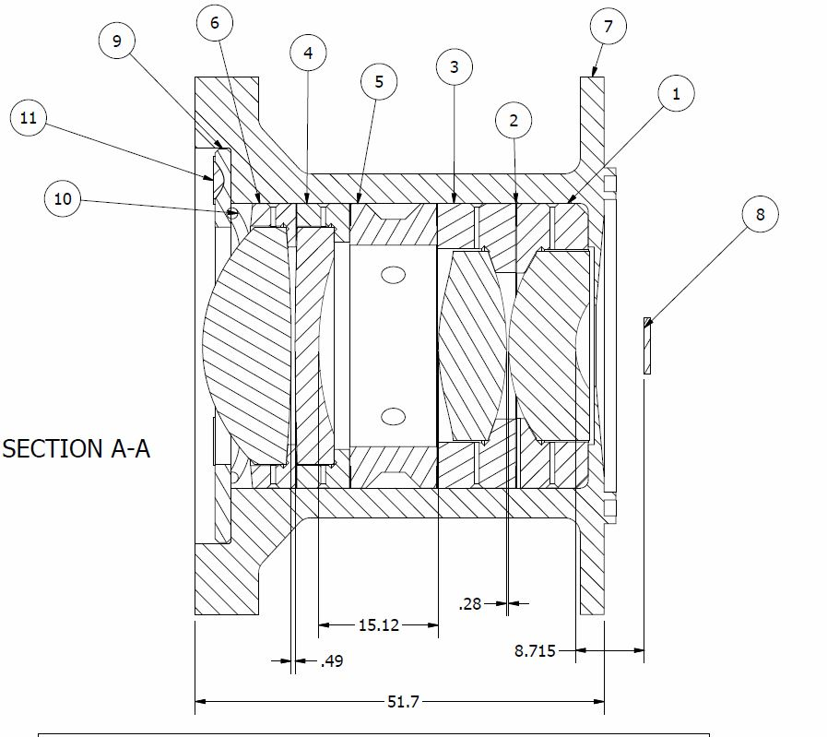
Tips, Tricks, and Lessons Learned
Elements
  Make assembly and integration easier and cheaper by
    Use different radii of curvature for biconvex or biconcave
    Eliminate large radii of curvature, redesign system while fixing surface to be plano
    Only use aspheres if necessary
    Only use one aspheric surface per element
    Use convex aspheres if possible
    Keep aspheric curvature either positive or negative, inflection points are hard
    Use air-gapped elements if possible
Credit: Wikipedia

Slide 17
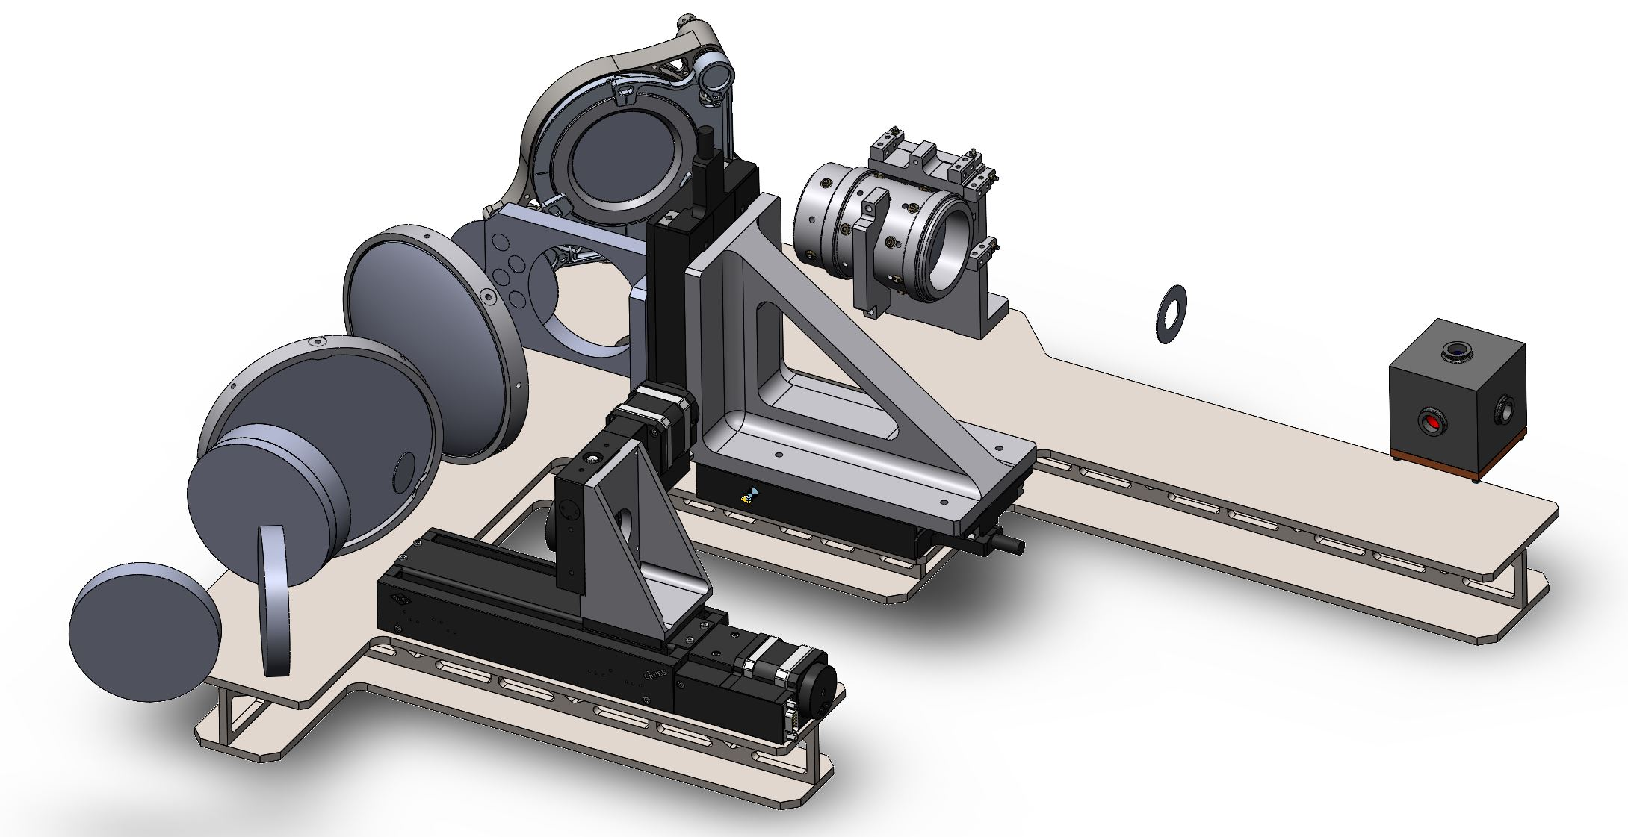
Tips, Tricks, and Lessons Learned
Think about mechanical space
  Work with your mechanical engineer
    Leave space for fixturing
    Design for standard/common diameters
    If possible leave extra space for actuated mechanisms
    Discuss fixturing methods and tolerances with mechanical
Credit: AITC

Slide 18
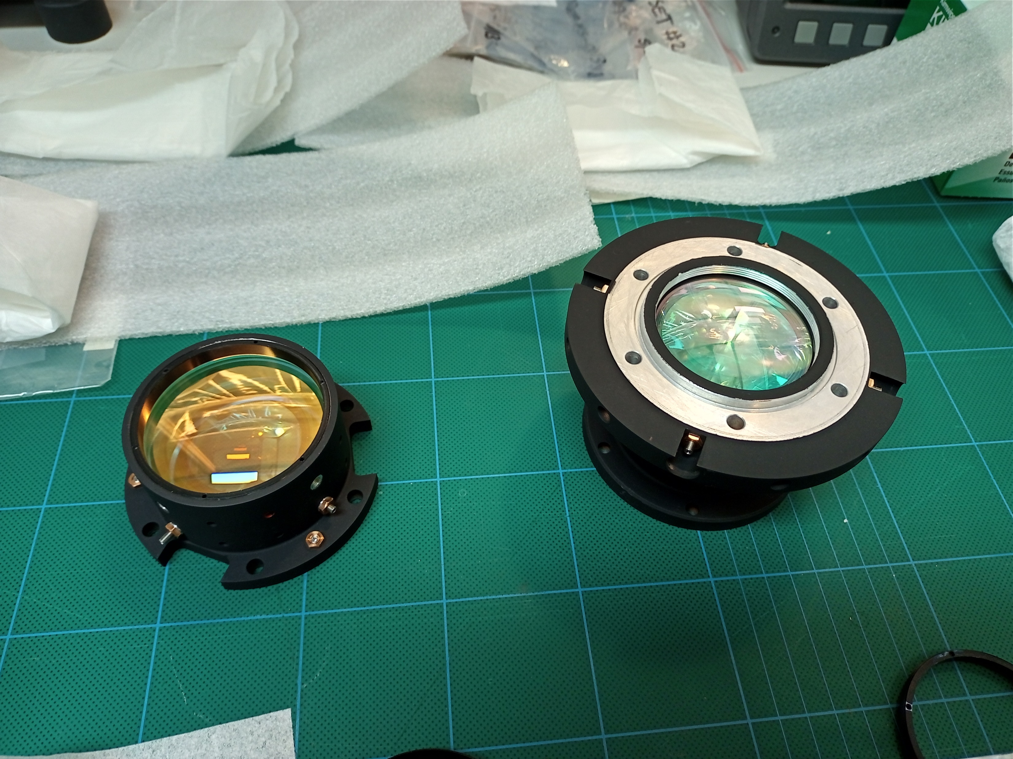
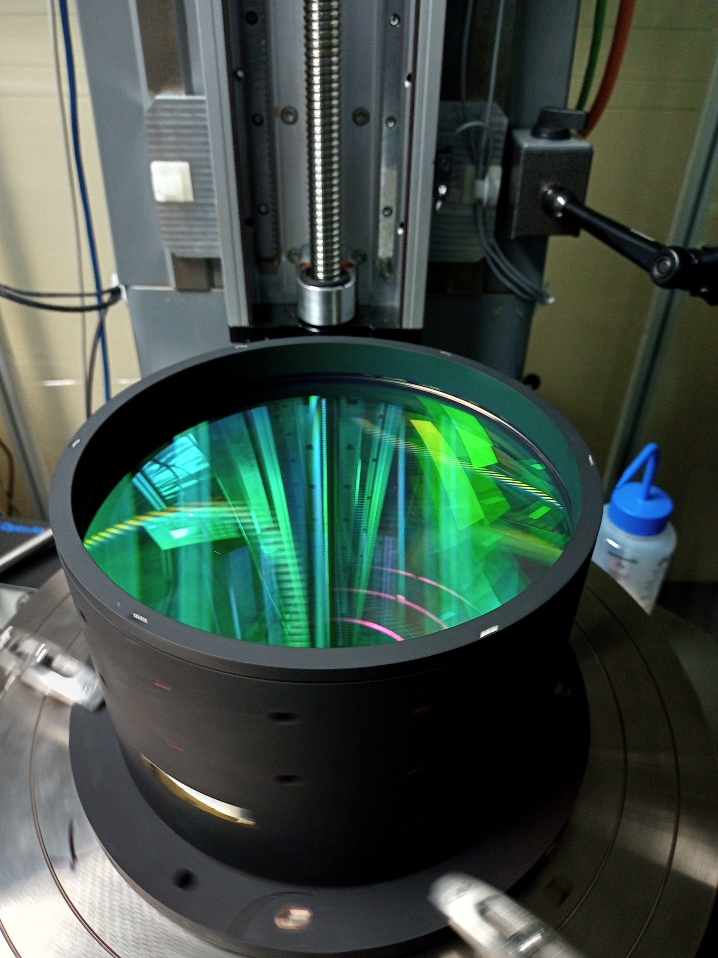
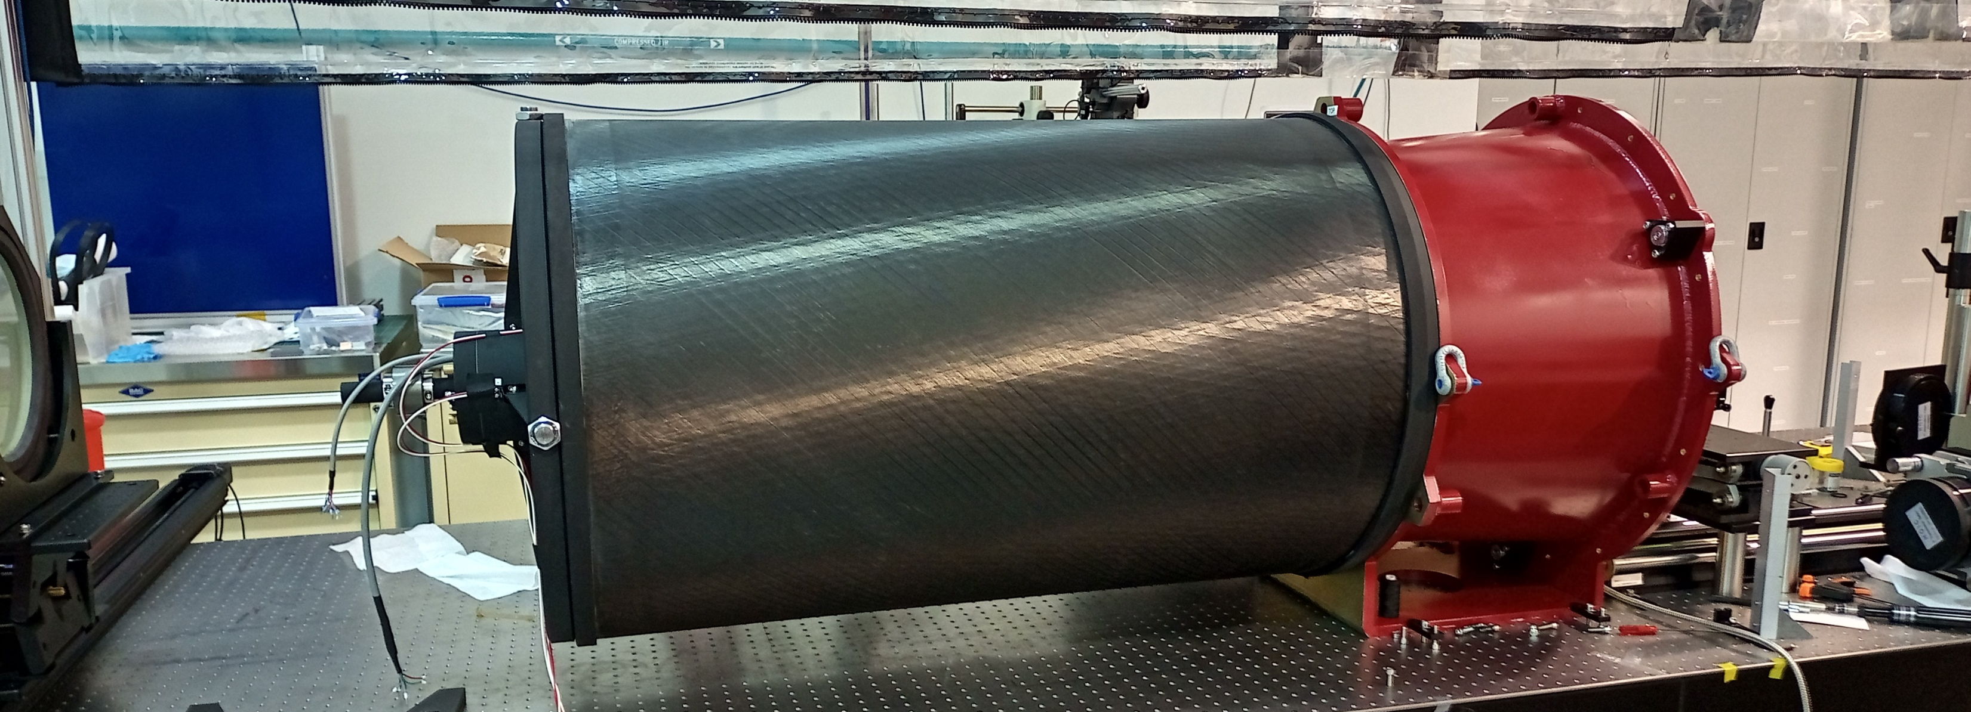
Tips, Tricks, and Lessons Learned
Mechanical design tips
  Assembly, test, and integration are expensive
    Assembly should stack in one direction as much as possible
    Retaining rings cause issues
    Non-rotationally symmetric parts need mechanical mounting references (e.g. round with a flat or a square/rectangular element)
    If tight tolerances are required, design element fixturing for realistic mechanical tolerancing ranges
    Use a suite of dissimilar material CTEs for athermalisation of element mounting and test
Credit: AITC

Slide 19
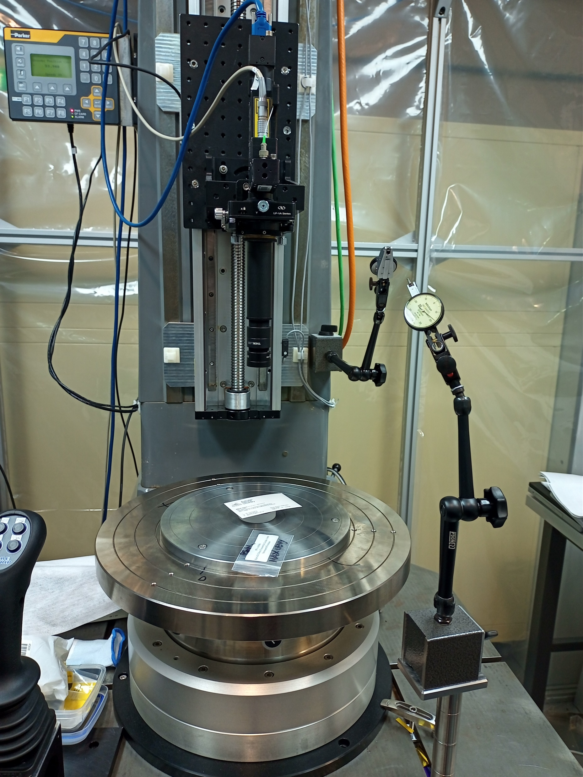
Tips, Tricks, and Lessons Learned
AIT design tips
  Assembly, test, and integration are expensive
    Think about where optical references will be needed for AIT and design to accommodate them
    Design test optics if needed during the optical design phase
    For space, vibration and thermal vacuum tests are crucial verification steps. Design for the space environment
    Have an AIT plan and review before going to manufacturing
    Think about thermal (when it matters)
Credit: AITC

Slide 20
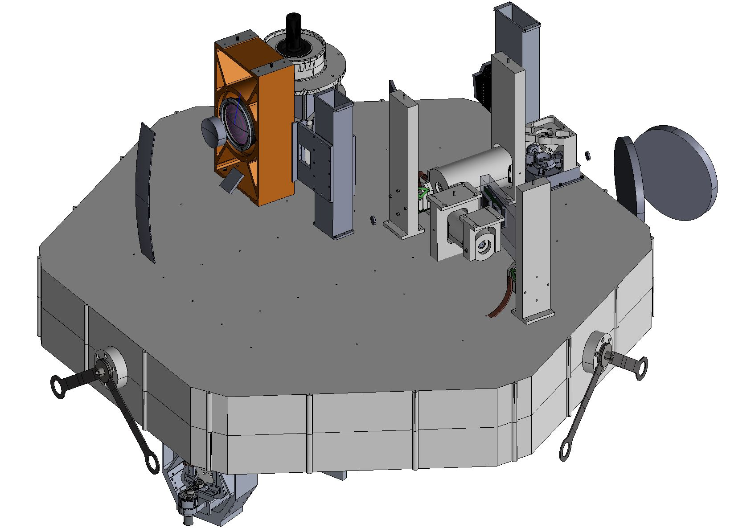
Thank you
Equipment list
    Large autostigmatic microscope (lens positioning and metrology)
    ESDI interferometer, 100mm aperture
    Spectroscopic lab and metrology
    Alignment scopes
    Autocollimators
    Suite of lenses, sensors, fibres, mirrors, lab oriented optics and opto-mechanics
    ISO Class 7 clean room (in NSTF)

